Slide 1
Online Social Networks and Media
Graph ML II
Graph Embeddings

Slide 2
Graph Machine Learning
Outline
Part I: Introduction, Traditional ML
Part II: Graph Embeddings
Part III: GNNs
Part IV (if time permits): Knowledge Graphs
Slides used based on:
CS224W: Machine Learning with Graphs
Jure Leskovec, Stanford University
http://cs224w.stanford.edu

Slide 3
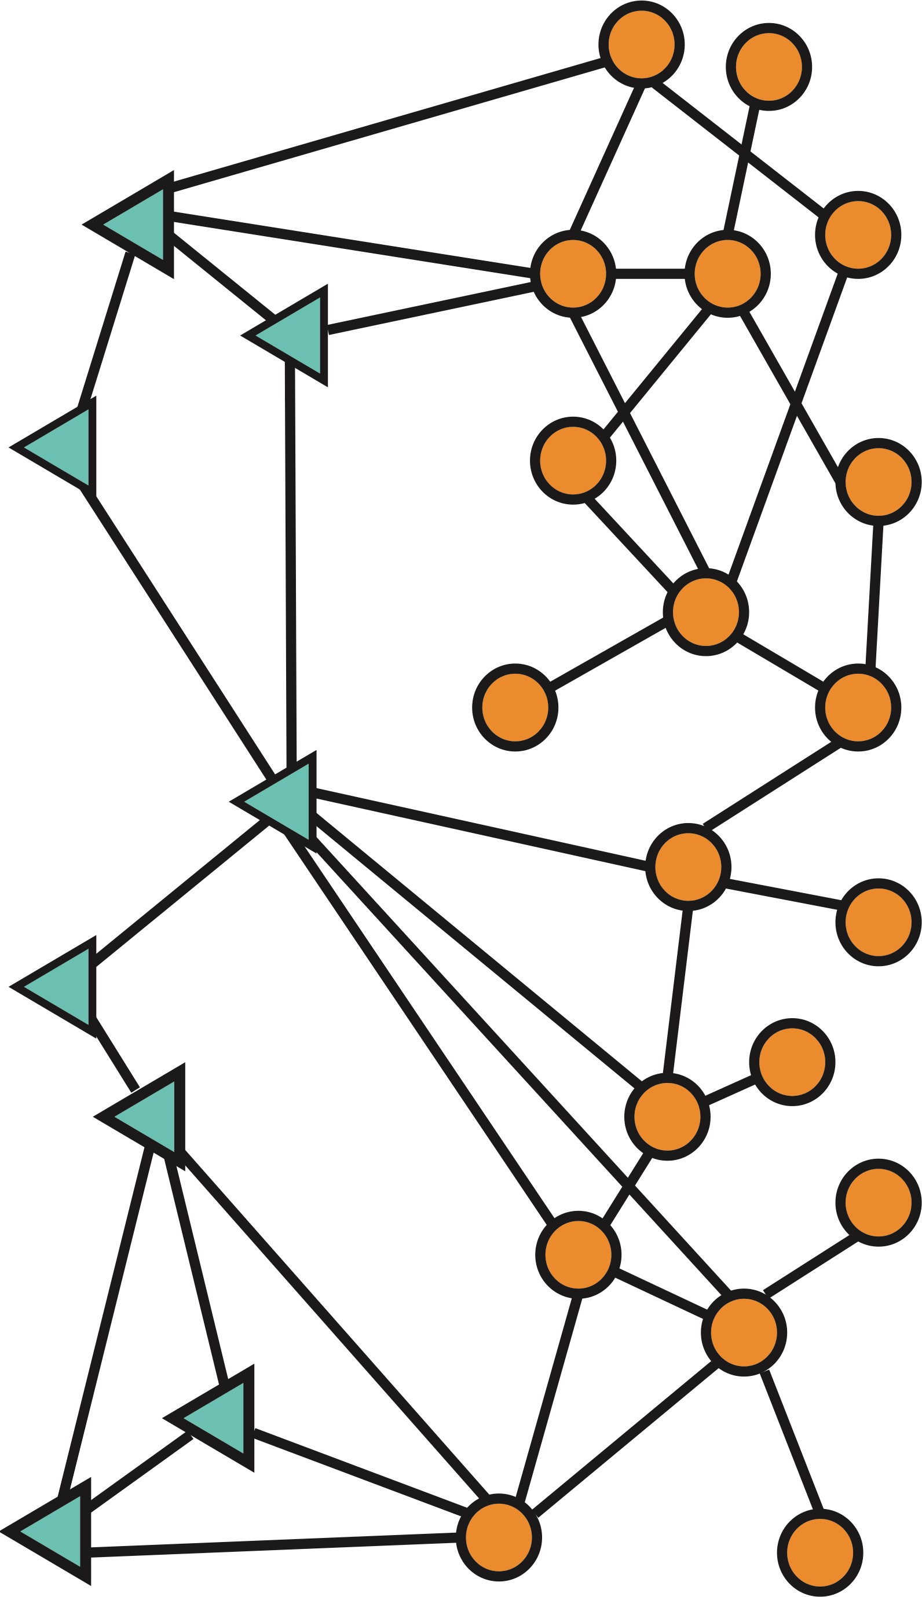
Types of ML tasks in graphs
Node
level
Graph-level prediction,
Graph generation
Community (subgraph)
level
Edge (link) level

Slide 4
Graph embeddings: why?
Machine learning lifecycle
Raw Data
Structured Data
Learning Algorithm
Model
Feature Engineering
Downstream
prediction task
degree, PageRank, graphlets, neighborhood overlap, etc

Slide 5
Part II:
Introduction to embeddings
Node embeddings on matrix decomposition random-walks
Quick overview of word embedding
Link and subgraph embeddings

Slide 6
Graph embeddings: why?
Machine learning lifecycle
Raw Data
Structured Data
Learning Algorithm
Model
Feature Engineering
Downstream
prediction task
degree, PageRank, graphlets, neighborhood overlap, etc
Representation Learning
Automatically learn the features

Slide 7


Node embeddings: what are they?
node
vector
u
$$f:u→ℝ^{d}$$
$$ℝ^{d}$$
Feature representation, embedding
Map nodes to d-dimensional vectors so that:
“similar” nodes in the graph have embeddings that are close together.
  Encode network information
  Potentially used for many downstream predictions

Slide 8
Example
  Zachary’s Karate Club Network:
Output
Input
using t-SNE
Image from: Perozzi et al.. DeepWalk: Online Learning of Social Representations. KDD 2014.

Slide 9
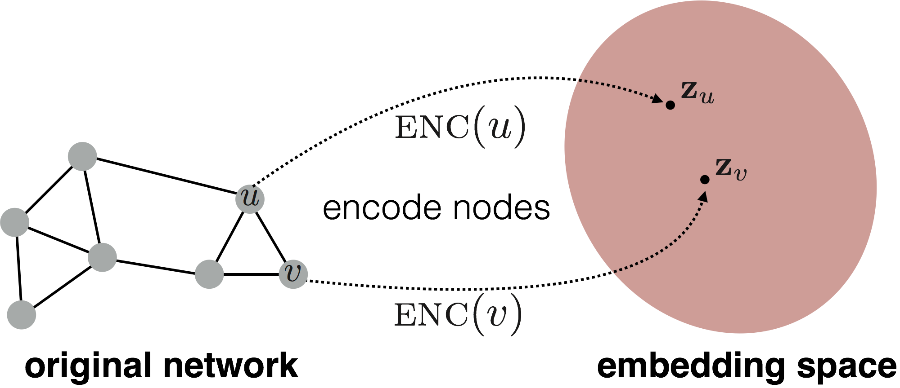
Graph embeddings
Goal is to encode nodes so that similarity in the embedding space (e.g., dot product) approximates similarity in the graph

Slide 10
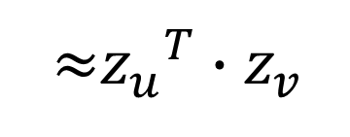

Two key components
Encoder: maps each node to a low-dimensional
vector
d-dimensional embedding
ENC 𝑣 =
$$z_{v}$$
node in the input graph
Similarity function: specifies how the relationships in vector space map to the relationships in the original network
similarity 𝑢, 𝑣
Similarity of 𝑢 and 𝑣 in the original network
≈ ${z_{u}}^{T}{∙z}_{v}$
Decoder
dot product between node embeddings

Slide 11
Embedding nodes
Goal: similarity($u$, $v$) $≈{z_{u}}^{T}{∙z}_{v}$
Similarity of the embedding
in the original network
Need to define!

Slide 12
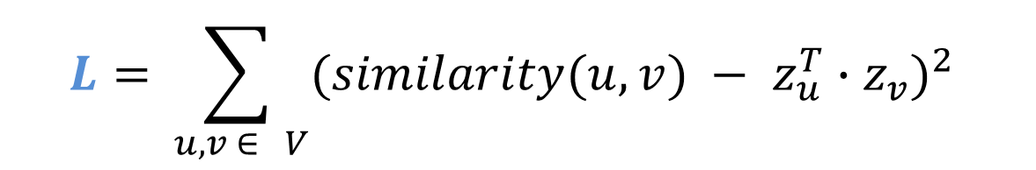
Learning node embeddings
Define an encoder ENC that maps nodes to low dimensional spaces
Define a node similarity function (i.e., a measure of similarity in the original network).
Decoder 𝐃𝐄𝐂 maps from embeddings to the similarity score
Optimize the parameters of the encoder so that we minimize a loss function L that looks (roughly) like:
$$L=\sum_{ u, v ∈ V}{(similarity(u, v}{) − z_{u}^{T}∙z_{v})}^{2}$$

Slide 13


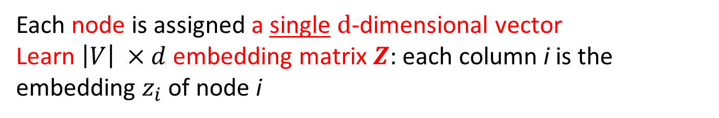
Shallow embeddings^{(*)}
Each node is assigned a single $d$-dimensional vector
Learn $\left|V\right| ×d$embedding matrix $Z$: each column i is the embedding $z_{i}$ of node i
embedding vector for a
embedding matrix
specific node
𝐙 =
Dimension/size of embeddings
one column per node
(*) As opposed to deep learning in graphs (GNN embeddings)

Slide 14



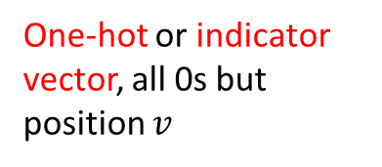

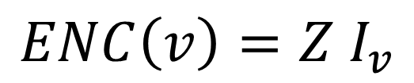

Shallow embeddings
Encoder is just an embedding lookup
$$ENC\left(v\right)=Z I_{v}$$
Z
i
$$I_{v}$$
0
0
One-hot or indicator vector, all 0s but position $v$
$$v$$
1
0
$$z_{i}$$
$$d × N$$
$$N × 1$$

Slide 15
Framework Summary
Encoder + Decoder Framework
  Shallow encoder: Embedding lookup
  Parameters to optimize: 𝐙 which contains node embeddings for all nodes 𝑢 ∈ 𝑉
  We will cover deep encoders in the GNNs
  Decoder: based on node similarity.
Objective: maximize $z_{u}^{T}∙z_{v}$ for node pairs (𝑢, 𝑣)
that are similar

Slide 16
How to define node similarity
Key choice of methods is how they define node similarity.
Should two nodes have a similar embedding if they…
  are linked?
  share neighbors?
  have similar “structural roles”?

Slide 17
Note on node embeddings
This is unsupervised/self-supervised way of learning node embeddings.
  We are not utilizing node labels
  We are not utilizing node features
  The goal is to directly estimate a set of coordinates (i.e., the embedding) of a node so that some aspect of the network structure (captured by DEC) is preserved.
These embeddings are task independent:
  They are not trained for a specific task but can be used for any task.

Slide 18
ADJACENCY-Based

Slide 19

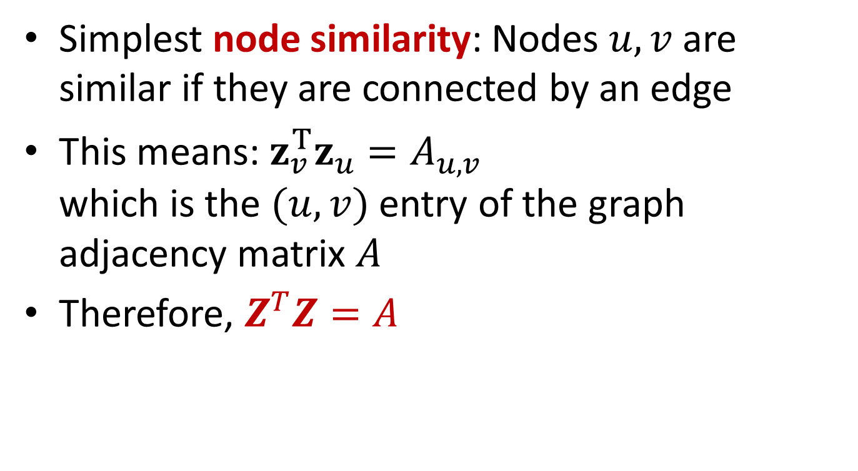




Adjacency Matrix
Simplest node similarity: Nodes $u, v$ are similar if they are connected by an edge
This means: $z_{v}^{Τ}z_{u}=A_{u, v}$
which is the $(u, v)$ entry of the graph adjacency matrix $A$
Therefore, $Z^{T}Z=A$
$$Z^{T}$$
$$Z$$
4
3
$$×$$
2
1
$$z_{u}$$
$$z_{v}$$

Slide 20
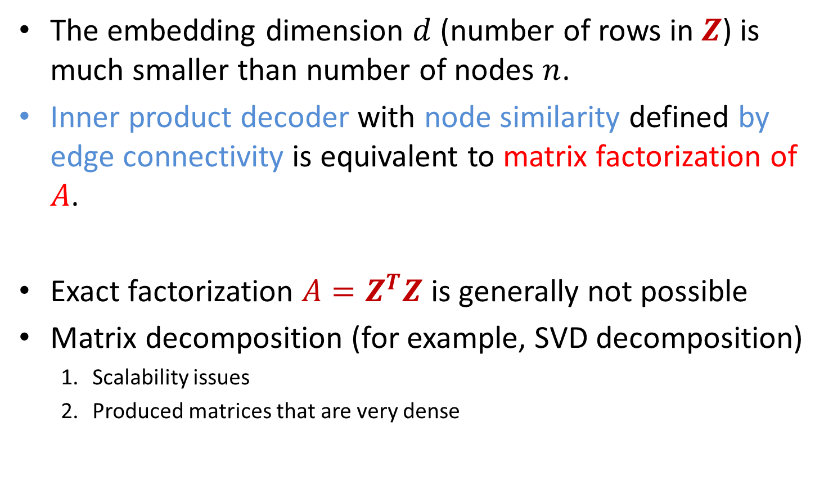
Adjacency-based approach
The embedding dimension $d$ (number of rows in $Z$) is much smaller than number of nodes $n$.
Inner product decoder with node similarity defined by edge connectivity is equivalent to matrix factorization of 𝐴.
Exact factorization $A=Z^{T}Z$ is generally not possible
Matrix decomposition (for example, SVD decomposition)
  Scalability issues
  Produced matrices that are very dense

Slide 21
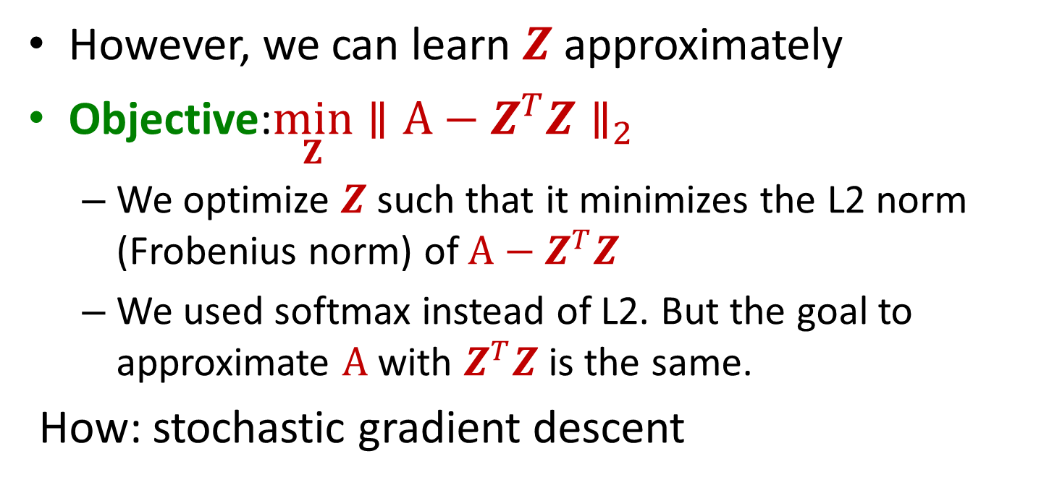
Adjacency-based approach
However, we can learn $Z$ approximately
Objective:$\min_{Z}∥A−Z^{T}Z∥_{2}$
  We optimize $Z$ such that it minimizes the L2 norm (Frobenius norm) of $A−Z^{T}Z$
  We used softmax instead of L2. But the goal to approximate $A$ with $Z^{T}Z$ is the same.
  How: stochastic gradient descent

Slide 22
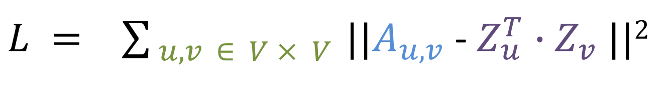
Adjacency-based approach
The loss that what we want to minimize
embedding similarity
$L = \sum_{ u,v ∈ V × V }{||A_{u,v}}$ - $Z_{u}^{T}$ ${∙Z}_{v}^{ }||2$
sum over all node pairs
(possibly weighted) adjacency matrix for the graph
A. Ahmed, N. Shervashidze, S. M. Narayanamurthy, V. Josifovski, A. J. Smola: Distributed large-scale natural graph factorization. WWW 2013

Slide 23
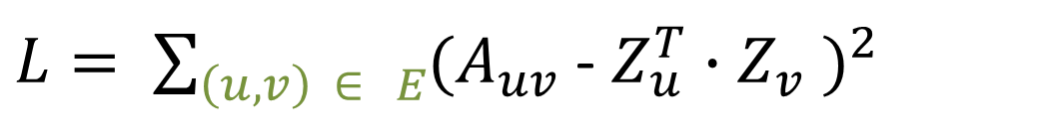
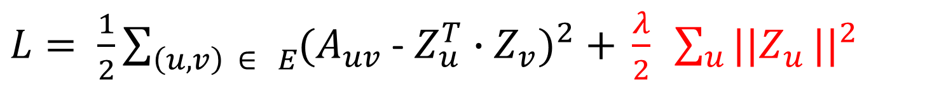
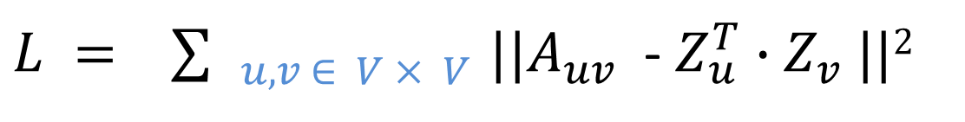
Adjacency-based approach – stochastic gradient descent
A few manipulations
$L = \sum_{ u, v ∈ V × V }{||A_{uv}}$ - $Z_{u}^{T}$ ${∙Z}_{v}^{ }||2$
sum over all node pairs
$L= \sum_{\left(u, v\right) ∈ E}{(A_{uv}}$ - $Z_{u}^{T}$ ${∙Z}_{v}^{ } )^{2}$
sum over all edges
$L= \frac{1}{2}\sum_{\left(u, v\right) ∈ E}{(A_{uv}}$ - $Z_{u}^{T}$ ${∙Z}_{v}^{ })^{2}\text{ + }\frac{λ}{2} \sum_{u}{||Z_{u}}\text{|}|^{2}$
regularization factor
Notes:
we impose a small amount of regularization to ensure that the problem remains well-posed even in the absence sufficient data

Slide 24


Stochastic Gradient Descent
After we obtain the objective function, how do we optimize (minimize) it?
Gradient Descent: a simple way to minimize $ℒ$:
  Initialize $z_{u}$ at some randomized value for all nodes $u$.
  Iterate until convergence:
    For all $u$, compute the derivative $\frac{∂ℒ}{∂z_{u}}$.
    For all $u$, make a step in reverse direction of derivative: $z_{u}←z_{u}−η\frac{∂ℒ}{∂z_{u}}$.
$L= \frac{1}{2}\sum_{\left(u, v\right) ∈ E}{(A_{uv}}$ - $Z_{u}^{T}$ ${∙Z}_{v}^{ } )^{2}\text{ + }\frac{λ}{2} \sum_{u∈V}{||Z_{u}}\text{|}|^{2}$
$η$: learning rate
Notes:
In Gradient Descent, we consider all the points in calculating loss and derivative, while in Stochastic gradient descent, we use single point in loss function and its derivative randomly.

Slide 25
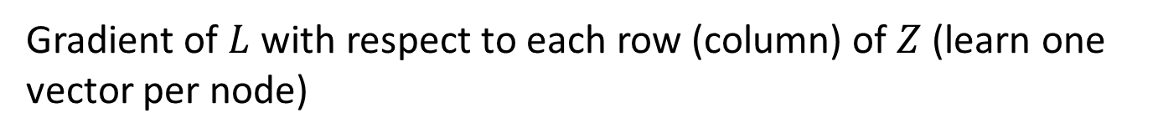
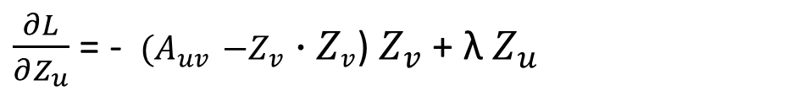
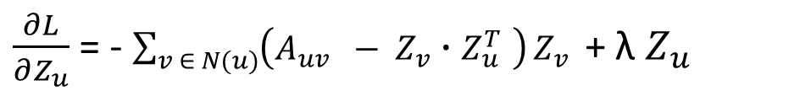
Adjacency-based approach
$L= \frac{1}{2}\sum_{\left(u, v\right) ∈ E}{(A_{uv}}$ - $Z_{u}^{T}$ ${∙Z}_{v}^{ } )^{2}\text{ + }\frac{λ}{2} \sum_{u∈V}{||Z_{u}}\text{|}|^{2}$
Taking the gradient
Gradient of $L$ with respect to each row (column) of $Z$ (learn one vector per node)
$\frac{∂L}{∂Z_{u}}$ = - $\sum_{v ∈ N(u)}{\left(A_{uv} − Z_{v}∙Z_{u }^{T}\right)}Z_{v }$ + λ $Z_{u}$
For each edge $(u, v) ∈E$this amounts for
$\frac{∂L}{∂Z_{u}}$ = - $(A_{uv}{ −Z}_{v }{∙Z}_{v}$) $Z_{v}$ + λ $Z_{u}$

Slide 26
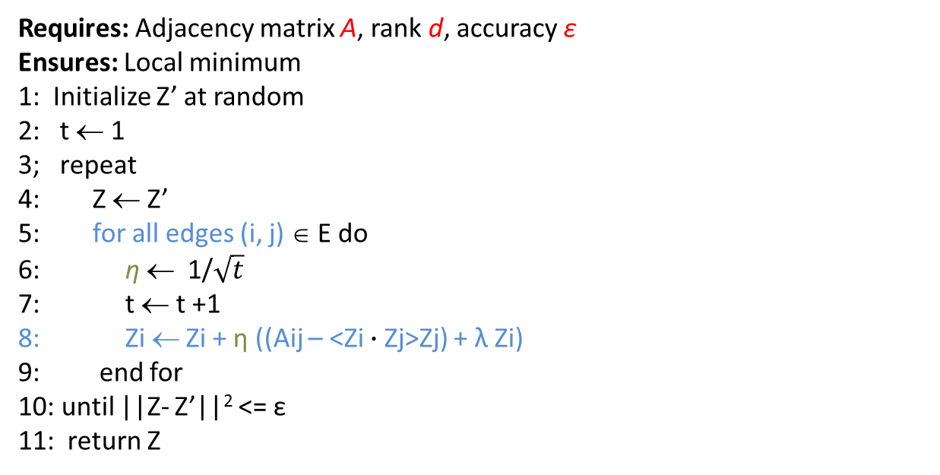
Adjacency-based approach
Requires: Adjacency matrix A, rank d, accuracy ε
Ensures: Local minimum
1: Initialize Z’ at random
2: t ← 1
3; repeat
4: Z ← Z’
5: for all edges (i, j) ∈ E do
6: η ← 1/$\sqrt{t}$
7: t ← t +1
8: Zi ← Zi + η ((Aij – <Zi $∙$Zj>Zj) + λ Ζi)
9: end for
10: until ||Z- Z’||² <= ε
11: return Z
η: learning rate, captures the extent at which newly acquired information overrides old
Complexity O(|E|)
Can be parallelized

Slide 27
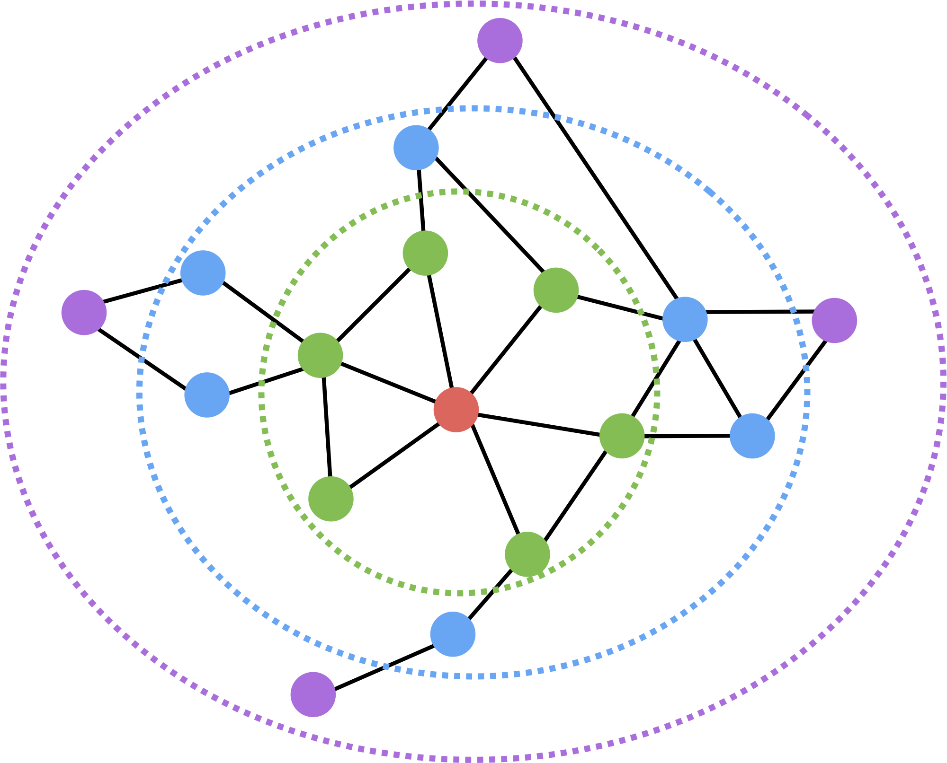
Multi-hop approaches
  Only considers direct connections
  What about further neighbors?
Look further than the 1-step neighbors and learn by using information from/for k-step neighbors
We will see two approaches
GraRep: looks at probabilities of reaching a node
HOPE: various metrics of similarity based on neighbors and paths

Slide 28
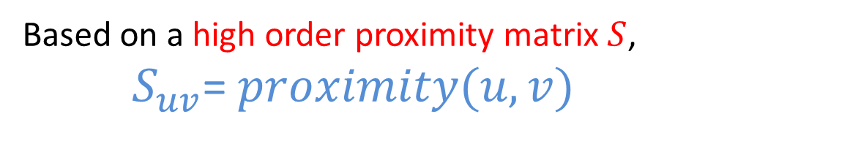
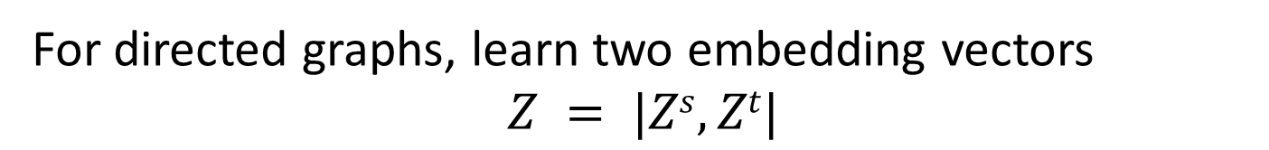
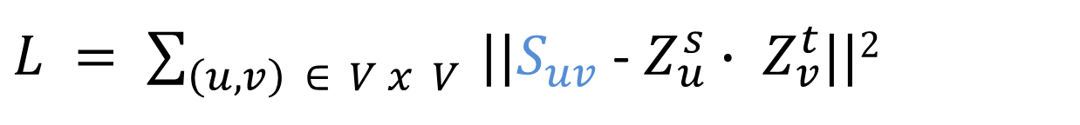
High-order Proximity Preserved Embeddings (HOPE)
Based on a high order proximity matrix $S$,
$S_{uv}$= $proximity(u, v)$
For directed graphs, learn two embedding vectors
$$Z = |Zs, Zt|$$
$L = \sum_{\left(u, v\right) ∈ V x V }{||S_{uv}}$ - $Z_{u}^{s}∙ Z_{v}^{t}$||²
M. Ou, P. Cui, J. Pei, Z.i Zhang, W. Zhu: Asymmetric Transitivity Preserving Graph Embedding. KDD 2016

Slide 29

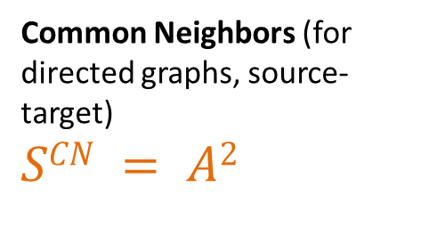


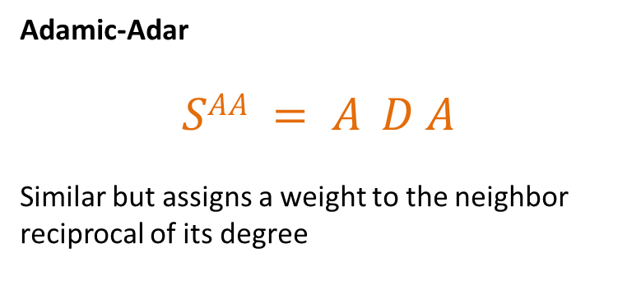


HOPE
Local High Order Proximity
Common Neighbors (for directed graphs, source-target)
$$SCN = A2$$
A² =
$$v_{2}$$
$$v_{1}$$
$$v_{3}$$
Adamic-Adar
$$SAA = A D A$$
Similar but assigns a weight to the neighbor reciprocal of its degree
$$v_{5}$$
$$v_{4}$$

Slide 30
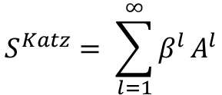
HOPE
Global High Order Proximity
Katz
Sum over all paths of length l, using a decay parameter
$$S^{Katz}= \sum_{l=1}^{∞}{β^{l}}A^{l}$$
Rooted Pagerank
SVD with some tricks to save computations

Slide 31
Node embeddings
Approaches based on:
Adjacency-like matrices
  Adjacency matrix
  Multi-hop neighborhoods
    HOPE
    GraRep (random walks)
Random-walks
  DeepWalk
  Node2Vec
Random walks based on
word embeddings

Slide 32
Word EMBeddings
(Some material from Chris Manning course)

Slide 33
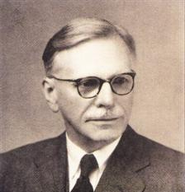
Basic Idea
You can get a lot of value by representing a word by means of its neighbors (distributional semantics)
“You shall know a word by the company it keeps”
(J. R. Firth 1957: 11)
One of the most successful ideas of modern statistical NLP

Slide 34
Basic Idea
A word is defined by its context
Context: words that appear in a fixed length window around the word
center
She reached up to pluck a ripe apple from the tree, its sweet aroma filling the air.
Window = 3
center
I enjoyed a crisp and juicy apple as a snack this afternoon.
Window = 3
Use the many contexts of $w$ to represent a word

Slide 35
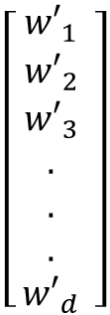
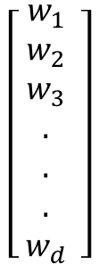
Basic idea
Learn two embeddings per word: (1) as context (2) as center
$$\left[\begin{aligned} w_{1} \\ w_{2} \\ w_{3} \\ . \\ . \\ . \\ w_{d}\end{aligned} \right]$$
Center
word
$$\left[\begin{aligned} {w′}_{1} \\ {w′}_{2} \\ {w′}_{3} \\ . \\ . \\ . \\ {w′}_{d}\end{aligned} \right]$$
Context
Center-embedding of a center word similar with the context embeddings of its context words
And vice-versa
Use text to learn these embeddings

Slide 36
Word2Vec
  Predict between every word and its context words
Two algorithms
  Skip-grams (SG)
    Predict context words given the center word
  Continuous Bag of Words (CBOW)
    Predict center word from a bag-of-words context
    Position independent (do not account for distance from center)
Two training methods
  Hierarchical softmax
  Negative sampling
Tomas Mikolov, Ilya Sutskever, Kai Chen, Gregory S. Corrado, Jeffrey Dean: Distributed Representations of Words and Phrases and their Compositionality. NIPS 2013: 3111-3119

Slide 37
Hierarchical softmax
Instead of learning O(|V|) vectors, learn O(log(|V|) vectors
How?
Build a binary tree with leaves the words and learn one vector for each internal node.
The value for each word w is the product of the values of the internal nodes in the path from the root to w.

Slide 38
Basic Idea
She reached up to pluck a ripe apple from the tree, its sweet aroma filling the air.
Window = 3
CBOW
pluck a ripe _____ from the tree
Skipgram
____ ____ ____ apple ____ ____ ____

Slide 39
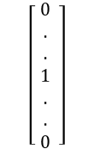
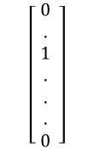

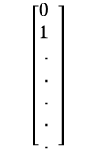
CBOW
Use a window of context words to predict the center word
Input
Output
1-hot vectors of context words
$$\left[\begin{aligned} 0 \\ . \\ 1 \\ . \\ . \\ . \\ 0\end{aligned} \right]$$
1-hot vector of center word
.
.
.
CBOW
$$\left[\begin{aligned}0 \\ 1 \\ . \\ . \\ . \\ . \\ .\end{aligned} \right]$$
$$2m$$
$$\left[\begin{aligned} 0 \\ . \\ . \\ 1 \\ . \\ . \\ 0\end{aligned} \right]$$

Slide 40


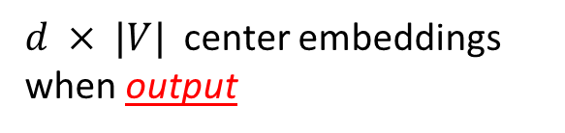
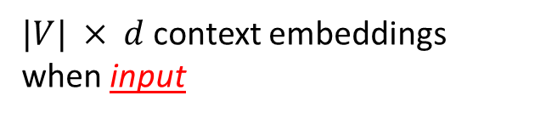
CBOW
$$W$$
Embedding of the i-th word when center word
d
$$W’$$
i
i
Embedding of the i-th word when context word
d
|V|
|V|
$d × |V|$center embeddings
when output
$|V| × d$context embeddings
when input

Slide 41
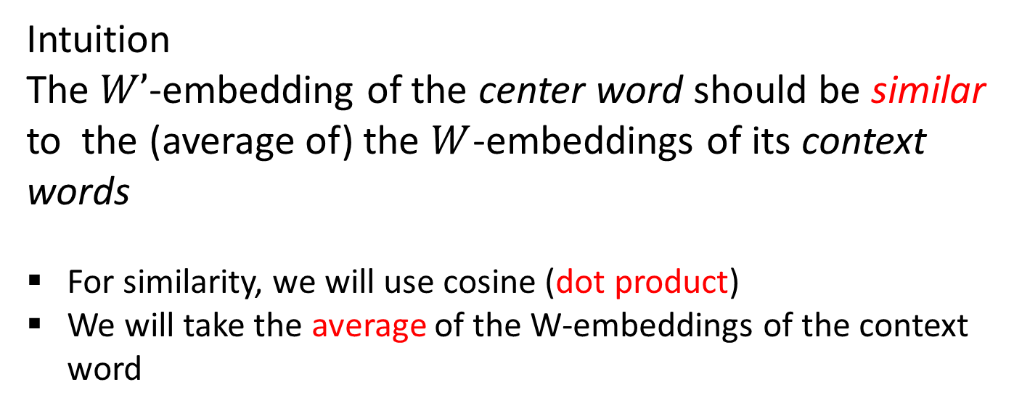
CBOW
Intuition
The $W’$-embedding of the center word should be similar to the (average of) the $W$-embeddings of its context words
For similarity, we will use cosine (dot product)
We will take the average of the W-embeddings of the context word
We want similarity close to one for the center word and close to 0 for all other words

Slide 42




cat sat on
window size = 1
We must learn W and W’
Input layer
0
1
Index of cat in vocabulary
0
cat
0
$$W_{|V|×d}$$
Hidden layer
Output layer
0
0
0
0
$$\hat{y}=softmax(z)$$
0
0
V-dim
…
0
0
$${W′}_{|V|×d}$$
0
0
sat
0
0
0
0
1
0
$$W_{|V|×d}$$
N-dim
…
V-dim
1
0
on
0
0
0
0
V-dim
…
N will be the size of word vector
0

Slide 43
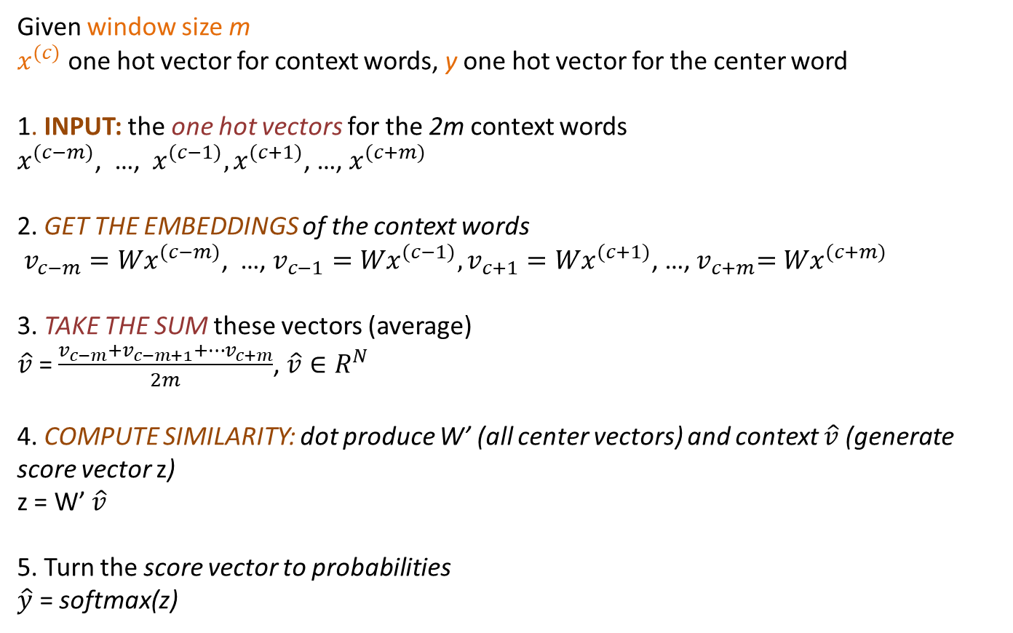
CBOW
Given window size m
$x^{(c)}$ one hot vector for context words, y one hot vector for the center word
1. INPUT: the one hot vectors for the 2m context words
$x^{(c−m)}$, …, $x^{(c−1)},x^{(c+1)}$, …, $x^{(c+m)}$
2. GET THE EMBEDDINGS of the context words
$v_{c−m}{=Wx}^{(c−m)}$, …, $v_{c−1}{=Wx}^{(c−1)},v_{c+1}{=Wx}^{(c+1)}$, …,${ v}_{c+m}{=Wx}^{(c+m)}$
3. TAKE THE SUM these vectors (average)
$\hat{v}$ = $\frac{v_{c−m}+v_{c−m+1}+…v_{c+m}}{2m}$, $\hat{v}∈R^{N}$
4. COMPUTE SIMILARITY: dot produce W’ (all center vectors) and context $\hat{v}$ (generate score vector z)
z = W’ $\hat{v}$
5. Turn the score vector to probabilities
$\hat{y}$ = softmax(z)
We want this to be close to 1 for the center word

Slide 44
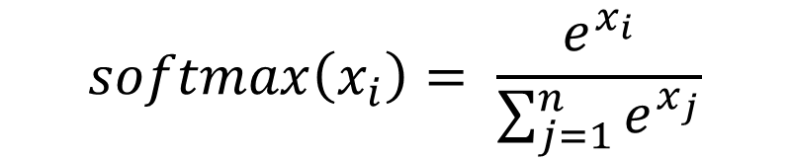
Softmax
From values to probability distributions
Exponentiate to make positive
$$softmax\left(x_{i}\right)= \frac{e^{x_{i}}}{\sum_{j=1}^{n}{e^{x_{j}}}}$$
Normalize to get probabilities
“Most” probability to the largest value (max)
“Some” probability to the other values (soft)
>>> import numpy as np
>>> a = [1.0, 2.0, 3.0, 4.0, 1.0, 2.0, 3.0]
>>> np.exp(a) / np.sum(np.exp(a))
array([0.02364054, 0.06426166, 0.1746813, 0.474833, 0.02364054, 0.06426166, 0.1746813])

Slide 45
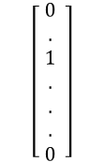
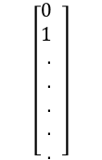
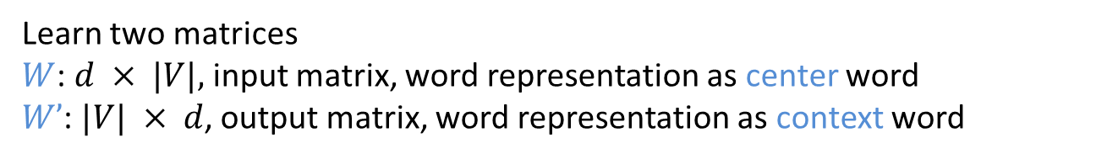

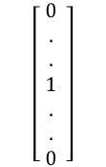
Skipgram
Given the center word, predict (or, generate) the context words
Input
Output
1-hot vector of center word
1-hot vectors of context words
$$\left[\begin{aligned} 0 \\ . \\ 1 \\ . \\ . \\ . \\ 0\end{aligned} \right]$$
$$\left[\begin{aligned}0 \\ 1 \\ . \\ . \\ . \\ . \\ .\end{aligned} \right]$$
.
.
.
$$2m$$
Skipgram
$$\left[\begin{aligned} 0 \\ . \\ . \\ 1 \\ . \\ . \\ 0\end{aligned} \right]$$
Learn two matrices
$W$: $d × |V|,$input matrix, word representation as center word
$W’$: $|V| × d$, output matrix, word representation as context word

Slide 46
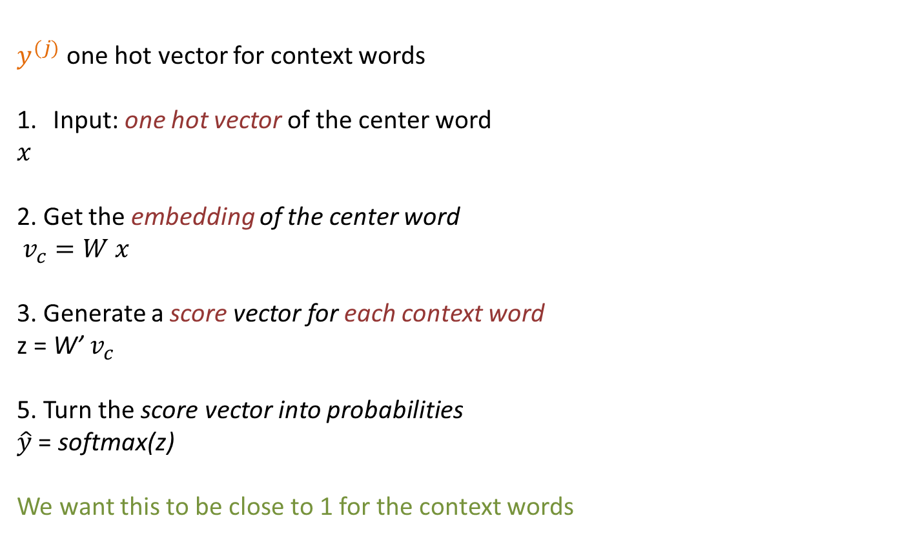
Skipgram
Given the center word, predict (or, generate) the context words
$y^{(j)}$ one hot vector for context words
Input: one hot vector of the center word
$$x$$
2. Get the embedding of the center word
$v_{c}=W x$
3. Generate a score vector for each context word
z = W’ $v_{c}$
5. Turn the score vector into probabilities
$\hat{y}$ = softmax(z)
We want this to be close to 1 for the context words

Slide 47
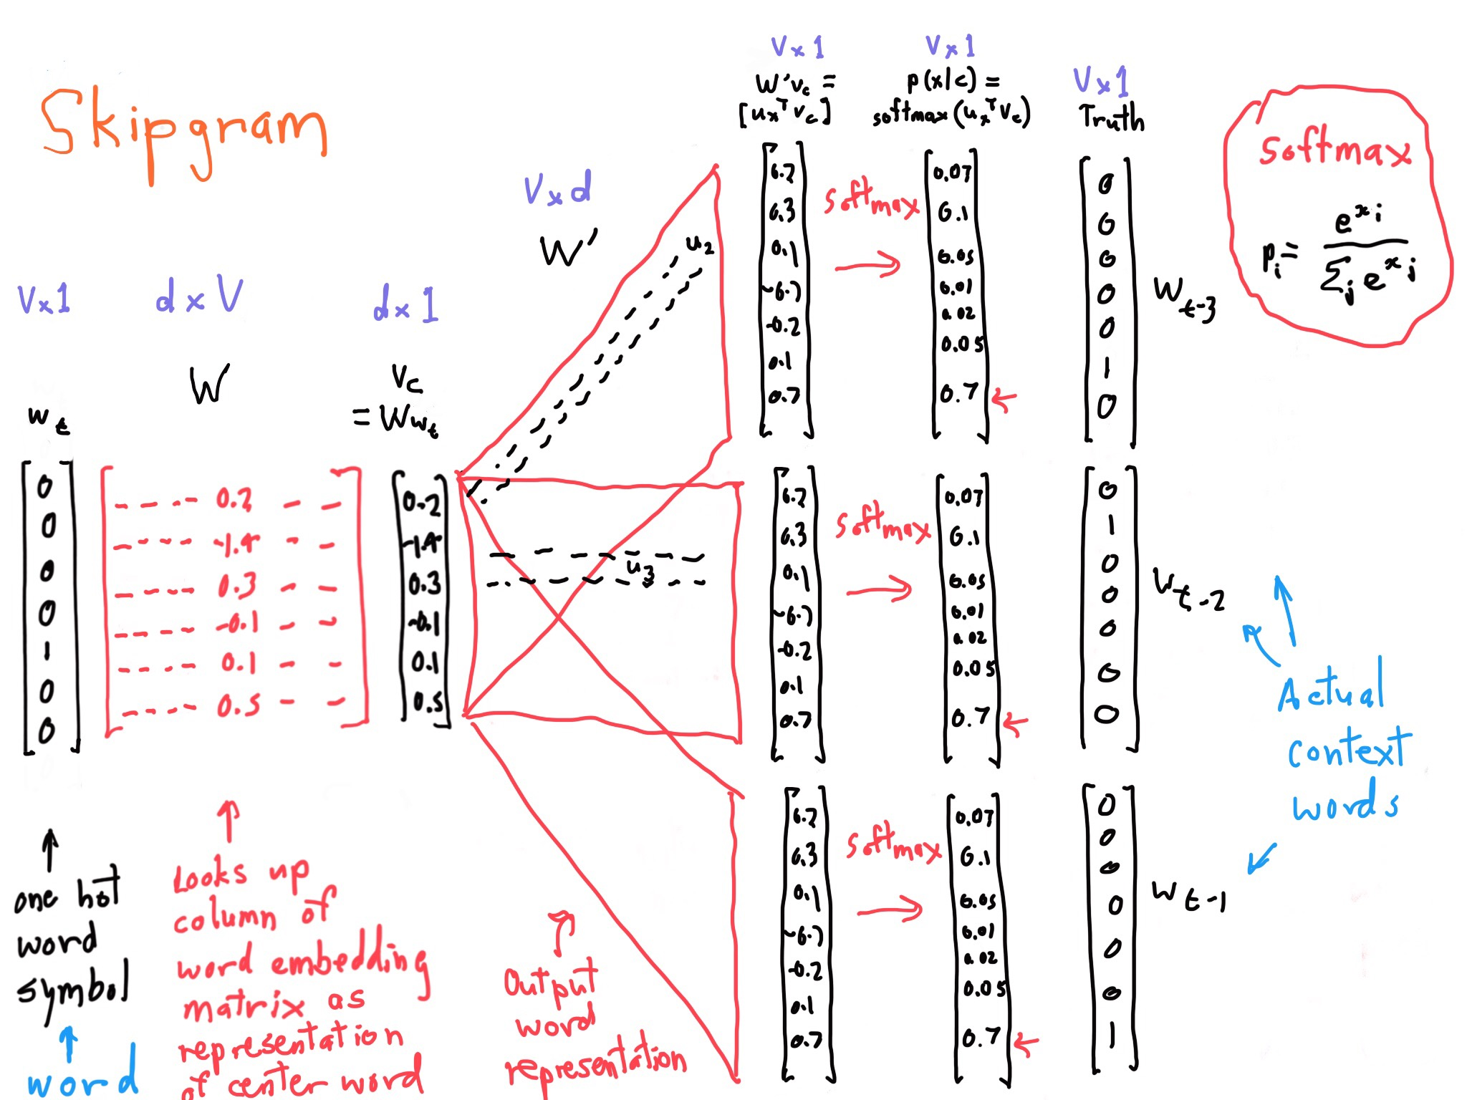

Slide 48
Back to graphs

Slide 49
Random -walk based embeddings

Slide 50
How?
Words = Nodes
Sentences = Paths, Random walks

Slide 51


Random Walk
10
9
12
2
Step 3
Step 4
8
Step 5
1
3
11
Given a graph and a starting point, we select a neighbor of it at random, and move to this neighbor; then we select a neighbor of this point at random, and move to it, etc.
The (random) sequence of points visited this way is a random walk on the graph.
4
Step 1
Step 2
6
5
7

Slide 52

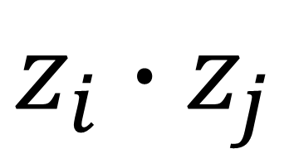
Random-walk embeddings
probability that i and j co-occur on a random walk over the network
$$z_{i}{∙z}_{j}$$
$$≈$$

Slide 53
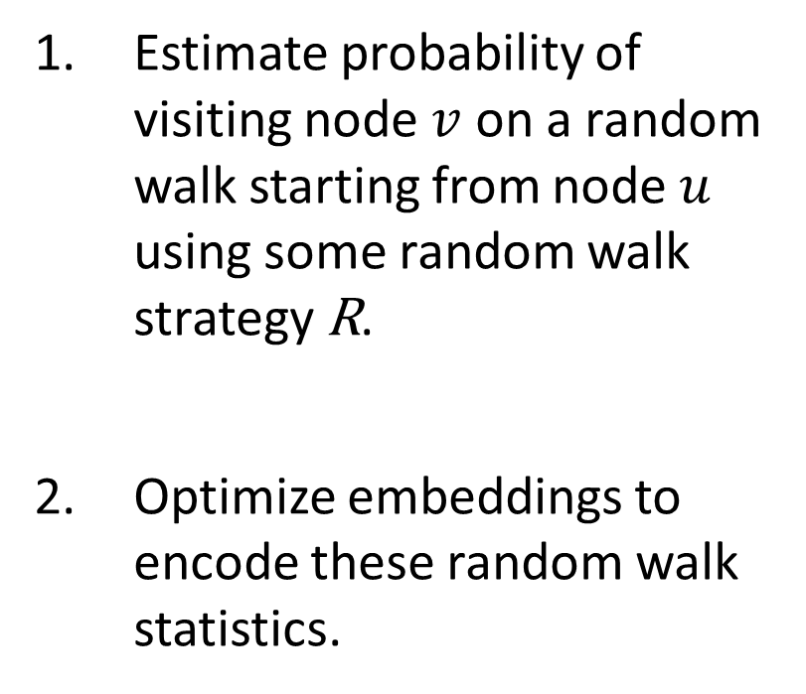
Random-walk Embeddings
Estimate probability of visiting node $v$ on a random walk starting from node $u$ using some random walk strategy R.
Optimize embeddings to encode these random walk statistics.

Slide 54
Why Random Walks?
Expressivity: Flexible stochastic definition of node similarity that incorporates both local and higher-order neighborhood information. Idea: if random walk starting from node 𝑢 visits 𝑣 with high probability, 𝑢 and 𝑣 are similar (high-order multi-hop information)
Efficiency: Do not need to consider all node pairs when training; only need to consider pairs that co-occur on random walks.

Slide 55
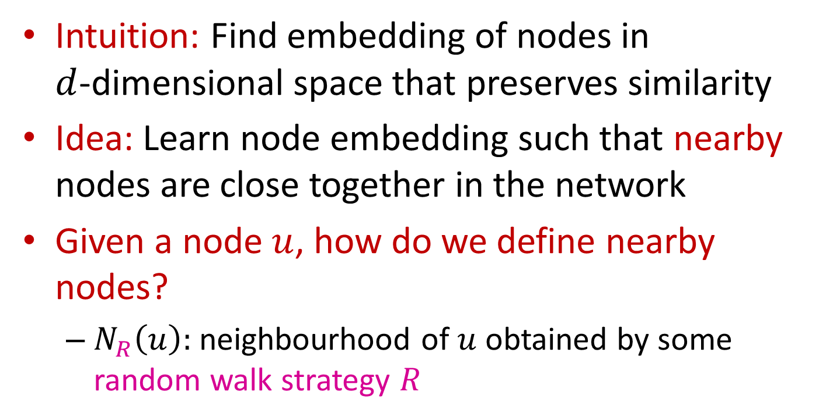
Unsupervised Feature Learning
Intuition: Find embedding of nodes in
$d$-dimensional space that preserves similarity
Idea: Learn node embedding such that nearby nodes are close together in the network
Given a node $u$, how do we define nearby nodes?
  $N_{R}\left(u\right):$ neighbourhood of $u$ obtained by some random walk strategy $R$

Slide 56
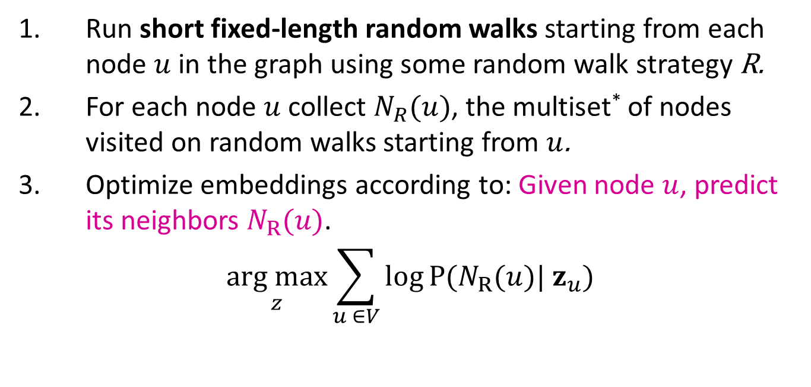
Random Walk Optimization
Run short fixed-length random walks starting from each node $u$ in the graph using some random walk strategy R.
For each node $u$ collect $N_{R}(u)$, the multiset* of nodes visited on random walks starting from $u$.
Optimize embeddings according to: Given node $u$, predict its neighbors $N_{R}(u)$.
$$\underset{z}{arg max}{\sum_{u ∈V}{\log{P(N_{R}(u})| z_{u})}}$$
Maximum likelihood objective
*$N_{R}(u)$ can have repeat elements since nodes can be visited multiple times on random walks

Slide 57
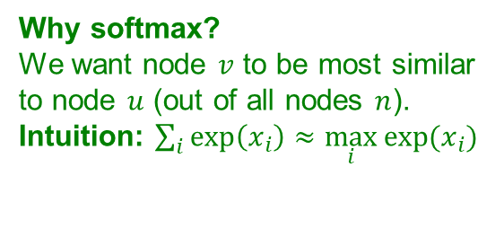
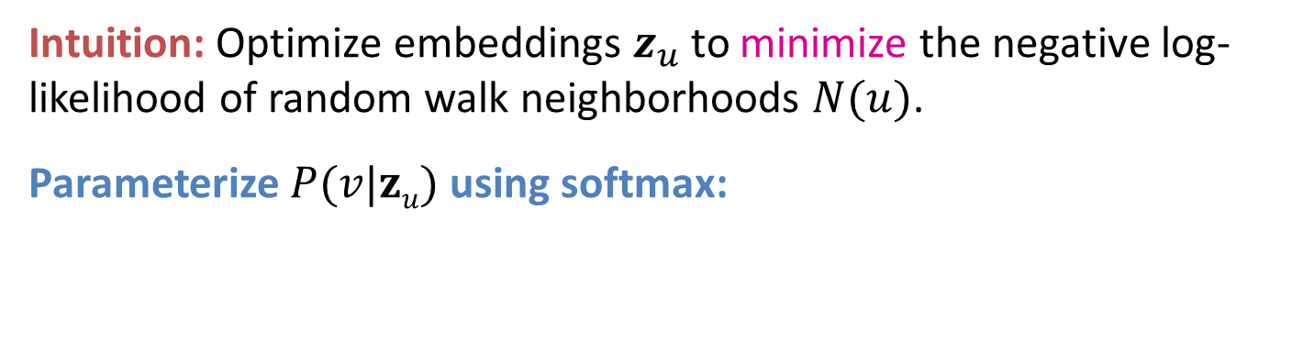
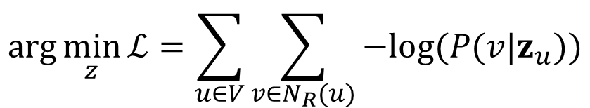

Random Walk Optimization
Equivalently,
$$\arg{\min_{z}{ℒ}}=\sum_{u∈V}{\sum_{v∈N_{R}(u)}{−log⁡(P(v|z_{u}))}}$$
Intuition: Optimize embeddings $z_{u}$ to minimize the negative log-likelihood of random walk neighborhoods $N(u)$.
Parameterize $P(v|zu)$ using softmax:
Why softmax?
We want node $v$ to be most similar to node $u$ (out of all nodes $n$).
Intuition: $\sum_{i}{exp\left(x_{i}\right)}≈\max_{i}{exp⁡(x_{i})}$
$$P\left(v | z_{u}\right)=\frac{exp⁡(z_{u}^{T}z_{v})}{\sum_{n∈V}{exp⁡(z_{u}^{T}z_{n})}}$$

Slide 58




Random Walk Optimization
Putting it all together:
$$ℒ=\sum_{u∈V}{\sum_{ v∈N_{R}(u)}{− log⁡( \frac{exp⁡(z_{u}^{T}z_{v})}{\sum_{n∈V}{exp⁡(z_{u}^{T}z_{n})}})}}$$
sum over all nodes $u$
sum over nodes $v$ seen on random walks starting from $u$
predicted probability of $u$ and $v$ co-occuring on random walk
Optimizing random walk embeddings = Finding embeddings $z_{u}$ that minimize L

Slide 59

Random Walk Optimization
But doing this naively is too expensive!
$$ℒ=\sum_{u∈V}{\sum_{ v∈N_{R}(u)}{−log⁡( \frac{exp⁡(z_{u}^{T}z_{v})}{\sum_{n∈V}{exp⁡(z_{u}^{T}z_{n})}})}}$$
Nested sum over nodes gives O(|V|²) complexity!

Slide 60
Random Walk Optimization
But doing this naively is too expensive!
$$ℒ=\sum_{u∈V}{\sum_{ v∈N_{R}(u)}{−log⁡( \frac{exp⁡(z_{u}^{T}z_{v})}{\sum_{n∈V}{exp⁡(z_{u}^{T}z_{n})}})}}$$
The normalization term from the softmax is the culprit… can we approximate it?

Slide 61




Negative Sampling
Why is the approximation valid?
Technically, this is a different objective. But Negative Sampling is a form of Noise Contrastive Estimation (NCE) which approx. maximizes the log probability of softmax.
New formulation corresponds to using a logistic regression (sigmoid func.) to distinguish the target node $v$ from nodes $n_{i}$ sampled from background distribution $P_{v}$.
More at https://arxiv.org/pdf/1402.3722.pdf
Solution: Negative sampling
Instead of normalizing w.r.t. all nodes, just normalize against $k$ random “negative samples” $n_{i}$
Negative sampling allows for quick likelihood calculation.
$$−log⁡( \frac{\exp\left(z_{u}^{T}z_{v}\right)}{\sum_{n∈V}{\exp\left(z_{u}^{T}z_{n}\right)}})$$
$≈\log\left(σ\left(z_{u}^{T}z_{v}\right)\right)+\sum_{i=1}^{k}{\log\left(σ\left(−z_{u}^{T}z_{n_{i}}\right)\right)}$, $n_{i}\sim P_{V}$
sigmoid function
(makes each term a “probability” between 0 and 1)
random distribution
over nodes
Notes:
-- Why is this approximation valid?
-- We loose soft-max by doing it?
-- Why can we move the log inside the sum in the approximation?

Slide 62



Negative Sampling
$$log⁡( \frac{\exp\left(z_{u}^{T}z_{v}\right)}{\sum_{n∈V}{\exp\left(z_{u}^{T}z_{n}\right)}})$$
random distribution
over nodes
$$≈\log\left(σ\left(z_{u}^{T}z_{v}\right)\right)+\sum_{i=1}^{k}{\log\left(σ\left(−z_{u}^{T}z_{n_{i}}\right)\right)}\text{, }n_{i}\sim P_{V}$$
Sample $k$ negative nodes $n_{i}$each with prob. proportional to its degree.
Two considerations for $k$ (# negative samples):
  Higher $k$ gives more robust estimates
  Higher $k$ corresponds to higher bias on negative events
  In practice $k=$5-20.
Can negative sample be any node or only the nodes not on the walk? People often sample any node (for efficiency).

Slide 63


Stochastic Gradient Descent
After we obtained the objective function, how do we optimize (minimize) it?
Gradient Descent: a simple way to minimize $ℒ$:
  Initialize $z_{u}$ at some randomized value for all nodes $u$.
  Iterate until convergence:
    For all $u$, compute the derivative $\frac{∂ℒ}{∂z_{u}}$.
    For all $u$, make a step in reverse direction of derivative: $z_{u}←z_{u}−η\frac{∂ℒ}{∂z_{u}}$.
$$ℒ=\sum_{u∈V}{\sum_{v∈N_{R}(u)}{−log⁡(P(v|z_{u}))}}$$
$η$: learning rate

Slide 64


Stochastic Gradient Descent
Stochastic Gradient Descent: Instead of evaluating gradients over all examples, evaluate it for each individual training example.
  Initialize $z_{u}$ at some randomized value for all nodes $u$.
  Iterate until convergence:
    Sample a node $u$, for all $v$ calculate the gradient $\frac{∂ℒ^{(u)}}{∂z_{v}}$.
    For all$v$, update:$z_{v}←z_{v}−η\frac{∂ℒ^{(u)}}{∂z_{v}}$.
$$ℒ^{(u)}=\sum_{v∈N_{R}(u)}{−log⁡(P(v|z_{u}))}$$

Slide 65


Random Walks: Summary
Run short fixed-length random walks starting from each node on the graph
For each node $u$ collect $N_{R}(u)$, the multiset of nodes visited on random walks starting from $u.$
Optimize embeddings $Z$ using Stochastic Gradient Descent:
$$ℒ=\sum_{u∈V}{\sum_{v∈N_{R}(u)}{−log⁡(P(v|z_{u}))}}$$
We can efficiently approximate this using negative sampling!

Slide 66
How should we randomly walk?
DeepWalk just runs fixed-length, unbiased random walks starting from each node
Node2vec: biased random walks that can trade-off between local and global views of the network
B. Perozzi, R. Al-Rfou, S. Skiena: DeepWalk: online learning of social representations. KDD 2014
A. Grover, J. Leskovec: node2vec: Scalable Feature Learning for Networks. KDD 2016

Slide 67
DeepWalk
Short random walks = sentences
Short truncated random walks are sentences in an artificial language

Slide 68
DeepWalk
Words frequency in a natural
language corpus follows a power law.
Node frequency in random walks on scale free graphs also follows a power law.

Slide 69
Representation mapping

Slide 70
DeepWalk
The algorithm consists of two main components; first a random walk generator and second an update procedure
Window w
Generate γ random walks for each vertex in the graph
Each short random walk has length t (intuitively, sentence length)
Pick the next step uniformly from the node neighbors

Slide 71
DeepWalk

Slide 72




node2vec: Biased Walks
Two classic strategies to define a neighborhood $N_{R}\left(u\right)$ of a given node $u$:
Walk of length 3 ($N_{R}\left(u\right)$ of size 3):
$$N_{BFS}\left(u\right)=\{ s_{1},s_{2},s_{3}\}$$
Local microscopic view (BFS)
$$N_{DFS}\left(u\right)=\{ s_{4},s_{5},s_{6}\}$$
Global macroscopic view (DFS)

Slide 73





BFS vs DFS
$$u$$
$$u$$
BFS:
$N_{R}(⋅)$ will provide a micro-view of neighbourhood
DFS:
$N_{R}(⋅)$will provide a macro-view of neighbourhood

Slide 74







Biased 2nd Order Random Walks
Walker from t, traversed ($t, v$) and is now in $v$, where to go next?
Same distance to $t$
x₁
x₂
$$v$$
Farther from $t$
$$t$$
Closer to $t$
How much far away from $t$? Only three possible choices:
Farther distance (distance =2)
Same distance (distance = 1)
Back to t (distance = 0)

Slide 75

Interpolating BFS and DFS
Biased random walk $R$ that given a node $u$ generates neighborhood $N_{R}\left(u\right)$
Two parameters:
  Return parameter $p$:
    Return to the previous node
  In-out parameter $q$:
    Moving outwards (DFS) vs. inwards (BFS)
    Intuitively, $q$ is the “ratio” of BFS vs. DFS
Specify how a single step of biased random walk is performed
  Random walk is then just a sequence of these steps.

Slide 76









One step of the biased random walk
At $v$ from $t$, where to go next?
Define the random walk by specifying the walk transition probabilities on edges adjacent to the current node $v$:
Same distance to $t$
x₁
$$1$$
x₂
1 to node with same distance
1/q node further apart
1/p back to t
(unnormalized probabilities)
$$v$$
Farther from $t$
$$1/q$$
$$t$$
$$1/p$$
Closer to $t$
  BFS-like walk: Low value of $p$
  DFS-like walk: Low value of $q$
Notes:
Parameter p controls the likelihood of immediately revisiting a node in the walk. Setting it to a high value
(> max(q; 1)) ensures that we are less likely to sample an already visited node in the following two steps (unless the next node in
the walk had no other neighbor). This strategy encourages moderate exploration and avoids 2-hop redundancy in sampling. On the
other hand, if p is low (< min(q; 1)), it would lead the walk to backtrack a step (Figure 2) and this would keep the walk “local”
close to the starting node u.

Slide 77














One step of the biased random walk
At $v$ from $S_{1}$
Target
Prob.
Dist. ${(S}_{i},t)$
0
1
2
2
s₂
$$1$$
$$1/q$$
s₃
$$t$$
s₂
s₃
s₄
$$1/p$$
$$1$$
$$1/q$$
$$1/q$$
$$v$$
$v→$
$$1/q$$
$$u$$
$$\text{t}$$
$$1/p$$
s₄
Unnormalized
transition prob.
segmented based on distance from $t$
$N_{R}(v)$ are the nodes visited by the biased walk

Slide 78

node2vec algorithm
1) Compute edge transition probabilities:
  For each edge $(s_{1}, w)$ we compute edge walk probabilities (based on $p,q$) of edges $(w,⋅)$
2) Simulate $r$ random walks of length $l$ starting from each node $u$
3) Optimize the node2vec objective using Stochastic Gradient Descent
Linear-time complexity
All 3 steps are individually parallelizable

Slide 79
Other Random Walk Ideas
Different kinds of biased random walks:
  Based on node attributes (Dong et al., 2017).
  Based on learned weights (Abu-El-Haija et al., 2017)
Alternative optimization schemes:
  Directly optimize based on 1-hop and 2-hop random walk probabilities (as in LINE from Tang et al. 2015).
Network preprocessing techniques:
  Run random walks on modified versions of the original network (e.g., Ribeiro et al. 2017 struct2vec, Chen et al. 2016 HARP).

Slide 80
GraRep
Path of length k =1
Look at the paths that connect the nodes
More paths -- more similar
  Probability from a node to reach the other
Considers paths of different lengths
Path of length k = 2
Path of length k = 3
Path of length k = 4
S. Cao, W. Lu, Q.i Xu: GraRep: Learning Graph Representations with Global Structural Information. CIKM 2015

Slide 81
GraRep
But not all k-neighbors equally important
Nearest neighborhoods more important
Maintain different k-step information differently in the graph representation
Notes:
Let us focus on learning the representation for the vertex A in the graph. We can see that A receives two types
of information when learning its representation: 1-step information from B, as well as 2-step information from all C
vertices. We note that if we do not distinguish these two different types of information, we can construct an alternative graph
as shown in (b) of Figure 2, where A receives exactly the same information as (a), but has a completely different structure

Slide 82






GraRep
$$v_{2}$$
$$v_{1}$$
$$v_{3}$$
$$v_{5}$$
$$v_{4}$$
Probabilistic adjacency matrix $Pij$ the probability of transition from node i to node j where the transition has length exactly 1

Slide 83






GraRep
$$v_{2}$$
$$v_{1}$$
$$v_{3}$$
$$v_{5}$$
$$v_{4}$$
Nodes reachable in 1-step from node 2
Nodes that reach node 4 in one step
$P_{ij}^{2}$ the probability of transition form node i from node j when the transition has length exactly 2

Slide 84


GraRep
$P_{ij}^{k}$: Transition probability from node i to node j where the transition consists of exactly k steps
1. Minimize the loss for a specific k
$L_{k} = \sum_{\left(i, j\right) ∈ V x V }{||P_{ij}^{k}}$ - $z_{i}{∙z}_{j}||2$
2. Concatenate the embeddings for the different k
Basic idea:
Train embeddings to predict k-hop neighbors.
Approach based on skipgrams

Slide 85


GraRep
Transition probability from node i (current node) to node j (context node) where the transition consists of exactly k steps
$$P_{ij}^{k}=p_{k}\left(j | i\right)$$
Skip-gram model
Given a center word w, predict the context words c, i.e., the words that appear within distance k from w
$$P_{cw}^{k}=p_{k}\left(c | w\right)$$
Learn two representations:
One for node i as the source node (i.e., center word)
One for node i as the destination node (i.e., context word)

Slide 86


GraRep
Use negative sampling (*) and maximum likelihood
Assume for a given k, the collection of all paths from G that start from i and end at j. Maximize
Probability that these pairs came from the graph, and
Probability that all other pairs did not come form the graph
probability that pair (i, j) came from the graph
probability that pair (i, j) did not come from the graph
$L_{k}\left(i\right)= \sum_{j ∈ V}{ (p_{k}\left(j | i\right) \text{log} σ(z_{i}∙}z_{j}))+λ E_{j′\sim p_{k}(V)}[\text{log} σ(−z_{i}{∙ z}_{j^{′}}) ]$
Sampled vertices drawn according to the vertex distribution over the graph ($p_{k}$(V))
σ: sigmoid function
hyper parameter indicating the number of negative samples

Slide 87


GraRep
$L_{k}\left(i\right)= \sum_{j ∈ V}{ (p_{k}\left(j | i\right) \text{log} σ(z_{i}}∙z_{j}))+λ E_{j′\sim p_{k}(V)}[\text{log} σ(−z_{i}{ ∙z}_{j^{′}}) ]$
Local objective for a specific pair of nodes
$L_{k}\left(i,j\right)= P_{ij}^{k} \text{log} σ\left(z_{i}{∙z}_{j}\right)+ \frac{λ}{N} \sum_{j′∈V}{P_{ij^{′}}^{k}} \text{log} σ(−z_{i}{∙z}_{j^{′}})]$
As before, compute the gradient and use stochastic gradient descent
Or solve by setting = 0 and get
$z_{i}z_{j}$= $log⁡(\frac{S_{i,jk}}{\sum_{i′}{A_{i^{′},jkk}}}$) – log(β), β =$\frac{λ}{Ν}$

Slide 88
Summary
Basic idea: Embed nodes so that distances in embedding space reflect node similarities in the original network.
Different notions of node similarity:
  Adjacency-based (i.e., similar if connected)
  Multi-hop similarity definitions (HOPE, GraRep)
  Random walk approaches (DeepWalk, node2vec)
No one method wins in all cases
  e.g., node2vec performs better on node classification while multi-hop methods performs better on link prediction

Slide 89
LINK ANG SUBGRAPH embeddings

Slide 90
From node to link embeddings
Also learns edge vectors based on the vectors of their endpoints

Slide 91



Embedding Entire Graphs
Goal: Want to embed a subgraph or an entire graph $G$. Graph embedding: $z_{G}$.
Tasks:
  Classifying toxic vs. non-toxic molecules
  Identifying anomalous graphs
$$z_{G}$$

Slide 92


Approach 1
Simple (but effective) approach 1:
Run a standard graph embedding technique on the (sub)graph $G$.
Then just sum (or average) the node embeddings in the (sub)graph $G.$
Used by Duvenaud et al., 2016 to classify molecules based on their graph structure
$$z_{G}=\sum_{v∈G}{z_{v}}$$

Slide 93

Approach 2
Approach 2: Introduce a “virtual node” to represent the (sub)graph and run a standard graph embedding technique
Proposed by Li et al., 2016 as a general technique for subgraph embedding

Slide 94

Preview: Hierarchical Embeddings
DiffPool: We can also hierarchically cluster nodes in graphs, and sum/avg the node embeddings according to these clusters.

Slide 95
EmBeddings and Factorization

Slide 96

Embeddings & Matrix Factorization
Recall: encoder as an embedding lookup
embedding vector for a specific node
embedding matrix
Dimension/size of embeddings
$$Z=$$
one column per node
Objective: maximize $z_{v}^{Τ}z_{u}$ for node pairs $(u, v)$ that are similar

Slide 97

Matrix Factorization
Simplest nodes similarity, two nodes are similar if connected by an edge.
Exact factorization $A=Z^{T}Z$ is generally not possible
However, we can learn $Z$ approximately
Objective:$\min_{Z}∥A−Z^{T}Z∥_{2}$
  We optimize $Z$ such that it minimizes the L2 norm (Frobenius norm) of $A−Z^{T}Z$
  Note today we used softmax instead of L2. But the goal to approximate $A$ with $Z^{T}Z$ is the same.
Conclusion: Inner product decoder with node similarity defined by edge connectivity is equivalent to matrix factorization of$A.$

Slide 98

Random Walk-based Similarity
DeepWalk and node2vec have a more complex node similarity definition based on random walks
DeepWalk is equivalent to matrix factorization of the following complex matrix expression:
  Explanation of this equation is on the next slide.
$$log\left(vol(G)\left( \frac{1}{T} \sum_{r=1}^{T}{{(D^{−1}A)}^{r}}\right)D^{−1}\right)−\log{b}$$
Notes:
vol: sum of degrees
trace: sum of the entries in the diagonal

Slide 99




Random Walk-based Similarity
Volume of graph
$$vol\left(G\right)=\sum_{i}{\sum_{j}{A_{i,j}}}$$
Node2vec can also be formulated as a matrix factorization (albeit a more complex matrix)
Refer to the paper for more details:
Diagonal matrix $D$
$$D_{u,u}=deg⁡(u)$$
$$\log\left(vol(G)\left( \frac{1}{T} \sum_{r=1}^{T}{{(D^{−1}A)}^{r}}\right)D^{−1}\right)−\log{b}$$
context window size
$T={|N}_{R}\left(u\right)|$
Number of
negative samples
Power of normalized
adjacency matrix
Network Embedding as Matrix Factorization: Unifying DeepWalk, LINE, PTE, and node2vec, WSDM 18

Slide 100
Summary

Slide 101

How to Use Embeddings
How to use embeddings $z_{i}$ of nodes:
  Clustering/community detection: Cluster points $z_{i}$
  Node classification: Predict label of node $i$ based on $z_{i}$
  Link prediction: Predict edge $(i,j)$ based on ${(z}_{i},z_{j})$
    Where we can: concatenate, avg, product, or take a difference between the embeddings:
      Concatenate: ${f(z}_{i},z_{j})$= ${g([z}_{i},z_{j}])$
      Hadamard: ${f(z}_{i},z_{j})$= ${g(z}_{i}∗z_{j})$ (per coordinate product)
      Sum/Avg: ${f(z}_{i},z_{j})$= ${g(z}_{i}+z_{j})$
      Distance: ${f(z}_{i},z_{j})$= ${g(||z}_{i}−z_{j}|{\left.​\right|}_{2})$
  Graph classification: Graph embedding $z_{G}$via aggregating node embeddings or virtual-node.
  Predict label based on graph embedding $z_{G}$.

Slide 102
Limitations (1)
Limitations of node embeddings via matrix factorization and random walks
  Transductive (not inductive) method: Cannot obtain embeddings for nodes not in the training set. Cannot apply to new graphs, evolving graphs.
A newly added node 5 at test time
(e.g., new user in a social network)
4
3
Cannot compute its embedding
with DeepWalk / node2vec. Need to recompute all node embeddings.
2
1
5
Training set

Slide 103

Limitation (2)
Cannot capture structural similarity:
  Node 1 and 11 are structurally similar – part of one triangle, degree 2, …
  However, they have very different embeddings.
    It is unlikely that a random walk will reach node 11 from node 1.
DeepWalk and node2vec do not capture structural similarity.
struct2vec
${similarity}_{r}\left(u, v\right):$based on the difference of the degree sequence of nodes at radius $r$ of $u$ and $v$
Builds a multilayer weighted graph, weights set based on similarity
Perform a random walk: change layer, or do a weight-biased walk in the same layer
3
13
4
5
10
2
12
1
11
LFR Ribeiro et. al., struc2vec Learning Node Representations from Structural Identity, KDD 2017

Slide 104
Limitations (3)
Cannot utilize node, edge and graph features
Feature vector
(e.g. protein properties in a
protein-protein interaction graph)
4
3
2
DeepWalk / node2vec embeddings do not incorporate such node features
1
5

Slide 105
Summary
We discussed graph representation learning, a way to learn node and graph embeddings for downstream tasks, without feature engineering.
Encoder-decoder framework:
  Encoder: embedding lookup
  Decoder: predict score based on embedding to match node similarity
Node similarity measure: (biased) random walk
  Examples: DeepWalk, Node2Vec
Extension to Graph embedding: Node embedding aggregation

Slide 106
Acknowledgement
Most slides from
CS224W: Machine Learning with Graphs, Jure Leskovec, Stanford University, http://cs224w.stanford.edu

