Slide 1
A Crash COURSE on PROBABILITY THEORY
Discrete and Continuous Probabilities
Data Mining
Fall 2025
n.theologis@uoi.gr

Slide 2
DISCRETE PROBABILITY THEORY

Slide 3

Events and Probabilities
Consider a random process
(Throw dice, pick a random card)
Each possible outcome is a simple even (or sample point)
The sample space Ω is the set of all possible simple events
An event is a set of simple events (a subset of the sample space)
With each simple event Ε we associate a real number 0 ≤ Pr(E) ≤ 1 which is the probability of event
What is Randomness?
Lack of Information
Ω = {1,2,3,4,5,6}
E = ”odd” = {1,3,5}

Slide 4
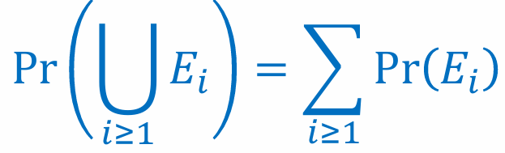
Probability Space – Definition
Three components of a Probability Space:
A sample space Ω , which is the set of all possible outcomes of the random process
A family of sets F representing the Allowable Events, where each set in F is a subset of the sample space. In discrete probability space: F = All subsets of Ω
A probability function Pr: F → R satisfying the definition below
A probability function is any function that satisfies the following conditions
For any event Ε, 0 ≤ Pr(E) ≤ 1
Pr(Ω) = 1
For any finite or countably infinite sequence of pairwise mutually disjoint events E₁,E₂,E₃,...
Corollary: The probability of an event is the sum of the probabilities of its simple events.
F = { {1} , {2} , … , {6}, {1,2}, … , {1,2,3,4,5,6} }
Pr(E = odd) = Pr({1,2,3})=
Pr(1)+Pr(2)+Pr(3) = 3/6

Slide 5

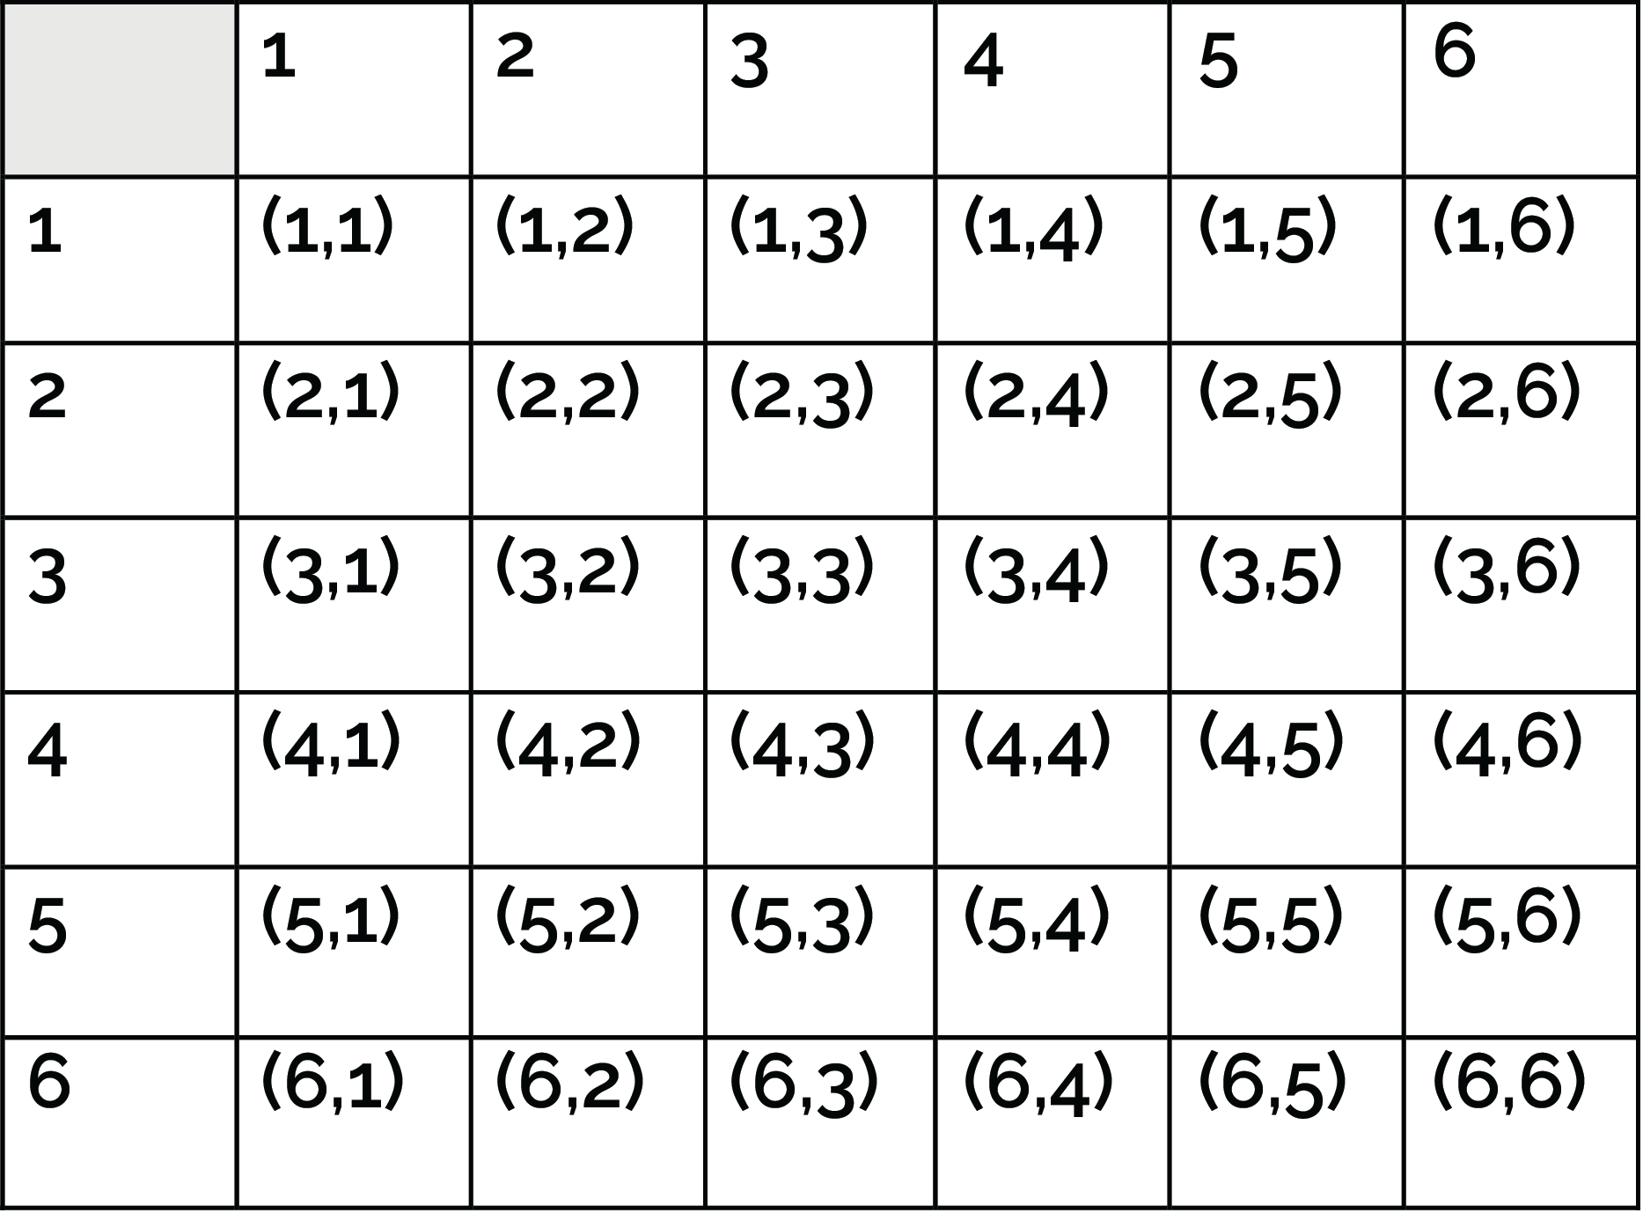
Example:
Rolling two dice. Sample space is the set of all ordered pairs
Ω = {(i,j): 1≤ i,j ≤ 6}
We assume each simple event has probability Pr(i,j) = 1/36
Event: Ε₁ = “Ντόρτια”
Event: Ε₂ = “sum = 8”
Event: Ε₃ = “sum at least = 8”
Event : Ε₄ = “Both dice have odd numbers”
  There are four combinations, equally likely: (odd,odd), (even, even), (odd, even), (even, odd)
Event : Ε₅ = E₃ ∩ E₄
Pr(E₁) = Pr(4,4) = 1/36
Pr(E₂) = Pr({(2,6),(3,5),(4,4),(5,3),(6,2)}) = 5/36
Pr(E₃) = Pr({E₂,(6,3),(5,4),(4,5),(3,6),(6,4),(5,5), (4,6),(6,5),(5,6),(6,6)}) = 15/36
Pr(E₄) = 1/4
Pr(E₅) = {(5,3),(3,5),(5,5)} = 3/36

Slide 6
Conditional Probability
In conditional probability we consider the probability that an event E₁ occurs, given that we know that an event E₂ has occurred.
Sample space: Ω = “Αll the people living in Ioannina”
Event Ε₁ = “People living in Ioannina who were born in Ioannina”
Event Ε₂ = “People living in Ioannina who are students at UoI”
Conditional probability of a person living in Ioannina to be born in Ioannina given that they are students at UoI: Pr(E₁ |E₂ )
Conditional probability is different from joint probability Pr(E₁∩E₂ ) ≠ Pr(E₁ |E₂ )
This is the probability that a person living in Ioannina is born in Ioannina and is also a student at UoI

Slide 7
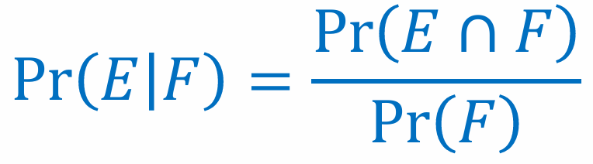

Computing Conditional Probability
The conditional probability that event E occurs given that event F occurs is
The conditional probability is well defined only if Pr(F) > 0
By conditioning on F we restrict the sample space from Ω to the set F. Thus, we are interested in Pr(E∩F) normalized by Pr(F)
Corollary:

Slide 8
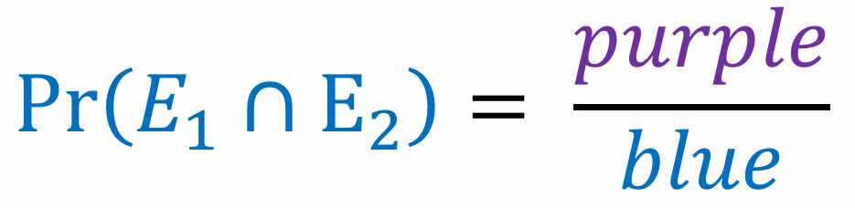
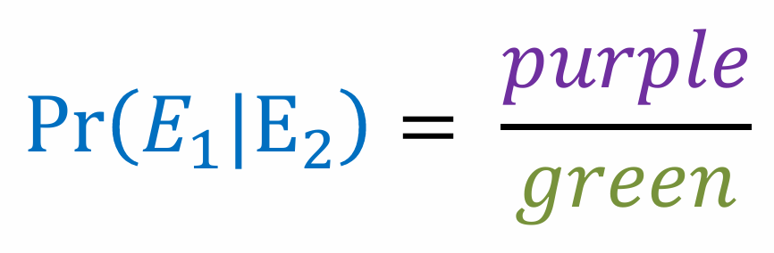
Venn Diagrams
We can represent events using Venn Diagrams
Sample space Ω:
All people living in Ioannina
Event Ε₁
People born in Ioannina
=
=
Event E₁∩E₂
Students at UoI born in Ioannina
Event Ε₂
Students at UoI

Slide 9
Example
What is the probability when rolling two dice that their sum is 8, given that their sum is even ?
E₁ = “sum is 8” = {(2,6),(3,5),(4,4),(5,3),(6,2)}: Pr(E₁) = 5/36
E₂ = “sum is even”: Pr(E₂) = 1/2
Pr(E₁ |E₂) = Pr(E₁∩E₂) / Pr(E₂) = (5/36) / (1/2) = 5/18
Notice: Pr(E₁∩E₂) = Pr(E₁) = 5/36 = 1/2 * Pr(E₁ |E₂)

Slide 10
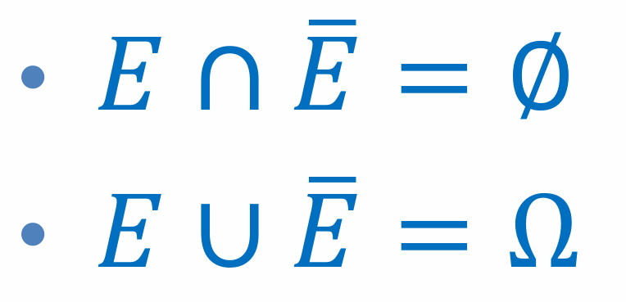
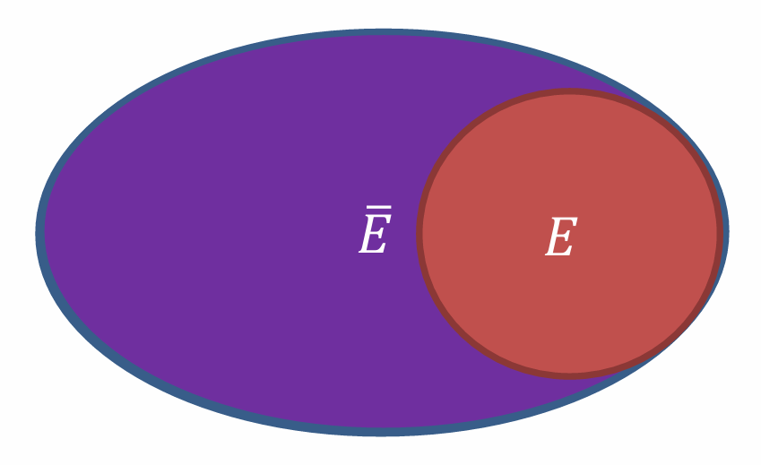
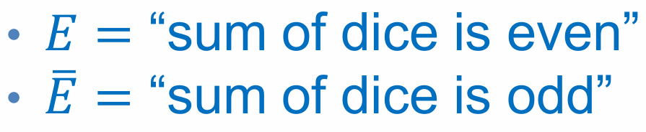

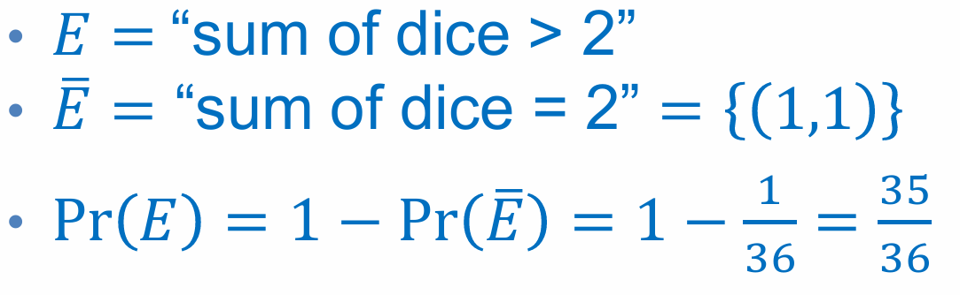

Complement
Let Ω be the sample space. If E ⊆ Ω is an event, then the complement of the event E is the event Ē, such that:
Example:
Probability of the complement:
Sometimes it is more convenient to work with the complement.
Example: Compute the probability that the sum of two dice is greater than 2

Slide 11
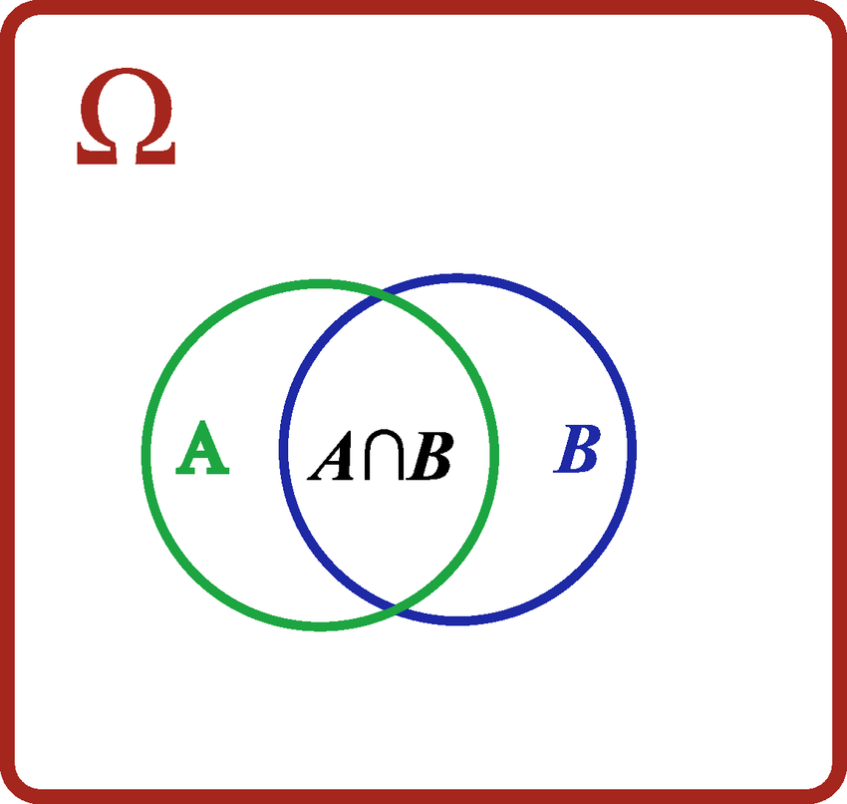
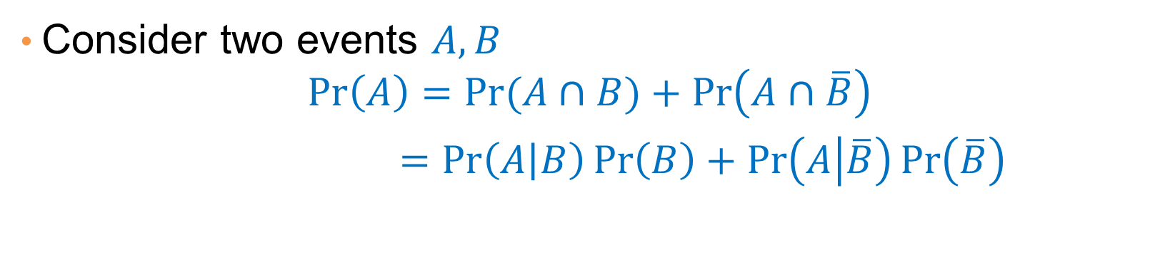


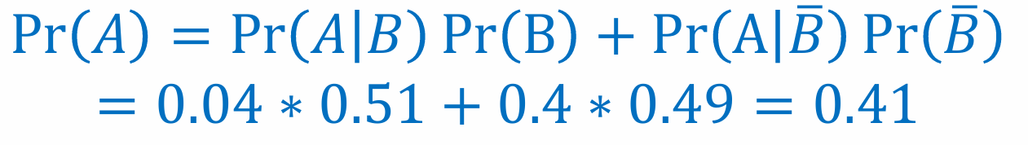
A Useful Identity
Why is this
True?
Application
Compute the probability that a randomly selected person has height greater than 1.80. Assume that we know that:
Probability that a man has height greater than 1.80 is 0.4
Probability that a woman has height greater than 1.80 is 0.04
Event A = “height greater than 1.80”
Event B = “person is a woman”. Pr(B)=0.51
Solution

Slide 12
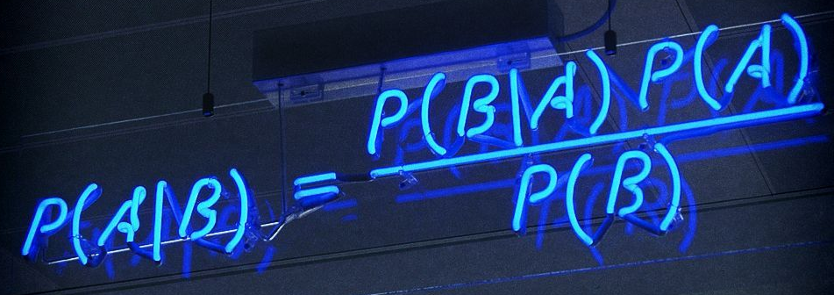
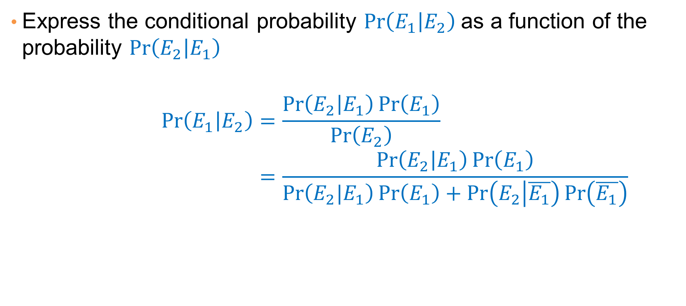
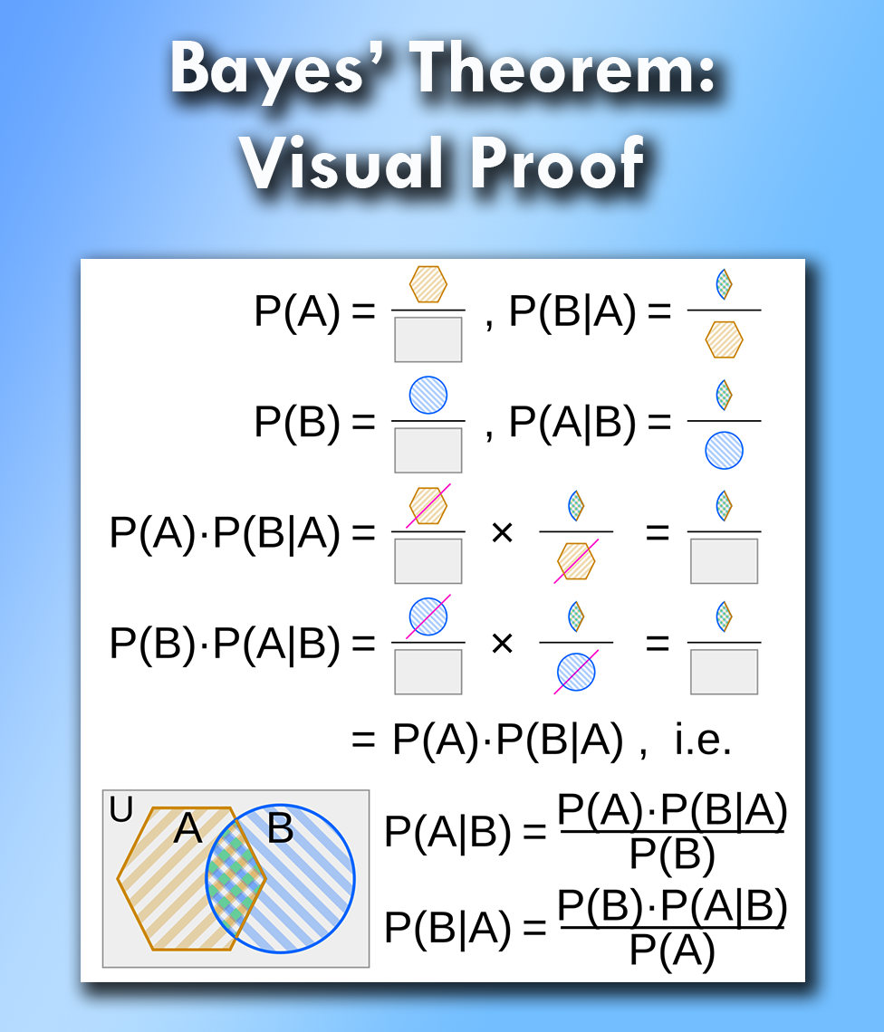
Bayes Rule
Why is this
True?
Remember that:

Slide 13
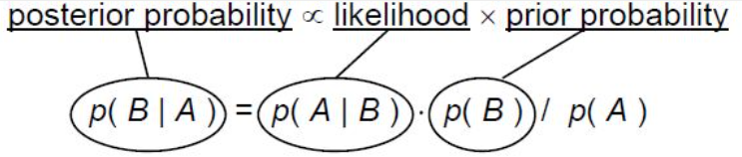

Example: A-posteriori probability
We are given 2 coins:
  one is a fair coin A
  the other coin, B, has head on both sides
We choose a coin at random, i.e. each coin is chosen with probability 1/2.
We then flip the coin.
Given that we got head, what is the probability that we chose the fair coin A ???
A
B

Slide 14
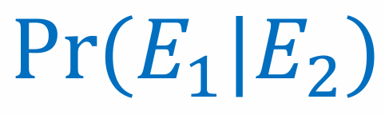
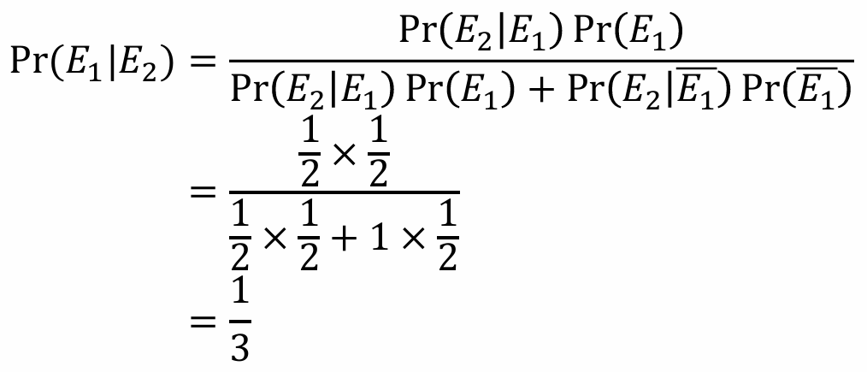
Example: A-posteriori probability
Event E₁ = “coin A was chosen”
Event E₂ = “output was head”
What do we want to compute?
Using Bayes Rule:
A = Fair
B = Unfair
Given that we got head, what is the probability that we chose the fair coin A

Slide 15


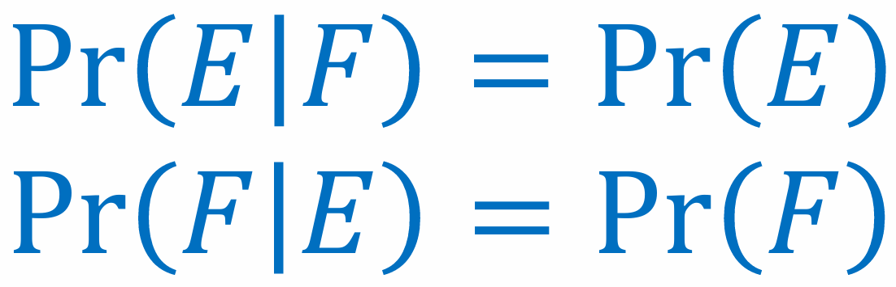
Independent Events
Two events and are independent if and only if
The probability of occurring together is equal to the product of the probabilities of occurring individually.
Equivalently:
The probability of one event occurring is not affected by the fact that we know the other event has occurred.

Slide 16


Examples
Pick a random card from a deck:
  E = “ace was picked”
  F = “heart was picked”
Roll a die:
  E = “even number ” = {2,4,6}
  F = “number ≤ 4” = {1,2,3,4}
Roll a die:
  E = “prime number” = {1,2,3,5}
  F = “number ≤ to 4” = {1,2,3,4}
Independent!
Even if we know that we have picked a heart
We still have probability 1/13 to pick an ace
Two independent processes
Independent!
The events are of the same process but even if we know that we have picked a number ≤ 4
We still have probability ½ to pick an even number
Not Independent!
If we know that we have picked a number ≤ 4
Then we have probability 3/4 to pick a prime number
While we have probability 4/6 overall

Slide 17
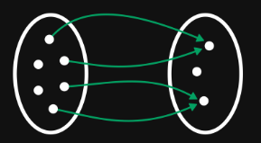
Random Variables
A radom variable X on the sample Space Ω is a function on Ω, that
is, X: Ω → ℝ
A discrete random variable is a random variable that takes only a finite or countably infinite number of values.
A random variable is a numeric quantity that we are interested in that is the by-product of the random process.
By defining the random variable, we assign a value to every simple event in the sample space
X
Ω
ℝ

Slide 18
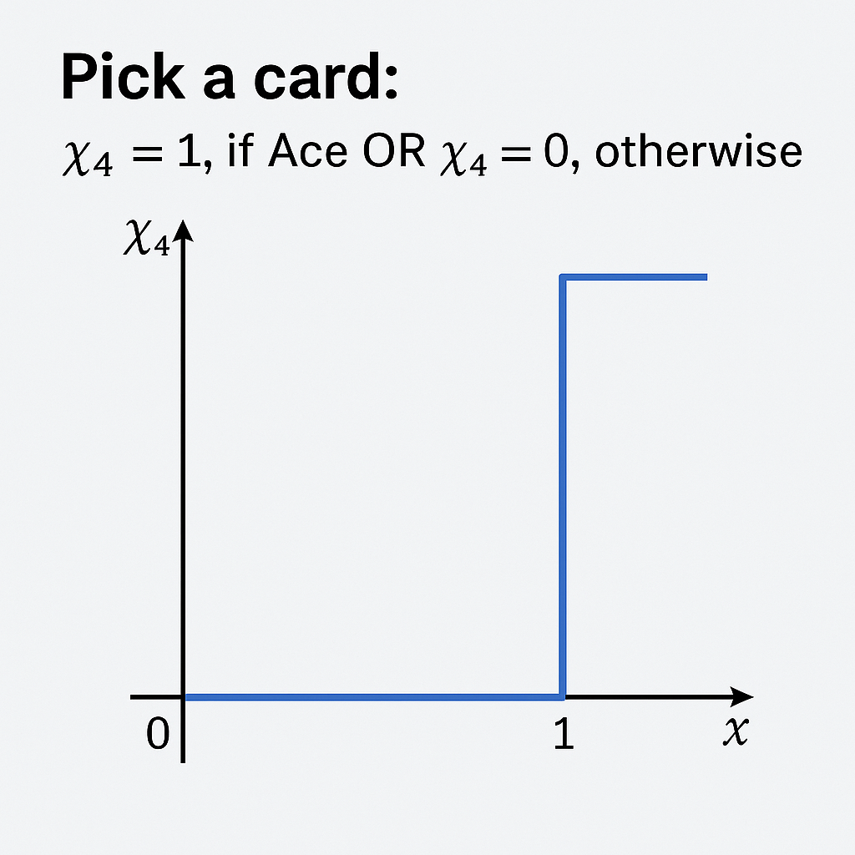




Examples
Ω = {1,2,3,4,5,6}
Roll a die: X₁ = "the number"
Roll 2 dice: X₂ = "the sum of the values" (i,j) (i+j)
Flip 2 coins: Χ₃ = 3$, if 2 Heads OR Χ₃ = 1$, otherwise
Pick a card: Χ₄ = 1, if Ace
OR Χ₄ = 0, otherwise
R = {1,2,3,4,5,6}
(i+j)

Slide 19
Probability Distribution
Each value x of the random variable X, defines an event (X=x) in the sample space Ω.
For example, for the random variable Χ₃ (money gained when drawing cards) the value Χ₃ =3$ corresponds to the event {(Η,Η)}, while the value Χ₃ =1$ corresponds to the events {(Η,Η), (T,H), (T,T)}
We can thus compute the probability of a value Pr(X=x), or Pr(x) Pr(Χ₃ =3$) = 1/4 , Pr(Χ₃ =1$) = 3/4
Thus we define: Probability distribution function for random variable X which satisfies: 0 ≤ Pr(x) ≤ 1 and Σ_{x} Pr(x) = 1

Slide 20
Independent Random Variables
Random Variables X and Y are independent if and only if:
Pr( (X=x) ∩ (Y=y) ) = Pr(X=x) Pr(Y=y), for all x,y
Also we can write:
Pr(X,Y) = Pr(X)Pr(Y) and Pr(X|Y) = Pr(X)
Example
Rolling 5 dice:
  The outcome of each roll is independent of the outcome of the other rolls
  The sum of the first three rolls is independent of the sum of the last two rolls
Drawing 3 cards:
  The number of Aces we have is independent of the number of Hearts we get

Slide 21
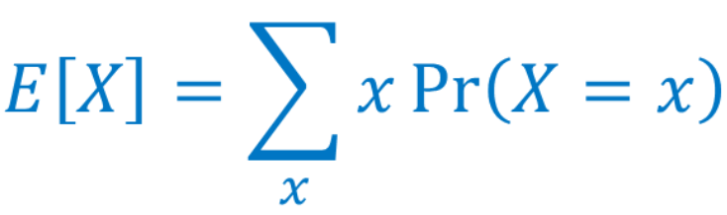
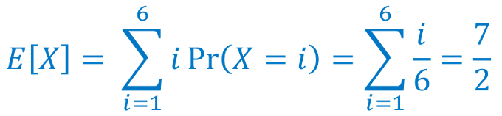

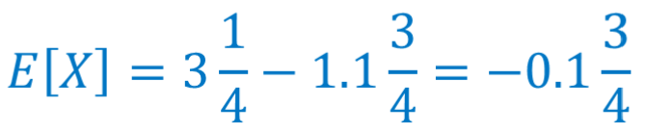
Expectation
The expectation of a discrete random variable X, E[X] is given by:
Think of the expectation as the mean value you would get if you took infinite values of the random variable X
Examples
The expected value of a dice roll:
The expected sum of 2 dice rolls:
Throw 2 coins. If both are head you win 3$ else you loose 1.1$ would you play this game?

Slide 22
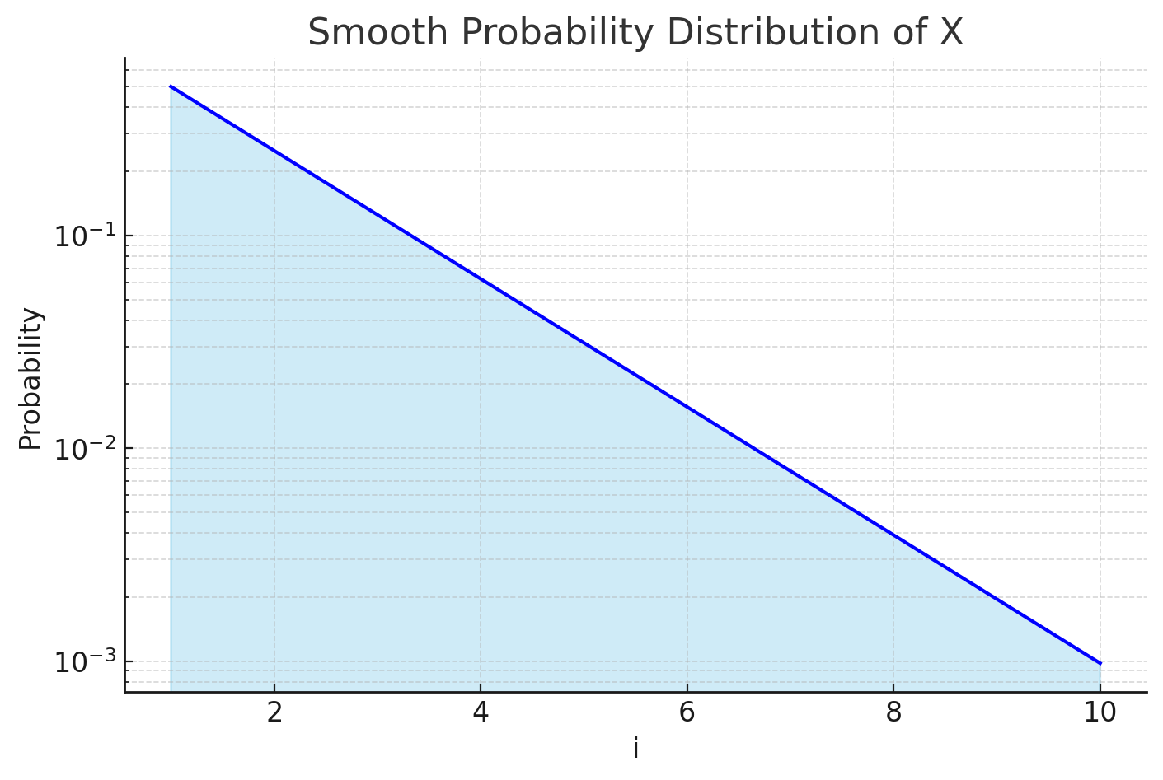
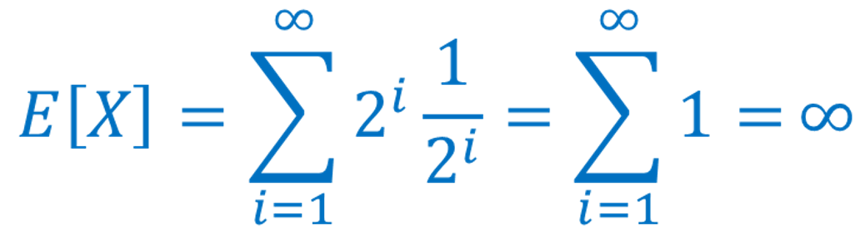
Examples
The expectation is not the most probable value. Consider random variable X that takes values {-2,0,2} with probability {0.4, 0.2, 0.4} The Expected value is:
E[X] = -2 • 0.4 + 0 • 0.2 + 2 • 0.4 = 0
The expectation may be unbounded. Consider the random variable X which takes value 2^{i} with probability 1/2^{i}, for i = 1,2,3,... (this distribution)
The most not probable value !
2¹⁰

Slide 23
Linearity of Expectation
For any two random variables X and Y:
E[X + Y] = E[X] + E[Y]
This holds for any random variables, X and Y do not need to be independent
For any constant and random variable :
E[cX] = cE[X]
Corollary: The expectation of a constant is the constant
E[c] = c

Slide 24
Examples
Roll n dice. What is the expected sum of their outputs?
Define random variables X₁,X₁, … ,X_{n} as the out of each dice then:
E[X] = E[Σ_{n} X_{i}] = Σ_{n} E[X_{i}] = Σ_{n} 7/2 = 7n / 2
Roll 2 dice. What is the expectation of the random variable X, which is definced as: The output of the 1st dice, plus 2 times the output of the 2nd dice?
E[X] = E[X1+2X2] = E[X1] + E[2X2] = E[X1] + 2E[X2] = 7/2 + 14/2 = 10.5

Slide 25
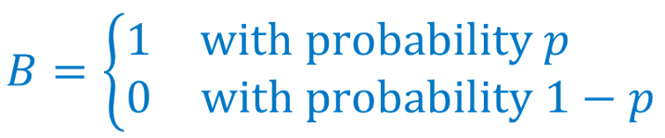
Bernoulli Random Variable
A Bernoulli Random Variable is one that takes values {0,1}. It has a
parameter p which is the probability of taking the value 1.
Bernoulli variables are used as indicator variables, whether some event of interest happened or not, e.g., 1 if you draw an Ace, 0 otherwise
Expectation:

Slide 26
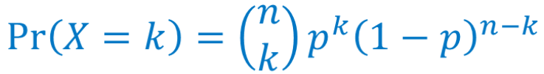
Binomial Random Variable
A binomial random variable measures the number of successes in a sequence of n trials, e.g. Toss a coing n times: What is the number of tails?
A binomial random variable X with parameters n,p, denoted B(n,p) is defined by the following probability distribution for k = 0,1,2, …,n
k: Number of successes
Probability of getting n-k failures
n: Number of trials
Probability of getting k successes
Number of ways to select k elements
out of n elements

Slide 27



Example
Giannis has a 70% chance to make a free throw
He takes n=4 free throws at clutch time
What is the probability to make k=3 baskets?

Slide 28
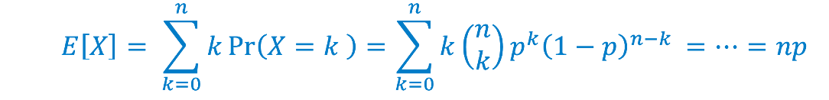
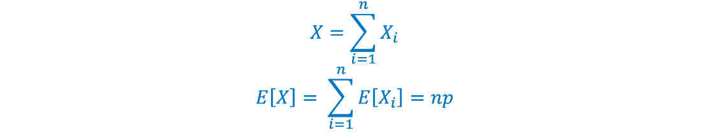
Expectation of a Binomial Random Variable
We can compute the expectation using the standard formula:
Is there a simpler way? Ideas?
Defining n Bernoulli random variables X₁,...,X_{n} with success probability p

Slide 29
Expectation is not everything
Consider the following 2 job offerings:
Job gives salary 1000$ per month
Job gives salary 1$ per month plus a bonus of 1.000.000$ but with probability 1/1000
Which job would you pick?
(A)
(B)
Using only the Metric of Expected value the “Correct” choice is B !!
E[A] = 1000
E[B] = 1 + (1 / 1000) * 1,000,000 = 1001
Would you choose
Job B?

Slide 30

Variance
The variance of a random variable is defined as:
Variance measures the expected deviation from the expected value, measured as the squared difference
The standard deviation of a random variable is:
In the Previous Job Example
Job A: Var(A) = σ(Α) = 0
Job B: Var(B) ≈ 10⁹
σ(Β) ≈ 31.600

Slide 31
Pr(A|B) = Pr(A)
Quiz
A∩B = ∅
Question: We have two events that are disjoint. Are they independent?
Answer: No. They are clearly dependent since if one happens the probability of the other happening is zero (think of coin toss)
Question: A coin has probability p of being head. What is the probability that I throw the coin 10 times and I get all heads?
Answer: Each coin toss is independent. Therefore, the probability is: p¹⁰
Question: A coin has probability p of being head. What is the probability that I throw the coin 10 times and I get at least one head?
Answer: Consider the complement of his event: I get NO heads. The probability of not getting a head is 1-p. The probability of getting NO heads is (1-p)¹⁰. The probability of this NOT happening is 1-(1-p)¹⁰

Slide 32

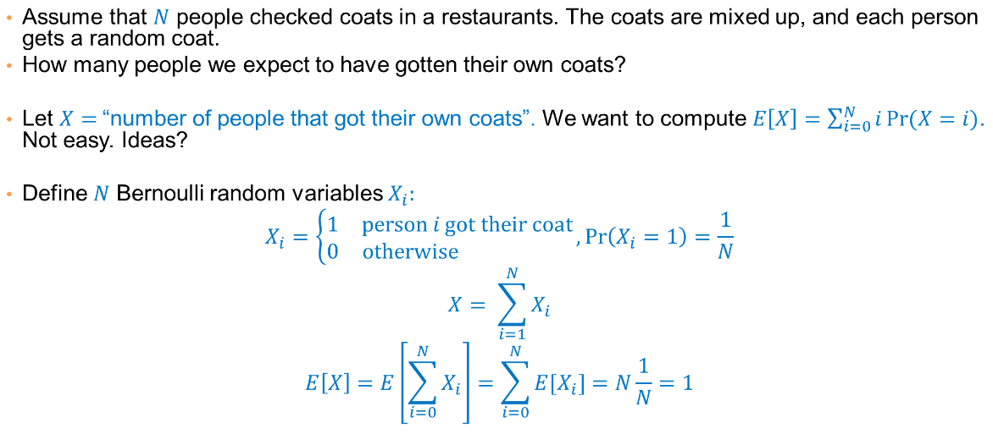
Exercise
Assume that N people check their coats in a restaurant. The coats get mixed up. Each person then gets a random coat.
How many people do we expect to get their coat back?
Let X = "number of people that got their coat back", we want to compute:
Define N Bernoulli random variables Xi:
Why?

Slide 33
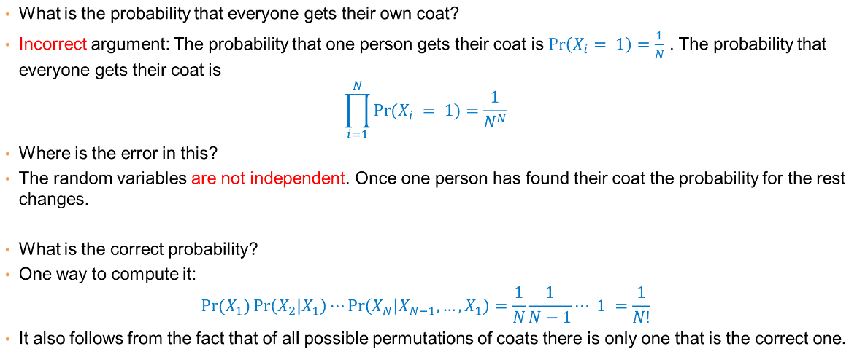
Exercise
Question: What is the probability that everyone gets their coat back?
Idea: The probability that one person gets their coat is: Pr(X_{i}=1) = 1/N
Then that everyone gets their coat is:
What is the error?
The random variables X_{i} are NOT independent. Once one person has found their coat the probability for the rest changes!
One way to compute it:
This makes sense since from all permutations of coats only one is correct

Slide 34
CONTINUOUS RANDOM VARIABLES

Slide 35
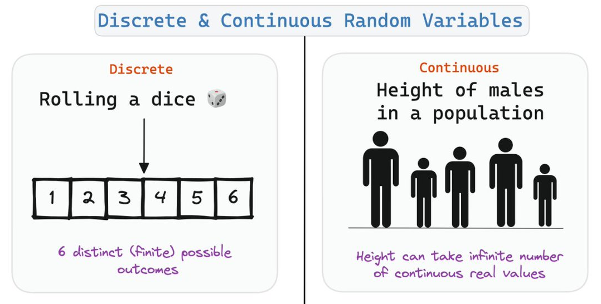
Continuous Random Variables
A continuous random variable X is one that takes values on a real interval, rather than a discrete set. (e.g. height, temperature, speed, etc...)
The probability value is NOT defined for a specific real value
The probability value is defined over an interval of values

Slide 36
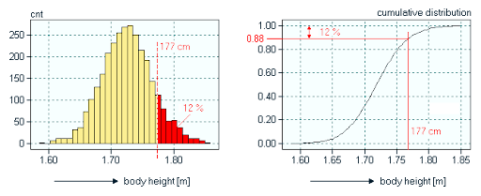
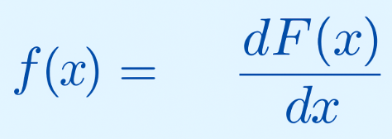
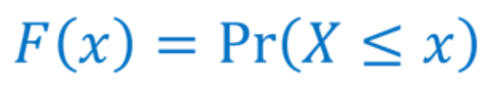
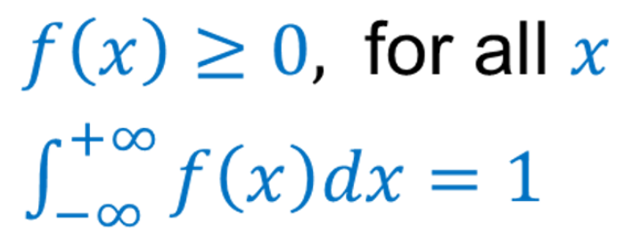
Cumulative & Density Probability Functions
CDF: Probability of a random variable X to be less than or equal to x
PDF: Density of Probability for random variable X at each value x
ProbabilityDensity
Probabilities

Slide 37
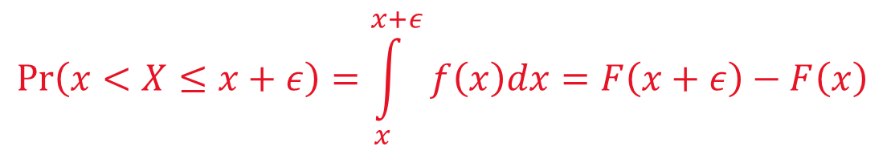


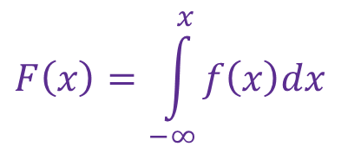
Probability Density Function
The PDF is the closest analog to the probability function of the discrete case, i.e. it tells us how the probability mass is distributed over some range of the random variable X
Sometimes, we may use f(x) as the probability of value x
The correct way to compute this is to take the integral of PDF in (x,x+ε)

Slide 38
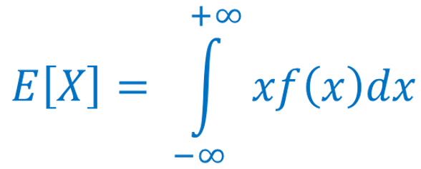
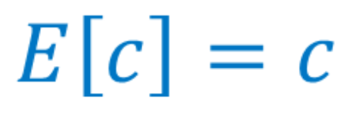
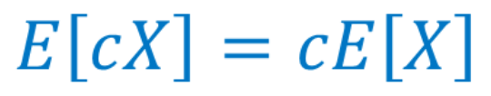

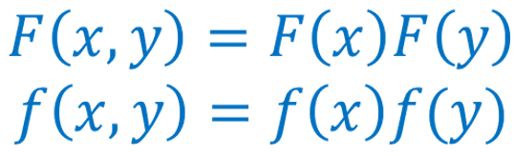
Expectation and Indepedence
The expectation is defined by taking the integral:
Same properties hold for linearity of Expectation
Independence is defined using the cumulative and the density function
Reminder for
Discrete

Slide 39
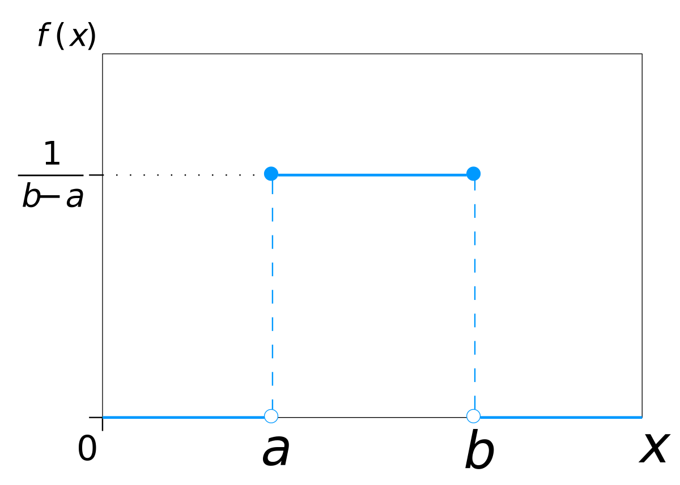
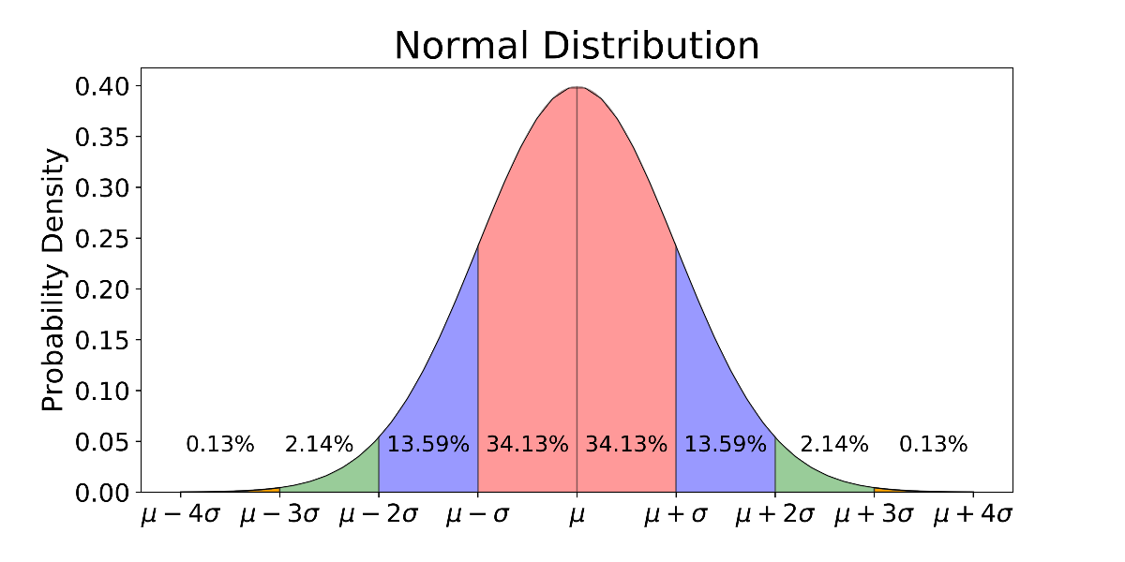
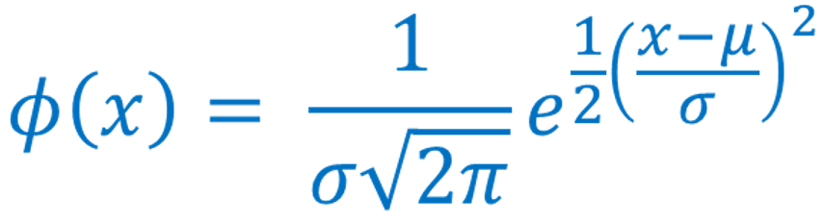
Important continuous distributions
Uniform Distribution:
The probability of any interval (a,b) is proportional to its length b-a.
The resulting PDF is a flat line:
Equal mass everywhere, how is the CDF?
Gaussian / Normal Distribution:
It is fully characterized by the mean μ and the standard deviation σ

Slide 40
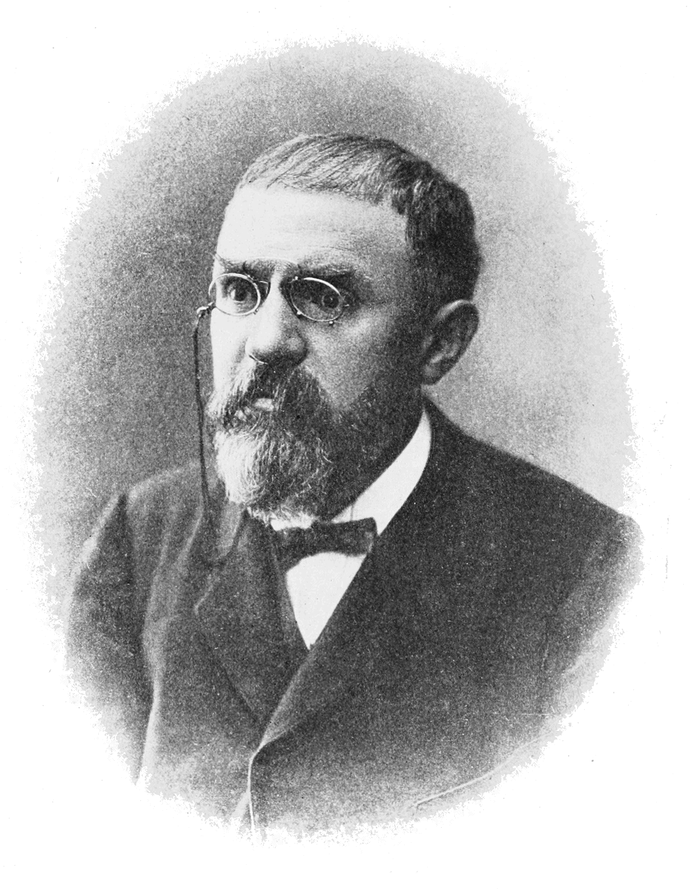
Poincare: Physicists think of CLT as a mathematics theorem while mathematicians think of CLT as a natural physical law
Central Limit Theorem
Let Y₁, Y₂, …, Y_{n} be independent identically distributed random variables with mean μ and variance σ² (for example n height measurements from a broader population)
Let Y = 1/n Σ_{i} Y_{i} , be the mean value of the n random variables (in our example the mean height)
When n is large the random variable Y converges to a normal distribution with mean μ and variance σ²/n !!
This means that if we repeat the height measurements multiple times, the distribution of the mean height will follow the gaussian/normal distribution

