Slide 1
DATA MINING Introduction
What is data mining?
Applications and techniques

Slide 2
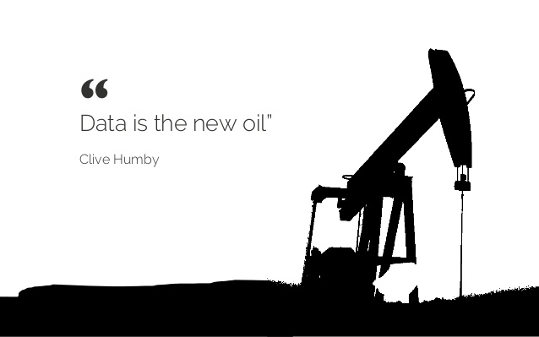

Slide 3
“Data is the new oil. It’s valuable, but if unrefined it cannot really be used. It has to be changed into gas, plastic, chemicals, etc to create a valuable entity that drives profitable activity; so must data be broken down, analyzed for it to have value.”

Slide 4
Data Mining
In simple terms:
Data
Value
Data Mining

Slide 5
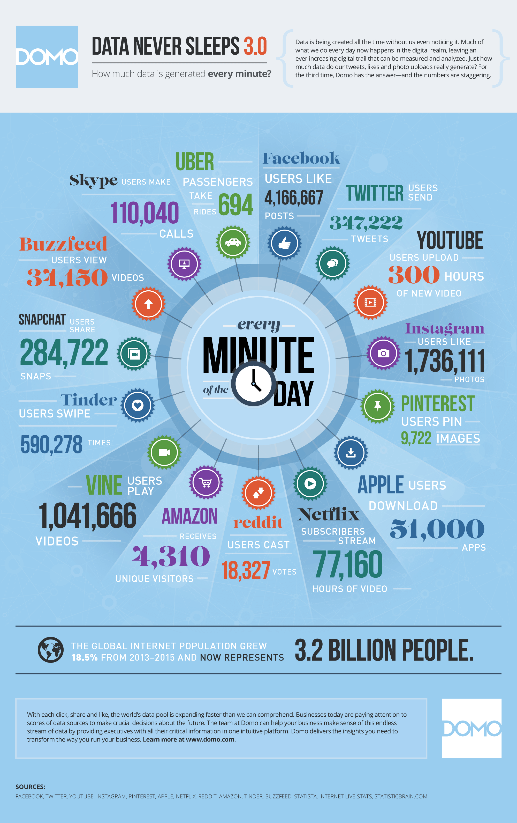
There is a lot of data
Every human, physical, or machine activity generates data.
Transaction data in stores, credit cards
Scientific measurements
DNA sequences, gene coexpression
Health records, brain images, daily measurements
The Web, Wikipedia, Facebook posts, Tweets, Online Reviews
Queries to Google, Clicks, Browsing behavior, Ads
Facebook likes and comments, Twitter retweets
The Web graph, Facebook friends, Twitter followers
Movement data, Trajectories,
Mobile use, telephone calls
Wearable devices
Machine and workflow monitoring
Everybody collects data!

Slide 6
The data is complex and interconnected
Multiple types of data: database tables, text, time series, images, videos, graphs, etc
Spatial and temporal aspect
Interconnected data of different types:
From the mobile phone we can collect, location of the user, friendship information, check-ins to venues, opinions through twitter, status updates in FB, images though cameras, queries to search engines

Slide 7
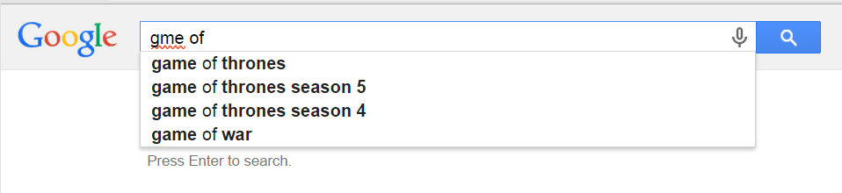

Data creates value
Natural language understanding is driven by data

Slide 8
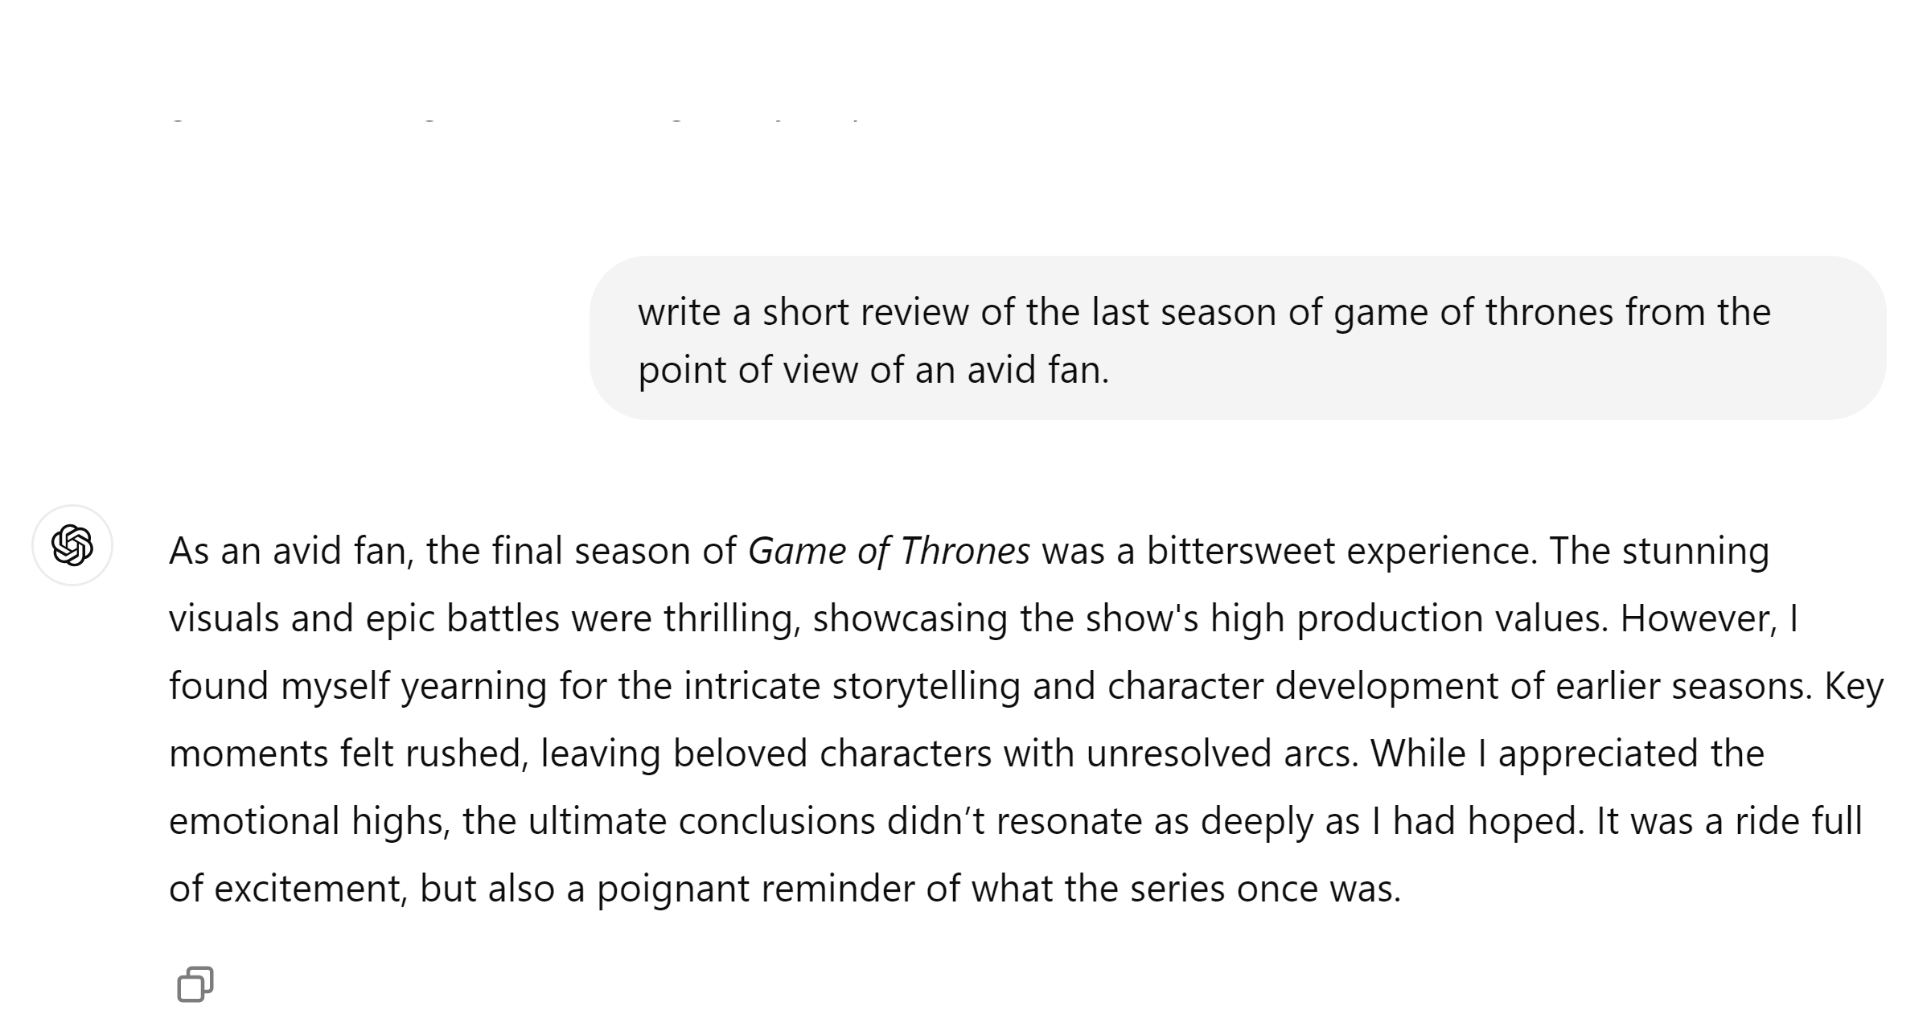
Data Creates Value
The NLP revolution relies on massive amounts of text data

Slide 9
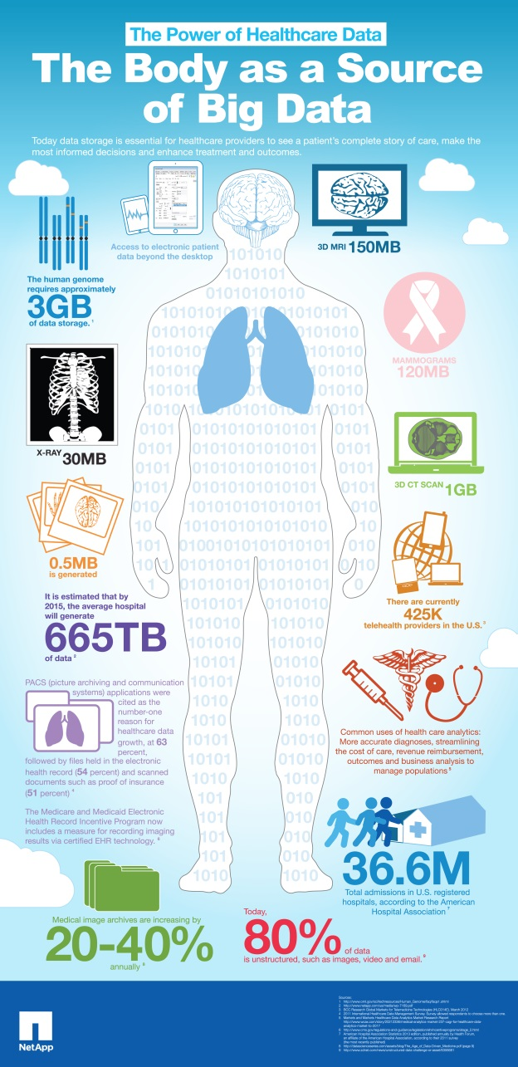
Data creates value
Precision/Personalized medicine:
Find the best treatment for patients using their genotype and all data that are related to them
Also: understanding drug side-effects through google queries

Slide 10
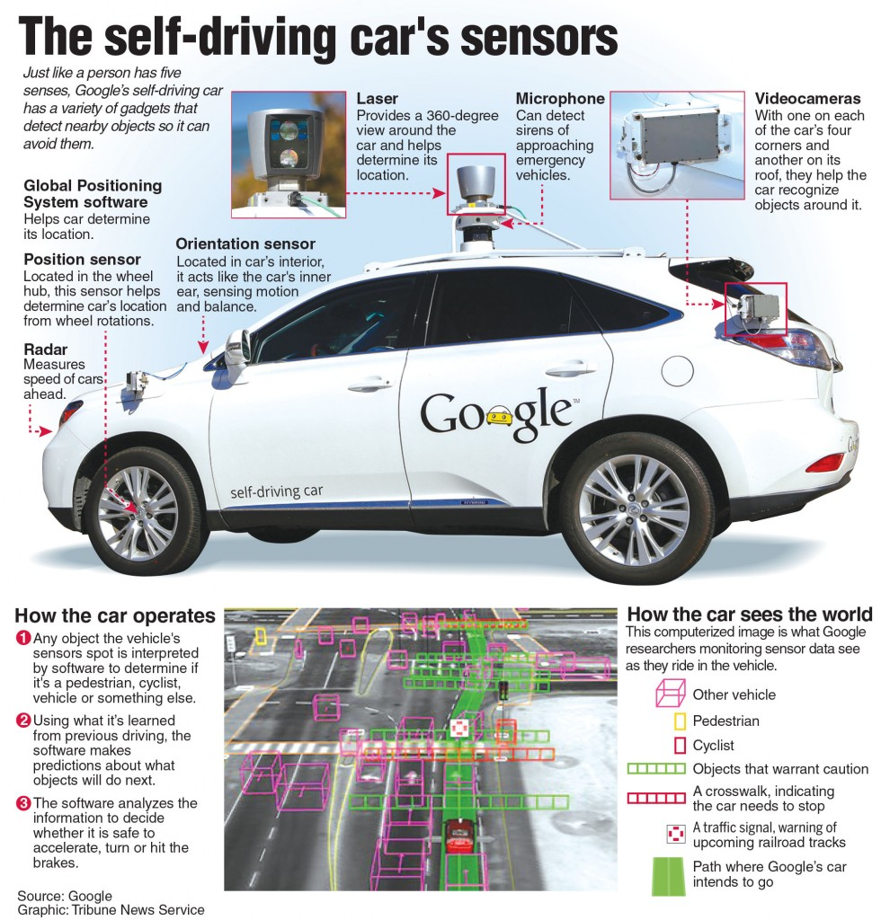
Data creates value
Self-Driving Cars:
Car is the next computer. A future of smart cars that can drive themselves and learn from data
Also: smart cities – urban computing

Slide 11

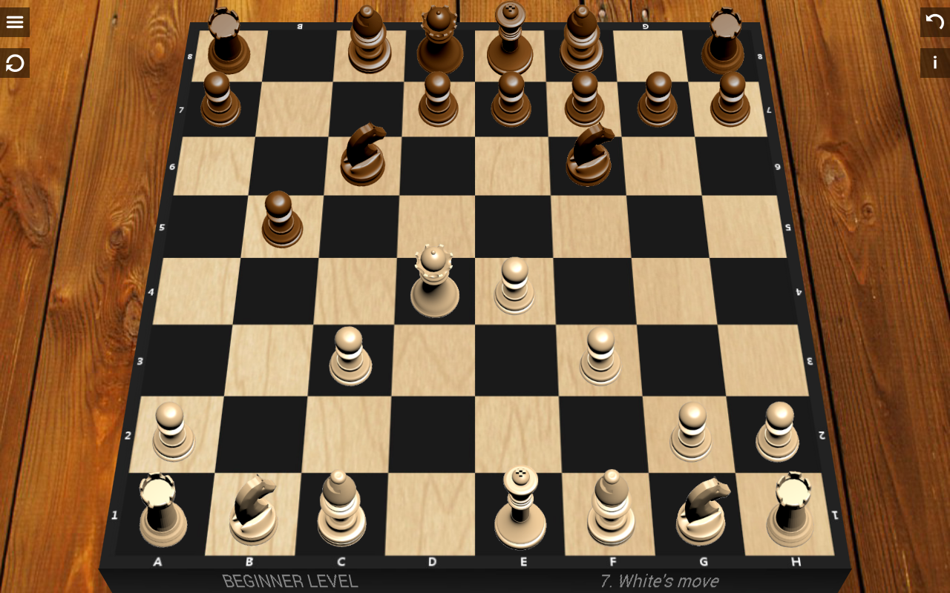
Data creates value
Computers learn to play games by observing data

Slide 12
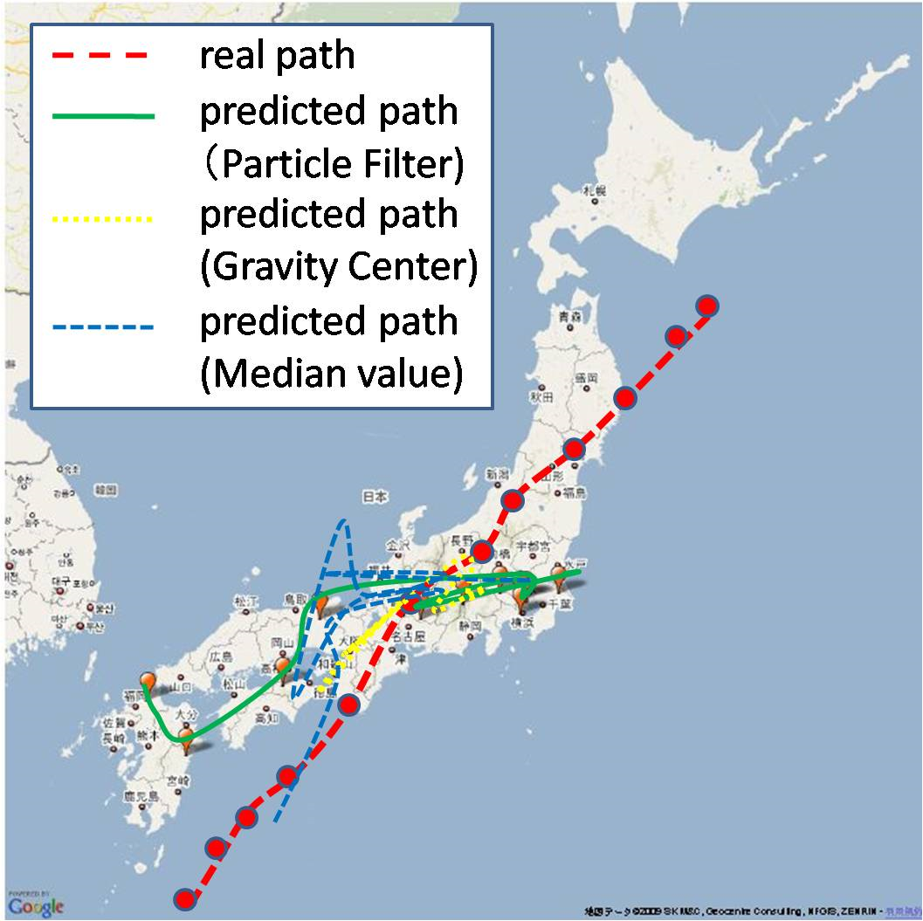
Data creates value
Use of data for crisis management

Slide 13



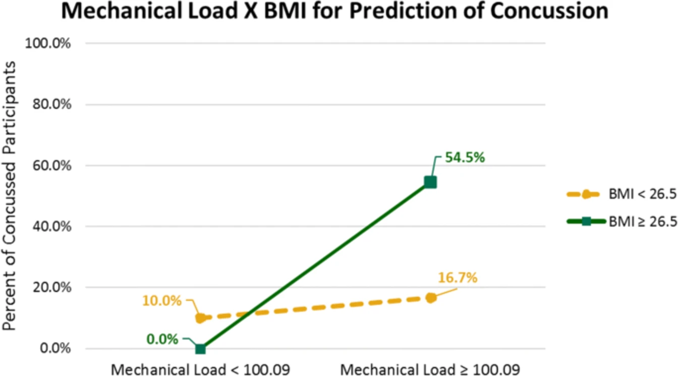
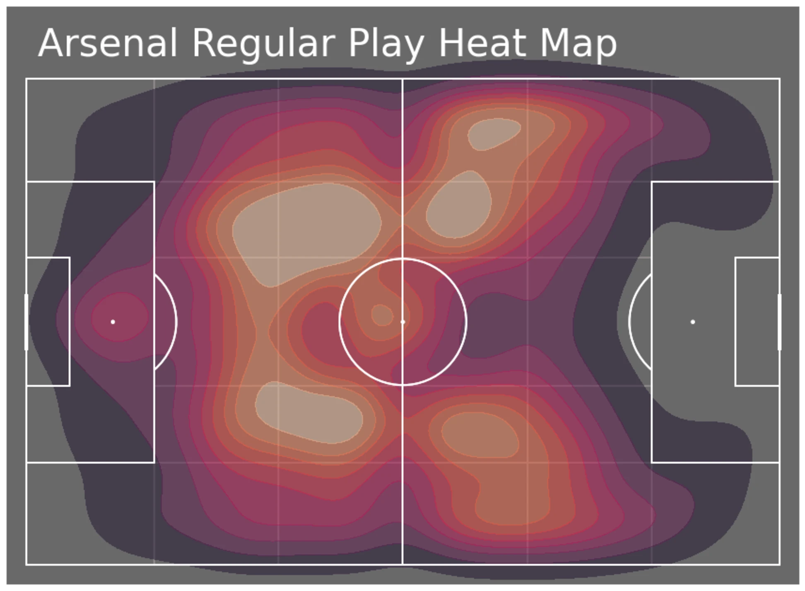
Data creates value
Sports Analytics: All major athletes and teams collect and analyze data.
Injury prediction and prevention
Team Strategy
Advanced metrics

Slide 14
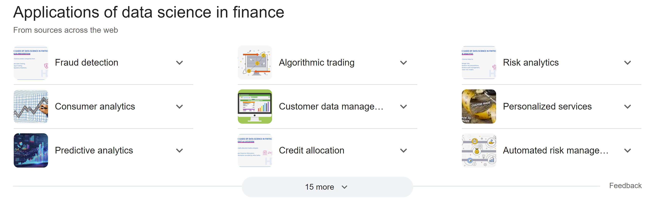
Data creates value

Slide 15
Putting it all together: The Data Mining Pipeline (LinkedIn)
Data Pipeline
Model Fitting Pipeline (Hadoop)
feature extraction
feature transformation
user modeling
offline modeling fitting
(cold-start model)
nearline modeling fitting
(warm-start model)
daily/weekly
minutes/hourly
Online Serving System
data tracking & logging
multi-pass rankers
candidates generation
real-time feedback
online A/B test
model evaluation

Slide 16
Data Mining Example
Suppose that you were creating the Greek Facebook.
What kind of data would you collect and store?
Posts, content of posts
Social network contacts
Interactions with feed: Clicks, Likes, Comments, Shares
Interaction with contacts: messages, likes, replies, shares
Photos
Videos uploaded videos consumed
Demographics: Age, City, etc
Ads seen, ads clicked
Products bought
and many more!
What would you do with this data?

Slide 17
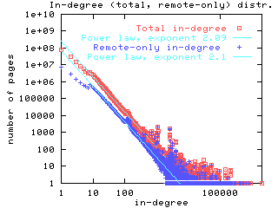
Exploratory Analysis
Make measurements to understand what the data looks like
Example: Posts
How often do users posts, how many posts per user, when do they post, is there a correlation between number of posts and number of friends, etc
This is one of the first steps when collecting data.
Metrics: Deciding what to measure is important
The example of the Web graph

Slide 18
Exploiting similarities
Consider the following data for six users:
Number of times they have clicked on posts from these pages
What conclusion can we draw?
 | NBA | ESPN | Sports.com | MSNBC | NY Times | Wall Street | Politico
A | 100 | 50 | 73 | 10 | 1 | 1 | 4
B | 500 | 200 | 400 | 20 | 10 | 4 | 1
C | 80 | 100 | 60 | 1 | 3 | 1 | 1
D | 4 | 2 | 1 | 12 | 90 | 100 | 80
E | 9 | 3 | 4 | 9 | 100 | 80 | 70
F | 3 | 4 | 5 | 30 | 300 | 200 | 500

Slide 19
Exploiting similarities
Two types of users and two types of pages
Sports and politics
Questions:
How do we compute similarity?
How do we group similar users? Clustering
 | NBA | ESPN | Sports.com | MSNBC | NY Times | Wall Street | Politico
A | 100 | 50 | 73 | 10 | 1 | 1 | 4
B | 500 | 200 | 400 | 20 | 10 | 4 | 1
C | 80 | 100 | 60 | 1 | 3 | 1 | 1
D | 4 | 2 | 1 | 12 | 90 | 100 | 80
E | 9 | 3 | 4 | 9 | 100 | 80 | 70
F | 3 | 4 | 5 | 30 | 300 | 200 | 500

Slide 20
Exploiting similarities
What if we were missing this entry?
Can we fill this value?
Similar users like items similarly: Recommendation systems
 | NBA | ESPN | Sports.com | MSNBC | NY Times | Wall Street | Politico
A | 100 | 50 | 73 | 10 | 1 | 1 | 4
B | 500 | 200 | 400 | 20 | 10 | 4 | 1
C | 80 | 100 | ??? | 1 | 3 | 1 | 1
D | 4 | 2 | 1 | 12 | 90 | 100 | 80
E | 9 | 3 | 4 | 9 | 100 | 80 | 70
F | 3 | 4 | 5 | 30 | 300 | 200 | 500

Slide 21

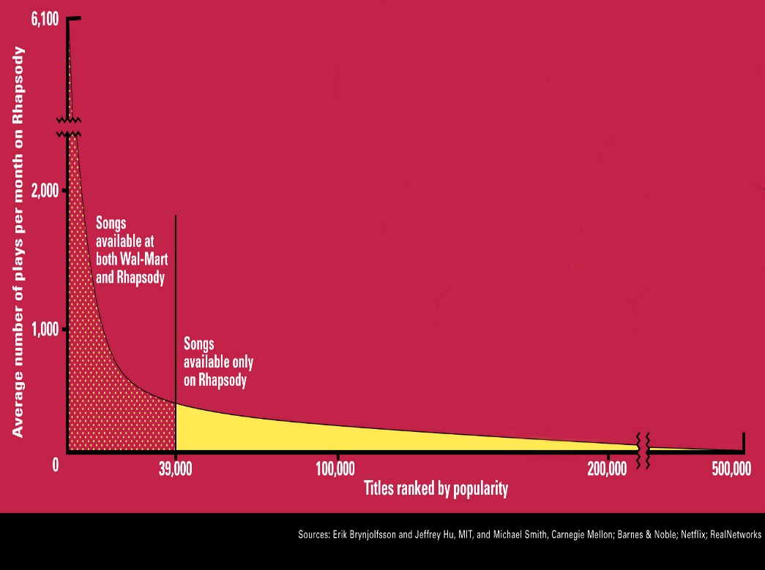
Amazon Recommendations
“People who have bought this also bought…”
A huge breakthrough for amazon
Took advantage of the long tail
A big breakthrough for data mining in general

Slide 22
Making predictions
Filling the missing value can also be viewed as a prediction task
Types of prediction tasks:
Predicting a real value (e.g. number of clicks): Regression
Predicting a YES/NO value (e.g., will the user click?): Binary classification
Predicting over multiple classes (e.g., what is the topic of a post): Classification
Can you think of prediction/classification tasks for your social network?
Predict if a post is offensive
Ad click prediction
Like prediction
Predict if a photo contains nudity
Ad clickthrough prediction
Predict if a user will like a post over another:
Learning to rank

Slide 23
Classification
Classification process:
Find features that describe an entity.
Use examples of the classes you want to predict.
Learn a model (function) that predicts
Classification is the engine behind the AI revolution
Used in all systems that make decisions
Became very powerful with Deep Learning
Huge applications in vision
Refund
Yes
No
NO
MarSt
Single, Divorced
Married
TaxInc
NO
< 80K
> 80K
NO
YES

Slide 24
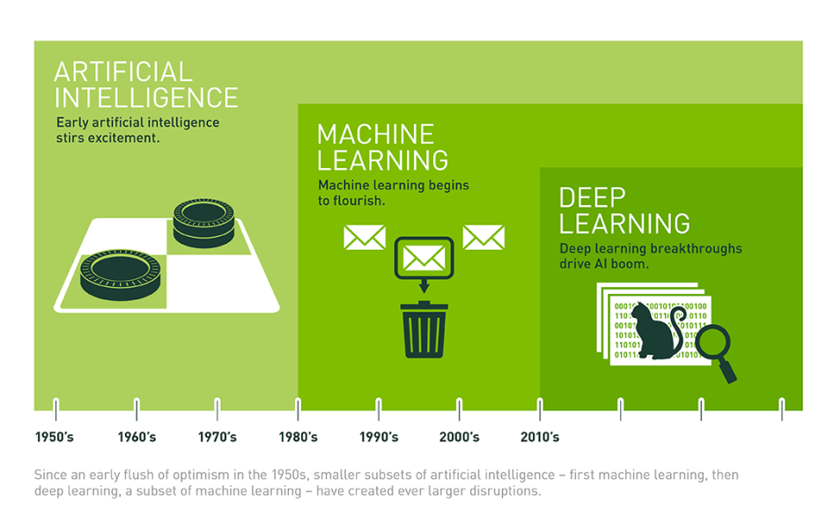
Deep learning
Machine learning systems that use neural networks with multiple layers and are trained on very large quantities of data
Able to learn complex representations and powerful models.
Applications in recommendations, network analysis, text analysis, image recognition, car driving, playing games…
Require less feature engineering

Slide 25



Generative AI
Machine learning tools that generate realistic text or images
ChatGPT
DALL·E 2, Midjourney
Trained on massive amounts of data to predict missing words, or the next frame in a video

Slide 26
The social graph
Your Greek Facebook also has a social graph. What can you do with this data?
Who is important and influential in the graph?
What is the shortest path between two nodes?
How does information spread in the network?
What becomes viral?
Will two users become friends in the future?

Slide 27
Node importance
What is the most important node in this graph?
The PageRank algorithm: A node is important is it is pointed to by other important nodes

Slide 28

The Web as a graph
When ranking pages, the authoritativeness is factored in the ranking.
This is the idea that made Google a success around 2000
Today a lot more information is used, like clicks, browsing behavior, etc
Ranking of the pages is a very complex task that requires sophisticated techniques

Slide 29
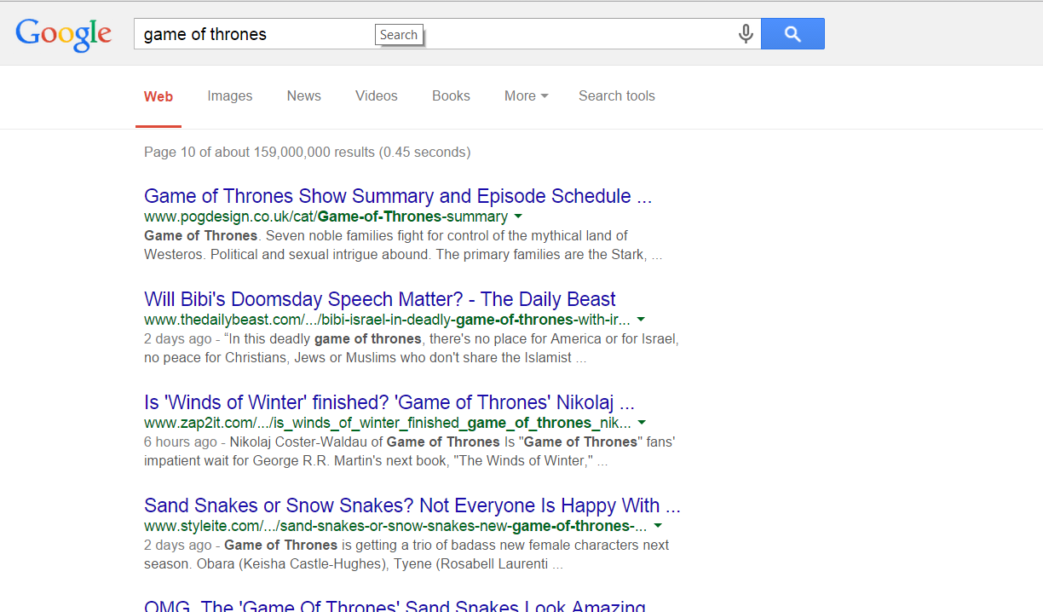

Slide 30



Friendship suggestions
LinkedIn, Twitter, Facebook friendship suggestions
Useful for the users to discover their friends, but also useful for the network in order to grow, and increase engagement
LinkedIn success story
Triadic closure principle: Links are created in a way that usually closes a triangle
If both Bob and Charlie know Alice, then they are likely to meet at some point.

Slide 31
What is Data Mining again?
“Data mining is the analysis of (often large) observational data sets to find unsuspected relationships and to summarize the data in novel ways that are both understandable and useful to the data analyst” (Hand, Mannila, Smyth)
“Data mining is the discovery of models for data” (Rajaraman, Ullman)
We can have the following types of models
Models that explain the data (e.g., a single function)
Models that predict the future data instances.
Models that summarize the data
Models the extract the most prominent features of the data.
“Data Mining is the study of collecting, processing, analyzing, and gaining useful insights from data” – Charu Aggarwal

Slide 32
Why data mining?
Scientific point of view
Scientists are at an unprecedented position where they can collect TB of information
Examples: Sensor data, astronomy data, social network data, gene data
We need the tools to analyze such data to get a better understanding of the world and advance science and help people
Commercial point of view
Data has become the key competitive advantage of companies
Examples: Facebook, Google, Amazon
Being able to extract useful information out of the data is key for exploiting them commercially.
Scale (in data size and feature dimension)
Why not use traditional analytic methods?
Enormity of data, curse of dimensionality
The amount and the complexity of data does not allow for manual processing of the data. We need automated techniques.
Notes:
Social point of view

Slide 33
Data Mining: Confluence of Multiple Disciplines
Databases
Statistics
Machine
Learning
Data Mining
Visualization
NLP
Distributed
Computing
Algorithms

Slide 34
The buzz around data
Data Science: Data is useful to understand a process and improve it. All organizations should have a data science team that analyses their data and proposes improvements
Focuses on more immediate applications and insights
Big Data: Data appear everywhere. We should process it collectively and interconnect them. We need infrastructure (cloud computing, cloud storage) to do this
More systems oriented
AI/Machine Learning/Deep Learning: These have been around for a while but now we have the data to learn more complex models that are significantly more powerful
More emphasis on scientific breakthroughs

Slide 35
New era of data mining
Boundaries are becoming less clear
Today data mining, machine learning, and AI are synonymous. It is assumed that the algorithms should scale. It is clear that statistical inference is used for building the models.
Data is the engine for AI
Data Mining touches everything related to data.

Slide 36

Which also has a dark side
Are the algorithms making fair and correct decisions?
Do algorithms create filter bubbles, echo chambers, and promote misinformation? Are they a threat to democracy?
Surveillance capitalism
Black box society
Is AI a threat?

Slide 37
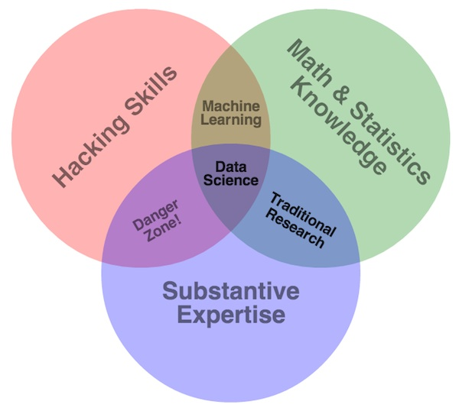
The Skills of a Data Miner – Data Scientist
It is a hard job

Slide 38
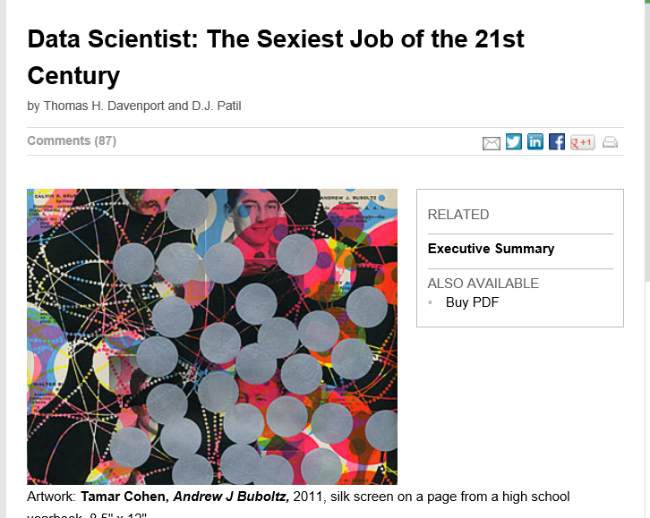
But also a rewarding one
Sexiest job but…
"The success of companies like Google, Facebook, Amazon, and Netflix, not to mention Wall Street firms and industries from manufacturing and retail to healthcare, is increasingly driven by better tools for extracting meaning from very large quantities of data. 'Data Scientist' is now the hottest job title in Silicon Valley." – Tim O'Reilly

