Slide 1
DATA MINING
THE EM Algorithm
Maximum Likelihood Estimation

Slide 2
Mixture Models and the EM Algorithm

Slide 3
Model-based clustering
In order to understand our data, we will assume that there is a generative process (a model) that creates/describes the data, and we will try to find the model that best fits the data.
  Models of different complexity can be defined, but we will assume that our model is a distribution from which data points are sampled
  Example: the data is the height of all adults in Greece
In most cases, a single distribution is not good enough to describe all data points: different parts of the data follow a different distribution
  Example: the data is the height of all adults and children in Greece
  We need a mixture model
  Different distributions correspond to different clusters in the data.

Slide 4
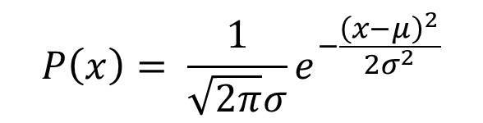
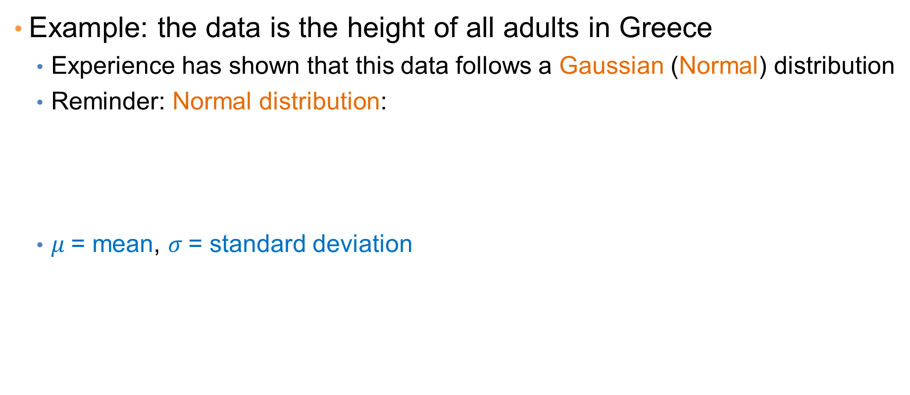
Gaussian Distribution
Example: the data is the height of all adults in Greece
  Experience has shown that this data follows a Gaussian (Normal) distribution
  Reminder: Normal distribution:
  $μ$= mean, $σ$= standard deviation
$$P\left(x\right)= \frac{1}{\sqrt{2π}σ}e^{−\frac{{\left(x−μ\right)}^{2}}{2σ^{2}}}$$

Slide 5
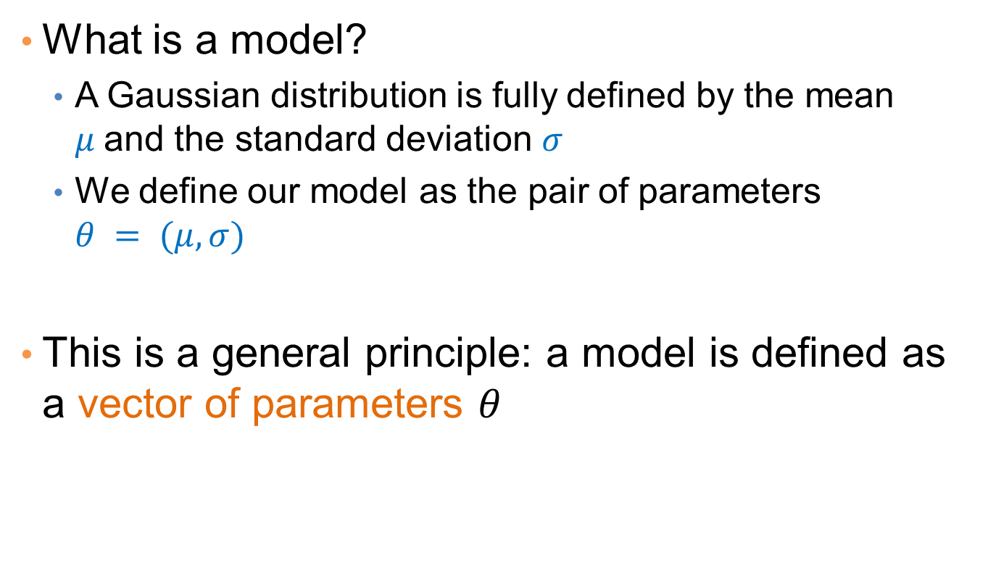
Gaussian Model
What is a model?
  A Gaussian distribution is fully defined by the mean $μ$and the standard deviation $σ$
  We define our model as the pair of parameters $θ = (μ, σ)$
This is a general principle: a model is defined as a vector of parameters $θ$

Slide 6
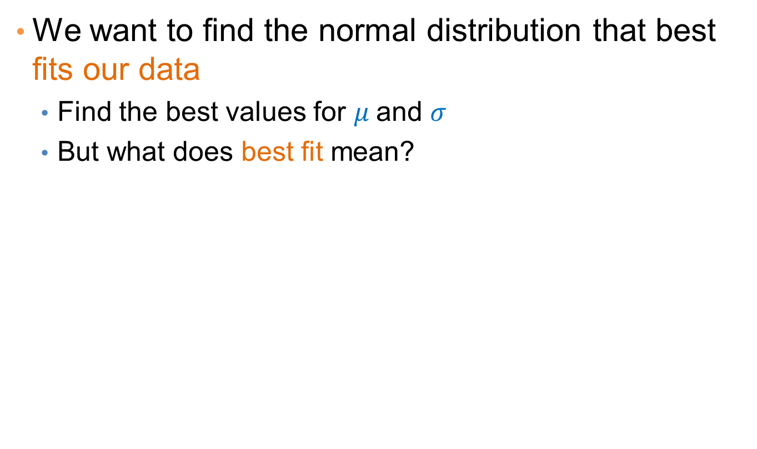
Fitting the model
We want to find the normal distribution that best fits our data
  Find the best values for $μ$and $σ$
  But what does best fit mean?

Slide 7
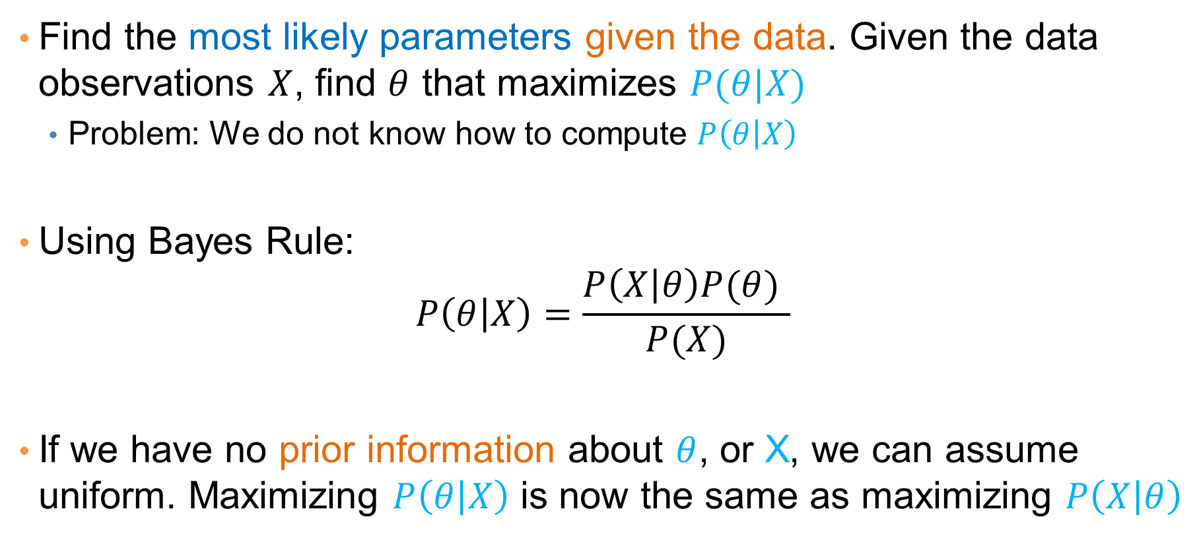
Maximum Likelihood Estimation (MLE)
Find the most likely parameters given the data. Given the data observations $X$, find $θ$ that maximizes $P(θ|X)$
  Problem: We do not know how to compute $P\left(θ | X\right)$
Using Bayes Rule:
$$P\left(θ | X\right)=\frac{P\left(X | θ\right)P(θ) }{P(X)}$$
If we have no prior information about $θ$, or X, we can assume uniform. Maximizing $P\left(θ | X\right)$ is now the same as maximizing $P\left(X | θ\right)$

Slide 8
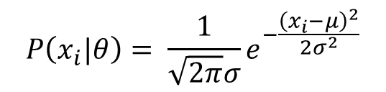
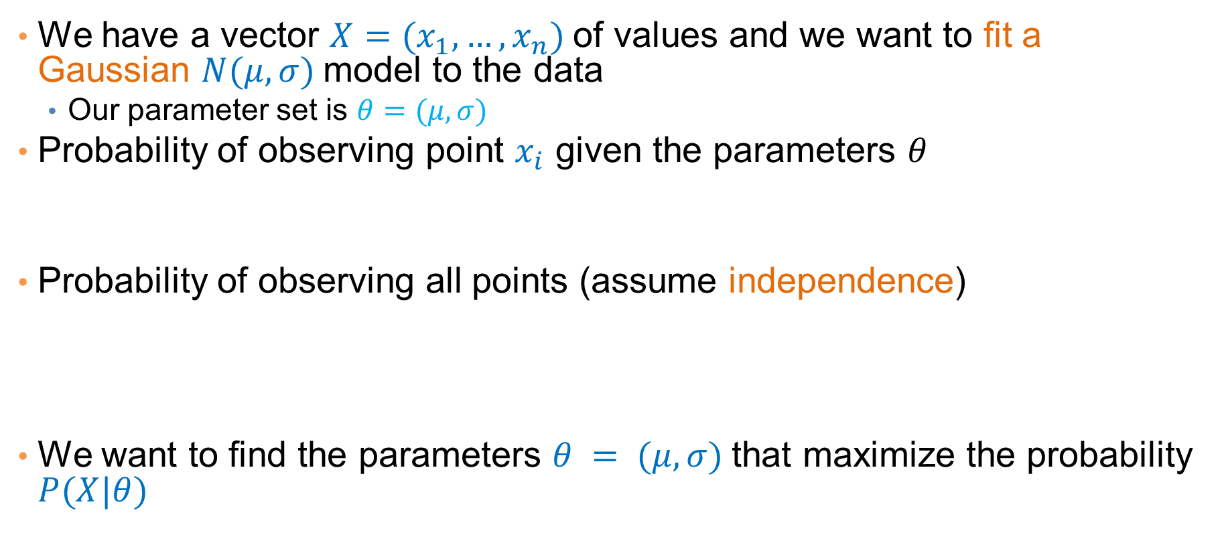
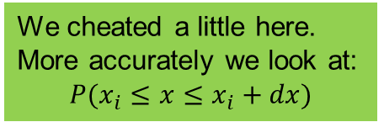
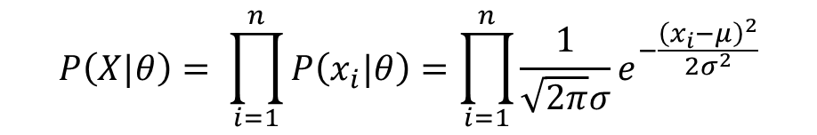
Maximum Likelihood Estimation (MLE)
We have a vector $X=(x_{1},…,x_{n})$of values and we want to fit a Gaussian $N(μ,σ)$model to the data
  Our parameter set is $θ=(μ, σ)$
Probability of observing point $x_{i}$ given the parameters $θ$
Probability of observing all points (assume independence)
We want to find the parameters $θ = (μ, σ)$that maximize the probability $P(X|θ)$
We cheated a little here.
More accurately we look at:
$$P(x_{i}≤x≤x_{i}+dx)$$
$$P\left(x_{i}|θ\right)= \frac{1}{\sqrt{2π}σ}e^{−\frac{{\left(x_{i}−μ\right)}^{2}}{2σ^{2}}}$$
$$P\left(X|θ\right)= \prod_{i=1}^{n}{P\left(x_{i}|θ\right)}=\prod_{i=1}^{n}{\frac{1}{\sqrt{2π}σ}e^{−\frac{{\left(x_{i}−μ\right)}^{2}}{2σ^{2}}}}$$

Slide 9

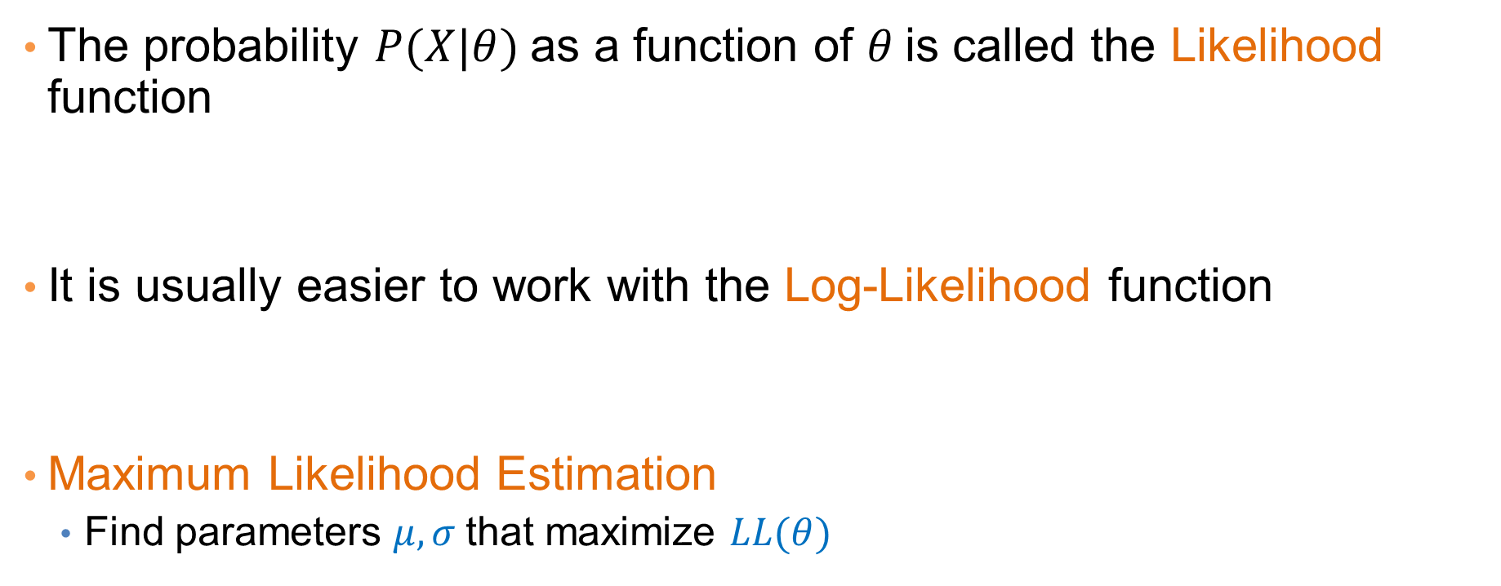
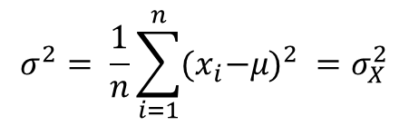
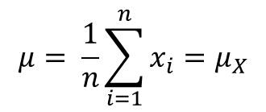
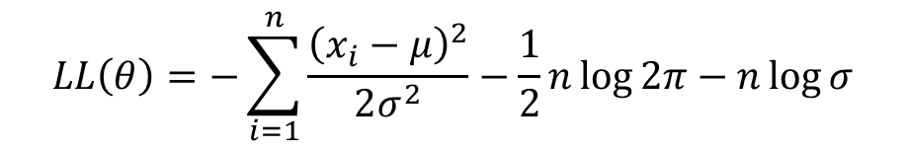
Maximum Likelihood Estimation (MLE)
The probability $P(X|θ)$as a function of $θ$is called the Likelihood function
It is usually easier to work with the Log-Likelihood function
Maximum Likelihood Estimation
  Find parameters $μ, σ$that maximize $LL(θ)$
$$L(θ)=\prod_{i=1}^{n}{\frac{1}{\sqrt{2π}σ}e^{−\frac{{\left(x_{i}−μ\right)}^{2}}{2σ^{2}}}}$$
$$LL\left(θ\right)=−\sum_{i=1}^{n}{\frac{{\left(x_{i}−μ\right)}^{2}}{2σ^{2}}−\frac{1}{2}n\log{2π}−n\log{σ}}$$
$$μ= \frac{1}{n}\sum_{i=1}^{n}{x_{i}=μ_{X}}$$
$$σ^{2}= \frac{1}{n}\sum_{i=1}^{n}{{{(x}_{i}−μ)}^{2} }=σ_{X}^{2}$$
Sample Mean
Sample Variance

Slide 10
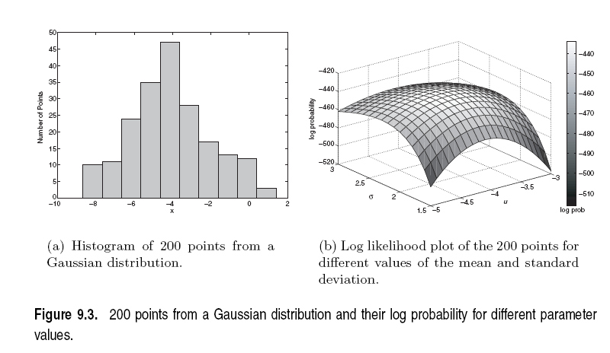

Slide 11
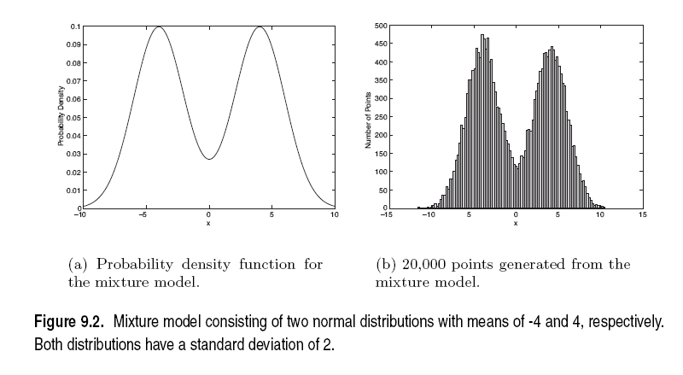
Mixture of Gaussians
Suppose that you have the heights of adults and children, and the distribution looks like the figure below

Slide 12
Mixture of Gaussians
In this case the data is the result of the mixture of two Gaussians
  One for Adults, and one for Children
  Identifying for each value which Gaussian is most likely to have generated it will give us a clustering.

Slide 13


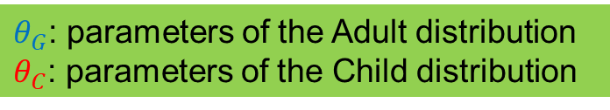
Mixture model
A value $x_{i}$ is generated according to the following process:
  First select the age group
    With probability $π_{A}$ select Adult, with probability $π_{C}$ select Child $(π_{G} +π_{C} = 1)$
  Given the nationality, generate the point from the corresponding Gaussian
    $P\left(x_{i} | θ_{A}\right) \sim N\left(μ_{A},σ_{A}\right)$if Adult
    $P\left(x_{i} | θ_{C}\right) \sim N\left(μ_{C},σ_{C}\right)$if Child
We can also think of this as a Hidden Variable Z that takes two values: Adult and Child
$$π_{A}=P\left(Z=Adult\right) , π_{C}=P\left(Z=Child\right)$$
$θ_{G}$: parameters of the Adult distribution
$θ_{C}$: parameters of the Child distribution
Using the Hidden Variable Z:
$$P\left(x_{i} | Z=Adult\right)=P\left(x_{i} | θ_{A}\right) \sim N\left(μ_{A},σ_{A}\right)$$
$P\left(x_{i} | Z=Child\right)=$ $P\left(x_{i} | θ_{C}\right) \sim N\left(μ_{C},σ_{C}\right)$

Slide 14



Mixture Model
Our model has the following parameters
$$Θ=(π_{A},π_{C},μ_{A},{σ_{A},μ}_{C}, σ_{C})$$
Mixture probabilities
$θ_{A}$: parameters of the Adult distribution
$θ_{C}$: parameters of the Child distribution

Slide 15
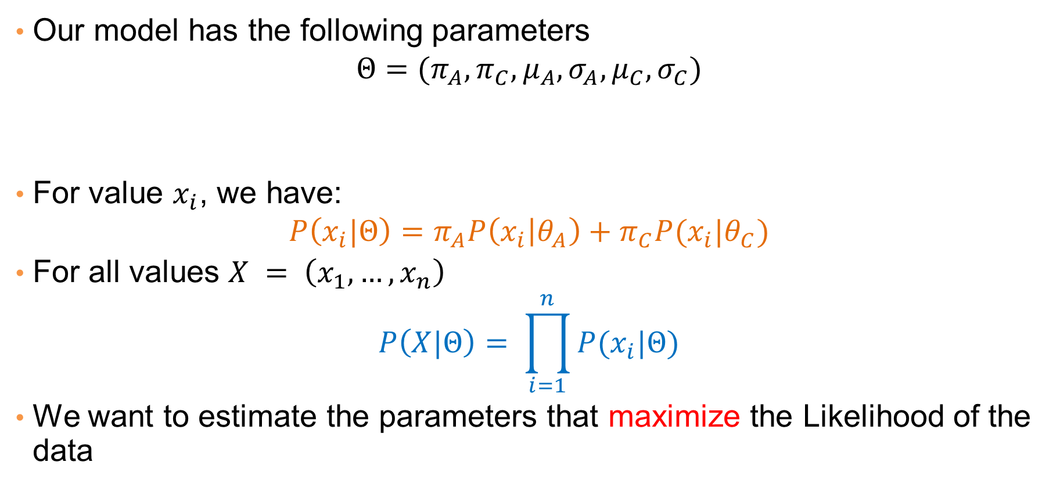
Mixture Model
Our model has the following parameters
$$Θ=(π_{A},π_{C},μ_{A},{σ_{A},μ}_{C}, σ_{C})$$
For value $x_{i}$, we have:
$$P\left(x_{i}|Θ\right)=π_{A}P\left(x_{i} | θ_{A}\right)+π_{C}P(x_{i}|θ_{C})$$
For all values $X = \left(x_{1},…,x_{n}\right)$
$$P\left(X|Θ\right)= \prod_{i=1}^{n}{P(x_{i}|Θ)}$$
We want to estimate the parameters that maximize the Likelihood of the data
Mixture probabilities
Distribution Parameters

Slide 16

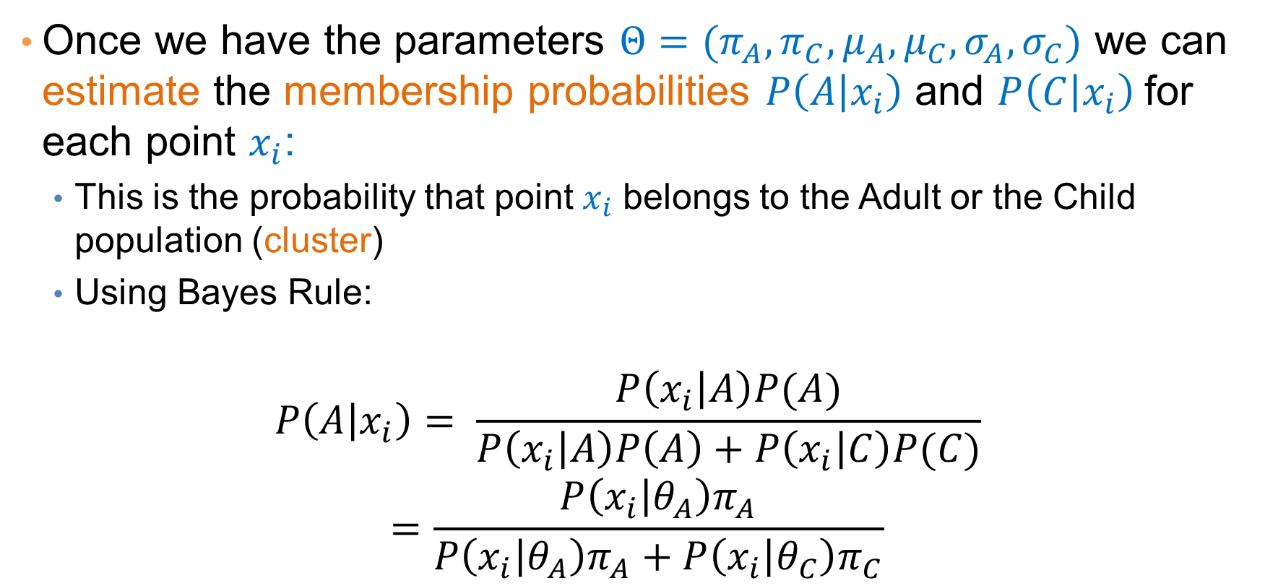
Mixture Models
Once we have the parameters $Θ=(π_{A},π_{C},μ_{A},μ_{C}, σ_{A},σ_{C})$ we can estimate the membership probabilities $P\left(A | x_{i}\right)$ and $P\left(C | x_{i}\right)$for each point $x_{i}$:
  This is the probability that point $x_{i}$ belongs to the Adult or the Child population (cluster)
  Using Bayes Rule:
$$P\left(A | x_{i}\right)= \frac{P\left(x_{i} | A\right)P(A)}{P\left(x_{i} | A\right)P\left(A\right)+P\left(x_{i} | C\right)P(C)}$$
$$=\frac{P\left(x_{i} | θ_{A}\right)π_{A}}{P\left(x_{i} | θ_{A}\right)π_{A}+P\left(x_{i} | θ_{C}\right)π_{C}}$$
Given from the Gaussian distribution $N(μ_{G}, σ_{G})$ for Greek

Slide 17
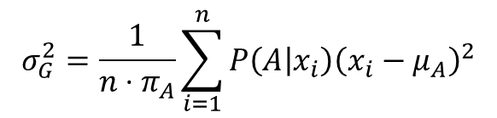
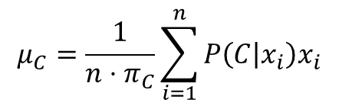
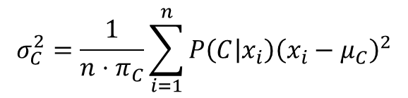
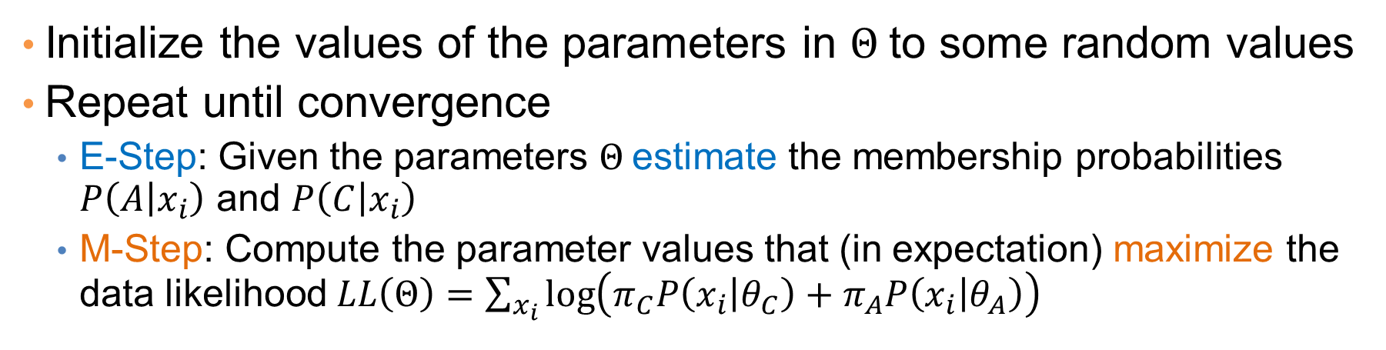
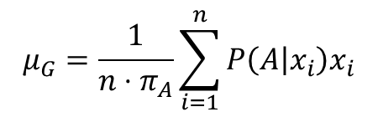
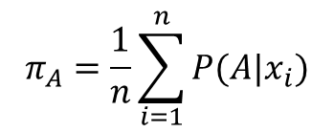
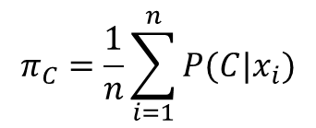
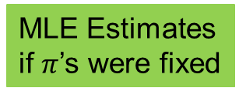
EM (Expectation Maximization) Algorithm
Initialize the values of the parameters in $Θ$to some random values
Repeat until convergence
  E-Step: Given the parameters $Θ$estimate the membership probabilities $P\left(A | x_{i}\right)$ and $P\left(C | x_{i}\right)$
  M-Step: Compute the parameter values that (in expectation) maximize the data likelihood $LL\left(Θ\right)=\sum_{x_{i}}{\log\left(π_{C}P\left(x_{i} | θ_{C}\right)+π_{A}P\left(x_{i} | θ_{A}\right)\right)}$
$$π_{C}=\frac{1}{n}\sum_{i=1}^{n}{P(C|x_{i})}$$
$$π_{A}=\frac{1}{n}\sum_{i=1}^{n}{P(A|x_{i})}$$
Fraction of population in G,C
$$μ_{C}=\frac{1}{n{⋅π}_{C}}\sum_{i=1}^{n}{{P\left(C | x_{i}\right)x}_{i}}$$
$$μ_{G}=\frac{1}{n{⋅π}_{A}}\sum_{i=1}^{n}{{P\left(A | x_{i}\right)x}_{i}}$$
MLE Estimates
if $π$’s were fixed
$$σ_{C}^{2}=\frac{1}{n{⋅π}_{C}}\sum_{i=1}^{n}{{P\left(C | x_{i}\right)\left(x_{i}−μ_{C}\right)}^{2}}$$
$$σ_{G}^{2}=\frac{1}{n{⋅π}_{A}}\sum_{i=1}^{n}{{P\left(A | x_{i}\right)\left(x_{i}−μ_{A}\right)}^{2}}$$

Slide 18
Relationship to K-means
E-Step: Assignment of points to clusters
  K-means: hard assignment, EM: soft assignment
M-Step: Computation of centroids
  K-means assumes common fixed variance (spherical clusters)
  EM: can change the variance for different clusters or different dimensions (ellipsoid clusters)
If the variance is fixed then both minimize the same error function

Slide 19
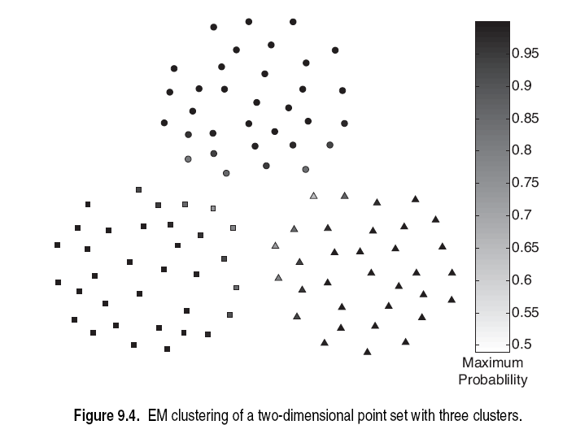

Slide 20
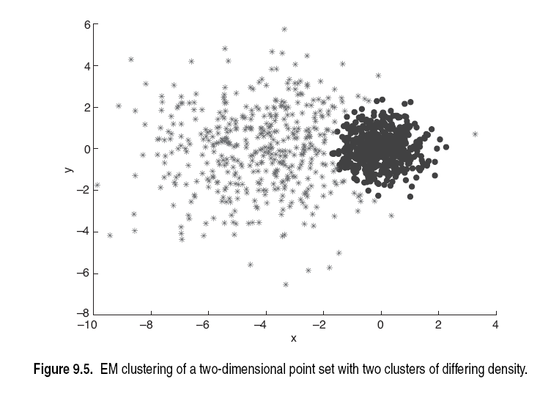

Slide 21
