Slide 1
Online Social Networks and Media
Signed Graphs
Positive and Negative Ties

Slide 2




Signed networks
+
-
$$u$$
$$v$$
$$u$$
$$v$$
Positive
friendship
Negative
foe
Examples
Sign expresses agreement/disagreement between users
Trust/distrust relationships
Edit conflicts in Wikipedia
Relationships between countries
Synonyms and antonym relation between words

Slide 3
Structural Balance Theory
originated in social psychology, by Heider in the 1940s
graph-theoretic approach by Cartwright and Harary in the 1960s
Considers the possible ways in which triangles on three individuals can be signed
  All possible relationships between 3 people => 4 cases

Slide 4
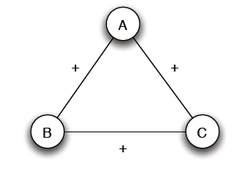
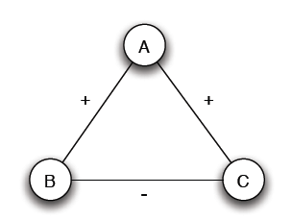
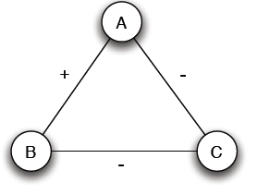
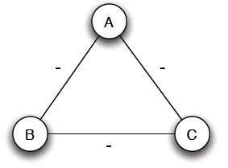
Structural Balance
3 +
2 +, 1 -
Mutual friends
A is friend with B and C, but B and C do not get well together
1 +, 2 -
3 -
Are there all equally possible?
Mutual enemies
A and B are friends with a mutual enemy

Slide 5
Structural Balance
3 +
2 +, 1 -
Stable or balanced
Unstable
A is friend with B and C, but B and C do not get well together
Implicit force to make B and C friends (- => +) or turn one of the + to -
Mutual friends
“the friend of my friend is my friend”
1 +, 2 -
3 -
Stable or balanced
Unstable
A and B are friends with a mutual enemy
“the enemy of my enemy is my friend”
Mutual enemies
Forces to team up against the third (turn one of the – to +)

Slide 6
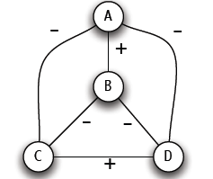
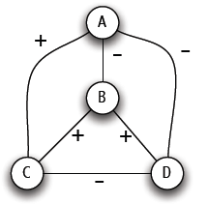
Structural Balance
A labeled complete graph is balanced if every one of its triangles is balanced
Structural Balance Property: For every set of three nodes, if we consider the three edges connecting them, either all three of these are labeled +, or else exactly one of them is labeled +, aka odd number of +
local property, individual triangles
What does a balanced network look like? (global property)

Slide 7
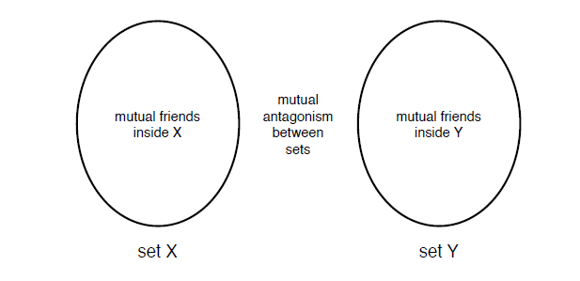
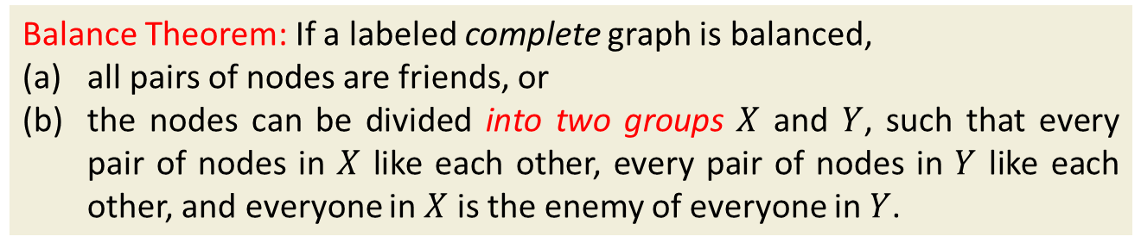
The Structure of Balanced Networks
Balance Theorem: If a labeled complete graph is balanced,
all pairs of nodes are friends, or
the nodes can be divided into two groups $X$ and $Y$, such that every pair of nodes in $X$ like each other, every pair of nodes in $Y$ like each other, and everyone in $X$ is the enemy of everyone in $Y$.
From a local to a global property
All -
All +
All +
Notes:
Take node A. Let X be all friends of A and Y all enemies of A. Every two nodes in X are friends. Every two nodes in Y are friends. Every node in X is an enemy of every node in Y.

Slide 8
Applications of Structural Balance
How a network evolves over time
Political science: International relationships
  Example: the separation of Bangladesh from Pakistan

Slide 9
A Weaker Form of Structural Balance
Weak Structural Balance Property: There is no set of three nodes such that the edges among them consist of exactly two positive edges and one negative edge
Unstable
This is allowed

Slide 10
A Weaker Form of Structural Balance
Weakly Balance Theorem: If a labeled complete graph is weakly balanced, its nodes can be divided into groups in such a way that every two nodes belonging to the same group are friends, and every two nodes belonging to different groups are enemies.
From a local to a global property

Slide 11
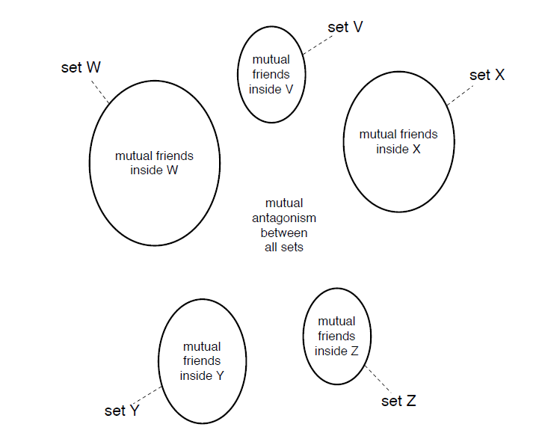
A Weaker Form of Structural Balance
Notes:
Let node A and X all its friends. X is our first group. All nodes in A are friends with each other. All nodes in X are enemies with everyone not in X. Ignore set X and repeat.

Slide 12
Generalizations
Non-complete graphs
Instead of all triangles, “most” triangles, approximately divide the graph
We shall use the original (“non-weak”) definition of structural balance

Slide 13
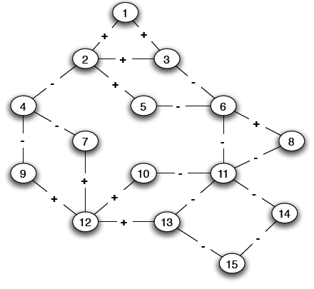
Structural Balance in Arbitrary Graphs
Three possible relations
Positive edge
Negative edge
Absence of an edge
What is a good definition of balance in a non-complete graph?

Slide 14
Balance Definition for General Graphs
Based on triangles (local view)
Division of the network (global view)

Slide 15
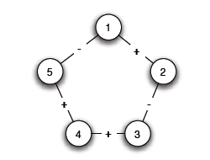
Balance for General Graphs: local
A (non-complete) graph is balanced if it can be completed by adding edges to form a signed complete graph that is balanced
-
+

Slide 16
Balance for General Graphs: local
+

Slide 17
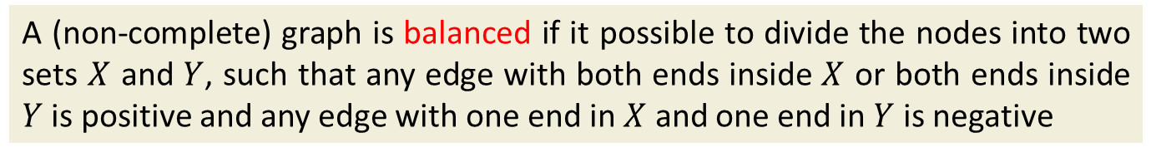
Balance for General Graphs: global
A (non-complete) graph is balanced if it possible to divide the nodes into two sets $X$ and $Y$, such that any edge with both ends inside $X$ or both ends inside $Y$ is positive and any edge with one end in $X$ and one end in $Y$ is negative
The two definitions are equivalent:
An arbitrary signed graph is balanced under the first definition, if and only if, it is balanced under the second definition

Slide 18
Balance Definition for General Graphs
Algorithm for dividing the nodes?

Slide 19
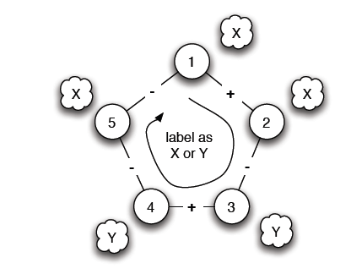
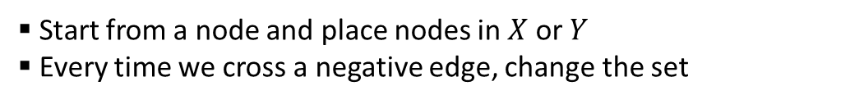
Balance Characterization
What prevents a network from being balanced?
Start from a node and place nodes in $X$ or $Y$
Every time we cross a negative edge, change the set
Cycle with odd number of negative edges
Notes:
Start with A, X friends of A, Y enemies of A. Start with A in X, if + remain in set, if – switch sets. If cycle with odd numbers, then problem, Need even to return back to friends.

Slide 20
Balance Definition for General Graphs
Is there such a cycle with an odd number of -?
Notes:
s, 2, 3, 6, 11, 13, 12, 9, 4

Slide 21
Balance Definition for General Graphs
Is there such a cycle with an odd number of -?
Notes:
s, 2, 3, 6, 11, 13, 12, 9, 4

Slide 22
Balance Characterization
Claim: A signed graph is balanced, if and only if, it contains no cycles with an odd number of negative edges
Proof by construction
Find a balanced division: partition into sets X and Y, all edges inside X and Y positive, crossing edges negative
Either succeeds or Stops with a cycle containing an odd number of -
Two steps:
Convert the graph into a reduced one with only negative edges
Solve the problem in the reduced graph

Slide 23
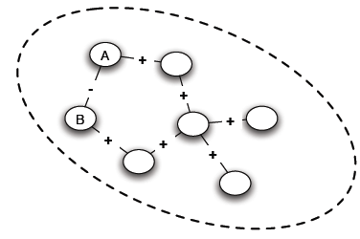
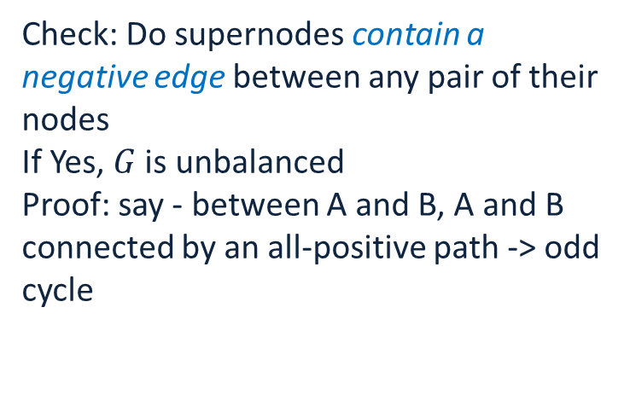
Balance Characterization: Step 1
Find connected components of $G$ by considering only positive edges, let us call then supernodes
Check: Do supernodes contain a negative edge between any pair of their nodes
If Yes, $G$ is unbalanced
Proof: say - between A and B, A and B connected by an all-positive path -> odd cycle
Notes:
If there is a negative edge between A and B, then connected thus an all positive path from A to B

Slide 24
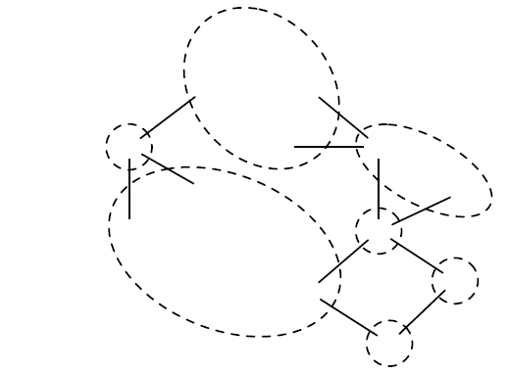
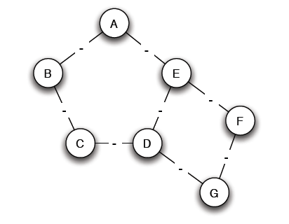
Balance Characterization: Step 1
Else:
Reduce the problem: a node for each supernode, an edge between two supernodes if an edge in the original

Slide 25
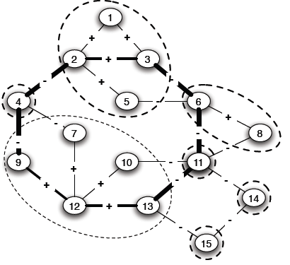
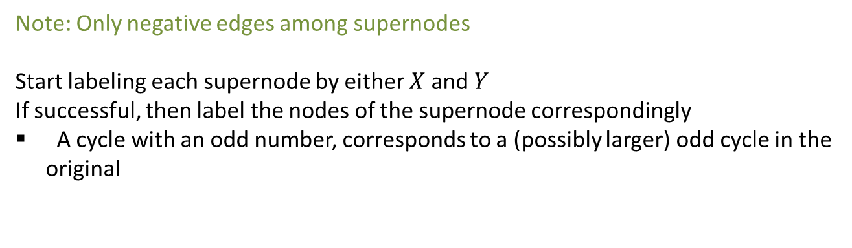
Balance Characterization: Step 2
Note: Only negative edges among supernodes
Start labeling each supernode by either $X$ and $Y$
If successful, then label the nodes of the supernode correspondingly
A cycle with an odd number, corresponds to a (possibly larger) odd cycle in the original

Slide 26
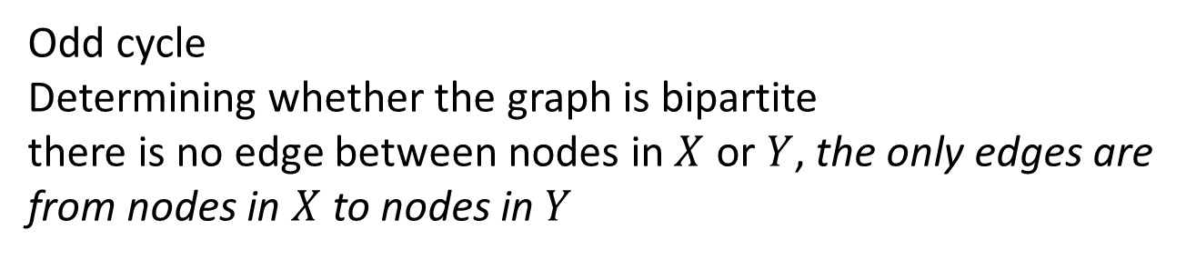
Balance Characterization: Step 2
Odd cycle
Determining whether the graph is bipartite
there is no edge between nodes in $X$ or $Y$, the only edges are from nodes in $X$ to nodes in $Y$
Use Breadth-First-Search (BFS)
Two type of edges: (1) between nodes in adjacent levels (2) between nodes in the same level
If only type (1), alternate X and Y labels at each level
If type (2), then odd cycle

Slide 27
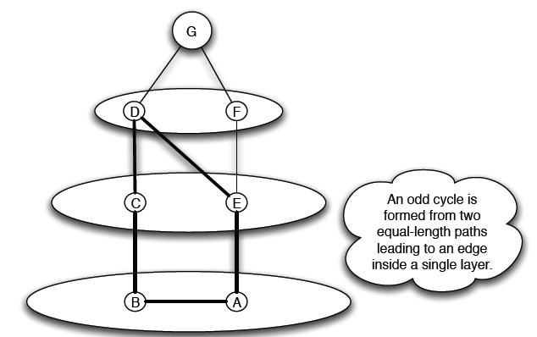
Balance Characterization: Step 2

Slide 28
Status theory in practice
Epinions: product review Web site, where users can indicate their trust or distrust of the reviews
Slashdot: the social network of the blog where a signed link indicates that one user likes or dislikes the comments
Wikipedia: its voting network where a signed link indicates a positive or negative vote by one user on the promotion to admin status of another.

Slide 29
Structural balance theory in practice
All-positive triad T₃ is heavily overrepresented in all three datasets. T₃ tends to be overrepresented by about 40% in all three datasets
Triad T₂ consisting of two enemies with a common friend is heavily underrepresented. T₂ is underrepresented by about 75%in Epinions and Slashdot and 50% in Wikipedia
More consistent with weak structural balance

Slide 30
A theory of status
Directed networks
A positive edge (A, B) means that A regards B as having higher status than A
A negative edge (A, B) means that A regards B as having lower status than A
A
A
+
-
B
B
Assuming that all participants agree on status ordering, status theory predicts that when the direction of an edge is flipped,
its sign should flip as well.
A
-
+
B

Slide 31
A theory of status
+
?
+
A
A
A
B
B
B
+
-
+
+
+
+
X
X
+
X
Structural balance
?
-
A
A
B
B
+
+
+
+
+
X
X

Slide 32
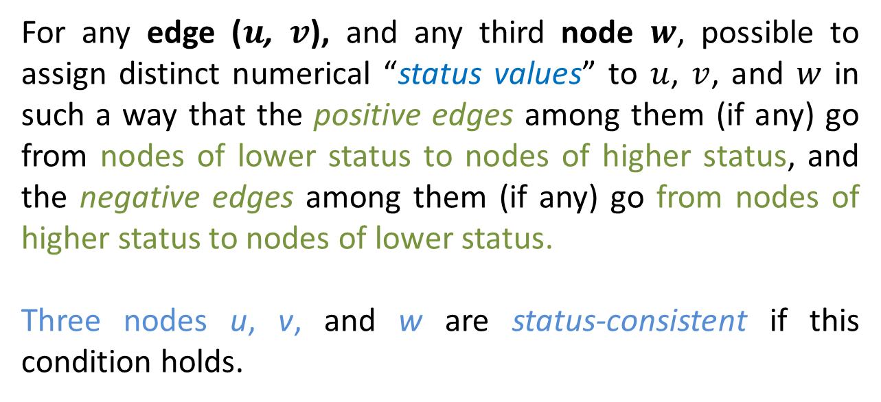
A theory of status: local property
For any edge ($u$, $v$), and any third node $w$, possible to assign distinct numerical “status values” to $u$, $v$, and $w$ in such a way that the positive edges among them (if any) go from nodes of lower status to nodes of higher status, and the negative edges among them (if any) go from nodes of higher status to nodes of lower status.
Three nodes u, v, and w are status-consistent if this condition holds.

Slide 33
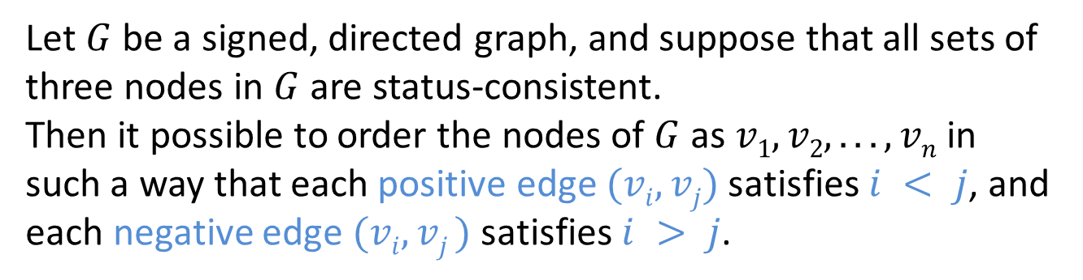
A theory of status: global property
Let $G$ be a signed, directed graph, and suppose that all sets of three nodes in $G$ are status-consistent.
Then it possible to order the nodes of $G$ as $v1, v2, . . . , vn$in such a way that each positive edge $(vi, vj)$satisfies $i < j$, and each negative edge $(vi, vj )$satisfies $i > j$.

Slide 34
Summary
Signed networks
Two interpretations
Friendship/Foe (undirected)
Status (directed)
Both at a local and global level

Slide 35
Questions?

Slide 36
References
Networks, Crowds, and Markets (Chapter 5)

Slide 37
Extra material

Slide 38
Applications of Structural Balance
The conflict of Bangladesh’s separation from Pakistan in 1972 (1)
₋
USSR
N. Vietnam
USA
Pakistan
-
-
-
₊
Bangladesh
China
-
India
USA support to Pakistan?
“[T]he United States’s somewhat surprising support of Pakistan ... becomes less surprising when one considers that the USSR was China’s enemy, China was India’s foe, and India had traditionally bad relations with Pakistan. Since the U.S. was at that time improving its relations with China, it supported the enemies of China’s enemies.
Further reverberations of this strange political constellation became inevitable: North Vietnam made friendly gestures toward India, Pakistan severed diplomatic relations with those countries of the Eastern Bloc which recognized Bangladesh, and China vetoed the acceptance of Bangladesh into the U.N.”

Slide 39
Applications of Structural Balance
International relationships (I)
The conflict of Bangladesh’s separation from Pakistan in 1972 (II)
₊
₋
USSR
N. Vietnam
USA
Pakistan
-
-
₊
-
Bangladesh
China
-
India
China?

Slide 40
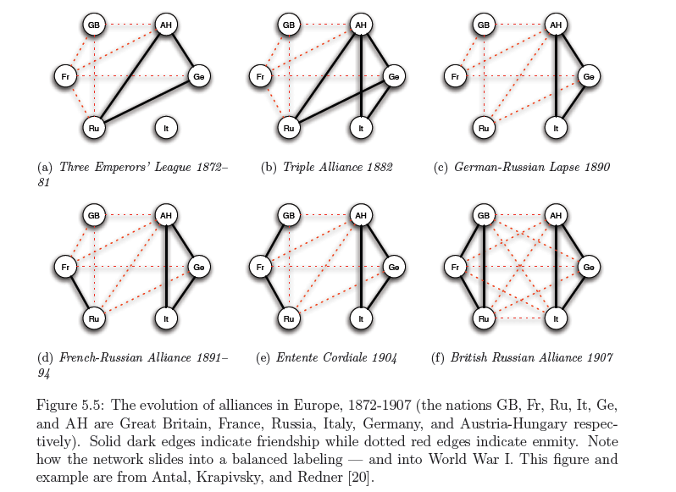
Applications of Structural Balance
International relationships (II)

