Slide 1
DATA MINING
Supervised Learning
Regression
Classification
Decision Trees
Classifier Expressiveness
Nearest Neighbor Classifier
Support Vector Machines (SVM)
Logistic Regression
Naïve Bayes

Slide 2
Supervised learning
In supervised learning, except for the feature variables that describe the data, we also have a target variable
The goal is to learn a function (model) that can estimate/predict the value of the target variable given the features
  We learn the function using a labeled training set.
Regression: The target variable (but also the features) is numerical and continuous
  The price of a stock, the GDP of a country, the grade in a class, the height of a child, the life expectancy etc
Classification: The target variable is discrete
  Does a taxpayer cheat or not? Will the stock go up or down? Will the student pass or fail? Is a transaction fraudulent or not? What is the topic of an article?

Slide 3
Applications
Descriptive modeling: Explanatory tool to understand the data:
  Regression: How does the change in the value of different factors affect our target variable?
    What factors contribute to the price of a stock?
    What factors contribute to the GDP of a country?
  Classification: Understand what attributes distinguish between objects of different classes
    Why people cheat on their taxes?
    What words make an post offensive?
Predictive modeling: Predict a class of a previously unseen record
  Regression: What will the life-expectancy of a patient be?
  Classification: Is this a cheater or not? Will the stock go up or not. Is this an offensive post?
Predictive modeling is in the heart of the data science revolution.

Slide 4

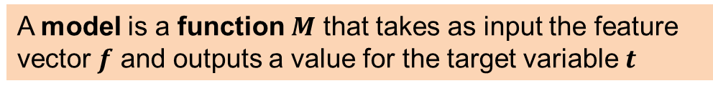









Supervised Learning Overview
$$f_{1}$$
$$f_{2}$$
$$f_{3}$$
$$f_{4}$$
$$f_{1}$$
$$f_{2}$$
$$f_{3}$$
$$f_{4}$$
$$t$$
Learning algorithm
Model
Training data
Train
Apply
Predict
Test data
Evaluate
$$t$$
A model is a function $M$ that takes as input the feature vector $f$ and outputs a value for the target variable $t$

Slide 5
Linear Regression

Slide 6
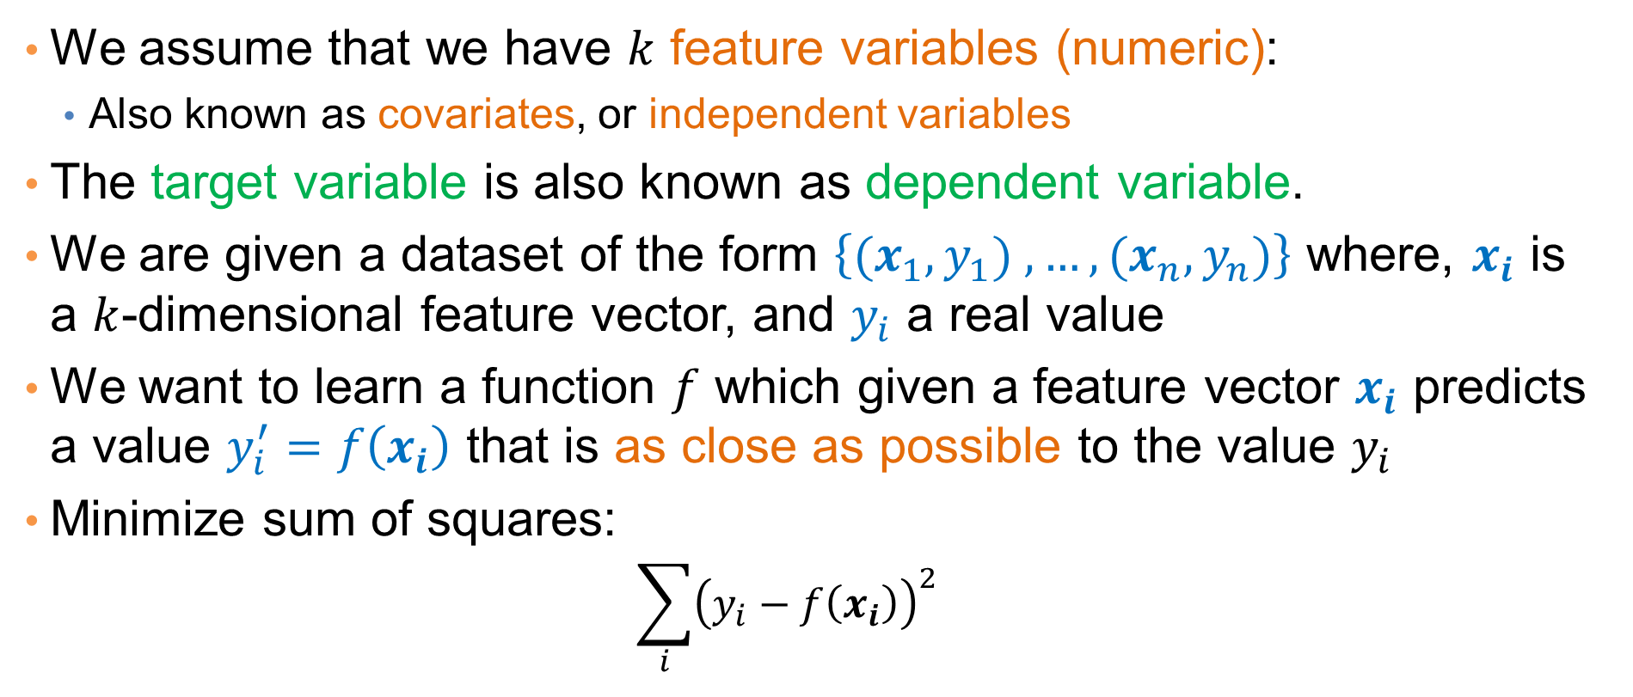
Regression
We assume that we have $k$ feature variables (numeric):
  Also known as covariates, or independent variables
The target variable is also known as dependent variable.
We are given a dataset of the form $\left\{{(x}_{1},y_{1}) ,…,{(x}_{n},y_{n})\right\}$ where, $x_{i}$ is a $k$-dimensional feature vector, and $y_{i}$ a real value
We want to learn a function $f$ which given a feature vector $x_{i}$ predicts a value $y_{i}^{′}=f\left(x_{i}\right)$ that is as close as possible to the value $y_{i}$
Minimize sum of squares:
  $$\sum_{i}{{\left(y_{i}−f\left(x_{i}\right)\right)}^{2}}$$

Slide 7
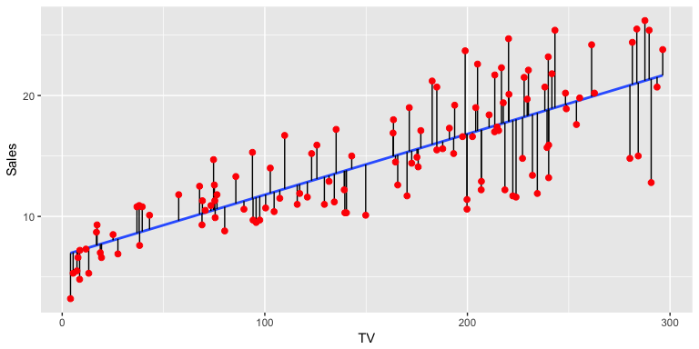
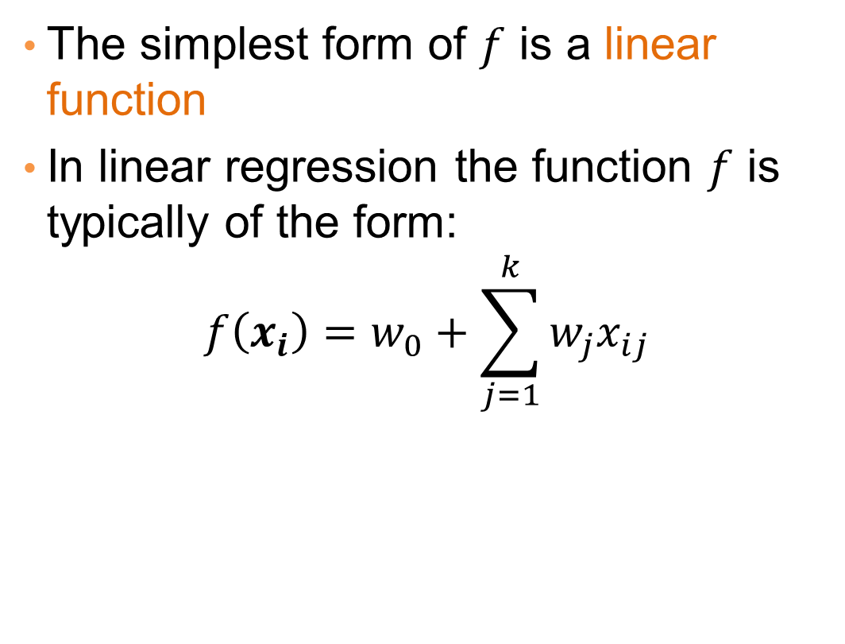
Linear regression
The simplest form of $f$ is a linear function
In linear regression the function $f$ is typically of the form:
$$f\left(x_{i}\right)=w_{0}+\sum_{j=1}^{k}{w_{j}x_{ij}}$$

Slide 8
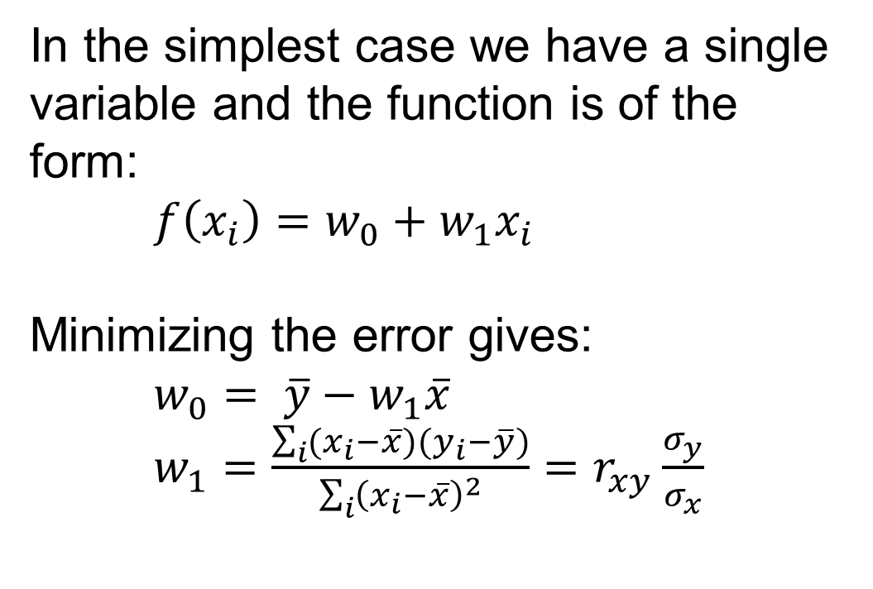
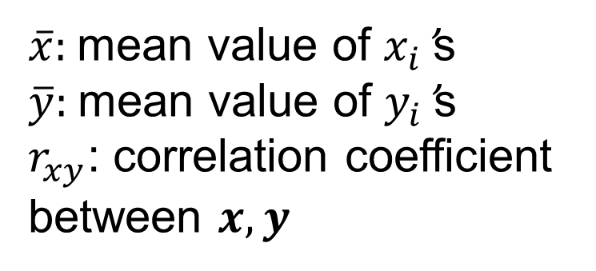
One-dimensional linear regression
In the simplest case we have a single variable and the function is of the form:
$f\left(x_{i}\right)=w_{0}+w_{1}x_{i}$
Minimizing the error gives:
$w_{0}= \overline{y}−w_{1}\overline{x}$
$w_{1}=\frac{\sum_{i}{(x_{i}−\overline{x})(y_{i}−\overline{y})}}{\sum_{i}{{\left(x_{i}−\overline{x}\right)}^{2}}}=r_{xy}\frac{σ_{y}}{σ_{x}}$
$\overline{x}$: mean value of $x_{i}$’s
$\overline{y}$: mean value of $y_{i}$’s
$r_{xy}$: correlation coefficient between $x,y$

Slide 9
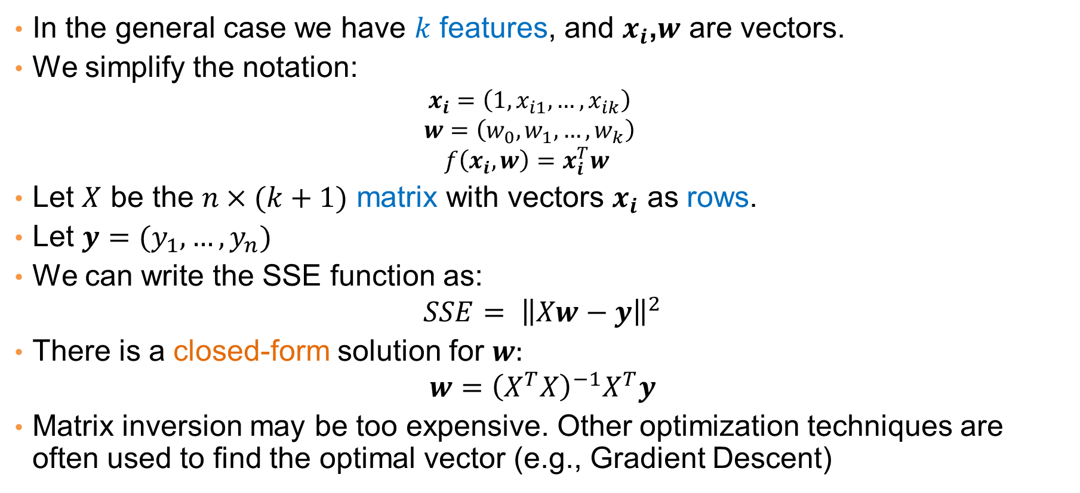
Multiple linear regression
In the general case we have $k$ features, and $x_{i}$,$w$ are vectors.
We simplify the notation:
  $$x_{i}=\left(1,x_{i1},…,x_{ik}\right)$$
  $$w=\left(w_{0},w_{1},…,w_{k}\right)$$
  $$f\left(x_{i},w\right)=x_{i}^{T}w$$
Let $X$ be the $n×(k+1)$ matrix with vectors $x_{i}$ as rows.
Let $y=(y_{1},…,y_{n})$
We can write the SSE function as:
$$SSE= {\left\|Xw−y\right\|}^{2}$$
There is a closed-form solution for $w:$
$$w={\left(X^{T}X\right)}^{−1}X^{T}y$$
Matrix inversion may be too expensive. Other optimization techniques are often used to find the optimal vector (e.g., Gradient Descent)

Slide 10
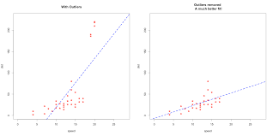
Outliers
Regression is sensitive to outliers:
  The line will “tilt” to accommodate very extreme values
Solution: remove the outliers
  But make sure that they do not capture useful information

Slide 11
Normalization
In the regression problem some times our features may have very different scales:
  For example: predict the GDP of a country using as features the percentage of home owners and the income
  The weights in this case will not be interpretable
Solution: Normalize the features by replacing the values with the z-scores
  Remove the mean and divide by the standard deviation

Slide 12
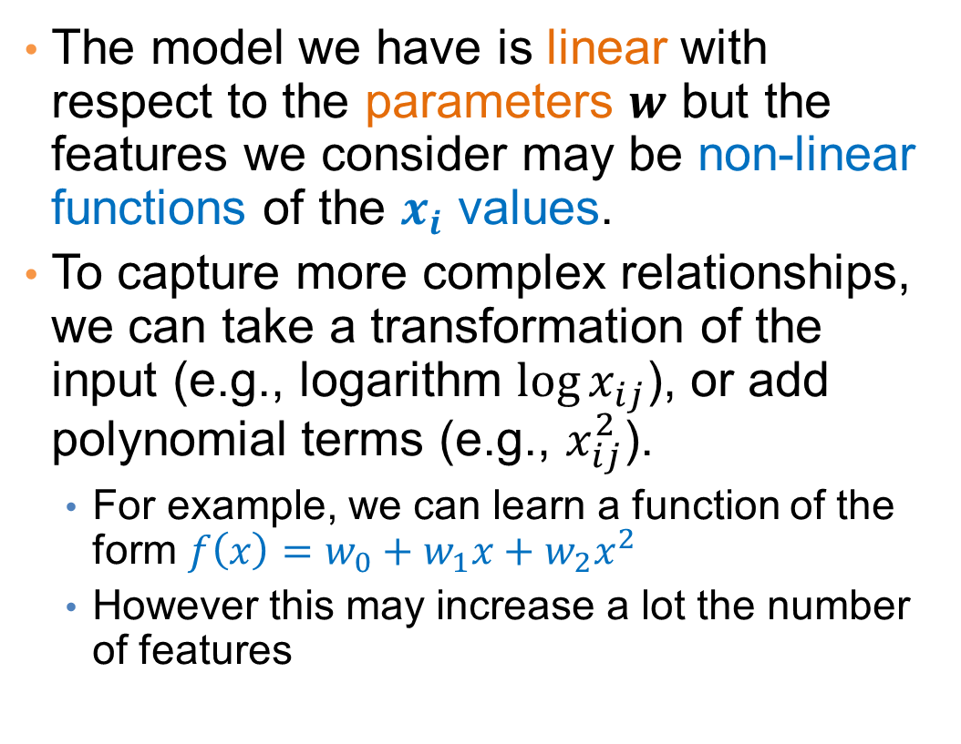
More complex models
The model we have is linear with respect to the parameters $w$ but the features we consider may be non-linear functions of the $x_{i}$ values.
To capture more complex relationships, we can take a transformation of the input (e.g., logarithm ${\log{x}}_{ij}$), or add polynomial terms (e.g., $x_{ij}^{2}$).
  For example, we can learn a function of the form $f\left(x\right)=w_{0}+w_{1}x+w_{2}x^{2}$
  However this may increase a lot the number of features

Slide 13
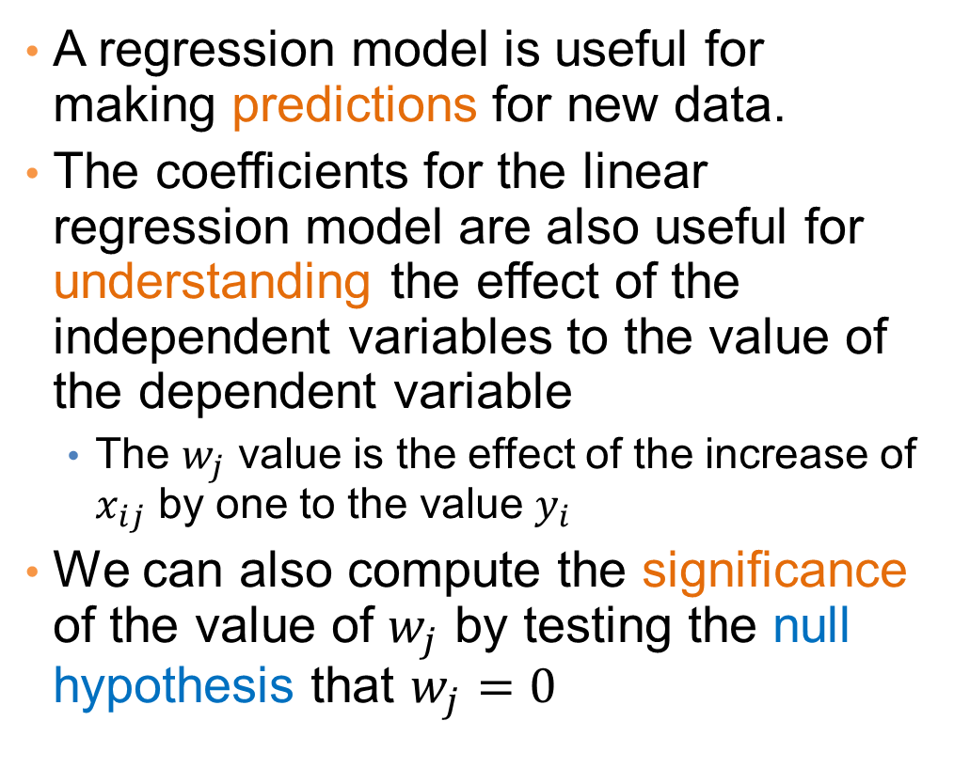
Interpretation and significance
A regression model is useful for making predictions for new data.
The coefficients for the linear regression model are also useful for understanding the effect of the independent variables to the value of the dependent variable
  The $w_{j}$ value is the effect of the increase of $x_{ij}$ by one to the value $y_{i}$
We can also compute the significance of the value of $w_{j}$ by testing the null hypothesis that $w_{j}=0$
Predicting Crime rate

Slide 14
Classification

Slide 15
Classification
Similar to the regression problem we have features and a target variable that we want to model/predict
The target variable is now discrete. It is often called the class label
  In the simplest case, it is a binary variable.
In classification the features may also be categorical.

Slide 16
Example: Catching tax-evasion
Tax-return data for year 2011
A new tax return for 2012
Is this a cheating tax return?
An instance of the classification problem: learn a method for discriminating between records of different classes (cheaters vs non-cheaters)

Slide 17
Classification
Classification is the task of learning a target function f that maps attribute set x to one of the predefined class labels y
The function may be defined as an algorithm (e.g., if Single and Income < 125K then No)
categorical
categorical
continuous
class
One of the attributes is the class attribute
In this case: Cheat
Two class labels (or classes): Yes (1), No (0)

Slide 18
Examples of Classification Tasks
Predicting tumor cells as benign or malignant
Classifying credit card transactions as legitimate or fraudulent
Categorizing news stories as finance, weather, entertainment, sports
Identifying spam email, spam web pages, adult content
Understanding if a web query has commercial intent or not
Classification is everywhere in data science
Big data has the answers to all questions.

Slide 19
General approach to classification
Obtain a training set consisting of records with known class labels
Training set is used to build a classification model
A labeled test set of previously unseen data records is used to evaluate the quality of the model.
The classification model is applied to new records with unknown class labels
Important intermediate step: Decide on what features to use

Slide 20
Illustrating Classification Task

Slide 21
Evaluation of classification models
Counts of test records that are correctly (or incorrectly) predicted by the classification model
Confusion matrix
Predicted Class
 | Class = 1 | Class = 0
Class = 1 | f₁₁ | f₁₀
Class = 0 | f₀₁ | f₀₀
Actual Class

Slide 22
Classification Techniques
Decision Tree based Methods
Rule-based Methods
Memory based reasoning
Neural Networks
Naïve Bayes and Bayesian Belief Networks
Support Vector Machines
Logistic Regression

Slide 23
DECISION TREES

Slide 24
Decision Trees
Decision tree
  A flow-chart-like tree structure
  Internal node denotes a test on an attribute
  Branch represents an outcome of the test
  Leaf nodes represent class labels or class distribution

Slide 25
Example of a Decision Tree
categorical
categorical
continuous
class
Splitting Attributes
Refund
Yes
No
Test outcome
NO
MarSt
Single, Divorced
Married
TaxInc
NO
< 80K
> 80K
NO
YES
Class labels
Training Data
Model: Decision Tree

Slide 26
Another Example of Decision Tree
categorical
categorical
continuous
class
MarSt
Single, Divorced
Married
NO
Refund
Yes
No
NO
TaxInc
< 80K
> 80K
NO
YES
There could be more than one tree that fits the same data!

Slide 27
Decision Tree Classification Task
Decision Tree

Slide 28
Apply Model to Test Data
Test Data
Start from the root of tree.
Refund
Yes
No
NO
MarSt
Single, Divorced
Married
TaxInc
NO
< 80K
> 80K
NO
YES

Slide 29
Apply Model to Test Data
Test Data
Refund
Yes
No
NO
MarSt
Single, Divorced
Married
TaxInc
NO
< 80K
> 80K
NO
YES

Slide 30
Apply Model to Test Data
Test Data
Refund
Yes
No
NO
MarSt
Single, Divorced
Married
TaxInc
NO
< 80K
> 80K
NO
YES

Slide 31
Apply Model to Test Data
Test Data
Refund
Yes
No
NO
MarSt
Single, Divorced
Married
TaxInc
NO
< 80K
> 80K
NO
YES

Slide 32
Apply Model to Test Data
Test Data
Refund
Yes
No
NO
MarSt
Single, Divorced
Married
TaxInc
NO
< 80K
> 80K
NO
YES

Slide 33
Apply Model to Test Data
Test Data
Refund
Yes
No
NO
MarSt
Single, Divorced
Married
Assign Cheat to “No”
TaxInc
NO
< 80K
> 80K
NO
YES

Slide 34
Decision Tree Classification Task
Decision Tree

Slide 35
Tree Induction
Goal: Find the tree that has low classification error in the training data (training error)
Finding the best decision tree (lowest training error) is NP-hard
Greedy strategy.
  Split the records based on an attribute test that optimizes certain criterion.
Many Algorithms:
  Hunt’s Algorithm (one of the earliest)
  CART
  ID3, C4.5
  SLIQ,SPRINT

Slide 36
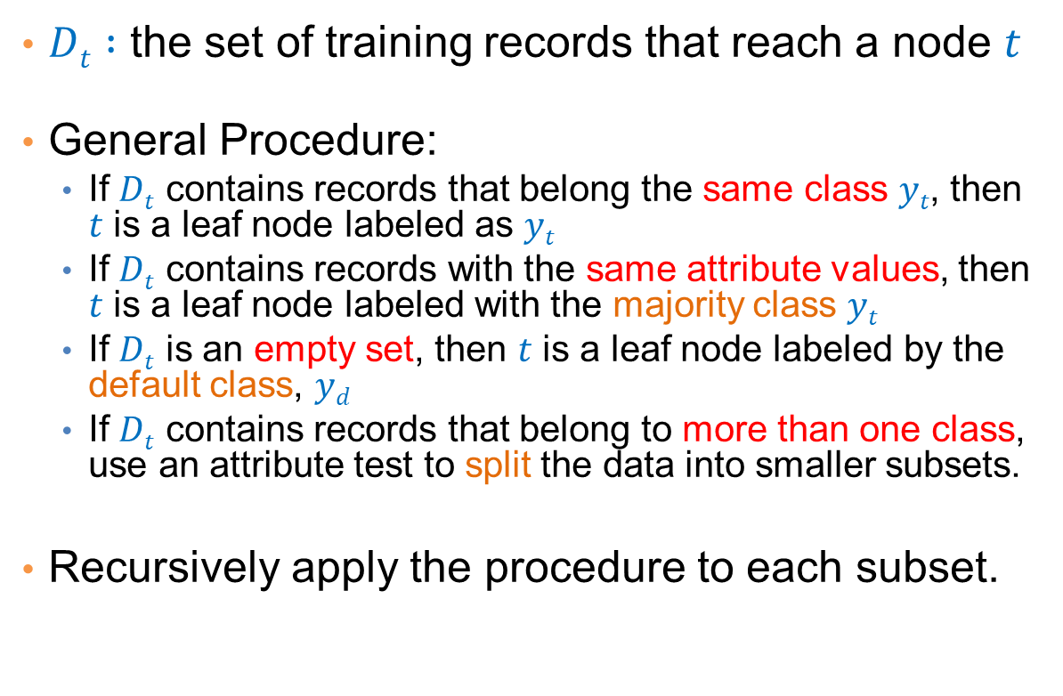

General Structure of Hunt’s Algorithm
$Dt :$ the set of training records that reach a node $t$
General Procedure:
  If $Dt$ contains records that belong the same class $yt$, then $t$ is a leaf node labeled as $yt$
  If $Dt$ contains records with the same attribute values, then $t$ is a leaf node labeled with the majority class $yt$
  If $Dt$ is an empty set, then $t$ is a leaf node labeled by the default class, $yd$
  If $Dt$ contains records that belong to more than one class, use an attribute test to split the data into smaller subsets.
Recursively apply the procedure to each subset.
$$Dt$$
?

Slide 37
Hunt’s Algorithm
Refund
Don’t
Cheat
Yes
No
Don’t
Cheat
Don’t
Cheat
Refund
Refund
Yes
No
Yes
No
Don’t
Cheat
Marital
Status
Don’t
Cheat
Marital
Status
Single,
Divorced
Single,
Divorced
Married
Married
Cheat
Don’t
Cheat
Taxable
Income
Don’t
Cheat
< 80K
>= 80K
Don’t
Cheat
Cheat

Slide 38
Constructing decision-trees (pseudocode)
GenDecTree(Sample S, Features F)
If stopping_condition(S,F) = true then
  leaf = createNode()
  leaf.label= Classify(S)
  return leaf
root = createNode()
root.test_condition = findBestSplit(S,F)
V = {v| v a possible outcome of root.test_condition}
for each value vєV:
  S_{v}: = {s | root.test_condition(s) = v and s є S};
  child = GenDecTree(S_{v} ,F) ;
  Add child as a descent of root and label the edge (root→child) as v
return root

Slide 39
Tree Induction
Issues
  How to Classify a leaf node
    Assign the majority class
    If leaf is empty, assign the default class – the class that has the highest popularity (overall or in the parent node).
  Determine how to split the records
    How to specify the attribute test condition?
    How to determine the best split?
  Determine when to stop splitting

Slide 40
How to Specify Test Condition?
Depends on attribute types
  Nominal
  Ordinal
  Continuous
Depends on number of ways to split
  2-way split
  Multi-way split

Slide 41
Splitting Based on Nominal Attributes
Multi-way split: Use as many partitions as distinct values.
Binary split: Divides values into two subsets.
Need to find optimal partitioning.
CarType
Family
Luxury
Sports
CarType
OR
CarType
{Sports, Luxury}
{Family,
Luxury}
{Family}
{Sports}

Slide 42
Splitting Based on Ordinal Attributes
Multi-way split: Use as many partitions as distinct values.
Binary split: Divides values into two subsets – respects the order. Need to find optimal partitioning.
What about this split?
Size
Small
Large
Medium
Size
Size
{Small, Medium}
OR
{Medium,
Large}
{Large}
{Small}
Size
{Small, Large}
{Medium}

Slide 43
Splitting Based on Continuous Attributes
Different ways of handling
  Discretization to form an ordinal categorical attribute
    Static – discretize once at the beginning
    Dynamic – ranges can be found by equal interval bucketing, equal frequency bucketing (percentiles), or clustering.
  Binary Decision: (A < v) or (A ≥ v)
    consider all possible splits and finds the best cut
    can be more computationally intensive

Slide 44
Splitting Based on Continuous Attributes

Slide 45
How to determine the Best Split
Before Splitting: 10 records of class 0,
10 records of class 1
Which test condition is the best?

Slide 46
How to determine the Best Split
Greedy approach:
  Creation of nodes with homogeneous class distribution is preferred
Need a measure of node impurity:
Ideas?
Non-homogeneous,
High degree of impurity
Homogeneous,
Low degree of impurity

Slide 47
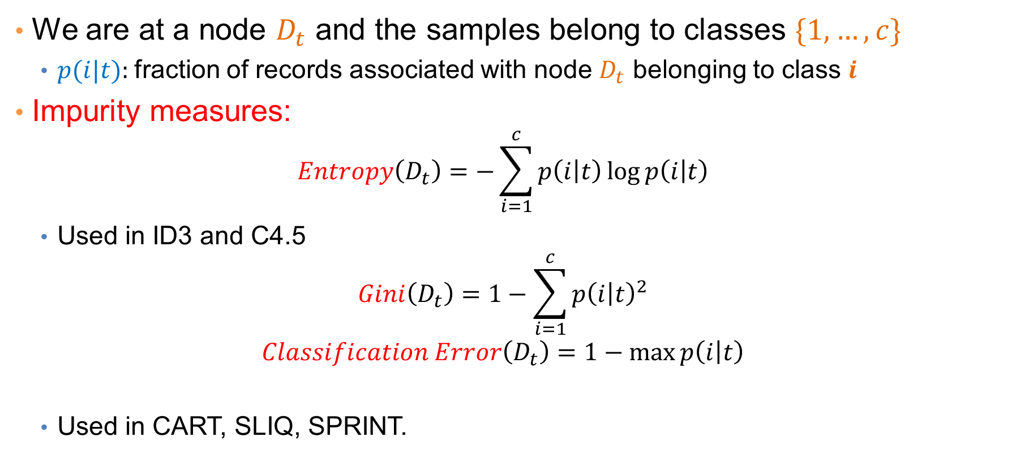
Measuring Node Impurity
We are at a node $D_{t}$ and the samples belong to classes $\{1,…,c\}$
  $p(i|t):$fraction of records associated with node $D_{t}$ belonging to class $i$
Impurity measures:
  $$Entropy\left(D_{t}\right)=−\sum_{i=1}^{c}{p\left(i | t\right)\log{p\left(i | t\right)}}$$
  Used in ID3 and C4.5
  $$Gini\left(D_{t}\right)=1−\sum_{i=1}^{c}{p{\left(i | t\right)}^{2}}$$
  $$Classification Error\left(D_{t}\right)=1−\max{p\left(i | t\right)}$$
  Used in CART, SLIQ, SPRINT.

Slide 48
Example: C4.5
Simple depth-first construction.
Uses Information Gain
Sorts Continuous Attributes at each node.
Needs entire data to fit in memory.
Unsuitable for Large Datasets.
  Needs out-of-core sorting.
You can download the software from:
http://www.cse.unsw.edu.au/~quinlan/c4.5r8.tar.gz

Slide 49
Expressiveness

Slide 50
Expressiveness
A classifier defines a function that discriminates between two (or more) classes.
The expressiveness of a classifier is the class of functions that it can model, and the kind of data that it can separate
When we have discrete (or binary) values, we are interested in the class of boolean functions that can be modeled
When the data-points are real vectors we talk about the decision boundary that the classifier can model
  The decision boundary is the (multi-dimensional) surface defined by the function of the classifier that separates the YES and NO decisions

Slide 51
Decision Boundary for Decision Trees
Consider a decision tree on real data where the test conditions involve a single attribute at a time, and a Yes/No question
Each test defines a line parallel to an axis (the one corresponding to the test attribute)
The decision boundary is a collection of lines parallel to the axes

Slide 52
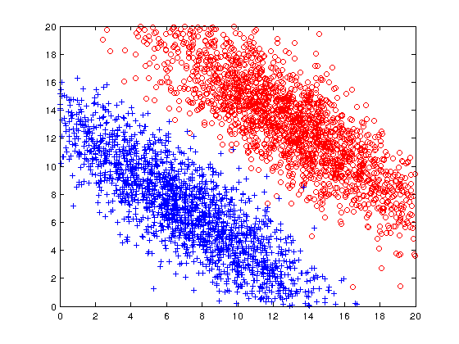
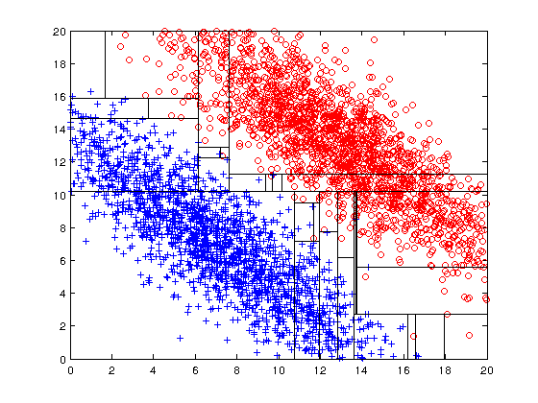
Limitations of single attribute-based decision boundaries
Both positive (+) and negative (o) classes generated from skewed Gaussians with centers at (8,8) and (12,12) respectively.
The resulting boundary is very complex.

Slide 53
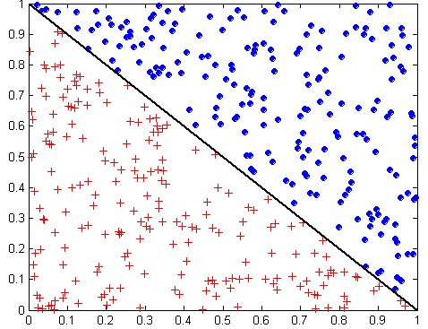
Oblique Decision Trees
x + y < 1
Class = +
Class =
Test condition may involve multiple attributes
More expressive representation
Finding optimal test condition is computationally expensive

Slide 54
Expressiveness
Decision tree provides expressive representation for learning discrete-valued function
  But they do not generalize well to certain types of Boolean functions
    Example: parity function:
      Class = 1 if there is an even number of Boolean attributes with truth value = True
      Class = 0 if there is an odd number of Boolean attributes with truth value = True
    For accurate modeling, must have a complete tree
Less expressive for modeling continuous variables
  Particularly when test condition involves only a single attribute at-a-time

Slide 55
NEAREST NEIGHBOR CLASSIFICATION

Slide 56
Instance-Based Classifiers
Store the training records
Use training records to
predict the class label of
unseen cases

Slide 57
Instance Based Classifiers
Examples:
  Rote-learner
    Memorizes entire training data and performs classification only if attributes of record match one of the training examples exactly
  Nearest neighbor classifier
    Uses k “closest” points (nearest neighbors) for performing classification

Slide 58
Nearest Neighbor Classifiers
Basic idea:
  “If it walks like a duck, quacks like a duck, then it’s probably a duck”
Compute Distance
Test Record
Training Records
Choose k of the “nearest” records

Slide 59
Nearest-Neighbor Classifiers
Requires three things
  The set of stored records
  Distance Metric to compute distance between records
  The value of k, the number of nearest neighbors to retrieve
To classify an unknown record:
  Compute distance to other training records
  Identify k nearest neighbors
  Use class labels of nearest neighbors to determine the class label of unknown record (e.g., by taking majority vote)

Slide 60
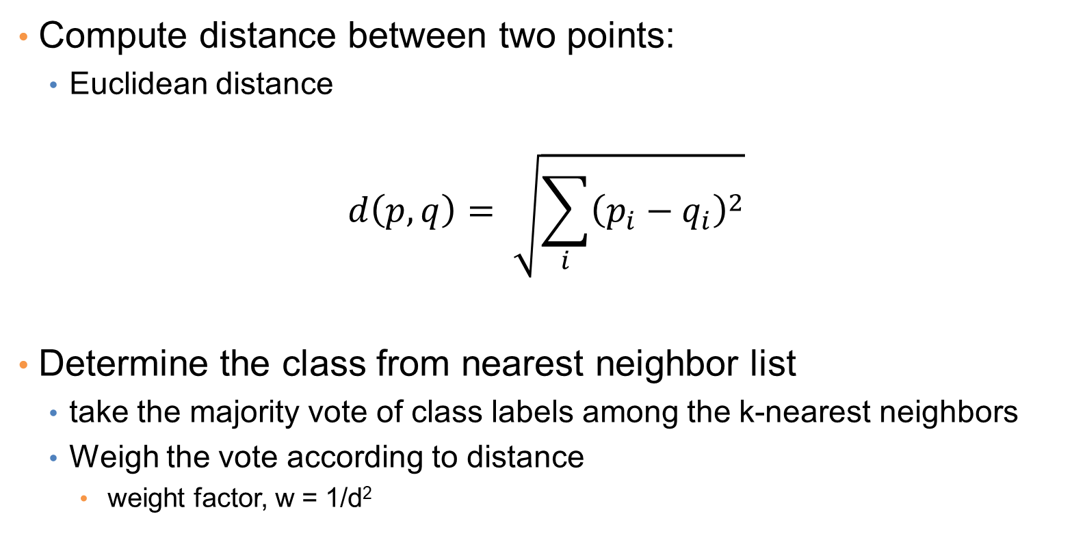
Nearest Neighbor Classification
Compute distance between two points:
  Euclidean distance
$$d\left(p,q\right)= \sqrt{\sum_{i}{{\left(p_{i}−q_{i}\right)}^{2}}}$$
Determine the class from nearest neighbor list
  take the majority vote of class labels among the k-nearest neighbors
  Weigh the vote according to distance
    weight factor, w = 1/d²

Slide 61
Definition of Nearest Neighbor
K-nearest neighbors of a record x are data points that have the k smallest distance to x

Slide 62
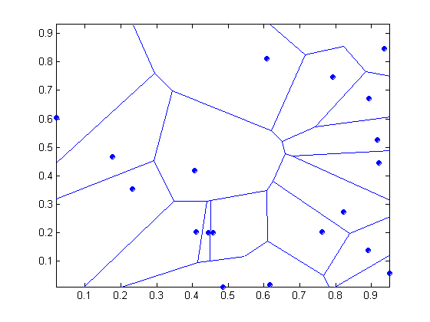
1 nearest-neighbor
Voronoi Diagram defines the classification boundary
The area takes the class of the green point

Slide 63
Nearest Neighbor Classification…
Choosing the value of k:
  If k is too small, sensitive to noise points
  If k is too large, neighborhood may include points from other classes
The value of k determines the complexity of the model
Lower k produces more complex models

Slide 64
Example

Slide 65
Example

Slide 66
Nearest Neighbor Classification…
Scaling issues
  Attributes may have to be scaled to prevent distance measures from being dominated by one of the attributes
  Example:
    height of a person may vary from 1.5m to 1.8m
    weight of a person may vary from 90lb to 300lb
    income of a person may vary from $10K to $1M

Slide 67
Nearest Neighbor Classification…
Problem with Euclidean measure:
  High dimensional data
    curse of dimensionality
  Can produce counter-intuitive results
1 1 1 1 1 1 1 1 1 1 1 0
1 0 0 0 0 0 0 0 0 0 0 0
vs
0 1 1 1 1 1 1 1 1 1 1 1
0 0 0 0 0 0 0 0 0 0 0 1
d = 1.4142
d = 1.4142
    Solution: Normalize the vectors to unit length

Slide 68
Nearest neighbor Classification…
k-NN classifiers are lazy learners
  It does not build models explicitly
  Unlike eager learners such as decision trees
Classifying unknown records is relatively expensive
  Naïve algorithm: O(n)
  Need for structures to retrieve nearest neighbors fast.
    The Nearest Neighbor Search problem.
    Also, Approximate Nearest Neighbor Search
Issues with distance in very high-dimensional spaces

Slide 69
SUPPORT VECTOR MACHINES

Slide 70
Linear classifiers
SVMs are part of a family of classifiers that assumes that the classes are linearly separable
That is, there is a hyperplane that separates (approximately, or exactly) the instances of the two classes.
The goal is to find this hyperplane

Slide 71
Support Vector Machines
Find a linear hyperplane (decision boundary) that will separate the data

Slide 72
Support Vector Machines
One Possible Solution

Slide 73
Support Vector Machines
Another possible solution

Slide 74
Support Vector Machines
Other possible solutions

Slide 75
Support Vector Machines
Which one is better? B1 or B2?
How do you define better?

Slide 76
Support Vector Machines
Find hyperplane maximizes the margin : B1 is better than B2

Slide 77
Support Vector Machines

Slide 78
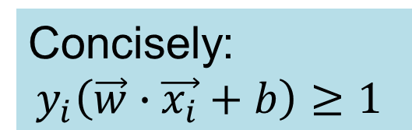
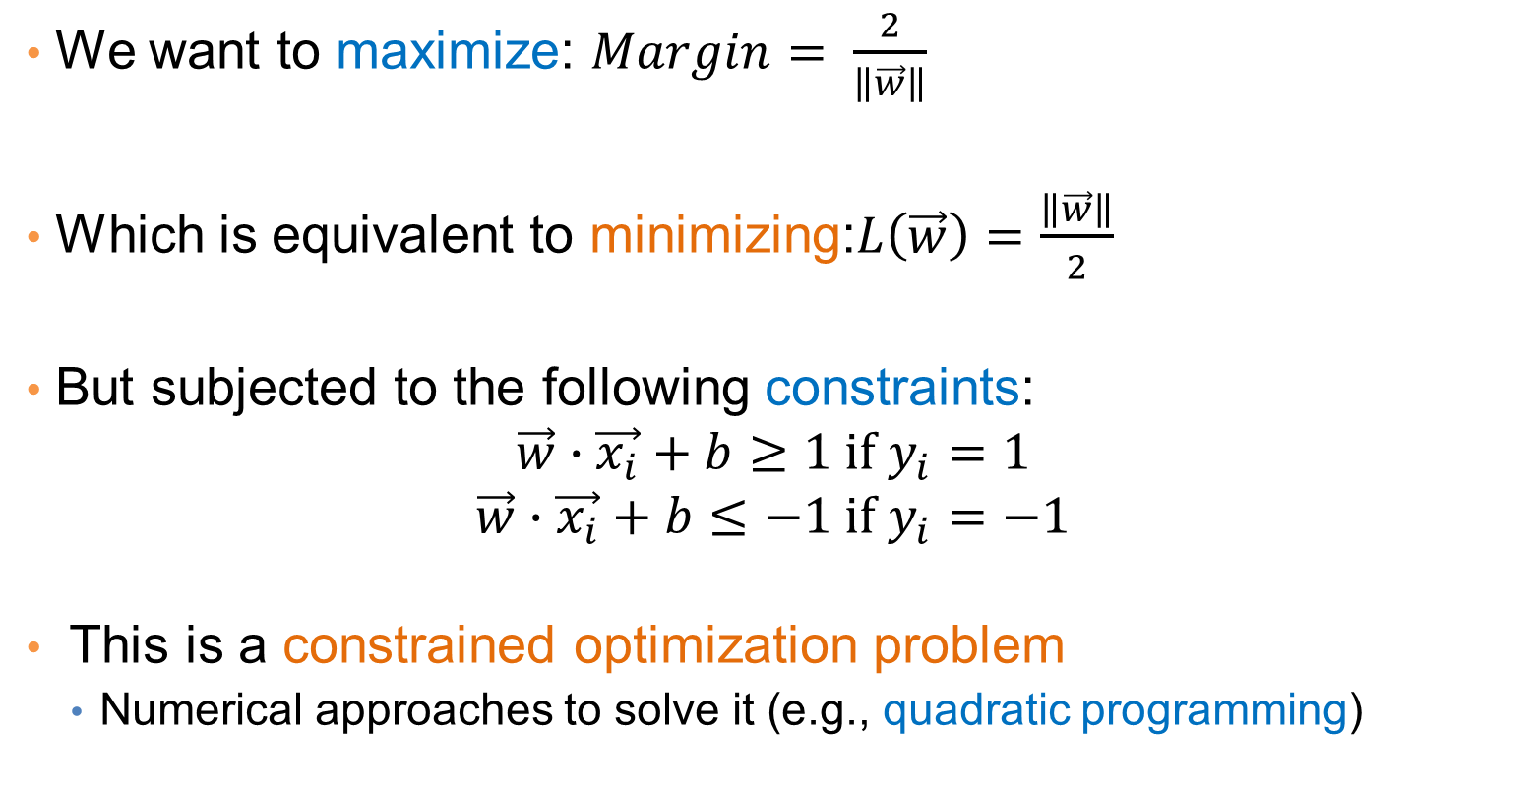
Support Vector Machines
We want to maximize: $Margin= \frac{2}{\left\|\vec{w}\right\|}$
Which is equivalent to minimizing:$L\left(\vec{w}\right)=\frac{\left\|\vec{w}\right\|}{2}$
But subjected to the following constraints:
$$\vec{w}∙\vec{x_{i}}+b≥1 if y_{i}=1$$
$$\vec{w}∙\vec{x_{i}}+b≤−1 if y_{i}=−1$$
This is a constrained optimization problem
  Numerical approaches to solve it (e.g., quadratic programming)
Concisely:
$$y_{i}\left(\vec{w}∙\vec{x_{i}}+b\right)≥1$$

Slide 79
Support Vector Machines
What if the problem is not linearly separable?

Slide 80


Support Vector Machines
What if the problem is not linearly separable?
$$\vec{w}⋅\vec{x}+b=−1+ξ_{i}$$
$$\frac{ξ_{i}}{\left\|w\right\|}$$

Slide 81
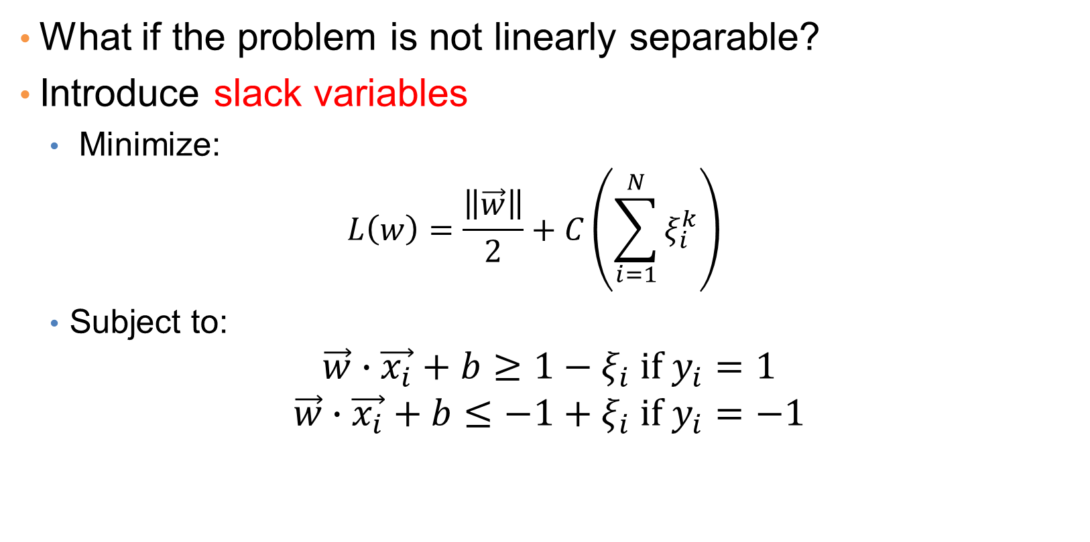
Support Vector Machines
What if the problem is not linearly separable?
Introduce slack variables
  Minimize:
  $$L\left(w\right)=\frac{\left\|\vec{w}\right\|}{2}+C\left(\sum_{i=1}^{N}{ξ_{i}^{k}}\right)$$
  Subject to:
$$\vec{w}∙\vec{x_{i}}+b≥1−ξ_{i} if y_{i}=1$$
$$\vec{w}∙\vec{x_{i}}+b≤−1+ξ_{i} if y_{i}=−1$$

Slide 82
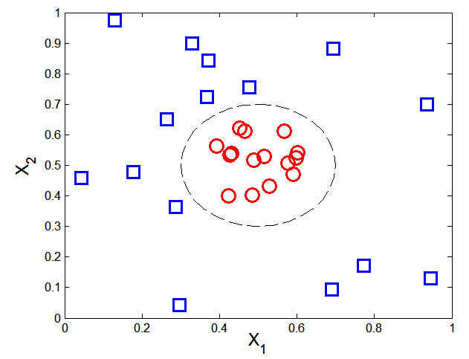

Nonlinear Support Vector Machines
What if decision boundary is not linear?

Slide 83
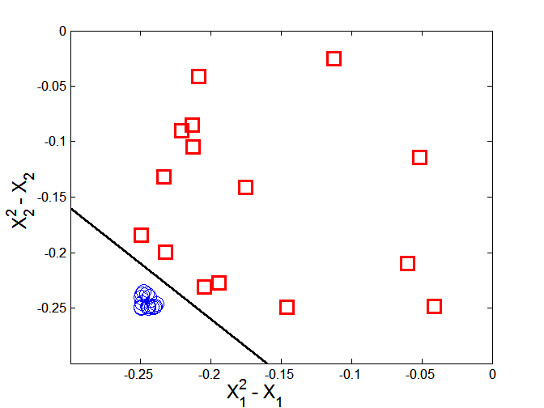



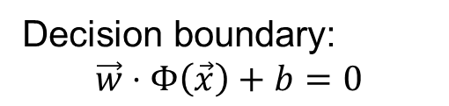
Nonlinear Support Vector Machines
Trick: Transform data into higher dimensional space
Decision boundary:
$$\vec{w}⋅Φ\left(\vec{x}\right)+b=0$$

Slide 84
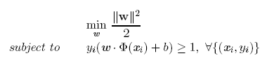

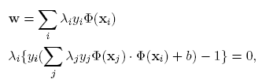


Learning Nonlinear SVM
Optimization problem:
Which leads to the same set of equations (but involve $(x)$ instead of $x$)

Slide 85

Learning NonLinear SVM
Issues:
  What type of mapping function $$ should be used?
  How to do the computation in high dimensional space?
    Most computations involve dot product $\left(xi\right)⋅ Φ(xj)$
    Curse of dimensionality?

Slide 86


Learning Nonlinear SVM
Kernel Trick:
  $\left(xi\right)⋅ Φ(xj) = K(xi, xj)$
  $K(xi, xj)$ is a kernel function (expressed in terms of the coordinates in the original space)
    Examples:

Slide 87
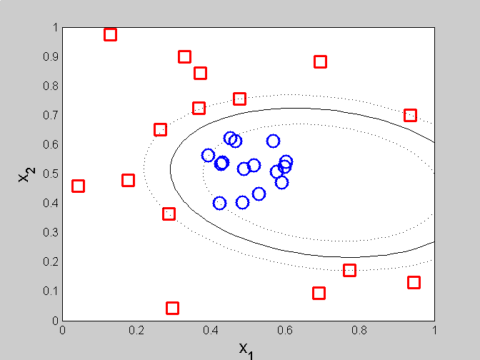
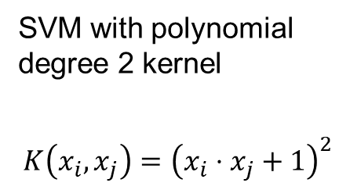
Example of Nonlinear SVM
SVM with polynomial degree 2 kernel
$$K\left(x_{i},x_{j}\right)={\left(x_{i}⋅x_{j}+1\right)}^{2}$$

Slide 88
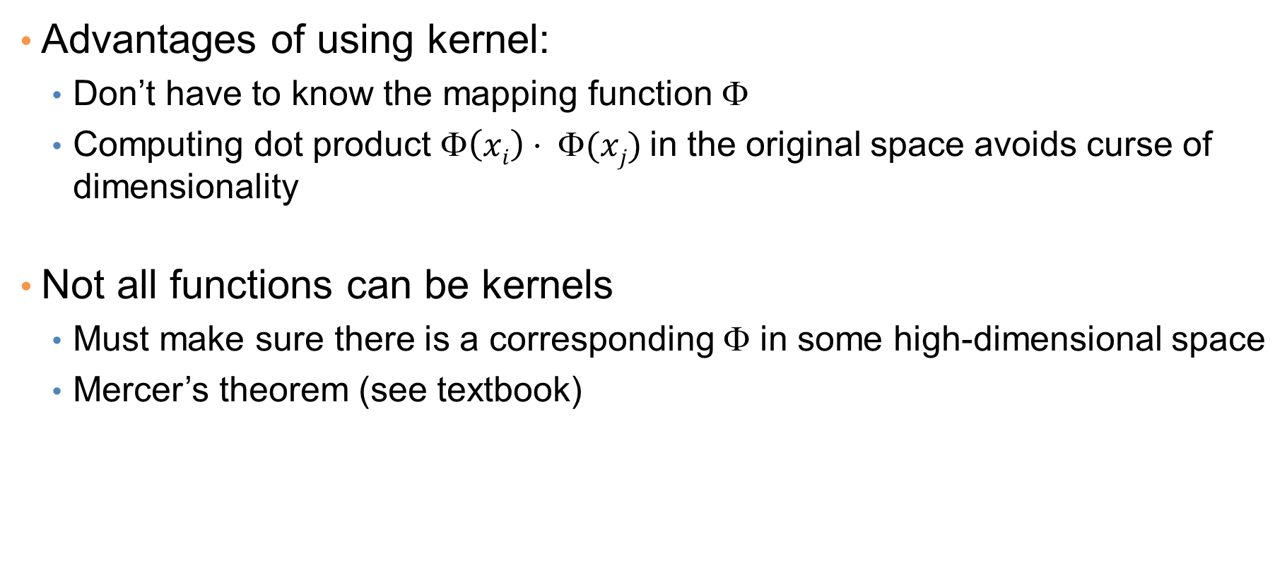
Learning Nonlinear SVM
Advantages of using kernel:
  Don’t have to know the mapping function $$
  Computing dot product $\left(xi\right)⋅ Φ(xj)$in the original space avoids curse of dimensionality
Not all functions can be kernels
  Must make sure there is a corresponding Φ in some high-dimensional space
  Mercer’s theorem (see textbook)

Slide 89
LOGISTIC REGRESSION

Slide 90
Classification via regression
Instead of predicting the class of a record we want to predict the probability of the class given the record
Transform the classification problem into a regression problem.
But how do you define the probability that you want to predict?

Slide 91
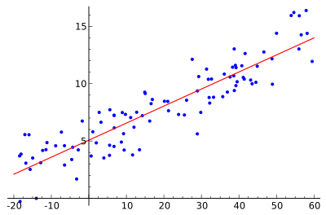
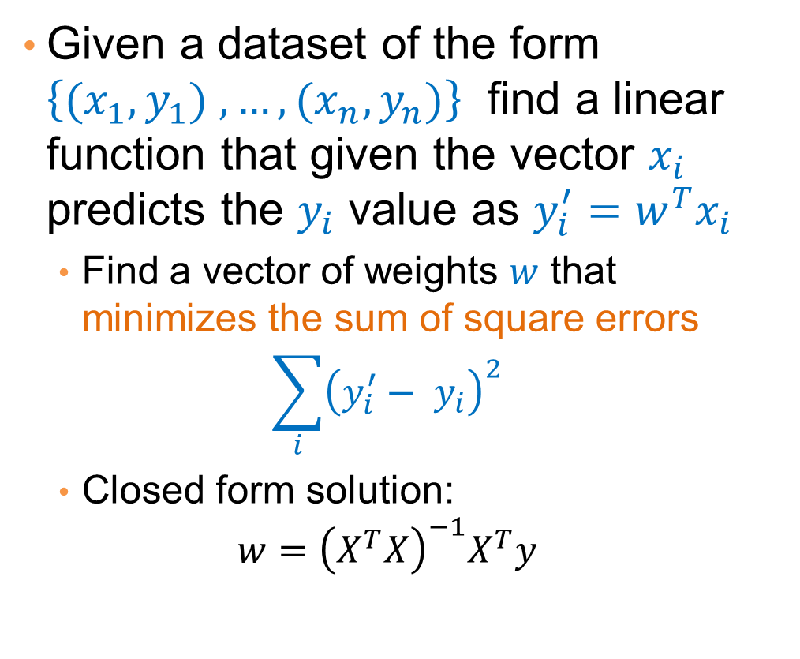
Linear regression
Given a dataset of the form $\left\{{(x}_{1},y_{1}) ,…,{(x}_{n},y_{n})\right\}$ find a linear function that given the vector $x_{i}$ predicts the $y_{i}$ value as $y_{i}^{′}=w^{T}x_{i}$
  Find a vector of weights $w$ that minimizes the sum of square errors
  $$\sum_{i}{{\left(y_{i}^{′}− y_{i}\right)}^{2}}$$
  Closed form solution:
  $$w={\left(X^{T}X\right)}^{−1}X^{T}y$$

Slide 92
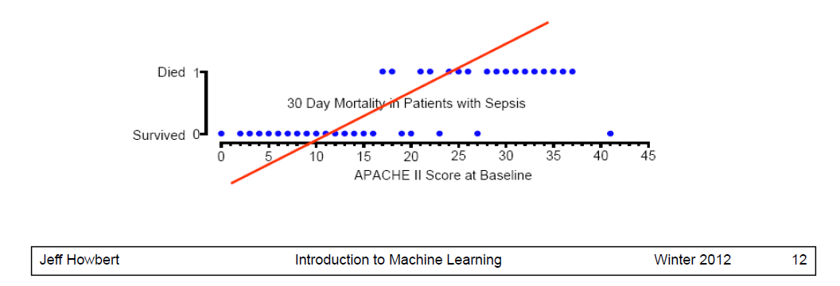
Linear regression
A simple approach: use linear regression to learn a linear function that predicts 0/1 values
  Not good: It may produce negative probabilities, or probabilities that are greater than 1.
  Also the probabilities it produces are not what we want. We want probability close to zero for small values, and close to 1 for large, and a transition from 0 to 1 around the value 20

Slide 93
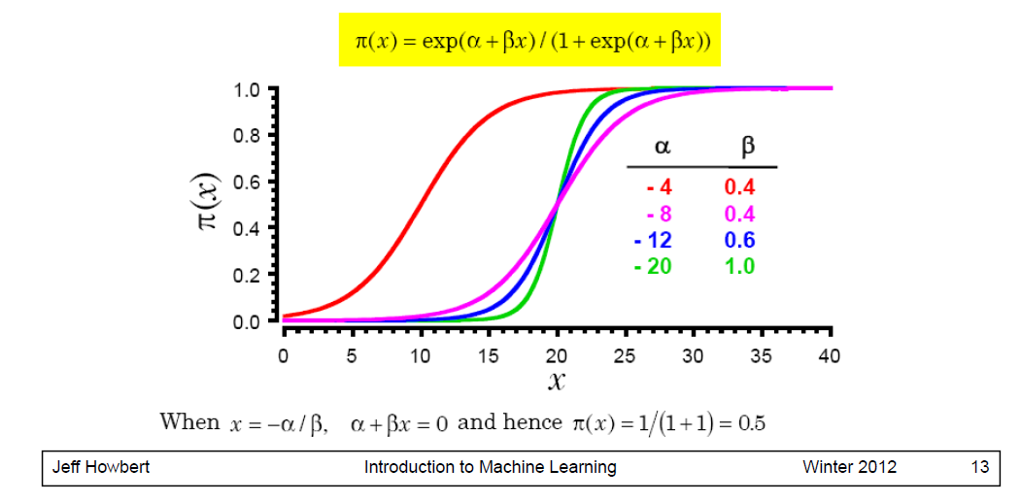
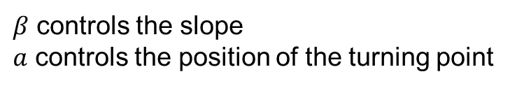
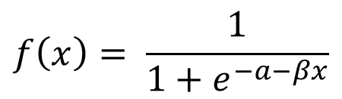
The logistic function
$$f\left(x\right)= \frac{1}{1+e^{−a−βx}}$$
$β$ controls the slope
$a$ controls the position of the turning point

Slide 94
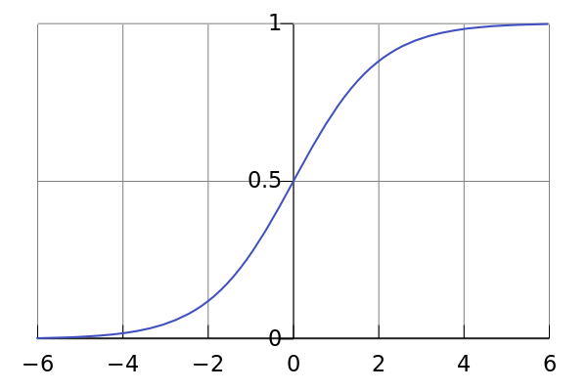
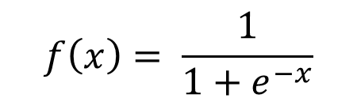
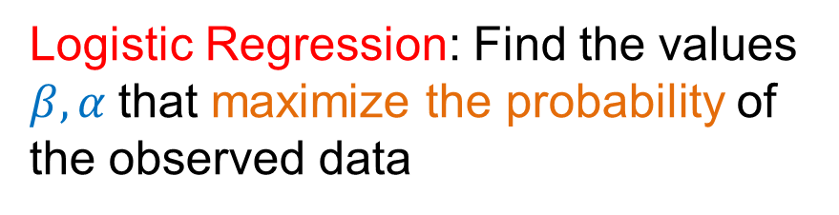
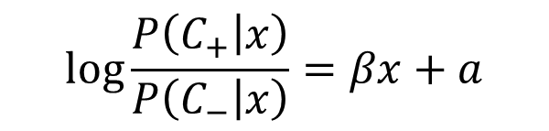
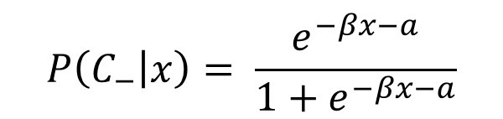
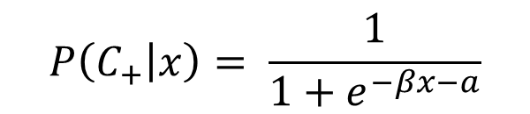
Logistic Regression
$$f\left(x\right)= \frac{1}{1+e^{−x}}$$
Class Probabilities
$$P\left(C_{+} | x\right)= \frac{1}{1+e^{−βx−a}}$$
$$P\left(C_{−} | x\right)= \frac{e^{−βx−a}}{1+e^{−βx−a}}$$
Logistic Regression: Find the values $β,α$that maximize the probability of the observed data
$$\log{\frac{P\left(C_{+} | x\right)}{P\left(C_{−} | x\right)}}=βx+a$$
Linear regression on the log-odds ratio

Slide 95
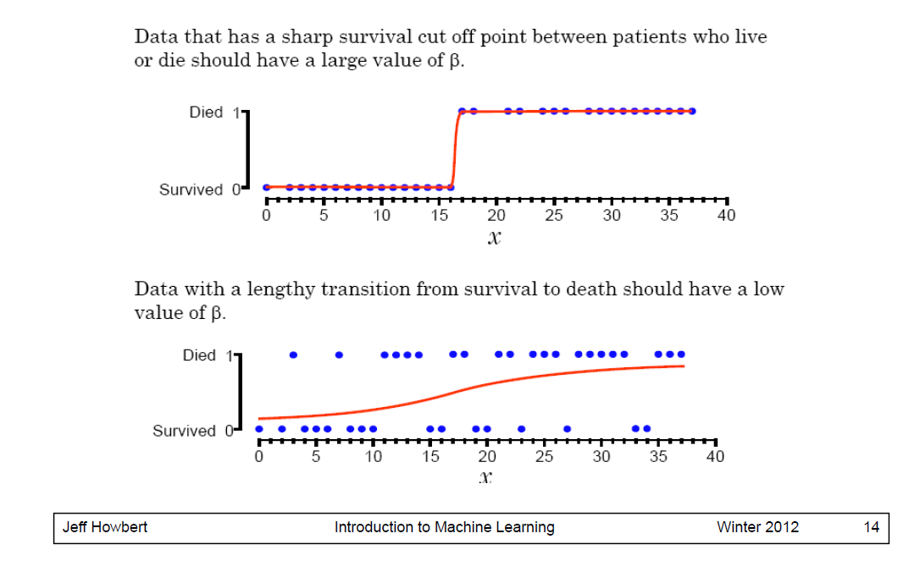
Logistic Regression in one dimension

Slide 96
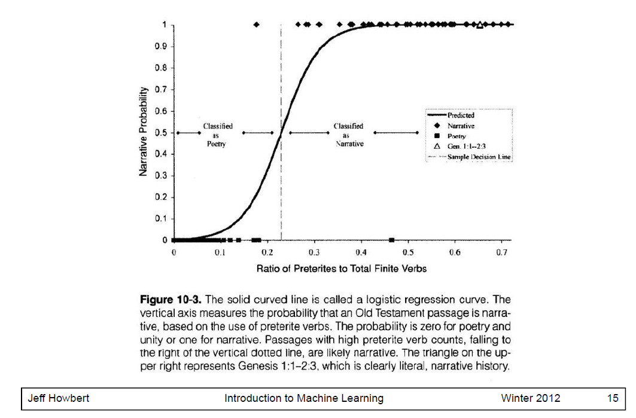
Logistic Regression in one dimension

Slide 97





Class probabilities for multiple dimensions
Assume a linear classification boundary
$$w⋅x>0$$
For the positive class the bigger the value of $w⋅x$, the further the point is from the classification boundary, the higher our certainty for the membership to the positive class
Define $P(C_{+}|x)$ as an increasing function of $w⋅x$
$$w⋅x=0$$
For the negative class the smaller the value of $w⋅x$, the further the point is from the classification boundary, the higher our certainty for the membership to the negative class
Define $P(C_{−}|x)$ as a decreasing function of $w⋅x$
$$w⋅x<0$$

Slide 98
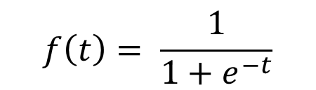
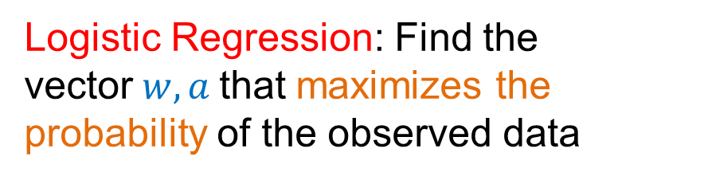



Logistic Regression
$$f\left(t\right)= \frac{1}{1+e^{−t}}$$
Class probabilities
$$P\left(C_{+} | x\right)= \frac{1}{1+e^{−w⋅x−a}}$$
$$P\left(C_{−} | x\right)= \frac{e^{−w⋅x−a}}{1+e^{−w⋅x−a}}$$
Logistic Regression: Find the vector$w,a$that maximizes the probability of the observed data
$$\log{\frac{P\left(C_{+} | x\right)}{P\left(C_{−} | x\right)}}=w⋅x+a$$
Linear regression on the log-odds ratio

Slide 99


Logistic regression in 2-d
Coefficients
$$β_{1}=−1.9$$
$$β_{2}=−0.4$$
$$α=13.04$$

Slide 100

Estimating the coefficients
Maximum Likelihood Estimation:
  We have pairs of the form $(x_{i},y_{i})$
Log Likelihood function
$$L\left(w\right)= \sum_{i}{\left[y_{i}\log{P\left(y_{i} | x_{i},w\right)+\left(1−y_{i}\right)\log{(1−P\left(y_{i} | x_{i},w\right))}}\right]}$$
Unfortunately, it does not have a closed form solution
  Use gradient descend to find local minimum

Slide 101
Logistic Regression
Produces a probability estimate for the class membership which is often very useful.
The weights can be useful for understanding the feature importance.
Works for relatively large datasets
Fast to apply.

Slide 102
NAÏVE BAYES CLASSIFIER

Slide 103
Bayes Classifier
A probabilistic framework for solving classification problems
A, C random variables
Joint probability: Pr(A=a,C=c)
Conditional probability: Pr(C=c | A=a)
Relationship between joint and conditional probability distributions
$$\operatorname{Pr}\left(C,A\right)=\operatorname{Pr}\left(C | A\right)P\left(A\right)=P\left(A | C\right)P(C)$$
Bayes Theorem:
$$P\left(C | A\right)=\frac{P\left(A | C\right)P(C)}{P(A)}$$

Slide 104
Bayesian Classifiers
  How to classify the new record X = (‘Yes’, ‘Single’, 80K)
Find the class with the highest probability given the vector values.
    Maximum Aposteriori Probability estimate:
  Find the value c for class C that maximizes P(C=c| X)
How do we estimate P(C|X) for the different values of C?
  We want to estimate
    P(C=Yes| X)
    P(C=No| X)

Slide 105

Bayesian Classifiers
In order for probabilities to be well defined:
  Consider each attribute and the class label as random variables
  Probabilities are determined from the data
Evade C
Event space: {Yes, No}
$$P(C) = (0.3, 0.7)$$
Refund A₁
Event space: {Yes, No}
$$P(A1) = (0.3,0.7)$$
Martial Status A₂
Event space: {Single, Married, Divorced}
$$P(A2) = (0.4,0.4,0.2)$$
Taxable Income A₃
Event space: R
$$P(A3) \sim Normal\left(μ,σ^{2}\right)$$
$μ = 104$:sample mean, $2=1874$:sample variance

Slide 106

Bayesian Classifiers
Approach:
  compute the posterior probability $P(C | A1, A2, …, An)$using the Bayes theorem
  $$P\left(C | A_{1},A_{2},…,A_{n}\right)=\frac{P\left(A_{1},A_{2},…,A_{n} | C\right)P(C)}{P(A_{1},A_{2},…,A_{n})}$$
  Maximizing
  $$P(C | A1, A2, …, An)$$
  is equivalent to maximizing
  $$P(A1, A2, …, An|C) P(C)$$
    The value $P(A_{1},…,A_{n})$ is the same for all values of $C$.
How do we estimate $P(A1, A2, …, A_{n}|C )?$

Slide 107
Naïve Bayes Classifier
Assume conditional independence among attributes $Ai$ when class C is given:
  $P(A_{1},A_{2},…,A_{n}|C)= P(A_{1}|C) P(A_{2}\left|C\right)⋯P(A_{n}|C)$
  We can estimate $P(Ai| C)$from the data.
  New point $X=(A_{1}=α_{1}, …,A_{n}=α_{n})$is classified to class c if
  $P\left(C=c | X\right)=P\left(C=c\right)\prod_{i}{P(A_{i}=α_{i}|c)}$
  is maximum over all possible values of C.

Slide 108
Example
  Record
    X = (Refund = Yes, Status = Single, Income =80K)
For the class C :‘Evade’, we want to compute:
  P(C = Yes|X) and P(C = No| X)
We compute:
  P(C = Yes|X) = P(C = Yes)*P(Refund = Yes |C = Yes)
  *P(Status = Single |C = Yes)
  *P(Income =80K |C= Yes)
  P(C = No|X) = P(C = No)*P(Refund = Yes |C = No)
  *P(Status = Single |C = No)
  *P(Income =80K |C= No)

Slide 109
How to Estimate Probabilities from Data?
Class Prior Probability:
$P\left(C=c\right)= \frac{N_{c}}{N }$
$Nc$: Number of records with class c
$N$ = Number of records
P(C = No) = 7/10
P(C = Yes) = 3/10

Slide 110
How to Estimate Probabilities from Data?
Discrete attributes:
$$P\left(A_{i}=a | C=c\right)=\frac{N_{a,c}}{N_{c}}$$
$N_{a,c}$: number of instances having attribute $A_{i}=a$and belong to class $c$
$N_{c}$: number of instances of class $c$

Slide 111
How to Estimate Probabilities from Data?
Discrete attributes:
$$P\left(A_{i}=a | C=c\right)=\frac{N_{a,c}}{N_{c}}$$
$N_{a,c}$: number of instances having attribute $A_{i}=a$and belong to class $c$
$N_{c}$: number of instances of class $c$
P(Refund = Yes|No) = 3/7

Slide 112
How to Estimate Probabilities from Data?
Discrete attributes:
$$P\left(A_{i}=a | C=c\right)=\frac{N_{a,c}}{N_{c}}$$
$N_{a,c}$: number of instances having attribute $A_{i}=a$and belong to class $c$
$N_{c}$: number of instances of class $c$
P(Refund = Yes|Yes) = 0

Slide 113
How to Estimate Probabilities from Data?
Discrete attributes:
$$P\left(A_{i}=a | C=c\right)=\frac{N_{a,c}}{N_{c}}$$
$N_{a,c}$: number of instances having attribute $A_{i}=a$and belong to class $c$
$N_{c}$: number of instances of class $c$
P(Status=Single|No) = 2/7

Slide 114
How to Estimate Probabilities from Data?
Discrete attributes:
$$P\left(A_{i}=a | C=c\right)=\frac{N_{a,c}}{N_{c}}$$
$N_{a,c}$: number of instances having attribute $A_{i}=a$and belong to class $c$
$N_{c}$: number of instances of class $c$
P(Status=Single|Yes) = 2/3

Slide 115

How to Estimate Probabilities from Data?
  Numerical Attributes:
Assume a normal distribution for each$(A_{i},c_{j})$pair
For Class=Yes and attribute Income
  sample mean $μ = 90$
  sample variance $σ2= 25$
For Income = 80

Slide 116

How to Estimate Probabilities from Data?
  Numerical Attributes:
Assume a normal distribution for each$(A_{i},c_{j})$pair
For Class=No and attribute Income
  sample mean $μ =110$
  sample variance $σ2= 2975$
For Income = 80

Slide 117
Example
  Record
    X = (Refund = Yes, Status = Single, Income =80K)
We compute:
  P(C = Yes|X) = P(C = Yes)*P(Refund = Yes |C = Yes)
  *P(Status = Single |C = Yes)
  *P(Income =80K |C= Yes)
  = 3/10* 0 * 2/3 * 0.01 = 0
  P(C = No|X) = P(C = No)*P(Refund = Yes |C = No)
  *P(Status = Single |C = No)
  *P(Income =80K |C= No)
  = 7/10 * 3/7 * 2/7 * 0.0062 = 0.0005

Slide 118
Example of Naïve Bayes Classifier
Creating a Naïve Bayes Classifier, essentially means to compute counts:
Total number of records: N = 10
Class No:
Number of records: 7
Attribute Refund:
Yes: 3
No: 4
Attribute Marital Status:
Single: 2
Divorced: 1
Married: 4
Attribute Income:
mean: 110
variance: 2975
Class Yes:
Number of records: 3
Attribute Refund:
Yes: 0
No: 3
Attribute Marital Status:
Single: 2
Divorced: 1
Married: 0
Attribute Income:
mean: 90
variance: 25

Slide 119
Example of Naïve Bayes Classifier
Given a Test Record:
    X = (Refund = Yes, Status = Single, Income =80K)
P(X|Class=No) = P(Refund=Yes|Class=No)
× P(Married| Class=No)
× P(Income=120K| Class=No)
= 3/7 * 2/7 * 0.0062 = 0.00075
P(X|Class=Yes) = P(Refund=No| Class=Yes)
× P(Married| Class=Yes)
× P(Income=120K| Class=Yes)
= 0 * 2/3 * 0.01 = 0
P(No) = 0.3, P(Yes) = 0.7
Since P(X|No)P(No) > P(X|Yes)P(Yes)
Therefore P(No|X) > P(Yes|X)
=> Class = No

Slide 120
Naïve Bayes Classifier
If one of the conditional probabilities is zero, then the entire expression becomes zero
Laplace Smoothing:
$$P\left(A_{i}=a | C=c\right)= \frac{N_{ac}+1}{N_{c}+N_{i}}$$
  $Ni$: number of attribute values for attribute $Ai$

Slide 121
Example of Naïve Bayes Classifier
Creating a Naïve Bayes Classifier, essentially means to compute counts:
With Laplace Smoothing
Total number of records: N = 10
Class No:
Number of records: 7
Attribute Refund:
Yes: 3
No: 4
Attribute Marital Status:
Single: 2
Divorced: 1
Married: 4
Attribute Income:
mean: 110
variance: 2975
Class Yes:
Number of records: 3
Attribute Refund:
Yes: 0
No: 3
Attribute Marital Status:
Single: 2
Divorced: 1
Married: 0
Attribute Income:
mean: 90
variance: 25

Slide 122
Example of Naïve Bayes Classifier
Given a Test Record:
With Laplace Smoothing
    X = (Refund = Yes, Status = Single, Income =80K)
P(X|Class=No) = P(Refund=No|Class=No)
× P(Married| Class=No)
× P(Income=120K| Class=No)
= 4/9 × 3/10 × 0.0062 = 0.00082
P(X|Class=Yes) = P(Refund=No| Class=Yes)
× P(Married| Class=Yes)
× P(Income=120K| Class=Yes)
= 1/5 × 3/6 × 0.01 = 0.001
P(No) = 0.7, P(Yes) = 0.3
P(X|No)P(No) = 0.0005
P(X|Yes)P(Yes) = 0.0003
=> Class = No

Slide 123
Implementation details
Computing the conditional probabilities involves multiplication of many very small numbers
  Numbers get very close to zero, and there is a danger of numeric instability
We can deal with this by computing the logarithm of the conditional probability
$$\log{P\left(C | A\right)\sim \log{P\left(A | C\right)+\log{P\left(C\right)}}}$$
$$=\sum_{i}{\log{P\left(A_{i} | C\right)}+\log{P(C)}}$$

Slide 124
Naïve Bayes for Text Classification
Naïve Bayes is commonly used for text classification
For a document with k terms $d=(t_{1},…, t_{k})$
$$P\left(c | d\right)=P\left(c\right)P(d|c)=P(c)\prod_{t_{i}∈d}{P(t_{i}|c)}$$
$P\left(t_{i} | c\right)$= Fraction of terms from all documents in c that are$t_{i}$.
  $$P\left(t_{i} | c\right)= \frac{N_{ic}+1}{N_{c}+T}$$
Easy to implement and works relatively well
Limitation: Hard to incorporate additional features (beyond words).
  E.g., number of adjectives used.
Fraction of documents in c
Number of times $t_{i}$ appears in all documents in c
Laplace Smoothing
Number of unique words
(vocabulary size)
Total number of terms in all documents in c

Slide 125
Multinomial document model
Probability of document $d=\left(t_{1},…, t_{k}\right)$ in class c:
$$P(d|c)=P(c)\prod_{t_{i}∈d}{P(t_{i}|c)}$$
This formula assumes a multinomial distribution for the document generation:
  If we have probabilities $p_{1},…, p_{T}$ for events $t_{1},…, t_{T}$ the probability of a subset of these is
  $$P\left(d\right)= \frac{N}{N_{t_{1}}!N_{t_{2}}!⋯N_{t_{T}}!}p_{1}^{N_{t_{1}}}p_{2}^{N_{t_{2}}}⋯p_{T}^{N_{t_{T}}}$$
Equivalently: There is an automaton spitting words from the above distribution
w

Slide 126


Slide 127
Example
News titles for Politics and Sports
Politics
Sports
“Obama meets Merkel”
“Obama elected again”
“Merkel visits Greece again”
“OSFP European basketball champion”
“Miami NBA basketball champion”
“Greece basketball coach?”
documents
P(p) = 0.5
P(s) = 0.5
terms
obama:2, meets:1, merkel:2, elected:1, again:2, visits:1, greece:1
OSFP:1, european:1, basketball:3, champion:2, miami:1, nba:1, greece:1, coach:1
Vocabulary size: 14
Total terms: 10
Total terms: 11
New title:
X = “Obama likes basketball”
P(Politics|X) ~ P(p)*P(obama|p)*P(likes|p)*P(basketball|p)
= 0.5 * 3/(10+14) *1/(10+14) * 1/(10+14) = 0.000108
P(Sports|X) ~ P(s)*P(obama|s)*P(likes|s)*P(basketball|s)
= 0.5 * 1/(11+14) *1/(11+14) * 4/(11+14) = 0.000128

Slide 128
Naïve Bayes (Summary)
Robust to isolated noise points
Handle missing values by ignoring the instance during probability estimate calculations
Robust to irrelevant attributes
Independence assumption may not hold for some attributes
  Use other techniques such as Bayesian Belief Networks (BBN)
Naïve Bayes can produce a probability estimate, but it is usually a very biased one
  Logistic Regression is better for obtaining probabilities.

Slide 129
Generative vs Discriminative models
Naïve Bayes is a type of a generative model
  Generative process:
    First pick the category of the record
    Then given the category, generate the attribute values from the distribution of the category
    Conditional independence given C
We use the training data to learn the distributions most likely to have generated the data
C
$$A_{1}$$
$$A_{2}$$
$$A_{n}$$

Slide 130
Generative vs Discriminative models
Logistic Regression and SVM are discriminative models
  The goal is to find the boundary that discriminates between the two classes from the training data
In order to classify the language of a document, you can
  Either learn the two languages and find which is more likely to have generated the words you see
  Or learn what differentiates the two languages.

