Slide 1
DATA MINING TUTORIAL
Introduction to Python Libraries

Slide 2
Python
In the last few years there is an increasing community that creates Data Mining tools in Python
There are also tools in other languages but we will use Python whenever we can for a common point of reference.
There are tons of resources online for Python.
For an introduction you can also look at the slides of the Introduction to Programming course by prof. N. Mamoulis
I assume you have installed Python to your laptop by now.

Slide 3
Anaconda
Installing libraries in Python can be complicated, so you should download the Anaconda Scientific Python distribution which will install most of the libraries that we will use.
Use Python 3.0
Installing Anaconda installs a lot of libraries and also:
Anaconda Navigator
Jupyter Notebook: An interactive web-based interface for running python.
Anaconda Powershell: terminal for running commands

Slide 4
Anaconda
Installing Anaconda will also install Jupyter Notebook,
It is very convenient for loading and experimenting with data
We will use it in our examples, and it is recommended for the assignments as well.

Slide 5
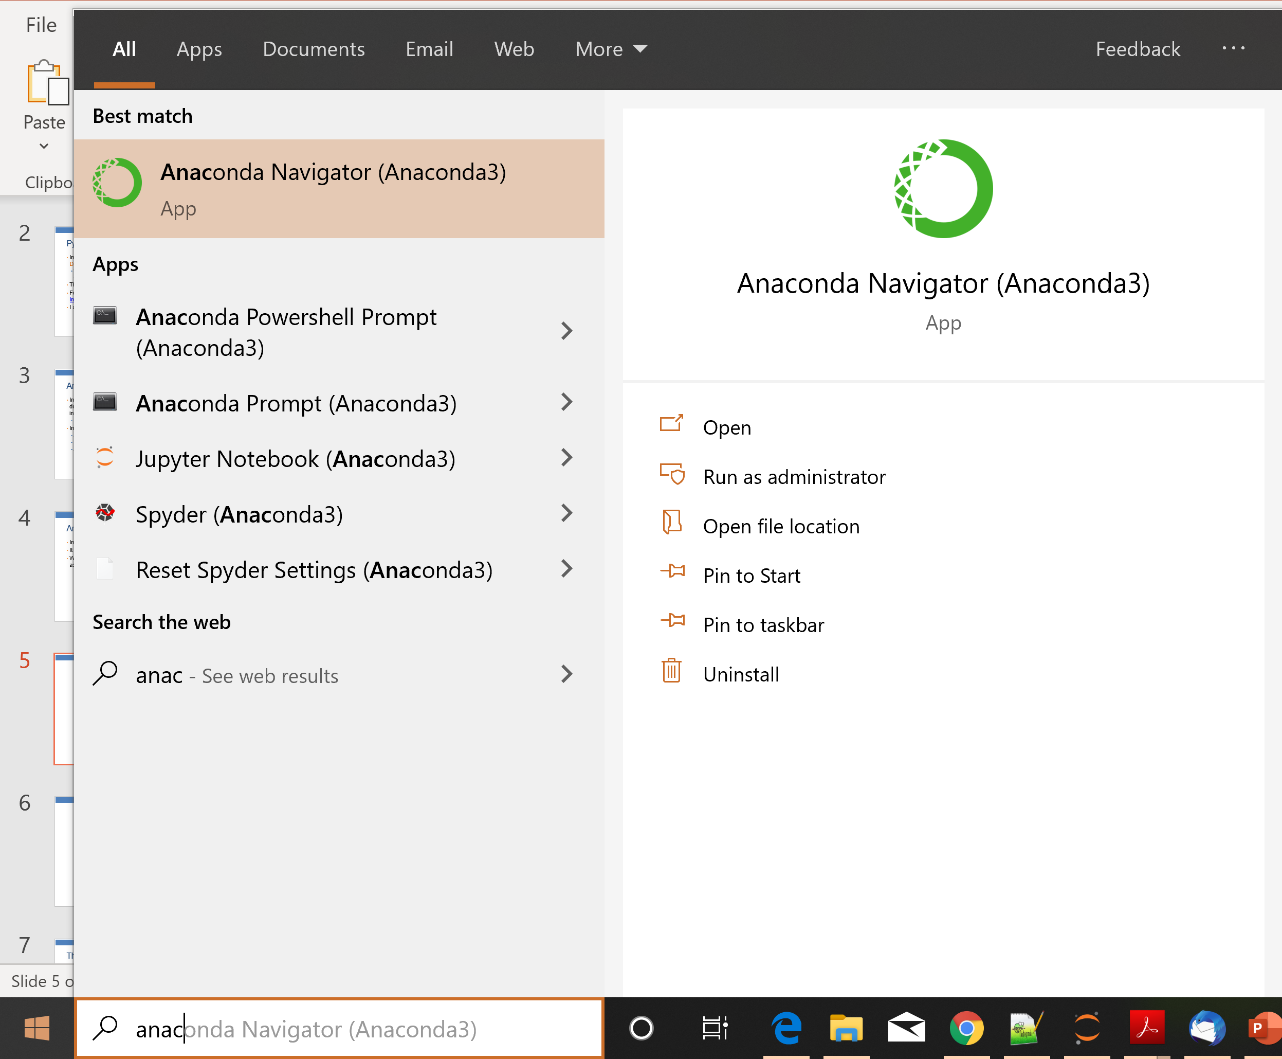

Slide 6
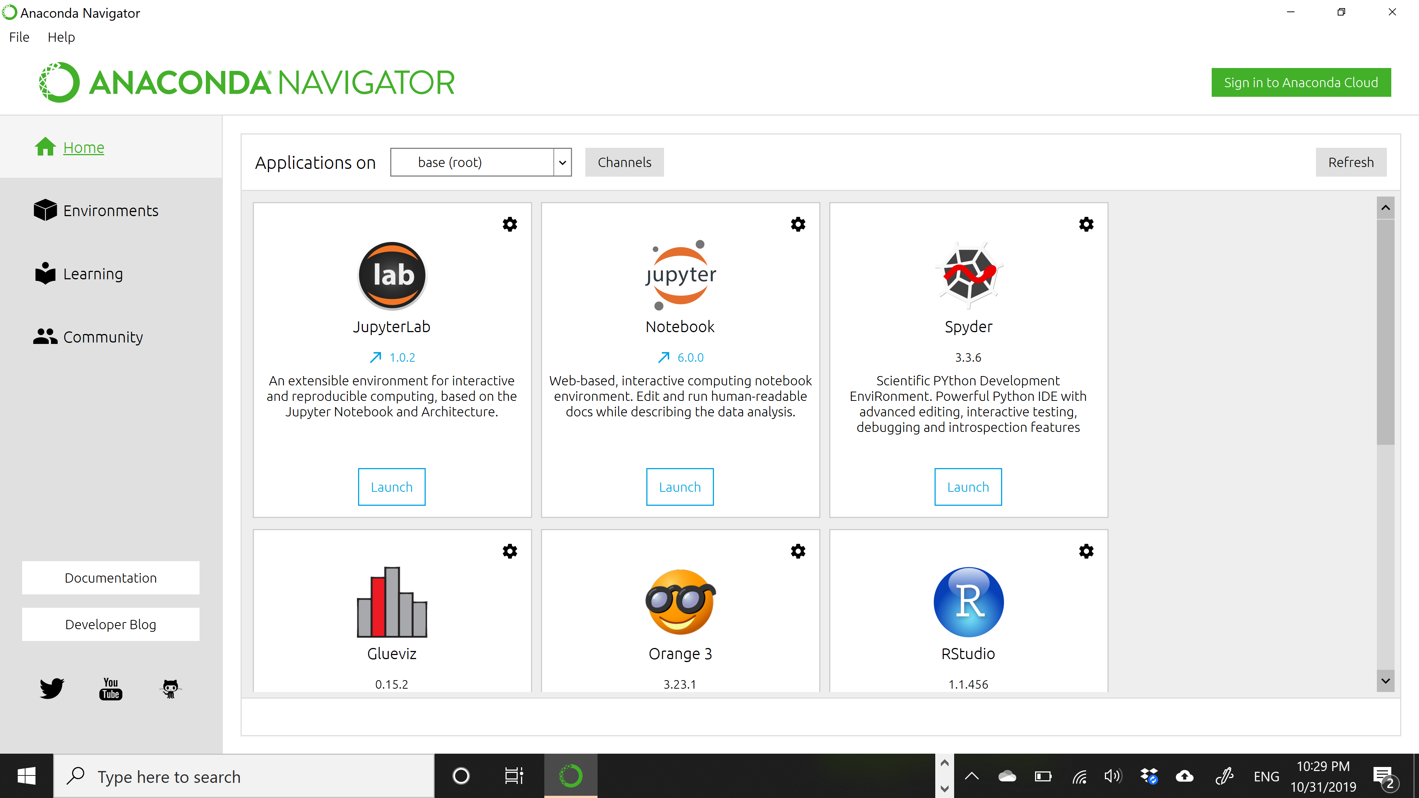
The Anaconda Navigator

Slide 7
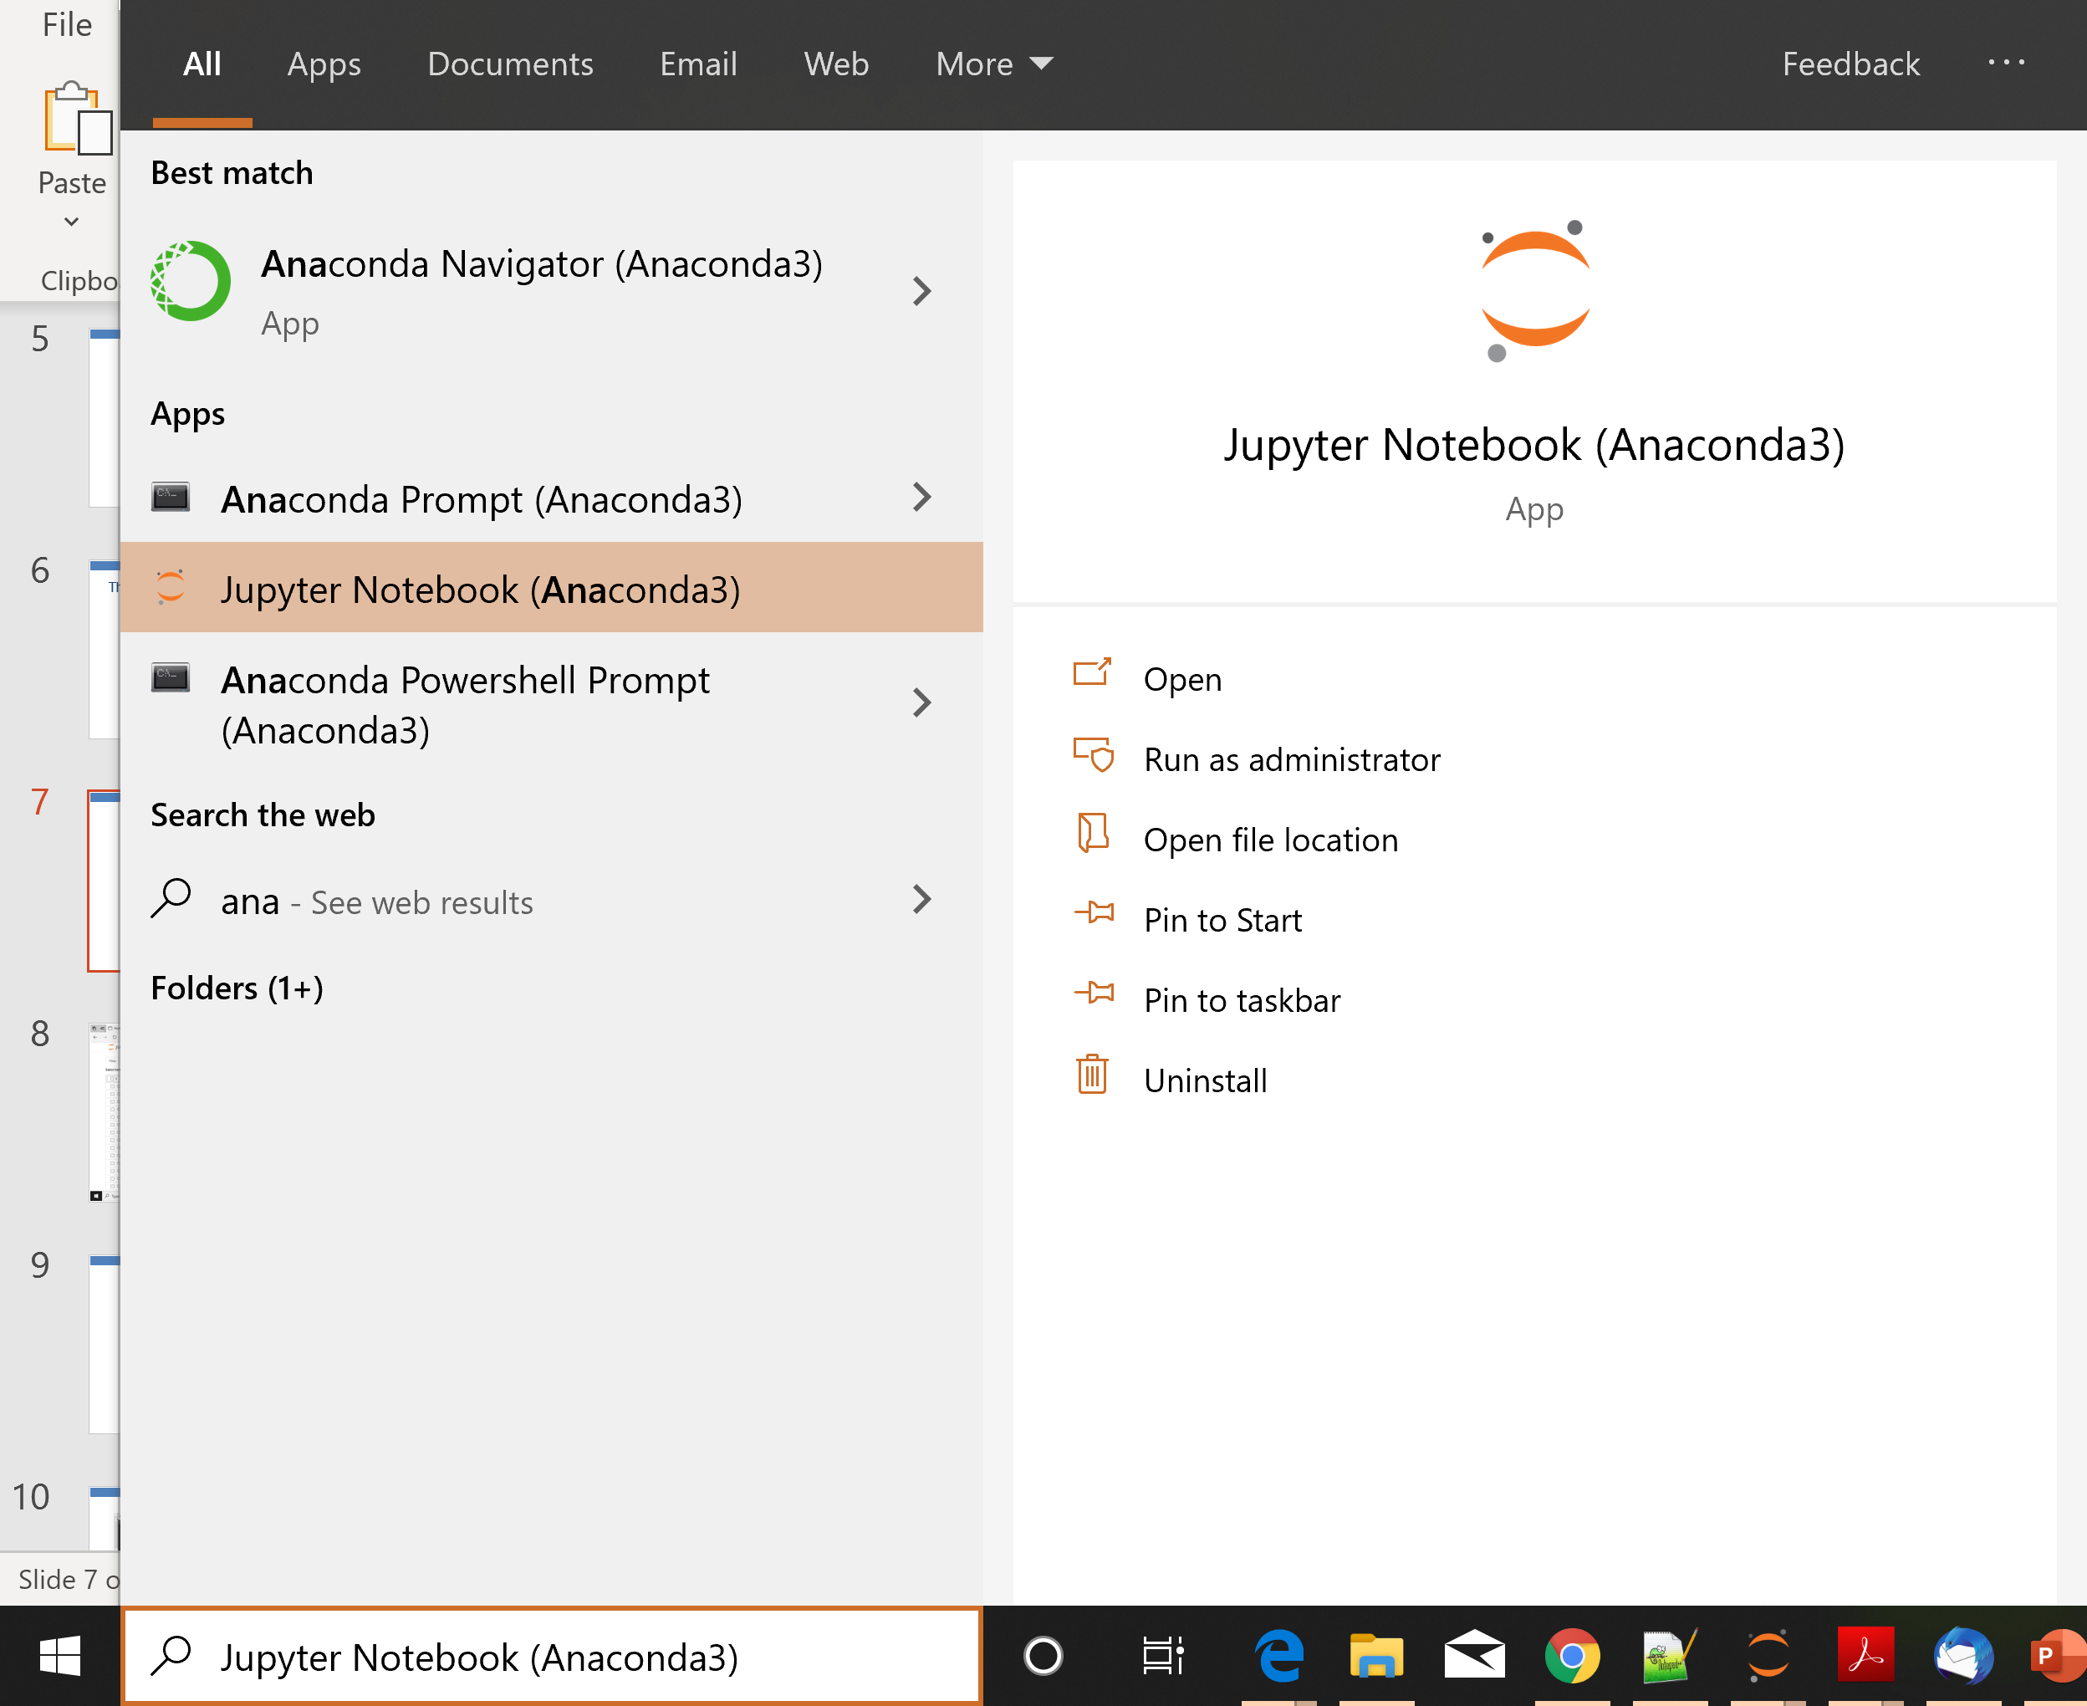

Slide 8
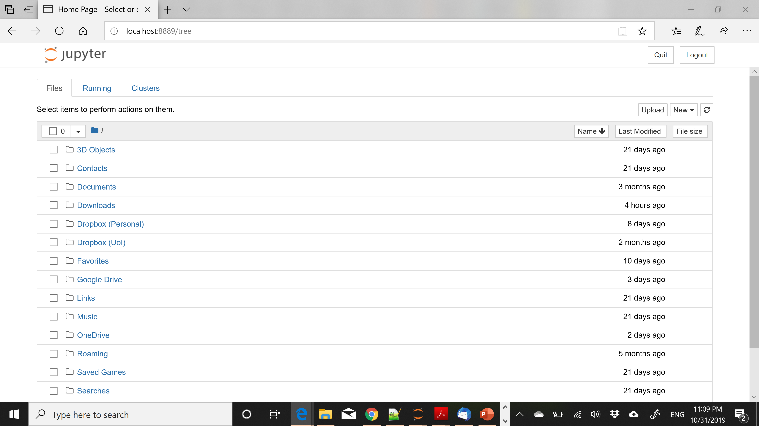

Slide 9
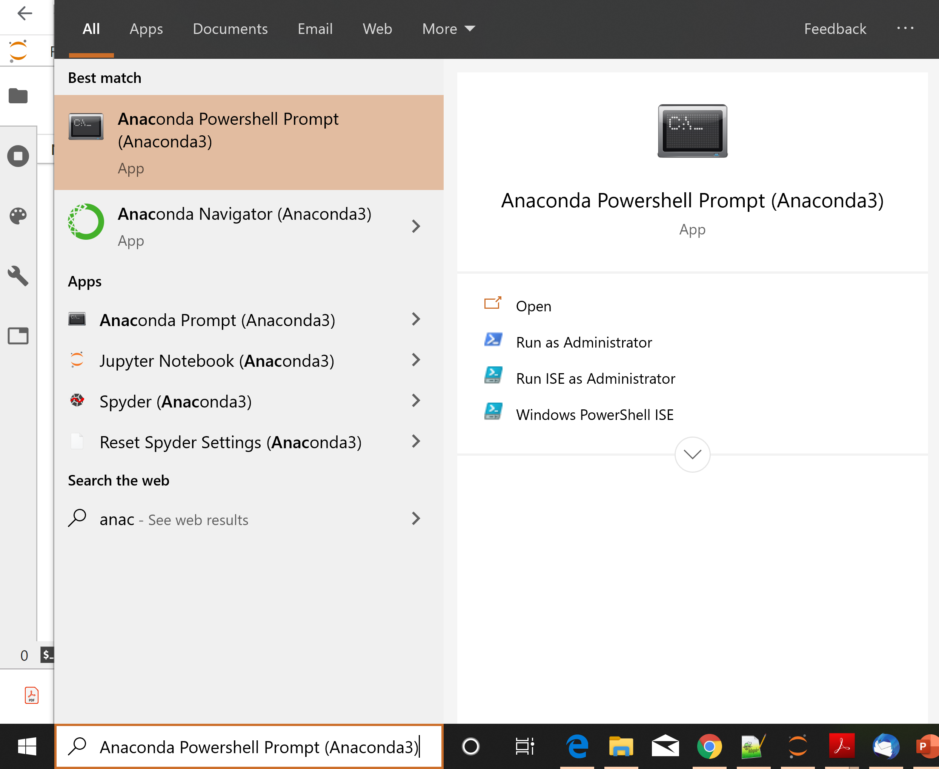

Slide 10
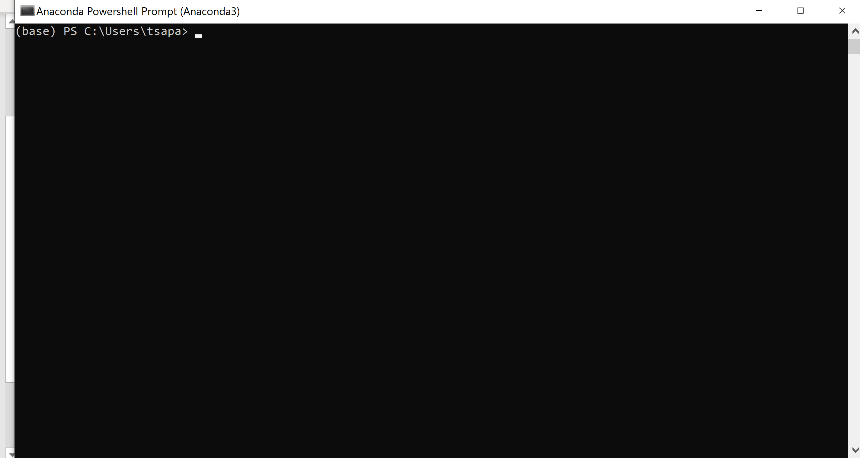

Slide 11
Installing Packages
You can install packages from the Anaconda terminal using the command:
conda install <name of package>
For example, Seaborn is a package for Statistical Data Visualization.
conda install seaborn
panda-datareader is a package for loading online datasets.
conda install pandas-datareader

Slide 12
Changing the notebook default directory
From the Anaconda terminal type the command:
jupyter notebook --generate-config
This will generate .jupiter/jupyter_notebook_config.py file under your home directory.
Find, un-comment and modify the line
# c.NotebookApp.notebook_dir = '‘ in the config file to point to the desired directory

Slide 13
Pandas
Python Data Analysis Library
A library for data analysis of (mostly) tabular data
Gives capabilities similar to Excel and SQL but also with some of the Matlab and R capabilities for data matrix manipulation.
In this class we will cover:
Data structures
Basic operations
Plotting
The full documentation here. The short version here.

