Slide 1
DATA MINING Classification
Nearest Neighbor Classification
Support Vector Machines
Logistic Regression
Naïve Bayes Classifier

Slide 2
Illustrating Classification Task

Slide 3
NEAREST NEIGHBOR CLASSIFICATION

Slide 4
Instance-Based Classifiers
Store the training records
Use training records to predict the class label of unseen cases

Slide 5
Instance Based Classifiers
Examples:
Rote-learner
Memorizes entire training data and performs classification only if attributes of record match one of the training examples exactly
Nearest neighbor classifier
Uses k “closest” points (nearest neighbors) for performing classification

Slide 6
Nearest Neighbor Classifiers
Basic idea:
“If it walks like a duck, quacks like a duck, then it’s probably a duck”
Compute Distance
Test Record
Training Records
Choose k of the “nearest” records

Slide 7
Nearest-Neighbor Classifiers
Requires three things
The set of stored records
Distance Metric to compute distance between records
The value of k, the number of nearest neighbors to retrieve
To classify an unknown record:
Compute distance to other training records
Identify k nearest neighbors
Use class labels of nearest neighbors to determine the class label of unknown record (e.g., by taking majority vote)

Slide 8
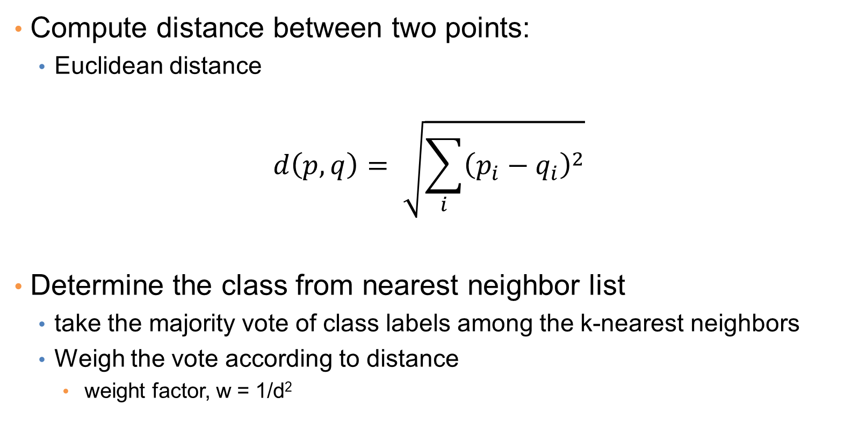
Nearest Neighbor Classification
Compute distance between two points:
Euclidean distance
$$d\left(p,q\right)= \sqrt{\sum_{i}{{\left(p_{i}−q_{i}\right)}^{2}}}$$
Determine the class from nearest neighbor list
take the majority vote of class labels among the k-nearest neighbors
Weigh the vote according to distance
weight factor, w = 1/d²

Slide 9
Definition of Nearest Neighbor
K-nearest neighbors of a record x are data points that have the k smallest distance to x

Slide 10
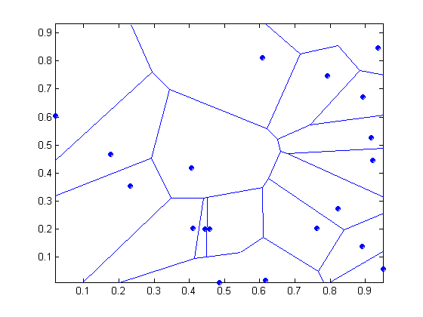
1 nearest-neighbor
Voronoi Diagram defines the classification boundary
The area takes the class of the green point

Slide 11
Nearest Neighbor Classification…
Choosing the value of k:
If k is too small, sensitive to noise points
If k is too large, neighborhood may include points from other classes
The value of k is the complexity of the model

Slide 12
Example

Slide 13
Example

Slide 14
Nearest Neighbor Classification…
Scaling issues
Attributes may have to be scaled to prevent distance measures from being dominated by one of the attributes
Example:
height of a person may vary from 1.5m to 1.8m
weight of a person may vary from 90lb to 300lb
income of a person may vary from $10K to $1M

Slide 15
Nearest Neighbor Classification…
Problem with Euclidean measure:
High dimensional data
curse of dimensionality
Can produce counter-intuitive results
1 1 1 1 1 1 1 1 1 1 1 0
1 0 0 0 0 0 0 0 0 0 0 0
vs
0 1 1 1 1 1 1 1 1 1 1 1
0 0 0 0 0 0 0 0 0 0 0 1
d = 1.4142
d = 1.4142
Solution: Normalize the vectors to unit length

Slide 16
Nearest neighbor Classification…
k-NN classifiers are lazy learners
It does not build models explicitly
Unlike eager learners such as decision trees
Classifying unknown records are relatively expensive
Naïve algorithm: O(n)
Need for structures to retrieve nearest neighbors fast.
The Nearest Neighbor Search problem.
Also, Approximate Nearest Neighbor Search

Slide 17
SUPPORT VECTOR MACHINES

Slide 18
Support Vector Machines
Find a linear hyperplane (decision boundary) that will separate the data

Slide 19
Support Vector Machines
One Possible Solution

Slide 20
Support Vector Machines
Another possible solution

Slide 21
Support Vector Machines
Other possible solutions

Slide 22
Support Vector Machines
Which one is better? B1 or B2?
How do you define better?

Slide 23
Support Vector Machines
Find hyperplane maximizes the margin => B1 is better than B2

Slide 24
Support Vector Machines

Slide 25
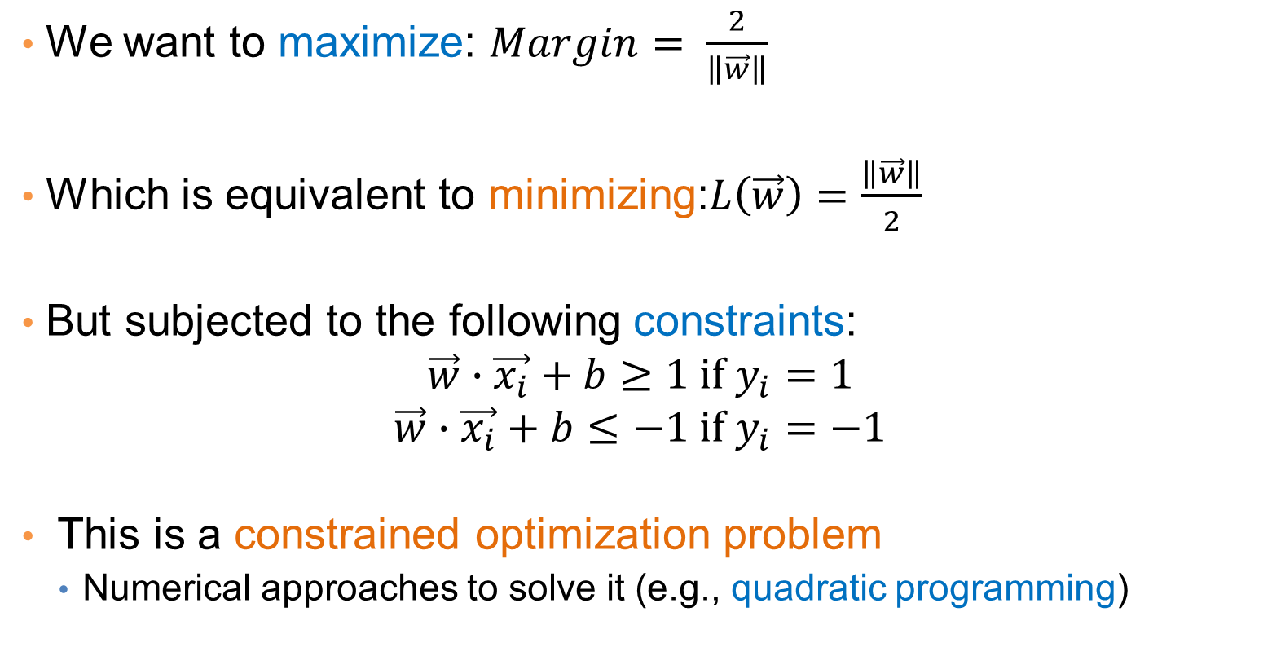
Support Vector Machines
We want to maximize: $Margin= \frac{2}{\left\|\vec{w}\right\|}$
Which is equivalent to minimizing:$L\left(\vec{w}\right)=\frac{\left\|\vec{w}\right\|}{2}$
But subjected to the following constraints:
$$\vec{w}∙\vec{x_{i}}+b≥1 if y_{i}=1$$
$$\vec{w}∙\vec{x_{i}}+b≤−1 if y_{i}=−1$$
This is a constrained optimization problem
Numerical approaches to solve it (e.g., quadratic programming)

Slide 26
Support Vector Machines
What if the problem is not linearly separable?

Slide 27


Support Vector Machines
What if the problem is not linearly separable?
$$\vec{w}⋅\vec{x}+b=−1+ξ_{i}$$
$$\frac{ξ_{i}}{\left\|w\right\|}$$

Slide 28
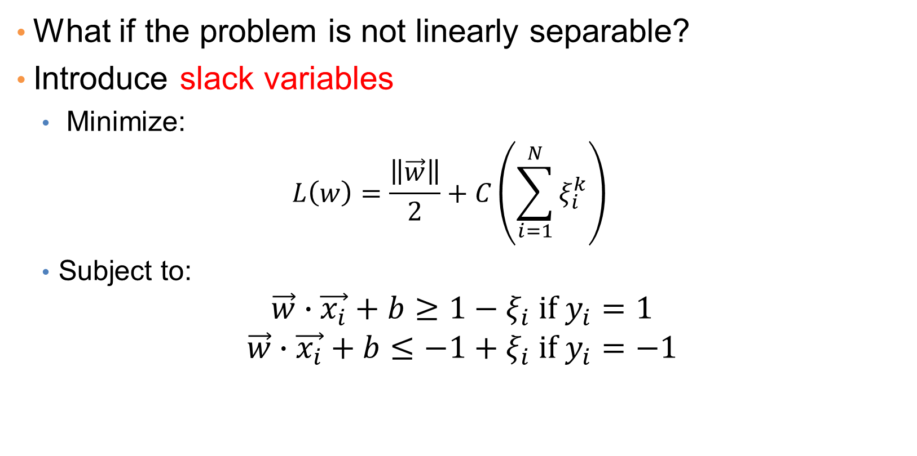
Support Vector Machines
What if the problem is not linearly separable?
Introduce slack variables
Minimize:
$$L\left(w\right)=\frac{\left\|\vec{w}\right\|}{2}+C\left(\sum_{i=1}^{N}{ξ_{i}^{k}}\right)$$
Subject to:
$$\vec{w}∙\vec{x_{i}}+b≥1−ξ_{i} if y_{i}=1$$
$$\vec{w}∙\vec{x_{i}}+b≤−1+ξ_{i} if y_{i}=−1$$

Slide 29
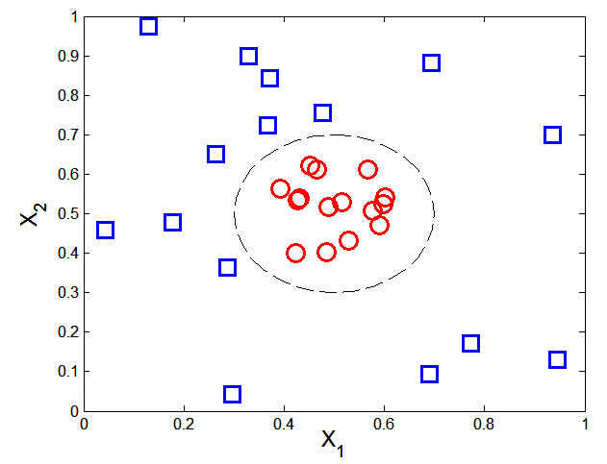

Nonlinear Support Vector Machines
What if decision boundary is not linear?

Slide 30
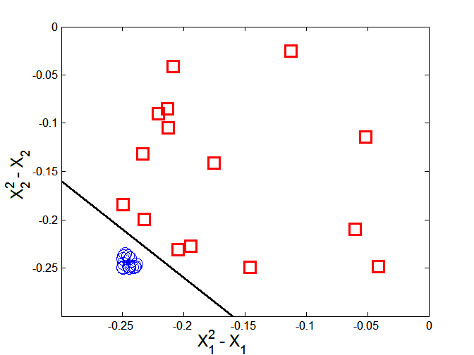



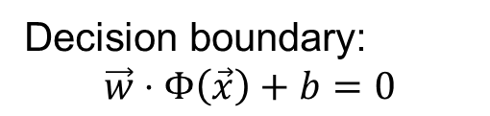
Nonlinear Support Vector Machines
Trick: Transform data into higher dimensional space
Decision boundary:
$$\vec{w}⋅Φ\left(\vec{x}\right)+b=0$$

Slide 31
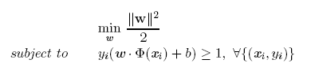

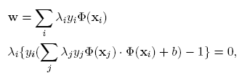


Learning Nonlinear SVM
Optimization problem:
Which leads to the same set of equations (but involve $(x)$ instead of $x$)

Slide 32

Learning NonLinear SVM
Issues:
What type of mapping function $$ should be used?
How to do the computation in high dimensional space?
Most computations involve dot product $\left(xi\right)⋅ Φ(xj)$
Curse of dimensionality?

Slide 33


Learning Nonlinear SVM
Kernel Trick:
$\left(xi\right)⋅ Φ(xj) = K(xi, xj)$
$K(xi, xj)$ is a kernel function (expressed in terms of the coordinates in the original space)
Examples:

Slide 34
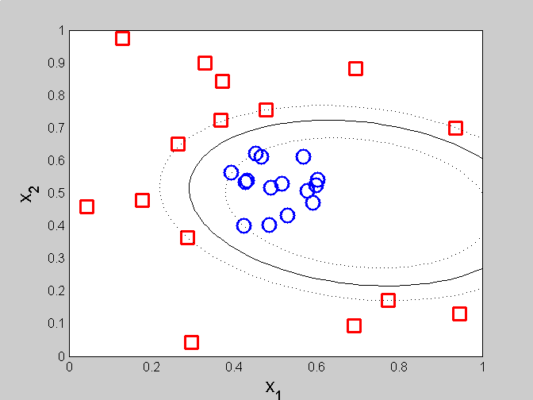
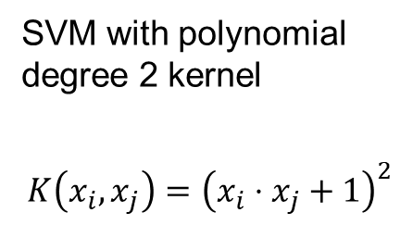
Example of Nonlinear SVM
SVM with polynomial degree 2 kernel
$$K\left(x_{i},x_{j}\right)={\left(x_{i}⋅x_{j}+1\right)}^{2}$$

Slide 35
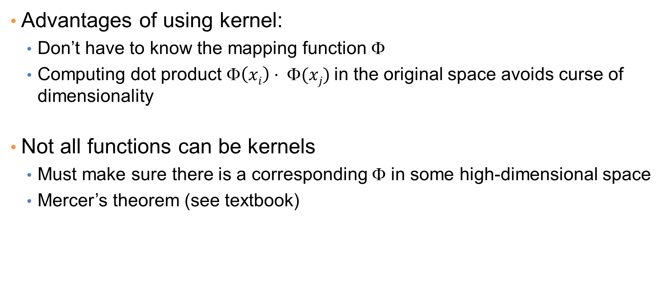
Learning Nonlinear SVM
Advantages of using kernel:
Don’t have to know the mapping function $$
Computing dot product $\left(xi\right)⋅ Φ(xj)$in the original space avoids curse of dimensionality
Not all functions can be kernels
Must make sure there is a corresponding Φ in some high-dimensional space
Mercer’s theorem (see textbook)

Slide 36
LOGISTIC REGRESSION

Slide 37
Classification via regression
Instead of predicting the class of a record we want to predict the probability of the class given the record
Transform the classification problem into a regression problem.
But how do you define the probability that you want to predict?

Slide 38
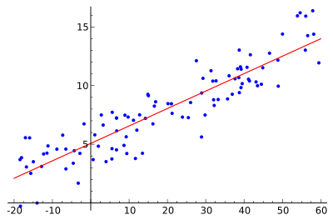
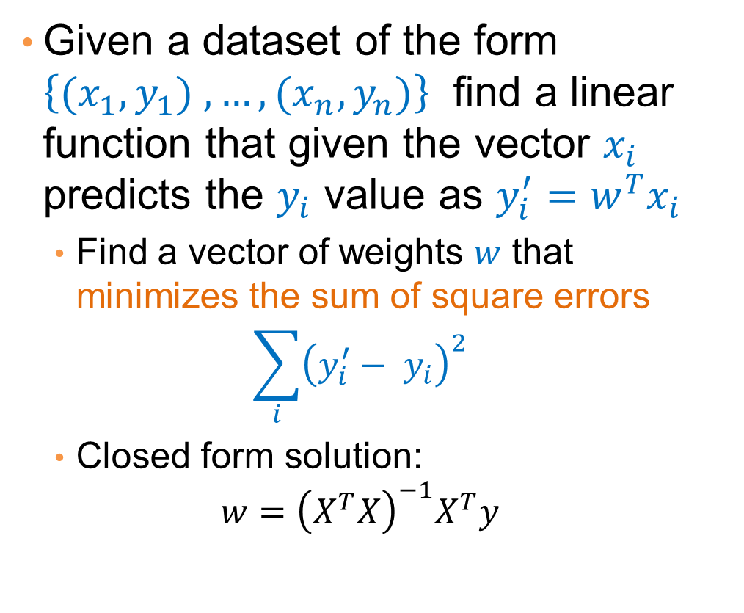
Linear regression
Given a dataset of the form $\left\{{(x}_{1},y_{1}) ,…,{(x}_{n},y_{n})\right\}$ find a linear function that given the vector $x_{i}$ predicts the $y_{i}$ value as $y_{i}^{′}=w^{T}x_{i}$
Find a vector of weights $w$ that minimizes the sum of square errors
$$\sum_{i}{{\left(y_{i}^{′}− y_{i}\right)}^{2}}$$
Closed form solution:
$$w={\left(X^{T}X\right)}^{−1}X^{T}y$$

Slide 39
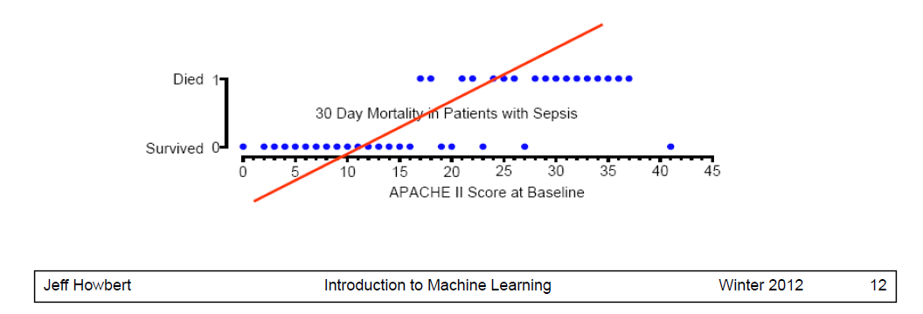
Linear regression
A simple approach: use linear regression to learn a linear function that predicts 0/1 values
Not good: It may produce negative probabilities, or probabilities that are greater than 1.

Slide 40





Class probabilities
Assume a linear classification boundary
$$w⋅x>0$$
For the positive class the bigger the value of $w⋅x$, the further the point is from the classification boundary, the higher our certainty for the membership to the positive class
Define $P(C_{+}|x)$ as an increasing function of $w⋅x$
$$w⋅x=0$$
For the negative class the smaller the value of $w⋅x$, the further the point is from the classification boundary, the higher our certainty for the membership to the negative class
Define $P(C_{−}|x)$ as a decreasing function of $w⋅x$
$$w⋅x<0$$

Slide 41
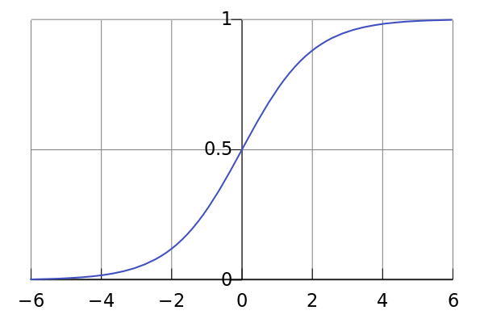
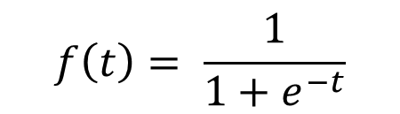
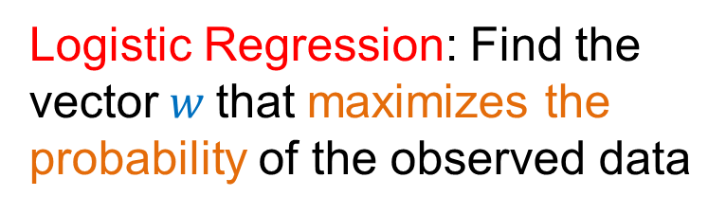
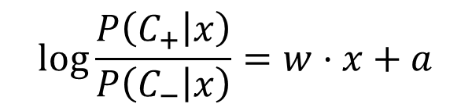
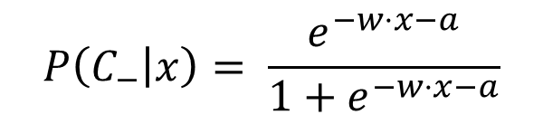
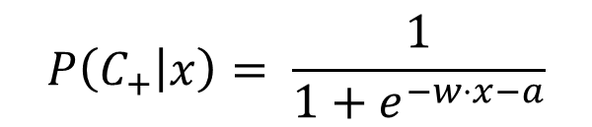
Logistic Regression
The logistic function
$$f\left(t\right)= \frac{1}{1+e^{−t}}$$
$$P\left(C_{+} | x\right)= \frac{1}{1+e^{−w⋅x−a}}$$
$$P\left(C_{−} | x\right)= \frac{e^{−w⋅x−a}}{1+e^{−w⋅x−a}}$$
$$\log{\frac{P\left(C_{+} | x\right)}{P\left(C_{−} | x\right)}}=w⋅x+a$$
Logistic Regression: Find the vector$w$that maximizes the probability of the observed data
Linear regression on the log-odds ratio

Slide 42
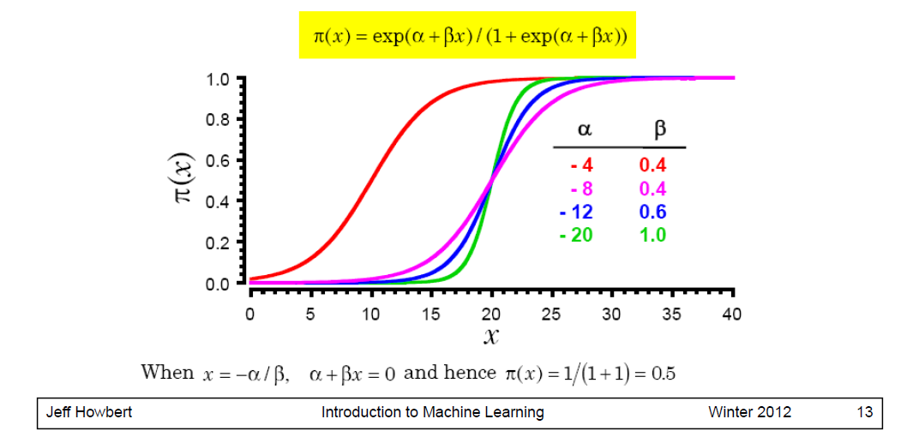
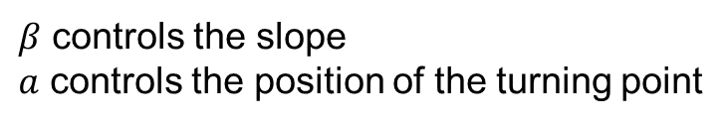
The logistic function
$β$ controls the slope
$a$ controls the position of the turning point

Slide 43
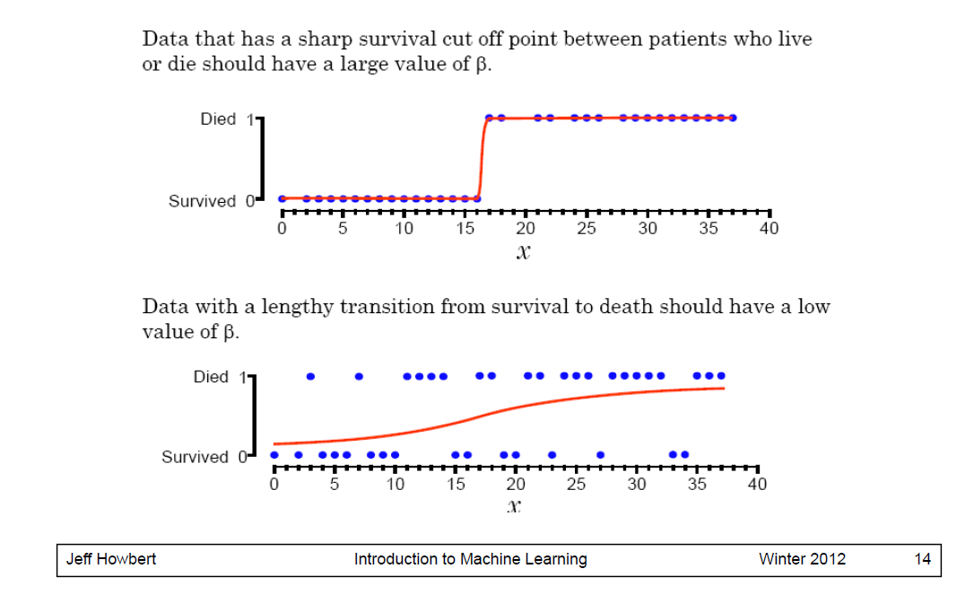
Logistic Regression in one dimension

Slide 44
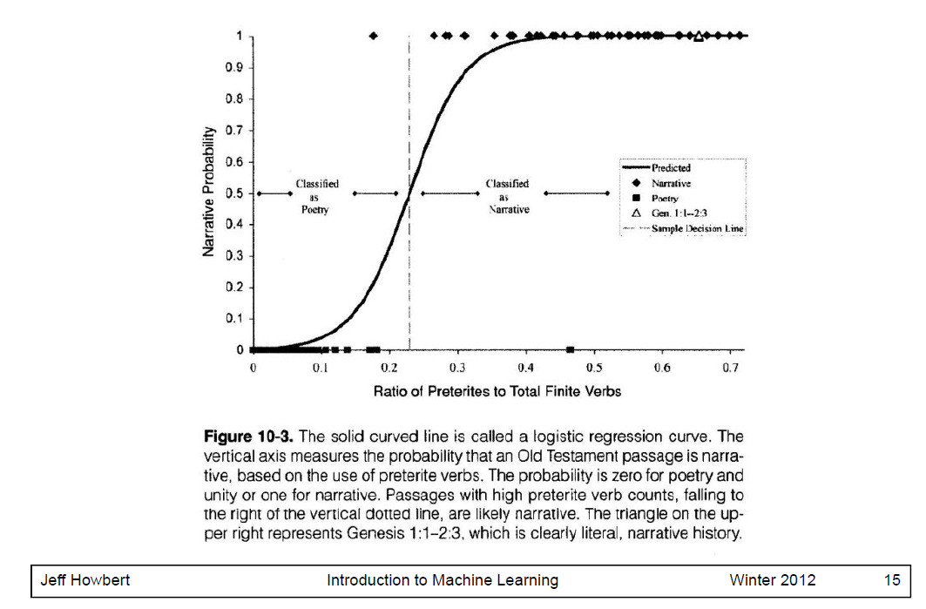
Logistic Regression in one dimension

Slide 45
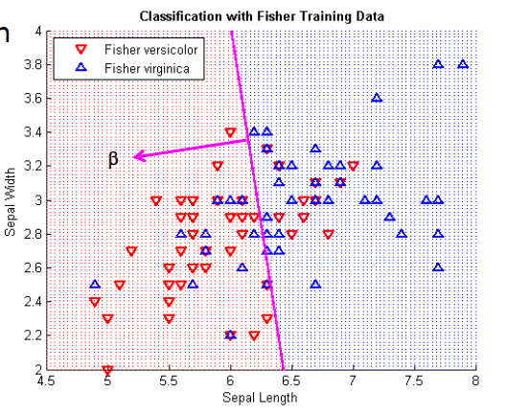
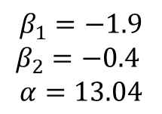
Logistic regression in 2-d
Coefficients
$$β_{1}=−1.9$$
$$β_{2}=−0.4$$
$$α=13.04$$

Slide 46
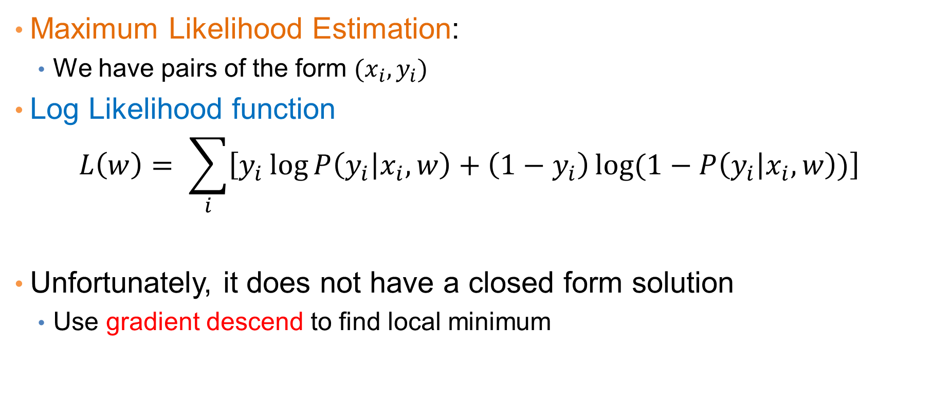
Estimating the coefficients
Maximum Likelihood Estimation:
We have pairs of the form $(x_{i},y_{i})$
Log Likelihood function
$$L\left(w\right)= \sum_{i}{\left[y_{i}\log{P\left(y_{i} | x_{i},w\right)+\left(1−y_{i}\right)\log{(1−P\left(y_{i} | x_{i},w\right))}}\right]}$$
Unfortunately, it does not have a closed form solution
Use gradient descend to find local minimum

Slide 47
Logistic Regression
Produces a probability estimate for the class membership which is often very useful.
The weights can be useful for understanding the feature importance.
Works for relatively large datasets
Fast to apply.

Slide 48
Introduction to Neural Networks
(Thanks to Philipp Koehn for the material borrowed from his slides)

Slide 49
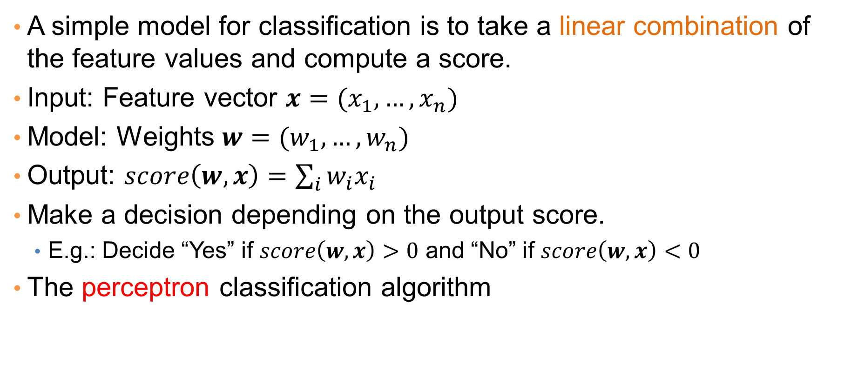
Linear Classification
A simple model for classification is to take a linear combination of the feature values and compute a score.
Input: Feature vector $x=(x_{1},…,x_{n})$
Model: Weights $w=(w_{1},…, w_{n})$
Output: $score\left(w,x\right)=\sum_{i}{w_{i}x_{i}}$
Make a decision depending on the output score.
E.g.: Decide “Yes” if $score\left(w,x\right)>0$ and “No” if $score\left(w,x\right)<0$
The perceptron classification algorithm

Slide 50











Linear Classification
We can represent this as a network
Edges correspond to weights
$$x_{1}$$
$$w_{1}$$
Input nodes correspond to features
$$x_{2}$$
$$w_{2}$$
$$x_{3}$$
$$w_{3}$$
$$score(w,x)$$
$$x_{4}$$
$$w_{4}$$
$$w_{5}$$
“Output” node with incoming edges computes the score
$$x_{5}$$

Slide 51
Linear models
Linear models partition the space according to a hyperplane
But they cannot model everything

Slide 52
Multiple layers
We can add more layers:
Each arrow has a weight
Nodes compute scores from incoming edges and give input to outgoing edges
Did we gain anything?

Slide 53
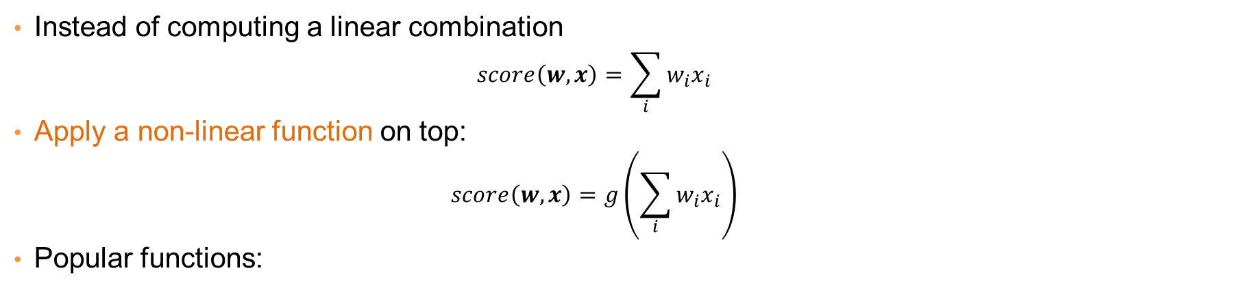
Non-linearity
Instead of computing a linear combination
$$score\left(w,x\right)=\sum_{i}{w_{i}x_{i}}$$
Apply a non-linear function on top:
$$score\left(w,x\right)=g\left(\sum_{i}{w_{i}x_{i}}\right)$$
Popular functions:
These functions play the role of a soft “switch” (threshold function)

Slide 54
Side note
Logistic regression classifier:
Single layer with a logistic function

Slide 55
Deep learning
Networks with multiple layers
Each layer can be thought of as a processing step
Multiple layers allow for the computation of more complex functions

Slide 56



Example
A network that implements XOR
Hidden node $h_{0}$ is OR
Output node $h_{1}−h_{0}$
Hidden node $h_{1}$ is AND
Bias term

Slide 57
Error
The computed value is 0.76 but the correct value is 1
There is an error in the computation
How do we set the weights so as to minimize this error?

Slide 58
Gradient Descent
The error is a function of the weights
We want to find the weights that minimize the error
Compute gradient: gives the direction to the minimum
Adjust weights, moving at the direction of the gradient.

Slide 59
Gradient Descent

Slide 60
Gradient Descent

Slide 61
Backpropagation
How can we compute the gradients? Backpropagation!
Main idea:
Start from the final layer: compute the gradients for the weights of the final layer.
Use these gradients to compute the gradients of previous layers using the chain rule
Propagate the error backwards
Backpropagation essentially is an application of the chain rule for differentiation.

Slide 62


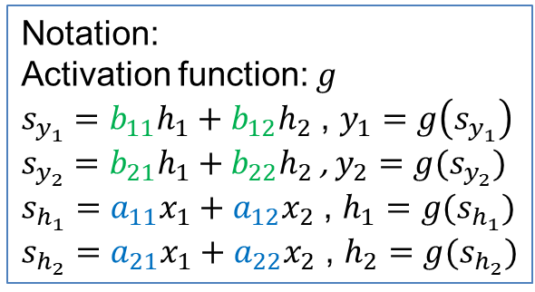





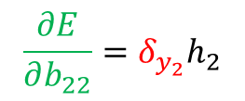

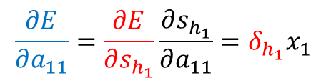
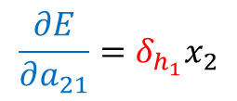


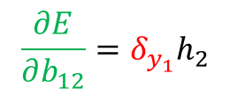



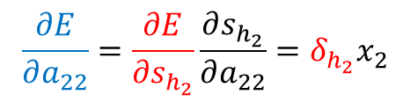

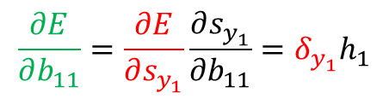



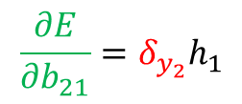

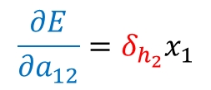
$$a_{11}$$
$$b_{11}$$
$$x_{1}$$
$$h_{1}$$
$$y_{1}$$
Error: $E={\left\|y−t\right\|}^{2}={\left(y_{1}−t_{1}\right)}^{2}+{\left(y_{2}−t_{2}\right)}^{2}$
$$a_{12}$$
$$b_{12}$$
$$\frac{∂E}{∂b_{11}}=\frac{∂E}{∂s_{y_{1}}}\frac{∂s_{y_{1}}}{∂b_{11}}=δ_{y_{1}}h_{1}$$
$$a_{21}$$
$$b_{21}$$
$$x_{2}$$
$$a_{22}$$
$$h_{2}$$
$$y_{2}$$
$$b_{22}$$
$δ_{y_{1}}$= $\frac{∂E}{∂s_{y_{1}}}$= $\frac{∂E}{∂y_{1}}\frac{∂y_{1}}{∂s_{y_{1}}}=2\left(y_{1}−t_{1}\right)g′(s_{y_{1}})$
Notation:
Activation function: $g$
$s_{y_{1}}=b_{11}h_{1}+b_{12}h_{2}$ , $y_{1}=g\left(s_{y_{1}}\right)$
$s_{y_{2}}=b_{21}h_{1}+b_{22}h_{2}$ , $y_{2}=g(s_{y_{2}})$
$s_{h_{1}}=a_{11}x_{1}+a_{12}x_{2}$ , $h_{1}=g(s_{h_{1}})$
$s_{h_{2}}=a_{21}x_{1}+a_{22}x_{2}$ , $h_{2}=g(s_{h_{2}})$
$$\frac{∂E}{∂b_{21}}=δ_{y_{2}}h_{1}$$
$δ_{y_{2}}$= $\frac{∂E}{∂s_{y_{2}} }$= $2\left(y_{2}−t_{2}\right)g′(s_{y_{2}})$
$$\frac{∂E}{∂b_{12}}=δ_{y_{1}}h_{2}$$
$$\frac{∂E}{∂b_{22}}=δ_{y_{2}}h_{2}$$
$$\frac{∂E}{∂a_{11}}=\frac{∂E}{∂s_{h_{1}}}\frac{∂s_{h_{1}}}{∂a_{11}}=δ_{h_{1}}x_{1}$$
$$\frac{∂E}{∂a_{22}}=\frac{∂E}{∂s_{h_{2}}}\frac{∂s_{h_{2}}}{∂a_{22}}=δ_{h_{2}}x_{2}$$
$$\frac{∂E}{∂a_{21}}=δ_{h_{1}}x_{2}$$
$$\frac{∂E}{∂a_{12}}=δ_{h_{2}}x_{1}$$
$$δ_{h_{1}}=\frac{∂E}{∂s_{h_{1}}}=\frac{∂E}{∂h_{1}}\frac{∂h_{1}}{∂s_{h_{1}}}=\left(\frac{∂E}{∂s_{y_{1}}}\frac{∂s_{y_{1}}}{∂h_{1}}+\frac{∂E}{∂s_{y_{2}}}\frac{∂s_{y_{2}}}{∂h_{1}}\right)g^{′}\left(s_{h_{1}}\right)=\left(δ_{y_{1}}b_{11}+δ_{y_{2}}b_{21}\right)g′(s_{h_{1}})$$
$$δ_{h_{2}}=\left(δ_{y_{1}}b_{12}+δ_{y_{2}}b_{22}\right)g′(s_{h_{2}})$$

Slide 63






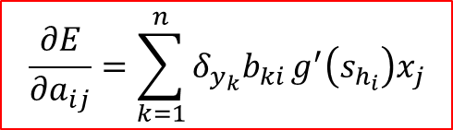

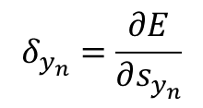
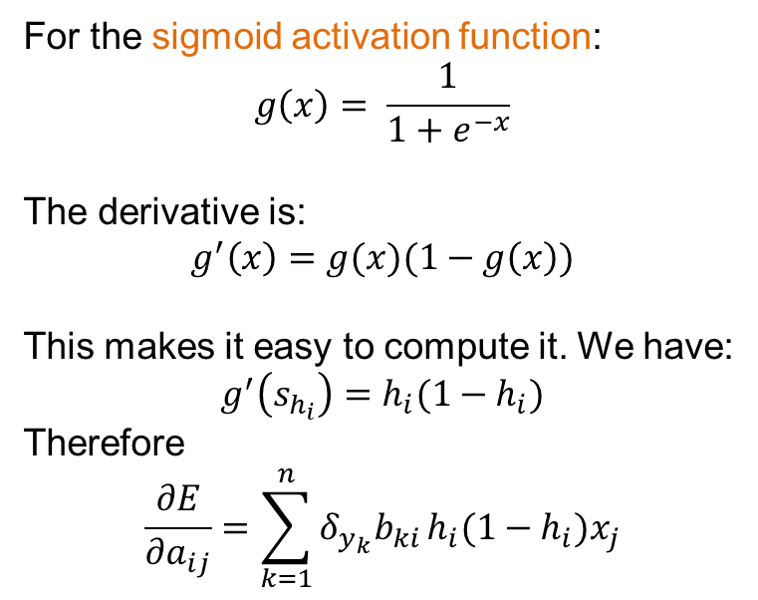



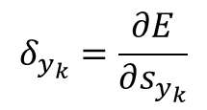

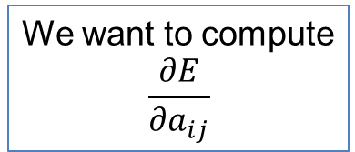




Backpropagation
We have already computed the $δ_{y_{k}}$’s
$$δ_{y_{1}}=\frac{∂E}{∂s_{y_{1}}}$$
$$δ_{y_{k}}=\frac{∂E}{∂s_{y_{k}}}$$
$$δ_{y_{n}}=\frac{∂E}{∂s_{y_{n}}}$$
$$\frac{∂E}{∂a_{ij}}=\sum_{k=1}^{n}{δ_{y_{k}}b_{ki}}g^{′}\left(s_{h_{i}}\right)x_{j}$$
$$y_{1}$$
$$y_{k}$$
$$y_{n}$$
$$s_{y_{1}}$$
$$s_{y_{k}}$$
$$s_{y_{n}}$$
For the sigmoid activation function:
$$g\left(x\right)= \frac{1}{1+e^{−x}}$$
The derivative is:
$$g^{′}\left(x\right)=g(x)(1−g\left(x\right))$$
This makes it easy to compute it. We have:
$$g^{′}\left(s_{h_{i}}\right)=h_{i}(1−h_{i})$$
Therefore
$$\frac{∂E}{∂a_{ij}}=\sum_{k=1}^{n}{δ_{y_{k}}b_{ki}}h_{i}(1−h_{i})x_{j}$$
$$b_{1i}$$
$$b_{ki}$$
$$b_{ni}$$
We want to compute
$$\frac{∂E}{∂a_{ij}}$$
$$h_{i}$$
$$s_{h_{i}}$$
$$a_{ij}$$
$$x_{j}$$

Slide 64
Stochastic gradient descent
Ideally the loss should be the average loss over all training data.
We would need to compute the loss for all training data every time we update the gradients.
However, this is expensive.
Stochastic gradient descent: Consider one input point at the time. Each point is considered only once.
Intermediate solution: Use mini-batches of data points.

Slide 65
Word EMBeddings
Thanks to Chris Manning for the slides

Slide 66
Basic Idea
You can get a lot of value by representing a word by means of its neighbors
“You shall know a word by the company it keeps”
(J. R. Firth 1957: 11)
One of the most successful ideas of modern statistical NLP
government debt problems turning into banking crises as has happened in
saying that Europe needs unified banking regulation to replace the hodgepodge
 These words will represent banking 

Slide 67

Basic idea
Define a model that aims to predict between a center word w_{c} and context words in some window of length m in terms of word vectors
$P\left(w_{c} \right|w_{c−m, }{…, w}_{c−1, }w_{c+1}…, w_{c+m}$)
Pairwise probabilities
Independence assumption (bigram model)
$P(w_{1}$, $w_{2}$, …, $w_{n}$) = $\prod_{i=2}^{n}{P(w_{i}|w_{i−1})}$
Notes:
The central new idea is that you change the word representation, as well as the other parameters of the model.
I’m going to directly and concretely build one, concrete prediction models. You may already know of some other things you might do, and we’ll come back to other possibilities next week, but this way of doing it is one of the best ways known.

Slide 68


Slide 69
Word2Vec
Predict between every word and its context words
Two algorithms
Skip-grams (SG)
Predict context words given the center word
Continuous Bag of Words (CBOW)
Predict center word from a bag-of-words context
Position independent (do not account for distance from center)
Tomas Mikolov, Ilya Sutskever, Kai Chen, Gregory S. Corrado, Jeffrey Dean: Distributed Representations of Words and Phrases and their Compositionality. NIPS 2013: 3111-3119

Slide 70
CBOW
Use a window of context words to predict the center word
Learn two matrices (N size of embedding, |V| number of words)
W
Embedding of the i-th word when center word
N
W’
i
i
Embedding of the i-th word when context word
N
|V|
|V|
N x |V| center embeddings
when output
|V| x N context embeddings
when input

Slide 71

CBOW
Given window size m
$x^{(c)}$ one hot vector for context words, y one hot vector for the center word
1. Input: the one hot vectors for the 2m context words
$x^{(c−m)}$, …, $x^{(c−1)},x^{(c+1)}$, …, $x^{(c+m)}$
2. Compute the embeddings of the context words
$v_{c−m}{=Wx}^{(c−m)}$, …, $v_{c−1}{=Wx}^{(c−1)},v_{c+1}{=Wx}^{(c+1)}$, …,${ v}_{c+m}{=Wx}^{(c+m)}$
3. Average these vectors
$\hat{v}$ = $\frac{v_{c−m}+v_{c−m+1}+…v_{c+m}}{2m}$, $\hat{v}∈R^{N}$
4. Generate a score vector
$z = W′ \hat{v}$
dot product, (embedding of center word) similar vectors close to each other
5. Turn the score vector to probabilities
$\hat{y}$ = softmax(z)
We want this to be close to 1 for the center word

Slide 72

Exponentiate to make positive
Softmax
$$p_{i}= \frac{e^{u_{i}}}{\sum_{j}{e^{u_{j}}}}$$
Normalize to give probability

Slide 73

E.g. “The cat sat on floor”
Window size = 2
the
cat
sat
on
floor

Slide 74
Input layer
0
Index of cat in vocabulary
1
0
cat
0
Hidden layer
Output layer
0
0
0
0
one-hot
vector
0
0
…
0
0
0
one-hot
vector
0
sat
0
0
0
0
1
0
…
on
1
0
0
0
0
0
…
0

Slide 75



Input layer
We must learn W and W’
0
1
0
Output layer
cat
0
$$W_{V×N}$$
Hidden layer
0
0
0
0
V-dim
0
0
…
0
0
$${W′}_{N×V}$$
0
0
sat
0
0
0
0
1
0
$$W_{V×N}$$
N-dim
…
on
1
0
0
V-dim
0
0
0
V-dim
…
N will be the size of word vector
0

Slide 76






$$W_{V×N}^{T} ×x_{cat}=v_{cat}$$
0.1 | 2.4 | 1.6 | 1.8 | 0.5 | 0.9 | … | … | … | 3.2
0.5 | 2.6 | 1.4 | 2.9 | 1.5 | 3.6 | … | … | … | 6.1
… | … | … | … | … | … | … | … | … | …
… | … | … | … | … | … | … | … | … | …
0.6 | 1.8 | 2.7 | 1.9 | 2.4 | 2.0 | … | … | … | 1.2
0
2.4
2.6
…
…
1.8
1
0
0
$$×$$
0
$$=$$
0
0
0
…
0
Input layer
0
1
0
Output layer
x_{cat}
0
0
0
$$W_{V×N}^{T}×x_{cat}=v_{cat}$$
0
0
0
0
V-dim
…
0
0
$$\hat{v}=\frac{v_{cat}+v_{on}}{2}$$
0
+
0
sat
0
0
0
0
$$W_{V×N}^{T}×x_{on}=v_{on}$$
1
x_{on}
0
…
V-dim
1
Hidden layer
0
0
0
0
N-dim
0
V-dim
…
0

Slide 77






$$W_{V×N}^{T} ×x_{on}=v_{on}$$
0.1 | 2.4 | 1.6 | 1.8 | 0.5 | 0.9 | … | … | … | 3.2
0.5 | 2.6 | 1.4 | 2.9 | 1.5 | 3.6 | … | … | … | 6.1
… | … | … | … | … | … | … | … | … | …
… | … | … | … | … | … | … | … | … | …
0.6 | 1.8 | 2.7 | 1.9 | 2.4 | 2.0 | … | … | … | 1.2
0
1.8
2.9
…
…
1.9
0
0
1
$$×$$
0
$$=$$
0
0
0
…
0
Input layer
0
1
0
x_{cat}
0
Output layer
0
0
$$W_{V×N}^{T}×x_{cat}=v_{cat}$$
0
0
0
0
V-dim
…
0
0
$$\hat{v}=\frac{v_{cat}+v_{on}}{2}$$
0
+
0
sat
0
0
0
0
$$W_{V×N}^{T}×x_{on}=v_{on}$$
1
0
…
V-dim
x_{on}
1
Hidden layer
0
0
0
N-dim
0
0
V-dim
…
0

Slide 78






Input layer
0
1
0
cat
0
$$W_{V×N}$$
Hidden layer
Output layer
0
0
0
0
0
0
V-dim
…
0
0
$$W_{V×N}^{′}×\hat{v}=z$$
0
$$\hat{y}=softmax(z)$$
0
0
0
0
0
$$\hat{v}$$
1
0
$$W_{V×N}$$
…
on
1
N-dim
0
0
${\hat{y}}_{sat}$
0
0
V-dim
0
V-dim
…
N will be the size of word vector
0

Slide 79







Input layer
0
We would prefer $\hat{y}$ close to ${\hat{y}}_{sat}$
1
0
cat
0
$$W_{V×N}$$
Hidden layer
Output layer
0
0
0.01
0.02
0.00
0.02
0.01
0.02
0.01
0.7
…
0.00
0
0
0
0
V-dim
…
0
0
0
$$W_{V×N}^{′}×\hat{v}=z$$
$$\hat{y}=softmax(z)$$
0
0
0
0
0
$$\hat{v}$$
1
0
$$W_{V×N}$$
…
1
N-dim
0
on
0
${\hat{y}}_{sat}$
0
0
V-dim
0
V-dim
…
N will be the size of word vector
$\hat{y}$
0

Slide 80




$$W_{V×N}^{T}$$
Input layer
0.1 | 2.4 | 1.6 | 1.8 | 0.5 | 0.9 | … | … | … | 3.2
0.5 | 2.6 | 1.4 | 2.9 | 1.5 | 3.6 | … | … | … | 6.1
… | … | … | … | … | … | … | … | … | …
… | … | … | … | … | … | … | … | … | …
0.6 | 1.8 | 2.7 | 1.9 | 2.4 | 2.0 | … | … | … | 1.2
Contain word’s vectors
0
1
0
x_{cat}
0
Output layer
0
0
$$W_{V×N}^{}$$
0
0
0
0
V-dim
…
0
0
$$W_{V×N}^{′}$$
0
0
sat
0
0
0
0
$$W_{V×N}^{}$$
1
0
…
V-dim
1
Hidden layer
0
x_{on}
0
0
N-dim
0
0
V-dim
…
0
We can consider either W (context) or W’ (center) as the word’s representation.
Or even take the average.
Notes:
W contains input word vectors.
W’ contains output word vectors.
We can consider either W or W’ as the word’s representation. Or even take the average.

Slide 81

Skipgram
Given the center word, predict (or, generate) the context words
W: N x |V|, input matrix, word representation as center word
W’: |V| x N, output matrix, word representation as context word
$y^{(j)}$ one hot vector for context words
Get one hot vector of the center word $x$
2. Get the embedding of the center word
$v_{c}=W x$
3. Generate a score vector for each context word
$z = W′ v_{c}$
5. Turn the score vector into probabilities
$\hat{y}$ = softmax(z)
We want this to be close to 1 for the context words

Slide 82


Slide 83


Skipgram
For each word t = 1 … T, predict surrounding words in a window of “radius” m of every word.
Objective function: Maximize the probability of any context word given the current center word:
where θ represents all variables we will optimize
$$J^{′}\left(θ\right)=\prod_{t=1}^{T}{\prod_{\begin{aligned}−m≤j≤m \\ j≠0\end{aligned}}{p\left(w_{t+j} | w_{t};θ\right)}}$$
likelihood
$$J\left(θ\right)=−\frac{1}{T}\sum_{t=1}^{T}{\sum_{\begin{aligned}−m≤j≤m \\ j≠0\end{aligned}}{\log{p\left(w_{t+j} | w_{t};θ\right)}}}$$
Negative
Log Likelihood

Slide 84

The basic skipgram utilizes the softmax function:
$$p\left(c | w\right)=\frac{\exp\left({v_{c}^{′}}^{T}v_{w}\right)}{\sum_{i=1}^{T}{exp⁡(}{v_{i}^{′}}^{T}v_{w})}$$
Where:
T – # of words in the corpus.
$v_{w}$ - input vector of w.
${v′}_{w}$ - output vector of w.
Word | Input | Output
King | [0.2,0.9,0.1] | [0.5,0.4,0.5]
Queen | [0.2,0.8,0.2] | [0.4,0.5,0.5]
Apple | [0.9,0.5,0.8] | [0.3,0.9,0.1]
Orange | [0.9,0.4,0.9] | [0.1,0.7,0.2]

Slide 85
An example

Slide 86
These representations are very good at encoding similarity and dimensions of similarity!
Analogies testing dimensions of similarity can be solved quite well just by doing vector subtraction in the embedding space
Syntactically
x_{apple} − x_{apples} ≈ x_{car} − x_{cars} ≈ x_{family} − x_{families}
Similarly for verb and adjective morphological forms
Semantically (Semeval 2012 task 2)
x_{shirt} − x_{clothing} ≈ x_{chair} − x_{furniture}
x_{king} − x_{man} ≈ x_{queen} − x_{woman}

Slide 87


Test for linear relationships, examined by Mikolov et al.
a:b :: c:?
man:woman :: king:?
+
king
[ 0.30 0.70 ]
king
−
man
[ 0.20 0.20 ]
+
woman
[ 0.60 0.30 ]
woman
queen
[ 0.70 0.80 ]
man

Slide 88
NAÏVE BAYES CLASSIFIER

Slide 89

Bayes Classifier
A probabilistic framework for solving classification problems
A, C random variables
Joint probability: Pr(A=a,C=c)
Conditional probability: Pr(C=c | A=a)
Relationship between joint and conditional probability distributions
$$\operatorname{Pr}\left(C,A\right)=\operatorname{Pr}\left(C | A\right)P\left(A\right)=P\left(A | C\right)P(C)$$
Bayes Theorem:
$$P\left(C | A\right)=\frac{P\left(A | C\right)P(C)}{P(A)}$$

Slide 90
Bayesian Classifiers
How to classify the new record X = (‘Yes’, ‘Single’, 80K)
Find the class with the highest probability given the vector values.
Maximum Aposteriori Probability estimate:
Find the value c for class C that maximizes P(C=c| X)
How do we estimate P(C|X) for the different values of C?
We want to estimate P(C=Yes| X)
and P(C=No| X)

Slide 91




Bayesian Classifiers
In order for probabilities to be well defined:
Consider each attribute and the class label as random variables
Probabilities are determined from the data
Evade C
Event space: {Yes, No}
$$P(C) = (0.3, 0.7)$$
Refund A₁
Event space: {Yes, No}
$$P(A1) = (0.3,0.7)$$
Martial Status A₂
Event space: {Single, Married, Divorced}
$$P(A2) = (0.4,0.4,0.2)$$
Taxable Income A₃
Event space: R
$$P(A3) \sim Normal(μ,σ2)$$
$μ = 104$:sample mean, $2=1874$:sample var

Slide 92

Bayesian Classifiers
Approach:
compute the posterior probability $P(C | A1, A2, …, An)$using the Bayes theorem
$$P\left(C | A_{1},A_{2},…,A_{n}\right)=\frac{P\left(A_{1},A_{2},…,A_{n} | C\right)P(C)}{P(A_{1},A_{2},…,A_{n})}$$
Maximizing
$$P(C | A1, A2, …, An)$$ is equivalent to maximizing $$P(A1, A2, …, An|C) P(C)$$
The value $P(A_{1},…,A_{n})$ is the same for all values of $C$.
How to estimate $P(A1, A2, …, An | C )?$

Slide 93

Naïve Bayes Classifier
Assume conditional independence among attributes $Ai$ when class C is given:
$P(A_{1},A_{2},…,A_{n}|C)= P(A_{1}|C) P(A_{2}\left|C\right)⋯P(A_{n}|C)$
We can estimate $P(Ai| C)$from the data.
New point $X=(A_{1}=α_{1}, …,A_{n}=α_{n})$is classified to class c if
$P\left(C=c | X\right)=P\left(C=c\right)\prod_{i}{P(A_{i}=α_{i}|c)}$
is maximum over all possible values of C.

Slide 94
Example
Record
X = (Refund = Yes, Status = Single, Income =80K)
For the class C = ‘Evade’, we want to compute:
P(C = Yes|X) and P(C = No| X)
We compute:
P(C = Yes|X) = P(C = Yes)*P(Refund = Yes |C = Yes)
*P(Status = Single |C = Yes)
*P(Income =80K |C= Yes)
P(C = No|X) = P(C = No)*P(Refund = Yes |C = No)
*P(Status = Single |C = No)
*P(Income =80K |C= No)

Slide 95

How to Estimate Probabilities from Data?
Class Prior Probability:
$P\left(C=c\right)= \frac{N_{c}}{N }$
$Nc$: Number of records with class c
$N$ = Number of records
P(C = No) = 7/10
P(C = Yes) = 3/10

Slide 96

How to Estimate Probabilities from Data?
Discrete attributes:
$$P\left(A_{i}=a | C=c\right)=\frac{N_{a,c}}{N_{c}}$$
$N_{a,c}$: number of instances having attribute $A_{i}=a$and belong to class $c$
$N_{c}$: number of instances of class $c$

Slide 97

How to Estimate Probabilities from Data?
Discrete attributes:
$$P\left(A_{i}=a | C=c\right)=\frac{N_{a,c}}{N_{c}}$$
$N_{a,c}$: number of instances having attribute $A_{i}=a$and belong to class $c$
$N_{c}$: number of instances of class $c$
P(Refund = Yes|No) = 3/7

Slide 98

How to Estimate Probabilities from Data?
Discrete attributes:
$$P\left(A_{i}=a | C=c\right)=\frac{N_{a,c}}{N_{c}}$$
$N_{a,c}$: number of instances having attribute $A_{i}=a$and belong to class $c$
$N_{c}$: number of instances of class $c$
P(Refund = Yes|Yes) = 0

Slide 99

How to Estimate Probabilities from Data?
Discrete attributes:
$$P\left(A_{i}=a | C=c\right)=\frac{N_{a,c}}{N_{c}}$$
$N_{a,c}$: number of instances having attribute $A_{i}=a$and belong to class $c$
$N_{c}$: number of instances of class $c$
P(Status=Single|No) = 2/7

Slide 100

How to Estimate Probabilities from Data?
Discrete attributes:
$$P\left(A_{i}=a | C=c\right)=\frac{N_{a,c}}{N_{c}}$$
$N_{a,c}$: number of instances having attribute $A_{i}=a$and belong to class $c$
$N_{c}$: number of instances of class $c$
P(Status=Single|Yes) = 2/3

Slide 101

How to Estimate Probabilities from Data?
Normal distribution:
One for each $(A_{i},c_{j})$pair
For Class=No
sample mean μ = 110
sample variance σ²= 2975
For Income = 80

Slide 102

How to Estimate Probabilities from Data?
Normal distribution:
One for each$(A_{i},c_{j})$pair
For Class=Yes
sample mean μ = 90
sample variance σ²= 2975
For Income = 80

Slide 103
Example
Record
X = (Refund = Yes, Status = Single, Income =80K)
We compute:
P(C = Yes|X) = P(C = Yes)*P(Refund = Yes |C = Yes)
*P(Status = Single |C = Yes)
*P(Income =80K |C= Yes)
= 3/10* 0 * 2/3 * 0.01 = 0
P(C = No|X) = P(C = No)*P(Refund = Yes |C = No)
*P(Status = Single |C = No)
*P(Income =80K |C= No)
= 7/10 * 3/7 * 2/7 * 0.0062 = 0.0005

Slide 104
Example of Naïve Bayes Classifier
Creating a Naïve Bayes Classifier, essentially means to compute counts:
Total number of records: N = 10
Class No:
Number of records: 7
Attribute Refund:
Yes: 3
No: 4
Attribute Marital Status:
Single: 2
Divorced: 1
Married: 4
Attribute Income:
mean: 110
variance: 2975
Class Yes:
Number of records: 3
Attribute Refund:
Yes: 0
No: 3
Attribute Marital Status:
Single: 2
Divorced: 1
Married: 0
Attribute Income:
mean: 90
variance: 25

Slide 105
Example of Naïve Bayes Classifier
Given a Test Record:
X = (Refund = Yes, Status = Single, Income =80K)
P(X|Class=No) = P(Refund=Yes|Class=No) × P(Married| Class=No) × P(Income=120K| Class=No) = 3/7 * 2/7 * 0.0062 = 0.00075
P(X|Class=Yes) = P(Refund=No| Class=Yes) × P(Married| Class=Yes) × P(Income=120K| Class=Yes) = 0 * 2/3 * 0.01 = 0
P(No) = 0.3, P(Yes) = 0.7
Since P(X|No)P(No) > P(X|Yes)P(Yes)
Therefore P(No|X) > P(Yes|X) => Class = No

Slide 106

Naïve Bayes Classifier
If one of the conditional probabilities is zero, then the entire expression becomes zero
Laplace Smoothing:
$$P\left(A_{i}=a | C=c\right)= \frac{N_{ac}+1}{N_{c}+N_{i}}$$
$Ni$: number of attribute values for attribute $Ai$

Slide 107
Example of Naïve Bayes Classifier
Creating a Naïve Bayes Classifier, essentially means to compute counts:
With Laplace Smoothing
Total number of records: N = 10
Class No:
Number of records: 7
Attribute Refund:
Yes: 3
No: 4
Attribute Marital Status:
Single: 2
Divorced: 1
Married: 4
Attribute Income:
mean: 110
variance: 2975
Class Yes:
Number of records: 3
Attribute Refund:
Yes: 0
No: 3
Attribute Marital Status:
Single: 2
Divorced: 1
Married: 0
Attribute Income:
mean: 90
variance: 25

Slide 108
Example of Naïve Bayes Classifier
Given a Test Record:
With Laplace Smoothing
X = (Refund = Yes, Status = Single, Income =80K)
P(X|Class=No) = P(Refund=No|Class=No) × P(Married| Class=No) × P(Income=120K| Class=No) = 4/9 × 3/10 × 0.0062 = 0.00082
P(X|Class=Yes) = P(Refund=No| Class=Yes) × P(Married| Class=Yes) × P(Income=120K| Class=Yes) = 1/5 × 3/6 × 0.01 = 0.001
P(No) = 0.7, P(Yes) = 0.3
P(X|No)P(No) = 0.0005
P(X|Yes)P(Yes) = 0.0003
=> Class = No

Slide 109

Implementation details
Computing the conditional probabilities involves multiplication of many very small numbers
Numbers get very close to zero, and there is a danger of numeric instability
We can deal with this by computing the logarithm of the conditional probability
$$\log{P\left(C | A\right)\sim \log{P\left(A | C\right)+\log{P\left(C\right)}}}$$
$$=\sum_{i}{\log{P\left(A_{i} | C\right)}+\log{P(C)}}$$

Slide 110


Naïve Bayes for Text Classification
Naïve Bayes is commonly used for text classification
For a document with k terms $d=(t_{1},…, t_{k})$
$$P\left(c | d\right)=P\left(c\right)P(d|c)=P(c)\prod_{t_{i}∈d}{P(t_{i}|c)}$$
$P\left(t_{i} | c\right)$= Fraction of terms from all documents in c that are$t_{i}$.
$$P\left(t_{i} | c\right)= \frac{N_{ic}+1}{N_{c}+T}$$
Easy to implement and works relatively well
Limitation: Hard to incorporate additional features (beyond words).
E.g., number of adjectives used.
Fraction of documents in c
Number of times $t_{i}$ appears in all documents in c
Laplace Smoothing
Number of unique words
(vocabulary size)
Total number of terms in all documents in c

Slide 111

Multinomial document model
Probability of document $d=\left(t_{1},…, t_{k}\right)$ in class c:
$$P(d|c)=P(c)\prod_{t_{i}∈d}{P(t_{i}|c)}$$
This formula assumes a multinomial distribution for the document generation:
If we have probabilities $p_{1},…, p_{T}$ for events $t_{1},…, t_{T}$ the probability of a subset of these is
$$P\left(d\right)= \frac{N}{N_{t_{1}}!N_{t_{2}}!⋯N_{t_{T}}!}p_{1}^{N_{t_{1}}}p_{2}^{N_{t_{2}}}⋯p_{T}^{N_{t_{T}}}$$
Equivalently: There is an automaton spitting words from the above distribution
w

Slide 112


Slide 113
Example
News titles for Politics and Sports
Politics
Sports
“Obama meets Merkel”
“Obama elected again”
“Merkel visits Greece again”
“OSFP European basketball champion”
“Miami NBA basketball champion”
“Greece basketball coach?”
documents
P(p) = 0.5
P(s) = 0.5
terms
obama:2, meets:1, merkel:2, elected:1, again:2, visits:1, greece:1
OSFP:1, european:1, basketball:3, champion:2, miami:1, nba:1, greece:1, coach:1
Vocabulary size: 14
Total terms: 10
Total terms: 11
New title:
X = “Obama likes basketball”
P(Politics|X) ~ P(p)*P(obama|p)*P(likes|p)*P(basketball|p)
= 0.5 * 3/(10+14) *1/(10+14) * 1/(10+14) = 0.000108
P(Sports|X) ~ P(s)*P(obama|s)*P(likes|s)*P(basketball|s)
= 0.5 * 1/(11+14) *1/(11+14) * 4/(11+14) = 0.000128

Slide 114
Naïve Bayes (Summary)
Robust to isolated noise points
Handle missing values by ignoring the instance during probability estimate calculations
Robust to irrelevant attributes
Independence assumption may not hold for some attributes
Use other techniques such as Bayesian Belief Networks (BBN)
Naïve Bayes can produce a probability estimate, but it is usually a very biased one
Logistic Regression is better for obtaining probabilities.

Slide 115



Generative vs Discriminative models
Naïve Bayes is a type of a generative model
Generative process:
First pick the category of the record
Then given the category, generate the attribute values from the distribution of the category
Conditional independence given C
We use the training data to learn the distribution of the values in a class
C
$$A_{1}$$
$$A_{2}$$
$$A_{n}$$

Slide 116
Generative vs Discriminative models
Logistic Regression and SVM are discriminative models
The goal is to find the boundary that discriminates between the two classes from the training data
In order to classify the language of a document, you can
Either learn the two languages and find which is more likely to have generated the words you see
Or learn what differentiates the two languages.

Slide 117
Supervised Learning

Slide 118
Learning
Supervised Learning: learn a model from the data using labeled data.
Classification and Regression are the prototypical examples of supervised learning tasks. Other are possible (e.g., ranking)
Unsupervised Learning: learn a model – extract structure from unlabeled data.
Clustering and Association Rules are prototypical examples of unsupervised learning tasks.
Semi-supervised Learning: learn a model for the data using both labeled and unlabeled data.

Slide 119
Supervised Learning Steps
Model the problem
What is you are trying to predict? What kind of optimization function do you need? Do you need classes or probabilities?
Extract Features
How do you find the right features that help to discriminate between the classes?
Obtain training data
Obtain a collection of labeled data. Make sure it is large enough, accurate and representative. Ensure that classes are well represented.
Decide on the technique
What is the right technique for your problem?
Apply in practice
Can the model be trained for very large data? How do you test how you do in practice? How do you improve?

Slide 120
Modeling the problem
Sometimes it is not obvious. Consider the following three problems
Detecting if an email is spam
Categorizing the queries in a search engine
Ranking the results of a web search
Predicting the reply to a question.

Slide 121
Feature extraction
Feature extraction, or feature engineering is the most tedious but also the most important step
How do you separate the players of the Greek national team from those of the Swedish national team?
One line of thought: throw features to the classifier and the classifier will figure out which ones are important
More features, means that you need more training data
Another line of thought: Feature Selection: Select carefully the features using various functions and techniques
Computationally intensive
Deep Neural Networks
They use raw data for classification
They learn a representation from the data

Slide 122
Training data
An overlooked problem: How do you get labeled data for training your model?
E.g., how do you get training data for ranking?
Chicken and egg problem
Usually requires a lot of manual effort and domain expertise and carefully planned labeling
Results are not always of high quality (lack of expertise)
And they are not sufficient (low coverage of the space)
Recent trends:
Find a source that generates the labeled data for you, or use the data themselves for the prediction task
Crowd-sourcing techniques

Slide 123
Dealing with small amounts of labeled data
Semi-supervised learning techniques have been developed for this purpose.
Self-training: Train a classifier on the data, and then feed back the high-confidence output of the classifier as input
Co-training: train two “independent” classifiers and feed the output of one classifier as input to the other.
Regularization: Treat learning as an optimization problem where you define relationships between the objects you want to classify, and you exploit these relationships
Example: Image restoration

Slide 124
Technique
The choice of technique depends on the problem requirements (do we need a probability estimate?) and the problem specifics (does independence assumption hold? do we think classes are linearly separable?)
For many cases finding the right technique may be trial and error
For many cases the exact technique does not matter.

Slide 125

Big Data Trumps Better Algorithms
If you have enough data then the algorithms are not so important
The web has made this possible.
Especially for text-related tasks
Search engine uses the collective human intelligence
Google lecture: Theorizing from the Data

Slide 126
Apply-Test
How do you scale to very large datasets?
Distributed computing – map-reduce implementations of machine learning algorithms (Mahaut, over Hadoop)
How do you test something that is running online?
You cannot get labeled data in this case
A/B testing
How do you deal with changes in data?
Active learning

