Slide 1
Online Social Networks and Media
Link Prediction, Classification,
Graph Embeddings

Slide 2


Graph embeddings: what are they?
node
vec
u
$$f:u→ℝ^{d}$$
$$ℝ^{d}$$
Feature representation, embedding
Map nodes to d-dimensional vectors so that:
“similar” nodes in the graph have embeddings that are close together.

Slide 3
Example
  Zachary’s Karate Club Network:
Input
Output
Image from: Perozzi et al.. DeepWalk: Online Learning of Social Representations. KDD 2014.

Slide 4
Graph embeddings: why?
Machine learning lifecycle
Raw Data
Structured Data
Learning Algorithm
Model
Feature Engineering
Downstream
prediction task
degree, PageRank, motifs, degrees of neighbors, Pagerank of neighbors, etc

Slide 5
Graph embeddings: why?
Machine learning lifecycle
Raw Data
Structured Data
Learning Algorithm
Model
Feature Engineering
Downstream
prediction task
degree, PageRank, motifs, degree of neighbors, Pagerank of neighbors, etc
Automatically learn the features (embeddings)

Slide 6
Machine Learning tasks in networks
Link prediction and link recommendations
Node labeling
Community detection (we have already seen an approach)
Network similarity

Slide 7
Link Prediction

Slide 8
Motivation
Recommending new friends in online social networks, suggesting interactions or collaborations, predicting hidden connections (e.g., terrorist),
In social networks:
Increases user engagement
Controls the growth of the network

Slide 9
Outline
Estimating a score for each edge (seminal work of Liben-Nowell&Kleinberg)
Classification approach
The who to follow service at Twitter (one more application of link analysis)

Slide 10
Problem Definition
Link prediction problem: Given the links in a social network at time t (G_{old}), predict the edges that will be added to the network during the time interval from time t to a given future time t’ (G_{new}).
Based solely on the topology of the network (social proximity) (the more general problem also considers attributes of the nodes and links)
Different from the problem of inferring missing (hidden) links (there is a temporal aspect)
  To save experimental effort in the laboratory or in the field

Slide 11
Approach
Assign a connection weight score(x, y) to each pair of nodes <x, y> based on the input graph
Produce a ranked list of edges in decreasing order of score
Recommend the ones with the highest score
Note
We can consider all links incident to a specific node x, and recommend to x the top ones
If we focus to a specific x, the score can be seen as a centrality measure for x

Slide 12
How to define the score
How to assign the score(x, y) between two nodes x and y?
Some form of similarity or node proximity
Two general methods
Neighbors
Paths

Slide 13
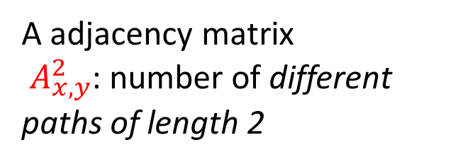
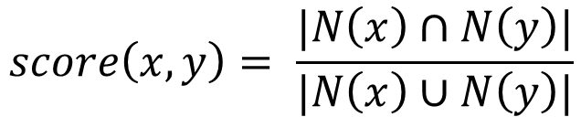

Neighborhood-based metrics
The larger the overlap of the neighbors of two nodes, the more likely the nodes to be linked in the future
Common neighbors:
A adjacency matrix
$A_{x,y}^{2}$: number of different paths of length 2
$$score\left(x, y\right)=\left|N\left(x\right)∩N\left(y\right)\right|$$
Jaccard coefficient:
The probability that both x and y have a feature from a randomly selected feature that either x or y has
$$score\left(x, y\right)= \frac{|N\left(x\right)∩N\left(y\right)|}{|N\left(x\right)∪N\left(y\right)|}$$

Slide 14
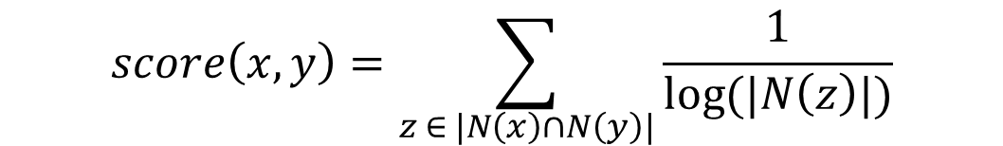
Neighborhood-based metrics
Adamic Adar:
$$score\left(x, y\right)=\sum_{z ∈ |N\left(x\right)∩N\left(y\right)|}{\frac{1}{log⁡(|N\left(z\right)|)}}$$
  Weighted version: common neighbors which themselves have few neighbors get larger weights (larger weights to rare features)
Neighbors who are linked with 2 nodes are assigned weight = 1/log(2)
Neighbors who are linked with 5 nodes are assigned weight = 1/log(5)
Note: |N(x)| = degree of x, inverse logarithmic centrality

Slide 15
Neighborhood-based metrics
Preferential attachment:
$$score\left(x, y\right)=\left|N\left(x\right)\right||N\left(y\right)|$$
Nodes like to form ties with ‘popular’ nodes
  E.g., empirical evidence suggest that co-authorship is correlated with the product of the neighborhood sizes
  Fall-back strategy: recommending popular users
Depends on the degrees of the nodes not on their neighbors per se

Slide 16
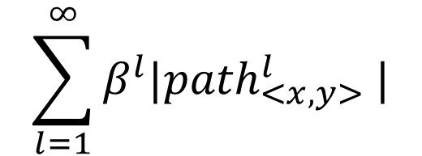
Path-based methods
score(x, y) = (negated) length of shortest path between x and y
Not just the shortest, but all paths between two nodes
Katz_{β} measure:
$$\sum_{l=1}^{∞}{β^{l}{|path}_{<x,y>}^{l} |}$$
Sum over all paths of length l
0 < β < 1 parameter of the predictor, exponentially damped to count short paths more heavily

Slide 17

Path-based methods
Katz_{β} measure:
$\sum_{l=1}^{∞}{β^{l}{|path}_{<x,y>}^{l} |}=βΑ_{xy}+β^{2}A_{xy}^{2}+β^{3}A_{xy}^{3}$+ …
$${(Ι−βΑ)}^{−1} − Ι$$
0 < β < 1
  Small β much like common neighbors
  β small: degree, β maximal: eigenvalue
  Weighted version

Slide 18
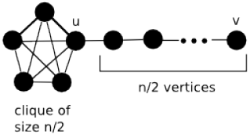

Path-based methods
Based on random walks that starts at x
Hitting Time H_{x,y} from x to y: the expected number of steps it takes for the random walk starting at x to reach y.
score(x, y) = − H_{x,y}
Commute Time C_{x,y} from x to y: the expected number of steps to travel from x to y and from y to x
score(x, y) = − (H_{x,y} + H_{y,x})
Not symmetric, can be shown

Slide 19
Path-based methods
Example: hit time h_{1,n} in a line
1
i-1 i i+1
n
Stationary-normed versions:
to counteract the fact that H_{x,y} is rather small when y is a node with a large stationary probability regardless of x
score(x, y) = − H_{x,y} π_{y}
score(x, y) = −(H_{x,y} π_{y} + H_{y,x} π_{x})
Personalized (or, Rooted) PageRank: with probability (1 – a) moves to a random neighbor and with probability a returns to x
score(x, y) = stationary probability of y in a personalized PageRank
Notes:
Recursive equation for h_i,i+1 when in i equal probability to go to i-1 and i+1 If to i+1 hit time = 1, If to i-1 hit time = 1+h_i-1,i (go back to i) + h_i,i,+1
2i-1 solves the recursive equation – Sum from i = 1 to n-1 gives us O(n^2)

Slide 20
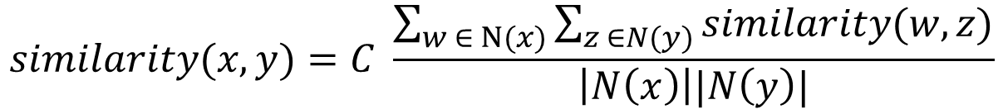
SimRank
Two objects are similar, if they are related to similar objects
x and y are similar, if they are related to objects w and z respectively and w and z are themselves similar
$$similarity(x, y)=C \frac{\sum_{w ∈ Ν(x)}{\sum_{z ∈N(y)}{similarity(w, z)}}}{\left|N\left(x\right)\right||N\left(y\right)|}$$
Base case: similarity(x, x) = 1
score(x, y) = similarity(x, y)

Slide 21
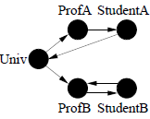
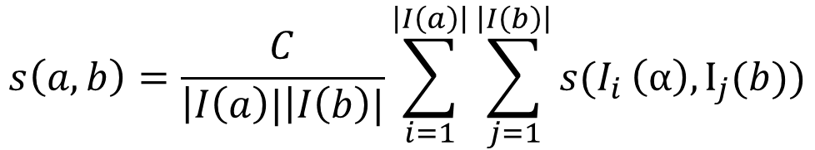
SimRank
Introduced for directed graphs: two objects are similar if referenced by similar objects
$$s\left(a, b\right)=\frac{C}{\left|I\left(a\right)|\right|I\left(b\right)|}\sum_{i=1}^{\left|I\left(a\right)\right|}{\sum_{j=1}^{\left|I\left(b\right)\right|}{s(I_{i}}}\left(α\right), Ι_{j}(b))$$
Average similarity between in-neighbors of a and in-neighbors of b
I(x): in-neighbors of x, C: constant between 0 and 1, decay
s(a, b) = 1, if a =b
Iterative computation
s₀(x, y) = 1 if x = y and 0 otherwise
s_{k+1} based on the s_{k} values of its (in-neighbors) computed at iteration k
Notes:
Univ -> similarity of ProfA and ProfB, sim of Prof A and Prof B-> sim of studA and StudB, sim of StudA and StudB sim of Univ and Prof B, etc

Slide 22
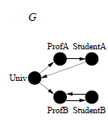
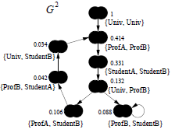
SimRank: the Pair Graph
Pair graph G²
A node for each pair of nodes
An edge (x, y) → (a, b), if x → a and y → b
a value per node: similarity of the corresponding pairs
Computation starts at singleton nodes (score = 1)
Scores flow from a node to its neighbors
C gives the rate of decay as similarity flows across edges (C = 0.8 in the example)
Symmetric pairs: (a, b) node same as (b, a) node (with the union of associated edges)
Omit singleton that do not contribute to score (no {ProfA, ProfA} node) and nodes with 0 score {ProfA, StudentA})
Self-loops and cycles reinforce similarity
Prune: by considering only nodes within a radius

Slide 23
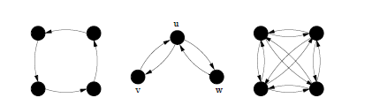
SimRank and random walks
Expected Meeting Distance (EMD) m (a, b) between a and b: the expected number of steps required before two random surfers, one starting at a and the other starting at b, would meet if they walked the graph randomly at lock-step
m(u, v) = m(u,w) = ∞,
m(v, w) = 1
v and w are much more similar than u is to v or w.
= 3,
a lower similarity than between v and w but higher than between u and v (or u and w).
= ∞

Slide 24
SimRank and random walks
Let us consider G²
A node (a, b) as a state of the tour in G:
if a moves to c, b moves to d in G,
then (a, b) moves to (c, d) in G²
A tour in G² of length n represents a pair of tours in G where each has length n
What are the states in G² that correspond to “meeting” points in G?
What is the meeting point of a and b? m(a, b)?

Slide 25
SimRank and random walks
What are the states in G² that correspond to “meeting” points in G?
Singleton nodes (common neighbors)
The EMD m(a, b) is just the expected distance - hitting time in G² between (a, b) and any singleton node
The sum is taken over all walks that start from (a, b) and end at a singleton node
This roughly corresponds to the SimRank of (a, b): when two surfers one from a and one from b that randomly walk the graph would meet

Slide 26
SimRank for bipartite graphs
People are similar if they purchase similar items.
Items are similar if they are purchased by similar people
Useful for recommendations in general

Slide 27
SimRank for bipartite graphs

Slide 28
SimRank
…
…
Q: What is most related
conference to ICDM?
…
…
Author
Conference

Slide 29
SimRank

Slide 30
Evaluation of link recommendations
Output
a list L_{p} of pairs in V × V − E_{old} ranked by score
predicted new links in decreasing order of confidence
Precision at recall
How many of the top-n predictions are correct where n = |E_{new}|
Improvement over baseline
Baseline: random predictor
Possible correct
Probability that a random prediction is correct:
|V|
Possible predictions

Slide 31
Can we combine the various scores?
How?
Classification (supervised learning)

Slide 32
Classification

Slide 33
Using Supervised Learning
Given a collection of records (training set )
Each record contains
a set of attributes (features) + the class attribute.
Find a model for the class attribute as a function of the values of other attributes.
Goal: previously unseen records should be assigned a class as accurately as possible.
A test set is used to determine the accuracy of the model.
Usually, the given data set is divided into training and test sets, with training set used to build the model and test set used to validate it.

Slide 34
Illustrating the Classification Task

Slide 35
Classification Techniques
Decision Tree based methods
Rule-based methods
Memory based reasoning
Neural networks (more soon)
Naïve Bayes and Bayesian Belief networks
Support vector machines
Logistic regression

Slide 36
Example of a Decision Tree
categorical
categorical
continuous
class
Splitting Attributes
Refund
Yes
No
NO
MarSt
Single, Divorced
Married
TaxInc
NO
< 80K
> 80K
NO
YES
Training Data
Model: Decision Tree

Slide 37
Classification for Link Prediction
Input
Features describing the two nodes
Output
Prediction

Slide 38
Metrics for Performance Evaluation
Confusion Matrix:
 | PREDICTED CLASS
ACTUAL CLASS |  | Class=Yes | Class=No
 | Class=Yes | TP | FN
 | Class=No | FP | TN

Slide 39
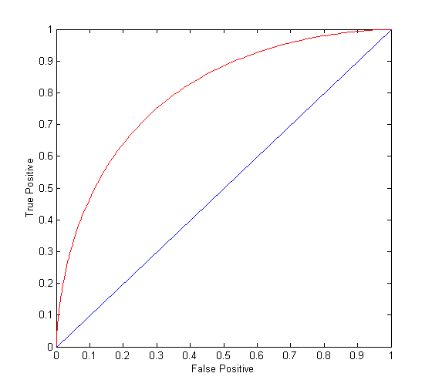
ROC Curve
TPR (sensitivity)=TP/(TP+FN) (percentage of positive classified as positive)
FPR = FP/(TN+FP) (percentage of negative classified as positive)
(0,0): declare everything
to be negative class
(1,1): declare everything
to be positive class
(0,1): ideal
Diagonal line: Random guessing
Below diagonal line: prediction is opposite of the true class
AUC: area under the ROC

Slide 40
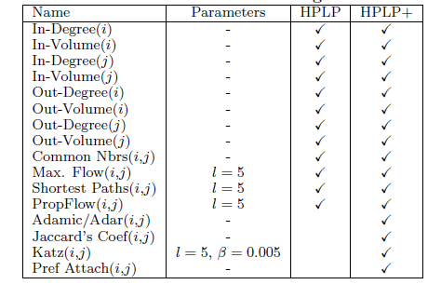
Classification for Link Prediction: features
For each edge (i, j)
PropFlow: corresponds to the probability that a restricted random walk starting at x ends at y in l steps or fewer using link weights as transition probabilities (stops in l steps or if revisits a node)

Slide 41
How to construct the training set
When to extract features and when to determine class?
Two time instances τ_{x} and τ_{y}
From t₀ to τ_{x} construct graph and extract features (G_{old})
From τ_{x} + 1 to τ_{y} examine if a link appears (determine class value)
What are good values
Large τ_{x} better topological features (as the network reaches saturation)
Large τ_{y} larger number of positives (size of positive class)
Should also match the real-world prediction interval

Slide 42
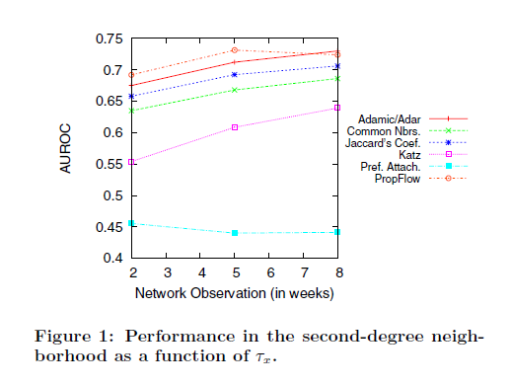
How to construct the training set
Unsupervised (single feature)

Slide 43
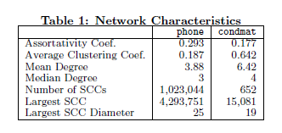
Datasets
712 million cellular phone calls
weighted, directed networks, weights correspond to the number of calls
use the first 5 weeks of data (5.5M nodes, 19.7M links) for extracting
features and the 6th week (4.4M nodes, 8.5M links) for obtaining ground truth.
19,464 condensed matter physics collaborations from 1995 to 2000.
weighted, undirected networks, weights correspond to the number of collaborations two authors share.
use the years 1995 to 1999 (13.9K nodes, 80.6K links) for extracting features and the year 2000 (8.5K nodes, 41.0K links) for obtaining ground truth.
The assortativity coefficient is the Pearson correlation coefficient of degree between pairs of linked nodes.
Positive values indicate a correlation between nodes of similar degree, while negative values indicate relationships between nodes of different degree.

Slide 44
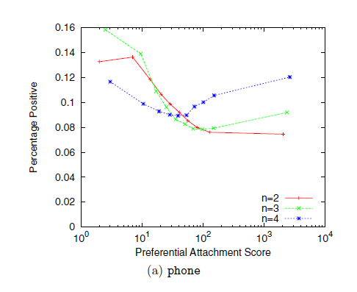
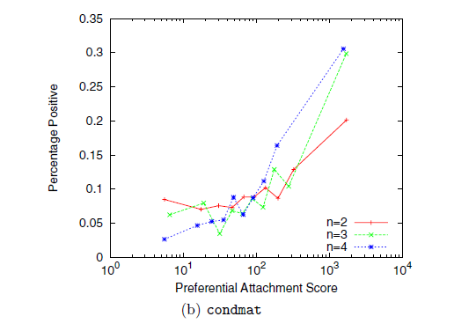
Using Supervised Learning: why?
A different prediction model for each distance
Predictors that work well in one network not in another
Should increase with the score (not in phone)
Preferential attachment increase with distance (when other may fail)

Slide 45
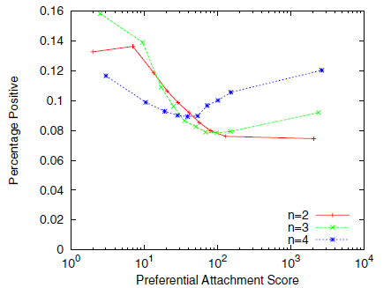
Using Supervised Learning: why?
Even training on a single feature may outperform ranking (if no clear bound on score)
Dependencies between features – use an ensemble of features

Slide 46
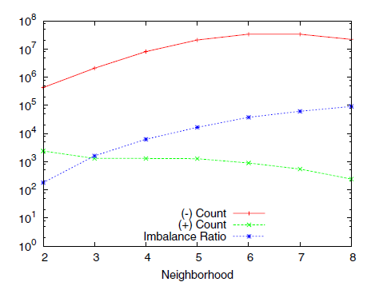
Imbalance
Sparse networks: |E| = k |V| for constant k << |V|
The class imbalance ratio for link prediction in a sparse network is Ω(|V|/1) when at most |V| nodes are added
Missing links is |V|²
Positives V
n-neighborhood exactly n hops way
Treat each neighborhood as a separate problem

Slide 47
Results
Ensemble of classifiers: Random Forest
Random forest: Ensemble classifier
constructs a multitude of decision trees at training time
output the class that is the mode (most frequent) of the classes (classification) or mean prediction (regression) of the individual trees.

Slide 48
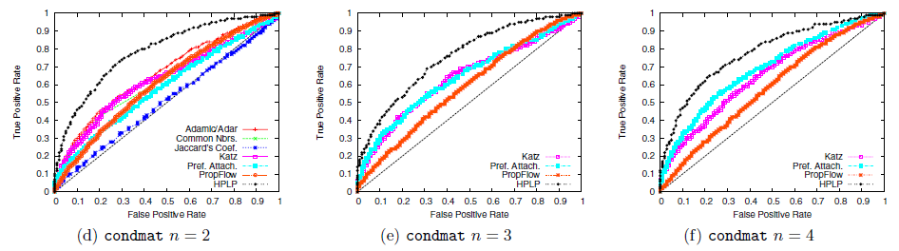
Results

Slide 49
Results
Mechanism by which links arise different both across networks and geodesic distances.
Local vs Global (preferential attachment)
  Better in condmat network,
  Improves with distance
HPLP achieves performance levels as much as 30% higher than the best unsupervised methods

Slide 50
Salsa

Slide 51
An application: Wtf
Wtf (“Who to Follow"): the Twitter user recommendation service
Twitter graph statistics (August 2012)
  over 20 billion edges (only active users)
  power law distributions of in-degrees and out-degrees.
    over 1000 with more than 1 million followers,
    25 users with more than 10 million followers.
Is it a “social” network as Facebook?
Difference between:
Interested in
Similar to
Example (follow @espn but not similar to it)
do not follow users similar to you, but follow users that the users that are similar to you follow

Slide 52
Algorithms
Asymmetric nature of the follow relationship (other social networks e.g., Facebook or LinkedIn require the consent of both participating members)
Directed edge case is similar to the user-item recommendations problem where the “item” is also a user.

Slide 53
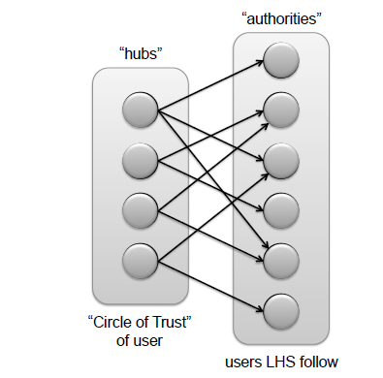
Bipartite graph
Authorities
Hubs
Hubs: 500 top-ranked nodes from the user's circle of trust
Circle of trust: the result of an egocentric random walk (similar to personalized PageRank)
Authorities: users that the hubs follow.
Users similar to u
Users followed by similar to u users

Slide 54
Algorithms: SALSA
SALSA (Stochastic Approach for Link-Structure Analysis)
a variation of HITS
As in HITS
  hubs
  authorities
HITS
Good hubs point to good authorities
Good authorities are pointed by good hubs
hub weight = sum of the authority weights of the authorities pointed to by the hub
authority weight = sum of the hub weights that point to this authority.
hubs
authorities

Slide 55
Algorithms: SALSA
Random walks to rank hubs and authorities
Two different random walks (Markov chains): a chain of hubs and a chain of authorities
Each walk traverses nodes only in one side by traversing two links in each step h->a->h, a->h->a
Transition matrices of each Markov chain: H and A
W: the adjacency of the directed graph
W_{r}: divide each entry by the sum of its row
W_{c}: divide each entry by the sum of its column
H = W_{r}W_{c}^{T}
A = W_{c}^{T} W_{r}
Proportional to the degree
hubs
authorities

Slide 56
Algorithms: SALSA
Authorities
Hubs
Use SALSA to assign scores to both sides
Hub scores: user similarity (based on homophily, also useful)
Authority scores : “interested in" user recommendations.
Recommend best in the RHS

Slide 57
SALSA: summary
How it works
SALSA mimics the recursive nature of the problem:
A user u is likely to follow those who are followed by users that are similar to u.
A user is similar to u if the user follows the same (or similar) users.
SALSA provides similar users to u on the LHS and similar followings of those on the RHS.
The random walk ensures equitable distribution of scores in both directions
Similar users are selected from the circle of trust of the user through personalized PageRank.

Slide 58
Real evaluation
Offline experiments on retrospective data
Online A/B testing on live traffic
Various parameters may interfere:
How the results are rendered (e.g., explanations)
Platform (mobile, etc.)
New vs old users

Slide 59
Evaluation: metrics
Follow-through rate (FTR) (precision)
Does not capture recall
Does not capture lifecycle effects (newer users more receptive, etc. )
Does not measure the quality of the recommendations: all follow edges are not equal
Engagement per impression (EPI):
After a recommendation is accepted, the amount of engagement by the user on that recommendation in a specified time interval called the observation interval.

Slide 60
Extensions
Add metadata to vertices (e.g., user profile information) and edges (e.g., edge weights, timestamp, etc.)
Consider interaction graphs (e.g., graphs defined in terms of retweets, favorites, replies, etc.)

Slide 61
References
D. Liben-Nowell, and J. Kleinberg, The link-prediction problem for social networks. Journal of the American Society for Information Science and Technology, 58(7) 1019–1031 (2007)
R. Lichtenwalter, J. T. Lussier, N. V. Chawla: New perspectives and methods in link prediction. KDD 2010: 243-252
G. Jeh, J. Widom: SimRank: a measure of structural-context similarity. KDD 2002: 538-543
P-N Tan, . Steinbach, V. Kumar. Introduction to Data Mining (Chapter 4)
P. Gupta, A. Goel, J. Lin, A. Sharma, D. Wang, R.Zadeh. WTF: The Who to Follow Service at Twitter, WWW 2013
R. Lempel, S. Moran: SALSA: the stochastic approach for link-structure analysis. ACM Trans. Inf. Syst. 19(2): 131-160 (2001)

