Slide 1
Online Social Networks and Media
Graph Embeddings

Slide 2


Graph embeddings: what are they?
node
vec
u
$$f:u→ℝ^{d}$$
$$ℝ^{d}$$
Feature representation, embedding
Map nodes to d-dimensional vectors so that:
“similar” nodes in the graph have embeddings that are close together.

Slide 3
Example
  Zachary’s Karate Club Network:
Input
Output
Image from: Perozzi et al.. DeepWalk: Online Learning of Social Representations. KDD 2014.

Slide 4
Graph embeddings: why?
Machine learning lifecycle
Raw Data
Structured Data
Learning Algorithm
Model
Feature Engineering
Downstream
prediction task
degree, PageRank, motifs, degrees of neighbors, Pagerank of neighbors, etc

Slide 5
Graph embeddings: why?
Machine learning lifecycle
Raw Data
Structured Data
Learning Algorithm
Model
Feature Engineering
Downstream
prediction task
degree, PageRank, motifs, degree of neighbors, Pagerank of neighbors, etc
Automatically learn the features (embeddings)

Slide 6


Embedding nodes
Input: Graph G(V, E)
Goal: encode nodes so that similarity in the embedding space approximates similarity in the original network.
ENC(i)
$$z_{i}$$
i
$$z_{j}$$
j
ENC(j)
G: original network
embedding space
Based on: W. L. Hamilton, R. Ying, J. Leskovec: Representation Learning on Graphs: Methods and Applications. IEEE Data Eng. Bull. 40(3): 52-74 (2017)

Slide 7
Embedding nodes
Goal: similarity(i, j) $≈z_{i}{ ∙z}_{j}$
to be defined
how relationships in vector space map to relationships in the original network
encode structure
dot product (other definitions possible)
ENC(i)
$$z_{i}$$
i
$$z_{j}$$
j
ENC(j)
G: original network
embedding space
Based on: W. L. Hamilton, R. Ying, J. Leskovec: Representation Learning on Graphs: Methods and Applications. IEEE Data Eng. Bull. 40(3): 52-74 (2017)

Slide 8
Learning node embeddings
Define an encoder that maps nodes to low dimensional spaces
Define a node similarity function in the original network.
Optimize the parameters of the encoder so that we minimize a loss function L that looks (roughly) like:
$L=\sum_{ i, j ∈ V}{({similarity\left(i, j\right) −}_{}}$ $z_{i}^{}∙$ $z_{j}^{})^{2}$
When are two nodes similar? Any ideas?

Slide 9

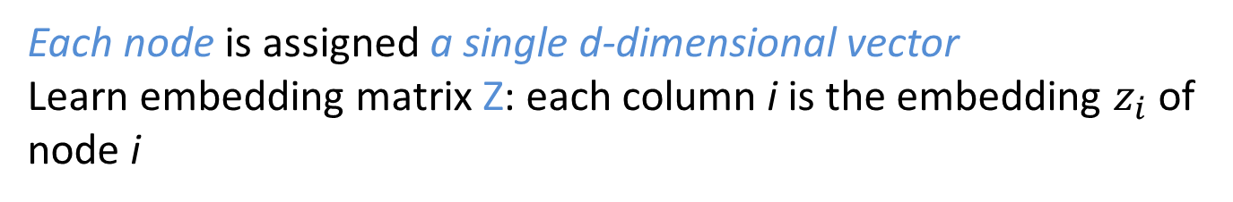
Shallow embeddings^{(*)}
Each node is assigned a single d-dimensional vector
Learn embedding matrix Z: each column i is the embedding $z_{i}$ of node i
|V|
Z
i
Dimension/size of the embedding
d
$$z_{i}$$
(*) As opposed to deep learning in graphs (neural networks embeddings)

Slide 10


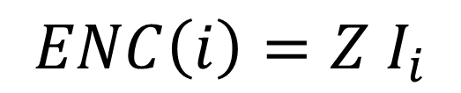
Shallow embeddings
Encoder is an embedding lookup
$$ENC\left(i\right)=Z I_{i}$$
Z
i
$$I_{i}$$
i
0
0
1
0
One-hot or indicator vector, all 0s but position i
$$z_{i}$$

Slide 11
Node embeddings
Three approaches based on:
Adjacency matrix
Multi-hop neighborhoods
  HOPE
  GraRep
  Background on word2vec
Random-walks
  DeepWalk
  Node2Vec

Slide 12





Adjacency-based approach
$$v_{2}$$
$$v_{1}$$
$$v_{3}$$
$$v_{5}$$
$$v_{4}$$
Similarity function is just the edge (weight) between u and v in the original network.
Dot products between node embeddings approximate edge existence.
A. Ahmed, N. Shervashidze, S. M. Narayanamurthy, V. Josifovski, A. J. Smola: Distributed large-scale natural graph factorization. WWW 2013

Slide 13
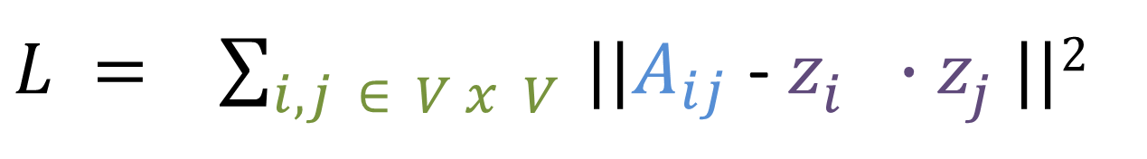
Adjacency-based approach
The loss that what we want to minimize
embedding similarity
$L = \sum_{i,j ∈ V x V }{||A_{ij}}$ - $z_{i}^{}$ ${∙z}_{j}^{ }||2$
sum over all node pairs
(weighted) adjacency matrix for the graph

Slide 14
How to minimize loss
Matrix decomposition (for example, SVD decomposition)
  Scalability issues
  Produced matrices that are very dense
Stochastic gradient descent

Slide 15
Singular Value Decomposition
r : rank of matrix A
σ₁≥ σ₂≥ … ≥σ_{r} : singular values (square roots of eigenvals AA^{T}, A^{T}A)
: left singular vectors (eigenvectors of AA^{T})
: right singular vectors (eigenvectors of A^{T}A)
[n×r]
[r×r]
[r×n]

Slide 16
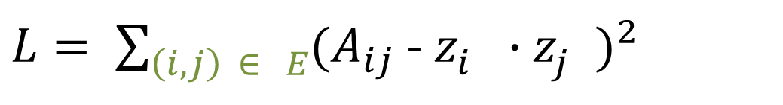
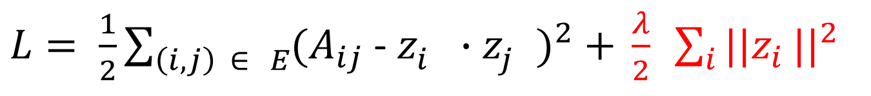
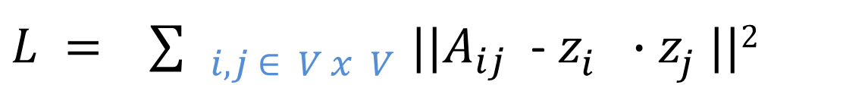
Adjacency-based approach – stochastic gradient descent
A few manipulations
$L = \sum_{ i, j ∈ V x V }{||A_{ij}}$ - $z_{i}^{}$ ${∙z}_{j}^{ }||2$
sum over all node pairs
$L= \sum_{\left(i, j\right) ∈ E}{(A_{ij}}$ - $z_{i}^{}$ $∙z_{j}^{})^{2}$
sum over all edges
$L= \frac{1}{2}\sum_{\left(i, j\right) ∈ E}{(A_{ij}}$ - $z_{i}^{}∙$ $z_{j}^{})^{2}\text{ + }\frac{λ}{2} \sum_{i}{||z_{i}}\text{|}|^{2}$
regularization factor

Slide 17
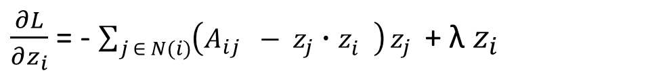
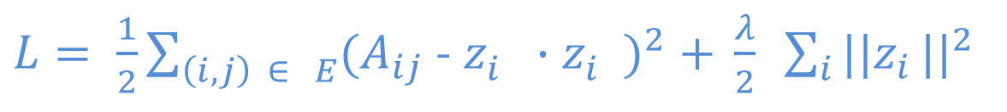
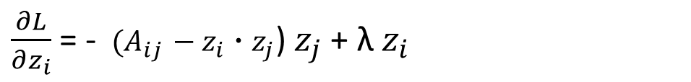
Adjacency-based approach
$L= \frac{1}{2}\sum_{\left(i, j\right) ∈ E}{(A_{ij}}$ - $z_{i}^{}∙$ $z_{i}^{})^{2}\text{ + }\frac{λ}{2} \sum_{i}{||z_{i}}\text{|}|^{2}$
Taking the gradient
Gradient of L with respect to each row (column) of Z (learn one vector per node)
$\frac{∂L}{∂z_{i}}$ = - $\sum_{j ∈ N(i)}{\left(A_{ij} − z_{j}∙z_{i }^{}\right)}z_{j }$ + λ $z_{i}$
For each edge (i, j) $∈E$this amounts for
$\frac{∂L}{∂z_{i}}$ = - $(A_{ij}{ − z}_{i }{∙z}_{j}$) $z_{j}$ + λ $z_{i}$

Slide 18
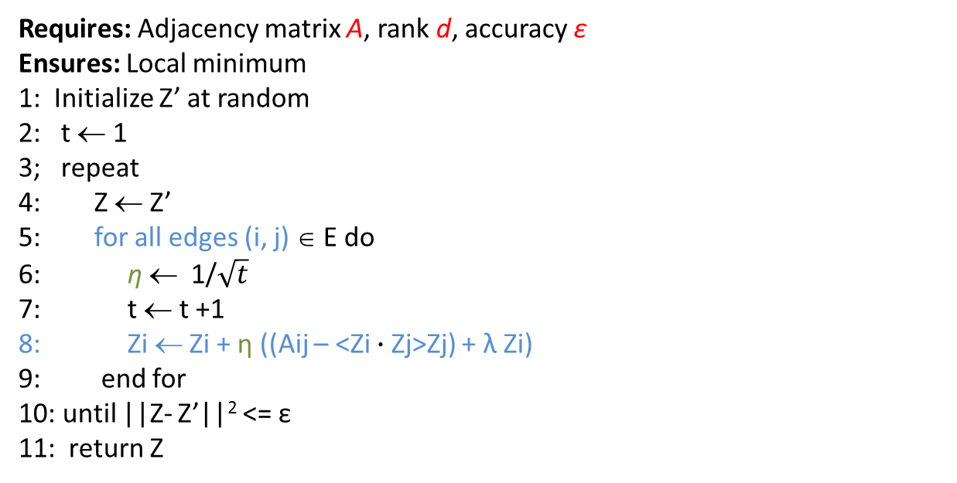
Adjacency-based approach
Requires: Adjacency matrix A, rank d, accuracy ε
Ensures: Local minimum
1: Initialize Z’ at random
2: t ← 1
3; repeat
4: Z ← Z’
5: for all edges (i, j) ∈ E do
6: η ← 1/$\sqrt{t}$
7: t ← t +1
8: Zi ← Zi + η ((Aij – <Zi $∙$Zj>Zj) + λ Ζi)
9: end for
10: until ||Z- Z’||² <= ε
11: return Z
η: learning rate, captures the extent at which newly acquired information overrides old
Complexity O(|E|)
Can be parallelized

Slide 19
Node embeddings
Three approaches based on:
Adjacency matrix
Multi-hop neighborhoods
  HOPE
  GraRep
Random-walks
  DeepWalk
  Node2Vec

Slide 20
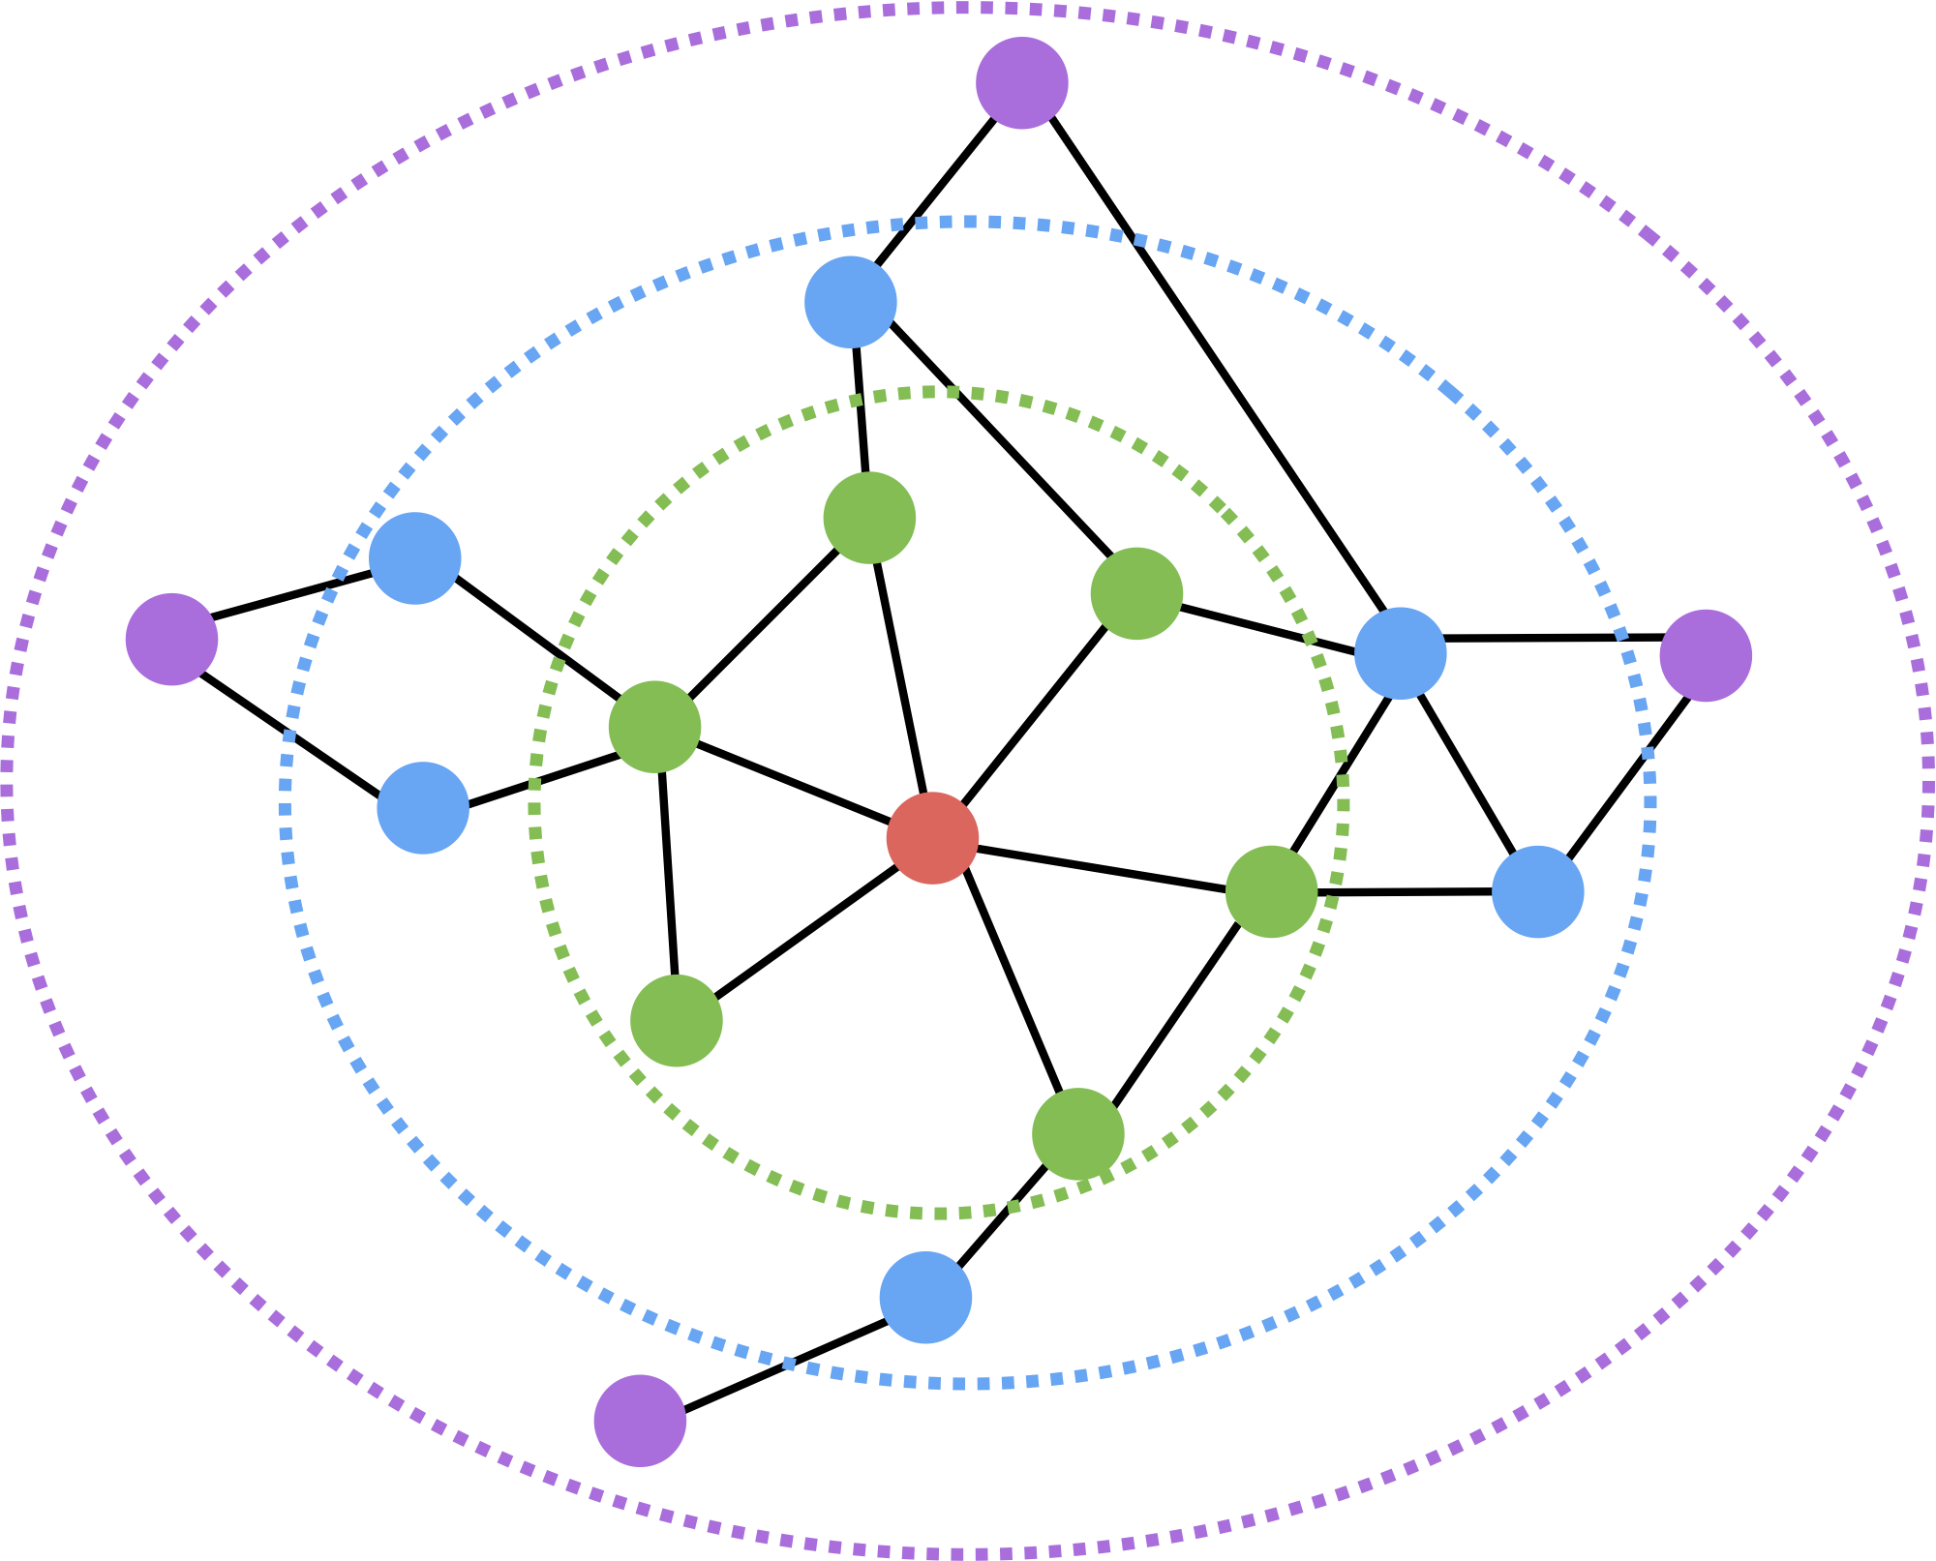
Multi-hop approaches
  Only considers direct connections
  What about further neighbors?
Look further than the 1-step neighbors and learn by using information from/for k-step neighbors
We will see two approaches
GraRep: looks at probabilities of reaching a node
HOPE: various metrics of similarity based on neighbors and paths

Slide 21
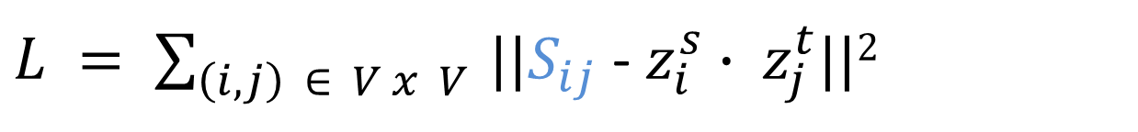
High-order Proximity Preserved Embeddings (HOPE)
Based on a high order proximity matrix S,
S_{ij} = proximity(i j)
Learn two embeddings vectors
Z = |Z^{s} , Z^{t}|
$L = \sum_{\left(i, j\right) ∈ V x V }{||S_{ij}}$ - $z_{i}^{s}∙ z_{j}^{t}$||²
M. Ou, P. Cui, J. Pei, Z.i Zhang, W. Zhu: Asymmetric Transitivity Preserving Graph Embedding. KDD 2016

Slide 22





HOPE
Local High Order Proximity
Common Neighbors (for directed graphs, source-target)
S^{CN} = A²
A² =
$$v_{2}$$
$$v_{1}$$
Adamic-Adar
S^{AA} = A D A
Similar but assigns a weight to the neighbor = reciprocal of its degree
The more vertexes a node is connected to, the less important it is on evaluating
the proximity between a pair of nodes
$$v_{3}$$
$$v_{5}$$
$$v_{4}$$

Slide 23
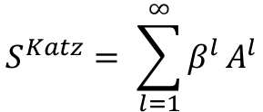
HOPE
Global High Order Proximity
Katz
Sum over all paths of length l, using a decay parameter
$$S^{Katz}= \sum_{l=1}^{∞}{β^{l}}A^{l}$$
Rooted Pagerank
SVD with some tricks to save computations

Slide 24
Introduction to Neural Networks
(Thanks to Philipp Koehn for the material borrowed from his slides)

Slide 25
Classification
Classification is the task of learning a target function f that maps attribute set x to one of the predefined class labels y
categorical
categorical
continuous
class
One of the attributes is the class attribute
In this case: Cheat
Two class labels (or classes): Yes (1), No (0)

Slide 26
Illustrating Classification Task

Slide 27
Example of a Model
categorical
categorical
continuous
class
Refund
Yes
No
NO
MarSt
Single, Divorced
Married
TaxInc
NO
< 80K
> 80K
NO
YES
Training Data
Model: Decision Tree

Slide 28
Classification in Networks
There are various problems in network analysis that can be mapped to a classification problem:
  Link prediction: Predict 0/1 for missing edges, whether they will appear or not in the future.
  Node classification: Classify nodes as democrat-republican/spammers-legitimate/other categories
    Use node features but also neighborhood and structural features
    Label propagation
  Edge classification: Classify edges according to type (professional/family relationships), or according to strength.
  More…
Recently all of this is done using Neural Networks.

Slide 29
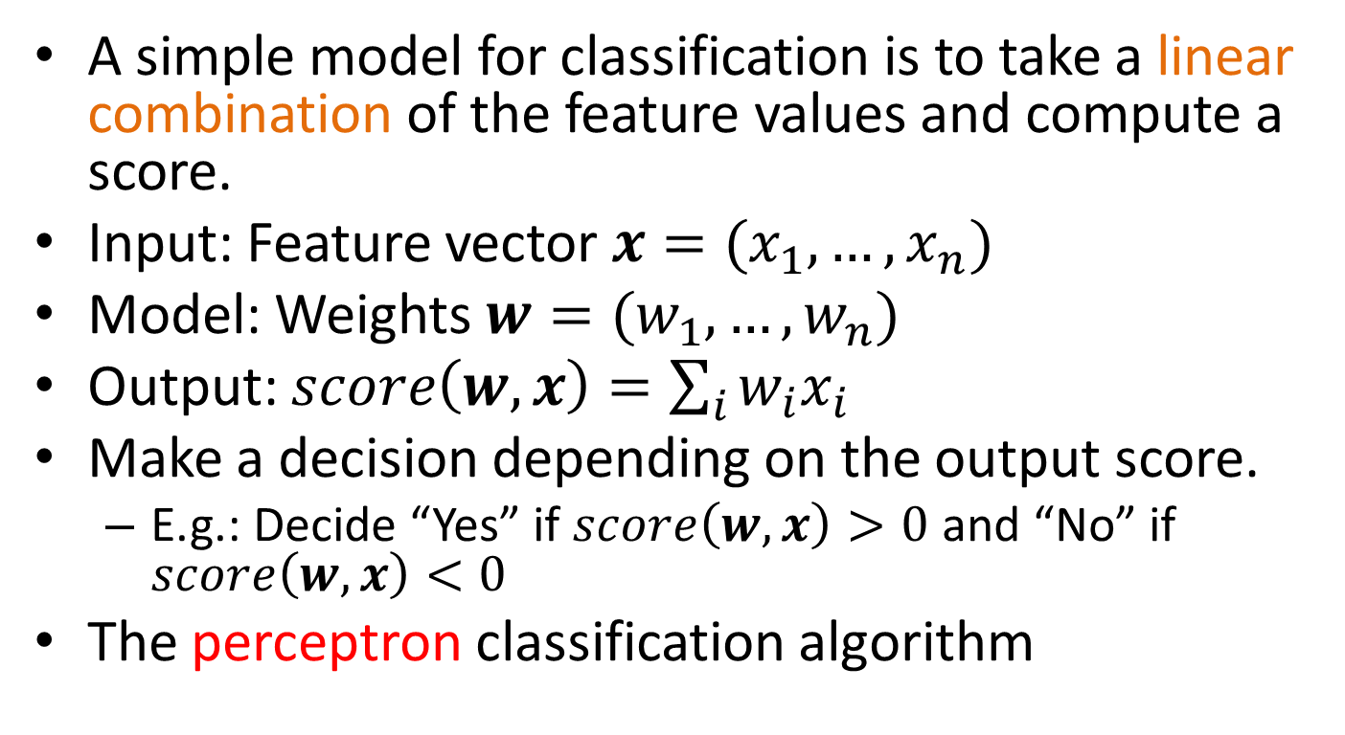
Linear Classification
A simple model for classification is to take a linear combination of the feature values and compute a score.
Input: Feature vector $x=(x_{1},…,x_{n})$
Model: Weights $w=(w_{1},…, w_{n})$
Output: $score\left(w,x\right)=\sum_{i}{w_{i}x_{i}}$
Make a decision depending on the output score.
  E.g.: Decide “Yes” if $score\left(w,x\right)>0$ and “No” if $score\left(w,x\right)<0$
The perceptron classification algorithm

Slide 30
Linear Classification
We can represent this as a network
Edges correspond to weights
$$x_{1}$$
$$w_{1}$$
Input nodes correspond to features
$$x_{2}$$
$$w_{2}$$
$$x_{3}$$
$$w_{3}$$
$$score(w,x)$$
$$x_{4}$$
$$w_{4}$$
$$w_{5}$$
“Output” node with incoming edges computes the score
$$x_{5}$$

Slide 31
Linear models
Linear models partition the space according to a hyperplane
But they cannot model everything

Slide 32
Multiple layers
We can add more layers:
  Each arrow has a weight
  Nodes compute scores from incoming edges and give input to outgoing edges
Did we gain anything?

Slide 33
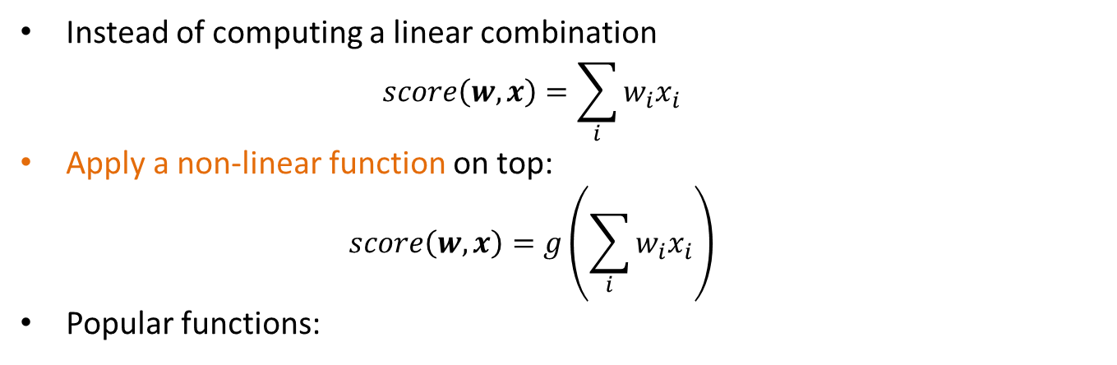
Non-linearity
Instead of computing a linear combination
  $$score\left(w,x\right)=\sum_{i}{w_{i}x_{i}}$$
Apply a non-linear function on top:
  $$score\left(w,x\right)=g\left(\sum_{i}{w_{i}x_{i}}\right)$$
Popular functions:
These functions play the role of a soft “switch” (threshold function)

Slide 34
Side note
Logistic regression classifier:
  Single layer with a logistic function

Slide 35
Deep learning
Networks with multiple layers
Each layer can be thought of as a processing step
Multiple layers allow for the computation of more complex functions

Slide 36
Example
A network that implements XOR
Hidden node $h_{0}$ is OR
Output node $h_{1}−h_{0}$
Hidden node $h_{1}$ is AND
Bias term

Slide 37
Error
The computed value is 0.76 but the correct value is 1
  There is an error in the computation
  How do we set the weights so as to minimize this error?

Slide 38
Gradient Descent
The error is a function of the weights
We want to find the weights that minimize the error
Compute gradient: gives the direction to the minimum
Adjust weights, moving at the direction of the gradient.

Slide 39
Gradient Descent

Slide 40
Gradient Descent

Slide 41
Backpropagation
How can we compute the gradients? Backpropagation!
Main idea:
  Start from the final layer: compute the gradients for the weights of the final layer.
  Use these gradients to compute the gradients of previous layers using the chain rule
  Propagate the error backwards
Backpropagation essentially is an application of the chain rule for differentiation.

Slide 42


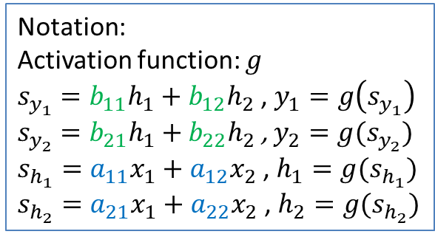





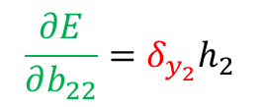

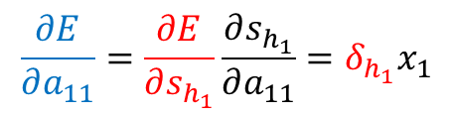
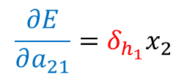


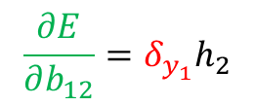



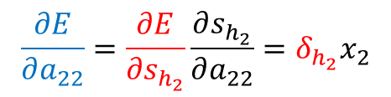

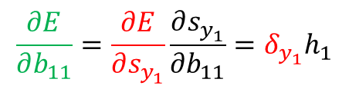



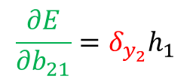

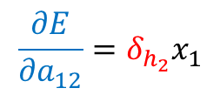
$$a_{11}$$
$$b_{11}$$
$$x_{1}$$
$$h_{1}$$
$$y_{1}$$
Error: $E={\left\|y−t\right\|}^{2}={\left(y_{1}−t_{1}\right)}^{2}+{\left(y_{2}−t_{2}\right)}^{2}$
$$a_{12}$$
$$b_{12}$$
$$\frac{∂E}{∂b_{11}}=\frac{∂E}{∂s_{y_{1}}}\frac{∂s_{y_{1}}}{∂b_{11}}=δ_{y_{1}}h_{1}$$
$$a_{21}$$
$$b_{21}$$
$$x_{2}$$
$$a_{22}$$
$$h_{2}$$
$$y_{2}$$
$$b_{22}$$
$δ_{y_{1}}$= $\frac{∂E}{∂s_{y_{1}}}$= $\frac{∂E}{∂y_{1}}\frac{∂y_{1}}{∂s_{y_{1}}}=2\left(y_{1}−t_{1}\right)g′(s_{y_{1}})$
Notation:
Activation function: $g$
$s_{y_{1}}=b_{11}h_{1}+b_{12}h_{2}$ , $y_{1}=g\left(s_{y_{1}}\right)$
$s_{y_{2}}=b_{21}h_{1}+b_{22}h_{2}$ , $y_{2}=g(s_{y_{2}})$
$s_{h_{1}}=a_{11}x_{1}+a_{12}x_{2}$ , $h_{1}=g(s_{h_{1}})$
$s_{h_{2}}=a_{21}x_{1}+a_{22}x_{2}$ , $h_{2}=g(s_{h_{2}})$
$$\frac{∂E}{∂b_{21}}=δ_{y_{2}}h_{1}$$
$δ_{y_{2}}$= $\frac{∂E}{∂s_{y_{2}} }$= $2\left(y_{2}−t_{2}\right)g′(s_{y_{2}})$
$$\frac{∂E}{∂b_{12}}=δ_{y_{1}}h_{2}$$
$$\frac{∂E}{∂b_{22}}=δ_{y_{2}}h_{2}$$
$$\frac{∂E}{∂a_{11}}=\frac{∂E}{∂s_{h_{1}}}\frac{∂s_{h_{1}}}{∂a_{11}}=δ_{h_{1}}x_{1}$$
$$\frac{∂E}{∂a_{22}}=\frac{∂E}{∂s_{h_{2}}}\frac{∂s_{h_{2}}}{∂a_{22}}=δ_{h_{2}}x_{2}$$
$$\frac{∂E}{∂a_{21}}=δ_{h_{1}}x_{2}$$
$$\frac{∂E}{∂a_{12}}=δ_{h_{2}}x_{1}$$
$$δ_{h_{1}}=\frac{∂E}{∂s_{h_{1}}}=\frac{∂E}{∂h_{1}}\frac{∂h_{1}}{∂s_{h_{1}}}=\left(\frac{∂E}{∂s_{y_{1}}}\frac{∂s_{y_{1}}}{∂h_{1}}+\frac{∂E}{∂s_{y_{2}}}\frac{∂s_{y_{2}}}{∂h_{1}}\right)g^{′}\left(s_{h_{1}}\right)=\left(δ_{y_{1}}b_{11}+δ_{y_{2}}b_{21}\right)g′(s_{h_{1}})$$
$$δ_{h_{2}}=\left(δ_{y_{1}}b_{12}+δ_{y_{2}}b_{22}\right)g′(s_{h_{2}})$$

Slide 43
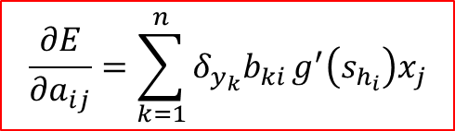
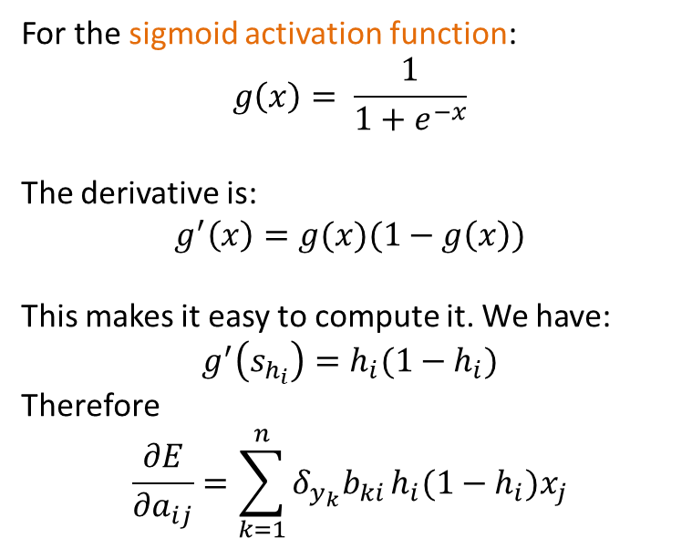
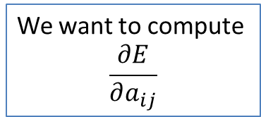

Backpropagation
We have already computed the $δ_{y_{k}}$’s
$$δ_{y_{1}}=\frac{∂E}{∂s_{y_{1}}}$$
$$δ_{y_{k}}=\frac{∂E}{∂s_{y_{k}}}$$
$$δ_{y_{n}}=\frac{∂E}{∂s_{y_{n}}}$$
$$\frac{∂E}{∂a_{ij}}=\sum_{k=1}^{n}{δ_{y_{k}}b_{ki}}g^{′}\left(s_{h_{i}}\right)x_{j}$$
$$y_{1}$$
$$y_{k}$$
$$y_{n}$$
$$s_{y_{1}}$$
For the sigmoid activation function:
$$g\left(x\right)= \frac{1}{1+e^{−x}}$$
The derivative is:
$$g^{′}\left(x\right)=g(x)(1−g\left(x\right))$$
This makes it easy to compute it. We have:
$$g^{′}\left(s_{h_{i}}\right)=h_{i}(1−h_{i})$$
Therefore
$$\frac{∂E}{∂a_{ij}}=\sum_{k=1}^{n}{δ_{y_{k}}b_{ki}}h_{i}(1−h_{i})x_{j}$$
$$s_{y_{k}}$$
$$s_{y_{n}}$$
$$b_{1i}$$
$$b_{ki}$$
$$b_{ni}$$
$$h_{i}$$
$$s_{h_{i}}$$
$$a_{ij}$$
$$x_{j}$$
We want to compute
$$\frac{∂E}{∂a_{ij}}$$

Slide 44
Stochastic gradient descent
Ideally the loss should be the average loss over all training data.
We would need to compute the loss for all training data every time we update the gradients.
  However, this is expensive.
Stochastic gradient descent: Consider one input point at the time. Each point is considered only once.
Intermediate solution: Use mini-batches of data points.

Slide 45
Word EMBeddings
(Thanks to Chris Manning for the material borrowed from his slides)

Slide 46
Basic Idea
You can get a lot of value by representing a word by means of its neighbors
“You shall know a word by the company it keeps”
(J. R. Firth 1957: 11)
One of the most successful ideas of modern statistical NLP
  government debt problems turning into banking crises as has happened in
  saying that Europe needs unified banking regulation to replace the hodgepodge
   These words will represent banking 

Slide 47
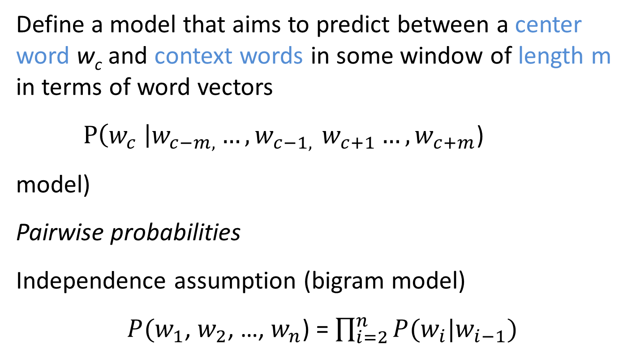
Basic idea
Define a model that aims to predict between a center word w_{c} and context words in some window of length m in terms of word vectors
$P\left(w_{c} \right|w_{c−m, }{…, w}_{c−1, }w_{c+1}…, w_{c+m}$)
model)
Pairwise probabilities
Independence assumption (bigram model)
$P(w_{1}$, $w_{2}$, …, $w_{n}$) = $\prod_{i=2}^{n}{P(w_{i}|w_{i−1})}$
Notes:
The central new idea is that you change the word representation, as well as the other parameters of the model.
I’m going to directly and concretely build one, concrete prediction models. You may already know of some other things you might do, and we’ll come back to other possibilities next week, but this way of doing it is one of the best ways known.

Slide 48
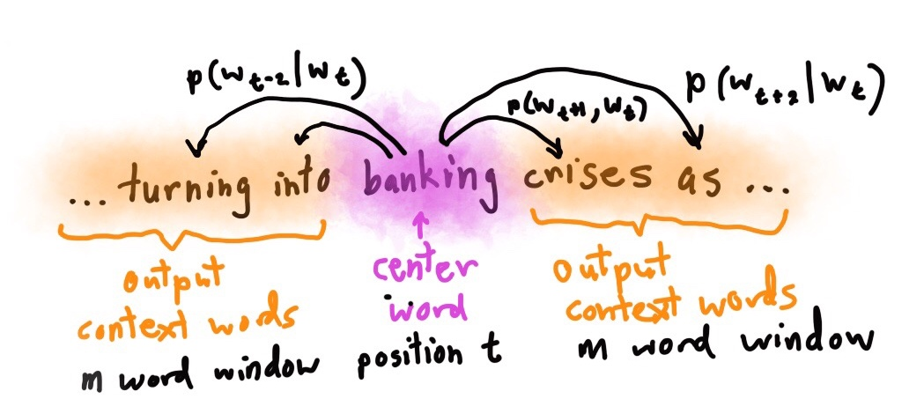

Slide 49
Word2Vec
  Predict between every word and its context words
Two algorithms
  Skip-grams (SG)
    Predict context words given the center word
  Continuous Bag of Words (CBOW)
    Predict center word from a bag-of-words context
    Position independent (do not account for distance from center)
Two training methods
  Hierarchical softmax
  Negative sampling
Tomas Mikolov, Ilya Sutskever, Kai Chen, Gregory S. Corrado, Jeffrey Dean: Distributed Representations of Words and Phrases and their Compositionality. NIPS 2013: 3111-3119

Slide 50
CBOW
  Use a window of context words to predict the center word
Learn two matrices (N size of embedding, |V| number of words)
W
N
W’
Embedding of the i-th word when center word
i
i
Embedding of the i-th word when context word
N
|V|
|V|
N x |V| center embeddings
when output
|V| x N context embeddings
when input

Slide 51
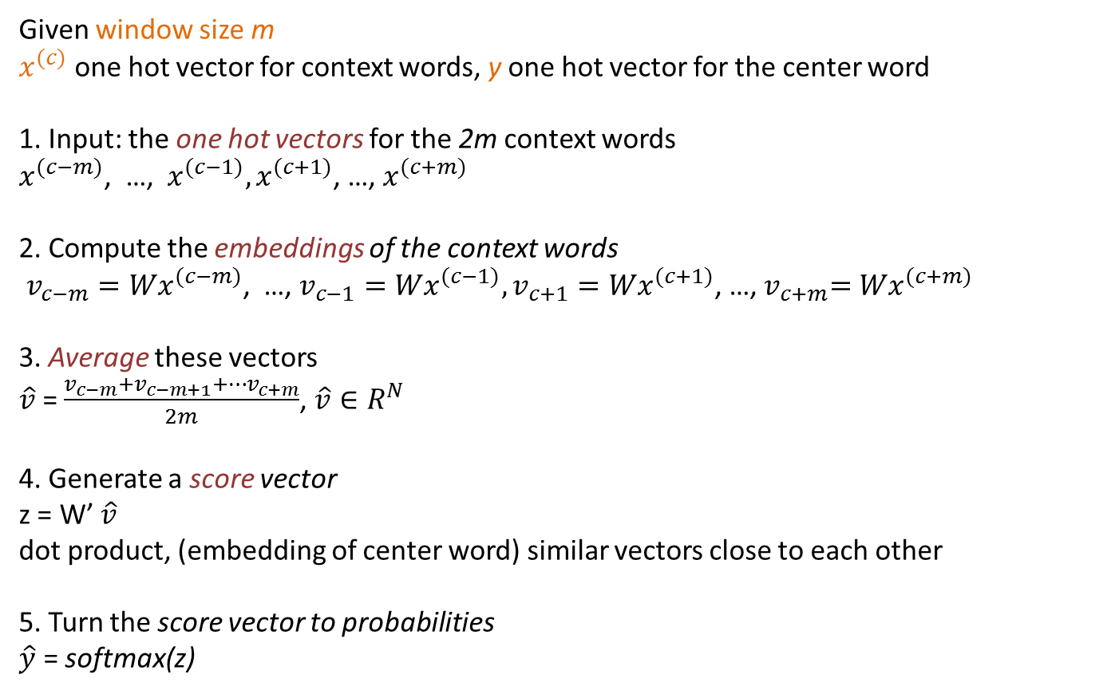
CBOW
Given window size m
$x^{(c)}$ one hot vector for context words, y one hot vector for the center word
1. Input: the one hot vectors for the 2m context words
$x^{(c−m)}$, …, $x^{(c−1)},x^{(c+1)}$, …, $x^{(c+m)}$
2. Compute the embeddings of the context words
$v_{c−m}{=Wx}^{(c−m)}$, …, $v_{c−1}{=Wx}^{(c−1)},v_{c+1}{=Wx}^{(c+1)}$, …,${ v}_{c+m}{=Wx}^{(c+m)}$
3. Average these vectors
$\hat{v}$ = $\frac{v_{c−m}+v_{c−m+1}+…v_{c+m}}{2m}$, $\hat{v}∈R^{N}$
4. Generate a score vector
z = W’ $\hat{v}$
dot product, (embedding of center word) similar vectors close to each other
5. Turn the score vector to probabilities
$\hat{y}$ = softmax(z)
We want this to be close to 1 for the center word

Slide 52
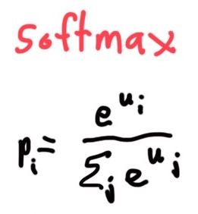
Exponentiate to
make positive
Normalize to
give probability

Slide 53
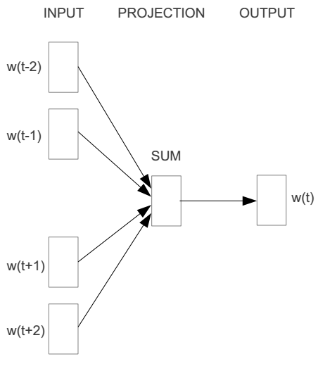
E.g. “The cat sat on floor”
  Window size = 2
the
cat
sat
on
floor

Slide 54
Input layer
Index of cat in vocabulary
0
1
0
cat
0
Hidden layer
Output layer
0
0
0
0
0
0
…
0
one-hot
vector
0
0
one-hot
vector
0
sat
0
0
0
0
1
0
…
1
0
on
0
0
0
0
…
0

Slide 55



We must learn W and W’
Input layer
0
1
0
cat
0
$$W_{V×N}$$
Hidden layer
Output layer
0
0
0
0
0
0
V-dim
…
0
0
$${W′}_{N×V}$$
0
0
sat
0
0
0
0
1
0
$$W_{V×N}$$
N-dim
…
V-dim
1
0
on
0
0
0
0
V-dim
…
N will be the size of word vector
0

Slide 56
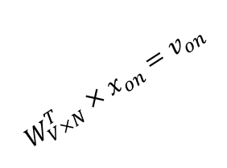

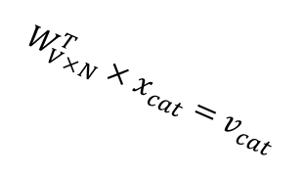



$$W_{V×N}^{T} ×x_{cat}=v_{cat}$$
Input layer
0.1 | 2.4 | 1.6 | 1.8 | 0.5 | 0.9 | … | … | … | 3.2
0.5 | 2.6 | 1.4 | 2.9 | 1.5 | 3.6 | … | … | … | 6.1
… | … | … | … | … | … | … | … | … | …
… | … | … | … | … | … | … | … | … | …
0.6 | 1.8 | 2.7 | 1.9 | 2.4 | 2.0 | … | … | … | 1.2
0
2.4
2.6
…
…
1.8
1
0
$$×$$
0
$$=$$
1
0
0
0
0
0
x_{cat}
0
0
Output layer
0
0
0
$$W_{V×N}^{T}×x_{cat}=v_{cat}$$
…
0
0
0
0
V-dim
…
0
0
$$\hat{v}=\frac{v_{cat}+v_{on}}{2}$$
0
+
0
sat
0
0
0
0
$$W_{V×N}^{T}×x_{on}=v_{on}$$
1
0
…
V-dim
1
Hidden layer
0
x_{on}
0
0
N-dim
0
0
V-dim
…
0

Slide 57

$$W_{V×N}^{T} ×x_{on}=v_{on}$$
Input layer
0.1 | 2.4 | 1.6 | 1.8 | 0.5 | 0.9 | … | … | … | 3.2
0.5 | 2.6 | 1.4 | 2.9 | 1.5 | 3.6 | … | … | … | 6.1
… | … | … | … | … | … | … | … | … | …
… | … | … | … | … | … | … | … | … | …
0.6 | 1.8 | 2.7 | 1.9 | 2.4 | 2.0 | … | … | … | 1.2
0
1.8
2.9
…
…
1.9
0
0
$$×$$
0
$$=$$
1
1
0
0
0
0
x_{cat}
0
0
Output layer
0
0
0
$$W_{V×N}^{T}×x_{cat}=v_{cat}$$
…
0
0
0
0
V-dim
…
0
0
$$\hat{v}=\frac{v_{cat}+v_{on}}{2}$$
0
+
0
sat
0
0
0
0
$$W_{V×N}^{T}×x_{on}=v_{on}$$
1
0
…
V-dim
1
Hidden layer
0
x_{on}
0
0
N-dim
0
0
V-dim
…
0

Slide 58






Input layer
0
1
0
cat
0
$$W_{V×N}$$
Hidden layer
Output layer
0
0
0
0
0
0
V-dim
…
0
0
$$W_{V×N}^{′}×\hat{v}=z$$
0
$$\hat{y}=softmax(z)$$
0
0
0
0
0
$$\hat{v}$$
1
0
$$W_{V×N}$$
…
1
N-dim
0
on
0
${\hat{y}}_{sat}$
0
0
V-dim
0
V-dim
…
N will be the size of word vector
0

Slide 59


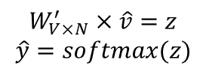
Input layer
0
We would prefer $\hat{y}$ close to ${\hat{y}}_{sat}$
1
0
cat
0
$$W_{V×N}$$
Hidden layer
Output layer
0
0
0.01
0.02
0.00
0.02
0.01
0.02
0.01
0.7
…
0.00
0
0
0
0
V-dim
…
0
0
0
$$W_{V×N}^{′}×\hat{v}=z$$
$$\hat{y}=softmax(z)$$
0
0
0
0
0
$$\hat{v}$$
1
0
$$W_{V×N}$$
…
1
N-dim
0
on
0
${\hat{y}}_{sat}$
0
0
V-dim
0
V-dim
…
N will be the size of word vector
$\hat{y}$
0

Slide 60




$$W_{V×N}^{T}$$
Input layer
0.1 | 2.4 | 1.6 | 1.8 | 0.5 | 0.9 | … | … | … | 3.2
0.5 | 2.6 | 1.4 | 2.9 | 1.5 | 3.6 | … | … | … | 6.1
… | … | … | … | … | … | … | … | … | …
… | … | … | … | … | … | … | … | … | …
0.6 | 1.8 | 2.7 | 1.9 | 2.4 | 2.0 | … | … | … | 1.2
Contain word’s vectors
0
1
0
x_{cat}
0
Output layer
0
0
$$W_{V×N}^{}$$
0
0
0
0
V-dim
…
0
0
$$W_{V×N}^{′}$$
0
0
sat
0
0
0
0
$$W_{V×N}^{}$$
1
0
…
V-dim
1
Hidden layer
0
x_{on}
0
0
N-dim
0
0
V-dim
…
0
We can consider either W (context) or W’ (center) as the word’s representation.
Or even take the average.
Notes:
W contains input word vectors.
W’ contains output word vectors.
We can consider either W or W’ as the word’s representation. Or even take the average.

Slide 61
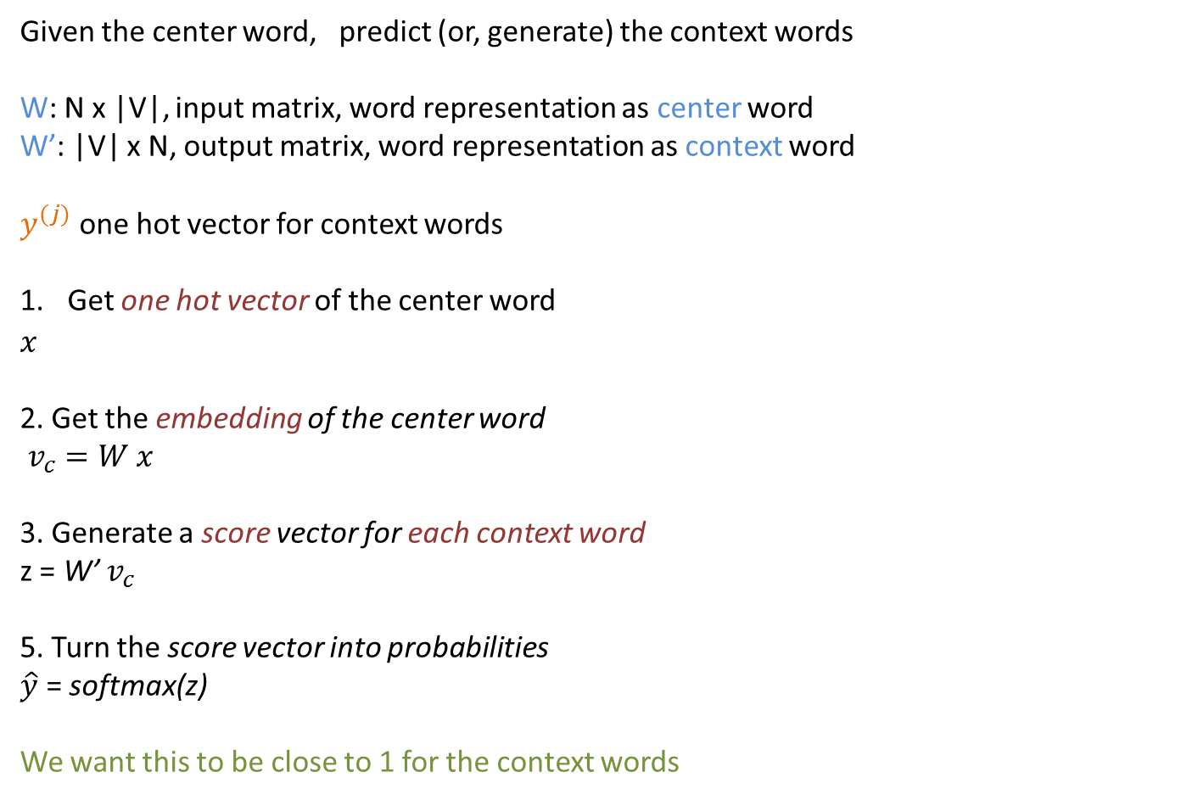
Skipgram
Given the center word, predict (or, generate) the context words
W: N x |V|, input matrix, word representation as center word
W’: |V| x N, output matrix, word representation as context word
$y^{(j)}$ one hot vector for context words
Get one hot vector of the center word
$$x^{}$$
2. Get the embedding of the center word
$v_{c}=W x$
3. Generate a score vector for each context word
z = W’ $v_{c}$
5. Turn the score vector into probabilities
$\hat{y}$ = softmax(z)
We want this to be close to 1 for the context words

Slide 62
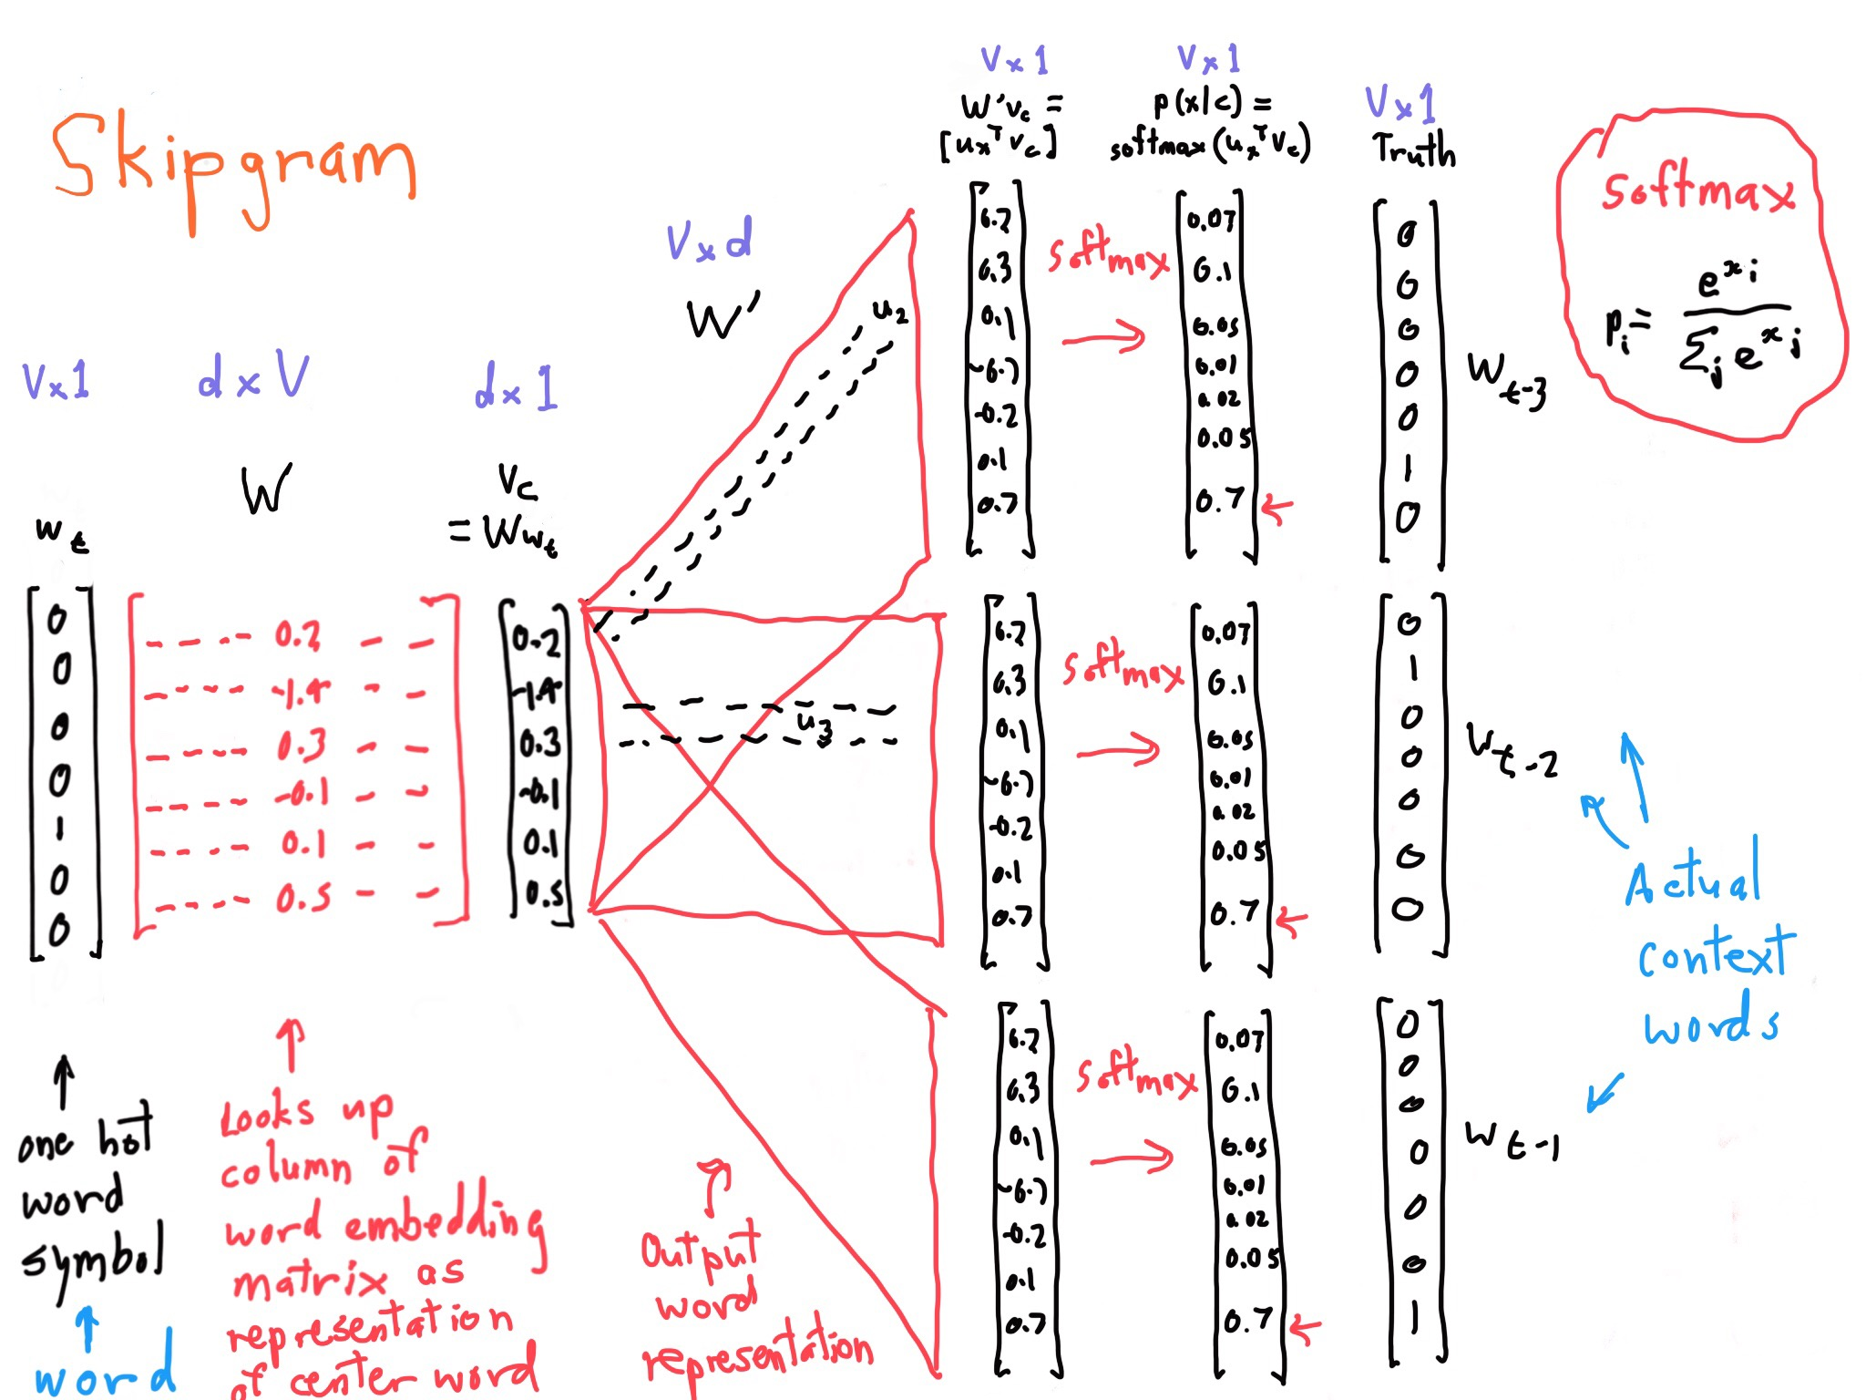

Slide 63
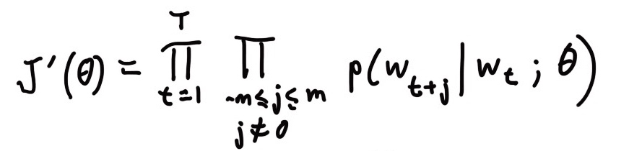
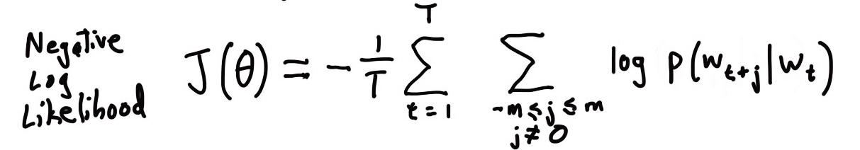
Skipgram
For each word t = 1 … T, predict surrounding words in a window of “radius” m of every word.
Objective function: Maximize the probability of any context word given the current center word:
where θ represents all variables we will optimize

Slide 64
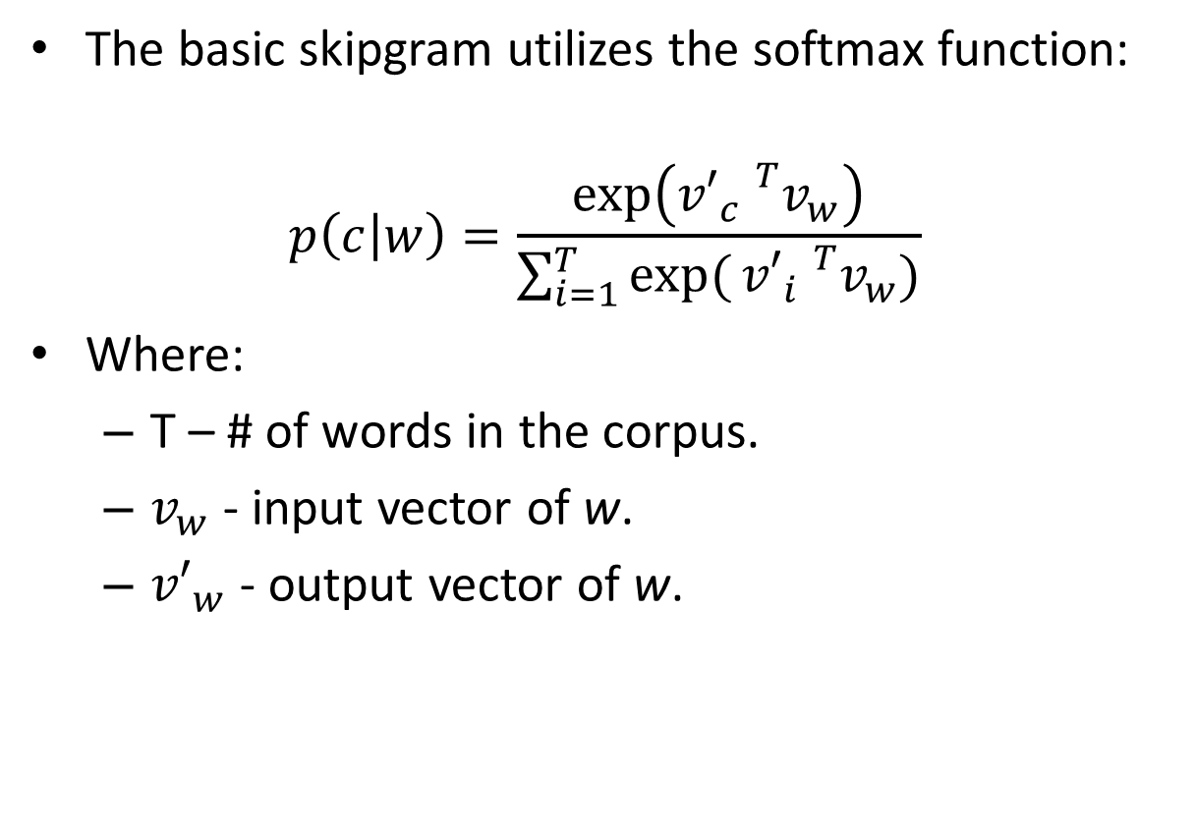
The basic skipgram utilizes the softmax function:
$$p\left(c | w\right)=\frac{\exp\left({v′}_{c}{}_{}^{T}{v_{w}}\right)}{\sum_{i=1}^{T}{exp⁡(}{v′}_{i}{}_{}^{T}{v_{w}})}$$
Where:
  T – # of words in the corpus.
  $v_{w}$ - input vector of w.
  ${v′}_{w}$ - output vector of w.
Word | Input | Output
King | [0.2,0.9,0.1] | [0.5,0.4,0.5]
Queen | [0.2,0.8,0.2] | [0.4,0.5,0.5]
Apple | [0.9,0.5,0.8] | [0.3,0.9,0.1]
Orange | [0.9,0.4,0.9] | [0.1,0.7,0.2]

Slide 65
An example

Slide 66
These representations are very good at encoding similarity and dimensions of similarity!
Analogies testing dimensions of similarity can be solved quite well just by doing vector subtraction in the embedding space
  Syntactically
  x_{apple} − x_{apples} ≈ x_{car} − x_{cars} ≈ x_{family} − x_{families}
  Similarly for verb and adjective morphological forms
  Semantically (Semeval 2012 task 2)
  x_{shirt} − x_{clothing} ≈ x_{chair} − x_{furniture}
  x_{king} − x_{man} ≈ x_{queen} − x_{woman}

Slide 67
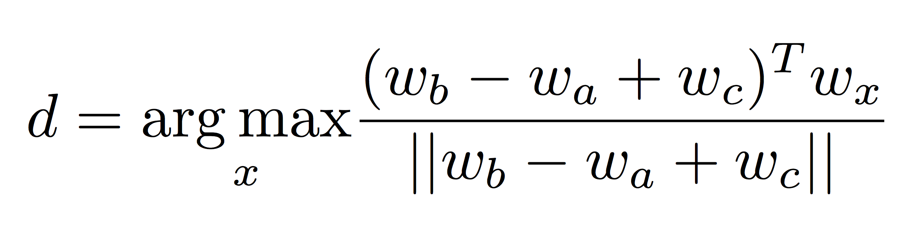
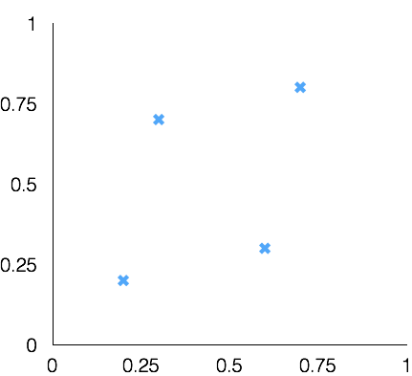
Test for linear relationships, examined by Mikolov et al.
a:b :: c:?
man:woman :: king:?
+
king
[ 0.30 0.70 ]
king
−
man
[ 0.20 0.20 ]
+
woman
[ 0.60 0.30 ]
woman
queen
[ 0.70 0.80 ]
man

Slide 68
Hierarchical softmax
Instead of learning O(|V|) vectors, learn O(log(|V|) vectors
How?
Build a binary tree with leaves the words, and learn one vector for each internal node.
The value for each word w is the product of the values of the internal nodes in the path from the root to w.

Slide 69
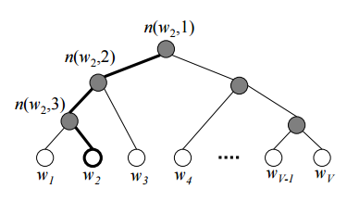

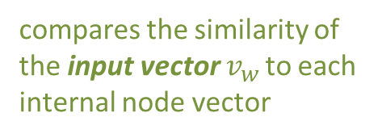

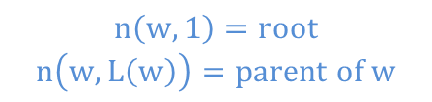
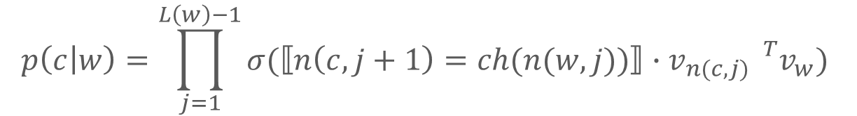
The probability of a word being the context word is defined as:
where:
  $n\left(w,j\right)$– is the j-th node on the path from the root to w.
  $L\left(w\right)$ – is the length of the path from root to w.
  $ch(n$) – is the left child of node n.
  $⟦x⟧=\{\begin{matrix}1 if x is true \\ −1 otherwise\end{matrix}$
  $σ\left(x\right)=\frac{1}{1+e^{−x}}$
compares the similarity of the input vector $v_{w }$to each internal node vector
$$p\left(c | w\right)=\prod_{j=1}^{L\left(w\right)−1}{σ(⟦n\left(c,j+1\right)=ch(n(w,j))⟧∙v_{n(c,j) }{}_{}^{T}{v_{w}}})$$
returns 1 if the path goes left,
- 1 if it goes right
$$n\left(w,1\right)=root$$
$$n\left(w,L\left(w\right)\right)=parent of w$$
$$L\left(w2\right)=3$$

Slide 70
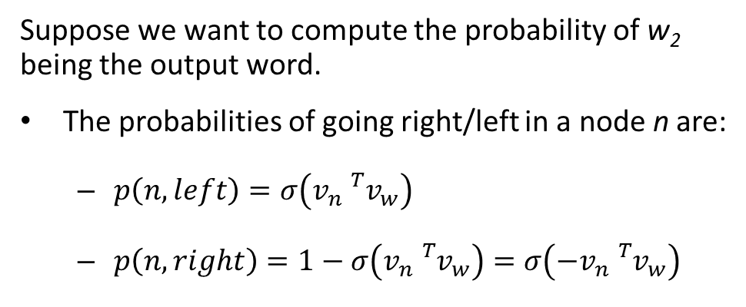
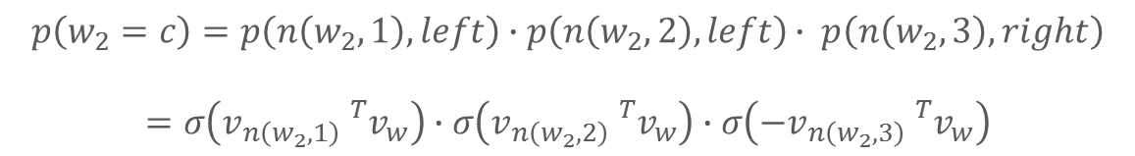
Suppose we want to compute the probability of w₂ being the output word.
The probabilities of going right/left in a node n are:
  $p\left(n,left\right)=σ\left(v_{n}{}_{}^{T}{v_{w}}\right)$
  $p\left(n,right\right)=1−σ\left(v_{n}{}_{}^{T}{v_{w}}\right)=σ\left(−v_{n}{}_{}^{T}{v_{w}}\right)$
$$p\left(w_{2}=c\right)=p\left(n\left(w_{2},1\right),left\right)∙p\left(n\left(w_{2},2\right),left\right)∙ p\left(n\left(w_{2},3\right),right\right)$$
$$=σ\left(v_{n\left(w_{2},1\right)}{}_{}^{T}{v_{w}}\right)∙σ\left(v_{n\left(w_{2},2\right)}{}_{}^{T}{v_{w}}\right)∙σ\left(−v_{n\left(w_{2},3\right)}{}_{}^{T}{v_{w}}\right)$$
Complexity improved even further using a Huffman tree:
Designed to compress binary code of a given text.
A full binary suffix tree that guarantees a minimal average weighted path length when some words are frequently used.

Slide 71
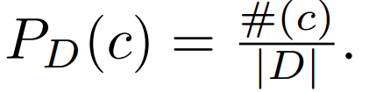
Negative Sampling
For each positive example we draw K negative examples.
The negative examples are drawn according to the unigram distribution of the data

Slide 72




$p\left(D=1|w,c\right)$ is the probability that $\left(w,c\right)∈D.$
$p\left(D=0|w,c\right)=1−p\left(D=1|w,c\right)$ is the probability that $(w,c)∉D$.
For negative samples: $p(D=1|w,c)$ must be low ⇒ $p(D=0|w,c)$ will be high.
For one sample:

Slide 73
Back to graphs

Slide 74
How?
Words = Nodes
Sentences = Paths, Random walks

Slide 75


Random-walk embeddings
probability that i and j co-occur on a random walk over the network
$$z_{i}{∙z}_{j}$$
$$≈$$

Slide 76
Random-walk Embeddings
Estimate probability of visiting node v on a random walk starting from node u using some random walk strategy R.
Optimize embeddings to encode these random walk statistics.

Slide 77

Random Walk Optimization
Run short random walks starting from each node on the graph using some strategy R.
For each node u collect N_{R}(u), the multiset* of nodes visited on random walks starting from u.
Optimize embeddings according to (maximum likelihood):
$$L= \sum_{i ∈V}{\sum_{j ∈N(i)}{−log⁡(P\left(j | z_{i}\right))}}$$
* N_{R}(u) can have repeat elements since nodes can be visited multiple times on random walks.

Slide 78



Random Walk optimization
$$L= \sum_{i ∈V}{\sum_{j ∈N(i)}{−log⁡(P\left(j | z_{i}\right))}}$$
Intuition: Optimize embeddings to maximize likelihood of random walk co-occurrences.
Parameterize P(v | z_{u}) using softmax:
predicted probability of i and j co-occuring on random walk
$$P(j|z_{i})=\frac{exp⁡(z_{i}∙z_{j})}{\sum_{m∈V}{exp}(z_{i}∙z_{m})}$$
$$L=−log⁡(\sum_{i ∈V}{\sum_{j ∈N(i)}{\frac{exp⁡(z_{i}∙z_{j})}{\sum_{m∈V}{exp}(z_{i}∙z_{m})})}}$$
sum over all nodes i
sum over nodes m seen on random walks starting from i

Slide 79
Why Random Walks?
Expressivity: Flexible stochastic definition of node similarity that incorporates both local and higher-order neighborhood information.
Efficiency: Do not need to consider all node pairs when training; only need to consider pairs that co-occur on random walks.

Slide 80
DeepWalk
Short random walks = sentences
Short truncated random walks are sentences in an artificial language
B. Perozzi, R. Al-Rfou, S. Skiena: DeepWalk: online learning of social representations. KDD 2014

Slide 81
DeepWalk
Words frequency in a natural
language corpus follows a power law.
Node frequency in random walks on scale free graphs also follows a power law.

Slide 82
DeepWalk

Slide 83
DeepWalk
Window w
Generate γ random walks for each vertex in the graph
Each short random walk has length t (intuitively, sentence length)
Pick the next step uniformly from the node neighbors

Slide 84
Representation mapping

Slide 85
Random Walk strategies
DeepWalk just runs fixed-length, unbiased random walks starting from each node
Node2vec: biased random walks that can trade off between local and global views of the network
A. Grover, J. Leskovec: node2vec: Scalable Feature Learning for Networks. KDD 2016

Slide 86



node2vec: Biased Walks
Two classic strategies to define a neighborhood $N_{R}\left(u\right)$ of a given node $u$:
$$N_{BFS}\left(u\right)=\{ s_{1},s_{2},s_{3}\}$$
Local microscopic view (BFS)
$$N_{DFS}\left(u\right)=\{ s_{4},s_{5},s_{6}\}$$
Global macroscopic view (DFS)

Slide 87



Biased 2nd Order Random Walks
Walker from t, traversed (t, v) and is now in v, where to go next?
Same distance to $t$
x₁
x₂
v
Farther from $t$
t
x₃
Closer to $t$
How much far away from t? Only three possible choices:
Farther distance (distance =2)
Same distance (distance = 1)
Back to t (distance = 0)

Slide 88





Biased Random Walks
At V from t, where to go next?
Same distance to $t$
x₁
$$1$$
x₂
v
Farther from $t$
$$1/q$$
t
$$1/p$$
x₃
Closer to $t$
$p,q$ model transition probabilities
  $p$ return parameter
  $q$ ”walk away” parameter
How much far away from t?
Farther distance (distance =2)
Same distance (distance = 1)
Back to t (distance = 0)

Slide 89




Biased Random Walks
Walker at V from t, where to go next?
Same distance to $t$
x₁
$$1$$
x₂
v
Farther from $t$
$$1/q$$
t
$$1/p$$
x₃
Closer to $t$
  BFS-like walk: Low value of $p$
  DFS-like walk: Low value of $q$
$p,q$ model transition probabilities
  $p$ return parameter
  $q$ ”walk away” parameter
$N_{S}(u)$ are the nodes visited by the walker

Slide 90

Interpolating BFS and DFS
Biased random walk $R$ that given a node $u$ generates neighborhood $N_{R}\left(u\right)$
Two parameters:
  Return parameter $p$:
    Return back to the previous node
  In-out parameter $q$:
    Moving outwards (DFS) vs. inwards (BFS)

Slide 91
node2vec
Also learns edge vectors based on the vectors of their endpoints

Slide 92
Node embeddings
Three approaches based on:
Adjacency matrix
Multi-hop neighborhoods
  HOPE
  GraRep
Random-walks
  DeepWalk
  Node2Vec

Slide 93
GraRep
Path of length k =1
Look at the paths that connect the nodes
More paths -- more similar
  Probability from a node to reach the other
Considers paths of different lengths
Path of length k = 2
Path of length k = 3
Path of length k = 4
S. Cao, W. Lu, Q.i Xu: GraRep: Learning Graph Representations with Global Structural Information. CIKM 2015

Slide 94
GraRep
But not all k-neighbors equally important
Nearest neighborhoods more important
Maintain different k-step information differently in the graph representation
Notes:
Let us focus on learning the representation for the vertex A in the graph. We can see that A receives two types
of information when learning its representation: 1-step information from B, as well as 2-step information from all C
vertices. We note that if we do not distinguish these two different types of information, we can construct an alternative graph
as shown in (b) of Figure 2, where A receives exactly the same information as (a), but has a completely different structure

Slide 95





GraRep
$$v_{2}$$
$$v_{1}$$
$$v_{3}$$
$$v_{5}$$
$$v_{4}$$
Probabilistic adjacency matrix P_{ij} the probability of transition from node i to node j where the transition has length exactly 1

Slide 96






GraRep
$$v_{2}$$
$$v_{1}$$
$$v_{3}$$
$$v_{5}$$
$$v_{4}$$
Nodes reachable in 1-step from node 2
Nodes that reach node 4 in one step
$P_{ij}^{2}$ the probability of transition form node i from node j when the transition has length exactly 2

Slide 97


GraRep
$P_{ij}^{k}$: Transition probability from node i to node j where the transition consists of exactly k steps
1. Minimize the loss for a specific k
$L_{k} = \sum_{\left(i, j\right) ∈ V x V }{||P_{ij}^{k}}$ - $z_{i}{∙z}_{j}||2$
2. Concatenate the embeddings for the different k
Basic idea:
Train embeddings to predict k-hop neighbors.
Approach based on skipgrams

Slide 98


GraRep
Transition probability from node i (current node) to node j (context node) where the transition consists of exactly k steps
$$P_{ij}^{k}=p_{k}\left(j | i\right)$$
Skip-gram model
Given a center word w, predict the context words c, i.e., the words that appear within distance k from w
$$P_{cw}^{k}=p_{k}\left(c | w\right)$$
Learn two representations:
One for node i as the source node (i.e., center word)
One for node i as the destination node (i.e., context word)

Slide 99


GraRep
Use negative sampling (*) and maximum likelihood
Assume for a given k, the collection of all paths from G that start from i and end at j. Maximize
Probability that these pairs came from the graph, and
Probability that all other pairs did not come form the graph
probability that pair (i, j) came from the graph
probability that pair (i, j) did not come from the graph
$L_{k}\left(i\right)= \sum_{j ∈ V}{ (p_{k}\left(j | i\right) \text{log} σ(z_{i}∙}z_{j}))+λ E_{j′\sim p_{k}(V)}[\text{log} σ(−z_{i}{∙ z}_{j^{′}}) ]$
Sampled vertices drawn according to the vertex distribution over the graph ($p_{k}$(V))
σ: sigmoid function
hyper parameter indicating the number of negative samples

Slide 100


GraRep
$L_{k}\left(i\right)= \sum_{j ∈ V}{ (p_{k}\left(j | i\right) \text{log} σ(z_{i}}∙z_{j}))+λ E_{j′\sim p_{k}(V)}[\text{log} σ(−z_{i}{ ∙z}_{j^{′}}) ]$
Local objective for a specific pair of nodes
$L_{k}\left(i,j\right)= P_{ij}^{k} \text{log} σ\left(z_{i}{∙z}_{j}\right)+ \frac{λ}{N} \sum_{j′∈V}{P_{ij^{′}}^{k}} \text{log} σ(−z_{i}{∙z}_{j′}]$
As before, compute the gradient and use stochastic gradient descent
Or solve by setting = 0 and get
$z_{i}z_{j}$= $log⁡(\frac{S_{i,jk}}{\sum_{i′}{A_{i^{′},jkk}}}$) – log(β), β =$\frac{λ}{Ν}$

Slide 101
Summary
Basic idea: Embed nodes so that distances in embedding space reflect node similarities in the original network.
Different notions of node similarity:
  Adjacency-based (i.e., similar if connected)
  Multi-hop similarity definitions (HOPE, GraRep).
  Random walk approaches (DeepWalk, node2vec).
No one method wins in all cases
  e.g., node2vec performs better on node classification while multi-hop methods performs better on link prediction

Slide 102
Graph neural networks

Slide 103
Outline
Basic Variant
Convolution GNNs
GraphSAGE
Gated GNNs

Slide 104
Embeddings: Key Components
Encoder maps each node to a low-dimensional vector.
Similarity function specifies how relationships in vector space map to relationships in the original network.
d-dimensional embedding
node in the input graph
Similarity of u and v in the original network
dot product between node embeddings (*)
(*) other distance measures than dot products could be used (e.g., Euclidean distance), but the dot product is the standard measure of similarity used.
Notes:
Note again that other distance measures other than dot products could be used (e.g., Euclidean distance), but the dot product is the standard measure of similarity used.

Slide 105
From “Shallow” to “Deep”
So far, “shallow” encoders, i.e. embedding lookups:
embedding vector for a specific node
embedding matrix
Dimension/size of embeddings
one column per node

Slide 106
From “Shallow” to “Deep”
“deeper” methods based on graph neural networks.
In general, all these more complex encoders can be combined with the similarity functions we discussed
complex function that depends on graph structure.

Slide 107

Setup
Assume we have a graph G:
  V is the vertex set.
  A is the adjacency matrix (assume binary).
  X $∈{\text{R}}^{m×|V|}$ is a matrix of m node features (input representation of a node)
    Categorical attributes, text, image data
      E.g., profile information in a social network.
    Node degrees, clustering coefficients, etc.
    Indicator vectors (i.e., one-hot encoding of each node)

Slide 108
Neighborhood Aggregation
Key idea: Generate node embeddings based on local neighborhoods.

Slide 109
Neighborhood Aggregation
Intuition: Nodes aggregate information from their neighbors using neural networks

Slide 110
Neighborhood Aggregation
Intuition: Network neighborhood defines a computation graph
Every node defines a unique computation graph!

Slide 111
Neighborhood Aggregation
Nodes have embeddings at each layer.
Model can be of arbitrary depth.
layer-0 embedding of node u is its input feature, i.e. x_{u}.
Layer-0
Layer-1
Layer-2

Slide 112
Neighborhood Aggregation
Key distinctions in how different approaches aggregate information across the layers.
what’s in the box!
?
???
?
?

Slide 113
Neighborhood Aggregation
Basic approach: Average neighbor information and apply a neural network.
1) average messages from neighbors
2) apply neural network

Slide 114
The Math
Basic approach: Average neighbor information and apply a neural network.
Initial “layer 0” embeddings are equal to node features
previous layer embedding of v
kth layer embedding of v
non-linearity (e.g., ReLU or tanh)
average of neighbor’s previous layer embeddings

Slide 115
Graph Convolution
Each pixel in an image as a node with neighbors determined by the filter size.
2D convolution takes a weighted average of pixel values of the red node along with its neighbors.
Neighbors of a node are ordered and have a fixed size.
To get a hidden representation of the red graph node, takes the average value of the node features of the red node along with its neighbors.
Neighbors of a node are unordered and variable in size.
Zonghan Wu, Shirui Pan, Fengwen Chen, Guodong Long, Chengqi Zhang, Philip S. Yu: A Comprehensive Survey on Graph Neural Networks. CoRR abs/1901.00596 (2019)

Slide 116
Training the Model
How do we train the model to generate high-quality embeddings?
Need to define a loss function on the embeddings, L(z_{u})!

Slide 117
Training the Model
trainable matrices (i.e., what we learn)
After K-layers of neighborhood aggregation, we get output embeddings for each node.
We can feed these embeddings into any loss function and run stochastic gradient descent to train the aggregation parameters.

Slide 118
Training the Model
Train in an unsupervised manner using only the graph structure.
Unsupervised loss function can be anything from the last section, e.g., based on
  Random walks (node2vec, DeepWalk)
  Graph factorization
  i.e., train the model so that “similar” nodes have similar embeddings.

Slide 119
Training the Model
λ number of negative samples
L$\left(z_{u}\right)=−\log\left(σ\left({z_{u}}^{Τ}z_{v}\right)\right)−λ E_{v_{n}\sim P_{n} \left(v\right)}[\text{log} σ\left(−z_{u}^{T}z_{v_{n}}\right))$
P_{n} negative sampling distribution
v a node that co-occurs near u on fixed-length random walk
representations z_{u} feed into thε loss function are generated from the features contained within a node’s local neighborhood, rather than training a unique embedding for each node

Slide 120
Training the Model
Alternative: Directly train the model for a supervised task (e.g., node classification):
Human or bot?
Human or bot?
e.g., an online social network

Slide 121
Training the Model
Alternative: Directly train the model for a supervised task (e.g., node classification):
classification weights
Human or bot?
output node embedding
node class label

Slide 122
Overview of Model Design
1) Define a neighborhood aggregation function.
2) Define a loss function on the embeddings, L(z_{u})

Slide 123
Overview of Model Design
3) Train on a set of nodes, i.e., a batch of compute graphs

Slide 124
Overview of Model
4) Generate embeddings for nodes as needed
Even for nodes we never trained on!!!!

Slide 125
Inductive Capability
The same aggregation parameters are shared for all nodes.
The number of model parameters is sublinear in |V| and we can generalize to unseen nodes!

Slide 126


Inductive Capability
train on one graph
generalize to new graph
Inductive node embedding generalize to entirely unseen graphs
e.g., train on protein interaction graph from model organism A and generate embeddings on newly collected data about organism B

Slide 127



Inductive Capability
generate embedding for new node
train with snapshot
new node arrives
Many application settings constantly encounter previously unseen nodes.
e.g., Reddit, YouTube, GoogleScholar, ….
Need to generate new embeddings “on the fly”

Slide 128
Quick Recap
Basic variant: Generate node embeddings by aggregating neighborhood information.
  Allows for parameter sharing in the encoder.
  Allows for inductive learning.

Slide 129
Graph Convolutional Networks (GCNs)
Variation on the neighborhood aggregation idea:
Kipf et al., 2017. Semisupervised Classification with Graph Convolutional Networks. ICLR.

Slide 130
Graph Convolutional Networks
Basic Neighborhood Aggregation
VS.
GCN Neighborhood Aggregation
same matrix for self and neighbor embeddings
per-neighbor normalization

Slide 131
Graph Convolutional Networks
Empirically, they found this configuration to give the best results.
  More parameter sharing.
  Down-weights high degree neighbors.
use the same transformation matrix for self and neighbor embeddings
instead of simple average, normalization varies across neighbors

Slide 132
GraphSAGE Idea
So far we have aggregated the neighbor messages by taking their (weighted) average, can we do better?
?
???
?
?
Hamilton et al., 2017. Inductive Representation Learning on Large Graphs. NIPS

Slide 133
GraphSAGE Idea
Any differentiable function that maps set of vectors to a single vector.

Slide 134
GraphSAGE Differences
Simple neighborhood aggregation:
GraphSAGE:
concatenate self embedding and neighbor embedding
generalized aggregation

Slide 135
GraphSAGE Variants
Mean:
Pool
  Transform neighbor vectors and apply symmetric vector function
LSTM:
  Apply LSTM (Long Short-Term Memory) to random permutation of neighbors.
element-wise mean/max

Slide 136
Neighborhood Aggregation
Basic idea: Nodes aggregate “messages” from their neighbors using neural networks

Slide 137
Neighborhood Aggregation
GCNs and GraphSAGE generally only 2-3 layers deep.

Slide 138
Neighborhood Aggregation
But what if we want to go deeper?
10+ layers!?

Slide 139
Gated Graph Neural Networks
How can we build models with many layers of neighborhood aggregation?
Challenges:
  Overfitting from too many parameters.
  Vanishing/exploding gradients during backpropagation.
Idea: Use techniques from modern recurrent neural networks
Li et al., 2016. Gated Graph Sequence Neural Networks. ICLR.

Slide 140
Gated Graph Neural Networks
Idea 1: Parameter sharing across layers.
same neural network across layers

Slide 141
Gated Graph Neural Networks
Idea 2: Recurrent state update.
RNN module!
RNN module

Slide 142
Summary
Graph convolutional networks
  Average neighborhood information and stack neural networks.
GraphSAGE
  Generalized neighborhood aggregation.
Gated Graph Neural Networks
  Neighborhood aggregation + RNNs

Slide 143
Acknowledgement
Most slides adopted from the following tutorial
William Hamilton, Rex Ying, Jure Leskovec and Rok Sosic, Representation Learning on Networks. Held at WWW 2018 (April 24, Lyon, France).

