Slide 1
DATA MINING
THE EM Algorithm
Maximum Likelihood Estimation

Slide 2
Mixture Models and the EM Algorithm

Slide 3
Model-based clustering
In order to understand our data, we will assume that there is a generative process (a model) that creates/describes the data, and we will try to find the model that best fits the data.
  Models of different complexity can be defined, but we will assume that our model is a distribution from which data points are sampled
  Example: the data is the height of all people in Greece
In most cases, a single distribution is not good enough to describe all data points: different parts of the data follow a different distribution
  Example: the data is the height of all people in Greece and China
  We need a mixture model
  Different distributions correspond to different clusters in the data.

Slide 4
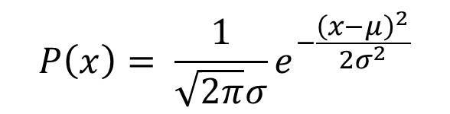
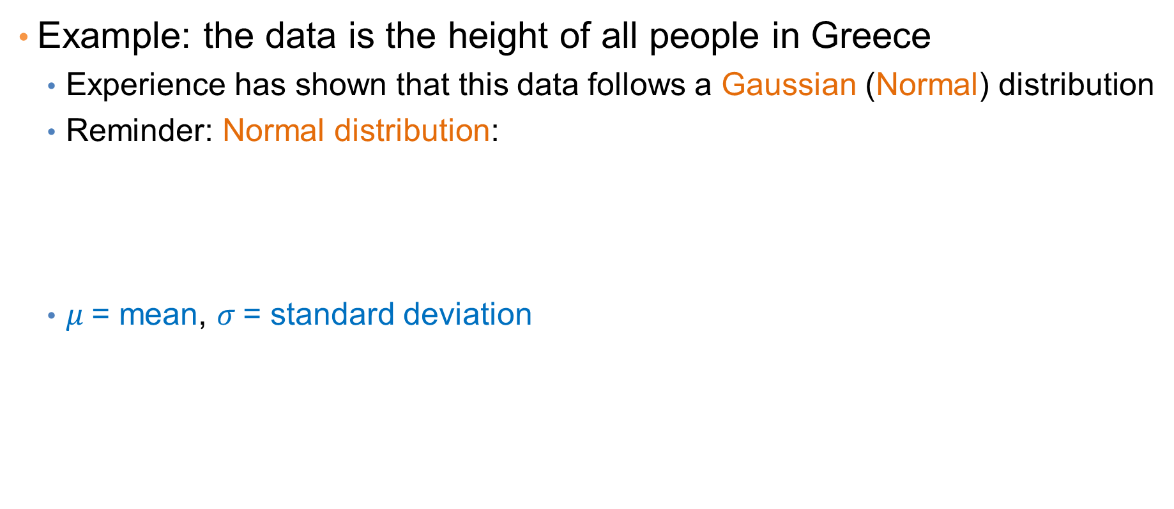
Gaussian Distribution
Example: the data is the height of all people in Greece
  Experience has shown that this data follows a Gaussian (Normal) distribution
  Reminder: Normal distribution:
  $μ$= mean, $σ$= standard deviation
$$P\left(x\right)= \frac{1}{\sqrt{2π}σ}e^{−\frac{{\left(x−μ\right)}^{2}}{2σ^{2}}}$$

Slide 5
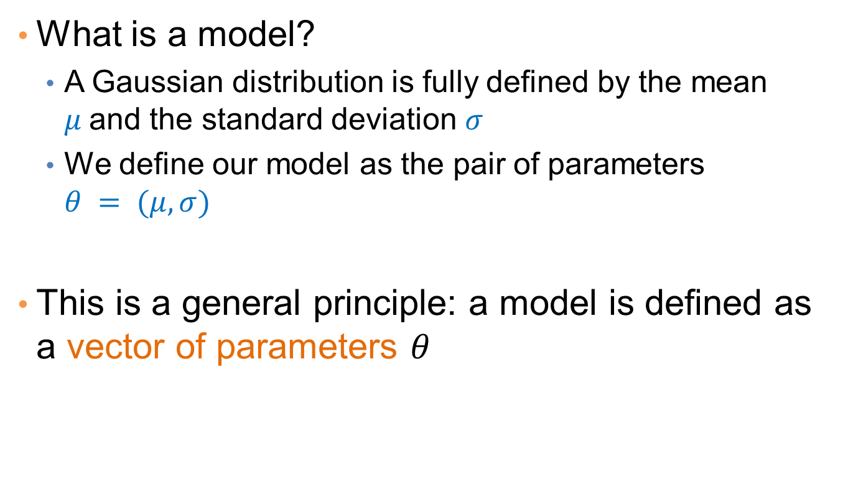
Gaussian Model
What is a model?
  A Gaussian distribution is fully defined by the mean $μ$and the standard deviation $σ$
  We define our model as the pair of parameters $θ = (μ, σ)$
This is a general principle: a model is defined as a vector of parameters $θ$

Slide 6
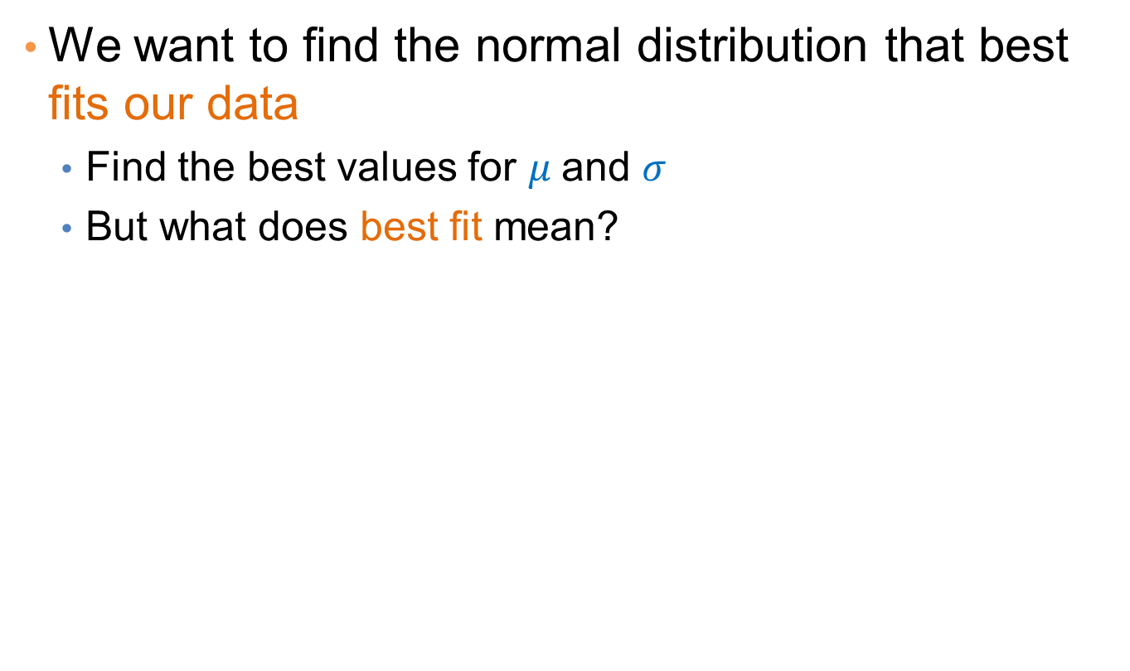
Fitting the model
We want to find the normal distribution that best fits our data
  Find the best values for $μ$and $σ$
  But what does best fit mean?

Slide 7
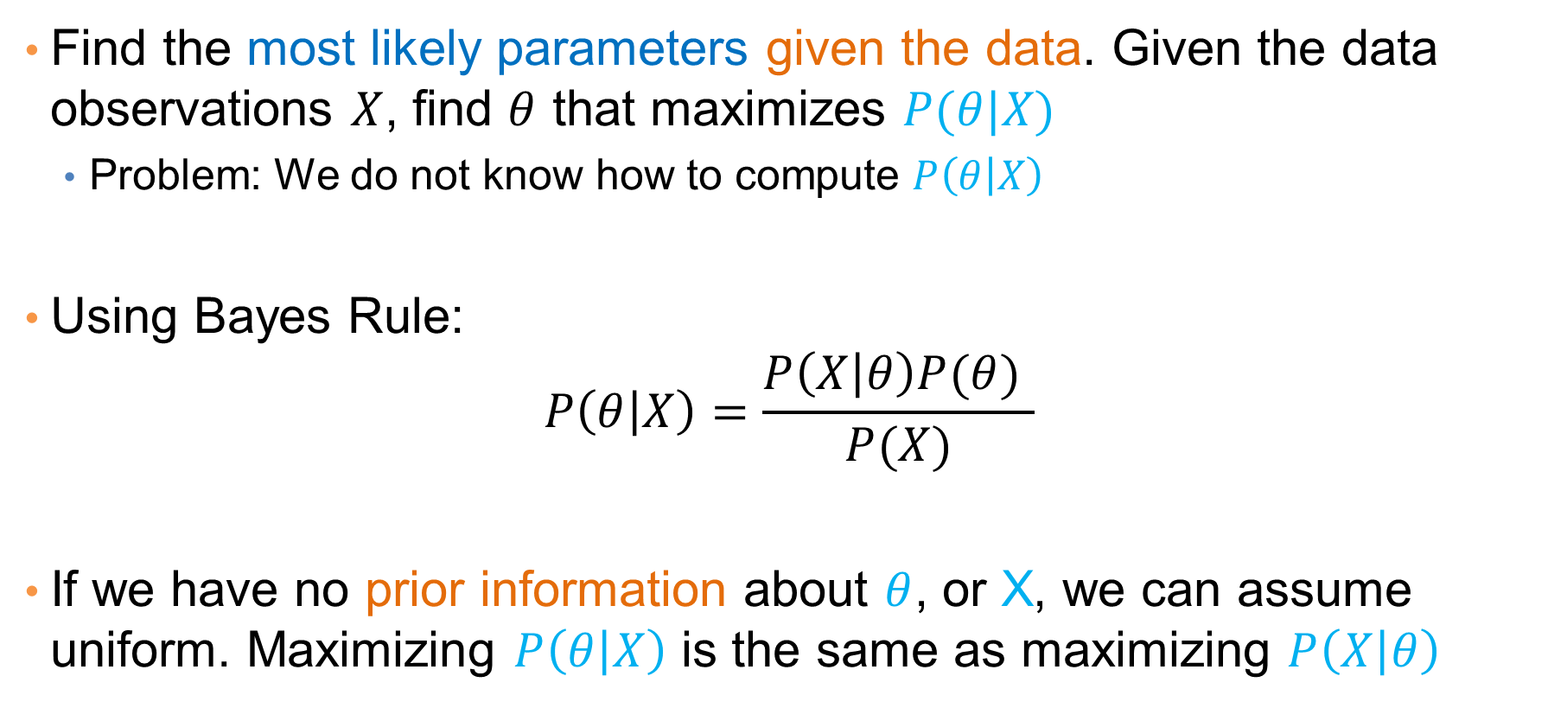
Maximum Likelihood Estimation (MLE)
Find the most likely parameters given the data. Given the data observations $X$, find $θ$ that maximizes $P(θ|X)$
  Problem: We do not know how to compute $P\left(θ | X\right)$
Using Bayes Rule:
$$P\left(θ | X\right)=\frac{P\left(X | θ\right)P(θ) }{P(X)}$$
If we have no prior information about $θ$, or X, we can assume uniform. Maximizing $P\left(θ | X\right)$ is the same as maximizing $P\left(X | θ\right)$

Slide 8
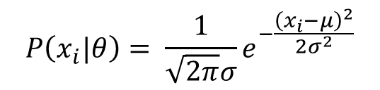
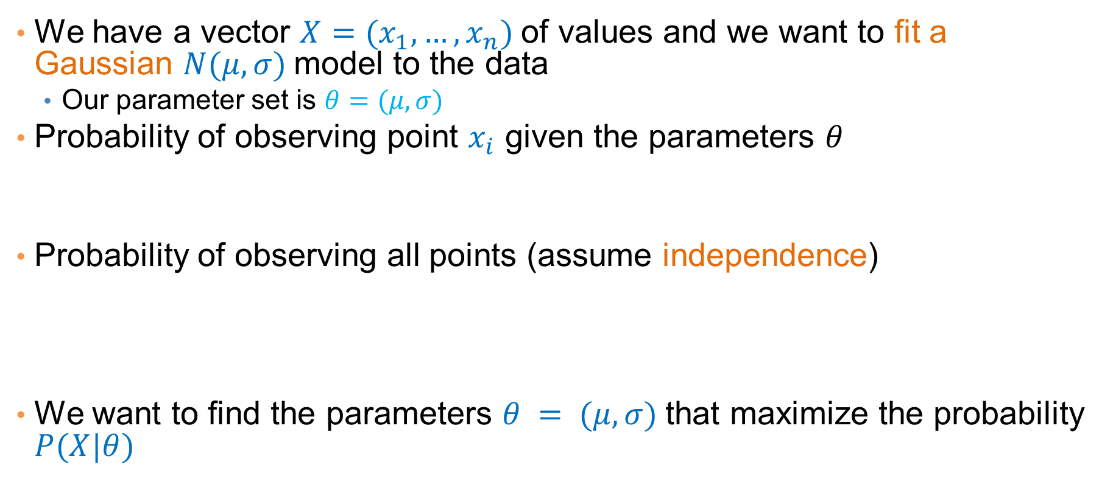
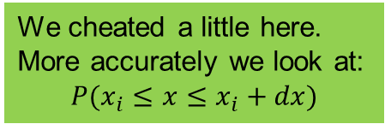
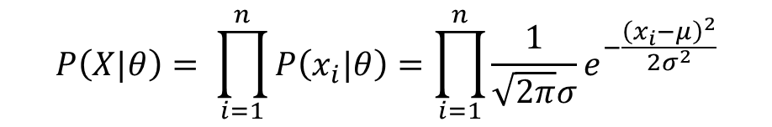
Maximum Likelihood Estimation (MLE)
We have a vector $X=(x_{1},…,x_{n})$of values and we want to fit a Gaussian $N(μ,σ)$model to the data
  Our parameter set is $θ=(μ, σ)$
Probability of observing point $x_{i}$ given the parameters $θ$
Probability of observing all points (assume independence)
We want to find the parameters $θ = (μ, σ)$that maximize the probability $P(X|θ)$
We cheated a little here.
More accurately we look at:
$$P(x_{i}≤x≤x_{i}+dx)$$
$$P\left(x_{i}|θ\right)= \frac{1}{\sqrt{2π}σ}e^{−\frac{{\left(x_{i}−μ\right)}^{2}}{2σ^{2}}}$$
$$P\left(X|θ\right)= \prod_{i=1}^{n}{P\left(x_{i}|θ\right)}=\prod_{i=1}^{n}{\frac{1}{\sqrt{2π}σ}e^{−\frac{{\left(x_{i}−μ\right)}^{2}}{2σ^{2}}}}$$

Slide 9

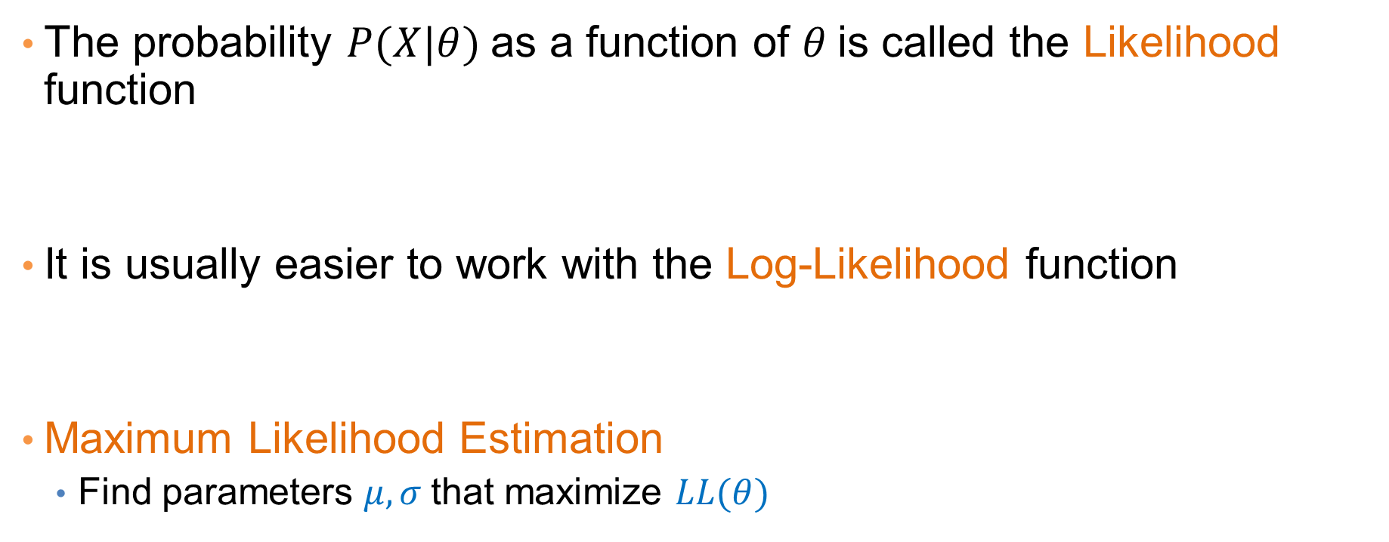
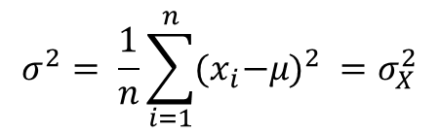
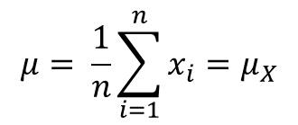
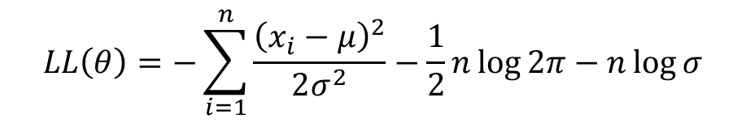
Maximum Likelihood Estimation (MLE)
The probability $P(X|θ)$as a function of $θ$is called the Likelihood function
It is usually easier to work with the Log-Likelihood function
Maximum Likelihood Estimation
  Find parameters $μ, σ$that maximize $LL(θ)$
$$L(θ)=\prod_{i=1}^{n}{\frac{1}{\sqrt{2π}σ}e^{−\frac{{\left(x_{i}−μ\right)}^{2}}{2σ^{2}}}}$$
$$LL\left(θ\right)=−\sum_{i=1}^{n}{\frac{{\left(x_{i}−μ\right)}^{2}}{2σ^{2}}−\frac{1}{2}n\log{2π}−n\log{σ}}$$
$$μ= \frac{1}{n}\sum_{i=1}^{n}{x_{i}=μ_{X}}$$
$$σ^{2}= \frac{1}{n}\sum_{i=1}^{n}{{{(x}_{i}−μ)}^{2} }=σ_{X}^{2}$$
Sample Mean
Sample Variance

Slide 10
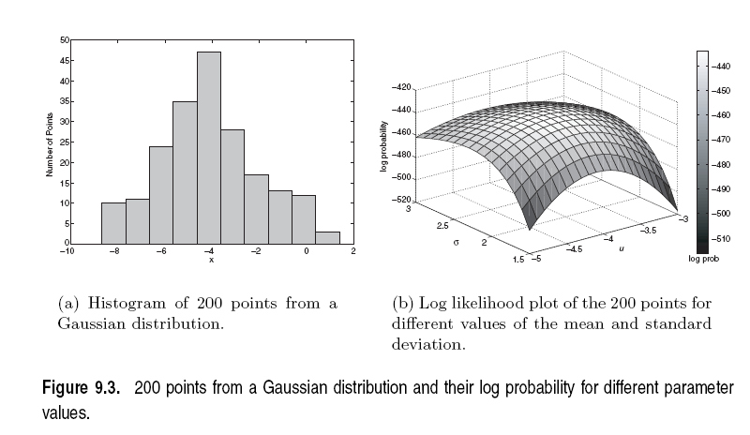

Slide 11
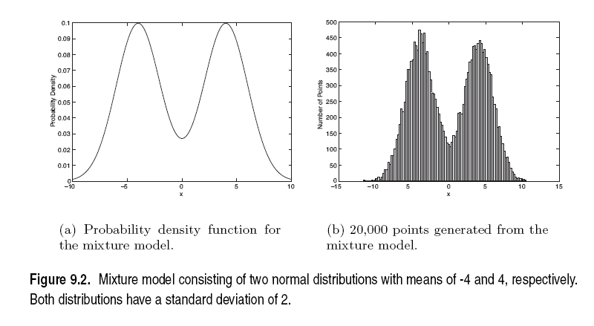
Mixture of Gaussians
Suppose that you have the heights of people from Greece and China and the distribution looks like the figure below (dramatization)

Slide 12
Mixture of Gaussians
In this case the data is the result of the mixture of two Gaussians
  One for Greek people, and one for Chinese people
  Identifying for each value which Gaussian is most likely to have generated it will give us a clustering.

Slide 13
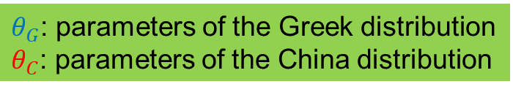
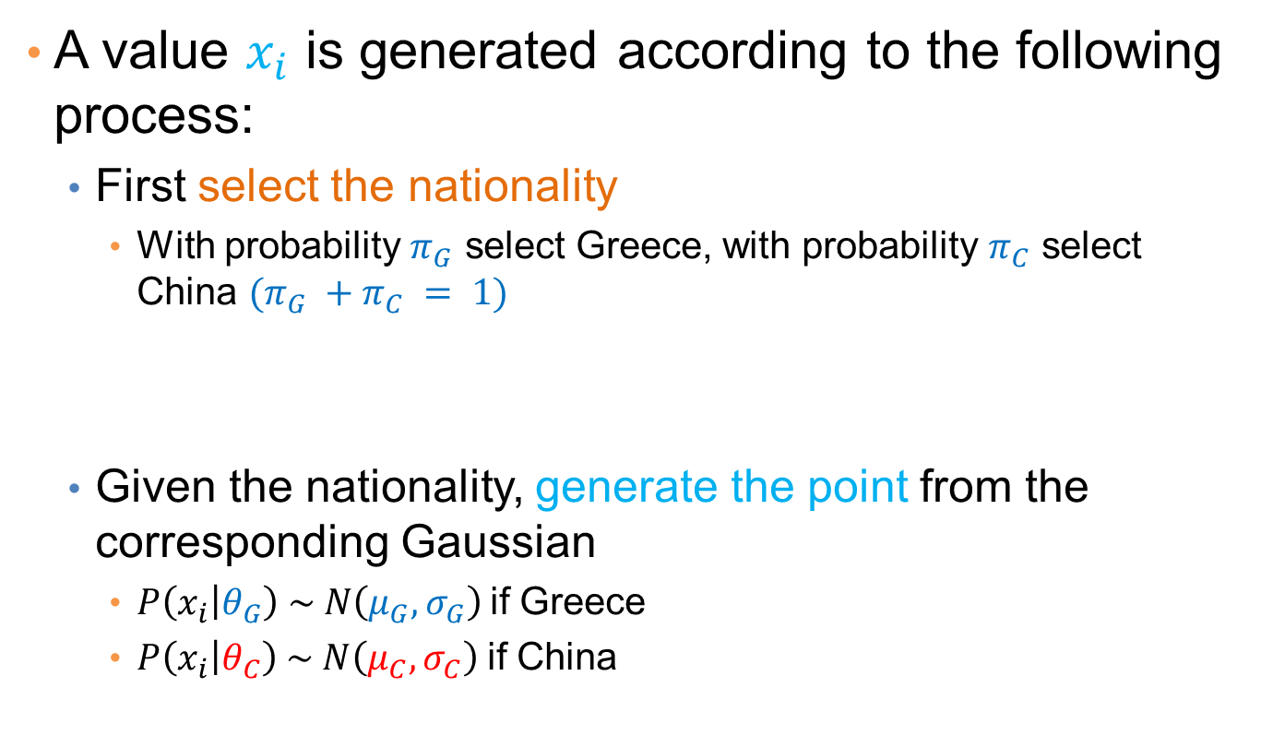
Mixture model
A value $x_{i}$ is generated according to the following process:
  First select the nationality
    With probability $π_{G}$ select Greece, with probability $π_{C}$ select China $(π_{G} +π_{C} = 1)$
  Given the nationality, generate the point from the corresponding Gaussian
    $P\left(x_{i} | θ_{G}\right) \sim N\left(μ_{G},σ_{G}\right)$if Greece
    $P\left(x_{i} | θ_{C}\right) \sim N\left(μ_{C},σ_{C}\right)$if China
We can also thing of this as a Hidden Variable Z that takes two values: Greece and China
$θ_{G}$: parameters of the Greek distribution
$θ_{C}$: parameters of the China distribution

Slide 14

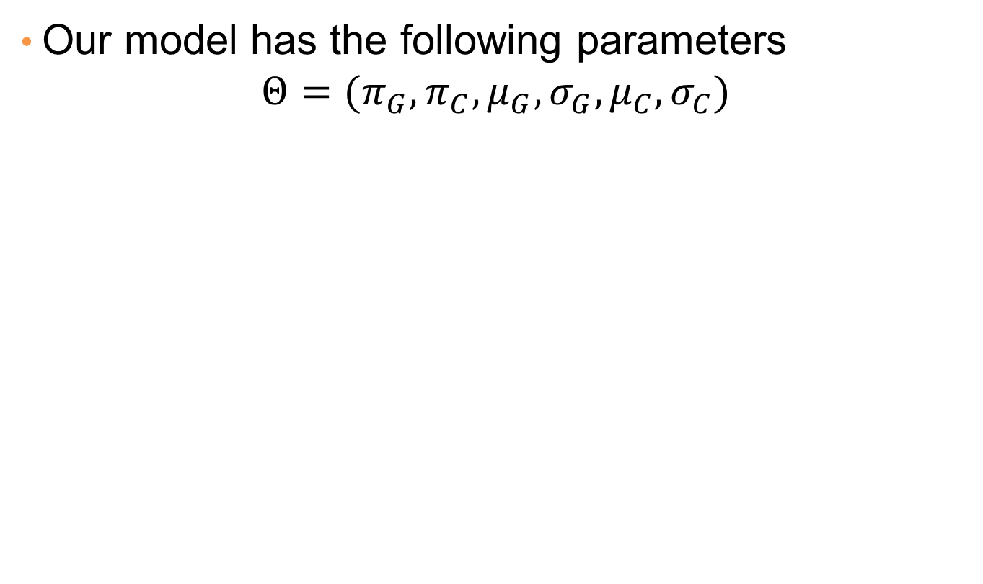

Mixture Model
Our model has the following parameters
$$Θ=(π_{G},π_{C},μ_{G},{σ_{G},μ}_{C}, σ_{C})$$
Mixture probabilities
$θ_{G}$: parameters of the Greek distribution
$θ_{C}$: parameters of the China distribution

Slide 15
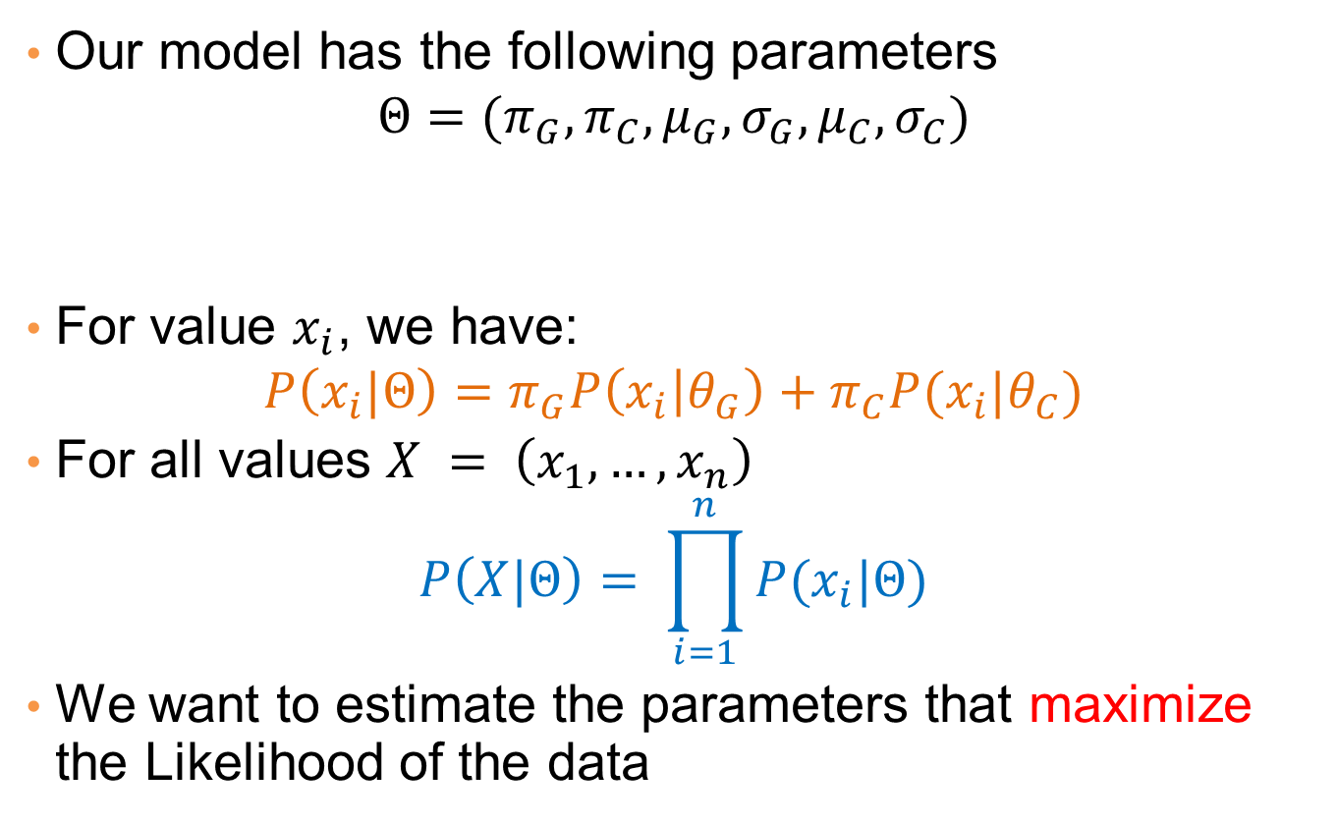
Mixture Model
Our model has the following parameters
$$Θ=(π_{G},π_{C},μ_{G},{σ_{G},μ}_{C}, σ_{C})$$
For value $x_{i}$, we have:
$$P\left(x_{i}|Θ\right)=π_{G}P\left(x_{i} | θ_{G}\right)+π_{C}P(x_{i}|θ_{C})$$
For all values $X = \left(x_{1},…,x_{n}\right)$
$$P\left(X|Θ\right)= \prod_{i=1}^{n}{P(x_{i}|Θ)}$$
We want to estimate the parameters that maximize the Likelihood of the data
Mixture probabilities
Distribution Parameters

Slide 16

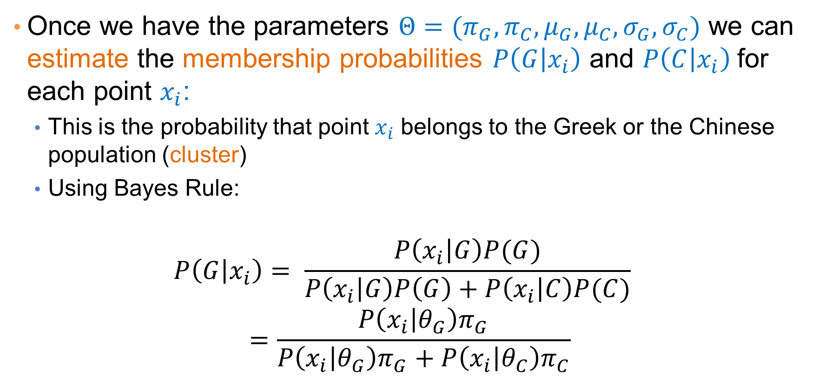
Mixture Models
Once we have the parameters $Θ=(π_{G},π_{C},μ_{G},μ_{C}, σ_{G},σ_{C})$ we can estimate the membership probabilities $P\left(G | x_{i}\right)$ and $P\left(C | x_{i}\right)$for each point $x_{i}$:
  This is the probability that point $x_{i}$ belongs to the Greek or the Chinese population (cluster)
  Using Bayes Rule:
$$P\left(G | x_{i}\right)= \frac{P\left(x_{i} | G\right)P(G)}{P\left(x_{i} | G\right)P\left(G\right)+P\left(x_{i} | C\right)P(C)} =\frac{P\left(x_{i} | θ_{G}\right)π_{G}}{P\left(x_{i} | θ_{G}\right)π_{G}+P\left(x_{i} | θ_{C}\right)π_{C}}$$
Given from the Gaussian distribution $N(μ_{G}, σ_{G})$ for Greek

Slide 17
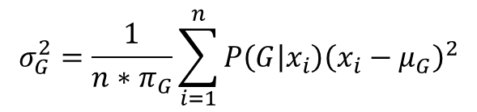
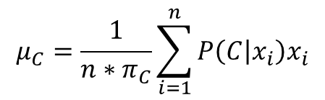
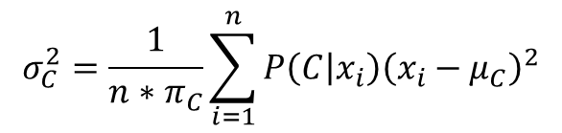
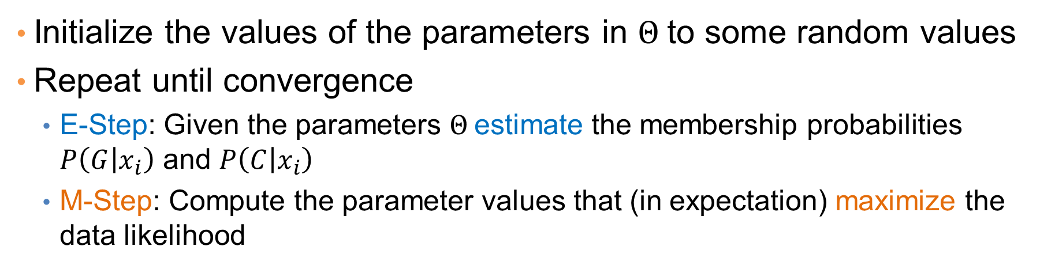
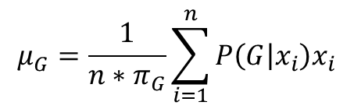
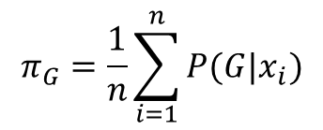
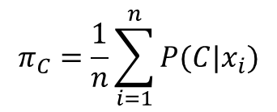
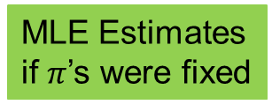
EM (Expectation Maximization) Algorithm
Initialize the values of the parameters in $Θ$to some random values
Repeat until convergence
  E-Step: Given the parameters $Θ$estimate the membership probabilities $P\left(G | x_{i}\right)$ and $P\left(C | x_{i}\right)$
  M-Step: Compute the parameter values that (in expectation) maximize the data likelihood
$$π_{C}=\frac{1}{n}\sum_{i=1}^{n}{P(C|x_{i})}$$
$$π_{G}=\frac{1}{n}\sum_{i=1}^{n}{P(G|x_{i})}$$
Fraction of population in G,C
$$μ_{C}=\frac{1}{n{∗π}_{C}}\sum_{i=1}^{n}{{P\left(C | x_{i}\right)x}_{i}}$$
$$μ_{G}=\frac{1}{n{∗π}_{G}}\sum_{i=1}^{n}{{P\left(G | x_{i}\right)x}_{i}}$$
MLE Estimates
if $π$’s were fixed
$$σ_{C}^{2}=\frac{1}{n{∗π}_{C}}\sum_{i=1}^{n}{{P\left(C | x_{i}\right)\left(x_{i}−μ_{C}\right)}^{2}}$$
$$σ_{G}^{2}=\frac{1}{n{∗π}_{G}}\sum_{i=1}^{n}{{P\left(G | x_{i}\right)\left(x_{i}−μ_{G}\right)}^{2}}$$

Slide 18
Relationship to K-means
E-Step: Assignment of points to clusters
  K-means: hard assignment, EM: soft assignment
M-Step: Computation of centroids
  K-means assumes common fixed variance (spherical clusters)
  EM: can change the variance for different clusters or different dimensions (ellipsoid clusters)
If the variance is fixed then both minimize the same error function

Slide 19
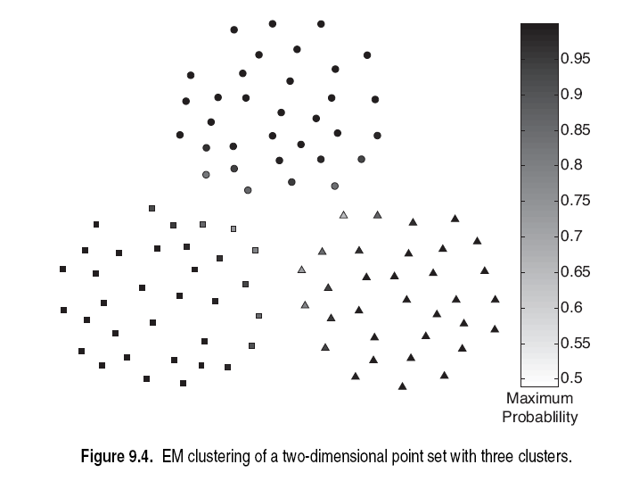

Slide 20
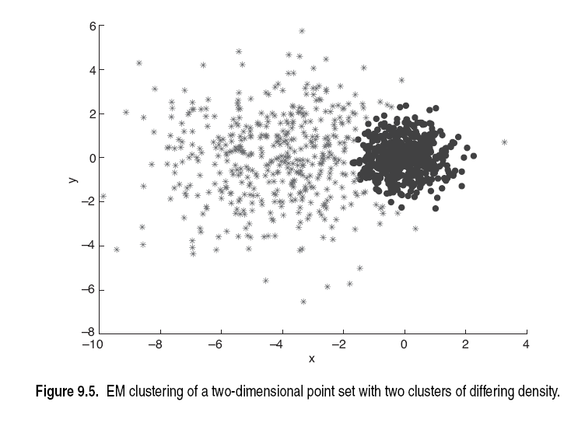

Slide 21
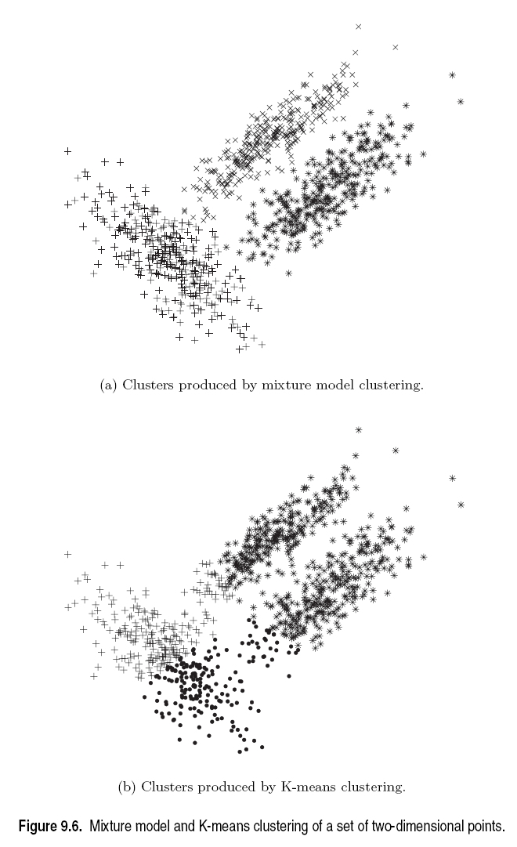

Slide 22
Sequence Segmentation

Slide 23
Sequential data
Sequential data (or time series) refers to data that appear in a specific order.
  The order defines a time axis, that differentiates this data from other cases we have seen so far
Examples
  The price of a stock (or of many stocks) over time
  Environmental data (pressure, temperature, precipitation etc) over time
  The sequence of queries in a search engine, or the frequency of a single query over time
  The words in a document as they appear in order
  A DNA sequence of nucleotides
  Event occurrences in a log over time
  Etc…
Time series: usually we assume that we have a vector of numeric values that change over time.

Slide 24
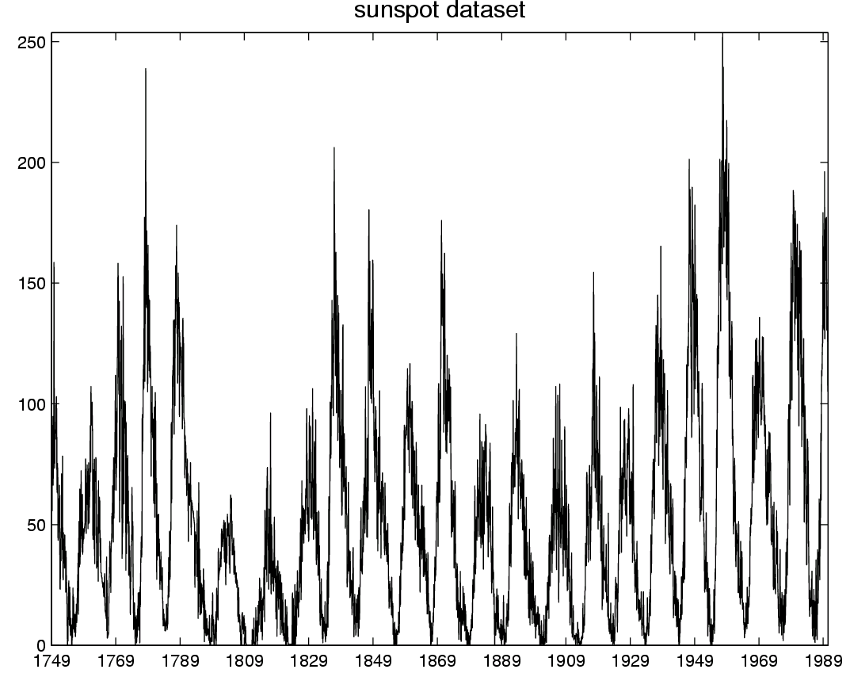
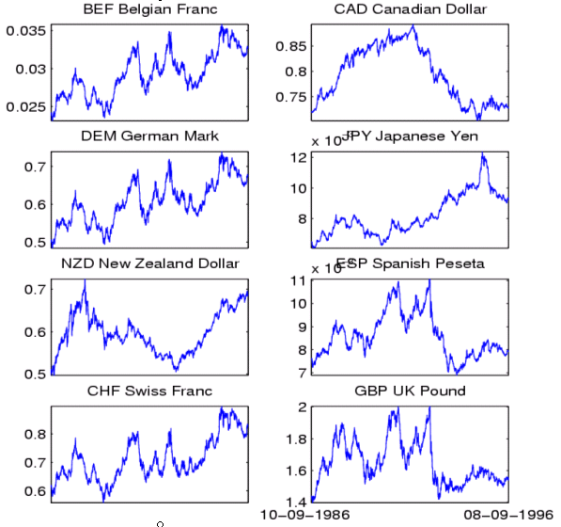
Time-series data
Financial time series, process monitoring…

Slide 25
Time series analysis
The addition of the time axis defines new sets of problems
  Discovering periodic patterns in time series
  Defining similarity between time series
  Finding bursts, or outliers
Also, some existing problems need to be revisited taking sequential order into account
  Association rules and Frequent Itemsets in sequential data
  Summarization and Clustering: Sequence Segmentation

Slide 26
Sequence Segmentation
Goal: discover structure in the sequence and provide a concise summary
Given a sequence T, segment it into K contiguous segments that are as homogeneous as possible
Similar to clustering but now we require the points in the cluster to be contiguous
Commonly used for summarization of histograms in databases

Slide 27
Example
R
t
R
Segmentation into 4 segments
Homogeneity: points are close to the mean value (small error)
t

Slide 28
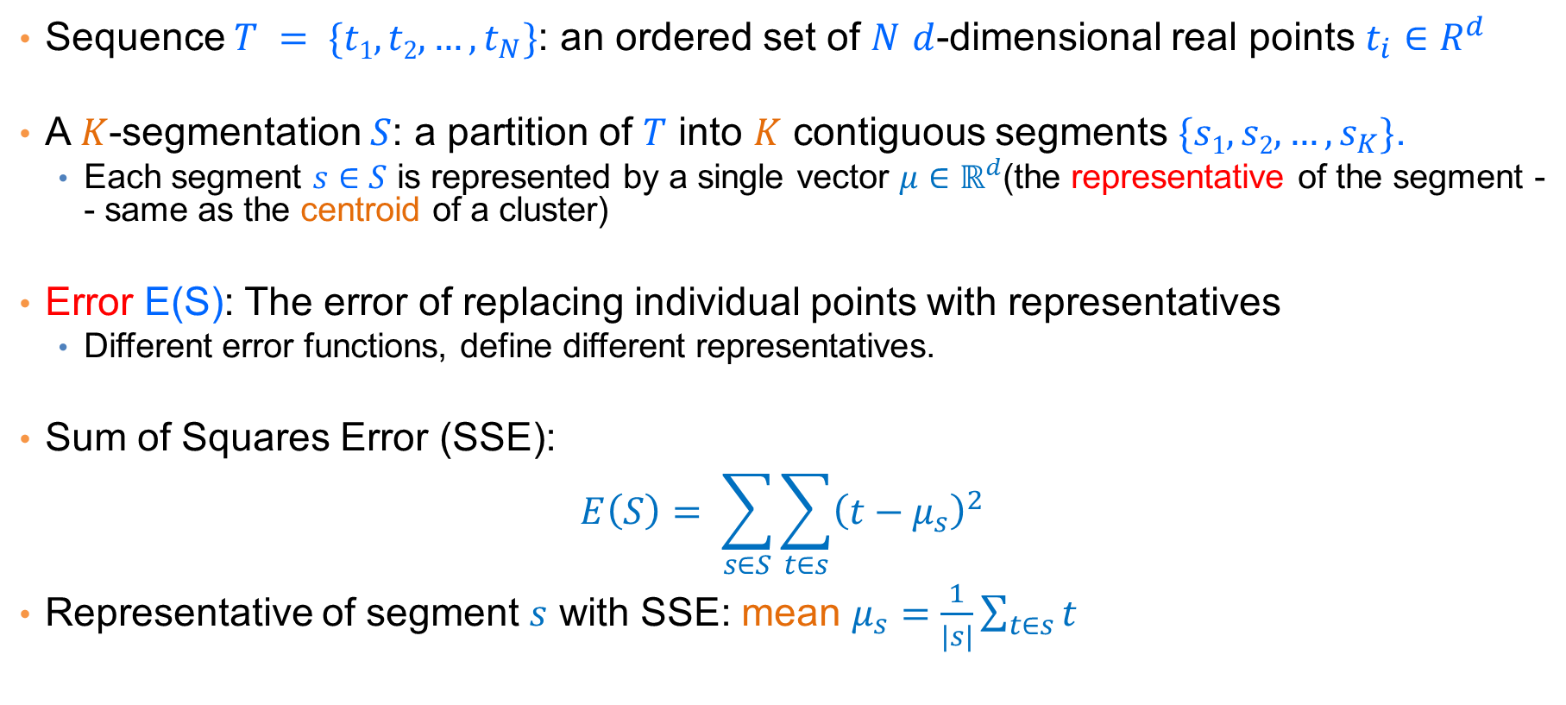
Basic definitions
Sequence $T = \{t1,t2,…,t_{N}\}$: an ordered set of $N$ $d$-dimensional real points $t_{i}∈R^{d}$
A $K$-segmentation $S$: a partition of $T$ into $K$ contiguous segments $\{s1,s2,…,s_{K}\}$.
  Each segment $s∈S$ is represented by a single vector $μ∈ℝ^{d}$(the representative of the segment -- same as the centroid of a cluster)
Error E(S): The error of replacing individual points with representatives
  Different error functions, define different representatives.
Sum of Squares Error (SSE):
$$E\left(S\right)= \sum_{s∈S}{\sum_{t∈s}{{\left(t−μ_{s}\right)}^{2}}}$$
Representative of segment $s$ with SSE: mean $μ_{s}=\frac{1}{|s|}\sum_{t∈s}{t}$

Slide 29
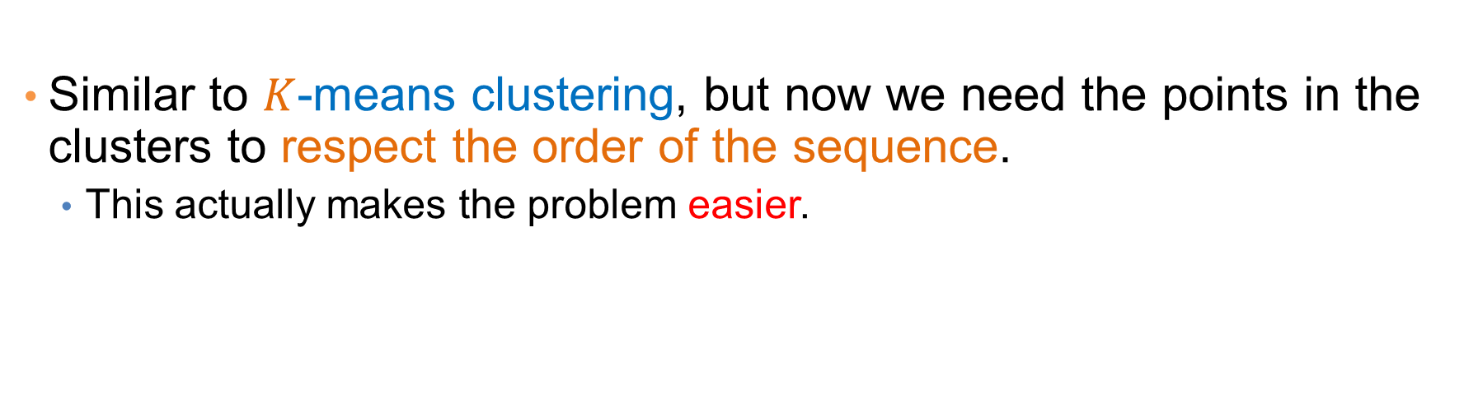
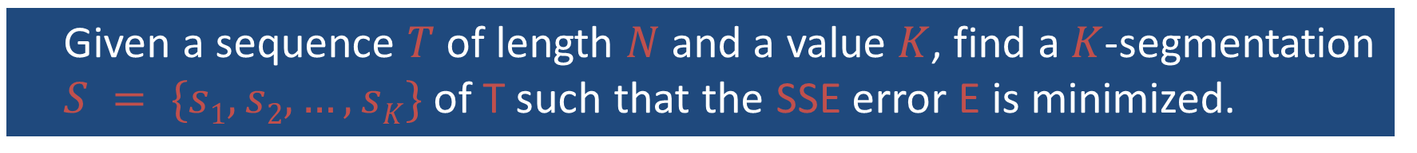
The K-segmentation problem
Given a sequence $T$ of length $N$ and a value $K$, find a $K$-segmentation $S = \{s1, s2, …,sK\}$of T such that the SSE error E is minimized.
Similar to $K$-means clustering, but now we need the points in the clusters to respect the order of the sequence.
  This actually makes the problem easier.

Slide 30


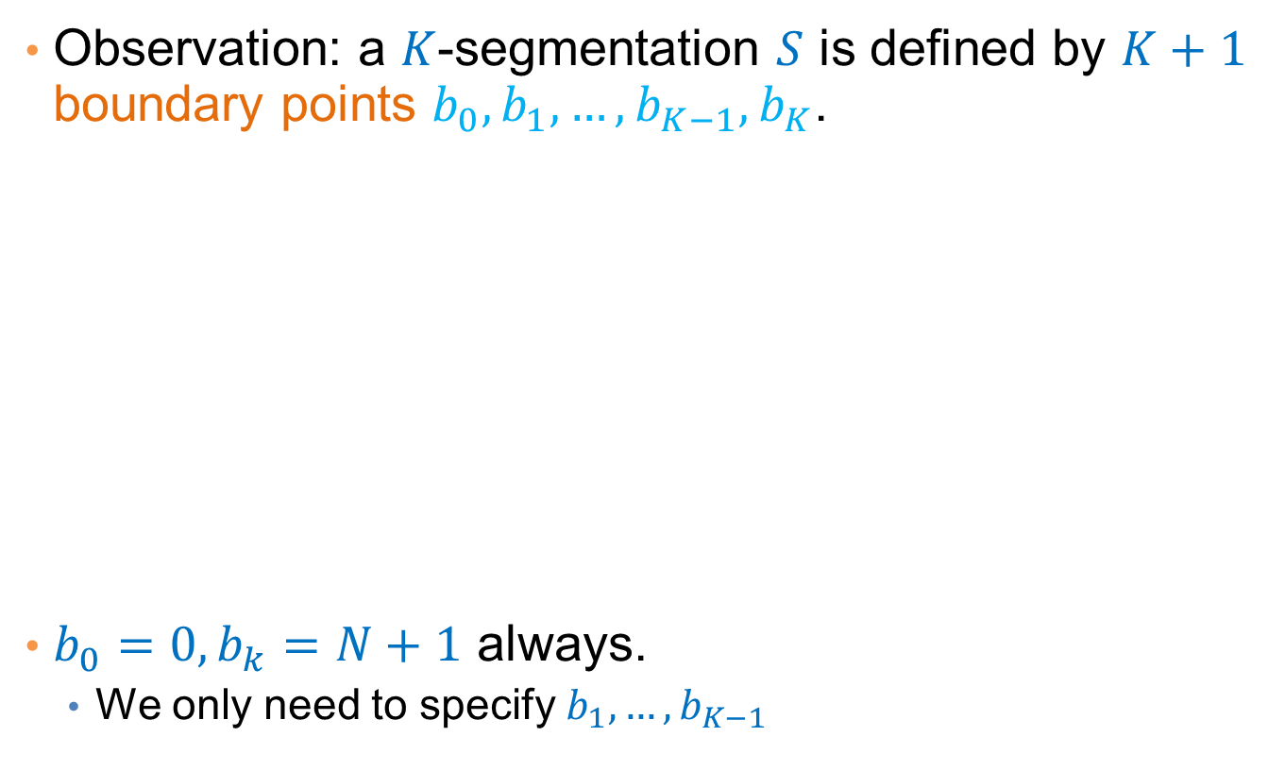



Basic Definitions
Observation: a $K$-segmentation $S$ is defined by $K+1$ boundary points $b_{0},b_{1},…,b_{K−1},b_{K}$.
$b_{0}=0, b_{k}=N+1$ always.
  We only need to specify$b_{1},…,b_{K−1}$
R
t
$$b_{0}$$
$$b_{1}$$
$$b_{2}$$
$$b_{3}$$
$$b_{4}$$

Slide 31
Optimal solution for the k-segmentation problem
Bellman’61: The K-segmentation problem can be solved optimally using a standard dynamic programming algorithm
Dynamic Programming:
  Construct the solution of the problem by using solutions to problems of smaller size
    Define the dynamic programming recursion
  Build the solution bottom up from smaller to larger instances
    Define the dynamic programming table that stores the solutions to the sub-problems

Slide 32
Rule of thumb
Most optimization problems where order is involved can be solved optimally in polynomial time using dynamic programming.
  The polynomial exponent may be large though

Slide 33
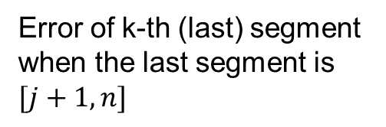
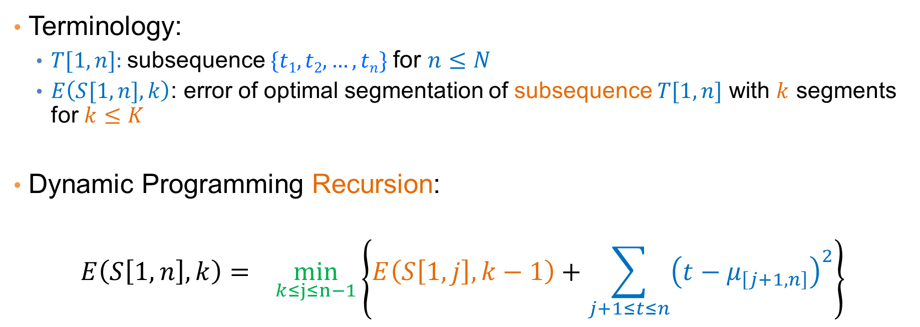
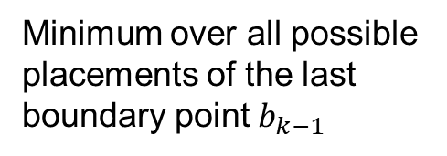
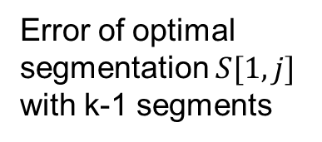
Dynamic Programming Recursion
Terminology:
  $T[1,n]$: subsequence $\{t1,t2,…,tn\}$for $n≤N$
  $E\left(S[1,n],k\right)$: error of optimal segmentation of subsequence $T[1,n]$ with $k$ segments for $k≤K$
Dynamic Programming Recursion:
$$E\left(S\left[1,n\right],k\right)= \min_{k≤j≤n−1}\left\{E\left(S\left[1,j\right],k−1\right)+\sum_{j+1≤t≤n}{{\left(t−μ_{\left[j+1,n\right]}\right)}^{2}}\right\}$$
Minimum over all possible placements of the last boundary point $b_{k−1}$
Error of optimal segmentation $S[1,j]$ with k-1 segments
Error of k-th (last) segment when the last segment is $[j+1,n]$

Slide 34


Dynamic programming table
$\text{Two}\text{−}\text{dimensional} \text{table} A[1…K, 1…N]$
  $$E\left(S\left[1,n\right],k\right)=\min_{k≤j≤n−1}\left\{E\left(S\left[1,j\right],k−1\right)+\sum_{j+1≤t≤n}{{\left(t−μ_{\left[j+1,n\right]}\right)}^{2}}\right\}$$
Fill the table, top to bottom, left to right.
$$A\left[k,n\right]= E\left(S\left[1,n\right],k\right)$$
1
n-1
n
N
1
k-1
k
K
Error of optimal K-segmentation

Slide 35
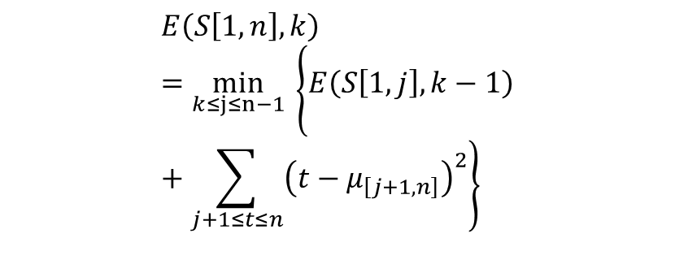



Example
k = 3
n-th point
$$b_{1}$$
$$b_{2}$$
R
  $$E\left(S\left[1,n\right],k\right)=\min_{k≤j≤n−1}\left\{E\left(S\left[1,j\right],k−1\right)+\sum_{j+1≤t≤n}{{\left(t−μ_{\left[j+1,n\right]}\right)}^{2}}\right\}$$
1
n
N
1
2
3
Three segnments means two boundaries $b_{1},b_{2}$
4
Where should we place boundary $b_{2}$?

Slide 36
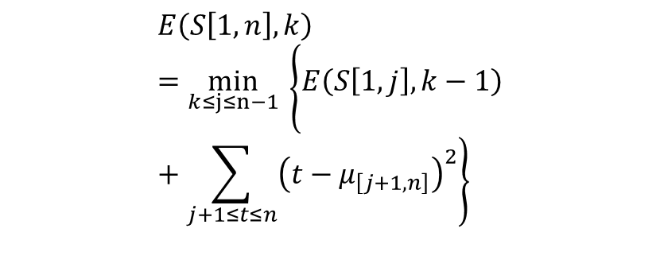


Example
k = 3
n-th point
$$b_{2}$$
$$b_{1}$$
R
  $$E\left(S\left[1,n\right],k\right)=\min_{k≤j≤n−1}\left\{E\left(S\left[1,j\right],k−1\right)+\sum_{j+1≤t≤n}{{\left(t−μ_{\left[j+1,n\right]}\right)}^{2}}\right\}$$
1
n
N
1
2
3
4
Where should we place boundary $b_{2}$?

Slide 37


Example
k = 3
n-th point
$$b_{1}$$
$$b_{2}$$
R
  $$E\left(S\left[1,n\right],k\right)=\min_{k≤j≤n−1}\left\{E\left(S\left[1,j\right],k−1\right)+\sum_{j+1≤t≤n}{{\left(t−μ_{\left[j+1,n\right]}\right)}^{2}}\right\}$$
1
n
N
1
2
3
4
Where should we place boundary $b_{2}$?

Slide 38

Example
k = 3
n-th point
$$b_{1}$$
$$b_{2}$$
R
  $$E\left(S\left[1,n\right],k\right)=\min_{k≤j≤n−1}\left\{E\left(S\left[1,j\right],k−1\right)+\sum_{j+1≤t≤n}{{\left(t−μ_{\left[j+1,n\right]}\right)}^{2}}\right\}$$
1
n
N
1
2
3
4
Where should we place boundary $b_{2}$?

Slide 39
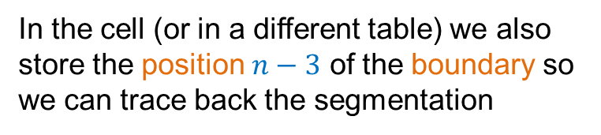
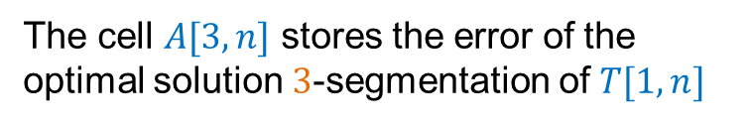
Example
k = 3
n-th point
$$b_{1}$$
$$b_{2}$$
R
Optimal segmentation S[1:n]
1
n-3
n
N
The cell $A[3,n]$ stores the error of the optimal solution $3$-segmentation of $T[1,n]$
1
2
3
In the cell (or in a different table) we also store the position $n−3$ of the boundary so we can trace back the segmentation
4

Slide 40
Dynamic-programming algorithm
Input: Sequence T, length N, K segments, error function E()
  For i=1 to N //Initialize first row
    A[1,i]=E(T[1…i]) //Error when everything is in one cluster
  For k=1 to K // Initialize diagonal
    A[k,k] = 0 // Error when each point in its own cluster
  For k=2 to K
    For i=k+1 to N
      A[k,i] = min_{j<i}{A[k-1,j]+E(T[j+1…i])}
To recover the actual segmentation (not just the optimal cost) store also the minimizing values j

Slide 41
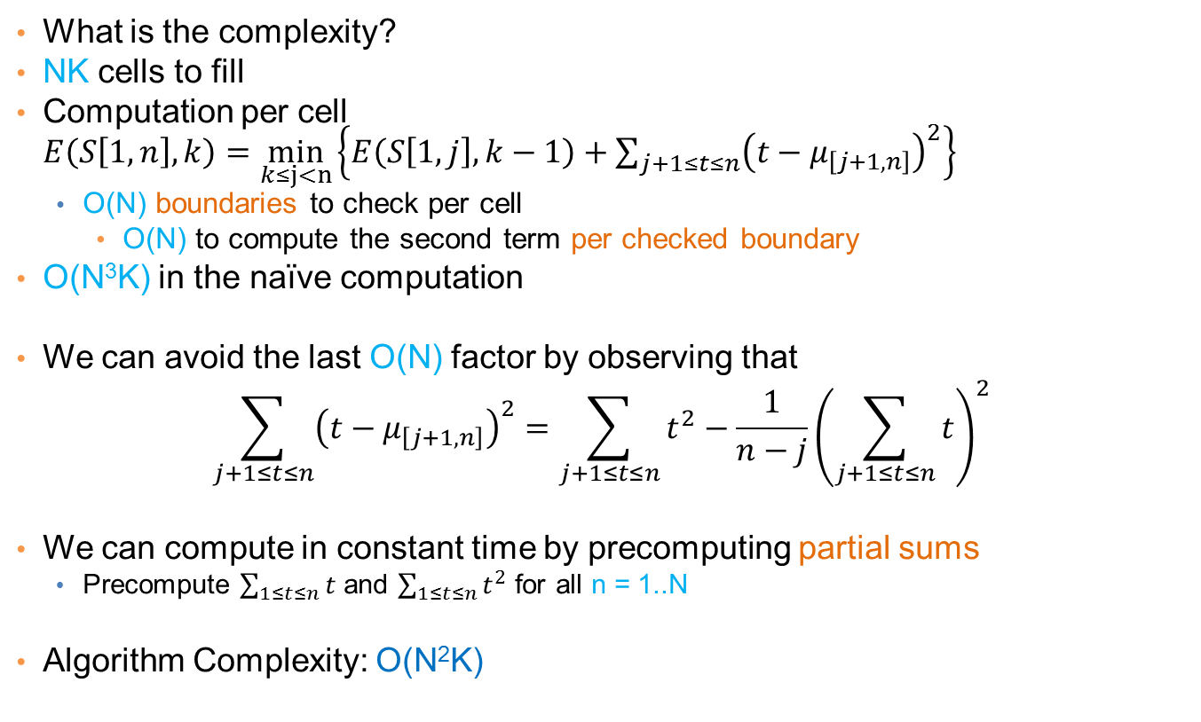
Algorithm Complexity
What is the complexity?
NK cells to fill
Computation per cell $E\left(S\left[1,n\right],k\right)=\min_{k≤j<n}\left\{E\left(S\left[1,j\right],k−1\right)+\sum_{j+1≤t≤n}{{\left(t−μ_{\left[j+1,n\right]}\right)}^{2}}\right\}$
  O(N) boundaries to check per cell
    O(N) to compute the second term per checked boundary
O(N³K) in the naïve computation
We can avoid the last O(N) factor by observing that
$$\sum_{j+1≤t≤n}{{\left(t−μ_{\left[j+1,n\right]}\right)}^{2}}=\sum_{j+1≤t≤n}{t^{2}}−\frac{1}{n−j}{\left(\sum_{j+1≤t≤n}{t}\right)}^{2}$$
We can compute in constant time by precomputing partial sums
  Precompute $\sum_{1≤t≤n}{t}$ and $\sum_{1≤t≤n}{t^{2}}$ for all n = 1..N
Algorithm Complexity: O(N²K)

Slide 42
Heuristics
Top-down greedy (TD): O(NK)
  Introduce boundaries one at the time so that you get the largest decrease in error, until K segments are created.
Bottom-up greedy (BU): O(NlogN)
  Merge adjacent points each time selecting the two points that cause the smallest increase in the error until K segments
Local Search Heuristics: O(NKI)
  Assign the breakpoints randomly and then move them so that you reduce the error

Slide 43
Local Search Heuristics
Local Search refers to a class of heuristic optimization algorithms where we start with some solution and we try to reach an optimum by iteratively improving the solution with small (local) changes
  Each solution has a set of neighboring solutions:
    The set of solutions that can be created with the allowed local changes.
  Usually we move to the best of the neighboring solutions, or one that improves our optimization function
Local Search algorithms are surprisingly effective
  For some problems they yield optimal solutions or solutions with good approximation bounds
They have been studied extensively
  Simulated Annealing
  Taboo Search

Slide 44
Other time series analysis
Using signal processing techniques is common for defining similarity between series
  Fast Fourier Transform
  Wavelets
Rich literature in the field

