Slide 1
DATA MINING
LECTURE 5
Sketching, Locality Sensitive Hashing

Slide 2
Jaccard Similarity
The Jaccard similarity (Jaccard coefficient) of two sets S₁, S₂ is the size of their intersection divided by the size of their union.
  JSim (S₁, S₂) = |S₁∩S₂| / |S₁∪S₂|.
  Extreme behavior:
    Jsim(X,Y) = 1, iff X = Y
    Jsim(X,Y) = 0 iff X,Y have no elements in common
  JSim is symmetric
3 in intersection.
8 in union.
Jaccard similarity
= 3/8

Slide 3
Cosine Similarity
Sim(X,Y) = cos(X,Y)
  The cosine of the angle between X and Y
If the vectors are aligned (correlated) angle is zero degrees and cos(X,Y)=1
If the vectors are orthogonal (no common coordinates) angle is 90 degrees and cos(X,Y) = 0
Cosine is commonly used for comparing documents, where we assume that the vectors are normalized by the document length.

Slide 4
Application: Recommendations
Recommendation systems
  When a user buys or rates an item we want to recommend other items that the user may like
    Initially applied to books, but now recommendations are everywhere: songs, movies, products, restaurants, hotels, etc.
Commonly used algorithms:
  Find the k users most similar to the user at hand and recommend items that they like.
  Find the items most similar to the items that the user has previously liked, and recommend these items.

Slide 5
Application: Finding near duplicates
Find duplicate and near-duplicate documents from a web crawl.
Why is it important:
  Identify mirrored web pages, and avoid indexing them, or serving them multiple times
  Find replicated news stories and cluster them under a single story.
  Identify plagiarism
Near duplicate documents differ in a few characters, words or sentences

Slide 6
Finding similar items
The problems we have seen so far have a common component
  We need a quick way to find highly similar items to a query item
  OR, we need a method for finding all pairs of items that are highly similar.
Also known as the Nearest Neighbor problem, or the All Nearest Neighbors problem

Slide 7
SKETCHING
AND
LOCALITY SENSITIVE HASHING
Thanks to:
Rajaraman and Ullman, “Mining Massive Datasets”
Evimaria Terzi, slides for Data Mining Course.

Slide 8
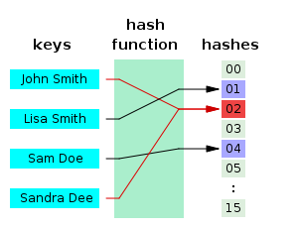
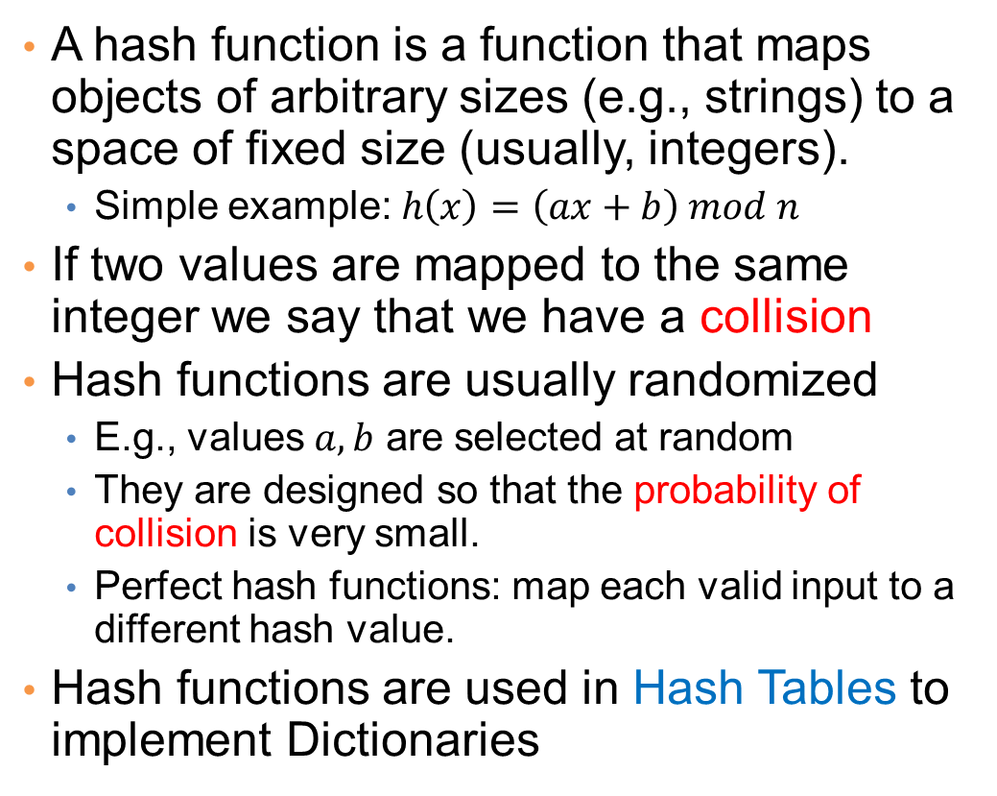
Before we start: Hash Functions
A hash function is a function that maps objects of arbitrary sizes (e.g., strings) to a space of fixed size (usually, integers).
  Simple example: $h\left(x\right)=\left(ax+b\right) mod n$
If two values are mapped to the same integer we say that we have a collision
Hash functions are usually randomized
  E.g., values $a,b$ are selected at random
  They are designed so that the probability of collision is very small.
  Perfect hash functions: map each valid input to a different hash value.
Hash functions are used in Hash Tables to implement Dictionaries

Slide 9
Problem
Given a (large) collection of documents find all pairs of documents which are near duplicates
  Their similarity is very high
What if we want to find identical documents?

Slide 10
Main issues
What is the right representation of the document when we check for similarity?
  E.g., representing a document as a set of characters will not do (why?)
When we have billions of documents, keeping the full text in memory is not an option.
  We need to find a shorter representation
How do we do pairwise comparisons of billions of documents?
  If we wanted exact match it would be ok, can we replicate this idea?

Slide 11
Three Essential Techniques for Similar Documents
Shingling : convert documents, emails, etc., to sets.
Minhashing : convert large sets to short signatures, while preserving similarity.
Locality-Sensitive Hashing (LSH): focus on pairs of signatures likely to be similar.

Slide 12
The Big Picture
Candidate
pairs :
those pairs
of signatures
that we need
to test for
similarity.
Shingling
Minhash-
ing
Locality-
sensitive
Hashing
Docu-
ment
The set
of strings
of length k
that appear
in the doc-
ument
Signatures :
short integer
vectors that
represent the
sets, and
reflect their
similarity

Slide 13
Shingles
A k -shingle (or k -gram) for a document is a sequence of k characters that appears in the document.
Example: document = abcab. k=2
  Set of 2-shingles = {ab, bc, ca}.
  Option: regard shingles as a bag, and count ab twice.
Represent a document by its set of k-shingles.

Slide 14
Shingling
Shingle: a sequence of k contiguous characters
a rose is a rose is a rose
a rose is
rose is a
rose is a
ose is a r
se is a ro
e is a ros
is a rose
is a rose
s a rose i
a rose is
a rose is

Slide 15
Shingling
Shingle: a sequence of k contiguous characters
a rose is a rose is a rose
a rose is
rose is a
rose is a
ose is a r
se is a ro
e is a ros
is a rose
is a rose
s a rose i
a rose is
a rose is
a rose is
rose is a
rose is a
ose is a r
se is a ro
e is a ros
is a rose
is a rose
s a rose i
a rose is

Slide 16
Working Assumption
Documents that have lots of shingles in common have similar text, even if the text appears in different order.
Careful: you must pick k large enough, or most documents will have most shingles.
  Extreme case k = 1: all documents are the same
  k = 5 is OK for short documents; k = 10 is better for long documents.
Alternative ways to define shingles:
  Use words instead of characters
  Anchor on stop words (to avoid templates)

Slide 17
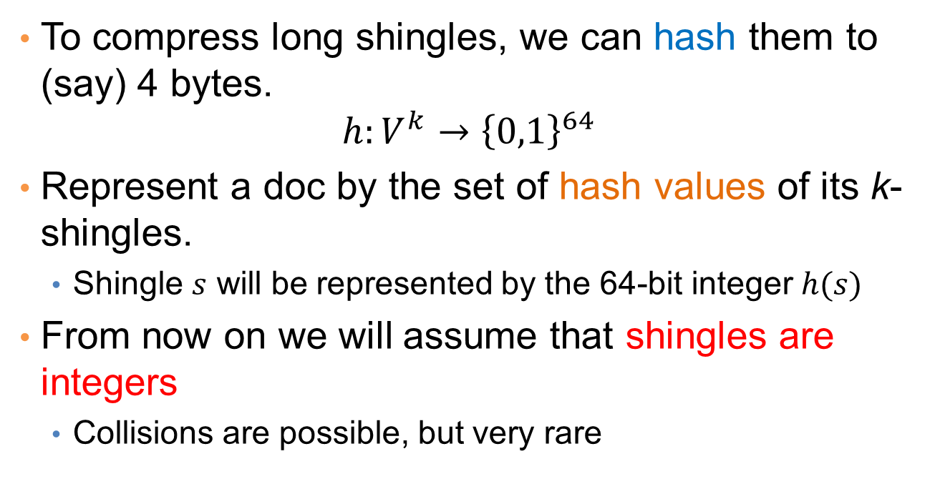
Shingles: Compression Option
To compress long shingles, we can hash them to (say) 4 bytes.
$$h:V^{k}→{\left\{0,1\right\}}^{64}$$
Represent a doc by the set of hash values of its k-shingles.
  Shingle $s$ will be represented by the 64-bit integer $h(s)$
From now on we will assume that shingles are integers
  Collisions are possible, but very rare

Slide 18
Fingerprinting
Hash shingles to 64-bit integers
Set of Shingles
Set of 64-bit integers
Hash function
(Rabin’s fingerprints)
a rose is
rose is a
rose is a
ose is a r
se is a ro
e is a ros
is a rose
is a rose
s a rose i
a rose is
1111
2222
3333
4444
5555
6666
7777
8888
9999
0000

Slide 19
Basic Data Model: Sets
Document: A document is represented as a set shingles (more accurately, hashes of shingles)
Document similarity: Jaccard similarity of the sets of shingles.
  Common shingles over the union of shingles
  Sim (C₁, C₂) = |C₁∩C₂|/|C₁∪C₂|.
Although we use the documents as our driving example the techniques we will describe apply to any kind of sets.
  E.g., similar customers or items.

Slide 20
Signatures
Problem: shingle sets are still too large to be kept in memory.
Key idea: “hash” each set S to a small signature Sig (S), such that:
  Sig (S) is small enough that we can fit a signature in main memory for each set.
  Sim (S₁, S₂) is (almost) the same as the “similarity” of Sig (S₁) and Sig (S₂). (signature preserves similarity).
Warning: This method can produce false negatives, and false positives (if an additional check is not made).
  False negatives: Similar items deemed as non-similar
  False positives: Non-similar items deemed as similar

Slide 21
From Sets to Boolean Matrices
Represent the data as a boolean matrix M
  Rows = the universe of all possible set elements
    In our case, shingle fingerprints take values in [0…2⁶⁴-1]
  Columns = the sets
    In our case, documents, sets of shingle fingerprints
  M(r,S) = 1 in row r and column S if and only if r is a member of S.
Typical matrix is sparse.
  We do not really materialize the matrix

Slide 22

Example
Universe: U = {A,B,C,D,E,F,G}
X = {A,B,F,G}
Y = {A,E,F,G}
Sim(X,Y) = $\frac{3}{5}$
 | X | Y
A | 1 | 1
B | 1 | 0
C | 0 | 0
D | 0 | 0
E | 0 | 1
F | 1 | 1
G | 1 | 1

Slide 23

Example
Universe: U = {A,B,C,D,E,F,G}
X = {A,B,F,G}
Y = {A,E,F,G}
Sim(X,Y) = $\frac{3}{5}$
 | X | Y
A | 1 | 1
B | 1 | 0
C | 0 | 0
D | 0 | 0
E | 0 | 1
F | 1 | 1
G | 1 | 1
At least one of the columns has value 1

Slide 24

Example
Universe: U = {A,B,C,D,E,F,G}
X = {A,B,F,G}
Y = {A,E,F,G}
Sim(X,Y) = $\frac{3}{5}$
 | X | Y
A | 1 | 1
B | 1 | 0
C | 0 | 0
D | 0 | 0
E | 0 | 1
F | 1 | 1
G | 1 | 1
Both columns have value 1

Slide 25
Minhashing
Pick a random permutation of the rows (the universe U).
Define “hash” function for set S
  h(S) = the index of the first row (in the permuted order) in which column S has 1.
  same as:
  h(S) = the index of the first element of S in the permuted order.
Use k (e.g., k = 100) independent random permutations to create a signature.

Slide 26
Example of minhash signatures
Input matrix
Random
Permutation
element | S₁ | S₂ | S₃ | S₄
A | 1 | 0 | 1 | 0
B | 1 | 0 | 0 | 1
C | 0 | 1 | 0 | 1
D | 0 | 1 | 0 | 1
E | 0 | 1 | 1 | 1
F | 1 | 0 | 1 | 0
G | 1 | 0 | 1 | 0
index | element | S₁ | S₂ | S₃ | S₄
1 | A | 1 | 0 | 1 | 0
2 | C | 0 | 1 | 0 | 1
3 | G | 1 | 0 | 1 | 0
4 | F | 1 | 0 | 1 | 0
5 | B | 1 | 0 | 0 | 1
6 | E | 0 | 1 | 1 | 1
7 | D | 0 | 1 | 0 | 1
A
C
G
F
B
E
D
1 | 2 | 1 | 2

Slide 27
Example of minhash signatures
Input matrix
Random
Permutation
element | S₁ | S₂ | S₃ | S₄
A | 1 | 0 | 1 | 0
B | 1 | 0 | 0 | 1
C | 0 | 1 | 0 | 1
D | 0 | 1 | 0 | 1
E | 0 | 1 | 1 | 1
F | 1 | 0 | 1 | 0
G | 1 | 0 | 1 | 0
index | element | S₁ | S₂ | S₃ | S₄
1 | D | 0 | 1 | 0 | 1
2 | B | 1 | 0 | 0 | 1
3 | A | 1 | 0 | 1 | 0
4 | C | 0 | 1 | 0 | 1
5 | F | 1 | 0 | 1 | 0
6 | G | 1 | 0 | 1 | 0
7 | E | 0 | 1 | 1 | 1
D
B
A
C
F
G
E
2 | 1 | 3 | 1

Slide 28
Example of minhash signatures
Input matrix
Random
Permutation
element | S₁ | S₂ | S₃ | S₄
A | 1 | 0 | 1 | 0
B | 1 | 0 | 0 | 1
C | 0 | 1 | 0 | 1
D | 0 | 1 | 0 | 1
E | 0 | 1 | 1 | 1
F | 1 | 0 | 1 | 0
G | 1 | 0 | 1 | 0
index | element | S₁ | S₂ | S₃ | S₄
1 | C | 0 | 1 | 0 | 1
2 | D | 0 | 1 | 0 | 1
3 | G | 1 | 0 | 1 | 0
4 | F | 1 | 0 | 1 | 0
5 | A | 1 | 0 | 1 | 0
6 | B | 1 | 0 | 0 | 1
7 | E | 0 | 1 | 1 | 1
C
D
G
F
A
B
E
3 | 1 | 3 | 1

Slide 29
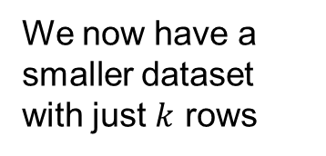
Example of minhash signatures
Input matrix
 | S₁ | S₂ | S₃ | S₄
A | 1 | 0 | 1 | 0
B | 1 | 0 | 0 | 1
C | 0 | 1 | 0 | 1
D | 0 | 1 | 0 | 1
E | 0 | 1 | 1 | 1
F | 1 | 0 | 1 | 0
G | 1 | 0 | 1 | 0
Signature matrix
 | S₁ | S₂ | S₃ | S₄
h₁ | 1 | 2 | 1 | 2
h₂ | 2 | 1 | 3 | 1
h₃ | 3 | 1 | 3 | 1
We now have a smaller dataset with just $k$ rows
≈
Sig(S) = vector of hash values
  e.g., Sig(S₂) = [2,1,1]
Sig(S,i) = value of the i-th hash function for set S
  E.g., Sig(S₂,3) = 1

Slide 30
A Subtle Point
People sometimes ask whether the minhash value should be the original number of the row, or the number in the permuted order (as we did in our example).
Answer: it doesn’t matter.
You only need to be consistent, and assure that two columns get the same value if and only if their first 1’s in the permuted order are in the same row.

Slide 31
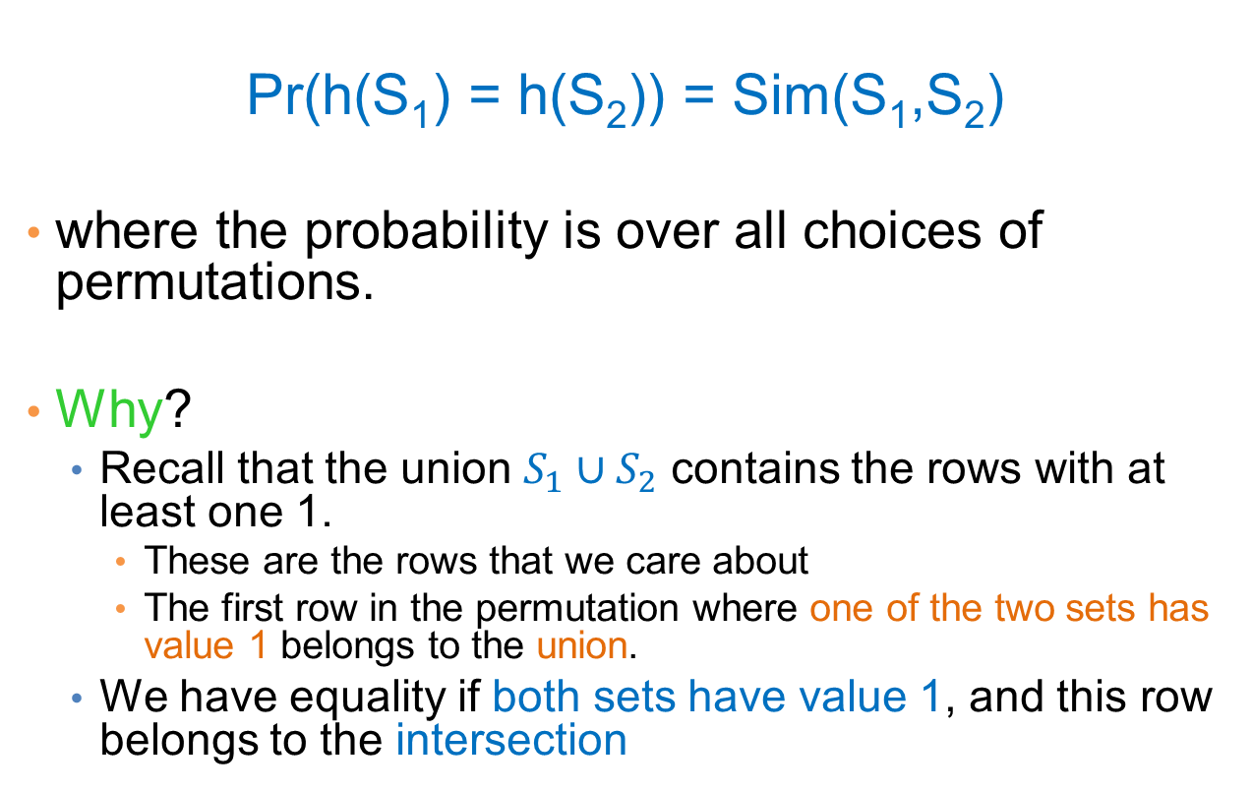
Hash function Property
Pr(h(S₁) = h(S₂)) = Sim(S₁,S₂)
where the probability is over all choices of permutations.
Why?
  Recall that the union $S_{1}∪S_{2}$ contains the rows with at least one 1.
    These are the rows that we care about
    The first row in the permutation where one of the two sets has value 1 belongs to the union.
  We have equality if both sets have value 1, and this row belongs to the intersection

Slide 32
Example
Universe: U = {A,B,C,D,E,F,G}
X = {A,B,F,G}
Y = {A,E,F,G}
Union =
{A,B,E,F,G}
Intersection =
{A,F,G}
Rows C,D could be anywhere they do not affect the probability
 | X | Y
A | 1 | 1
B | 1 | 0
C | 0 | 0
D | 0 | 0
E | 0 | 1
F | 1 | 1
G | 1 | 1
 | X | Y
D | 0 | 0
C | 0 | 0
D
*
*
C
*
*
*

Slide 33
Example
Universe: U = {A,B,C,D,E,F,G}
X = {A,B,F,G}
Y = {A,E,F,G}
Union =
{A,B,E,F,G}
Intersection =
{A,F,G}
The * rows belong to the union
 | X | Y
A | 1 | 1
B | 1 | 0
C | 0 | 0
D | 0 | 0
E | 0 | 1
F | 1 | 1
G | 1 | 1
 | X | Y
D | 0 | 0
C | 0 | 0
D
*
*
C
*
*
*

Slide 34
Example
Universe: U = {A,B,C,D,E,F,G}
X = {A,B,F,G}
Y = {A,E,F,G}
Union =
{A,B,E,F,G}
Intersection =
{A,F,G}
The question is what is the value of the first * element
 | X | Y
A | 1 | 1
B | 1 | 0
C | 0 | 0
D | 0 | 0
E | 0 | 1
F | 1 | 1
G | 1 | 1
 | X | Y
D | 0 | 0
C | 0 | 0
D
*
*
C
*
*
*

Slide 35
Example
Universe: U = {A,B,C,D,E,F,G}
X = {A,B,F,G}
Y = {A,E,F,G}
Union =
{A,B,E,F,G}
Intersection =
{A,F,G}
If it belongs to the intersection then h(X) = h(Y)
 | X | Y
A | 1 | 1
B | 1 | 0
C | 0 | 0
D | 0 | 0
E | 0 | 1
F | 1 | 1
G | 1 | 1
 | X | Y
D | 0 | 0
C | 0 | 0
D
*
*
C
*
*
*

Slide 36
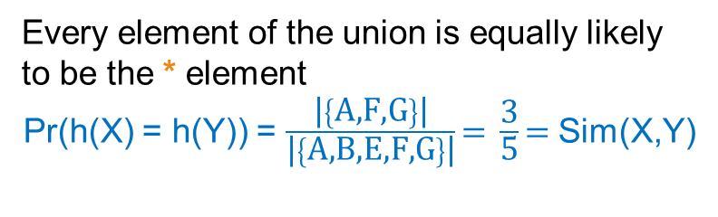
Example
Universe: U = {A,B,C,D,E,F,G}
X = {A,B,F,G}
Y = {A,E,F,G}
Union =
{A,B,E,F,G}
Intersection =
{A,F,G}
Every element of the union is equally likely to be the * element
Pr(h(X) = h(Y)) = $\frac{\text{|}\left\{\text{A}\text{,}\text{F}\text{,}\text{G}\right\}\text{|}}{\text{|}\left\{\text{A}\text{,}\text{B}\text{,}\text{E}\text{,}\text{F}\text{,}\text{G}\right\}\text{|}}\text{= }\frac{\text{3}}{\text{5}}\text{= }$Sim(X,Y)
 | X | Y
A | 1 | 1
B | 1 | 0
C | 0 | 0
D | 0 | 0
E | 0 | 1
F | 1 | 1
G | 1 | 1
 | X | Y
D | 0 | 0
C | 0 | 0
D
*
*
C
*
*
*

Slide 37
Similarity for Signatures
The similarity of signatures is the fraction of the hash functions in which they agree.
With multiple signatures we get a good approximation
  Why? What is the expected value of the fraction of agreements?
 | S₁ | S₂ | S₃ | S₄
A | 1 | 0 | 1 | 0
B | 1 | 0 | 0 | 1
C | 0 | 1 | 0 | 1
D | 0 | 1 | 0 | 1
E | 0 | 1 | 1 | 1
F | 1 | 0 | 1 | 0
G | 1 | 0 | 1 | 0
Signature matrix
 | Actual | Sig
(S₁, S₂) | 0 | 0
(S₁, S₃) | 3/5 | 2/3
(S₁, S₄) | 1/7 | 0
(S₂, S₃) | 0 | 0
(S₂, S₄) | 3/4 | 1
(S₃, S₄) | 0 | 0
S₁ | S₂ | S₃ | S₄
1 | 2 | 1 | 2
2 | 1 | 3 | 1
3 | 1 | 3 | 1
≈
Zero similarity is preserved
High similarity is well approximated

Slide 38
Is it now feasible?
Assume a billion rows
Hard to pick a random permutation of 1…billion
Even representing a random permutation requires 1 billion entries!!!
How about accessing rows in permuted order?
☹
Instead of permutations we will consider hash functions that map the N rows to N buckets
  Some collisions may happen, but with well chosen functions they are rare.

Slide 39
Approximating row permutations
Pick k=100 hash functions (h₁,…,h_{k})
for each set S
for each row r that appears in S
for each hash function h_{i}
compute h_{i} (r )
for each hash function h_{i}
Sig(S,i) = min h_{i} (r);
In practice this means selecting the function parameters
h_{i} (r) = index of shingle r in permutation
Find the minimum index for hash function h_{i}
Sig(S,i) will become the smallest value of h_{i}(r) among all rows (shingles) for which column S has value 1 (shingle belongs in S); i.e., h_{i} (r) gives the min index for the i-th permutation

Slide 40
Approximating row permutations
In practice this means selecting the function parameters
Pick k=100 hash functions (h₁,…,h_{k})
for each row r
for each hash function h_{i}
compute h_{i} (r )
for each column S that has 1 in row r
if h_{i} (r ) is a smaller value than Sig(S,i) then
  Sig(S,i) = h_{i} (r);
In practice only the rows (shingles) that appear in the data
h_{i} (r) = index of shingle r in permutation
S contains shingle r
Find the shingle r with minimum index
Sig(S,i) will become the smallest value of h_{i}(r) among all rows (shingles) for which column S has value 1 (shingle belongs in S); i.e., h_{i} (r) gives the min index for the i-th permutation

Slide 41
Example
Sig1 Sig2
h(0) = 1 1 -
g(0) = 3 3 -
x
0
1
2
3
4
Row S1 S2
A 1 0
B 0 1
C 1 1
D 1 0
E 0 1
h(x)
1
2
3
4
0
g(x)
3
0
2
4
1
h(1) = 2 1 2
g(1) = 0 3 0
h(2) = 3 1 2
g(2) = 2 2 0
h(3) = 4 1 2
g(3) = 4 2 0
h(x) = x+1 mod 5
g(x) = 2x+1 mod 5
Row S1 S2
E 0 1
A 1 0
B 0 1
C 1 1
D 1 0
Row S1 S2
B 0 1
E 0 1
C 1 0
A 1 1
D 1 0
h(4) = 0 1 0
g(4) = 1 2 0

Slide 42
Implementation – (4)
Often, data is given by column, not row.
  E.g., columns = documents, rows = shingles.
If so, sort matrix once so it is by row.
And always compute h_{i} (r ) only once for each row.

Slide 43
Finding similar pairs
Problem: Find all pairs of documents with similarity at least t = 0.8
While the signatures of all columns may fit in main memory, comparing the signatures of all pairs of columns is quadratic in the number of columns.
Example: 10⁶ columns implies 5*10¹¹ column-comparisons.
At 1 microsecond/comparison: 6 days.

Slide 44
Locality-Sensitive Hashing
What we want: a function f(X,Y) that tells whether or not X and Y is a candidate pair: a pair of elements whose similarity must be evaluated.
A simple idea: X and Y are a candidate pair if they have the same min-hash signature.
  Easy to test by hashing the signatures.
  Similar sets are more likely to have the same signature.
  Likely to produce many false negatives.
    Requiring full match of signature is strict, some similar sets will be lost.
Improvement: Compute multiple signatures; candidate pairs should have at least one common signature.
  Reduce the probability for false negatives.
! Multiple levels of Hashing!

Slide 45
Signature matrix reminder
Prob(Sig(S,i) == Sig(S’,i)) = sim(S,S’)
Sig(S,i)
Sig(S’,i)
hash function i
n hash functions
Sig(S):
signature for set S
signature for set S’
Matrix M

Slide 46
Partition into Bands – (1)
Divide the signature matrix Sig into b bands of r rows.
  Each band is a mini-signature with r hash functions.

Slide 47
Partitioning into bands
n = b*r hash functions
Matrix Sig
r rows
per band
b bands
b mini-signatures
One
signature

Slide 48
Partition into Bands – (2)
Divide the signature matrix Sig into b bands of r rows.
  Each band is a mini-signature with r hash functions.
For each band, hash the mini-signature to a hash table.
  Mini-signatures that hash to the same bucket are almost certainly identical.

Slide 49
Hash Table
Columns 2 and 6
are (almost certainly) identical.
Columns 6 and 7 are
surely different.
Matrix M
1
2
3
4
5
6
7
r rows
b bands

Slide 50
Partition into Bands – (2)
Divide the signature matrix Sig into b bands of r rows.
  Each band is a mini-signature with r hash functions.
For each band, hash the mini-signature to a hash table.
  Mini-signatures that hash to the same bucket are almost certainly identical.
Candidate column pairs are those that hash to the same bucket for at least 1 band.
  I.e., they have at least one mini-signature in common.
Tune b and r to catch most similar pairs, but few non-similar pairs.

Slide 51
Analysis of LSH – What We Want
Probability
= 1 if s > t
Probability
of sharing
a bucket
No chance
if s < t
t
Similarity s of two sets

Slide 52
What One Band of One Row Gives You
Single hash signature
Probability
of sharing
a bucket
Remember:
probability of
equal hash-values
= similarity
t
Prob(Sig(S,i) == Sig(S’,i)) = sim(S,S’)
Similarity s of two sets

Slide 53
What b Bands of r Rows Gives You
At least
one band
identical
No bands
identical
(
s ^{r}
t ~ (1/b)^{1/r}
1 -
1 -
)^{b}
Probability
of sharing
a bucket
Some row
of a band
unequal
All rows
of a band
are equal
t
Similarity s of two sets

Slide 54
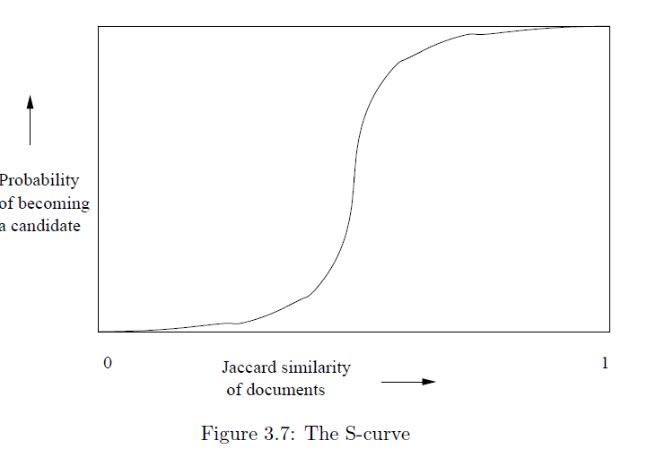
Example: b = 20; r = 5
t = 0.5
s | 1-(1-s^{r})^{b}
.2 | .006
.3 | .047
.4 | .186
.5 | .470
.6 | .802
.7 | .975
.8 | .9996

Slide 55
Suppose S₁, S₂ are 80% Similar
We want all 80%-similar pairs. Choose 20 bands of 5 integers/band.
Probability S₁, S₂ identical in one particular band:
(0.8)⁵ = 0.328.
Probability S₁, S₂ are not similar in any of the 20 bands:
(1-0.328)²⁰ = 0.00035
    i.e., about 1/3000-th of the 80%-similar column pairs are false negatives.
Probability S₁, S₂ are similar in at least one of the 20 bands:
1-0.00035 = 0.999

Slide 56
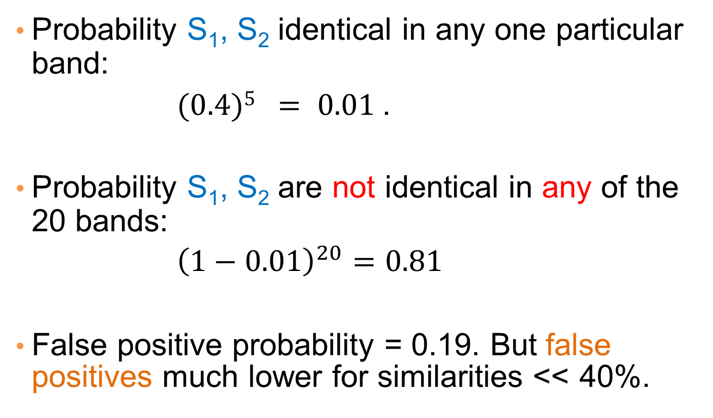
Suppose S₁, S₂ Only 40% Similar
Probability S₁, S₂ identical in any one particular band:
$(0.4)5 = 0.01$.
Probability S₁, S₂ are not identical in any of the 20 bands:
${\left(1−0.01\right)}^{20}=0.81$
False positive probability = 0.19. But false positives much lower for similarities << 40%.

Slide 57
LSH Summary
Tune to get almost all pairs with similar signatures, but eliminate most pairs that do not have similar signatures.
Check in main memory that candidate pairs really do have similar signatures.
Optional: In another pass through data, check that the remaining candidate pairs really represent similar sets .

Slide 58
Locality-sensitive hashing (LSH)
Big Picture: Construct hash functions h: R^{d}→ U such that for any pair of objects p,q, for distance function D we have:
  If D(p,q)≤r, then Pr[h(p)=h(q)] is high
    Close (similar) objects have high probability to be hashed together
  If D(p,q)≥cr, then Pr[h(p)=h(q)] is small
    Distant (dissimilar) objects have small probability of being hashed together
Then, we can find close pairs by hashing
LSH is a general framework: for a given distance function D we need to find the right h

Slide 59
LSH for Cosine Distance
For cosine distance, there is a technique analogous to minhashing for generating a Locality Sensitive Hashing functions
Using random hyperplanes.

Slide 60
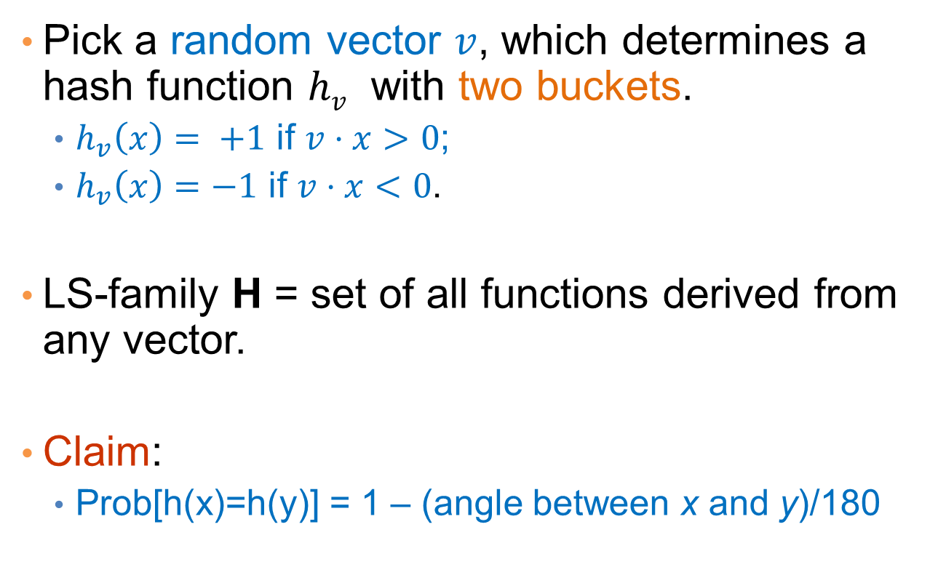
Random Hyperplanes
Pick a random vector $v$, which determines a hash function $hv$ with two buckets.
  $h_{v}\left(x\right)= +1$ if $v⋅x>0$;
  $h_{v}\left(x\right)=−1$ if $v⋅x<0$.
LS-family H = set of all functions derived from any vector.
Claim:
  Prob[h(x)=h(y)] = 1 – (angle between x and y)/180

Slide 61
Proof of Claim
Look in the plane of x and y.
For a random vector v the values of the hash functions h_{v}(x) and h_{v}(y) depend on where the vector v falls
h_{v}(x) = +1
h_{v}(x) = -1
x
θ
h_{v}(x) ≠ h_{v}(y) when v falls into the shaded area.
What is the probability of this for a randomly chosen vector v?
θ
θ
h_{v}(y) = -1
y
P[h_{v}(x) ≠ h_{v}(y)] = 2θ/360 = θ/180
P[h_{v}(x) = h_{v}(y)] = 1- θ/180
h_{v}(y) = +1

Slide 62
Signatures for Cosine Distance
Pick some number of vectors, and hash your data for each vector.
The result is a signature (sketch ) of +1’s and –1’s that can be used for LSH like the minhash signatures for Jaccard distance.

Slide 63
Simplification
We need not pick from among all possible vectors v to form a component of a sketch.
It suffices to consider only vectors v consisting of +1 and –1 components.

