Slide 1
DATA MINING
LECTURE 4
Similarity and Distance
Recommender Systems

Slide 2
SIMILARITY AND DISTANCE
Thanks to:
Tan, Steinbach, and Kumar, “Introduction to Data Mining”
Rajaraman and Ullman, “Mining Massive Datasets”

Slide 3
Similarity and Distance
For many different problems we need to quantify how close two objects are.
Examples:
  For an item bought by a customer, find other similar items
  Group together the customers of a site so that similar customers are shown the same ad.
  Group together web documents so that you can separate the ones that talk about politics and the ones that talk about sports.
  Find all the near-duplicate mirrored web documents.
  Find credit card transactions that are very different from previous transactions.
To solve these problems we need a definition of similarity, or distance.
  The definition depends on the type of data that we have

Slide 4
Similarity
Numerical measure of how alike two data objects are.
  A function that maps pairs of objects to real values
  Higher when objects are more alike.
Often falls in the range [0,1], sometimes in [-1,1]
Desirable properties for similarity
  s(p, q) = 1 (or maximum similarity) only if p = q. (Identity)
  s(p, q) = s(q, p) for all p and q. (Symmetry)

Slide 5
Similarity between sets
Consider the following documents
Which ones are more similar?
How would you quantify their similarity?
apple releases new ipod
apple releases new ipad
new apple pie recipe

Slide 6
Similarity: Intersection
Number of words in common
Sim(D,D) = 3, Sim(D,D) = Sim(D,D) =2
What about this document?
Sim(D,D) = Sim(D,D) = 3
apple releases new ipod
apple releases new ipad
new apple pie recipe
Vefa releases new book with apple pie recipes

Slide 7
Jaccard Similarity
The Jaccard similarity (Jaccard coefficient) of two sets S₁, S₂ is the size of their intersection divided by the size of their union.
  JSim (S₁, S₂) = |S₁∩S₂| / |S₁∪S₂|.
  Extreme behavior:
    Jsim(X,Y) = 1, iff X = Y
    Jsim(X,Y) = 0 iff X,Y have no elements in common
  JSim is symmetric
3 in intersection.
8 in union.
Jaccard similarity
= 3/8

Slide 8
Jaccard Similarity between sets
The distance for the documents
JSim(D,D) = 3/5
JSim(D,D) = JSim(D,D) = 2/6
JSim(D,D) = JSim(D,D) = 3/9
apple releases new ipod
apple releases new ipad
new apple pie recipe
Vefa releases new book with apple pie recipes

Slide 9
Similarity between vectors
Documents (and sets in general) can also be represented as vectors
document | Apple | Microsoft | Obama | Election
D1 | 10 | 20 | 0 | 0
D2 | 30 | 60 | 0 | 0
D3 | 60 | 30 | 0 | 0
D4 | 0 | 0 | 10 | 20
How do we measure the similarity of two vectors?
  We could view them as sets of words. Jaccard Similarity will show that D4 is different form the rest
  But all pairs of the other three documents are equally similar
We want to capture how well the two vectors are aligned

Slide 10
Example
document | Apple | Microsoft | Obama | Election
D1 | 10 | 20 | 0 | 0
D2 | 30 | 60 | 0 | 0
D3 | 60 | 30 | 0 | 0
D4 | 0 | 0 | 10 | 20
apple
Documents D1, D2 are in the “same direction”
Document D3 is on the same plane as D1, D2
Document D4 is orthogonal to the rest
microsoft
{Obama, election}

Slide 11
Example
document | Apple | Microsoft | Obama | Election
D1 | 1/3 | 2/3 | 0 | 0
D2 | 1/3 | 2/3 | 0 | 0
D3 | 2/3 | 1/3 | 0 | 0
D4 | 0 | 0 | 1/3 | 2/3
apple
Documents D1, D2 are in the “same direction”
Document D3 is on the same plane as D1, D2
Document D4 is orthogonal to the rest
microsoft
{Obama, election}

Slide 12
Cosine Similarity
Sim(X,Y) = cos(X,Y)
  The cosine of the angle between X and Y
If the vectors are aligned (correlated) angle is zero degrees and cos(X,Y)=1
If the vectors are orthogonal (no common coordinates) angle is 90 degrees and cos(X,Y) = 0
Cosine is commonly used for comparing documents, where we assume that the vectors are normalized by the document length, or words are weighted by tf-idf.

Slide 13
Cosine Similarity - math
If d₁ and d₂ are two vectors, then
cos( d₁, d₂ ) = (d₁ • d₂) / ||d₁|| ||d₂|| ,
where • indicates vector dot product and || d || is the length of vector d.
Example:
d₁ = 3 2 0 5 0 0 0 2 0 0
d₂ = 1 0 0 0 0 0 0 1 0 2
d₁ • d₂= 3*1 + 2*0 + 0*0 + 5*0 + 0*0 + 0*0 + 0*0 + 2*1 + 0*0 + 0*2 = 5
||d₁|| = (3*3+2*2+0*0+5*5+0*0+0*0+0*0+2*2+0*0+0*0)^{0.5} = (42) ^{0.5} = 6.481
||d₂|| = (1*1+0*0+0*0+0*0+0*0+0*0+0*0+1*1+0*0+2*2) ^{0.5} = (6) ^{0.5} = 2.245
cos( d₁, d₂ ) = .3150

Slide 14
Example
document | Apple | Microsoft | Obama | Election
D1 | 10 | 20 | 0 | 0
D2 | 30 | 60 | 0 | 0
D3 | 60 | 30 | 0 | 0
D4 | 0 | 0 | 10 | 20
apple
Cos(D1,D2) = 1
Cos (D3,D1) = Cos(D3,D2) = 4/5
Cos(D4,D1) = Cos(D4,D2) = Cos(D4,D3) = 0
microsoft
{Obama, election}

Slide 15
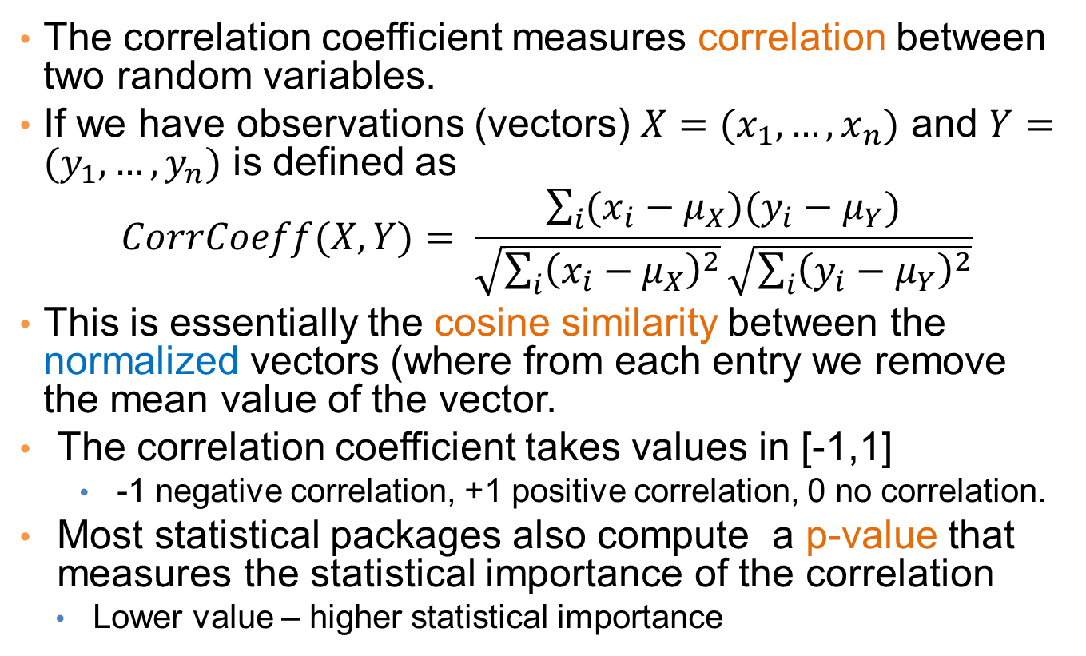
Correlation Coefficient
The correlation coefficient measures correlation between two random variables.
If we have observations (vectors) $X=(x_{1},…,x_{n})$ and $Y=(y_{1},…,y_{n})$ is defined as
$$CorrCoeff(X,Y)= \frac{\sum_{i}{(x_{i}−μ_{X})(y_{i}−μ_{Y})}}{\sqrt{\sum_{i}{{\left(x_{i}−μ_{X}\right)}^{2}}}\sqrt{\sum_{i}{{\left(y_{i}−μ_{Y}\right)}^{2}}}}$$
This is essentially the cosine similarity between the normalized vectors (where from each entry we remove the mean value of the vector.
The correlation coefficient takes values in [-1,1]
  -1 negative correlation, +1 positive correlation, 0 no correlation.
Most statistical packages also compute a p-value that measures the statistical importance of the correlation
  Lower value – higher statistical importance

Slide 16
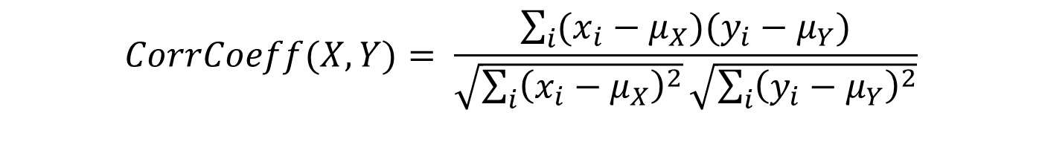
Correlation Coefficient
Normalized vectors
document | Apple | Microsoft | Obama | Election
D1 | -5 | +5 | 0 | 0
D2 | -15 | +15 | 0 | 0
D3 | +15 | -15 | 0 | 0
D4 | 0 | 0 | -5 | +5
$$CorrCoeff(X,Y)= \frac{\sum_{i}{(x_{i}−μ_{X})(y_{i}−μ_{Y})}}{\sqrt{\sum_{i}{{\left(x_{i}−μ_{X}\right)}^{2}}}\sqrt{\sum_{i}{{\left(y_{i}−μ_{Y}\right)}^{2}}}}$$
CorrCoeff(D1,D2) = 1
CorrCoeff(D1,D3) = CorrCoeff(D2,D3) = -1
CorrCoeff(D1,D4) = CorrCoeff(D2,D4) = CorrCoeff(D3,D4) = 0

Slide 17
Distance
Numerical measure of how different two data objects are
  A function that maps pairs of objects to real values
  Lower when objects are more alike
  Higher when two objects are different
Minimum distance is 0, when comparing an object with itself.
Upper limit varies

Slide 18
Distance Metric
A distance function d is a distance metric if it is a function from pairs of objects to real numbers such that:
  d(x,y) > 0. (non-negativity)
  d(x,y) = 0 iff x = y. (identity)
  d(x,y) = d(y,x). (symmetry)
  d(x,y) < d(x,z) + d(z,y) (triangle inequality ).

Slide 19
Triangle Inequality
Triangle inequality guarantees that the distance function is well-behaved.
  The direct connection is the shortest distance
It is useful also for proving useful properties about the data.

Slide 20
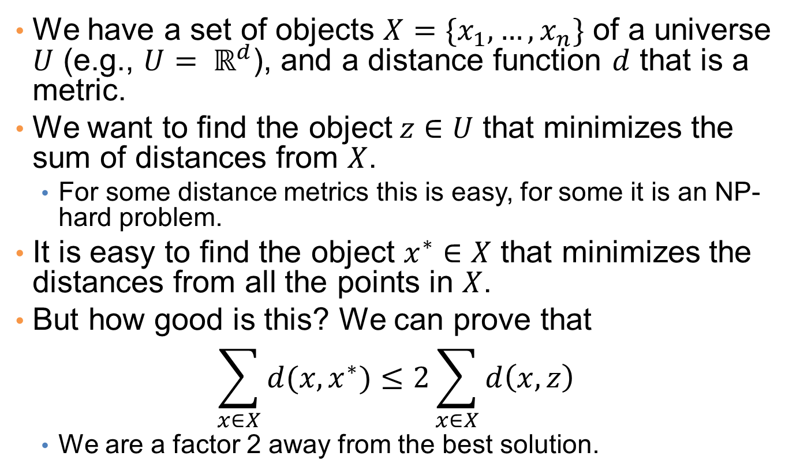
Example
We have a set of objects $X=\{x_{1},…,x_{n}\}$ of a universe $U$ (e.g., $U= ℝ^{d}$), and a distance function $d$ that is a metric.
We want to find the object$z∈U$ that minimizes the sum of distances from $X$.
  For some distance metrics this is easy, for some it is an NP-hard problem.
It is easy to find the object $x^{∗}∈X$ that minimizes the distances from all the points in $X$.
But how good is this? We can prove that
$$\sum_{x∈X}{d(x,x^{∗})}≤2\sum_{x∈X}{d\left(x,z\right)}$$
  We are a factor 2 away from the best solution.

Slide 21
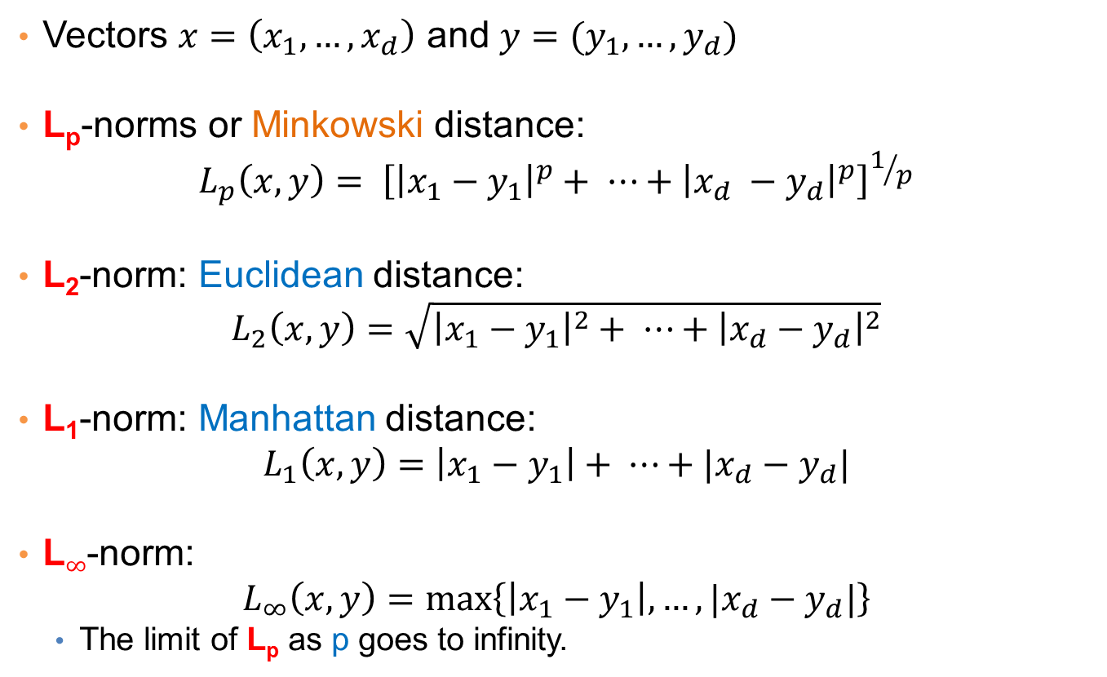
Distances for real vectors
Vectors $x=\left(x_{1},…,x_{d}\right)$ and $y=(y_{1},…,y_{d})$
L_{p}-norms or Minkowski distance:
$$L_{p}\left(x,y\right)= {\left[{\left|x_{1}−y_{1}\right|}^{p}+ ⋯+{\left|x_{d} −y_{d}\right|}^{p}\right]}^{1/p}$$
L₂-norm: Euclidean distance:
$$L_{2}\left(x,y\right)=\sqrt{{\left|x_{1}−y_{1}\right|}^{2}+ ⋯+{\left|x_{d}−y_{d}\right|}^{2}}$$
L₁-norm: Manhattan distance:
$$L_{1}\left(x,y\right)=\left|x_{1}−y_{1}\right|+ ⋯+|x_{d}−y_{d}|$$
L$∞$-norm:
$$L_{∞}\left(x,y\right)=\max\left\{\left|x_{1}−y_{1}\right|,…,|x_{d}−y_{d}|\right\}$$
  The limit of L_{p} as p goes to infinity.
L_{p} norms are known to be distance metrics

Slide 22
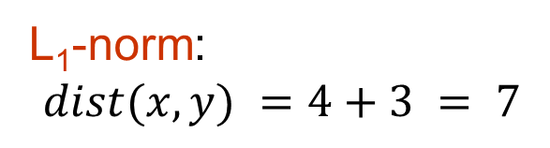
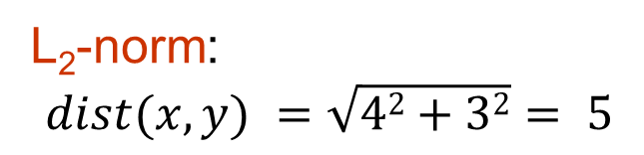
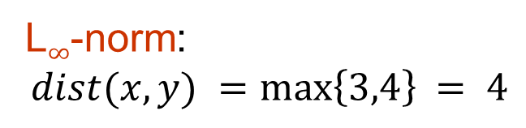
Example of Distances
y = (9,8)
L₂-norm:
$$dist(x,y) =\sqrt{42+32}= 5$$
5
3
L₁-norm:
$$dist(x,y) =4+3 = 7$$
4
x = (5,5)
L$∞$-norm:
$$dist(x,y) =\max\left\{3,4\right\}⁡= 4$$

Slide 23

Example
r
$$x= (x_{1},…,x_{n})$$
Green: All points y at distance L₁(x,y) = r from point x
Blue: All points y at distance L₂(x,y) = r from point x
Red: All points y at distance L$∞$(x,y) = r from point x

Slide 24
L_{p} distances for sets
We can apply all the L_{p} distances to the cases of sets of attributes, with or without counts, if we represent the sets as vectors
  E.g., a transaction is a 0/1 vector
  E.g., a document is a vector of counts.

Slide 25
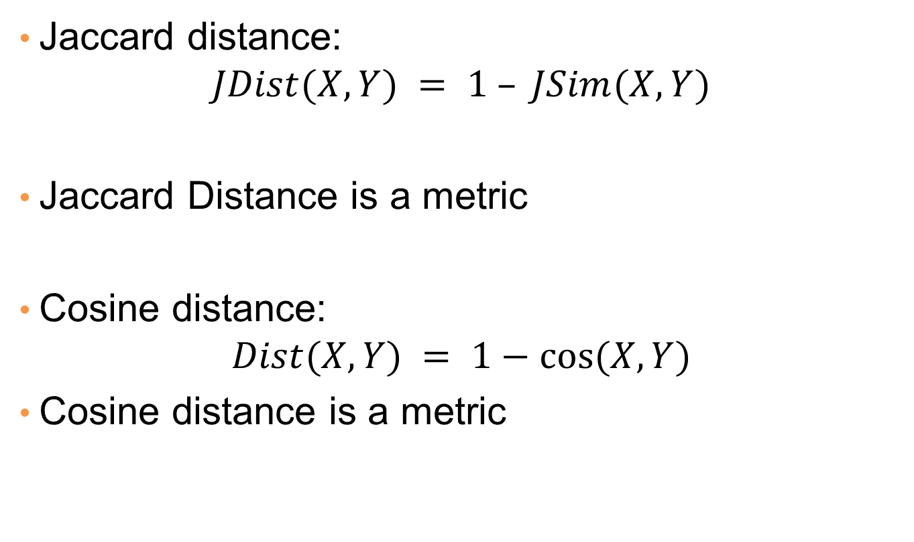
Similarities into distances
Jaccard distance:
$$JDist(X,Y) = 1 – JSim(X,Y)$$
Jaccard Distance is a metric
Cosine distance:
$$Dist(X,Y) = 1−cos⁡(X,Y)$$
Cosine distance is a metric

Slide 26
Why Jaccard Distance Is a Distance Metric
JDist(x,x) = 0
  since JSim(x,x) = 1
JDist(x,y) = JDist(y,x)
  by symmetry of intersection
JDist(x,y) > 0
  since intersection of X,Y cannot be bigger than the union.
Triangle inequality:
  Follows from the fact that JSim(X,Y) is the probability of randomly selected element from the union of X and Y to belong to the intersection

Slide 27
Hamming Distance
Hamming distance is the number of positions in which bit-vectors differ.
  Example: p₁ = 10101 p₂ = 10011.
    d(p₁, p₂) = 2 because the bit-vectors differ in the 3rd and 4th positions.
    The L₁ norm for the binary vectors
Hamming distance between two vectors of categorical attributes is the number of positions in which they differ.
  Example: x = (married, low income, cheat), y = (single, low income, not cheat)
  d(x,y) = 2

Slide 28
Why Hamming Distance Is a Distance Metric
d(x,x) = 0 since no positions differ.
d(x,y) = d(y,x) by symmetry of “different from.”
d(x,y) > 0 since strings cannot differ in a negative number of positions.
Triangle inequality: changing x to z and then to y is one way to change x to y.
For binary vectors if follows from the fact that L₁ norm is a metric

Slide 29
Distance between strings
How do we define similarity between strings?
Important for recognizing and correcting typing errors and analyzing DNA sequences.
weird wierd
intelligent unintelligent
Athena Athina

Slide 30
Edit Distance for strings
The edit distance of two strings is the number of inserts and deletes of characters needed to turn one into the other.
Example: x = abcde ; y = bcduve.
  Turn x into y by deleting a, then inserting u and v after d.
  Edit distance = 3.
Minimum number of operations can be computed using dynamic programming
Common distance measure for comparing DNA sequences

Slide 31
Why Edit Distance Is a Distance Metric
d(x,x) = 0 because 0 edits suffice.
d(x,y) = d(y,x) because insert/delete are inverses of each other.
d(x,y) > 0: no notion of negative edits.
Triangle inequality: changing x to z and then to y is one way to change x to y. The minimum is no more than that

Slide 32
Variant Edit Distances
Allow insert, delete, and mutate.
  Change one character into another.
Minimum number of inserts, deletes, and mutates also forms a distance measure.
Same for any set of operations on strings.
  Example: substring reversal or block transposition OK for DNA sequences
  Example: character transposition is used for spelling

Slide 33
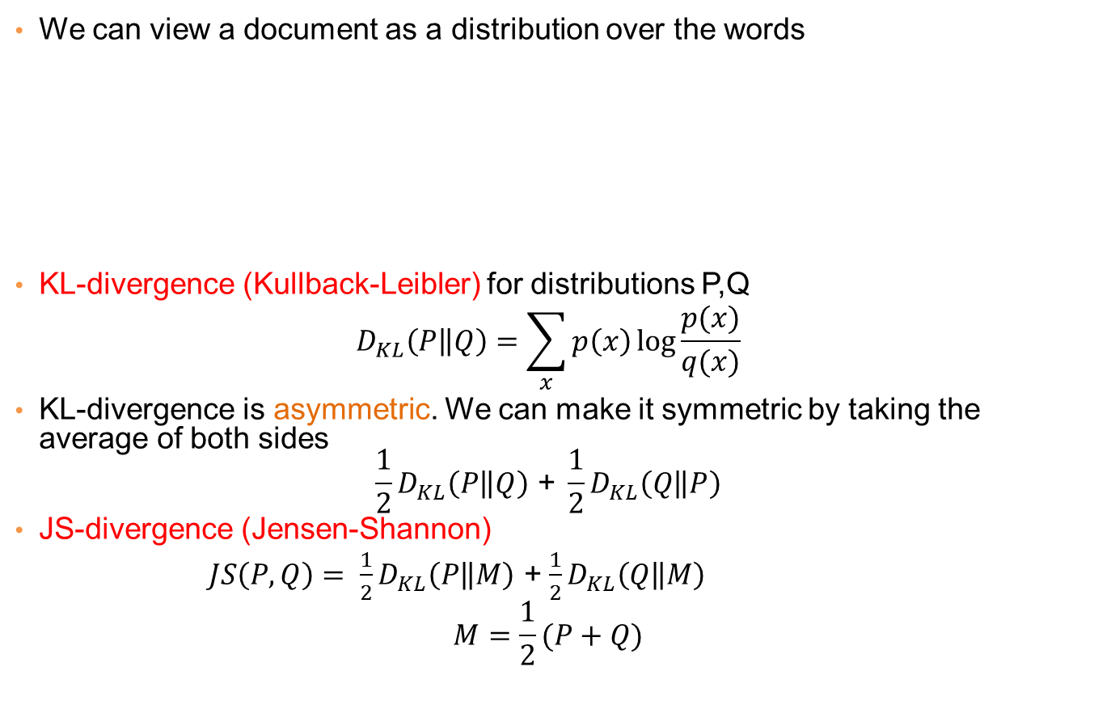
Distances between distributions
We can view a document as a distribution over the words
KL-divergence (Kullback-Leibler) for distributions P,Q
$$D_{KL}\left(P\left\|Q\right.\right)=\sum_{x}{p\left(x\right)\log{\frac{p(x)}{q(x)}}}$$
KL-divergence is asymmetric. We can make it symmetric by taking the average of both sides
$$\frac{1}{2}D_{KL}\left(P\left\|Q\right.\right)\text{ + }\frac{1}{2}D_{KL}\left(Q\left\|P\right.\right)$$
JS-divergence (Jensen-Shannon)
$JS\left(P,Q\right)= \frac{1}{2}D_{KL}\left(P\left\|M\right.\right)$ + $\frac{1}{2}D_{KL}\left(Q\left\|M\right.\right)$
$$M=\frac{1}{2}(P+Q)$$
document | Apple | Microsoft | Obama | Election
D1 | 0.35 | 0.5 | 0.1 | 0.05
D2 | 0.4 | 0.4 | 0.1 | 0.1
D2 | 0.05 | 0.05 | 0.6 | 0.3
Average distribution

Slide 34
Why is similarity important?
We saw many definitions of similarity and distance
How do we make use of similarity in practice?
What issues do we have to deal with?

Slide 35
Applications of Similarity:
Recommendation Systems

Slide 36
An important problem
Recommendation systems
  When a user buys an item (initially books) we want to recommend other items that the user may like
  When a user rates a movie, we want to recommend movies that the user may like
  When a user likes a song, we want to recommend other songs that they may like
A big success of data mining
Exploits the long tail
  How Into Thin Air made Touching the Void popular

Slide 37
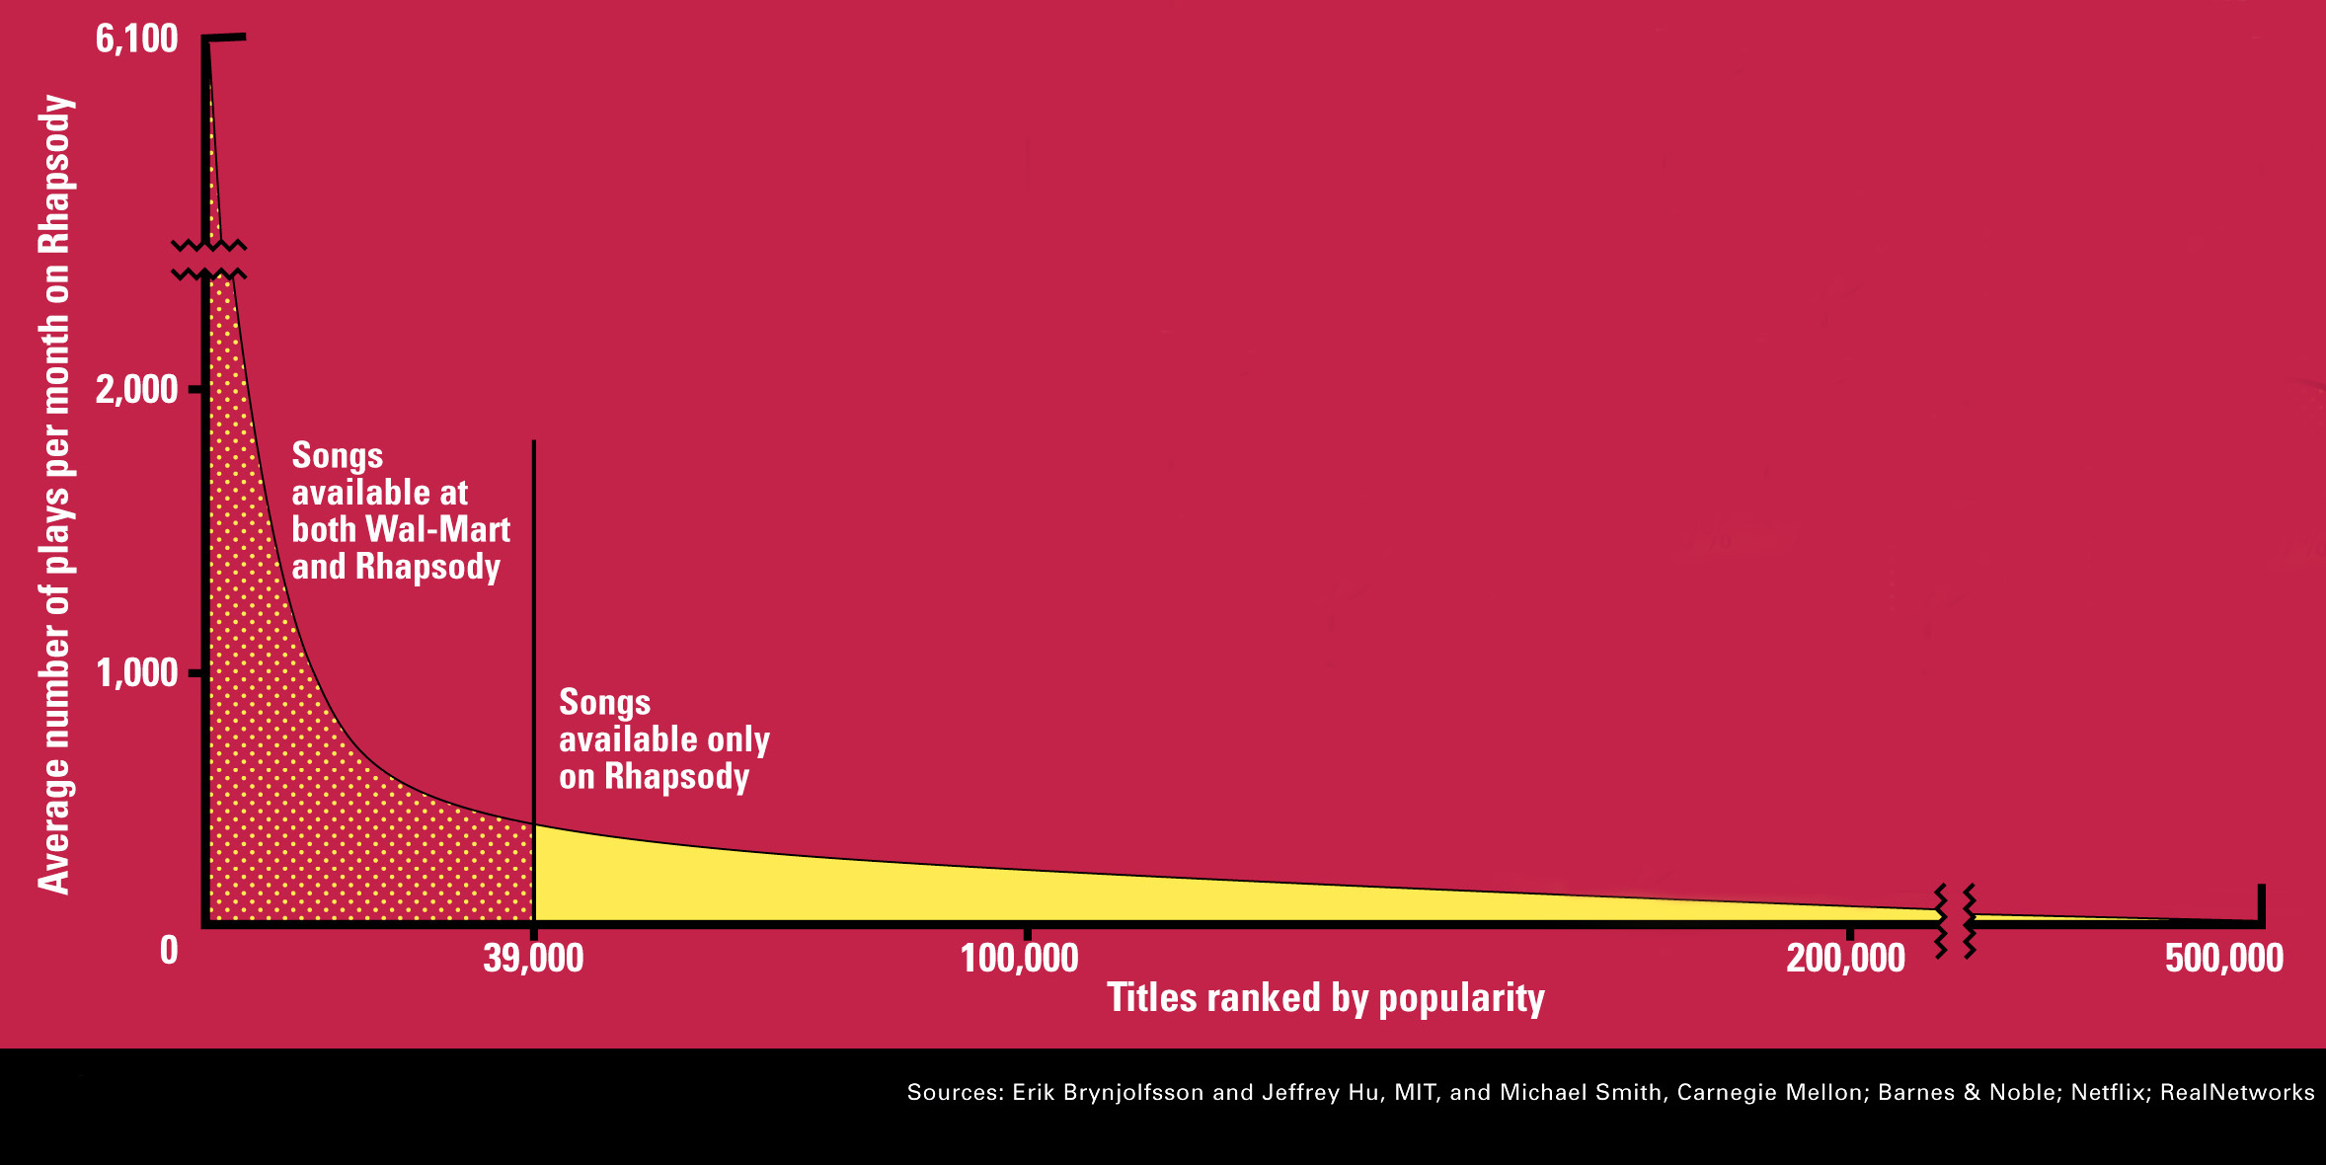
The Long Tail
Source: Chris Anderson (2004)

Slide 38
Utility (Preference) Matrix
 | Harry Potter 1 | Harry Potter 2 | Harry Potter 3 | Twilight | Star Wars 1 | Star Wars 2 | Star Wars 3
A | 4 |  |  | 5 | 1
B | 5 | 5 | 4
C |  |  |  | 2 | 4 | 5
D |  | 3 |  |  |  |  | 3
Rows: Users
Columns: Movies (in general Items)
Values: The rating of the user for the movie
How can we fill the empty entries of the matrix?

Slide 39
Recommendation Systems
Content-based:
  Represent the items into a feature space and recommend items to customer C similar to previous items rated highly by C
    Movie recommendations: recommend movies with same actor(s), director, genre, …
    Websites, blogs, news: recommend other sites with “similar” content

Slide 40
Content-based prediction
 | Harry Potter 1 | Harry Potter 2 | Harry Potter 3 | Twilight | Star Wars 1 | Star Wars 2 | Star Wars 3
A | 4 |  |  | 5 | 1
B | 5 | 5 | 4
C |  |  |  | 2 | 4 | 5
D |  | 3 |  |  |  |  | 3
Someone who likes one of the Harry Potter (or Star Wars)
movies is likely to like the rest
  Same actors, similar story, same genre

Slide 41
Intuition
Item profiles
likes
build
recommend
match
Red
Circles
Triangles
User profile

Slide 42
Approach
Map items into a feature space:
  For movies:
    Actors, directors, genre, rating, year,…
    Challenge: make all features compatible.
  For documents?
To compare items with users we need to map users to the same feature space. How?
  Take all the movies that the user has seen and take the average vector
    Other aggregation functions are also possible.
Recommend to user C the most similar item i computing similarity in the common feature space
  Distributional distance measures also work well.

Slide 43
Limitations of content-based approach
Finding the appropriate features
  e.g., images, movies, music
Overspecialization
  Never recommends items outside user’s content profile
  People might have multiple interests
Recommendations for new users
  How to build a profile?

Slide 44
Collaborative filtering
 | Harry Potter 1 | Harry Potter 2 | Harry Potter 3 | Twilight | Star Wars 1 | Star Wars 2 | Star Wars 3
A | 4 |  |  | 5 | 1
B | 5 | 5 | 4
C |  |  |  | 2 | 4 | 5
D |  | 3 |  |  |  |  | 3
Two users are similar if they rate the same items in a similar way
Recommend to user C, the items
liked by many of the most similar users.

Slide 45
User Similarity
 | Harry Potter 1 | Harry Potter 2 | Harry Potter 3 | Twilight | Star Wars 1 | Star Wars 2 | Star Wars 3
A | 4 |  |  | 5 | 1
B | 5 | 5 | 4
C |  |  |  | 2 | 4 | 5
D |  | 3 |  |  |  |  | 3
Which pair of users do you consider as the most similar?
What is the right definition of similarity?

Slide 46
User Similarity
 | Harry Potter 1 | Harry Potter 2 | Harry Potter 3 | Twilight | Star Wars 1 | Star Wars 2 | Star Wars 3
A | 1 |  |  | 1 | 1
B | 1 | 1 | 1
C |  |  |  | 1 | 1 | 1
D |  | 1 |  |  |  |  | 1
Jaccard Similarity: users are sets of movies
Disregards the ratings.
Jsim(A,B) = 1/5
Jsim(A,C) = 1/2
Jsim(B,D) = 1/4

Slide 47
User Similarity
 | Harry Potter 1 | Harry Potter 2 | Harry Potter 3 | Twilight | Star Wars 1 | Star Wars 2 | Star Wars 3
A | 4 |  |  | 5 | 1
B | 5 | 5 | 4
C |  |  |  | 2 | 4 | 5
D |  | 3 |  |  |  |  | 3
Cosine Similarity:
Assumes zero entries are negatives:
Cos(A,B) = 0.38
Cos(A,C) = 0.32

Slide 48
User Similarity
 | Harry Potter 1 | Harry Potter 2 | Harry Potter 3 | Twilight | Star Wars 1 | Star Wars 2 | Star Wars 3
A | 2/3 |  |  | 5/3 | -7/3
B | 1/3 | 1/3 | -2/3
C |  |  |  | -5/3 | 1/3 | 4/3
D |  | 0 |  |  |  |  | 0
Normalized Cosine Similarity:
  Subtract the mean rating per user and then compute Cosine (correlation coefficient)
Corr(A,B) = 0.092
Corr(A,C) = -0.559

Slide 49
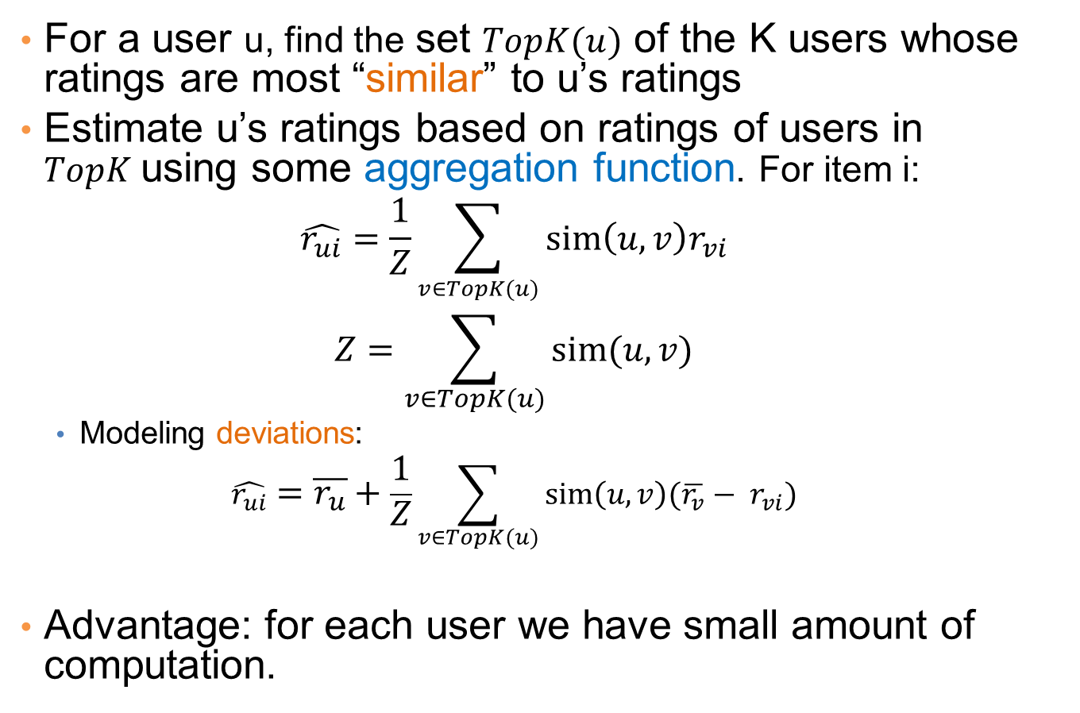
User-User Collaborative Filtering
For a user u, find the set $TopK(u)$ of the K users whose ratings are most “similar” to u’s ratings
Estimate u’s ratings based on ratings of users in $TopK$using some aggregation function. For item i:
  $$\hat{r_{ui}}=\frac{1}{Z}\sum_{v∈TopK(u)}{sim\left(u,v\right)r_{vi}}$$
  $$Z=\sum_{v∈TopK(u)}{sim(u,v)}$$
  Modeling deviations:
  $$\hat{r_{ui}}=\overline{r_{u}}+\frac{1}{Z}\sum_{v∈TopK(u)}{sim\left(u,v\right){(\overline{r_{v}}− r}_{vi})}$$
Advantage: for each user we have small amount of computation.
Deviation from mean for v
Mean rating of u
Mean deviation of similar users

Slide 50
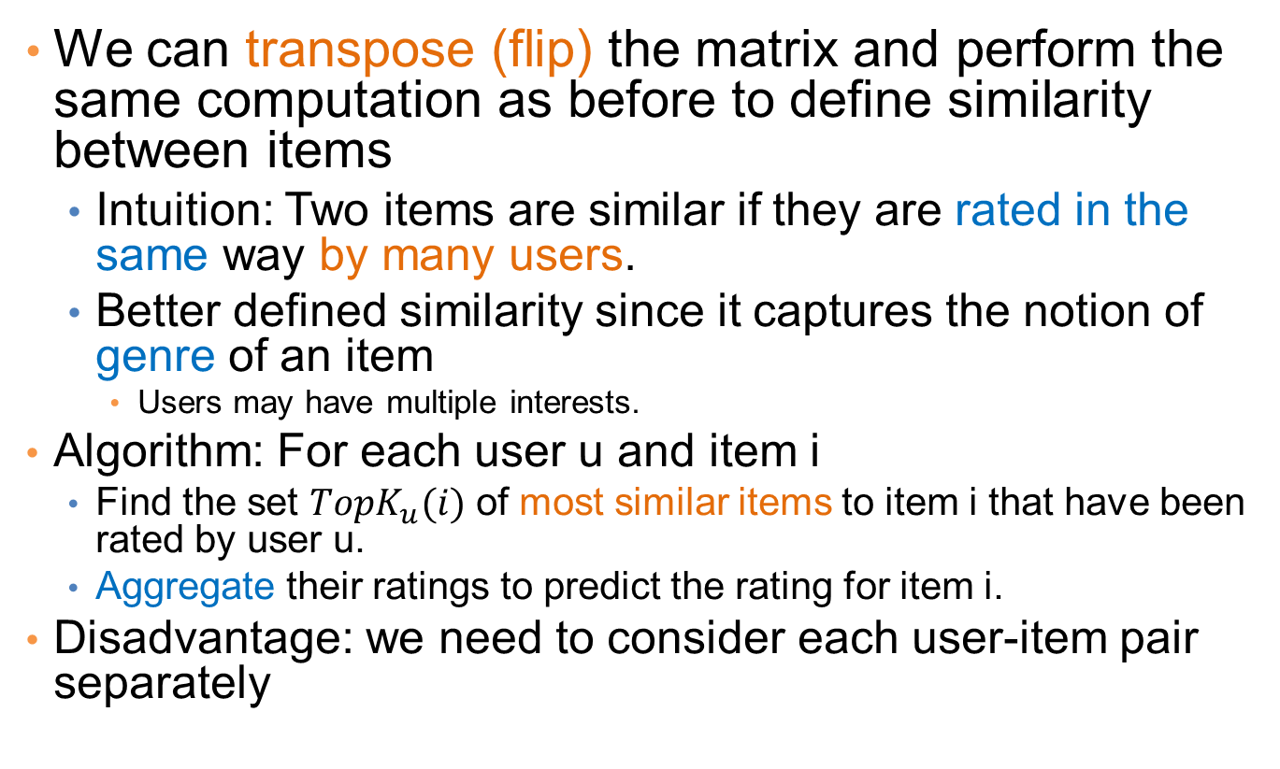
Item-Item Collaborative Filtering
We can transpose (flip) the matrix and perform the same computation as before to define similarity between items
  Intuition: Two items are similar if they are rated in the same way by many users.
  Better defined similarity since it captures the notion of genre of an item
    Users may have multiple interests.
Algorithm: For each user u and item i
  Find the set $TopK_{u}(i)$ of most similar items to item i that have been rated by user u.
  Aggregate their ratings to predict the rating for item i.
Disadvantage: we need to consider each user-item pair separately

Slide 51
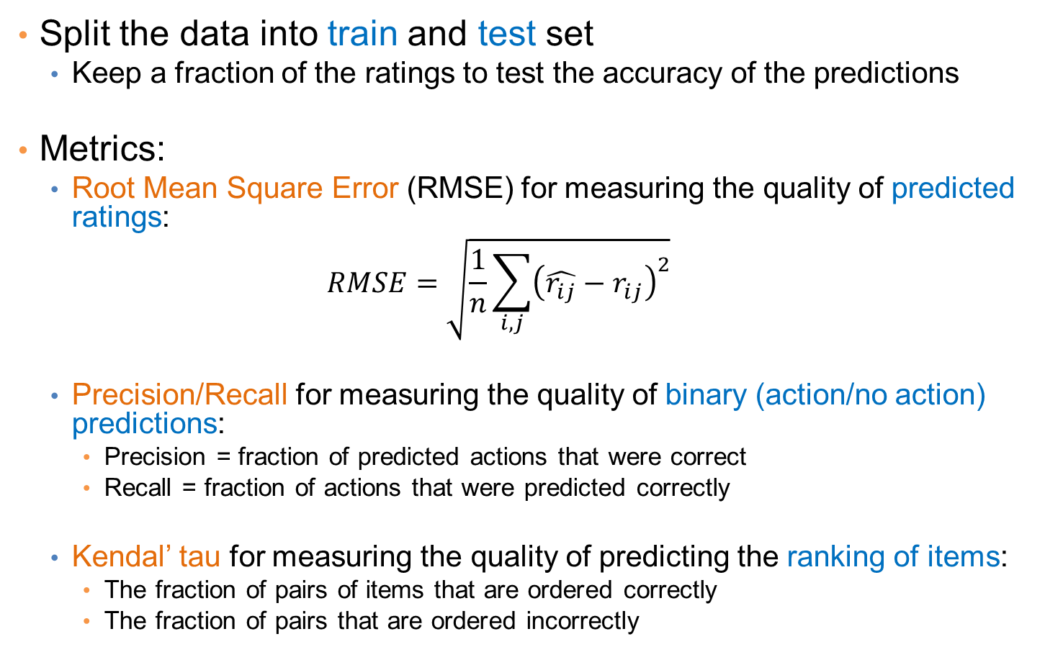
Evaluation
Split the data into train and test set
  Keep a fraction of the ratings to test the accuracy of the predictions
Metrics:
  Root Mean Square Error (RMSE) for measuring the quality of predicted ratings:
  $$RMSE=\sqrt{\frac{1}{n}\sum_{i,j}{{\left(\hat{r_{ij}}−r_{ij}\right)}^{2}}}$$
  Precision/Recall for measuring the quality of binary (action/no action) predictions:
    Precision = fraction of predicted actions that were correct
    Recall = fraction of actions that were predicted correctly
  Kendal’ tau for measuring the quality of predicting the ranking of items:
    The fraction of pairs of items that are ordered correctly
    The fraction of pairs that are ordered incorrectly

Slide 52
Pros and cons of collaborative filtering
Works for any kind of item
  No feature selection needed
New user problem
New item problem
Sparsity of rating matrix
  Cluster-based smoothing?

Slide 53

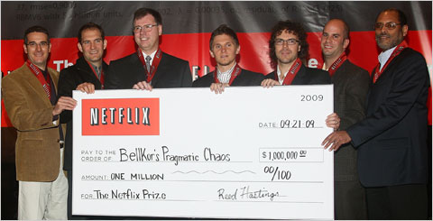
The Netflix Challenge
1M prize to improve the prediction accuracy by 10%

