Slide 1
DATA MINING
LECTURE 12
Coverage
Approximation Algorithms

Slide 2
Example
Promotion campaign on a social network
  We have a social network as a graph.
  People are more likely to buy a product if they have a friend who has the product.
  We want to offer the product for free to some people such that every person in the graph is covered: they have a friend who has the product.
  We want the number of free products to be as small as possible

Slide 3
Example
Promotion campaign on a social network
  We have a social network as a graph.
  People are more likely to buy a product if they have a friend who has the product.
  We want to offer the product for free to some people such that every person in the graph is covered: they have a friend who has the product.
  We want the number of free products to be as small as possible
One possible selection

Slide 4
Example
Promotion campaign on a social network
  We have a social network as a graph.
  People are more likely to buy a product if they have a friend who has the product.
  We want to offer the product for free to some people such that every person in the graph is covered: they have a friend who has the product.
  We want the number of free products to be as small as possible
A better selection

Slide 5
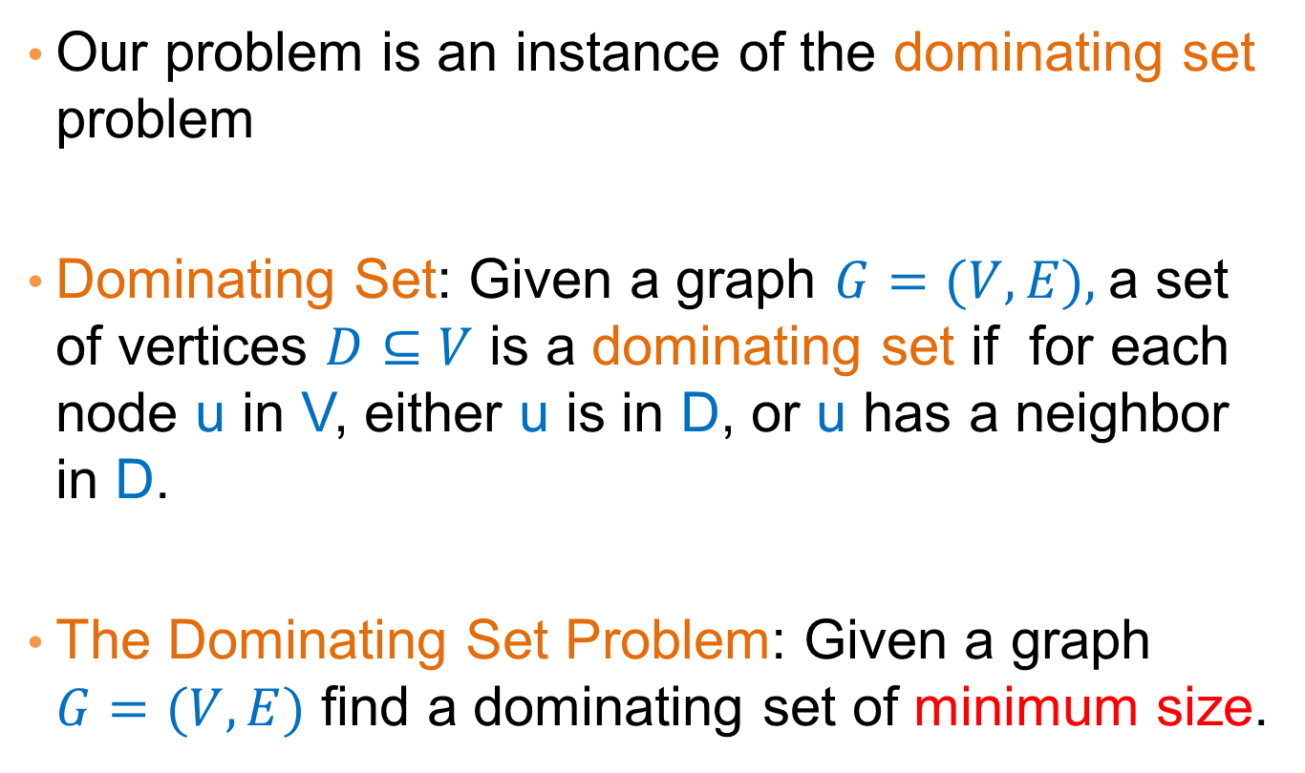
Dominating set
Our problem is an instance of the dominating set problem
Dominating Set: Given a graph $G=(V,E),$a set of vertices $D⊆V$ is a dominating set if for each node u in V, either u is in D, or u has a neighbor in D.
The Dominating Set Problem: Given a graph $G=(V,E)$ find a dominating set of minimum size.

Slide 6
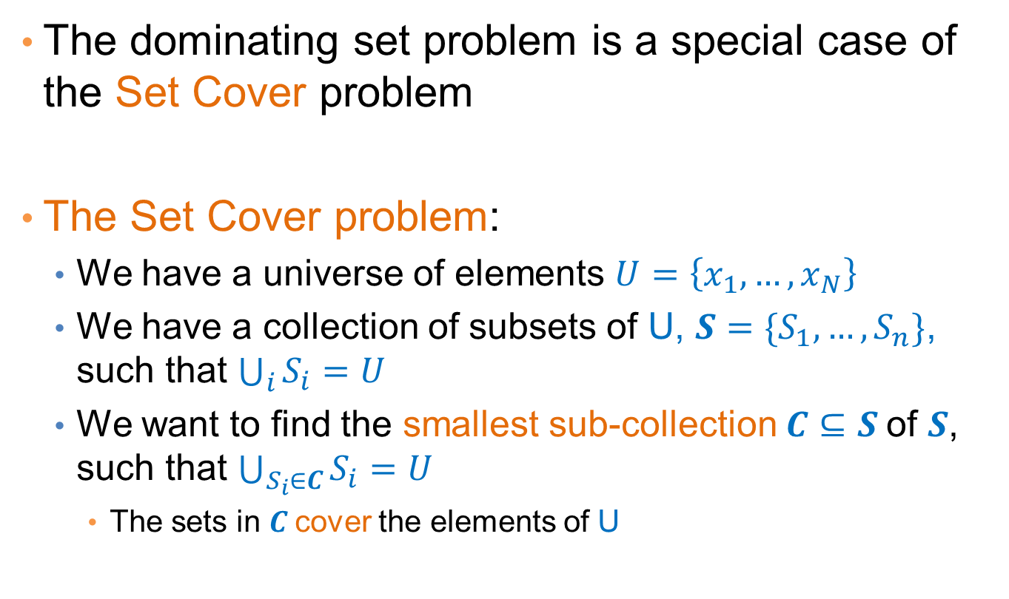
Set Cover
The dominating set problem is a special case of the Set Cover problem
The Set Cover problem:
  We have a universe of elements $U=\left\{x_{1},…,x_{N}\right\}$
  We have a collection of subsets of U, $S=\{S_{1},…,S_{n}\}$, such that $\bigcup_{i}{S_{i}}=U$
  We want to find the smallest sub-collection$C⊆S$ of $S$, such that $\bigcup_{S_{i}∈C}{S_{i}=U}$
    The sets in $C$cover the elements of U

Slide 7
An application of Set Cover
Suppose that we want to create a catalog (with coupons) to give to customers of a store:
  We want for every customer, the catalog to contain a product bought by the customer (this is a small store)
How can we model this as a set cover problem?

Slide 8
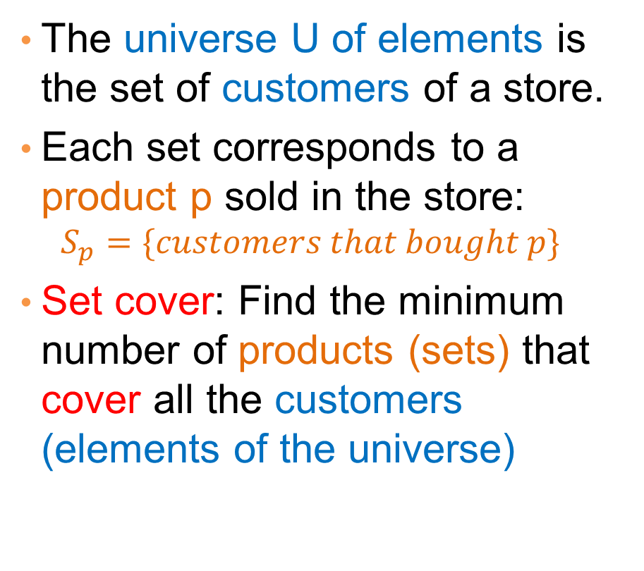
Applications
milk
1
The universe U of elements is the set of customers of a store.
Each set corresponds to a product p sold in the store:
  $$S_{p}=\{customers that bought p\}$$
Set cover: Find the minimum number of products (sets) that cover all the customers (elements of the universe)
2
coffee
3
coke
4
beer
5
6
tea
7

Slide 9
Applications
milk
1
The universe U of elements is the set of customers of a store.
Each set corresponds to a product p sold in the store:
  $$S_{p}=\{customers that bought p\}$$
Set cover: Find the minimum number of products (sets) that cover all the customers (elements of the universe)
2
coffee
3
coke
4
beer
5
6
tea
7

Slide 10
Applications
milk
1
The universe U of elements is the set of customers of a store.
Each set corresponds to a product p sold in the store:
  $$S_{p}=\{customers that bought p\}$$
Set cover: Find the minimum number of products (sets) that cover all the customers (elements of the universe)
2
coffee
3
coke
4
beer
5
6
tea
7

Slide 11
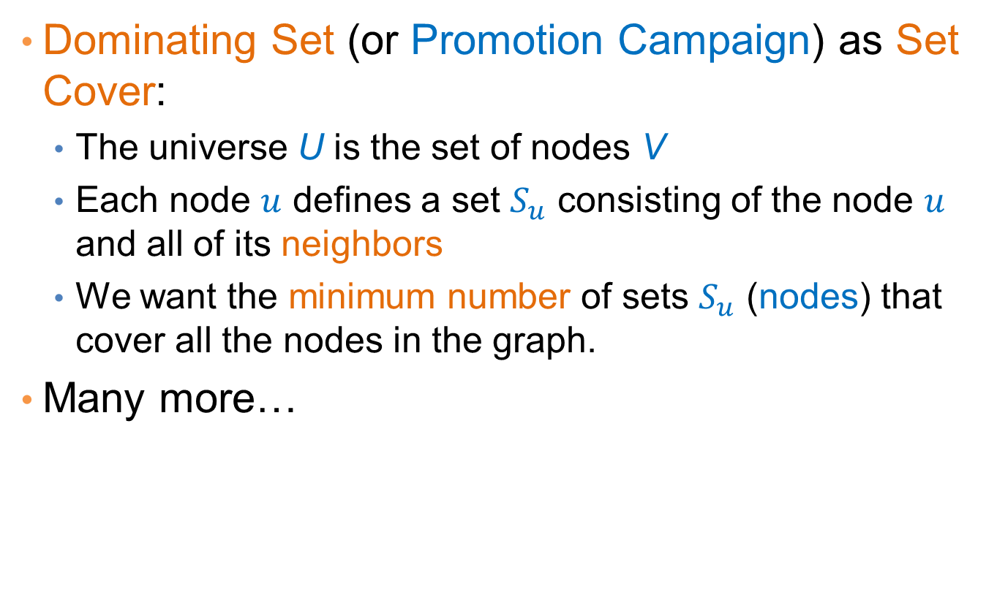
Applications
Dominating Set (or Promotion Campaign) as Set Cover:
  The universe U is the set of nodes V
  Each node $u$ defines a set $S_{u}$ consisting of the node $u$ and all of its neighbors
  We want the minimum number of sets $S_{u}$ (nodes) that cover all the nodes in the graph.
Many more…

Slide 12
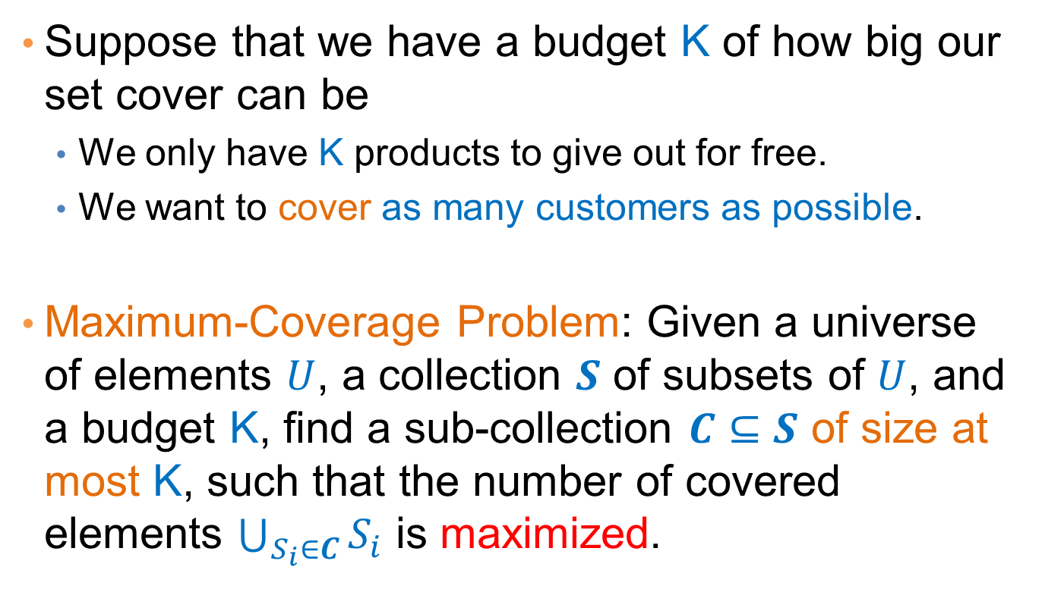
Best selection variant
Suppose that we have a budget K of how big our set cover can be
  We only have K products to give out for free.
  We want to cover as many customers as possible.
Maximum-Coverage Problem: Given a universe of elements $U$, a collection $S$ of subsets of $U$, and a budget K, find a sub-collection $C⊆S$ of size at most K, such that the number of covered elements $\bigcup_{S_{i}∈C}{S_{i}}$ is maximized.

Slide 13
Complexity
Both the Set Cover and the Maximum Coverage problems are NP-complete
  What does this mean?
  Why do we care?
There is no algorithm that can guarantee finding the best solution in polynomial time
  Can we find an algorithm that can guarantee to find a solution that is close to the optimal?
  Approximation Algorithms.

Slide 14
Approximation Algorithms
For an (combinatorial) optimization problem, where:
  X is an instance of the problem,
  OPT(X) is the value of the optimal solution for X,
  ALG(X) is the value of the solution of an algorithm ALG for X
ALG is a good approximation algorithm if the ratio of OPT(X) and ALG(X) is bounded for all input instances X
Minimum set cover: input X = (U,S) is the universe of elements and the set collection, OPT(X) is the size of minimum set cover, ALG(X) is the size of the set cover found by an algorithm ALG.
Maximum coverage: input X = (U,S,K) is the input instance, OPT(X) is the coverage of the optimal algorithm, ALG(X) is the coverage of the set found by an algorithm ALG.

Slide 15
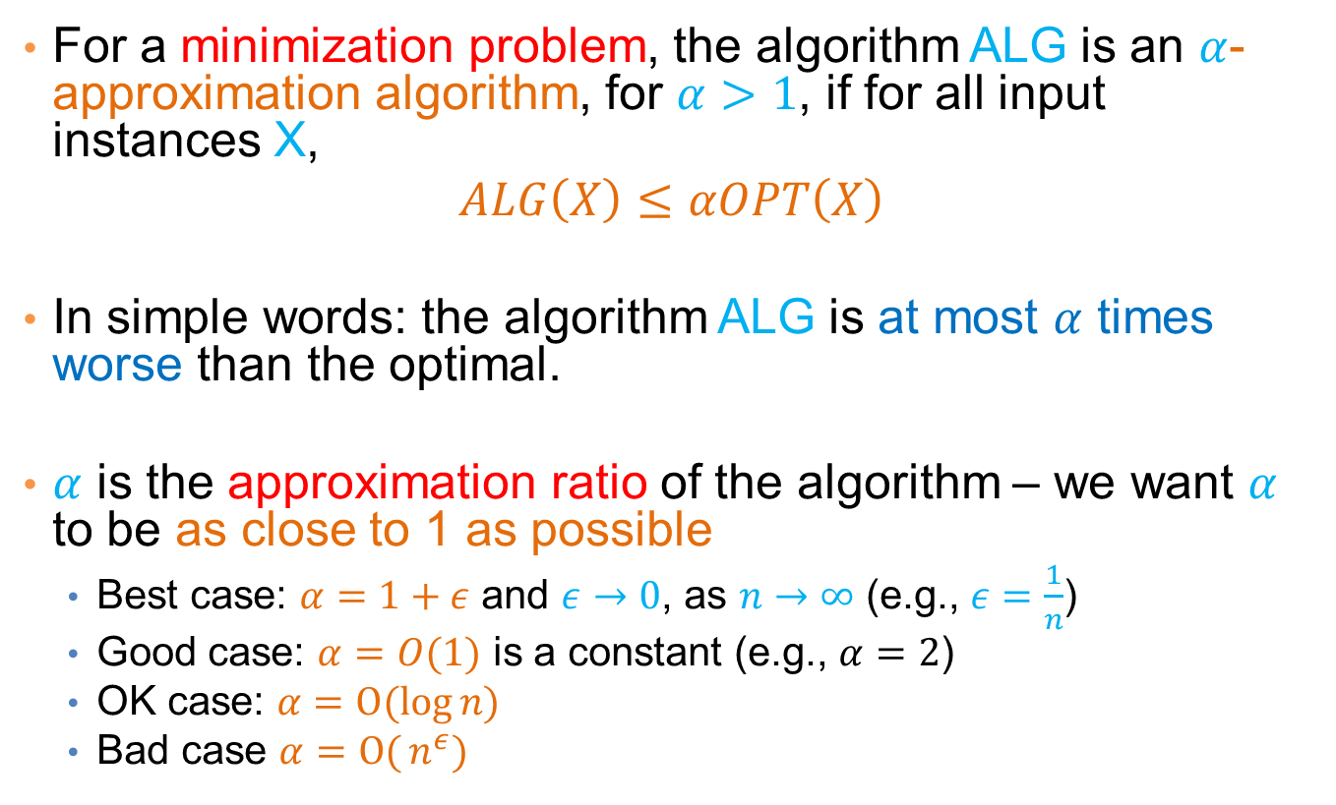
Approximation Algorithms
For a minimization problem, the algorithm ALG is an $α$-approximation algorithm, for $α>1$, if for all input instances X,
$$ALG\left(X\right)≤αOPT\left(X\right)$$
In simple words: the algorithm ALG is at most $α$ times worse than the optimal.
$α$ is the approximation ratio of the algorithm – we want $α$ to be as close to 1 as possible
  Best case: $α=1+ε$ and $ε→0$, as $n→∞$ (e.g., $ε=\frac{1}{n}$)
  Good case: $α=O(1)$ is a constant (e.g., $α=2$)
  OK case: $α=O(log{n)}$
  Bad case $α=O({n^{ε})}$

Slide 16
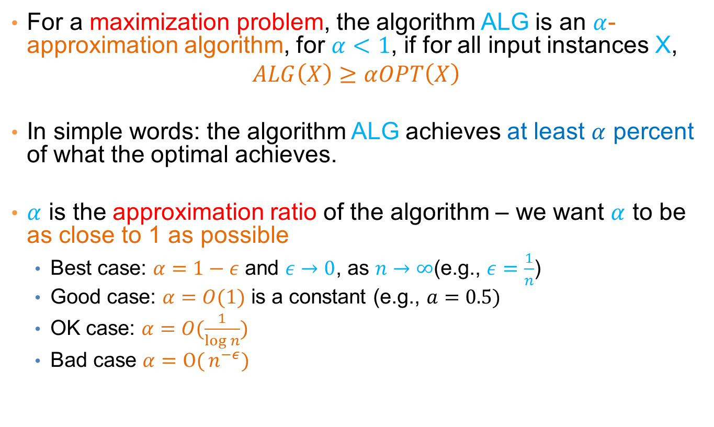
Approximation Algorithms
For a maximization problem, the algorithm ALG is an $α$-approximation algorithm, for $α<1$, if for all input instances X,
$$ALG\left(X\right)≥αOPT\left(X\right)$$
In simple words: the algorithm ALG achieves at least $α$ percent of what the optimal achieves.
$α$ is the approximation ratio of the algorithm – we want $α$ to be as close to 1 as possible
  Best case: $α=1−ε$ and $ε→0$, as $n→∞$(e.g., $ε=\frac{1}{n}$)
  Good case: $α=O(1)$ is a constant (e.g., $a=0.5)$
  OK case: $α=O(\frac{1}{\log{n}})$
  Bad case $α=O({n^{−ε})}$

Slide 17
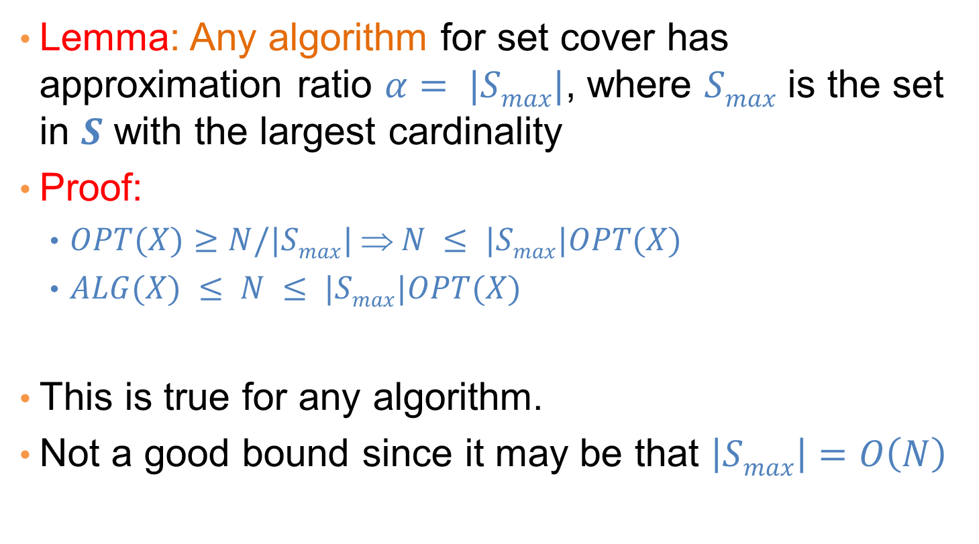
A simple approximation ratio for set cover
Lemma: Any algorithm for set cover has approximation ratio $α= |Smax|$, where $Smax$ is the set in $S$ with the largest cardinality
Proof:
  $OPT(X)≥N/|Smax| ⇒ N ≤ |Smax|OPT(X)$
  $ALG(X) ≤ N ≤ |Smax|OPT(X)$
This is true for any algorithm.
Not a good bound since it may be that $\left|Smax\right|=O\left(N\right)$

Slide 18
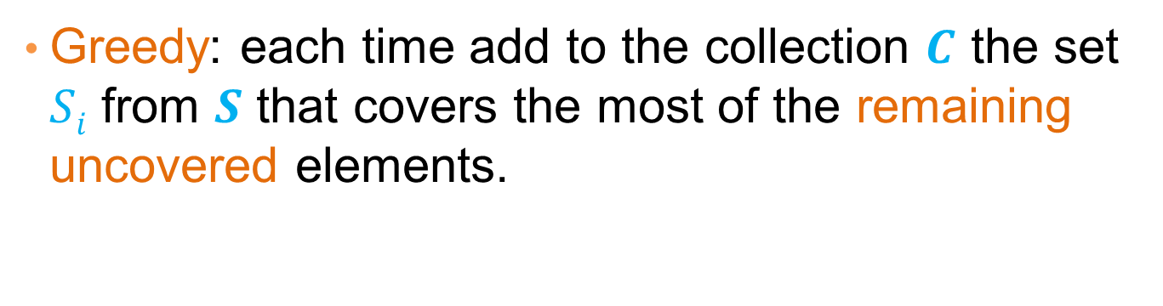
An algorithm for Set Cover
What is a natural algorithm for Set Cover?
Greedy: each time add to the collection $C$ the set $Si$ from $S$ that covers the most of the remaining uncovered elements.

Slide 19
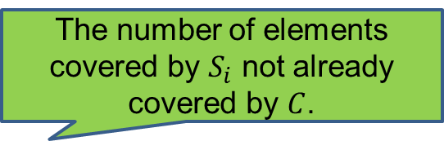
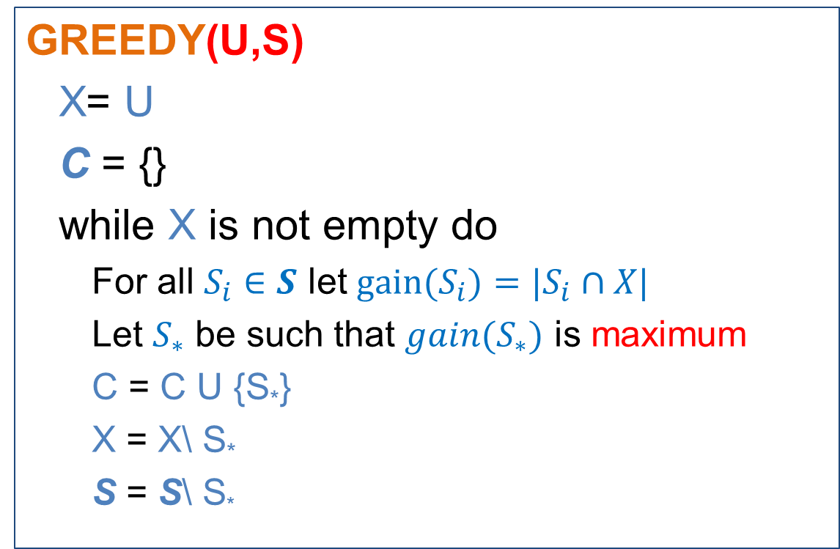
The GREEDY algorithm
GREEDY(U,S)
  X= U
  C = {}
  while X is not empty do
    For all $S_{i}∈S$ let $gain(S_{i})={|S}_{i}∩X|$
    Let $S_{∗}$ be such that $gain(S_{∗})$ is maximum
    C = C U {S*}
    X = X\ S*
    S = S\ S*
The number of elements covered by $S_{i}$ not already covered by $C$.

Slide 20
Greedy is not always optimal
Optimal
Greedy
milk
1
milk
1
2
2
coffee
coffee
3
3
coke
coke
4
4
5
beer
5
beer
6
6
tea
tea
7
7

Slide 21
Greedy is not always optimal
Optimal
Greedy
milk
1
milk
1
2
2
coffee
coffee
3
3
coke
coke
4
4
5
beer
5
beer
6
6
tea
tea
7
7

Slide 22
Greedy is not always optimal
Optimal
Greedy
milk
1
milk
1
2
2
coffee
coffee
3
3
coke
coke
4
4
5
beer
5
beer
6
6
tea
tea
7
7

Slide 23
Greedy is not always optimal
Optimal
Greedy
milk
1
milk
1
2
2
coffee
coffee
3
3
coke
coke
4
4
5
beer
5
beer
6
6
tea
tea
7
7

Slide 24
Greedy is not always optimal
Optimal
Greedy
milk
1
milk
1
2
2
coffee
coffee
3
3
coke
coke
4
4
5
beer
5
beer
6
6
tea
tea
7
7

Slide 25
Greedy is not always optimal
milk
1
Adding Coke to the set is useless.
We need Milk (or Coffee) and Beer to cover all customers
milk
1
2
2
coffee
coffee
3
3
coke
coke
4
4
5
beer
5
beer
6
6
tea
tea
7
7

Slide 26
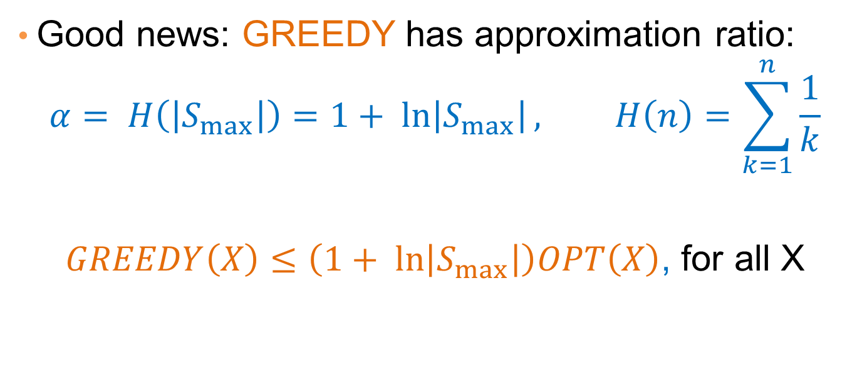
Approximation ratio of GREEDY
Good news: GREEDY has approximation ratio:
$$α= H\left(\left|S_{max}\right|\right)=1+ ln\left|S_{max}\right|, H\left(n\right)=\sum_{k=1}^{n}{\frac{1}{k}}$$
$GREEDY\left(X\right)≤\left(1+ ln\left|S_{max}\right|\right)OPT\left(X\right)$, for all X

Slide 27

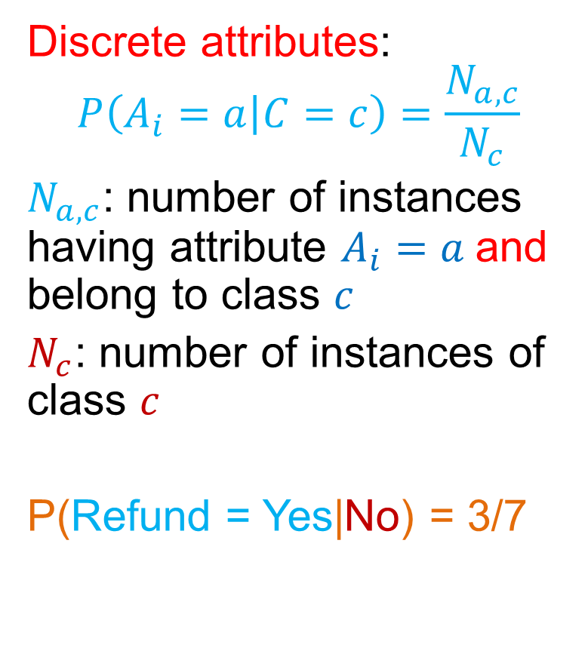
Maximum Coverage
Greedy is also applicable here
GREEDY(U,S,K)
  X = U
  C = {}
  while |C| < K
    For all $S_{i}∈S$ let $gain(S_{i})={|S}_{i}∩X|$
    Let $S_{∗}$ be such that $gain(S_{∗})$ is maximum
    C = C U {S*}
    X = X\ S*
    S= S\ S*
The number of elements covered by $S_{i}$ not already covered by $C$.

Slide 28
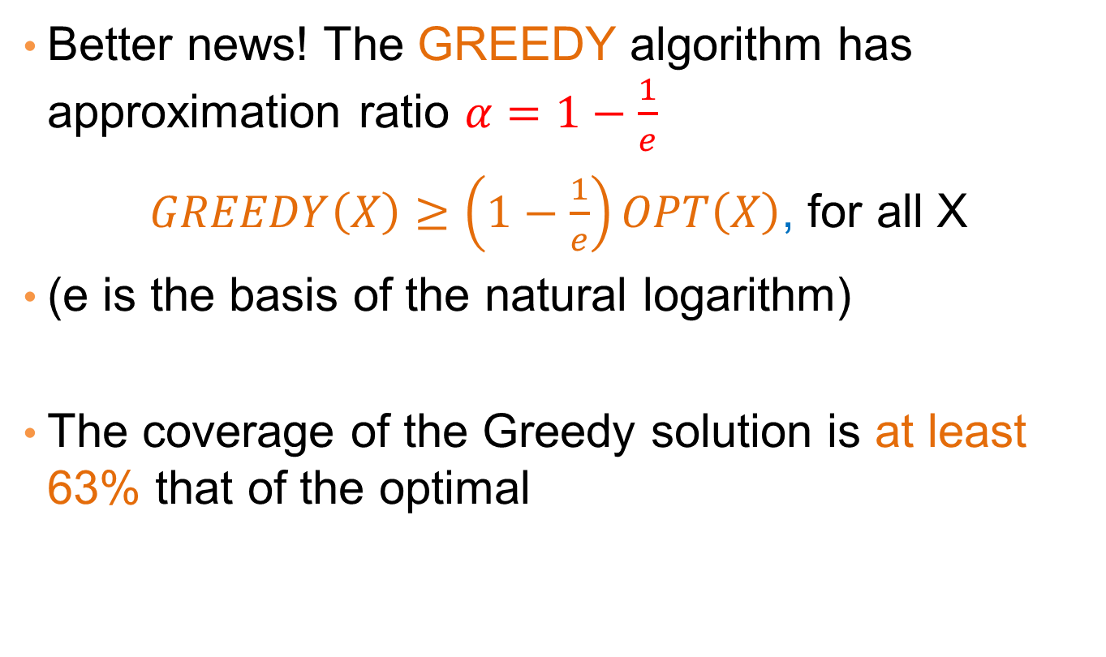
Approximation Ratio for Max-K Coverage
Better news! The GREEDY algorithm has approximation ratio $α=1−\frac{1}{e}$
$GREEDY\left(X\right)≥\left(1−\frac{1}{e}\right)OPT\left(X\right)$, for all X
(e is the basis of the natural logarithm)
The coverage of the Greedy solution is at least 63% that of the optimal

Slide 29
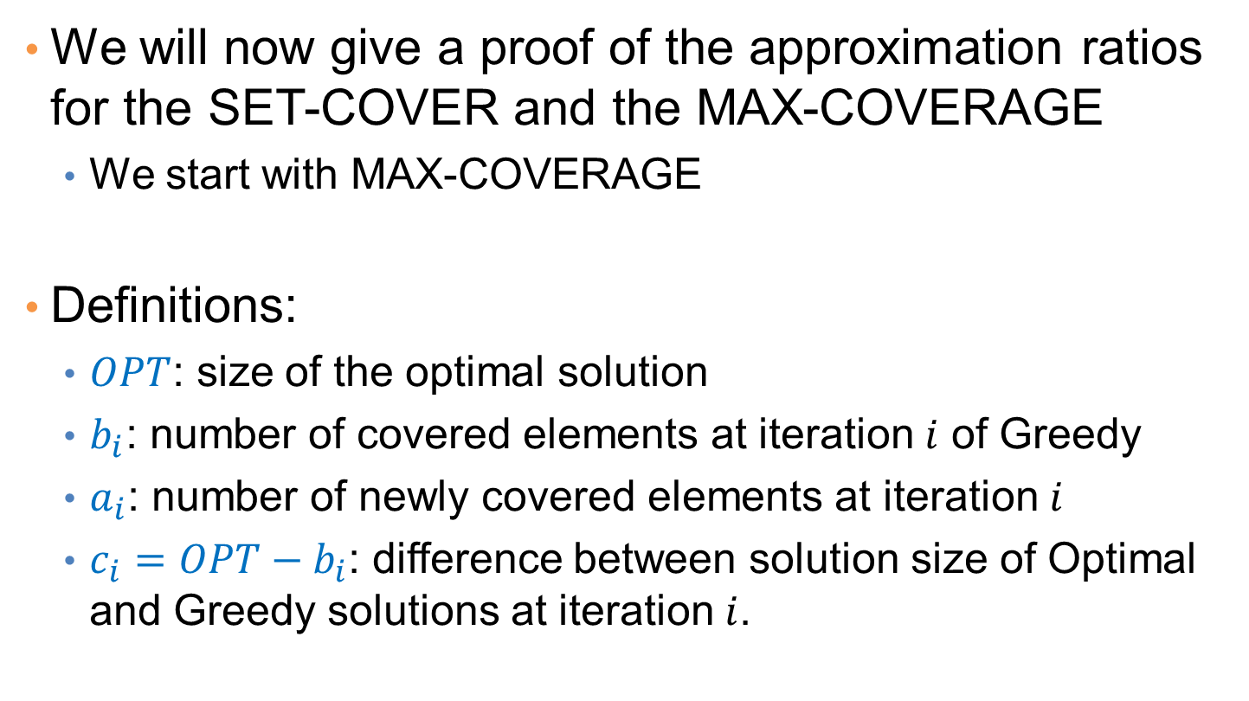
Proof of approximation ratios
We will now give a proof of the approximation ratios for the SET-COVER and the MAX-COVERAGE
  We start with MAX-COVERAGE
Definitions:
  $OPT$: size of the optimal solution
  $b_{i}$: number of covered elements at iteration $i$ of Greedy
  $a_{i}$: number of newly covered elements at iteration $i$
  $c_{i}=OPT−b_{i}$: difference between solution size of Optimal and Greedy solutions at iteration $i$.

Slide 30



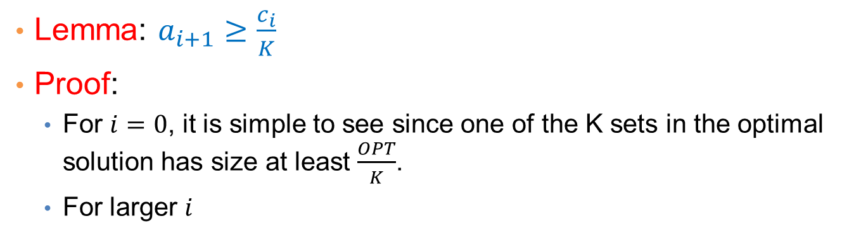
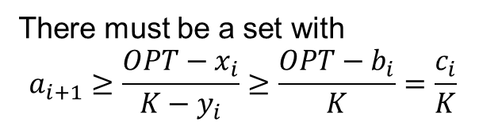
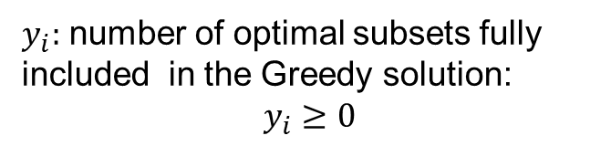
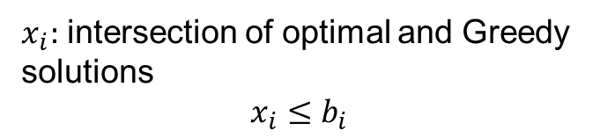
Lemma: $a_{i+1}≥\frac{c_{i}}{K}$
Proof:
  For $i=0$, it is simple to see since one of the K sets in the optimal solution has size at least $\frac{OPT}{K}$.
  For larger $i$
Universe
Optimal solution for K = 5
Greedy solution at iteration $i$
$x_{i}:$ intersection of optimal and Greedy solutions
$$x_{i}≤b_{i}$$
OPT
$$b_{i}$$
$y_{i}:$ number of optimal subsets fully included in the Greedy solution:
$$y_{i}≥0$$
There must be a set with
$$a_{i+1}≥\frac{OPT−x_{i}}{K−y_{i}}≥\frac{OPT−b_{i}}{K}=\frac{c_{i}}{K}$$
$$K−y_{i}=3$$

Slide 31
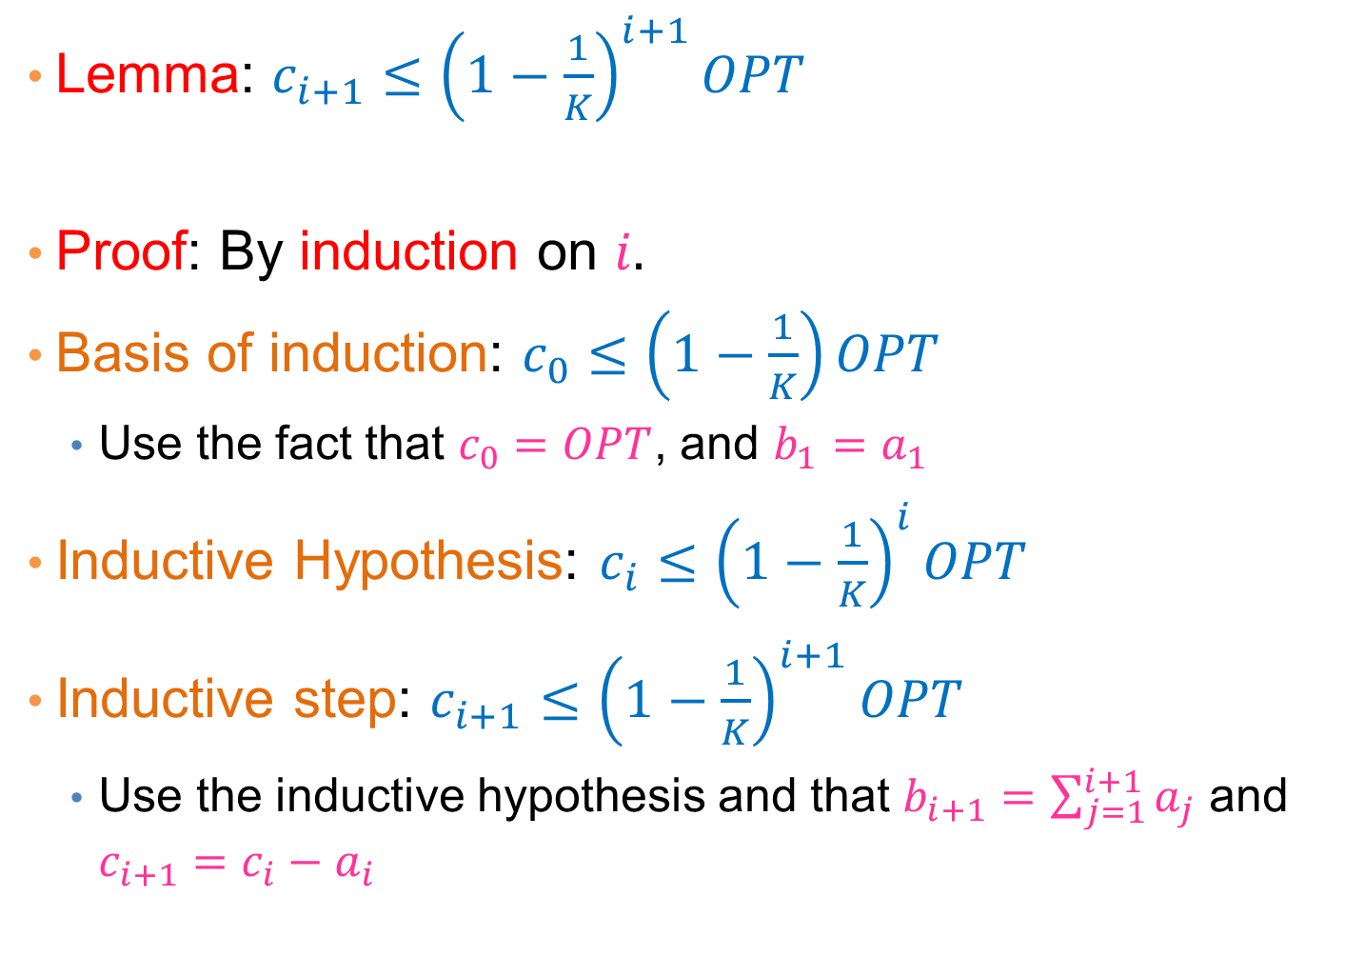
Lemma: $c_{i+1}≤{\left(1−\frac{1}{K}\right)}^{i+1}OPT$
Proof: By induction on $i.$
Basis of induction: $c_{0}≤\left(1−\frac{1}{K}\right)OPT$
  Use the fact that $c_{0}=OPT$, and $b_{1}=a_{1}$
Inductive Hypothesis: $c_{i}≤{\left(1−\frac{1}{K}\right)}^{i}OPT$
Inductive step: $c_{i+1}≤{\left(1−\frac{1}{K}\right)}^{i+1}OPT$
  Use the inductive hypothesis and that $b_{i+1}=\sum_{j=1}^{i+1}{a_{j}}$ and $c_{i+1}=c_{i}−a_{i}$

Slide 32
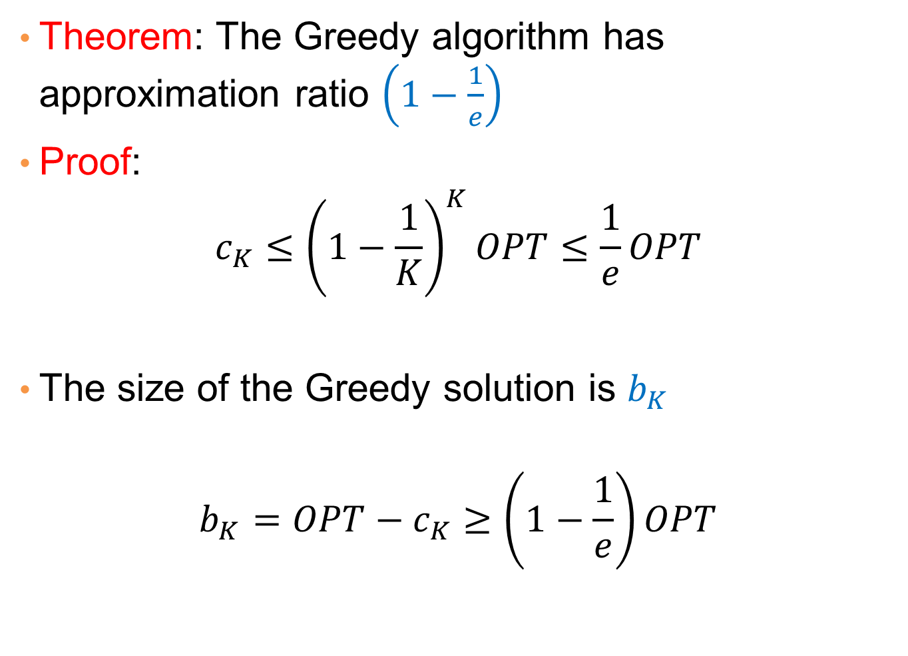
Theorem: The Greedy algorithm has approximation ratio $\left(1−\frac{1}{e}\right)$
Proof:
$$c_{K}≤{\left(1−\frac{1}{K}\right)}^{K}OPT≤\frac{1}{e}OPT$$
The size of the Greedy solution is $b_{K}$
$$b_{K}=OPT−c_{K}≥\left(1−\frac{1}{e}\right)OPT$$

Slide 33
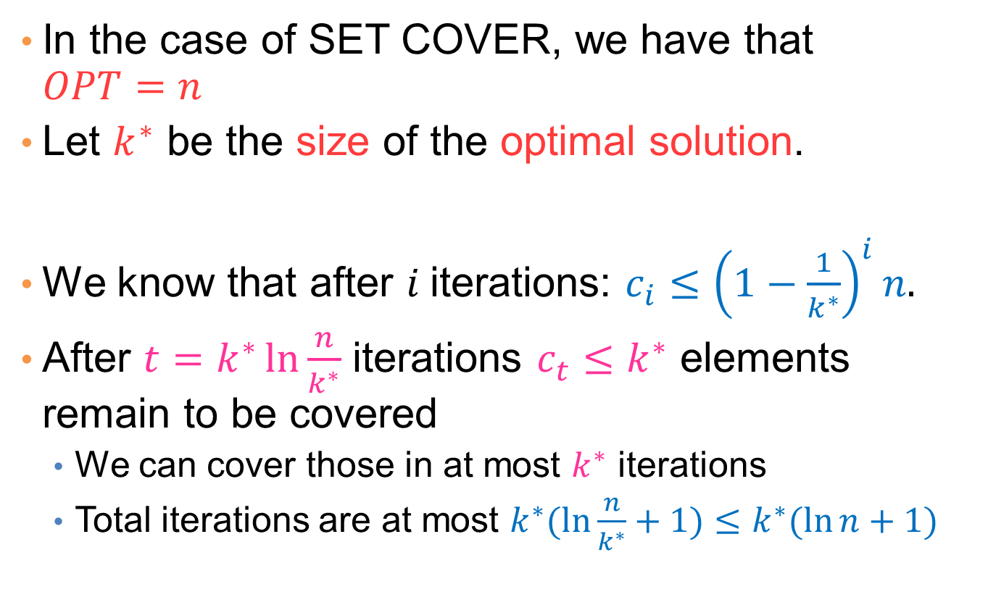
Proof for SET COVER
In the case of SET COVER, we have that $OPT=n$
Let $k^{∗}$ be the size of the optimal solution.
We know that after $i$iterations: $c_{i}≤{\left(1−\frac{1}{k^{∗}}\right)}^{i}n.$
After $t=k^{∗}\ln{\frac{n}{k^{∗}}}$ iterations $c_{t}≤k^{∗}$ elements remain to be covered
  We can cover those in at most $k^{∗}$ iterations
  Total iterations are at most $k^{∗}(\ln{\frac{n}{k^{∗}}+1)≤k^{∗}(\ln{n}+1)}$

Slide 34
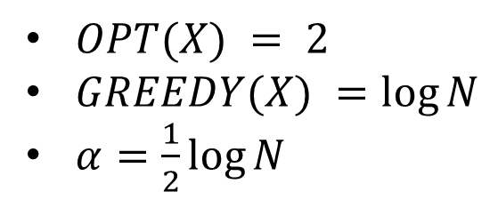
Lower bound
The approximation ratio is tight up to a constant
  Tight means that we can find a counter example with this ratio
$OPT(X) = 2$
$GREEDY(X) =\log{N}$
$α=\frac{1}{2}\log{N}$

Slide 35
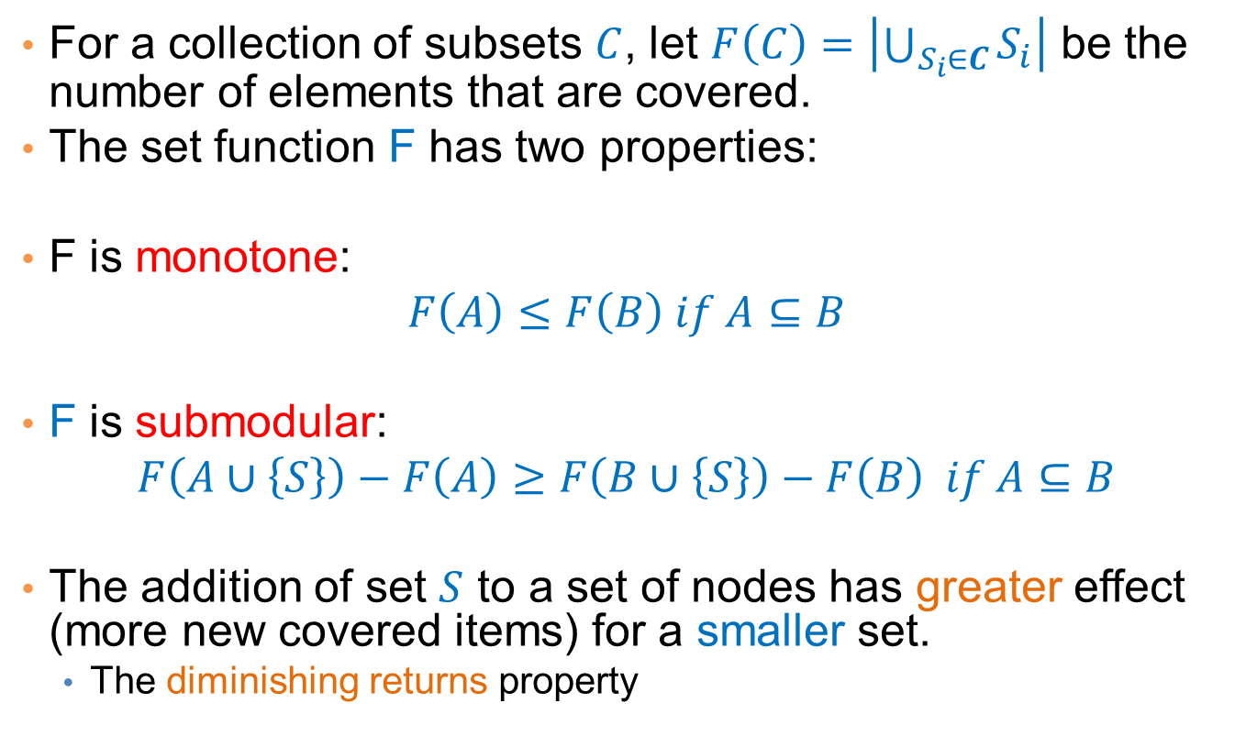
Another proof of the approximation ratio for MAX-K COVERAGE
For a collection of subsets $C$, let $F\left(C\right)=\left|\bigcup_{S_{i}∈C}{S_{i}}\right|$ be the number of elements that are covered.
The set function F has two properties:
F is monotone:
$$F\left(A\right)≤F\left(B\right) if A⊆B$$
F is submodular:
$$F\left(A∪\left\{S\right\}\right)−F\left(A\right)≥F\left(B∪\left\{S\right\}\right)−F\left(B\right) if A⊆B$$
The addition of set $S$ to a set of nodes has greater effect (more new covered items) for a smaller set.
  The diminishing returns property

Slide 36
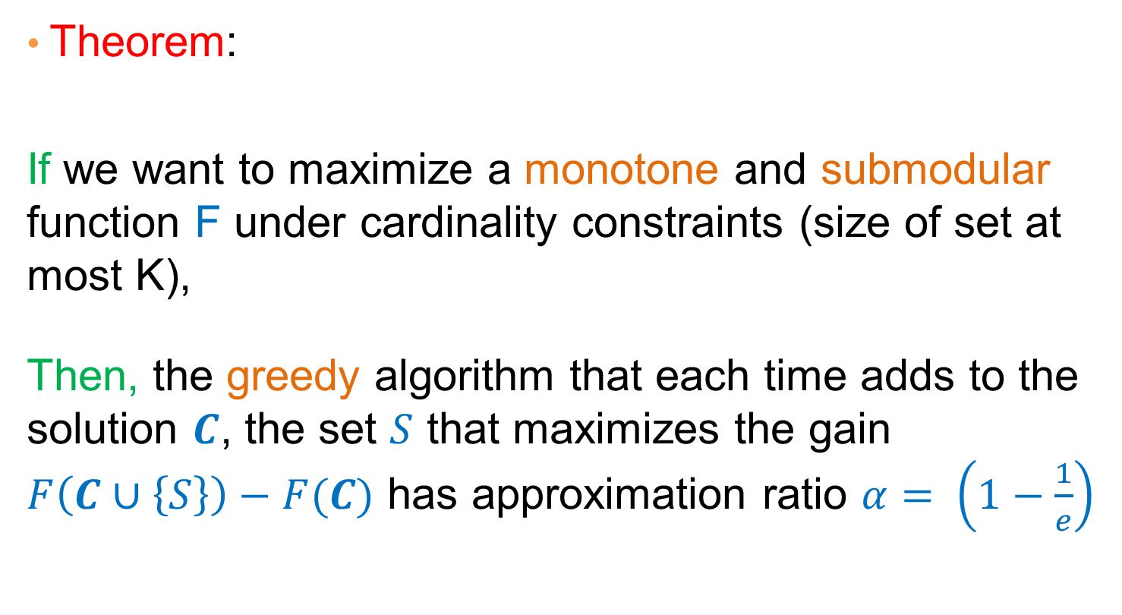
Optimizing submodular functions
Theorem:
If we want to maximize a monotone and submodular function F under cardinality constraints (size of set at most K),
Then, the greedy algorithm that each time adds to the solution $C$, the set $S$ that maximizes the gain $F\left(C∪\left\{S\right\}\right)−F(C)$ has approximation ratio $α= \left(1−\frac{1}{e}\right)$
True for any monotone and submodular set function!

Slide 37
Other variants of Set Cover
Hitting Set: select a set of elements so that you hit all the sets (the same as the set cover, reversing the roles)
Vertex Cover: Select a set of vertices from a graph such that you cover all edges (for every edge an endpoint of the edge is in the set)
  There is a 2-approximation algorithm
Edge Cover: Select a set of edges that cover all vertices (for every vertex, there is one edge that has as endpoint this vertex)
  There is a polynomial algorithm

Slide 38
OverVIEW

Slide 39
Class Overview
In this class you saw a set of tools for analyzing data
  Frequent Itemsets, Association Rules
  Sketching
  Recommendation Systems
  Clustering
  Singular Value Decomposition
  Classification
  Link Analysis Ranking
  Random Walks
  Coverage
All these are useful when trying to make sense of the data. A lot more tools exist.
I hope that you found this interesting, useful and fun.

