Slide 1
DATA MINING
Python

Slide 2
Python
In the last few years there is an increasing community that creates Data Mining tools in Python
  There are also tools in other languages but we will use Python whenever we can for a common point of reference.
We will use Iron Python that interfaces with .NET and we can run Notebooks in a browser.
  You can also use any editor and compile and run from a terminal

Slide 3
Installing Python
Installing libraries in Python is complex, so you should download the Anaconda Scientific Python distribution which will install most of the libraries that we will use.
  There are two versions, Python 2.7 and Python 3.0 and they are not compatible. We will use Python 3.0

Slide 4
Resources
There are tons of resources online for Python.
For an introduction you can also look at the slides of the Introduction to Programming course by prof. N. Mamoulis

Slide 5
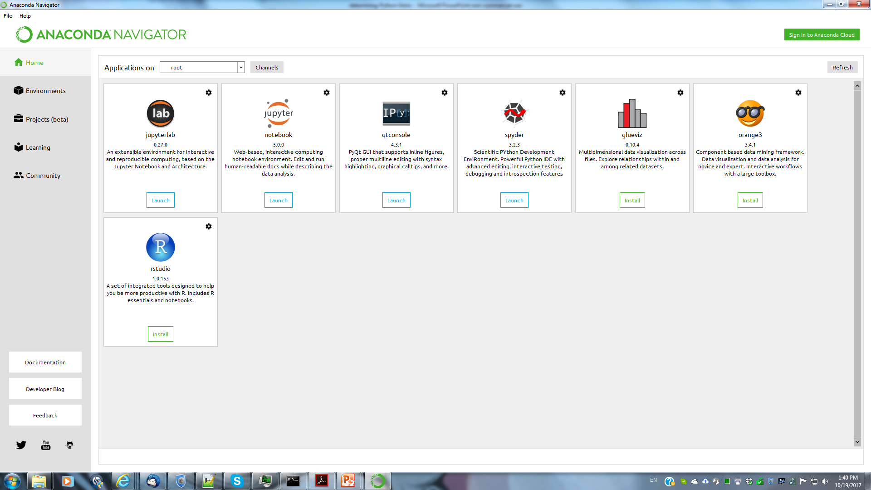
The Anaconda Navigator

Slide 6
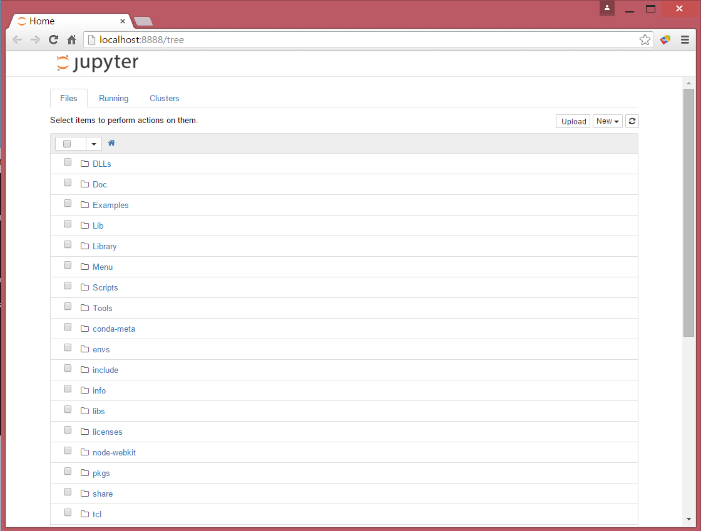

Slide 7
The Anaconda Navigator

Slide 8
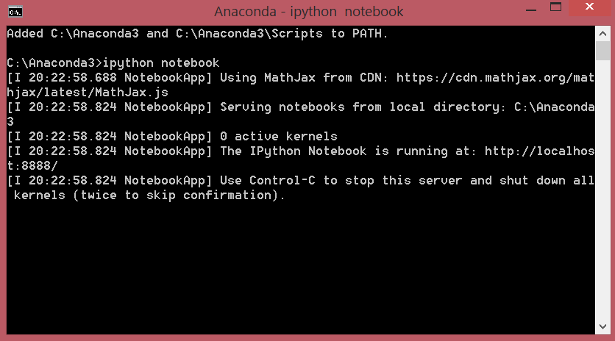
Starting iPython notebook

Slide 9
Changing the notebook default directory
From the Anaconda terminal type the command:
  jupyter notebook --generate-config
This will generate .jupiter/jupyter_notebook_config.py file under your home directory.
Find, un-comment and modify the line
# c.NotebookApp.notebook_dir = '‘ in the config file to point to the desired directory

Slide 10
Installing Packages
You can install packages from the Anaconda terminal using the command:
  conda install <name of package>
For example, Seaborn is a package for Statistical Data Visualization.
  conda install seaborn
panda-datareader is a package for loading online datasets.
  conda install panda_datareader

