Slide 1
Λ14 Διαδικτυακά Κοινωνικά Δίκτυα και Μέσα
Link Prediction

Slide 2
Motivation
Recommending new friends in online social networks.
Predicting the participation of actors in events
Suggesting interactions between the members of a company/organization that are external to the hierarchical structure of the organization itself.
Predicting connections between members of terrorist organizations who have not been directly observed to work together.
Suggesting collaborations between researchers based on co-authorship.
Overcoming the data-sparsity problem in recommender systems using collaborative filtering

Slide 3
Motivation
In social networks:
Increases user engagement
Controls the growth of the network

Slide 4
Outline
Estimating a score for each edge (seminal work of Liben-Nowell&Kleinberg)
Classification approach
The who to follow service at Twitter

Slide 5
Problem Definition
Link prediction problem: Given the links in a social network at time t (G_{old}), predict the edges that will be added to the network during the time interval from time t to a given future time t’ (G_{new}).
Based solely on the topology of the network (social proximity) (the more general problem also considers attributes of the nodes and links)
Different from the problem of inferring missing (hidden) links (there is a temporal aspect)
  To save experimental effort in the laboratory or in the field

Slide 6
Problem Formulation (details)
Consider a social network G = (V, E) where each edge e = <u, v> ∈ E represents an interaction between u and v that took place at a particular time t(e)
(multiple interactions between two nodes as parallel edges with different timestamps)
For two times, t < t′, let G[t, t′] denote subgraph of G consisting of all edges with a timestamp between t and t′
For four times, t₀ < t′₀ < t₁ < t′₁, given G[t₀, t′₀], we wish to output a list of edges not in G[t₀, t′ ₀] that are predicted to appear in G[t₁, t′₁]
[t₀, t′₀] training interval
[t₁, t′₁] test interval

Slide 7
Methods for Link Prediction (outline)
Assign a connection weight score(x, y) to each pair of nodes <x, y> based on the input graph
Produce a ranked list of decreasing order of score
We can consider all links incident to a specific node x, and recommend to x the top ones
If we focus to a specific x, the score can be seen as a centrality measure for x

Slide 8
Methods for Link Prediction (outline)
How to assign the score(x, y) between two nodes x and y?
Some form of similarity or node proximity

Slide 9
Methods for Link Prediction: Neighborhood-based
The larger the overlap of the neighbors of two nodes, the more likely the nodes to be linked in the future

Slide 10


Methods for Link Prediction: Neighborhood-based
Let Γ(x) denote the set of neighbors of x in G_{old}
Common neighbors:
A adjacency matrix
A_{x,y}² :Number of different paths of length 2
Jaccard coefficient:
The probability that both x and y have a feature for a randomly selected feature that either x or y has

Slide 11

Methods for Link Prediction: Neighborhood-based
Adamic/Adar
Assigns large weights to common neighbors z of x and y which themselves have few neighbors (weight rare features more heavily)
Neighbors who are linked with 2 nodes are assigned weight = 1/log(2)
Neighbors who are linked with 5 nodes are assigned weight = 1/log(5)

Slide 12
Methods for Link Prediction: Neighborhood-based
Preferential attachment
Based on the premise that the probability that a new edge has node x as its endpoint is proportional to |Γ(x)|, i.e., nodes like to form ties with ‘popular’ nodes
Researchers found empirical evidence to suggest that co-authorship is correlated with the product of the neighborhood sizes
This depends on the degrees of the nodes not on their neighbors per se

Slide 13
Methods for Link Prediction: Neighborhood-based
Overlap
Jaccard
Adamic/Adar
Preferential attachment

Slide 14
Methods for Link Prediction: Shortest Path
For x, y ∈ V × V − E_{old},
score(x, y) = (negated) length of shortest path between x and y
If there are more than n pairs of nodes tied for the shortest path length, order them at random.

Slide 15
Methods for Link Prediction: based on the ensemble of all paths
Not just the shortest, but all paths between two nodes

Slide 16

Methods for Link Prediction: based on the ensemble of all paths
Katz_{β} measure
Sum over all paths of length l
β > 0 (< 1) is a parameter of the predictor, exponentially damped to count short paths more heavily
Small β predictions much like common neighbors
β small, degree, maximal β, eigenvalue

Slide 17


Methods for Link Prediction: based on the ensemble of all paths
Katz_{β} measure
Closed form:
Unweighted version, in which path_{x,y}⁽¹⁾ = 1, if x and y have collaborated, 0 otherwise
Weighted version, in which path_{x,y}⁽¹⁾ = #times x and y have collaborated

Slide 18
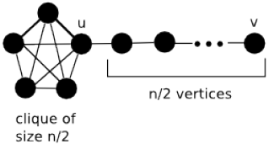

Methods for Link Prediction: based on the ensemble of all paths
Consider a random walk on G_{old} that starts at x and iteratively moves to a neighbor of x chosen uniformly at random from Γ(x).
The Hitting Time H_{x,y} from x to y is the expected number of steps it takes for the random walk starting at x to reach y.
score(x, y) = − H_{x,y}
The Commute Time C_{x,y} from x to y is the expected number of steps to travel from x to y and from y to x
score(x, y) = − (H_{x,y} + H_{y,x})
Not symmetric, can be shown

Slide 19
Methods for Link Prediction: based on the ensemble of all paths
Example: hit time in a line
1
i-1 i i+1
n
Can also consider stationary-normed versions:
(to counteract the fact that H_{x,y} is rather small when y is a node with a large stationary probability)
score(x, y) = − H_{x,y} π_{y}
score(x, y) = −(H_{x,y} π_{y} + H_{y,x} π_{x})

Slide 20
Methods for Link Prediction: based on the ensemble of all paths
The hitting time and commute time measures are sensitive to parts of the graph far away from x and y -> periodically reset the walk
Random walk with restart: Random walk on G_{old} that starts at x and has a probability α of returning to x at each step
Rooted PageRank: Starts from x, with probability (1 – a) moves to a random neighbor and with probability a returns to x
score(x, y) = stationary probability of y in a rooted PageRank

Slide 21

Methods for Link Prediction: based on the ensemble of all paths
SimRank
Two objects are similar, if they are related to similar objects
Two objects x and y are similar, if they are related to objects a and b respectively and a and b are themselves similar
Average similarity between neighbors of x and neighbors of y
Base case: similarity(x, x) = 1
score(x, y) = similarity(x, y)

Slide 22
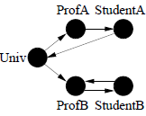

SimRank
Introduced for directed graphs (similar if referenced by similar objects)
I(x): in-neighbors of x
Average similarity between in-neighbors of a and in-neighbors of b
C a constant between 0 and 1
n² equations
Iterative computation
s₀(x, y) = 1 if x = y and 0 otherwise
s_{k+1} based on the s_{k} values of its (in-neighbors) computed at iteration k

Slide 23
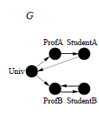
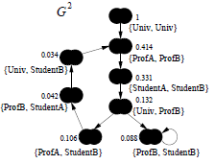
SimRank as a random walk
Similarity as propagating among pairs
Pair graph G²:
A node for each pair of nodes
An edge (x, y) → (a, b), if x → a and y → b
Scores flow from a node to its neighbors
Computation starts at singleton nodes
C gives the rate of decay as similarity flows across edges (C = 0.8 in the example)
Symmetric pairs (a, b) node same as (b, a) node (with the union of associated edges), Self-loops
Prune by considering only nodes within a a radius

Slide 24
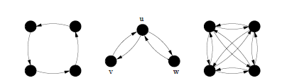
SimRank
Expected Meeting Distance (EMD): how soon two random surfers are expected to meet at the same node if they started at nodes x and y and randomly walked (in lock step) the graph backwards
m(u, v) = m(u,w) = ∞, m(v, w) = 1
v and w are much more similar than u is to v or w.
= ∞
= 3,
a lower similarity than between v and w but higher than between u and v (or u and w).

Slide 25
SimRank
Let us consider G²
A node (a, b) as a state of the tour in G:
if a moves to c, b moves to d in G,
then (a, b) moves to (c, d) in G²
A tour in G² of length n represents a pair of tours in G where each has length n
What are the states in G² that correspond to “meeting” points in G?

Slide 26
SimRank
What are the states in G² that correspond to “meeting” points in G?
Singleton nodes (common neighbors)
The EMD m(a, b) is just the expected distance (hitting time) in G² between (a, b) and any singleton node
The sum is taken over all walks that start from (a, b) and end at a singleton node
This roughly corresponds to the SimRank of (a, b)

Slide 27
SimRank for bipartite graphs
People are similar if they purchase similar items.
Items are similar if they are purchased by similar people
Useful for recommendations in general

Slide 28
SimRank for bipartite graphs

Slide 29
SimRank
…
…
Q: What is most related
conference to ICDM?
…
…
Author
Conference

Slide 30
SimRank

Slide 31
Methods for Link Prediction: based on paths
Shortest paths
Katz
Hitting and commute time
Rooted PageRank
SimRank

Slide 32
Methods for Link Prediction: other
Low rank approximations
M adjacency matrix, represent M with a lower rank matrix M_{k}
Apply SVD (singular value decomposition)
The rank-k matrix that best approximates M

Slide 33
Singular Value Decomposition
r : rank of matrix A
σ₁≥ σ₂≥ … ≥σ_{r} : singular values (square roots of eigenvals AA^{T}, A^{T}A)
: left singular vectors (eigenvectors of AA^{T})
: right singular vectors (eigenvectors of A^{T}A)
[n×r]
[r×r]
[r×n]

Slide 34


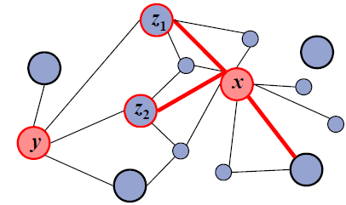
Methods for Link Prediction: other
Unseen Bigrams
Unseen bigrams: pairs of word that co-occur in a test corpus, but not in the corresponding training corpus
Not just x but also nodes similar to x, similar how?
S_{x}^{(δ)} -- δ nodes z with largest score(x, z)

Slide 35
Methods for Link Prediction: High-level approaches
Clustering
Compute score(x, y) for al edges in E_{old}
Delete the (1-p) fraction of the edges whose score is the lowest, for some parameter p
Recompute score(x, y) for all pairs in the subgraph

Slide 36
Problem Formulation (implementation details)
Prediction for a subset of nodes
Two parameters: κ_{training} and κ_{test}
Core: all nodes that are incident to at least κ_{training} edges in G[t₀, t′₀], and at least κ_{test} edges in G[t₁, t′₁]
Predict new edges between the nodes in Core

Slide 37
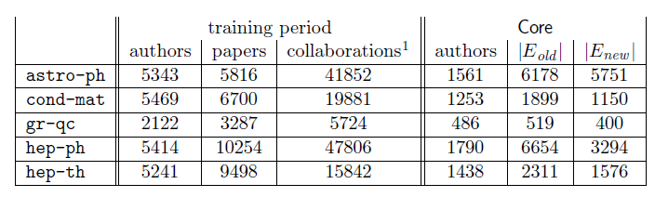
Example Dataset: co-authorship
t₀ = 1994, t′₀ = 1996: training interval -> [1994, 1996]
t₁ = 1997, t′₁ = 1999: test interval -> [1997, 1999]
- G_{collab} = <V, E_{old}> = G[1994, 1996]
- E_{new}: authors in V that co-author a paper during the test interval but not during the training interval
κ_{training} = 3, κ_{test} = 3: Core consists of all authors who have written at least 3 papers during the training period and at least 3 papers during the test period
Predict E_{new}

Slide 38
How to Evaluate the Prediction (outline)
Each link predictor p outputs a ranked list L_{p} of pairs in V × V − E_{old}: predicted new collaborations in decreasing order of confidence
How many of the top-n (relevant) predictions are correct (precision?)
Define n as |E∗_{new}|
E∗_{new} = E_{new} ∩ (Core × Core) = |E∗_{new}|
Evaluation method: Size of the intersection of
  the first n edge predictions from L_{p} that are in Core × Core, and
  the set E∗_{new}
  Precision at recall

Slide 39
Evaluation: baseline
Baseline: random predictor
Randomly select pairs of authors who did not collaborate in the training interval
Probability that a random prediction is correct:
In the datasets, from 0.15% (cond-mat) to 0.48% (astro-ph)

Slide 40
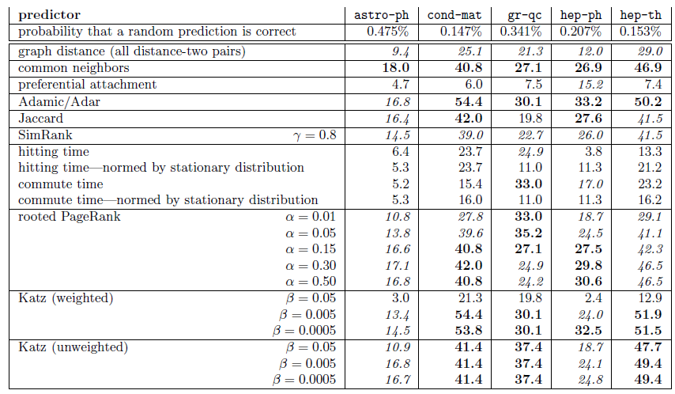
Evaluation: Factor improvement over random

Slide 41
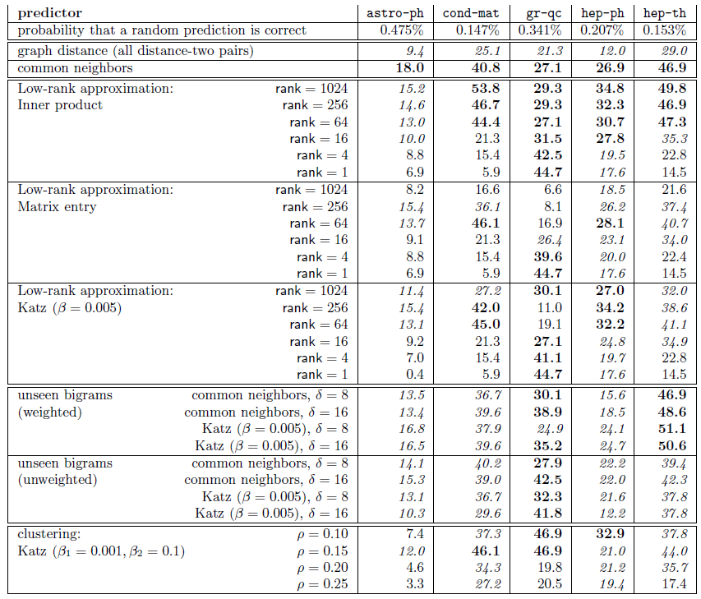
Evaluation: Factor improvement over random

Slide 42
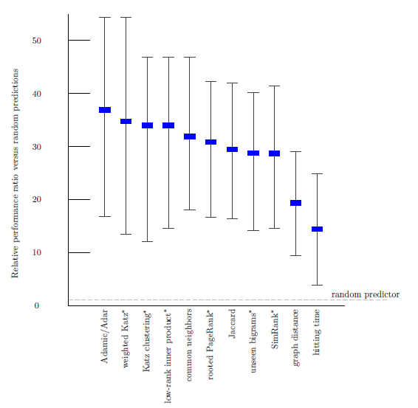
Evaluation: Average relevance performance (random)
average ratio over the five datasets of the given predictor's performance versus a baseline predictor's performance.
the error bars indicate the minimum and maximum of this ratio over the five datasets.
the parameters for the starred predictors are: (1) for weighted Katz, β= 0.005; (2) for Katz clustering, β1 = 0.001; ρ = 0.15; β2 = 0.1; (3) for low-rank inner product, rank = 256; (4) for rooted Pagerank, α = 0.15; (5) for unseen bigrams, unweighted, common neighbors with δ = 8; and (6) for SimRank, C ( γ) = 0.8.

Slide 43
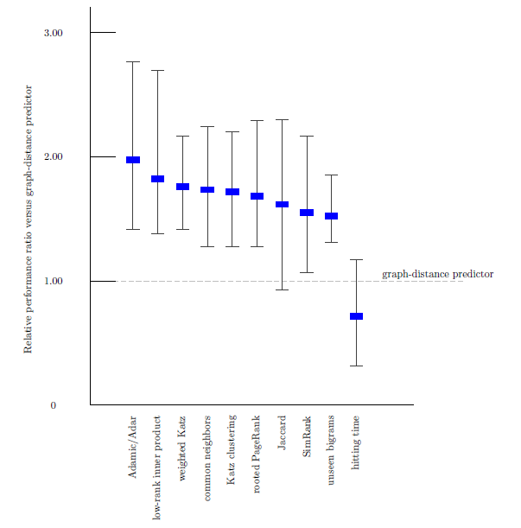
Evaluation: Average relevance performance (distance)

Slide 44
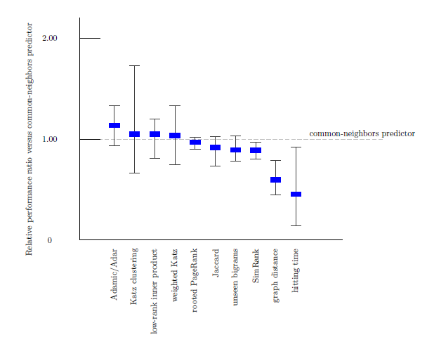
Evaluation: Average relevance performance (neighbors)

Slide 45
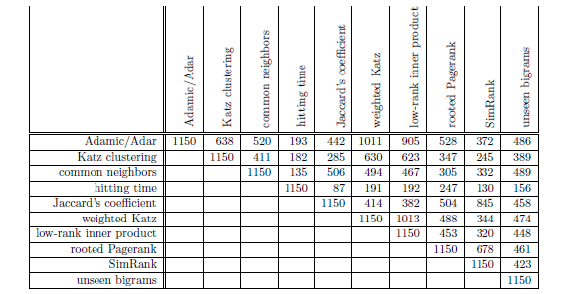
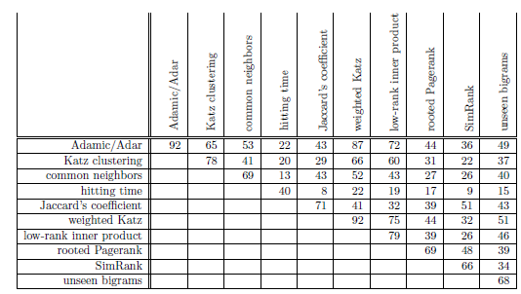
Evaluation: prediction overlap
How much similar are the predictions made by the different methods?
Why?
correct

Slide 46
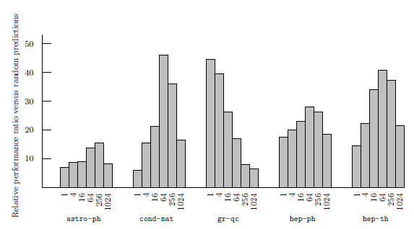
Evaluation: datasets
How much does the performance of the different methods depends on the dataset?
(rank) On 4 of the 5 datasets best at an intermediate rank
On qr-qc, best at rank 1, does it have a “simpler” structure”?
On hep-ph, preferential attachment the best
Why is astro-ph “difficult”?
The culture of physicists and physics collaboration

Slide 47
Evaluation: small world
The shortest path even in unrelated disciplines is often very short
Basic classifier on graph distances does not work

Slide 48
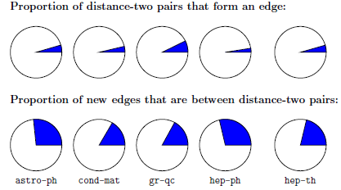
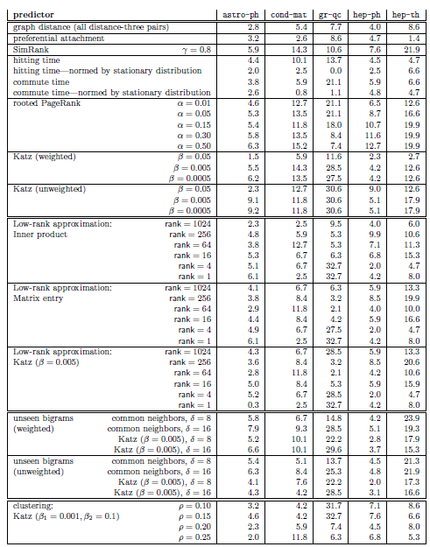

Evaluation: restricting to distance three
Many pairs of authors separated by a graph distance of 2 will not collaborate and
Many pairs who collaborate are at distance greater than 2
Disregard all distance 2 pairs (do not just “close” triangles)

Slide 49
Evaluation: the breadth of data
Three additional datasets
Proceedings of STOC and FOCS
Papers for Citeseer
All five of the arXiv sections
Common neighbors vs Random
Suggests that is easier to predict links within communities

Slide 50
Extensions
Improve performance. Even the best (Katz clustering on gr-qc) correct on only about 16% of its prediction
Improve efficiency on very large networks (approximation of distances)
Treat more recent collaborations as more important
Additional information (paper titles, author institutions, etc)
To some extent latently present in the graph

Slide 51
Summary
Problem definition
Compute score(u, v)
Neighborhood-based
common neighbors
Jaccard coefficient
Adamic/Adar
preferential attachment
Path-based
shortest path
Katz
hitting time, commute time – normed by stationary distribution
rooted Page Rank
SimRank

Slide 52
Summary (SimRank)
Two objects are as similar, as their neighbors
score(x, y) = similarity(x, y)
Base case: similarity(x, x) = 1
Average similarity between neighbors of x and neighbors of y

Slide 53
Summary (SimRank)
Introduced for directed graphs (similar if referenced by similar objects)
I(x): in-neighbors of x
Expected meeting point of two random surfers that move backwards in lock step

Slide 54
Summary (SimRank)
Pair graph G²:
A node for each pair of nodes
An edge (x, y) → (a, b), if x → a and y → b
Scores flow from a node to its neighbors
Computation starts at singleton nodes
C gives the rate of decay as similarity flows across edges (C = 0.8 in the example)
A tour in G² of length n represents a pair of tours in G where each has length n
The EMD m(a, b) is just the hitting time in G² between (a, b) and any singleton node

Slide 55
Summary (Evaluation)
Output
a list L_{p} of pairs in V × V − E_{old} ranked by score
(predicted new links in decreasing order of confidence)
Precision at recall
How many of the top-n predictions are correct where n = |E_{new}|
Improvement over baseline
Baseline: random predictor
Probability that a random prediction is correct:
|V|
Preprocessing:
Core
Low Rank Approximation, ignore low score, add friends

Slide 56
Outline
Estimating a score for each edge (seminal work of Liben-Nowell&Kleinberg
  Neighbors measures, Distance measures, Other methods
  Evaluation
Classification approach
Twitter

Slide 57
Using Supervised Learning
Given a collection of records (training set )
Each record contains
a set of attributes (features) + the class attribute.
Find a model for the class attribute as a function of the values of other attributes.
Goal: previously unseen records should be assigned a class as accurately as possible.
A test set is used to determine the accuracy of the model.
Usually, the given data set is divided into training and test sets, with training set used to build the model and test set used to validate it.

Slide 58
Illustrating the Classification Task

Slide 59
Classification Techniques
Decision Tree based methods
Rule-based methods
Memory based reasoning
Neural networks
Naïve Bayes and Bayesian Belief networks
Support vector machines
Logistic regression

Slide 60
Example of a Decision Tree
categorical
categorical
continuous
class
Splitting Attributes
Refund
Yes
No
NO
MarSt
Single, Divorced
Married
TaxInc
NO
< 80K
> 80K
NO
YES
Training Data
Model: Decision Tree

Slide 61
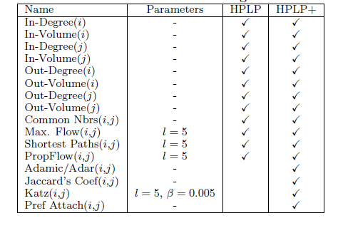
Classification for Link Prediction
Class?
Features (predictors)?
PropFlow: corresponds to the probability that a restricted random walk starting at x ends at y in l steps or fewer using link weights as transition probabilities (stops in l steps or if revisits a node)

Slide 62
How to construct the training set
When to extract features and when to determine class?
Two time instances τ_{x} and τ_{y}
From t₀ to τ_{x} construct graph and extract features (G_{old})
From τ_{x} + 1 to τ_{y} examine if a link appears (determine class value)
What are good values
Large τ_{x} better topological features (as the network reaches saturation)
Large τ_{y} larger number of positives (size of positive class)
Should also match the real-world prediction interval

Slide 63
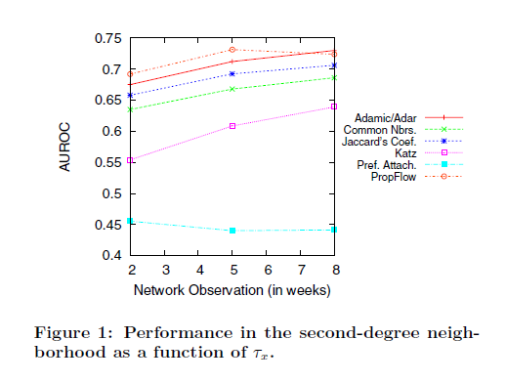
How to construct the training set
Unsupervised

Slide 64
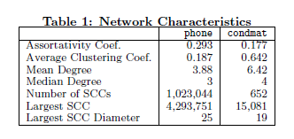
Datasets
712 million cellular phone calls
weighted, directed networks, weights correspond to the number of calls
use the first 5 weeks of data (5.5M nodes, 19.7M links) for extracting
features and the sixth week (4.4M nodes, 8.5M links) for obtaining ground truth.
19,464 condensed matter physics collaborations from 1995 to 2000.
weighted, undirected networks, weights correspond to the number of collaborations two authors share.
use the years 1995 to 1999 (13.9K nodes, 80.6K links) for extracting features and the year 2000 (8.5K nodes, 41.0K links) for obtaining ground truth.

Slide 65
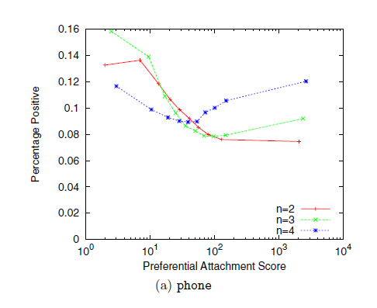
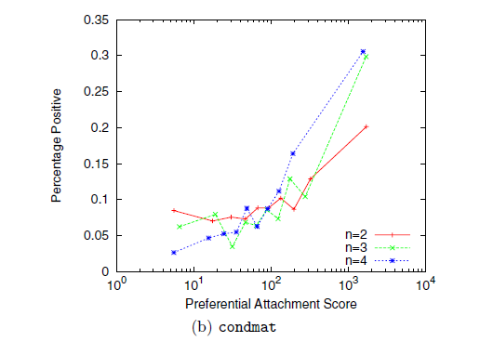
Using Supervised Learning: why?
A different prediction model for each distance
Predictors that work well in one network not in another
Should increase with the score (not in phone)
Preferential attachment increase with distance (when other may fail)

Slide 66
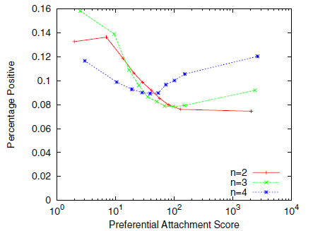
Using Supervised Learning: why?
Even training on a single feature may outperform ranking (if no clear bound on score)
Dependencies between features – use an ensemble of features

Slide 67
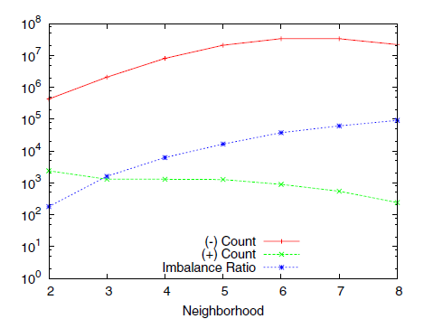
Imbalance
Sparse networks: |E| = k |V| for constant k << |V|
The class imbalance ratio for link prediction in a sparse network is Ω(|V|/1) when at most |V| nodes are added
Missing links is |V|²
Positives V
n-neigborhood exactly n hops way
Treat each neighborhood as a separate problem

Slide 68
Metrics for Performance Evaluation
Confusion Matrix:
 | PREDICTED CLASS
ACTUAL CLASS |  | Class=Yes | Class=No
 | Class=Yes | TP | FN
 | Class=No | FP | TN

Slide 69
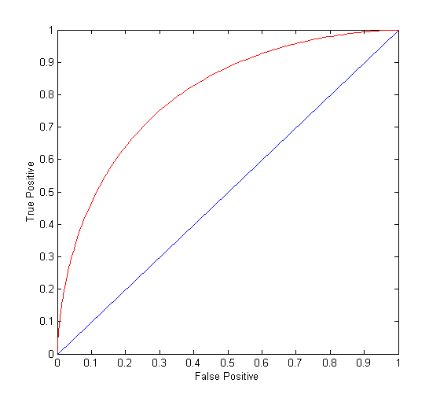
ROC Curve
TPR (sensitivity)=TP/(TP+FN) (percentage of positive classified as positive)
FPR = FP/(TN+FP) (percentage of negative classified as positive)
(0,0): declare everything
to be negative class
(1,1): declare everything
to be positive class
(0,1): ideal
Diagonal line: Random guessing
Below diagonal line: prediction is opposite of the true class
AUC: area under the ROC

Slide 70
Results
Ensemble of classifiers: Random Forest
Random forest: Ensemble classifier
constructs a multitude of decision trees at training time
output the class that is the mode (most frequent) of the classes (classification) or mean prediction (regression) of the individual trees.

Slide 71
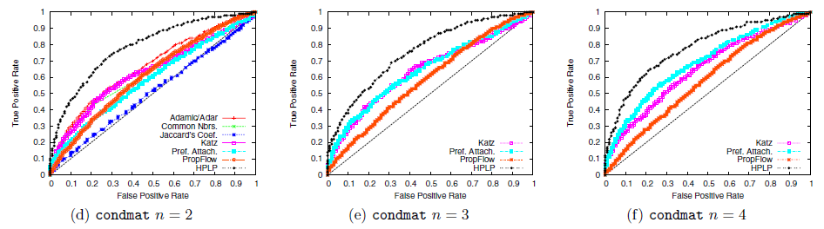
Results

Slide 72
Results
Mechanism by which links arise different both across networks and geodesic distances.
Local vs Global (preferential attachment)
  Better in condmat network,
  Improves with distance
HPLP achieves performance levels as much as 30% higher than the best unsupervised methods

Slide 73
Outline
Estimating a score for each edge (seminal work of Liben-Nowell&Kleinberg
  Neighbors measures, distance measures, other methods
  Evaluation
Classification approach
  Brief background on classification
  Issues
The who to follow service at Twitter

Slide 74
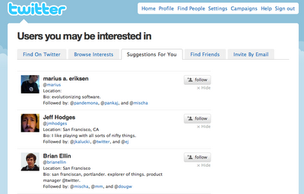
Introduction
Wtf (“Who to Follow"): the Twitter user recommendation service
Twitter: 200 million users, 400 million tweets every day (as of early 2013)
http://www.internetlivestats.com/twitter-statistics/
Twitter needs to help existing and new users to discover connections to sustain and grow
Also used for search relevance, discovery, promoted products, etc.

Slide 75
History of WTF
3 engineers, project started in spring 2010, product delivered in summer 2010
Basic assumption: the whole graph fits into memory of a single server

Slide 76
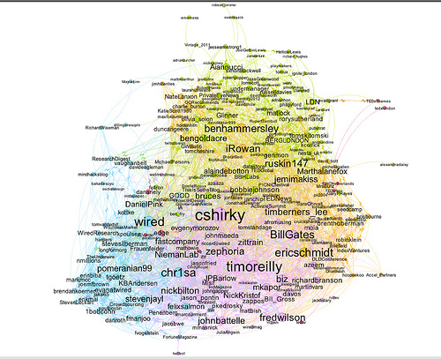
The Twitter graph
Node: user (directed) edge: follows
Statistics (August 2012)
  over 20 billion edges (only active users)
  power law distributions of in-degrees and out-degrees.
  over 1000 with more than 1 million followers,
  25 users with more than 10 million followers.
http://blog.ouseful.info/2011/07/07/visualising-twitter-friend-connections-using-gephi-an-example-using-wireduk-friends-network/

Slide 77
Introduction
Difference between:
Interested in
Similar to
Example (follow @espn but not similar to it)
Is it a “social” network as Facebook?

Slide 78
Algorithms
Asymmetric nature of the follow relationship (other social networks e.g., Facebook or LinkedIn require the consent of both participating members)
Directed edge case is similar to the user-item recommendations problem where the “item” is also a user.

Slide 79
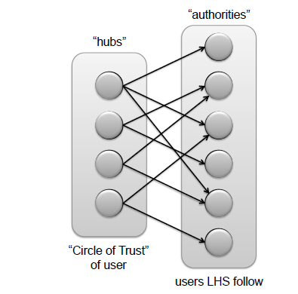
Bipartite graph
Hubs: 500 top-ranked nodes from the user's circle of trust
Authorities: users that the hubs follow.

Slide 80
Algorithms: Circle of trust
Circle of trust: the result of an egocentric random walk (similar to personalized (rooted) PageRank)
Computed in an online fashion (from scratch each time) given a set of parameters (# of random walk steps, reset probability, pruning settings to discard low probability vertices, parameters to control sampling of outgoing edges at vertices with large out-degrees, etc.)
Used in a variety of Twitter products, e.g., in search and discovery, content from users in one's circle of trust upweighted

Slide 81
Algorithms: SALSA
SALSA (Stochastic Approach for Link-Structure Analysis)
a variation of HITS
As in HITS
  hubs
  authorities
HITS
Good hubs point to good authorities
Good authorities are pointed by good hubs
hub weight = sum of the authority weights of the authorities pointed to by the hub
authority weight = sum of the hub weights that point to this authority.
hubs
authorities

Slide 82
Algorithms: SALSA
Random walks to rank hubs and authorities
Two different random walks (Markov chains): a chain of hubs and a chain of authorities
Each walk traverses nodes only in one side by traversing two links in each step h->a->h, a->h->a
Transition matrices of each Markov chain: H and A
W: the adjacency of the directed graph
W_{r}: divide each entry by the sum of its row
W_{c}: divide each entry by the sum of its column
H = W_{r}W_{c}^{T}
A = W_{c}^{T} W_{r}
Proportional to the degree
hubs
authorities

Slide 83
Algorithms: SALSA
Hubs: 500 top-ranked nodes from the user's circle of trust
Authorities: users that the hubs follow
Use SALSA assign scores to both sides, recommend best in the RHS
Hub vertices: user similarity (based on homophily, also useful)
Authority vertices : “interested in" user recommendations.

Slide 84
Algorithms: SALSA
How it works
SALSA mimics the recursive nature of the problem:
A user u is likely to follow those who are followed by users that are similar to u.
A user is similar to u if the user follow the same (or similar) users.
SALSA provides similar users to u on the LHS and similar followings of those on the RHS.
The random walk ensures equitable distribution of scores in both directions
Similar users are selected from the circle of trust of the user through personalized PageRank.

Slide 85
Evaluation
Offline experiments on retrospective data
Online A/B testing on live traffic
Various parameters may interfere:
How the results are rendered (e.g., explanations)
Platform (mobile, etc.)
New vs old users

Slide 86
Evaluation: metrics
Follow-through rate (FTR) (precision)
Does not capture recall
Does not capture lifecycle effects (newer users more receptive, etc. )
Does not measure the quality of the recommendations: all follow edges are not equal
Engagement per impression (EPI):
After a recommendation is accepted, the amount of engagement by the user on that recommendation in a specified time interval called the observation interval.

Slide 87
Extensions
Add metadata to vertices (e.g., user profile information) and edges (e.g., edge weights, timestamp, etc.)
Consider interaction graphs (e.g., graphs defined in terms of retweets, favorites, replies, etc.)

Slide 88
Extensions
Two phase algorithm
Candidate generation: produce a list of promising recommendations for each user, using any algorithm
Rescoring: apply a machine-learned model to the candidates, binary classification problem (logistic regression)
First phase: recall + diversity
Second phase: precision + maintain diversity

Slide 89
References
D. Liben-Nowell, and J. Kleinberg, The link-prediction problem for social networks. Journal of the American Society for Information Science and Technology, 58(7) 1019–1031 (2007)
R. Lichtenwalter, J. T. Lussier, N. V. Chawla: New perspectives and methods in link prediction. KDD 2010: 243-252
G. Jeh, J. Widom: SimRank: a measure of structural-context similarity. KDD 2002: 538-543
P-N Tan, . Steinbach, V. Kumar. Introduction to Data Mining (Chapter 4)
P. Gupta, A. Goel, J. Lin, A. Sharma, D. Wang, R.Zadeh. WTF: The Who to Follow Service at Twitter, WWW 2013
R. Lempel, S. Moran: SALSA: the stochastic approach for link-structure analysis. ACM Trans. Inf. Syst. 19(2): 131-160 (2001)

