Slide 1
Online Social Networks and Media
Team Formation in Social Networks

Slide 2
Algorithms for Team Formation
Thanks to Evimari Terzi

Slide 3
Team-formation problems
Boston University Slideshow Title Goes Here
Given a task and a set of experts (organized in a network) find the subset of experts that can effectively perform the task
Task: set of required skills and potentially a budget
Expert: has a set of skills and potentially a price
Network: represents strength of relationships
evimaria@cs.bu.edu

Slide 4

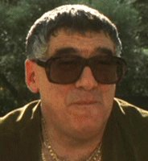
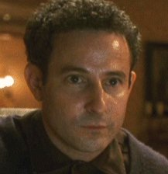
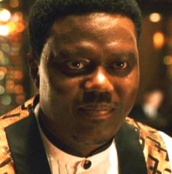
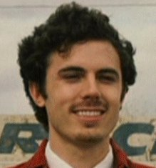

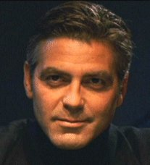

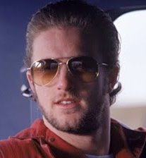
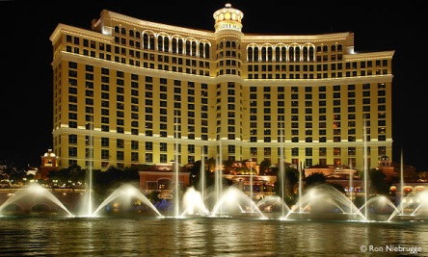

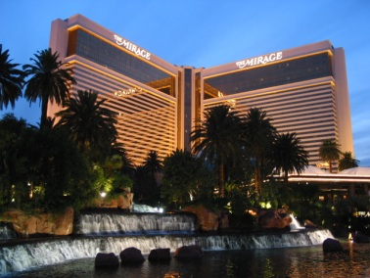
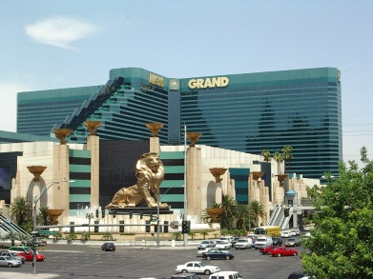
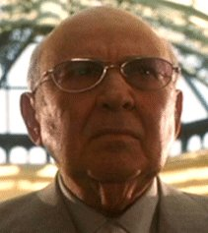
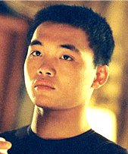
2001
Security expert
Boston University Slideshow Title Goes Here
Electronics expert
Insider
Mechanic
Organizer
Pick-pocket thief
Co-organizer
Mechanic
Explosives expert
Con-man
Acrobat

Slide 5
2001
Security expert
Boston University Slideshow Title Goes Here
Electronics expert
Insider
Mechanic
Organizer
Pick-pocket thief
Co-organizer
Mechanic
Explosives expert
Con-man
Acrobat

Slide 6
Applications
Boston University Slideshow Title Goes Here
Collaboration networks (e.g., scientists, actors)
Organizational structure of companies
LinkedIn, UpWork, FreeLance
Geographical (map) of experts

Slide 7
Simple Team formation Problem
Boston University Slideshow Title Goes Here
Input:
  A task T, consisting of a set of skills
  A set of candidate experts each having a subset of skills
Problem: Given a task and a set of experts, find the smallest subset (team) of experts that together have all the required skills for the task
T = {algorithms, java, graphics, python}
Alice
Bob
Cynthia
David
Eleanor
Eleanor
{algorithms}
{python}
{graphics, java}
{graphics}
{graphics,java,python}
{graphics,java,python}

Slide 8
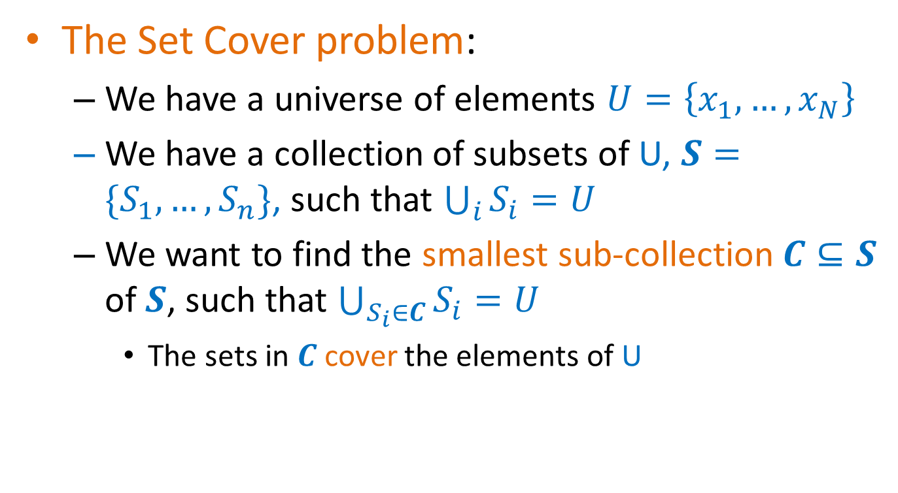
Set Cover
The Set Cover problem:
  We have a universe of elements $U=\left\{x_{1},…,x_{N}\right\}$
  We have a collection of subsets of U, $S=\{S_{1},…,S_{n}\}$, such that $\bigcup_{i}{S_{i}}=U$
  We want to find the smallest sub-collection$C⊆S$ of $S$, such that $\bigcup_{S_{i}∈C}{S_{i}=U}$
    The sets in $C$cover the elements of U

Slide 9

Coverage
The Simple Team Formation Problem is a just an instance of the Set Cover problem
  Universe $U$ of elements = Set of all skills
  Collection $S$ of subsets = The set of experts and the subset of skills they possess.
T = {algorithms, java, graphics, python}
Alice
Bob
Cynthia
David
Eleanor
Eleanor
{algorithms}
{python}
{graphics, java}
{graphics}
{graphics,java,python}
{graphics,java,python}

Slide 10
Complexity
The Set Cover problem are NP-complete
  What does this mean?
  Why do we care?
There is no algorithm that can guarantee finding the best solution in polynomial time
  Can we find an algorithm that can guarantee to find a solution that is close to the optimal?
  Approximation Algorithms.

Slide 11
Approximation Algorithms
For a (combinatorial) minimization problem, where:
  X is an instance of the problem,
  OPT(X) is the value of the optimal solution for X,
  ALG(X) is the value of the solution of an algorithm ALG for X
  ALG is a good approximation algorithm if the ratio of ALG(X)/OPT(X) and is bounded for all input instances X
    We want the ratio to be close to 1
Minimum set cover: input X = (U,S) is the universe of elements and the set collection, OPT(X) is the size of minimum set cover, ALG(X) is the size of the set cover found by an algorithm ALG.

Slide 12
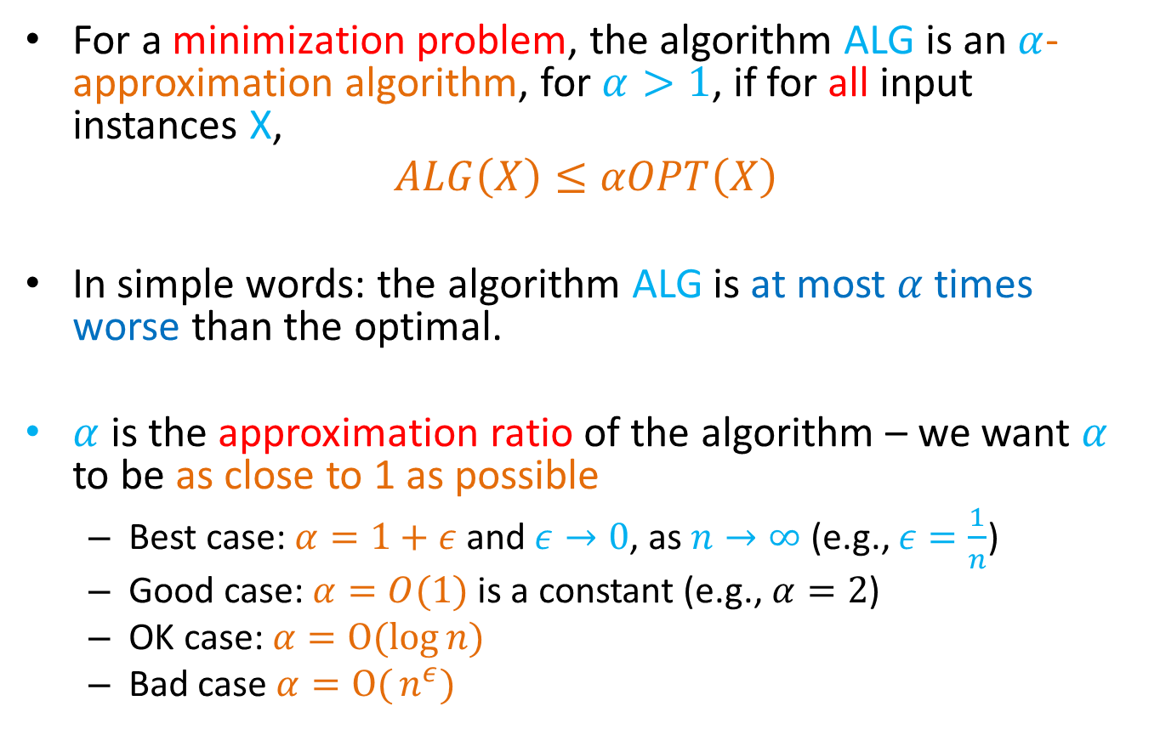
Approximation Algorithms
For a minimization problem, the algorithm ALG is an $α$-approximation algorithm, for $α>1$, if for all input instances X,
$$ALG\left(X\right)≤αOPT\left(X\right)$$
In simple words: the algorithm ALG is at most $α$ times worse than the optimal.
$α$ is the approximation ratio of the algorithm – we want $α$ to be as close to 1 as possible
  Best case: $α=1+ε$ and $ε→0$, as $n→∞$ (e.g., $ε=\frac{1}{n}$)
  Good case: $α=O(1)$ is a constant (e.g., $α=2$)
  OK case: $α=O(log{n)}$
  Bad case $α=O({n^{ε})}$

Slide 13
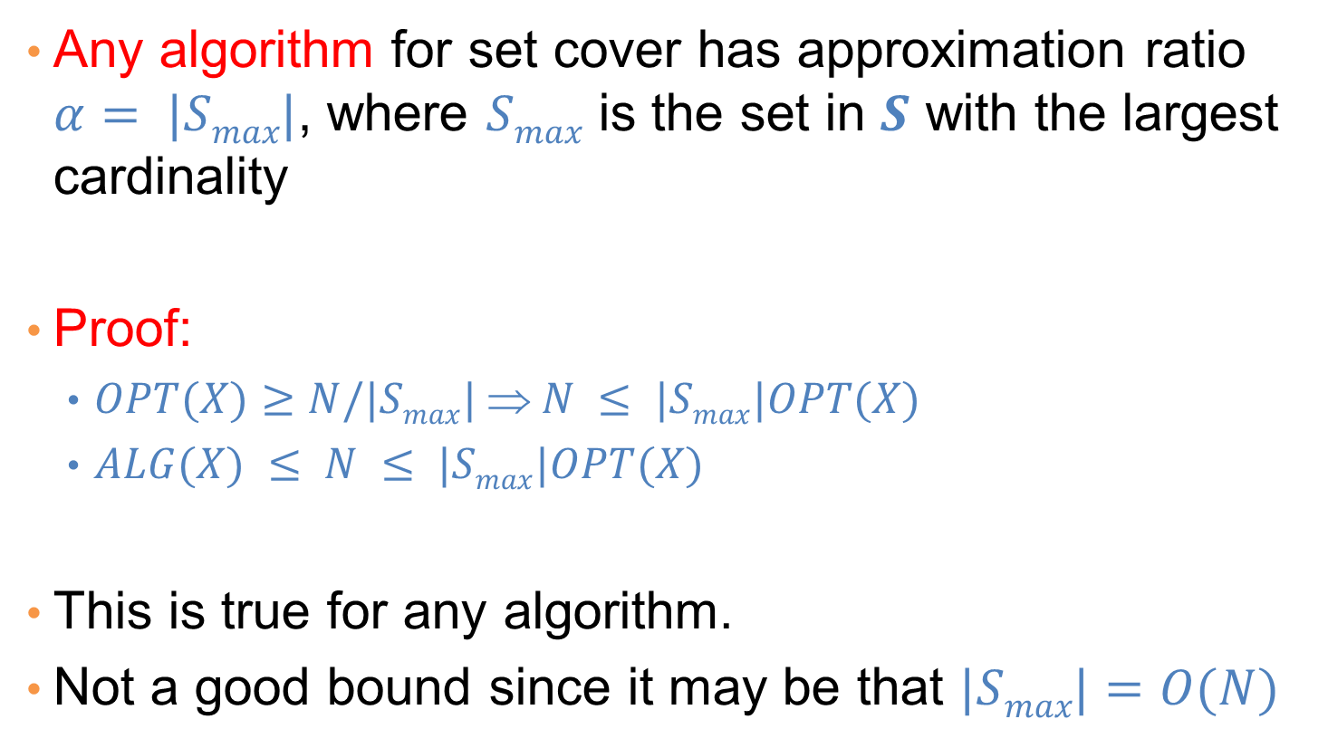
A simple approximation ratio for set cover
Any algorithm for set cover has approximation ratio $α= |Smax|$, where $Smax$ is the set in $S$ with the largest cardinality
Proof:
  $OPT(X)≥N/|Smax| ⇒ N ≤ |Smax|OPT(X)$
  $ALG(X) ≤ N ≤ |Smax|OPT(X)$
This is true for any algorithm.
Not a good bound since it may be that $|Smax|=O(N)$

Slide 14
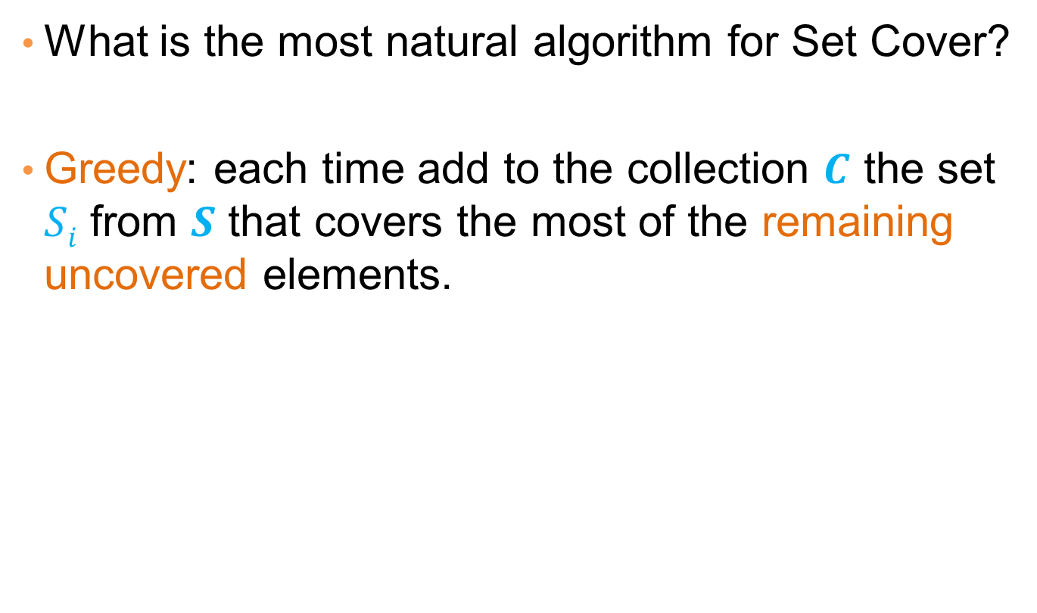
An algorithm for Set Cover
What is the most natural algorithm for Set Cover?
Greedy: each time add to the collection $C$ the set $Si$ from $S$ that covers the most of the remaining uncovered elements.

Slide 15
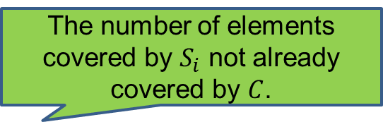
The GREEDY algorithm
GREEDY(U,S)
  X= U
  C = {}
  while X is not empty do
    For all $S_{i}∈S$ let $gain(S_{i})={|S}_{i}∩X|$
    Let $S_{∗}$ be such that $gain(S_{∗})$ is maximum
    C = C U {S*}
    X = X\ S*
    S = S\ S*
The number of elements covered by $S_{i}$ not already covered by $C$.

Slide 16
Greedy is not always optimal
Alice
C, C++, Unix
Eleanor
Python, Joomla
Required Skills
C, C++, Unix, php, Java, Python, Joomla
David
php, Java, Python
Bob
C++, Unix, Java
Charlie
C, C++, Java, Python

Slide 17
Greedy is not always optimal
Alice
C
C++
Bob
Unix
A different representation
Charlie
php
David
Java
Python
Eleanor
Joomla

Slide 18
Greedy is not always optimal
Alice
C
Optimal
Size 3 Set Cover
C++
Bob
Unix
Charlie
php
David
Java
Python
Eleanor
Joomla

Slide 19
Greedy is not always optimal
Optimal
Greedy
Alice
C
Alice
C
C++
C++
Bob
Bob
Unix
Unix
Charlie
Charlie
php
php
David
Java
David
Java
Python
Python
Eleanor
Eleanor
Joomla
Joomla

Slide 20
Greedy is not always optimal
Optimal
Greedy
Alice
C
Alice
C
C++
C++
Bob
Bob
Unix
Unix
Charlie
Charlie
php
php
David
Java
David
Java
Python
Python
Eleanor
Eleanor
Joomla
Joomla

Slide 21
Greedy is not always optimal
Optimal
Greedy
Alice
C
Alice
C
C++
C++
Bob
Bob
Unix
Unix
Charlie
Charlie
php
php
David
Java
David
Java
Python
Python
Eleanor
Eleanor
Joomla
Joomla

Slide 22
Greedy is not always optimal
Optimal
Greedy
Alice
C
Alice
C
C++
C++
Bob
Bob
Unix
Unix
Charlie
Charlie
php
php
David
Java
David
Java
Python
Python
Eleanor
Eleanor
Joomla
Joomla

Slide 23
Greedy is not always optimal
Optimal
Greedy
Alice
C
Alice
C
C++
C++
Bob
Bob
Unix
Unix
Charlie
Charlie
php
php
David
Java
David
Java
Python
Python
Eleanor
Eleanor
Joomla
Joomla

Slide 24
Greedy is not always optimal
Optimal
Greedy
Alice
C
Selecting Charlie is useless since we still need Alice and David
Alice and David cover together a superset of the skills covered by Charlie
Alice
C
C++
C++
Bob
Bob
Unix
Unix
Charlie
Charlie
php
php
David
Java
David
Java
Python
Python
Eleanor
Eleanor
Joomla
Joomla

Slide 25
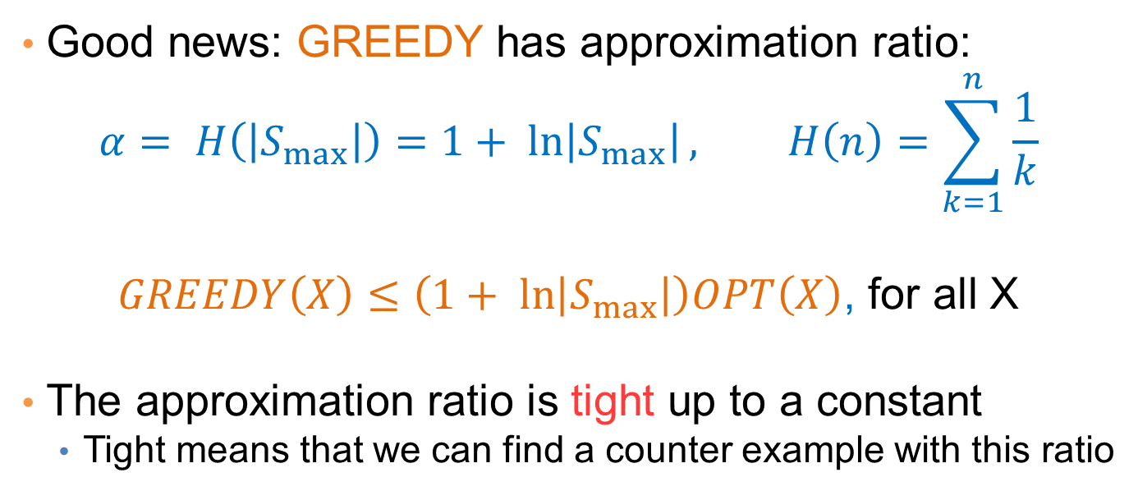
Approximation ratio of GREEDY
Good news: GREEDY has approximation ratio:
$$α= H\left(\left|S_{max}\right|\right)=1+ ln\left|S_{max}\right|, H\left(n\right)=\sum_{k=1}^{n}{\frac{1}{k}}$$
$GREEDY\left(X\right)≤\left(1+ ln\left|S_{max}\right|\right)OPT\left(X\right)$, for all X
The approximation ratio is tight up to a constant
  Tight means that we can find a counter example with this ratio
OPT(X) = 2
GREEDY(X) = logN
α=½logN

Slide 26
Team formation in the presence of a social network
Boston University Slideshow Title Goes Here
Given a task and a set of experts organized in a network find the subset of experts that can effectively perform the task
Task: set of required skills
Expert: has a set of skills
Network: relationships and their strength
Effectively: There is good communication between the team members
  What does good mean? E.g., all team members are connected.

Slide 27
Coverage is NOT enough
T={algorithms,java,graphics,python}
Boston University Slideshow Title Goes Here
Alice
Bob
Cynthia
David
Eleanor
{algorithms}
{python}
{graphics, java}
{graphics}
{graphics,java,python}
Alice and Eleanor are the smallest team that covers all skills
A
A,E can no longer perform the task since they cannot communicate
A,B,C form an effective group that can communicate
A
D
E
B
E
B
C
C
E
Communication: the members of the team must be able to
efficiently communicate and work together

Slide 28
How to measure effective communication?
Boston University Slideshow Title Goes Here
The longest shortest path between any two nodes in the subgraph
Diameter of the subgraph defined by the group members
A
A
D
B
B
C
C
E
E
E
diameter = infty
diameter = 1

Slide 29
How to measure effective communication?
Boston University Slideshow Title Goes Here
The total weight of the edges of a tree that spans all the team nodes
MST (Minimum spanning tree) of the subgraph defined by the group members
A
A
D
B
B
C
C
E
E
E
MST = infty
MST = 2

Slide 30
Problem definition (MinDiameter)
Boston University Slideshow Title Goes Here
Given a task and a social network $G$ of experts, find the subset (team) of experts that can perform the given task and they define a subgraph $G’$ in $G$ with the minimum diameter.
Problem is NP-hard
Equivalent to the Multiple Choice Cover (MCC)
  We have a set cover instance $(U,S)$, but we also have a distance matrix $D$ with distances between the different sets in $S$.
  We want a cover that has the minimum diameter (minimizes the largest pairwise distance in the cover)

Slide 31
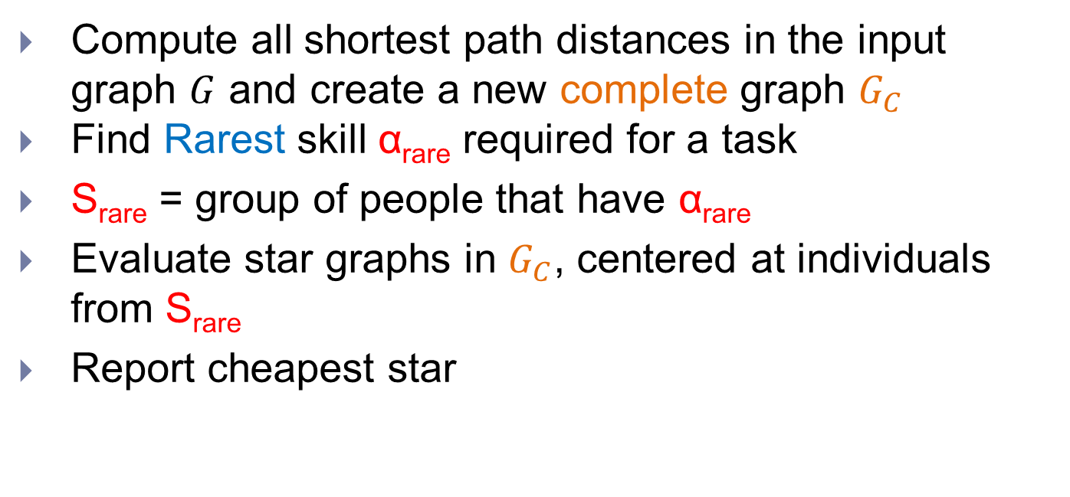
The RarestFirst algorithm
Boston University Slideshow Title Goes Here
Compute all shortest path distances in the input graph $G$ and create a new complete graph $G_{C}$
Find Rarest skill α_{rare} required for a task
S_{rare} = group of people that have α_{rare}
Evaluate star graphs in $G_{C}$, centered at individuals from S_{rare}
Report cheapest star
Running time: Quadratic to the number of nodes
Approximation factor: 2×OPT

Slide 32
The RarestFirst algorithm
T={algorithms,java,graphics,python}
Boston University Slideshow Title Goes Here
{graphics,python,java}
{algorithms,graphics}
A
B
A
B
Skills:
algorithms
graphics
java
python
E
{algorithms,graphics,java}
E
C
D
{python,java}
{python}
α_{rare} = algorithms
S_{rare} ={Bob, Eleanor}
Diameter = 2

Slide 33
The RarestFirst algorithm
T={algorithms,java,graphics,python}
Boston University Slideshow Title Goes Here
{graphics,python,java}
{algorithms,graphics}
A
B
Skills:
algorithms
graphics
java
python
E
E
{algorithms,graphics,java}
C
C
D
{python,java}
{python}
α_{rare} = algorithms
S_{rare} ={Bob, Eleanor}
Diameter = 1

Slide 34
Analysis of RarestFirst
Boston University Slideshow Title Goes Here
S₁
The diameter is
  either D = d_{k}, for some node k,
  or D = d_{ℓk} for some pair of nodes ℓ, k
Fact: OPT ≥ d_{k}
Fact: OPT ≥ d_{ℓ}
D ≤ d_{ℓk} ≤ d_{ℓ} + d_{k} ≤ 2*OPT
d₁
….
S_{rare}
d_{ℓ}
S_{ℓ}
….
d_{k}
d_{ℓk}
S_{k}

Slide 35
Problem definition (MinMST)
Boston University Slideshow Title Goes Here
Given a task and a social network $G$ of experts, find the subset (team) of experts that can perform the given task and they define a subgraph $G’$ in $G$ with the minimum MST cost.
Problem is NP-hard
Follows from a connection with Group Steiner Tree problem

Slide 36
The SteinerTree problem
Boston University Slideshow Title Goes Here
Graph G(V,E)
Partition of V into V = {R,N}
Find G’ subgraph of G such that G’ contains all the required vertices (R) and MST(G’) is minimized
  Find the cheapest tree that contains all the required nodes.
Required vertices

Slide 37
The EnhancedSteiner algorithm
Put a large weight on the new edges (more than the sum of all edges) to ensure that you only pick one for each skill
T={algorithms,java,graphics,python}
Boston University Slideshow Title Goes Here
graphics
MST Cost = 1
{graphics,python,java}
{algorithms,graphics}
java
A
B
E
{algorithms,graphics,java}
algorithms
E
C
D
python
D
{python,java}
{python}
Add the skills as new nodes in the graph, connected to the graph nodes that have the skill
Solve the Steiner Tree on this graph, with the skill nodes being required

Slide 38
The CoverSteiner algorithm
T={algorithms,java,graphics,python}
Boston University Slideshow Title Goes Here
{graphics,python,java}
{algorithms,graphics}
A
B
Solve SetCover
Solve Steiner
E
{algorithms,graphics,java}
E
C
D
D
{python,java}
{python}
MST Cost = 1

Slide 39
How good is CoverSteiner?
T={algorithms,java,graphics,python}
Boston University Slideshow Title Goes Here
{graphics,python,java}
{algorithms,graphics}
A
B
A
B
Solve SetCover
Solve Steiner
E
{algorithms,graphics,java}
C
D
{python,java}
{python}
MST Cost = Infty

Slide 40
References
Theodoros Lappas, Kun Liu, Evimaria Terzi, Finding a team of experts in social networks. KDD 2009: 467-476

