Slide 1
DATA MINING LECTURE 8
The EM Algorithm
Sequence segmentation

Slide 2
CLUSTERING

Slide 3
What is a Clustering?
In general a grouping of objects such that the objects in a group (cluster) are similar (or related) to one another and different from (or unrelated to) the objects in other groups
Inter-cluster distances are maximized
Intra-cluster distances are minimized

Slide 4
Clustering Algorithms
K-means and its variants
Hierarchical clustering
DBSCAN

Slide 5
Mixture Models and the EM Algorithm

Slide 6
Model-based clustering
In order to understand our data, we will assume that there is a generative process (a model) that creates/describes the data, and we will try to find the model that best fits the data.
Models of different complexity can be defined, but we will assume that our model is a distribution from which data points are sampled
Example: the data is the height of all people in Greece
In most cases, a single distribution is not good enough to describe all data points: different parts of the data follow a different distribution
Example: the data is the height of all people in Greece and China
We need a mixture model
Different distributions correspond to different clusters in the data.

Slide 7
Gaussian Distribution
Example: the data is the height of all people in Greece
Experience has shown that this data follows a Gaussian (Normal) distribution
Reminder: Normal distribution:
$μ$= mean, $σ$= standard deviation
$$P\left(x\right)= \frac{1}{\sqrt{2π}σ}e^{−\frac{{\left(x−μ\right)}^{2}}{2σ^{2}}}$$

Slide 8
Gaussian Model
What is a model?
A Gaussian distribution is fully defined by the mean $μ$and the standard deviation $σ$
We define our model as the pair of parameters $θ = (μ, σ)$
This is a general principle: a model is defined as a vector of parameters $θ$

Slide 9
Fitting the model
We want to find the normal distribution that best fits our data
Find the best values for $μ$and $σ$
But what does best fit mean?

Slide 10
Maximum Likelihood Estimation (MLE)
Find the most likely parameters given the data. Given the data observations $X$, find $θ$ that maximizes $P(θ|X)$
Problem: We do not know how to compute $P\left(θ | X\right)$
Using Bayes Rule:
$$P\left(θ | X\right)=\frac{P\left(X | θ\right)P(θ) }{P(X)}$$
If we have no prior information about $θ$, or X, we can assume uniform. Maximizing $P\left(θ | X\right)$ is the same as maximizing $P\left(X | θ\right)$

Slide 11
Maximum Likelihood Estimation (MLE)
We have a vector $X=(x_{1},…,x_{n})$of values and we want to fit a Gaussian $N(μ,σ)$model to the data
Our parameter set is $θ=(μ, σ)$
Probability of observing point $x_{i}$ given the parameters $θ$
Probability of observing all points (assume independence)
We want to find the parameters $θ = (μ, σ)$that maximize the probability $P(X|θ)$
$$P\left(x_{i}|θ\right)= \frac{1}{\sqrt{2π}σ}e^{−\frac{{\left(x_{i}−μ\right)}^{2}}{2σ^{2}}}$$
$$P\left(X|θ\right)= \prod_{i=1}^{n}{P\left(x_{i}|θ\right)}=\prod_{i=1}^{n}{\frac{1}{\sqrt{2π}σ}e^{−\frac{{\left(x_{i}−μ\right)}^{2}}{2σ^{2}}}}$$

Slide 12
Maximum Likelihood Estimation (MLE)
The probability $P(X|θ)$as a function of $θ$is called the Likelihood function
It is usually easier to work with the Log-Likelihood function
Maximum Likelihood Estimation
Find parameters $μ, σ$that maximize $LL(θ)$
$$L(θ)=\prod_{i=1}^{n}{\frac{1}{\sqrt{2π}σ}e^{−\frac{{\left(x_{i}−μ\right)}^{2}}{2σ^{2}}}}$$
$$LL\left(θ\right)=−\sum_{i=1}^{n}{\frac{{\left(x_{i}−μ\right)}^{2}}{2σ^{2}}−\frac{1}{2}n\log{2π}−n\log{σ}}$$
$$μ= \frac{1}{n}\sum_{i=1}^{n}{x_{i}=μ_{X}}$$
$$σ^{2}= \frac{1}{n}\sum_{i=1}^{n}{{{(x}_{i}−μ)}^{2} }=σ_{X}^{2}$$
Sample Mean
Sample Variance

Slide 13
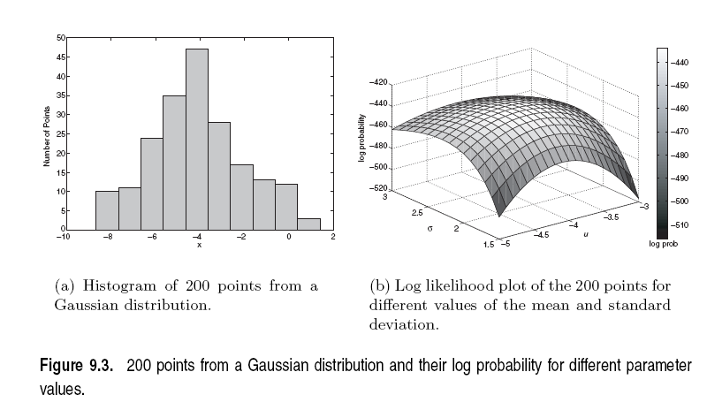

Slide 14
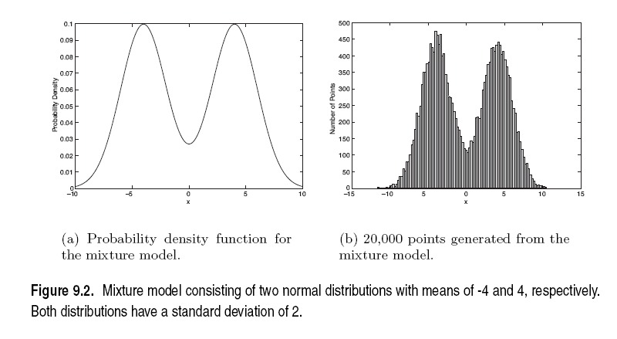
Mixture of Gaussians
Suppose that you have the heights of people from Greece and China and the distribution looks like the figure below (dramatization)

Slide 15
Mixture of Gaussians
In this case the data is the result of the mixture of two Gaussians
One for Greek people, and one for Chinese people
Identifying for each value which Gaussian is most likely to have generated it will give us a clustering.

Slide 16
Mixture model
A value $x_{i}$ is generated according to the following process:
First select the nationality
With probability $π_{G}$ select Greece, with probability $π_{C}$ select China $(π_{G} +π_{C} = 1)$
Given the nationality, generate the point from the corresponding Gaussian
$P\left(x_{i} | θ_{G}\right) \sim N\left(μ_{G},σ_{G}\right)$if Greece
$P\left(x_{i} | θ_{C}\right) \sim N\left(μ_{C},σ_{C}\right)$if China
We can also thing of this as a Hidden Variable Z that takes two values: Greece and China
$θ_{G}$: parameters of the Greek distribution
$θ_{C}$: parameters of the China distribution

Slide 17
Mixture Model
Our model has the following parameters
$$Θ=(π_{G},π_{C},μ_{G},{σ_{G},μ}_{C}, σ_{C})$$
Mixture probabilities
$θ_{G}$: parameters of the Greek distribution
$θ_{C}$: parameters of the China distribution

Slide 18
Mixture Model
Our model has the following parameters
$$Θ=(π_{G},π_{C},μ_{G},{σ_{G},μ}_{C}, σ_{C})$$
For value $x_{i}$, we have:
$$P\left(x_{i}|Θ\right)=π_{G}P\left(x_{i} | θ_{G}\right)+π_{C}P(x_{i}|θ_{C})$$
For all values $X = \left(x_{1},…,x_{n}\right)$
$$P\left(X|Θ\right)= \prod_{i=1}^{n}{P(x_{i}|Θ)}$$
We want to estimate the parameters that maximize the Likelihood of the data
Mixture probabilities
Distribution Parameters

Slide 19
Mixture Models
Once we have the parameters $Θ=(π_{G},π_{C},μ_{G},μ_{C}, σ_{G},σ_{C})$ we can estimate the membership probabilities $P\left(G | x_{i}\right)$ and $P\left(C | x_{i}\right)$for each point $x_{i}$:
This is the probability that point $x_{i}$ belongs to the Greek or the Chinese population (cluster)
$$P\left(G | x_{i}\right)= \frac{P\left(x_{i} | G\right)P(G)}{P\left(x_{i} | G\right)P\left(G\right)+P\left(x_{i} | C\right)P(C)} =\frac{P\left(x_{i} | θ_{G}\right)π_{G}}{P\left(x_{i} | θ_{G}\right)π_{G}+P\left(x_{i} | θ_{C}\right)π_{C}}$$
Given from the Gaussian distribution $N(μ_{G}, σ_{G})$ for Greek

Slide 20
EM (Expectation Maximization) Algorithm
Initialize the values of the parameters in $Θ$to some random values
Repeat until convergence
E-Step: Given the parameters $Θ$estimate the membership probabilities $P\left(G | x_{i}\right)$ and $P\left(C | x_{i}\right)$
M-Step: Compute the parameter values that (in expectation) maximize the data likelihood
$$π_{C}=\frac{1}{n}\sum_{i=1}^{n}{P(C|x_{i})}$$
$$π_{G}=\frac{1}{n}\sum_{i=1}^{n}{P(G|x_{i})}$$
Fraction of population in G,C
$$μ_{C}=\frac{1}{n{∗π}_{C}}\sum_{i=1}^{n}{{P\left(C | x_{i}\right)x}_{i}}$$
$$μ_{G}=\frac{1}{n{∗π}_{G}}\sum_{i=1}^{n}{{P\left(G | x_{i}\right)x}_{i}}$$
MLE Estimates
if $π$’s were fixed
$$σ_{C}^{2}=\frac{1}{n{∗π}_{C}}\sum_{i=1}^{n}{{P\left(C | x_{i}\right)\left(x_{i}−μ_{C}\right)}^{2}}$$
$$σ_{G}^{2}=\frac{1}{n{∗π}_{G}}\sum_{i=1}^{n}{{P\left(G | x_{i}\right)\left(x_{i}−μ_{G}\right)}^{2}}$$

Slide 21
Relationship to K-means
E-Step: Assignment of points to clusters
K-means: hard assignment, EM: soft assignment
M-Step: Computation of centroids
K-means assumes common fixed variance (spherical clusters)
EM: can change the variance for different clusters or different dimensions (ellipsoid clusters)
If the variance is fixed then both minimize the same error function

Slide 22
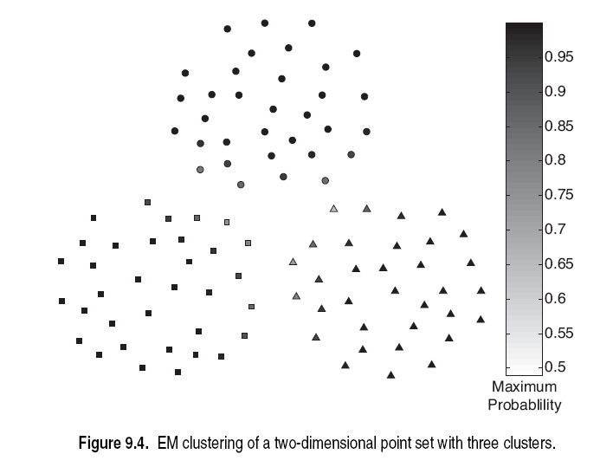

Slide 23
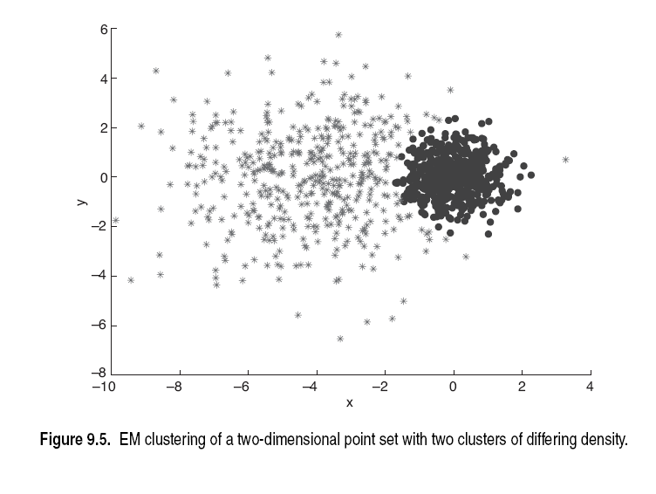

Slide 24
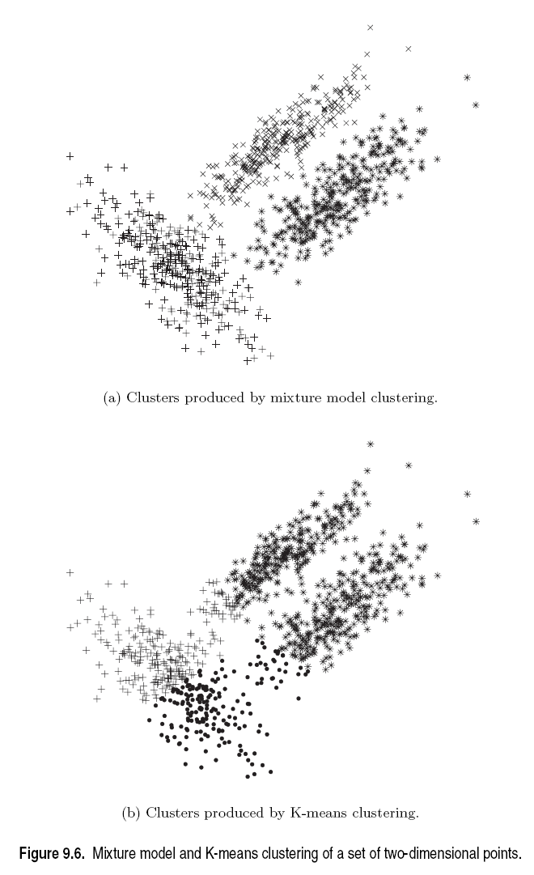

Slide 25
Sequence Segmentation

Slide 26
Sequential data
Sequential data (or time series) refers to data that appear in a specific order.
The order defines a time axis, that differentiates this data from other cases we have seen so far
Examples
The price of a stock (or of many stocks) over time
Environmental data (pressure, temperature, precipitation etc) over time
The sequence of queries in a search engine, or the frequency of a single query over time
The words in a document as they appear in order
A DNA sequence of nucleotides
Event occurrences in a log over time
Etc…
Time series: usually we assume that we have a vector of numeric values that change over time.

Slide 27
Time-series data
Financial time series, process monitoring…

Slide 28
Time series analysis
The addition of the time axis defines new sets of problems
Discovering periodic patterns in time series
Defining similarity between time series
Finding bursts, or outliers
Also, some existing problems need to be revisited taking sequential order into account
Association rules and Frequent Itemsets in sequential data
Summarization and Clustering: Sequence Segmentation

Slide 29
Sequence Segmentation
Goal: discover structure in the sequence and provide a concise summary
Given a sequence T, segment it into K contiguous segments that are as homogeneous as possible
Similar to clustering but now we require the points in the cluster to be contiguous
Commonly used for summarization of histograms in databases

Slide 30
Example
R
t
R
Segmentation into 4 segments
Homogeneity: points are close to the mean value (small error)
t

Slide 31
Basic definitions
Sequence $T = \{t1,t2,…,t_{N}\}$: an ordered set of $N$ $d$-dimensional real points $t_{i}∈R^{d}$
A $K$-segmentation $S$: a partition of $T$ into $K$ contiguous segments $\{s1,s2,…,s_{K}\}$.
Each segment $s∈S$ is represented by a single vector $μ∈ℝ^{d}$(the representative of the segment -- same as the centroid of a cluster)
Error E(S): The error of replacing individual points with representatives
Different error functions, define different representatives.
Sum of Squares Error (SSE):
$$E\left(S\right)= \sum_{s∈S}{\sum_{t∈s}{{\left(t−μ_{s}\right)}^{2}}}$$
Representative of segment $s$ with SSE: mean $μ_{s}=\frac{1}{|s|}\sum_{t∈s}{t}$

Slide 32
The K-segmentation problem
Given a sequence $T$ of length $N$ and a value $K$, find a $K$-segmentation $S = \{s1, s2, …,sK\}$of T such that the SSE error E is minimized.
Similar to $K$-means clustering, but now we need the points in the clusters to respect the order of the sequence.
This actually makes the problem easier.

Slide 33
Basic Definitions
Observation: a $K$-segmentation $S$ is defined by $K+1$ boundary points $b_{0},b_{1},…,b_{K−1},b_{K}$.
$b_{0}=0, b_{k}=N+1$ always.
We only need to specify$b_{1},…,b_{K−1}$
R
t
$$b_{0}$$
$$b_{1}$$
$$b_{2}$$
$$b_{3}$$
$$b_{4}$$

Slide 34
Optimal solution for the k-segmentation problem
[Bellman’61: The K-segmentation problem can be solved optimally using a standard dynamic programming algorithm
Dynamic Programming:
Construct the solution of the problem by using solutions to problems of smaller size
Define the dynamic programming recursion
Build the solution bottom up from smaller to larger instances
Define the dynamic programming table that stores the solutions to the sub-problems

Slide 35
Rule of thumb
Most optimization problems where order is involved can be solved optimally in polynomial time using dynamic programming.
The polynomial exponent may be large though

Slide 36
Dynamic Programming Recursion
Terminology:
$T[1,n]$: subsequence $\{t1,t2,…,tn\}$for $n≤N$
$E\left(S[1,n],k\right)$: error of optimal segmentation of subsequence $T[1,n]$ with $k$ segments for $k≤K$
Dynamic Programming Recursion:
$$E\left(S\left[1,n\right],k\right)= \min_{k≤j≤n−1}\left\{E\left(S\left[1,j\right],k−1\right)+\sum_{j+1≤t≤n}{{\left(t−μ_{\left[j+1,n\right]}\right)}^{2}}\right\}$$
Minimum over all possible placements of the last boundary point $b_{k−1}$
Error of optimal segmentation $S[1,j]$ with k-1 segments
Error of k-th (last) segment when the last segment is $[j+1,n]$

Slide 37
Dynamic programming table
$\text{Two}\text{−}\text{dimensional} \text{table} A[1…K, 1…N]$
$$E\left(S\left[1,n\right],k\right)=\min_{k≤j≤n−1}\left\{E\left(S\left[1,j\right],k−1\right)+\sum_{j+1≤t≤n}{{\left(t−μ_{\left[j+1,n\right]}\right)}^{2}}\right\}$$
Fill the table top to bottom, left to right.
$$A\left[k,n\right]= E\left(S\left[1,n\right],k\right)$$
1
n-1
n
N
1
k-1
k
K
Error of optimal K-segmentation

Slide 38
Example
k = 3
n-th point
$$b_{1}$$
$$b_{2}$$
R
$$E\left(S\left[1,n\right],k\right)=\min_{k≤j≤n−1}\left\{E\left(S\left[1,j\right],k−1\right)+\sum_{j+1≤t≤n}{{\left(t−μ_{\left[j+1,n\right]}\right)}^{2}}\right\}$$
1
n
N
1
2
3
Three segnments means two boundaries $b_{1},b_{2}$
4
Where should we place boundary $b_{2}$?

Slide 39
Example
k = 3
n-th point
$$b_{2}$$
$$b_{1}$$
R
$$E\left(S\left[1,n\right],k\right)=\min_{k≤j≤n−1}\left\{E\left(S\left[1,j\right],k−1\right)+\sum_{j+1≤t≤n}{{\left(t−μ_{\left[j+1,n\right]}\right)}^{2}}\right\}$$
1
n
N
1
2
3
4
Where should we place boundary $b_{2}$?

Slide 40
Example
k = 3
n-th point
$$b_{1}$$
$$b_{2}$$
R
$$E\left(S\left[1,n\right],k\right)=\min_{k≤j≤n−1}\left\{E\left(S\left[1,j\right],k−1\right)+\sum_{j+1≤t≤n}{{\left(t−μ_{\left[j+1,n\right]}\right)}^{2}}\right\}$$
1
n
N
1
2
3
4
Where should we place boundary $b_{2}$?

Slide 41
Example
k = 3
n-th point
$$b_{1}$$
$$b_{2}$$
R
$$E\left(S\left[1,n\right],k\right)=\min_{k≤j≤n−1}\left\{E\left(S\left[1,j\right],k−1\right)+\sum_{j+1≤t≤n}{{\left(t−μ_{\left[j+1,n\right]}\right)}^{2}}\right\}$$
1
n
N
1
2
3
4
Where should we place boundary $b_{2}$?

Slide 42
Example
k = 3
n-th point
$$b_{1}$$
$$b_{2}$$
R
Optimal segmentation S[1:n]
1
n-3
n
N
The cell $A[3,n]$ stores the error of the optimal solution $3$-segmentation of $T[1,n]$
1
2
3
In the cell (or in a different table) we also store the position $n−3$ of the boundary so we can trace back the segmentation
4

Slide 43
Dynamic-programming algorithm
Input: Sequence T, length N, K segments, error function E()
For i=1 to N //Initialize first row
A[1,i]=E(T[1…i]) //Error when everything is in one cluster
For k=1 to K // Initialize diagonal
A[k,k] = 0 // Error when each point in its own cluster
For k=2 to K
For i=k+1 to N
A[k,i] = min_{j<i}{A[k-1,j]+E(T[j+1…i])}
To recover the actual segmentation (not just the optimal cost) store also the minimizing values j

Slide 44
Algorithm Complexity
What is the complexity?
NK cells to fill
Computation per cell $E\left(S\left[1,n\right],k\right)=\min_{k≤j<n}\left\{E\left(S\left[1,j\right],k−1\right)+\sum_{j+1≤t≤n}{{\left(t−μ_{\left[j+1,n\right]}\right)}^{2}}\right\}$
O(N) boundaries to check per cell
O(N) to compute the second term per checked boundary
O(N³K) in the naïve computation
We can avoid the last O(N) factor by observing that
$$\sum_{j+1≤t≤n}{{\left(t−μ_{\left[j+1,n\right]}\right)}^{2}}=\sum_{j+1≤t≤n}{t^{2}}−\frac{1}{n−j}{\left(\sum_{j+1≤t≤n}{t}\right)}^{2}$$
We can compute in constant time by precomputing partial sums
Precompute $\sum_{1≤t≤n}{t}$ and $\sum_{1≤t≤n}{t^{2}}$ for all n = 1..N
Algorithm Complexity: O(N²K)

Slide 45
Heuristics
Top-down greedy (TD): O(NK)
Introduce boundaries one at the time so that you get the largest decrease in error, until K segments are created.
Bottom-up greedy (BU): O(NlogN)
Merge adjacent points each time selecting the two points that cause the smallest increase in the error until K segments
Local Search Heuristics: O(NKI)
Assign the breakpoints randomly and then move them so that you reduce the error

Slide 46
Local Search Heuristics
Local Search refers to a class of heuristic optimization algorithms where we start with some solution and we try to reach an optimum by iteratively improving the solution with small (local) changes
Each solution has a set of neighboring solutions:
The set of solutions that can be created with the allowed local changes.
Usually we move to the best of the neighboring solutions, or one that improves our optimization function
Local Search algorithms are surprisingly effective
For some problems they yield optimal solutions or solutions with good approximation bounds
They have been studied extensively
Simulated Annealing
Taboo Search

Slide 47
Other time series analysis
Using signal processing techniques is common for defining similarity between series
Fast Fourier Transform
Wavelets
Rich literature in the field

