Slide 1
DATA MINING
LECTURE 12
Community detection in graphs

Slide 2
Communities
Real-life graphs are not random
  E.g., in a social network people pick their friends based on their common interests and activities
We expect that the nodes in a graph will be organized in communities
  Groups of vertices which probably share common properties and/or play similar roles within the graph
How do we find them?
  Nodes in communities will be densely connected to each other, and sparsely connected with other communities
  Sounds familiar?

Slide 3
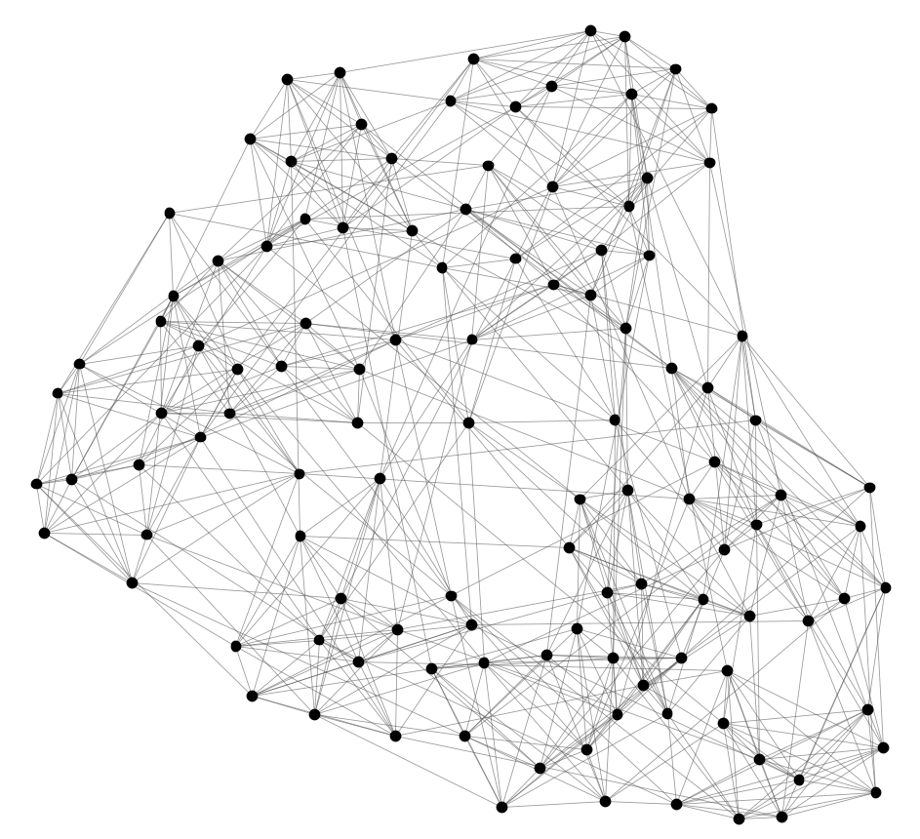
NCAA Football network
Can we identify node groups?
(communities, modules, clusters)
Nodes: Football Teams
Edges: Games played

Slide 4
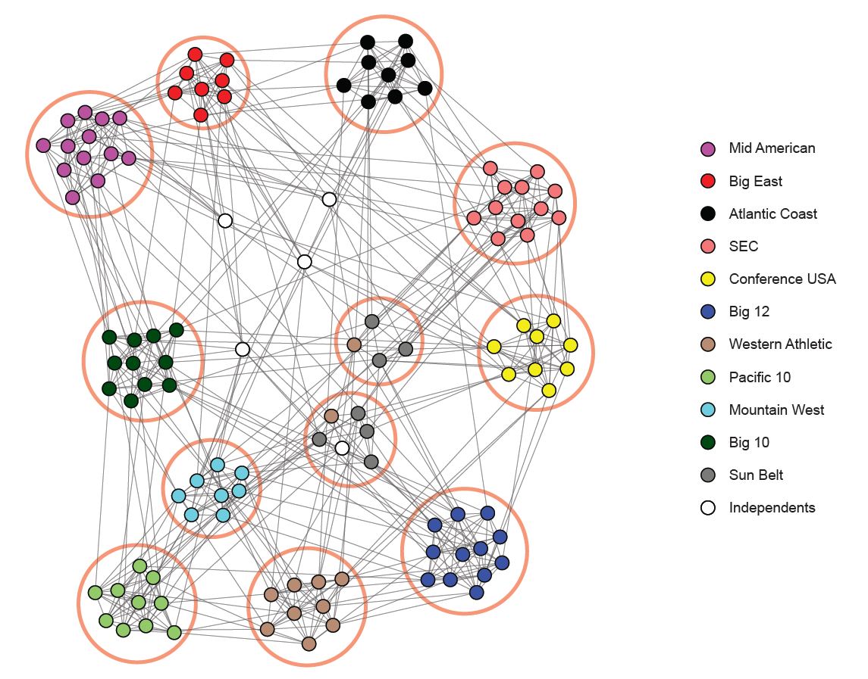
NCAA conferences
Nodes: Football Teams
Edges: Games played

Slide 5
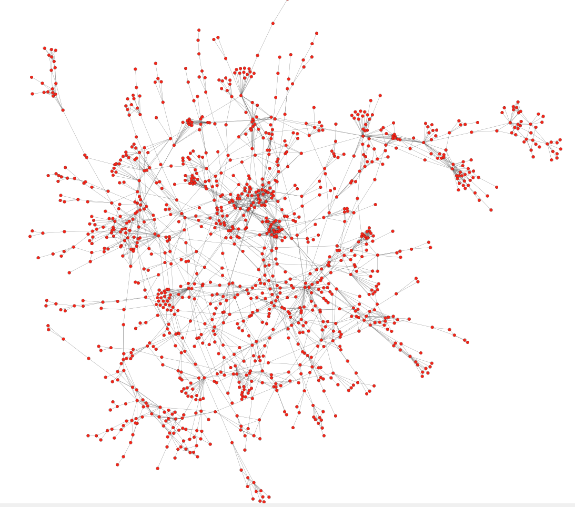
Protein-Protein interaction networks
Can we identify functional modules?
Nodes: Proteins
Edges: Physical interactions

Slide 6
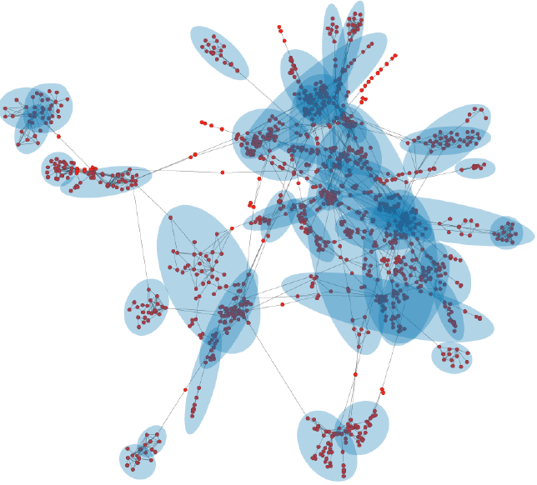
Functional modules
Nodes: Proteins
Edges: Physical interactions

Slide 7
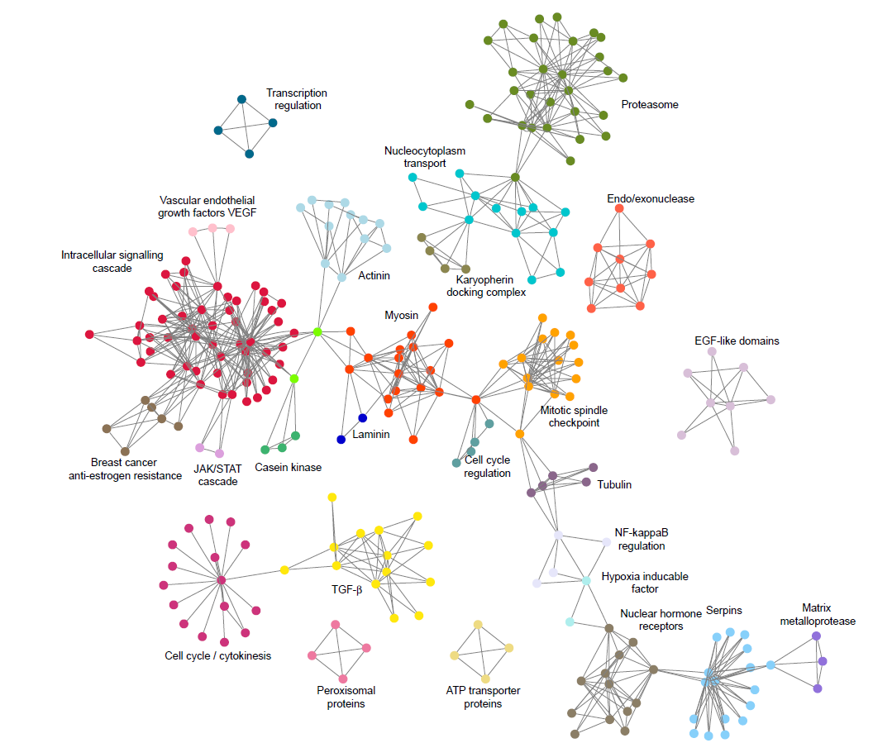

Slide 8
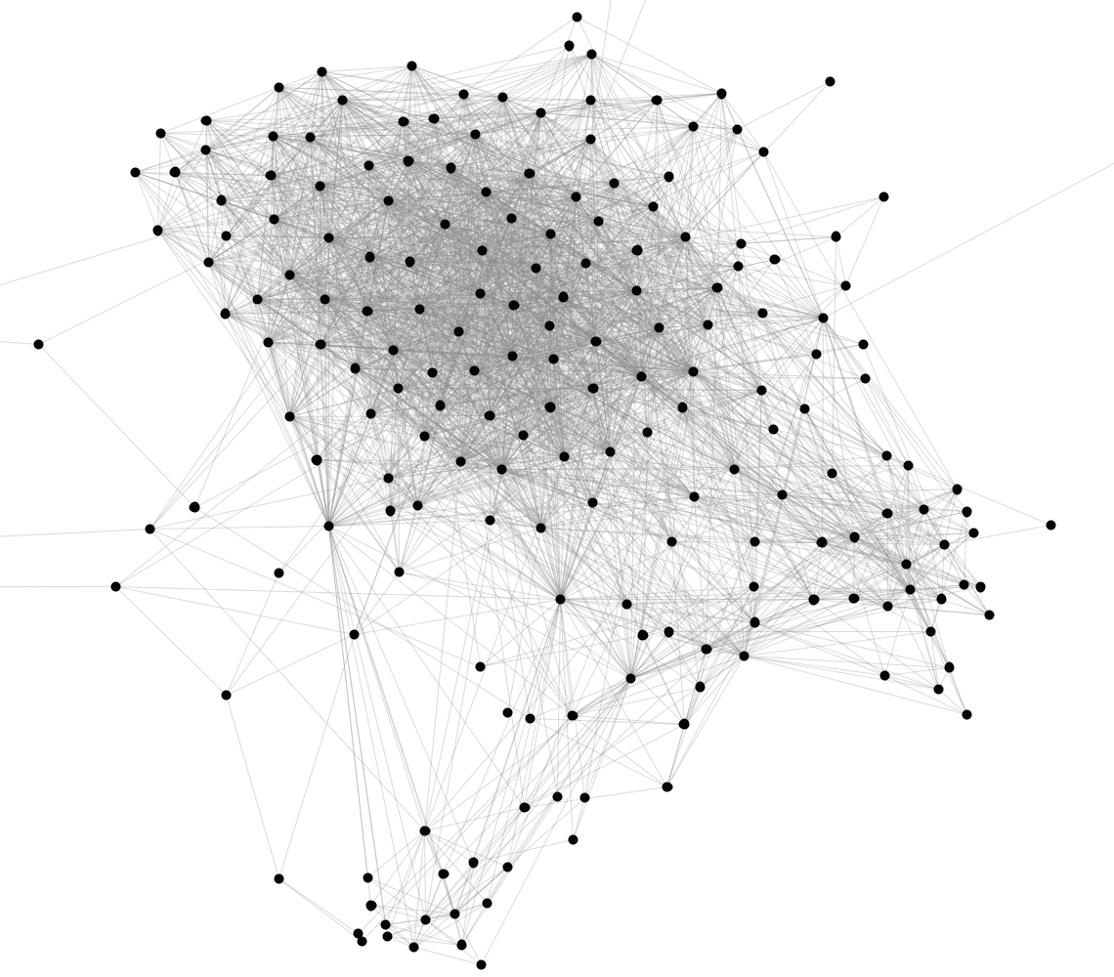
Stanford Facebook network
Can we identify social communities?
Nodes: Facebook Users
Edges: Friendships

Slide 9
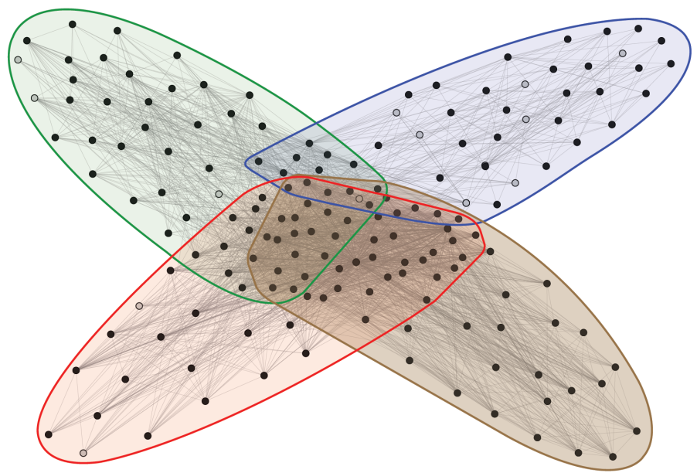
Social communities
High school
Summer
internship
Stanford (Squash)
Stanford (Basketball)
Nodes: Facebook Users
Edges: Friendships

Slide 10
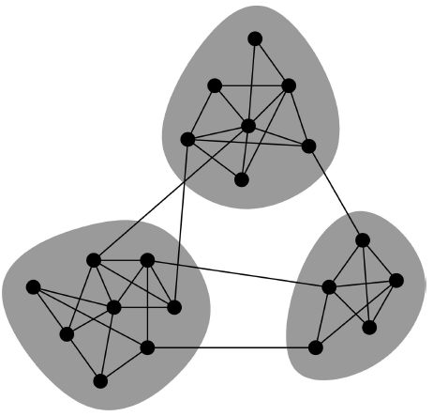
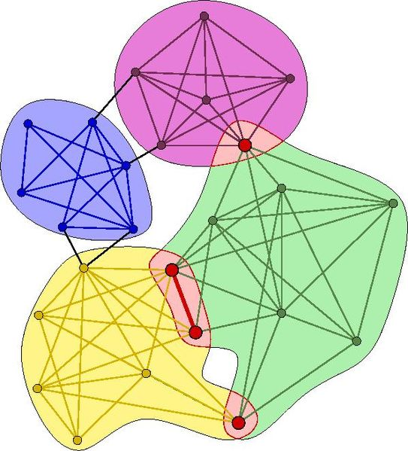
Community types
Overlapping communities vs non-overlapping communities

Slide 11
Non-Overlapping communities
Dense connectivity within the community, sparse across communities
Nodes
Nodes
Network
Adjacency matrix

Slide 12
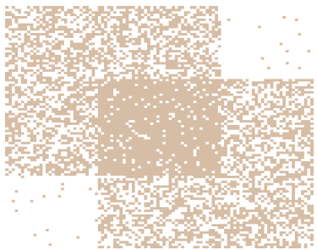
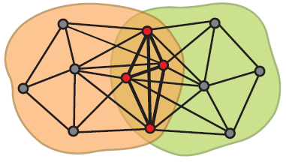
Overlapping communities

Slide 13
Community detection as clustering
In many ways community detection is just clustering on graphs.
We can apply clustering algorithms on the adjacency matrix (e.g., k-means)
We can define a distance or similarity measure between nodes in the graph and apply other algorithms (e.g., hierarchical clustering)
  Similarity using jaccard similarity on the neighbors sets
  Distance using shortest paths or random walks.
There are also algorithms that are specific to graphs

Slide 14
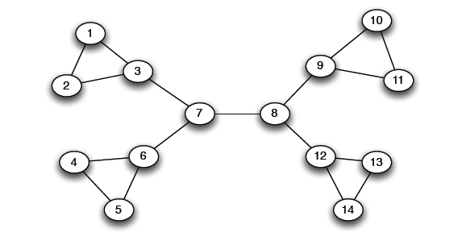
The Girvan-Newman method
Hierarchical divisive method
  Start with the whole graph
  Find edges whose removal “partitions” the graph
  Repeat with each subgraph until single vertices
Which edge to remove?

Slide 15
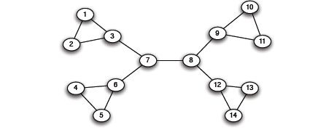
The Girvan-Newman method
Select cut-edges (a.k.a. bridge edges): edges that when removed they disconnect the graph
There may be many of those

Slide 16
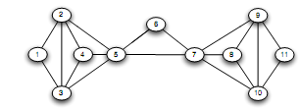
The Girvan-Newman method
Select cut-edges (a.k.a. bridge edges): edges that when removed they disconnect the graph
Or, more often, there may be none

Slide 17
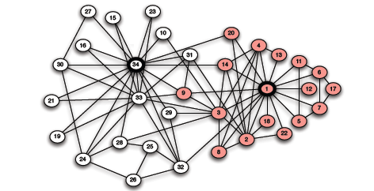
The Girvan-Newman method
Select cut-edges (a.k.a. bridge edges): edges that when removed they disconnect the graph
Or, more often, there may be none

Slide 18
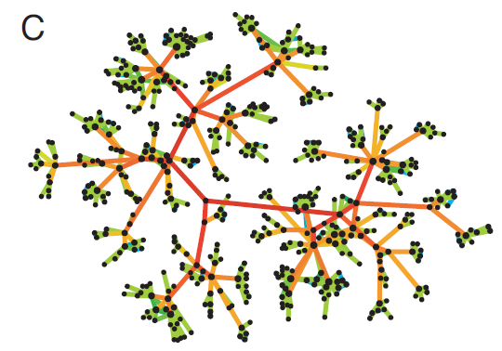
Edge importance
We need a measure of how important an edge is in keeping the graph connected
Edge betweenness: Number of shortest paths that pass through the edge

Slide 19
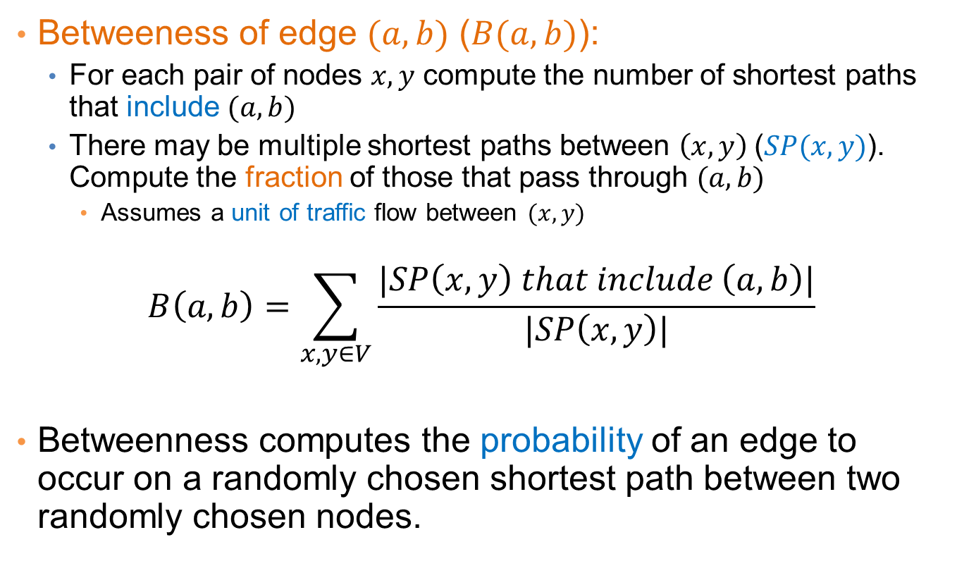
Edge Betweeness
Betweeness of edge $(a,b)$ ($B(a,b)$):
  For each pair of nodes $x,y$ compute the number of shortest paths that include $(a,b)$
  There may be multiple shortest paths between $\left(x,y\right) \text{(}SP(x,y)\text{)}$. Compute the fraction of those that pass through $(a,b)$
    Assumes a unit of traffic flow between $(x,y)$
$$B\left(a,b\right)=\sum_{x,y∈V}{\frac{|SP\left(x,y\right) that include \left(a,b\right)|}{|SP\left(x,y\right)|}}$$
Betweenness computes the probability of an edge to occur on a randomly chosen shortest path between two randomly chosen nodes.

Slide 20
Examples
3x11 = 33
1x12 = 12
7x7 = 49
1
B
F
H
A
D
E
C
G
b=16
b=7.5

Slide 21
The Girvan Newman Algorithm
Given an undirected unweighted graph:
Repeat until no edges are left:
  Compute the edge betweeness for all edges
  Remove the edge with the highest betweeness
At each step of the algorithm, the connected components are the communities
Gives a hierarchical decomposition of the graph into communities

Slide 22
Girvan Newman method: An example
Betweenness(7, 8)= 7x7 = 49
Betweenness(1, 3) = 1X12=12
Betweenness(3, 7) = Betweenness(6, 7) =
Betweenness(8, 9) = Betweenness(8, 12)= 3X11=33

Slide 23
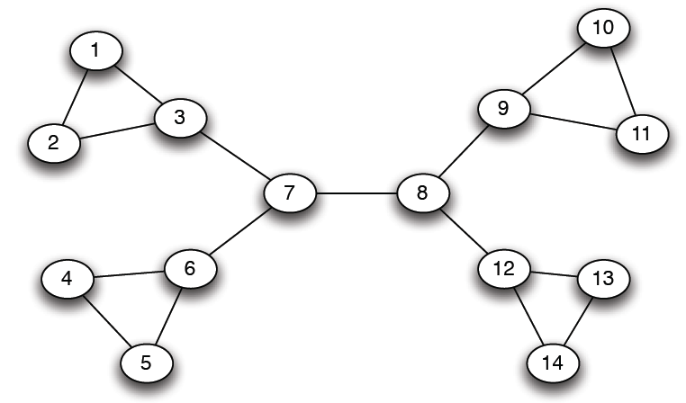
Girvan-Newman: Example
12
1
33
49
Need to re-compute betweenness at every step

Slide 24
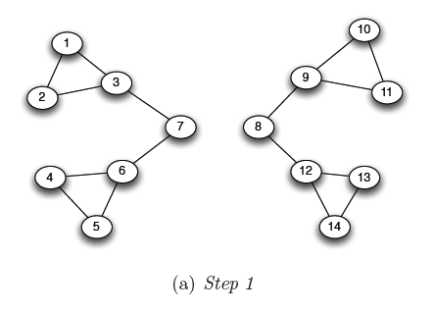
Girvan Newman method: An example
Betweenness(1, 3) = 1X5=5
Betweenness(3,7) = Betweenness(6,7) =
Betweenness(8,9) = Betweenness(8,12) = 3X4=12

Slide 25
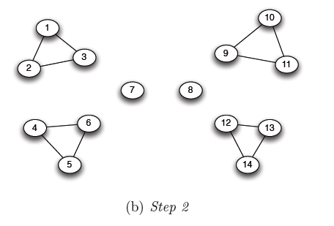
Girvan Newman method: An example
Betweenness of every edge = 1

Slide 26
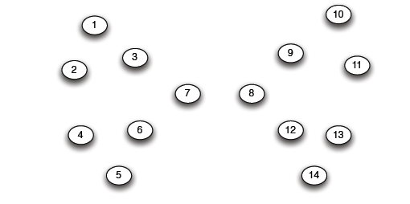
Girvan Newman method: An example

Slide 27
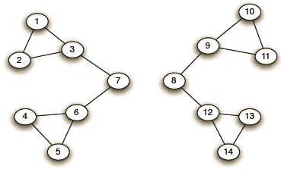
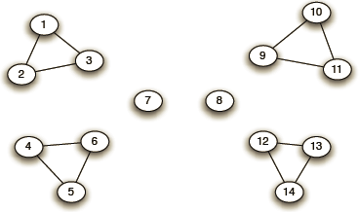
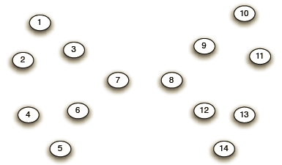
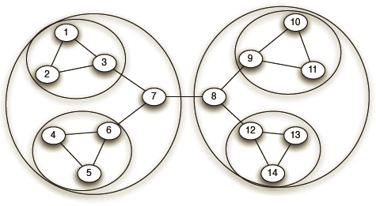
Girvan-Newman: Example
Step 1:
Step 2:
Step 3:
Hierarchical network decomposition:

Slide 28
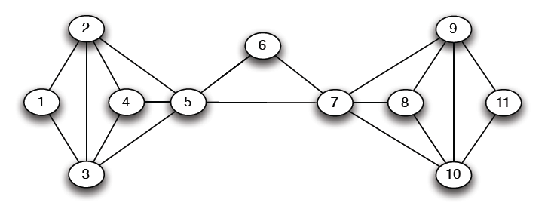
Another example
5X5=25

Slide 29
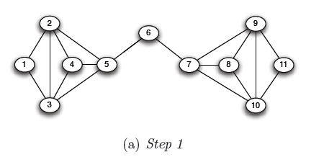
Another example
5X6=30
5X6=30

Slide 30
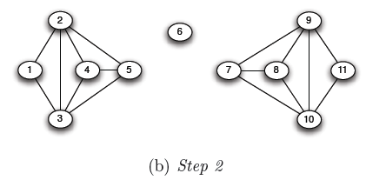
Another example

Slide 31
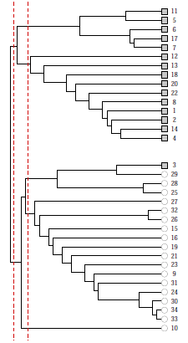
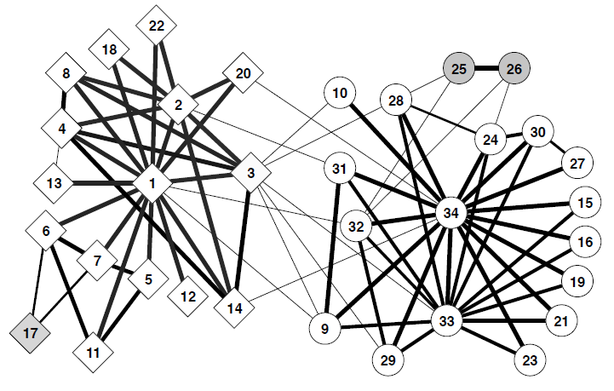
Girvan-Newman: Results
Zachary’s Karate club:
Hierarchical decomposition

Slide 32
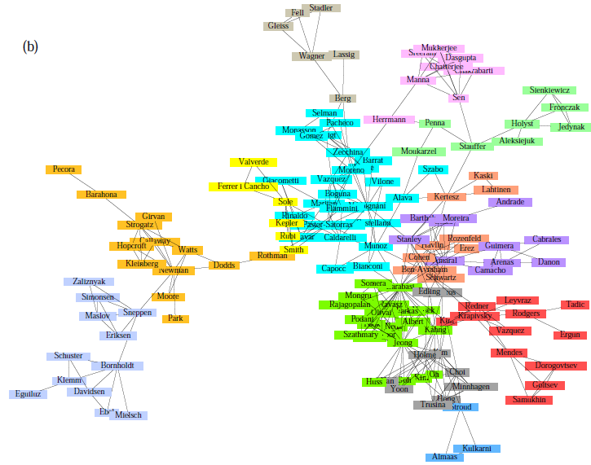
Girvan-Newman: Results
Communities in physics collaborations

Slide 33
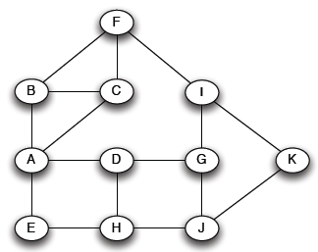

How to Compute Betweenness?
Want to compute betweenness of paths starting from node $A$

Slide 34
Computing Betweenness
Perform a BFS starting from A
Determine the number of shortest path from A to each other node
Based on these numbers, determine the amount of flow from A to all other nodes that uses each edge

Slide 35
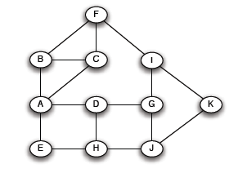
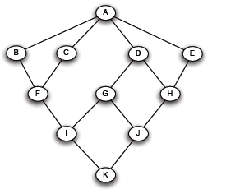
Computing Betweenness: step 1
Initial network
BFS from A

Slide 36
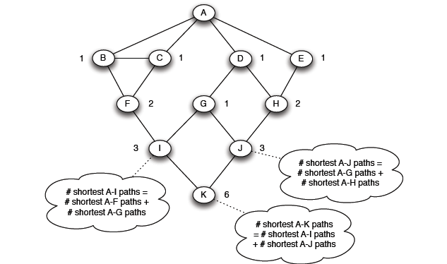
Computing Betweenness: step 2
Count how many shortest paths from A to a specific node
Level 1
Level 2
Top-down
Level 3
Level 4

Slide 37
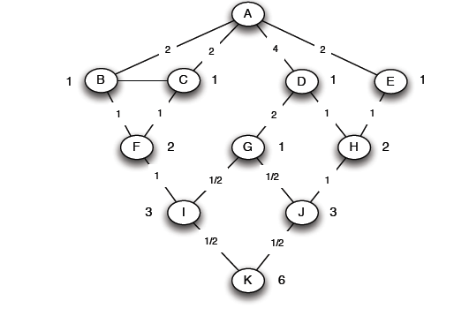
Computing Betweeness: Step 3
Compute betweenness by working up the tree:
  For every node there is a unit of flow destined for that node that it is divided fractionally to the edges that reach that node
There is a unit of flow to K that reaches K through edges (I,K) and (J,K)
Since there are 3 paths from I to K and 3 from J, each edge gets ½ of the flow: Betweeness ½
Bottom-up

Slide 38
Computing Betweeness: Step 3
Compute betweenness by working up the tree:
  If the node has descendants in the BFS DAG, we also need to take into account the flow that passes from that node towards the descendants
For node I, there is a unit of flow to I from A, but also ½ of flow that passes from I towards K (we have computed that as the betweeness of edge (I,K)): Total flow 3/2
There are 2 paths from F to I and 1 path from G to I edge (F,I) gets 2/3 of the total flow: Betweeness 2/3*3/2 = 1
Edge (G,I) gets 1/3 of the total flow: Betweeness 2/3*3/2 = 1
Bottom-up

Slide 39
Computing Betweeness
Repeat the process for all nodes and take the sum

Slide 40
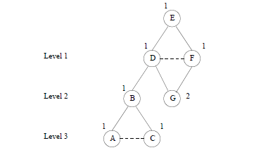
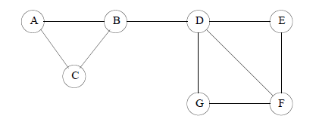
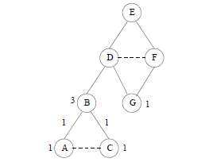
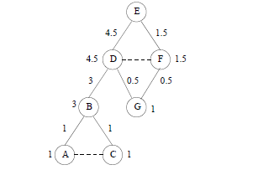
Example

Slide 41
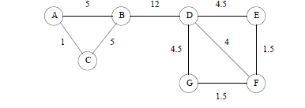
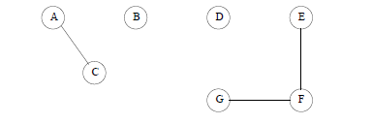
Example

Slide 42
Computing Betweenness
Issues
  Scalability
  Test for connectivity?
  Re-compute all paths, or only those affected
  Parallel computation
  Sampling

