Slide 1
Online Social Networks and Media
Fairness, Diversity

Slide 2
Outline
Fairness (case studies, basic definitions)
Diversity
An experiment on the diversity of Facebook

Slide 3
Fairness, Non-discrimination
To discriminate is to treat someone differently
(Unfair) discrimination is based on group membership, not individual merit
Some attributes should be irrelevant (protected)

Slide 4
Disparate treatment and impact
Disparate treatment: Treatment depends on class membership
Disparate impact: Outcome depends on class membership (Even if (apparently) people are treated the same way)
Doctrine solidified in the US after [Griggs v. Duke Power Co. 1971] where a high school diploma was required for unskilled work, excluding black applicants

Slide 5
Case Study: Gender bias in image search [CHI15]
What images do people choose to represent careers?
In search results:
evidence for stereotype exaggeration
systematic underrepresentation of women
People rate search results higher when they are consistent with stereotypes for a career
Shifting the representation of gender in image search results can shift people’s perceptions about real-world distributions. (after search slight increase in their believes)
Tradeoff between high-quality result and broader societal goals for equality of representation

Slide 6
Case Study: Latanya
The importance of being Latanya
Names used predominantly by black men and women are much more likely to generate ads related to arrest records, than names used predominantly by white men and women.

Slide 7
Case Study: AdFisher
Tool to automate the creation of behavioral and demographic profiles.
setting gender = female results in less ads for high-paying jobs
browsing substance abuse websites leads to rehab ads
http://possibility.cylab.cmu.edu/adfisher/

Slide 8
Case Study: Capital One
Capital One uses tracking information provided by the tracking network [x+1] to personalize offers for credit cards
Steering minorities into higher rates
capitalone.com

Slide 9
Fairness: google search and autocomplete
Donald Tramp accused Google “suppressing negative information” about Clinton
Autocomplete feature - “hillary clinton cri” vs “donald tramp cri”
Autocomplete:
are jews
are women
https://www.theguardian.com/us-news/2016/sep/29/donald-trump-attacks-biased-lester-holt-and-accuses-google-of-conspiracy
https://www.theguardian.com/technology/2016/dec/04/google-democracy-truth-internet-search-facebook?CMP=fb_gu

Slide 10
Google+ names
Google+ tries to classify Real vs Fake names
Fairness problem:
– Most training examples standard white American names
– Ethnic names often unique, much fewer training examples
Likely outcome:
Prediction accuracy worse on ethnic names
Katya Casio. “Due to Google's ethnocentricity I was prevented from using my real last name (my nationality is: Tungus and Sami)”
Google Product Forums

Slide 11
Other
LinkedIn: female vs male names (for female prompts suggestions for male, e.g., Andrea Jones” to “Andrew Jones,” Danielle to Daniel, Michaela to Michael and Alexa to Alex.)
http://www.seattletimes.com/business/microsoft/how-linkedins-search-engine-may-reflect-a-bias/
Flickr: auto-tagging system labels images of black people as apes or animals and concentration camps as sport or jungle jyms. https://www.theguardian.com/technology/2015/may/20/flickr-complaints-offensive-auto-tagging-photos
Airbnb: race discrimination
Against guest
http://www.debiasyourself.org/
Community commitment
http://blog.airbnb.com/the-airbnb-community-commitment/
Non-black hosts can charge ~12% more than black hosts
Edelman, Benjamin G. and Luca, Michael, Digital Discrimination: The Case of Airbnb.com (January 10, 2014). Harvard Business School NOM Unit Working Paper No. 14-054.
Google maps: China is about 21% larger by pixels when shown in Google Maps for China
  Gary Soeller, Karrie Karahalios, Christian Sandvig, and Christo Wilson: MapWatch: Detecting and Monitoring International Border Personalization on Online Maps. Proc. of WWW. Montreal, Quebec, Canada, April 2016

Slide 12
Reasons for bias/lack of fairness
Data input
Data as a social mirror: Protected attributes redundantly encoded in observables
Correctness and completeness: Garbage in, garbage out (GIGO)
Sample size disparity: learn on majority (Errors concentrated in the minority class)
Poorly selected, incomplete, incorrect, or outdated
Selected with bias
Perpetuating and promoting historical biases

Slide 13
Reasons for bias/lack of fairness
Algorithmic processing
Poorly designed matching systems
Personalization and recommendation services that narrow instead of expand user options
Decision making systems that assume correlation implies causation
Algorithms that do not compensate for datasets that disproportionately represent populations
Output models that are hard to understand or explain hinder detection and mitigation of bias

Slide 14
Fairness through blindness
Ignore all irrelevant/protected attributes
Useful to avoid formal disparate treatment

Slide 15
Fairness: definition
Classification
  Classification/prediction for people with similar non-protected attributes should be similar
  Differences should be mostly explainable by non-protected attributes
  A (trusted) data owner that holds the data of individuals, a vendor that classifies the individuals

Slide 16
M: V -> A
M(x)
x
V: Individuals
A: Outcomes

Slide 17
Main points
Individual-based fairness: any two individuals who are similar with respect to a particular task should be classified similarly
Optimization problem: construct fair classifiers that minimize the expected utility loss of the vendor

Slide 18
Formulation
V: set of individuals
A: set of classifier outcomes
Classifier maps individuals to outcomes
Randomized mapping M: V -> Δ(Α) from individuals to probability distributions over outcomes
  To classify x ∈ V, choose an outcome a according to distribution M(x)

Slide 19
Formulation
A task-specific distance metric d: V x V -> R on individuals
Expresses ground truth (or, best available approximation)
Public
Open to discussion and refinement
  Externally imposed, e.g., by a regulatory body, or externally proposed, e.g., by a civil rights organization

Slide 20
M: V -> A
M(x)
x
d(x, y)
M(y)
y
V: Individuals
A: Outcomes

Slide 21
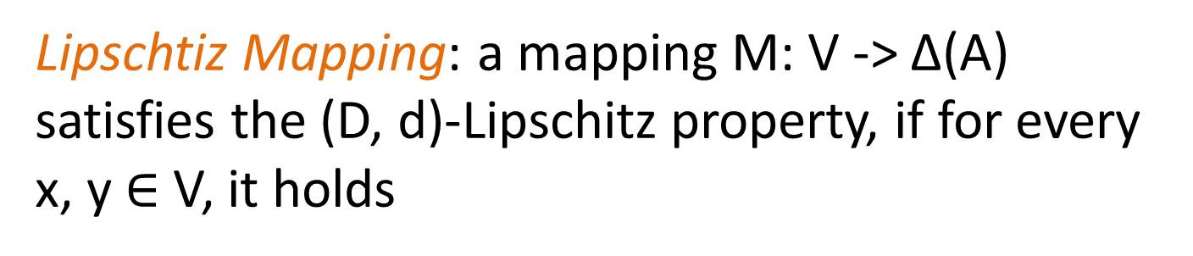

Formulation
Lipschtiz Mapping: a mapping M: V -> Δ(Α) satisfies the (D, d)-Lipschitz property, if for every x, y $∈$ V, it holds
$$D\left(M(x), M(y)\right)≤d(x, y)$$

Slide 22
Formulation
There exists a classifier that satisfies the Lipschitz condition
• Map all individuals to the same distribution over outcomes
Vendors specify arbitrary utility function
U: V x A -> R
Find a mapping from individuals to distributions over outcomes that minimizes expected loss subject to the Lipschitz condition.

Slide 23
Formulation

Slide 24
What is D?
M: V -> A
M(x)
x
d(x, y)
M(y)
y
V: Individuals
A: Outcomes

Slide 25
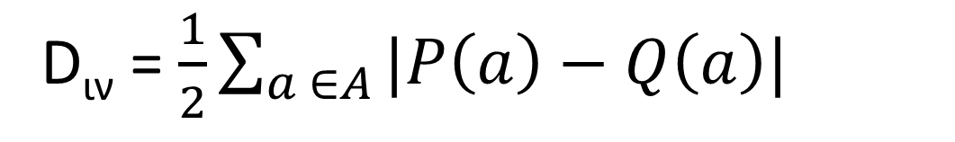
What is D?
Statistical distance or local variation between two probability measures P and Q on a finite domain A
D_{ιν} = $\frac{1}{2}\sum_{a ∈A}{|P\left(a\right)−Q\left(a\right)|}$
Example
A = {0, 1}
Most different
P(0) = 1, P(1) = 0
Q(0) = 0, Q(1) = 1
D(P, Q) = 1
Most similar
P(0) = 1, P(1) = 0
Q(0) = 1, Q(1) = 0
D(P, Q) = 0
P(0) = P(1) = 1/2
Q(0) = 1/4, Q(1) = 3/4
D(P, Q) = 1/4
Assumes d(x, y) close to 0 for similar and close to 1 for dissimilar

Slide 26
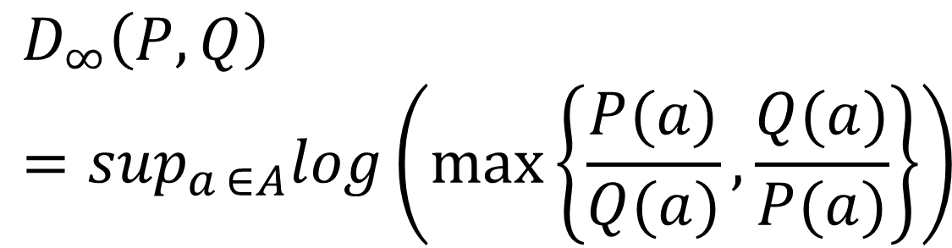
What is D?
$$D_{∞}\left(P, Q\right)=\sup_{a ∈A}log\left(\max\left\{\frac{P(a)}{Q(a)}, \frac{Q(a)}{P(a)}\right\}\right)$$
Example
A = {0, 1}
Most different
P(0) = 1, P(1) = 0
Q(0) = 0, Q(1) = 1
Most similar
P(0) = 1, P(1) = 0
Q(0) = 1, Q(1) = 0
P(0) = P(1) = 1/2
Q(0) = 1/4, Q(1) = 3/4

Slide 27
Statistical parity (group fairness)
If M satisfies statistical parity, then members of S are equally likely to observe a set of outcomes O as are not members
$\left|\operatorname{Pr}\left\{M\left(x\right)∈O \right|x ∈S\}−\operatorname{Pr}\left\{M\left(x\right)∈O \right|x ∈S^{c}\}\right|≤ε$
If M satisfies statistical parity, the fact that an individual observed a particular outcome provides no information as to whether the individual is a member of S or not
$\left|\operatorname{Pr}\left\{x ∈S | M\left(x\right)∈O\right\}−Pr⁡\{ x ∈S^{c}\right|M\left(x\right)∈O\}|≤ε$

Slide 28
Catalog of evils
1. Blatant explicit discrimination:
membership in S explicitly tested for and a worse outcome is given to members of S than to members of S^{c}
2. Discrimination Based on Redundant Encoding:
Explicit test for membership in S replaced by an essentially equivalent test
successful attack against “fairness through blindness”

Slide 29
Catalog of evils
3. Redlining:
well-known form of discrimination based on redundant encoding.
Definition [Hun05]: “the practice of arbitrarily denying or limiting financial services to specific neighborhoods, generally because its residents are people of color or are poor.“
4. Cutting off business with a segment of the population
in which membership in the protected set is disproportionately high:
generalization of redlining, in which members of S need not be a majority; instead, the fraction of the redlined population belonging to S may simply exceed the fraction of S in the population as a whole.

Slide 30
Catalog of evils
5. Self-fullfilling prophecy:
Deliberately choosing the “wrong" members of S in order to build a bad “track record" for S
A less malicious vendor simply selects random members of S rather than qualified members
6. Reverse tokenism:
Goal is to create convincing refutations
Deny access to a qualified member of S^{c}
c is a token rejectee

Slide 31
References
Cynthia Dwork, Moritz Hardt, Toniann Pitassi, Omer Reingold, Richard S. Zemel: Fairness through awareness. ITCS 2012: 214-226

Slide 32
Diversity:
Why, What, How
Talk at Dagstuhl seminar on “Data, Responsibly”, July 2016
With Marina Drosou

Slide 33
Why?

Slide 34
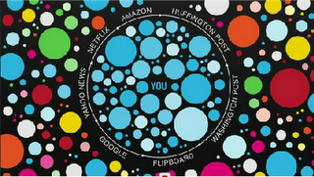
Over Personalization
Filter Bubble: Search results, browsing, recommendations (friends, things, information, …) based on user profiles (own past behavior, similar people, friends, … )
Echo chambers: individuals are exposed only to information from like-minded individuals

Slide 35
What the majority likes
Ranking based on popularity:
popular items get more popular
Other bias
Political, economical, .. (sponsored)
Besides search results diversity also in
Summaries (e.g., reviews) or representatives
Forming committees or teams

Slide 36
Diversity is good
No useful information is missed: results that cover all user intents
Better user experience: less boring, more interesting, human desire for discovery, variety, change
Personal growth: limited, incomplete knowledge, a self-reinforcing cycle of opinion
Better (Fair? Responsible?) decisions

Slide 37
Filter Bubble – Eco Chambers: an experiment
Created two Facebook accounts
“Rusty Smith”, right-wing avatar, liked a variety of conservative news sources, organizations, and personalities, from the Wall Street Journal and The Hoover Institution to Breitbart News and Bill O’Reilly.
“Natasha Smith”, left-wing avatar, liked The New York Times, Mother Jones, Democracy Now and Think Progress.
Ten US voters – five conservative and five liberal – liberals were given log-ins to the conservative feed, and vice versa
https://www.theguardian.com/us-news/2016/nov/16/facebook-bias-bubble-us-election-conservative-liberal-news-feed

Slide 38
What?
Aspects of diversity (varying in their relevance to fairness)

Slide 39
The Data Diversity Problem
Given a set P of n items
Select a subset S ⊆ P with the most diverse items in P
Variations of the problem:
(size) Top-k: the k most diverse items in P
(quality) Threshold: items with diversity larger than some threshold value
39

Slide 40
Coverage
Assuming different topics (e.g., concepts, categories, aspects, intents, interpretations, perspectives, opinions, etc)
Find items that cover all (most) of the topics
For example,
Rakesh Agrawal, Sreenivas Gollapudi, Alan Halverson, Samuel Ieong: Diversifying search results. WSDM 2009
40

Slide 41
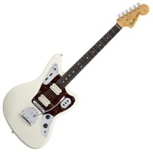

We get the “car” and the “animal” topics but also a “team”, a “guitar”, etc ..
Assumes “known” topics

Slide 42
Content Dissimilarity
Assuming (multi-dimensional, multi-attribute) items + a distance measure (metric) between the items
Find the most different/distant/dissimilar items
Distance depends on the items and the problem
Diversity ordering of the attributes
Defining distance/dissimilarity is key
For example, Sreenivas Gollapudi, Aneesh Sharma: An axiomatic approach for result diversification. WWW 2009
42

Slide 43
Example: Two-bedroom apartments up to $300K in London
Top based on price without (location) diversity
Top based on price with (location) diversity
43

Slide 44
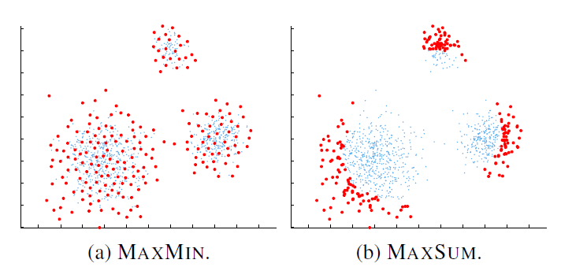
Maximize Set Diversity
Given a distance measure d and a function f measuring the diversity of set of k items,

Slide 45
Novelty
Assuming the history of items seen in the past
Find the items that are the most diverse (coverage, distance) with respect to what a user (or, a community) has seen in the past
Marginal relevance
Cascade (evaluation) models: users are assumed to scan result lists from the top down, eventually stopping because either their information need is satisfied or their patience is exhausted
45

Slide 46
Novelty
Relevant concept: serendipity
represents the “unusualness" or “surprise“
(some notion of semantics – the guitar vs the animal)
For example, Charles L. A. Clarke, Maheedhar Kolla, Gordon V. Cormack, Olga Vechtomova, Azin Ashkan, Stefan Büttcher, Ian MacKinnon: Novelty and diversity in information retrieval evaluation. SIGIR 2008
Yuan Cao Zhang, Diarmuid Ó Séaghdha, Daniele Quercia, Tamas Jambor: Auralist: introducing serendipity into music recommendation. WSDM 2012
46

Slide 47
Multi-criteria
Diversity (coverage, dissimilarity, novelty, serendipity) is just one of the criteria in data selection or ranking
E.g., relevance in IR or accuracy in recommendations
MaxSum diversification: maximize the sum (average) relevance (r) and dissimilarity
MaxMin diversification: maximize the minimum relevance (r) and dissimilarity
47

Slide 48
Multi-criteria
Many different ways to combine
Maximal Marginal Relevance (MMR) a document has high marginal relevance if it is both relevant to the query and contains minimal similarity to previously selected documents
Non-linear functions: E.g., maximize the probability that an item is both relevant and diverse (e.g., non-redundant)
Using thresholds
48

Slide 49
How?

Slide 50
Diversity: Algorithms
Most formulations of the diversity problems are NP-hard, because a set selection problem (set coverage)
Item selection at each step depends on the item selected in the previous step
Compute first a (relevant) result and then “diversify” it
Produce a relevant and diverse result on the fly

Slide 51
Diversity: Algorithms
Interchange (swap) methods: start with the top-k relevant items and replace items that improve the objective function
Greedy methods: build the set incrementally, by selecting the item (or, pair of items) with the largest increase of the objective function
  Appropriate re-writing to the maxmin-maxsum dispersion problems in facility location (OR) (approximation bounds)

Slide 52
Diversity: Algorithms
Optimization problem
Clustering problem: cluster items and select the centers
Random walks on graphs

Slide 53
GrassHopper
Graph of items
Edge weight represents their (cosine) similarity
Node weight: prior ranking as a probability distribution r over the nodes (for example, based on relevance)
Parameter λ to combine the two
Random Walk with Jumps: At each step, the walker either
with probability λ moves to a neighbor state according to similarity (the edge weights); or
teleports to a random state according to ranking (the distribution r).
One-at-a-time, the highest rank item is turned into an absorbing state and the walk is repeated

Slide 54
Data Diversity in Various Contexts
Centrality measures in graphs (DivRank)
Graph patterns
Keyword search
Location based queries
Skylines queries
…

Slide 55
References I (partial list) indicative
[AGH+09] Rakesh Agrawal, Sreenivas Gollapudi, Alan Halverson, Samuel Ieong: Diversifying search results. WSDM 2009: 5-14 (example of coverage-based diversity)
[GS09] Sreenivas Gollapudi, Aneesh Sharma: An axiomatic approach for result diversification. WWW 2009: 381-390 (theoretical treatment, greedy algorithms with links to the dispersion problems)
[DP10] Marina Drosou, Evaggelia Pitoura: Search result diversification. SIGMOD Record 39(1): 41-47 (2010) (survey)
[AK11] Albert Angel, Nick Koudas: Efficient diversity-aware search. SIGMOD Conference 2011: 781-792 (threshold-based algorithm, usefulness = probability of both relevant and diverse)
[VSS+08] Erik Vee, Utkarsh Srivastava, Jayavel Shanmugasundaram, Prashant Bhat, Sihem Amer-Yahia: Efficient Computation of Diverse Query Results. ICDE 2008: 228-236 (diversity ordering of attributes, index structure)
[CKC+08] Charles L. A. Clarke, Maheedhar Kolla, Gordon V. Cormack, Olga Vechtomova, Azin Ashkan, Stefan Büttcher, Ian MacKinnon: Novelty and diversity in information retrieval evaluation. SIGIR 2008: 659-666 (novelty-based diversity in IR, evaluation metrics)
[CCS+11] Charles L. A. Clarke, Nick Craswell, Ian Soboroff, Azin Ashkan:
A comparative analysis of cascade measures for novelty and diversity. WSDM 2011: 75-84 (IR diversity-aware metrics)
[CG98] Jaime G. Carbonell, Jade Goldstein: The Use of MMR, Diversity-Based Reranking for Reordering Documents and Producing Summaries. SIGIR 1998: 335-336 (seminal paper on MMR)

Slide 56
References II (partial list)
[ZMK+05] Cai-Nicolas Ziegler, Sean M. McNee, Joseph A. Konstan, Georg Lausen: Improving recommendation lists through topic diversification. WWW 2005: 22-32 (assumes taxonomy of topics, evaluation)
[VC11] Saul Vargas, Pablo Castells: Rank and relevance in novelty and diversity metrics for recommender systems. RecSys 2011: 109-116 (various aspects of diversity and metrics, discovery-choice-relevance aspects)
[YLA09] Cong Yu, Laks V. S. Lakshmanan, Sihem Amer-Yahia: It takes variety to make a world: diversification in recommender systems. EDBT 2009: 368-378 (diversification based on dissimilarity of explanations associated with each recommended item)
[BLY12] Allan Borodin, Hyun Chul Lee, Yuli Ye: Max-Sum diversification, monotone submodular functions and dynamic updates. PODS 2012: 155-166 (approximation bounds for the maxsum problem using submodularity)
[CZS+12] Yuan Cao Zhang, Diarmuid Ó Séaghdha, Daniele Quercia, Tamas Jambor:
Auralist: introducing serendipity into music recommendation. WSDM 2012: 13-22 (serendipity, nice treatment of various aspects of diversity)
[ZGG+07] Xiaojin Zhu, Andrew B. Goldberg, Jurgen Van Gael, David Andrzejewski:
Improving Diversity in Ranking using Absorbing Random Walks. HLT-NAACL 2007: 97-104 (the GrassHopper algorithm)
[VRB+11] Marcos R. Vieira, Humberto Luiz Razente, Maria Camila Nardini Barioni, Marios Hadjieleftheriou, Divesh Srivastava, Caetano Traina Jr., Vassilis J. Tsotras:
On query result diversification. ICDE 2011: 1163-1174 (comparison of various algorithms, proposal of “randomized” greedy)
[TTH+15] Duong Chi Thang, Nguyen Thanh Tam, Nguyen Quoc Viet Hung, Karl Aberer:
An Evaluation of Diversification Techniques. DEXA (2) 2015: 215-231 (experimental evaluation of algorithms)

Slide 57

Our work

Slide 58
r-DisC set: r-Dissimilar and Covering set
What is the right size for the diverse subset S? What is a good k?
What if… instead of k, a radius r
Select a representative subset S ⊆ P such that:
  For each item p in P, there is at least one similar item p’ in S, d(p, p’) <= r (coverage)
  No two items p, p’ in the diverse set S are similar with each other, d(p, p’) > r (dissimilarity)
58

Slide 59
r-DisC set: r-Dissimilar and Covering set
Zoom-in
Zoom-out
Local zoom
Small r: more and less dissimilar items (zoom in)
Large r: less and more dissimilar items (zoom out)
Local zooming at specific items
r < smallest distance, |S| = n
r > largest distance, |S| = 1

Slide 60
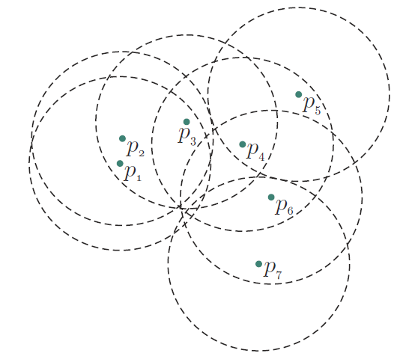
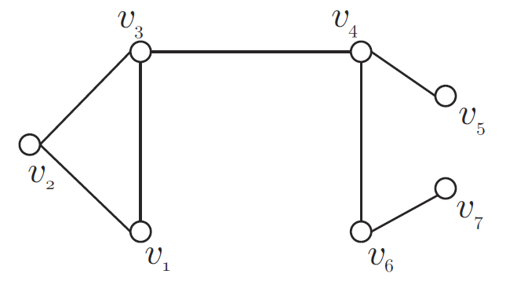
Graph Model
Model the problem as a graph
  Items are nodes
  There is an edge between two nodes, if distance ≤ r
Equivalent to finding a minimal
Independent (no edge about nodes in the set) and
Dominating (all nodes outside connected with at least one inside)
subset of the corresponding graph (aka maximal independent subset)
60

Slide 61
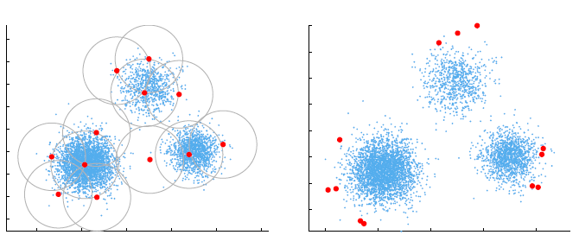
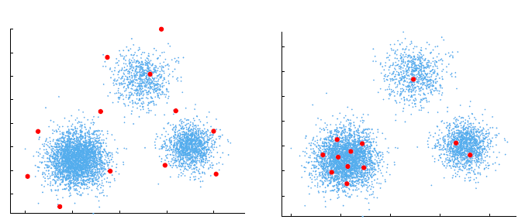
Comparison with other models
r-DisC
MaxSum
MaxMin
k-medoids
61

Slide 62
Zooming
User interactively change the radius r to r’ and compute a new diverse set
  r’ < r: zoom-in
  r’ > r: zoom-out
Two requirements:
Support an incremental mode of operation:
  the new set should be as close as possible to the already seen result
The size of the new set should be as close as possible to the size of the minimum r’-DisC diverse subset
  There is no subset relation between the r-DisC diverse and the r’-DisC diverse subsets of a set of objects P (the two sets may be completely different)

Slide 63
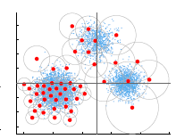
DisC-Extensions
Different radii per item
Radius as a function of the item
Based on importance
Based on relevance
Directed graph
In general, there may be no solution
In our case, constructive proof there exists
63

Slide 64
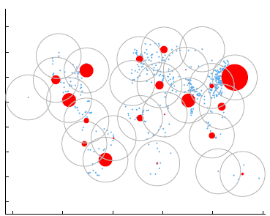
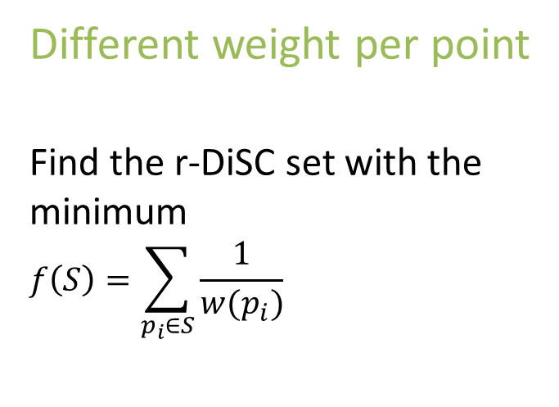
DisC-Extensions
Different weight per point
Find the r-DiSC set with the minimum
$$f\left(S\right)=\sum_{p_{i}∈S}{\frac{1}{w(p_{i})}}$$
When all weights are equal, the problem is reduced to finding a minimum r-DisC subset
64

Slide 65
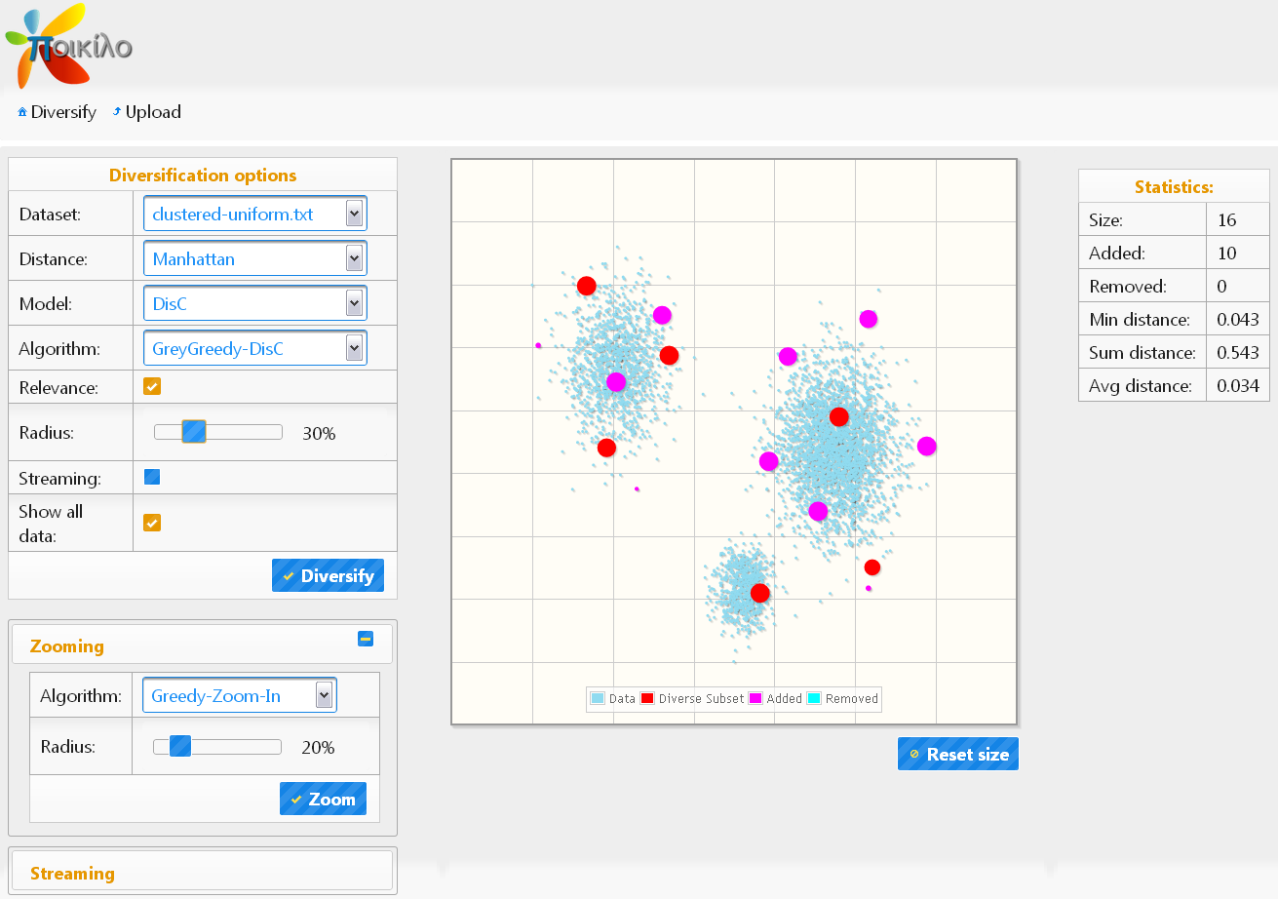
Visualizing Diverse Items
Selecting diversification parameters
Result
Zooming and Streaming
Statistics

Slide 66
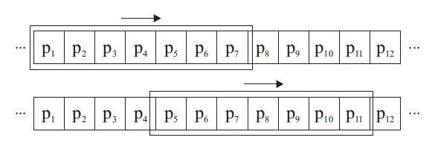
Diversity over Dynamic Sets
We study the dynamic/streaming diversification problem:
  New items (books, movies etc.) are added to a recommender system.
  News apartments become available while old ones are not available any more.
  Microblogging applications (e.g., twitter)
Window P_{i-1}
Window P_{i}
jump step
w
New items arrive and older items expire (window jumps, e.g., consequent logins)
We want to provide users with a continuously updated subset of the top-k most diverse recent items in the stream.

Slide 67
Indexing
We index items in P using a cover tree*
Cover tree:
  Leveled tree: Lowest level <- items in P
  Levels are numbered, e.g., -4 (leaf), -3, …, 0, … 3, .. 5 (root) and each level is a “cover” for all levels beneath it
  Items at higher levels are farther apart from each other than items at lower levels.
level C_{l}
level C_{l-1}
level C_{l-2}
* [BKL06] A. Beygelzimer, S. Kakade, and J. Langford. Cover Trees for Nearest Neighbor. ICML, 2006.

Slide 68
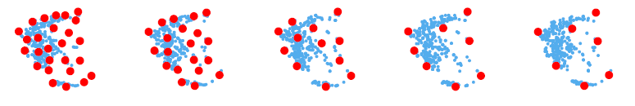
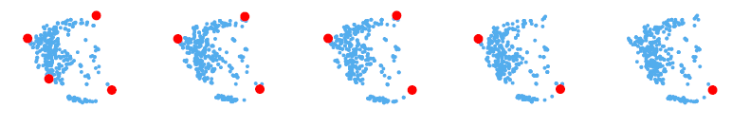
Cover Tree: Example of some levels
Example: higher levels of a cover tree for cities in Greece, where distance is their geographical distance
68

Slide 69
Cover Tree: Diversity computation
The Level Family of Algorithms
Basic Idea: Select k distinct items from the highest possible level
k = 10
k = 5
Scalability: depend on the size of the level not on the size of the dataset
69

Slide 70
DisC Diversity
Marina Drosou, Evaggelia Pitoura: Multiple Radii DisC Diversity: Result Diversification Based on Dissimilarity and Coverage. ACM Trans. Database Syst. 40(1): 4 (2015)
Marina Drosou, Evaggelia Pitoura: DisC diversity: result diversification based on dissimilarity and coverage. PVLDB 6(1): 13-24 (2013) (Best paper award)
Diversity in Streams
Marina Drosou, Evaggelia Pitoura: Diverse Set Selection Over Dynamic Data. IEEE Trans. Knowl. Data Eng. 26(5): 1102-1116 (2014)
Marina Drosou, Evaggelia Pitoura: Dynamic diversification of continuous data. EDBT 2012: 216-227
Marina Drosou, Kostas Stefanidis, Evaggelia Pitoura: Preference-aware publish/subscribe delivery with diversity. DEBS 2009

Slide 71
Summary
Diversity (coverage, dissimilarity, novelty, serendipity) improves the value of data
DisC diversity provides a zoom-able view of a data set that ensures both coverage and dissimilarity
Diversity of streaming data adds the dimension of time
71

Slide 72
Diversity in Social Networks

Slide 73
Homophily
“Όμοιος ομοίω αεί πελάζει” (Plato)
“Birds of a feather flock together”
Caused by two related social forces
Selection: People seek out similar people to interact with
Social influence: People become similar to those they interact with
Both processes contribute to homophily and lack of diversity, but
Social influence leads to community-wide homogeneity
Selection leads to fragmentation of the community

Slide 74
Opinion Formation
Complex process: many models
Commonly-used opinion-formation model (of Friedkin and Johnsen, 1990) (opinion – real number)
Each individual i has an innate and an expressed opinion.
At each step updates her expressed opinion
  adheres to her innate opinion with a certain weight a_{i} and
  is socially influenced by its neighbors with a weight 1-a_{i}

Slide 75
Opinion Formation
An opinion formation process is polarizing if it results in increased divergence of opinions.
Empirical studies have shown that homophily results in polarization.

Slide 76
A past Λ14 project
Diversify opinions within communities
Select a set of k individuals to influence so that they “change” opinions
Create a set of k new connections between nodes in different communities with contrasting views

Slide 77
Debiasing the Wisdom of the Crowd
Wisdom of the crowd (collective wisdom): aggregation of information in groups, results in decisions often better than by any single member of the group.
When individuals become aware of the estimates of others, they may revise their own estimates
Experimental evidence that this holds also for factual questions and monetary incentives: Groups were initially “wise,” knowledge about estimates of others narrows the diversity of opinions

Slide 78
Debiasing the Wisdom of the Crowd
Take into account the effect of social influence when estimating the collective wisdom of a crowd
  Efficient sampling for innate opinions
  Since only the expressed opinion of the nodes (cannot directly observe their innate opinion), algorithms need to take care of debiasing the expressed opinions of the nodes that they sample.
J. Lorenz, H. Rauhut, F. Schweitzer, and D. Helbing. How social influence can undermine the wisdom of crowd effect. Proc. Natl. Acad. Sci. USA, 108(22), 1990
Abhimanyu Das, Sreenivas Gollapudi, Rina Panigrahy, Mahyar Salek: Debiasing social wisdom. KDD 2013

Slide 79
Opinion Diversity in
Crowdsourcing Markets
Similarity-driven Model (S-Model)
No specific query/task
Given the similarity of workers maximize their average diversity (MAXAVG)
Task-driven model (T-Model)
Specific query/task
Model the opinion of each worker as a probability ranging from 0 to 1 (indicating opinions from negative to positive)
A user specifies a required number of workers with positive and negative opinions.
Maximize the probability that the user’s demand is satisfied.
Ting Wu, Lei Chen, Pan Hui, Chen Jason Zhang, Weikai Li: Hear the Whole Story: Towards the Diversity of Opinion in Crowdsourcing Markets. PVLDB 8(5): 485-496 (2015)

Slide 80
Diversity, Fairness, Responsibility
Diversity of data and opinions
How does diversity of data presented to individuals or groups affects the fairness of their decision?
Lack of (opinion, data) diversity leads to polarization and bias?

Slide 81
Bakshy, Eytan, Solomon Messing, and Lada A. Adamic. Exposure to Ideologically Diverse News and Opinion on Facebook. Science 348:1130–1132, 2014

Slide 82
Stages in Facebook Exposure Process
Friends network: ideological homophily
News feed: more or less diverse content with algorithmically ranked News Feed
Users’ choices: click through to ideologically discordant content.

Slide 83
News Feed Ranking
“The order in which users see stories in the News Feed depends on many factors, including
how often the viewer visits Facebook,
how much they interact with certain friends, and
how often users have clicked on links to certain websites in News Feed in the past.”

Slide 84
Dataset: users
10.1 million active U.S. users who self-report their ideological affiliation
All Facebook users can self-report their political affiliation, 9% of U.S. over 18

Slide 85
Dataset: content
7 million distinct Web links (URLs) shared by U.S. users over a 6-month period between 7 July 2014 and 7 January 2015
Classified stories as
Hard content (such as national news, politics, or world affairs) or
Soft content (such as sports, entertainment, or travel)
by training a support vector machine on unigram, bigram, and trigram text
features
Approximately 13% hard content.
226,000 distinct hard-content URLs shared by at least 20 users who volunteered their ideological affiliation in their profile

Slide 86
Labeling stories (content alignment)
measure content alignment (A) for each hard story:
average of the ideological affiliation of each user who shared the article.
measure of the ideological alignment of the audience who shares an article, not a measure of political bias or slant of the article

Slide 87
Labeling stories (content alignment)
FoxNews.com is aligned with conservatives (As = +.80)
HuffingtonPost.com is aligned with liberals (As = -.65)
Substantial polarization

Slide 88
Homophily in the Friends Network

Slide 89
Homophily in the Friends Network
Median proportion of friendships
of liberals with conservatives 0.20,
of conservatives maintain with liberals 0.18

Slide 90
Homophily in the Friends Network
On average, about 23 percent of their friends report an affiliation on the opposite side
A wide range of network diversity
50% between 9 and 33 percent,
25% less than 9 percent
25% more than 33 percent

Slide 92
Content shared by friends
If from random others,
~45% cross-cutting for liberals
~40% for conservatives
If from friends,
~24% crosscutting for liberals
~35% crosscutting for conservatives

Slide 93
News Feed
After ranking, there is on average slightly less crosscutting
risk ratio of x percent:
people were x percent less likely to see crosscutting articles that have been shared by friends, compared to the likelihood of seeing ideologically consistent articles that have been shared by
friends.
risk ratio
5% for conservatives
8% for liberals

Slide 94
Clicked
Risk ratio
17% for conservatives
6% for liberals,
On average, viewers clicked on 7% of hard content available in their feeds

Slide 95
Clicked
the click rate on a link is negatively correlated with its position in the News Feed

Slide 97
Limitation (as described by the authors)
Limited to active users who volunteer an ideological affiliation
Facebook users tend to be younger, more educated, and more often female as compared with the U.S. population as a whole
Other forms of social media, such as blogs or Twitter, different patterns of homophily among politically interested users (largely because ties tend primarily to form based on common topical interests and/or specific content, whereas Facebook ties primarily reflect many different offline social contexts: school, family, social activities, and work, which favor cross-cutting social ties
Distinction between exposure and consumption is imperfect; individuals may read the summaries of articles that appear in the News Feed and therefore be exposed to some of the articles’ content without clicking through.

Slide 98
A WSJ site
Blue Feed, Red Feed site
See Liberal Facebook and Conservative Facebook, Side by Side
Based on the reactions by conservative/liberals as in the paper
http://graphics.wsj.com/blue-feed-red-feed/

Slide 99
Questions?

