Slide 1
DATA MINING
LECTURE 9
The EM Algorithm
Clustering Evaluation
Sequence segmentation

Slide 2
CLUSTERING

Slide 3
What is a Clustering?
In general a grouping of objects such that the objects in a group (cluster) are similar (or related) to one another and different from (or unrelated to) the objects in other groups
Inter-cluster distances are maximized
Intra-cluster distances are minimized

Slide 4
Clustering Algorithms
K-means and its variants
Hierarchical clustering
DBSCAN

Slide 5
Mixture Models and the EM Algorithm

Slide 6
Model-based clustering
In order to understand our data, we will assume that there is a generative process (a model) that creates/describes the data, and we will try to find the model that best fits the data.
  Models of different complexity can be defined, but we will assume that our model is a distribution from which data points are sampled
  Example: the data is the height of all people in Greece
In most cases, a single distribution is not good enough to describe all data points: different parts of the data follow a different distribution
  Example: the data is the height of all people in Greece and China
  We need a mixture model
  Different distributions correspond to different clusters in the data.

Slide 7
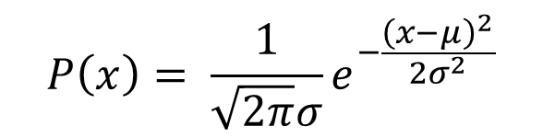
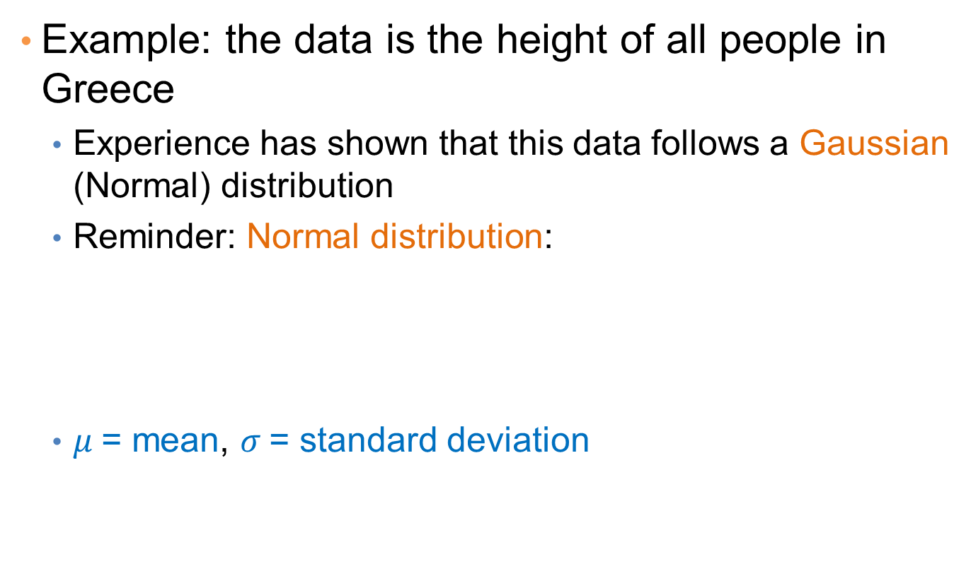
Gaussian Distribution
Example: the data is the height of all people in Greece
  Experience has shown that this data follows a Gaussian (Normal) distribution
  Reminder: Normal distribution:
  $μ$= mean, $σ$= standard deviation
$$P\left(x\right)= \frac{1}{\sqrt{2π}σ}e^{−\frac{{\left(x−μ\right)}^{2}}{2σ^{2}}}$$

Slide 8
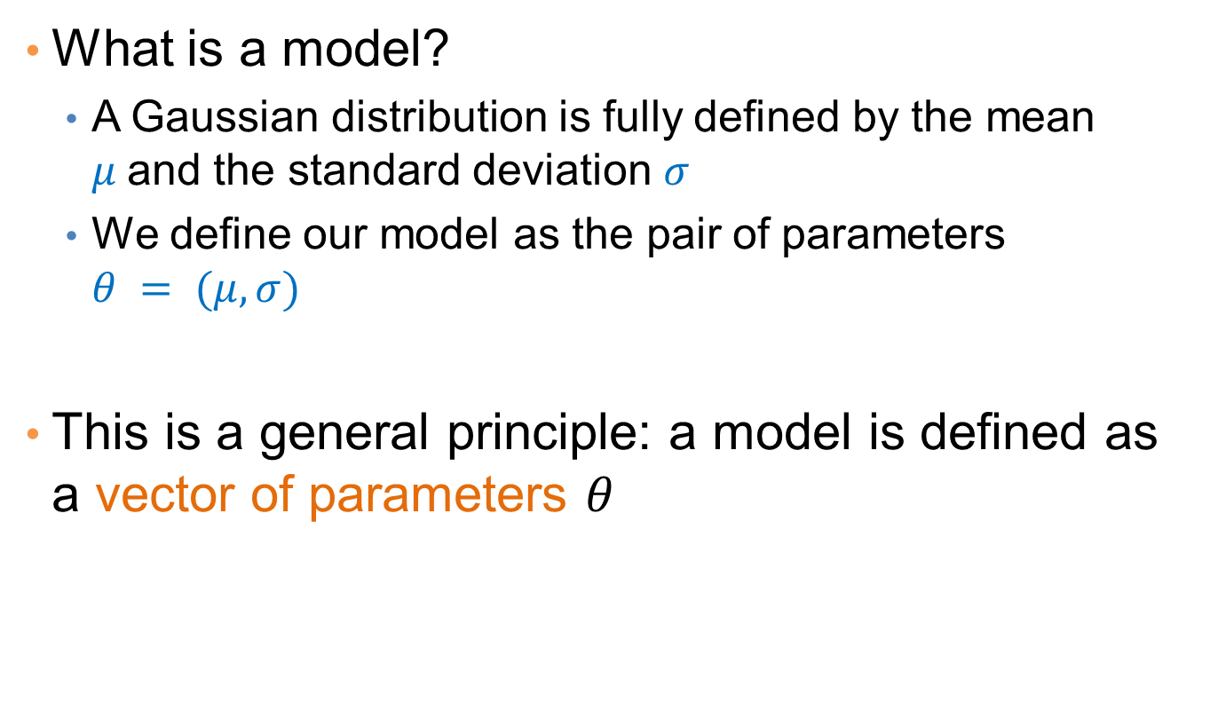
Gaussian Model
What is a model?
  A Gaussian distribution is fully defined by the mean $μ$and the standard deviation $σ$
  We define our model as the pair of parameters $θ = (μ, σ)$
This is a general principle: a model is defined as a vector of parameters $θ$

Slide 9

Fitting the model
We want to find the normal distribution that best fits our data
  Find the best values for $μ$and $σ$
  But what does best fit mean?

Slide 10
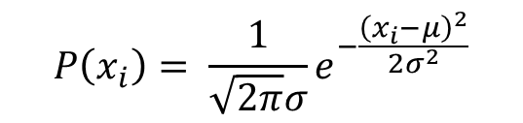
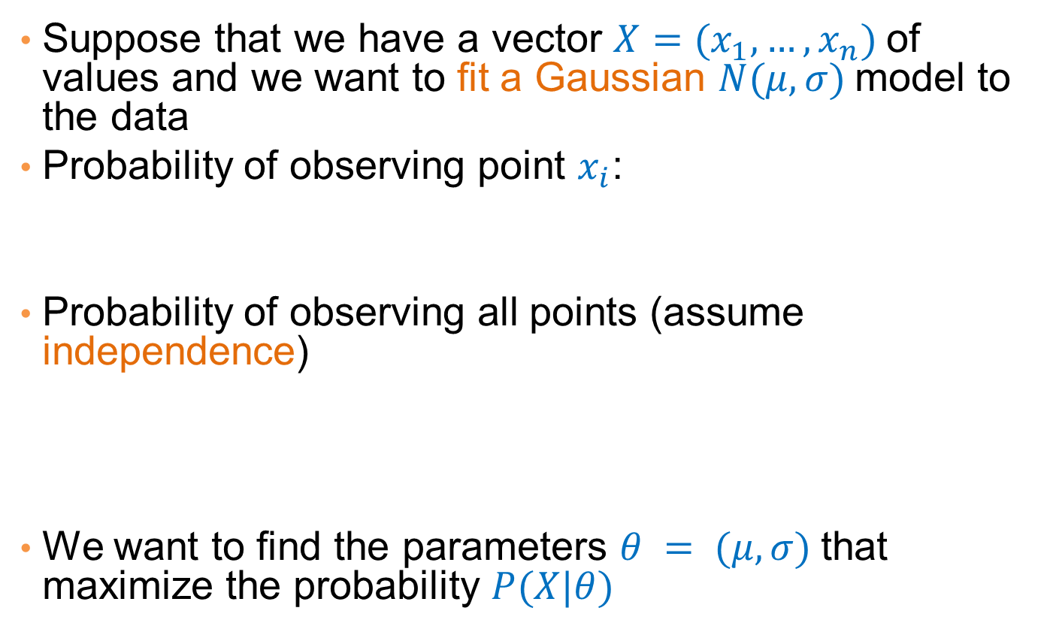
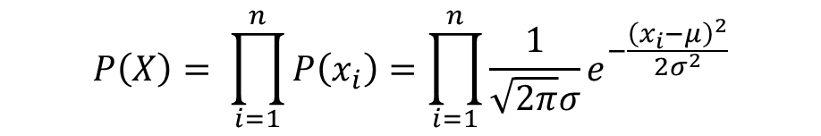
Maximum Likelihood Estimation (MLE)
Suppose that we have a vector $X=(x_{1},…,x_{n})$of values and we want to fit a Gaussian $N(μ,σ)$model to the data
Probability of observing point $x_{i}$:
Probability of observing all points (assume independence)
We want to find the parameters $θ = (μ, σ)$that maximize the probability $P(X|θ)$
$$P\left(x_{i}\right)= \frac{1}{\sqrt{2π}σ}e^{−\frac{{\left(x_{i}−μ\right)}^{2}}{2σ^{2}}}$$
$$P\left(X\right)= \prod_{i=1}^{n}{P\left(x_{i}\right)}=\prod_{i=1}^{n}{\frac{1}{\sqrt{2π}σ}e^{−\frac{{\left(x_{i}−μ\right)}^{2}}{2σ^{2}}}}$$

Slide 11

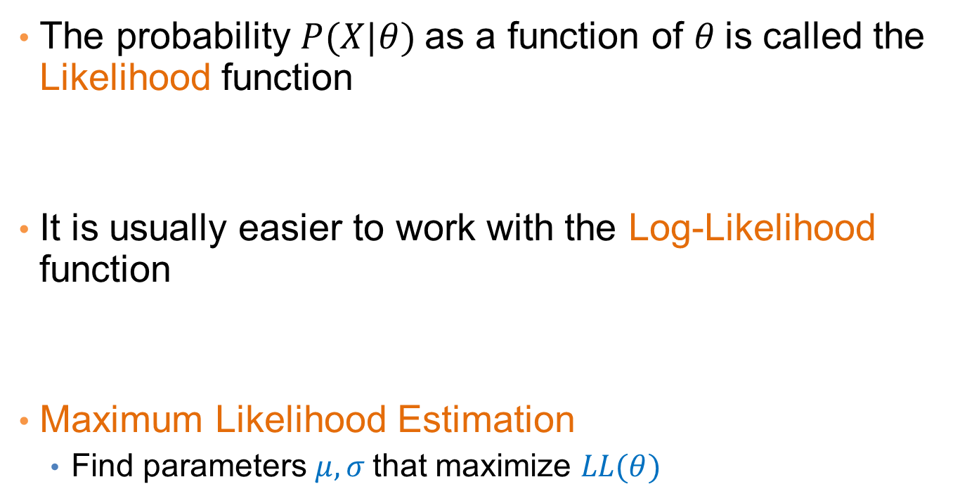
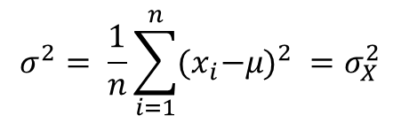
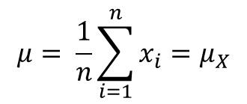
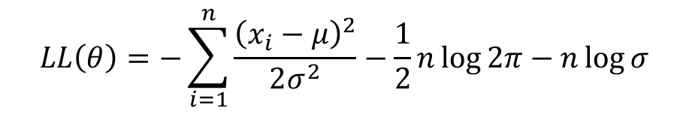
Maximum Likelihood Estimation (MLE)
The probability $P(X|θ)$as a function of $θ$is called the Likelihood function
It is usually easier to work with the Log-Likelihood function
Maximum Likelihood Estimation
  Find parameters $μ, σ$that maximize $LL(θ)$
$$L(θ)=\prod_{i=1}^{n}{\frac{1}{\sqrt{2π}σ}e^{−\frac{{\left(x_{i}−μ\right)}^{2}}{2σ^{2}}}}$$
$$LL\left(θ\right)=−\sum_{i=1}^{n}{\frac{{\left(x_{i}−μ\right)}^{2}}{2σ^{2}}−\frac{1}{2}n\log{2π}−n\log{σ}}$$
$$μ= \frac{1}{n}\sum_{i=1}^{n}{x_{i}=μ_{X}}$$
$$σ^{2}= \frac{1}{n}\sum_{i=1}^{n}{{{(x}_{i}−μ)}^{2} }=σ_{X}^{2}$$
Sample Mean
Sample Variance

Slide 12
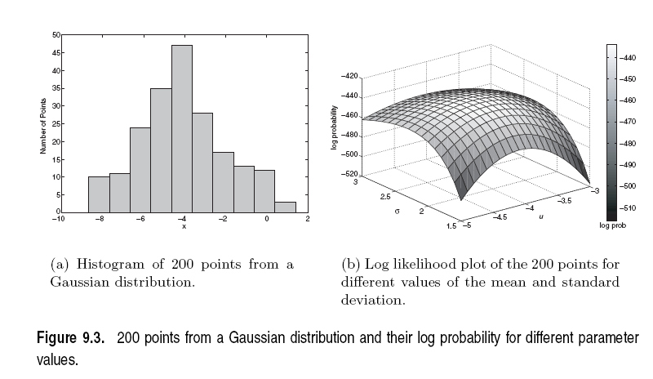

Slide 13
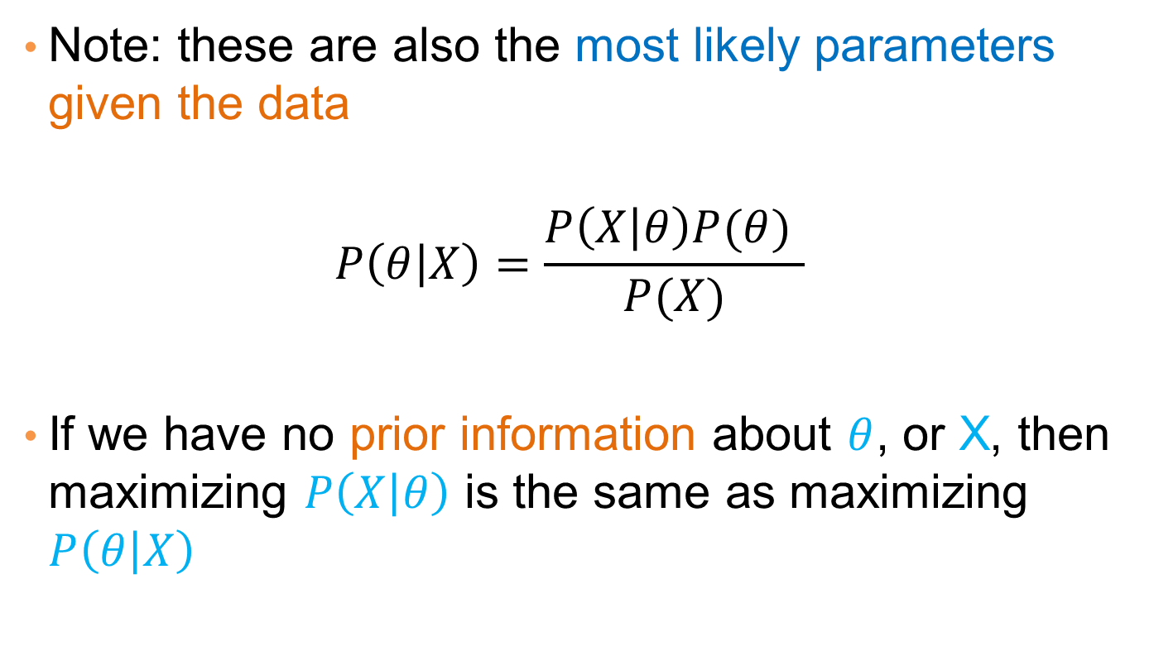
MLE
Note: these are also the most likely parameters given the data
$$P\left(θ | X\right)=\frac{P\left(X | θ\right)P(θ) }{P(X)}$$
If we have no prior information about $θ$, or X, then maximizing $P\left(X | θ\right)$ is the same as maximizing $P\left(θ | X\right)$

Slide 14
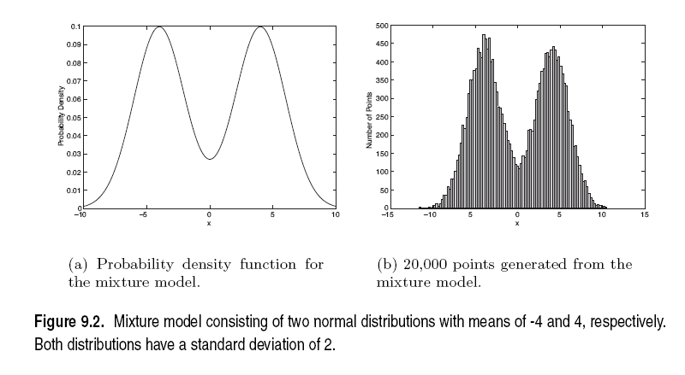
Mixture of Gaussians
Suppose that you have the heights of people from Greece and China and the distribution looks like the figure below (dramatization)

Slide 15
Mixture of Gaussians
In this case the data is the result of the mixture of two Gaussians
  One for Greek people, and one for Chinese people
  Identifying for each value which Gaussian is most likely to have generated it will give us a clustering.

Slide 16
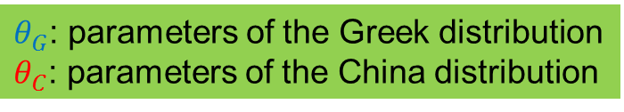
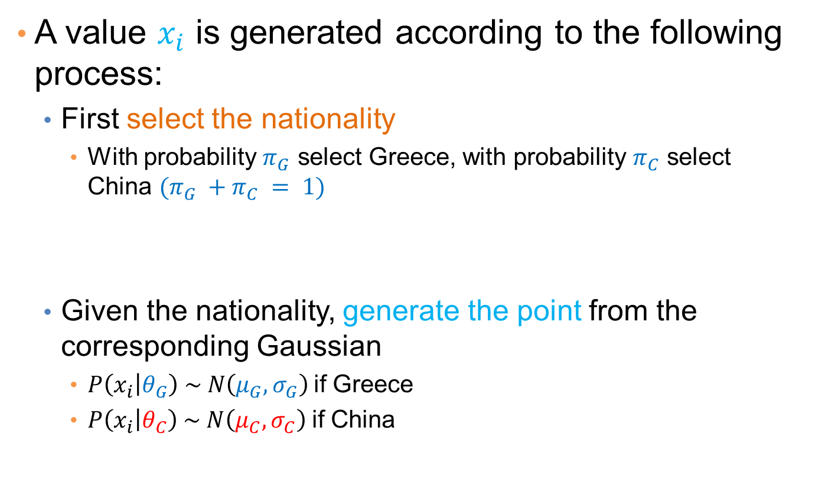
Mixture model
A value $x_{i}$ is generated according to the following process:
  First select the nationality
    With probability $π_{G}$ select Greece, with probability $π_{C}$ select China $(π_{G} +π_{C} = 1)$
  Given the nationality, generate the point from the corresponding Gaussian
    $P\left(x_{i} | θ_{G}\right) \sim N\left(μ_{G},σ_{G}\right)$if Greece
    $P\left(x_{i} | θ_{C}\right) \sim N\left(μ_{C},σ_{C}\right)$if China
We can also thing of this as a Hidden Variable Z that takes two values: Greece and China
$θ_{G}$: parameters of the Greek distribution
$θ_{C}$: parameters of the China distribution

Slide 17



Mixture Model
Our model has the following parameters
$$Θ=(π_{G},π_{C},μ_{G},{σ_{G},μ}_{C}, σ_{C})$$
Mixture probabilities
$θ_{G}$: parameters of the Greek distribution
$θ_{C}$: parameters of the China distribution

Slide 18
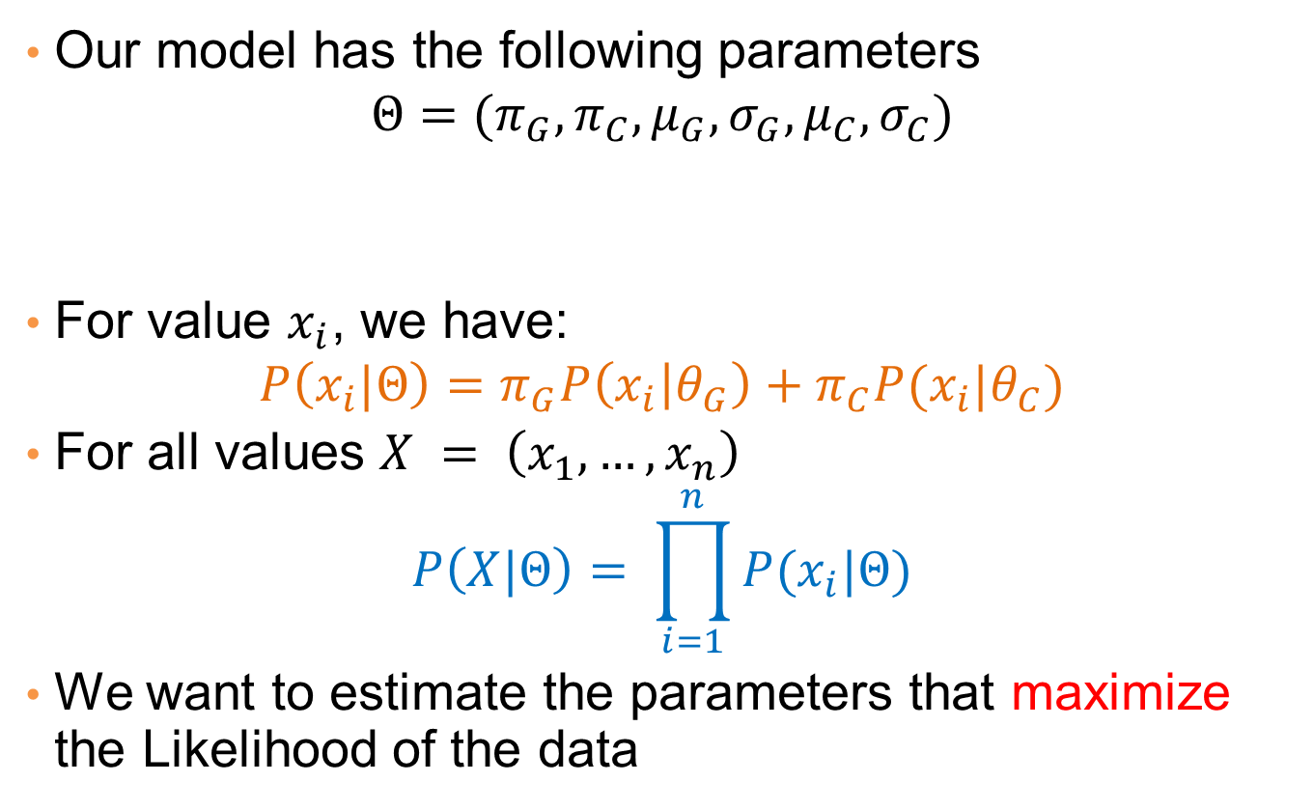
Mixture Model
Our model has the following parameters
$$Θ=(π_{G},π_{C},μ_{G},{σ_{G},μ}_{C}, σ_{C})$$
For value $x_{i}$, we have:
$$P\left(x_{i}|Θ\right)=π_{G}P\left(x_{i} | θ_{G}\right)+π_{C}P(x_{i}|θ_{C})$$
For all values $X = \left(x_{1},…,x_{n}\right)$
$$P\left(X|Θ\right)= \prod_{i=1}^{n}{P(x_{i}|Θ)}$$
We want to estimate the parameters that maximize the Likelihood of the data
Mixture probabilities
Distribution Parameters

Slide 19
Mixture Model
Our model has the following parameters
$$Θ=(π_{G},π_{C},μ_{G},{σ_{G},μ}_{C}, σ_{C})$$
For value $x_{i}$, we have:
$$P\left(x_{i}|Θ\right)=π_{G}P\left(x_{i} | θ_{G}\right)+π_{C}P(x_{i}|θ_{C})$$
For all values $X = \left(x_{1},…,x_{n}\right)$
$$P\left(X|Θ\right)= \prod_{i=1}^{n}{P(x_{i}|Θ)}$$
We want to estimate the parameters that maximize the Likelihood of the data
Mixture probabilities
Distribution Parameters

Slide 20

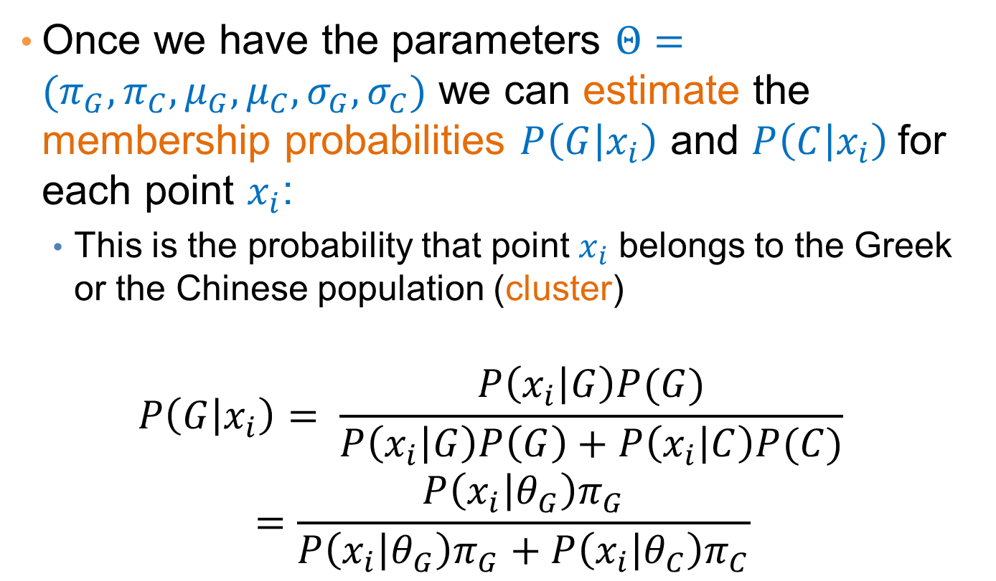
Mixture Models
Once we have the parameters $Θ=(π_{G},π_{C},μ_{G},μ_{C}, σ_{G},σ_{C})$ we can estimate the membership probabilities $P\left(G | x_{i}\right)$ and $P\left(C | x_{i}\right)$for each point $x_{i}$:
  This is the probability that point $x_{i}$ belongs to the Greek or the Chinese population (cluster)
$$P\left(G | x_{i}\right)= \frac{P\left(x_{i} | G\right)P(G)}{P\left(x_{i} | G\right)P\left(G\right)+P\left(x_{i} | C\right)P(C)} =\frac{P\left(x_{i} | θ_{G}\right)π_{G}}{P\left(x_{i} | θ_{G}\right)π_{G}+P\left(x_{i} | θ_{C}\right)π_{C}}$$
Given from the Gaussian distribution $N(μ_{G}, σ_{G})$ for Greek

Slide 21
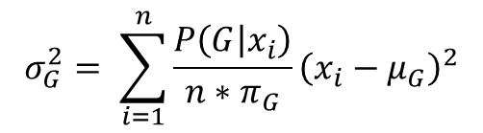
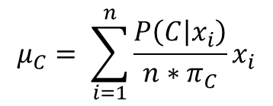
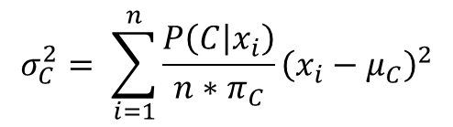
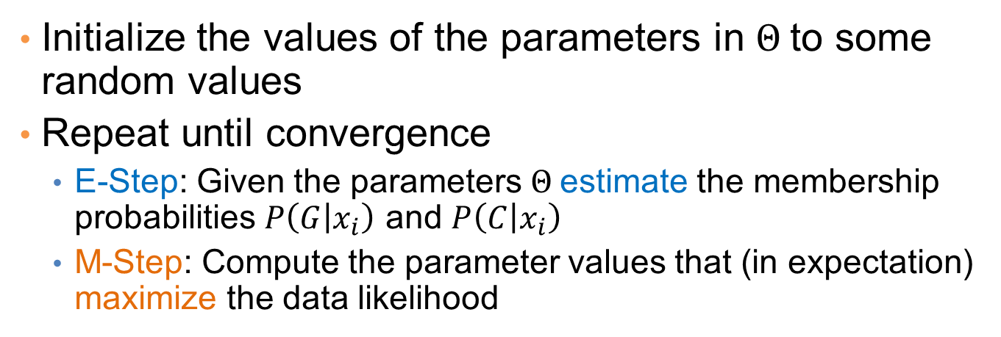
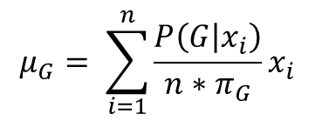
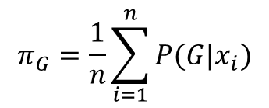
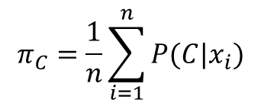
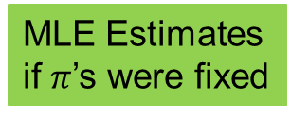
EM (Expectation Maximization) Algorithm
Initialize the values of the parameters in $Θ$to some random values
Repeat until convergence
  E-Step: Given the parameters $Θ$estimate the membership probabilities $P\left(G | x_{i}\right)$ and $P\left(C | x_{i}\right)$
  M-Step: Compute the parameter values that (in expectation) maximize the data likelihood
$$π_{C}=\frac{1}{n}\sum_{i=1}^{n}{P(C|x_{i})}$$
$$π_{G}=\frac{1}{n}\sum_{i=1}^{n}{P(G|x_{i})}$$
Fraction of population in G,C
$$μ_{C}= \sum_{i=1}^{n}{\frac{P\left(C | x_{i}\right)}{n{∗π}_{C}}x_{i}}$$
$$μ_{G}= \sum_{i=1}^{n}{\frac{P\left(G | x_{i}\right)}{n{∗π}_{G}}x_{i}}$$
MLE Estimates
if $π$’s were fixed
$$σ_{C}^{2}= \sum_{i=1}^{n}{\frac{P\left(C | x_{i}\right)}{n{∗π}_{C}}{\left(x_{i}−μ_{C}\right)}^{2}}$$
$$σ_{G}^{2}= \sum_{i=1}^{n}{\frac{P\left(G | x_{i}\right)}{n{∗π}_{G}}{\left(x_{i}−μ_{G}\right)}^{2}}$$

Slide 22
Relationship to K-means
E-Step: Assignment of points to clusters
  K-means: hard assignment, EM: soft assignment
M-Step: Computation of centroids
  K-means assumes common fixed variance (spherical clusters)
  EM: can change the variance for different clusters or different dimensions (ellipsoid clusters)
If the variance is fixed then both minimize the same error function

Slide 23
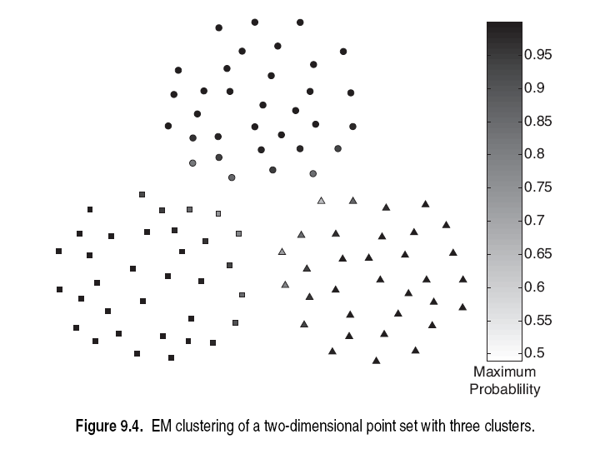

Slide 24
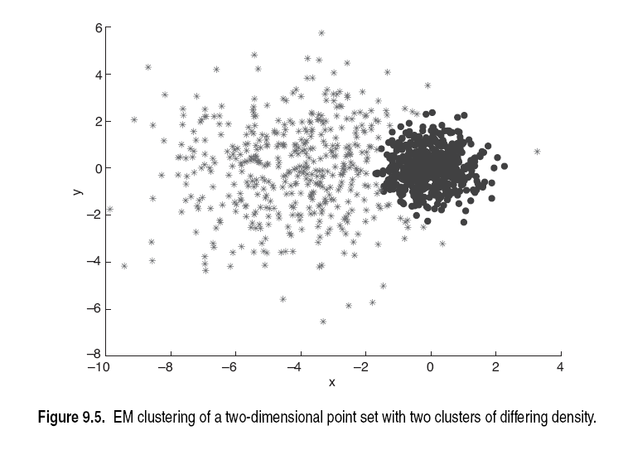

Slide 25
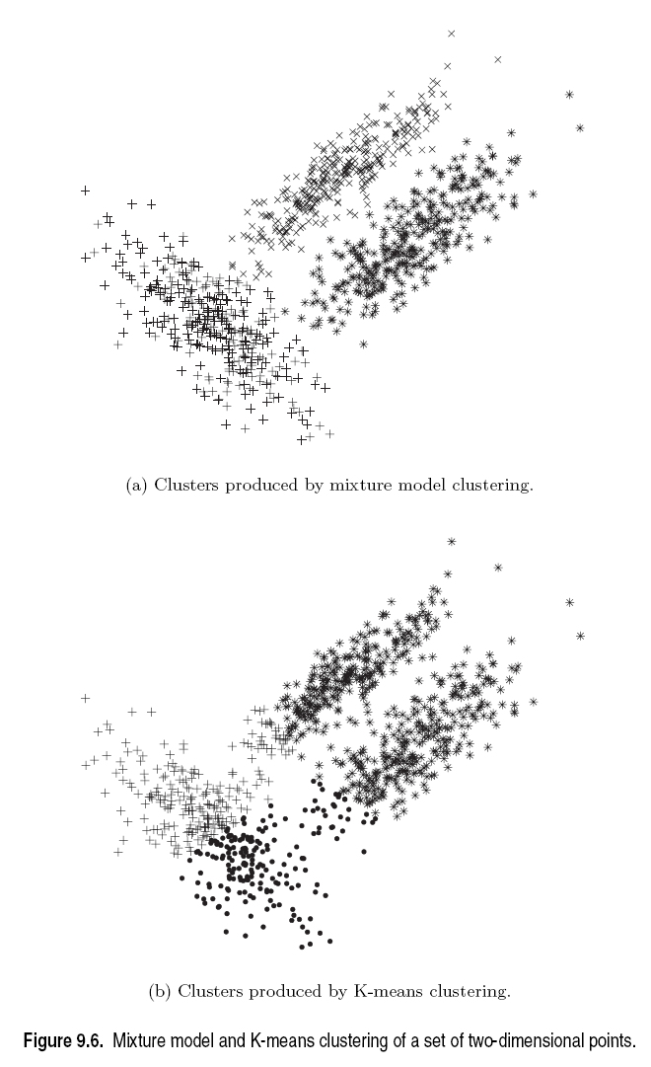

Slide 26
CLUSTERING Evaluation

Slide 27
Clustering Evaluation
How do we evaluate the “goodness” of the resulting clusters?
But “clustering lies in the eye of the beholder”!
Then why do we want to evaluate them?
  To avoid finding patterns in noise
  To compare clusterings, or clustering algorithms
  To compare against a “ground truth”

Slide 28
Clusters found in Random Data
Random Points
DBSCAN
K-means
Complete Link

Slide 29
Different Aspects of Cluster Validation
Determining the clustering tendency of a set of data, i.e., distinguishing whether non-random structure actually exists in the data.
Comparing the results of a cluster analysis to externally known results, e.g., to externally given class labels.
Evaluating how well the results of a cluster analysis fit the data without reference to external information.
  - Use only the data
Comparing the results of two different sets of cluster analyses to determine which is better.
Determining the ‘correct’ number of clusters.
For 2, 3, and 4, we can further distinguish whether we want to evaluate the entire clustering or just individual clusters.

Slide 30
Measures of Cluster Validity
Numerical measures that are applied to judge various aspects of cluster validity, are classified into the following three types.
  External Index: Used to measure the extent to which cluster labels match externally supplied class labels.
    E.g., entropy, precision, recall
  Internal Index: Used to measure the goodness of a clustering structure without reference to external information.
    E.g., Sum of Squared Error (SSE)
  Relative Index: Used to compare two different clusterings or clusters.
    Often an external or internal index is used for this function, e.g., SSE or entropy
Sometimes these are referred to as criteria instead of indices
  However, sometimes criterion is the general strategy and index is the numerical measure that implements the criterion.

Slide 31
Measuring Cluster Validity Via Correlation
Two matrices
  Similarity or Distance Matrix
    One row and one column for each data point
    An entry is the similarity or distance of the associated pair of points
  “Incidence” Matrix
    One row and one column for each data point
    An entry is 1 if the associated pair of points belong to the same cluster
    An entry is 0 if the associated pair of points belongs to different clusters
Compute the correlation between the two matrices
  Since the matrices are symmetric, only the correlation between
  n(n-1) / 2 entries needs to be calculated.
High correlation (positive for similarity, negative for distance) indicates that points that belong to the same cluster are close to each other.
Not a good measure for some density or contiguity based clusters.

Slide 32
Measuring Cluster Validity Via Correlation
Correlation of incidence and proximity matrices for the K-means clusterings of the following two data sets.
Corr = -0.9235
Corr = -0.5810

Slide 33
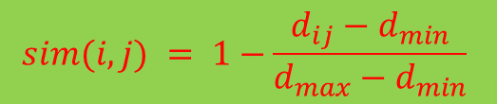
Using Similarity Matrix for Cluster Validation
Order the similarity matrix with respect to cluster labels and inspect visually.
$$sim(i,j) = 1−\frac{d_{ij}−d_{min}}{d_{max}−d_{min}}$$

Slide 34
Using Similarity Matrix for Cluster Validation
Clusters in random data are not so crisp
DBSCAN

Slide 35
Using Similarity Matrix for Cluster Validation
Clusters in random data are not so crisp
K-means

Slide 36
Using Similarity Matrix for Cluster Validation
Clusters in random data are not so crisp
Complete Link

Slide 37
Using Similarity Matrix for Cluster Validation
DBSCAN
Clusters in more complicated figures are not well separated
This technique can only be used for small datasets since it requires a quadratic computation

Slide 38
Internal Measures: SSE
Internal Index: Used to measure the goodness of a clustering structure without reference to external information
  Example: SSE
SSE is good for comparing two clusterings or two clusters (average SSE).
Can also be used to estimate the number of clusters

Slide 39
Estimating the “right” number of clusters
Typical approach: find a “knee” in an internal measure curve.
Question: why not the k that minimizes the SSE?
  Forward reference: minimize a measure, but with a “simple” clustering
Desirable property: the clustering algorithm does not require the number of clusters to be specified (e.g., DBSCAN)

Slide 40
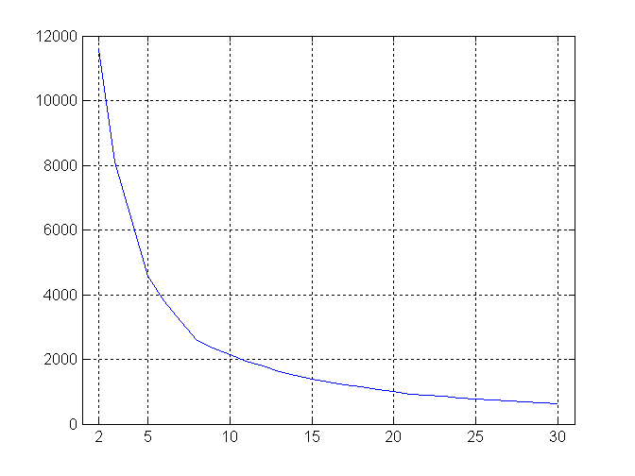
Internal Measures: SSE
SSE curve for a more complicated data set
SSE of clusters found using K-means

Slide 41
Internal Measures: Cohesion and Separation
Cluster Cohesion: Measures how closely related are objects in a cluster
Cluster Separation: Measure how distinct or well-separated a cluster is from other clusters
Example: Squared Error
  Cohesion is measured by the within cluster sum of squares (SSE)
  Separation is measured by the between cluster sum of squares
      Where m_{i} is the size of cluster i , c the overall mean
We want this to be small
We want this to be large

Slide 42
Internal Measures: Cohesion and Separation
A proximity graph based approach can also be used for cohesion and separation.
  Cluster cohesion is the sum of the weight of all links within a cluster.
  Cluster separation is the sum of the weights between nodes in the cluster and nodes outside the cluster.
cohesion
separation

Slide 43
Internal measures – caveats
Internal measures have the problem that the clustering algorithm did not set out to optimize this measure, so it is will not necessarily do well with respect to the measure.
An internal measure can also be used as an objective function for clustering

Slide 44
Framework for Cluster Validity
Need a framework to interpret any measure.
  For example, if our measure of evaluation has the value, 10, is that good, fair, or poor?
Statistics provide a framework for cluster validity
  The more “non-random” a clustering result is, the more likely it represents valid structure in the data
  Can compare the values of an index that result from random data or clusterings to those of a clustering result.
    If the value of the index is unlikely, then the cluster results are valid
For comparing the results of two different sets of cluster analyses, a framework is less necessary.
  However, there is the question of whether the difference between two index values is significant

Slide 45
Statistical Framework for SSE
Example
  Compare SSE of 0.005 against three clusters in random data
  Histogram of SSE for three clusters in 500 random data sets of 100 random points distributed in the range 0.2 – 0.8 for x and y
    Value 0.005 is very unlikely

Slide 46
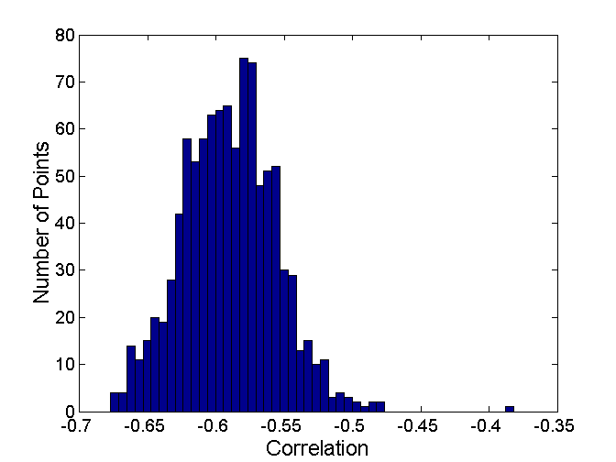
Statistical Framework for Correlation
Correlation of incidence and proximity matrices for the K-means clusterings of the following two data sets.
Corr = -0.9235
Corr = -0.5810

Slide 47
Empirical p-value
If we have a measurement v (e.g., the SSE value)
..and we have N measurements on random datasets
…the empirical p-value is the fraction of measurements in the random data that have value less or equal than value v (or greater or equal if we want to maximize)
  i.e., the value in the random dataset is at least as good as that in the real data
We usually require that p-value ≤ 0.05
Hard question: what is the right notion of a random dataset?

Slide 48
External Measures for Clustering Validity
Assume that the data is labeled with some class labels
  E.g., documents are classified into topics, people classified according to their income, politicians classified according to the political party.
  This is called the “ground truth”
In this case we want the clusters to be homogeneous with respect to classes
  Each cluster should contain elements of mostly one class
  Each class should ideally be assigned to a single cluster
This does not always make sense
  Clustering is not the same as classification
  …but this is what people use most of the time

Slide 49
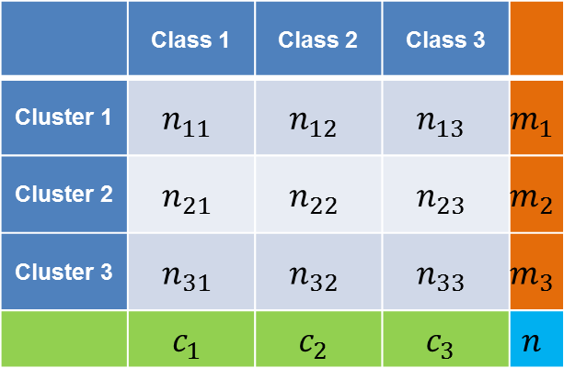
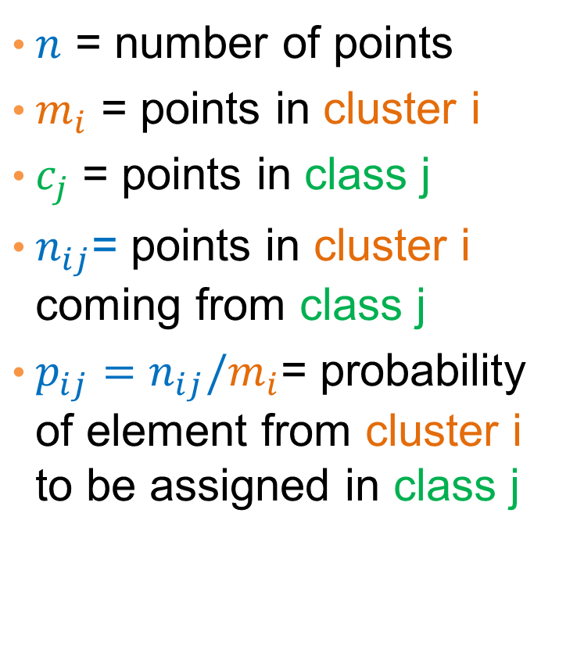

Confusion matrix
 | Class 1 | Class 2 | Class 3
Cluster 1 | $$n_{11}$$ | $$n_{12}$$ | $$n_{13}$$ | $$m_{1}$$
Cluster 2 | $$n_{21}$$ | $$n_{22}$$ | $$n_{23}$$ | $$m_{2}$$
Cluster 3 | $$n_{31}$$ | $$n_{32}$$ | $$n_{33}$$ | $$m_{3}$$
 | $$c_{1}$$ | $$c_{2}$$ | $$c_{3}$$ | $$n$$
$n$ = number of points
$m_{i}$ = points in cluster i
$c_{j}$ = points in class j
$n_{ij}$= points in cluster i coming from class j
$p_{ij}=n_{ij}/m_{i}$= probability of element from cluster i to be assigned in class j
 | Class 1 | Class 2 | Class 3
Cluster 1 | $$p_{11}$$ | $$p_{12}$$ | $$p_{13}$$ | $$m_{1}$$
Cluster 2 | $$p_{21}$$ | $$p_{22}$$ | $$p_{23}$$ | $$m_{2}$$
Cluster 3 | $$p_{31}$$ | $$p_{32}$$ | $$p_{33}$$ | $$m_{3}$$
 | $$c_{1}$$ | $$c_{2}$$ | $$c_{3}$$ | $$n$$

Slide 50
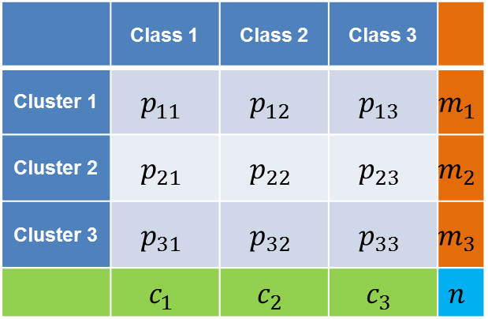
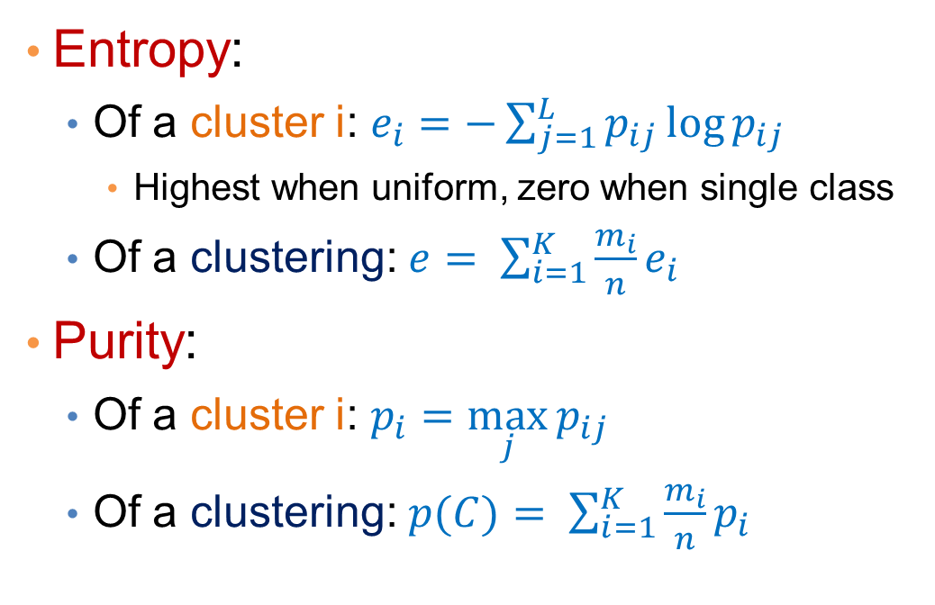
Measures
 | Class 1 | Class 2 | Class 3
Cluster 1 | $$p_{11}$$ | $$p_{12}$$ | $$p_{13}$$ | $$m_{1}$$
Cluster 2 | $$p_{21}$$ | $$p_{22}$$ | $$p_{23}$$ | $$m_{2}$$
Cluster 3 | $$p_{31}$$ | $$p_{32}$$ | $$p_{33}$$ | $$m_{3}$$
 | $$c_{1}$$ | $$c_{2}$$ | $$c_{3}$$ | $$n$$
Entropy:
  Of a cluster i: $e_{i}=−\sum_{j=1}^{L}{p_{ij}\log{p_{ij}}}$
    Highest when uniform, zero when single class
  Of a clustering: $e= \sum_{i=1}^{K}{\frac{m_{i}}{n}e_{i}}$
Purity:
  Of a cluster i: $p_{i}=\max_{j}{p_{ij}}$
  Of a clustering: $p(C)= \sum_{i=1}^{K}{\frac{m_{i}}{n}p_{i}}$

Slide 51
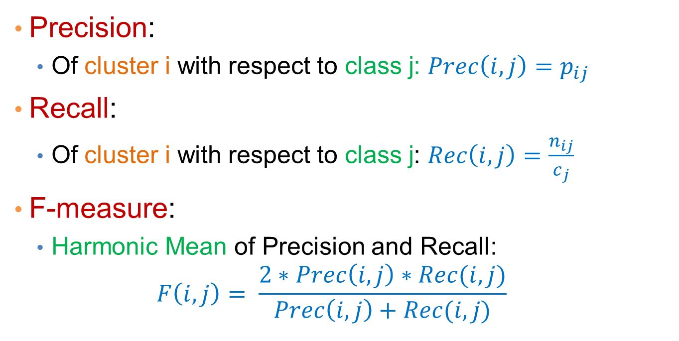
Measures
 | Class 1 | Class 2 | Class 3
Cluster 1 | $$p_{11}$$ | $$p_{12}$$ | $$p_{13}$$ | $$m_{1}$$
Cluster 2 | $$p_{21}$$ | $$p_{22}$$ | $$p_{23}$$ | $$m_{2}$$
Cluster 3 | $$p_{31}$$ | $$p_{32}$$ | $$p_{33}$$ | $$m_{3}$$
 | $$c_{1}$$ | $$c_{2}$$ | $$c_{3}$$ | $$n$$
Precision:
  Of cluster i with respect to class j: $Prec\left(i,j\right)=p_{ij}$
Recall:
  Of cluster i with respect to class j: $Rec\left(i,j\right)=\frac{n_{ij}}{c_{j}}$
F-measure:
  Harmonic Mean of Precision and Recall:
  $$F\left(i,j\right)= \frac{2∗Prec\left(i,j\right)∗Rec(i,j)}{Prec\left(i,j\right)+Rec(i,j)}$$

Slide 52
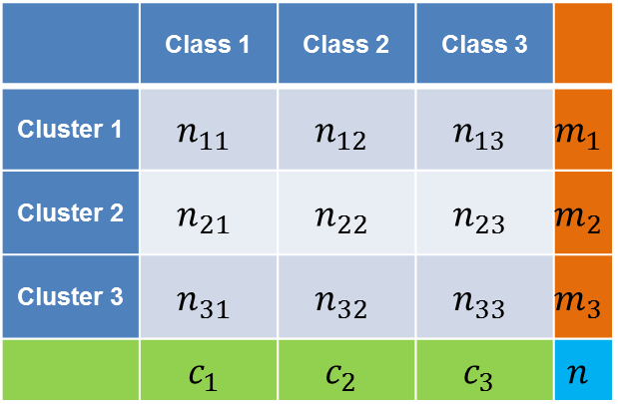
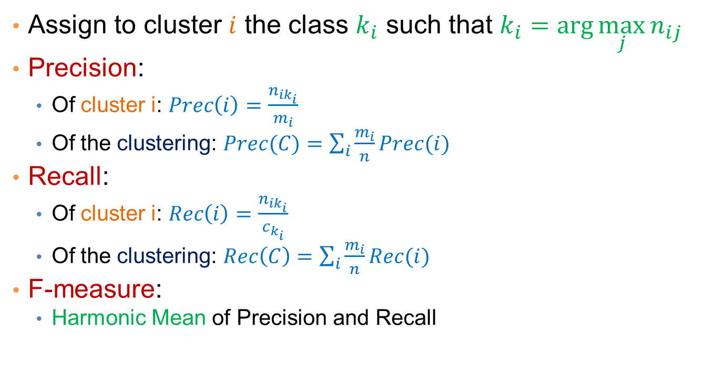
Measures
 | Class 1 | Class 2 | Class 3
Cluster 1 | $$n_{11}$$ | $$n_{12}$$ | $$n_{13}$$ | $$m_{1}$$
Cluster 2 | $$n_{21}$$ | $$n_{22}$$ | $$n_{23}$$ | $$m_{2}$$
Cluster 3 | $$n_{31}$$ | $$n_{32}$$ | $$n_{33}$$ | $$m_{3}$$
 | $$c_{1}$$ | $$c_{2}$$ | $$c_{3}$$ | $$n$$
Precision/Recall for clusters and clusterings
Assign to cluster $i$ the class $k_{i}$ such that $k_{i}=\arg{\max_{j}{n_{ij}}}$
Precision:
  Of cluster i: $Prec\left(i\right)=\frac{n_{ik_{i}}}{m_{i}}$
  Of the clustering: $Prec(C)=\sum_{i}{\frac{m_{i}}{n}}Prec(i)$
Recall:
  Of cluster i: $Rec\left(i\right)=\frac{n_{ik_{i}}}{c_{k_{i}}}$
  Of the clustering: $Rec\left(C\right)=\sum_{i}{\frac{m_{i}}{n}}Rec(i)$
F-measure:
  Harmonic Mean of Precision and Recall

Slide 53
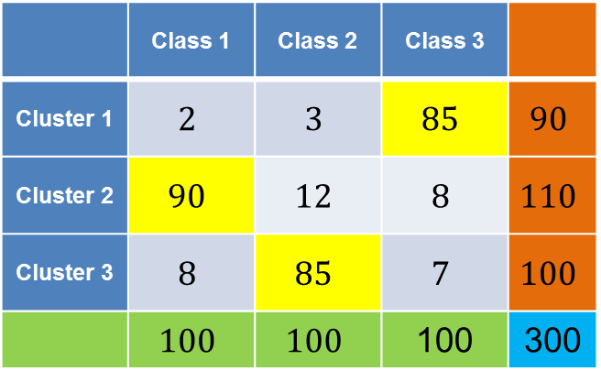
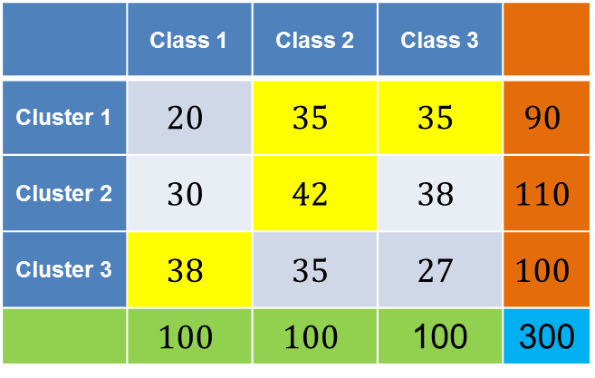
Good and bad clustering
 | Class 1 | Class 2 | Class 3
Cluster 1 | $$2$$ | $$3$$ | $$85$$ | $$90$$
Cluster 2 | $$90$$ | $$12$$ | $$8$$ | $$110$$
Cluster 3 | $$8$$ | $$85$$ | $$7$$ | $$100$$
 | $$100$$ | $$100$$ | 100 | 300
 | Class 1 | Class 2 | Class 3
Cluster 1 | $$20$$ | $$35$$ | $$35$$ | $$90$$
Cluster 2 | $$30$$ | $$42$$ | $$38$$ | $$110$$
Cluster 3 | $$38$$ | $$35$$ | $$27$$ | $$100$$
 | $$100$$ | $$100$$ | 100 | 300
Purity: (0.94, 0.81, 0.85)
– overall 0.86
Precision: (0.94, 0.81, 0.85)
– overall 0.86
Recall: (0.85, 0.9, 0.85)
- overall 0.87
Purity: (0.38, 0.38, 0.38)
– overall 0.38
Precision: (0.38, 0.38, 0.38)
– overall 0.38
Recall: (0.35, 0.42, 0.38)
– overall 0.39

Slide 54
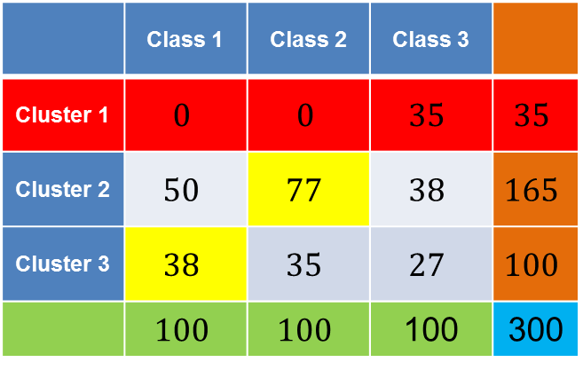
Another clustering
 | Class 1 | Class 2 | Class 3
Cluster 1 | $$0$$ | $$0$$ | $$35$$ | $$35$$
Cluster 2 | $$50$$ | $$77$$ | $$38$$ | $$165$$
Cluster 3 | $$38$$ | $$35$$ | $$27$$ | $$100$$
 | $$100$$ | $$100$$ | 100 | 300
Cluster 1:
  Purity: 1
  Precision: 1
  Recall: 0.35

Slide 55
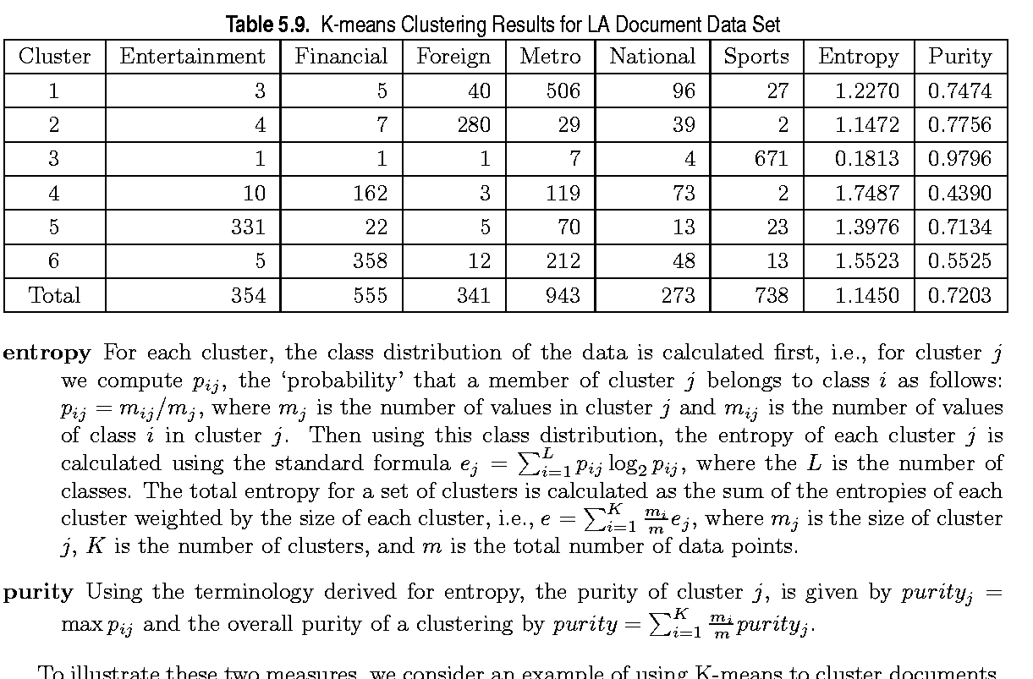
External Measures of Cluster Validity: Entropy and Purity

Slide 56
Final Comment on Cluster Validity
“The validation of clustering structures is the most difficult and frustrating part of cluster analysis.
Without a strong effort in this direction, cluster analysis will remain a black art accessible only to those true believers who have experience and great courage.”
Algorithms for Clustering Data, Jain and Dubes

Slide 57
Sequence Segmentation

Slide 58
Sequential data
Sequential data (or time series) refers to data that appear in a specific order.
  The order defines a time axis, that differentiates this data from other cases we have seen so far
Examples
  The price of a stock (or of many stocks) over time
  Environmental data (pressure, temperature, precipitation etc) over time
  The sequence of queries in a search engine, or the frequency of a single query over time
  The words in a document as they appear in order
  A DNA sequence of nucleotides
  Event occurrences in a log over time
  Etc…
Time series: usually we assume that we have a vector of numeric values that change over time.

Slide 59
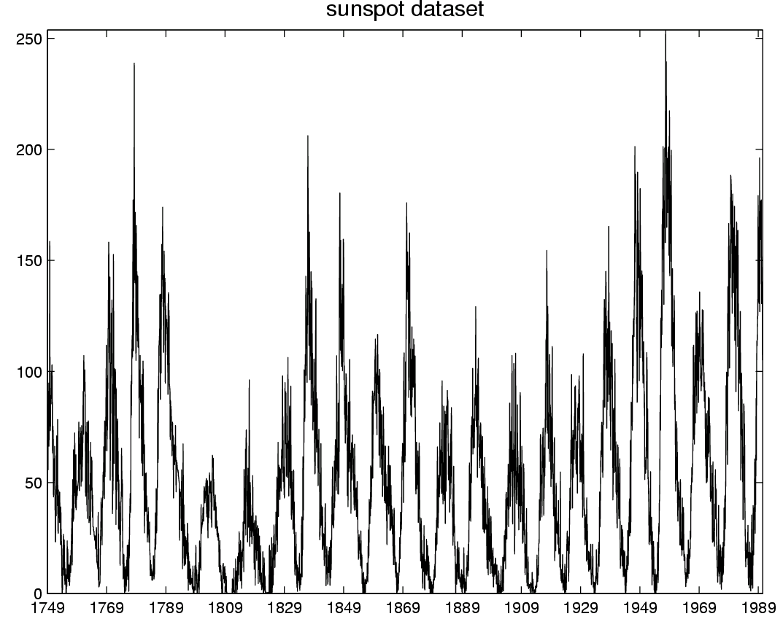
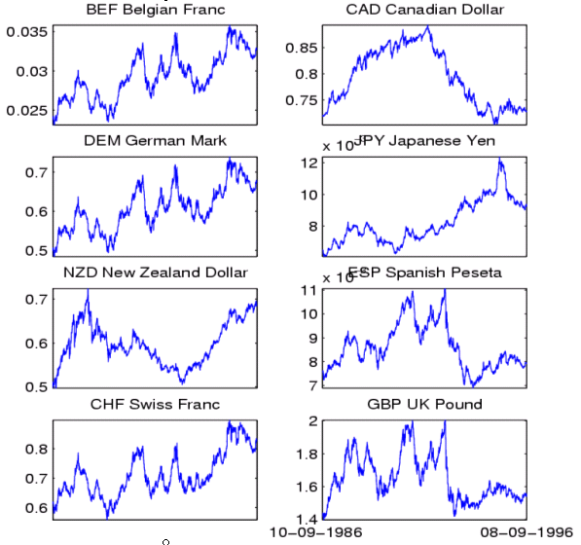
Time-series data
Financial time series, process monitoring…

Slide 60
Time series analysis
The addition of the time axis defines new sets of problems
  Discovering periodic patterns in time series
  Defining similarity between time series
  Finding bursts, or outliers
Also, some existing problems need to be revisited taking sequential order into account
  Association rules and Frequent Itemsets in sequential data
  Summarization and Clustering: Sequence Segmentation

Slide 61
Sequence Segmentation
Goal: discover structure in the sequence and provide a concise summary
Given a sequence T, segment it into K contiguous segments that are as homogeneous as possible
Similar to clustering but now we require the points in the cluster to be contiguous
Commonly used for summarization of histograms in databases

Slide 62
Example
R
t
R
Segmentation into 4 segments
Homogeneity: points are close to the mean value (small error)
t

Slide 63
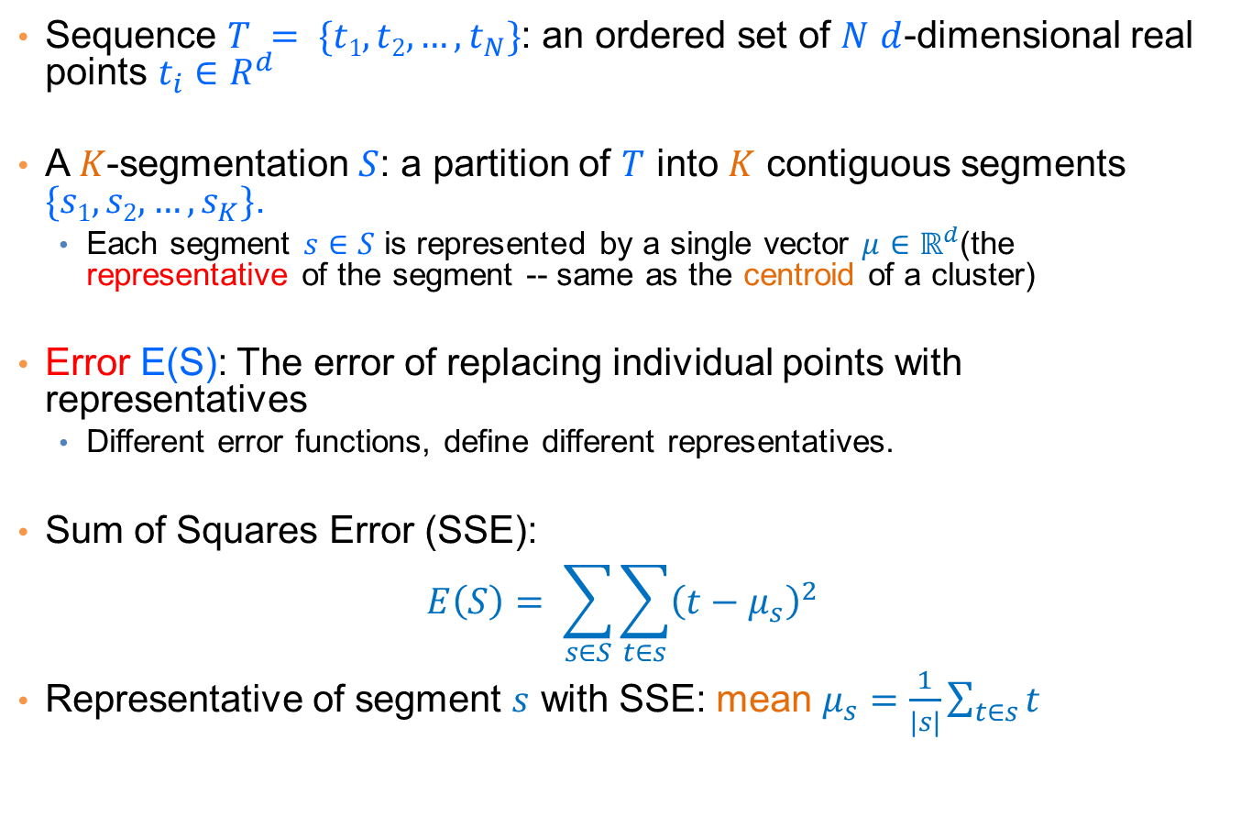
Basic definitions
Sequence $T = \{t1,t2,…,t_{N}\}$: an ordered set of $N$ $d$-dimensional real points $t_{i}∈R^{d}$
A $K$-segmentation $S$: a partition of $T$ into $K$ contiguous segments $\{s1,s2,…,s_{K}\}$.
  Each segment $s∈S$ is represented by a single vector $μ∈ℝ^{d}$(the representative of the segment -- same as the centroid of a cluster)
Error E(S): The error of replacing individual points with representatives
  Different error functions, define different representatives.
Sum of Squares Error (SSE):
$$E\left(S\right)= \sum_{s∈S}{\sum_{t∈s}{{\left(t−μ_{s}\right)}^{2}}}$$
Representative of segment $s$ with SSE: mean $μ_{s}=\frac{1}{|s|}\sum_{t∈s}{t}$

Slide 64
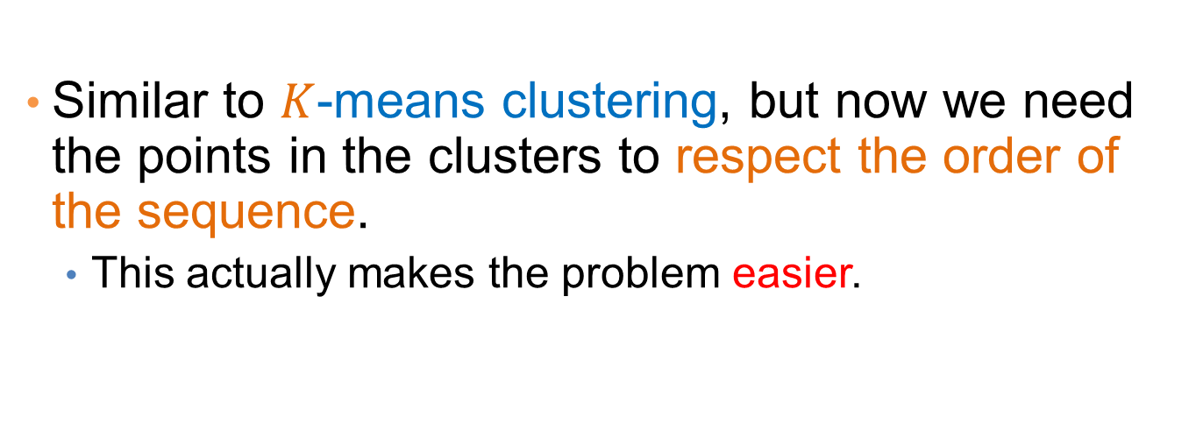
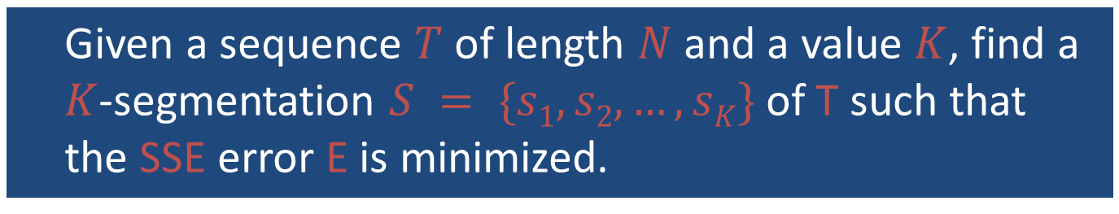
The K-segmentation problem
Given a sequence $T$ of length $N$ and a value $K$, find a $K$-segmentation $S = \{s1, s2, …,sK\}$of T such that the SSE error E is minimized.
Similar to $K$-means clustering, but now we need the points in the clusters to respect the order of the sequence.
  This actually makes the problem easier.

Slide 65






Basic Definitions
Observation: a $K$-segmentation $S$ is defined by $K+1$ boundary points $b_{0},b_{1},…,b_{K−1},b_{K}$.
$b_{0}=0, b_{k}=N+1$ always.
  We only need to specify$b_{1},…,b_{K−1}$
R
t
$$b_{0}$$
$$b_{1}$$
$$b_{2}$$
$$b_{3}$$
$$b_{4}$$

Slide 66
Optimal solution for the k-segmentation problem
[Bellman’61: The K-segmentation problem can be solved optimally using a standard dynamic programming algorithm
Dynamic Programming:
  Construct the solution of the problem by using solutions to problems of smaller size
    Define the dynamic programming recursion
  Build the solution bottom up from smaller to larger instances
    Define the dynamic programming table that stores the solutions to the sub-problems

Slide 67
Rule of thumb
Most optimization problems where order is involved can be solved optimally in polynomial time using dynamic programming.
  The polynomial exponent may be large though

Slide 68


Dynamic Programming Recursion
Terminology:
  $T[1,n]$: subsequence $\{t1,t2,…,tn\}$for $n≤N$
  $E\left(S[1,n],k\right)$: error of optimal segmentation of subsequence $T[1,n]$ with $k$ segments for $k≤K$
Dynamic Programming Recursion:
$$E\left(S\left[1,n\right],k\right)= \min_{k≤j≤n−1}\left\{E\left(S\left[1,j\right],k−1\right)+\sum_{j+1≤t≤n}{{\left(t−μ_{\left[j+1,n\right]}\right)}^{2}}\right\}$$
Minimum over all possible placements of the last boundary point $b_{k−1}$
Error of optimal segmentation S[1,j] with k-1 segments
Error of k-th (last) segment when the last segment is [j+1,n]

Slide 69


Dynamic programming table
$\text{Two}\text{−}\text{dimensional} \text{table} A[1…K, 1…N]$
  $$E\left(S\left[1,n\right],k\right)=\min_{k≤j≤n−1}\left\{E\left(S\left[1,j\right],k−1\right)+\sum_{j+1≤t≤n}{{\left(t−μ_{\left[j+1,n\right]}\right)}^{2}}\right\}$$
Fill the table top to bottom, left to right.
$$A\left[k,n\right]= E\left(S\left[1,n\right],k\right)$$
1
n
N
1
k
K
Error of optimal K-segmentation

Slide 70




Example
k = 3
n-th point
$$b_{1}$$
$$b_{2}$$
R
  $$E\left(S\left[1,n\right],k\right)=\min_{k≤j≤n−1}\left\{E\left(S\left[1,j\right],k−1\right)+\sum_{j+1≤t≤n}{{\left(t−μ_{\left[j+1,n\right]}\right)}^{2}}\right\}$$
1
n
N
1
2
3
4
Where should we place boundary $b_{2}$?

Slide 71

Example
k = 3
n-th point
$$b_{2}$$
$$b_{1}$$
R
  $$E\left(S\left[1,n\right],k\right)=\min_{k≤j≤n−1}\left\{E\left(S\left[1,j\right],k−1\right)+\sum_{j+1≤t≤n}{{\left(t−μ_{\left[j+1,n\right]}\right)}^{2}}\right\}$$
1
n
N
1
2
3
4
Where should we place boundary $b_{2}$?

Slide 72


Example
k = 3
n-th point
$$b_{1}$$
$$b_{2}$$
R
  $$E\left(S\left[1,n\right],k\right)=\min_{k≤j≤n−1}\left\{E\left(S\left[1,j\right],k−1\right)+\sum_{j+1≤t≤n}{{\left(t−μ_{\left[j+1,n\right]}\right)}^{2}}\right\}$$
1
n
N
1
2
3
4
Where should we place boundary $b_{2}$?

Slide 73

Example
k = 3
n-th point
$$b_{1}$$
$$b_{2}$$
R
  $$E\left(S\left[1,n\right],k\right)=\min_{k≤j≤n−1}\left\{E\left(S\left[1,j\right],k−1\right)+\sum_{j+1≤t≤n}{{\left(t−μ_{\left[j+1,n\right]}\right)}^{2}}\right\}$$
1
n
N
1
2
3
4
Where should we place boundary $b_{2}$?

Slide 74


Example
k = 3
n-th point
$$b_{1}$$
$$b_{2}$$
R
Optimal segmentation S[1:n]
1
n-3
n
N
The cell $A[3,n]$ stores the error of the optimal solution $3$-segmentation of $T[1,n]$
1
2
3
In the cell (or in a different table) we also store the position $n−3$ of the boundary so we can trace back the segmentation
4

Slide 75
Dynamic-programming algorithm
Input: Sequence T, length N, K segments, error function E()
  For i=1 to N //Initialize first row
    A[1,i]=E(T[1…i]) //Error when everything is in one cluster
  For k=1 to K // Initialize diagonal
    A[k,k] = 0 // Error when each point in its own cluster
  For k=2 to K
    For i=k+1 to N
      A[k,i] = min_{j<i}{A[k-1,j]+E(T[j+1…i])}
To recover the actual segmentation (not just the optimal cost) store also the minimizing values j

Slide 76

Algorithm Complexity
What is the complexity?
NK cells to fill
Computation per cell $E\left(S\left[1,n\right],k\right)=\min_{k≤j<n}\left\{E\left(S\left[1,j\right],k−1\right)+\sum_{j+1≤t≤n}{{\left(t−μ_{\left[j+1,n\right]}\right)}^{2}}\right\}$
  O(N) boundaries to check per cell
    O(N) to compute the second term per checked boundary
O(N³K) in the naïve computation
We can avoid the last O(N) factor by observing that
$$\sum_{j+1≤t≤n}{{\left(t−μ_{\left[j+1,n\right]}\right)}^{2}}=\sum_{j+1≤t≤n}{t^{2}}−\frac{1}{n−j}{\left(\sum_{j+1≤t≤n}{t}\right)}^{2}$$
We can compute in constant time by precomputing partial sums
  Precompute $\sum_{1≤t≤n}{t}$ and $\sum_{1≤t≤n}{t^{2}}$ for all n = 1..N
Algorithm Complexity: O(N²K)

Slide 77
Heuristics
Top-down greedy (TD): O(NK)
  Introduce boundaries one at the time so that you get the largest decrease in error, until K segments are created.
Bottom-up greedy (BU): O(NlogN)
  Merge adjacent points each time selecting the two points that cause the smallest increase in the error until K segments
Local Search Heuristics: O(NKI)
  Assign the breakpoints randomly and then move them so that you reduce the error

Slide 78
Local Search Heuristics
Local Search refers to a class of heuristic optimization algorithms where we start with some solution and we try to reach an optimum by iteratively improving the solution with small (local) changes
  Each solution has a set of neighboring solutions:
    The set of solutions that can be created with the allowed local changes.
  Usually we move to the best of the neighboring solutions, or one that improves our optimization function
Local Search algorithms are surprisingly effective
  For some problems they yield optimal solutions or solutions with good approximation bounds
They have been studied extensively
  Simulated Annealing
  Taboo Search

Slide 79
Other time series analysis
Using signal processing techniques is common for defining similarity between series
  Fast Fourier Transform
  Wavelets
Rich literature in the field

