Slide 1
DATA MINING
LECTURE 15
The Map-Reduce Computational Paradigm
Most of the slides are taken from:
Mining of Massive Datasets
Jure Leskovec, Anand Rajaraman, Jeff Ullman
Stanford University
http://www.mmds.org

Slide 2
Large Scale data mining
Challenges:
  How to deal with massive amount of data?
    Storing the web requires Petabytes of data!
  How to distribute computation?
    Distributed/parallel programming is hard
Map-reduce addresses all of the above
  Google’s computational/data manipulation model
  Elegant way to work with big data

Slide 3
Single Node Architecture
CPU
Machine Learning, Statistics
Memory
“Classical” Data Mining
Disk

Slide 4
Motivation: Google Example
20+ billion web pages x 20KB = 400+ TB
1 computer reads 30-35 MB/sec from disk
  ~4 months to read the web
~1,000 hard drives to store the web
Takes even more to do something useful
with the data!
Today, a standard architecture for such problems is emerging:
  Cluster of commodity Linux nodes
  Commodity network (ethernet) to connect them

Slide 5
Cluster Architecture
2-10 Gbps backbone between racks
1 Gbps between
any pair of nodes
in a rack
Switch
Switch
Switch
CPU
CPU
CPU
CPU
Mem
…
Mem
Mem
…
Mem
Disk
Disk
Disk
Disk
Each rack contains 16-64 nodes
In 2011 it was guestimated that Google had 1M machines, http://bit.ly/Shh0RO

Slide 6
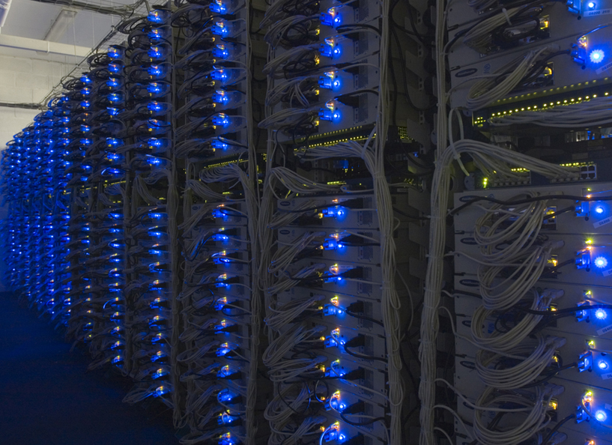

Slide 7
Large-scale Computing
Large-scale computing for data mining
problems on commodity hardware
Challenges:
  How do you distribute computation?
  How can we make it easy to write distributed programs?
  Machines fail:
    One server may stay up 3 years (1,000 days)
    If you have 1,000 servers, expect to loose 1/day
    People estimated Google had ~1M machines in 2011
      1,000 machines fail every day!

Slide 8
Idea and Solution
Issue: Copying data over a network takes time
Idea:
  Bring computation close to the data
  Store files multiple times for reliability
Map-reduce addresses these problems
  Google’s computational/data manipulation model
  Elegant way to work with big data
  Storage Infrastructure – File system
    Google: GFS. Hadoop: HDFS
  Programming model
    Map-Reduce

Slide 9
Storage Infrastructure
Problem:
  If nodes fail, how to store data persistently?
Answer:
  Distributed File System:
    Provides global file namespace
    Google GFS; Hadoop HDFS;
Typical usage pattern
  Huge files (100s of GB to TB)
  Data is rarely updated in place
  Reads and appends are common

Slide 10
Distributed File System
Chunk servers
  File is split into contiguous chunks
  Typically each chunk is 16-64MB
  Each chunk replicated (usually 2x or 3x)
  Try to keep replicas in different racks
Master node
  a.k.a. Name Node in Hadoop’s HDFS
  Stores metadata about where files are stored
  Might also be replicated
Client library for file access
  Talks to master to find chunk servers
  Connects directly to chunk servers to access data

Slide 11
Distributed File System
Reliable distributed file system
Data kept in “chunks” spread across machines
Each chunk replicated on different machines
  Seamless recovery from disk or machine failure
C₀
C₁
D₀
C₁
C₂
C₅
C₀
C₅
…
C₅
Chunk server 1
C₂
C₅
Chunk server 2
C₃
D₀
Chunk server 3
D₁
D₀
Chunk server N
C₂
Bring computation directly to the data!
Chunk servers also serve as compute servers
Notes:
11

Slide 12
Programming Model: MapReduce
Warm-up task:
We have a huge text document
Count the number of times each distinct word appears in the file
Sample application:
  Analyze web server logs to find popular URLs
  Find the frequency of words in the Web.

Slide 13
Task: Word Count
Case 1:
  File too large for memory, but all <word, count> pairs fit in memory
Case 2:
Count occurrences of words:
  words(doc.txt) | sort | uniq -c
    where words takes a file and outputs the words in it, one per a line
Case 2 captures the essence of MapReduce
  Great thing is that it is naturally parallelizable

Slide 14
MapReduce: Overview
Sequentially read a lot of data
Map:
  Extract something you care about
Group by key: Sort and Shuffle
Reduce:
  Aggregate, summarize, filter or transform
Write the result
Outline stays the same, Map and Reduce change to fit the problem

Slide 15
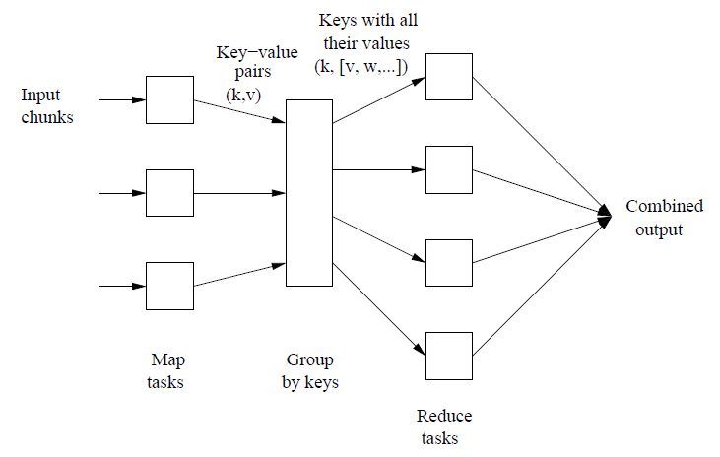
MapReduce in a figure

Slide 16
MapReduce: The Map Step
Input
Data elements
(key-value pairs)
Intermediate
key-value pairs
k
v
map
Important:
Different shapes correspond to different types of keys and values!
k
v
k
v
map
k
v
k
v
…
…
k
v
k
v

Slide 17
MapReduce: The Reduce Step
Output
key-value pairs
Intermediate
key-value pairs
Key-value groups
reduce
k
v
k
v
v
v
k
v
Group
by key
reduce
k
v
k
v
v
k
v
k
v
…
…
…
k
v
k
v
k
v

Slide 18
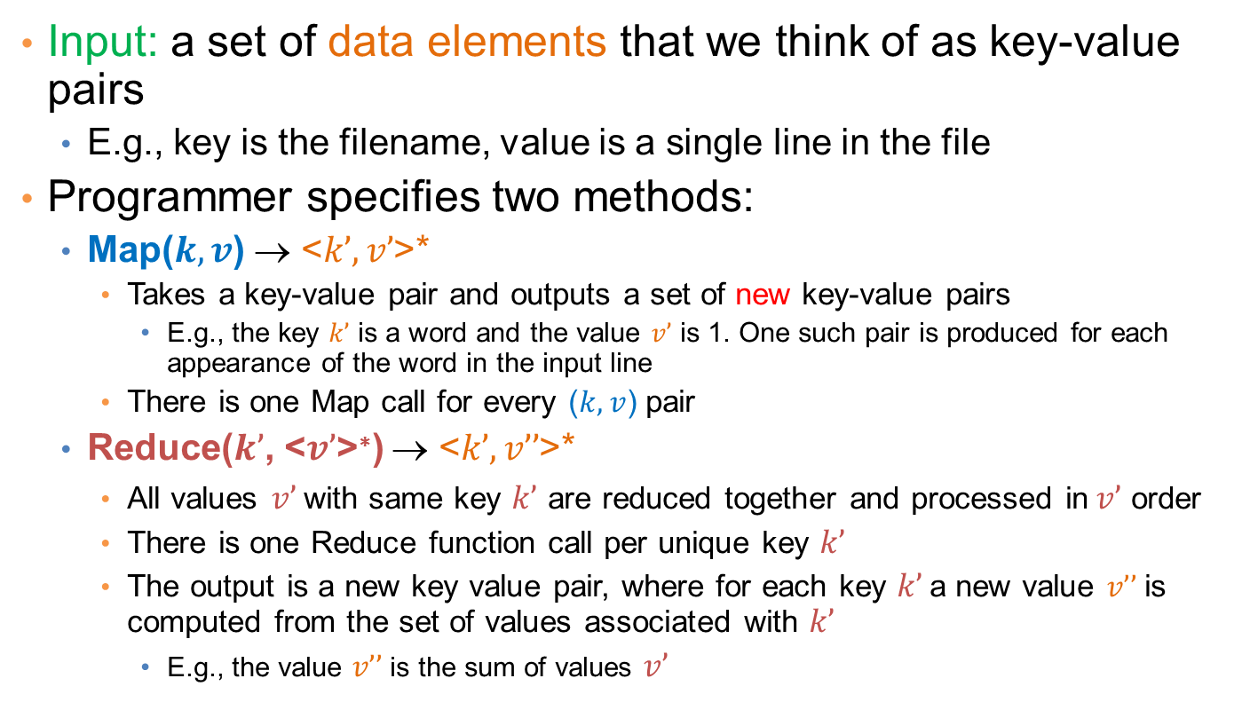
More Specifically
Input: a set of data elements that we think of as key-value pairs
  E.g., key is the filename, value is a single line in the file
Programmer specifies two methods:
  Map($k, v$) → <$k’, v’$>*
    Takes a key-value pair and outputs a set of new key-value pairs
      E.g., the key $k’$ is a word and the value $v’$ is 1. One such pair is produced for each appearance of the word in the input line
    There is one Map call for every ($k,v$) pair
  Reduce($k’$, <$v’$>∗) → <$k’, v’’$>*
    All values $v’$with same key $k’$ are reduced together and processed in$v’$ order
    There is one Reduce function call per unique key $k’$
    The output is a new key value pair, where for each key $k’$a new value $v’’$is computed from the set of values associated with $k’$
      E.g., the value $v’’$is the sum of values $v’$

Slide 19
MapReduce: Word Counting
Provided by the programmer
Provided by the programmer
MAP:
Read input and produces a set of key-value pairs
Group by key:
Collect all pairs with same key
Reduce:
Collect all values belonging to the key and output
The crew of the space shuttle Endeavor recently returned to Earth as ambassadors, harbingers of a new era of space exploration. Scientists at NASA are saying that the recent assembly of the Dextre bot is the first step in a long-term space-based man/mache partnership. '"The work we're doing now -- the robotics we're doing -- is what we're going to need ……………………..
(The, 1)
(crew, 1)
(of, 1)
(the, 1)
(space, 1)
(shuttle, 1)
(Endeavor, 1)
(recently, 1)
….
(crew, 1)
(crew, 1)
(space, 1)
(the, 1)
(the, 1)
(the, 1)
(shuttle, 1)
(recently, 1)
…
(crew, 2)
(space, 1)
(the, 3)
(shuttle, 1)
(recently, 1)
…
Sequentially read the data
Only sequential reads
Big document
(key, value)
(key, value)
(key, value)

Slide 20
Word Count Using MapReduce
map(key, value):
// key: document name; value: text of the document
for each word w in words(value):
emit(w, 1)
reduce(key, values):
// key: a word; value: an iterator over counts
result = 0
for each count v in values:
result += v
emit(key, result)

Slide 21
Map-Reduce: Environment
Map-Reduce environment takes care of:
Partitioning the input data
Scheduling the program’s execution across a
set of machines
Performing the group by key step
Handling machine failures
Managing required inter-machine communication

Slide 22
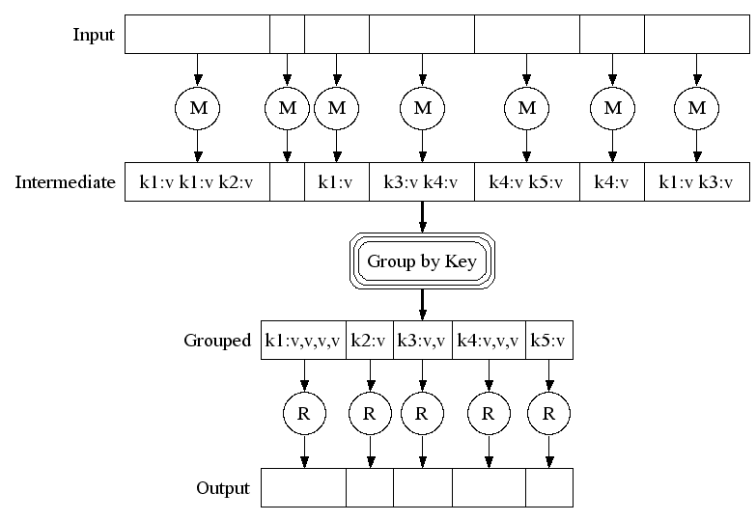
Map-Reduce: A diagram
Big document
MAP:
Read input and produces a set of key-value pairs
Group by key:
Collect all pairs with same key
(Hash merge, Shuffle, Sort, Partition)
Reduce:
Collect all values belonging to the key and output

Slide 23
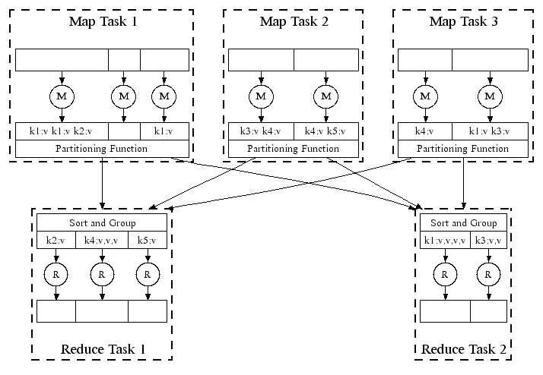
Map-Reduce: In Parallel
All phases are distributed with many tasks doing the work

Slide 24
Map-Reduce
Programmer specifies:
  Map and Reduce and input files
Workflow:
  Read inputs as a set of key-value-pairs
  Map transforms input (k,v)-pairs into a new set of (k’,v’)-pairs
  Sorts & Shuffles the (k'v’)-pairs to output nodes
  All (k’,v’)-pairs with a given k’ are sent to the same reduce
  Reduce processes all (k’,v’)-pairs grouped by key into new (k’,v’’)-pairs
  Write the resulting pairs to files
All phases are distributed with many tasks doing the work
Input 0
Input 1
Input 2
Map 0
Map 1
Map 2
Shuffle
Reduce 0
Reduce 1
Out 0
Out 1

Slide 25
Data Flow
Input and final output are stored on a distributed file system (FS):
  Scheduler tries to schedule map tasks “close” to physical storage location of input data
Intermediate results are stored on local FS
of Map and Reduce workers
Output is often input to another
MapReduce task

Slide 26
Coordination: Master
Master node takes care of coordination:
  Task status: (idle, in-progress, completed)
  Idle tasks get scheduled as workers become available
  When a map task completes, it sends the master the location and sizes of its R intermediate files, one for each reducer
  Master pushes this info to reducers
Master pings workers periodically to detect failures

Slide 27
Overview

Slide 28
Dealing with Failures
Map worker failure
  Map tasks completed or in-progress at
  worker are reset to idle
  Reduce workers are notified when task is rescheduled on another worker
Reduce worker failure
  Only in-progress tasks are reset to idle
  Reduce task is restarted
Master failure
  MapReduce task is aborted and client is notified

Slide 29
How many Map and Reduce jobs?
M map tasks, R reduce tasks
Rule of a thumb:
  Make M much larger than the number of nodes in the cluster
  One DFS chunk per map is common
  Improves dynamic load balancing and speeds up recovery from worker failures
Usually R is smaller than M
  Because output is spread across R files

Slide 30
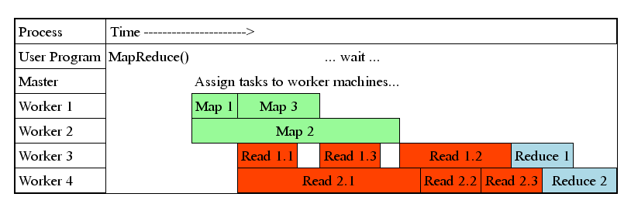
Task Granularity & Pipelining
Fine granularity tasks: map tasks >> machines
  Minimizes time for fault recovery
  Can do pipeline shuffling with map execution
  Better dynamic load balancing

Slide 31
Refinements: Backup Tasks
Problem
  Slow workers significantly lengthen the job completion time:
    Other jobs on the machine
    Bad disks
    Weird things
Solution
  Near end of phase, spawn backup copies of tasks
    Whichever one finishes first “wins”
Effect
  Dramatically shortens job completion time

Slide 32
Refinement: Combiners
Often a Map task will produce many pairs of the form (k,v₁), (k,v₂), … for the same key k
  E.g., popular words in the word count example
Can save network time by
pre-aggregating values in
the mapper:
  combine(k, list(v₁)) → v₂
  Combiner is usually same
  as the reduce function
Works only if Reduce
function is commutative and associative

Slide 33
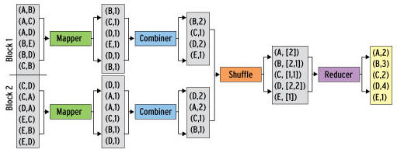
Refinement: Combiners
Back to our word counting example:
  Combiner combines the values of all keys of a single mapper (single machine):
  Much less data needs to be copied and shuffled!

Slide 34
Refinement: Partition Function
Want to control how keys get partitioned
  Inputs to map tasks are created by contiguous splits of input file
  Reduce needs to ensure that records with the same intermediate key end up at the same worker
System uses a default partition function:
  hash(key) mod R
Sometimes useful to override the hash function:
  E.g., hash(hostname(URL)) mod R ensures URLs from a host end up in the same output file

Slide 35
Problems Suited for
Map-Reduce

Slide 36
Examples
Counting tasks
  Find the total size in bytes of a host
  Compute the frequency of all k-grams on the web
  Compute the frequency of queries
  Compute the frequency of query,url pairs
Other examples:
  Link analysis and graph processing – PageRank
  Machine Learning algorithms
  Linear algebra operations (matrix-vector, matrix-matrix multiplication)

Slide 37
Example: Join By Map-Reduce
Compute the natural join R(A,B) ⋈ S(B,C)
R and S are each stored in files
Tuples are pairs (a,b) or (b,c)
A | B
a₁ | b₁
a₂ | b₁
a₃ | b₂
a₄ | b₃
B | C
b₂ | c₁
b₂ | c₂
b₃ | c₃
A | B | C
a₃ | b₂ | c₁
a₃ | b₂ | c₂
a₄ | b₃ | c₃
⋈
=
S
R

Slide 38
Map-Reduce Join
A Map process turns:
  Each input tuple R(a,b) into key-value pair (b,(a,R))
  Each input tuple S(b,c) into (b,(c,S))
Map processes send each key-value pair with key b to Reduce process h(b) (where h is a hash function)
  Hadoop does this automatically; just tell it what the key is.
Each Reduce process matches all the pairs (b,(a,R)) with all (b,(c,S)) from the list of values associated with b, and outputs (a,b,c).

Slide 39
Other database operations
All SQL operations can be implemented using map-reduce:
  Select
  Project
  Union
  Difference
  Equi-Join
  Left-outer join

Slide 40
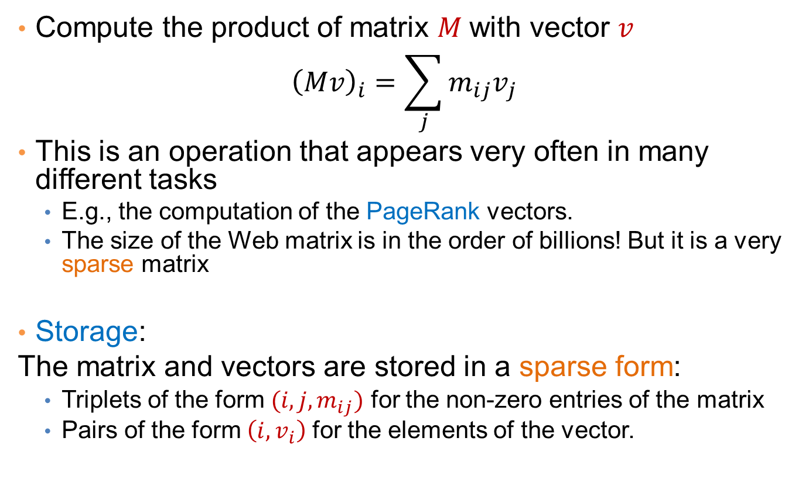
Matrix-Vector multiplication
Compute the product of matrix $M$with vector $v$
$${\left(Mv\right)}_{i}=\sum_{j}{m_{ij}v_{j}}$$
This is an operation that appears very often in many different tasks
  E.g., the computation of the PageRank vectors.
  The size of the Web matrix is in the order of billions! But it is a very sparse matrix
Storage:
The matrix and vectors are stored in a sparse form:
  Triplets of the form $(i,j,m_{ij})$ for the non-zero entries of the matrix
  Pairs of the form $\left(i, v_{i}\right)$ for the elements of the vector.

Slide 41
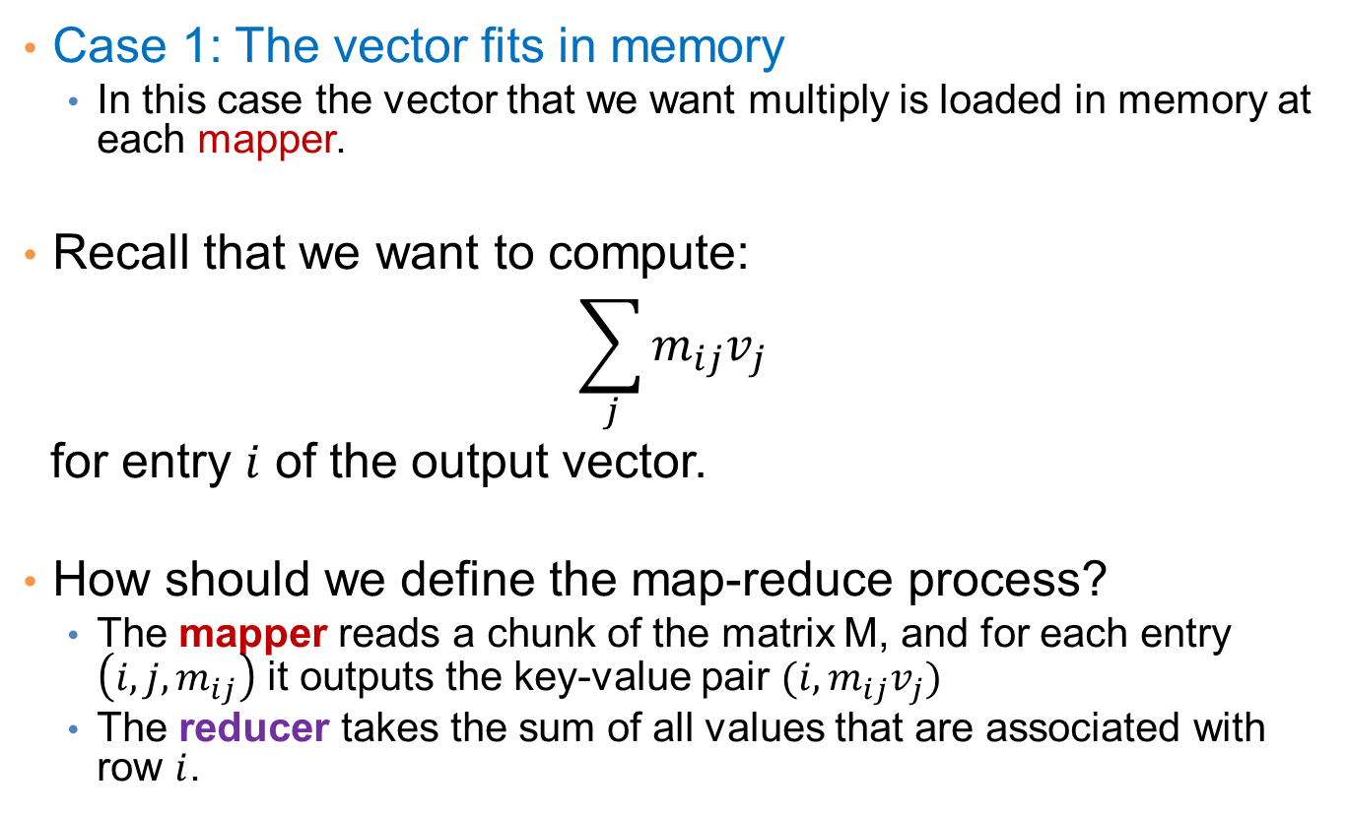
Matrix-vector multiplication
Case 1: The vector fits in memory
  In this case the vector that we want multiply is loaded in memory at each mapper.
Recall that we want to compute:
$$\sum_{j}{m_{ij}v_{j}}$$
for entry $i$ of the output vector.
How should we define the map-reduce process?
  The mapper reads a chunk of the matrix M, and for each entry $\left(i,j,m_{ij}\right)$ it outputs the key-value pair $(i, m_{ij}v_{j})$
  The reducer takes the sum of all values that are associated with row $i$.

Slide 42
Matrix-vector multiplication
Case 2: The vector does not fit in memory
In this case we split the matrix and the vector into stripes:
We perform the computation for each stripe of the matrix, where the vector can fit into memory
  For PageRank it is better to split the matrix into blocks.

Slide 43
Extenstions: Pregel- Giraph
Data and computation is modeled as a Graph.
  Each node in the graph handles a task
  Each node output messages to the remaining nodes
  Each node processes the incoming messages from other nodes.
Computation is performed in supersteps:
  In one superstep all messages are processed, and new messages are sent out.
Failures
  The computation is periodically checkpointed after a number of supersteps.
Pregel: developed by Google. Giraph: open-source version
  Although a general computation model, it is usually used for computations on graphs.

Slide 44
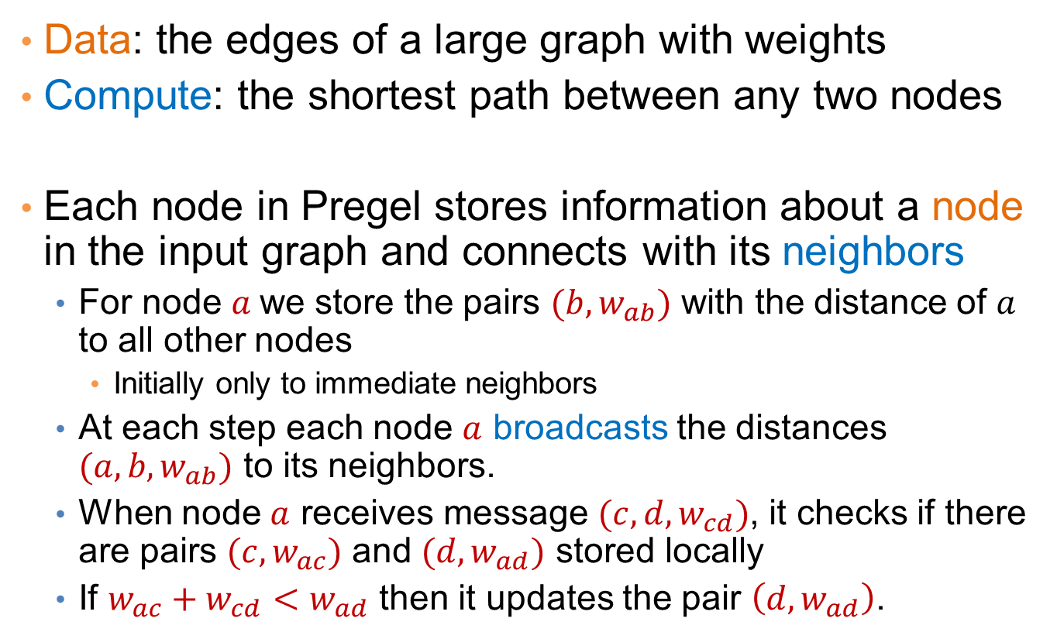
Example: All pairs shortest paths
Data: the edges of a large graph with weights
Compute: the shortest path between any two nodes
Each node in Pregel stores information about a node in the input graph and connects with its neighbors
  For node $a$we store the pairs $(b,w_{ab})$ with the distance of $a$ to all other nodes
    Initially only to immediate neighbors
  At each step each node $a$ broadcasts the distances $(a,b,w_{ab})$ to its neighbors.
  When node $a$ receives message $(c,d,w_{cd})$, it checks if there are pairs $(c,w_{ac})$ and $(d,w_{ad})$ stored locally
  If $w_{ac}+w_{cd}<w_{ad}$ then it updates the pair $\left(d,w_{ad}\right)$.

Slide 45
Pointers and Further Reading

Slide 46
Implementations
Google
  Not available outside Google
Hadoop
  An open-source implementation in Java
  Uses HDFS for stable storage
  Download: http://lucene.apache.org/hadoop/
Aster Data
  Cluster-optimized SQL Database that also implements MapReduce

Slide 47
Reading
Jeffrey Dean and Sanjay Ghemawat: MapReduce: Simplified Data Processing on Large Clusters
  http://labs.google.com/papers/mapreduce.html
Sanjay Ghemawat, Howard Gobioff, and Shun-Tak Leung: The Google File System
  http://labs.google.com/papers/gfs.html

Slide 48
Resources
Hadoop Wiki
  Introduction
    http://wiki.apache.org/lucene-hadoop/
  Getting Started
    http://wiki.apache.org/lucene-hadoop/GettingStartedWithHadoop
  Map/Reduce Overview
    http://wiki.apache.org/lucene-hadoop/HadoopMapReduce
    http://wiki.apache.org/lucene-hadoop/HadoopMapRedClasses
  Eclipse Environment
    http://wiki.apache.org/lucene-hadoop/EclipseEnvironment
Hadoop releases from Apache download mirrors
  http://www.apache.org/dyn/closer.cgi/lucene/hadoop/
Javadoc
  http://lucene.apache.org/hadoop/docs/api/

Slide 49
Other systems
Apache Spark
  https://spark.apache.org/
  A different distributed computation software stack running over HDFS, or Amazon S3
  Developed by UC Berkeley
On top of Apache Spark:
  Spark SQL: allows for querying structured and semi-structured data
  MLlib – Apache Mahout: Distributed Machine Learning framework
    Implements clustering, classification, dimensionality reduction algorithims
  GraphX: Distributed Graph processing framework, similar to Pregel
    Implements several graph processing algorithms

Slide 50
Other systems
Apache Hive:
  https://hive.apache.org/
  Distributed Data Warehousing system. Works over HDFS and Amazon S3.
  HiveQL: SQL like querying language.
  Developed by Facebook.
GraphLab and GraphChi
  Distributed Graph processing framework
  Pregel-like computation

Slide 51
Cloud Computing
Ability to rent computing by the hour
  Additional services e.g., persistent storage
Amazon’s “Elastic Compute Cloud” (EC2)
Aster Data and Hadoop can both be run on EC2
R on the Cloud:
  Several resources that allow to run R scripts on the cloud. Useful for bio-informatics applications.

