Slide 1
DATA MINING
LECTURE 14
Absorbing Random walks
Coverage

Slide 2
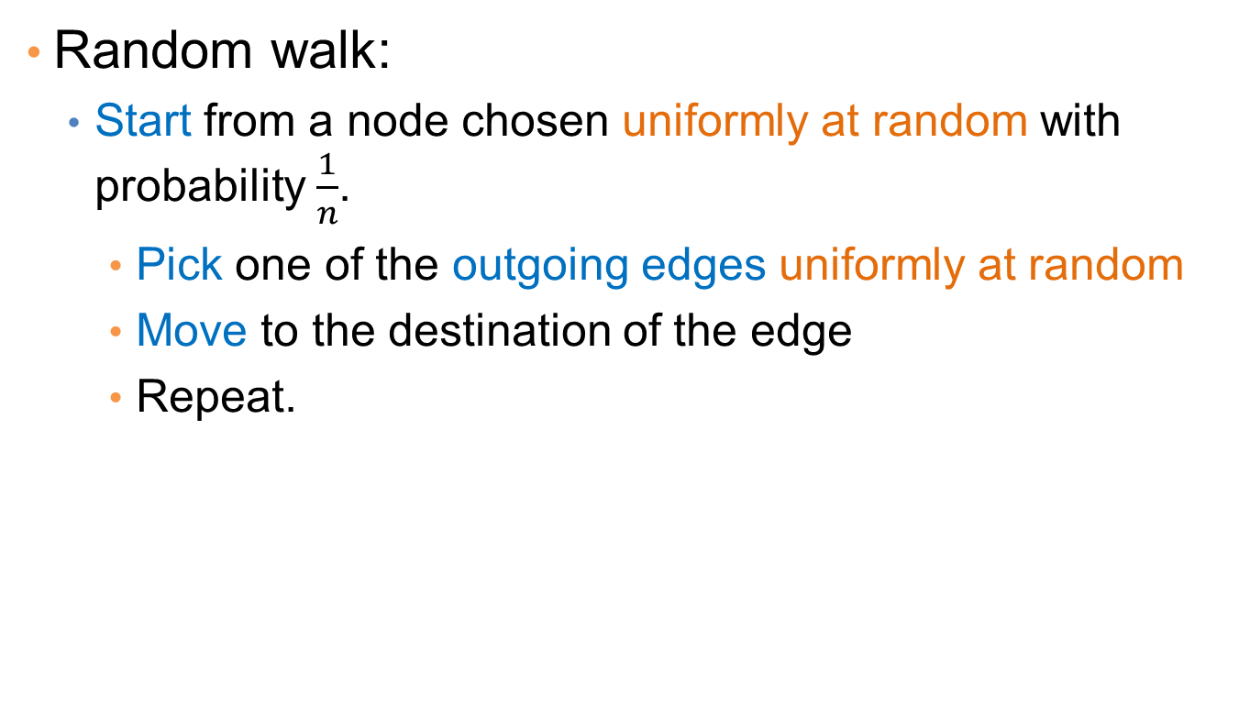
Random Walks on Graphs
Random walk:
  Start from a node chosen uniformly at random with probability $\frac{1}{n}$.
    Pick one of the outgoing edges uniformly at random
    Move to the destination of the edge
    Repeat.

Slide 3

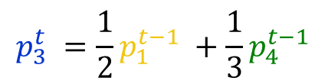


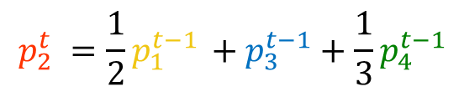




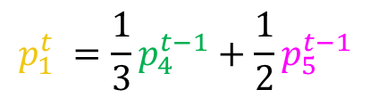






Random walk
Question: what is the probability $p_{i}^{t}$ of being at node $i$after $t$ steps?
$$v_{2}$$
$$p_{1}^{0} =\frac{1}{5}$$
$$p_{1}^{t} =\frac{1}{3}p_{4}^{t−1}+\frac{1}{2}p_{5}^{t−1}$$
$$v_{1}$$
$$v_{3}$$
$$p_{2}^{0} =\frac{1}{5}$$
$$p_{2}^{t} =\frac{1}{2}p_{1}^{t−1} +p_{3}^{t−1}+\frac{1}{3}p_{4}^{t−1}$$
$$p_{3}^{0}=\frac{1}{5}$$
$$p_{3}^{t} =\frac{1}{2}p_{1}^{t−1} +\frac{1}{3}p_{4}^{t−1}$$
$$p_{4}^{0}=\frac{1}{5}$$
$$p_{4}^{t} =\frac{1}{2}p_{5}^{t−1}$$
$$v_{5}$$
$$v_{4}$$
$$p_{5}^{0}=\frac{1}{5}$$
$$p_{5}^{t} = p_{2}^{t−1}$$

Slide 4
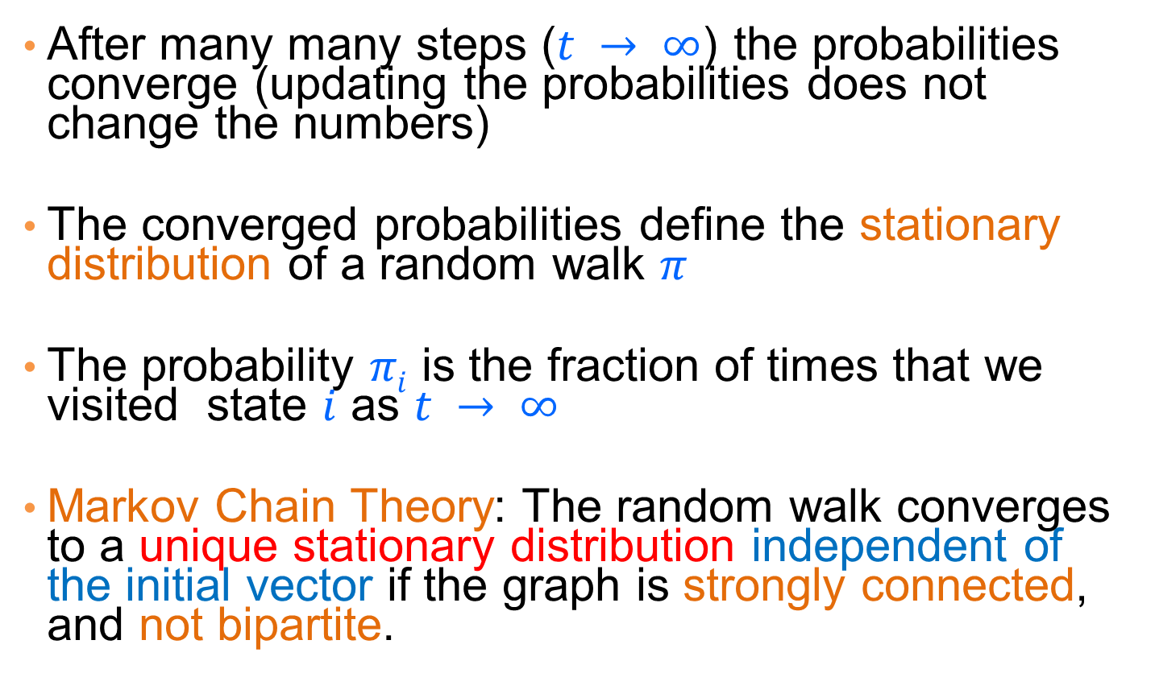
Stationary distribution
After many many steps ($t → ∞$) the probabilities converge (updating the probabilities does not change the numbers)
The converged probabilities define the stationary distribution of a random walk $π$
The probability $πi$ is the fraction of times that we visited state $i$ as $t → ∞$
Markov Chain Theory: The random walk converges to a unique stationary distribution independent of the initial vector if the graph is strongly connected, and not bipartite.

Slide 5
Random walk with Restarts
This is the random walk used by the PageRank algorithm
  At every step with probability 1-α do a step of the random walk (follow a random link)
  With probability α restart the random walk from a randomly selected node.
The effect of the restart is that paths followed are never too long.
  In expectation paths have length 1/α
Restarts can also be from a specific node in the graph (always start the random walk from there)
What is the effect of that?
  The nodes that are close to the starting node have higher probability to be visited.
  The probability defines a notion of proximity between the starting node and all the other nodes in the graph

Slide 6
ABSORBING RANDOM WALKS

Slide 7
Random walk with absorbing nodes
What happens if we do a random walk on this graph? What is the stationary distribution?
All the probability mass on the red sink node:
  The red node is an absorbing node

Slide 8
Random walk with absorbing nodes
What happens if we do a random walk on this graph? What is the stationary distribution?
There are two absorbing nodes: the red and the blue.
The probability mass will be divided between the two

Slide 9
Absorption probability
If there are more than one absorbing nodes in the graph a random walk that starts from a non-absorbing node will be absorbed in one of them with some probability
  The probability of absorption gives an estimate of how close the node is to red or blue

Slide 10
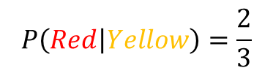
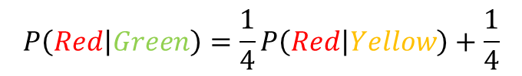
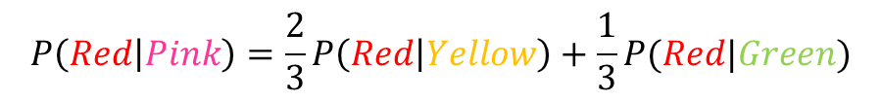
Absorption probability
Computing the probability of being absorbed:
  The absorbing nodes have probability 1 of being absorbed in themselves and zero of being absorbed in another node.
  For the non-absorbing nodes, take the (weighted) average of the absorption probabilities of your neighbors
    if one of the neighbors is the absorbing node, it has probability 1
  Repeat until convergence (= very small change in probs)
$$P\left(Red | Pink\right)=\frac{2}{3}P\left(Red | Yellow\right)+\frac{1}{3}P(Red|Green)$$
2
1
$$P\left(Red | Green\right)=\frac{1}{4}P\left(Red | Yellow\right)+\frac{1}{4}$$
1
1
2
$$P\left(Red | Yellow\right)=\frac{2}{3}$$
2
1
$$P\left(Red | Red\right)=1 , P\left(Red | Blue\right)=0$$

Slide 11
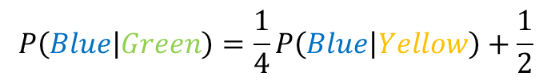
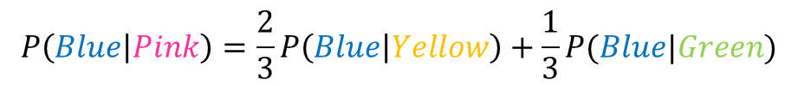
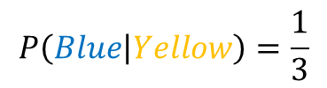
Absorption probability
Computing the probability of being absorbed:
  The absorbing nodes have probability 1 of being absorbed in themselves and zero of being absorbed in another node.
  For the non-absorbing nodes, take the (weighted) average of the absorption probabilities of your neighbors
    if one of the neighbors is the absorbing node, it has probability 1
  Repeat until convergence (= very small change in probs)
$$P\left(Blue | Pink\right)=\frac{2}{3}P\left(Blue | Yellow\right)+\frac{1}{3}P(Blue|Green)$$
2
$$P\left(Blue | Green\right)=\frac{1}{4}P\left(Blue | Yellow\right)+\frac{1}{2}$$
1
1
1
$$P\left(Blue | Yellow\right)=\frac{1}{3}$$
2
2
1
$$P\left(Blue | Blue\right)=1 , P\left(Blue | Red\right)=0$$

Slide 12
Why do we care?
Why do we care to compute the absorption probability to sink nodes?
Given a graph (directed or undirected) we can choose to make some nodes absorbing.
  Simply direct all edges incident on the chosen nodes towards them and remove outgoing edges.
The absorbing random walk provides a measure of proximity of non-absorbing nodes to the chosen nodes.
  Useful for understanding proximity in graphs
  Useful for propagation in the graph
    E.g, some nodes have positive opinions for an issue, some have negative, to which opinion is a non-absorbing node closer?

Slide 13
Example
In this undirected graph we want to learn the proximity of nodes to the red and blue nodes
2
1
1
1
2
2
1

Slide 14
Example
Make the nodes absorbing
2
1
1
1
2
2
1

Slide 15
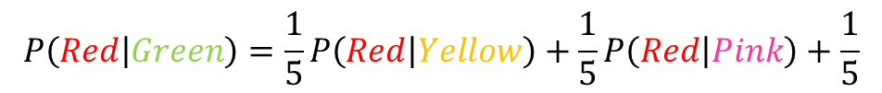
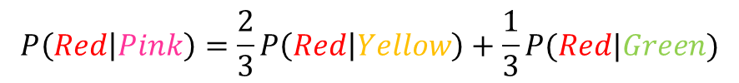
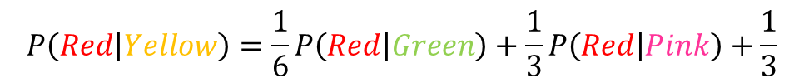
Absorption probability
Compute the absorbtion probabilities for red and blue
$$P\left(Red | Pink\right)=\frac{2}{3}P\left(Red | Yellow\right)+\frac{1}{3}P(Red|Green)$$
$$P\left(Red | Green\right)=\frac{1}{5}P\left(Red | Yellow\right)+\frac{1}{5}P\left(Red | Pink\right)+\frac{1}{5}$$
0.57
0.43
2
$$P\left(Red | Yellow\right)=\frac{1}{6}P\left(Red | Green\right)+\frac{1}{3}P\left(Red | Pink\right)+\frac{1}{3}$$
1
1
1
$$P\left(Blue | Pink\right)=1−P\left(Red | Pink\right)$$
2
2
$$P\left(Blue | Green\right)=1− P\left(Red | Green\right)$$
1
$$P\left(Blue | Yellow\right)=1−P\left(Red | Yellow\right)$$
0.52
0.48
0.42
0.58

Slide 16


Penalizing long paths
The orange node has the same probability of reaching red and blue as the yellow one
Intuitively though it is further away
0.57
0.43
0.57
0.43
2
$$P\left(Red | Orange\right)=P\left(Red | Yellow\right)$$
1
$P\left(Blue | Orange\right)=$ $P\left(Blue | Yellow\right)$
1
1
1
2
2
1
0.52
0.48
0.42
0.58

Slide 17
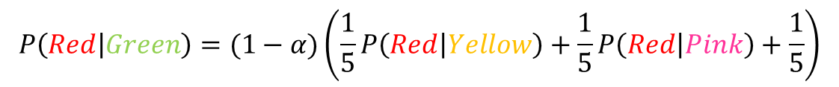
Penalizing long paths
Add an universal absorbing node to which each node gets absorbed with probability α.
With probability α the random walk dies
With probability (1-α) the random walk continues as before
α
1-α
1-α
α
1-α
1-α
The longer the path from a node to an absorbing node the more likely the random walk dies along the way, the lower the absorbtion probability
α
α
e.g.
$$P\left(Red | Green\right)=(1−α)\left(\frac{1}{5}P\left(Red | Yellow\right)+\frac{1}{5}P\left(Red | Pink\right)+\frac{1}{5}\right)$$

Slide 18
Random walk with restarts
Adding a jump with probability α to a universal absorbing node seems similar to Pagerank
Random walk with restart:
  Start a random walk from node u
  At every step with probability α, jump back to u
  The probability of being at node v after large number of steps defines again a similarity between nodes u,v
The Random Walk With Restarts (RWS) and Absorbing Random Walk (ARW) are similar but not the same
  RWS computes the probability of paths from the starting node u to a node v, while AWR the probability of paths from a node v, to the absorbing node u.
  RWS defines a distribution over all nodes, while AWR defines a probability for each node
  An absorbing node blocks the random walk, while restarts simply bias towards starting nodes
    Makes a difference when having multiple (and possibly competing) absorbing nodes

Slide 19
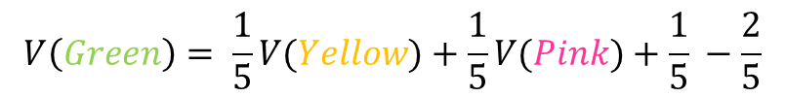

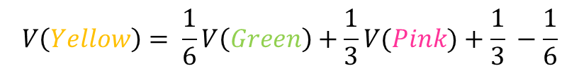
Propagating values
Assume that Red has a positive value and Blue a negative value
  Positive/Negative class, Positive/Negative opinion
We can compute a value for all the other nodes by repeatedly averaging the values of the neighbors
  The value of node u is the expected value at the point of absorption for a random walk that starts from u
+1
$$V(Pink)=\frac{2}{3}V(Yellow)+\frac{1}{3}V(Green)$$
0.16
2
-1
1
$$V\left(Green\right)= \frac{1}{5}V(Yellow)+\frac{1}{5}V(Pink)+\frac{1}{5} −\frac{2}{5}$$
1
2
1
2
$$V\left(Yellow\right)= \frac{1}{6}V\left(Green\right)+\frac{1}{3}V(Pink)+\frac{1}{3} −\frac{1}{6}$$
1
0.05
-0.16

Slide 20

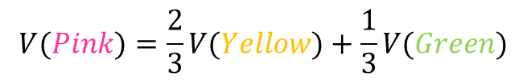
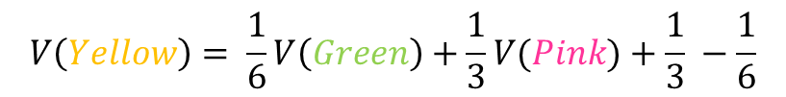
Electrical networks and random walks
Our graph corresponds to an electrical network
There is a positive voltage of +1 at the Red node, and a negative voltage -1 at the Blue node
There are resistances on the edges inversely proportional to the weights (or conductance proportional to the weights)
The computed values are the voltages at the nodes
+1
+1
0.16
2
$$V(Pink)=\frac{2}{3}V(Yellow)+\frac{1}{3}V(Green)$$
-1
1
$$V\left(Green\right)= \frac{1}{5}V(Yellow)+\frac{1}{5}V(Pink)+\frac{1}{5} −\frac{2}{5}$$
1
1
2
2
$$V\left(Yellow\right)= \frac{1}{6}V\left(Green\right)+\frac{1}{3}V(Pink)+\frac{1}{3} −\frac{1}{6}$$
1
0.05
-0.16

Slide 21
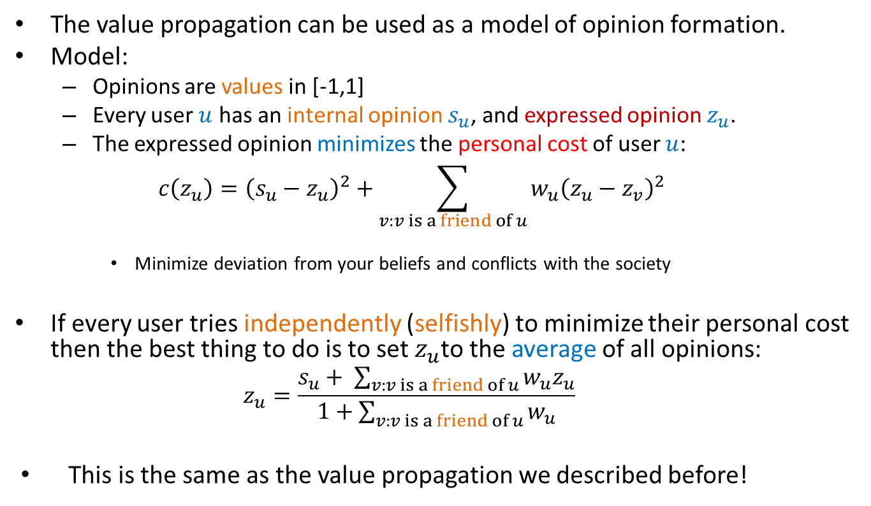
Opinion formation
The value propagation can be used as a model of opinion formation.
Model:
  Opinions are values in [-1,1]
  Every user $u$ has an internal opinion $s_{u}$, and expressed opinion $z_{u}$.
  The expressed opinion minimizes the personal cost of user $u$:
  $$c\left(z_{u}\right)={\left(s_{u}−z_{u}\right)}^{2}+\sum_{v:v is a friend of u}{w_{u}{\left(z_{u}−z_{v}\right)}^{2}}$$
    Minimize deviation from your beliefs and conflicts with the society
If every user tries independently (selfishly) to minimize their personal cost then the best thing to do is to set $z_{u}$to the average of all opinions:
  $$z_{u}=\frac{s_{u}+ \sum_{v:v is a friend of u}{w_{u}z_{u}}}{1+\sum_{v:v is a friend of u}{w_{u}}}$$
This is the same as the value propagation we described before!

Slide 22
Example
Social network with internal opinions
s = +0.5
2
s = +0.8
1
s = -0.3
1
1
2
2
1
s = +0.2
s = -0.1

Slide 23
Example
One absorbing node per user with value the internal opinion of the user
One non-absorbing node per user that links to the corresponding absorbing node
s = +0.5
1
z = +0.17
z = +0.22
2
1
s = +0.8
1
1
s = -0.3
2
1
The external opinion for each node is computed using the value propagation we described before
  Repeated averaging
1
z = -0.01
2
1
z = -0.03
z = 0.04
1
1
Intuitive model: my opinion is a combination of what I believe and what my social network believes.
s = -0.5
s = -0.1

Slide 24
Hitting time
A related quantity: Hitting time H(u,v)
  The expected number of steps for a random walk starting from node u to end up in v for the first time
    Make node v absorbing and compute the expected number of steps to reach v
    Assumes that the graph is strongly connected, and there are no other absorbing nodes.
Commute time H(u,v) + H(v,u): often used as a distance metric
  Proportional to the total resistance between nodes u, and v

Slide 25
Transductive learning
If we have a graph of relationships and some labels on some nodes we can propagate them to the remaining nodes
  Make the labeled nodes to be absorbing and compute the probability for the rest of the graph
  E.g., a social network where some people are tagged as spammers
  E.g., the movie-actor graph where some movies are tagged as action or comedy.
This is a form of semi-supervised learning
  We make use of the unlabeled data, and the relationships
It is also called transductive learning because it does not produce a model, but just labels the unlabeled data that is at hand.
  Contrast to inductive learning that learns a model and can label any new example

Slide 26
Implementation details
Implementation is in many ways similar to the PageRank implementation
  For an edge $(u,v)$instead of updating the value of v we update the value of u.
    The value of a node is the average of its neighbors
  We need to check for the case that a node u is absorbing, in which case the value of the node is not updated.
  Repeat the updates until the change in values is very small.

Slide 27
Coverage

Slide 28
Example
Promotion campaign on a social network
  We have a social network as a graph.
  People are more likely to buy a product if they have a friend who has the product.
  We want to offer the product for free to some people such that every person in the graph is covered: they have a friend who has the product.
  We want the number of free products to be as small as possible

Slide 29
Example
Promotion campaign on a social network
  We have a social network as a graph.
  People are more likely to buy a product if they have a friend who has the product.
  We want to offer the product for free to some people such that every person in the graph is covered: they have a friend who has the product.
  We want the number of free products to be as small as possible
One possible selection

Slide 30
Example
Promotion campaign on a social network
  We have a social network as a graph.
  People are more likely to buy a product if they have a friend who has the product.
  We want to offer the product for free to some people such that every person in the graph is covered: they have a friend who has the product.
  We want the number of free products to be as small as possible
A better selection

Slide 31
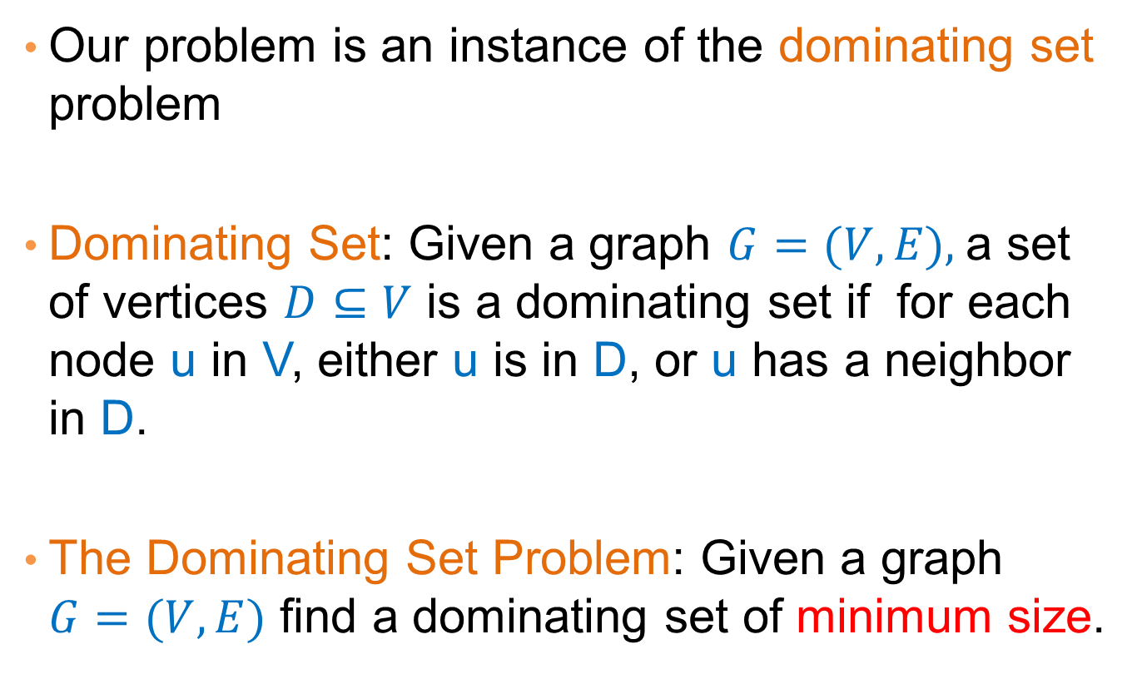
Dominating set
Our problem is an instance of the dominating set problem
Dominating Set: Given a graph $G=(V,E),$a set of vertices $D⊆V$ is a dominating set if for each node u in V, either u is in D, or u has a neighbor in D.
The Dominating Set Problem: Given a graph $G=(V,E)$ find a dominating set of minimum size.

Slide 32
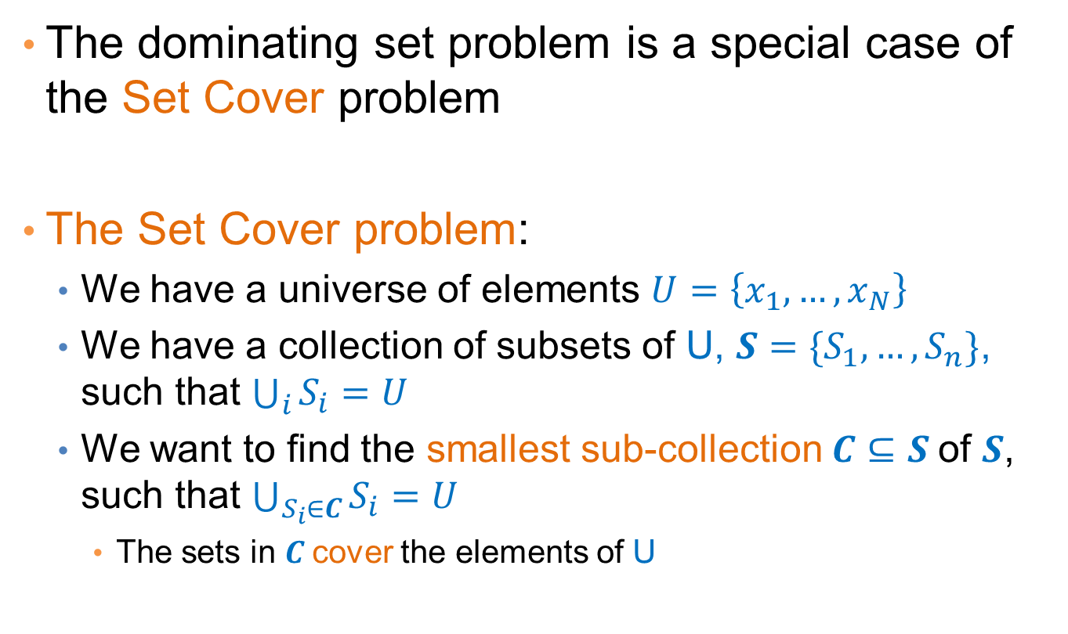
Set Cover
The dominating set problem is a special case of the Set Cover problem
The Set Cover problem:
  We have a universe of elements $U=\left\{x_{1},…,x_{N}\right\}$
  We have a collection of subsets of U, $S=\{S_{1},…,S_{n}\}$, such that $\bigcup_{i}{S_{i}}=U$
  We want to find the smallest sub-collection$C⊆S$ of $S$, such that $\bigcup_{S_{i}∈C}{S_{i}=U}$
    The sets in $C$cover the elements of U

Slide 33
Applications
Suppose that we want to create a catalog (with coupons) to give to customers of a store:
  We want for every customer, the catalog to contain a product bought by the customer (this is a small store)
How can we model this as a set cover problem?

Slide 34
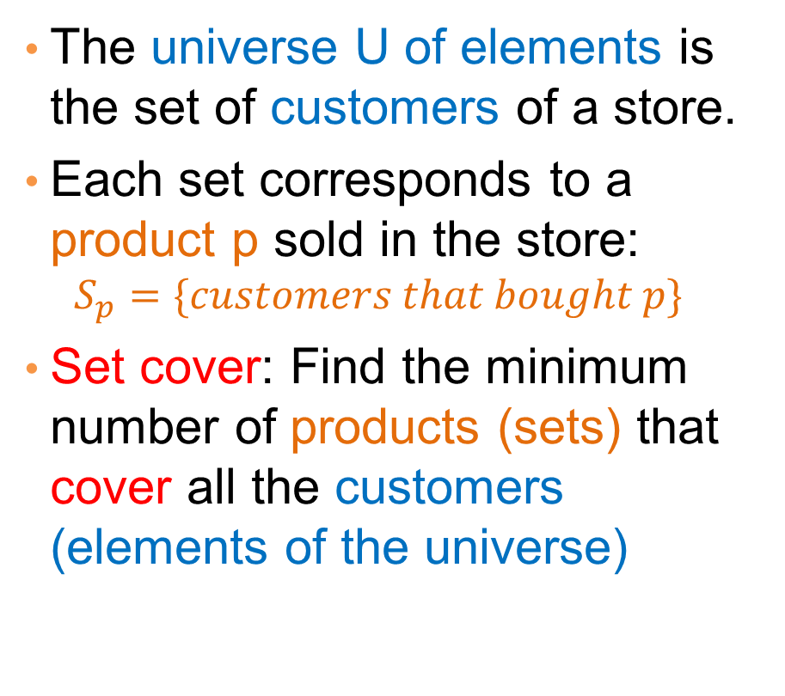
Applications
milk
The universe U of elements is the set of customers of a store.
Each set corresponds to a product p sold in the store:
  $$S_{p}=\{customers that bought p\}$$
Set cover: Find the minimum number of products (sets) that cover all the customers (elements of the universe)
coffee
coke
beer
tea

Slide 35
Applications
milk
The universe U of elements is the set of customers of a store.
Each set corresponds to a product p sold in the store:
  $$S_{p}=\{customers that bought p\}$$
Set cover: Find the minimum number of products (sets) that cover all the customers (elements of the universe)
coffee
coke
beer
tea

Slide 36
Applications
milk
The universe U of elements is the set of customers of a store.
Each set corresponds to a product p sold in the store:
  $$S_{p}=\{customers that bought p\}$$
Set cover: Find the minimum number of products (sets) that cover all the customers (elements of the universe)
coffee
coke
beer
tea

Slide 37
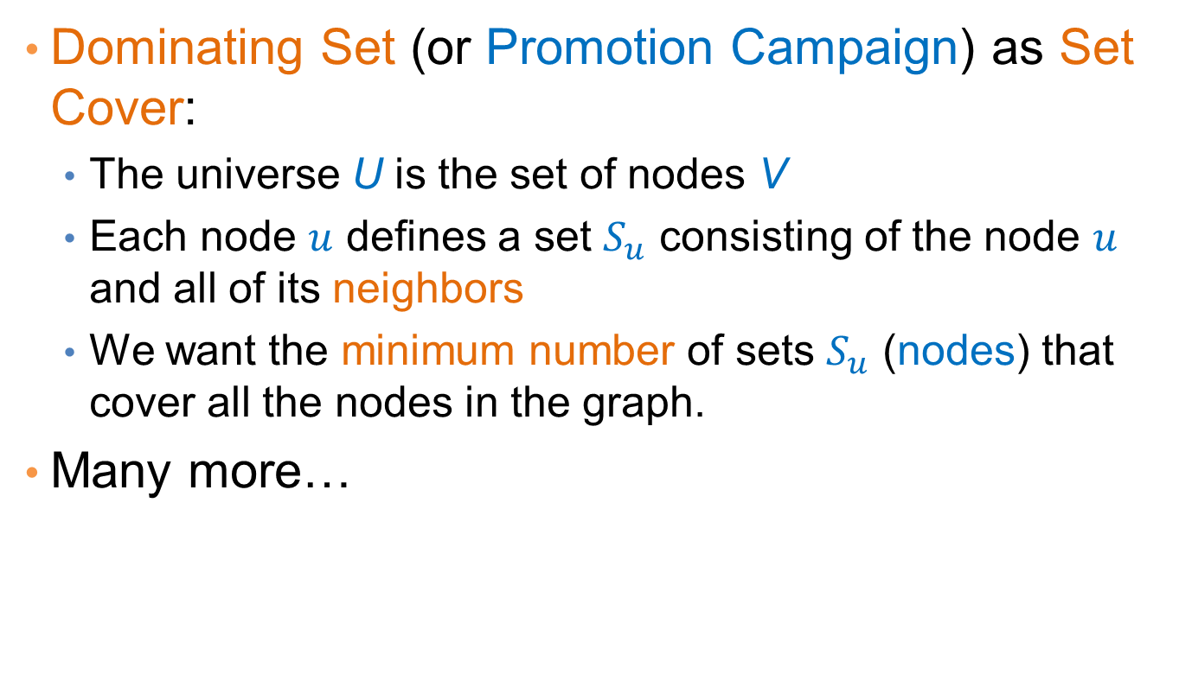
Applications
Dominating Set (or Promotion Campaign) as Set Cover:
  The universe U is the set of nodes V
  Each node $u$ defines a set $S_{u}$ consisting of the node $u$ and all of its neighbors
  We want the minimum number of sets $S_{u}$ (nodes) that cover all the nodes in the graph.
Many more…

Slide 38
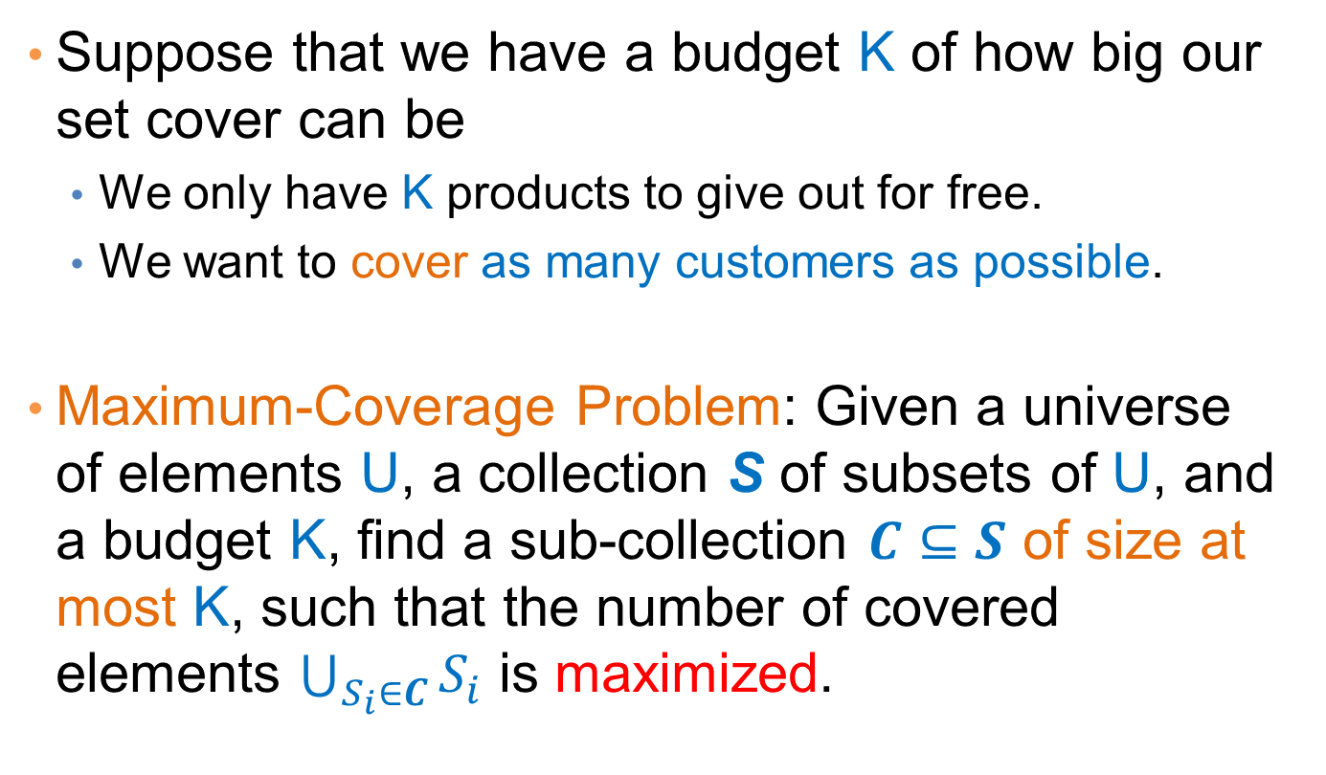
Best selection variant
Suppose that we have a budget K of how big our set cover can be
  We only have K products to give out for free.
  We want to cover as many customers as possible.
Maximum-Coverage Problem: Given a universe of elements U, a collection S of subsets of U, and a budget K, find a sub-collection $C⊆S$ of size at most K, such that the number of covered elements $\bigcup_{S_{i}∈C}{S_{i}}$ is maximized.

Slide 39
Complexity
Both the Set Cover and the Maximum Coverage problems are NP-complete
  What does this mean?
  Why do we care?
There is no algorithm that can guarantee to find the best solution in polynomial time
  Can we find an algorithm that can guarantee to find a solution that is close to the optimal?
  Approximation Algorithms.

Slide 40
Approximation Algorithms
For an (combinatorial) optimization problem, where:
  X is an instance of the problem,
  OPT(X) is the value of the optimal solution for X,
  ALG(X) is the value of the solution of an algorithm ALG for X
ALG is a good approximation algorithm if the ratio of OPT(X) and ALG(X) is bounded for all input instances X
Minimum set cover: X = G is the input graph, OPT(G) is the size of minimum set cover, ALG(G) is the size of the set cover found by an algorithm ALG.
Maximum coverage: X = (G,k) is the input instance, OPT(G,k) is the coverage of the optimal algorithm, ALG(G,k) is the coverage of the set found by an algorithm ALG.

Slide 41
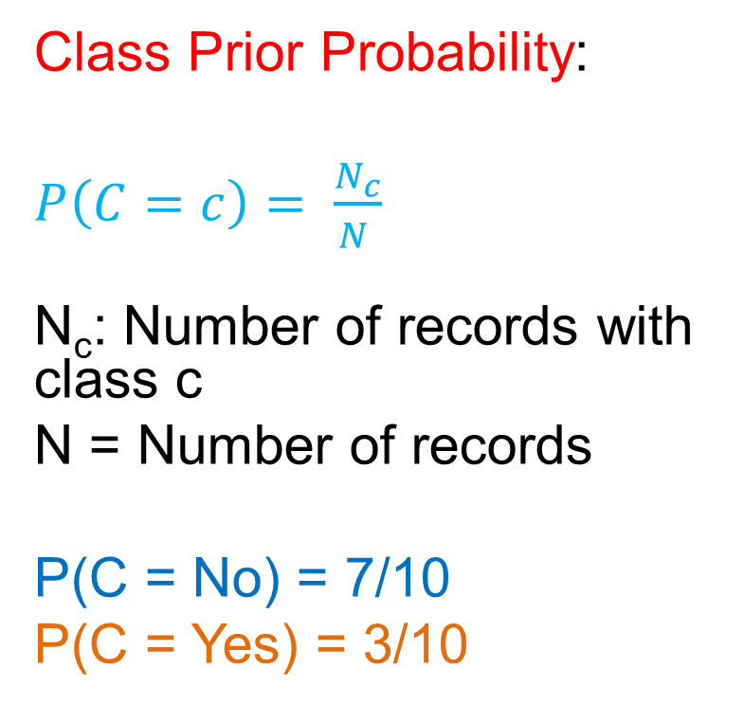
Approximation Algorithms
For a minimization problem, the algorithm ALG is an $α$-approximation algorithm, for $α>1$, if for all input instances X,
$$ALG\left(X\right)≤αOPT\left(X\right)$$
$α$ is the approximation ratio of the algorithm – we want $α$ to be as close to 1 as possible
  Best case: $α=1+ε$ and $ε→0$, as $n→∞$ (e.g., $ε=\frac{1}{n}$)
  Good case: $α=O(1)$ is a constant
  OK case: $α=O(log{n)}$
  Bad case $α=O({n^{ε})}$

Slide 42
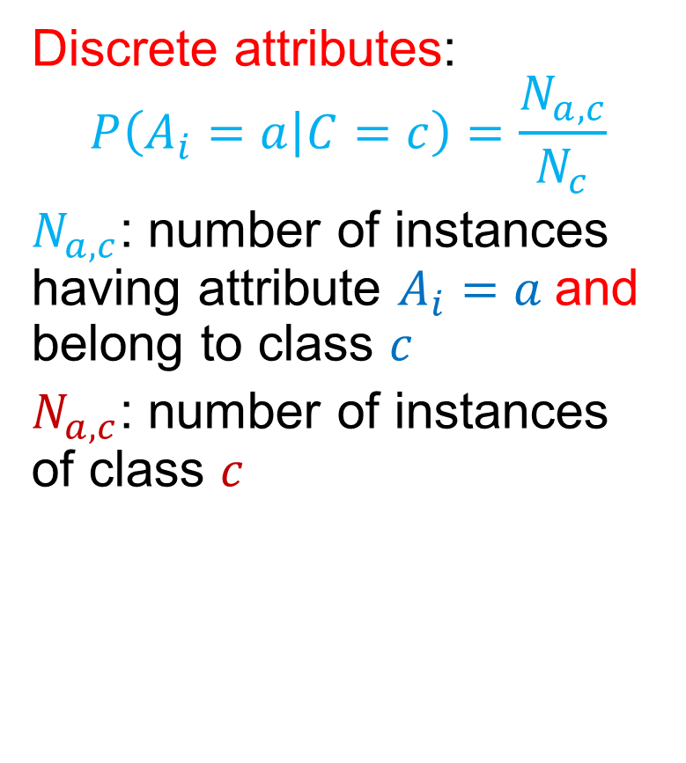
Approximation Algorithms
For a maximization problem, the algorithm ALG is an $α$-approximation algorithm, for $α<1$, if for all input instances X,
$$ALG\left(X\right)≥αOPT\left(X\right)$$
$α$ is the approximation ratio of the algorithm – we want $α$ to be as close to 1 as possible
  Best case: $α=1−ε$ and $ε→0$, as $n→∞$(e.g., $ε=\frac{1}{n}$)
  Good case: $α=O(1)$ is a constant
  OK case: $α=O(\frac{1}{\log{n}})$
  Bad case $α=O({n^{−ε})}$

Slide 43
A simple approximation ratio for set cover
Any algorithm for set cover has approximation ratio α = |S_{max}|, where S_{max} is the set in S with the largest cardinality
Proof:
  OPT(X)≥N/|S_{max}| ⇒ N ≤ |S_{max}|OPT(X)
  ALG(X) ≤ N ≤ |S_{max}|OPT(X)
This is true for any algorithm.
Not a good bound since it can be that |S_{max}|=O(N)

Slide 44
An algorithm for Set Cover
What is the most natural algorithm for Set Cover?
Greedy: each time add to the collection C the set S_{i} from S that covers the most of the remaining elements.

Slide 45
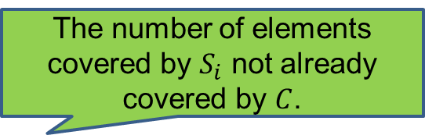
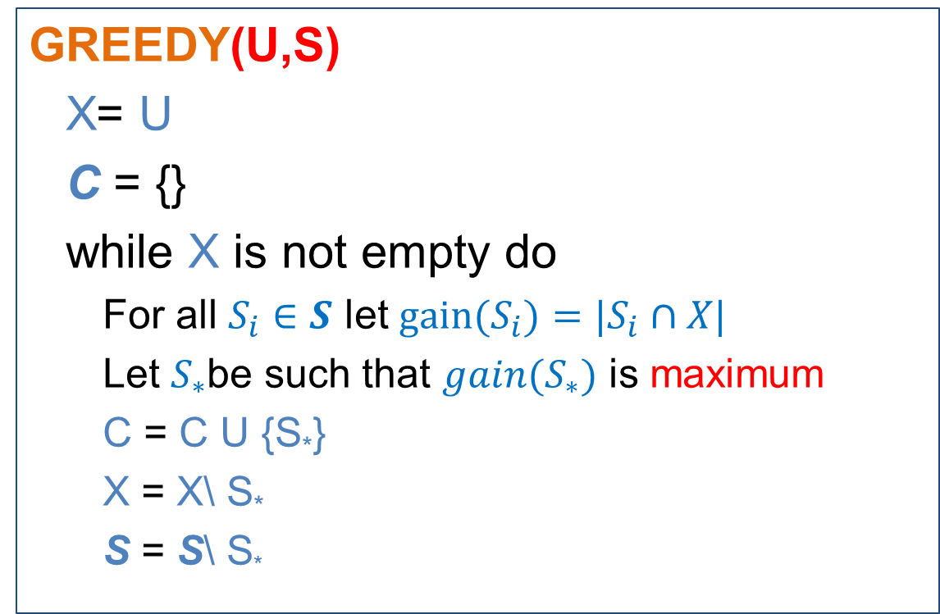
The GREEDY algorithm
GREEDY(U,S)
  X= U
  C = {}
  while X is not empty do
    For all $S_{i}∈S$ let $gain(S_{i})={|S}_{i}∩X|$
    Let $S_{∗}$be such that $gain(S_{∗})$ is maximum
    C = C U {S*}
    X = X\ S*
    S = S\ S*
The number of elements covered by $S_{i}$ not already covered by $C$.

Slide 46
Greedy is not always optimal
Optimal
Greedy
milk
milk
coffee
coffee
coke
coke
beer
beer
tea
tea

Slide 47
Greedy is not always optimal
Optimal
Greedy
milk
milk
coffee
coffee
coke
coke
beer
beer
tea
tea

Slide 48
Greedy is not always optimal
Optimal
Greedy
milk
milk
coffee
coffee
coke
coke
beer
beer
tea
tea

Slide 49
Greedy is not always optimal
Optimal
Greedy
milk
milk
coffee
coffee
coke
coke
beer
beer
tea
tea

Slide 50
Greedy is not always optimal
Optimal
Greedy
milk
milk
coffee
coffee
coke
coke
beer
beer
tea
tea

Slide 51
Greedy is not always optimal
milk
Selecting Coke first forces us to pick coffee as well
Milk and Beer cover more customers together
milk
coffee
coffee
coke
coke
beer
beer
tea
tea

Slide 52
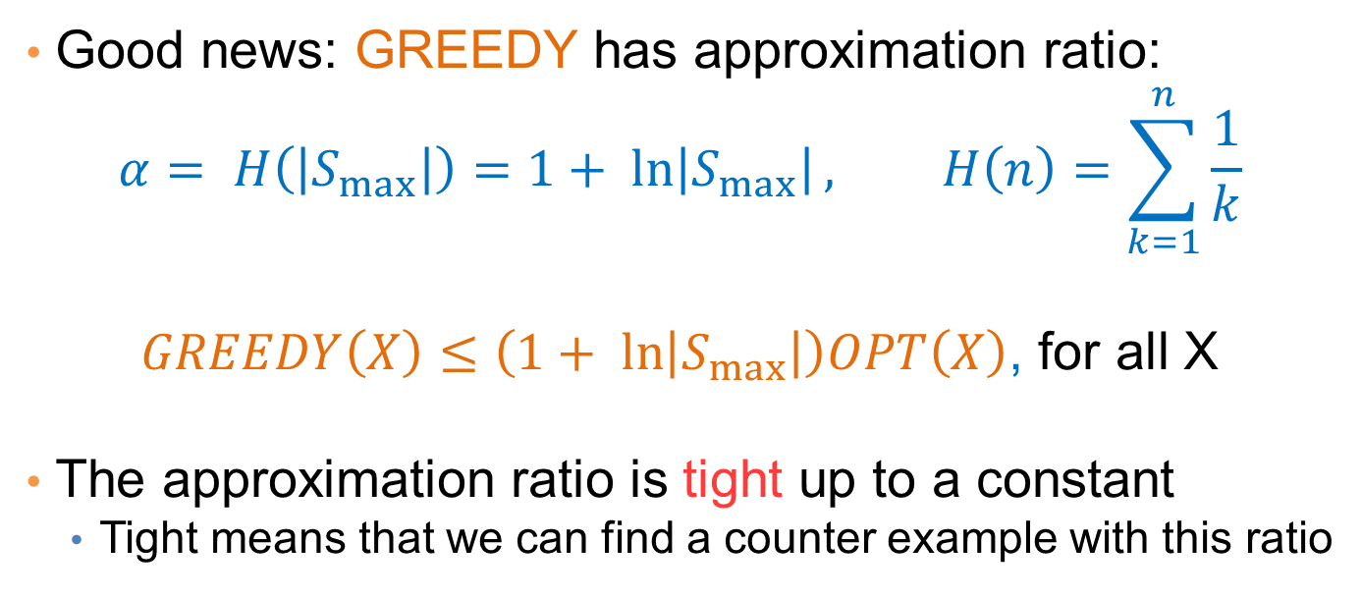
Approximation ratio of GREEDY
Good news: GREEDY has approximation ratio:
$$α= H\left(\left|S_{max}\right|\right)=1+ ln\left|S_{max}\right|, H\left(n\right)=\sum_{k=1}^{n}{\frac{1}{k}}$$
$GREEDY\left(X\right)≤\left(1+ ln\left|S_{max}\right|\right)OPT\left(X\right)$, for all X
The approximation ratio is tight up to a constant
  Tight means that we can find a counter example with this ratio
OPT(X) = 2
GREEDY(X) = logN
α=½logN

Slide 53

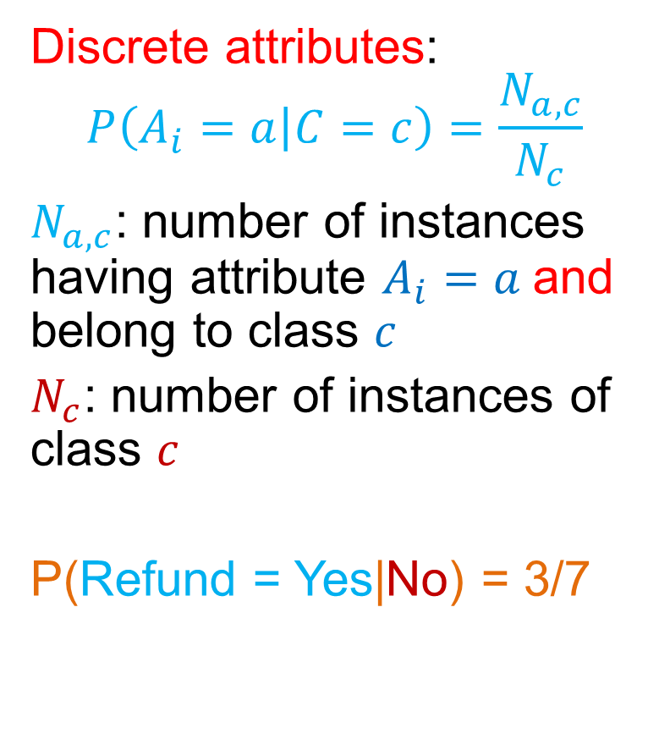
Maximum Coverage
What is a reasonable algorithm?
GREEDY(U,S,K)
  X = U
  C = {}
  while |C| < K
    For all $S_{i}∈S$ let $gain(S_{i})={|S}_{i}∩X|$
    Let $S_{∗}$ be such that $gain(S_{∗})$ is maximum
    C = C U {S*}
    X = X\ S*
    S= S\ S*
The number of elements covered by $S_{i}$ not already covered by $C$.

Slide 54
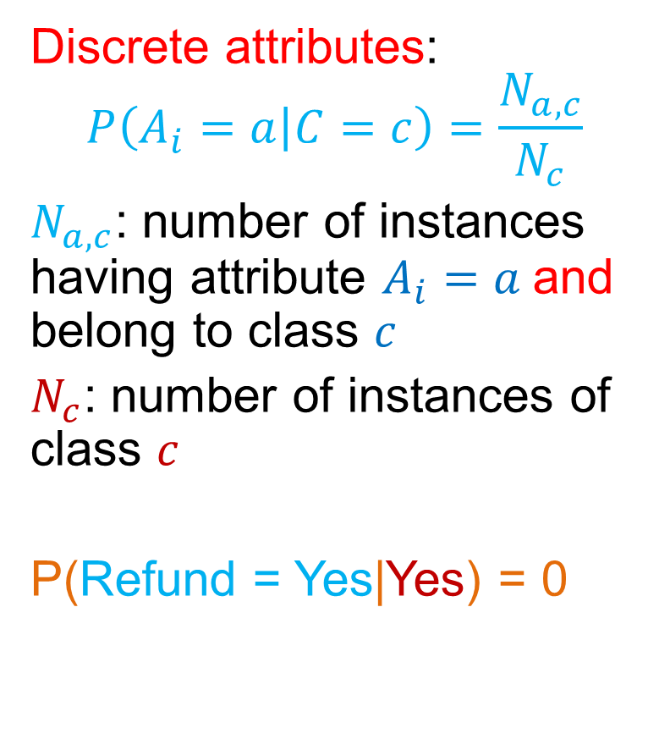
Approximation Ratio for Max-K Coverage
Better news! The GREEDY algorithm has approximation ratio $α=1−\frac{1}{e}$
$GREEDY\left(X\right)≥\left(1−\frac{1}{e}\right)OPT\left(X\right)$, for all X
The coverage of the Greedy solution is at least 63% that of the optimal

Slide 55
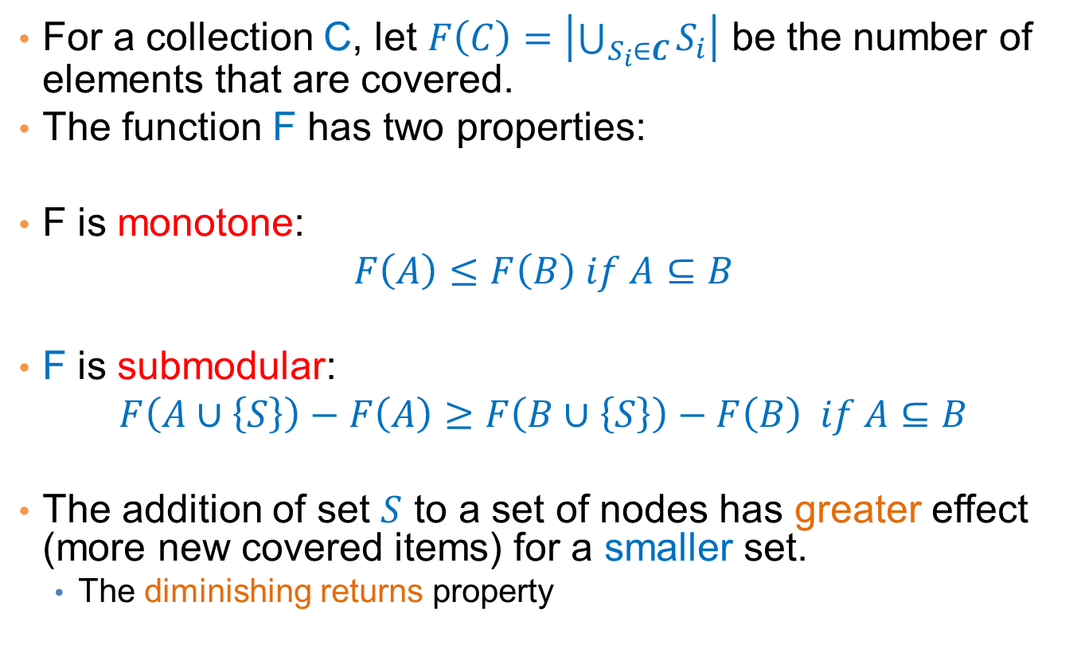
Proof of approximation ratio
For a collection C, let $F\left(C\right)=\left|\bigcup_{S_{i}∈C}{S_{i}}\right|$ be the number of elements that are covered.
The function F has two properties:
F is monotone:
$$F\left(A\right)≤F\left(B\right) if A⊆B$$
F is submodular:
$$F\left(A∪\left\{S\right\}\right)−F\left(A\right)≥F\left(B∪\left\{S\right\}\right)−F\left(B\right) if A⊆B$$
The addition of set $S$ to a set of nodes has greater effect (more new covered items) for a smaller set.
  The diminishing returns property

Slide 56
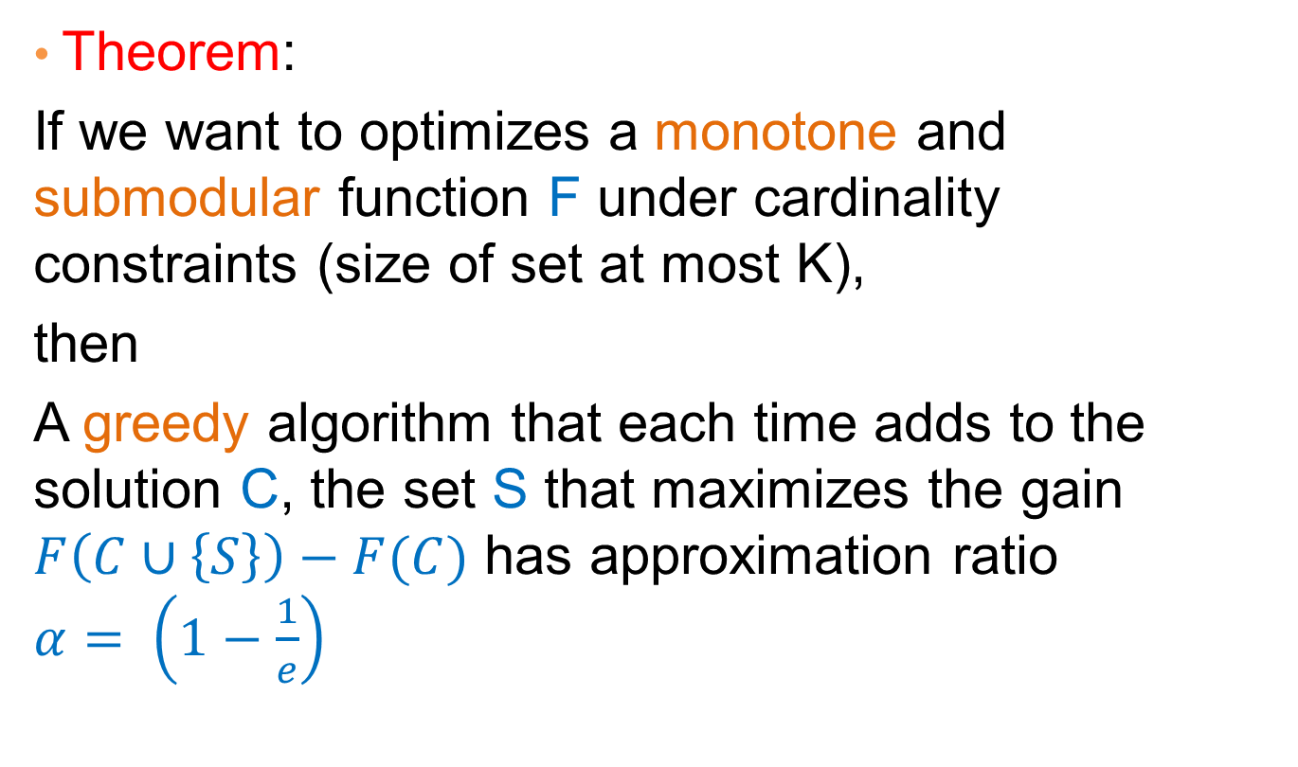
Optimizing submodular functions
Theorem:
If we want to optimizes a monotone and submodular function F under cardinality constraints (size of set at most K),
then
A greedy algorithm that each time adds to the solution C, the set S that maximizes the gain $F\left(C∪\left\{S\right\}\right)−F(C)$ has approximation ratio $α= \left(1−\frac{1}{e}\right)$
True for any monotone and submodular set function!

Slide 57
Other variants of Set Cover
Hitting Set: select a set of elements so that you hit all the sets (the same as the set cover, reversing the roles)
Vertex Cover: Select a subset of vertices such that you cover all edges (an endpoint of each edge is in the set)
  There is a 2-approximation algorithm
Edge Cover: Select a set of edges that cover all vertices (there is one edge that has endpoint the vertex)
  There is a polynomial algorithm

Slide 58
OverVIEW

Slide 59
Class Overview
In this class you saw a set of tools for analyzing data
  Frequent Itemsets, Association Rules
  Sketching
  Recommendation Systems
  Clustering
  Minimum Description Length
  Singular Value Decomposition
  Classification
  Link Analysis Ranking
  Random Walks
  Coverage
All these are useful when trying to make sense of the data. A lot more tools exist.
I hope that you found this interesting, useful and fun.

