Slide 1
DATA MINING
LECTURE 10
Minimum Description Length
Information Theory
Co-Clustering

Slide 2
MINIMUM DESCRIPTION LENGTH

Slide 3
Occam’s razor
Most data mining tasks can be described as creating a model for the data
  E.g., the EM algorithm models the data as a mixture of Gaussians, the K-means models the data as a set of centroids.
What is the right model?
Occam’s razor: All other things being equal, the simplest model is the best.
  A good principle for life as well

Slide 4
Occam's Razor and MDL
What is a simple model?
Minimum Description Length Principle: Every model provides a (lossless) encoding of our data. The model that gives the shortest encoding (best compression) of the data is the best.
  Related: Kolmogorov complexity. Find the shortest program that produces the data (uncomputable).
  MDL restricts the family of models considered
  Encoding cost: cost of party A to transmit to party B the data.

Slide 5
Minimum Description Length (MDL)
The description length consists of two terms
  The cost of describing the model (model cost)
  The cost of describing the data given the model (data cost).
  L(D) = L(M) + L(D|M)
There is a tradeoff between the two costs
  Very complex models describe the data in a lot of detail but are expensive to describe the model
  Very simple models are cheap to describe but it is expensive to describe the data given the model
This is generic idea for finding the right model
  We use MDL as a blanket name.

Slide 6
Example
Regression: find a polynomial for describing a set of values
  Model complexity (model cost): polynomial coefficients
  Goodness of fit (data cost): difference between real value and the polynomial value
Minimum model cost
High data cost
High model cost
Minimum data cost
Low model cost
Low data cost
MDL avoids overfitting automatically!
Source: Grunwald et al. (2005) Tutorial on MDL.

Slide 7
Example
Suppose you want to describe a set of integer numbers
  Cost of describing a single number is proportional to the value of the number x (e.g., logx).
  How can we get an efficient description?
Cluster integers into two clusters and describe the cluster by the centroid and the points by their distance from the centroid
  Model cost: cost of the centroids
  Data cost: cost of cluster membership and distance from centroid
What are the two extreme cases?

Slide 8
MDL and Data Mining
Why does the shorter encoding make sense?
  Shorter encoding implies regularities in the data
  Regularities in the data imply patterns
  Patterns are interesting
Example
00001000010000100001000010000100001000010001000010000100001
Short description length, just repeat 12 times 00001
0100111001010011011010100001110101111011011010101110010011100
Random sequence, no patterns, no compression

Slide 9
Is everything about compression?
Jürgen Schmidhuber: A theory about creativity, art and fun
  Interesting Art corresponds to a novel pattern that we cannot compress well, yet it is not too random so we can learn it
  Good Humor corresponds to an input that does not compress well because it is out of place and surprising
  Scientific discovery corresponds to a significant compression event
    E.g., a law that can explain all falling apples.
Fun lecture:
  Compression Progress: The Algorithmic Principle Behind Curiosity and Creativity

Slide 10
Issues with MDL
What is the right model family?
  This determines the kind of solutions that we can have
    E.g., polynomials
    Clusterings
What is the encoding cost?
  Determines the function that we optimize
  Information theory

Slide 11
INFORMATION THEORY
A short introduction

Slide 12
Encoding
Consider the following sequence
AAABBBAAACCCABACAABBAACCABAC
Suppose you wanted to encode it in binary form, how would you do it?
50% A
25% B
25% C
A → 0
B → 10
C → 11
A is 50% of the sequence
We should give it a shorter representation
This is actually provably the best encoding!

Slide 13
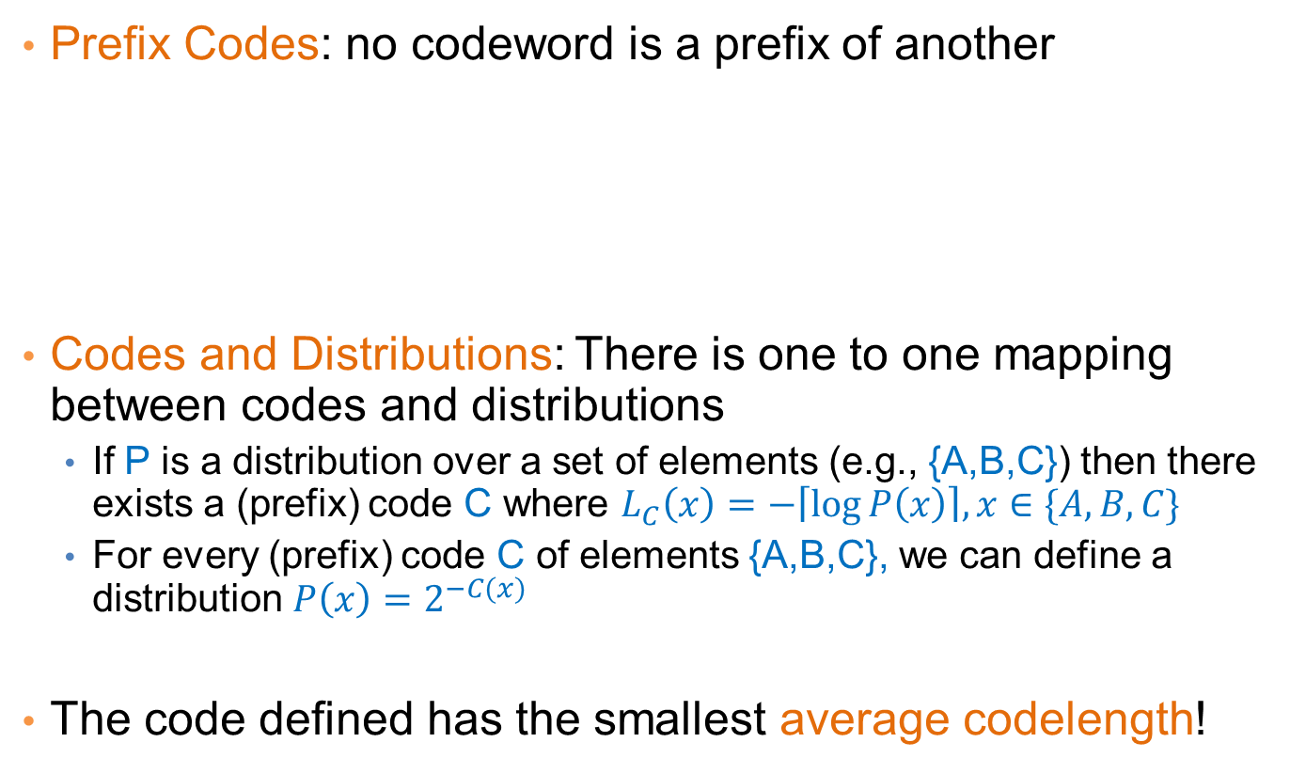
Encoding
Prefix Codes: no codeword is a prefix of another
Codes and Distributions: There is one to one mapping between codes and distributions
  If P is a distribution over a set of elements (e.g., {A,B,C}) then there exists a (prefix) code C where $L_{C}\left(x\right)=−\left\lceil \log{P\left(x\right)}\right\rceil , x∈\{A,B,C\}$
  For every (prefix) code C of elements {A,B,C}, we can define a distribution $P\left(x\right)=2^{−C(x)}$
The code defined has the smallest average codelength!
A → 0
B → 10
C → 11
Uniquely directly decodable
For every code we can find a prefix code of equal length

Slide 14
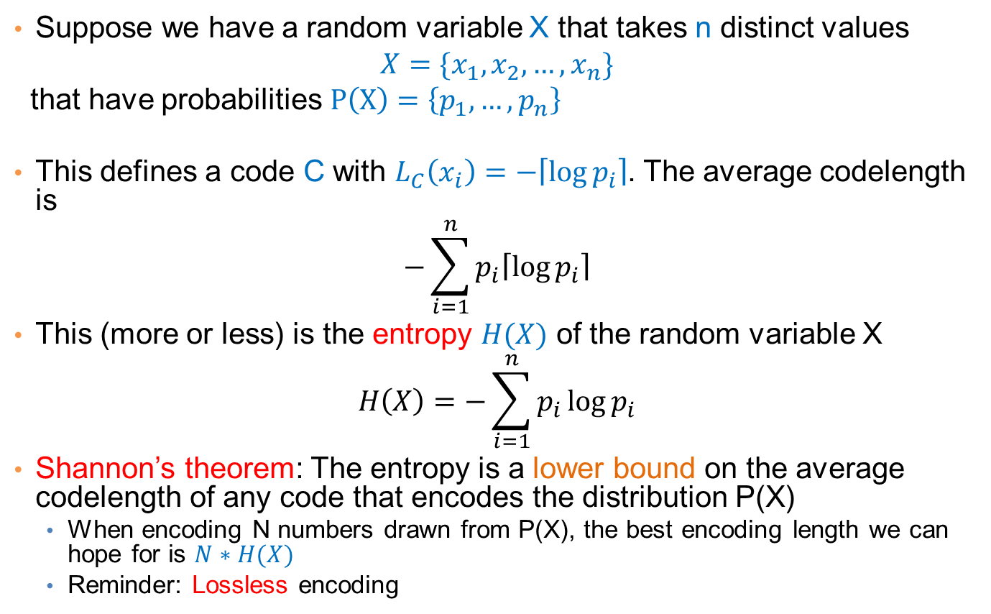
Entropy
Suppose we have a random variable X that takes n distinct values
$$X=\{x_{1},x_{2},…, x_{n}\}$$
that have probabilities $P\left(X\right)=\left\{p_{1},…, p_{n}\right\}$
This defines a code C with $L_{C}\left(x_{i}\right)=−\left\lceil \log{p_{i}}\right\rceil$. The average codelength is
$$−\sum_{i=1}^{n}{p_{i}\left\lceil \log{p_{i}}\right\rceil }$$
This (more or less) is the entropy $H(X)$ of the random variable X
$$H\left(X\right)=−\sum_{i=1}^{n}{p_{i}\log{p_{i}}}$$
Shannon’s theorem: The entropy is a lower bound on the average codelength of any code that encodes the distribution P(X)
  When encoding N numbers drawn from P(X), the best encoding length we can hope for is $N∗H(X)$
  Reminder: Lossless encoding

Slide 15
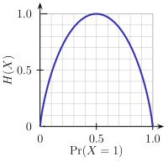
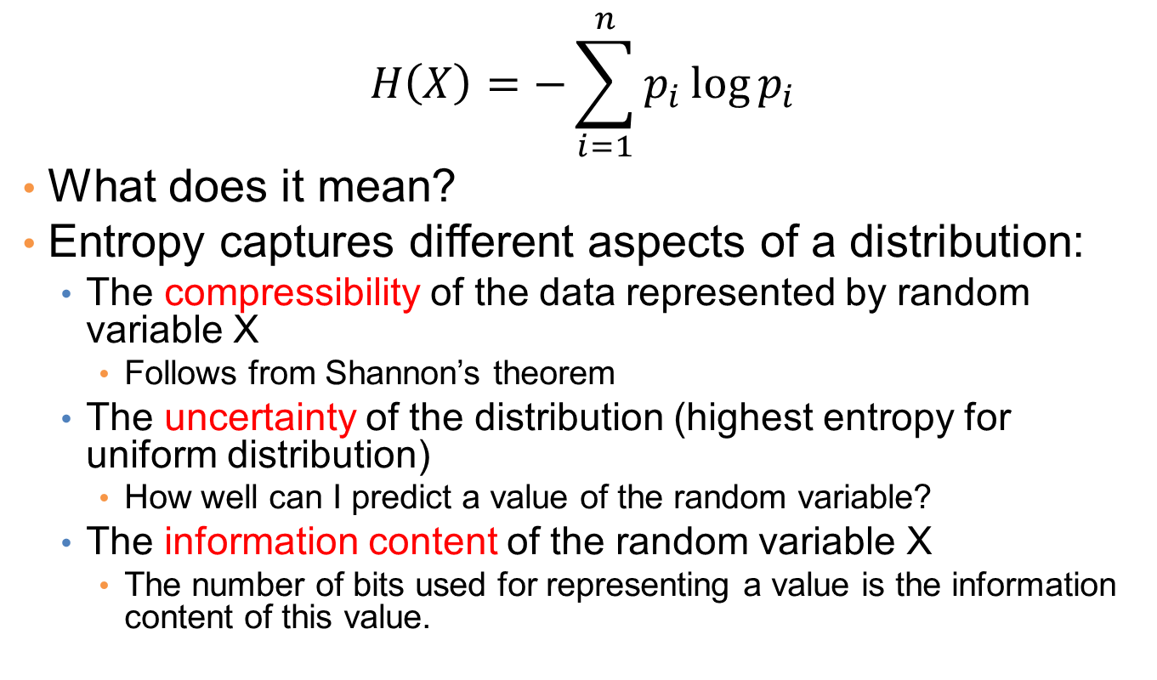
Entropy
$$H\left(X\right)=−\sum_{i=1}^{n}{p_{i}\log{p_{i}}}$$
What does it mean?
Entropy captures different aspects of a distribution:
  The compressibility of the data represented by random variable X
    Follows from Shannon’s theorem
  The uncertainty of the distribution (highest entropy for uniform distribution)
    How well can I predict a value of the random variable?
  The information content of the random variable X
    The number of bits used for representing a value is the information content of this value.

Slide 16
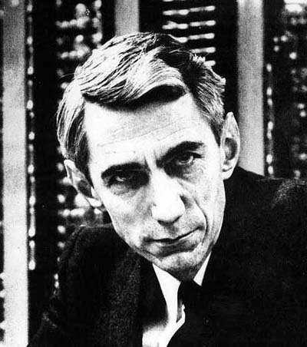
Claude Shannon
Father of Information Theory
Envisioned the idea of communication of information with 0/1 bits
Introduced the word “bit”
The word entropy was suggested by Von Neumann
  Similarity to physics, but also
  “nobody really knows what entropy really is, so in any conversation you will have an advantage”

Slide 17
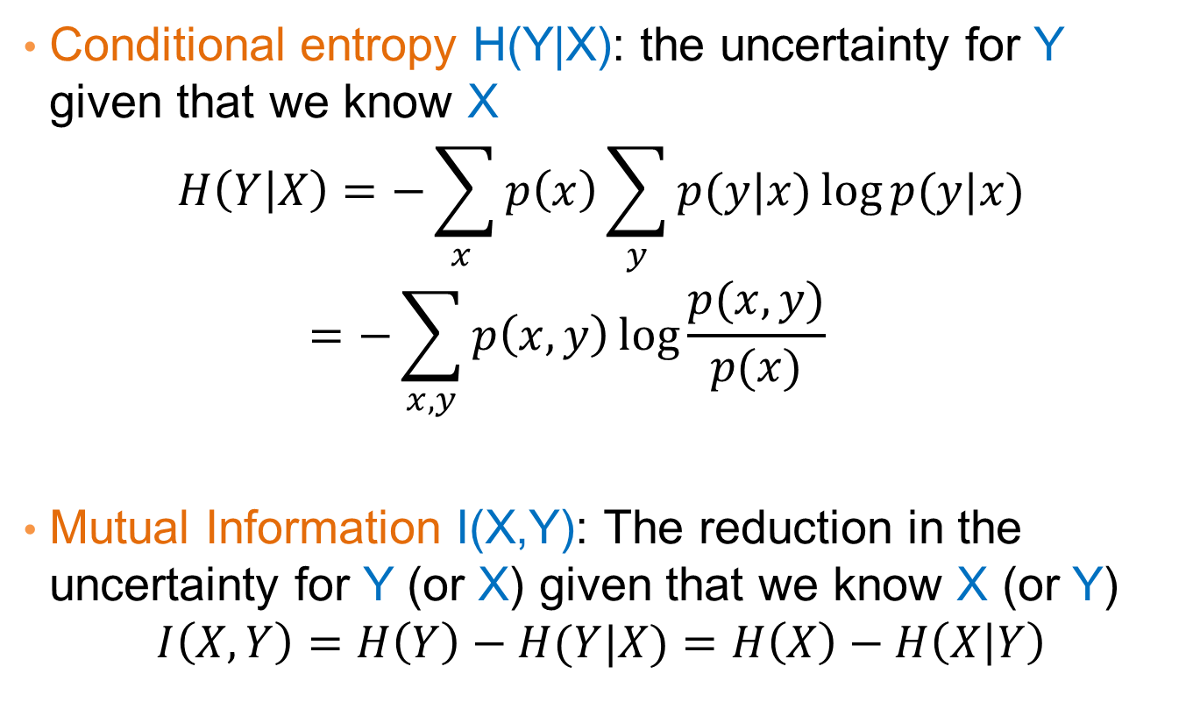
Some information theoretic measures
Conditional entropy H(Y|X): the uncertainty for Y given that we know X
$$H\left(Y | X\right)=−\sum_{x }{p\left(x\right)\sum_{y}{p(y|x)\log{p(y|x)}}}=−\sum_{x,y}{p\left(x,y\right)\log{\frac{p(x,y)}{p(x)}}}$$
Mutual Information I(X,Y): The reduction in the uncertainty for Y (or X) given that we know X (or Y)
$$I\left(X,Y\right)=H\left(Y\right)−H(Y|X)=H\left(X\right)−H\left(X | Y\right)$$

Slide 18
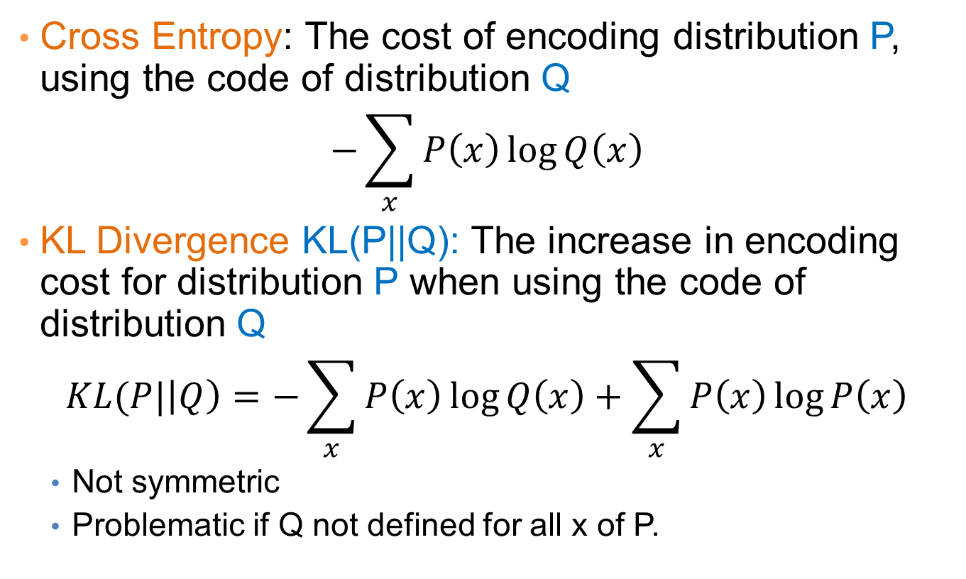
Some information theoretic measures
Cross Entropy: The cost of encoding distribution P, using the code of distribution Q
$$−\sum_{x}{P\left(x\right)\log{Q\left(x\right)}}$$
KL Divergence KL(P||Q): The increase in encoding cost for distribution P when using the code of distribution Q
$$KL(P|\left|Q\right)=−\sum_{x}{P\left(x\right)\log{Q\left(x\right)}}+\sum_{x}{P\left(x\right)\log{P\left(x\right)}}$$
  Not symmetric
  Problematic if Q not defined for all x of P.

Slide 19
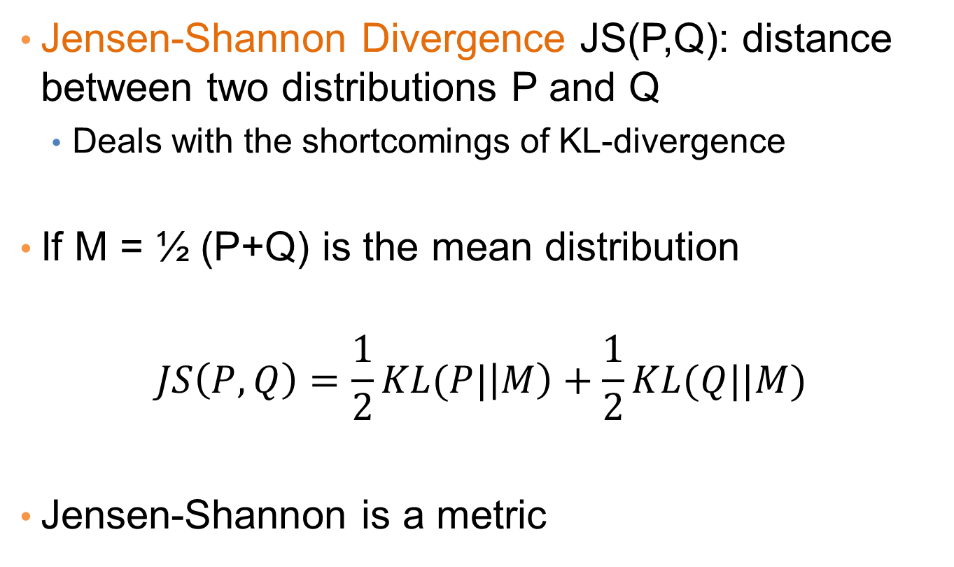
Some information theoretic measures
Jensen-Shannon Divergence JS(P,Q): distance between two distributions P and Q
  Deals with the shortcomings of KL-divergence
If M = ½ (P+Q) is the mean distribution
$$JS\left(P,Q\right)=\frac{1}{2}KL(P|\left|M\right)+\frac{1}{2}KL(Q||M)$$
Jensen-Shannon is a metric

Slide 20
Using MDL for
Co-CLUSTERING
(CROSS-ASSOCIATIONS)
Thanks to Spiros Papadimitriou.

Slide 21

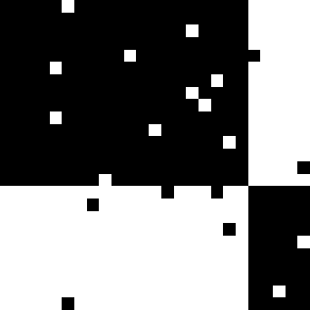
Co-clustering
Simultaneous grouping of rows and columns of a matrix into homogeneous groups
Students buying books
5
5
97%
3%
10
10
Customers
54%
Customer groups
15
15
20
20
3%
96%
25
25
5
10
15
20
25
5
10
15
20
25
Product groups
Products
CEOs buying BMWs

Slide 22
Co-clustering
Step 1: How to define a “good” partitioning?
Intuition and formalization
Step 2: How to find it?

Slide 23
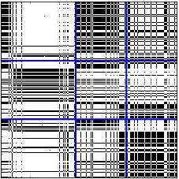
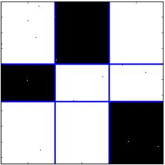
Co-clustering
Intuition
Why is this better?
Row groups
Row groups
versus
Column groups
Column groups
Good Clustering
Similar nodes are grouped together
As few groups as necessary
A few, homogeneous blocks
Good Compression
implies

Slide 24
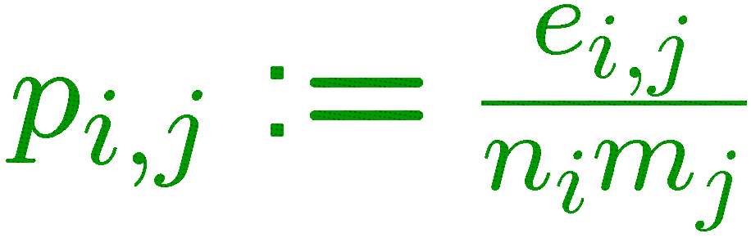
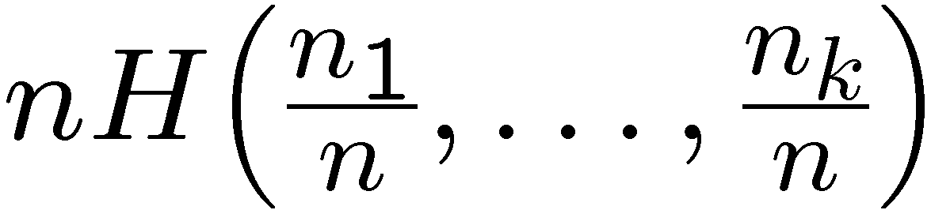
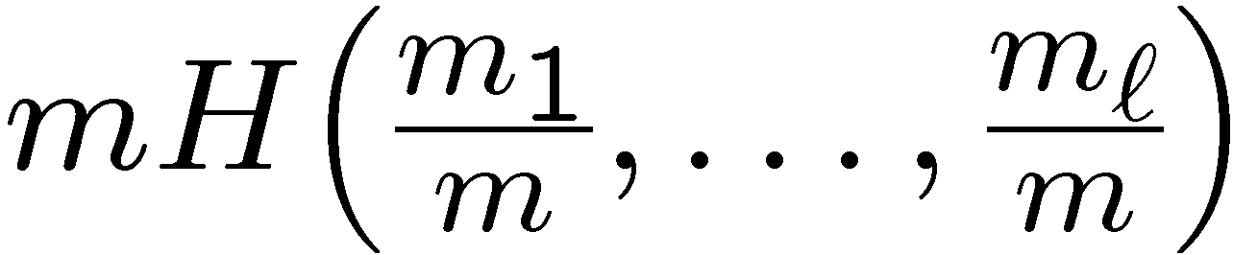
Co-clustering
MDL formalization—Cost objective
ℓ = 3 col. groups
m₁
m₂
m₃
density of ones
n₁
n₁m₂ H(p_{1,2}) bits for (1,2)
p_{1,1}
p_{1,2}
p_{1,3}
block size
entropy
∑_{i,j} n_{i}m_{j} H(p_{i,j})
bits total
k = 3 row groups
n₂
p_{2,1}
p_{2,2}
p_{2,3}
data cost
+
model cost
n₃
p_{3,1}
p_{3,2}
p_{3,3}
+
row-partition
description
col-partition
description
+
log*k + log*ℓ
+
∑_{i,j}
⎡log n_{i}m_{j}⎤
n × m matrix
transmit
#partitions
transmit
#ones e_{i,j}

Slide 25
Co-clustering
MDL formalization—Cost objective
✗
✗
one row group
one col group
n row groups
m col groups
high
low
code cost
(block contents)
+
low
high
description cost
(block structure)

Slide 26
Co-clustering
MDL formalization—Cost objective
✓
k = 3 row groups
ℓ = 3 col groups
low
code cost
(block contents)
+
low
description cost
(block structure)

Slide 27
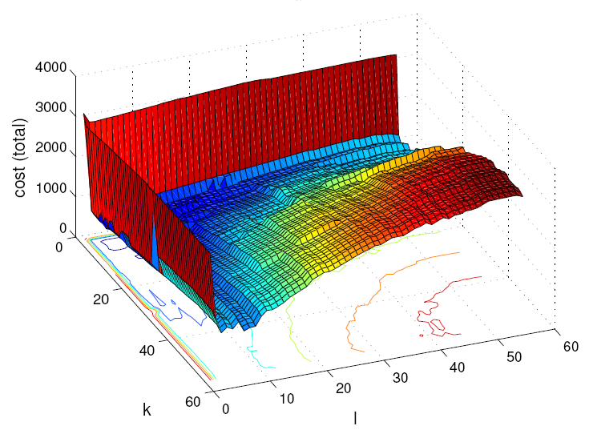
Co-clustering
MDL formalization—Cost objective
Cost vs. number of groups
one row group
one col group
total bit cost
n row groups
m col groups
k
ℓ
k = 3 row groups
ℓ = 3 col groups

Slide 28
Co-clustering
Step 1: How to define a “good” partitioning?
Intuition and formalization
Step 2: How to find it?

Slide 29
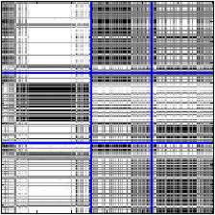
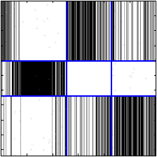
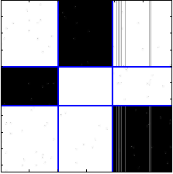
Search for solution
Overview: assignments w/ fixed number of groups (shuffles)
original groups
row shuffle
column shuffle
row shuffle
reassign all rows,
holding column
assignments fixed
reassign all columns,
holding row
assignments fixed
No cost improvement:
Discard

Slide 30
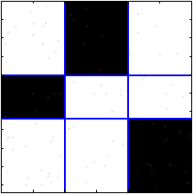
Search for solution
Overview: assignments w/ fixed number of groups (shuffles)
Final shuffle result
row shuffle
column shuffle
column shuffle
column shuffle
row shuffle
No cost improvement:
Discard

Slide 31
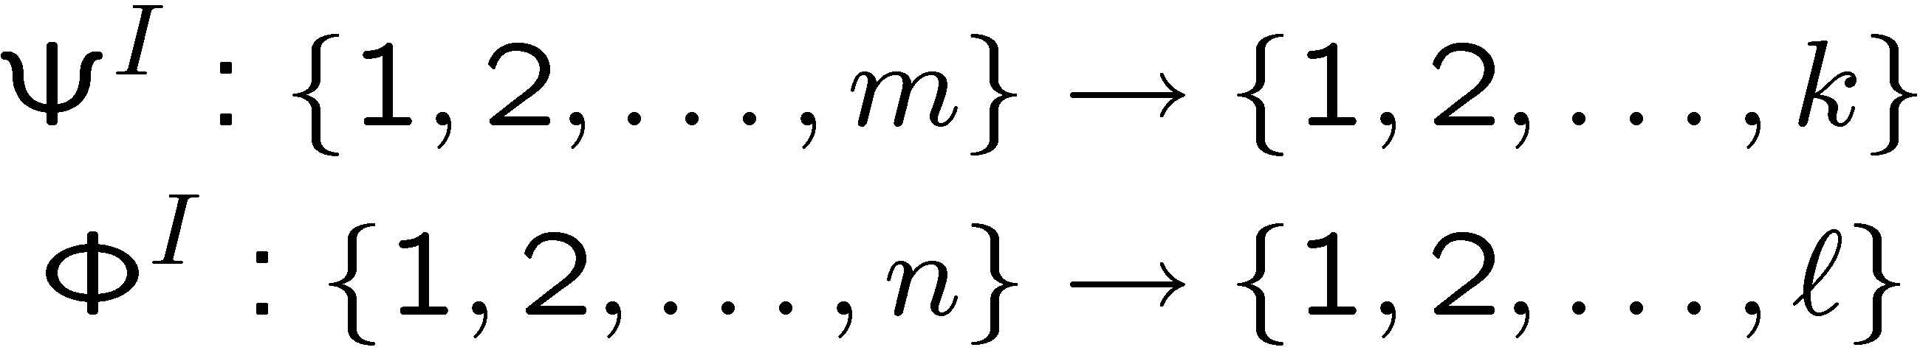
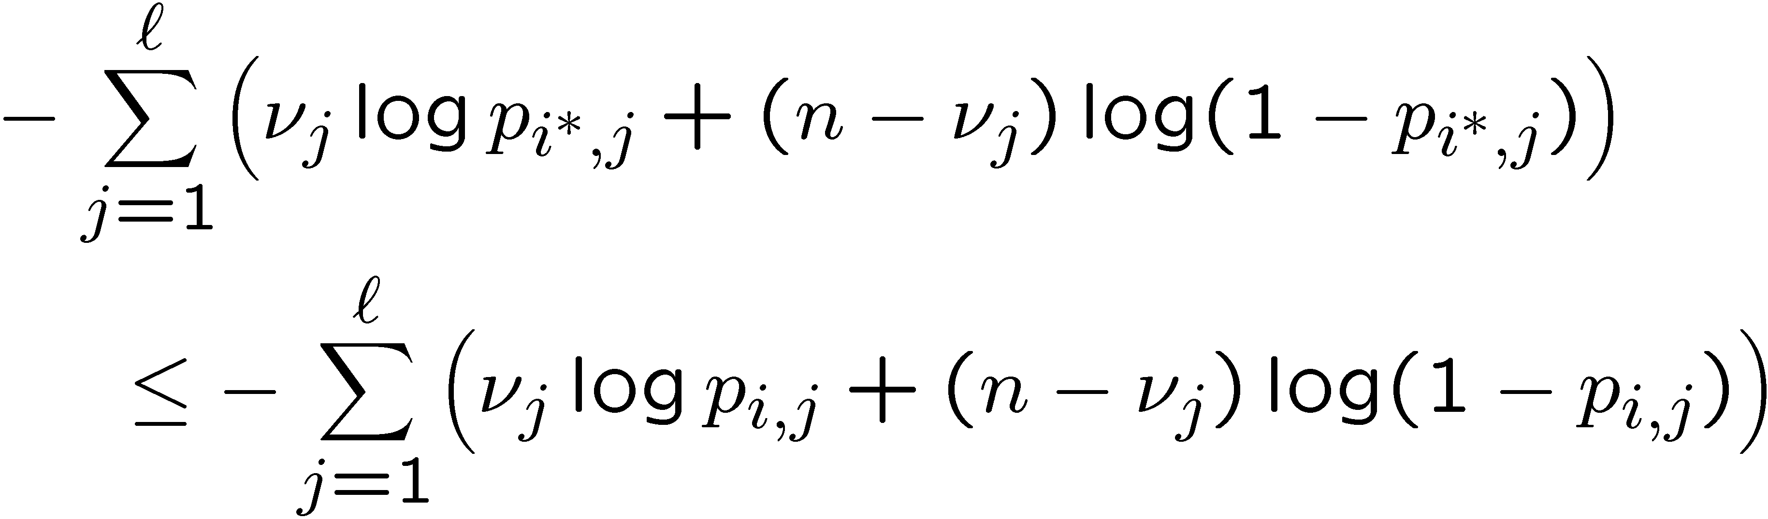
Search for solution
Shuffles
Let
denote row and col. partitions at the I-th iteration
Fix Φ^{I} and for every row x:
  Splice into ℓ parts, one for each column group
  Let ν_{j}, for j = 1,…,ℓ, be the number of ones in each part
  Assign row x to the row group i¤ ≡ Ψ^{I+1}(x) such that, for all i = 1,…,k,
Similarity (“KL-divergences”)
of row fragments
to blocks of a row group
p_{1,1}
p_{1,2}
p_{1,3}
p_{2,1}
p_{2,2}
p_{2,3}
Assign to second row-group
p_{3,1}
p_{3,2}
p_{3,3}

Slide 32
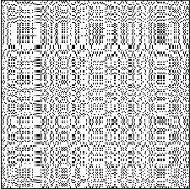
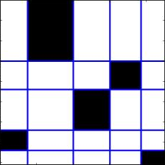
Search for solution
Overview: number of groups k and ℓ (splits & shuffles)
k = 5, ℓ = 5

Slide 33
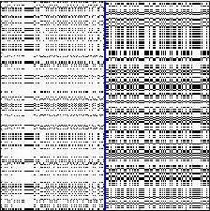
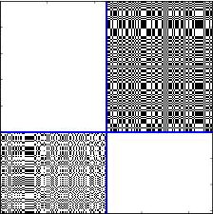
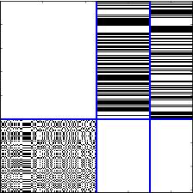
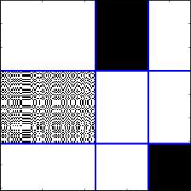
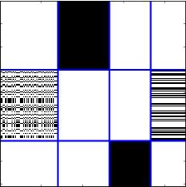
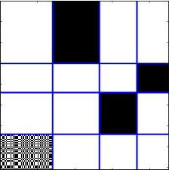
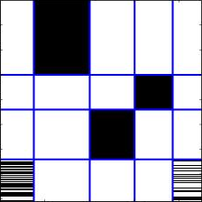
Search for solution
Overview: number of groups k and ℓ (splits & shuffles)
k = 1, ℓ = 1
shuffle
shuffle
col. split
row split
row split
No cost improvement:
Discard
k = 5, ℓ = 6
k = 6, ℓ = 5
k = 5, ℓ = 5
shuffle
shuffle
shuffle
shuffle
shuffle
shuffle
shuffle
col. split
row split
col. split
row split
col. split
row split
col. split
k=1, ℓ=2
k=2, ℓ=2
k=2, ℓ=3
k=3, ℓ=3
k=3, ℓ=4
k=4, ℓ=4
k=4, ℓ=5
Split:
Increase k or ℓ
Shuffle:
Rearrange rows or cols

Slide 34
Search for solution
Overview: number of groups k and ℓ (splits & shuffles)
k = 1, ℓ = 1
k = 5, ℓ = 5
k = 5, ℓ = 5
Final result
k=1, ℓ=2
k=2, ℓ=2
k=2, ℓ=3
k=3, ℓ=3
k=3, ℓ=4
k=4, ℓ=4
k=4, ℓ=5
Split:
Increase k or ℓ
Shuffle:
Rearrange rows or cols

Slide 35
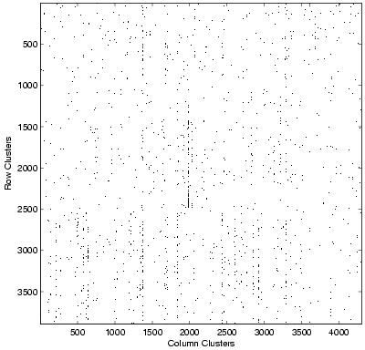
Co-clustering
CLASSIC
CLASSIC corpus
3,893 documents
4,303 words
176,347 “dots” (edges)
Combination of 3 sources:
MEDLINE (medical)
CISI (info. retrieval)
CRANFIELD (aerodynamics)
Documents
Words

Slide 36
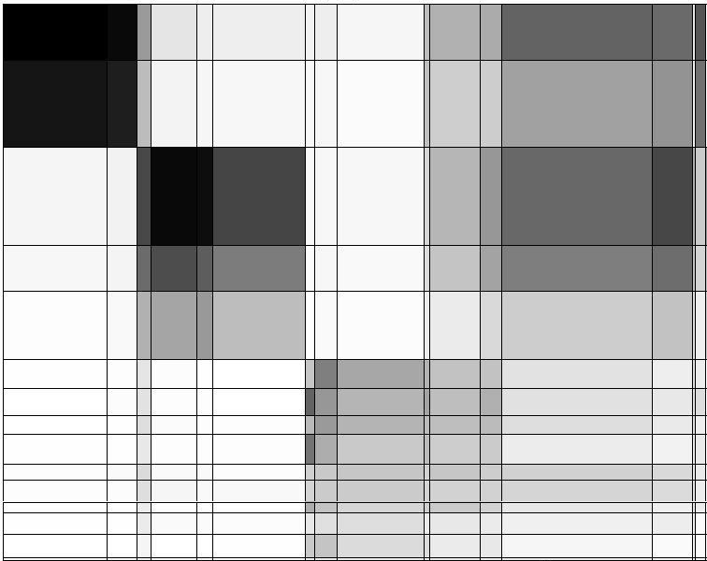
Graph co-clustering
CLASSIC
Documents
Words
“CLASSIC” graph of documents & words:
k = 15, ℓ = 19

Slide 37
Co-clustering
CLASSIC
insipidus, alveolar, aortic, death, prognosis, intravenous
blood, disease, clinical, cell, tissue, patient
paint, examination, fall, raise, leave, based
MEDLINE
(medical)
CISI
(Information Retrieval)
CRANFIELD (aerodynamics)
providing, studying, records, development, students, rules
abstract, notation, works, construct, bibliographies
shape, nasa, leading, assumed, thin
“CLASSIC” graph of documents & words:
k = 15, ℓ = 19

Slide 38
Co-clustering
CLASSIC
Document cluster # | Document class |  |  | Precision
 | CRANFIELD | CISI | MEDLINE
1 | 0 | 1 | 390 | 0.997
2 | 0 | 0 | 610 | 1.000
3 | 2 | 676 | 9 | 0.984
4 | 1 | 317 | 6 | 0.978
5 | 3 | 452 | 16 | 0.960
6 | 207 | 0 | 0 | 1.000
7 | 188 | 0 | 0 | 1.000
8 | 131 | 0 | 0 | 1.000
9 | 209 | 0 | 0 | 1.000
10 | 107 | 2 | 0 | 0.982
11 | 152 | 3 | 2 | 0.968
12 | 74 | 0 | 0 | 1.000
13 | 139 | 9 | 0 | 0.939
14 | 163 | 0 | 0 | 1.000
15 | 24 | 0 | 0 | 1.000
Recall | 0.996 | 0.990 | 0.968
0.999
0.975
0.94-1.00
0.987
0.97-0.99

