Slide 1
Online Social Networks and Media
Cascading Behavior in Networks
Epidemic Spread
Influence Maximization

Slide 2
Introduction
Diffusion: process by which a piece of information is spread and reaches individuals through interactions.

Slide 3
Cascading Behavior in Networks

Slide 4
Innovation Diffusion in Networks
How new behaviors, practices, opinions and technologies spread from person to person through a social network as people influence their friends to adopt new ideas
Information effect: choices made by others can provide indirect information about what they know
Old studies:
Adoption of hybrid seed corn among farmers in Iowa
Adoption of tetracycline by physicians in US
Basic observations:
Characteristics of early adopters
Decisions made in the context of social structure

Slide 5
Spread of Innovation
Direct-Benefit Effect: there are direct payoffs from copying the decisions of others (relative advantage)
Spread of technologies such as the phone, email, etc
Common principles:
Complexity of people to understand and implement
Observability, so that people can become aware that others are using it
Trialability, so that people can mitigate its risks by adopting it gradually and incrementally
Compatibility with the social system that is entering (homophily?)

Slide 6
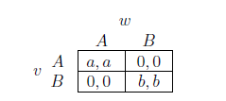
A Direct-Benefit Model
An individual level model of direct-benefit effects in networks due to S. Morris
The benefits of adopting a new behavior increase as more and more of the social network neighbors adopt it
A Coordination Game
Two players (nodes), u and w linked by an edge
Two possible behaviors (strategies): A and B
If both u and w adapt A, get payoff a > 0
If both u and w adapt B, get payoff b > 0
If opposite behaviors, than each get a payoff 0

Slide 7
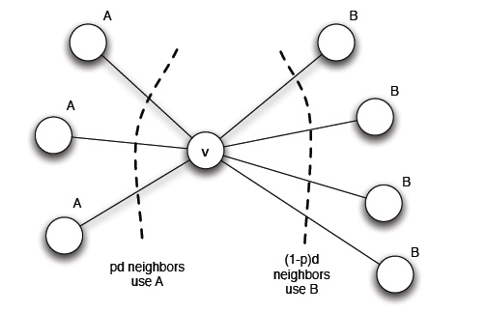
Modeling Diffusion through a Network
u plays a copy of the game with each of its neighbors, its payoff is the sum of the payoffs in the games played on each edge
Say some of its neighbors adopt A and some B, what should u do to maximize its payoff?
Threshold q = b/(a+b) for preferring A
(at least q of the neighbors follow A)
Two obvious equilibria, which ones?

Slide 8
Modeling Diffusion through a Network: Cascading Behavior
Suppose that initially everyone is using B as a default behavior
A small set of “initial adopters” decide to use A
When will this result in everyone eventually switching to A?
If this does not happen, what causes the spread of A to stop?
Depends on the choice of the initial adapters and threshold q
Observation: strictly progressive sequence of switches from B to A

Slide 9
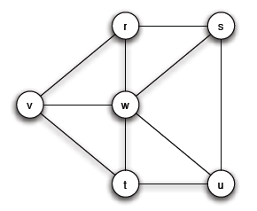
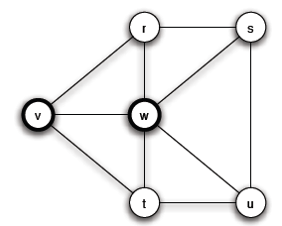
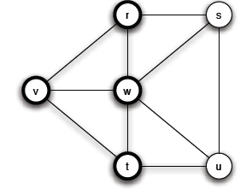
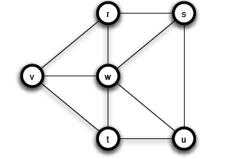
Modeling Diffusion through a Network: Cascading Behavior
a = 3, b = 2, q = 2/5
A
A
Step 1
Chain reaction of switches to B -> A cascade of adoptions of A
Step 2

Slide 10
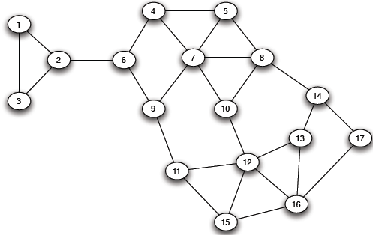
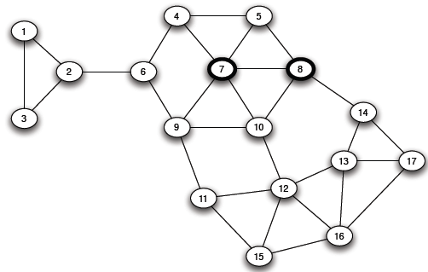
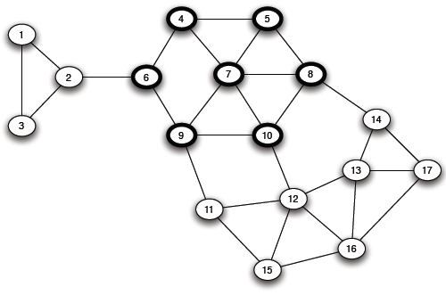
Modeling Diffusion through a Network: Cascading Behavior
a = 3, b = 2, q = 2/5
Step 3

Slide 11
Modeling Diffusion through a Network: Cascading Behavior
A set of initial adopters who start with a new behavior A, while every other node starts with behavior B.
Nodes repeatedly evaluate the decision to switch from B to A using a threshold of q.
If the resulting cascade of adoptions of A eventually causes every node to switch from B to A, then we say that the set of initial adopters causes a complete cascade at threshold q.

Slide 12
Modeling Diffusion through a Network: Cascading Behavior and “Viral Marketing”
Tightly-knit communities in the network can work to hinder the spread of an innovation
(examples, age groups and life-styles in social networking sites, Mac users, political opinions)
Strategies
Improve the quality of A (increase the payoff a) (in the example, set a = 4)
Convince a small number of key people to switch to A
Network-level cascade innovation adoption models vs population-level

Slide 13
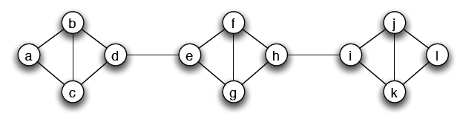
Cascades and Clusters
A cluster of density p is a set of nodes such that each node in the set has at least a p fraction of its neighbors in the set
However,
Does not imply that any two nodes in the same cluster necessarily have much in common (what is the density of a cluster with all nodes?)
The union of any two cluster of density p is also a cluster of density at least p

Slide 14
Cascades and Clusters

Slide 15
Cascades and Clusters
Claim: Consider a set of initial adopters of behavior A, with a threshold of q for nodes in the remaining network to adopt behavior A.
(clusters as obstacles to cascades)
If the remaining network contains a cluster of density greater than 1 − q, then the set of initial adopters will not cause a complete cascade.
(ii) (clusters are the only obstacles to cascades)
Whenever a set of initial adopters does not cause a complete cascade with threshold q, the remaining network must contain a cluster of density greater than 1 − q.

Slide 16
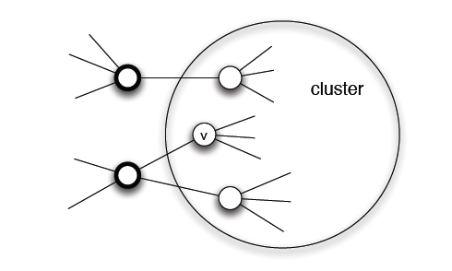
Cascades and Clusters
Proof of (i) (clusters as obstacles to cascades)
Proof by contradiction
Let v be the first node in the cluster that adopts A

Slide 17
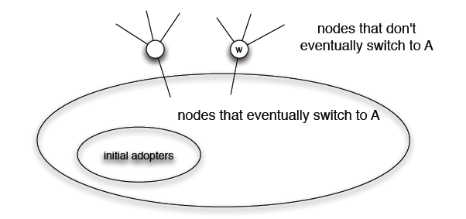
Cascades and Clusters
Proof of (ii) (clusters are the only obstacles to cascades)
Let S be the set of all nodes using B at the end of the process
Show that S is a cluster of density > 1 - q

Slide 18
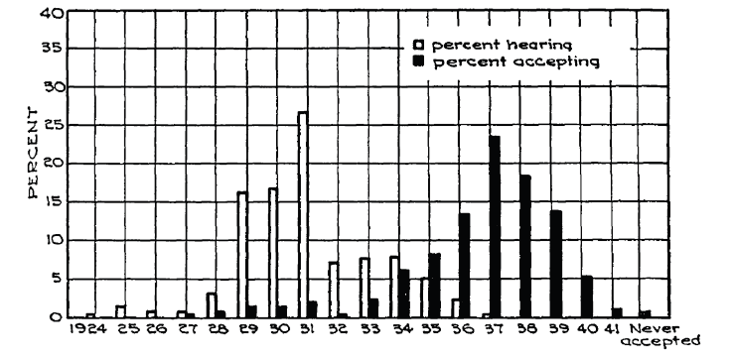
Innovation Adoption Characteristics
A crucial difference between learning a new idea and actually deciding to accept it

Slide 19
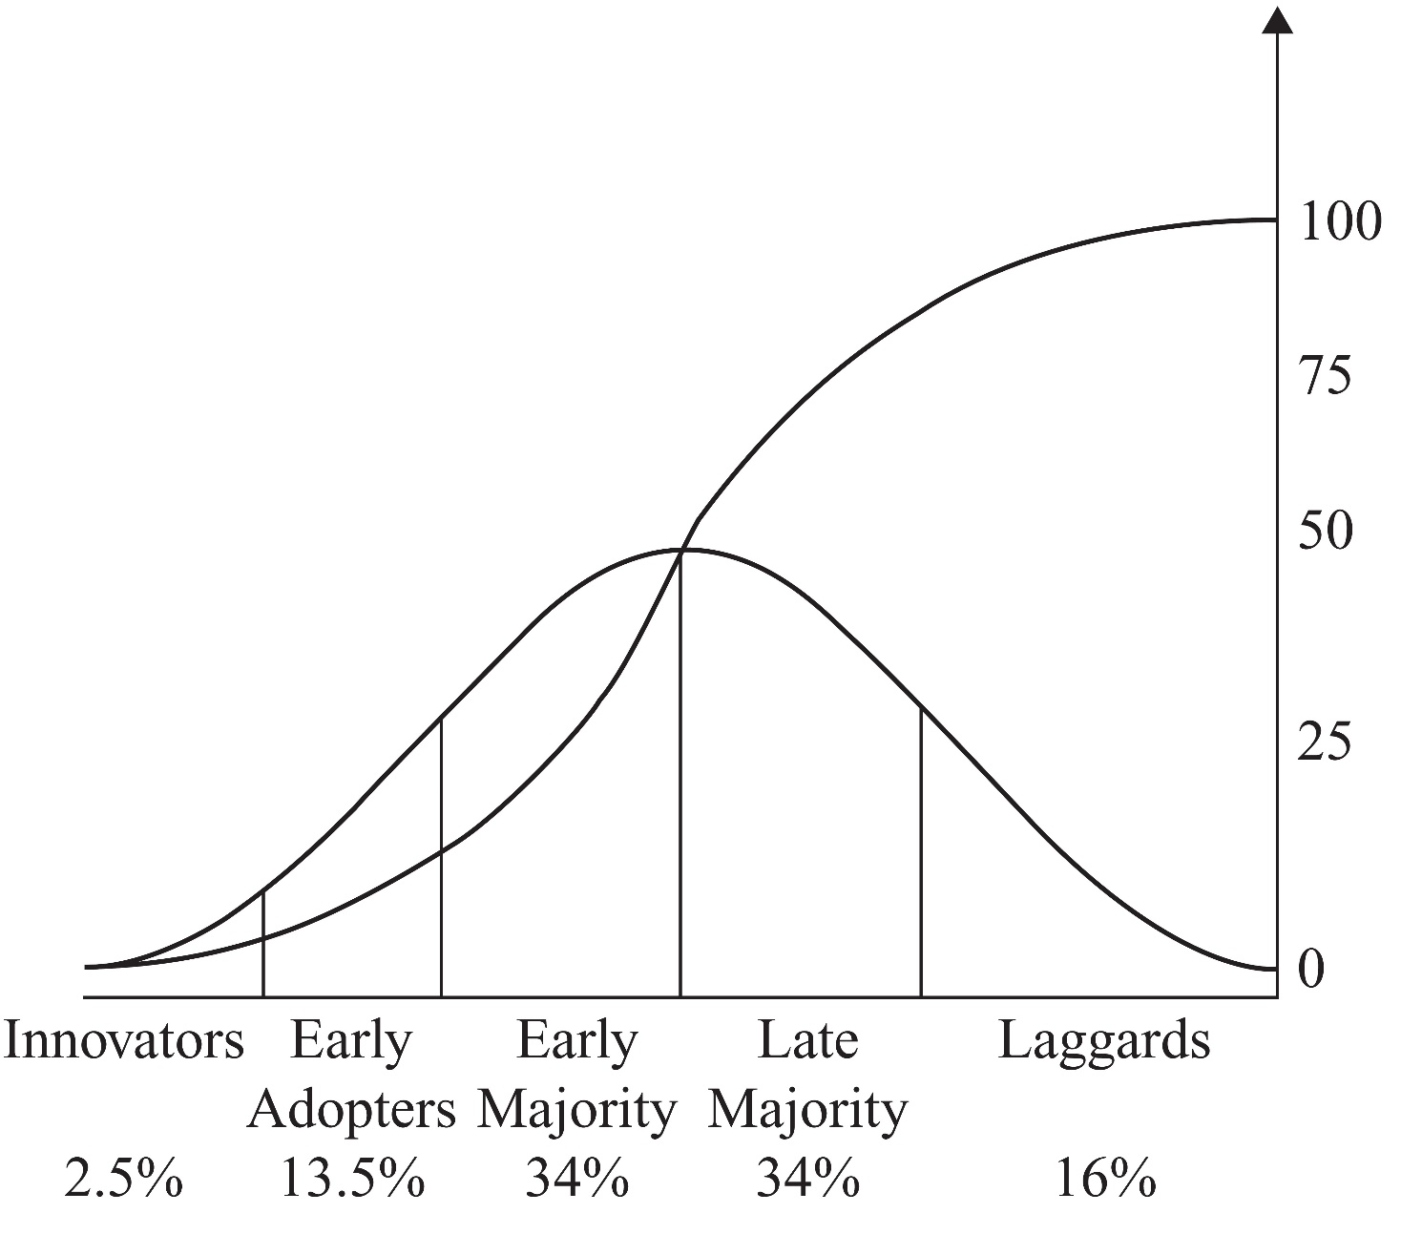
Innovation Adoption Characteristics
Category of Adopters in the corn study

Slide 20
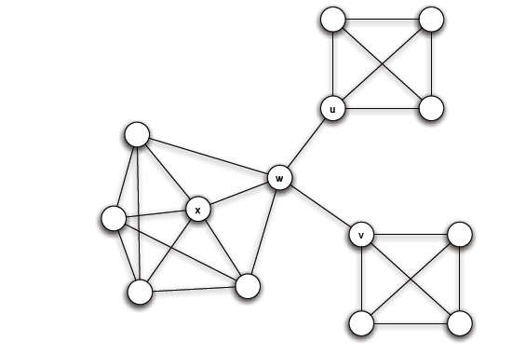
Diffusion, Thresholds and the Role of Weak Ties
Relation to weak ties and local bridges
q = 1/2
Bridges convey awareness but are weak at transmitting costly to adopt behaviors

Slide 21

Extensions of the Basic Cascade Model: Heterogeneous Thresholds
Each person values behaviors A and B differently:
If both u and w adapt A, u gets a payoff a_{u} > 0 and w a payoff a_{w} > 0
If both u and w adapt B, u gets a payoff b_{u} > 0 and w a payoff b_{w} > 0
If opposite behaviors, than each gets a payoff 0
Each node u has its own personal threshold q_{u} ≥ b_{u} /(a_{u}+ b_{u})

Slide 22
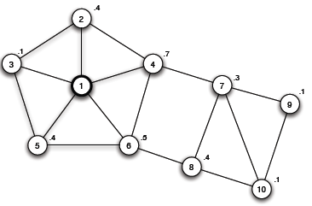
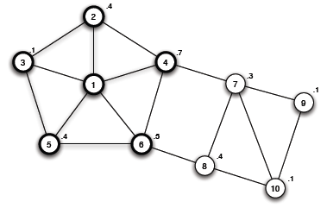
Extensions of the Basic Cascade Model: Heterogeneous Thresholds
Not just the power of influential people, but also the extent to which they have access to easily influenceable people
What about the role of clusters?
A blocking cluster in the network is a set of nodes for which each node u has more that 1 – q_{u} fraction of its friends also in the set.

Slide 23
Knowledge, Thresholds and Collective Action: Collective Action and Pluralistic Ignorance
A collective action problem: an activity produces benefits only if enough people participate (population level effect)
Pluralistic ignorance: a situation in which people have wildly erroneous estimates about the prevalence of certain opinions in the population at large (lack of knowledge)

Slide 24
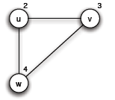
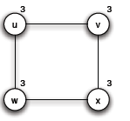
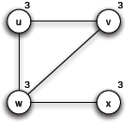
Knowledge, Thresholds and Collective Action:
A model for the effect of knowledge on collective actions
Each person has a personal threshold which encodes her willingness to participate
A threshold of k means that she will participate if at least k people in total (including herself) will participate
Each person in the network knows the thresholds of her neighbors in the network
w will never join, since there are only 3 people
v
u
Is it safe for u to join?
Is it safe for u to join? (common knowledge)

Slide 25
Knowledge, Thresholds and Collective Action:
Common Knowledge and Social Institutions
Not just transmit a message, but also make the listeners or readers aware that many others have gotten the message as well
Social networks do not simply allow for interaction and flow of information, but these processes in turn allow individuals to base decisions on what other knows and on how they expect others to behave as a result

Slide 26
The Cascade Capacity
Given a network, what is the largest threshold at which any “small” set of initial adopters can cause a complete cascade?
Called cascade capacity of the network
Infinite network in which each node has a finite number of neighbors
Small means finite set of nodes

Slide 27
The Cascade Capacity: Cascades on Infinite Networks
Same model as before:
Initially, a finite set S of nodes has behavior A and all others adopt B
Time runs forwards in steps, t = 1, 2, 3, …
In each step t, each node other than those in S uses the decision rule with threshold q to decide whether to adopt behavior A or B
The set S causes a complete cascade if, starting from S as the early adopters of A, every node in the network eventually switched permanently to A.
The cascade capacity of the network is the largest value of the threshold q for which some finite set of early adopters can cause a complete cascade.

Slide 28

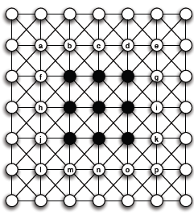
The Cascade Capacity: Cascades on Infinite Networks
An infinite path
Spreads if ≤ 1/2
An infinite grid
Spreads if ≤ 3/8
An intrinsic property of the network
Even if A better, for q strictly between 3/8 and ½, A cannot win

Slide 29
The Cascade Capacity: Cascades on Infinite Networks
How large can a cascade capacity be?
At least 1/2
Is there any network with a higher cascade capacity?
This will mean that an inferior technology can displace a superior one, even when the inferior technology starts at only a small set of initial adopters.

Slide 30
The Cascade Capacity: Cascades on Infinite Networks
Claim: There is no network in which the cascade capacity exceeds 1/2

Slide 31
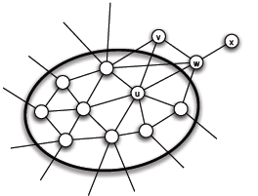
The Cascade Capacity: Cascades on Infinite Networks
Interface: the set of A-B edges
Prove that in each step the size of the interface strictly decreases
Why is this enough?

Slide 32
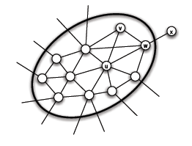
The Cascade Capacity: Cascades on Infinite Networks
At some step, a number of nodes decide to switch from B to A
General Remark: In this simple model, a worse technology cannot displace a better and wide-spread one

Slide 33

Compatibility and its Role in Cascades
An extension where a single individual can sometimes choose a combination of two available behaviors -> three strategies A, B and AB
Coordination game with a bilingual option
Two bilingual nodes can interact using the better of the two behaviors
A bilingual and a monolingual node can only interact using the behavior of the monolingual node
AB is a dominant strategy?
Cost c associated with the AB strategy

Slide 34

Compatibility and its Role in Cascades
Example (a = 2, b =3, c =1)
B: 0+b = 3
A: 0+a = 2
AB: b+a-c = 4 √
B: b+b = 6 √
A: 0+a = 2
AB: b+b-c = 5

Slide 35
Compatibility and its Role in Cascades
Example (a = 5, b =3, c =1)
B: 0+b = 3
A: 0+a = 5
AB: b+a-c = 7 √
B: 0+b = 3
A: 0+a = 5
AB: b+a-c = 7 √
B: 0+b = 3
A: α+a = 10 √
AB: a+a-c = 9

Slide 36

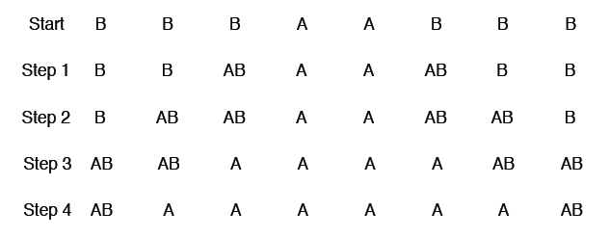
Compatibility and its Role in Cascades
Example (a = 5, b =3, c =1)
First, strategy AB spreads, then behind it, nodes switch permanently from AB to A
Strategy B becomes vestigial

Slide 37
Compatibility and its Role in Cascades
Given an infinite graph, for which payoff values of a, b and c, is it possible for a finite set of nodes to cause a complete cascade of adoptions of A?
Fixing b = 1 (default technology)
Given an infinite graph, for which payoff values of a (how much better the new behavior A) and c (how compatible should it be with B), is it possible for a finite set of nodes to cause a complete cascade of adoptions of A?
A does better when it has a higher payoff, but in general it has a particularly hard time cascading when the level of compatibility is “intermediate” – when the value of c is neither too high nor too low

Slide 38

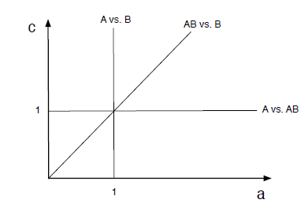
Compatibility and its Role in Cascades
Example: Infinite path
Spreads when q ≤ 1/2, a ≥ b (a better technology always spreads)
Assume that the set of initial adopters forms a contiguous interval of nodes on the path
Because of the symmetry, how strategy changes occur to the right of the initial adopters
Initially,
B better than AB
Break-even:
a + 1 – c = 1 => c = a
A: 0+a = a
B: 0+b = 1
AB: a+b-c = a+1-c

Slide 39
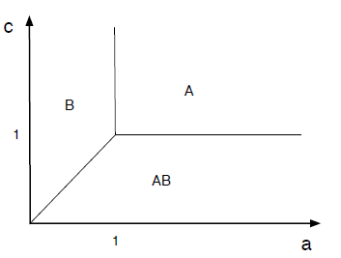
Compatibility and its Role in Cascades
Initially,
A: 0+a = a
B: 0+b = 1
AB: a+b-c = a+1-c

Slide 40

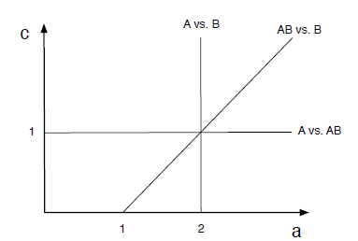
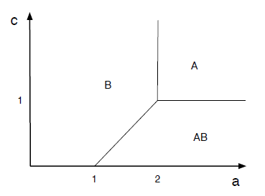
Compatibility and its Role in Cascades
Then,
a < 1,
A: 0+a = a
B: b+b = 2 √
AB: b+b-c = 2-c
a ≥ 1
A: a
B: 2
AB: a+1-c

Slide 41
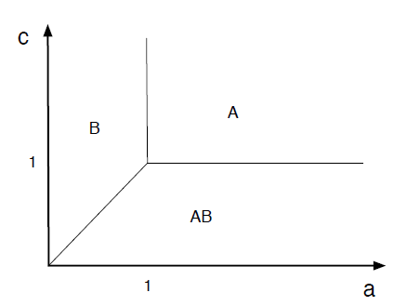
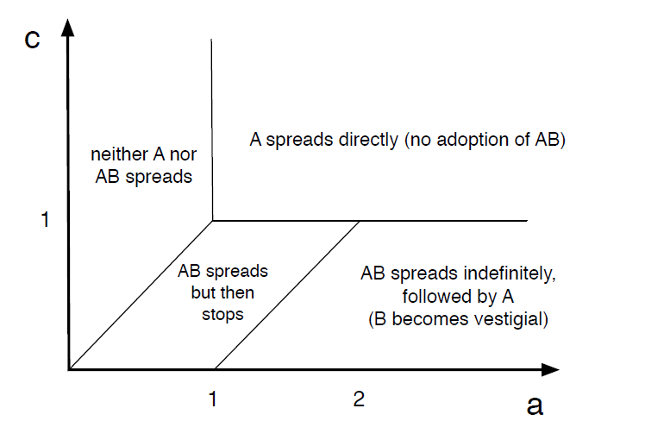
Compatibility and its Role in Cascades

Slide 42
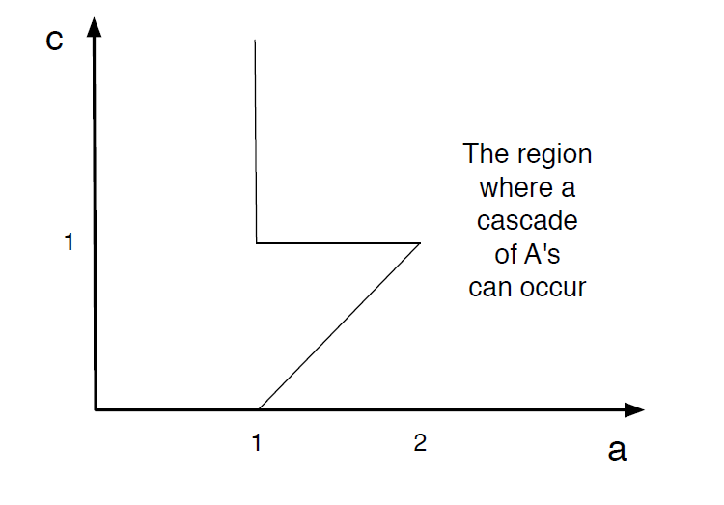
Compatibility and its Role in Cascades
What does the triangular cut-out means?

Slide 43
Reference
Networks, Crowds, and Markets (Chapter 19)

Slide 44
Epidemic Spread

Slide 45

Epidemics
Understanding the spread of viruses and epidemics is of great interest to
Health officials
Sociologists
Mathematicians
Hollywood
The underlying contact network clearly affects the spread of an epidemic
Model epidemic spread as a random process on the graph and study its properties
Main question: will the epidemic take over most of the network?
Diffusion of ideas and the spread of influence can also be modeled as epidemics

Slide 46
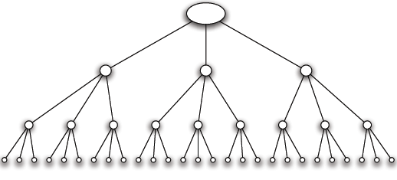
Branching Processes
A person transmits the disease to each people she meets independently with a probability p
Meets k people while she is contagious
A person carrying a new disease enters a population, first wave of k people
Second wave of k² people
Subsequent waves
A contact network with k =3
Tree (root, each node but the root, a single node in the level above it)

Slide 47
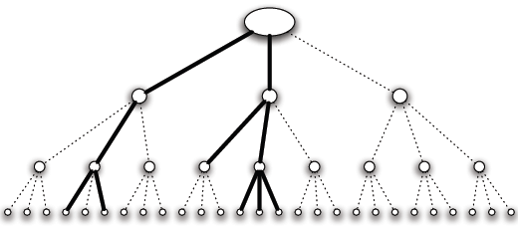
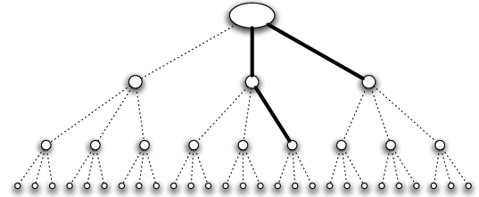
Branching Processes
Aggressive epidemic (high contagion probability)
Mild epidemic (low contagion probability)
If it ever reaches a wave where it infects no one, then it dies out
Or, it continues to infect people in every wave infinitely

Slide 48
Branching Processes: Basic Reproductive Number
Basic Reproductive Number (R₀): the expected number of new cases of the disease caused by a single individual
Claim: (a) If R₀ < 1, then with probability 1, the disease dies out after a finite number of waves. (b) If R₀ > 1, then with probability greater than 0 the disease persists by infecting at least one person in each wave.
R₀ = pk
R₀ < 1 -- Each infected person produces less than one new case in expectation Outbreak constantly trends downwards
R₀ > 1 – trends upwards, and the disease persists with positive probability (when p < 1, the disease can get unlucky!)
A “knife-edge” quality around the critical value of R₀ = 1

Slide 49
Branching process
Assumes no network structure, no triangles or shared neihgbors

Slide 50
The SIR model
Each node may be in the following states
Susceptible: healthy but not immune
Infected: has the virus and can actively propagate it
Removed: (Immune or Dead) had the virus but it is no longer active
probability of an Infected node to infect a Susceptible neighbor

Slide 51
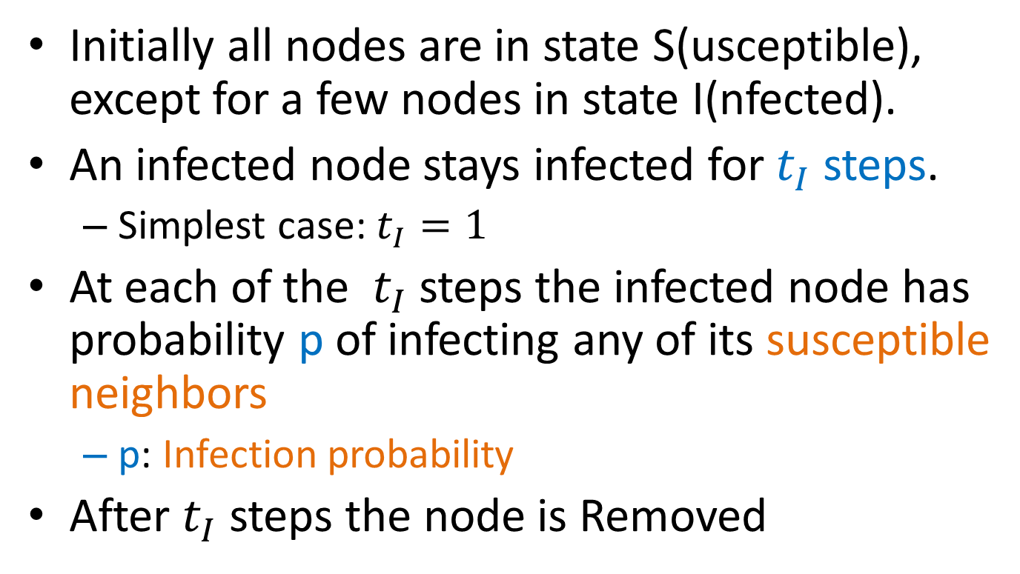
The SIR process
Initially all nodes are in state S(usceptible), except for a few nodes in state I(nfected).
An infected node stays infected for $t_{I}$ steps.
Simplest case: $t_{I}=1$
At each of the $t_{I}$ steps the infected node has probability p of infecting any of its susceptible neighbors
p: Infection probability
After $t_{I}$ steps the node is Removed

Slide 52
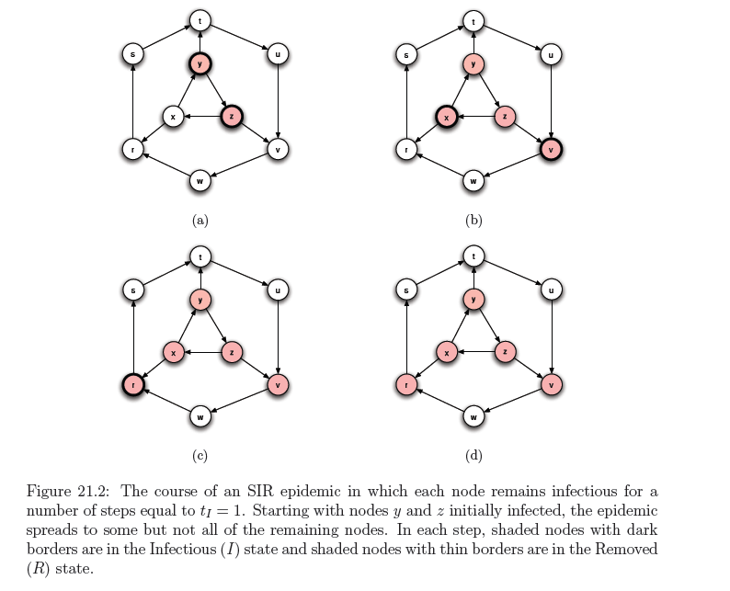

Slide 53
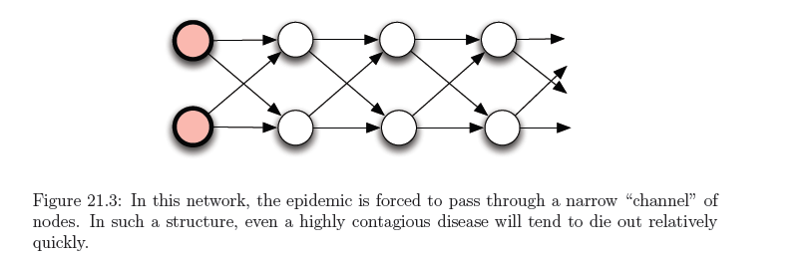
SIR and the Branching process
The branching process is a special case where the graph is a tree (and the infected node is the root)
The basic reproductive number is not necessarily informative in the general case

Slide 54
Percolation
Percolation: we have a network of “pipes” which can curry liquids, and they can be either open with probability p, or close with probability (1-p)
The pipes can be pathways within a material
If liquid enters the network from some nodes, does it reach most of the network?
The network percolates

Slide 55
SIR and Percolation
There is a connection between SIR model and percolation
When a virus is transmitted from u to v, the edge (u,v) is activated with probability p
We can assume that all edge activations have happened in advance, and the input graph has only the active edges.
Which nodes will be infected?
The nodes reachable from the initial infected nodes
In this way we transformed the dynamic SIR process into a static one.

Slide 56
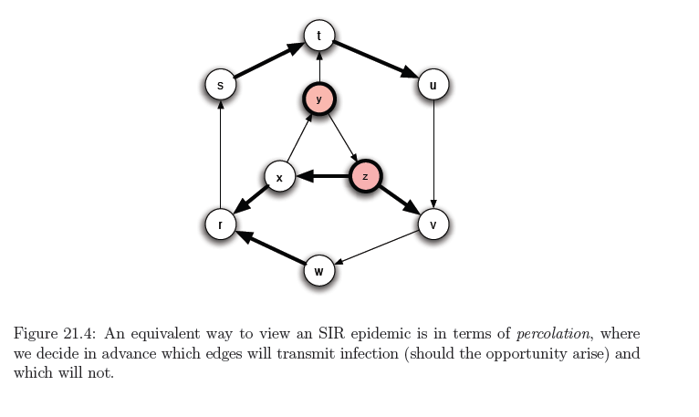
Example

Slide 57
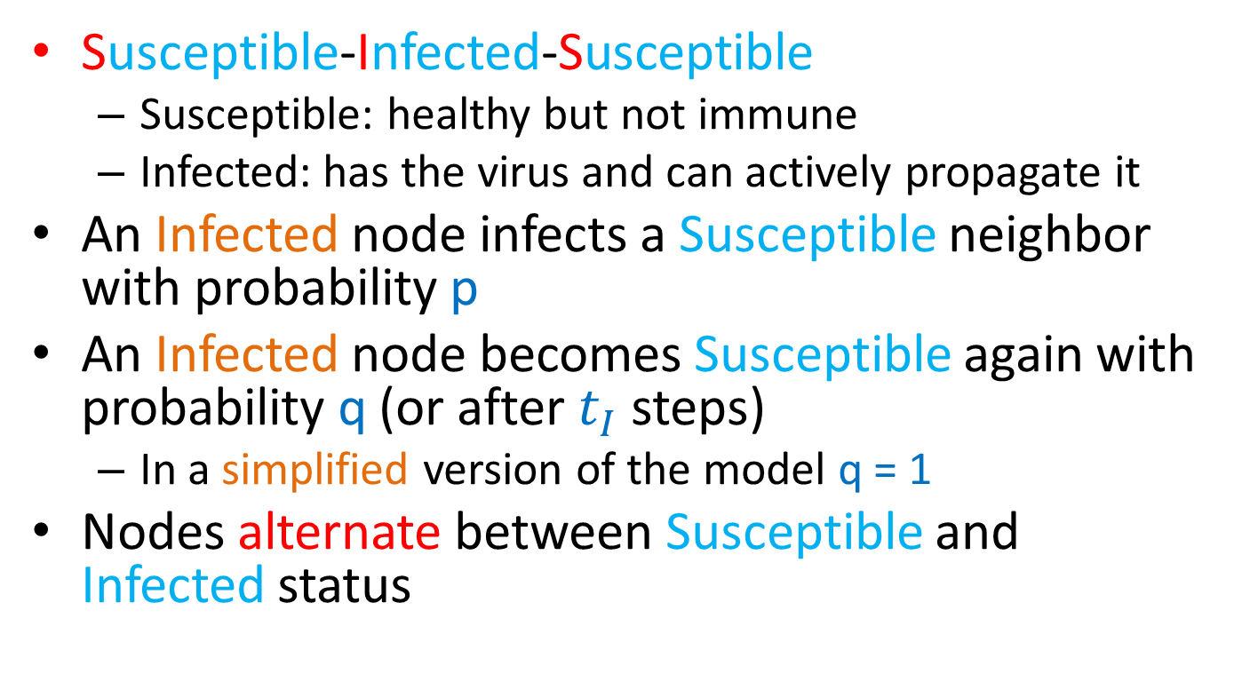
The SIS model
Susceptible-Infected-Susceptible
Susceptible: healthy but not immune
Infected: has the virus and can actively propagate it
An Infected node infects a Susceptible neighbor with probability p
An Infected node becomes Susceptible again with probability q (or after $t_{I}$ steps)
In a simplified version of the model q = 1
Nodes alternate between Susceptible and Infected status

Slide 58
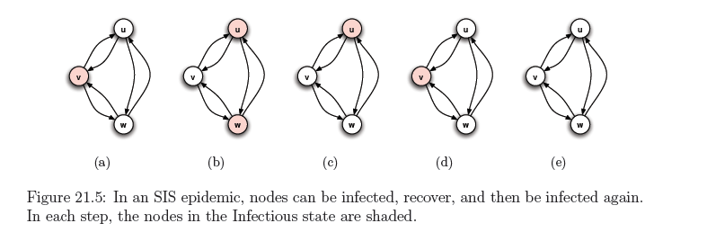
Example
When no Infected nodes, virus dies out
Question: will the virus die out?

Slide 59

An eigenvalue point of view
If A is the adjacency matrix of the network, then the virus dies out if
Where $λ_{1}$ is the first eigenvalue of A

Slide 60
Multiple copies model
Each node may have multiple copies of the same virus
v: state vector : v_{i} : number of virus copies at node i
At time t = 0, the state vector is initialized to v⁰
At time t,
For each node i
For each of the v_{i}^{t} virus copies at node i
the copy is copied to a neighbor j with prob p
the copy dies with probability q

Slide 61
Analysis
The expected state of the system at time t is given by
As t → ∞
the probability that all copies die converges to 1
the probability that all copies die converges to 1
the probability that all copies die converges to a constant < 1

Slide 62
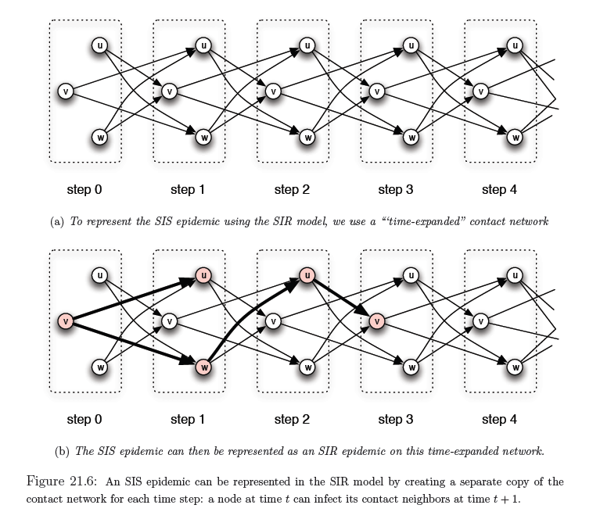
SIS and SIR

Slide 63
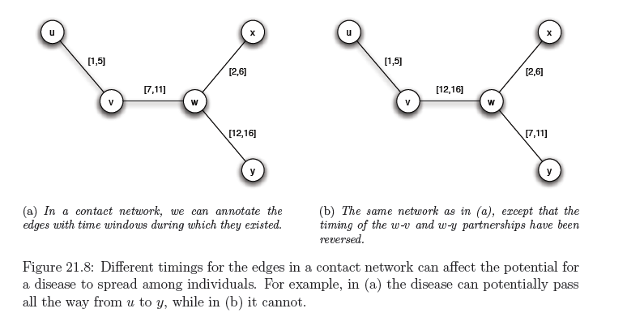
Including time
Infection can only happen within the active window

Slide 64
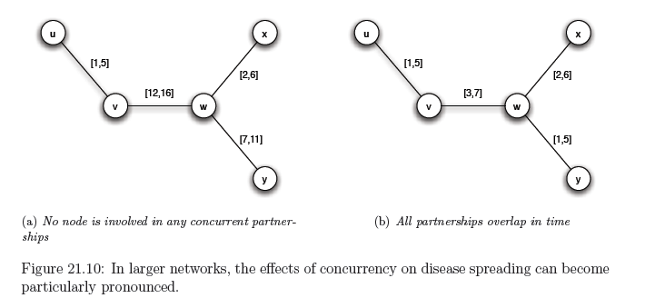
Concurrency
Importance of concurrency – enables branching

Slide 65
Influence maximization

Slide 66
Maximizing spread
Suppose that instead of a virus we have an item (product, idea, video) that propagates through contact
Word of mouth propagation.
An advertiser is interested in maximizing the spread of the item in the network
The holy grail of “viral marketing”
Question: which nodes should we “infect” so that we maximize the spread? [KKT2003]

Slide 67
Independent cascade model
Each node may be active (has the item) or inactive (does not have the item)
Time proceeds at discrete time-steps. At time t, every node v that became active in time t-1 actives a non-active neighbor w with probability p_{uw}. If it fails, it does not try again
The same as the simple SIR model

Slide 68
Influence maximization
Influence function: for a set of nodes A (target set) the influence s(A) is the expected number of active nodes at the end of the diffusion process if the item is originally placed in the nodes in A.
Influence maximization problem [KKT03]: Given an network, a diffusion model, and a value k, identify a set A of k nodes in the network that maximizes s(A).
The problem is NP-hard

Slide 69
A Greedy algorithm
What is a simple algorithm for selecting the set A?
Computing s(A): perform multiple simulations of the process and take the average.
How good is the solution of this algorithm compared to the optimal solution?
Greedy algorithm
Start with an empty set A
Proceed in k steps
At each step add the node u to the set A the maximizes the increase in function s(A)
The node that activates the most additional nodes

Slide 70
Approximation Algorithms
Suppose we have a (combinatorial) optimization problem, and X is an instance of the problem, OPT(X) is the value of the optimal solution for X, and ALG(X) is the value of the solution of an algorithm ALG for X
In our case: X = (G,k) is the input instance, OPT(X) is the spread S(A*) of the optimal solution, GREEDY(X) is the spread S(A) of the solution of the Greedy algorithm
ALG is a good approximation algorithm if the ratio of OPT and ALG is bounded.

Slide 71
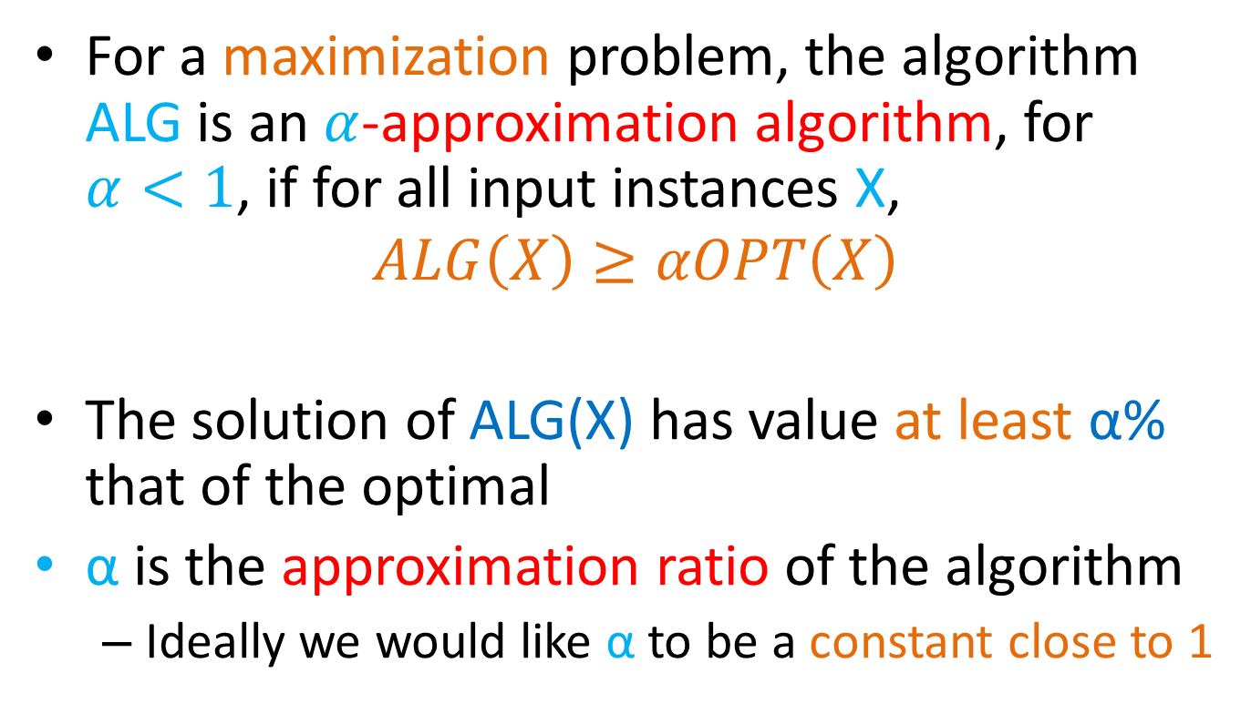
Approximation Ratio
For a maximization problem, the algorithm ALG is an $α$-approximation algorithm, for $α<1$, if for all input instances X,
$$ALG\left(X\right)≥αOPT\left(X\right)$$
The solution of ALG(X) has value at least α% that of the optimal
α is the approximation ratio of the algorithm
Ideally we would like α to be a constant close to 1

Slide 72

Approximation Ratio for Influence Maximization
The GREEDY algorithm has approximation ratio $α=1−\frac{1}{e}$
$GREEDY\left(X\right)≥\left(1−\frac{1}{e}\right)OPT\left(X\right)$, for all X

Slide 73
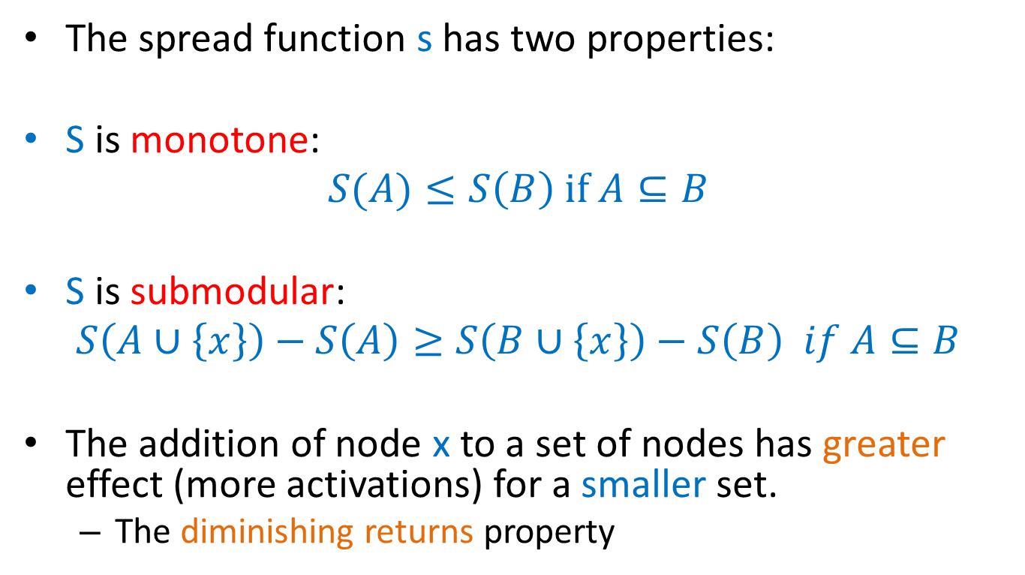
Proof of approximation ratio
The spread function s has two properties:
S is monotone:
$$S(A)≤S\left(B\right) if A⊆B$$
S is submodular:
$$S\left(A∪\left\{x\right\}\right)−S\left(A\right)≥S\left(B∪\left\{x\right\}\right)−S\left(B\right) if A⊆B$$
The addition of node x to a set of nodes has greater effect (more activations) for a smaller set.
The diminishing returns property

Slide 74
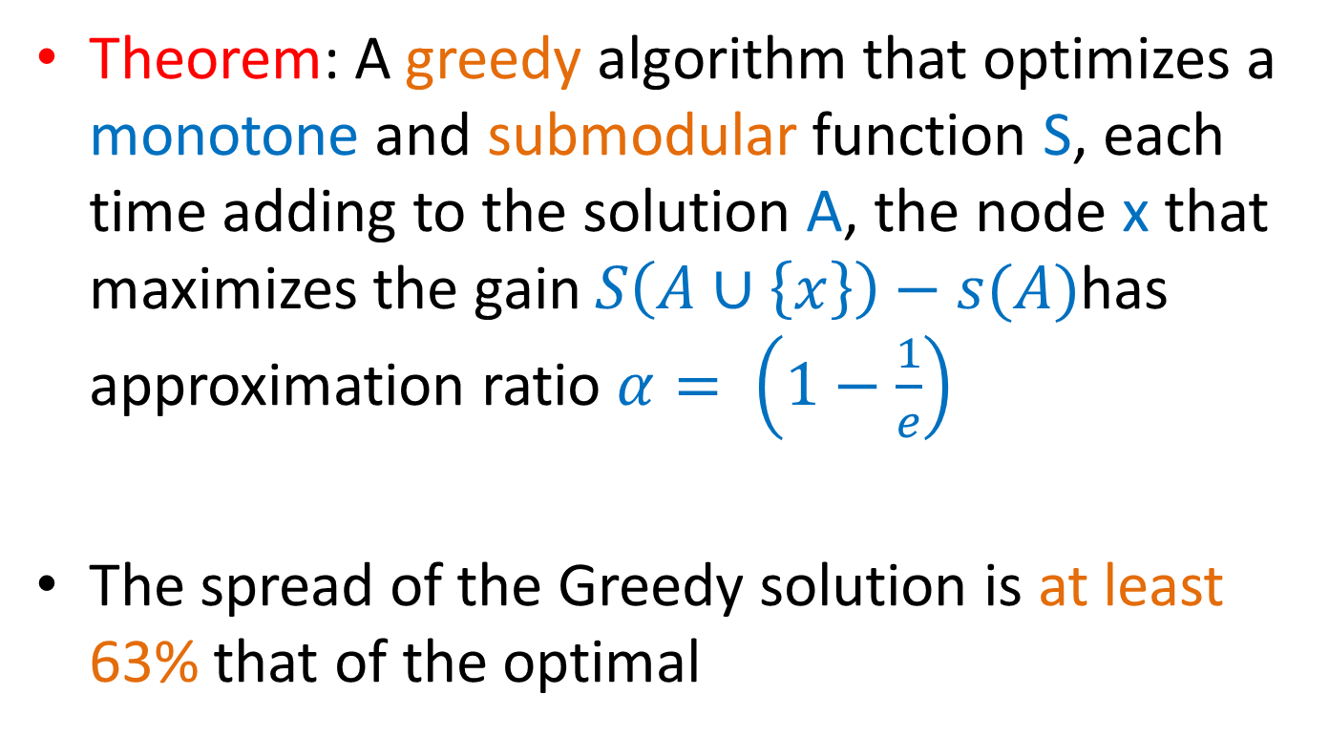
Optimizing submodular functions
Theorem: A greedy algorithm that optimizes a monotone and submodular function S, each time adding to the solution A, the node x that maximizes the gain $S\left(A∪\left\{x\right\}\right)−s(A)$has approximation ratio $α= \left(1−\frac{1}{e}\right)$
The spread of the Greedy solution is at least 63% that of the optimal

Slide 75
Submodularity of influence
Why is S(A) submodular?
How do we deal with the fact that influence is defined as an expectation?
We will use the fact that probabilistic propagation on a fixed graph can be viewed as deterministic propagation over a randomized graph
Express S(A) as an expectation over the input graph rather than the choices of the algorithm

Slide 76
Independent cascade model
Each edge (u,v) is considered only once, and it is “activated” with probability p_{uv}.
We can assume that all random choices have been made in advance
generate a sample subgraph of the input graph where edge (u,v) is included with probability p_{uv}
propagate the item deterministically on the input graph
the active nodes at the end of the process are the nodes reachable from the target set A
The influence function is obviously(?) submodular when propagation is deterministic
The linear combination of submodular functions is also a submodular function

Slide 77
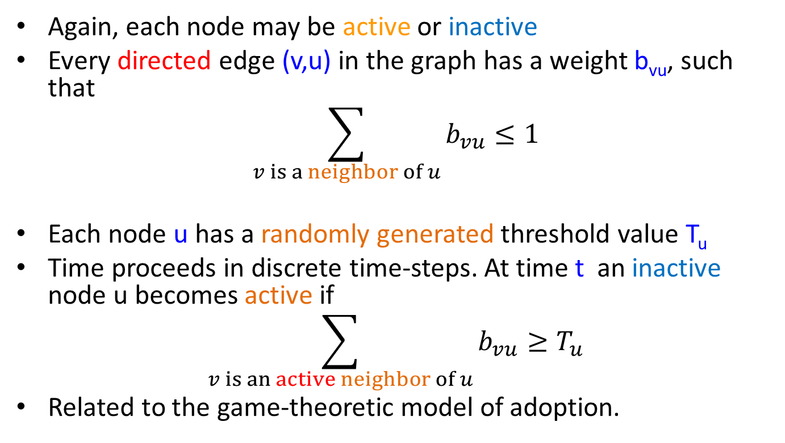
Linear threshold model
Again, each node may be active or inactive
Every directed edge (v,u) in the graph has a weight b_{vu}, such that
$$\sum_{v is a neighbor of u}{b_{vu}}≤1$$
Each node u has a randomly generated threshold value T_{u}
Time proceeds in discrete time-steps. At time t an inactive node u becomes active if
$$\sum_{v is an active neighbor of u}{b_{vu}}≥T_{u}$$
Related to the game-theoretic model of adoption.

Slide 78
Influence Maximization
KKT03 showed that in this case the influence S(A) is still a submodular function, using a similar technique
Assumes uniform random thresholds
The Greedy algorithm achieves a (1-1/e) approximation

Slide 79
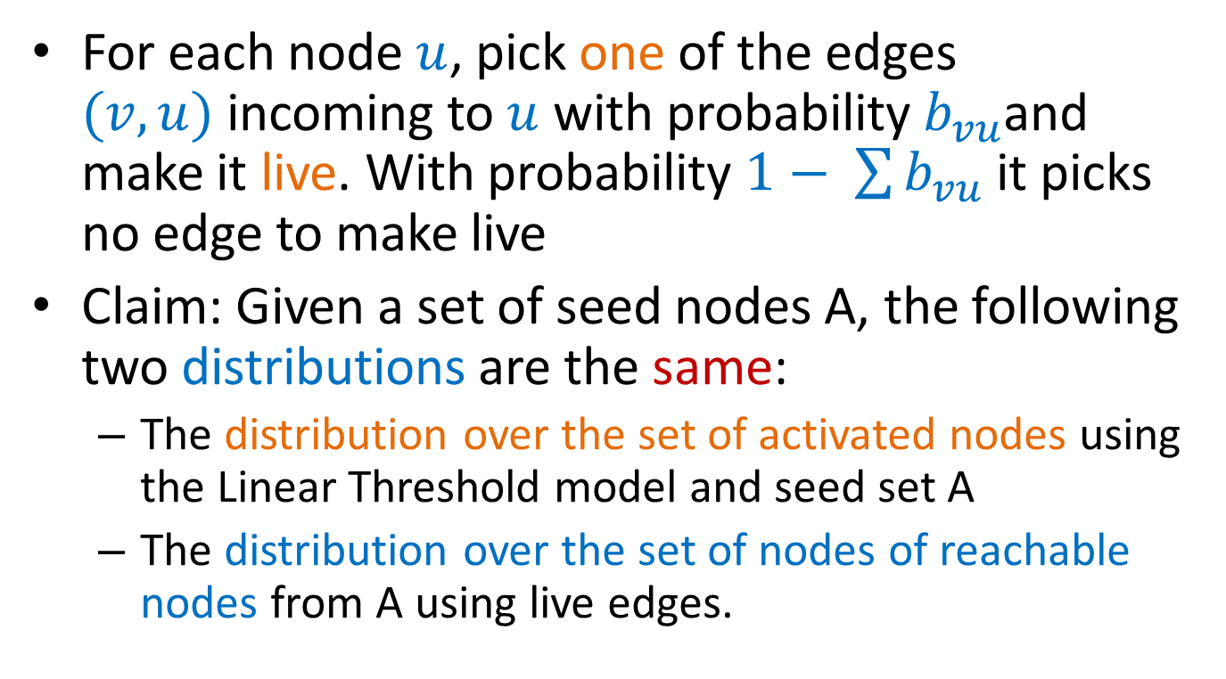
Proof idea
For each node $u$, pick one of the edges $(v,u)$incoming to $u$ with probability $b_{vu}$and make it live. With probability $1− \sum{b_{vu}}$ it picks no edge to make live
Claim: Given a set of seed nodes A, the following two distributions are the same:
The distribution over the set of activated nodes using the Linear Threshold model and seed set A
The distribution over the set of nodes of reachable nodes from A using live edges.

Slide 80

Proof idea
Consider the special case of a DAG (Directed Acyclic Graph)
There is a topological ordering of the nodes $v_{0}, v_{1},…, v_{n}$ such that edges go from left to right
Consider node $v_{i}$ in this ordering and assume that $S_{i}$ is the set of neighbors of $v_{i}$ that are active.
What is the probability that node $v_{i}$ becomes active in either of the two models?
In the Linear Threshold model the random threshold $θ_{i}$ must be greater than $\sum_{u∈S_{i}}{b_{ui}≥θ_{i}}$
In the live-edge model we should pick one of the edges in $S_{i}$
This proof idea generalizes to general graphs
Note: if we know the thresholds in advance submodularity does not hold!

Slide 81


Experiments

Slide 82
Another example
What is the spread from the red node?
Inclusion of time changes the problem of influence maximization
N. Gayraud, E. Pitoura, P. Tsaparas, Diffusion Maximization on Evolving networks, submitted to SDM 2015

Slide 83

Evolving network
Consider a network that changes over time
Edges and nodes can appear and disappear at discrete time steps
Model:
The evolving network is a sequence of graphs $\{G_{1},G_{2},…,G_{n}\}$ defined over the same set of vertices $V$, with different edge sets $E_{1},E_{2},…,E_{n}$
Graph snapshot $G_{i}$ is the graph at time-step $i$.

Slide 84

Time
How does the evolution of the network relates to the evolution of the diffusion?
How much physical time does a diffusion step last?
Assumption: The two processes are in sync. One diffusion step happens in on one graph snapshot
Evolving IC model: at time-step $t$, the infectious nodes try to infect their neighbors in the graph $G_{t}$.
Evolving LT model: at time-step $t$ if the weight of the active neighbors of node $v$in graph $G_{t}$ is greater than the threshold the nodes gets activated.

Slide 85
Submodularity
Will the spread function remain monotone and submodular?
No!

Slide 86










Evolving IC model
$$v_{1}$$
$$v_{1}$$
$$v_{1}$$
$$v_{2}$$
$$v_{4}$$
$$v_{2}$$
$$v_{4}$$
$$v_{2}$$
$$v_{4}$$
$$v_{3}$$
$$v_{3}$$
$$v_{3}$$
$$u_{1}$$
$$u_{3}$$
$$u_{1}$$
$$u_{3}$$
$$u_{1}$$
$$u_{3}$$
$$u_{2}$$
$$u_{2}$$
$$u_{2}$$
$$G^{1}$$
$$G^{2}$$
$$G^{3}$$

Slide 87





Evolving IC model
$$G^{0}$$
$$G^{1}$$
$$G^{2}$$
$$G^{3}$$
$$G^{0}$$
$$G^{1}$$
$$G^{2}$$
$$G^{3}$$
The spread is not even monotone in the case of the Evolving IC model

Slide 88










Evolving LT model
The evolving LT model is monotone but it is not submodular
Expected Spread: the probability that $u$ gets infected
Adding node $v_{3}$ has a larger effect if $v_{2}$ is already in the set.
$$v_{2}$$
$$v_{2}$$
$$v_{2}$$
$$v_{1}$$
$$v_{3}$$
$$v_{1}$$
$$v_{3}$$
$$v_{1}$$
$$v_{3}$$
$$u$$
$$u$$
$$u$$
$$G_{U}$$
$$G^{1}$$
$$G^{2}$$

