Slide 1
Online Social Networks and Media
Link Analysis and Web Search

Slide 2
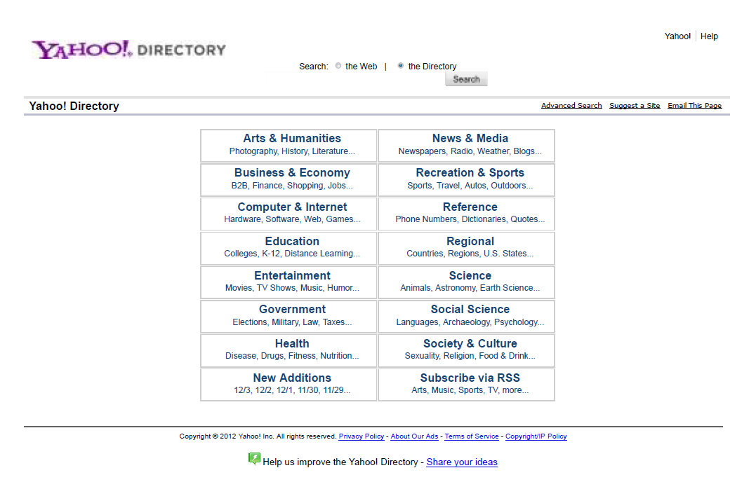
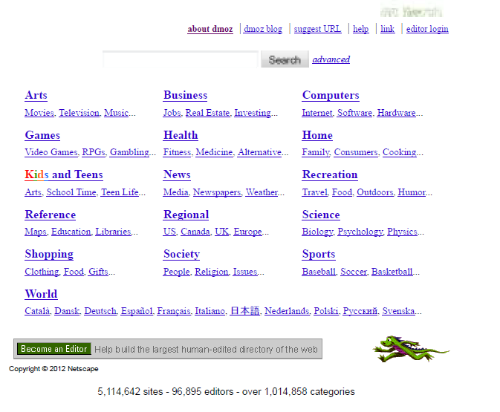
How to Organize the Web
First try: Human curated Web directories
  Yahoo, DMOZ, LookSmart

Slide 3
How to organize the web
Second try: Web Search
  Information Retrieval investigates:
    Find relevant docs in a small and trusted set e.g., Newspaper articles, Patents, etc. (“needle-in-a-haystack”)
    Limitation of keywords (synonyms, polysemy, etc)
But: Web is huge, full of untrusted documents, random things, web spam, etc.
  Everyone can create a web page of high production value
  Rich diversity of people issuing queries
  Dynamic and constantly-changing nature of web content

Slide 4
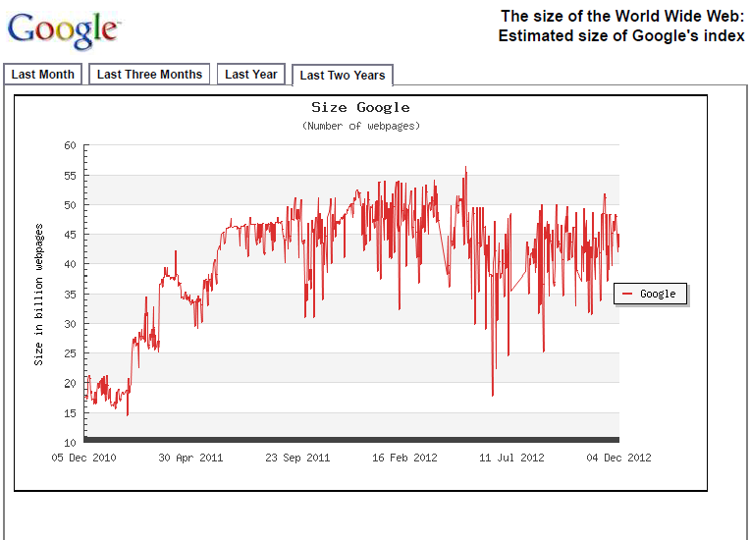
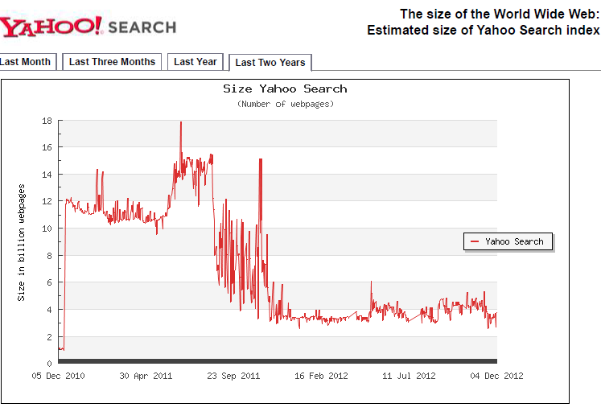
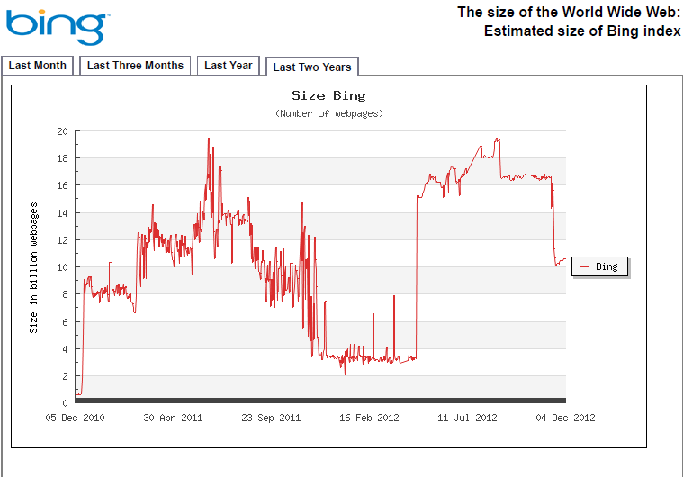
Size of the Search Index
http://www.worldwidewebsize.com/

Slide 5
How to organize the web
Third try (the Google era): using the web graph
  Swift from relevance to authoritativeness
  It is not only important that a page is relevant, but that it is also important on the web
For example, what kind of results would we like to get for the query “greek newspapers”?

Slide 6
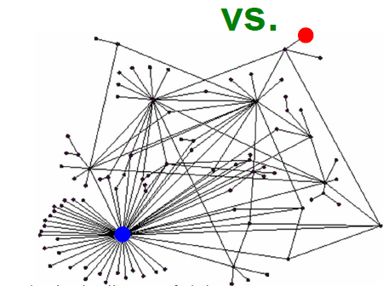
Link Analysis
Not all web pages are equal on the web
The links act as endorsements:
  When page p links to q it endorses the content of the content of q
What is the simplest way to measure importance of a page on the web?

Slide 7
Rank by Popularity
Rank pages according to the number of incoming edges (in-degree, degree centrality)
$$v_{2}$$
Red Page
Yellow Page
Blue Page
Purple Page
Green Page
$$v_{1}$$
$$v_{3}$$
$$v_{5}$$
$$v_{4}$$

Slide 8
Popularity
It is not important only how many link to you, but also how important are the people that link to you.
Good authorities are pointed by good authorities
  Recursive definition of importance

Slide 9
THE PageRank ALGORITHM

Slide 10

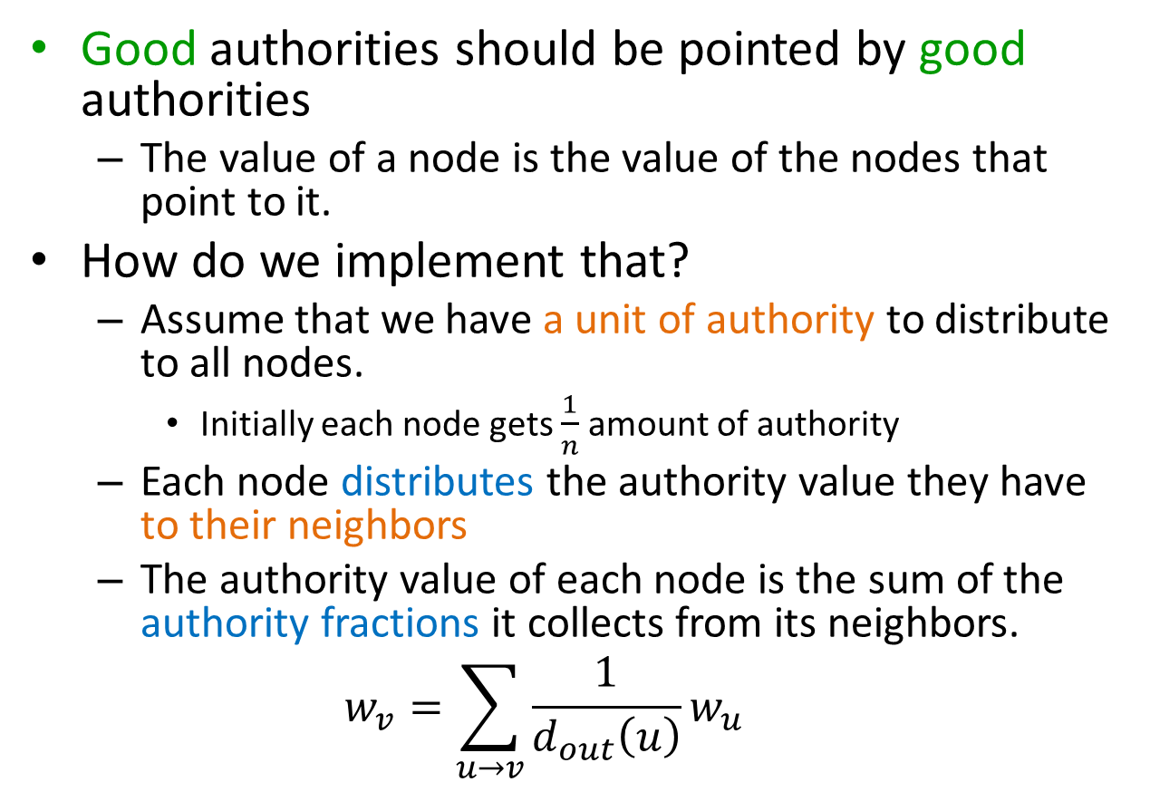
PageRank
Good authorities should be pointed by good authorities
  The value of a node is the value of the nodes that point to it.
How do we implement that?
  Assume that we have a unit of authority to distribute to all nodes.
    Initially each node gets $\frac{1}{n}$ amount of authority
  Each node distributes the authority value they have to their neighbors
  The authority value of each node is the sum of the authority fractions it collects from its neighbors.
  $$w_{v}=\sum_{u→v}{\frac{1}{d_{out}\left(u\right)}w_{u}}$$
$w_{v}:$ the PageRank value of node $v$
Recursive definition

Slide 11
A simple example
w
w + w + w = 1
w = w + w
w = ½ w
w = ½ w
w
w
Solving the system of equations we get the authority values for the nodes
  w = ½ w = ¼ w = ¼

Slide 12
A more complex example
$$v_{2}$$
$$v_{1}$$
w₁ = 1/3 w₄ + 1/2 w₅
$$v_{3}$$
w₂ = 1/2 w₁ + w₃ + 1/3 w₄
w₃ = 1/2 w₁ + 1/3 w₄
w₄ = 1/2 w₅
w₅ = w₂
$$v_{5}$$
$$v_{4}$$
$$w_{v}=\sum_{u→v}{\frac{1}{d_{out}\left(u\right)}w_{u}}$$

Slide 13
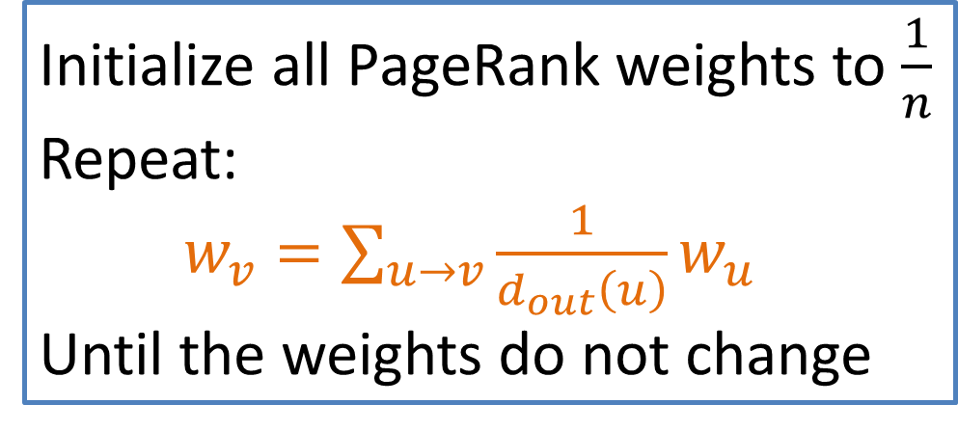
Computing PageRank weights
A simple way to compute the weights is by iteratively updating the weights
PageRank Algorithm
This process converges
Initialize all PageRank weights to $\frac{1}{n}$
Repeat:
$w_{v}=\sum_{u→v}{\frac{1}{d_{out}\left(u\right)}w_{u}}$
Until the weights do not change

Slide 14
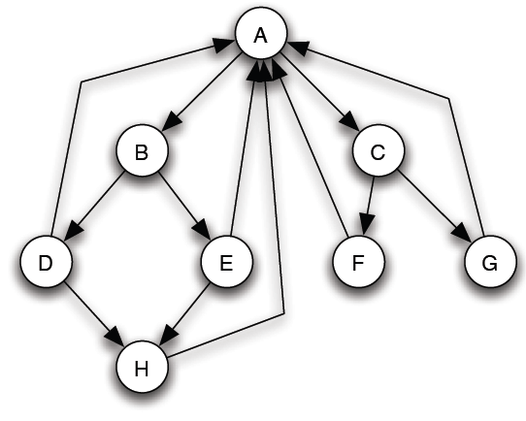
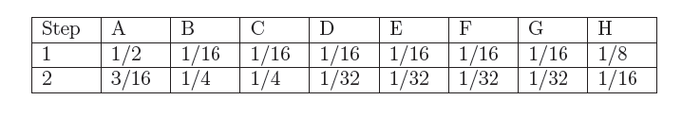
PageRank
Initially, all nodes PageRank 1/8
As a kind of “fluid” that circulates through the network
The total PageRank in the network remains constant (no need to normalize)

Slide 15
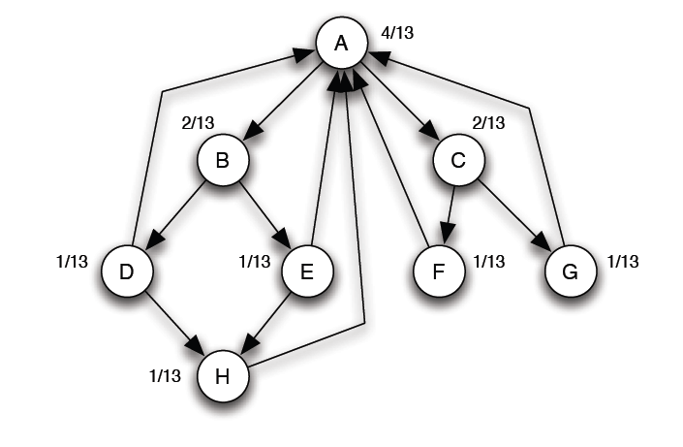
PageRank: equilibrium
A simple way to check whether an assignment of numbers forms an equilibrium set of PageRank values: check that they sum to 1, and that when apply the Basic PageRank Update Rule, we get the same values back.
If the network is strongly connected, then there is a unique set of equilibrium values.

Slide 16
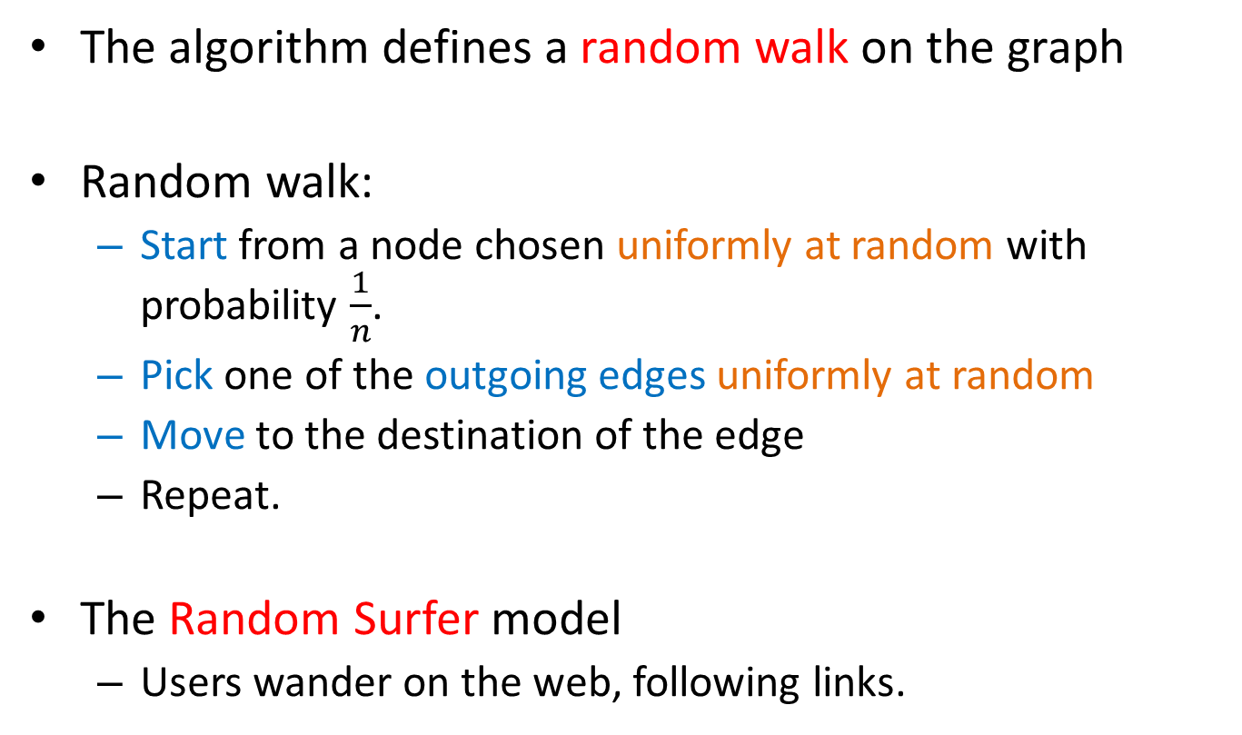
Random Walks on Graphs
The algorithm defines a random walk on the graph
Random walk:
  Start from a node chosen uniformly at random with probability $\frac{1}{n}$.
  Pick one of the outgoing edges uniformly at random
  Move to the destination of the edge
  Repeat.
The Random Surfer model
  Users wander on the web, following links.

Slide 17
Example
Step 0
$$v_{2}$$
$$v_{1}$$
$$v_{3}$$
$$v_{5}$$
$$v_{4}$$

Slide 18
Example
Step 0
$$v_{2}$$
$$v_{1}$$
$$v_{3}$$
$$v_{5}$$
$$v_{4}$$

Slide 19
Example
Step 1
$$v_{2}$$
$$v_{1}$$
$$v_{3}$$
$$v_{5}$$
$$v_{4}$$

Slide 20
Example
Step 1
$$v_{2}$$
$$v_{1}$$
$$v_{3}$$
$$v_{5}$$
$$v_{4}$$

Slide 21
Example
Step 2
$$v_{2}$$
$$v_{1}$$
$$v_{3}$$
$$v_{5}$$
$$v_{4}$$

Slide 22
Example
Step 2
$$v_{2}$$
$$v_{1}$$
$$v_{3}$$
$$v_{5}$$
$$v_{4}$$

Slide 23
Example
Step 3
$$v_{2}$$
$$v_{1}$$
$$v_{3}$$
$$v_{5}$$
$$v_{4}$$

Slide 24
Example
Step 3
$$v_{2}$$
$$v_{1}$$
$$v_{3}$$
$$v_{5}$$
$$v_{4}$$

Slide 25
Example
Step 4…
$$v_{2}$$
$$v_{1}$$
$$v_{3}$$
$$v_{5}$$
$$v_{4}$$

Slide 26

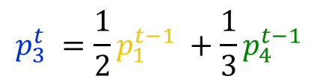
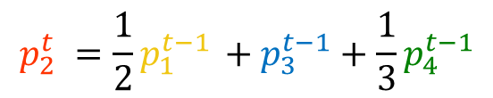



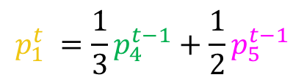




Random walk
Question: what is the probability $p_{i}^{t}$ of being at node $i$after $t$ steps?
$$v_{2}$$
$$v_{1}$$
$$p_{1}^{0} =\frac{1}{5}$$
$$p_{1}^{t} =\frac{1}{3}p_{4}^{t−1}+\frac{1}{2}p_{5}^{t−1}$$
$$v_{3}$$
$$p_{2}^{0} =\frac{1}{5}$$
$$p_{2}^{t} =\frac{1}{2}p_{1}^{t−1} +p_{3}^{t−1}+\frac{1}{3}p_{4}^{t−1}$$
$$p_{3}^{0}=\frac{1}{5}$$
$$p_{3}^{t} =\frac{1}{2}p_{1}^{t−1} +\frac{1}{3}p_{4}^{t−1}$$
$$p_{4}^{0}=\frac{1}{5}$$
$$p_{4}^{t} =\frac{1}{2}p_{5}^{t−1}$$
$$v_{5}$$
$$v_{4}$$
$$p_{5}^{0}=\frac{1}{5}$$
$$p_{5}^{t} = p_{2}^{t−1}$$

Slide 27
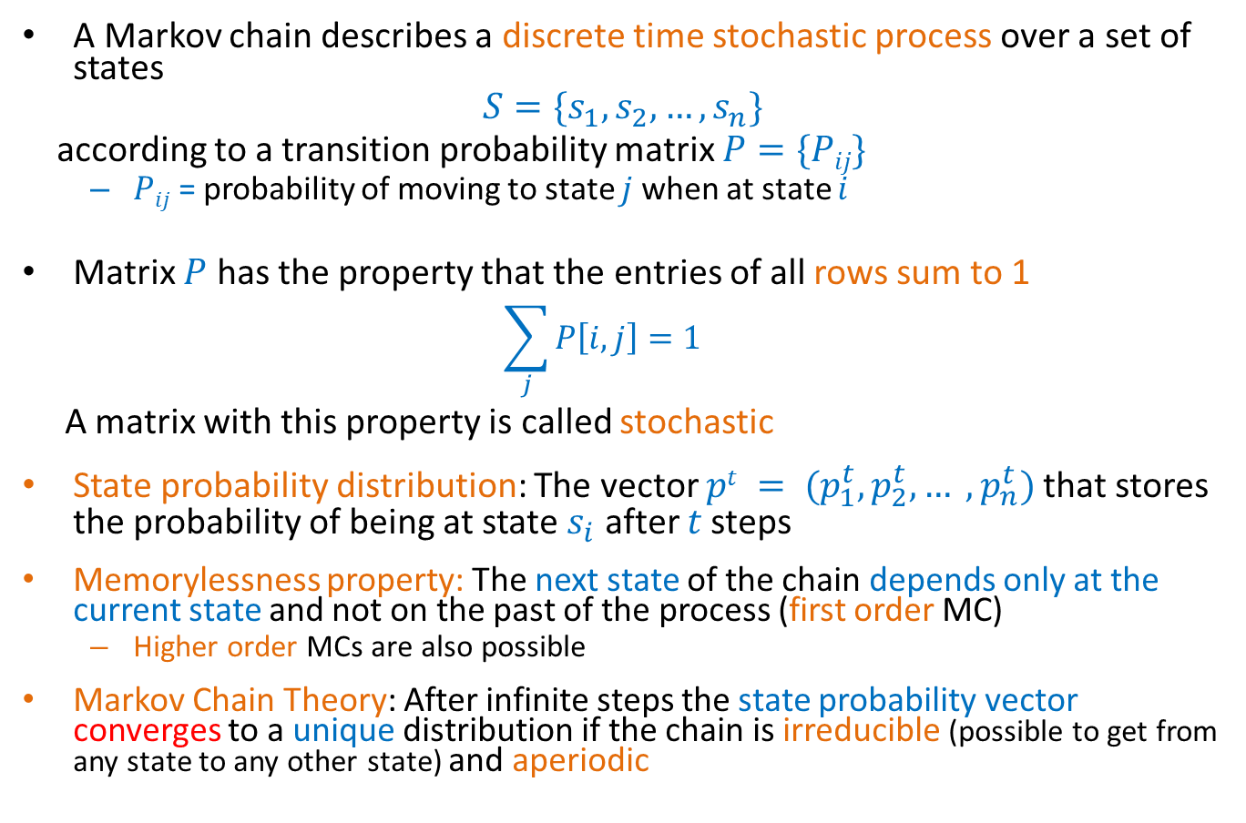
Markov chains
A Markov chain describes a discrete time stochastic process over a set of states
$$S=\{s_{1}, s_{2},…, s_{n}\}$$
according to a transition probability matrix $P=\{Pij\}$
  $Pij$ = probability of moving to state $j$ when at state $i$
Matrix $P$ has the property that the entries of all rows sum to 1
  $$\sum_{j}{P\left[i,j\right]=1}$$
A matrix with this property is called stochastic
State probability distribution: The vector $pt = (p_{1}^{t},p_{2}^{t}, … ,p_{n}^{t})$that stores the probability of being at state $s_{i}$ after $t$ steps
Memorylessness property: The next state of the chain depends only at the current state and not on the past of the process (first order MC)
  Higher order MCs are also possible
Markov Chain Theory: After infinite steps the state probability vector converges to a unique distribution if the chain is irreducible (possible to get from any state to any other state) and aperiodic

Slide 28
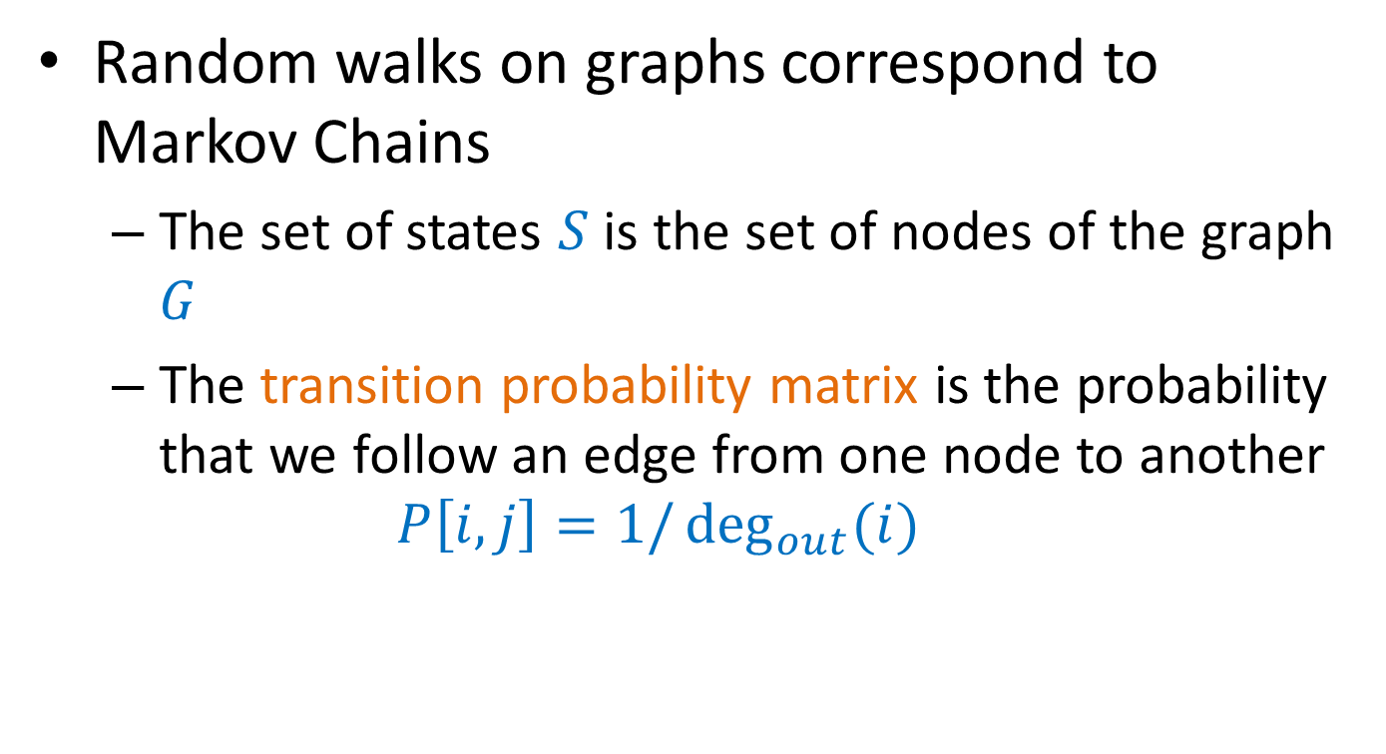
Random walks
Random walks on graphs correspond to Markov Chains
  The set of states $S$ is the set of nodes of the graph $G$
  The transition probability matrix is the probability that we follow an edge from one node to another
  $$P\left[i,j\right]=1/\deg_{out}{(i)}$$

Slide 29





An example
$$v_{2}$$
$$v_{1}$$
$$v_{3}$$
$$v_{5}$$
$$v_{4}$$

Slide 30
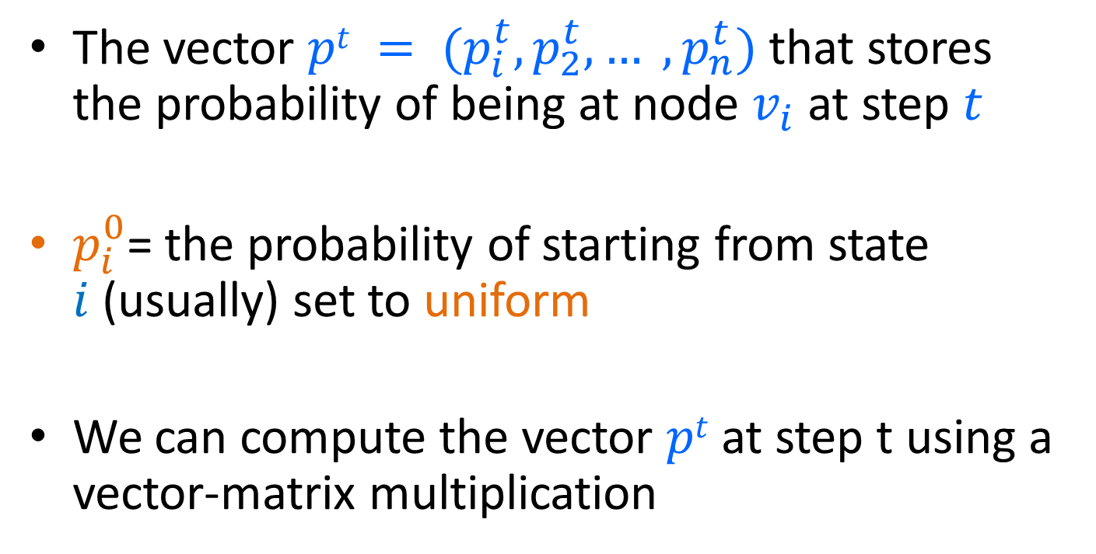

Node Probability vector
The vector $pt = (p_{i}^{t},p_{2}^{t}, … ,p_{n}^{t})$that stores the probability of being at node $v_{i}$ at step $t$
$p_{i}^{0}$= the probability of starting from state $i$(usually) set to uniform
We can compute the vector $pt$ at step t using a vector-matrix multiplication
$$p^{t}=p^{t−1} P$$

Slide 31
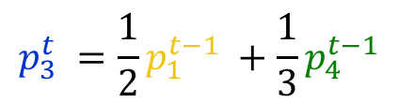
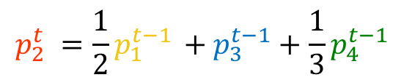
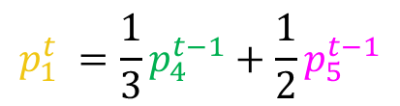


An example
$$v_{2}$$
$$v_{1}$$
$$v_{3}$$
$$p_{1}^{t} =\frac{1}{3}p_{4}^{t−1}+\frac{1}{2}p_{5}^{t−1}$$
$$p_{2}^{t} =\frac{1}{2}p_{1}^{t−1} +p_{3}^{t−1}+\frac{1}{3}p_{4}^{t−1}$$
$$v_{5}$$
$$v_{4}$$
$$p_{3}^{t} =\frac{1}{2}p_{1}^{t−1} +\frac{1}{3}p_{4}^{t−1}$$
$$p_{4}^{t} =\frac{1}{2}p_{5}^{t−1}$$
$$p_{5}^{t} = p_{2}^{t−1}$$

Slide 32
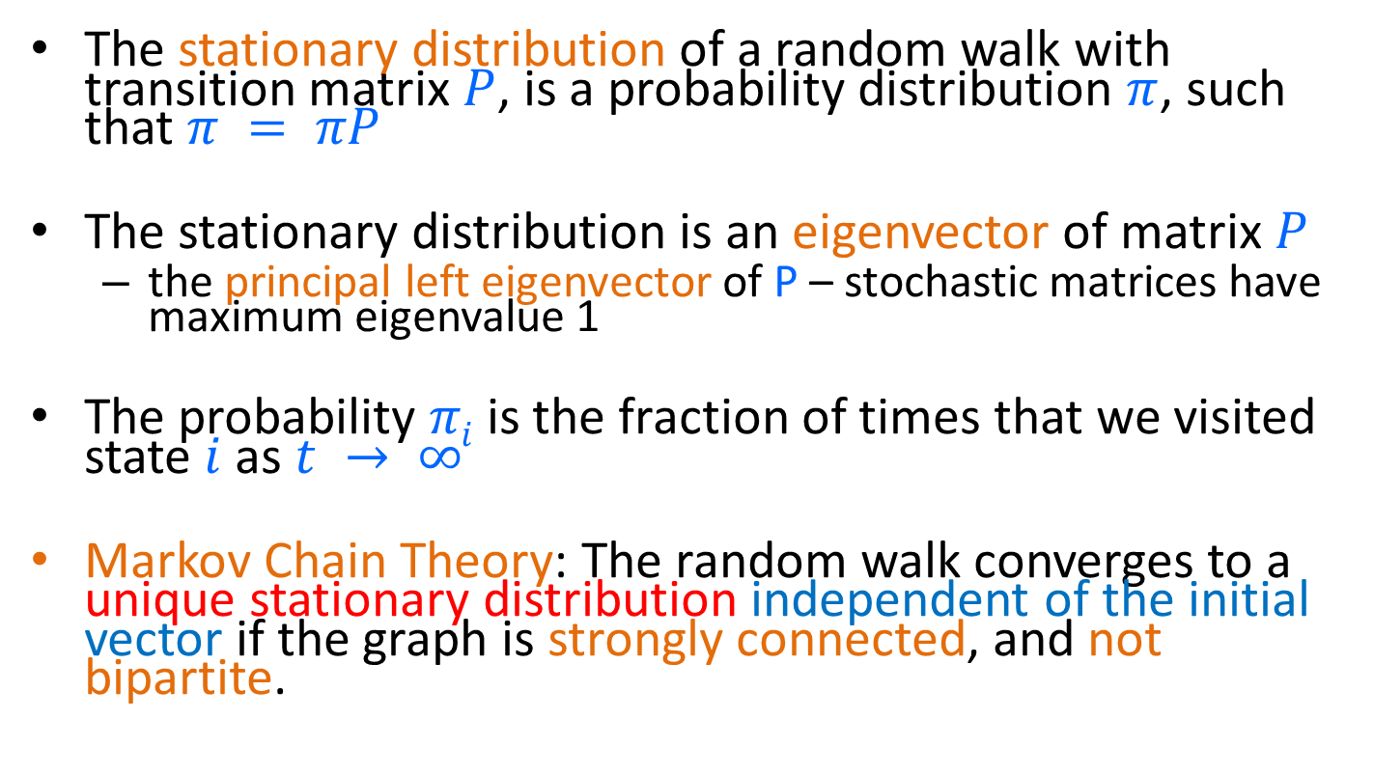
Stationary distribution
The stationary distribution of a random walk with transition matrix $P$, is a probability distribution $π$, such that $π = πP$
The stationary distribution is an eigenvector of matrix $P$
  the principal left eigenvector of P – stochastic matrices have maximum eigenvalue 1
The probability $πi$ is the fraction of times that we visited state $i$ as $t → ∞$
Markov Chain Theory: The random walk converges to a unique stationary distribution independent of the initial vector if the graph is strongly connected, and not bipartite.

Slide 33
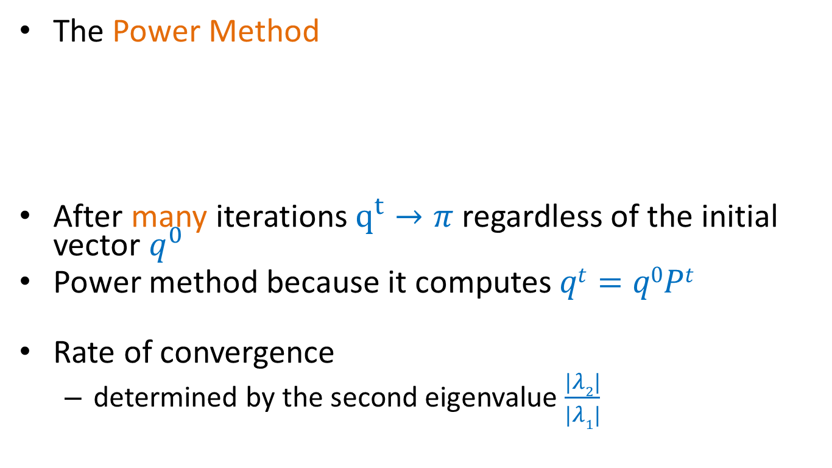
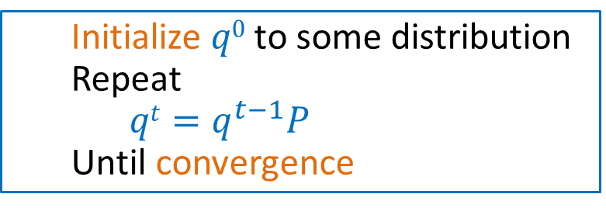
Computing the stationary distribution
The Power Method
After many iterations $q^{t}→π$regardless of the initial vector $q^{0}$
Power method because it computes $qt=q0Pt$
Rate of convergence
  determined by the second eigenvalue $\frac{|λ2|}{|λ1|}$
  Initialize $q0$ to some distribution
  Repeat
  $qt=q^{t−1}P$
  Until convergence

Slide 34
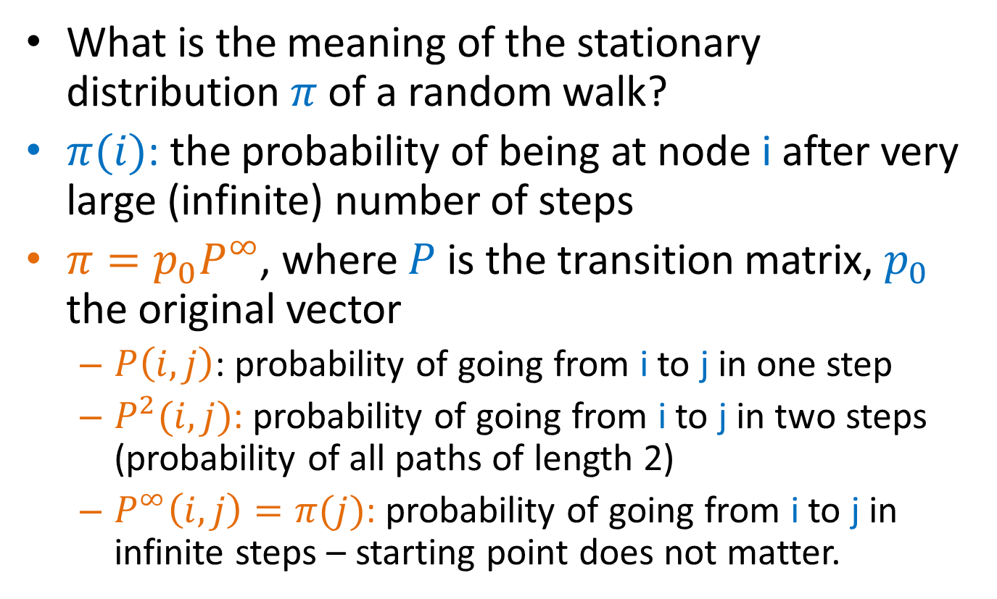
The stationary distribution
What is the meaning of the stationary distribution $π$ of a random walk?
$π(i)$: the probability of being at node i after very large (infinite) number of steps
$π=p_{0}P^{∞}$, where $P$ is the transition matrix, $p_{0}$ the original vector
  $P\left(i,j\right)$: probability of going from i to j in one step
  $P^{2}(i,j)$: probability of going from i to j in two steps (probability of all paths of length 2)
  $P^{∞}\left(i,j\right)=π(j)$: probability of going from i to j in infinite steps – starting point does not matter.

Slide 35
The PageRank random walk
Vanilla random walk
  make the adjacency matrix stochastic and run a random walk

Slide 36
The PageRank random walk
What about sink nodes?
  what happens when the random walk moves to a node without any outgoing inks?

Slide 37
The PageRank random walk
Replace these row vectors with a vector v
  typically, the uniform vector
P’ = P + dv^{T}

Slide 38
The PageRank random walk
What about loops?
  Spider traps

Slide 39
The PageRank random walk
Add a random jump to vector v with prob 1-α
  typically, to a uniform vector
Restarts after 1/(1-α) steps in expectation
  Guarantees irreducibility, convergence
P’’ = αP’ + (1-α)uv^{T}, where u is the vector of all 1s
Random walk with restarts

Slide 40
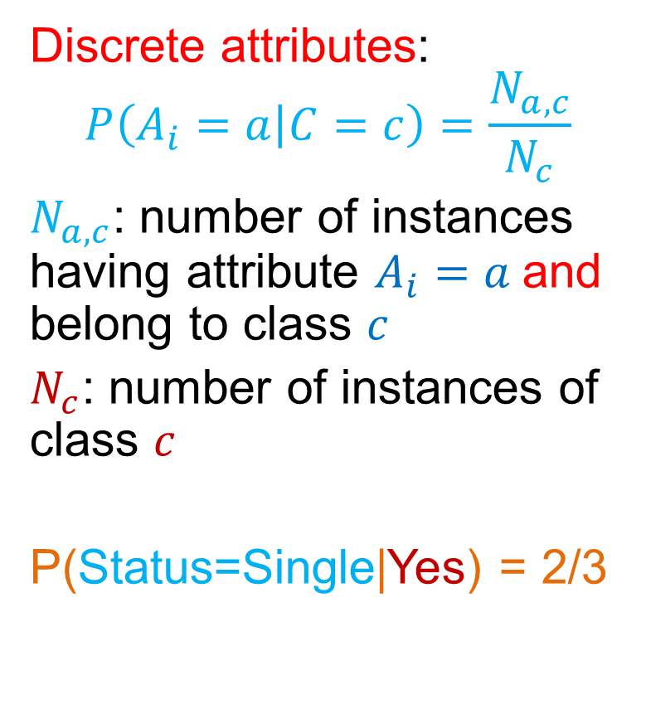
PageRank algorithm [BP98]
The Random Surfer model
  pick a page at random
  with probability 1- α jump to a random page
  with probability α follow a random outgoing link
Rank according to the stationary distribution
Red Page
Purple Page
Yellow Page
Blue Page
Green Page
$α = 0.85$in most cases

Slide 41
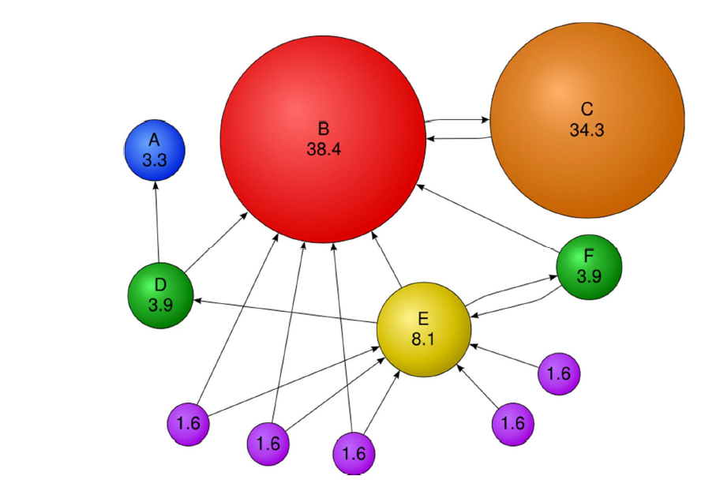
PageRank: Example

Slide 42
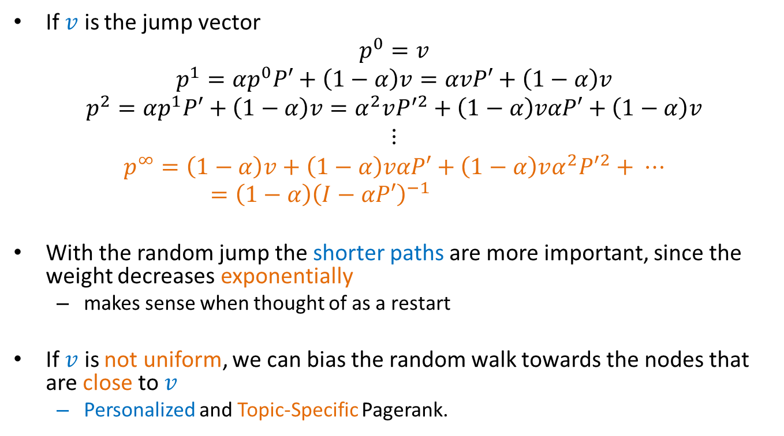
Stationary distribution with random jump
If $v$ is the jump vector
$$p^{0}=v$$
$$p^{1}=αp^{0}P′+\left(1−α\right)v=αvP′+\left(1−α\right)v$$
$$p^{2}=αp^{1}P′+\left(1−α\right)v=α^{2}vP^{′2}+\left(1−α\right)vαP′+\left(1−α\right)v$$
$$⋮$$
$$p^{∞}=\left(1−α\right)v+\left(1−α\right)vαP′+\left(1−α\right)vα^{2}{P′}^{2}+ ⋯=\left(1−α\right){\left(I−αP′\right)}^{−1}$$
With the random jump the shorter paths are more important, since the weight decreases exponentially
  makes sense when thought of as a restart
If $v$ is not uniform, we can bias the random walk towards the nodes that are close to $v$
  Personalized and Topic-Specific Pagerank.

Slide 43
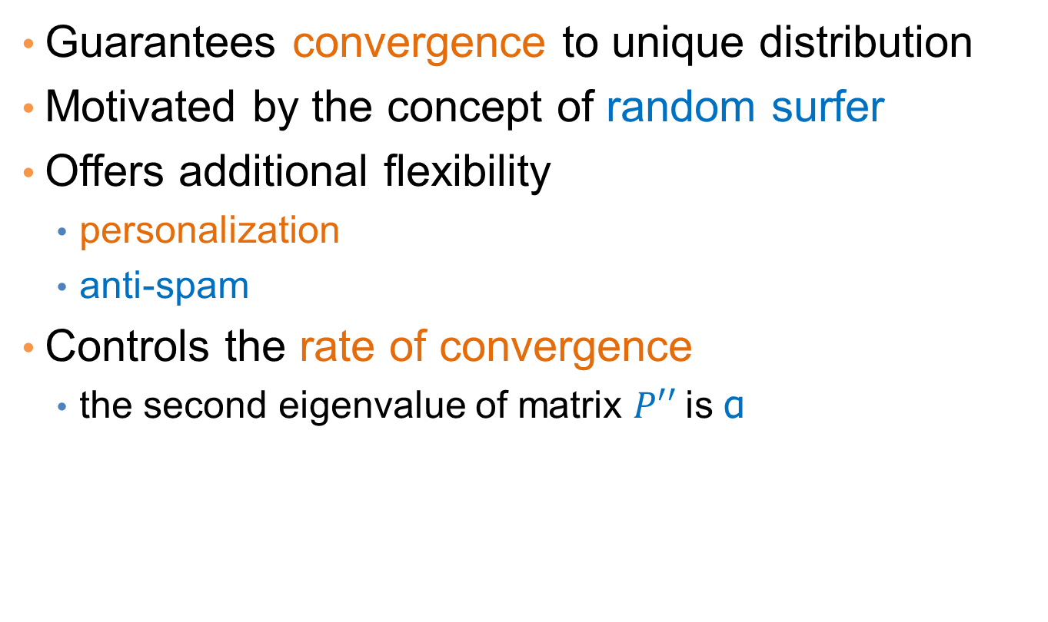
Effects of random jump
Guarantees convergence to unique distribution
Motivated by the concept of random surfer
Offers additional flexibility
  personalization
  anti-spam
Controls the rate of convergence
  the second eigenvalue of matrix $P′′$is α

Slide 44
Random walks on undirected graphs
For undirected graphs, the stationary distribution is proportional to the degrees of the nodes
  Thus in this case a random walk is the same as degree popularity
This is not longer true if we do random jumps
  Now the short paths play a greater role, and the previous distribution does not hold.

Slide 45
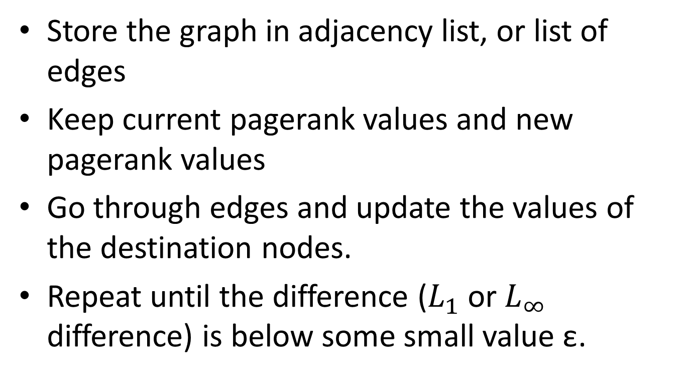
PageRank implementation
Store the graph in adjacency list, or list of edges
Keep current pagerank values and new pagerank values
Go through edges and update the values of the destination nodes.
Repeat until the difference ($L_{1}$ or $L_{∞}$ difference) is below some small value ε.

Slide 46
A (Matlab-friendly) PageRank algorithm
Performing vanilla power method is now too expensive – the matrix is not sparse
q⁰ = v
t = 1
repeat
t = t +1
until δ < ε
Efficient computation of y = (P’’)^{T} x
P = normalized adjacency matrix
P’ = P + dv^{T}, where d_{i} is 1 if i is sink and 0 o.w.
P’’ = αP’ + (1-α)uv^{T}, where u is the vector of all 1s

Slide 47
PageRank history
Huge advantage for Google in the early days
  It gave a way to get an idea for the value of a page, which was useful in many different ways
    Put an order to the web.
  After a while it became clear that the anchor text was probably more important for ranking
  Also, link spam became a new (dark) art
Flood of research
  Numerical analysis got rejuvenated
  Huge number of variations
  Efficiency became a great issue.
  Huge number of applications in different fields
    Random walk is often referred to as PageRank.

Slide 48
THE HITS ALGORITHM

Slide 49
The HITS algorithm
Another algorithm proposed around the same time as PageRank for using the hyperlinks to rank pages
  Kleinberg: then an intern at IBM Almaden
  IBM never made anything out of it

Slide 50
Query dependent input
Root set obtained from a text-only search engine
Root Set

Slide 51
Query dependent input
Root Set
IN
OUT

Slide 52
Query dependent input
Root Set
IN
OUT

Slide 53
Query dependent input
Base Set
Root Set
IN
OUT

Slide 54
Hubs and Authorities [K98]
Authority is not necessarily transferred directly between authorities
Pages have double identity
  hub identity
  authority identity
Good hubs point to good authorities
Good authorities are pointed by good hubs
hubs
authorities

Slide 55
Hubs and Authorities
Two kind of weights:
  Hub weight
  Authority weight
The hub weight is the sum of the authority weights of the authorities pointed to by the hub
The authority weight is the sum of the hub weights that point to this authority.

Slide 56
HITS Algorithm
Initialize all weights to 1.
Repeat until convergence
  O operation : hubs collect the weight of the authorities
  I operation: authorities collect the weight of the hubs
  Normalize weights under some norm

Slide 57
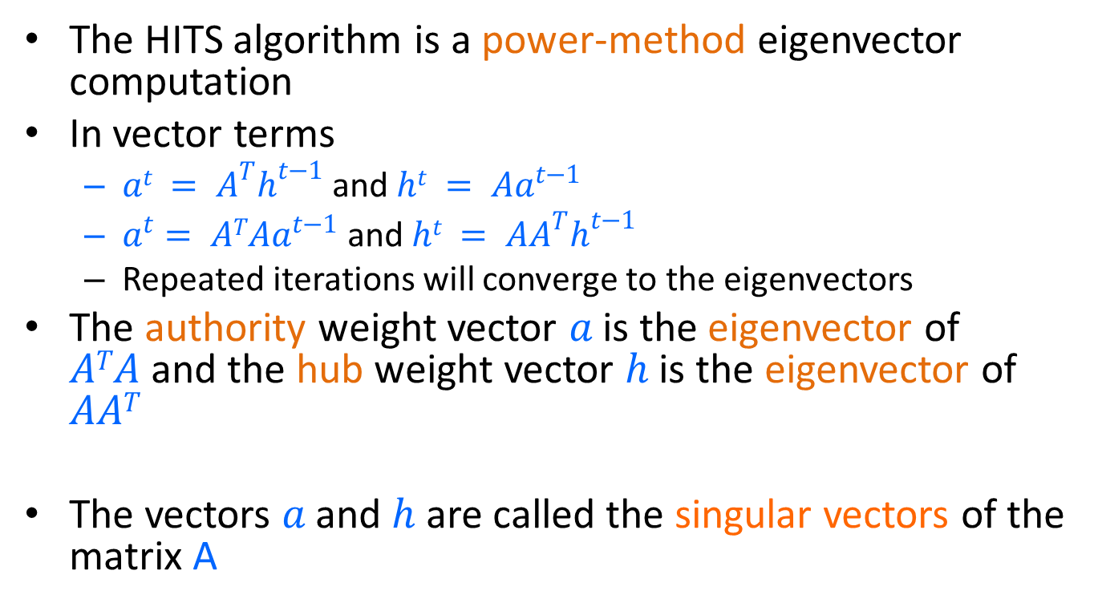
HITS and eigenvectors
The HITS algorithm is a power-method eigenvector computation
In vector terms
  $at = A^{T}h^{t−1}$and $ht = Aa^{t−1}$
  $a^{t}= ATAa^{t−1}$and $ht = AA^{T}h^{t−1}$
  Repeated iterations will converge to the eigenvectors
The authority weight vector $a$ is the eigenvector of $ATA$and the hub weight vector $h$ is the eigenvector of $AAT$
The vectors $a$ and $h$ are called the singular vectors of the matrix A

Slide 58
Singular Value Decomposition
r : rank of matrix A
σ₁≥ σ₂≥ … ≥σ_{r} : singular values (square roots of eig-vals AA^{T}, A^{T}A)
: left singular vectors (eig-vectors of AA^{T})
: right singular vectors (eig-vectors of A^{T}A)
[n×r]
[r×r]
[r×n]

Slide 59
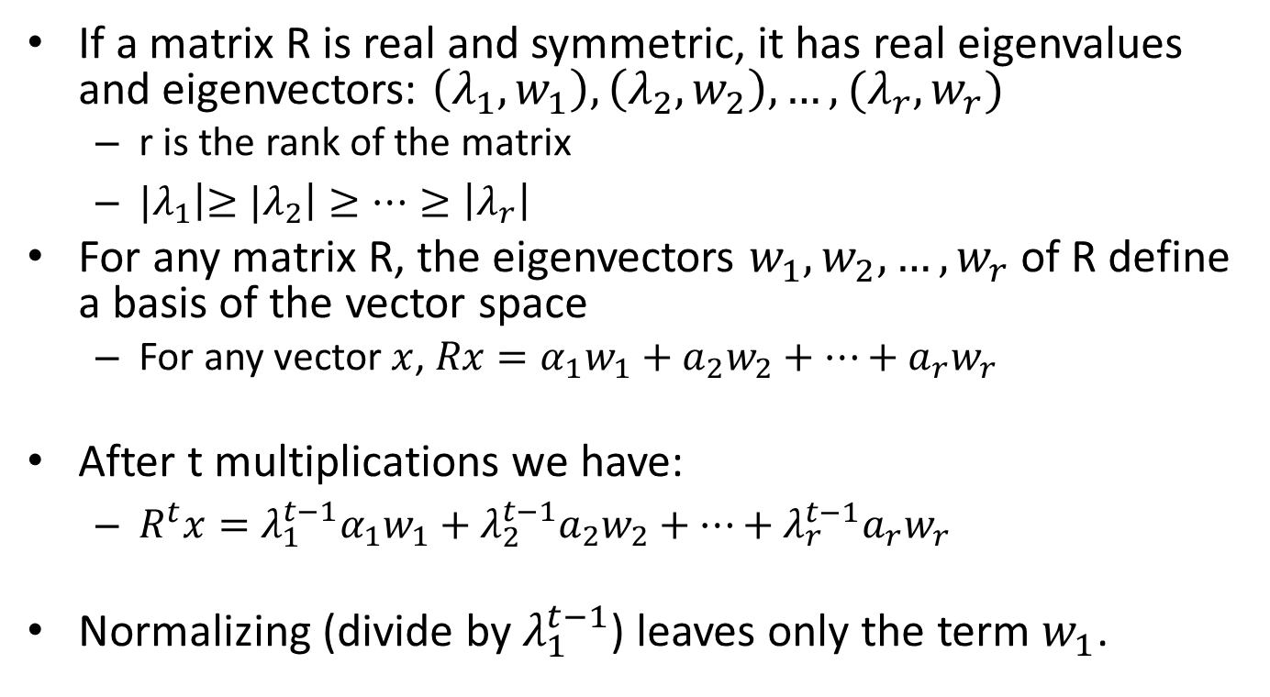
Why does the Power Method work?
If a matrix R is real and symmetric, it has real eigenvalues and eigenvectors: $\left(λ_{1},w_{1}\right), \left(λ_{2}, w_{2}\right), …, (λ_{r}, w_{r})$
  r is the rank of the matrix
  ${|λ}_{1}\left|≥{|λ}_{2}\right|≥⋯≥\left|λ_{r}\right|$
For any matrix R, the eigenvectors $w_{1},w_{2},…,w_{r}$ of R define a basis of the vector space
  For any vector $x$, $Rx=α_{1}w_{1}+a_{2}w_{2}+⋯+a_{r}w_{r}$
After t multiplications we have:
  $R^{t}x={λ_{1}^{t−1}α}_{1}w_{1}+{λ_{2}^{t−1}a}_{2}w_{2}+⋯+{λ_{r}^{t−1}a}_{r}w_{r}$
Normalizing (divide by $λ_{1}^{t−1}$) leaves only the term $w_{1}$.

Slide 60
Example
Initialize
1
1
1
1
1
1
1
1
1
1
hubs
authorities

Slide 61
Example
Step 1: O operation
1
1
2
1
3
1
2
1
1
1
hubs
authorities

Slide 62
Example
Step 1: I operation
1
6
2
5
3
5
2
2
1
1
hubs
authorities

Slide 63
Example
Step 1: Normalization (Max norm)
1/3
1
2/3
5/6
1
5/6
2/3
2/6
1/3
1/6
hubs
authorities

Slide 64
Example
Step 2: O step
1
1
11/6
5/6
16/6
5/6
7/6
2/6
1/6
1/6
hubs
authorities

Slide 65
Example
Step 2: I step
1
33/6
11/6
27/6
16/6
23/6
7/6
7/6
1/6
1/6
hubs
authorities

Slide 66
Example
Step 2: Normalization
6/16
1
11/16
27/33
1
23/33
7/16
7/33
1/16
1/33
hubs
authorities

Slide 67
Example
Convergence
0.4
1
0.75
0.8
1
0.6
0.3
0.14
0
0
hubs
authorities

Slide 68
Absorbing Random Walks
Label Propagation
Opinion formation on Social Networks

Slide 69
Random walk with absorbing nodes
What happens if we do a random walk on this graph? What is the stationary distribution?
All the probability mass on the red sink node:
  The red node is an absorbing node

Slide 70
Random walk with absorbing nodes
What happens if we do a random walk on this graph? What is the stationary distribution?
There are two absorbing nodes: the red and the blue.
The probability mass will be divided between the two

Slide 71
Absorption probability
If there are more than one absorbing nodes in the graph a random walk that starts from a non-absorbing node will be absorbed in one of them with some probability
  The probability of absorption gives an estimate of how close the node is to red or blue

Slide 72
Absorption probability
Computing the probability of being absorbed:
  The absorbing nodes have probability 1 of being absorbed in themselves and zero of being absorbed in another node.
  For the non-absorbing nodes, take the (weighted) average of the absorption probabilities of your neighbors
    if one of the neighbors is the absorbing node, it has probability 1
  Repeat until convergence (= very small change in probs)
$$P\left(Red | Pink\right)=\frac{2}{3}P\left(Red | Yellow\right)+\frac{1}{3}P(Red|Green)$$
2
1
$$P\left(Red | Green\right)=\frac{1}{4}P\left(Red | Yellow\right)+\frac{1}{4}$$
1
1
2
$$P\left(Red | Yellow\right)=\frac{2}{3}$$
2
1

Slide 73
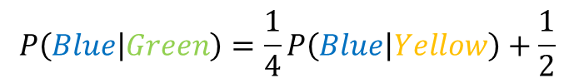
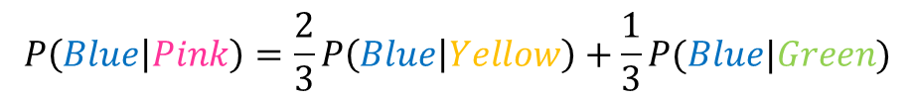
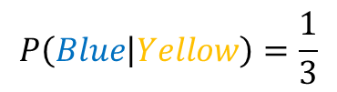
Absorption probability
Computing the probability of being absorbed:
  The absorbing nodes have probability 1 of being absorbed in themselves and zero of being absorbed in another node.
  For the non-absorbing nodes, take the (weighted) average of the absorption probabilities of your neighbors
    if one of the neighbors is the absorbing node, it has probability 1
  Repeat until convergence (= very small change in probs)
$$P\left(Blue | Pink\right)=\frac{2}{3}P\left(Blue | Yellow\right)+\frac{1}{3}P(Blue|Green)$$
2
1
$$P\left(Blue | Green\right)=\frac{1}{4}P\left(Blue | Yellow\right)+\frac{1}{2}$$
1
1
2
$$P\left(Blue | Yellow\right)=\frac{1}{3}$$
2
1

Slide 74
Why do we care?
Why do we care to compute the absorbtion probability to sink nodes?
Given a graph (directed or undirected) we can choose to make some nodes absorbing.
  Simply direct all edges incident on the chosen nodes towards them.
The absorbing random walk provides a measure of proximity of non-absorbing nodes to the chosen nodes.
  Useful for understanding proximity in graphs
  Useful for propagation in the graph
    E.g, on a social network some nodes have high income, some have low income, to which income class is a non-absorbing node closer?

Slide 75
Example
In this undirected graph we want to learn the proximity of nodes to the red and blue nodes
2
1
1
1
2
2
1

Slide 76
Example
Make the nodes absorbing
2
1
1
1
2
2
1

Slide 77
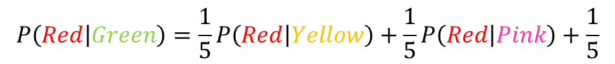
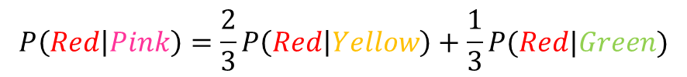
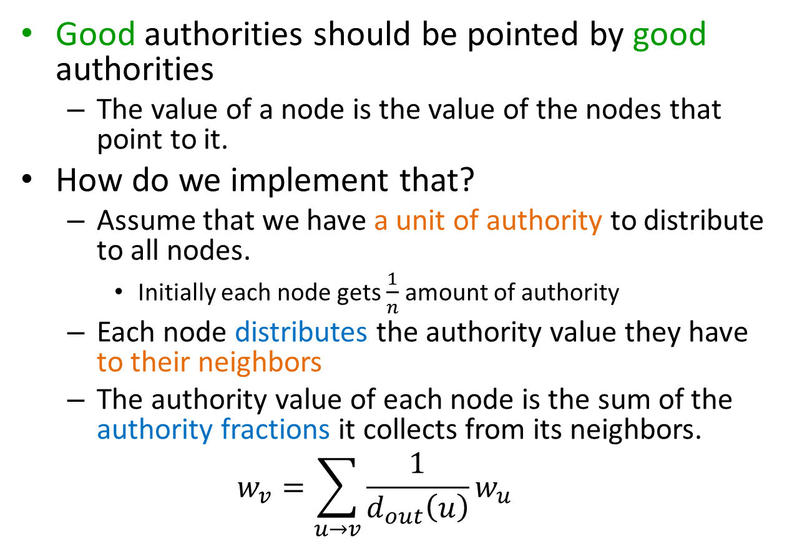
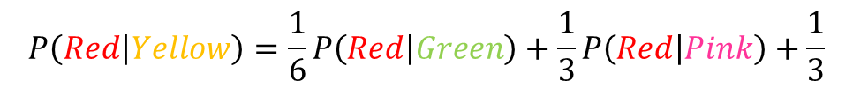
Absorption probability
Compute the absorbtion probabilities for red and blue
$$P\left(Red | Pink\right)=\frac{2}{3}P\left(Red | Yellow\right)+\frac{1}{3}P(Red|Green)$$
$$P\left(Red | Green\right)=\frac{1}{5}P\left(Red | Yellow\right)+\frac{1}{5}P\left(Red | Pink\right)+\frac{1}{5}$$
0.57
0.43
2
$$P\left(Red | Yellow\right)=\frac{1}{6}P\left(Red | Green\right)+\frac{1}{3}P\left(Red | Pink\right)+\frac{1}{3}$$
1
1
1
$$P\left(Blue | Pink\right)=1−P\left(Red | Pink\right)$$
2
2
$$P\left(Blue | Green\right)=1− P\left(Red | Green\right)$$
1
$$P\left(Blue | Yellow\right)=1−P\left(Red | Yellow\right)$$
0.52
0.48
0.42
0.58

Slide 78
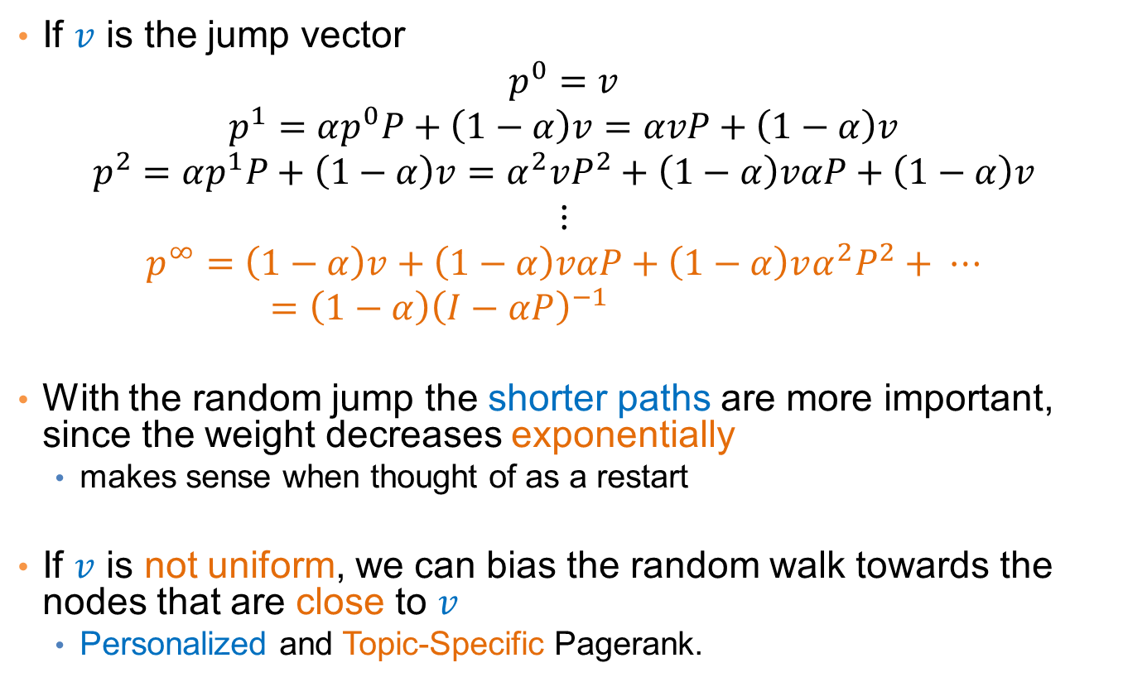

Penalizing long paths
The orange node has the same probability of reaching red and blue as the yellow one
Intuitively though it is further away
0.57
0.43
0.57
0.43
2
$$P\left(Red | Orange\right)=P\left(Red | Yellow\right)$$
1
$P\left(Blue | Orange\right)=$ $P\left(Blue | Yellow\right)$
1
1
1
2
2
1
0.52
0.48
0.42
0.58

Slide 79
Penalizing long paths
Add an universal absorbing node to which each node gets absorbed with probability α.
With probability α the random walk dies
With probability (1-α) the random walk continues as before
α
1-α
1-α
α
1-α
1-α
The longer the path from a node to an absorbing node the more likely the random walk dies along the way, the lower the absorbtion probability
α
α
$$P\left(Red | Green\right)=(1−α)\left(\frac{1}{5}P\left(Red | Yellow\right)+\frac{1}{5}P\left(Red | Pink\right)+\frac{1}{5}\right)$$

Slide 80
Propagating values
Assume that Red has a positive value and Blue a negative value
  Positive/Negative class, Positive/Negative opinion
We can compute a value for all the other nodes in the same way
  This is the expected value for the node
+1
$$V(Pink)=\frac{2}{3}V(Yellow)+\frac{1}{3}V(Green)$$
0.16
2
-1
1
$$V\left(Green\right)= \frac{1}{5}V(Yellow)+\frac{1}{5}V(Pink)+\frac{1}{5} −\frac{2}{5}$$
1
2
1
2
$$V\left(Yellow\right)= \frac{1}{6}V\left(Green\right)+\frac{1}{3}V(Pink)+\frac{1}{3} −\frac{1}{6}$$
1
0.05
-0.16

Slide 81
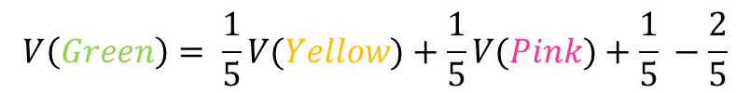
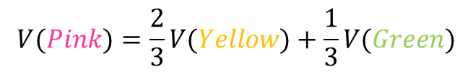
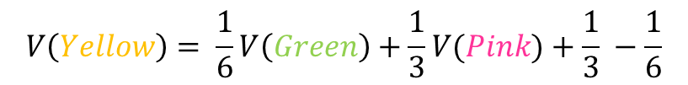
Electrical networks and random walks
Our graph corresponds to an electrical network
There is a positive voltage of +1 at the Red node, and a negative voltage -1 at the Blue node
There are resistances on the edges inversely proportional to the weights (or conductance proportional to the weights)
The computed values are the voltages at the nodes
+1
+1
0.16
2
$$V(Pink)=\frac{2}{3}V(Yellow)+\frac{1}{3}V(Green)$$
-1
1
$$V\left(Green\right)= \frac{1}{5}V(Yellow)+\frac{1}{5}V(Pink)+\frac{1}{5} −\frac{2}{5}$$
1
1
2
2
$$V\left(Yellow\right)= \frac{1}{6}V\left(Green\right)+\frac{1}{3}V(Pink)+\frac{1}{3} −\frac{1}{6}$$
1
0.05
-0.16

Slide 82
Opinion formation
The value propagation can be used as a model of opinion formation.
Model:
  Opinions are values in [-1,1]
  Every user $u$ has an internal opinion $s_{u}$, and expressed opinion $z_{u}$.
  The expressed opinion minimizes the personal cost of user $u$:
  $$c\left(z_{u}\right)={\left(s_{u}−z_{u}\right)}^{2}+\sum_{v:v is a friend of u}{w_{u}{\left(z_{u}−z_{v}\right)}^{2}}$$
    Minimize deviation from your beliefs and conflicts with the society
If every user tries independently (selfishly) to minimize their personal cost then the best thing to do is to set $z_{u}$to the average of all opinions:
  $$z_{u}=\frac{s_{u}+ \sum_{v:v is a friend of u}{w_{u}z_{u}}}{1+\sum_{v:v is a friend of u}{w_{u}}}$$
This is the same as the value propagation we described before!

Slide 83
Example
Social network with internal opinions
s = +0.5
2
s = +0.8
1
s = -0.3
1
1
2
2
1
s = +0.2
s = -0.1

Slide 84
Example
One absorbing node per user with value the internal opinion of the user
One non-absorbing node per user that links to the corresponding absorbing node
s = +0.5
1
z = +0.17
z = +0.22
2
1
s = +0.8
1
1
s = -0.3
2
1
The external opinion for each node is computed using the value propagation we described before
  Repeated averaging
1
z = -0.01
2
1
z = -0.03
z = 0.04
1
1
Intuitive model: my opinion is a combination of what I believe and what my social network believes.
s = -0.5
s = -0.1

Slide 85
Transductive learning
If we have a graph of relationships and some labels on some nodes we can propagate them to the remaining nodes
  Make the labeled nodes to be absorbing and compute the probability for the rest of the graph
  E.g., a social network where some people are tagged as spammers
  E.g., the movie-actor graph where some movies are tagged as action or comedy.
This is a form of semi-supervised learning
  We make use of the unlabeled data, and the relationships
It is also called transductive learning because it does not produce a model, but just labels the unlabeled data that is at hand.
  Contrast to inductive learning that learns a model and can label any new example

Slide 86

Implementation details
Implementation is in many ways similar to the PageRank implementation
  For an edge $(u,v)$instead of updating the value of v we update the value of u.
    The value of a node is the average of its neighbors
  We need to check for the case that a node u is absorbing, in which case the value of the node is not updated.
  Repeat the updates until the change in values is very small.

