Slide 1
Online Social Networks and Media

Slide 2
Graph partitioning
The general problem
  Input: a graph G=(V,E)
    edge (u,v) denotes similarity between u and v
    weighted graphs: weight of edge captures the degree of similarity
  Partitioning as an optimization problem:
    Partition the nodes in the graph such that nodes within clusters are well interconnected (high edge weights), and nodes across clusters are sparsely interconnected (low edge weights)
    most graph partitioning problems are NP hard

Slide 3
Measuring connectivity
What does it mean that a set of nodes are well or sparsely interconnected?
min-cut: the min number of edges such that when removed cause the graph to become disconnected
  small min-cut implies sparse connectivity
This problem can be solved in polynomial time
Min-cut/Max-flow algorithm
U
V-U

Slide 4
Measuring connectivity
What does it mean that a set of nodes are well interconnected?
min-cut: the min number of edges such that when removed cause the graph to become disconnected
  not always a good idea!
U
V-U
U
V-U

Slide 5
A bad example

Slide 6
Graph Bisection
Since the minimum cut does always yield good results we need an extra constraints to make the problem meaningful.
Graph Bisection refers to the problem of partitioning the nodes of the graph into two equal sets.
Kernighan-Lin algorithm: Start with random equal partitions and then swap nodes to improve some quality metric (e.g., cut, modularity, etc).

Slide 7
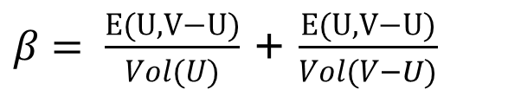
Graph expansion
Normalize the cut by the size of the smallest component
Cut ratio:
Graph expansion:
Other Normalized Cut Ratio:
$β= \frac{E(U,V−U)}{Vol(U)}$ + $\frac{E(U,V−U)}{Vol(V−U)}$
Vol(U) = number of edges with one endpoint in U
= total degree of nodes in U

Slide 8
Spectral analysis
The Laplacian matrix L = D – A where
  A = the adjacency matrix
  D = diag(d₁,d₂,…,d_{n})
    d_{i} = degree of node i
Therefore
  L(i,i) = d_{i}
  L(i,j) = -1, if there is an edge (i,j)

Slide 9
Laplacian Matrix properties
The matrix L is symmetric and positive semi-definite
  all eigenvalues of L are positive
The matrix L has 0 as an eigenvalue, and corresponding eigenvector w₁ = (1,1,…,1)
  λ₁ = 0 is the smallest eigenvalue

Slide 10
The second smallest eigenvalue
The second smallest eigenvalue (also known as Fielder value) λ₂ satisfies
The eigenvector for eigenvalue λ₂ is called the Fielder vector. It minimizes
where

Slide 11
Spectral ordering
The values of x minimize
For weighted matrices
The ordering according to the x_{i} values will group similar (connected) nodes together
Physical interpretation: The stable state of springs placed on the edges of the graph

Slide 12
Spectral partition
Partition the nodes according to the ordering induced by the Fielder vector
If u = (u₁,u₂,…,u_{n}) is the Fielder vector, then split nodes according to a threshold value s
  bisection: s is the median value in u
  ratio cut: s is the value that minimizes α
  sign: separate positive and negative values (s=0)
  gap: separate according to the largest gap in the values of u
This works well (provably for special cases)

Slide 13
Fielder Value
The value λ₂ is a good approximation of the graph expansion
For the minimum ratio cut of the Fielder vector we have that
If the max degree d is bounded we obtain a good approximation of the minimum expansion cut
d = maximum degree

Slide 14
Maximum Densest SUBGRAPH
Thanks to Aris Gionis

Slide 15
Finding dense subgraphs
Dense subgraph: A collection of vertices such that there are a lot of edges between them
  E.g., find the subset of email users that talk the most between them
  Or, find the subset of genes that are most commonly expressed together
Similar to community identification but we do not require that the dense subgraph is sparsely connected with the rest of the graph.

Slide 16
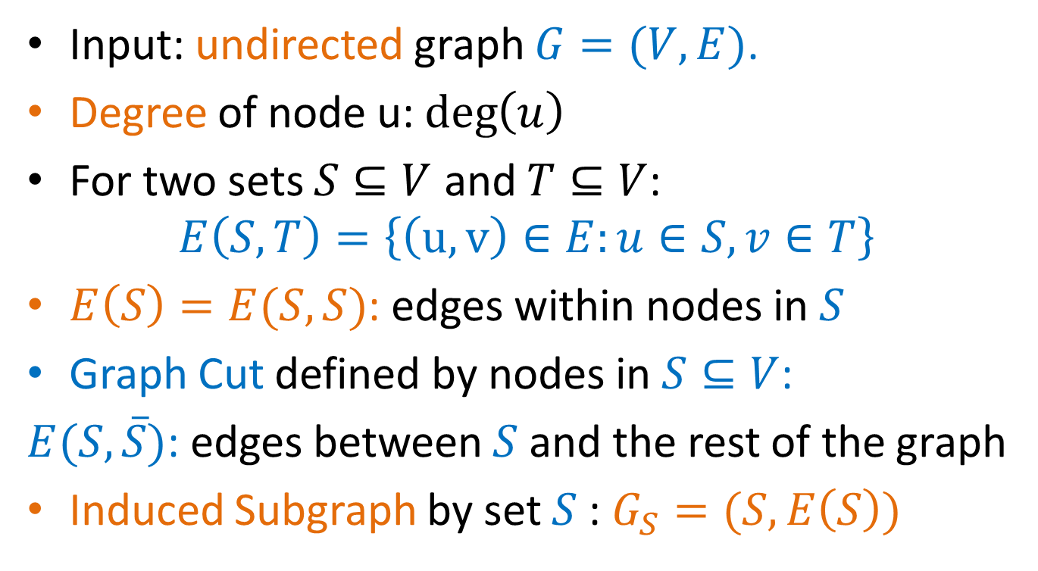
Definitions
Input: undirected graph $G=(V,E)$.
Degree of node u: $\deg\left(u\right)$
For two sets $S⊆V$ and $T⊆V$:
$$E\left(S,T\right)=\left\{\left(u,v\right)∈E:u∈S, v∈T\right\}$$
$E\left(S\right)=E(S,S)$: edges within nodes in $S$
Graph Cut defined by nodes in $S⊆V$:
$E(S,\overline{S})$: edges between $S$ and the rest of the graph
Induced Subgraph by set $S$: $G_{S}=(S,E\left(S\right))$

Slide 17
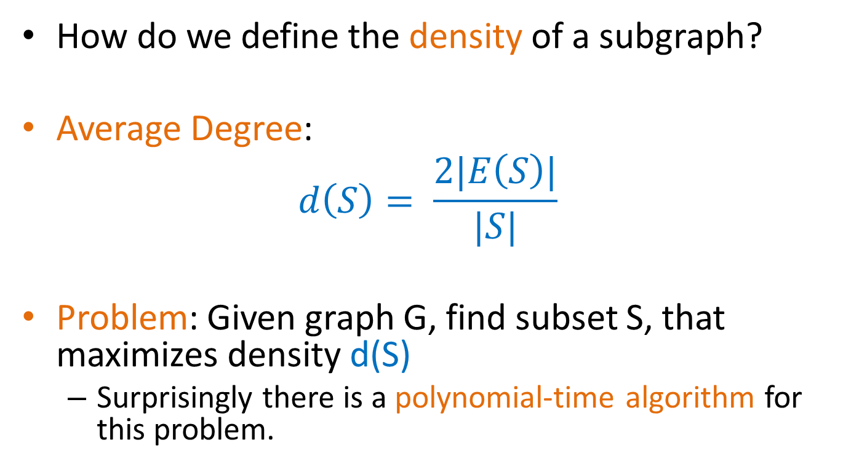
Definitions
How do we define the density of a subgraph?
Average Degree:
$$d\left(S\right)= \frac{2|E\left(S\right)|}{|S|}$$
Problem: Given graph G, find subset S, that maximizes density d(S)
  Surprisingly there is a polynomial-time algorithm for this problem.

Slide 18
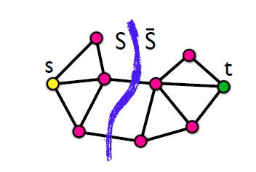
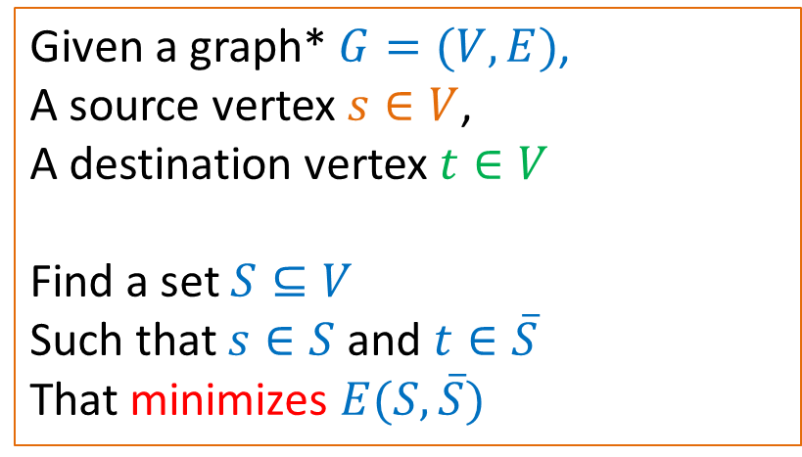
Min-Cut Problem
Given a graph* $G=(V,E)$,
A source vertex $s∈V$,
A destination vertex $t∈V$
Find a set $S⊆V$
Such that $s∈S$ and $t∈\overline{S}$
That minimizes $E(S,\overline{S})$
* The graph may be weighted
Min-Cut = Max-Flow: the minimum cut maximizes the flow that can be sent from s to t. There is a polynomial time solution.

Slide 19
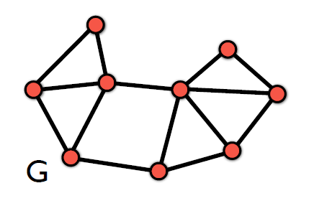
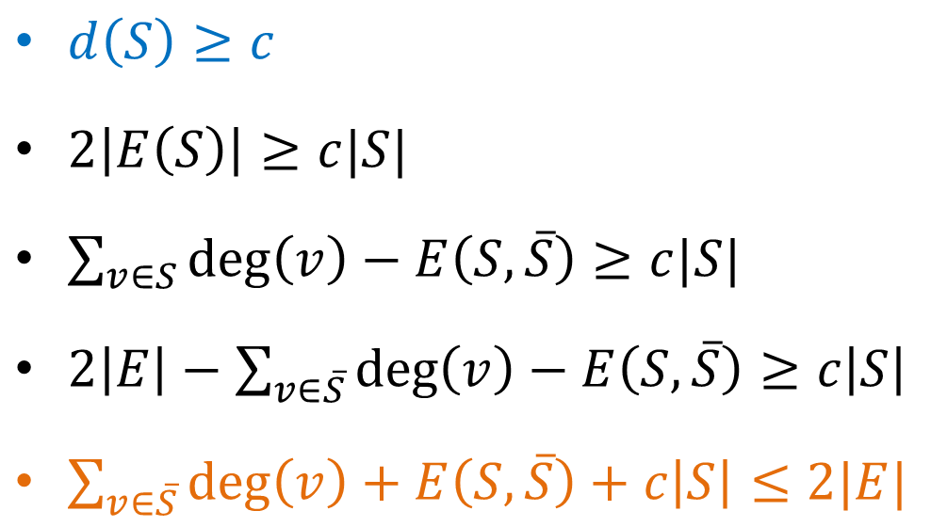
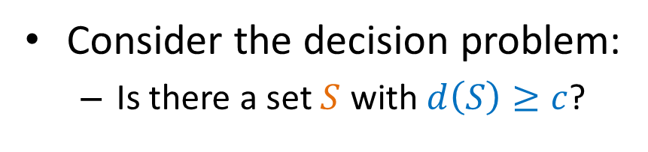
Decision problem
Consider the decision problem:
  Is there a set $S$ with $d\left(S\right)≥c$?
$d\left(S\right)≥c$
$2\left|E\left(S\right)\right|≥c|S|$
$\sum_{v∈S}{\deg\left(v\right)−E\left(S,\overline{S}\right)≥c|S|}$
$2\left|E\right|−\sum_{v∈\overline{S}}{\deg\left(v\right)}−E\left(S,\overline{S}\right)≥c\left|S\right|$
$\sum_{v∈\overline{S}}{\deg\left(v\right)}+E\left(S,\overline{S}\right)+c\left|S\right|≤2|E|$

Slide 20
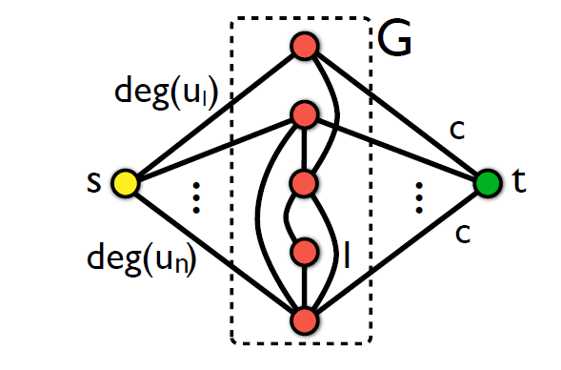

Transform to min-cut
For a value $c$ we do the following transformation
We ask for a min s-t cut in the new graph

Slide 21
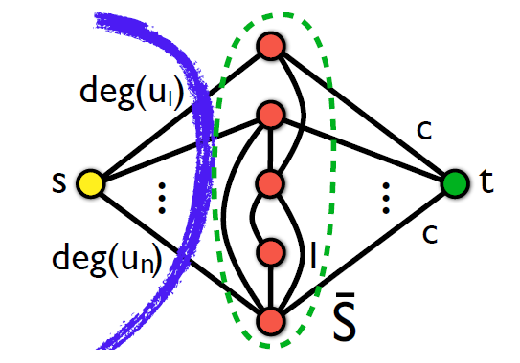

Transformation to min-cut
There is a cut that has value $2|E|$

Slide 22
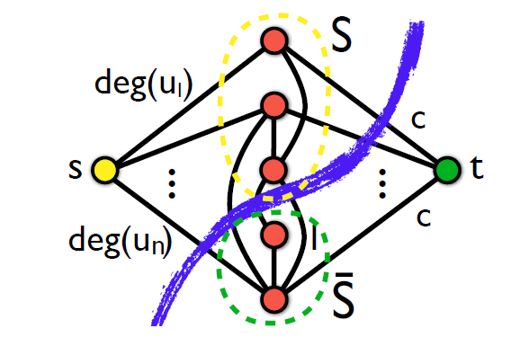

Transformation to min-cut
Every other cut has value:
$\sum_{v∈\overline{S}}{\deg\left(v\right)}+E\left(S,\overline{S}\right)+c\left|S\right|$

Slide 23

Transformation to min-cut
If $\sum_{v∈\overline{S}}{\deg\left(v\right)}+E\left(S,\overline{S}\right)+c\left|S\right|≤2|E|$ then $S≠∅$ and $d\left(S\right)≥c$

Slide 24
Algorithm (Goldberg)
Given the input graph G, and value c
Create the min-cut instance graph
Compute the min-cut
If the set S is not empty, return YES
Else return NO
How do we find the set with maximum density?

Slide 25
Min-cut algorithm
The min-cut algorithm finds the optimal solution in polynomial time O(nm), but this is too expensive for real networks.
We will now describe a simpler approximation algorithm that is very fast
  Approximation algorithm: the ratio of the density of the set produced by our algorithm and that of the optimal is bounded.
    We will show that the ratio is at most ½
    The optimal set is at most twice as dense as that of the approximation algorithm.
Any ideas for the algorithm?

Slide 26
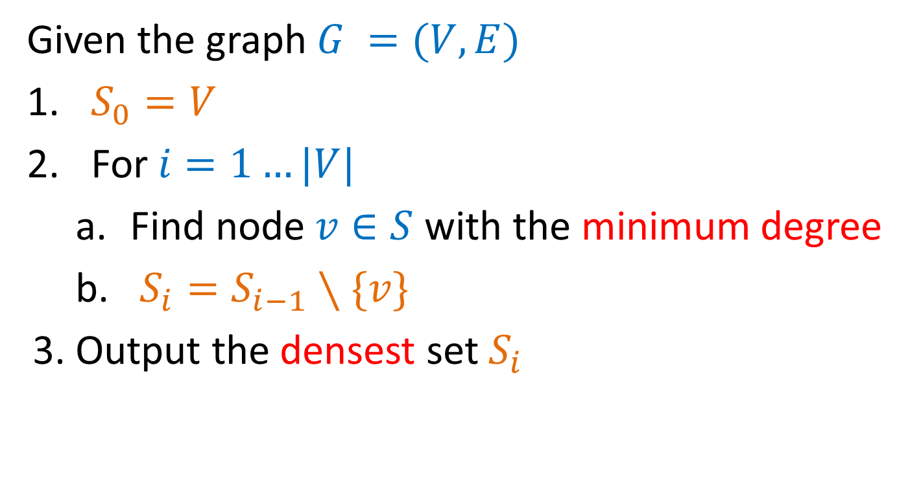
Greedy Algorithm
Given the graph $G =(V,E)$
$S_{0}=V$
For $i=1…|V|$
  Find node $v∈S$ with the minimum degree
  $S_{i}=S_{i−1}∖\{v\}$
3. Output the densest set $S_{i}$

Slide 27
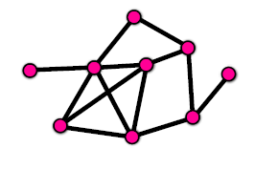
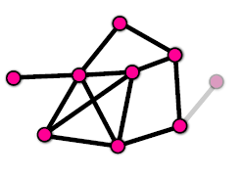
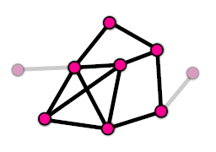
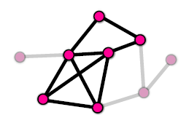
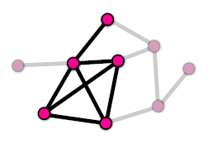
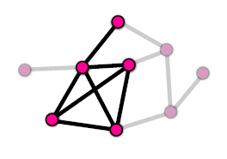

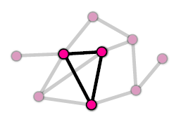
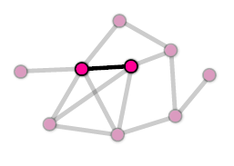
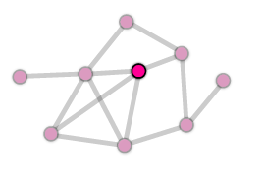
Example

Slide 28
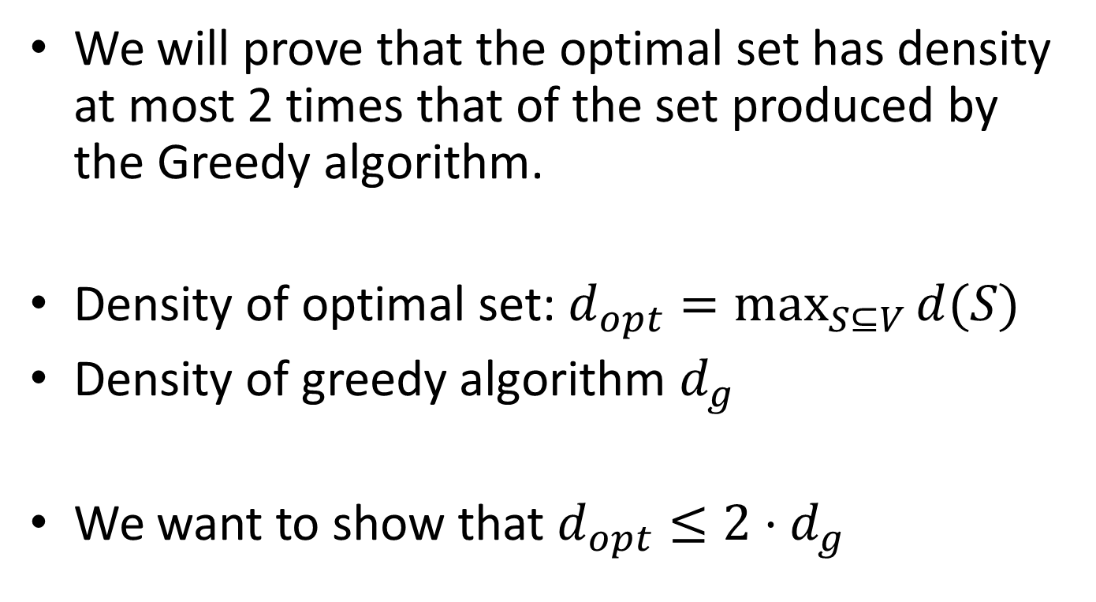
Analysis
We will prove that the optimal set has density at most 2 times that of the set produced by the Greedy algorithm.
Density of optimal set: $d_{opt}=\max_{S⊆V}{d(S)}$
Density of greedy algorithm $d_{g}$
We want to show that $d_{opt}≤{2⋅d}_{g}$

Slide 29
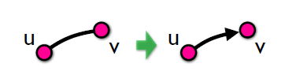
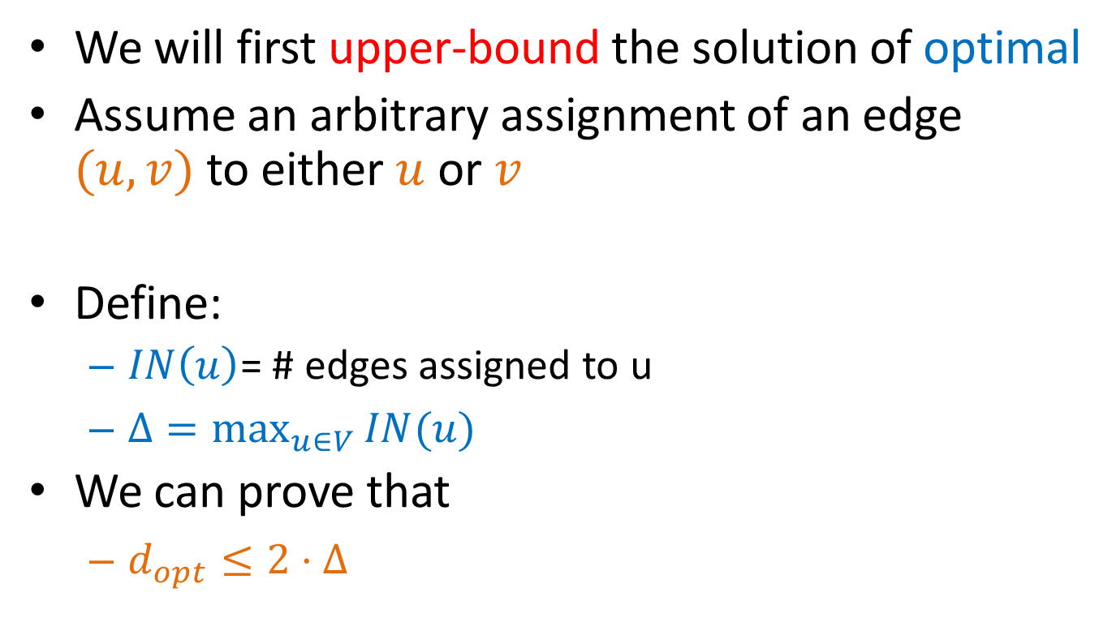
Upper bound
We will first upper-bound the solution of optimal
Assume an arbitrary assignment of an edge $(u,v)$to either $u$ or $v$
Define:
  $IN\left(u\right)$= # edges assigned to u
  $Δ=\max_{u∈V}{IN(u)}$
We can prove that
  $d_{opt}≤2⋅Δ$
This is true for any assignment of the edges!

Slide 30
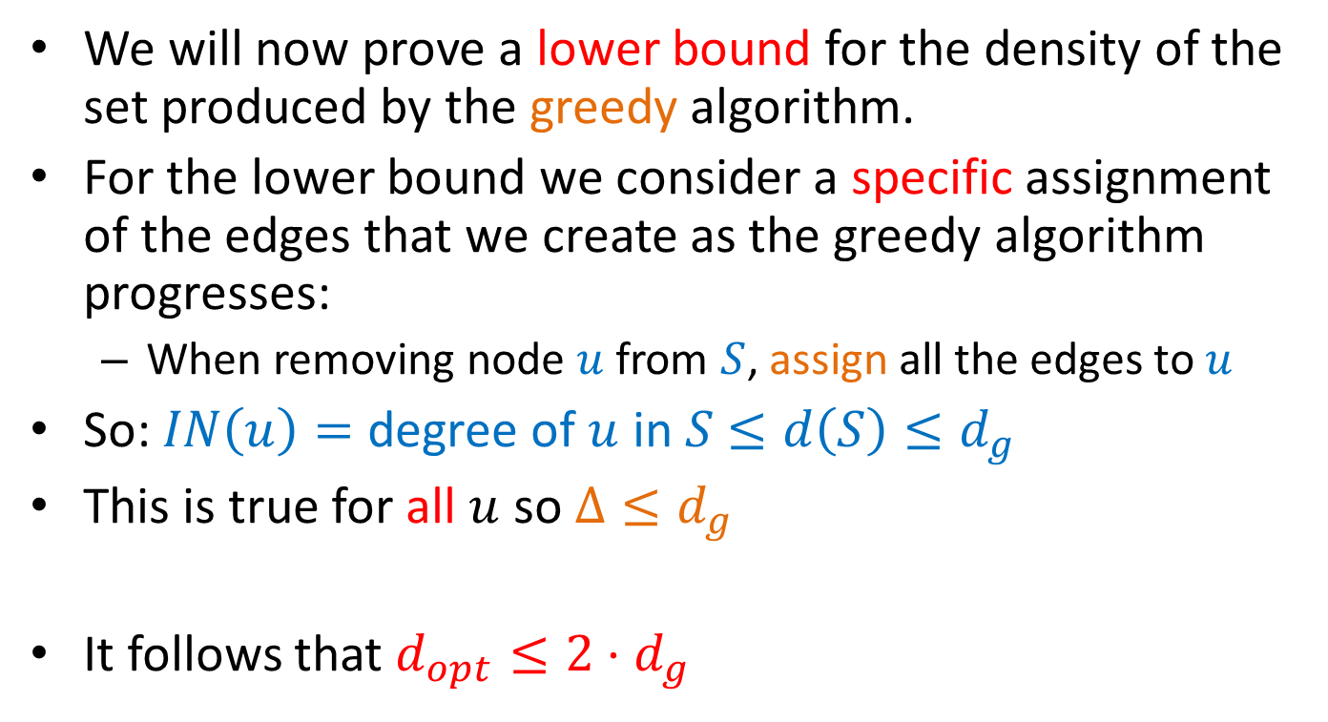
Lower bound
We will now prove a lower bound for the density of the set produced by the greedy algorithm.
For the lower bound we consider a specific assignment of the edges that we create as the greedy algorithm progresses:
  When removing node $u$ from $S$, assign all the edges to $u$
So: $IN\left(u\right)=$ degree of $u$ in $S$ $≤d\left(S\right)≤d_{g}$
This is true for all $u$ so $Δ≤d_{g}$
It follows that $d_{opt}≤2⋅d_{g}$

Slide 31

The k-densest subgraph
The k-densest subgraph problem: Find the set of $k$ nodes $S$, such that the density $d(S)$ is maximized.
  The k-densest subgraph problem is NP-hard!

