Slide 1
DATA MINING
LECTURE 10
Classification
Basic Concepts
Decision Trees
Evaluation
Nearest-Neighbor Classifier

Slide 2
Catching tax-evasion
Tax-return data for year 2011
A new tax return for 2012
Is this a cheating tax return?
An instance of the classification problem: learn a method for discriminating between records of different classes (cheaters vs non-cheaters)

Slide 3
What is classification?
Classification is the task of learning a target function f that maps attribute set x to one of the predefined class labels y
categorical
categorical
continuous
class
One of the attributes is the class attribute
In this case: Cheat
Two class labels (or classes): Yes (1), No (0)

Slide 4
Why classification?
The target function f is known as a classification model
Descriptive modeling: Explanatory tool to distinguish between objects of different classes (e.g., understand why people cheat on their taxes)
Predictive modeling: Predict a class of a previously unseen record

Slide 5
Examples of Classification Tasks
Predicting tumor cells as benign or malignant
Classifying credit card transactions as legitimate or fraudulent
Categorizing news stories as finance,
weather, entertainment, sports, etc
Identifying spam email, spam web pages, adult content
Understanding if a web query has commercial intent or not

Slide 6
General approach to classification
Training set consists of records with known class labels
Training set is used to build a classification model
A labeled test set of previously unseen data records is used to evaluate the quality of the model.
The classification model is applied to new records with unknown class labels

Slide 7
Illustrating Classification Task

Slide 8
Evaluation of classification models
Counts of test records that are correctly (or incorrectly) predicted by the classification model
Confusion matrix
Predicted Class
 | Class = 1 | Class = 0
Class = 1 | f₁₁ | f₁₀
Class = 0 | f₀₁ | f₀₀
Actual Class

Slide 9
Classification Techniques
Decision Tree based Methods
Rule-based Methods
Memory based reasoning
Neural Networks
Naïve Bayes and Bayesian Belief Networks
Support Vector Machines

Slide 10
Classification Techniques
Decision Tree based Methods
Rule-based Methods
Memory based reasoning
Neural Networks
Naïve Bayes and Bayesian Belief Networks
Support Vector Machines

Slide 11
Decision Trees
Decision tree
  A flow-chart-like tree structure
  Internal node denotes a test on an attribute
  Branch represents an outcome of the test
  Leaf nodes represent class labels or class distribution

Slide 12
Example of a Decision Tree
categorical
categorical
continuous
class
Splitting Attributes
Refund
Yes
No
Test outcome
NO
MarSt
Single, Divorced
Married
TaxInc
NO
< 80K
> 80K
NO
YES
Class labels
Training Data
Model: Decision Tree

Slide 13
Another Example of Decision Tree
categorical
categorical
continuous
class
MarSt
Single, Divorced
Married
NO
Refund
Yes
No
NO
TaxInc
< 80K
> 80K
NO
YES
There could be more than one tree that fits the same data!

Slide 14
Decision Tree Classification Task
Decision Tree

Slide 15
Apply Model to Test Data
Test Data
Start from the root of tree.
Refund
Yes
No
NO
MarSt
Single, Divorced
Married
TaxInc
NO
< 80K
> 80K
NO
YES

Slide 16
Apply Model to Test Data
Test Data
Refund
Yes
No
NO
MarSt
Single, Divorced
Married
TaxInc
NO
< 80K
> 80K
NO
YES

Slide 17
Apply Model to Test Data
Test Data
Refund
Yes
No
NO
MarSt
Single, Divorced
Married
TaxInc
NO
< 80K
> 80K
NO
YES

Slide 18
Apply Model to Test Data
Test Data
Refund
Yes
No
NO
MarSt
Single, Divorced
Married
TaxInc
NO
< 80K
> 80K
NO
YES

Slide 19
Apply Model to Test Data
Test Data
Refund
Yes
No
NO
MarSt
Single, Divorced
Married
TaxInc
NO
< 80K
> 80K
NO
YES

Slide 20
Apply Model to Test Data
Test Data
Refund
Yes
No
NO
MarSt
Single, Divorced
Married
Assign Cheat to “No”
TaxInc
NO
< 80K
> 80K
NO
YES

Slide 21
Decision Tree Classification Task
Decision Tree

Slide 22
Tree Induction
Finding the best decision tree is NP-hard
Greedy strategy.
  Split the records based on an attribute test that optimizes certain criterion.
Many Algorithms:
  Hunt’s Algorithm (one of the earliest)
  CART
  ID3, C4.5
  SLIQ,SPRINT

Slide 23
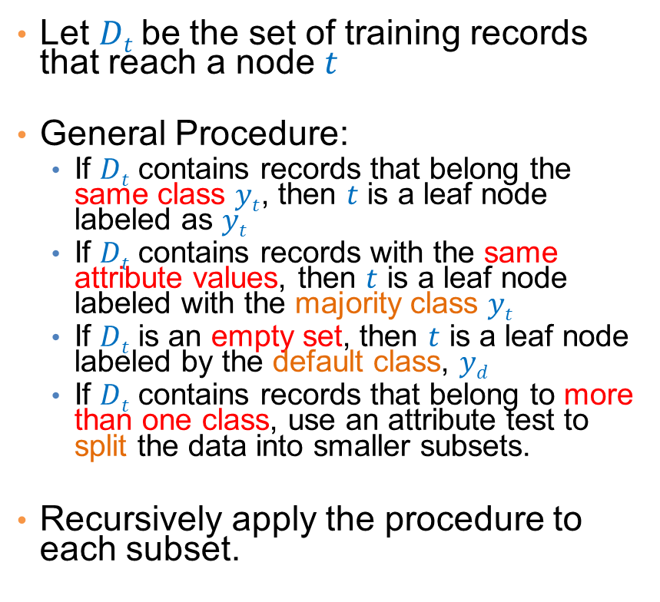

General Structure of Hunt’s Algorithm
Let $Dt$be the set of training records that reach a node $t$
General Procedure:
  If $Dt$ contains records that belong the same class $yt$, then $t$ is a leaf node labeled as $yt$
  If $Dt$ contains records with the same attribute values, then $t$ is a leaf node labeled with the majority class $yt$
  If $Dt$ is an empty set, then $t$ is a leaf node labeled by the default class, $yd$
  If $Dt$ contains records that belong to more than one class, use an attribute test to split the data into smaller subsets.
Recursively apply the procedure to each subset.
$$Dt$$
?

Slide 24
Hunt’s Algorithm
Refund
Don’t
Cheat
Yes
No
Don’t
Cheat
Don’t
Cheat
Refund
Refund
Yes
No
Yes
No
Don’t
Cheat
Marital
Status
Don’t
Cheat
Marital
Status
Single,
Divorced
Single,
Divorced
Married
Married
Cheat
Don’t
Cheat
Taxable
Income
Don’t
Cheat
< 80K
>= 80K
Don’t
Cheat
Cheat

Slide 25
Constructing decision-trees (pseudocode)
GenDecTree(Sample S, Features F)
If stopping_condition(S,F) = true then
  leaf = createNode()
  leaf.label= Classify(S)
  return leaf
root = createNode()
root.test_condition = findBestSplit(S,F)
V = {v| v a possible outcome of root.test_condition}
for each value vєV:
  S_{v}: = {s | root.test_condition(s) = v and s є S};
  child = GenDecTree(S_{v} ,F) ;
  Add child as a descent of root and label the edge (root→child) as v
return root

Slide 26
Tree Induction
Issues
  How to Classify a leaf node
    Assign the majority class
    If leaf is empty, assign the default class – the class that has the highest popularity.
  Determine how to split the records
    How to specify the attribute test condition?
    How to determine the best split?
  Determine when to stop splitting

Slide 27
How to Specify Test Condition?
Depends on attribute types
  Nominal
  Ordinal
  Continuous
Depends on number of ways to split
  2-way split
  Multi-way split

Slide 28
Splitting Based on Nominal Attributes
Multi-way split: Use as many partitions as distinct values.
Binary split: Divides values into two subsets.
Need to find optimal partitioning.
CarType
Family
Luxury
Sports
CarType
OR
CarType
{Sports, Luxury}
{Family,
Luxury}
{Family}
{Sports}

Slide 29
Splitting Based on Ordinal Attributes
Multi-way split: Use as many partitions as distinct values.
Binary split: Divides values into two subsets – respects the order. Need to find optimal partitioning.
What about this split?
Size
Small
Large
Medium
Size
Size
{Small, Medium}
OR
{Medium,
Large}
{Large}
{Small}
Size
{Small, Large}
{Medium}

Slide 30
Splitting Based on Continuous Attributes
Different ways of handling
  Discretization to form an ordinal categorical attribute
    Static – discretize once at the beginning
    Dynamic – ranges can be found by equal interval bucketing, equal frequency bucketing (percentiles), or clustering.
  Binary Decision: (A < v) or (A ≥ v)
    consider all possible splits and finds the best cut
    can be more compute intensive

Slide 31
Splitting Based on Continuous Attributes

Slide 32
How to determine the Best Split
Before Splitting: 10 records of class 0,
10 records of class 1
Which test condition is the best?

Slide 33
How to determine the Best Split
Greedy approach:
  Creation of nodes with homogeneous class distribution is preferred
Need a measure of node impurity:
Ideas?
Non-homogeneous,
High degree of impurity
Homogeneous,
Low degree of impurity

Slide 34
Measuring Node Impurity
p(i|t): fraction of records associated with node t belonging to class i
  Used in ID3 and C4.5
  Used in CART, SLIQ, SPRINT.

Slide 35
Gain
Gain of an attribute split: compare the impurity of the parent node with the average impurity of the child nodes
Maximizing the gain ⇔ Minimizing the weighted average impurity measure of children nodes
If I() = Entropy(), then Δ_{info} is called information gain

Slide 36
Example
P(C1) = 0/6 = 0 P(C2) = 6/6 = 1
Gini = 1 – P(C1)² – P(C2)² = 1 – 0 – 1 = 0
Entropy = – 0 log 0 – 1 log 1 = – 0 – 0 = 0
Error = 1 – max (0, 1) = 1 – 1 = 0
P(C1) = 1/6 P(C2) = 5/6
Gini = 1 – (1/6)² – (5/6)² = 0.278
Entropy = – (1/6) log₂ (1/6) – (5/6) log₂ (1/6) = 0.65
Error = 1 – max (1/6, 5/6) = 1 – 5/6 = 1/6
P(C1) = 2/6 P(C2) = 4/6
Gini = 1 – (2/6)² – (4/6)² = 0.444
Entropy = – (2/6) log₂ (2/6) – (4/6) log₂ (4/6) = 0.92
Error = 1 – max (2/6, 4/6) = 1 – 4/6 = 1/3

Slide 37
Impurity measures
All of the impurity measures take value zero (minimum) for the case of a pure node where a single value has probability 1
All of the impurity measures take maximum value when the class distribution in a node is uniform.

Slide 38
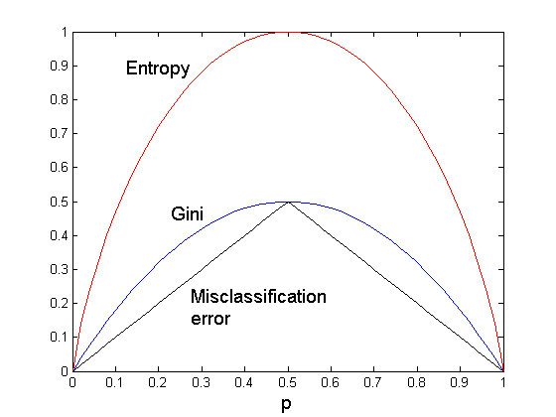
Comparison among Splitting Criteria
For a 2-class problem:
The different impurity measures are consistent

Slide 39
Categorical Attributes
For binary values split in two
For multivalued attributes, for each distinct value, gather counts for each class in the dataset
  Use the count matrix to make decisions
Multi-way split
Two-way split
(find best partition of values)

Slide 40
Continuous Attributes
Use Binary Decisions based on one value
Choices for the splitting value
  Number of possible splitting values
  = Number of distinct values
Each splitting value has a count matrix associated with it
  Class counts in each of the partitions, A < v and A ≥ v
Exhaustive method to choose best v
  For each v, scan the database to gather count matrix and compute the impurity index
  Computationally Inefficient! Repetition of work.

Slide 41
Continuous Attributes
For efficient computation: for each attribute,
  Sort the attribute on values
  Linearly scan these values, each time updating the count matrix and computing impurity
  Choose the split position that has the least impurity
Sorted Values
Split Positions

Slide 42
Splitting based on impurity
Impurity measures favor attributes with large number of values
A test condition with large number of outcomes may not be desirable
  # of records in each partition is too small to make predictions

Slide 43
Splitting based on INFO

Slide 44
Gain Ratio
Splitting using information gain
    Parent Node, p is split into k partitions
    n_{i} is the number of records in partition i
  Adjusts Information Gain by the entropy of the partitioning (SplitINFO). Higher entropy partitioning (large number of small partitions) is penalized!
  Used in C4.5
  Designed to overcome the disadvantage of impurity

Slide 45
Stopping Criteria for Tree Induction
Stop expanding a node when all the records belong to the same class
Stop expanding a node when all the records have similar attribute values
Early termination (to be discussed later)

Slide 46
Decision Tree Based Classification
Advantages:
  Inexpensive to construct
  Extremely fast at classifying unknown records
  Easy to interpret for small-sized trees
  Accuracy is comparable to other classification techniques for many simple data sets

Slide 47
Example: C4.5
Simple depth-first construction.
Uses Information Gain
Sorts Continuous Attributes at each node.
Needs entire data to fit in memory.
Unsuitable for Large Datasets.
  Needs out-of-core sorting.
You can download the software from:
http://www.cse.unsw.edu.au/~quinlan/c4.5r8.tar.gz

Slide 48
Other Issues
Data Fragmentation
Expressiveness

Slide 49
Data Fragmentation
Number of instances gets smaller as you traverse down the tree
Number of instances at the leaf nodes could be too small to make any statistically significant decision
You can introduce a lower bound on the number of items per leaf node in the stopping criterion.

Slide 50
Expressiveness
A classifier defines a function that discriminates between two (or more) classes.
The expressiveness of a classifier is the class of functions that it can model, and the kind of data that it can separate
  When we have discrete (or binary) values, we are interested in the class of boolean functions that can be modeled
  If the data-points are real vectors we talk about the decision boundary that the classifier can model

Slide 51
Decision Boundary
Border line between two neighboring regions of different classes is known as decision boundary
Decision boundary is parallel to axes because test condition involves a single attribute at-a-time

Slide 52
Expressiveness
Decision tree provides expressive representation for learning discrete-valued function
  But they do not generalize well to certain types of Boolean functions
    Example: parity function:
      Class = 1 if there is an even number of Boolean attributes with truth value = True
      Class = 0 if there is an odd number of Boolean attributes with truth value = True
    For accurate modeling, must have a complete tree
Less expressive for modeling continuous variables
  Particularly when test condition involves only a single attribute at-a-time

Slide 53
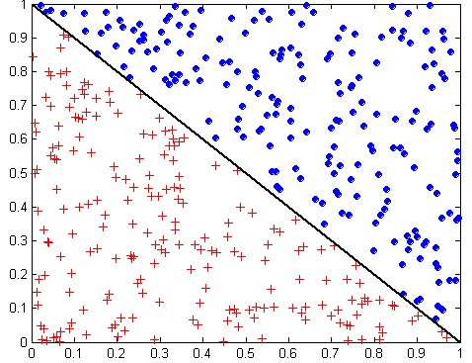
Oblique Decision Trees
x + y < 1
Class = +
Class =
Test condition may involve multiple attributes
More expressive representation
Finding optimal test condition is computationally expensive

Slide 54
Practical Issues of Classification
Underfitting and Overfitting
Evaluation

Slide 55
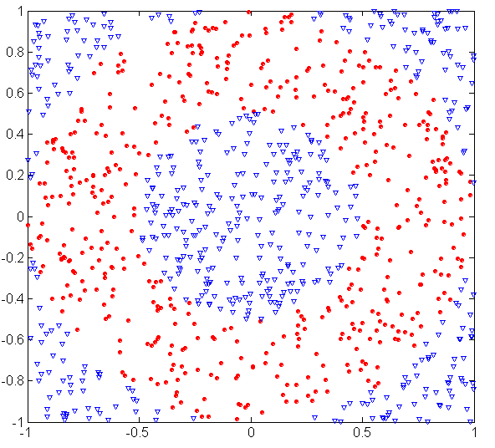
Underfitting and Overfitting (Example)
500 circular and 500 triangular data points.
Circular points:
0.5 ≤ sqrt(x₁²+x₂²) ≤ 1
Triangular points:
sqrt(x₁²+x₂²) > 0.5 or
sqrt(x₁²+x₂²) < 1

Slide 56
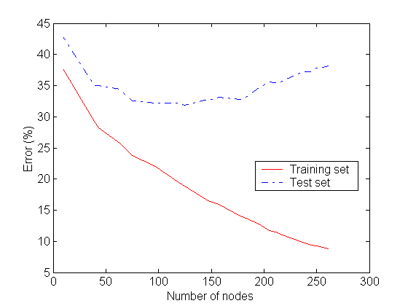
Underfitting and Overfitting
Underfitting
Overfitting
Underfitting: when model is too simple, both training and test errors are large
Overfitting: when model is too complex it models the details of the training set and fails on the test set

Slide 57
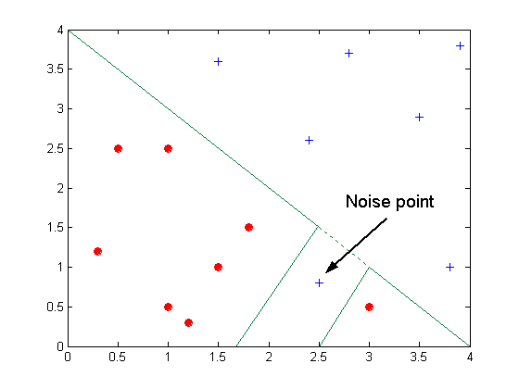
Overfitting due to Noise
Decision boundary is distorted by noise point

Slide 58
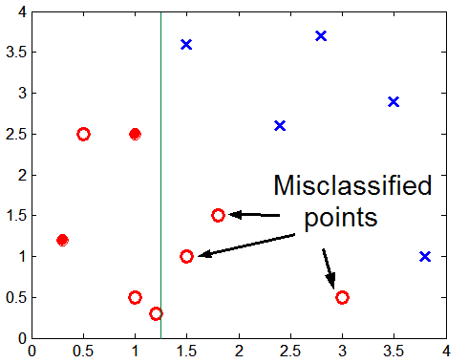
Overfitting due to Insufficient Examples
Lack of data points in the lower half of the diagram makes it difficult to predict correctly the class labels of that region
- Insufficient number of training records in the region causes the decision tree to predict the test examples using other training records that are irrelevant to the classification task

Slide 59
Notes on Overfitting
Overfitting results in decision trees that are more complex than necessary
Training error no longer provides a good estimate of how well the tree will perform on previously unseen records
  The model does not generalize well
Need new ways for estimating errors

Slide 60
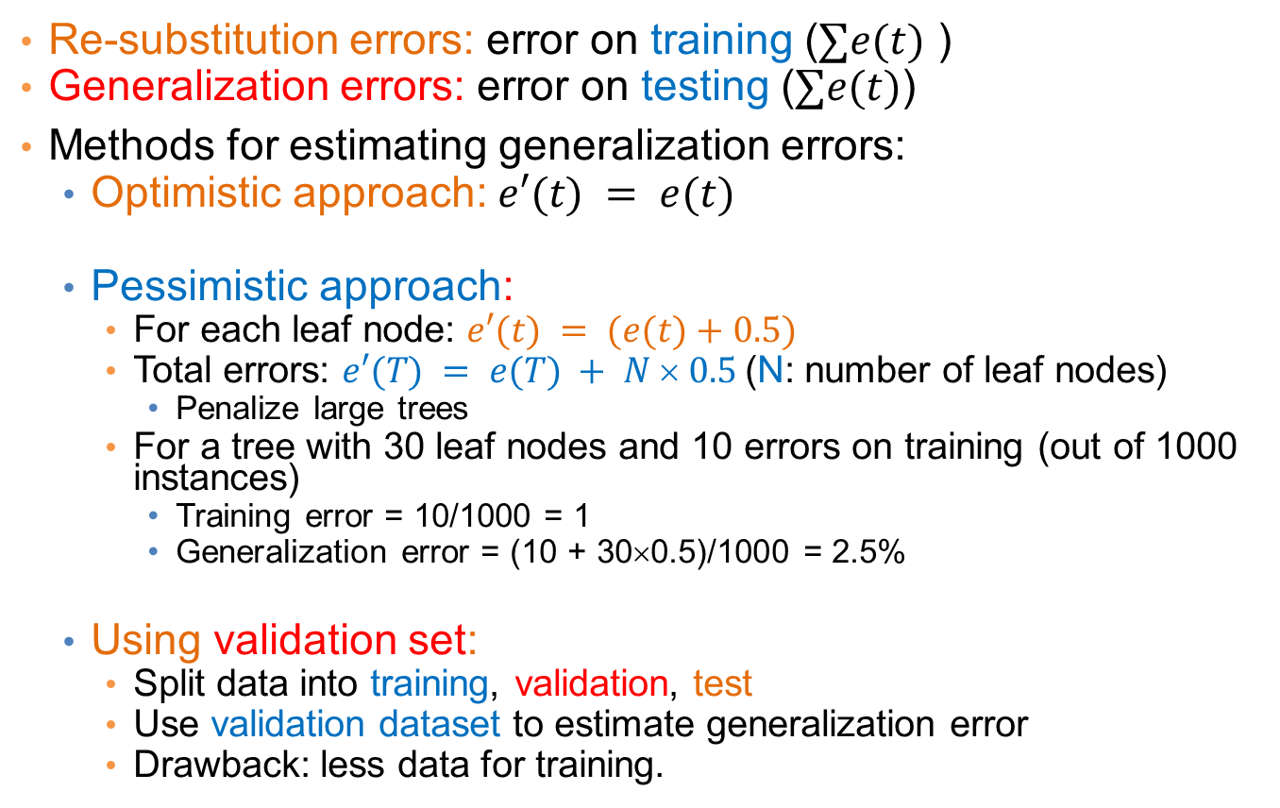
Estimating Generalization Errors
Re-substitution errors: error on training ($∑e(t)$ )
Generalization errors: error on testing ($∑e(t)$)
Methods for estimating generalization errors:
  Optimistic approach: $e′(t) = e(t)$
  Pessimistic approach:
    For each leaf node: $e′(t) = (e(t)+0.5)$
    Total errors: $e′(T) = e(T) + N  0.5$(N: number of leaf nodes)
      Penalize large trees
    For a tree with 30 leaf nodes and 10 errors on training (out of 1000 instances)
      Training error = 10/1000 = 1
      Generalization error = (10 + 30×0.5)/1000 = 2.5%
  Using validation set:
    Split data into training, validation, test
    Use validation dataset to estimate generalization error
    Drawback: less data for training.

Slide 61
Occam’s Razor
Given two models of similar generalization errors, one should prefer the simpler model over the more complex model
For complex models, there is a greater chance that it was fitted accidentally by errors in data
Therefore, one should include model complexity when evaluating a model

Slide 62
Minimum Description Length (MDL)
Cost(Model,Data) = Cost(Data|Model) + Cost(Model)
  Search for the least costly model.
Cost(Data|Model) encodes the misclassification errors.
Cost(Model) encodes the decision tree
  node encoding (number of children) plus splitting condition encoding.

Slide 63
How to Address Overfitting
Pre-Pruning (Early Stopping Rule)
  Stop the algorithm before it becomes a fully-grown tree
  Typical stopping conditions for a node:
    Stop if all instances belong to the same class
    Stop if all the attribute values are the same
  More restrictive conditions:
    Stop if number of instances is less than some user-specified threshold
    Stop if class distribution of instances are independent of the available features (e.g., using χ ² test)
    Stop if expanding the current node does not improve impurity measures (e.g., Gini or information gain).

Slide 64
How to Address Overfitting…
Post-pruning
  Grow decision tree to its entirety
  Trim the nodes of the decision tree in a bottom-up fashion
  If generalization error improves after trimming, replace sub-tree by a leaf node.
  Class label of leaf node is determined from majority class of instances in the sub-tree
  Can use MDL for post-pruning

Slide 65
Example of Post-Pruning
Training Error (Before splitting) = 10/30
Pessimistic error = (10 + 0.5)/30 = 10.5/30
Training Error (After splitting) = 9/30
Pessimistic error (After splitting)
= (9 + 4 × 0.5)/30 = 11/30
PRUNE!
Class = Yes | 20
Class = No | 10
Error = 10/30
Class = Yes | 8
Class = No | 4
Class = Yes | 3
Class = No | 4
Class = Yes | 4
Class = No | 1
Class = Yes | 5
Class = No | 1

Slide 66
Model Evaluation
Metrics for Performance Evaluation
  How to evaluate the performance of a model?
Methods for Performance Evaluation
  How to obtain reliable estimates?
Methods for Model Comparison
  How to compare the relative performance among competing models?

Slide 67
Model Evaluation
Metrics for Performance Evaluation
  How to evaluate the performance of a model?
Methods for Performance Evaluation
  How to obtain reliable estimates?
Methods for Model Comparison
  How to compare the relative performance among competing models?

Slide 68
Metrics for Performance Evaluation
Focus on the predictive capability of a model
  Rather than how fast it takes to classify or build models, scalability, etc.
Confusion Matrix:
 | PREDICTED CLASS
ACTUAL CLASS |  | Class=Yes | Class=No
 | Class=Yes | a | b
 | Class=No | c | d
a: TP (true positive)
b: FN (false negative)
c: FP (false positive)
d: TN (true negative)

Slide 69
Metrics for Performance Evaluation…
 | PREDICTED CLASS
ACTUAL CLASS |  | Class=Yes | Class=No
 | Class=Yes | a (TP) | b (FN)
 | Class=No | c (FP) | d (TN)
Most widely-used metric:

Slide 70
Limitation of Accuracy
Consider a 2-class problem
  Number of Class 0 examples = 9990
  Number of Class 1 examples = 10
If model predicts everything to be class 0, accuracy is 9990/10000 = 99.9 %
  Accuracy is misleading because model does not detect any class 1 example

Slide 71
Cost Matrix
 | PREDICTED CLASS
ACTUAL CLASS | C(i|j) | Class=Yes | Class=No
 | Class=Yes | C(Yes|Yes) | C(No|Yes)
 | Class=No | C(Yes|No) | C(No|No)
C(i|j): Cost of classifying class j example as class i

Slide 72
Computing Cost of Classification
Cost Matrix | PREDICTED CLASS
ACTUAL CLASS | C(i|j) | + | -
 | + | -1 | 100
 | - | 1 | 0
Model M₁ | PREDICTED CLASS
ACTUAL CLASS |  | + | -
 | + | 150 | 40
 | - | 60 | 250
Model M₂ | PREDICTED CLASS
ACTUAL CLASS |  | + | -
 | + | 250 | 45
 | - | 5 | 200
Accuracy = 80%
Cost = 3910
Accuracy = 90%
Cost = 4255

Slide 73
Cost vs Accuracy
Count | PREDICTED CLASS
ACTUAL CLASS |  | Class=Yes | Class=No
 | Class=Yes | a | b
 | Class=No | c | d
Accuracy is proportional to cost if
1. C(Yes|No)=C(No|Yes) = q
2. C(Yes|Yes)=C(No|No) = p
N = a + b + c + d
Accuracy = (a + d)/N
Cost = p (a + d) + q (b + c)
= p (a + d) + q (N – a – d)
= q N – (q – p)(a + d)
= N [q – (q-p) × Accuracy]
Cost | PREDICTED CLASS
ACTUAL CLASS |  | Class=Yes | Class=No
 | Class=Yes | p | q
 | Class=No | q | p

Slide 74
Precision-Recall
Count | PREDICTED CLASS
ACTUAL CLASS |  | Class=Yes | Class=No
 | Class=Yes | a | b
 | Class=No | c | d
Precision is biased towards C(Yes|Yes) & C(Yes|No)
Recall is biased towards C(Yes|Yes) & C(No|Yes)
F-measure is biased towards all except C(No|No)

Slide 75
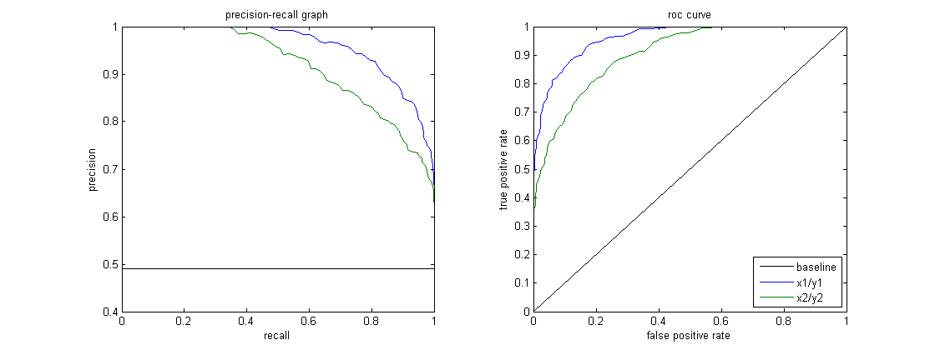
Precision-Recall plot
Usually for parameterized models, it controls the precision/recall tradeoff

Slide 76
Model Evaluation
Metrics for Performance Evaluation
  How to evaluate the performance of a model?
Methods for Performance Evaluation
  How to obtain reliable estimates?
Methods for Model Comparison
  How to compare the relative performance among competing models?

Slide 77
Methods for Performance Evaluation
How to obtain a reliable estimate of performance?
Performance of a model may depend on other factors besides the learning algorithm:
  Class distribution
  Cost of misclassification
  Size of training and test sets

Slide 78
Methods of Estimation
Holdout
  Reserve 2/3 for training and 1/3 for testing
Random subsampling
  One sample may be biased -- Repeated holdout
Cross validation
  Partition data into k disjoint subsets
  k-fold: train on k-1 partitions, test on the remaining one
  Leave-one-out: k=n
  Guarantees that each record is used the same number of times for training and testing
Bootstrap
  Sampling with replacement
  ~63% of records used for training, ~27% for testing

Slide 79
Dealing with class Imbalance
If the class we are interested in is very rare, then the classifier will ignore it.
  The class imbalance problem
Solution
  We can modify the optimization criterion by using a cost sensitive metric
  We can balance the class distribution
    Sample from the larger class so that the size of the two classes is the same
    Replicate the data of the class of interest so that the classes are balanced
      Over-fitting issues

Slide 80
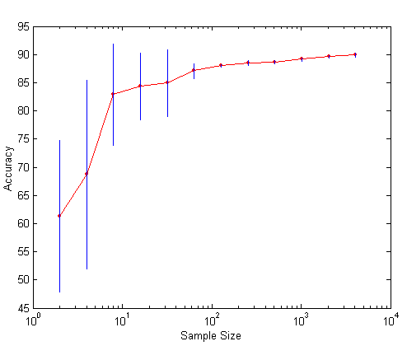
Learning Curve
Learning curve shows how accuracy changes with varying sample size
Requires a sampling schedule for creating learning curve
Effect of small sample size:
  Bias in the estimate
  Variance of estimate

Slide 81
Model Evaluation
Metrics for Performance Evaluation
  How to evaluate the performance of a model?
Methods for Performance Evaluation
  How to obtain reliable estimates?
Methods for Model Comparison
  How to compare the relative performance among competing models?

Slide 82
ROC (Receiver Operating Characteristic)
Developed in 1950s for signal detection theory to analyze noisy signals
  Characterize the trade-off between positive hits and false alarms
ROC curve plots TPR (on the y-axis) against FPR (on the x-axis)
 | PREDICTED CLASS
Actual |  | Yes | No
 | Yes | a (TP) | b (FN)
 | No | c (FP) | d (TN)
Fraction of positive instances predicted correctly
Fraction of negative instances predicted incorrectly

Slide 83
ROC (Receiver Operating Characteristic)
Performance of a classifier represented as a point on the ROC curve
Changing some parameter of the algorithm, sample distribution or cost matrix changes the location of the point

Slide 84
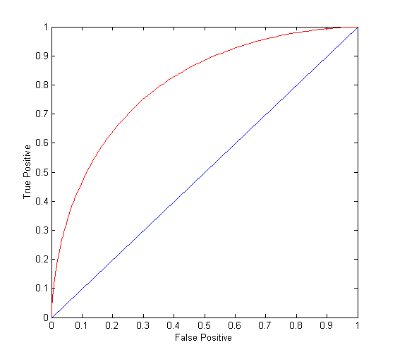
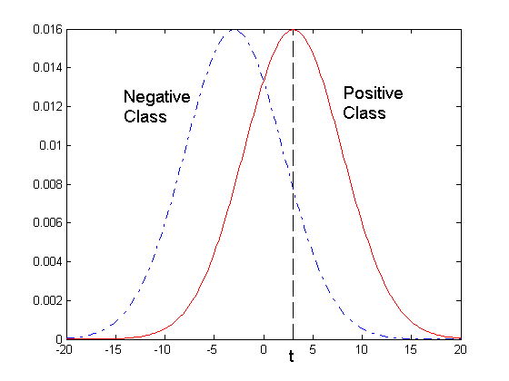
ROC Curve
- 1-dimensional data set containing 2 classes (positive and negative)
- any points located at x > t is classified as positive
At threshold t:
TP=0.5, FN=0.5, FP=0.12, FN=0.88

Slide 85
ROC Curve
(TP,FP):
(0,0): declare everything
to be negative class
(1,1): declare everything
to be positive class
(1,0): ideal
Diagonal line:
  Random guessing
  Below diagonal line:
    prediction is opposite of the true class
 | PREDICTED CLASS
Actual |  | Yes | No
 | Yes | a (TP) | b (FN)
 | No | c (FP) | d (TN)

Slide 86
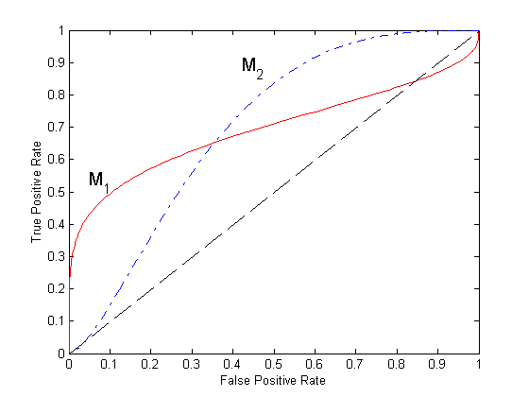
Using ROC for Model Comparison
No model consistently outperform the other
  M₁ is better for small FPR
  M₂ is better for large FPR
Area Under the ROC curve (AUC)
  Ideal: Area = 1
  Random guess:
    Area = 0.5

Slide 87
ROC curve vs Precision-Recall curve
Area Under the Curve (AUC) as a single number for evaluation

Slide 88
NEAREST NEIGHBOR CLASSIFICATION

Slide 89
Illustrating Classification Task

Slide 90
Instance-Based Classifiers
Store the training records
Use training records to
predict the class label of
unseen cases

Slide 91
Instance Based Classifiers
Examples:
  Rote-learner
    Memorizes entire training data and performs classification only if attributes of record match one of the training examples exactly
  Nearest neighbor classifier
    Uses k “closest” points (nearest neighbors) for performing classification

Slide 92
Nearest Neighbor Classifiers
Basic idea:
  “If it walks like a duck, quacks like a duck, then it’s probably a duck”
Compute Distance
Test Record
Training Records
Choose k of the “nearest” records

Slide 93
Nearest-Neighbor Classifiers
Requires three things
  The set of stored records
  Distance Metric to compute distance between records
  The value of k, the number of nearest neighbors to retrieve
To classify an unknown record:
  Compute distance to other training records
  Identify k nearest neighbors
  Use class labels of nearest neighbors to determine the class label of unknown record (e.g., by taking majority vote)

Slide 94
Definition of Nearest Neighbor
K-nearest neighbors of a record x are data points that have the k smallest distance to x

Slide 95
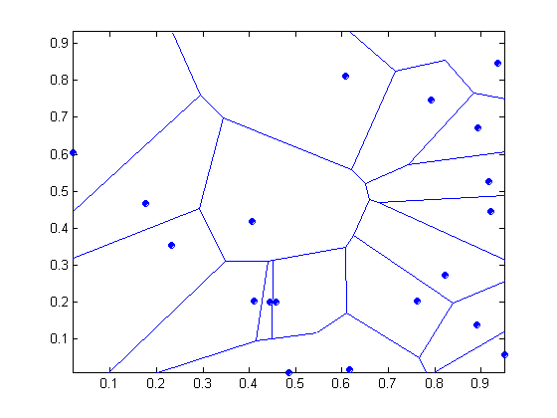
1 nearest-neighbor
Voronoi Diagram defines the classification boundary
The area takes the class of the green point

Slide 96
Nearest Neighbor Classification
Compute distance between two points:
  Euclidean distance
Determine the class from nearest neighbor list
  take the majority vote of class labels among the k-nearest neighbors
  Weigh the vote according to distance
    weight factor, w = 1/d²

Slide 97
Nearest Neighbor Classification…
Choosing the value of k:
  If k is too small, sensitive to noise points
  If k is too large, neighborhood may include points from other classes

Slide 98
Nearest Neighbor Classification…
Scaling issues
  Attributes may have to be scaled to prevent distance measures from being dominated by one of the attributes
  Example:
    height of a person may vary from 1.5m to 1.8m
    weight of a person may vary from 90lb to 300lb
    income of a person may vary from $10K to $1M

Slide 99
Nearest Neighbor Classification…
Problem with Euclidean measure:
  High dimensional data
    curse of dimensionality
  Can produce counter-intuitive results
1 1 1 1 1 1 1 1 1 1 1 0
1 0 0 0 0 0 0 0 0 0 0 0
vs
0 1 1 1 1 1 1 1 1 1 1 1
0 0 0 0 0 0 0 0 0 0 0 1
d = 1.4142
d = 1.4142
    Solution: Normalize the vectors to unit length

Slide 100
Nearest neighbor Classification…
k-NN classifiers are lazy learners
  It does not build models explicitly
  Unlike eager learners such as decision trees
Classifying unknown records are relatively expensive
  Naïve algorithm: O(n)
  Need for structures to retrieve nearest neighbors fast.
    The Nearest Neighbor Search problem.

Slide 101
Nearest Neighbor Search
Two-dimensional kd-trees
  A data structure for answering nearest neighbor queries in R²
kd-tree construction algorithm
  Select the x or y dimension (alternating between the two)
  Partition the space into two with a line passing from the median point
  Repeat recursively in the two partitions as long as there are enough points

Slide 102
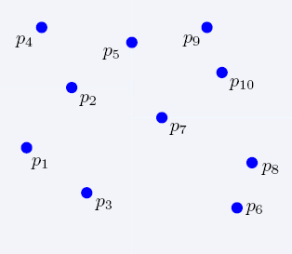
Nearest Neighbor Search
2-dimensional kd-trees

Slide 103
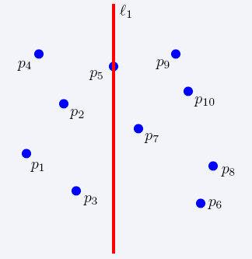
Nearest Neighbor Search
2-dimensional kd-trees

Slide 104
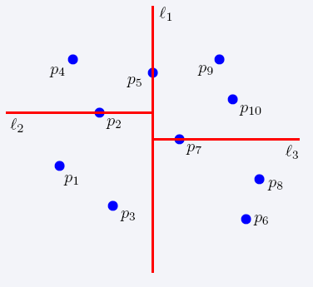
Nearest Neighbor Search
2-dimensional kd-trees

Slide 105
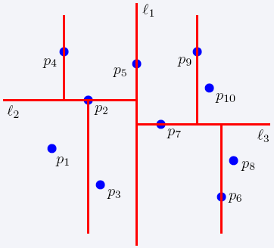
Nearest Neighbor Search
2-dimensional kd-trees

Slide 106
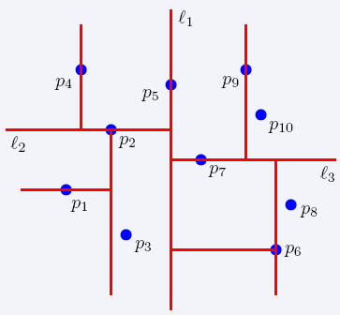
Nearest Neighbor Search
2-dimensional kd-trees

Slide 107
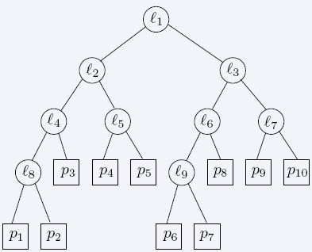
Nearest Neighbor Search
2-dimensional kd-trees

Slide 108
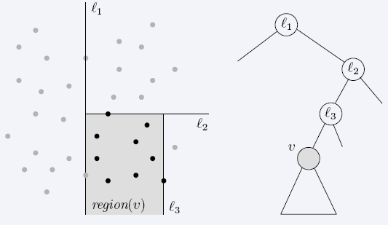
Nearest Neighbor Search
2-dimensional kd-trees
region(u) – all the black points in the subtree of u

Slide 109
Nearest Neighbor Search
2-dimensional kd-trees
A binary tree:
  Size O(n)
  Depth O(logn)
  Construction time O(nlogn)
  Query time: worst case O(n), but for many cases O(logn)
Generalizes to d dimensions
Example of Binary Space Partitioning

