Slide 1
Online Social Networks and Media
Absorbing Random Walks
Link Prediction

Slide 2
Why does the Power Method work?
If a matrix R is real and symmetric, it has real eigenvalues and eigenvectors: $\left(λ_{1},w_{1}\right), \left(λ_{2}, w_{2}\right), …, (λ_{r}, w_{r})$
r is the rank of the matrix
${|λ}_{1}\left|≥{|λ}_{2}\right|≥⋯≥\left|λ_{r}\right|$
The vector space of R is the set of vectors that can be written as a linear combination of its rows (or columns)
The eigenvectors $w_{1},w_{2},…,w_{r}$ of R define a basis of the vector space
For any vector $x$, $Rx=α_{1}w_{1}+a_{2}w_{2}+⋯+a_{r}w_{r}$
After t multiplications we have:
$R^{t}x={λ_{1}^{t−1}α}_{1}w_{1}+{λ_{2}^{t−1}a}_{2}w_{2}+⋯+{λ_{2}^{t−1}a}_{r}w_{r}$
Normalizing leaves only the term $w_{1}$.

Slide 3
Absorbing Random Walks Label Propagation Opinion formation on Social Networks

Slide 4
Random walk with absorbing nodes
What happens if we do a random walk on this graph? What is the stationary distribution?
All the probability mass on the red sink node:
The red node is an absorbing node

Slide 5
Random walk with absorbing nodes
What happens if we do a random walk on this graph? What is the stationary distribution?
There are two absorbing nodes: the red and the blue.
The probability mass will be divided between the two

Slide 6
Absorption probability
If there are more than one absorbing nodes in the graph a random walk that starts from a non-absorbing node will be absorbed in one of them with some probability
The probability of absorption gives an estimate of how close the node is to red or blue

Slide 7
Absorption probability
Computing the probability of being absorbed:
The absorbing nodes have probability 1 of being absorbed in themselves and zero of being absorbed in another node.
For the non-absorbing nodes, take the (weighted) average of the absorption probabilities of your neighbors
if one of the neighbors is the absorbing node, it has probability 1
Repeat until convergence (= very small change in probs)
$$P\left(Red | Pink\right)=\frac{2}{3}P\left(Red | Yellow\right)+\frac{1}{3}P(Red|Green)$$
2
1
$$P\left(Red | Green\right)=\frac{1}{4}P\left(Red | Yellow\right)+\frac{1}{4}$$
1
1
2
$$P\left(Red | Yellow\right)=\frac{2}{3}$$
2
1

Slide 8
Absorption probability
Computing the probability of being absorbed:
The absorbing nodes have probability 1 of being absorbed in themselves and zero of being absorbed in another node.
For the non-absorbing nodes, take the (weighted) average of the absorption probabilities of your neighbors
if one of the neighbors is the absorbing node, it has probability 1
Repeat until convergence (= very small change in probs)
$$P\left(Blue | Pink\right)=\frac{2}{3}P\left(Blue | Yellow\right)+\frac{1}{3}P(Blue|Green)$$
2
1
$$P\left(Blue | Green\right)=\frac{1}{4}P\left(Blue | Yellow\right)+\frac{1}{2}$$
1
1
2
$$P\left(Blue | Yellow\right)=\frac{1}{3}$$
2
1

Slide 9
Why do we care?
Why do we care to compute the absorbtion probability to sink nodes?
Given a graph (directed or undirected) we can choose to make some nodes absorbing.
Simply direct all edges incident on the chosen nodes towards them.
The absorbing random walk provides a measure of proximity of non-absorbing nodes to the chosen nodes.
Useful for understanding proximity in graphs
Useful for propagation in the graph
E.g, on a social network some nodes have high income, some have low income, to which income class is a non-absorbing node closer?

Slide 10
Example
In this undirected graph we want to learn the proximity of nodes to the red and blue nodes
2
1
1
1
2
2
1

Slide 11
Example
Make the nodes absorbing
2
1
1
1
2
2
1

Slide 12
Absorption probability
Compute the absorbtion probabilities for red and blue
$$P\left(Red | Pink\right)=\frac{2}{3}P\left(Red | Yellow\right)+\frac{1}{3}P(Red|Green)$$
$$P\left(Red | Green\right)=\frac{1}{5}P\left(Red | Yellow\right)+\frac{1}{5}P\left(Red | Pink\right)+\frac{1}{5}$$
0.57
0.43
2
$$P\left(Red | Yellow\right)=\frac{1}{6}P\left(Red | Green\right)+\frac{1}{3}P\left(Red | Pink\right)+\frac{1}{3}$$
1
1
1
$$P\left(Blue | Pink\right)=1−P\left(Red | Pink\right)$$
2
2
$$P\left(Blue | Green\right)=1− P\left(Red | Green\right)$$
1
$$P\left(Blue | Yellow\right)=1−P\left(Red | Yellow\right)$$
0.52
0.48
0.42
0.58

Slide 13
Penalizing long paths
The orange node has the same probability of reaching red and blue as the yellow one
Intuitively though it is further away
0.57
0.43
0.57
0.43
2
$$P\left(Red | Orange\right)=P\left(Red | Yellow\right)$$
1
$P\left(Blue | Orange\right)=$ $P\left(Blue | Yellow\right)$
1
1
1
2
2
1
0.52
0.48
0.42
0.58

Slide 14
Penalizing long paths
Add an universal absorbing node to which each node gets absorbed with probability α.
With probability α the random walk dies
With probability (1-α) the random walk continues as before
α
1-α
1-α
α
1-α
1-α
The longer the path from a node to an absorbing node the more likely the random walk dies along the way, the lower the absorbtion probability
α
α
$$P\left(Red | Green\right)=(1−α)\left(\frac{1}{5}P\left(Red | Yellow\right)+\frac{1}{5}P\left(Red | Pink\right)+\frac{1}{5}\right)$$

Slide 15
Propagating values
Assume that Red has a positive value and Blue a negative value
Positive/Negative class, Positive/Negative opinion
We can compute a value for all the other nodes in the same way
This is the expected value for the node
+1
$$V(Pink)=\frac{2}{3}V(Yellow)+\frac{1}{3}V(Green)$$
0.16
2
-1
1
$$V\left(Green\right)= \frac{1}{5}V(Yellow)+\frac{1}{5}V(Pink)+\frac{1}{5} −\frac{2}{5}$$
1
2
1
2
$$V\left(Yellow\right)= \frac{1}{6}V\left(Green\right)+\frac{1}{3}V(Pink)+\frac{1}{3} −\frac{1}{6}$$
1
0.05
-0.16

Slide 16
Electrical networks and random walks
Our graph corresponds to an electrical network
There is a positive voltage of +1 at the Red node, and a negative voltage -1 at the Blue node
There are resistances on the edges inversely proportional to the weights (or conductance proportional to the weights)
The computed values are the voltages at the nodes
+1
+1
0.16
2
$$V(Pink)=\frac{2}{3}V(Yellow)+\frac{1}{3}V(Green)$$
-1
1
$$V\left(Green\right)= \frac{1}{5}V(Yellow)+\frac{1}{5}V(Pink)+\frac{1}{5} −\frac{2}{5}$$
1
1
2
2
$$V\left(Yellow\right)= \frac{1}{6}V\left(Green\right)+\frac{1}{3}V(Pink)+\frac{1}{3} −\frac{1}{6}$$
1
0.05
-0.16

Slide 17
Opinion formation
The value propagation can be used as a model of opinion formation.
Model:
Opinions are values in [-1,1]
Every user $u$ has an internal opinion $s_{u}$, and expressed opinion $z_{u}$.
The expressed opinion minimizes the personal cost of user $u$:
$$c\left(z_{u}\right)={\left(s_{u}−z_{u}\right)}^{2}+\sum_{v:v is a friend of u}{w_{u}{\left(z_{u}−z_{v}\right)}^{2}}$$
Minimize deviation from your beliefs and conflicts with the society
If every user tries independently (selfishly) to minimize their personal cost then the best thing to do is to set $z_{u}$to the average of all opinions:
$$z_{u}=\frac{s_{u}+ \sum_{v:v is a friend of u}{w_{u}z_{u}}}{1+\sum_{v:v is a friend of u}{w_{u}}}$$
This is the same as the value propagation we described before!

Slide 18
Example
Social network with internal opinions
s = +0.5
2
s = +0.8
1
s = -0.3
1
1
2
2
1
s = +0.2
s = -0.1

Slide 19
Example
One absorbing node per user with value the internal opinion of the user
One non-absorbing node per user that links to the corresponding absorbing node
s = +0.5
1
z = +0.17
z = +0.22
2
1
s = +0.8
1
1
s = -0.3
2
1
The external opinion for each node is computed using the value propagation we described before
Repeated averaging
1
z = -0.01
2
1
z = -0.03
z = 0.04
1
1
Intuitive model: my opinion is a combination of what I believe and what my social network believes.
s = -0.5
s = -0.1

Slide 20
Transductive learning
If we have a graph of relationships and some labels on some nodes we can propagate them to the remaining nodes
Make the labeled nodes to be absorbing and compute the probability for the rest of the graph
E.g., a social network where some people are tagged as spammers
E.g., the movie-actor graph where some movies are tagged as action or comedy.
This is a form of semi-supervised learning
We make use of the unlabeled data, and the relationships
It is also called transductive learning because it does not produce a model, but just labels the unlabeled data that is at hand.
Contrast to inductive learning that learns a model and can label any new example

Slide 21
Implementation details
Implementation is in many ways similar to the PageRank implementation
For an edge $(u,v)$instead of updating the value of v we update the value of u.
The value of a node is the average of its neighbors
We need to check for the case that a node u is absorbing, in which case the value of the node is not updated.
Repeat the updates until the change in values is very small.

Slide 22
Link Prediction

Slide 23
The Problem
Link prediction problem: Given the links in a social network at time t, predict which edges that will be added to the network
Which features to use?
User characteristics (profile), network interactions, topology
Different from the problem of inferring missing (hidden) links (there is a temporal aspect, uses a static snapshot)
To save experimental effort in the laboratory or in the field

Slide 24
Applications
Recommending new friends on online social networks.
Predicting the participants or actors in events
Suggesting interactions between the members of a company/organization
Predicting connections between members of terrorist organizations who have not been directly observed to work together
Suggesting collaborations between researchers based on co-authorship.
Network evolution model

Slide 25
Link Prediction
Unsupervised (usually, assign scores based on similarity of endpoints)
Supervised (given some positive (created edges) and negative examples (nonexistent edges)
Classification Problem
Problem: Class imbalance
Instead of 0/1, rank each edge by its probability to appear in the network

Slide 26
D. Liben-Nowell, D. and J. Kleinberg, The link-prediction problem for social networks. Journal of the American Society for Information Science and Technology, 58(7) 1019–1031 (2007)

Slide 27
The Problem
Link prediction problem: Given the links in a social network at time t, predict the edges that will be added to the network during the time interval from time t to a given future time t’
Which features to use?
Based solely on the topology of the network (social proximity) (the more general problem also considers attributes of the nodes and links)

Slide 28
Problem Formulation I
Consider a social network G = (V, E) where each edge e = <y, v> ∈ E represents an interaction between u and v that took place at a particular time t(e)
(multiple interactions between two nodes as parallel edges with different timestamps)
G[t, t′]: subgraph of G consisting of all edges with a timestamp between t and t′, t < t′,
For four times, t₀ < t′₀ < t₁ < t′₁,
Given G[t₀, t′₀], we wish to output a list of edges not in G[t₀, t′ ₀] that are predicted to appear in G[t₁, t′₁]
[t₀, t′₀] training interval
[t₁, t′₁] test interval

Slide 29
Problem Formulation II
What about new nodes (node not in the training interval)?
Two parameters: κ_{training} and κ_{test}
Core: all nodes that are incident to at least κ_{training} edges in G[t₀, t′₀], and at least κ_{test} edges in G[t₁, t′₁]
Predict new edges between the nodes in Core

Slide 30
Example Dataset: co-authorship
t₀ = 1994, t′₀ = 1996: training interval -> [1994, 1996]
t₁ = 1997, t′₁ = 1999: test interval -> [1997, 1999]
- G_{collab} = <A, E_{old}> = G[1994, 1996]
- E_{new}: authors in A that co-author a paper during the test interval but not during the training interval
κ_{training} = 3, κ_{test} = 3: Core consists of all authors who have written at least 3 papers during the training period and at least 3 papers during the test period
Predict E_{new}

Slide 31
How to Evaluate the Prediction
Each link predictor p outputs a ranked list L_{p} of pairs in A × A − E_{old} : predicted new collaborations in decreasing order of confidence
Actual edges:
E∗new = E_{new} ∩ (Core × Core), n = |E∗_{new}|
Evaluation method: Size of the intersection of
the first n edge predictions from L_{p} that are in Core × Core (predicted) and
the set E∗_{new} (actual)
How many of the top-n predictions are correct (precision?)

Slide 32
Methods for Link Prediction
Assign a connection weight score(x, y) to each pair of nodes <x, y> based on the input graph (G_{collab}) and produce a ranked list of decreasing order of score
How to assign the score between two nodes x and y?
Some form of similarity or node proximity
Most measures focus on the giant component

Slide 33
Methods for Link Prediction: Shortest Path
For x, y ∈ A × A − E_{old},
score(x, y) = (negated) length of shortest path between x and y
If there are more than n pairs of nodes tied for the shortest path length, order them at random.
Geodesic distance: number of edges in the shortest path

Slide 34
Methods for Link Prediction: Neighborhood-based
The “larger” the overlap of the neighbors of two nodes, the more likely to be linked in the future
Let Γ(x) denote the set of neighbors of x in G_{collab}
Common neighbors:
A adjacency matrix -> A_{x,y}²
Number of different paths of length 2
Jaccard coefficient:
The probability that both x and y have a feature f, for a randomly selected feature that either x or y has

Slide 35
Methods for Link Prediction: Neighborhood-based
Adamic/Adar:
Assigns large weights to common neighbors z of x and y which themselves have few neighbors
(weight rare features more heavily)
connections to “unpopular” nodes are more relevant

Slide 36
Methods for Link Prediction: Neighborhood-based
Preferential attachment:
the probability that a new edge has node x as its endpoint is proportional to |Γ(x)|, i.e., nodes like to form ties with ‘popular’ nodes
Researchers found empirical evidence to suggest that co-authorship is correlated with the product of the neighborhood sizes

Slide 37
Methods for Link Prediction: based on the ensemble of all paths
Not just the shortest, but all paths between two nodes

Slide 38
Methods for Link Prediction: based on the ensemble of all paths
Katz_{β} measure:
Sum over all paths of length l, β > 0 is a parameter of the predictor, exponentially damped to count short paths more heavily
Small β predictions much like common neighbors
Unweighted version, in which path_{x,y}⁽¹⁾ = 1, if x and y have collaborated, 0 otherwise
Weighted version, in which path_{x,y}⁽¹⁾ = #times x and y have collaborated

Slide 39
Methods for Link Prediction: based on the ensemble of all paths
Consider a random walk on G_{collab} that starts at x and iteratively moves to a neighbor of x chosen uniformly at random from Γ(x).
The Hitting Time H_{x,y} from x to y is the expected number of steps it takes for the random walk starting at x to reach y.
score(x, y) = −H_{x,y}
(symmetric version) The Commute Time C_{x,y} from x to y is the expected number of steps to travel from x to y and from y to x
score(x, y) = − (H_{x,y} + H_{y,x})
Can also consider stationary-normed versions:
score(x, y) = − H_{x,y} π_{y}
score(x, y) = −(H_{x,y} π_{y} + H_{y,x} π_{x})

Slide 40
Methods for Link Prediction: based on the ensemble of all paths
The hitting time and commute time measures are sensitive to parts of the graph far away from x and y -> periodically reset the walk
Random walk on G_{collab} that starts at x and has a probability of α of returning to x at each step.
Rooted (Personalized) Page Rank: Starts from x, with probability (1 – a) moves to a random neighbor and with probability a returns to x
score(x, y) = stationary probability of y in a rooted PageRank

Slide 41
Methods for Link Prediction: based on the ensemble of all paths
SimRank
score(x, y) = similarity(x, y)
The expected value of γ^{l} where l is a random variable giving the time at which random walks started from x and y first meet

Slide 42
Methods for Link Prediction: High-level approaches
Low rank approximations
A adjacency matrix
Apply SVD (singular value decomposition)
The rank-k matrix that best approximates A

Slide 43
Methods for Link Prediction: High-level approaches
Unseen Bigrams
Unseen bigrams: pairs of word that co-occur in a test corpus, but not in the corresponding training corpus
Not just score(x, y) but score(z, y) for nodes z that are similar to x
S_{x}^{(δ)} the δ nodes most related to x

Slide 44
Methods for Link Prediction: High-level approaches
Clustering
Compute score(x, y) for al edges in E_{old}
Delete the (1-p) fraction of these edges for which the score is the lowest, for some parameter p
Recompute score(x, y) for all pairs in the subgraph

Slide 45
Evaluation: baseline
Baseline: random predictor
Randomly select pairs of authors who did not collaborate in the training interval
Probability that a random prediction is correct,
Number of possible predictions
Correct predictions
In the datasets, from 0.15% (cond-mat) to 0.48% (astro-ph)

Slide 46
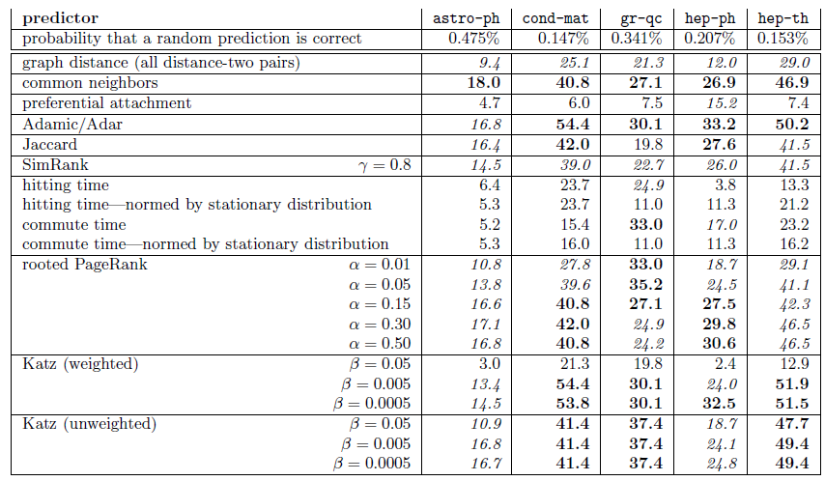
Evaluation: Factor improvement over random

Slide 47
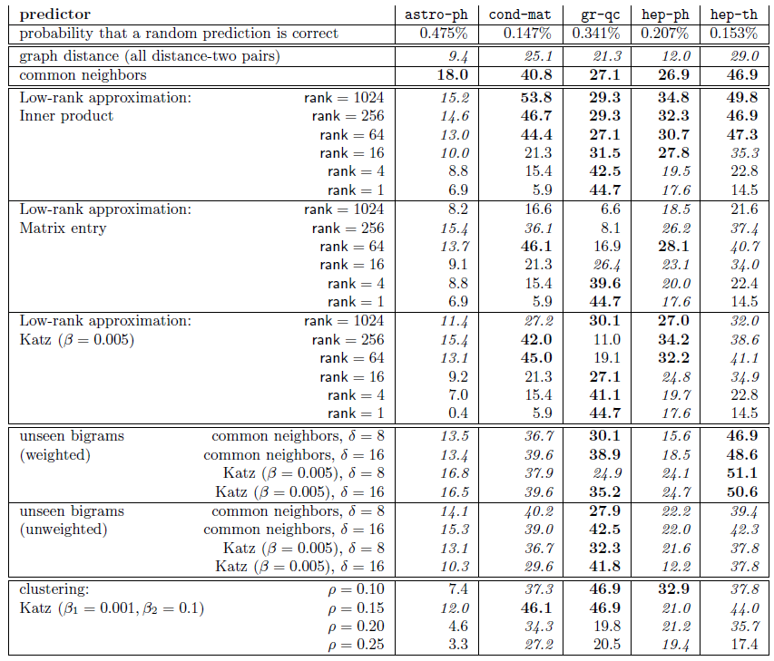
Evaluation: Factor improvement over random

Slide 48
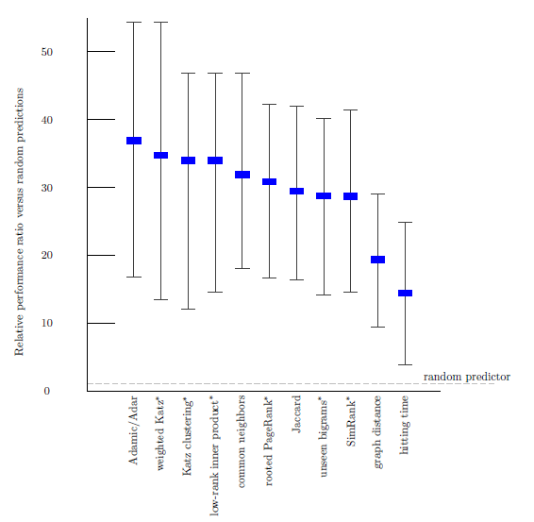
Evaluation: Average relevance performance (random)
average ratio over the five datasets of the given predictor's performance versus a baseline predictor's performance.
The error bars indicate the minimum and maximum of this ratio over the five datasets.
The parameters for the starred predictors are as follows: (1) for weighted Katz, β= 0.005; (2) for Katz clustering, β1 = 0.001; ρ = 0.15; β2 = 0.1; (3) for low-rank inner product, rank = 256; (4) for rooted Pagerank, α = 0.15; (5) for unseen bigrams, unweighted
common neighbors with δ = 8; and (6) for SimRank, γ = 0.8.

Slide 49
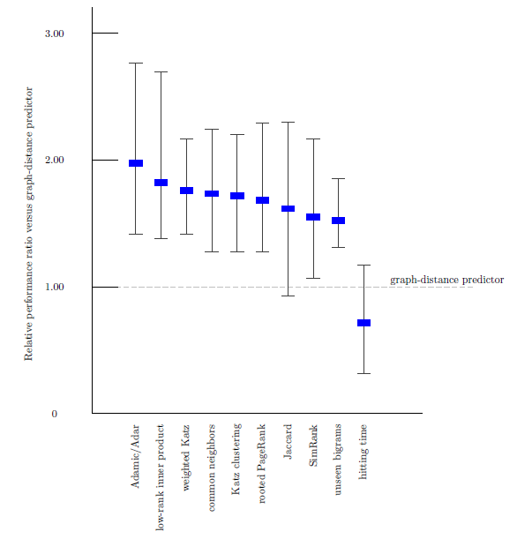
Evaluation: Average relevance performance (distance)

Slide 50
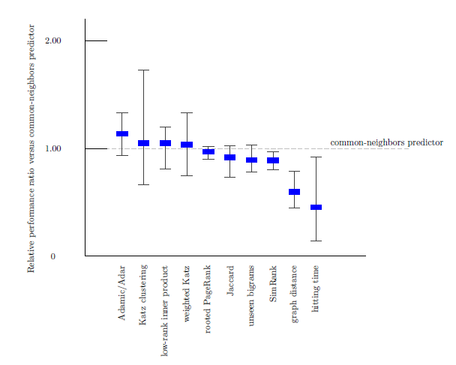
Evaluation: Average relevance performance (neighbors)

Slide 51
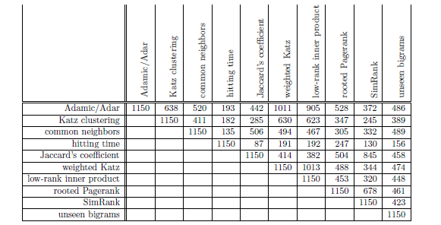
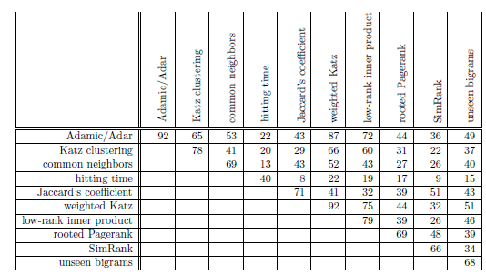
Evaluation: prediction overlap
How much similar are the predictions made by the different methods (common predictions)?
Why?
correct

Slide 52
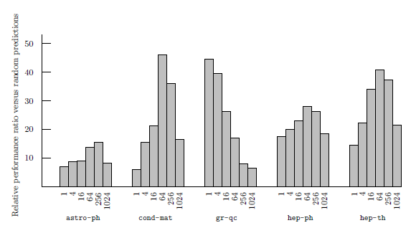
Evaluation: datasets
How much does the performance of the different methods depends on the dataset?
(rank) On 4 of the 5 datasets best at an intermediate rank
On qr-qc, best at rank 1, does it have a “simpler” structure”?
On hep-ph, preferential attachment the best
Why is astro-ph “difficult”?
The culture of physicists and physics collaboration

Slide 53
Evaluation: small world
The shortest path even in unrelated disciplines is often very short

Slide 54
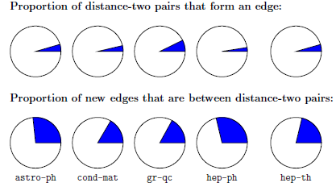
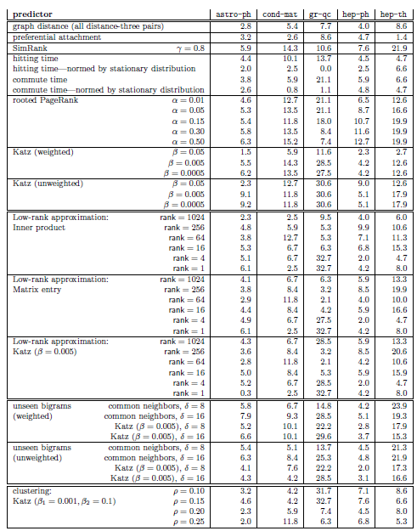
Evaluation: restricting to distance three
Many pairs of authors separated by a graph distance of 2 who will not collaborate and many pairs who collaborate at distance greater than 2
Disregard all distance 2 pairs

Slide 55
Evaluation: the breadth of data
Three additional datasets
Proceedings of STOC and FOCS
Papers for Citeseer
All five of the arXiv sections
Common neighbors vs Random

Slide 56
Future Directions
Improve performance. Even the best (Katz clustering on gr-qc) correct on only about 16% of its prediction
Improve efficiency on very large networks (approximation of distances)
Treat more recent collaborations as more important
Additional information (paper titles, author institutions, etc)
To some extent latently present in the graph

Slide 57
Future Directions
Consider bipartite graph (e.g., some form of an affiliation network)
author
paper
Coauthor graph
Apply classification techniques from machine learning
A simple binary classification problem: given two nodes x and y predict whether <x, y> is 1 or 0

Slide 59
Aaron Clauset, Cristopher Moore & M. E. J. Newman. Hierarchical structure and the prediction of missing links in network, Nature, 453, 98-101 (2008)

Slide 60
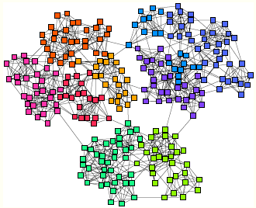
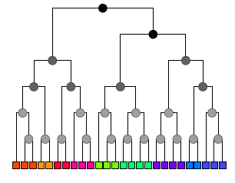
Hierarchical Random Graphs
Dendrogram D a binary tree with n leaves
Each internal node corresponds to the group of nodes that descend from it
Graph G with n nodes
Each internal node r of the dendrogram is associated with a probability p_{r} that a pair of vertices in the left and right subtrees of that node are connected
Given two nodes i and j of G the probability p_{ij} that they are connected by an edge is equal to p_{r} where r is their lowest common ancestor

Slide 61
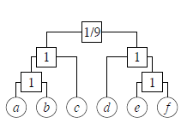
Hierarchical Random Graphs
Example
graph
Possible dendrogram
Assortativity (dense connections within groups of nodes and sparse between them) -> probabilities p_{r} decrease as we move up the tree
Given D and the probabilities p_{r}, we can generate a graph, called a hierarchical random graph
D: topological structure and parameters {p_{r}}

Slide 62
Hierarchical Random Graphs
Use to predict missing interactions in the network
Given an observed but incomplete network, generate a set of hierarchical random graphs (i.e., a dendrogam and the associated probabilities) that fit the network (using statistical inference)
Then look for pair of nodes that have a high probability of connection
Is this better than link prediction?
Experiments show that link prediction works well for strongly assortative networks (e.g, collaboration, citation) but not for networks that exhibit more general structure (e.g., food webs)

Slide 63
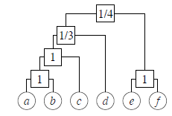
A rough idea of how to generate the model
r a node in dendrogram D
E_{r} the number of edges in G whose endpoints have r as their lowest common ancestor in D,
L_{r} and R_{r} the numbers of leaves in the left and right subtrees rooted at r
Then the likelihood of the hierarchical random graph is
L(D1) = (1/9)(8/9)⁸ = 0.0433..
If we fix the dendrogram D, it is easy to find the probabilities {p_{r}} that maximize L(D, {p_{r}}). For each r, they are given by the fraction of potential edges between the two subtrees of r that actually appear in the graph G.
L(D2) = (1/3)(2/3)²(1/4)²(3/4)⁶ = 0.0165 ..

Slide 64
A rough idea of how to generate the model
Sample dendrograms D with probability proportional to their likelihood
Choose an internal node uniformly at random and consider one of the two ways to reshuffle
Always accept the transition if it increases the likelihood else accept with some probability

Slide 65
How to Evaluate the Prediction (other)
An undirected network G(V, E)
Predict Missing links (links not in E)
To test, randomly divide E into a training set E^{T} and a probe (test) set E^{P}
Apply standard techniques (k-fold cross validation)
Each time we randomly pick a missing link and a nonexistent link to compare their scores
If among n independent comparisons, there are n′ times the missing link having a higher score and n′′ times they have the same score, the AUC value is
the probability that a randomly chosen missing link is given a higher score than a randomly chosen nonexistent link
If all the scores are generated from an independent and identical distribution, the AUC value should be about 0.5.

Slide 66
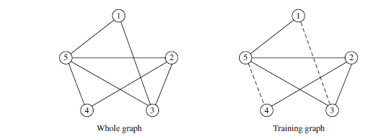
How to Evaluate the Prediction (other)
Algorithm assigns scores of all non-observed links as
s12 = 0.4, s13 = 0.5, s14 = 0.6, s34 = 0.5 and s45 = 0.6.
To calculate AUC, compare the scores of a probe (missing) link and a nonexistent link.
(n=) 6 pairs: s13 > s12, s13 < s14, s13 = s34, s45 > s12, s45 = s14, s45 > s34.
AUC = (3 × 1 + 2 × 0.5)/6 ≈ 0.67.

