Slide 1
Online Social Networks and Media
Homophilly
Networks with Positive and Negative ties

Slide 2
HOMOPHILLY
Chapter 4, from D. Easley and J. Kleinberg book

Slide 3
Introduction
Surrounding context: factors other than node and edges that affect how the network structure evolves
Homophily: people tend to be similar to their friends
Αριστοτέλης love those who are like themselves
Πλάτωνα Όμοιος ομοίω αεί πελάζει (similarity begets friendship)
Birds of a feather flock together
Factors intrinsic to the network (introduced by a common friend) and contextual factors (eg attend the same school)

Slide 4
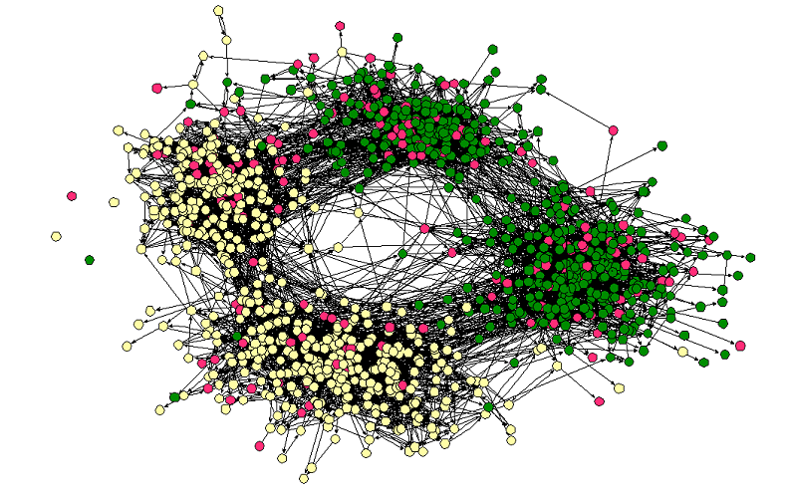
Homophily
Middle – High School
Race

Slide 5
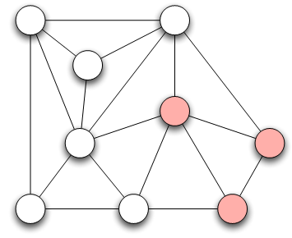
Measuring Homophily
If the fraction of cross-gender edges is significantly less than expected, then there is evidence for homophily
gender male with probability p
gender female with probability q
Probability of cross-gender edge?

Slide 6
Measuring Homophily
“significantly” less than
Inverse homophily
Characteristics with more than two values:
  Number of heterogeneous edges (edge between two nodes that are different)

Slide 7
Mechanisms Underlying Homophily: Selection and Social Influence
Selection: tendency of people to form friendships with others who are like then
Socialization or Social Influence: the existing social connections in a network are influencing the individual characteristics of the individuals
Social Influence as the inverse of Selection
Mutable & immutable characteristics

Slide 8
The Interplay of Selection and Social Influence
Longitudinal studies in which the social connections and the behaviors within a group are tracked over a period of time
Why?
Study teenagers, scholastic achievements/drug use (peer pressure and selection)
Relative impact?
- Effect of possible interventions (example, drug use)

Slide 9
The Interplay of Selection and Social Influence
Christakis and Fowler on obesity, 12,000 people over a period of 32-years
People more similar on obesity status to the network neighbors than if assigned randomly
Why?
(i) Because of selection effects, choose friends of similar obesity status,
(ii) Because of confounding effects of homophily according to other characteristics that correlate with obesity
(iii) Because changes in the obesity status of person’s friends was exerting an influence that affected her
(iii) As well -> “contagion” in a social sense

Slide 10
Tracking Link Formation in Online Data: interplay between selection and social influence
Underlying social network
Measure for behavioral similarity
Wikipedia
Node: Wikipedia editor who maintains a user account and user talk page
Link: if they have communicated with one writing on the user talk page of the other
Editor’s behavior: set of articles she has edited
Neighborhood overlap in the bipartite affiliation network of editors and articles consisting only of edges between editors and the articles they have edited
FACT: Wikipedia editors who have communicated are significantly more similar in their behavior than pairs of Wikipedia editors who have not (homomphily), why?
Selection (editors form connections with those have edited the same articles) vs Social Influence (editors are led to the articles of people they talk to)

Slide 11
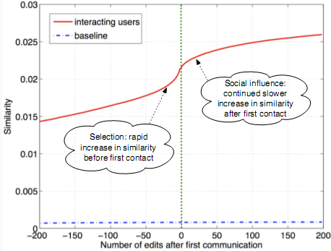
Tracking Link Formation in Online Data: interplay between selection and social influence
Actions in Wikipedia are time-stamped
For each pair of editors A and B who have ever communicated,
  Record their similarity over time
  Time 0 when they first communicated -- Time moves in discrete units, advancing by one “tick” whenever either A or B performs an action on Wikipedia
  Plot one curve for each pair of editors
Average, single plot: average level of similarity relative to the time of first interaction
Similarity is clearly increasing both before and after the moment of first interaction
(both selection and social influence)
Not symmetric around time 0 (particular role on similarity): Significant increase before they meet
Blue line shows similarity of a random pair (non-interacting)

Slide 12
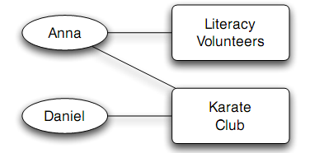
Affiliation
A larger network that contains both people and context as nodes
foci
Affiliation network
Bipartite graph
A node for each person and a node for each focus
An edge between a person A and focus X, if A participates in X

Slide 13
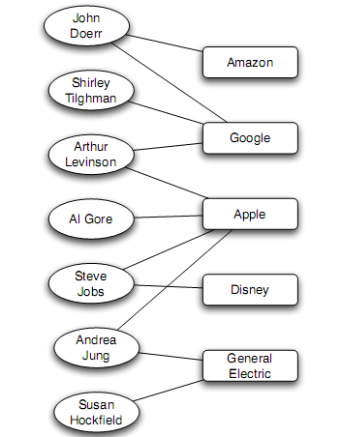
Affiliation
Example:
Board of directors
Companies implicitly links by having the same person sit on both their boards
People implicitly linked by serving together on a aboard
Other contexts, president of two major universities and a former Vice-President

Slide 14
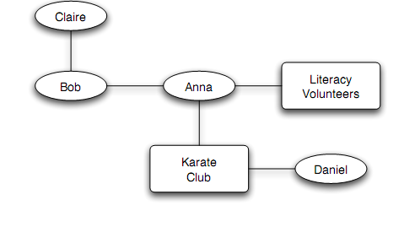
Co-evolution of Social and Affiliation Networks
Social Affiliation Network
Two type of edges:
Friendship: between two people
Participation: between a person and a focus
Co-evolution reflect the interplay of selection and social influence: if two people in a shared focus opportunity to become friends, if friends, influence each other foci.

Slide 15
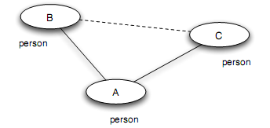
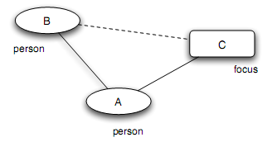
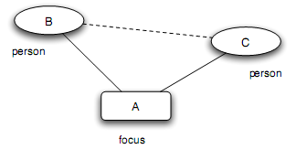
Co-evaluation of Social and Affiliation Networks: Closure process
Triadic closure: (two people with a friend in common - A introduces B to C)
Membership closure: (a person joining a focus that a friend is already involved in - A introduces focus C to B) (social influence)
Focal closure: (two people with a focus in common - focus A introduces B to C) (selection)

Slide 16
Co-evaluation of Social and Affiliation Networks

Slide 17
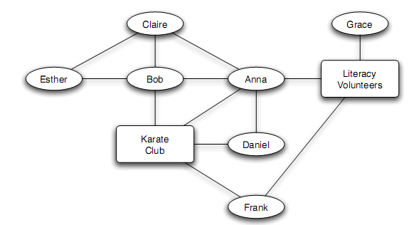
Tracking Link Formation in Online Data: triadic closure
Triadic closure:
How much more likely is a link to form between two people if they have a friend in common
How much more likely is a link to form between two people if they have multiple friends in common?

Slide 18
Tracking Link Formation in Online Data: triadic closure
Take two snapshots of the network at different times
For each k, identify all pairs of nodes that have exactly k friends in common in the first snapshot, but who are not directly connected
Define T(k) to be the fraction of these pairs that have formed an edge by the time of the second snapshot
Plot T(k) as a function of k
T(0): rate at which link formation happens when it does not close any triangle
T(k): the rate at which link formation happens when it does close a triangle (k common neighbors, triangles)

Slide 19
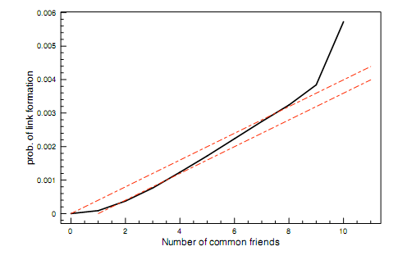
Tracking Link Formation in Online Data: triadic closure
E-mail (“who-talks-to-whom” dataset type)
Among 22,000 undergrad and grad students (large US university)
For 1-year
Network evolving over time
At each instance (snapshot), two people join, if they have exchanged e-mail in each direction at some point in the past 60 days
Multiple pairs of snapshots ->
Built a curve for T(k) on each pair, then average all the curves
Snapshots – one day apart (average probability that two people form a link per day)
From 0 to 1 to 2 friends
From 8 to 9 to 10 friend (but on a much smaller population)
Almost linear
Having two common friends produces significantly more than twice the effect compared to a single common friend

Slide 20
Tracking Link Formation in Online Data: triadic closure
Baseline model:
Assume triadic closure:
Each common friend two people have gives them an independent probability p of forming a link each day
For two people with k friend in common,
Probability not forming a link on any given day
(1-p)^{k}
Probability forming a link on any given day
T_{baseline}(k) = 1 - (1-p)^{k}
Given the small absolute effect of the first common friend in the data
T_{baseline}(k) = 1 - (1-p)^{k-1}
Qualitative similar (linear), but independent assumption too simple

Slide 21
Tracking Link Formation in Online Data: focal and membership closure
Focal closure: what is the probability that two people form a link as a function of the number of foci that are jointly affiliated with
Membership closure: what is the probability that a person becomes involved with a particular focus as a function of the number of friends who are already involved in it?

Slide 22
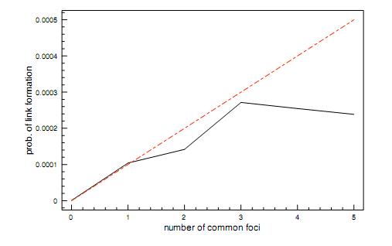
Tracking Link Formation in Online Data: focal closure
E-mail (“who-talks-to-whom” dataset type)
Use the class schedule of each student
Focus: class (common focus – a class together)
A single shared class same effect as a single shared friend, then different
Subsequent shared classes after the first produce a diminishing returns effect

Slide 23
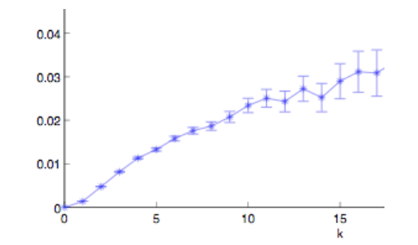
Tracking Link Formation in Online Data: membership closure
Node: Wikipedia editor who maintains a user account and user talk page
Link: if they have communicated by one user writing on the user talk page of the other
Focus: Wikipedia article
Association to focus: edited the article
Again, an initial increasing effect: the probability of editing a Wikipedia article is more than twice as large when you have two connections into the focus than one
Also, multiple effects can operate simultaneously

Slide 24
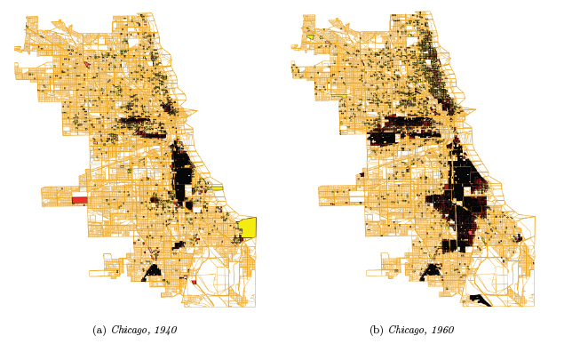
A Spatial Model of Segregation
Formation of ethnically and racially homogeneous neighbors in cities

Slide 25
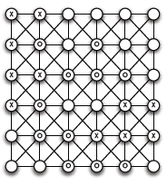
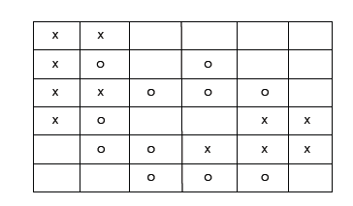
A Spatial Model of Segregation: The Schelling Model
Simple model at a local level
Population of individuals called agents, of type X or type O
Agents reside in cells of a grid
Neighbor cells that touch it (including diagonal)
Possible to show as a graph, but use geometric grid

Slide 26
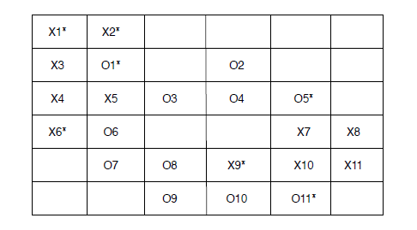
A Spatial Model of Segregation: The Schelling Model
Threshold t: Each agent wants to have at least t agents of its own type as neighbors
If an agent discovers that fewer than t of its neighbors are of the same type of itself, then it has an interest to move to a new cell
Unsatisfied (shown with *)
t = 3

Slide 27
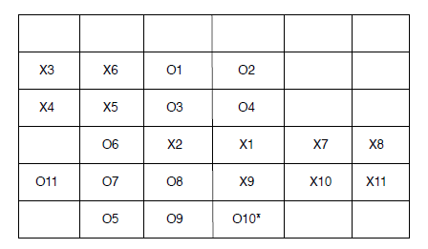
A Spatial Model of Segregation: The Schelling Model
Agents move in sequence of rounds:
In each round, consider unsatisfied agents at some order, move to an unoccupied cell where it will be satisfied
How to move? (in a random order, downwards?) Where to move? what if no satisfying position?
t = 3. one row at a time working downwards, agent moves to the nearest cell that will make it satisfied

Slide 28
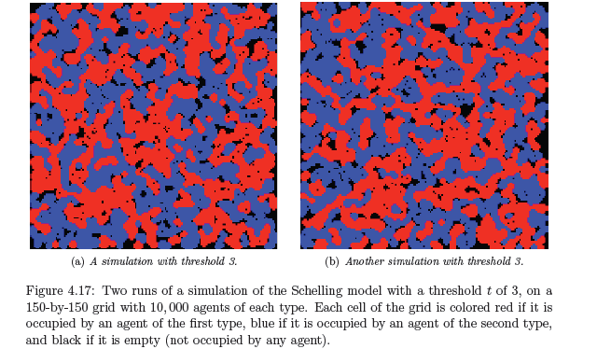
A Spatial Model of Segregation: The Schelling Model
Simulation, unsatisfied agents move to a random location
~50 rounds, all satisfied
Different random starts
Large homogeneous regions

Slide 29
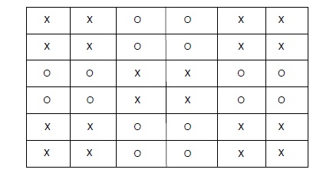
A Spatial Model of Segregation: The Schelling Model
Spatial segregation is taking place even if no individual agent is actively seeking it
For t = 3, satisfied even in the minority among its neighbors
Requirements not globally incompatible
If we start from a random configuration, attach to clusters, grow, some fall below, move, “unraveling” of more integrated regions

Slide 30
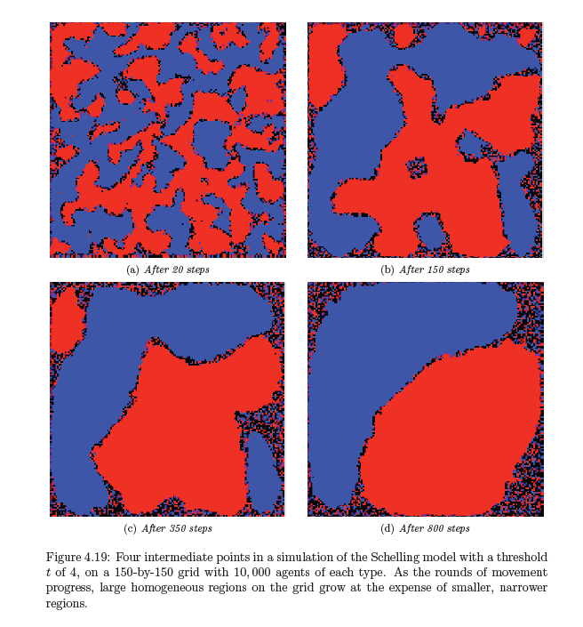
A Spatial Model of Segregation: The Schelling Model

Slide 31
End of Chapter 4
Homophily (selection vs social influence)
Graphs with more than one type of nodes (bipartite)
  Affiliation networks
Spatial model of segregation

Slide 32
Network with Positive and Negative Ties
Chapter 5, from D. Easley and J. Kleinberg book

Slide 33
Structural Balance
What about negative edges?
Initially, a complete graph (or clique): every edge either + or -
  Let us first look at individual triangles
  Lets look at 3 people => 4 Cases
  See if all are equally possible (local property)

Slide 34
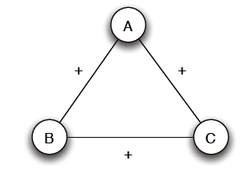
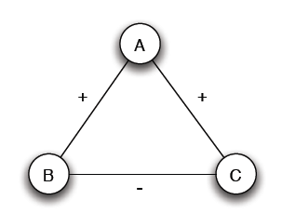
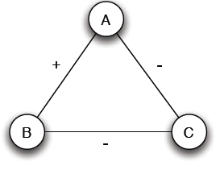
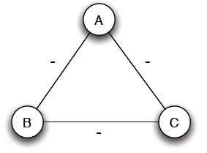
Structural Balance
Case (a): 3 +
Case (b): 2 +, 1 -
Mutual friends
A is friend with B and C, but B and C do not get well together
Case (c): 1 +, 2 -
Case (d): 3 -
Mutual enemies
A and B are friends with a mutual enemy

Slide 35
Structural Balance
Case (a): 3 +
Case (b): 2 +, 1 -
Stable or balanced
Unstable
Mutual friends
A is friend with B and C, but B and C do not get well together
Implicit force to make B and C friends (- => +) or turn one of the + to -
Case (c): 1 +, 2 -
Case (d): 3 -
Stable or balanced
Unstable
Mutual enemies
Forces to team up against the third (turn 1 – to +)
A and B are friends with a mutual enemy

Slide 36
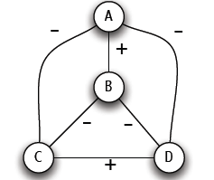
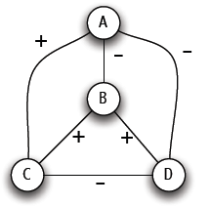
Structural Balance
A labeled complete graph is balanced if every one of its triangles is balanced
Structural Balance Property: For every set of three nodes, if we consider the three edges connecting them, either all three of these are labeled +, or else exactly one of them is labeled – (odd number of +)
What does a balanced network look like?

Slide 37
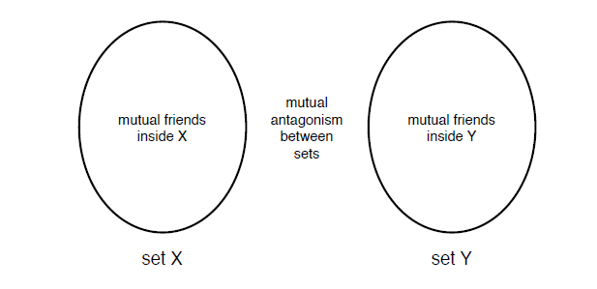
The Structure of Balanced Networks
Balance Theorem: If a labeled complete graph is balanced,
all pairs of nodes are friends, or
the nodes can be divided into two groups X and Y, such that every pair of nodes in X like each other, every pair of nodes in Y like each other, and every one in X is the enemy of every one in Y.
Proof ...
From a local to a global property

Slide 38
Applications of Structural Balance
How a network evolves over time
Political science: International relationships (I)
The conflict of Bangladesh’s separation from Pakistan in 1972 (1)
₋
USSR
N. Vietnam
USA
Pakistan
-
-
-
₊
Bangladesh
China
-
India
USA support to Pakistan?

Slide 39
Applications of Structural Balance
International relationships (I)
The conflict of Bangladesh’s separation from Pakistan in 1972 (II)
₊
₋
USSR
N. Vietnam
USA
Pakistan
-
-
₊
-
Bangladesh
China
-
India
China?

Slide 40
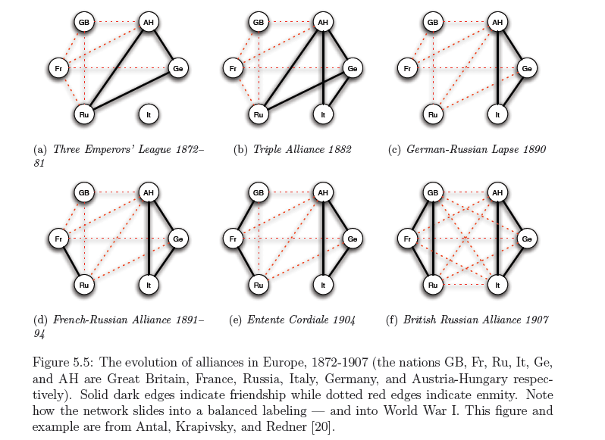
Applications of Structural Balance
International relationships (II)

Slide 41
A Weaker Form of Structural Balance
Allow this
Weak Structural Balance Property: There is no set of three nodes such that the edges among them consist of exactly two positive edges and one negative edge

Slide 42
A Weaker Form of Structural Balance
Weakly Balance Theorem: If a labeled complete graph is weakly balanced, its nodes can be divided into groups in such a way that every two nodes belonging to the same group are friends, and every two nodes belonging to different groups are enemies.
Proof …

Slide 43
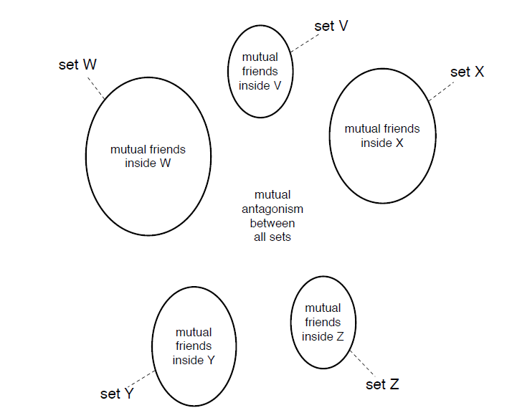
A Weaker Form of Structural Balance

Slide 44
Trust, distrust and online ratings
Evaluation of products and trust/distrust of other users
Directed Graphs
A
A
C
C
+
-
+
-
B
B
A trusts B, B trusts C, A ? C
A distrusts B, B distrusts C, A ? C
If distrust enemy relation, +
A distrusts means that A is better than B, -
Depends on the application
Rating political books or
Consumer rating electronics products

Slide 45
Generalizing
Non-complete graphs
Instead of all triangles, “most” triangles, approximately divide the graph
We shall use the original (“non-weak” definition of structural balance)

Slide 46
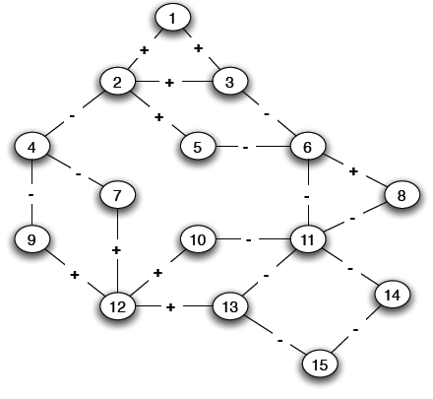
Structural Balance in Arbitrary Graphs
Thee possible relations
Positive edge
Negative edge
Absence of an edge

Slide 47
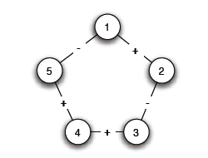
Balance Definition for General Graphs
Based on triangles (local view)
Division of the network (global view)
A (non-complete) graph is balanced if it can be completed by adding edges to form a signed complete graph that is balanced
-
+

Slide 48
Balance Definition for General Graphs
+

Slide 49
Balance Definition for General Graphs
Based on triangles (local view)
Division of the network (global view)
A (non-complete) graph is balanced if it possible to divide the nodes into two sets X and Y, such that any edge with both ends inside X or both ends inside Y is positive and any edge with one end in X and one end in Y is negative
The two definition are equivalent:
An arbitrary signed graph is balanced under the first definition, if and only if, it is balanced under the second definitions

Slide 50
Balance Definition for General Graphs
Algorithm for dividing the nodes?

Slide 51
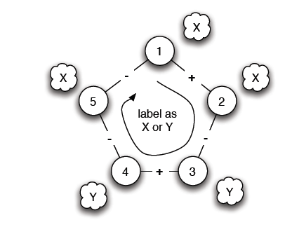
Balance Characterization
What prevents a network from being balanced?
Start from a node and place nodes in X or Y
Every time we cross a negative edge, change the set
Cycle with odd number of negative edges

Slide 52
Balance Definition for General Graphs
Cycle with odd number of - => unbalanced
Is there such a cycle with an odd number of -?

Slide 53
Balance Characterization
Claim: A signed graph is balanced, if and only if, it contains no cycles with an odd number of negative edges
(proof by construction)
Find a balanced division: partition into sets X and Y, all edges inside X and Y positive, crossing edges negative
Either succeeds or Stops with a cycle containing an odd number of -
Two steps:
Convert the graph into a reduced one with only negative edges
Solve the problem in the reduced graph

Slide 54
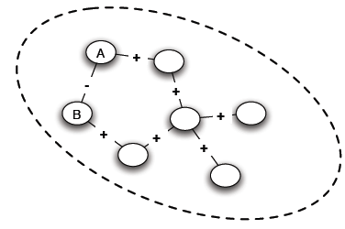
Balance Characterization: Step 1
1. Find connected components (supernodes) by considering only positive edges
2. Check: Do supernodes contain a negative edge between any pair of their nodes
(a) Yes -> odd cycle (1)
(b) No -> each supernode either X or Y

Slide 55
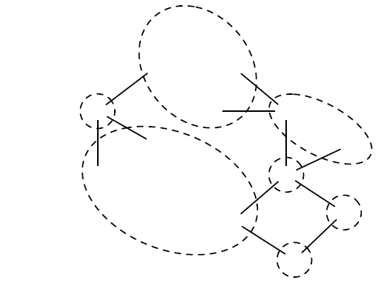
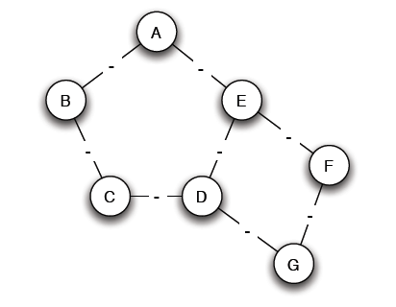
Balance Characterization: Step 1
3. Reduced problem: a node for each supernode, an edge between two supernodes if an edge in the original

Slide 56
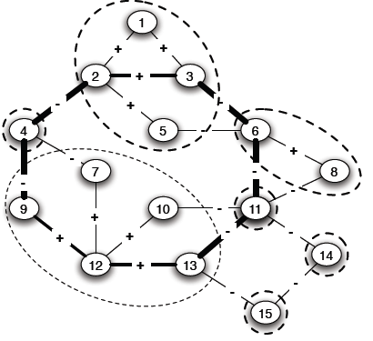
Balance Characterization: Step 2
Note: Only negative edges among supernodes
Start labeling by either X and Y
If successful, then label the nodes of the supernode correspondingly
A cycle with an odd number, corresponds to a (possibly larger) odd cycle in the original

Slide 57
Balance Characterization: Step 2
Determining whether the graph is bipartite (there is no edge between nodes in X or Y, the only edges are from nodes in X to nodes in Y)
Use Breadth-First-Search (BFS)
Start the search at any node and give alternating labels to the vertices visited during the search. That is, give label X to the starting node, Y to all its neighbors, X to those neighbors' neighbors, and so on.
If at any step a node has (visited) neighbors with the same label as itself, then the graph is not bipartite (cross-level edge)
If the search ends without such a situation occurring, then the graph is bipartite.
Why is this an “odd” cycle?

Slide 58
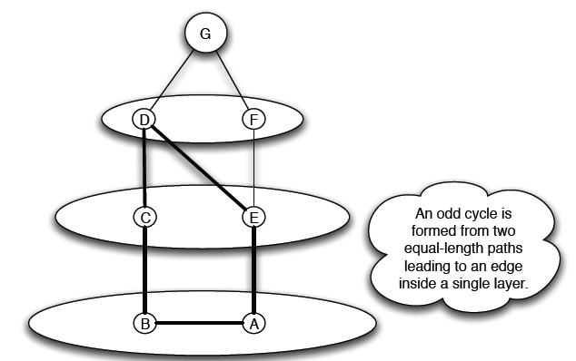
Balance Characterization

Slide 59
Generalizing
Non-complete graphs
Instead of all triangles, “most” triangles, approximately divide the graph

Slide 60
Approximately Balance Networks
a complete graph (or clique): every edge either + or -
Claim: If all triangles in a labeled complete graph are balanced, than either
all pairs of nodes are friends or,
the nodes can be divided into two groups X and Y, such that
  every pair of nodes in X like each other,
  every pair of nodes in Y like each other, and
  every one in X is the enemy of every one in Y.
Not all, but most, triangles are balanced
Claim: If at least 99.9% of all triangles in a labeled compete graph are balanced, then either,
There is a set consisting of at least 90% of the nodes in which at least 90% of all pairs are friends, or,
the nodes can be divided into two groups X and Y, such that
  at least 90% of the pairs in X like each other,
  at least 90% of the pairs in Y like each other, and
  at least 90% of the pairs with one end in X and one in Y are enemies

Slide 61
Approximately Balance Networks
Claim: If at least 99.9% of all triangles in a labeled complete graph are balanced, then either,
There is a set consisting of at least 90% of the nodes in which at least 90% of all pairs are friends, or,
the nodes can be divided into two groups X and Y, such that
  at least 90% of the pairs in X like each other,
  at least 90% of the pairs in Y like each other, and
  at least 90% of the pairs with one end in X and one in Y are enemies
Claim: Let ε be any number, such that 0 ≤ ε < 1/8. If at least 1 – ε of all triangles in a labeled complete graph are balanced, then either
There is a set consisting of at least 1-δ of the nodes in which at least 1-δ of all pairs are friends, or,
the nodes can be divided into two groups X and Y, such that
  at least 1-δ of the pairs in X like each other,
  at least 1-δ of the pairs in Y like each other, and
  at least 1-δ of the pairs with one end in X and one in Y are enemies

Slide 62
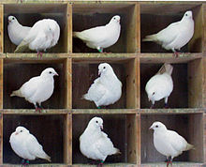
Approximately Balance Networks
Basic idea – find a “good” node A (s.t., it does not belong to too many unbalanced triangles) to partition into X and Y
Pigeonhole principle: if n items are put into m pigeonholes with n > m, then at least one pigeonhole must contain more than one item
Counting argument based on pigeonhole: compute the average value of a set of objects and then argue that there must be at least one node that is equal to the average or below (or equal and above)

Slide 63
End of Chapter 5
Balanced networks in the case of both positive and negative edges

