Slide 1
Online Social Networks and Media
Navigation in a small world

Slide 2

Small world phenomena
Small worlds: networks with short paths
Stanley Milgram (1933-1984): “The man who shocked the world”
Obedience to authority (1963)
Small world experiment (1967)

Slide 3
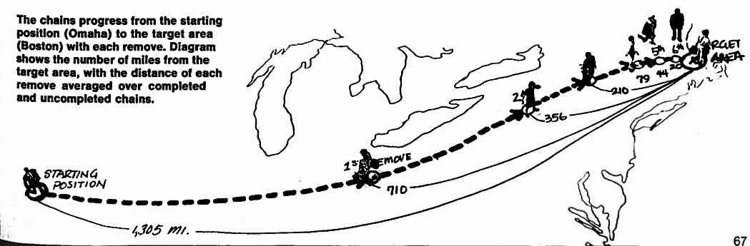
Small world experiment
Letters were handed out to people in Nebraska to be sent to a target in Boston
People were instructed to pass on the letters to someone they knew on first-name basis
The letters that reached the destination followed paths of length around 6
Six degrees of separation: (play of John Guare)

Slide 4
Milgram’s experiment revisited
What did Milgram’s experiment show?
  (a) There are short paths in large networks that connect individuals
  (b) People are able to find these short paths using a simple, greedy, decentralized algorithm

Slide 5
A simple explanation
If everyone had different friends, number of people reachable increases exponentially with the size of the path

Slide 6
Simple explanation does not work
As we have seen friendships tend to form triangles, so the previous assumption is not true.
How can we have both many triangles and short paths?

Slide 7
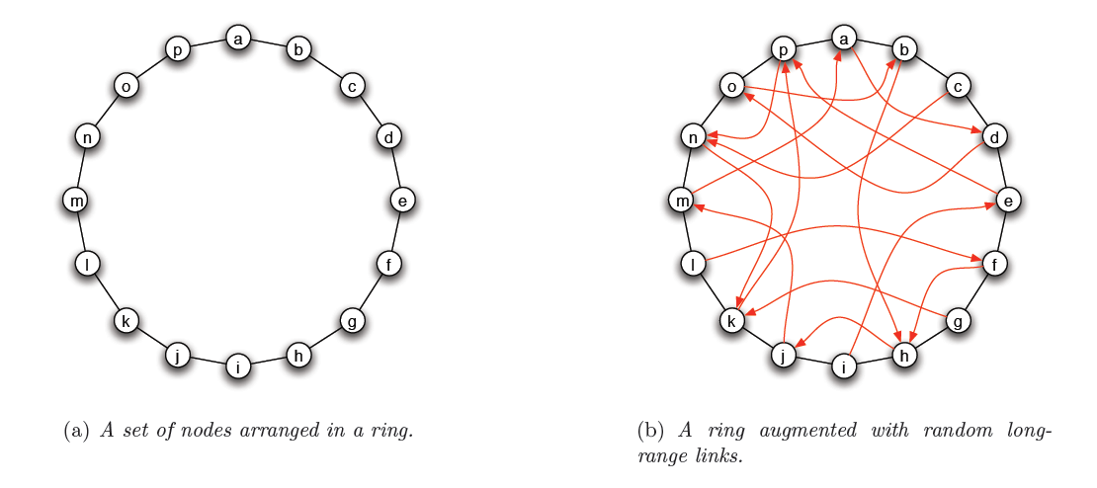
Small worlds
We can construct graphs with short paths
  E.g., the Watts-Strogatz model

Slide 8
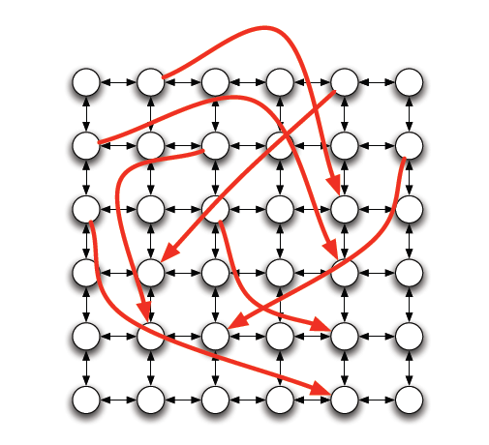
Small worlds
Same idea to different graphs

Slide 9
Explanation
Assume that we add k random links from every node.
Looking at the graph formed by the random links it is unlikely that we have many common neighbors
  Therefore, we have almost exponential growth of the reachable nodes.

Slide 10
Navigation in a small world
Kleinberg: Many random graphs contain short paths, but how can we find them in a decentralized way?
In Milgram’s experiment every recipient acted without knowledge of the global structure of the social graph, using only
  information about geography
  their own social connections

Slide 11
Kleinberg’s navigation model
Assume a graph similar (but not the same!) to that of Watts-Strogatz
  There is some underlying “geography”: ring, grid, hierarchy
    Defines the local contacts of a node
    Enables to navigate towards a node
  There are also shortcuts added between nodes
    The long-range contacts of a node
    Similar to WS model – creates short paths

Slide 12
Kleinberg’s navigational model
Given a source node s, and a navigation target t we want to reach, we assume
  No centralized coordination
    Each node makes decisions on their own
  Each node knows the “geography” of the graph
    They can always move closer to the target node
  Nodes make decisions based only on their own contacts (local and long-range)
    They do not have access to other nodes’ contacts
  No flooding is allowed
    A node cannot send the message to all of her friends.
  Greedy (myopic) decisions
    Always move to the node that is closest to the target.

Slide 13
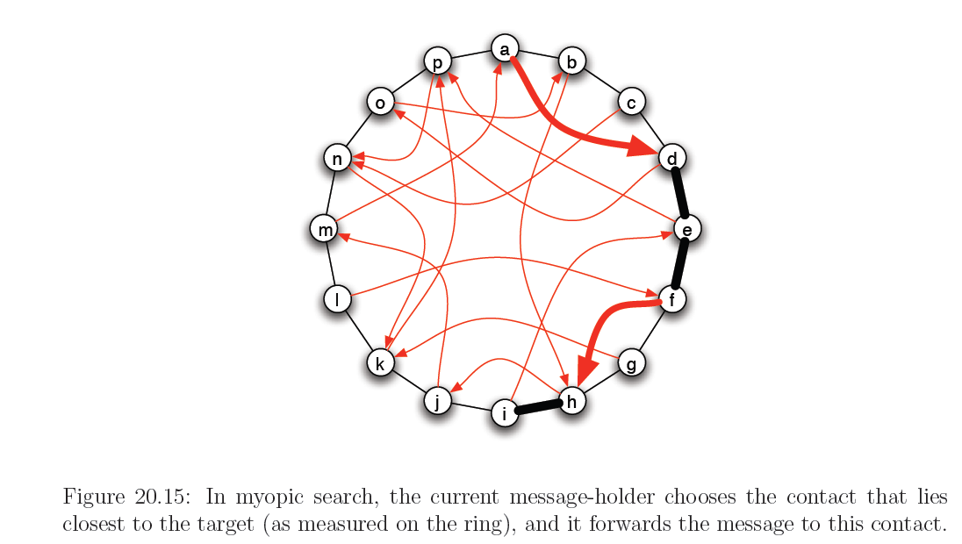
Example

Slide 14
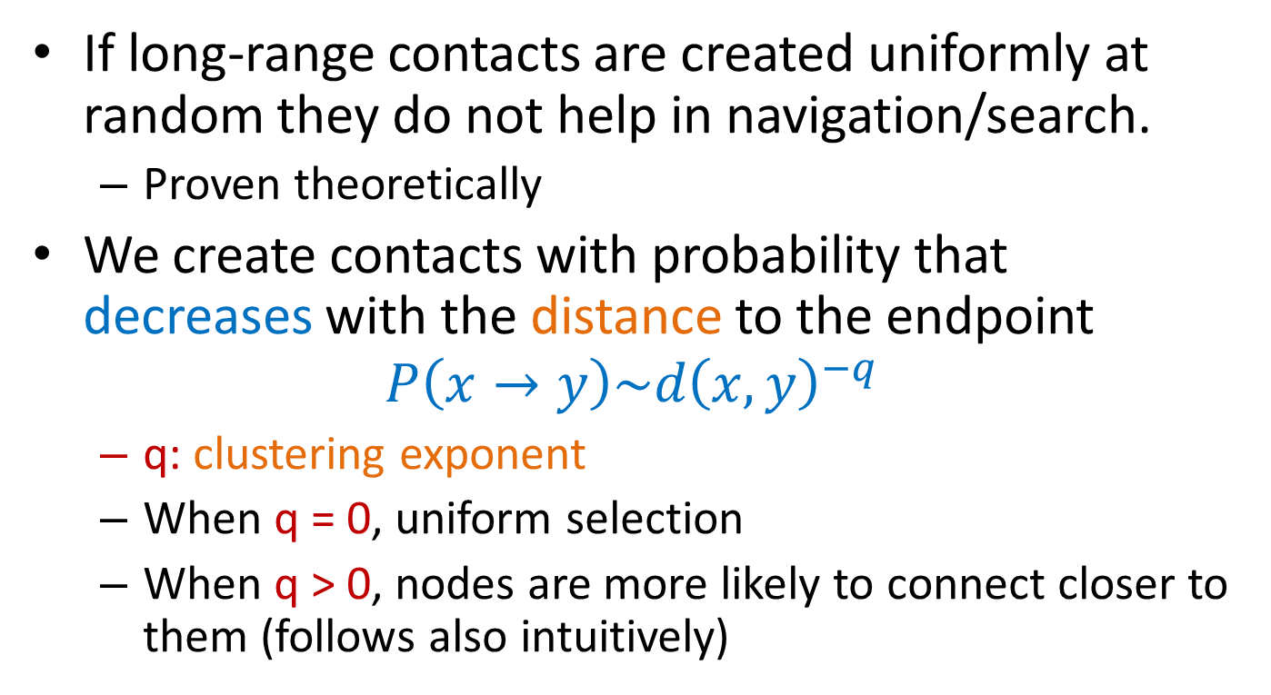
Long-range contacts
If long-range contacts are created uniformly at random they do not help in navigation/search.
  Proven theoretically
We create contacts with probability that decreases with the distance to the endpoint
$$P\left(x→y\right)\sim d{\left(x,y\right)}^{−q}$$
  q: clustering exponent
  When q = 0, uniform selection
  When q > 0, nodes are more likely to connect closer to them (follows also intuitively)

Slide 15
Clustering exponent

Slide 16
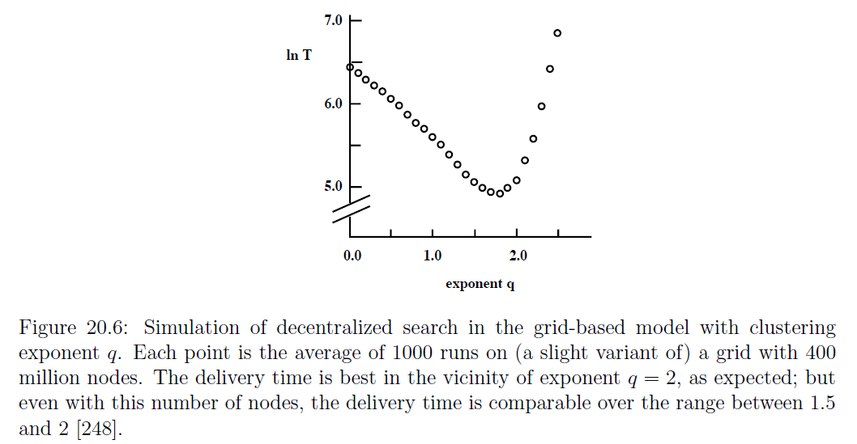
Clustering exponent
The right (clustering) exponent q depends on the geography:
  q = 1 for a 1-dimensional ring, q = 2 for a 2-dimensional grid.
This exponent is the only one for which greedy search follows “short” (polylogarithmic length) paths

Slide 17
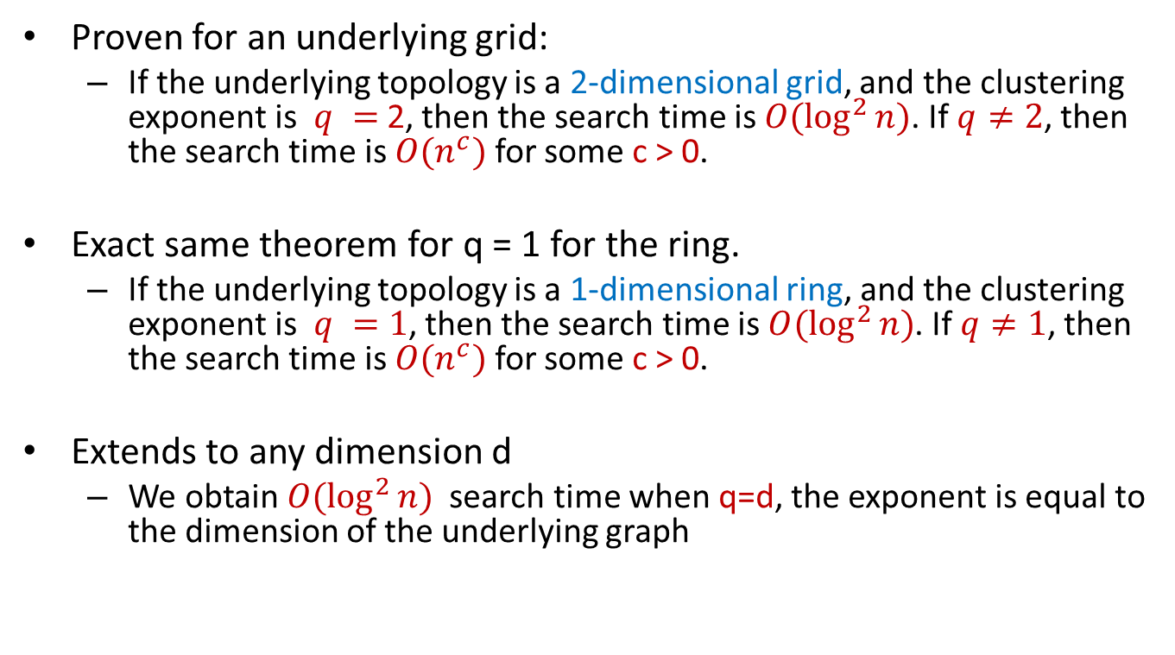
Theoretical results
Proven for an underlying grid:
  If the underlying topology is a 2-dimensional grid, and the clustering exponent is $q =$2, then the search time is $O(\log^{2}{n})$. If $q≠2$, then the search time is $O(n^{c})$ for some c > 0.
Exact same theorem for q = 1 for the ring.
  If the underlying topology is a 1-dimensional ring, and the clustering exponent is $q =1$, then the search time is $O(\log^{2}{n})$. If $q≠1$, then the search time is $O(n^{c})$ for some c > 0.
Extends to any dimension d
  We obtain $O(\log^{2}{n})$ search time when q=d, the exponent is equal to the dimension of the underlying graph

Slide 18
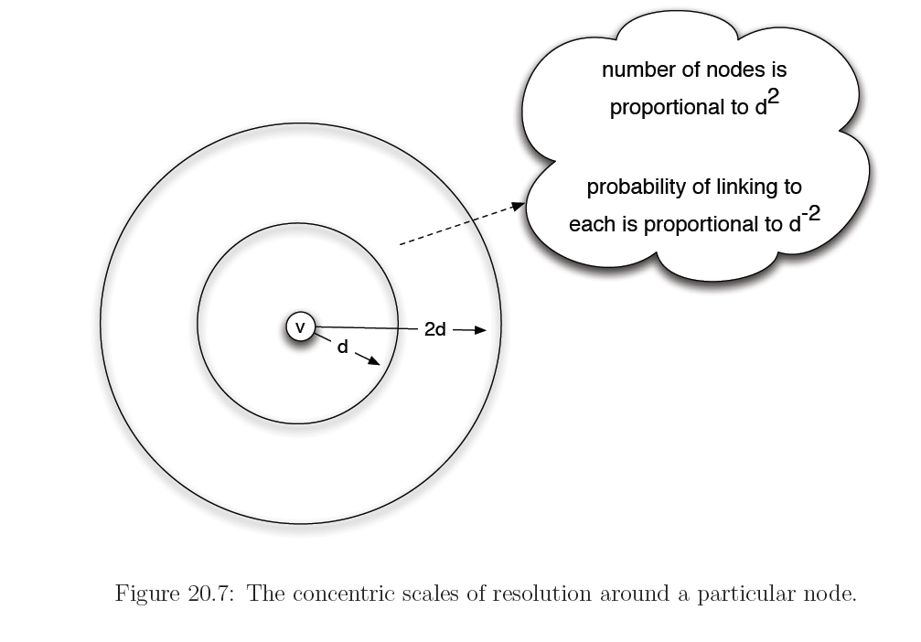
Proof Intuition
The algorithm has the same probability to link to any scale of resolution

Slide 19
Proof intuition
The algorithm is able to replicate what happens in the Milgram experiment
  logn scales, logn steps in expectation to change scale
x
y

Slide 20
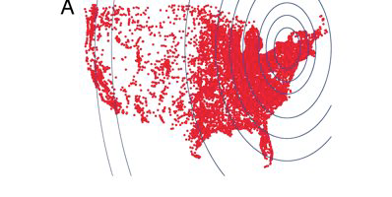
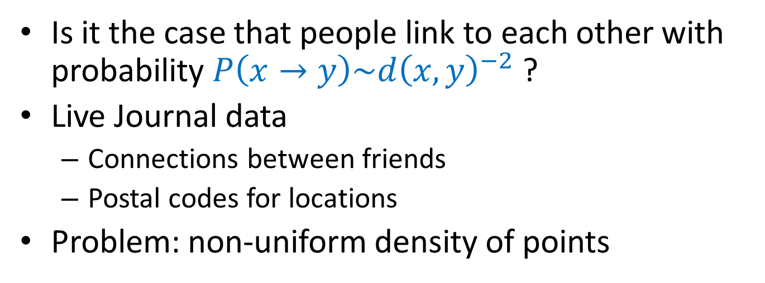
Long range links in the real world
Is it the case that people link to each other with probability $P\left(x→y\right)\sim d{\left(x,y\right)}^{−2}$?
Live Journal data
  Connections between friends
  Postal codes for locations
Problem: non-uniform density of points

Slide 21
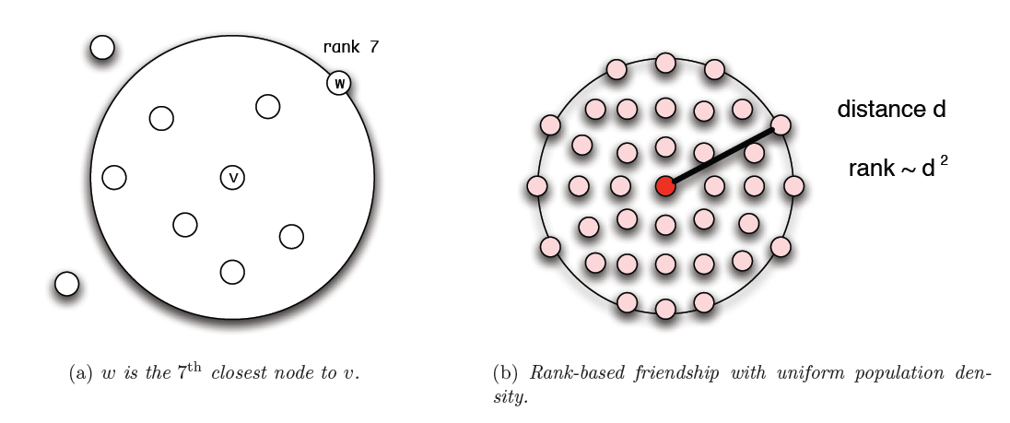
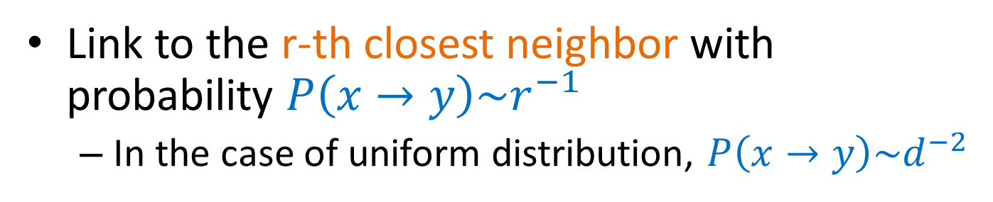
Linking by rank
Link to the r-th closest neighbor with probability $P\left(x→y\right)\sim r^{−1}$
  In the case of uniform distribution, $P\left(x→y\right)\sim d^{−2}$

Slide 22
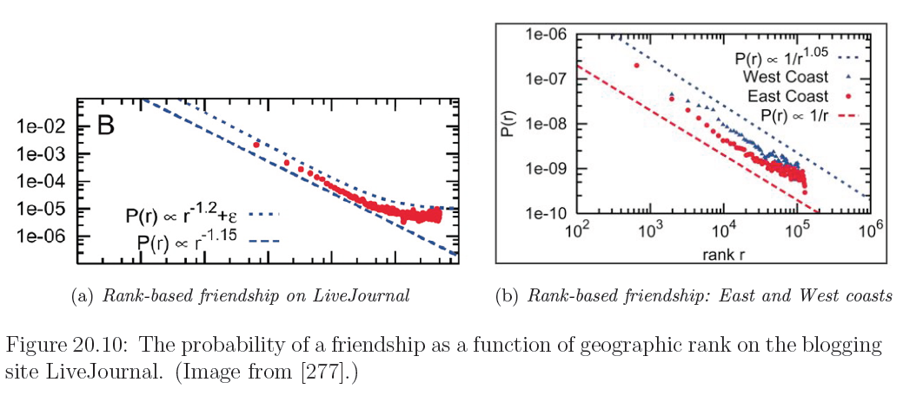
Live Journal measurements
Replicated for other networks as well (FB)
Is there a mechanism that drives this behavior?

Slide 23
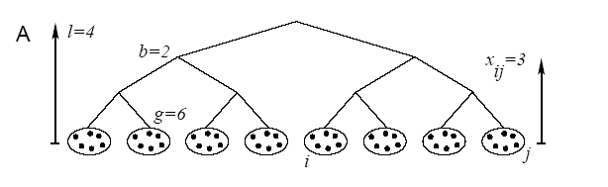
Other models
Lattice captures geographic distance. How do we capture social distance (e.g. occupation)?
Hierarchical organization of groups
  distance h(i,j) = height of Least Common Ancestor

Slide 24

Other models
Generate links between leaves with probability
$$P\left(x→y\right)\sim b^{−αh(x,y)}$$
  b=2 the branching factor

Slide 25
Other models
Theorem: For α=1 there is a polylogarithimic search algorithm. For α≠1 there is no decentralized algorithm with poly-log time
  note that α=1 and the exponential dependency results in uniform probability of linking to the subtrees

Slide 26
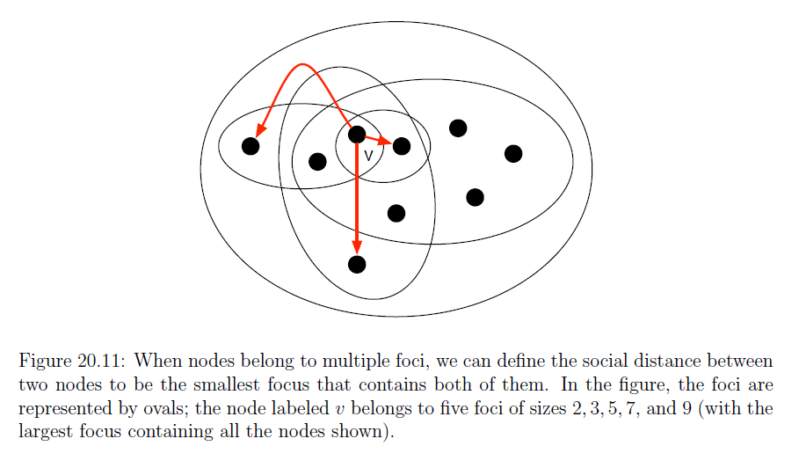
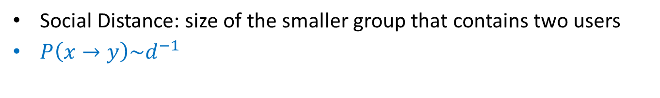
Generalization
Social Distance: size of the smaller group that contains two users
$P\left(x→y\right)\sim d^{−1}$

Slide 27
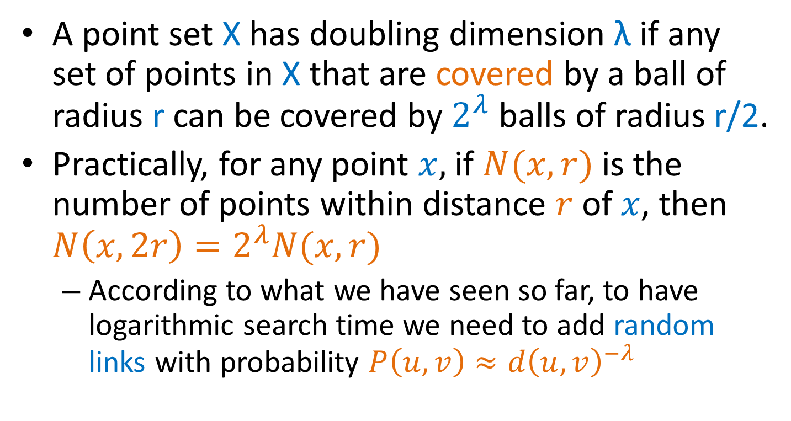
Doubling dimension
A point set X has doubling dimension λ if any set of points in X that are covered by a ball of radius r can be covered by $2^{λ}$ balls of radius r/2.
Practically, for any point $x,$ if $N(x,r)$ is the number of points within distance $r$ of $x$, then $N\left(x,2r\right)=2^{λ}N(x,r)$
  According to what we have seen so far, to have logarithmic search time we need to add random links with probability $P\left(u,v\right)≈d{\left(u,v\right)}^{−λ}$

Slide 28
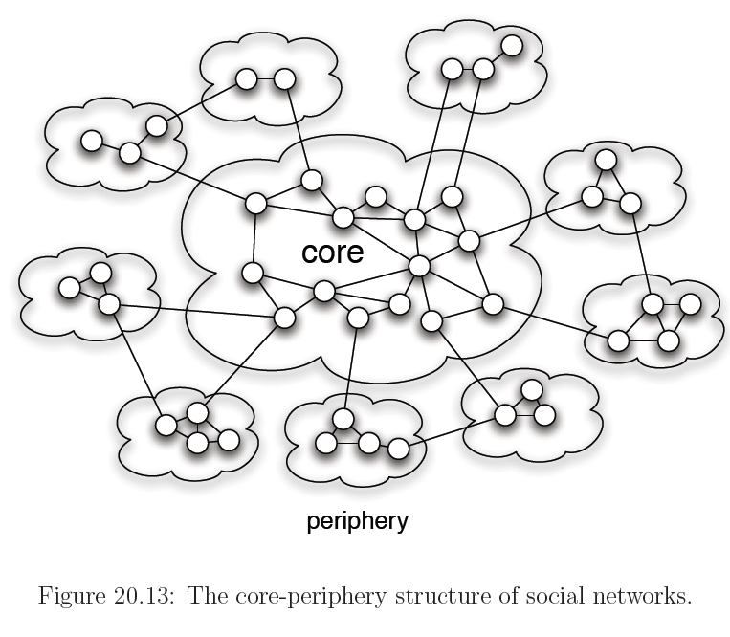
Small worlds with nodes of different status

Slide 29
Application: P2P search -- Symphony
Map the nodes and keys to the ring
  Assign keys to the closest node
Link every node with its successor and predecessor
Add k random links with probability proportional to 1/(dlogn), where d is the distance on the ring
Lookup time O(log²n)
If k = logn lookup time O(logn)
Easy to insert and remove nodes (perform periodical refreshes for the links)

Slide 30

Proof of Kleinberg’s theorem
We will consider the ring and clustering exponent $q=1$

Slide 31
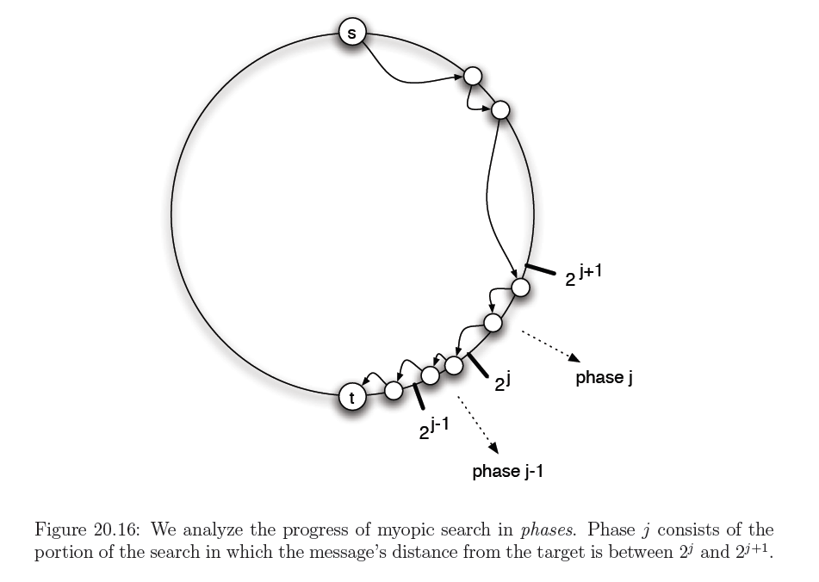
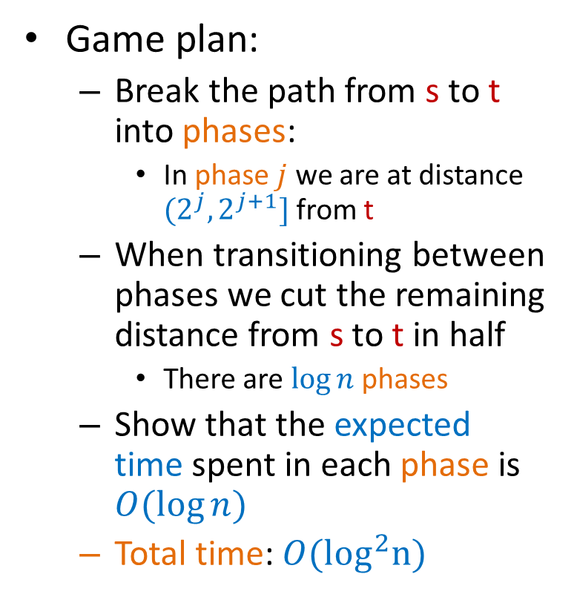
Proof of Kleinberg’s theorem
Game plan:
  Break the path from s to t into phases:
    In phase $j$ we are at distance $(2^{j},2^{j+1}]$from t
  When transitioning between phases we cut the remaining distance from s to t in half
    There are $\log{n}$ phases
  Show that the expected time spent in each phase is $O(\log{n})$
  Total time: $O(\log^{2}n)$

Slide 32
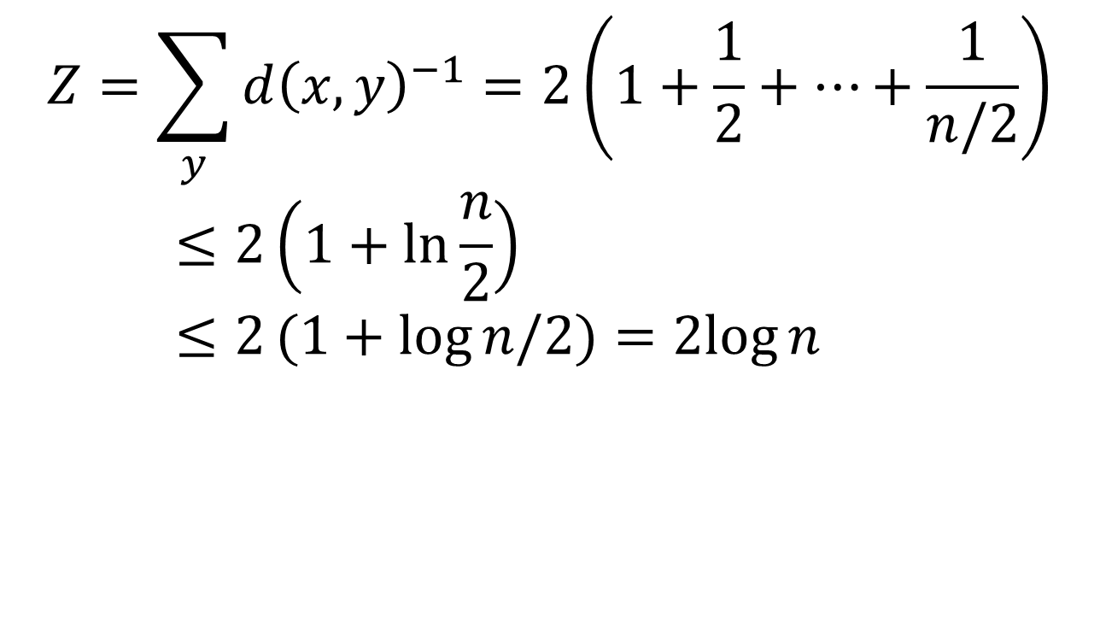
Normalization constant
$$Z=\sum_{y}{d{\left(x,y\right)}^{−1}=2\left(1+\frac{1}{2}+⋯+\frac{1}{n/2}\right)}≤2\left(1+\ln{\frac{n}{2}}\right)≤2(1+log{n/2)=2log{n}}$$

Slide 33
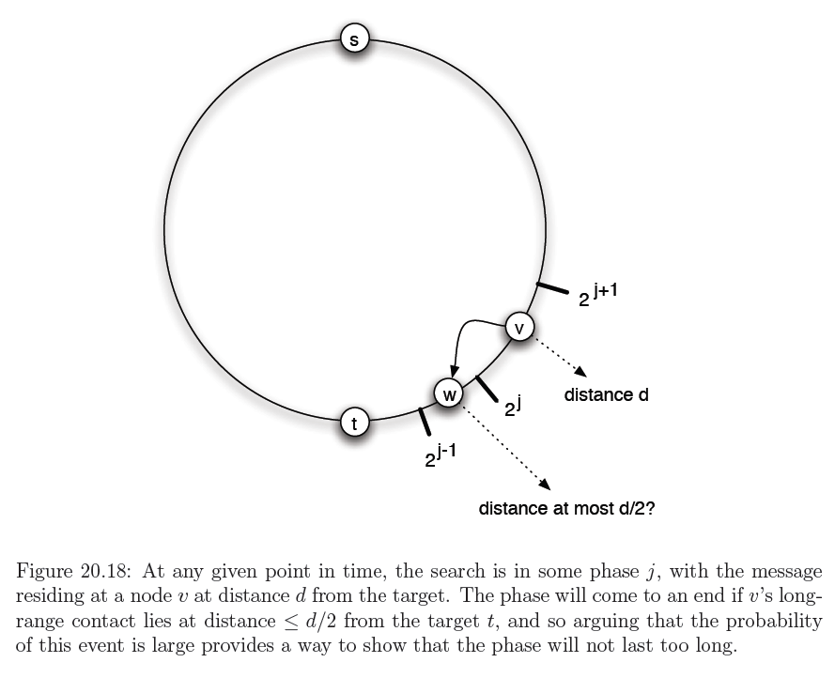

Slide 34
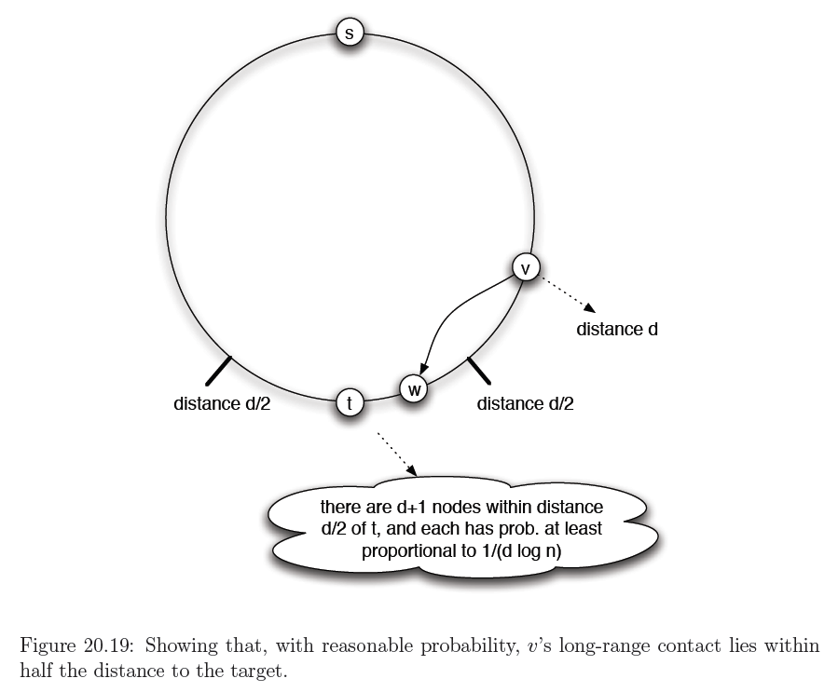

Slide 35
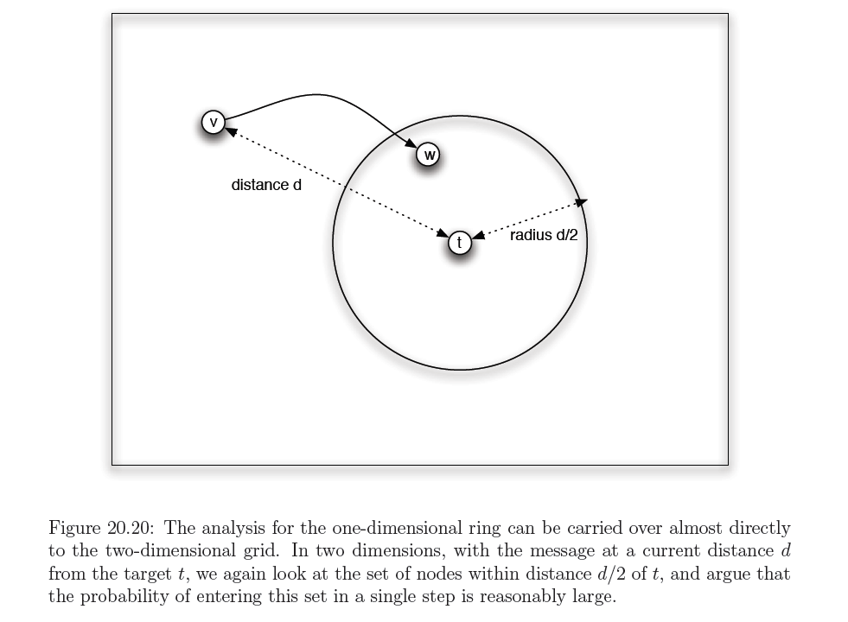

Slide 36
