Slide 1
DATA MINING
LECTURE 8
Dimensionality Reduction
PCA -- SVD

Slide 2
The curse of dimensionality
Real data usually have thousands, or millions of dimensions
  E.g., web documents, where the dimensionality is the vocabulary of words
  Facebook graph, where the dimensionality is the number of users
Huge number of dimensions causes problems
  Data becomes very sparse, some algorithms become meaningless (e.g. density based clustering)
  The complexity of several algorithms depends on the dimensionality and they become infeasible.

Slide 3
Dimensionality Reduction
Usually the data can be described with fewer dimensions, without losing much of the meaning of the data.
  The data reside in a space of lower dimensionality
Essentially, we assume that some of the data is noise, and we can approximate the useful part with a lower dimensionality space.
  Dimensionality reduction does not just reduce the amount of data, it often brings out the useful part of the data

Slide 4
Dimensionality Reduction
We have already seen a form of dimensionality reduction
LSH, and random projections reduce the dimension while preserving the distances

Slide 5
Data in the form of a matrix
We are given n objects and d attributes describing the objects. Each object has d numeric values describing it.
We will represent the data as a n×d real matrix A.
  We can now use tools from linear algebra to process the data matrix
Our goal is to produce a new n×k matrix B such that
  It preserves as much of the information in the original matrix A as possible
  It reveals something about the structure of the data in A

Slide 6
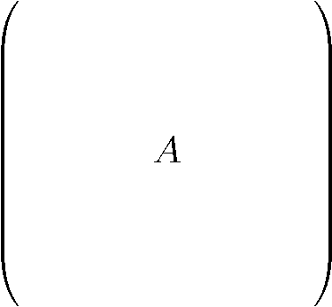
Example: Document matrices
d terms
(e.g., theorem, proof, etc.)
n documents
A_{ij} = frequency of the j-th term in the i-th document
Find subsets of terms that bring documents together

Slide 7
Example: Recommendation systems
d movies
n customers
A_{ij} = rating of j-th product by the i-th customer
Find subsets of movies that capture the behavior or the customers

Slide 8
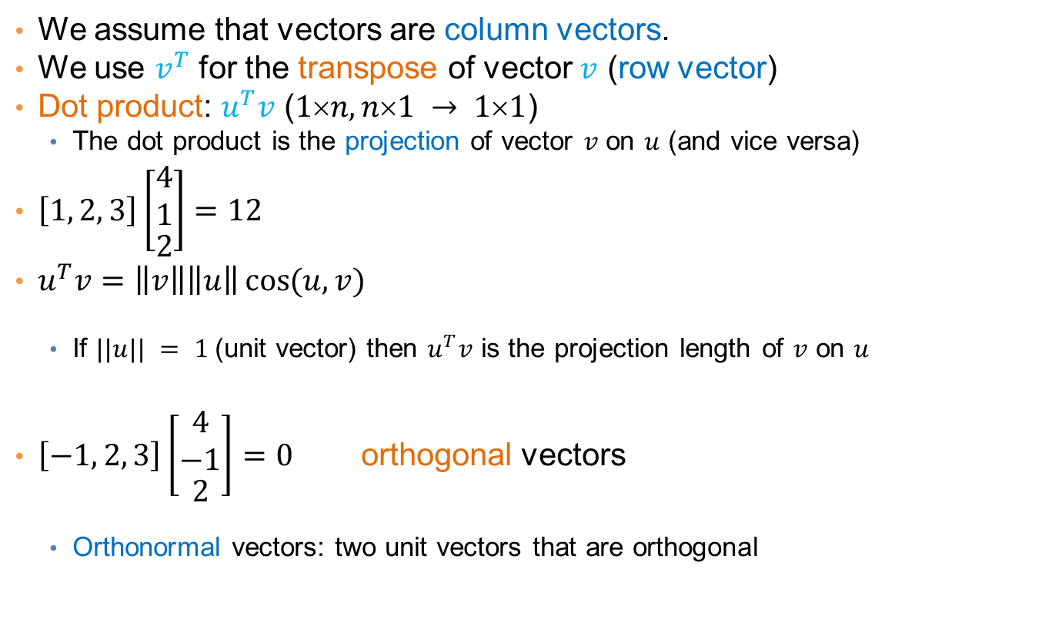
Linear algebra
We assume that vectors are column vectors.
We use $v^{T}$ for the transpose of vector $v$ (row vector)
Dot product: $u^{T}v$ ($1n, n1 → 11$)
  The dot product is the projection of vector $v$ on $u$ (and vice versa)
$\left[1, 2, 3\right]\left[\begin{matrix}\begin{matrix}4 \\ 1\end{matrix} \\ 2\end{matrix}\right]=12$
$u^{T}v=\left\|v\right\|\left\|u\right\|\cos{(u,v)}$
  If $||u|| = 1$(unit vector) then $u^{T}v$ is the projection length of $v$ on $u$
$\left[−1, 2, 3\right]\left[\begin{matrix}\begin{matrix}4 \\ −1\end{matrix} \\ 2\end{matrix}\right]=0$ orthogonal vectors
  Orthonormal vectors: two unit vectors that are orthogonal

Slide 9
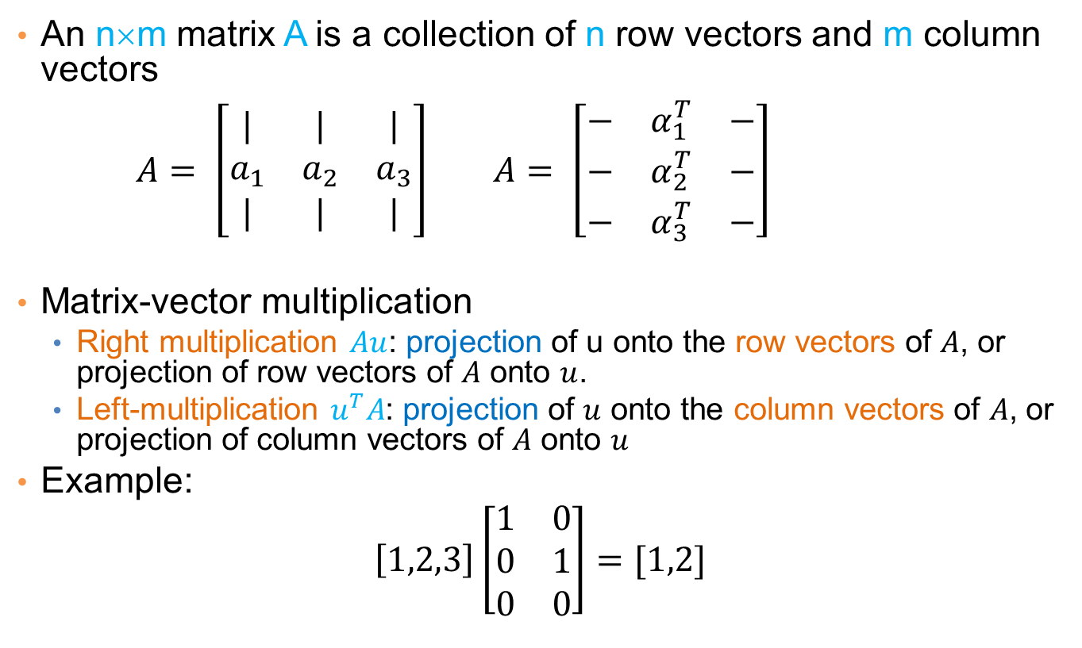
Matrices
An n×m matrix A is a collection of n row vectors and m column vectors
$A= \left[\begin{matrix}| & | & | \\ a_{1} & a_{2} & a_{3} \\ | & | & |\end{matrix}\right]$ $A= \left[\begin{matrix}− & α_{1}^{T} & − \\ − & α_{2}^{T} & − \\ − & α_{3}^{T} & −\end{matrix}\right]$
Matrix-vector multiplication
  Right multiplication $Au$: projection of u onto the row vectors of $A$, or projection of row vectors of $A$ onto $u$.
  Left-multiplication $u^{T}A$: projection of $u$ onto the column vectors of $A$, or projection of column vectors of $A$ onto $u$
Example:
$$\left[1,2,3\right]\left[\begin{matrix}1 & 0 \\ 0 & 1 \\ 0 & 0\end{matrix}\right]=[1,2]$$

Slide 10
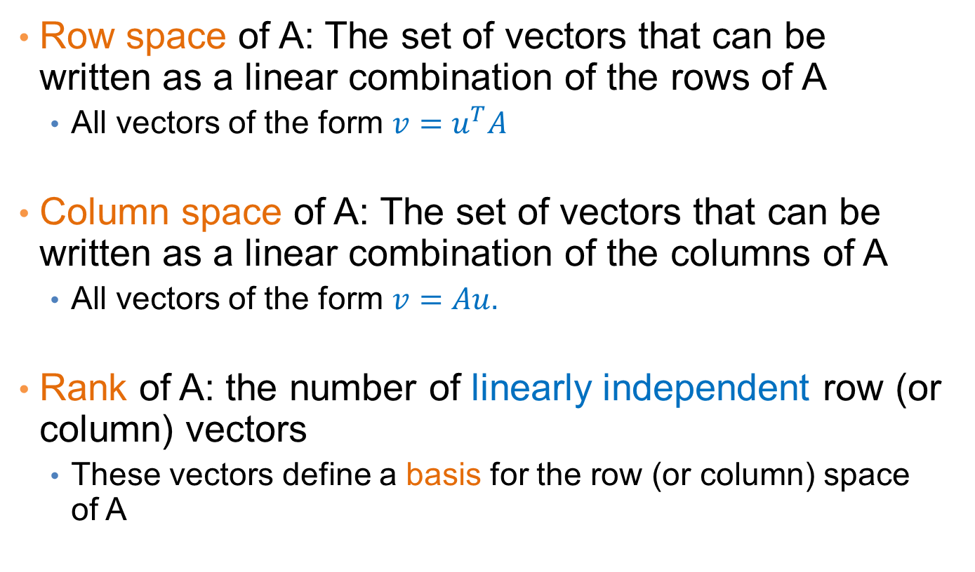
Rank
Row space of A: The set of vectors that can be written as a linear combination of the rows of A
  All vectors of the form $v=u^{T}A$
Column space of A: The set of vectors that can be written as a linear combination of the columns of A
  All vectors of the form $v=Au.$
Rank of A: the number of linearly independent row (or column) vectors
  These vectors define a basis for the row (or column) space of A

Slide 11
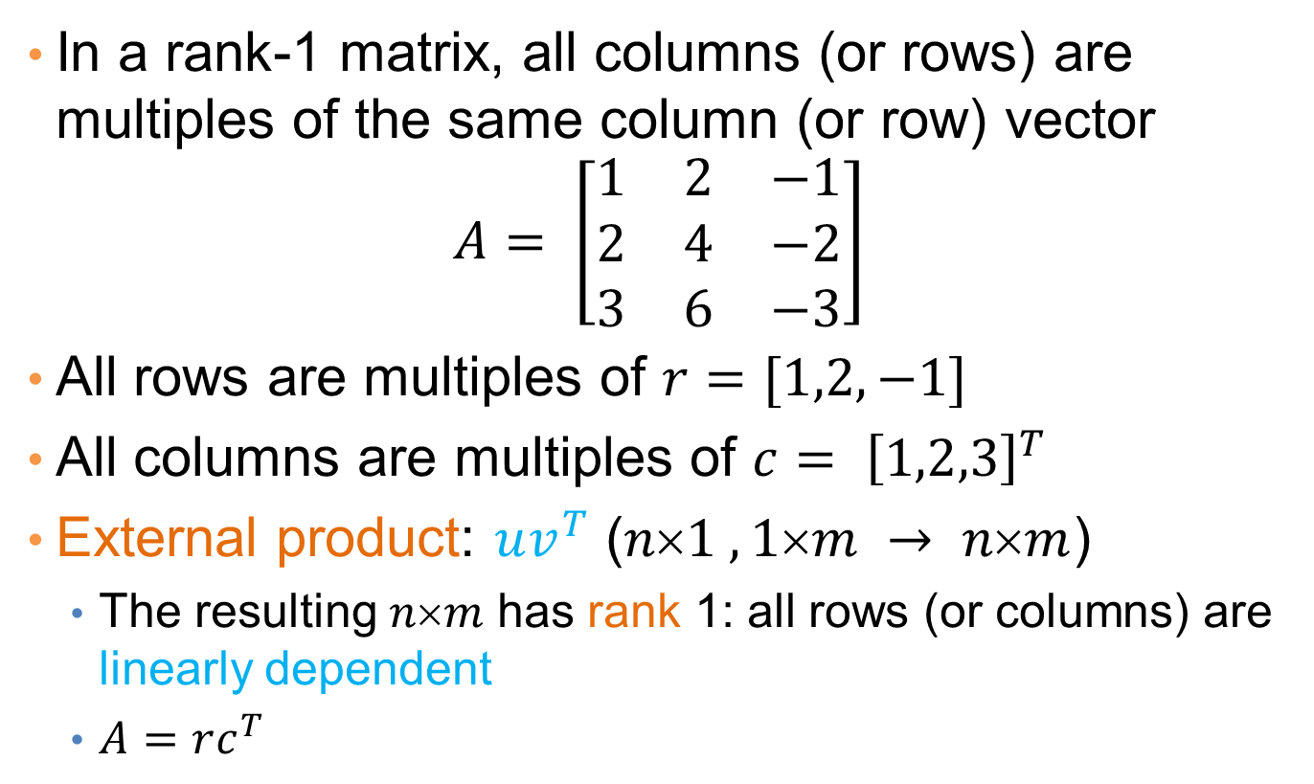
Rank-1 matrices
In a rank-1 matrix, all columns (or rows) are multiples of the same column (or row) vector
$$A= \left[\begin{matrix}1 & 2 & −1 \\ 2 & 4 & −2 \\ 3 & 6 & −3\end{matrix}\right]$$
All rows are multiples of $r=[1,2,−1]$
All columns are multiples of ${c= \left[1,2,3\right]}^{T}$
External product: $uv^{T}$ ($n1 ,1m → nm$)
  The resulting $nm$ has rank 1: all rows (or columns) are linearly dependent
  $A=rc^{T}$

Slide 12
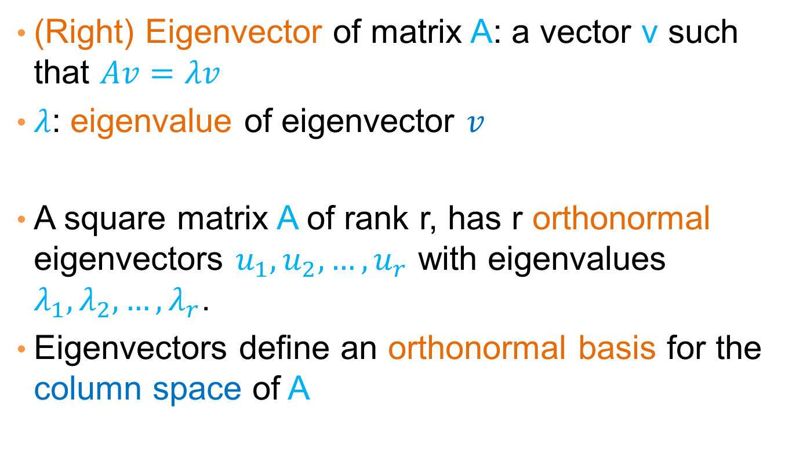
Eigenvectors
(Right) Eigenvector of matrix A: a vector v such that $Av=λv$
$λ$: eigenvalue of eigenvector $v$
A square matrix A of rank r, has r orthonormal eigenvectors $u_{1},u_{2},…,u_{r}$ with eigenvalues $λ_{1},λ_{2},…,λ_{r}$.
Eigenvectors define an orthonormal basis for the column space of A

Slide 13
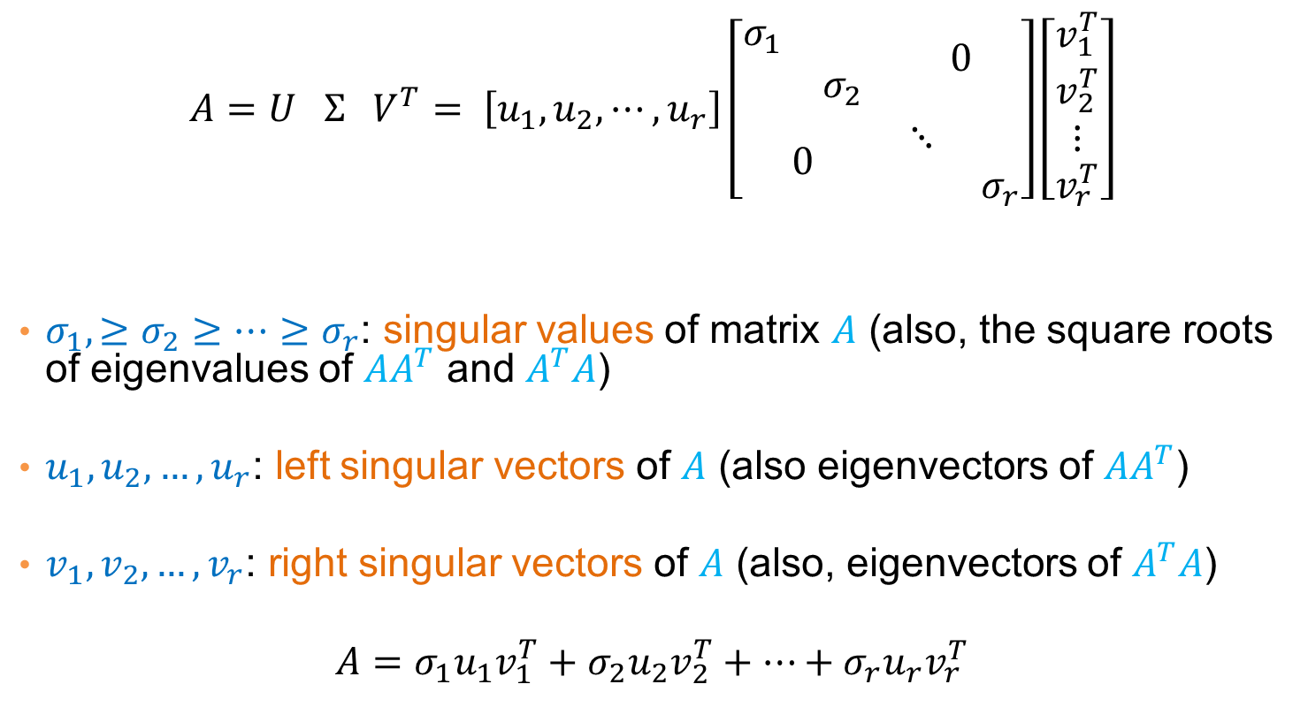
Singular Value Decomposition
$$A=U Σ{ V}^{T}= \left[u_{1}, u_{2}, ⋯,u_{r}\right]\left[\begin{matrix}\begin{matrix}σ_{1} & \\ & σ_{2}\end{matrix} & 0 \\ 0 & \begin{matrix}⋱ & \\ & σ_{r}\end{matrix}\end{matrix}\right]\left[\begin{matrix}\begin{matrix}v_{1}^{T} \\ v_{2}^{T}\end{matrix} \\ ⋮ \\ v_{r}^{T}\end{matrix}\right]$$
$σ_{1},≥σ_{2}≥…≥σ_{r}$: singular values of matrix $A$ (also, the square roots of eigenvalues of $AA^{T}$ and $A^{T}A$)
$u_{1},u_{2},…,u_{r}$: left singular vectors of $A$ (also eigenvectors of $AA^{T}$)
$v_{1},v_{2},…,v_{r}$: right singular vectors of $A$ (also, eigenvectors of $A^{T}A$)
$$A=σ_{1}u_{1}v_{1}^{T}+σ_{2}u_{2}v_{2}^{T}+⋯+σ_{r}u_{r}v_{r}^{T}$$
[n×m] =
[n×r]
[r×r]
[r×m]
r: rank of matrix A

Slide 14
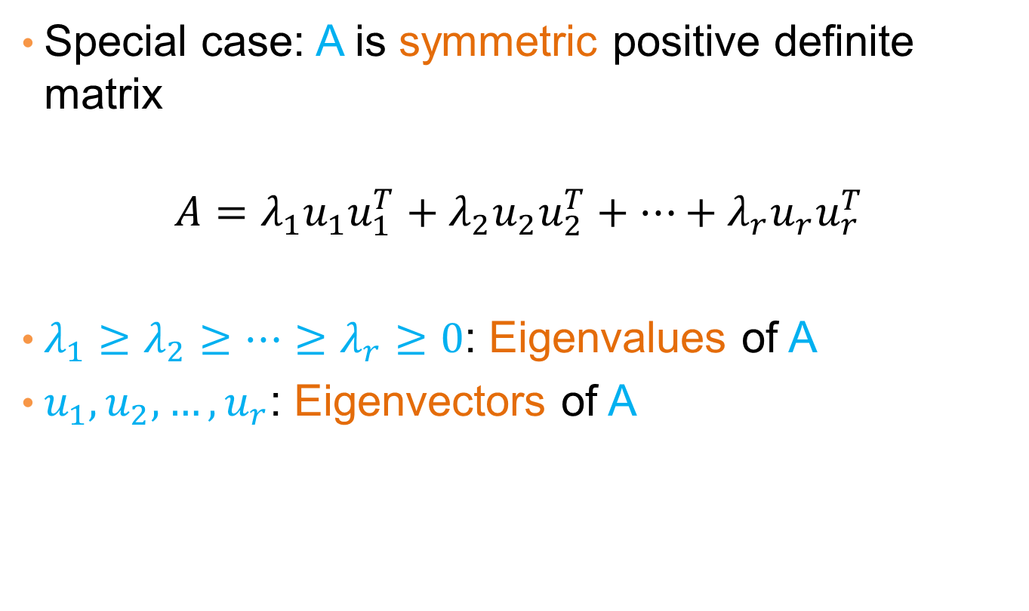
Symmetric matrices
Special case: A is symmetric positive definite matrix
$$A=λ_{1}u_{1}u_{1}^{T}+λ_{2}u_{2}u_{2}^{T}+⋯+λ_{r}u_{r}u_{r}^{T}$$
$λ_{1}≥λ_{2}≥⋯≥λ_{r}≥0$: Eigenvalues of A
$u_{1},u_{2},…, u_{r}$: Eigenvectors of A

Slide 15
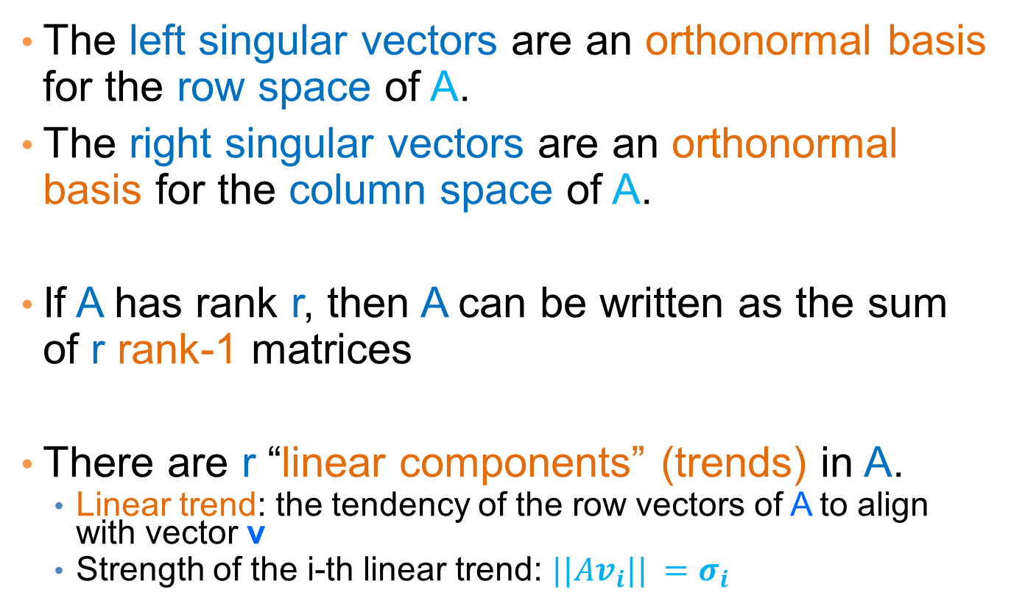
Singular Value Decomposition
The left singular vectors are an orthonormal basis for the row space of A.
The right singular vectors are an orthonormal basis for the column space of A.
If A has rank r, then A can be written as the sum of r rank-1 matrices
There are r “linear components” (trends) in A.
  Linear trend: the tendency of the row vectors of A to align with vector v
  Strength of the i-th linear trend: $||Av_{i}|| =σ_{i}$

Slide 16
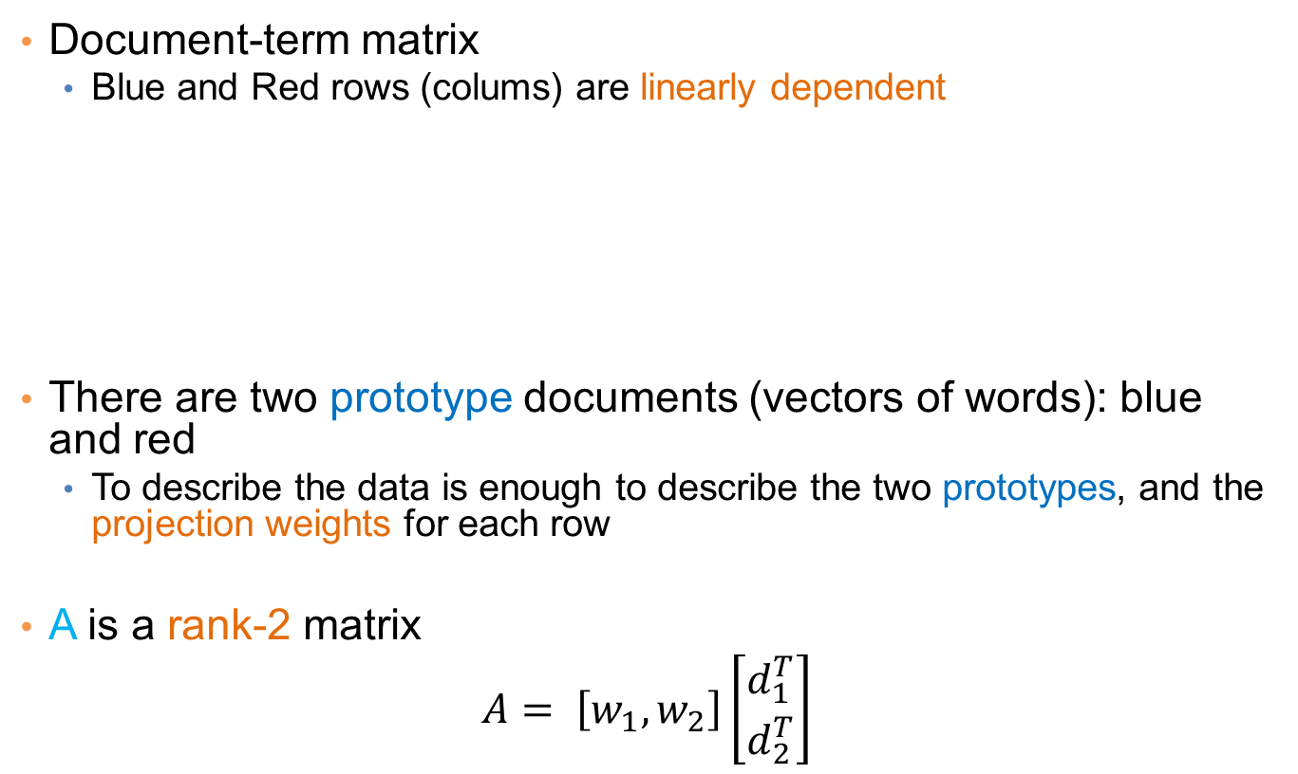
An (extreme) example
Document-term matrix
  Blue and Red rows (colums) are linearly dependent
There are two prototype documents (vectors of words): blue and red
  To describe the data is enough to describe the two prototypes, and the projection weights for each row
A is a rank-2 matrix
$$A= \left[w_{1},w_{2}\right]\left[\begin{matrix}d_{1}^{T} \\ d_{2}^{T}\end{matrix}\right]$$
A =

Slide 17
An (more realistic) example
Document-term matrix
There are two prototype documents and words but they are noisy
  We now have more than two singular vectors, but the strongest ones are still about the two types.
  By keeping the two strongest singular vectors we obtain most of the information in the data.
    This is a rank-2 approximation of the matrix A
A =

Slide 18
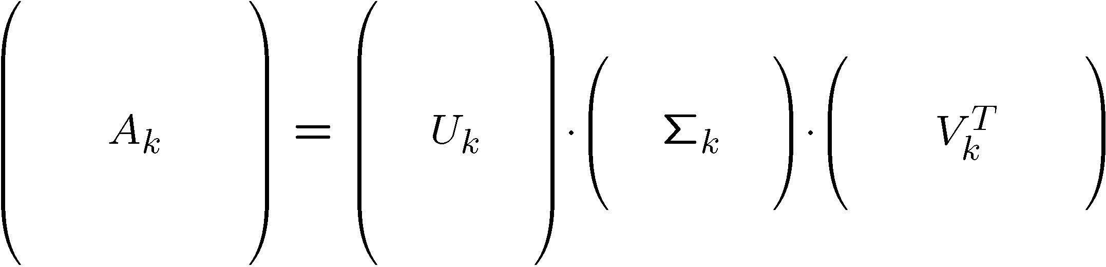
Rank-k approximations (A_{k})
n x d
n x k
k x k
k x d
U_{k} (V_{k}): orthogonal matrix containing the top k left (right) singular vectors of A.
_{k}: diagonal matrix containing the top k singular values of A
A_{k} is an approximation of A
A_{k} is the best approximation of A

Slide 19
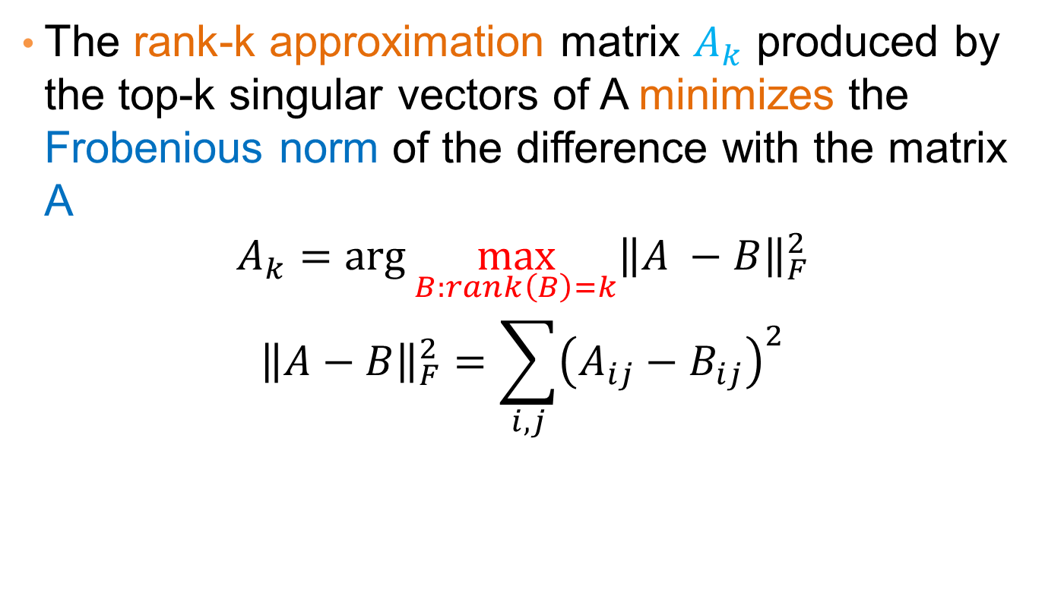
SVD as an optimization
The rank-k approximation matrix $A_{k}$ produced by the top-k singular vectors of A minimizes the Frobenious norm of the difference with the matrix A
$$A_{k}=\arg{\max_{B:rank\left(B\right)=k}{{\left\|A −B\right\|}_{F}^{2}}}$$
$${\left\|A−B\right\|}_{F}^{2}=\sum_{i,j}{{\left(A_{ij}−B_{ij}\right)}^{2}}$$

Slide 20
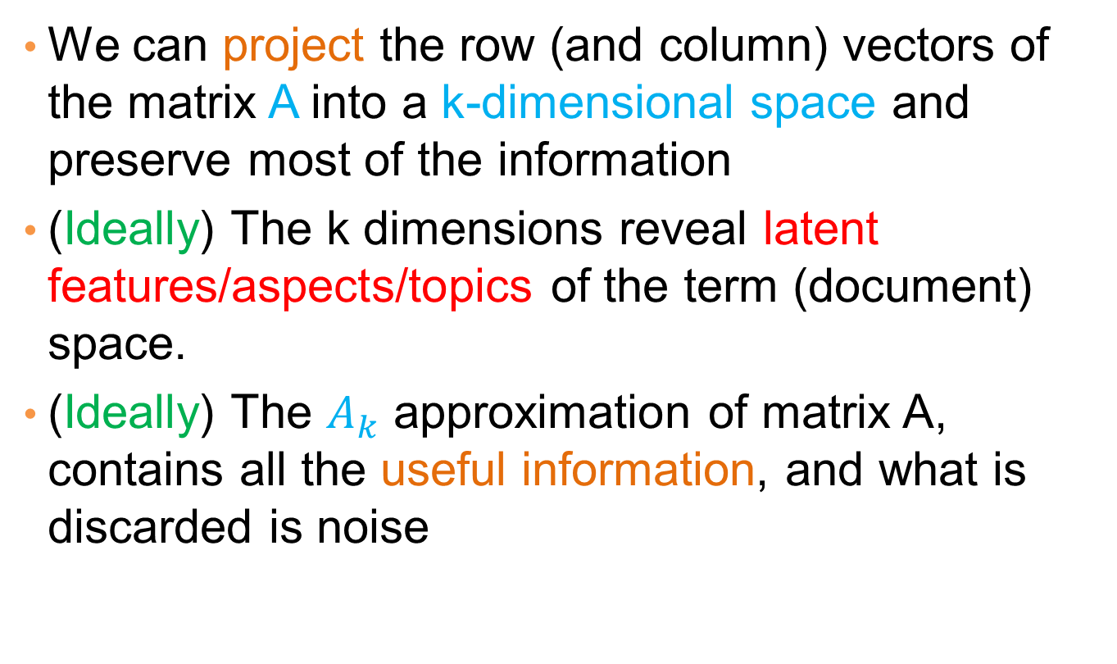
What does this mean?
We can project the row (and column) vectors of the matrix A into a k-dimensional space and preserve most of the information
(Ideally) The k dimensions reveal latent features/aspects/topics of the term (document) space.
(Ideally) The $A_{k}$ approximation of matrix A, contains all the useful information, and what is discarded is noise

Slide 21
Latent factor model
Rows (columns) are linear combinations of k latent factors
  E.g., in our extreme document example there are two factors
Some noise is added to this rank-k matrix resulting in higher rank
SVD retrieves the latent factors (hopefully).

Slide 22
SVD and Rank-k approximations
A
=
U
Σ
V^{T}
features
sig.
significant
=
noise
noise
significant
noise
objects

Slide 23
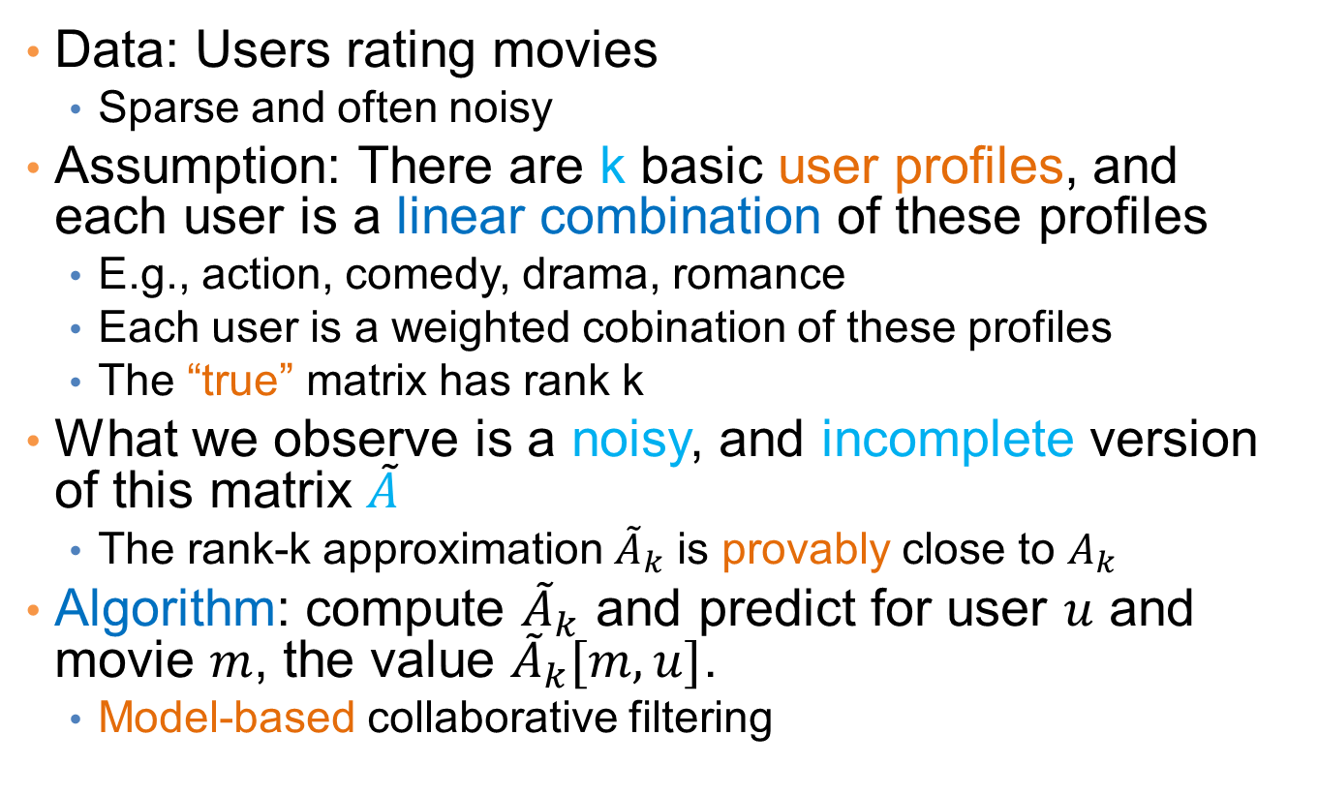
Application: Recommender systems
Data: Users rating movies
  Sparse and often noisy
Assumption: There are k basic user profiles, and each user is a linear combination of these profiles
  E.g., action, comedy, drama, romance
  Each user is a weighted cobination of these profiles
  The “true” matrix has rank k
What we observe is a noisy, and incomplete version of this matrix $\tilde{A}$
  The rank-k approximation ${\tilde{A}}_{k}$ is provably close to $A_{k}$
Algorithm: compute ${\tilde{A}}_{k}$ and predict for user $u$ and movie $m$, the value ${\tilde{A}}_{k}[m,u]$.
  Model-based collaborative filtering

Slide 24
SVD and PCA
PCA is a special case of SVD on the centered covariance matrix.

Slide 25
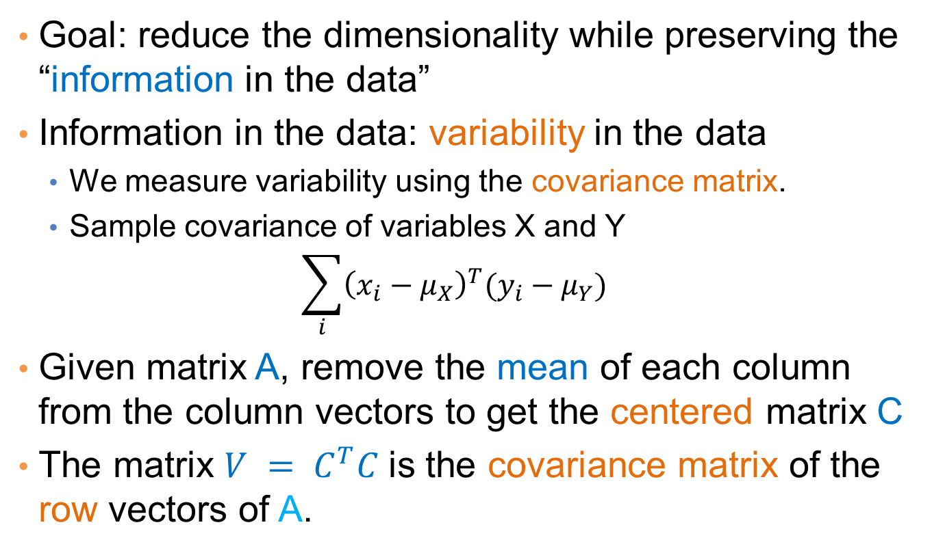
Covariance matrix
Goal: reduce the dimensionality while preserving the “information in the data”
Information in the data: variability in the data
  We measure variability using the covariance matrix.
  Sample covariance of variables X and Y
  $$\sum_{i}{{\left(x_{i}−μ_{X}\right)}^{T}(y_{i}−μ_{Y})}$$
Given matrix A, remove the mean of each column from the column vectors to get the centered matrix C
The matrix $V = C^{T}C$is the covariance matrix of the row vectors of A.

Slide 26
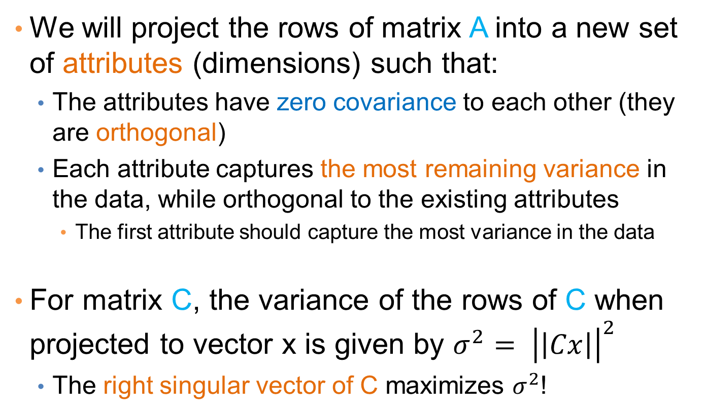
PCA: Principal Component Analysis
We will project the rows of matrix A into a new set of attributes (dimensions) such that:
  The attributes have zero covariance to each other (they are orthogonal)
  Each attribute captures the most remaining variance in the data, while orthogonal to the existing attributes
    The first attribute should capture the most variance in the data
For matrix C, the variance of the rows of C when projected to vector x is given by ${σ^{2}= \left|\left|Cx\right|\right|}^{2}$
  The right singular vector of C maximizes $σ^{2}$!

Slide 27
PCA
Input: 2-d dimensional points
Output:
2nd (right) singular vector
1st (right) singular vector:
direction of maximal variance,
2nd (right) singular vector:
direction of maximal variance, after removing the projection of the data along the first singular vector.
1st (right) singular vector

Slide 28
Singular values
2nd (right) singular vector
σ₁: measures how much of the data variance is explained by the first singular vector.
σ₂: measures how much of the data variance is explained by the second singular vector.
σ₁
1st (right) singular vector

Slide 29
Singular values tell us something about the variance
The variance in the direction of the k-th principal component is given by the corresponding singular value σ_{k}²
Singular values can be used to estimate how many components to keep
Rule of thumb: keep enough to explain 85% of the variation:

Slide 30

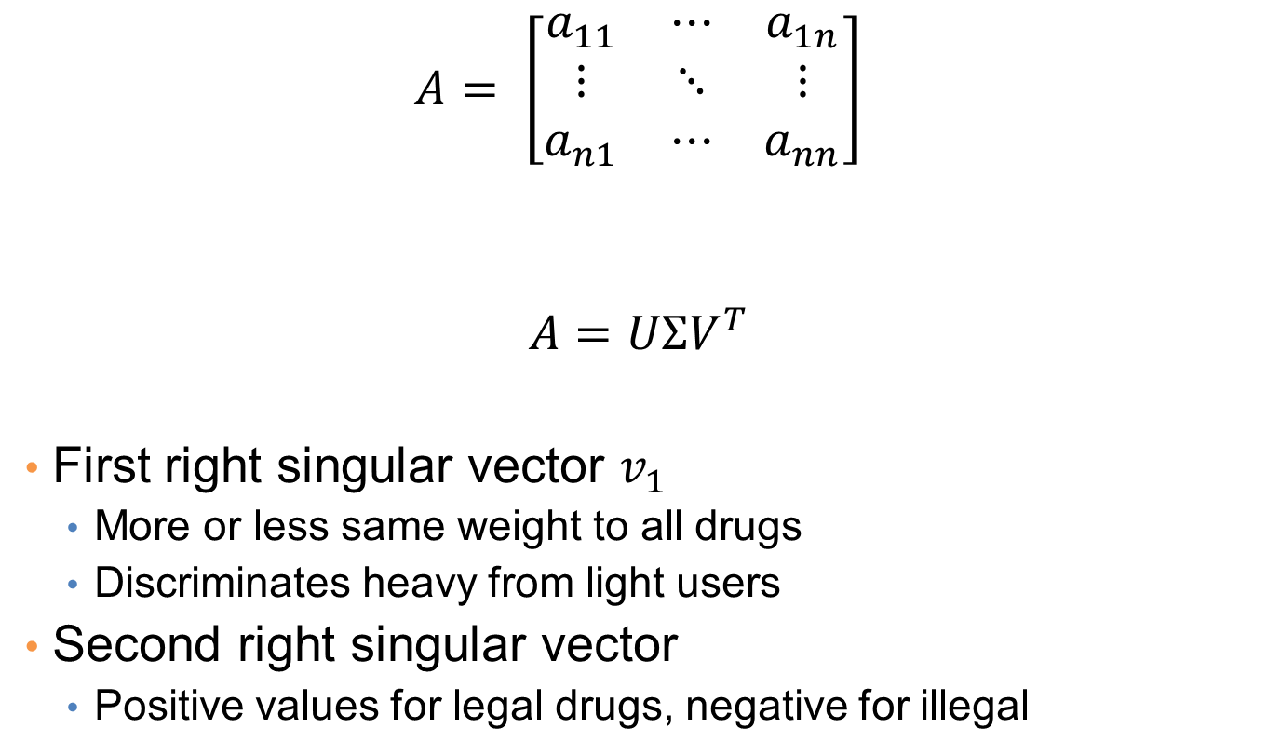
Example
drugs
$$A= \left[\begin{matrix}a_{11} & ⋯ & a_{1n} \\ ⋮ & ⋱ & ⋮ \\ a_{n1} & ⋯ & a_{nn}\end{matrix}\right]$$
$$A=UΣV^{T}$$
First right singular vector $v_{1}$
  More or less same weight to all drugs
  Discriminates heavy from light users
Second right singular vector
  Positive values for legal drugs, negative for illegal
students
legal
illegal
$a_{ij}$: usage of student i of drug j
Drug 1
Drug 2

Slide 31
Another property of PCA/SVD
The chosen vectors are such that minimize the sum of square differences between the data vectors and the low-dimensional projections
1st (right) singular vector

Slide 32
Application
Latent Semantic Indexing (LSI):
  Apply PCA on the document-term matrix, and index the k-dimensional vectors
  When a query comes, project it onto the k-dimensional space and compute cosine similarity in this space
  Principal components capture main topics, and enrich the document representation

Slide 33
SVD is “the Rolls-Royce and the Swiss Army Knife of Numerical Linear Algebra.”*
*Dianne O’Leary, MMDS ’06

