Slide 1
DATA MINING LECTURE 8b
Time series analysis and
Sequence Segmentation

Slide 2
Sequential data
Sequential data (or time series) refers to data that appear in a specific order.
The order defines a time axis, that differentiates this data from other cases we have seen so far
Examples
The price of a stock (or of many stocks) over time
Environmental data (pressure, temperature, precipitation etc) over time
The sequence of queries in a search engine, or the frequency of a query over time
The words in a document as they appear in order
A DNA sequence of nucleotides
Event occurrences in a log over time
Etc…
Time series: usually we assume that we have a vector of numeric values that change over time.

Slide 3
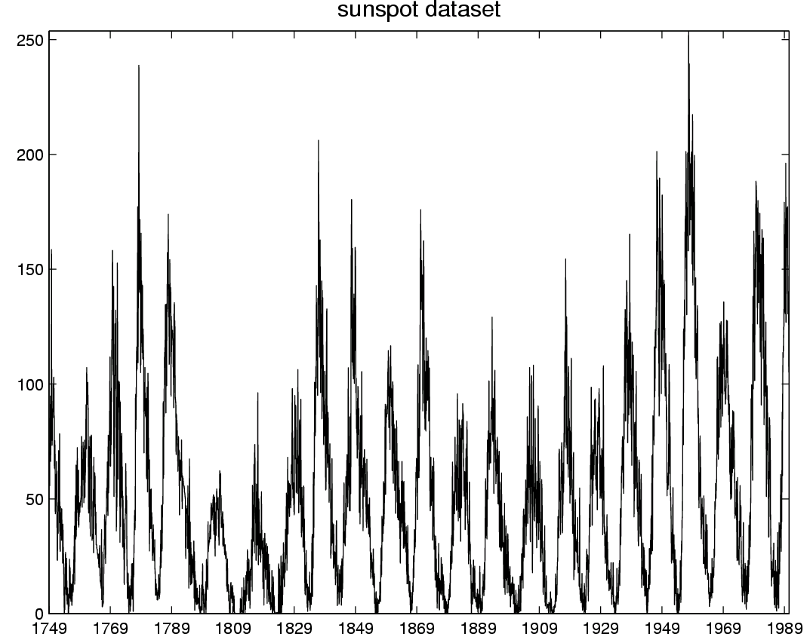
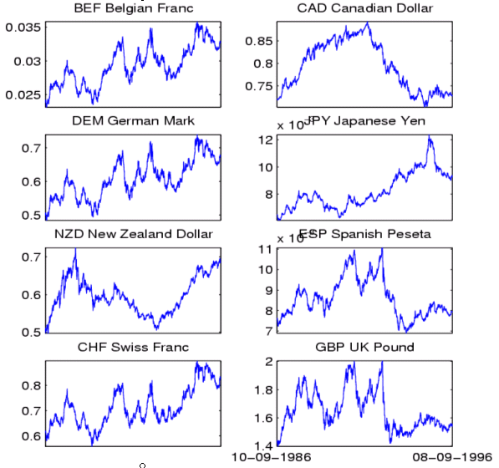
Time-series data
Financial time series, process monitoring…

Slide 4
Why deal with sequential data?
Because all data is sequential ☺
All data items arrive in the data store in some order
In some (many) cases the order does not matter
E.g., we can assume a bag of words model for a document
In many cases the order is of interest
E.g., stock prices do not make sense without the time information.

Slide 5
Time series analysis
The addition of the time axis defines new sets of problems
Discovering periodic patterns in time series
Defining similarity between time series
Finding bursts, or outliers
Also, some existing problems need to be revisited taking sequential order into account
Association rules and Frequent Itemsets in sequential data
Summarization and Clustering: Sequence Segmentation

Slide 6
Sequence Segmentation
Goal: discover structure in the sequence and provide a concise summary
Given a sequence T, segment it into K contiguous segments that are as homogeneous as possible
Similar to clustering but now we require the points in the cluster to be contiguous
Commonly used for summarization of histograms in databases

Slide 7
Example
R
t
R
Segmentation into 4 segments
Homogeneity: points are close to the mean value (small error)
t

Slide 8
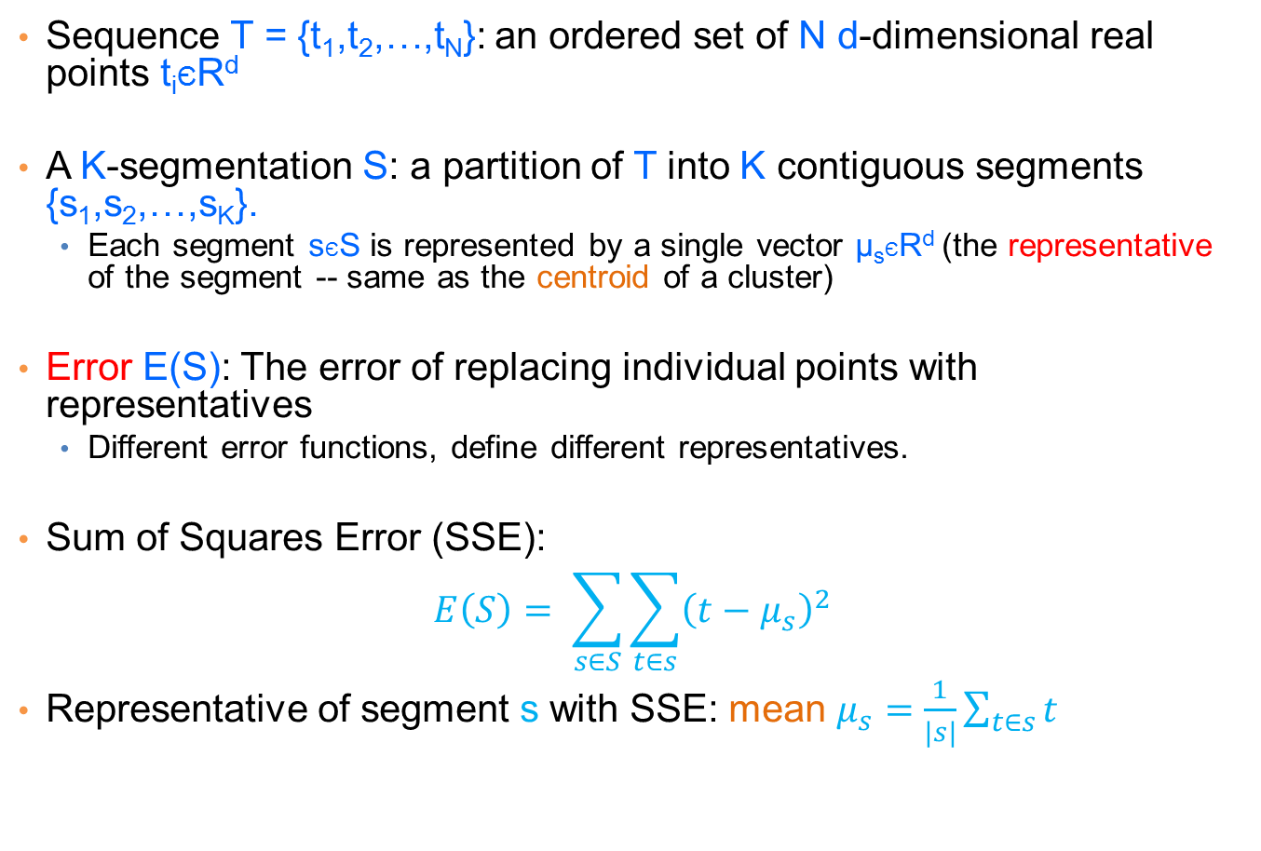
Basic definitions
Sequence T = {t₁,t₂,…,t_{N}}: an ordered set of N d-dimensional real points t_{i}ЄR^{d}
A K-segmentation S: a partition of T into K contiguous segments {s₁,s₂,…,s_{K}}.
Each segment sЄS is represented by a single vector μ_{s}ЄR^{d} (the representative of the segment -- same as the centroid of a cluster)
Error E(S): The error of replacing individual points with representatives
Different error functions, define different representatives.
Sum of Squares Error (SSE):
$$E\left(S\right)= \sum_{s∈S}{\sum_{t∈s}{{\left(t−μ_{s}\right)}^{2}}}$$
Representative of segment s with SSE: mean $μ_{s}=\frac{1}{|s|}\sum_{t∈s}{t}$

Slide 9






Basic Definitions
Observation: a K-segmentation S is defined by K+1 boundary points $b_{0},b_{1},…,b_{K−1},b_{K}$.
$b_{0}=0, b_{k}=N+1$ always.
We only need to specify$b_{1},…,b_{K−1}$
R
t
$$b_{0}$$
$$b_{1}$$
$$b_{2}$$
$$b_{3}$$
$$b_{4}$$

Slide 10
The K-segmentation problem
Given a sequence T of length N and a value K, find a K-segmentation S = {s₁, s₂, …,s_{K}} of T such that the SSE error E is minimized.
Similar to K-means clustering, but now we need the points in the clusters to respect the order of the sequence.
This actually makes the problem easier.

Slide 11
Optimal solution for the k-segmentation problem
[Bellman’61: The K-segmentation problem can be solved optimally using a standard dynamic-programming algorithm
Dynamic Programming:
Construct the solution of the problem by using solutions to problems of smaller size
Define the dynamic programming recursion
Build the solution bottom up from smaller to larger instances
Define the dynamic programming table that stores the solutions to the sub-problems

Slide 12
Rule of thumb
Most optimization problems where order is involved can be solved optimally in polynomial time using dynamic programming.
The polynomial exponent may be large though

Slide 13
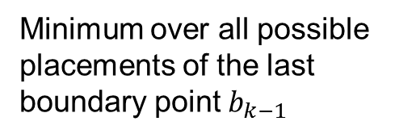
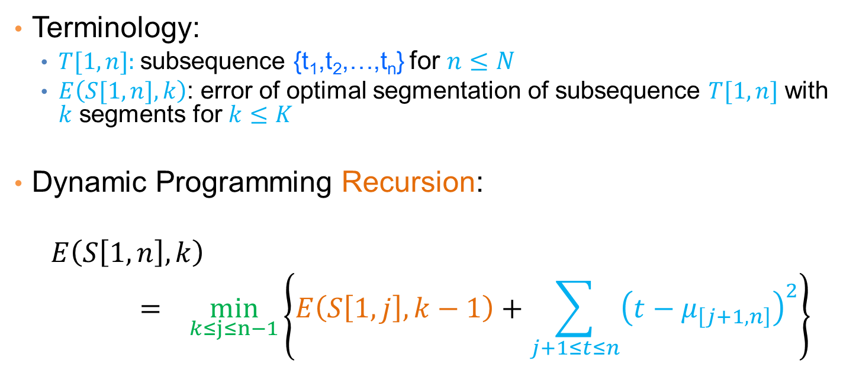
Dynamic Programming Recursion
Terminology:
$T[1,n]$: subsequence {t₁,t₂,…,t_{n}} for $n≤N$
$E\left(S[1,n],k\right)$: error of optimal segmentation of subsequence $T[1,n]$ with $k$ segments for $k≤K$
Dynamic Programming Recursion:
$$E\left(S\left[1,n\right],k\right)= \min_{k≤j≤n−1}\left\{E\left(S\left[1,j\right],k−1\right)+\sum_{j+1≤t≤n}{{\left(t−μ_{\left[j+1,n\right]}\right)}^{2}}\right\}$$
Minimum over all possible placements of the last boundary point $b_{k−1}$
Error of optimal segmentation S[1,j] with k-1 segments
Error of k-th (last) segment when the last segment is [j+1,n]

Slide 14


Dynamic programming table
$\text{Two}\text{−}\text{dimensional} \text{table} A[1…K, 1…N]$
$$E\left(S\left[1,n\right],k\right)=\min_{k≤j≤n−1}\left\{E\left(S\left[1,j\right],k−1\right)+\sum_{j+1≤t≤n}{{\left(t−μ_{\left[j+1,n\right]}\right)}^{2}}\right\}$$
Fill the table top to bottom, left to right.
$$A\left[k,n\right]= E\left(S\left[1,n\right],k\right)$$
1
n
N
1
k
K
Error of optimal K-segmentation

Slide 15
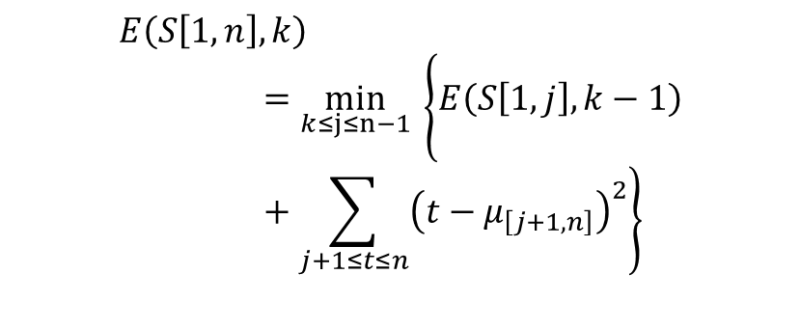



Example
k = 3
n-th point
$$b_{1}$$
$$b_{2}$$
R
$$E\left(S\left[1,n\right],k\right)=\min_{k≤j≤n−1}\left\{E\left(S\left[1,j\right],k−1\right)+\sum_{j+1≤t≤n}{{\left(t−μ_{\left[j+1,n\right]}\right)}^{2}}\right\}$$
1
n
N
1
2
3
4
Where should we place boundary $b_{2}$?

Slide 16

Example
k = 3
n-th point
$$b_{2}$$
$$b_{1}$$
R
$$E\left(S\left[1,n\right],k\right)=\min_{k≤j≤n−1}\left\{E\left(S\left[1,j\right],k−1\right)+\sum_{j+1≤t≤n}{{\left(t−μ_{\left[j+1,n\right]}\right)}^{2}}\right\}$$
1
n
N
1
2
3
4
Where should we place boundary $b_{2}$?

Slide 17


Example
k = 3
n-th point
$$b_{1}$$
$$b_{2}$$
R
$$E\left(S\left[1,n\right],k\right)=\min_{k≤j≤n−1}\left\{E\left(S\left[1,j\right],k−1\right)+\sum_{j+1≤t≤n}{{\left(t−μ_{\left[j+1,n\right]}\right)}^{2}}\right\}$$
1
n
N
1
2
3
4
Where should we place boundary $b_{2}$?

Slide 18

Example
k = 3
n-th point
$$b_{1}$$
$$b_{2}$$
R
$$E\left(S\left[1,n\right],k\right)=\min_{k≤j≤n−1}\left\{E\left(S\left[1,j\right],k−1\right)+\sum_{j+1≤t≤n}{{\left(t−μ_{\left[j+1,n\right]}\right)}^{2}}\right\}$$
1
n
N
1
2
3
4
Where should we place boundary $b_{2}$?

Slide 19
Example
k = 3
n-th point
$$b_{1}$$
$$b_{2}$$
R
Optimal segmentation S[1:n]
1
n-3
n
N
The cell A[3,n] stores the error of the optimal solution 3-segmentation of T[1,n]
1
2
3
In the cell (or in a different table) we also store the position n-3 of the boundary so we can trace back the segmentation
4

Slide 20
Dynamic-programming algorithm
Input: Sequence T, length N, K segments, error function E()
For i=1 to N //Initialize first row
A[1,i]=E(T[1…i]) //Error when everything is in one cluster
For k=1 to K // Initialize diagonal
A[k,k] = 0 // Error when each point in its own cluster
For k=2 to K
For i=k+1 to N
A[k,i] = min_{j<i}{A[k-1,j]+E(T[j+1…i])}
To recover the actual segmentation (not just the optimal cost) store also the minimizing values j

Slide 21
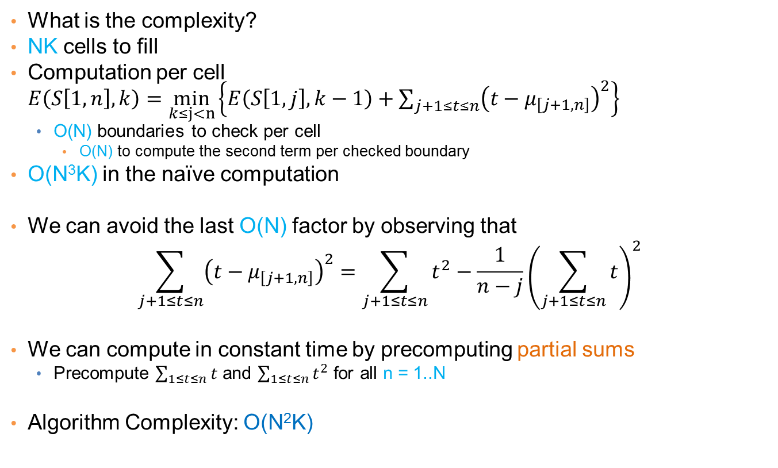
Algorithm Complexity
What is the complexity?
NK cells to fill
Computation per cell $E\left(S\left[1,n\right],k\right)=\min_{k≤j<n}\left\{E\left(S\left[1,j\right],k−1\right)+\sum_{j+1≤t≤n}{{\left(t−μ_{\left[j+1,n\right]}\right)}^{2}}\right\}$
O(N) boundaries to check per cell
O(N) to compute the second term per checked boundary
O(N³K) in the naïve computation
We can avoid the last O(N) factor by observing that
$$\sum_{j+1≤t≤n}{{\left(t−μ_{\left[j+1,n\right]}\right)}^{2}}=\sum_{j+1≤t≤n}{t^{2}}−\frac{1}{n−j}{\left(\sum_{j+1≤t≤n}{t}\right)}^{2}$$
We can compute in constant time by precomputing partial sums
Precompute $\sum_{1≤t≤n}{t}$ and $\sum_{1≤t≤n}{t^{2}}$ for all n = 1..N
Algorithm Complexity: O(N²K)

Slide 22
Heuristics
Top-down greedy (TD): O(NK)
Introduce boundaries one at the time so that you get the largest decrease in error, until K segments are created.
Bottom-up greedy (BU): O(NlogN)
Merge adjacent points each time selecting the two points that cause the smallest increase in the error until K segments
Local Search Heuristics: O(NKI)
Assign the breakpoints randomly and then move them so that you reduce the error

Slide 23
Other time series analysis
Using signal processing techniques is common for defining similarity between series
Fast Fourier Transform
Wavelets
Rich literature in the field

