Slide 1
DATA MINING
LECTURE 7
Hierarchical Clustering, DBSCAN
The EM Algorithm

Slide 2
CLUSTERING

Slide 3
What is a Clustering?
In general a grouping of objects such that the objects in a group (cluster) are similar (or related) to one another and different from (or unrelated to) the objects in other groups
Inter-cluster distances are maximized
Intra-cluster distances are minimized

Slide 4
Clustering Algorithms
K-means and its variants
Hierarchical clustering
DBSCAN

Slide 5
HIERARCHICAL CLUSTERING

Slide 6
Hierarchical Clustering
Two main types of hierarchical clustering
  Agglomerative:
    Start with the points as individual clusters
    At each step, merge the closest pair of clusters until only one cluster (or k clusters) left
  Divisive:
    Start with one, all-inclusive cluster
    At each step, split a cluster until each cluster contains a point (or there are k clusters)
Traditional hierarchical algorithms use a similarity or distance matrix
  Merge or split one cluster at a time

Slide 7
Hierarchical Clustering
Produces a set of nested clusters organized as a hierarchical tree
Can be visualized as a dendrogram
  A tree like diagram that records the sequences of merges or splits

Slide 8
Strengths of Hierarchical Clustering
Do not have to assume any particular number of clusters
  Any desired number of clusters can be obtained by ‘cutting’ the dendogram at the proper level
They may correspond to meaningful taxonomies
  Example in biological sciences (e.g., animal kingdom, phylogeny reconstruction, …)

Slide 9
Agglomerative Clustering Algorithm
More popular hierarchical clustering technique
Basic algorithm is straightforward
  Compute the proximity matrix
  Let each data point be a cluster
  Repeat
  Merge the two closest clusters
  Update the proximity matrix
  Until only a single cluster remains
Key operation is the computation of the proximity of two clusters
  Different approaches to defining the distance between clusters distinguish the different algorithms

Slide 10
Starting Situation
Start with clusters of individual points and a proximity matrix
p1
p2
p3
p4
p5
. . .
p1
p2
p3
p4
p5
.
.
.
Proximity Matrix

Slide 11
Intermediate Situation
After some merging steps, we have some clusters
C1
C2
C3
C4
C5
C1
C2
C3
C3
C4
C4
C5
C1
Proximity Matrix
C2
C5

Slide 12
Intermediate Situation
We want to merge the two closest clusters (C2 and C5) and update the proximity matrix.
C1
C2
C3
C4
C5
C1
C2
C3
C3
C4
C4
C5
Proximity Matrix
C1
C2
C5

Slide 13
After Merging
The question is “How do we update the proximity matrix?”
C2 U C5
C1
C3
C4
C1
?
C2 U C5
? ? ? ?
C3
C3
?
C4
C4
?
C1
Proximity Matrix
C2 U C5

Slide 14
How to Define Inter-Cluster Similarity
p1
p2
p3
p4
p5
. . .
p1
Similarity?
p2
p3
p4
p5
MIN
MAX
Group Average
Distance Between Centroids
Other methods driven by an objective function
  Ward’s Method uses squared error
.
.
.
Proximity Matrix

Slide 15
How to Define Inter-Cluster Similarity
p1
p2
p3
p4
p5
. . .
p1
p2
p3
p4
p5
MIN
MAX
Group Average
Distance Between Centroids
Other methods driven by an objective function
  Ward’s Method uses squared error
.
.
.
Proximity Matrix

Slide 16
How to Define Inter-Cluster Similarity
p1
p2
p3
p4
p5
. . .
p1
p2
p3
p4
p5
MIN
MAX
Group Average
Distance Between Centroids
Other methods driven by an objective function
  Ward’s Method uses squared error
.
.
.
Proximity Matrix

Slide 17
How to Define Inter-Cluster Similarity
p1
p2
p3
p4
p5
. . .
p1
p2
p3
p4
p5
MIN
MAX
Group Average
Distance Between Centroids
Other methods driven by an objective function
  Ward’s Method uses squared error
.
.
.
Proximity Matrix

Slide 18
How to Define Inter-Cluster Similarity
p1
p2
p3
p4
p5
. . .
p1
×
×
p2
p3
p4
p5
MIN
MAX
Group Average
Distance Between Centroids
Other methods driven by an objective function
  Ward’s Method uses squared error
.
.
.
Proximity Matrix

Slide 19
Single Link – Complete Link
Another way to view the processing of the hierarchical algorithm is that we create links between their elements in order of increasing distance
  The MIN – Single Link, will merge two clusters when a single pair of elements is linked
  The MAX – Complete Linkage will merge two clusters when all pairs of elements have been linked.

Slide 20
Hierarchical Clustering: MIN
 | 1 | 2 | 3 | 4 | 5 | 6
1 | 0 | .24 | .22 | .37 | .34 | .23
2 | .24 | 0 | .15 | .20 | .14 | .25
3 | .22 | .15 | 0 | .15 | .28 | .11
4 | .37 | .20 | .15 | 0 | .29 | .22
5 | .34 | .14 | .28 | .29 | 0 | .39
6 | .23 | .25 | .11 | .22 | .39 | 0
5
1
3
5
2
1
2
3
6
4
4
Nested Clusters
Dendrogram

Slide 21
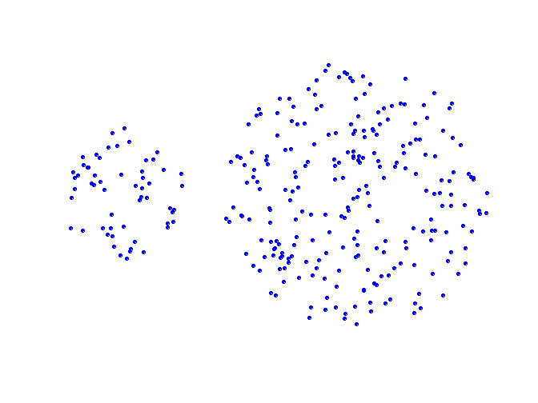
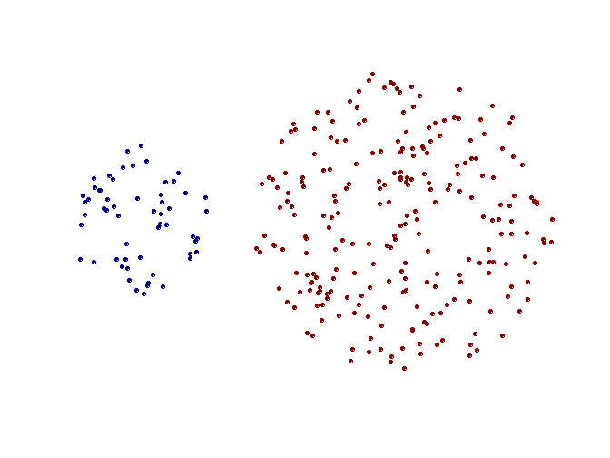
Strength of MIN
Original Points
Two Clusters
Can handle non-elliptical shapes

Slide 22
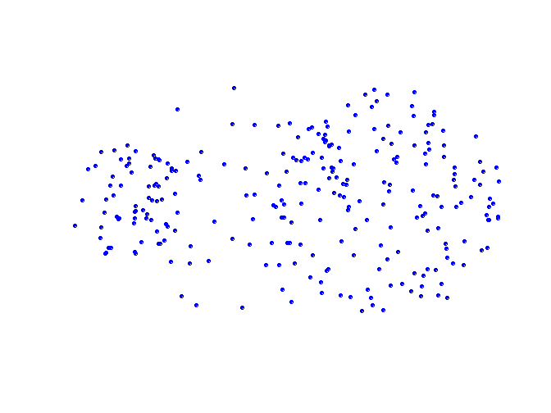
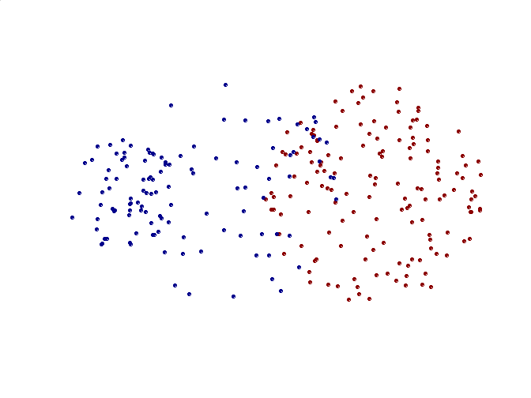
Limitations of MIN
Original Points
Two Clusters
Sensitive to noise and outliers

Slide 23
Hierarchical Clustering: MAX
 | 1 | 2 | 3 | 4 | 5 | 6
1 | 0 | .24 | .22 | .37 | .34 | .23
2 | .24 | 0 | .15 | .20 | .14 | .25
3 | .22 | .15 | 0 | .15 | .28 | .11
4 | .37 | .20 | .15 | 0 | .29 | .22
5 | .34 | .14 | .28 | .29 | 0 | .39
6 | .23 | .25 | .11 | .22 | .39 | 0
4
1
2
5
5
2
3
6
3
1
4
Nested Clusters
Dendrogram

Slide 24
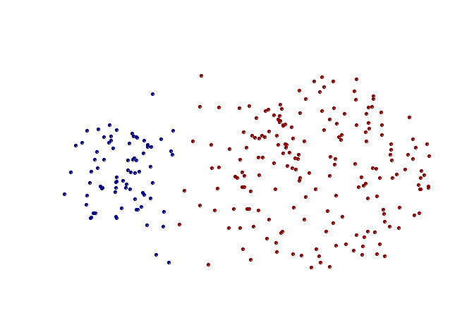
Strength of MAX
Original Points
Two Clusters
Less susceptible to noise and outliers

Slide 25
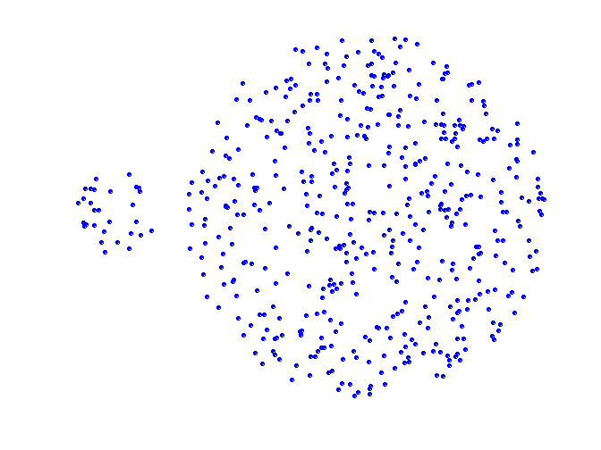
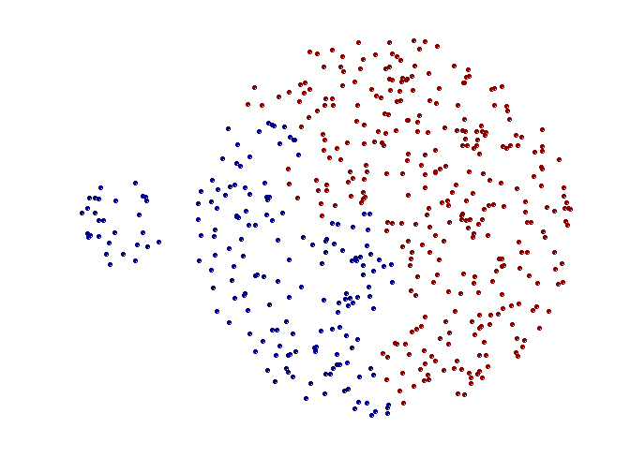
Limitations of MAX
Original Points
Two Clusters
Tends to break large clusters
Biased towards globular clusters

Slide 26
Cluster Similarity: Group Average
Proximity of two clusters is the average of pairwise proximity between points in the two clusters.
Need to use average connectivity for scalability since total proximity favors large clusters
 | 1 | 2 | 3 | 4 | 5 | 6
1 | 0 | .24 | .22 | .37 | .34 | .23
2 | .24 | 0 | .15 | .20 | .14 | .25
3 | .22 | .15 | 0 | .15 | .28 | .11
4 | .37 | .20 | .15 | 0 | .29 | .22
5 | .34 | .14 | .28 | .29 | 0 | .39
6 | .23 | .25 | .11 | .22 | .39 | 0

Slide 27
Hierarchical Clustering: Group Average
 | 1 | 2 | 3 | 4 | 5 | 6
1 | 0 | .24 | .22 | .37 | .34 | .23
2 | .24 | 0 | .15 | .20 | .14 | .25
3 | .22 | .15 | 0 | .15 | .28 | .11
4 | .37 | .20 | .15 | 0 | .29 | .22
5 | .34 | .14 | .28 | .29 | 0 | .39
6 | .23 | .25 | .11 | .22 | .39 | 0
5
4
1
2
5
2
3
6
1
4
3
Nested Clusters
Dendrogram

Slide 28
Hierarchical Clustering: Group Average
Compromise between Single and Complete Link
Strengths
  Less susceptible to noise and outliers
Limitations
  Biased towards globular clusters

Slide 29
Cluster Similarity: Ward’s Method
Similarity of two clusters is based on the increase in squared error (SSE) when two clusters are merged
  Similar to group average if distance between points is distance squared
Less susceptible to noise and outliers
Biased towards globular clusters
Hierarchical analogue of K-means
  Can be used to initialize K-means

Slide 30
Hierarchical Clustering: Comparison
5
1
4
1
3
2
5
5
5
2
1
MIN
2
MAX
2
3
6
3
3
6
1
4
4
4
5
5
1
4
1
2
2
5
2
Ward’s Method
5
2
3
6
Group Average
3
3
6
4
1
1
4
4
3

Slide 31
Hierarchical Clustering:
Time and Space requirements
O(N²) space since it uses the proximity matrix.
  N is the number of points.
O(N³) time in many cases
  There are N steps and at each step the size, N², proximity matrix must be updated and searched
  Complexity can be reduced to O(N² log(N) ) time for some approaches

Slide 32
Hierarchical Clustering:
Problems and Limitations
Computational complexity in time and space
Once a decision is made to combine two clusters, it cannot be undone
No objective function is directly minimized
Different schemes have problems with one or more of the following:
  Sensitivity to noise and outliers
  Difficulty handling different sized clusters and convex shapes
  Breaking large clusters

Slide 33
DBSCAN

Slide 34
DBSCAN: Density-Based Clustering
DBSCAN is a Density-Based Clustering algorithm
Reminder: In density based clustering we partition points into dense regions separated by not-so-dense regions.
Important Questions:
  How do we measure density?
  What is a dense region?
DBSCAN:
  Density at point p: number of points within a circle of radius Eps
  Dense Region: A circle of radius Eps that contains at least MinPts points

Slide 35
DBSCAN
Characterization of points
  A point is a core point if it has more than a specified number of points (MinPts) within Eps
    These points belong in a dense region and are at the interior of a cluster
  A border point has fewer than MinPts within Eps, but is in the neighborhood of a core point.
  A noise point is any point that is not a core point or a border point.

Slide 36
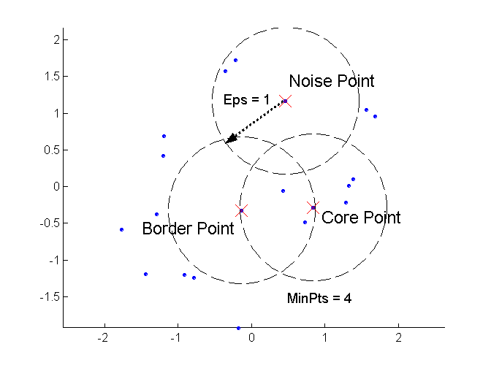
DBSCAN: Core, Border, and Noise Points

Slide 37
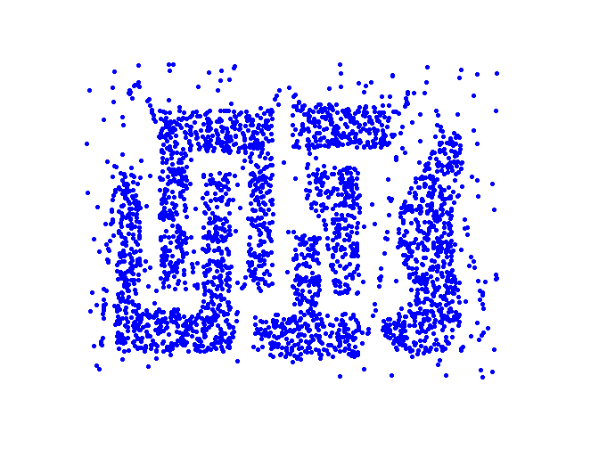
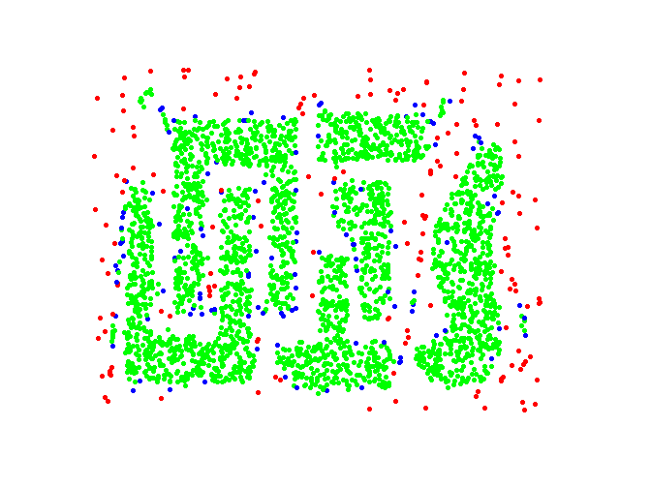
DBSCAN: Core, Border and Noise Points
Point types: core, border and noise
Original Points
Eps = 10, MinPts = 4

Slide 38
Density-Connected points
Density edge
  We place an edge between two core points q and p if they are within distance Eps.
Density-connected
  A point p is density-connected to a point q if there is a path of edges from p to q
p
p₁
q
p
q
o

Slide 39
DBSCAN Algorithm
Label points as core, border and noise
Eliminate noise points
For every core point p that has not been assigned to a cluster
  Create a new cluster with the point p and all the points that are density-connected to p.
Assign border points to the cluster of the closest core point.

Slide 40
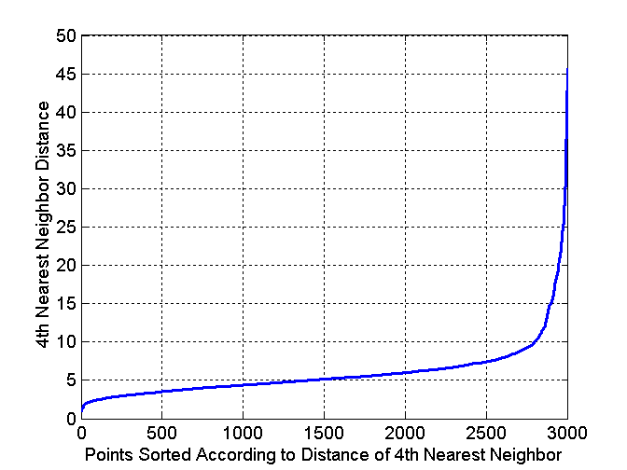
DBSCAN: Determining Eps and MinPts
Idea is that for points in a cluster, their k^{th} nearest neighbors are at roughly the same distance
Noise points have the k^{th} nearest neighbor at farther distance
So, plot sorted distance of every point to its k^{th} nearest neighbor
Find the distance d where there is a “knee” in the curve
  Eps = d, MinPts = k
Eps ~ 7-10
MinPts = 4

Slide 41
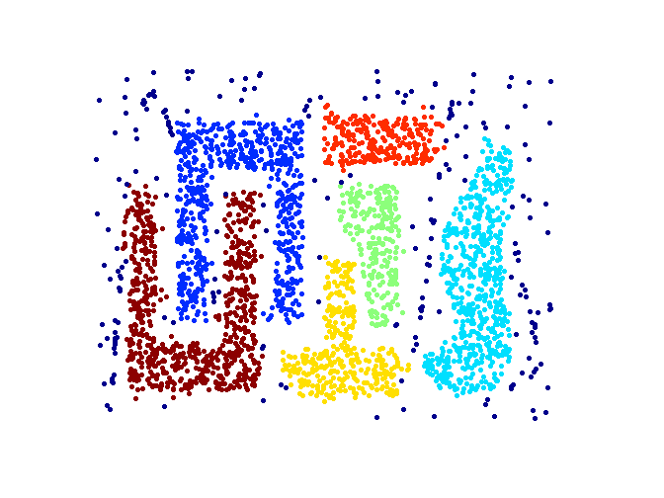
When DBSCAN Works Well
Original Points
Clusters
Resistant to Noise
Can handle clusters of different shapes and sizes

Slide 42
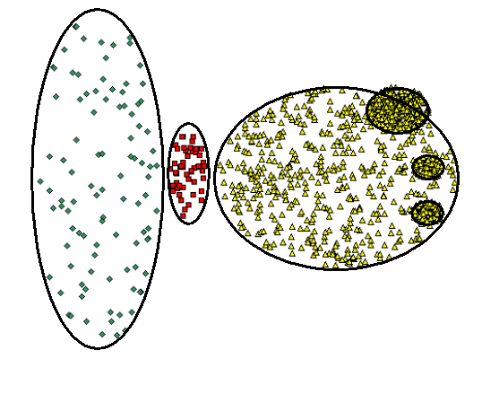
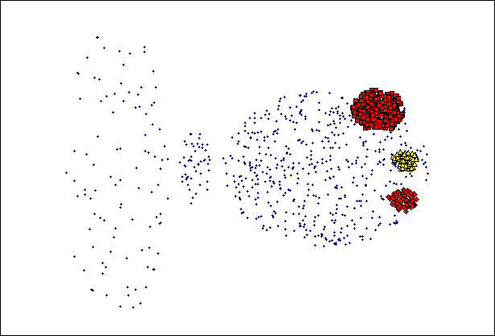
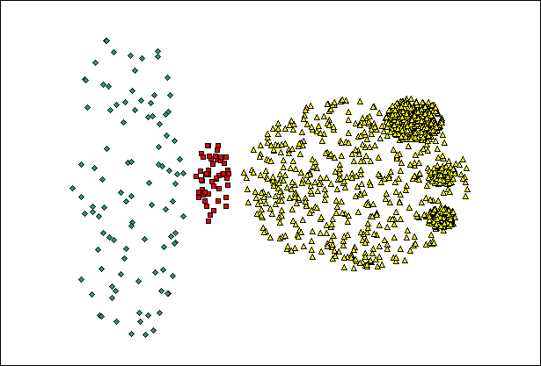
When DBSCAN Does NOT Work Well
(MinPts=4, Eps=9.75).
Original Points
Varying densities
High-dimensional data
(MinPts=4, Eps=9.92)

Slide 43
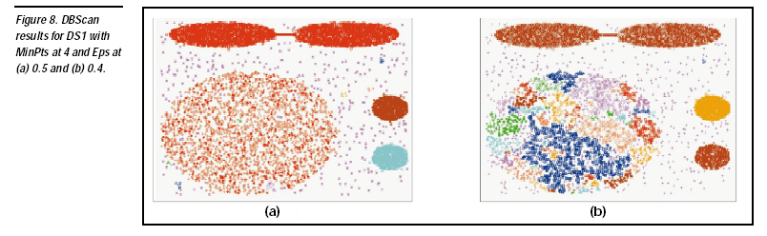

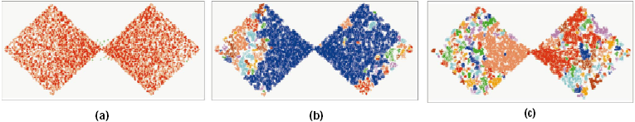
DBSCAN: Sensitive to Parameters

Slide 44
Other algorithms
PAM, CLARANS: Solutions for the k-medoids problem
BIRCH: Constructs a hierarchical tree that acts a summary of the data, and then clusters the leaves.
MST: Clustering using the Minimum Spanning Tree.
ROCK: clustering categorical data by neighbor and link analysis
LIMBO, COOLCAT: Clustering categorical data using information theoretic tools.
CURE: Hierarchical algorithm uses different representation of the cluster
CHAMELEON: Hierarchical algorithm uses closeness and interconnectivity for merging

Slide 45
Mixture Models and the EM Algorithm

Slide 46
Model-based clustering
In order to understand our data, we will assume that there is a generative process (a model) that creates/describes the data, and we will try to find the model that best fits the data.
  Models of different complexity can be defined, but we will assume that our model is a distribution from which data points are sampled
  Example: the data is the height of all people in Greece
In most cases, a single distribution is not good enough to describe all data points: different parts of the data follow a different distribution
  Example: the data is the height of all people in Greece and China
  We need a mixture model
  Different distributions correspond to different clusters in the data.

Slide 47
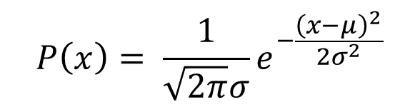
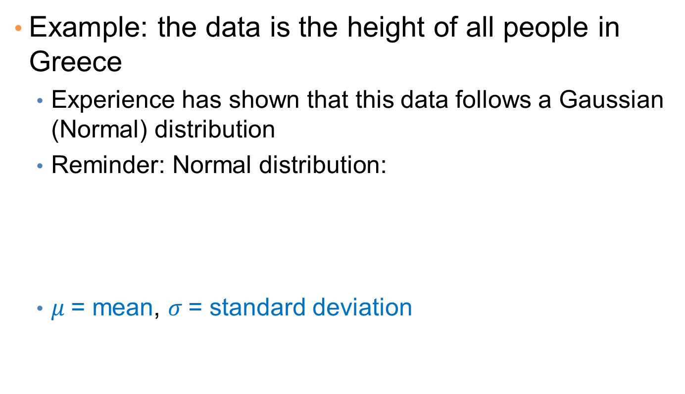
Gaussian Distribution
Example: the data is the height of all people in Greece
  Experience has shown that this data follows a Gaussian (Normal) distribution
  Reminder: Normal distribution:
  $μ$= mean, $σ$= standard deviation
$$P\left(x\right)= \frac{1}{\sqrt{2π}σ}e^{−\frac{{\left(x−μ\right)}^{2}}{2σ^{2}}}$$

Slide 48
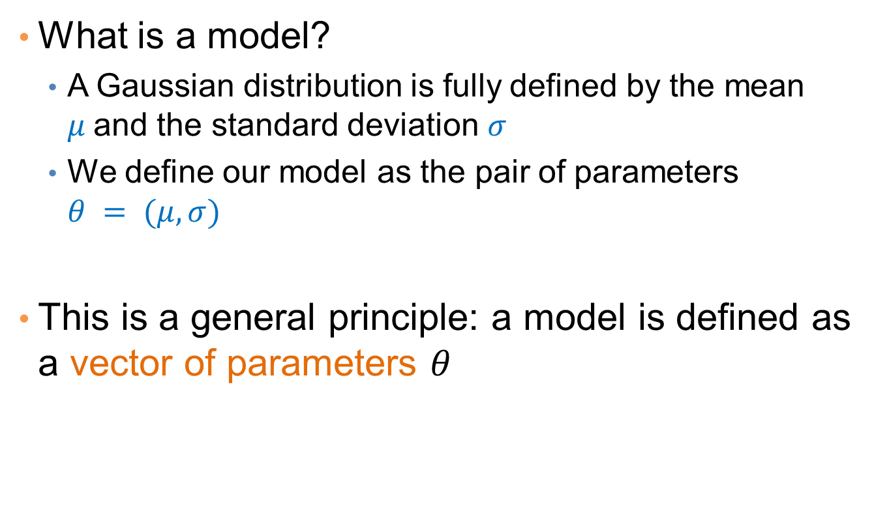
Gaussian Model
What is a model?
  A Gaussian distribution is fully defined by the mean $μ$and the standard deviation $σ$
  We define our model as the pair of parameters $θ = (μ, σ)$
This is a general principle: a model is defined as a vector of parameters $θ$

Slide 49

Fitting the model
We want to find the normal distribution that best fits our data
  Find the best values for $μ$and $σ$
  But what does best fit mean?

Slide 50
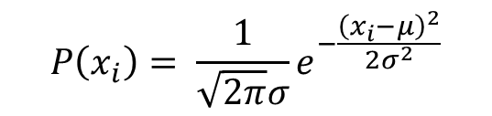
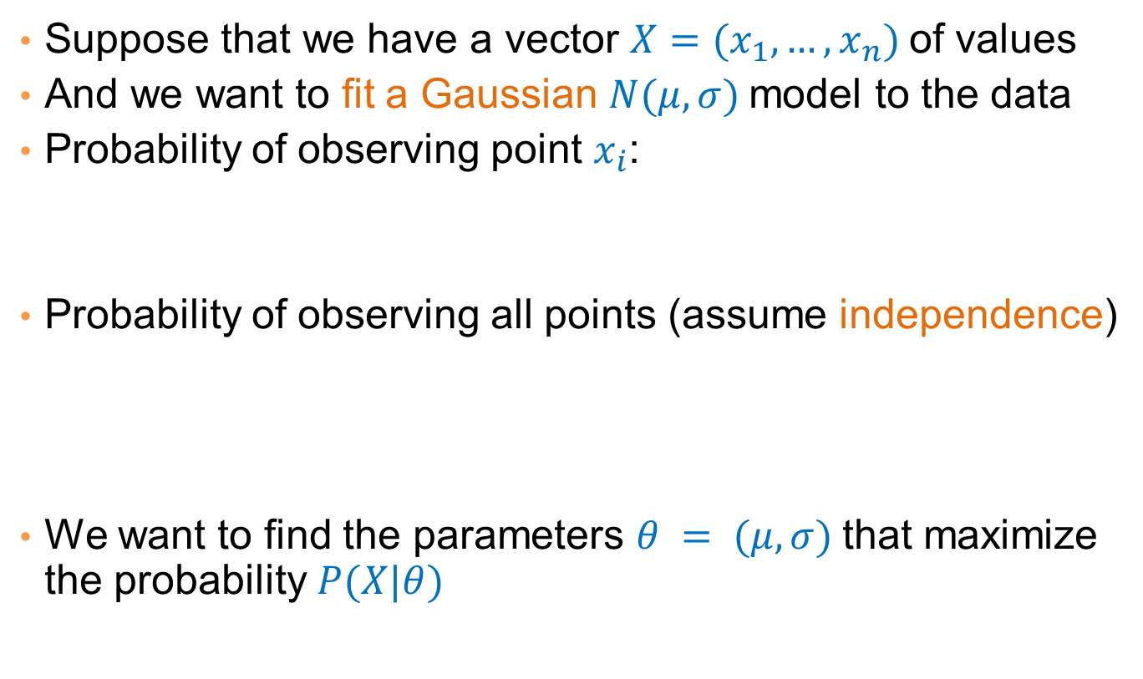
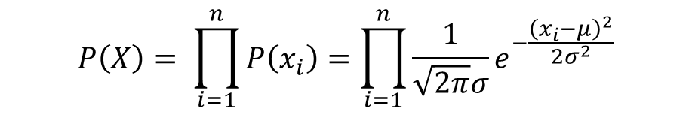
Maximum Likelihood Estimation (MLE)
Suppose that we have a vector $X=(x_{1},…,x_{n})$of values
And we want to fit a Gaussian $N(μ,σ)$model to the data
Probability of observing point $x_{i}$:
Probability of observing all points (assume independence)
We want to find the parameters $θ = (μ, σ)$that maximize the probability $P(X|θ)$
$$P\left(x_{i}\right)= \frac{1}{\sqrt{2π}σ}e^{−\frac{{\left(x_{i}−μ\right)}^{2}}{2σ^{2}}}$$
$$P\left(X\right)= \prod_{i=1}^{n}{P\left(x_{i}\right)}=\prod_{i=1}^{n}{\frac{1}{\sqrt{2π}σ}e^{−\frac{{\left(x_{i}−μ\right)}^{2}}{2σ^{2}}}}$$

Slide 51

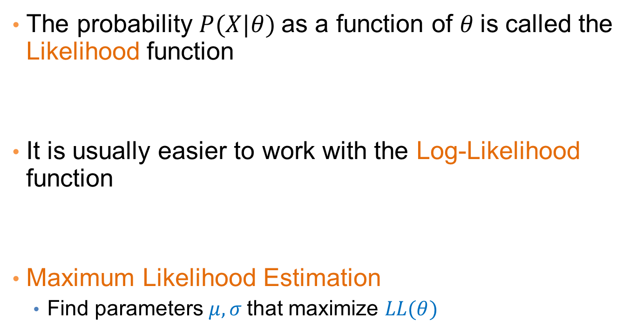
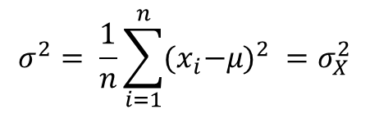
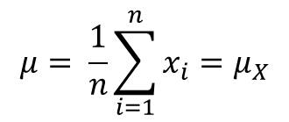
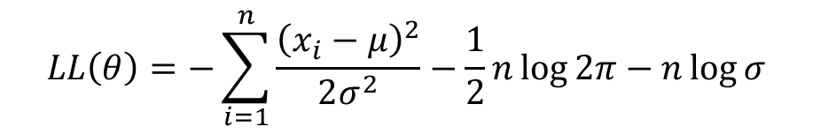
Maximum Likelihood Estimation (MLE)
The probability $P(X|θ)$as a function of $θ$is called the Likelihood function
It is usually easier to work with the Log-Likelihood function
Maximum Likelihood Estimation
  Find parameters $μ, σ$that maximize $LL(θ)$
$$L(θ)=\prod_{i=1}^{n}{\frac{1}{\sqrt{2π}σ}e^{−\frac{{\left(x_{i}−μ\right)}^{2}}{2σ^{2}}}}$$
$$LL\left(θ\right)=−\sum_{i=1}^{n}{\frac{{\left(x_{i}−μ\right)}^{2}}{2σ^{2}}−\frac{1}{2}n\log{2π}−n\log{σ}}$$
$$μ= \frac{1}{n}\sum_{i=1}^{n}{x_{i}=μ_{X}}$$
$$σ^{2}= \frac{1}{n}\sum_{i=1}^{n}{{{(x}_{i}−μ)}^{2} }=σ_{X}^{2}$$
Sample Mean
Sample Variance

Slide 52
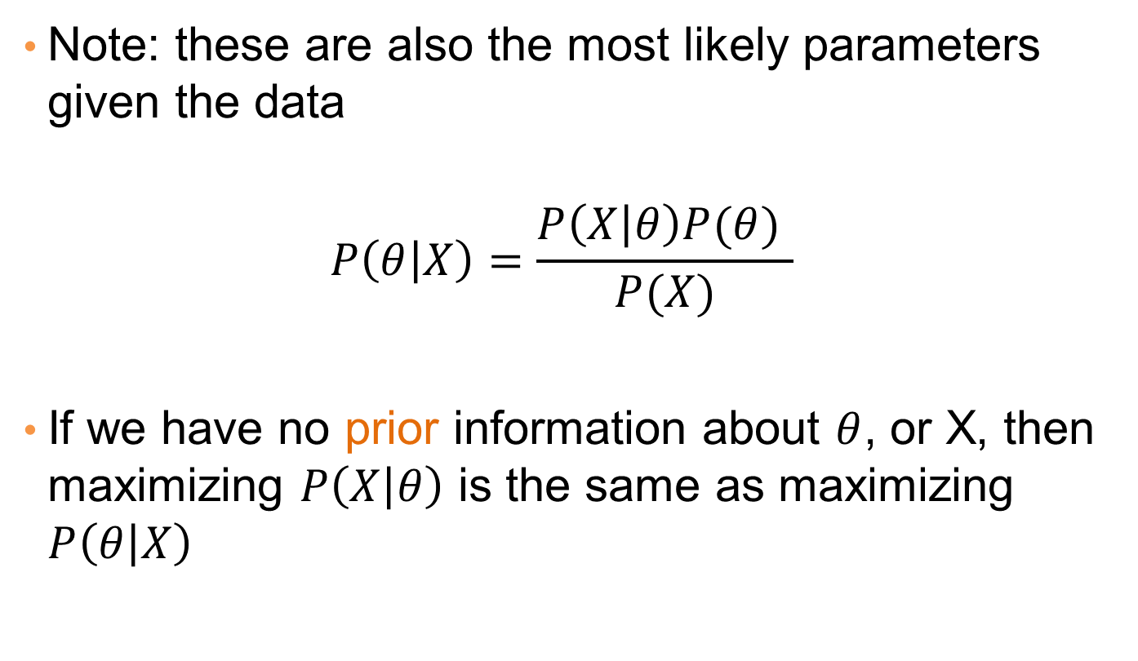
MLE
Note: these are also the most likely parameters given the data
$$P\left(θ | X\right)=\frac{P\left(X | θ\right)P(θ) }{P(X)}$$
If we have no prior information about $θ$, or X, then maximizing $P\left(X | θ\right)$ is the same as maximizing $P\left(θ | X\right)$

Slide 53
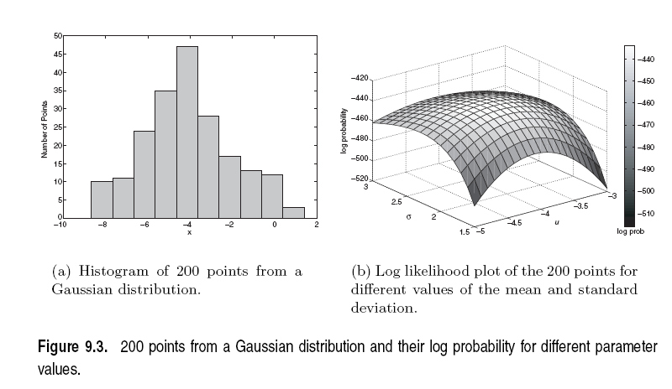

Slide 54
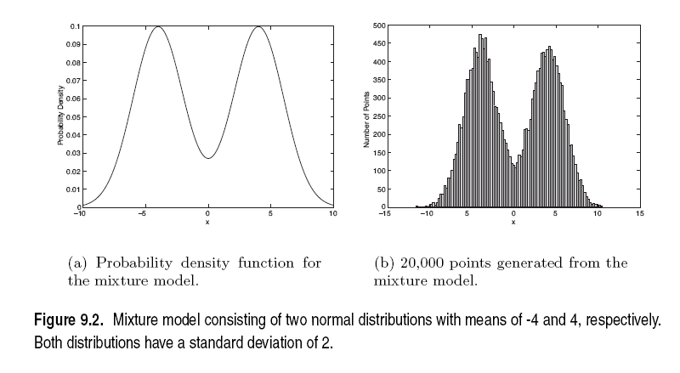
Mixture of Gaussians
Suppose that you have the heights of people from Greece and China and the distribution looks like the figure below (dramatization)

Slide 55
Mixture of Gaussians
In this case the data is the result of the mixture of two Gaussians
  One for Greek people, and one for Chinese people
  Identifying for each value which Gaussian is most likely to have generated it will give us a clustering.

Slide 56
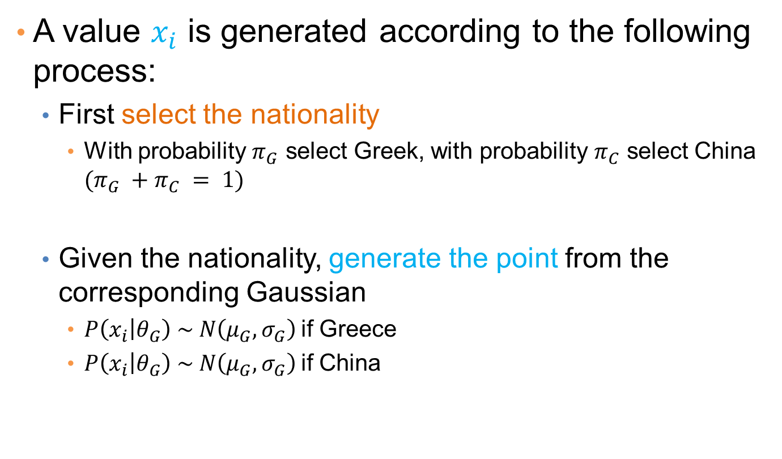
Mixture model
A value $x_{i}$ is generated according to the following process:
  First select the nationality
    With probability $π_{G}$ select Greek, with probability $π_{C}$ select China $(π_{G} +π_{C} = 1)$
  Given the nationality, generate the point from the corresponding Gaussian
    $P\left(x_{i} | θ_{G}\right) \sim N\left(μ_{G},σ_{G}\right)$if Greece
    $P\left(x_{i} | θ_{G}\right) \sim N\left(μ_{G},σ_{G}\right)$if China
We can also thing of this as a Hidden Variable Z

Slide 57
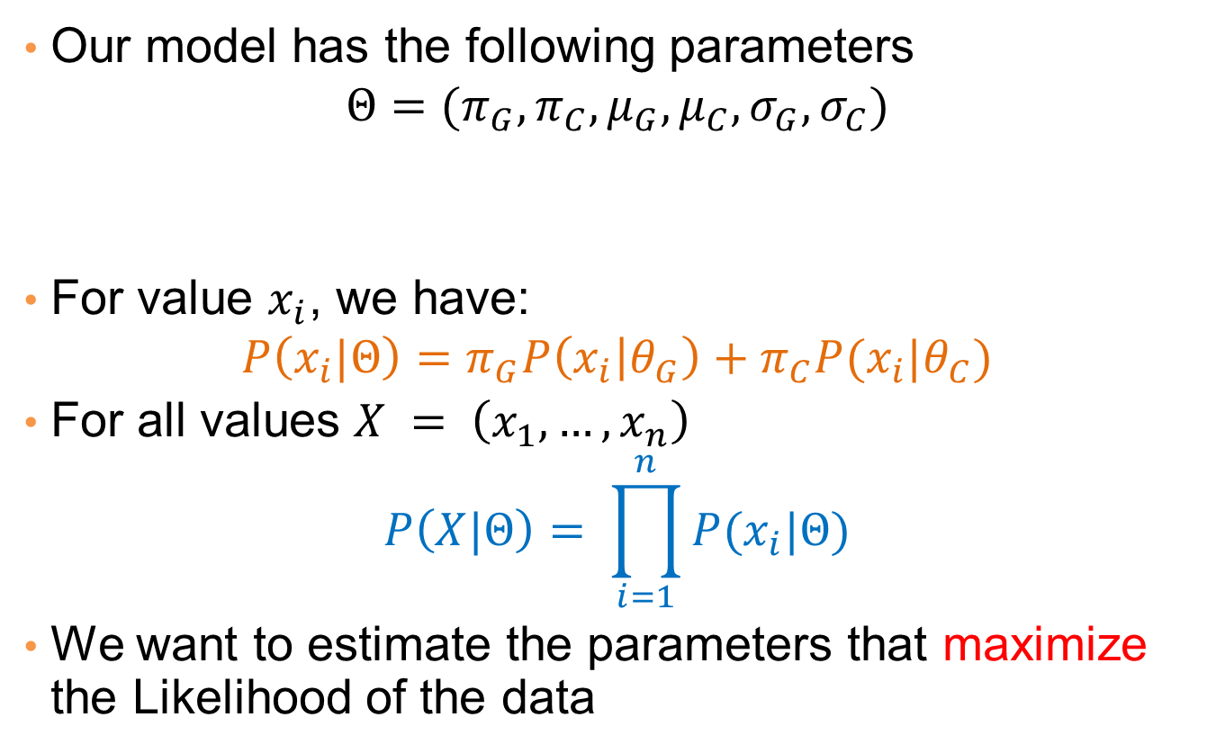
Mixture Model
Our model has the following parameters
$$Θ=(π_{G},π_{C},μ_{G},μ_{C}, σ_{G},σ_{C})$$
For value $x_{i}$, we have:
$$P\left(x_{i}|Θ\right)=π_{G}P\left(x_{i} | θ_{G}\right)+π_{C}P(x_{i}|θ_{C})$$
For all values $X = \left(x_{1},…,x_{n}\right)$
$$P\left(X|Θ\right)= \prod_{i=1}^{n}{P(x_{i}|Θ)}$$
We want to estimate the parameters that maximize the Likelihood of the data
Mixture probabilities
Distribution Parameters

Slide 58
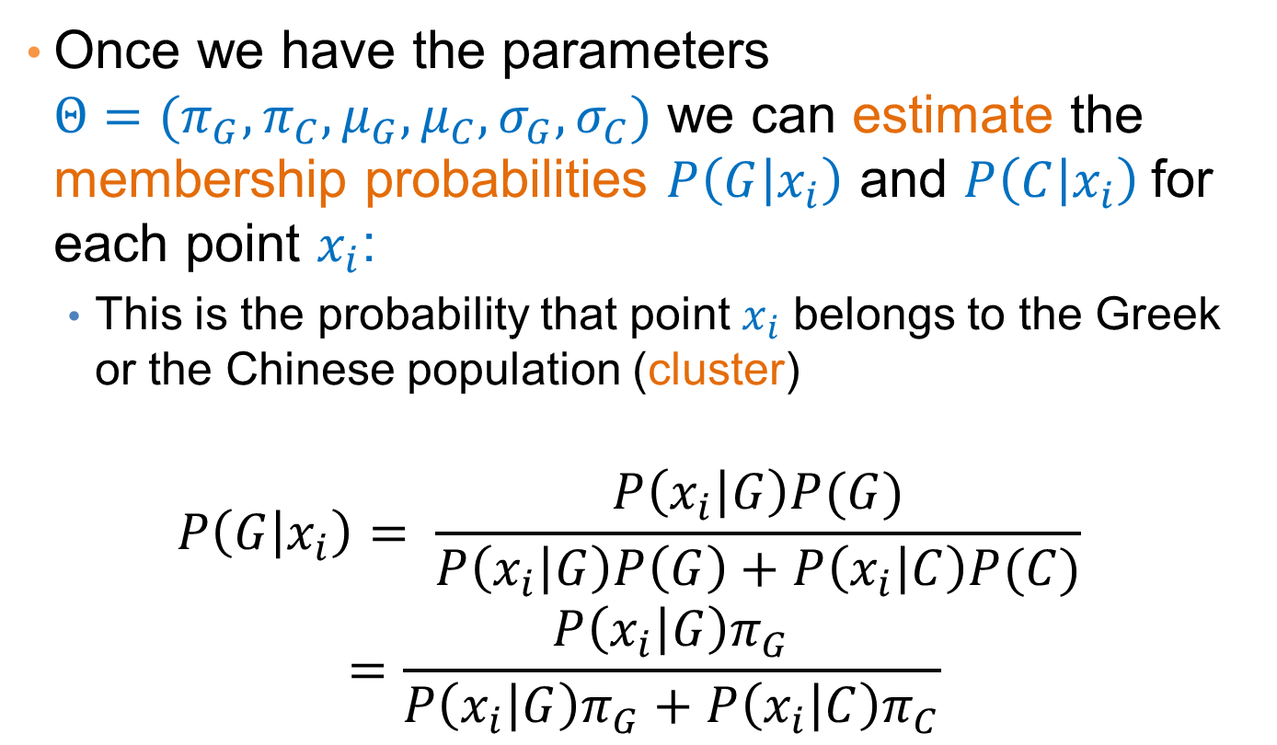
Mixture Models
Once we have the parameters $Θ=(π_{G},π_{C},μ_{G},μ_{C}, σ_{G},σ_{C})$ we can estimate the membership probabilities $P\left(G | x_{i}\right)$ and $P\left(C | x_{i}\right)$for each point $x_{i}$:
  This is the probability that point $x_{i}$ belongs to the Greek or the Chinese population (cluster)
$$P\left(G | x_{i}\right)= \frac{P\left(x_{i} | G\right)P(G)}{P\left(x_{i} | G\right)P\left(G\right)+P\left(x_{i} | C\right)P(C)} =\frac{P\left(x_{i} | G\right)π_{G}}{P\left(x_{i} | G\right)π_{G}+P\left(x_{i} | C\right)π_{C}}$$

Slide 59
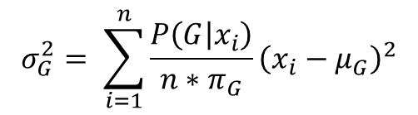
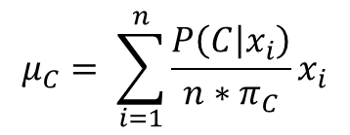
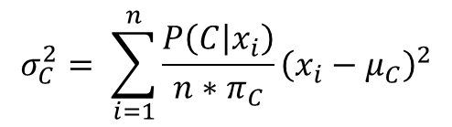
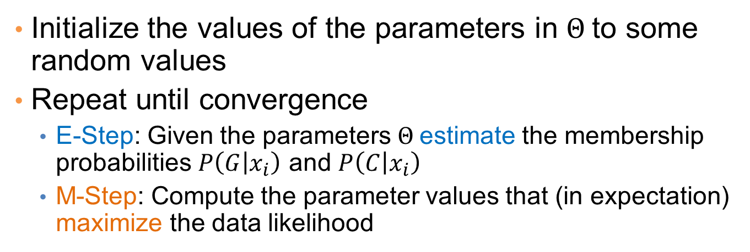
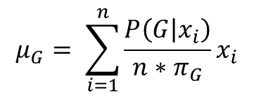
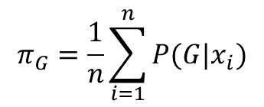
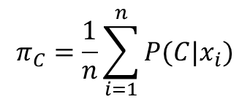
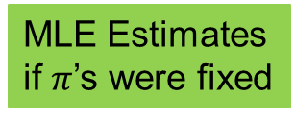
EM (Expectation Maximization) Algorithm
Initialize the values of the parameters in $Θ$to some random values
Repeat until convergence
  E-Step: Given the parameters $Θ$estimate the membership probabilities $P\left(G | x_{i}\right)$ and $P\left(C | x_{i}\right)$
  M-Step: Compute the parameter values that (in expectation) maximize the data likelihood
$$π_{G}=\frac{1}{n}\sum_{i=1}^{n}{P(G|x_{i})}$$
$$π_{C}=\frac{1}{n}\sum_{i=1}^{n}{P(C|x_{i})}$$
Fraction of population in G,C
$$μ_{C}= \sum_{i=1}^{n}{\frac{P\left(C | x_{i}\right)}{n{∗π}_{C}}x_{i}}$$
$$μ_{G}= \sum_{i=1}^{n}{\frac{P\left(G | x_{i}\right)}{n{∗π}_{G}}x_{i}}$$
MLE Estimates
if $π$’s were fixed
$$σ_{C}^{2}= \sum_{i=1}^{n}{\frac{P\left(C | x_{i}\right)}{n{∗π}_{C}}{\left(x_{i}−μ_{C}\right)}^{2}}$$
$$σ_{G}^{2}= \sum_{i=1}^{n}{\frac{P\left(G | x_{i}\right)}{n{∗π}_{G}}{\left(x_{i}−μ_{G}\right)}^{2}}$$

Slide 60
Relationship to K-means
E-Step: Assignment of points to clusters
  K-means: hard assignment, EM: soft assignment
M-Step: Computation of centroids
  K-means assumes common fixed variance (spherical clusters)
  EM: can change the variance for different clusters or different dimensions (elipsoid clusters)
If the variance is fixed then both minimize the same error function

Slide 61
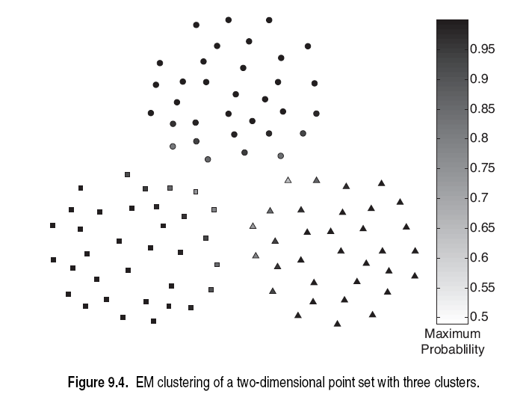

Slide 62
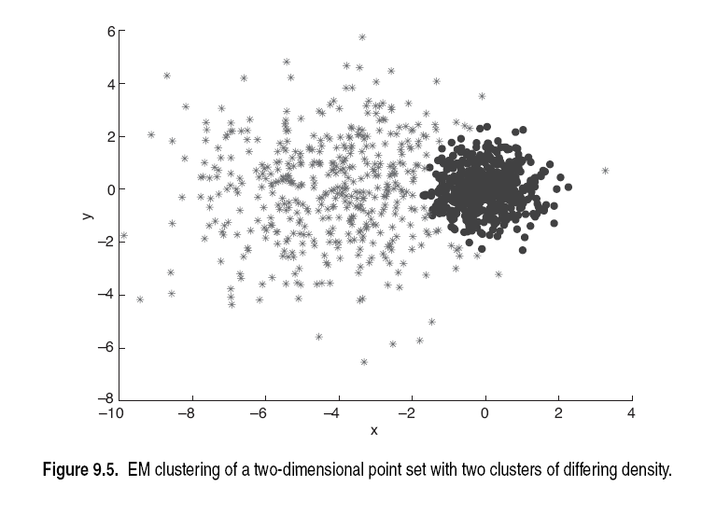

Slide 63
