Slide 1
DATA MINING
LECTURE 6
Min-Hashing, Locality Sensitive Hashing
Clustering

Slide 2
MIN-HASHING
AND
LOCALITY SENSITIVE HASHING
Thanks to:
Rajaraman and Ullman, “Mining Massive Datasets”
Evimaria Terzi, slides for Data Mining Course.

Slide 3
Motivating problem
Find duplicate and near-duplicate documents from a web crawl.
If we wanted exact duplicates we could do this by hashing
  We will see how to adapt this technique for near duplicate documents

Slide 4
Main issues
What is the right representation of the document when we check for similarity?
  E.g., representing a document as a set of characters will not do (why?)
When we have billions of documents, keeping the full text in memory is not an option.
  We need to find a shorter representation
How do we do pairwise comparisons of billions of documents?
  If exact match was the issue it would be ok, can we replicate this idea?

Slide 5
The Big Picture
Candidate
pairs :
those pairs
of signatures
that we need
to test for
similarity.
Shingling
Minhash-
ing
Locality-
sensitive
Hashing
Docu-
ment
The set
of strings
of length k
that appear
in the doc-
ument
Signatures :
short integer
vectors that
represent the
sets, and
reflect their
similarity

Slide 6
Shingling
Shingle: a sequence of k contiguous characters
Set of Shingles
Set of 64-bit integers
Hash function
(Rabin’s fingerprints)
a rose is
rose is a
rose is a
ose is a r
se is a ro
e is a ros
is a rose
is a rose
s a rose i
a rose is
1111
2222
3333
4444
5555
6666
7777
8888
9999
0000

Slide 7
Basic Data Model: Sets
Document: A document is represented as a set shingles (more accurately, hashes of shingles)
Document similarity: Jaccard similarity of the sets of shingles.
  Common shingles over the union of shingles
  Sim (C₁, C₂) = |C₁∩C₂|/|C₁∪C₂|.
Applicable to any kind of sets.
  E.g., similar customers or items.

Slide 8
Signatures
Key idea: “hash” each set S to a small signature Sig (S), such that:
  Sig (S) is small enough that we can fit a signature in main memory for each set.
  Sim (S₁, S₂) is (almost) the same as the “similarity” of Sig (S₁) and Sig (S₂). (signature preserves similarity).
Warning: This method can produce false negatives, and false positives (if an additional check is not made).
  False negatives: Similar items deemed as non-similar
  False positives: Non-similar items deemed as similar

Slide 9
From Sets to Boolean Matrices
Represent the data as a boolean matrix M
  Rows = the universe of all possible set elements
    In our case, shingle fingerprints take values in [0…2⁶⁴-1]
  Columns = the sets
    In our case, documents, sets of shingle fingerprints
  M(r,S) = 1 in row r and column S if and only if r is a member of S.
Typical matrix is sparse.
  We do not really materialize the matrix

Slide 10
Minhashing
Pick a random permutation of the rows (the universe U).
Define “hash” function for set S
  h(S) = the index of the first row (in the permuted order) in which column S has 1.
  OR
  h(S) = the index of the first element of S in the permuted order.
Use k (e.g., k = 100) independent random permutations to create a signature.

Slide 11
Example of minhash signatures
Input matrix
 | S₁ | S₂ | S₃ | S₄
A | 1 | 0 | 1 | 0
B | 1 | 0 | 0 | 1
C | 0 | 1 | 0 | 1
D | 0 | 1 | 0 | 1
E | 0 | 1 | 0 | 1
F | 1 | 0 | 1 | 0
G | 1 | 0 | 1 | 0
 |  | S₁ | S₂ | S₃ | S₄
1 | A | 1 | 0 | 1 | 0
2 | C | 0 | 1 | 0 | 1
3 | G | 1 | 0 | 1 | 0
4 | F | 1 | 0 | 1 | 0
5 | B | 1 | 0 | 0 | 1
6 | E | 0 | 1 | 0 | 1
7 | D | 0 | 1 | 0 | 1
A
C
G
F
B
E
D
1 | 2 | 1 | 2

Slide 12
Example of minhash signatures
Input matrix
 | S₁ | S₂ | S₃ | S₄
A | 1 | 0 | 1 | 0
B | 1 | 0 | 0 | 1
C | 0 | 1 | 0 | 1
D | 0 | 1 | 0 | 1
E | 0 | 1 | 0 | 1
F | 1 | 0 | 1 | 0
G | 1 | 0 | 1 | 0
 |  | S₁ | S₂ | S₃ | S₄
1 | D | 0 | 1 | 0 | 1
2 | B | 1 | 0 | 0 | 1
3 | A | 1 | 0 | 1 | 0
4 | C | 0 | 1 | 0 | 1
5 | F | 1 | 0 | 1 | 0
6 | G | 1 | 0 | 1 | 0
7 | E | 0 | 1 | 0 | 1
D
B
A
C
F
G
E
2 | 1 | 3 | 1

Slide 13
Example of minhash signatures
Input matrix
 | S₁ | S₂ | S₃ | S₄
A | 1 | 0 | 1 | 0
B | 1 | 0 | 0 | 1
C | 0 | 1 | 0 | 1
D | 0 | 1 | 0 | 1
E | 0 | 1 | 0 | 1
F | 1 | 0 | 1 | 0
G | 1 | 0 | 1 | 0
 |  | S₁ | S₂ | S₃ | S₄
1 | C | 0 | 1 | 0 | 1
2 | D | 0 | 1 | 0 | 1
3 | G | 1 | 0 | 1 | 0
4 | F | 1 | 0 | 1 | 0
5 | A | 1 | 0 | 1 | 0
6 | B | 1 | 0 | 0 | 1
7 | E | 0 | 1 | 0 | 1
C
D
G
F
A
B
E
3 | 1 | 3 | 1

Slide 14
Example of minhash signatures
Input matrix
 | S₁ | S₂ | S₃ | S₄
A | 1 | 0 | 1 | 0
B | 1 | 0 | 0 | 1
C | 0 | 1 | 0 | 1
D | 0 | 1 | 0 | 1
E | 0 | 1 | 0 | 1
F | 1 | 0 | 1 | 0
G | 1 | 0 | 1 | 0
Signature matrix
 | S₁ | S₂ | S₃ | S₄
h₁ | 1 | 2 | 1 | 2
h₂ | 2 | 1 | 3 | 1
h₃ | 3 | 1 | 3 | 1
≈
Sig(S) = vector of hash values
  e.g., Sig(S₂) = [2,1,1]
Sig(S,i) = value of the i-th hash function for set S
  E.g., Sig(S₂,3) = 1

Slide 15
Hash function Property
Pr(h(S₁) = h(S₂)) = Sim(S₁,S₂)
where the probability is over all choices of permutations.
Why?
  The first row where one of the two sets has value 1 belongs to the union.
    Recall that union contains rows with at least one 1.
  We have equality if both sets have value 1, and this row belongs to the intersection

Slide 16
Example
Universe: U = {A,B,C,D,E,F,G}
X = {A,B,F,G}
Y = {A,E,F,G}
Union =
{A,B,E,F,G}
Intersection =
{A,F,G}
Rows C,D could be anywhere they do not affect the probability
 | X | Y
A | 1 | 1
B | 1 | 0
C | 0 | 0
D | 0 | 0
E | 0 | 1
F | 1 | 1
G | 1 | 1
 | X | Y
D | 0 | 0
C | 0 | 0
D
*
*
C
*
*
*

Slide 17
Example
Universe: U = {A,B,C,D,E,F,G}
X = {A,B,F,G}
Y = {A,E,F,G}
Union =
{A,B,E,F,G}
Intersection =
{A,F,G}
The * rows belong to the union
 | X | Y
A | 1 | 1
B | 1 | 0
C | 0 | 0
D | 0 | 0
E | 0 | 1
F | 1 | 1
G | 1 | 1
 | X | Y
D | 0 | 0
C | 0 | 0
D
*
*
C
*
*
*

Slide 18
Example
Universe: U = {A,B,C,D,E,F,G}
X = {A,B,F,G}
Y = {A,E,F,G}
Union =
{A,B,E,F,G}
Intersection =
{A,F,G}
The question is what is the value of the first * element
 | X | Y
A | 1 | 1
B | 1 | 0
C | 0 | 0
D | 0 | 0
E | 0 | 1
F | 1 | 1
G | 1 | 1
 | X | Y
D | 0 | 0
C | 0 | 0
D
*
*
C
*
*
*

Slide 19
Example
Universe: U = {A,B,C,D,E,F,G}
X = {A,B,F,G}
Y = {A,E,F,G}
Union =
{A,B,E,F,G}
Intersection =
{A,F,G}
If it belongs to the intersection then h(X) = h(Y)
 | X | Y
A | 1 | 1
B | 1 | 0
C | 0 | 0
D | 0 | 0
E | 0 | 1
F | 1 | 1
G | 1 | 1
 | X | Y
D | 0 | 0
C | 0 | 0
D
*
*
C
*
*
*

Slide 20
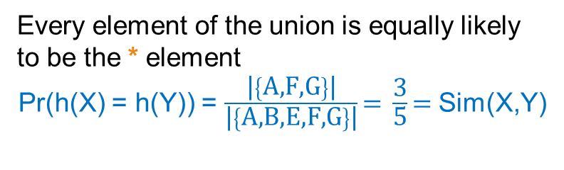
Example
Universe: U = {A,B,C,D,E,F,G}
X = {A,B,F,G}
Y = {A,E,F,G}
Union =
{A,B,E,F,G}
Intersection =
{A,F,G}
Every element of the union is equally likely to be the * element
Pr(h(X) = h(Y)) = $\frac{\text{|}\left\{\text{A}\text{,}\text{F}\text{,}\text{G}\right\}\text{|}}{\text{|}\left\{\text{A}\text{,}\text{B}\text{,}\text{E}\text{,}\text{F}\text{,}\text{G}\right\}\text{|}}\text{= }\frac{\text{3}}{\text{5}}\text{= }$Sim(X,Y)
 | X | Y
A | 1 | 1
B | 1 | 0
C | 0 | 0
D | 0 | 0
E | 0 | 1
F | 1 | 1
G | 1 | 1
 | X | Y
D | 0 | 0
C | 0 | 0
D
*
*
C
*
*
*

Slide 21
Similarity for Signatures
The similarity of signatures is the fraction of the hash functions in which they agree.
With multiple signatures we get a good approximation
 | S₁ | S₂ | S₃ | S₄
A | 1 | 0 | 1 | 0
B | 1 | 0 | 0 | 1
C | 0 | 1 | 0 | 1
D | 0 | 1 | 0 | 1
E | 0 | 1 | 0 | 1
F | 1 | 0 | 1 | 0
G | 1 | 0 | 1 | 0
Signature matrix
 | Actual | Sig
(S₁, S₂) | 0 | 0
(S₁, S₃) | 3/5 | 2/3
(S₁, S₄) | 1/7 | 0
(S₂, S₃) | 0 | 0
(S₂, S₄) | 3/4 | 1
(S₃, S₄) | 0 | 0
S₁ | S₂ | S₃ | S₄
1 | 2 | 1 | 2
2 | 1 | 3 | 1
3 | 1 | 3 | 1
≈
Zero similarity is preserved
High similarity is well approximated

Slide 22
Is it now feasible?
Assume a billion rows
Hard to pick a random permutation of 1…billion
Even representing a random permutation requires 1 billion entries!!!
How about accessing rows in permuted order? ☹

Slide 23
Being more practical
Instead of permuting the rows we will apply a hash function that maps the rows to a new (possibly larger) space
  The value of the hash function is the position of the row in the new order (permutation).
  Each set is represented by the smallest hash value among the elements in the set
The space of the hash functions should be such that if we select one at random each element (row) has equal probability to have the smallest value
  Min-wise independent hash functions

Slide 24
Algorithm – One set, one hash function
Computing Sig(S,i) for a single column S and single hash function h_{i}
for each row r
compute h_{i} (r )
if column S that has 1 in row r
if h_{i} (r ) is a smaller value than Sig(S,i) then
  Sig(S,i) = h_{i} (r);
In practice only the rows (shingles) that appear in the data
h_{i} (r) = index of row r in permutation
S contains row r
Find the row r with minimum index
Sig(S,i) will become the smallest value of h_{i}(r) among all rows (shingles) for which column S has value 1 (shingle belongs in S); i.e., h_{i} (r) gives the min index for the i-th permutation

Slide 25
Algorithm – All sets, k hash functions
Pick k=100 hash functions (h₁,…,h_{k})
for each row r
for each hash function h_{i}
compute h_{i} (r )
for each column S that has 1 in row r
if h_{i} (r ) is a smaller value than Sig(S,i) then
  Sig(S,i) = h_{i} (r);
In practice this means selecting the hash function parameters
Compute h_{i} (r) only once for all sets

Slide 26
Example
Sig1 Sig2
h(0) = 1 1 -
g(0) = 3 3 -
x
0
1
2
3
4
Row S1 S2
A 1 0
B 0 1
C 1 1
D 1 0
E 0 1
h(x)
1
2
3
4
0
g(x)
3
0
2
4
1
h(1) = 2 1 2
g(1) = 0 3 0
h(2) = 3 1 2
g(2) = 2 2 0
h(3) = 4 1 2
g(3) = 4 2 0
h(x) = x+1 mod 5
g(x) = 2x+3 mod 5
h(Row)
0
1
2
3
4
Row S1 S2
E 0 1
A 1 0
B 0 1
C 1 1
D 1 0
g(Row)
0
1
2
3
4
Row S1 S2
B 0 1
E 0 1
C 1 0
A 1 1
D 1 0
h(4) = 0 1 0
g(4) = 1 2 0

Slide 27
Implementation
Often, data is given by column, not row.
  E.g., columns = documents, rows = shingles.
If so, sort matrix once so it is by row.
And always compute h_{i} (r ) only once for each row.

Slide 28
Finding similar pairs
Problem: Find all pairs of documents with similarity at least t = 0.8
While the signatures of all columns may fit in main memory, comparing the signatures of all pairs of columns is quadratic in the number of columns.
Example: 10⁶ columns implies 5*10¹¹ column-comparisons.
At 1 microsecond/comparison: 6 days.

Slide 29
Locality-Sensitive Hashing
What we want: a function f(X,Y) that tells whether or not X and Y is a candidate pair: a pair of elements whose similarity must be evaluated.
A simple idea: X and Y are a candidate pair if they have the same min-hash signature.
  Easy to test by hashing the signatures.
  Similar sets are more likely to have the same signature.
  Likely to produce many false negatives.
    Requiring full match of signature is strict, some similar sets will be lost.
Improvement: Compute multiple signatures; candidate pairs should have at least one common signature.
  Reduce the probability for false negatives.
! Multiple levels of Hashing!

Slide 30
Signature matrix reminder
Prob(Sig(S,i) == Sig(S’,i)) = sim(S,S’)
Sig(S,i)
Sig(S’,i)
hash function i
n hash functions
Sig(S):
signature for set S
signature for set S’
Matrix M

Slide 31
Partition into Bands – (1)
Divide the signature matrix Sig into b bands of r rows.
  Each band is a mini-signature with r hash functions.

Slide 32
Partitioning into bands
n = b*r hash functions
r rows
per band
b bands
b mini-signatures
One
signature
Matrix Sig

Slide 33
Partition into Bands – (2)
Divide the signature matrix Sig into b bands of r rows.
  Each band is a mini-signature with r hash functions.
For each band, hash the mini-signature to a hash table with k buckets.
  Make k as large as possible so that mini-signatures that hash to the same bucket are almost certainly identical.

Slide 34
Hash Table
Columns 2 and 6
are (almost certainly) identical.
Columns 6 and 7 are
surely different.
Matrix M
1
2
3
4
5
6
7
r rows
b bands

Slide 35
Partition into Bands – (3)
Divide the signature matrix Sig into b bands of r rows.
  Each band is a mini-signature with r hash functions.
For each band, hash the mini-signature to a hash table with k buckets.
  Make k as large as possible so that mini-signatures that hash to the same bucket are almost certainly identical.
Candidate column pairs are those that hash to the same bucket for at least 1 band.
Tune b and r to catch most similar pairs, but few non-similar pairs.

Slide 36
Analysis of LSH – What We Want
Probability
= 1 if s > t
Probability
of sharing
a bucket
No chance
if s < t
t
Similarity s of two sets

Slide 37
What One Band of One Row Gives You
Single hash signature
Probability
of sharing
a bucket
Remember:
probability of
equal hash-values
= similarity
t
Prob(Sig(S,i) == Sig(S’,i)) = sim(S,S’)
Similarity s of two sets

Slide 38
What b Bands of r Rows Gives You
At least
one band
identical
No bands
identical
(
s ^{r}
t ~ (1/b)^{1/r}
1 -
1 -
)^{b}
Probability
of sharing
a bucket
Some row
of a band
unequal
All rows
of a band
are equal
t
Similarity s of two sets

Slide 39
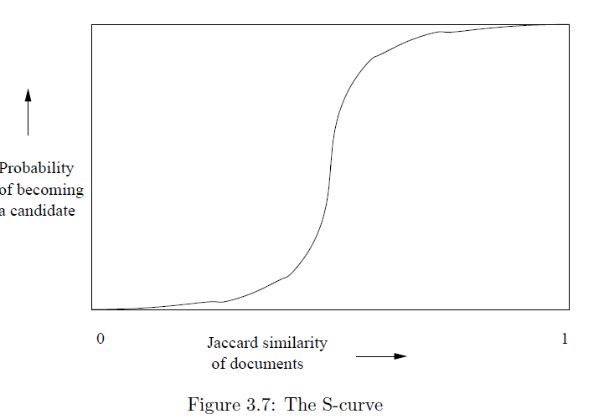
Example: b = 20; r = 5
t = 0.5
s | 1-(1-s^{r})^{b}
.2 | .006
.3 | .047
.4 | .186
.5 | .470
.6 | .802
.7 | .975
.8 | .9996

Slide 40
Suppose S₁, S₂ are 80% Similar
We want all 80%-similar pairs. Choose 20 bands of 5 integers/band.
Probability S₁, S₂ identical in one particular band:
(0.8)⁵ = 0.328.
Probability S₁, S₂ are not similar in any of the 20 bands:
(1-0.328)²⁰ = 0.00035
    i.e., about 1/3000-th of the 80%-similar column pairs are false negatives.
Probability S₁, S₂ are similar in at least one of the 20 bands:
1-0.00035 = 0.999

Slide 41
Suppose S₁, S₂ Only 40% Similar
Probability S₁, S₂ identical in any one particular band:
(0.4)⁵ = 0.01 .
Probability S₁, S₂ identical in at least 1 of 20 bands:
≤ 20 * 0.01 = 0.2 .
But false positives much lower for similarities << 40%.

Slide 42
LSH Summary
Tune to get almost all pairs with similar signatures, but eliminate most pairs that do not have similar signatures.
Check in main memory that candidate pairs really do have similar signatures.
Optional: In another pass through data, check that the remaining candidate pairs really represent similar sets .

Slide 43
Locality-sensitive hashing (LSH)
Big Picture: Construct hash functions h: R^{d}→ U such that for any pair of points p,q, for distance function D we have:
  If D(p,q)≤r, then Pr[h(p)=h(q)] ≥ α is high
  If D(p,q)≥cr, then Pr[h(p)=h(q)] ≤ β is small
Then, we can find close pairs by hashing
LSH is a general framework: for a given distance function D we need to find the right h
  h is (r,cr, α, β)-sensitive

Slide 44
LSH for Cosine Distance
For cosine distance, there is a technique analogous to minhashing for generating a (d₁,d₂,(1-d₁/180),(1-d₂/180))- sensitive family for any d₁ and d₂.
Called random hyperplanes.

Slide 45
Random Hyperplanes
Pick a random vector v, which determines a hash function h_{v} with two buckets.
h_{v}(x) = +1 if v.x > 0; = -1 if v.x < 0.
LS-family H = set of all functions derived from any vector.
Claim: Prob[h(x)=h(y)] = 1 – (angle between x and y divided by 180).

Slide 46
Proof of Claim
v
Look in the
plane of x
and y.
x
Hyperplanes
(normal to v )
for which h(x)
<> h(y)
θ
Hyperplanes
for which
h(x) = h(y)
y
Prob[Red case]
= θ/180

Slide 47
Signatures for Cosine Distance
Pick some number of vectors, and hash your data for each vector.
The result is a signature (sketch ) of +1’s and –1’s that can be used for LSH like the minhash signatures for Jaccard distance.

Slide 48
Simplification
We need not pick from among all possible vectors v to form a component of a sketch.
It suffices to consider only vectors v consisting of +1 and –1 components.

Slide 49
CLUSTERING

Slide 50
What is a Clustering?
In general a grouping of objects such that the objects in a group (cluster) are similar (or related) to one another and different from (or unrelated to) the objects in other groups
Inter-cluster distances are maximized
Intra-cluster distances are minimized

Slide 51
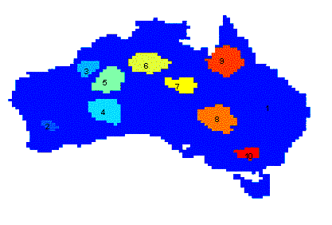
Applications of Cluster Analysis
Understanding
  Group related documents for browsing, group genes and proteins that have similar functionality, or group stocks with similar price fluctuations
Summarization
  Reduce the size of large data sets
Clustering precipitation in Australia

Slide 52
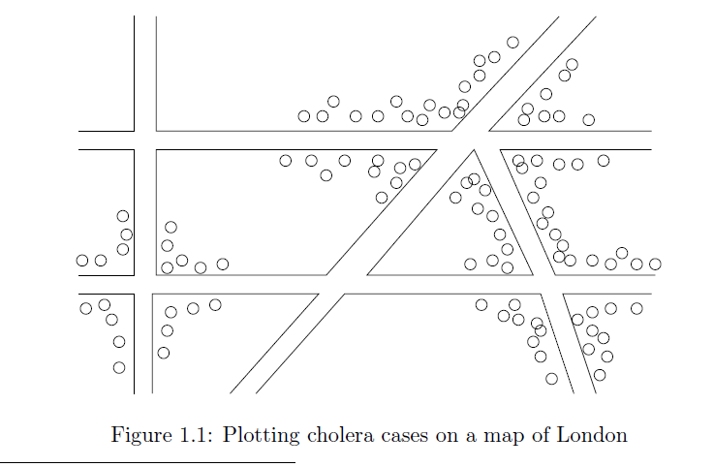
Early applications of cluster analysis
John Snow, London 1854

Slide 53
Notion of a Cluster can be Ambiguous
How many clusters?
Six Clusters
Two Clusters
Four Clusters

Slide 54
Types of Clusterings
A clustering is a set of clusters
Important distinction between hierarchical and partitional sets of clusters
Partitional Clustering
  A division data objects into subsets (clusters) such that each data object is in exactly one subset
Hierarchical clustering
  A set of nested clusters organized as a hierarchical tree

Slide 55
Partitional Clustering
Original Points
A Partitional Clustering

Slide 56
Hierarchical Clustering
Traditional Hierarchical Clustering
Traditional Dendrogram
Non-traditional Hierarchical Clustering
Non-traditional Dendrogram

Slide 57
Other types of clustering
Exclusive (or non-overlapping) versus non-exclusive (or overlapping)
  In non-exclusive clusterings, points may belong to multiple clusters.
    Points that belong to multiple classes, or ‘border’ points
Fuzzy (or soft) versus non-fuzzy (or hard)
  In fuzzy clustering, a point belongs to every cluster with some weight between 0 and 1
    Weights usually must sum to 1 (often interpreted as probabilities)
Partial versus complete
  In some cases, we only want to cluster some of the data

Slide 58
Types of Clusters: Well-Separated
Well-Separated Clusters:
  A cluster is a set of points such that any point in a cluster is closer (or more similar) to every other point in the cluster than to any point not in the cluster.
3 well-separated clusters

Slide 59
Types of Clusters: Center-Based
Center-based
  A cluster is a set of objects such that an object in a cluster is closer (more similar) to the “center” of a cluster, than to the center of any other cluster
  The center of a cluster is often a centroid, the minimizer of distances from all the points in the cluster, or a medoid, the most “representative” point of a cluster
4 center-based clusters

Slide 60
Types of Clusters: Contiguity-Based
Contiguous Cluster (Nearest neighbor or Transitive)
  A cluster is a set of points such that a point in a cluster is closer (or more similar) to one or more other points in the cluster than to any point not in the cluster.
8 contiguous clusters

Slide 61
Types of Clusters: Density-Based
Density-based
  A cluster is a dense region of points, which is separated by low-density regions, from other regions of high density.
  Used when the clusters are irregular or intertwined, and when noise and outliers are present.
6 density-based clusters

Slide 62
Types of Clusters: Conceptual Clusters
Shared Property or Conceptual Clusters
  Finds clusters that share some common property or represent a particular concept.
  .
2 Overlapping Circles

Slide 63
Types of Clusters: Objective Function
Clustering as an optimization problem
  Finds clusters that minimize or maximize an objective function.
  Enumerate all possible ways of dividing the points into clusters and evaluate the `goodness' of each potential set of clusters by using the given objective function. (NP Hard)
  Can have global or local objectives.
    Hierarchical clustering algorithms typically have local objectives
    Partitional algorithms typically have global objectives
  A variation of the global objective function approach is to fit the data to a parameterized model.
    The parameters for the model are determined from the data, and they determine the clustering
    E.g., Mixture models assume that the data is a ‘mixture' of a number of statistical distributions.

Slide 64
Clustering Algorithms
K-means and its variants
Hierarchical clustering
DBSCAN

Slide 65
K-means

Slide 66
K-means Clustering
Partitional clustering approach
Each cluster is associated with a centroid (center point)
Each point is assigned to the cluster with the closest centroid
Number of clusters, K, must be specified
The objective is to minimize the sum of distances of the points to their respective centroid

Slide 67
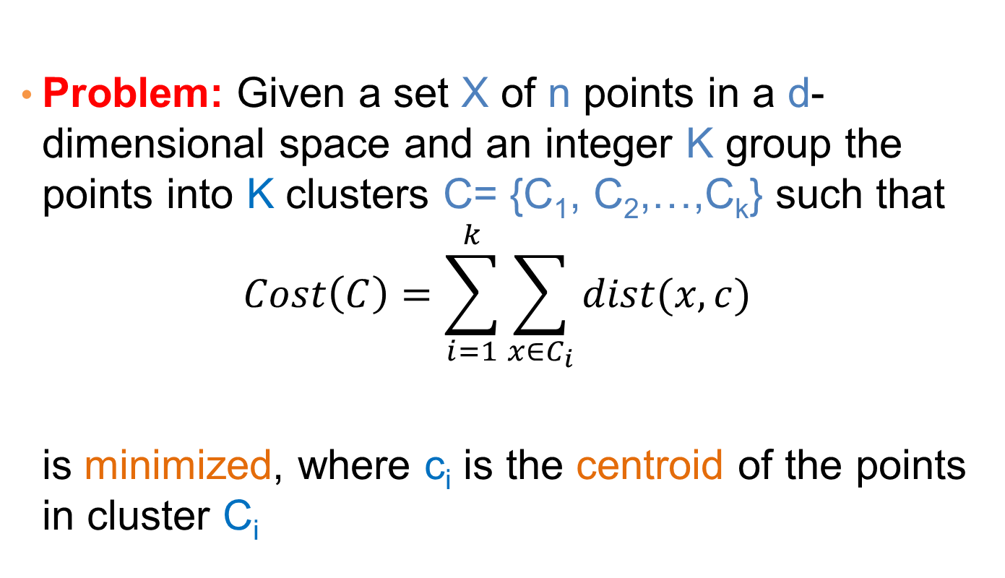
K-means Clustering
Problem: Given a set X of n points in a d-dimensional space and an integer K group the points into K clusters C= {C₁, C₂,…,C_{k}} such that
$$Cost\left(C\right)=\sum_{i=1}^{k}{\sum_{x∈C_{i}}{dist(x,c)}}$$
is minimized, where c_{i} is the centroid of the points in cluster C_{i}

Slide 68
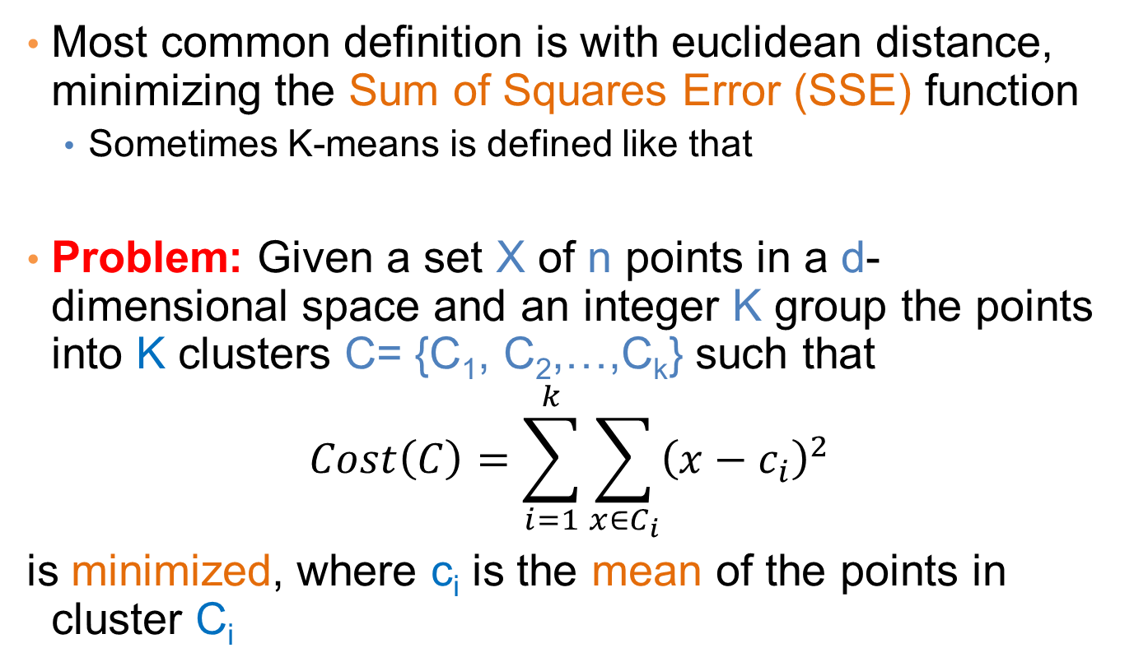
K-means Clustering
Most common definition is with euclidean distance, minimizing the Sum of Squares Error (SSE) function
  Sometimes K-means is defined like that
Problem: Given a set X of n points in a d-dimensional space and an integer K group the points into K clusters C= {C₁, C₂,…,C_{k}} such that
$$Cost\left(C\right)=\sum_{i=1}^{k}{\sum_{x∈C_{i}}{{\left(x−c_{i}\right)}^{2}}}$$
is minimized, where c_{i} is the mean of the points in cluster C_{i}
Sum of Squares Error (SSE)

Slide 69
Complexity of the k-means problem
NP-hard if the dimensionality of the data is at least 2 (d>=2)
  Finding the best solution in polynomial time is infeasible
For d=1 the problem is solvable in polynomial time (how?)
A simple iterative algorithm works quite well in practice

Slide 70
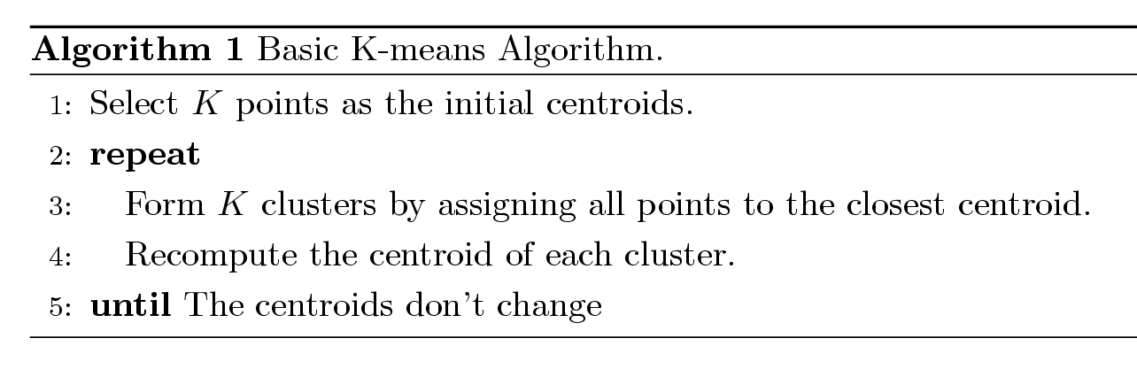
K-means Algorithm
Also known as Lloyd’s algorithm.
K-means is sometimes synonymous with this algorithm

Slide 71
K-means Algorithm – Initialization
Initial centroids are often chosen randomly.
  Clusters produced vary from one run to another.

Slide 72
Two different K-means Clusterings
Original Points
Optimal Clustering
Sub-optimal Clustering

Slide 73
Importance of Choosing Initial Centroids

Slide 74
Importance of Choosing Initial Centroids

Slide 75
Importance of Choosing Initial Centroids

Slide 76
Importance of Choosing Initial Centroids …

Slide 77
Dealing with Initialization
Do multiple runs and select the clustering with the smallest error
Select original set of points by methods other than random . E.g., pick the most distant (from each other) points as cluster centers (K-means++ algorithm)

Slide 78
K-means Algorithm – Centroids
The centroid depends on the distance function
  The minimizer for the distance function
‘Closeness’ is measured by Euclidean distance (SSE), cosine similarity, correlation, etc.
Centroid:
  The mean of the points in the cluster for SSE, and cosine similarity
  The median for Manhattan distance.
Finding the centroid is not always easy
  It can be an NP-hard problem for some distance functions
    E.g., median form multiple dimensions

Slide 79
K-means Algorithm – Convergence
K-means will converge for common similarity measures mentioned above.
  Most of the convergence happens in the first few iterations.
  Often the stopping condition is changed to ‘Until relatively few points change clusters’
Complexity is O( n * K * I * d )
  n = number of points, K = number of clusters,
  I = number of iterations, d = dimensionality
In general a fast and efficient algorithm

Slide 80
Limitations of K-means
K-means has problems when clusters are of different
  Sizes
  Densities
  Non-globular shapes
K-means has problems when the data contains outliers.

Slide 81
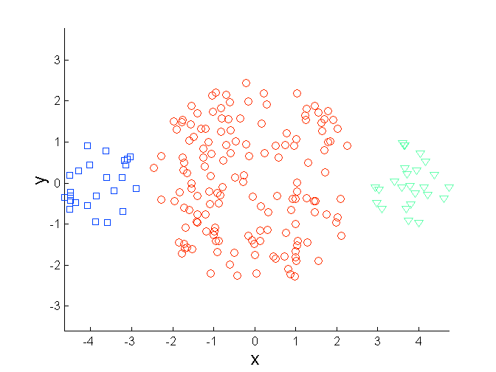
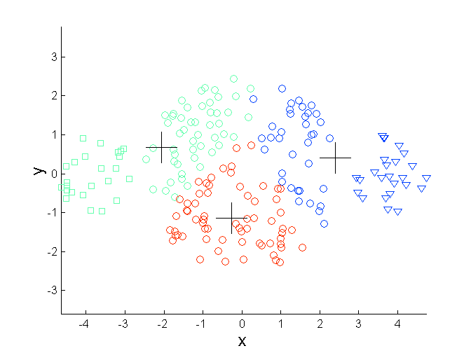
Limitations of K-means: Differing Sizes
Original Points
K-means (3 Clusters)

Slide 82
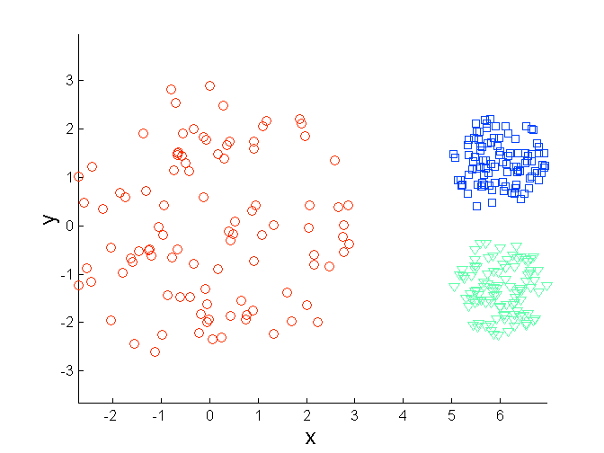
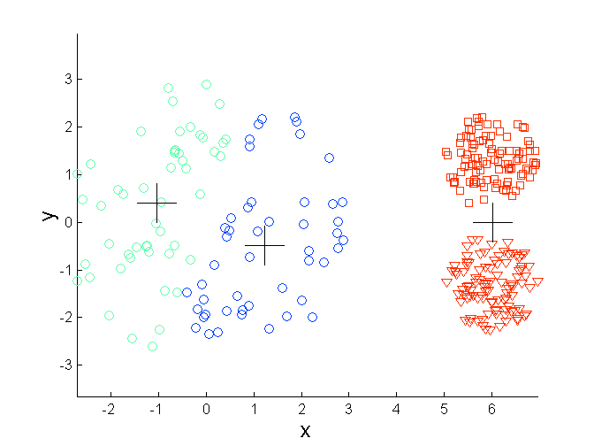
Limitations of K-means: Differing Density
Original Points
K-means (3 Clusters)

Slide 83
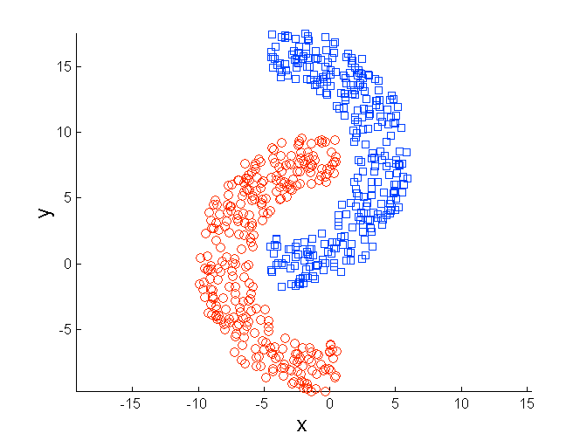
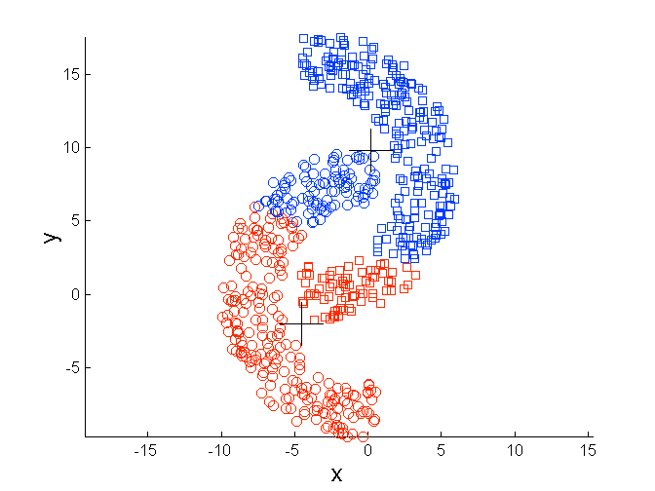
Limitations of K-means: Non-globular Shapes
Original Points
K-means (2 Clusters)

Slide 84
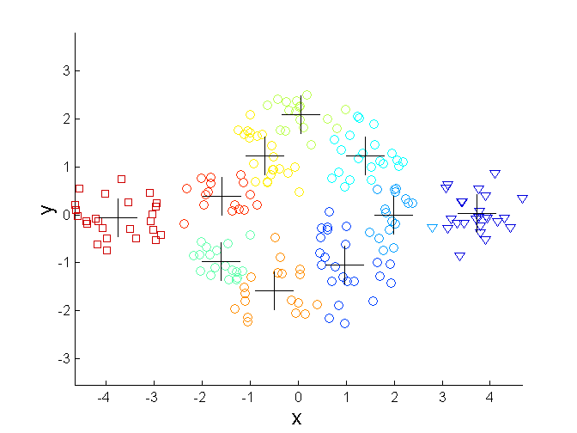
Overcoming K-means Limitations
Original Points K-means Clusters
One solution is to use many clusters.
  Find parts of clusters, but need to put together.

Slide 85
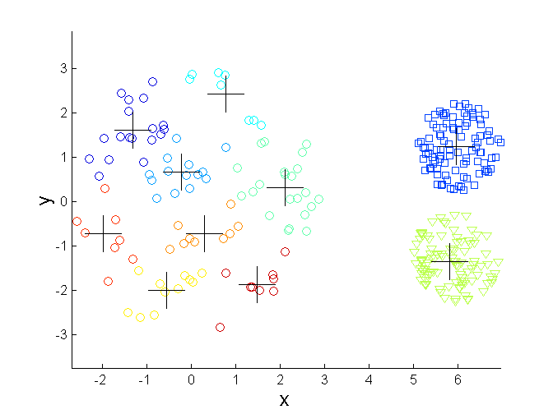
Overcoming K-means Limitations
Original Points K-means Clusters

Slide 86
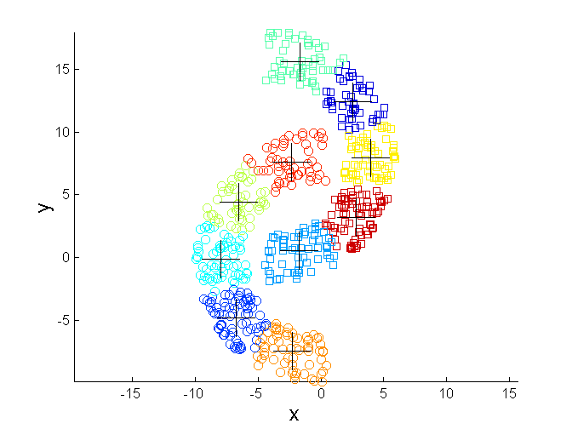
Overcoming K-means Limitations
Original Points K-means Clusters

Slide 87
Variations
K-medoids: Similar problem definition as in K-means, but the centroid of the cluster is defined to be one of the points in the cluster (the medoid).
K-centers: Similar problem definition as in K-means, but the goal now is to minimize the maximum diameter of the clusters (diameter of a cluster is maximum distance between any two points in the cluster).

