Slide 1
DATA MINING
LECTURE 5
Similarity and Distance
Sketching, Locality Sensitive Hashing

Slide 2
SIMILARITY AND DISTANCE
Thanks to:
Tan, Steinbach, and Kumar, “Introduction to Data Mining”
Rajaraman and Ullman, “Mining Massive Datasets”

Slide 3
Similarity and Distance
For many different problems we need to quantify how close two objects are.
Examples:
  For an item bought by a customer, find other similar items
  Group together the customers of site so that similar customers are shown the same ad.
  Group together web documents so that you can separate the ones that talk about politics and the ones that talk about sports.
  Find all the near-duplicate mirrored web documents.
  Find credit card transactions that are very different from previous transactions.
To solve these problems we need a definition of similarity, or distance.
  The definition depends on the type of data that we have

Slide 4
Similarity
Numerical measure of how alike two data objects are.
  A function that maps pairs of objects to real values
  Higher when objects are more alike.
Often falls in the range [0,1], sometimes in [-1,1]
Desirable properties for similarity
  s(p, q) = 1 (or maximum similarity) only if p = q. (Identity)
  s(p, q) = s(q, p) for all p and q. (Symmetry)

Slide 5
Similarity between sets
Consider the following documents
Which ones are more similar?
How would you quantify their similarity?
apple releases new ipod
apple releases new ipad
new apple pie recipe

Slide 6
Similarity: Intersection
Number of words in common
Sim(D,D) = 3, Sim(D,D) = Sim(D,D) =2
What about this document?
Sim(D,D) = Sim(D,D) = 3
apple releases new ipod
apple releases new ipad
new apple pie recipe
Vefa rereases new book with apple pie recipes

Slide 7
Jaccard Similarity
The Jaccard similarity (Jaccard coefficient) of two sets S₁, S₂ is the size of their intersection divided by the size of their union.
  JSim (C₁, C₂) = |C₁∩C₂| / |C₁∪C₂|.
  Extreme behavior:
    Jsim(X,Y) = 1, iff X = Y
    Jsim(X,Y) = 0 iff X,Y have not elements in common
  JSim is symmetric
3 in intersection.
8 in union.
Jaccard similarity
= 3/8

Slide 8
Similarity: Intersection
Number of words in common
JSim(D,D) = 3/5
JSim(D,D) = JSim(D,D) = 2/6
JSim(D,D) = JSim(D,D) = 3/9
apple releases new ipod
apple releases new ipad
new apple pie recipe
Vefa rereases new book with apple pie recipes

Slide 9
Similarity between vectors
Documents (and sets in general) can also be represented as vectors
document | Apple | Microsoft | Obama | Election
D1 | 10 | 20 | 0 | 0
D2 | 30 | 60 | 0 | 0
D2 | 0 | 0 | 10 | 20
How do we measure the similarity of two vectors?
How well are the two vectors aligned?

Slide 10
Example
document | Apple | Microsoft | Obama | Election
D1 | 1/3 | 2/3 | 0 | 0
D2 | 1/3 | 2/3 | 0 | 0
D2 | 0 | 0 | 1/3 | 2/3
Documents D1, D2 are in the “same direction”
Document D3 is orthogonal to these two

Slide 11
Cosine Similarity
Sim(X,Y) = cos(X,Y)
  The cosine of the angle between X and Y
If the vectors are aligned (correlated) angle is zero degrees and cos(X,Y)=1
If the vectors are orthogonal (no common coordinates) angle is 90 degrees and cos(X,Y) = 0
Cosine is commonly used for comparing documents, where we assume that the vectors are normalized by the document length.

Slide 12
Cosine Similarity - math
If d₁ and d₂ are two vectors, then
cos( d₁, d₂ ) = (d₁ • d₂) / ||d₁|| ||d₂|| ,
where • indicates vector dot product and || d || is the length of vector d.
Example:
d₁ = 3 2 0 5 0 0 0 2 0 0
d₂ = 1 0 0 0 0 0 0 1 0 2
d₁ • d₂= 3*1 + 2*0 + 0*0 + 5*0 + 0*0 + 0*0 + 0*0 + 2*1 + 0*0 + 0*2 = 5
||d₁|| = (3*3+2*2+0*0+5*5+0*0+0*0+0*0+2*2+0*0+0*0)^{0.5} = (42) ^{0.5} = 6.481
||d₂|| = (1*1+0*0+0*0+0*0+0*0+0*0+0*0+1*1+0*0+2*2) ^{0.5} = (6) ^{0.5} = 2.245
cos( d₁, d₂ ) = .3150

Slide 13
Similarity between vectors
document | Apple | Microsoft | Obama | Election
D1 | 10 | 20 | 0 | 0
D2 | 30 | 60 | 0 | 0
D2 | 0 | 0 | 10 | 20
cos(D1,D2) = 1
cos(D1,D3) = cos(D2,D3) = 0

Slide 14
Distance
Numerical measure of how different two data objects are
  A function that maps pairs of objects to real values
  Lower when objects are more alike
Minimum distance is 0, when comparing an object with itself.
Upper limit varies

Slide 15
Distance Metric
A distance function d is a distance metric if it is a function from pairs of objects to real numbers such that:
  d(x,y) > 0. (non-negativity)
  d(x,y) = 0 iff x = y. (identity)
  d(x,y) = d(y,x). (symmetry)
  d(x,y) < d(x,z) + d(z,y) (triangle inequality ).

Slide 16
Triangle Inequality
Triangle inequality guarantees that the distance function is well-behaved.
  The direct connection is the shortest distance
It is useful also for proving properties about the data
  For example, suppose I want to find an object that minimizes the sum of distances to all points in my dataset
  If I select the best point from my dataset, the sum of distances I get is at most twice that of the optimal point.

Slide 17
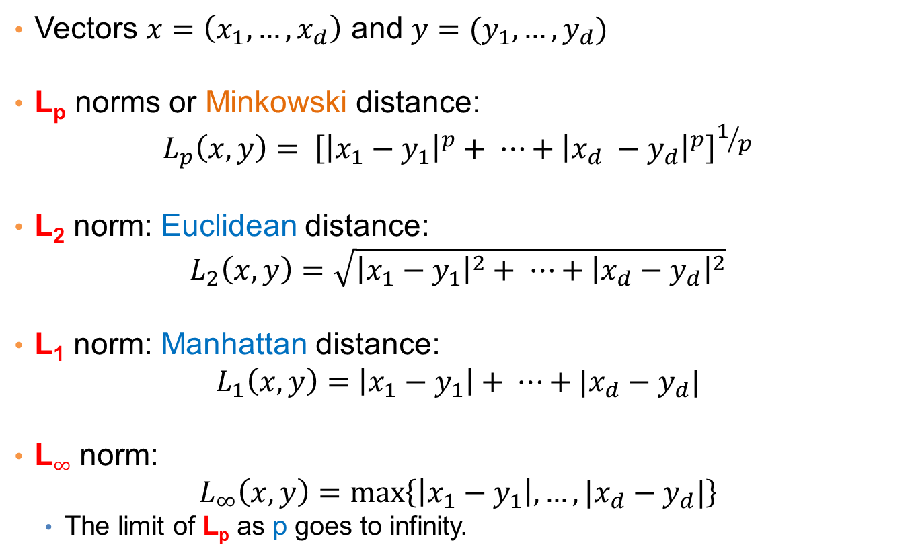
Distances for real vectors
Vectors $x=\left(x_{1},…,x_{d}\right)$ and $y=(y_{1},…,y_{d})$
L_{p} norms or Minkowski distance:
$$L_{p}\left(x,y\right)= {\left[{\left|x_{1}−y_{1}\right|}^{p}+ ⋯+{\left|x_{d} −y_{d}\right|}^{p}\right]}^{1/p}$$
L₂ norm: Euclidean distance:
$$L_{2}\left(x,y\right)=\sqrt{{\left|x_{1}−y_{1}\right|}^{2}+ ⋯+{\left|x_{d}−y_{d}\right|}^{2}}$$
L₁ norm: Manhattan distance:
$$L_{1}\left(x,y\right)=\left|x_{1}−y_{1}\right|+ ⋯+|x_{d}−y_{d}|$$
L$∞$ norm:
$$L_{∞}\left(x,y\right)=\max\left\{\left|x_{1}−y_{1}\right|,…,|x_{d}−y_{d}|\right\}$$
  The limit of L_{p} as p goes to infinity.
L_{p} norms are known to be distance metrics

Slide 18
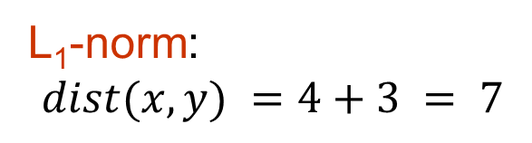
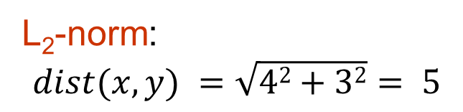
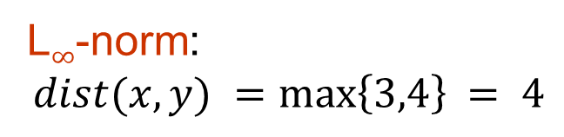
Example of Distances
y = (9,8)
L₂-norm:
$$dist(x,y) =\sqrt{42+32}= 5$$
5
3
L₁-norm:
$$dist(x,y) =4+3 = 7$$
4
x = (5,5)
L$∞$-norm:
$$dist(x,y) =\max\left\{3,4\right\}⁡= 4$$

Slide 19

Example
r
$$x= (x_{1},…,x_{n})$$
Green: All points y at distance L₁(x,y) = r from point x
Blue: All points y at distance L₂(x,y) = r from point x
Red: All points y at distance L$∞$(x,y) = r from point x

Slide 20
L_{p} distances for sets
We can apply all the L_{p} distances to the cases of sets of attributes, with or without counts, if we represent the sets as vectors
  E.g., a transaction is a 0/1 vector
  E.g., a document is a vector of counts.

Slide 21
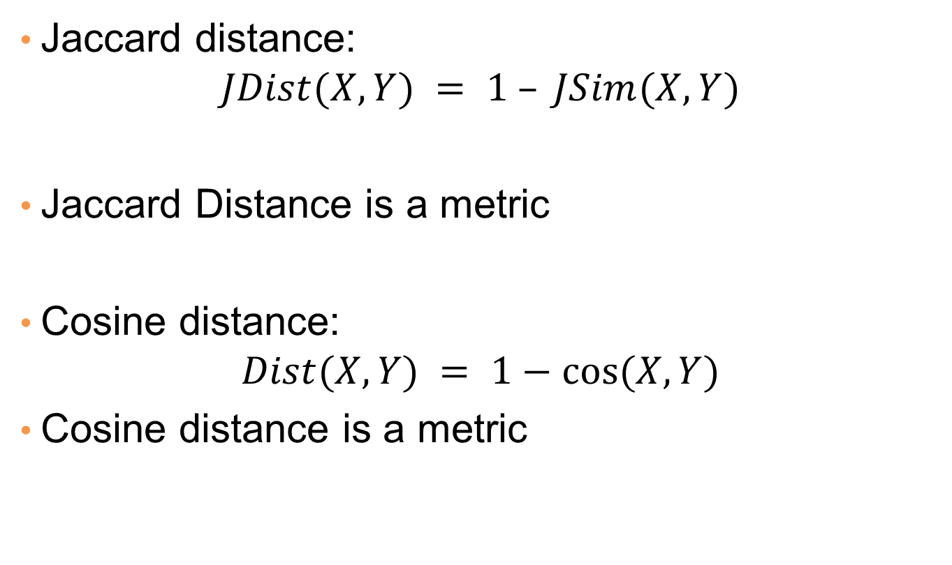
Similarities into distances
Jaccard distance:
$$JDist(X,Y) = 1 – JSim(X,Y)$$
Jaccard Distance is a metric
Cosine distance:
$$Dist(X,Y) = 1−cos⁡(X,Y)$$
Cosine distance is a metric

Slide 22
Why Jaccard Distance Is a Distance Metric
JDist(x,x) = 0
  since JSim(x,x) = 1
JDist(x,y) = JDist(y,x)
  by symmetry of intersection
JDist(x,y) > 0
  since intersection of X,Y cannot be bigger than the union.
Triangle inequality:
  Follows from the fact that JSim(X,Y) is the probability of randomly selected element from the union of X and Y to belong to the intersection

Slide 23
Hamming Distance
Hamming distance is the number of positions in which bit-vectors differ.
  Example: p₁ = 10101 p₂ = 10011.
    d(p₁, p₂) = 2 because the bit-vectors differ in the 3rd and 4th positions.
    The L₁ norm for the binary vectors
Hamming distance between two vectors of categorical attributes is the number of positions in which they differ.
  Example: x = (married, low income, cheat), y = (single, low income, not cheat)
  d(x,y) = 2

Slide 24
Why Hamming Distance Is a Distance Metric
d(x,x) = 0 since no positions differ.
d(x,y) = d(y,x) by symmetry of “different from.”
d(x,y) > 0 since strings cannot differ in a negative number of positions.
Triangle inequality: changing x to z and then to y is one way to change x to y.
For binary vectors if follows from the fact that L₁ norm is a metric

Slide 25
Distance between strings
How do we define similarity between strings?
Important for recognizing and correcting typing errors and analyzing DNA sequences.
weird wierd
intelligent unintelligent
Athena Athina

Slide 26
Edit Distance for strings
The edit distance of two strings is the number of inserts and deletes of characters needed to turn one into the other.
Example: x = abcde ; y = bcduve.
  Turn x into y by deleting a, then inserting u and v after d.
  Edit distance = 3.
Minimum number of operations can be computed using dynamic programming
Common distance measure for comparing DNA sequences

Slide 27
Why Edit Distance Is a Distance Metric
d(x,x) = 0 because 0 edits suffice.
d(x,y) = d(y,x) because insert/delete are inverses of each other.
d(x,y) > 0: no notion of negative edits.
Triangle inequality: changing x to z and then to y is one way to change x to y. The minimum is no more than that

Slide 28
Variant Edit Distances
Allow insert, delete, and mutate.
  Change one character into another.
Minimum number of inserts, deletes, and mutates also forms a distance measure.
Same for any set of operations on strings.
  Example: substring reversal or block transposition OK for DNA sequences
  Example: character transposition is used for spelling

Slide 29
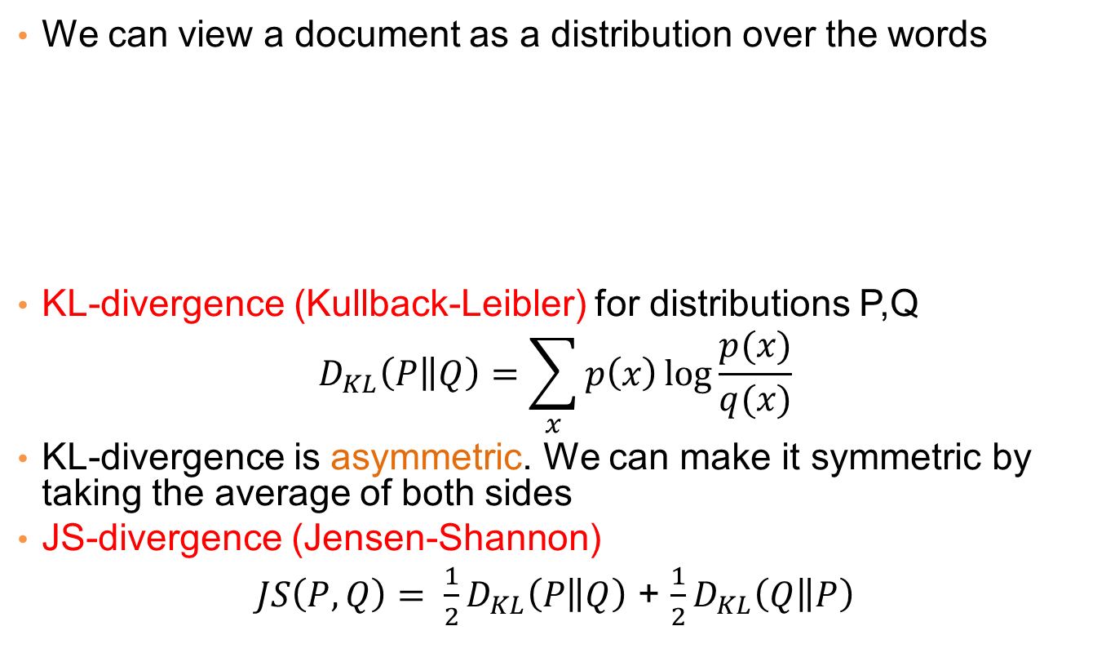
Distances between distributions
We can view a document as a distribution over the words
KL-divergence (Kullback-Leibler) for distributions P,Q
$$D_{KL}\left(P\left\|Q\right.\right)=\sum_{x}{p\left(x\right)\log{\frac{p(x)}{q(x)}}}$$
KL-divergence is asymmetric. We can make it symmetric by taking the average of both sides
JS-divergence (Jensen-Shannon)
$JS\left(P,Q\right)= \frac{1}{2}D_{KL}\left(P\left\|Q\right.\right)$ + $\frac{1}{2}D_{KL}\left(Q\left\|P\right.\right)$
document | Apple | Microsoft | Obama | Election
D1 | 0.35 | 0.5 | 0.1 | 0.05
D2 | 0.4 | 0.4 | 0.1 | 0.1
D2 | 0.05 | 0.05 | 0.6 | 0.3

Slide 30
SKETCHING
AND
LOCALITY SENSITIVE HASHING
Thanks to:
Rajaraman and Ullman, “Mining Massive Datasets”
Evimaria Terzi, slides for Data Mining Course.

Slide 31
Why is similarity important?
We saw many definitions of similarity and distance
How do we make use of similarity in practice?
What issues do we have to deal with?

Slide 32
An important problem
Recommendation systems
  When a user buys an item (initially books) we want to recommend other items that the user may like
  When a user rates a movie, we want to recommend movies that the user may like
  When a user likes a song, we want to recommend other songs that they may like
A big success of data mining
Exploits the long tail

Slide 33
Recommendation Systems
Content-based:
  Represent the items into a feature space and recommend items to customer C similar to previous items rated highly by C
    Movie recommendations: recommend movies with same actor(s), director, genre, …
    Websites, blogs, news: recommend other sites with “similar” content

Slide 34
Plan of action
Item profiles
likes
build
recommend
match
Red
Circles
Triangles
User profile

Slide 35
Limitations of content-based approach
Finding the appropriate features
  e.g., images, movies, music
Overspecialization
  Never recommends items outside user’s content profile
  People might have multiple interests
Recommendations for new users
  How to build a profile?

Slide 36
Recommendation Systems (II)
Collaborative Filtering (user –user)
  Consider user c
  Find set D of other users whose ratings are “similar” to c’s ratings
  Estimate user’s ratings based on ratings of users in D

Slide 37
Recommendation Systems (III)
Collaborative filtering (item-item)
  For item s, find other similar items
  Estimate rating for item based on ratings for similar items
  Can use same similarity metrics and prediction functions as in user-user model
In practice, it has been observed that item-item often works better than user-user

Slide 38
Pros and cons of collaborative filtering
Works for any kind of item
  No feature selection needed
New user problem
New item problem
Sparsity of rating matrix
  Cluster-based smoothing?

Slide 39
Another important problem
Find duplicate and near-duplicate documents from a web crawl.
Why is it important:
  Identify mirrored web pages, and avoid indexing them, or serving them multiple times
  Find replicated news stories and cluster them under a single story.
  Identify plagiarism
What if we wanted exact duplicates?

Slide 40
Finding similar items
Both the problems we described have a common component
  We need a quick way to find highly similar items to a query item
  OR, we need a method for finding all pairs of items that are highly similar.
Also known as the Nearest Neighbor problem, or the All Nearest Neighbors problem
We will examine it for the case of near-duplicate web documents.

Slide 41
Main issues
What is the right representation of the document when we check for similarity?
  E.g., representing a document as a set of characters will not do (why?)
When we have billions of documents, keeping the full text in memory is not an option.
  We need to find a shorter representation
How do we do pairwise comparisons of billions of documents?
  If exact match was the issue it would be ok, can we replicate this idea?

Slide 42
Three Essential Techniques for Similar Documents
Shingling : convert documents, emails, etc., to sets.
Minhashing : convert large sets to short signatures, while preserving similarity.
Locality-Sensitive Hashing (LSH): focus on pairs of signatures likely to be similar.

Slide 43
The Big Picture
Candidate
pairs :
those pairs
of signatures
that we need
to test for
similarity.
Shingling
Minhash-
ing
Locality-
sensitive
Hashing
Docu-
ment
The set
of strings
of length k
that appear
in the doc-
ument
Signatures :
short integer
vectors that
represent the
sets, and
reflect their
similarity

Slide 44
Shingles
A k -shingle (or k -gram) for a document is a sequence of k characters that appears in the document.
Example: document = abcab. k=2
  Set of 2-shingles = {ab, bc, ca}.
  Option: regard shingles as a bag, and count ab twice.
Represent a document by its set of k-shingles.

Slide 45
Shingling
Shingle: a sequence of k contiguous characters
a rose is a rose is a rose
a rose is
rose is a
rose is a
ose is a r
se is a ro
e is a ros
is a rose
is a rose
s a rose i
a rose is
a rose is

Slide 46
Working Assumption
Documents that have lots of shingles in common have similar text, even if the text appears in different order.
Careful: you must pick k large enough, or most documents will have most shingles.
  Extreme case k = 1: all documents are the same
  k = 5 is OK for short documents; k = 10 is better for long documents.
Alternative ways to define shingles:
  Use words instead of characters
  Anchor on stop words (to avoid templates)

Slide 47
Shingles: Compression Option
To compress long shingles, we can hash them to (say) 4 bytes.
Represent a doc by the set of hash values of its k-shingles.
From now on we will assume that shingles are integers
  Collisions are possible, but very rare

Slide 48
Fingerprinting
Hash shingles to 64-bit integers
Set of Shingles
Set of 64-bit integers
Hash function
(Rabin’s fingerprints)
a rose is
rose is a
rose is a
ose is a r
se is a ro
e is a ros
is a rose
is a rose
s a rose i
a rose is
1111
2222
3333
4444
5555
6666
7777
8888
9999
0000

Slide 49
Basic Data Model: Sets
Document: A document is represented as a set shingles (more accurately, hashes of shingles)
Document similarity: Jaccard similarity of the sets of shingles.
  Common shingles over the union of shingles
  Sim (C₁, C₂) = |C₁∩C₂|/|C₁∪C₂|.
Although we use the documents as our driving example the techniques we will describe apply to any kind of sets.
  E.g., similar customers or items.

Slide 50
Signatures
Problem: shingle sets are too large to be kept in memory.
Key idea: “hash” each set S to a small signature Sig (S), such that:
  Sig (S) is small enough that we can fit a signature in main memory for each set.
  Sim (S₁, S₂) is (almost) the same as the “similarity” of Sig (S₁) and Sig (S₂). (signature preserves similarity).
Warning: This method can produce false negatives, and false positives (if an additional check is not made).
  False negatives: Similar items deemed as non-similar
  False positives: Non-similar items deemed as similar

Slide 51
From Sets to Boolean Matrices
Represent the data as a boolean matrix M
  Rows = the universe of all possible set elements
    In our case, shingle fingerprints take values in [0…2⁶⁴-1]
  Columns = the sets
    In our case, documents, sets of shingle fingerprints
  M(r,S) = 1 in row r and column S if and only if r is a member of S.
Typical matrix is sparse.
  We do not really materialize the matrix

Slide 52

Example
Universe: U = {A,B,C,D,E,F,G}
X = {A,B,F,G}
Y = {A,E,F,G}
Sim(X,Y) = $\frac{3}{5}$
 | X | Y
A | 1 | 1
B | 1 | 0
C | 0 | 0
D | 0 | 0
E | 0 | 1
F | 1 | 1
G | 1 | 1

Slide 53

Example
Universe: U = {A,B,C,D,E,F,G}
X = {A,B,F,G}
Y = {A,E,F,G}
Sim(X,Y) = $\frac{3}{5}$
 | X | Y
A | 1 | 1
B | 1 | 0
C | 0 | 0
D | 0 | 0
E | 0 | 1
F | 1 | 1
G | 1 | 1
At least one of the columns has value 1

Slide 54

Example
Universe: U = {A,B,C,D,E,F,G}
X = {A,B,F,G}
Y = {A,E,F,G}
Sim(X,Y) = $\frac{3}{5}$
 | X | Y
A | 1 | 1
B | 1 | 0
C | 0 | 0
D | 0 | 0
E | 0 | 1
F | 1 | 1
G | 1 | 1
Both columns have value 1

Slide 55
Minhashing
Pick a random permutation of the rows (the universe U).
Define “hash” function for set S
  h(S) = the index of the first row (in the permuted order) in which column S has 1.
  OR
  h(S) = the index of the first element of S in the permuted order.
Use k (e.g., k = 100) independent random permutations to create a signature.

Slide 56
Example of minhash signatures
Input matrix
 | S₁ | S₂ | S₃ | S₄
A | 1 | 0 | 1 | 0
B | 1 | 0 | 0 | 1
C | 0 | 1 | 0 | 1
D | 0 | 1 | 0 | 1
E | 0 | 1 | 0 | 1
F | 1 | 0 | 1 | 0
G | 1 | 0 | 1 | 0
 |  | S₁ | S₂ | S₃ | S₄
1 | A | 1 | 0 | 1 | 0
2 | C | 0 | 1 | 0 | 1
3 | G | 1 | 0 | 1 | 0
4 | F | 1 | 0 | 1 | 0
5 | B | 1 | 0 | 0 | 1
6 | E | 0 | 1 | 0 | 1
7 | D | 0 | 1 | 0 | 1
A
C
G
F
B
E
D
1 | 2 | 1 | 2

Slide 57
Example of minhash signatures
Input matrix
 | S₁ | S₂ | S₃ | S₄
A | 1 | 0 | 1 | 0
B | 1 | 0 | 0 | 1
C | 0 | 1 | 0 | 1
D | 0 | 1 | 0 | 1
E | 0 | 1 | 0 | 1
F | 1 | 0 | 1 | 0
G | 1 | 0 | 1 | 0
 |  | S₁ | S₂ | S₃ | S₄
1 | D | 0 | 1 | 0 | 1
2 | B | 1 | 0 | 0 | 1
3 | A | 1 | 0 | 1 | 0
4 | C | 0 | 1 | 0 | 1
5 | F | 1 | 0 | 1 | 0
6 | G | 1 | 0 | 1 | 0
7 | E | 0 | 1 | 0 | 1
D
B
A
C
F
G
E
2 | 1 | 3 | 1

Slide 58
Example of minhash signatures
Input matrix
 | S₁ | S₂ | S₃ | S₄
A | 1 | 0 | 1 | 0
B | 1 | 0 | 0 | 1
C | 0 | 1 | 0 | 1
D | 0 | 1 | 0 | 1
E | 0 | 1 | 0 | 1
F | 1 | 0 | 1 | 0
G | 1 | 0 | 1 | 0
 |  | S₁ | S₂ | S₃ | S₄
1 | C | 0 | 1 | 0 | 1
2 | D | 0 | 1 | 0 | 1
3 | G | 1 | 0 | 1 | 0
4 | F | 1 | 0 | 1 | 0
5 | A | 1 | 0 | 1 | 0
6 | B | 1 | 0 | 0 | 1
7 | E | 0 | 1 | 0 | 1
C
D
G
F
A
B
E
3 | 1 | 3 | 1

Slide 59
Example of minhash signatures
Input matrix
 | S₁ | S₂ | S₃ | S₄
A | 1 | 0 | 1 | 0
B | 1 | 0 | 0 | 1
C | 0 | 1 | 0 | 1
D | 0 | 1 | 0 | 1
E | 0 | 1 | 0 | 1
F | 1 | 0 | 1 | 0
G | 1 | 0 | 1 | 0
Signature matrix
 | S₁ | S₂ | S₃ | S₄
h₁ | 1 | 2 | 1 | 2
h₂ | 2 | 1 | 3 | 1
h₃ | 3 | 1 | 3 | 1
≈
Sig(S) = vector of hash values
  e.g., Sig(S₂) = [2,1,1]
Sig(S,i) = value of the i-th hash function for set S
  E.g., Sig(S₂,3) = 1

Slide 60
Hash function Property
Pr(h(S₁) = h(S₂)) = Sim(S₁,S₂)
where the probability is over all choices of permutations.
Why?
  The first row where one of the two sets has value 1 belongs to the union.
    Recall that union contains rows with at least one 1.
  We have equality if both sets have value 1, and this row belongs to the intersection

Slide 61
Example
Universe: U = {A,B,C,D,E,F,G}
X = {A,B,F,G}
Y = {A,E,F,G}
Union =
{A,B,E,F,G}
Intersection =
{A,F,G}
Rows C,D could be anywhere they do not affect the probability
 | X | Y
A | 1 | 1
B | 1 | 0
C | 0 | 0
D | 0 | 0
E | 0 | 1
F | 1 | 1
G | 1 | 1
 | X | Y
D | 0 | 0
C | 0 | 0
D
*
*
C
*
*
*

Slide 62
Example
Universe: U = {A,B,C,D,E,F,G}
X = {A,B,F,G}
Y = {A,E,F,G}
Union =
{A,B,E,F,G}
Intersection =
{A,F,G}
The * rows belong to the union
 | X | Y
A | 1 | 1
B | 1 | 0
C | 0 | 0
D | 0 | 0
E | 0 | 1
F | 1 | 1
G | 1 | 1
 | X | Y
D | 0 | 0
C | 0 | 0
D
*
*
C
*
*
*

Slide 63
Example
Universe: U = {A,B,C,D,E,F,G}
X = {A,B,F,G}
Y = {A,E,F,G}
Union =
{A,B,E,F,G}
Intersection =
{A,F,G}
The question is what is the value of the first * element
 | X | Y
A | 1 | 1
B | 1 | 0
C | 0 | 0
D | 0 | 0
E | 0 | 1
F | 1 | 1
G | 1 | 1
 | X | Y
D | 0 | 0
C | 0 | 0
D
*
*
C
*
*
*

Slide 64
Example
Universe: U = {A,B,C,D,E,F,G}
X = {A,B,F,G}
Y = {A,E,F,G}
Union =
{A,B,E,F,G}
Intersection =
{A,F,G}
If it belongs to the intersection then h(X) = h(Y)
 | X | Y
A | 1 | 1
B | 1 | 0
C | 0 | 0
D | 0 | 0
E | 0 | 1
F | 1 | 1
G | 1 | 1
 | X | Y
D | 0 | 0
C | 0 | 0
D
*
*
C
*
*
*

Slide 65
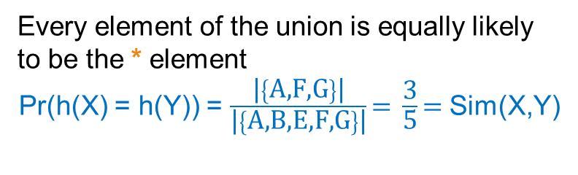
Example
Universe: U = {A,B,C,D,E,F,G}
X = {A,B,F,G}
Y = {A,E,F,G}
Union =
{A,B,E,F,G}
Intersection =
{A,F,G}
Every element of the union is equally likely to be the * element
Pr(h(X) = h(Y)) = $\frac{\text{|}\left\{\text{A}\text{,}\text{F}\text{,}\text{G}\right\}\text{|}}{\text{|}\left\{\text{A}\text{,}\text{B}\text{,}\text{E}\text{,}\text{F}\text{,}\text{G}\right\}\text{|}}\text{= }\frac{\text{3}}{\text{5}}\text{= }$Sim(X,Y)
 | X | Y
A | 1 | 1
B | 1 | 0
C | 0 | 0
D | 0 | 0
E | 0 | 1
F | 1 | 1
G | 1 | 1
 | X | Y
D | 0 | 0
C | 0 | 0
D
*
*
C
*
*
*

Slide 66
Similarity for Signatures
The similarity of signatures is the fraction of the hash functions in which they agree.
With multiple signatures we get a good approximation
 | S₁ | S₂ | S₃ | S₄
A | 1 | 0 | 1 | 0
B | 1 | 0 | 0 | 1
C | 0 | 1 | 0 | 1
D | 0 | 1 | 0 | 1
E | 0 | 1 | 0 | 1
F | 1 | 0 | 1 | 0
G | 1 | 0 | 1 | 0
Signature matrix
 | Actual | Sig
(S₁, S₂) | 0 | 0
(S₁, S₃) | 3/5 | 2/3
(S₁, S₄) | 1/7 | 0
(S₂, S₃) | 0 | 0
(S₂, S₄) | 3/4 | 1
(S₃, S₄) | 0 | 0
S₁ | S₂ | S₃ | S₄
1 | 2 | 1 | 2
2 | 1 | 3 | 1
3 | 1 | 3 | 1
≈
Zero similarity is preserved
High similarity is well approximated

Slide 67
Is it now feasible?
Assume a billion rows
Hard to pick a random permutation of 1…billion
Even representing a random permutation requires 1 billion entries!!!
How about accessing rows in permuted order?
☹

Slide 68
Being more practical
Approximating row permutations: pick k=100 hash functions (h₁,…,h_{k})
for each row r
for each hash function h_{i}
compute h_{i} (r )
for each column S that has 1 in row r
if h_{i} (r ) is a smaller value than Sig(S,i) then
  Sig(S,i) = h_{i} (r);
In practice this means selecting the function parameters
In practice only the rows (shingles) that appear in the data
h_{i} (r) = index of shingle r in permutation
S contains shingle r
Find the shingle r with minimum index
Sig(S,i) will become the smallest value of h_{i}(r) among all rows (shingles) for which column S has value 1 (shingle belongs in S); i.e., h_{i} (r) gives the min index for the i-th permutation

Slide 69
Example
Sig1 Sig2
h(0) = 1 1 -
g(0) = 3 3 -
x
0
1
2
3
4
Row S1 S2
A 1 0
B 0 1
C 1 1
D 1 0
E 0 1
h(1) = 2 1 2
g(1) = 0 3 0
h(2) = 3 1 2
g(2) = 2 2 0
h(3) = 4 1 2
g(3) = 4 2 0
h(x) = x+1 mod 5
g(x) = 2x+3 mod 5
h(x)
1
2
3
4
0
Row S1 S2
E 0 1
A 1 0
B 0 1
C 1 1
D 1 0
g(x)
3
0
2
4
1
Row S1 S2
B 0 1
E 0 1
C 1 0
A 1 1
D 1 0
h(4) = 0 1 0
g(4) = 1 2 0

Slide 70
Implementation – (4)
Often, data is given by column, not row.
  E.g., columns = documents, rows = shingles.
If so, sort matrix once so it is by row.
And always compute h_{i} (r ) only once for each row.

