Slide 1
DATA MINING
LECTURE 12
Link Analysis Ranking
Random walks

Slide 2
GRAPHS and LINK ANALYSIS RANKING

Slide 3
Link Analysis Ranking
Use the graph structure in order to determine the relative importance of the nodes
  Applications: Ranking on graphs (Web, Twitter, FB, etc)
Intuition: An edge from node p to node q denotes endorsement
  Node p endorses/recommends/confirms the authority/centrality/importance of node q
  Use the graph of recommendations to assign an authority value to every node

Slide 4





Rank by Popularity
Rank pages according to the number of incoming edges (in-degree, degree centrality)
$$v_{2}$$
Red Page
Yellow Page
Blue Page
Purple Page
Green Page
$$v_{1}$$
$$v_{3}$$
$$v_{5}$$
$$v_{4}$$

Slide 5
Popularity
It is not important only how many link to you, but how important are the people that link to you.
Good authorities are pointed by good authorities
  Recursive definition of importance

Slide 6
PageRank
w
Good authorities should be pointed by good authorities
  The value of a node is the value of the nodes that point to it.
How do we implement that?
  Assume that we have a unit of authority to distribute to all nodes.
  Each node distributes the authority value they have to their neighbors
  The authority value of each node is the sum of the authority fractions it collects from its neighbors.
  Solving the system of equations we get the authority values for the nodes
    w = ½ , w = ¼ , w = ¼
w
w
w + w + w = 1
w = w + w
w = ½ w
w = ½ w

Slide 7

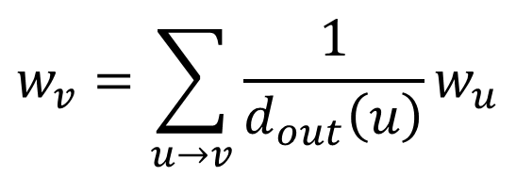




A more complex example
$$v_{2}$$
$$v_{1}$$
w₁ = 1/3 w₄ + 1/2 w₅
$$v_{3}$$
w₂ = 1/2 w₁ + w₃ + 1/3 w₄
w₃ = 1/2 w₁ + 1/3 w₄
w₄ = 1/2 w₅
w₅ = w₂
$$v_{5}$$
$$v_{4}$$
$$w_{v}=\sum_{u→v}{\frac{1}{d_{out}\left(u\right)}w_{u}}$$

Slide 8
Random Walks on Graphs
What we described is equivalent to a random walk on the graph
Random walk:
  Start from a node uniformly at random
  Pick one of the outgoing edges uniformly at random
  Move to the destination of the edge
  Repeat.

Slide 9





Example
Step 0
$$v_{2}$$
$$v_{1}$$
$$v_{3}$$
$$v_{5}$$
$$v_{4}$$

Slide 10
Example
Step 0
$$v_{2}$$
$$v_{1}$$
$$v_{3}$$
$$v_{5}$$
$$v_{4}$$

Slide 11
Example
Step 1
$$v_{2}$$
$$v_{1}$$
$$v_{3}$$
$$v_{5}$$
$$v_{4}$$

Slide 12
Example
Step 1
$$v_{2}$$
$$v_{1}$$
$$v_{3}$$
$$v_{5}$$
$$v_{4}$$

Slide 13
Example
Step 2
$$v_{2}$$
$$v_{1}$$
$$v_{3}$$
$$v_{5}$$
$$v_{4}$$

Slide 14
Example
Step 2
$$v_{2}$$
$$v_{1}$$
$$v_{3}$$
$$v_{5}$$
$$v_{4}$$

Slide 15
Example
Step 3
$$v_{2}$$
$$v_{1}$$
$$v_{3}$$
$$v_{5}$$
$$v_{4}$$

Slide 16
Example
Step 3
$$v_{2}$$
$$v_{1}$$
$$v_{3}$$
$$v_{5}$$
$$v_{4}$$

Slide 17
Example
Step 4…
$$v_{2}$$
$$v_{1}$$
$$v_{3}$$
$$v_{5}$$
$$v_{4}$$

Slide 18

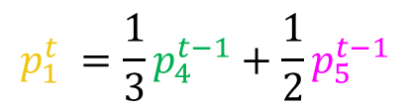





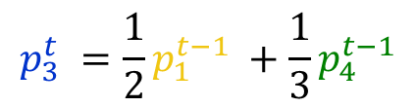


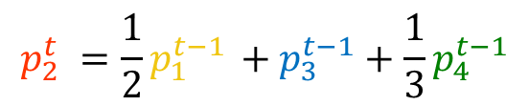
Memorylessness
Question: what is the probability $p_{i}^{t}$ of being at node $i$after $t$ steps?
Memorylessness property: The next node on the walk depends only at the current node and not on the past of the process
$$p_{1}^{t} =\frac{1}{3}p_{4}^{t−1}+\frac{1}{2}p_{5}^{t−1}$$
$$v_{2}$$
$$p_{1}^{t}$$
$$p_{2}^{t} =\frac{1}{2}p_{1}^{t−1} +p_{3}^{t−1}+\frac{1}{3}p_{4}^{t−1}$$
$$v_{1}$$
$$p_{2}^{t}$$
$$v_{3}$$
$$p_{3}^{t} =\frac{1}{2}p_{1}^{t−1} +\frac{1}{3}p_{4}^{t−1}$$
$$p_{3}^{t}$$
$$p_{4}^{t} =\frac{1}{2}p_{5}^{t−1}$$
$$p_{4}^{t}$$
$$p_{5}^{t} = p_{2}^{t−1}$$
$$p_{5}^{t}$$
$$v_{5}$$
$$v_{4}$$

Slide 19
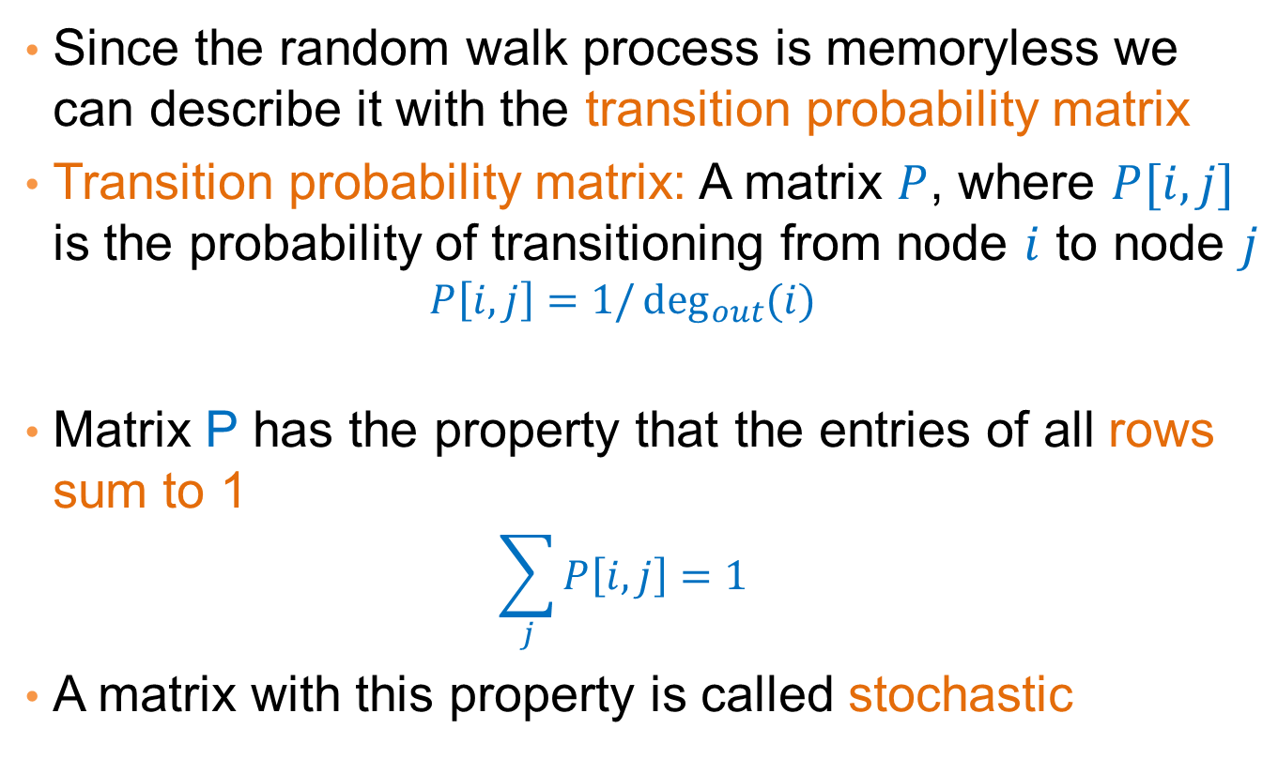
Transition probability matrix
Since the random walk process is memoryless we can describe it with the transition probability matrix
Transition probability matrix: A matrix $P$, where $P[i,j]$ is the probability of transitioning from node $i$ to node $j$
  $$P\left[i,j\right]=1/\deg_{out}{(i)}$$
Matrix P has the property that the entries of all rows sum to 1
  $$\sum_{j}{P\left[i,j\right]=1}$$
A matrix with this property is called stochastic

Slide 20





An example
$$v_{2}$$
$$v_{1}$$
$$v_{3}$$
$$v_{5}$$
$$v_{4}$$

Slide 21
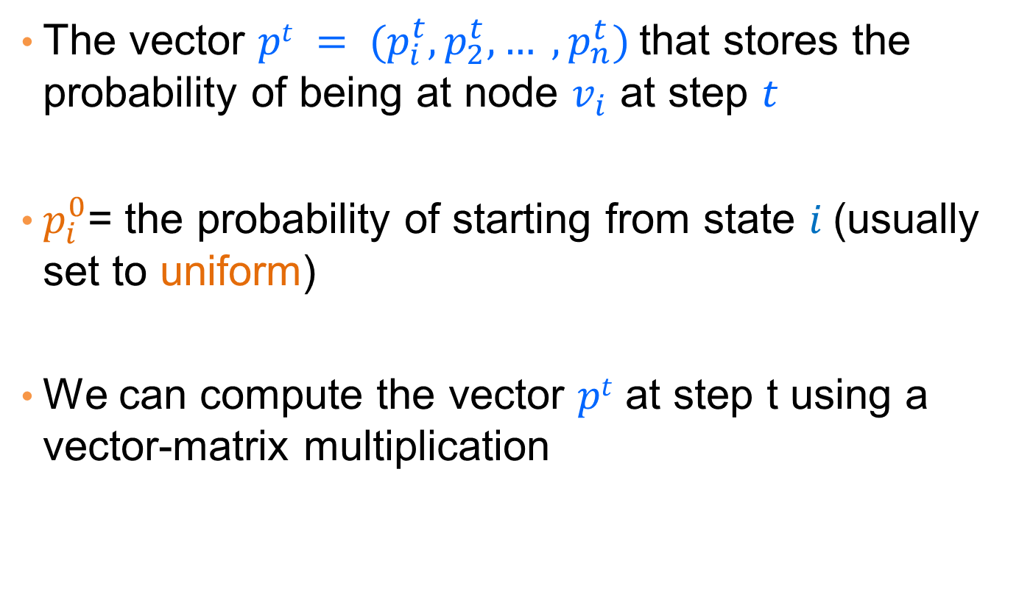

Node Probability vector
The vector $pt = (p_{i}^{t},p_{2}^{t}, … ,p_{n}^{t})$that stores the probability of being at node $v_{i}$ at step $t$
$p_{i}^{0}$= the probability of starting from state $i$(usually set to uniform)
We can compute the vector $pt$ at step t using a vector-matrix multiplication
$$p^{t}=p^{t−1} P$$

Slide 22
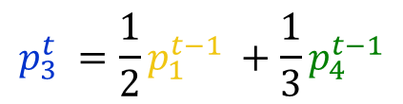
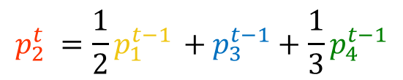
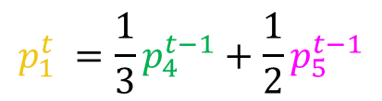

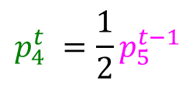
An example
$$v_{2}$$
$$v_{1}$$
$$v_{3}$$
$$p_{1}^{t} =\frac{1}{3}p_{4}^{t−1}+\frac{1}{2}p_{5}^{t−1}$$
$$p_{2}^{t} =\frac{1}{2}p_{1}^{t−1} +p_{3}^{t−1}+\frac{1}{3}p_{4}^{t−1}$$
$$v_{5}$$
$$v_{4}$$
$$p_{3}^{t} =\frac{1}{2}p_{1}^{t−1} +\frac{1}{3}p_{4}^{t−1}$$
$$p_{4}^{t} =\frac{1}{2}p_{5}^{t−1}$$
$$p_{5}^{t} = p_{2}^{t−1}$$

Slide 23
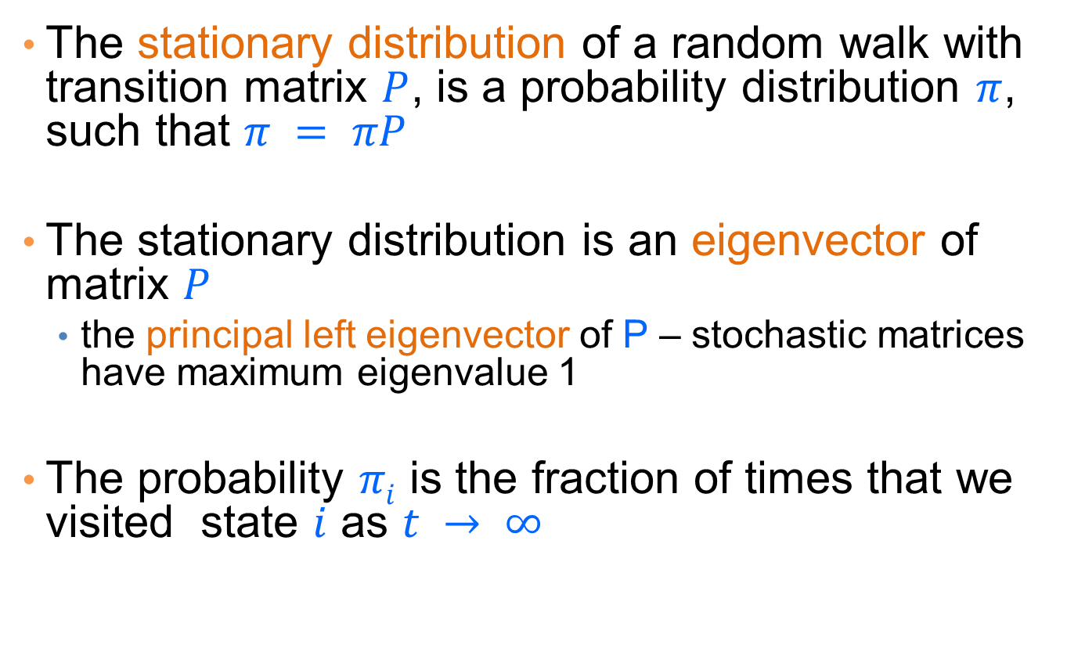
Stationary distribution
The stationary distribution of a random walk with transition matrix $P$, is a probability distribution $π$, such that $π = πP$
The stationary distribution is an eigenvector of matrix $P$
  the principal left eigenvector of P – stochastic matrices have maximum eigenvalue 1
The probability $πi$ is the fraction of times that we visited state $i$ as $t → ∞$

Slide 24
Computing the stationary distribution
The Power Method
  Initialize to some distribution q⁰
  Iteratively compute q^{t} = q^{t-1}P
  After many iterations q^{t} ≈ π regardless of the initial vector q⁰
  Power method because it computes q^{t} = q⁰P^{t}
Rate of convergence
  determined by the second eigenvalue λ₂^{t}

Slide 25
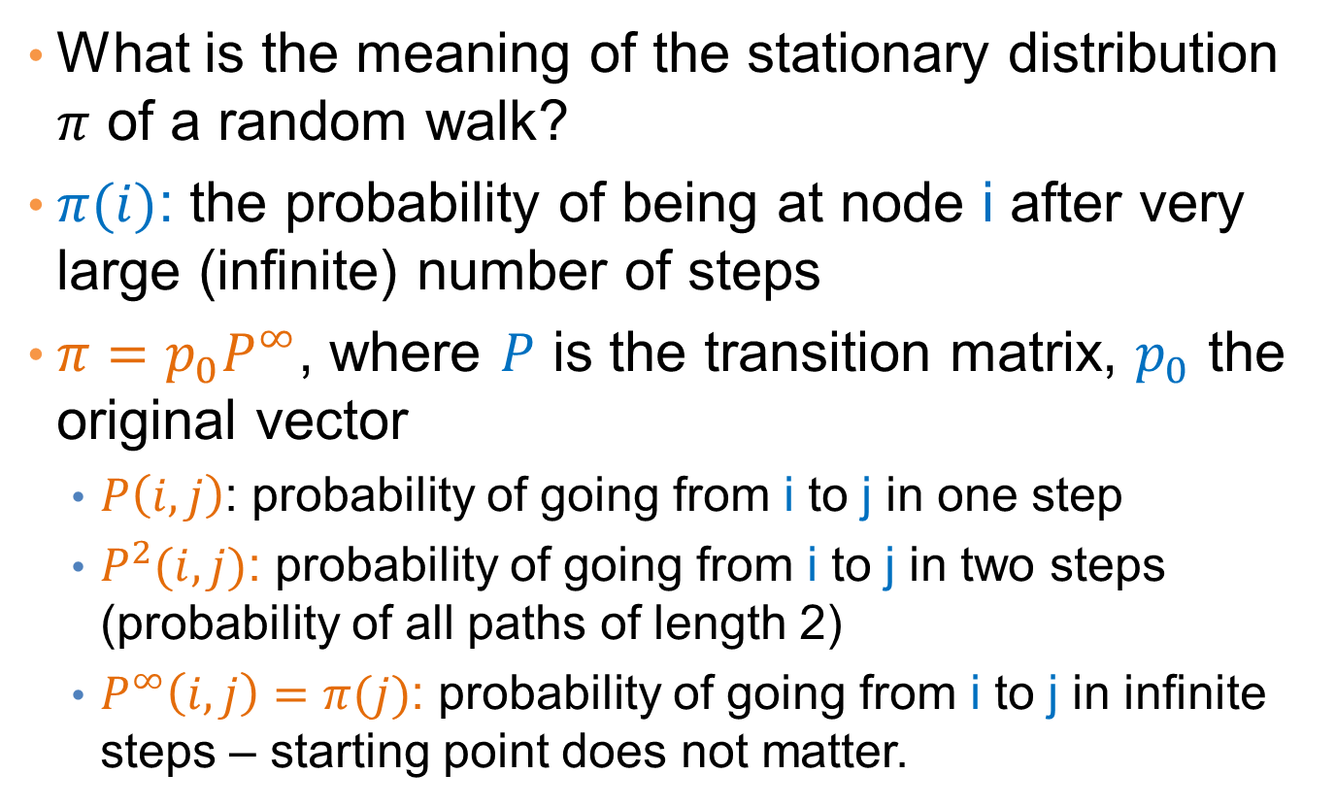
The stationary distribution
What is the meaning of the stationary distribution $π$ of a random walk?
$π(i)$: the probability of being at node i after very large (infinite) number of steps
$π=p_{0}P^{∞}$, where $P$ is the transition matrix, $p_{0}$ the original vector
  $P\left(i,j\right)$: probability of going from i to j in one step
  $P^{2}(i,j)$: probability of going from i to j in two steps (probability of all paths of length 2)
  $P^{∞}\left(i,j\right)=π(j)$: probability of going from i to j in infinite steps – starting point does not matter.

Slide 26
The PageRank random walk
Vanilla random walk
  make the adjacency matrix stochastic and run a random walk

Slide 27
The PageRank random walk
What about sink nodes?
  what happens when the random walk moves to a node without any outgoing inks?

Slide 28
The PageRank random walk
Replace these row vectors with a vector v
  typically, the uniform vector
P’ = P + dv^{T}

Slide 29
The PageRank random walk
What about loops?
  Spider traps

Slide 30
The PageRank random walk
Add a random jump to vector v with prob 1-α
  typically, to a uniform vector
Restarts after 1/(1-α) steps in expectation
  Guarantees irreducibility, convergence
P’’ = αP’ + (1-α)uv^{T}, where u is the vector of all 1s
Random walk with restarts

Slide 31
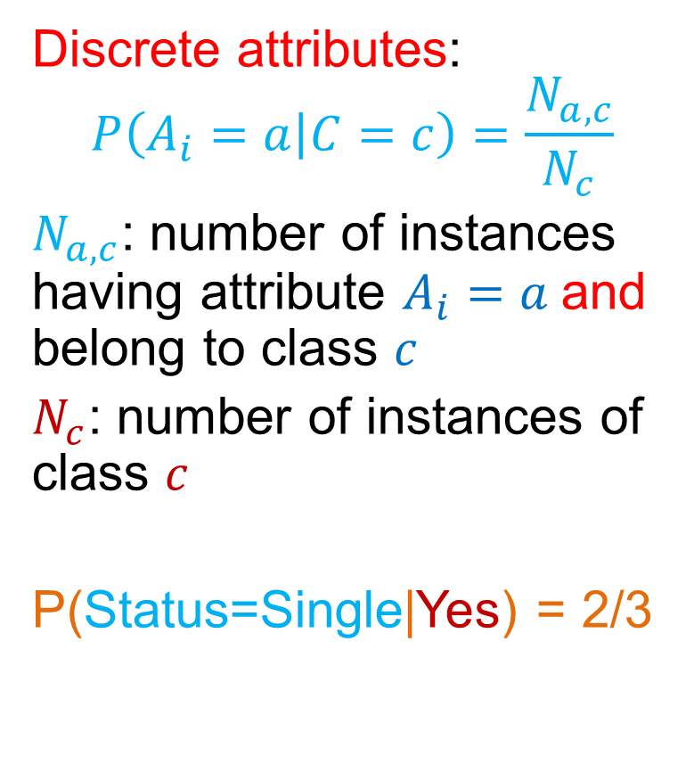
PageRank algorithm [BP98]
The Random Surfer model
  pick a page at random
  with probability 1- α jump to a random page
  with probability α follow a random outgoing link
Rank according to the stationary distribution
Red Page
Purple Page
Yellow Page
Blue Page
Green Page
$α = 0.85$in most cases

Slide 32
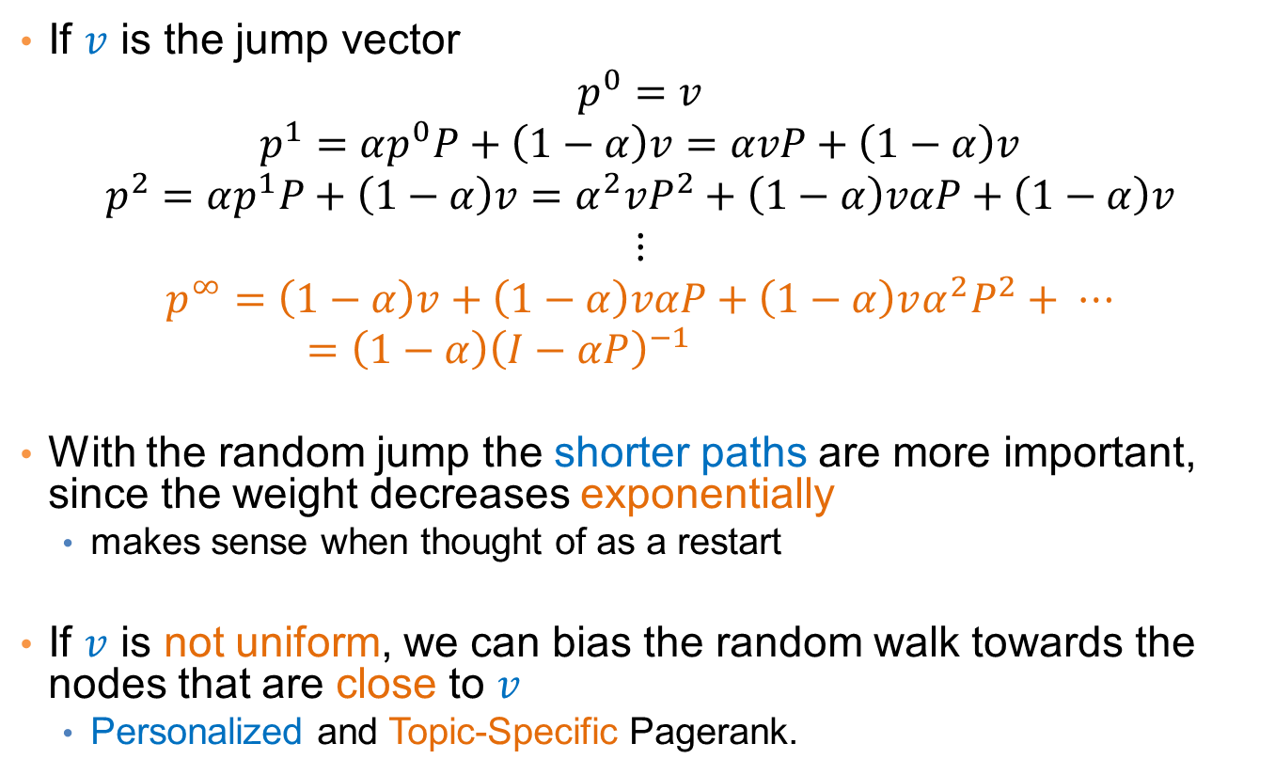
Stationary distribution with random jump
If $v$ is the jump vector
$$p^{0}=v$$
$$p^{1}=αp^{0}P+\left(1−α\right)v=αvP+\left(1−α\right)v$$
$$p^{2}=αp^{1}P+\left(1−α\right)v=α^{2}vP^{2}+\left(1−α\right)vαP+\left(1−α\right)v$$
$$⋮$$
$$p^{∞}=\left(1−α\right)v+\left(1−α\right)vαP+\left(1−α\right)vα^{2}P^{2}+ ⋯=\left(1−α\right){\left(I−αP\right)}^{−1}$$
With the random jump the shorter paths are more important, since the weight decreases exponentially
  makes sense when thought of as a restart
If $v$ is not uniform, we can bias the random walk towards the nodes that are close to $v$
  Personalized and Topic-Specific Pagerank.

Slide 33
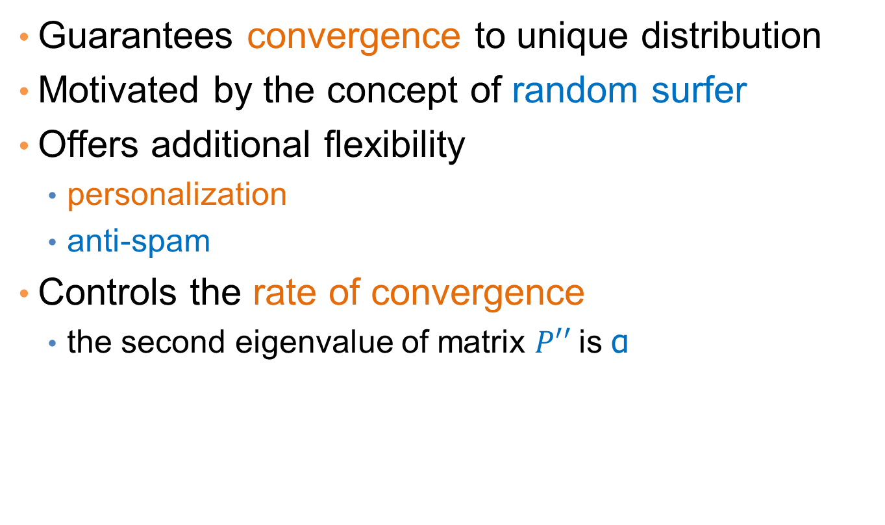
Effects of random jump
Guarantees convergence to unique distribution
Motivated by the concept of random surfer
Offers additional flexibility
  personalization
  anti-spam
Controls the rate of convergence
  the second eigenvalue of matrix $P′′$is α

Slide 34
Random walks on undirected graphs
For undirected graphs, the stationary distribution is proportional to the degrees of the nodes
  Thus in this case a random walk is the same as degree popularity
This is not longer true if we do random jumps
  Now the short paths play a greater role, and the previous distribution does not hold.

Slide 35
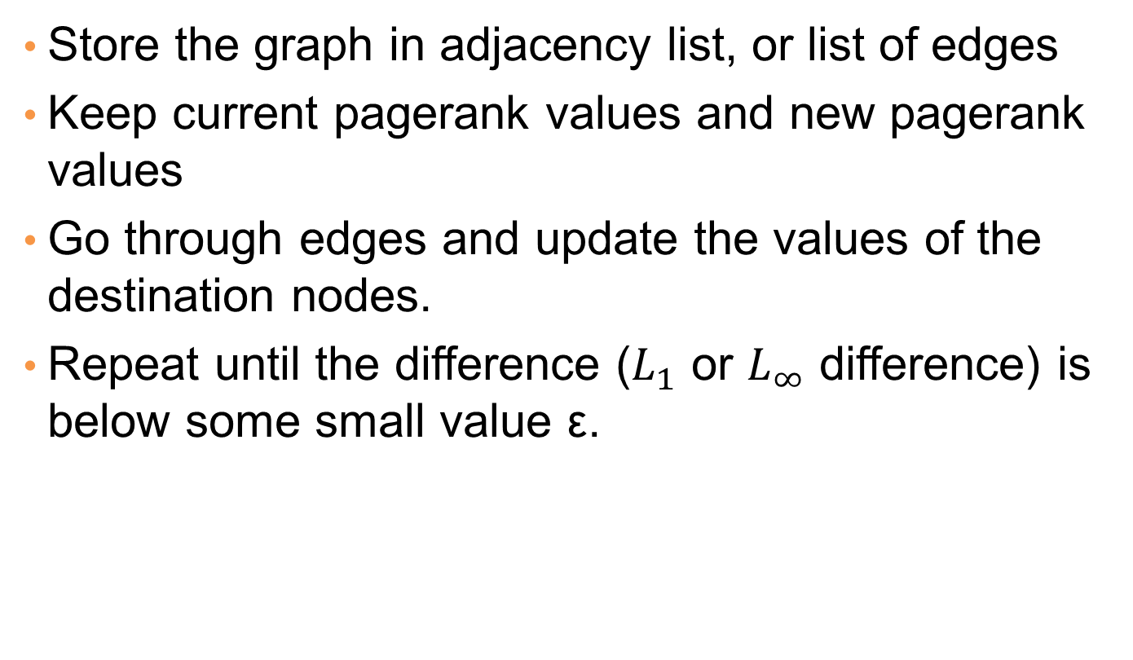
Pagerank implementation
Store the graph in adjacency list, or list of edges
Keep current pagerank values and new pagerank values
Go through edges and update the values of the destination nodes.
Repeat until the difference ($L_{1}$ or $L_{∞}$ difference) is below some small value ε.

Slide 36
A (Matlab-friendly) PageRank algorithm
Performing vanilla power method is now too expensive – the matrix is not sparse
q⁰ = v
t = 1
repeat
t = t +1
until δ < ε
Efficient computation of y = (P’’)^{T} x
P = normalized adjacency matrix
P’ = P + dv^{T}, where d_{i} is 1 if i is sink and 0 o.w.
P’’ = αP’ + (1-α)uv^{T}, where u is the vector of all 1s

Slide 37
Pagerank history
Huge advantage for Google in the early days
  It gave a way to get an idea for the value of a page, which was useful in many different ways
    Put an order to the web.
  After a while it became clear that the anchor text was probably more important for ranking
  Also, link spam became a new (dark) art
Flood of research
  Numerical analysis got rejuvenated
  Huge number of variations
  Efficiency became a great issue.
  Huge number of applications in different fields
    Random walk is often referred to as PageRank.

Slide 38
THE HITS ALGORITHM

Slide 39
The HITS algorithm
Another algorithm proposed around the same time as Pagerank for using the hyperlinks to rank pages
  Kleinberg: then an intern at IBM Almaden
  IBM never made anything out of it

Slide 40
Query dependent input
Root set obtained from a text-only search engine
Root Set

Slide 41
Query dependent input
Root Set
IN
OUT

Slide 42
Query dependent input
Root Set
IN
OUT

Slide 43
Query dependent input
Base Set
Root Set
IN
OUT

Slide 44
Hubs and Authorities [K98]
Authority is not necessarily transferred directly between authorities
Pages have double identity
  hub identity
  authority identity
Good hubs point to good authorities
Good authorities are pointed by good hubs
hubs
authorities

Slide 45
Hubs and Authorities
Two kind of weights:
  Hub weight
  Authority weight
The hub weight is the sum of the authority weights of the authorities pointed to by the hub
The authority weight is the sum of the hub weights that point to this authority.

Slide 46
HITS Algorithm
Initialize all weights to 1.
Repeat until convergence
  O operation : hubs collect the weight of the authorities
  I operation: authorities collect the weight of the hubs
  Normalize weights under some norm

Slide 47
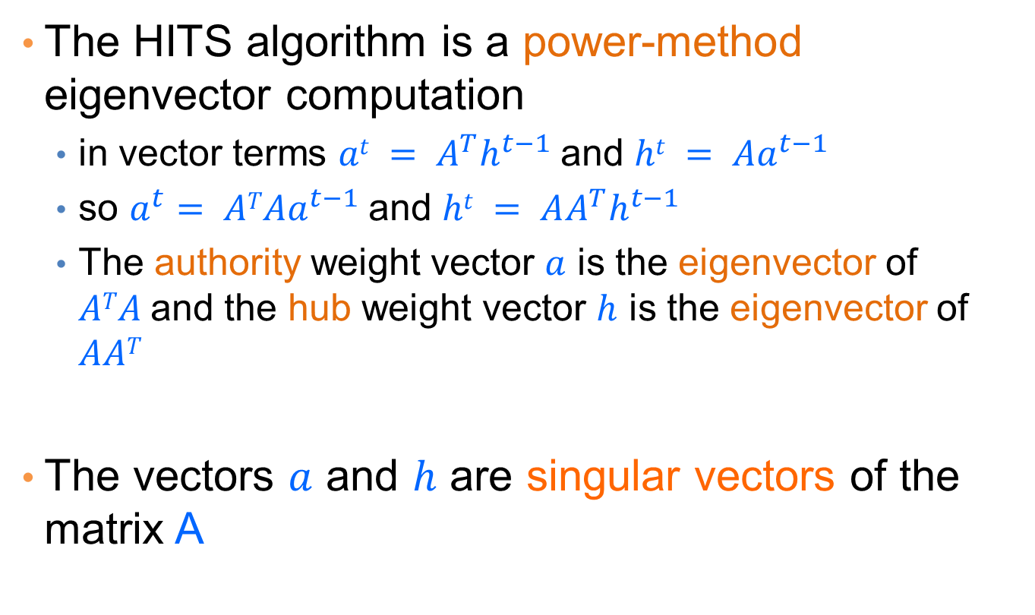
HITS and eigenvectors
The HITS algorithm is a power-method eigenvector computation
  in vector terms $at = A^{T}h^{t−1}$and $ht = Aa^{t−1}$
  so $a^{t}= ATAa^{t−1}$and $ht = AA^{T}h^{t−1}$
  The authority weight vector $a$ is the eigenvector of $ATA$and the hub weight vector $h$ is the eigenvector of $AAT$
The vectors $a$ and $h$ are singular vectors of the matrix A

Slide 48
Example
Initialize
1
1
1
1
1
1
1
1
1
1
hubs
authorities

Slide 49
Example
Step 1: O operation
1
1
2
1
3
1
2
1
1
1
hubs
authorities

Slide 50
Example
Step 1: I operation
1
6
2
5
3
5
2
2
1
1
hubs
authorities

Slide 51
Example
Step 1: Normalization (Max norm)
1/3
1
2/3
5/6
1
5/6
2/3
2/6
1/3
1/6
hubs
authorities

Slide 52
Example
Step 2: O step
1
1
11/6
5/6
16/6
5/6
7/6
2/6
1/6
1/6
hubs
authorities

Slide 53
Example
Step 2: I step
1
33/6
11/6
27/6
16/6
23/6
7/6
7/6
1/6
1/6
hubs
authorities

Slide 54
Example
Step 2: Normalization
6/16
1
11/16
27/33
1
23/33
7/16
7/33
1/16
1/33
hubs
authorities

Slide 55
Example
Convergence
0.4
1
0.75
0.8
1
0.6
0.3
0.14
0
0
hubs
authorities

Slide 56
OTHER ALGORITHMS

Slide 57
The SALSA algorithm [LM00]
Perform a random walk alternating between hubs and authorities
What does this random walk converge to?
The graph is essentially undirected, so it will be proportional to the degree.
hubs
authorities

Slide 58
Social network analysis
Evaluate the centrality of individuals in social networks
  degree centrality
    the (weighted) degree of a node
  distance centrality
    the average (weighted) distance of a node to the rest in the graph
  betweenness centrality
    the average number of (weighted) shortest paths that use node v

Slide 59
Counting paths – Katz 53
The importance of a node is measured by the weighted sum of paths that lead to this node
A^{m}[i,j] = number of paths of length m from i to j
Compute
converges when b < λ₁(A)
Rank nodes according to the column sums of the matrix P

Slide 60
Bibliometrics
Impact factor (E. Garfield 72)
  counts the number of citations received for papers of the journal in the previous two years
Pinsky-Narin 76
  perform a random walk on the set of journals
  P_{ij} = the fraction of citations from journal i that are directed to journal j

