Slide 1
DATA MINING
LECTURE 11
Classification
Naïve Bayes
Supervised Learning
Graphs And Centrality

Slide 2
NAÏVE BAYES CLASSIFIER

Slide 3
Bayes Classifier
A probabilistic framework for solving classification problems
A, C random variables
Joint probability: Pr(A=a,C=c)
Conditional probability: Pr(C=c | A=a)
Relationship between joint and conditional probability distributions
Bayes Theorem:

Slide 4
Bayesian Classifiers
  How to classify the new record X = (‘Yes’, ‘Single’, 80K)
Find the class with the highest probability given the vector values.
    Maximum Aposteriori Probability estimate:
  Find the value c for class C that maximizes P(C=c| X)
How do we estimate P(C|X) for the different values of C?
  We want to estimate P(C=Yes| X)
  and P(C=No| X)

Slide 5
Bayesian Classifiers
In order for probabilities to be well defined:
  Consider each attribute and the class label as random variables
  Probabilities are determined from the data
Evade C
Event space: {Yes, No}
P(C) = (0.3, 0.7)
Refund A₁
Event space: {Yes, No}
P(A₁) = (0.3,0.7)
Martial Status A₂
Event space: {Single, Married, Divorced}
P(A₂) = (0.4,0.4,0.2)
Taxable Income A₃
Event space: R
P(A₃) ~ Normal(μ,σ²)
μ = 104:sample mean, σ²=1874:sample var

Slide 6
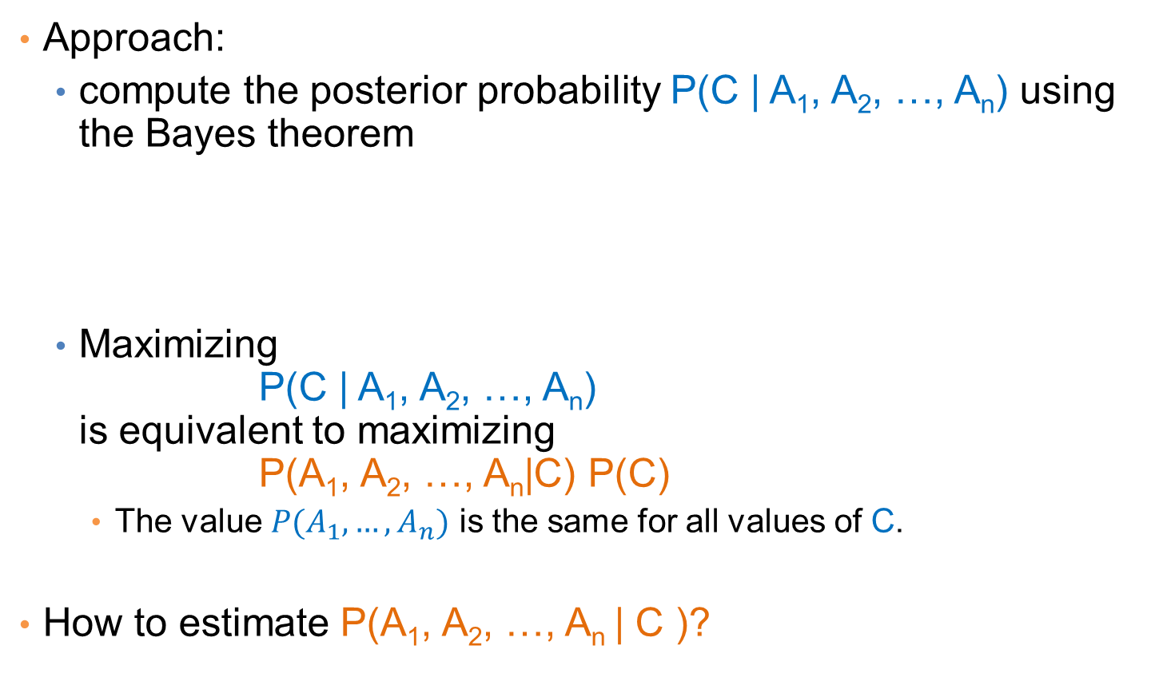
Bayesian Classifiers
Approach:
  compute the posterior probability P(C | A₁, A₂, …, A_{n}) using the Bayes theorem
  Maximizing
  P(C | A₁, A₂, …, A_{n})
  is equivalent to maximizing
  P(A₁, A₂, …, A_{n}|C) P(C)
    The value $P(A_{1},…,A_{n})$ is the same for all values of C.
How to estimate P(A₁, A₂, …, A_{n} | C )?

Slide 7
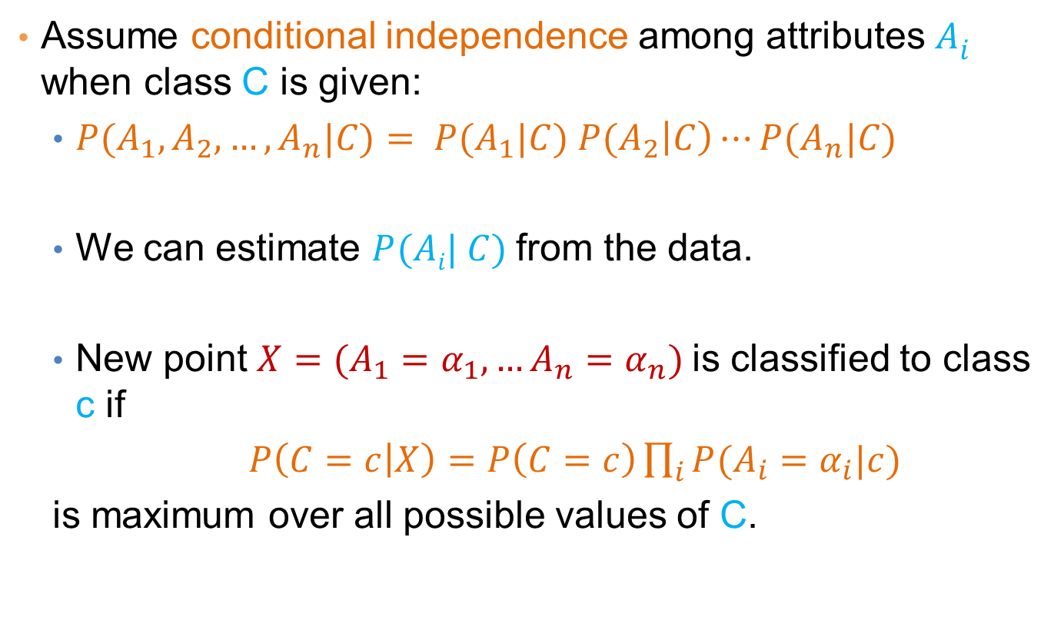
Naïve Bayes Classifier
Assume conditional independence among attributes $Ai$ when class C is given:
  $P(A_{1},A_{2},…,A_{n}|C)= P(A_{1}|C) P(A_{2}\left|C\right)⋯P(A_{n}|C)$
  We can estimate $P(Ai| C)$from the data.
  New point $X=(A_{1}=α_{1}, …A_{n}=α_{n})$is classified to class c if
  $P\left(C=c | X\right)=P\left(C=c\right)\prod_{i}{P(A_{i}=α_{i}|c)}$
  is maximum over all possible values of C.

Slide 8
Example
  Record
    X = (Refund = Yes, Status = Single, Income =80K)
For the class C = ‘Evade’, we want to compute:
  P(C = Yes|X) and P(C = No| X)
We compute:
  P(C = Yes|X) = P(C = Yes)*P(Refund = Yes |C = Yes)
  *P(Status = Single |C = Yes)
  *P(Income =80K |C= Yes)
  P(C = No|X) = P(C = No)*P(Refund = Yes |C = No)
  *P(Status = Single |C = No)
  *P(Income =80K |C= No)

Slide 9
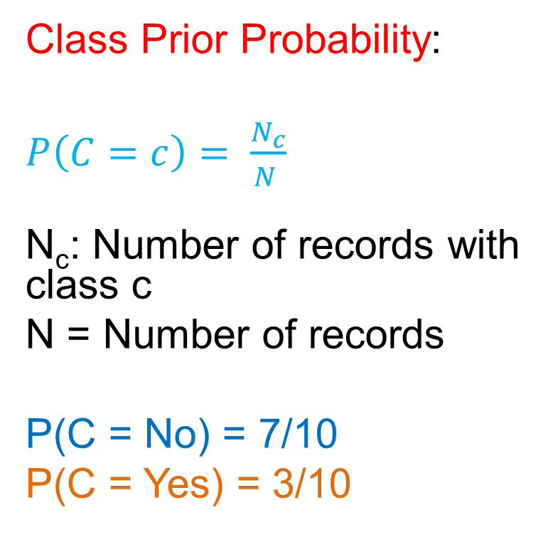
How to Estimate Probabilities from Data?
Class Prior Probability:
$P\left(C=c\right)= \frac{N_{c}}{N }$
N_{c}: Number of records with class c
N = Number of records
P(C = No) = 7/10
P(C = Yes) = 3/10

Slide 10
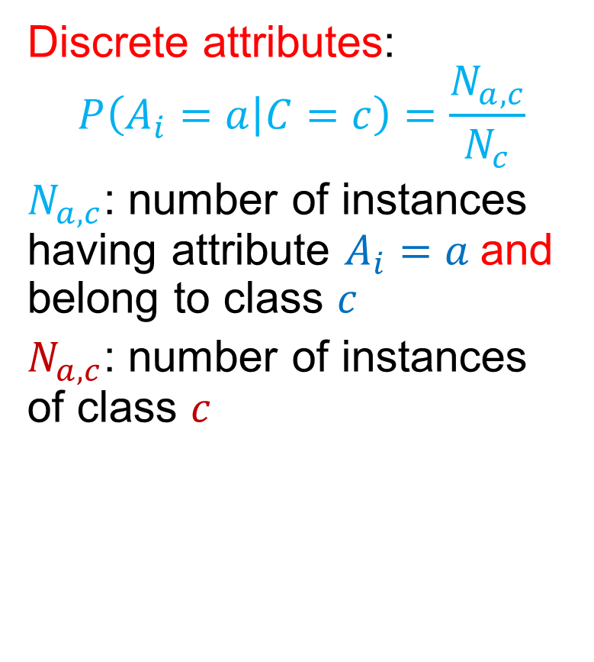
How to Estimate Probabilities from Data?
Discrete attributes:
$$P\left(A_{i}=a | C=c\right)=\frac{N_{a,c}}{N_{c}}$$
$N_{a,c}$: number of instances having attribute $A_{i}=a$and belong to class $c$
$N_{a,c}$: number of instances of class $c$

Slide 11
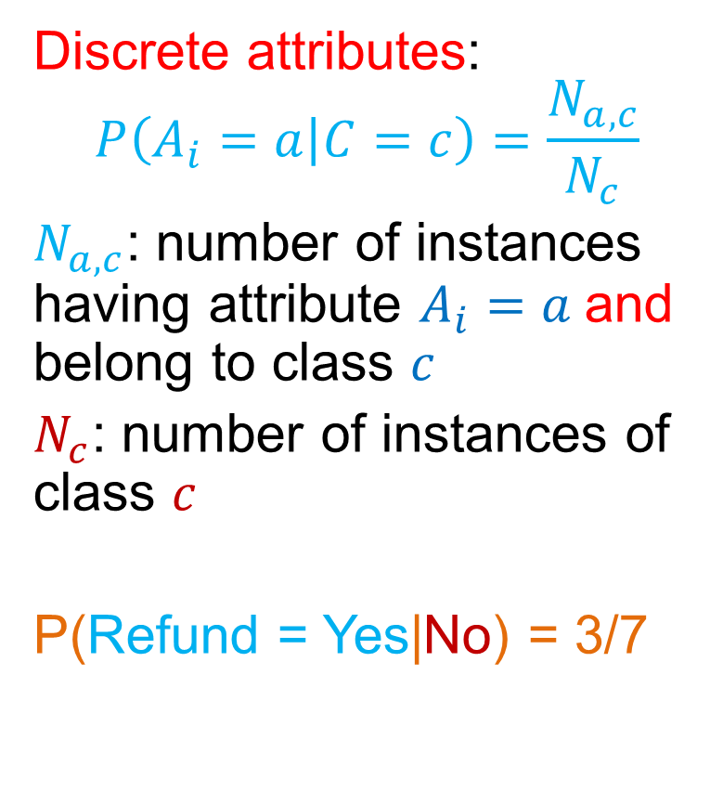
How to Estimate Probabilities from Data?
Discrete attributes:
$$P\left(A_{i}=a | C=c\right)=\frac{N_{a,c}}{N_{c}}$$
$N_{a,c}$: number of instances having attribute $A_{i}=a$and belong to class $c$
$N_{c}$: number of instances of class $c$
P(Refund = Yes|No) = 3/7

Slide 12
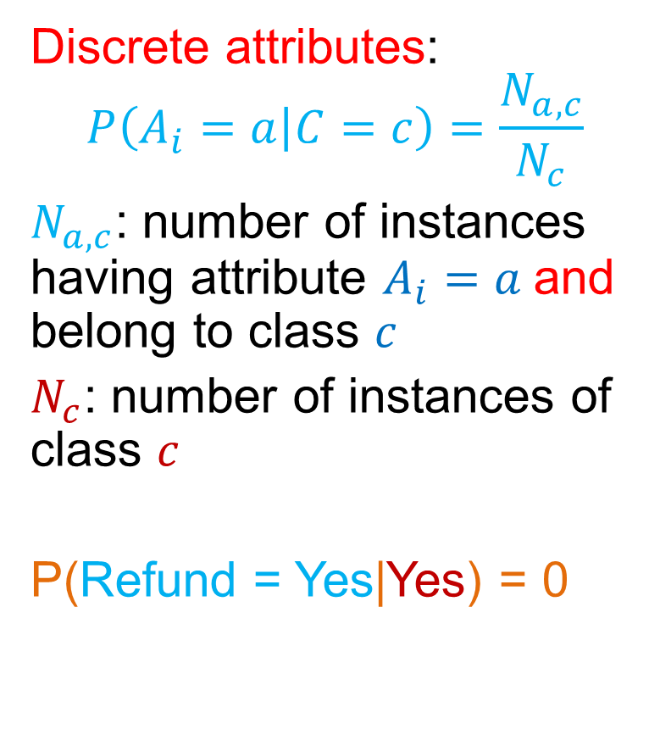
How to Estimate Probabilities from Data?
Discrete attributes:
$$P\left(A_{i}=a | C=c\right)=\frac{N_{a,c}}{N_{c}}$$
$N_{a,c}$: number of instances having attribute $A_{i}=a$and belong to class $c$
$N_{c}$: number of instances of class $c$
P(Refund = Yes|Yes) = 0

Slide 13
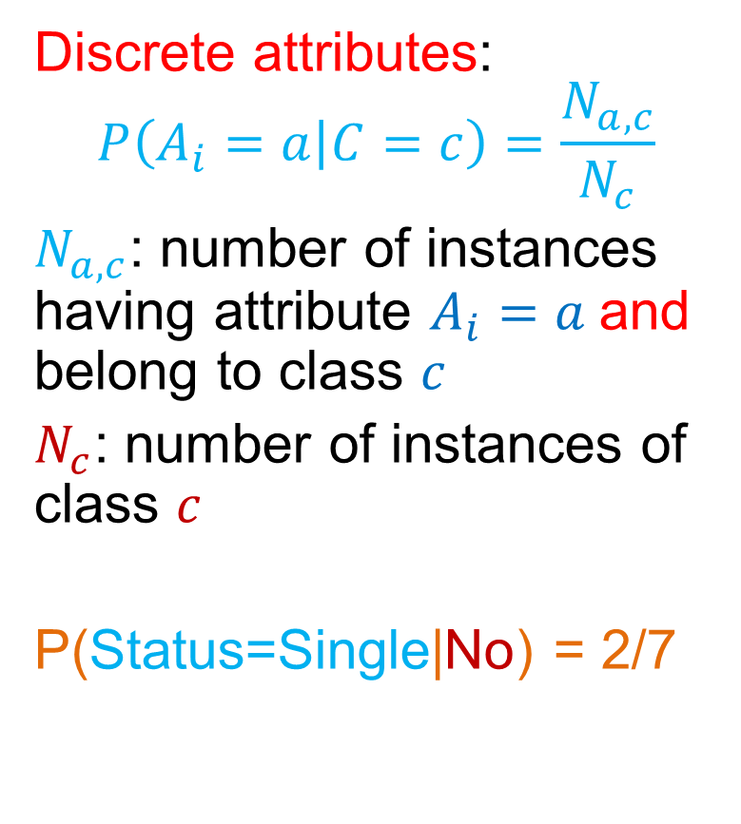
How to Estimate Probabilities from Data?
Discrete attributes:
$$P\left(A_{i}=a | C=c\right)=\frac{N_{a,c}}{N_{c}}$$
$N_{a,c}$: number of instances having attribute $A_{i}=a$and belong to class $c$
$N_{c}$: number of instances of class $c$
P(Status=Single|No) = 2/7

Slide 14
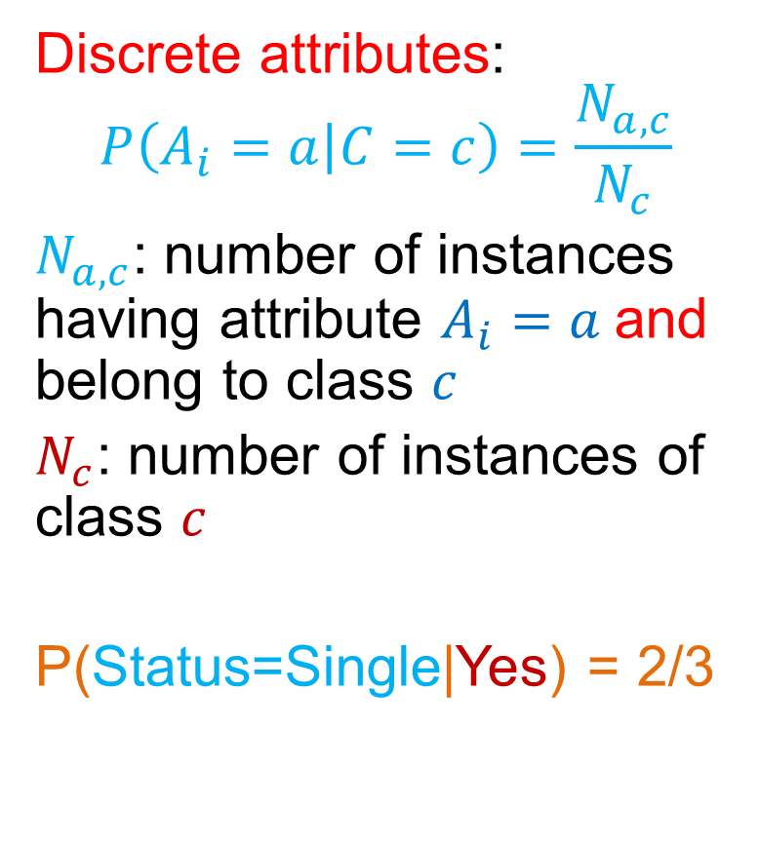
How to Estimate Probabilities from Data?
Discrete attributes:
$$P\left(A_{i}=a | C=c\right)=\frac{N_{a,c}}{N_{c}}$$
$N_{a,c}$: number of instances having attribute $A_{i}=a$and belong to class $c$
$N_{c}$: number of instances of class $c$
P(Status=Single|Yes) = 2/3

Slide 15
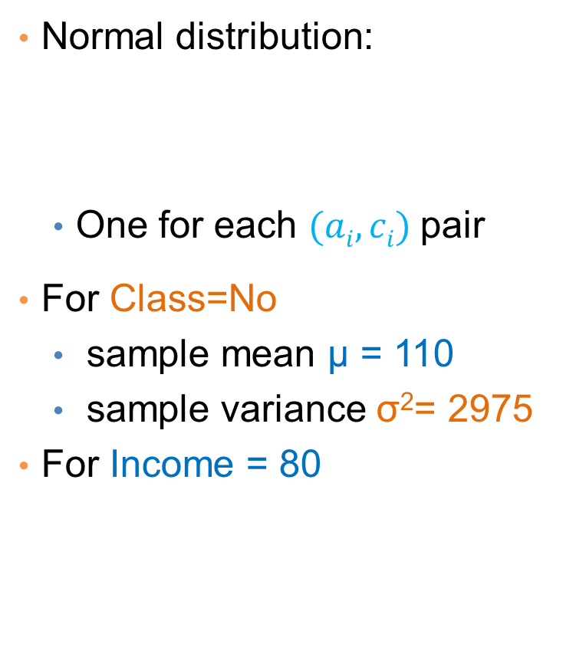
How to Estimate Probabilities from Data?
Normal distribution:
  One for each $(ai,ci)$pair
For Class=No
  sample mean μ = 110
  sample variance σ²= 2975
For Income = 80

Slide 16

How to Estimate Probabilities from Data?
Normal distribution:
  One for each $(ai,ci)$pair
For Class=Yes
  sample mean μ = 90
  sample variance σ²= 2975
For Income = 80

Slide 17
Example
  Record
    X = (Refund = Yes, Status = Single, Income =80K)
We compute:
  P(C = Yes|X) = P(C = Yes)*P(Refund = Yes |C = Yes)
  *P(Status = Single |C = Yes)
  *P(Income =80K |C= Yes)
  = 3/10* 0 * 2/3 * 0.01 = 0
  P(C = No|X) = P(C = No)*P(Refund = Yes |C = No)
  *P(Status = Single |C = No)
  *P(Income =80K |C= No)
  = 7/10 * 3/7 * 2/7 * 0.0062 = 0.0005

Slide 18
Example of Naïve Bayes Classifier
Creating a Naïve Bayes Classifier, essentially means to compute counts:
Total number of records: N = 10
Class No:
Number of records: 7
Attribute Refund:
Yes: 3
No: 4
Attribute Marital Status:
Single: 2
Divorced: 1
Married: 4
Attribute Income:
mean: 110
variance: 2975
Class Yes:
Number of records: 3
Attribute Refund:
Yes: 0
No: 3
Attribute Marital Status:
Single: 2
Divorced: 1
Married: 0
Attribute Income:
mean: 90
variance: 25

Slide 19
Example of Naïve Bayes Classifier
Given a Test Record:
    X = (Refund = Yes, Status = Single, Income =80K)
P(X|Class=No) = P(Refund=Yes|Class=No)
× P(Married| Class=No)
× P(Income=120K| Class=No)
= 3/7 * 2/7 * 0.0062 = 0.00075
P(X|Class=Yes) = P(Refund=No| Class=Yes)
× P(Married| Class=Yes)
× P(Income=120K| Class=Yes)
= 0 * 2/3 * 0.01 = 0
P(No) = 0.3, P(Yes) = 0.7
Since P(X|No)P(No) > P(X|Yes)P(Yes)
Therefore P(No|X) > P(Yes|X)
=> Class = No

Slide 20
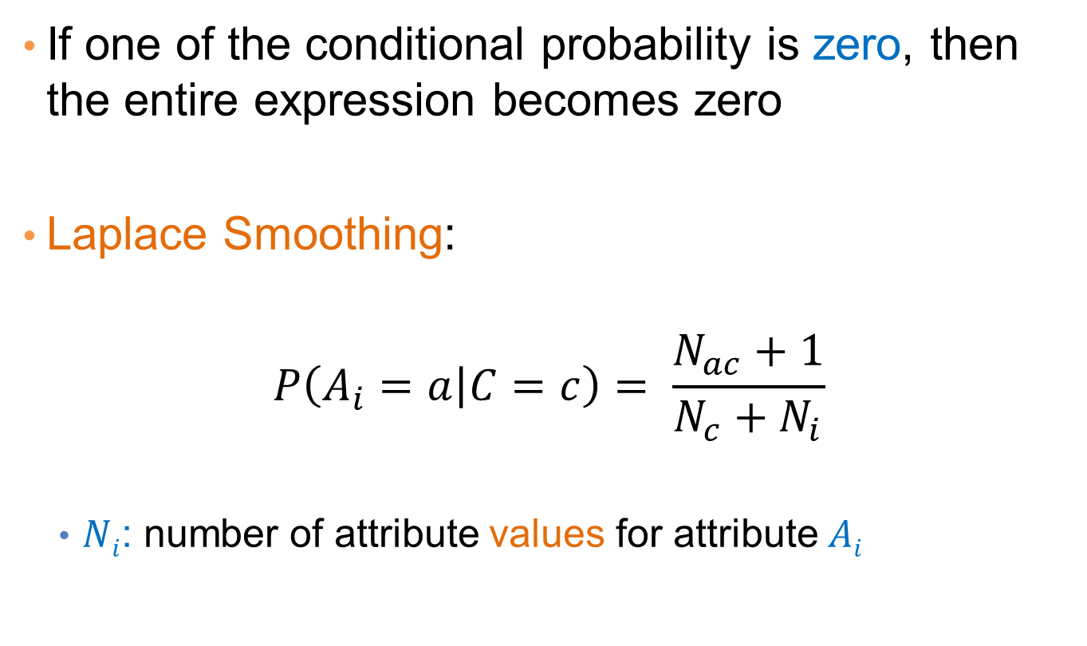
Naïve Bayes Classifier
If one of the conditional probability is zero, then the entire expression becomes zero
Laplace Smoothing:
$$P\left(A_{i}=a | C=c\right)= \frac{N_{ac}+1}{N_{c}+N_{i}}$$
  $Ni$: number of attribute values for attribute $Ai$

Slide 21
Example of Naïve Bayes Classifier
Given a Test Record:
With Laplace Smoothing
    X = (Refund = Yes, Status = Single, Income =80K)
P(X|Class=No) = P(Refund=No|Class=No)
× P(Married| Class=No)
× P(Income=120K| Class=No)
= 4/9 × 3/10 × 0.0062 = 0.00082
P(X|Class=Yes) = P(Refund=No| Class=Yes)
× P(Married| Class=Yes)
× P(Income=120K| Class=Yes)
= 1/5 × 3/6 × 0.01 = 0.001
P(No) = 0.7, P(Yes) = 0.3
P(X|No)P(No) = 0.0005
P(X|Yes)P(Yes) = 0.0003
=> Class = No

Slide 22
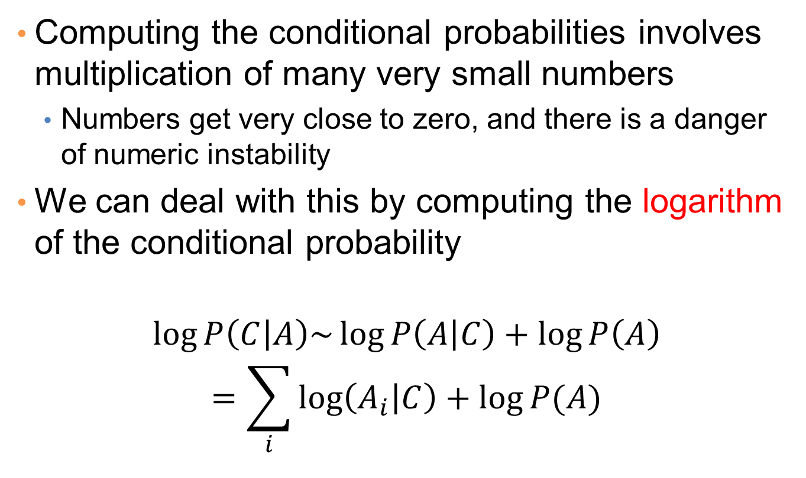
Implementation details
Computing the conditional probabilities involves multiplication of many very small numbers
  Numbers get very close to zero, and there is a danger of numeric instability
We can deal with this by computing the logarithm of the conditional probability
$$\log{P\left(C | A\right)\sim \log{P\left(A | C\right)+\log{P\left(A\right)}}}$$
$$=\sum_{i}{\log\left(A_{i} | C\right)+\log{P(A)}}$$

Slide 23
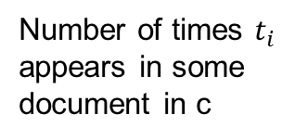
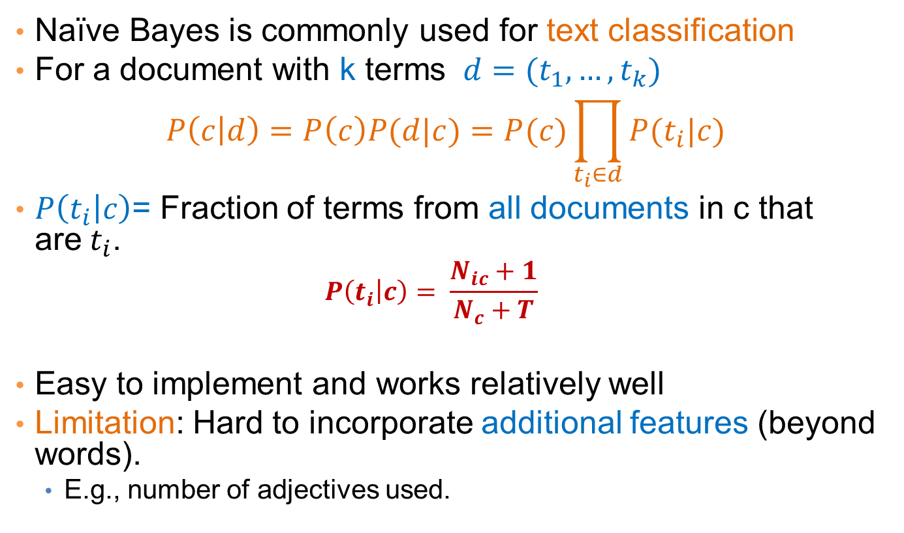
Naïve Bayes for Text Classification
Naïve Bayes is commonly used for text classification
For a document with k terms $d=(t_{1},…, t_{k})$
$$P\left(c | d\right)=P\left(c\right)P(d|c)=P(c)\prod_{t_{i}∈d}{P(t_{i}|c)}$$
$P\left(t_{i} | c\right)$= Fraction of terms from all documents in c that are$t_{i}$.
  $$P\left(t_{i} | c\right)= \frac{N_{ic}+1}{N_{c}+T}$$
Easy to implement and works relatively well
Limitation: Hard to incorporate additional features (beyond words).
  E.g., number of adjectives used.
Fraction of documents in c
Number of times $t_{i}$ appears in some document in c
Laplace Smoothing
Number of unique words
(vocabulary size)
Total number of terms in all documents in c

Slide 24
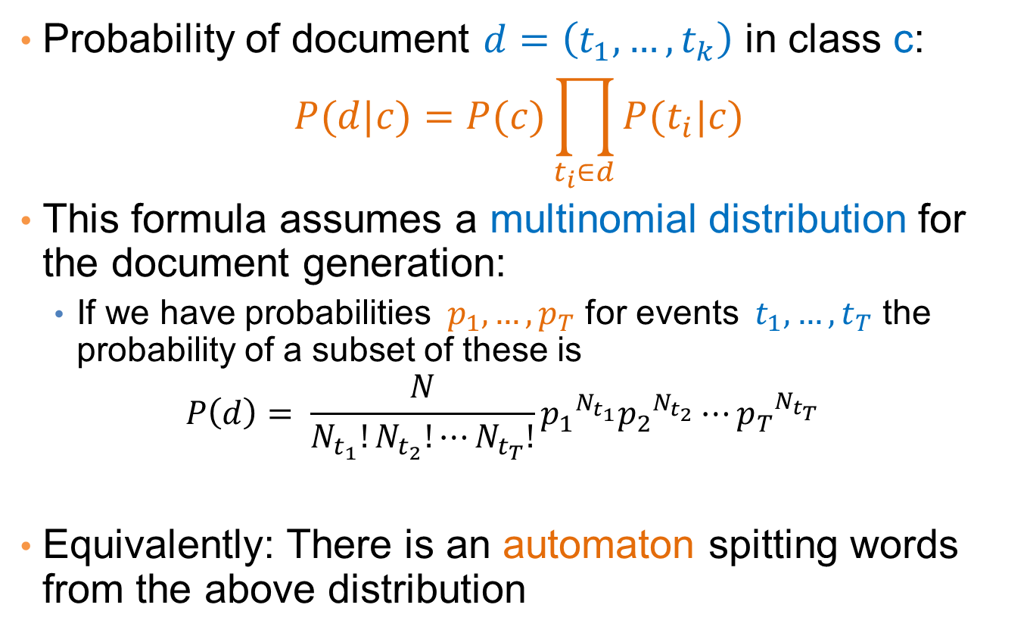
Multinomial document model
Probability of document $d=\left(t_{1},…, t_{k}\right)$ in class c:
$$P(d|c)=P(c)\prod_{t_{i}∈d}{P(t_{i}|c)}$$
This formula assumes a multinomial distribution for the document generation:
  If we have probabilities $p_{1},…, p_{T}$ for events $t_{1},…, t_{T}$ the probability of a subset of these is
  $$P\left(d\right)= \frac{N}{N_{t_{1}}!N_{t_{2}}!⋯N_{t_{T}}!}{p_{1}^{}}^{N_{t_{1}}}{p_{2}^{}}^{N_{t_{2}}}⋯{p_{T}^{}}^{N_{t_{T}}}$$
Equivalently: There is an automaton spitting words from the above distribution
w

Slide 25
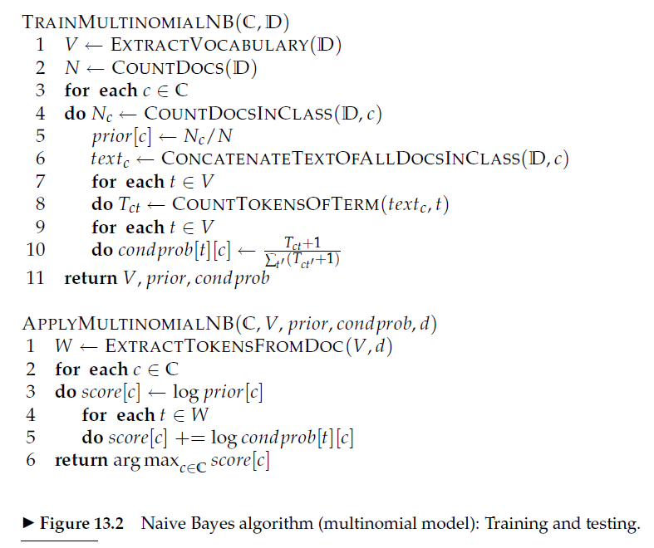

Slide 26
Example
News titles for Politics and Sports
Politics
Sports
“Obama meets Merkel”
“Obama elected again”
“Merkel visits Greece again”
“OSFP European basketball champion”
“Miami NBA basketball champion”
“Greece basketball coach?”
documents
P(p) = 0.5
P(s) = 0.5
terms
obama:2, meets:1, merkel:2, elected:1, again:2, visits:1, greece:1
OSFP:1, european:1, basketball:3, champion:2, miami:1, nba:1, greece:1, coach:1
Vocabulary size: 14
Total terms: 10
Total terms: 11
New title:
X = “Obama likes basketball”
P(Politics|X) ~ P(p)*P(obama|p)*P(likes|p)*P(basketball|p)
= 0.5 * 3/(10+14) *1/(10+14) * 1/(10+14) = 0.000108
P(Sports|X) ~ P(s)*P(obama|s)*P(likes|s)*P(basketball|s)
= 0.5 * 1/(11+14) *1/(11+14) * 4/(11+14) = 0.000128

Slide 27
Naïve Bayes (Summary)
Robust to isolated noise points
Handle missing values by ignoring the instance during probability estimate calculations
Robust to irrelevant attributes
Independence assumption may not hold for some attributes
  Use other techniques such as Bayesian Belief Networks (BBN)
Naïve Bayes can produce a probability estimate, but it is usually a very biased one
  Logistic Regression is better for obtaining probabilities.

Slide 28
Supervised Learning

Slide 29
Learning
Supervised Learning: learn a model from the data using labeled data.
  Classification and Regression are the prototypical examples of supervised learning tasks. Other are possible (e.g., ranking)
Unsupervised Learning: learn a model – extract structure from unlabeled data.
  Clustering and Association Rules are prototypical examples of unsupervised learning tasks.
Semi-supervised Learning: learn a model for the data using both labeled and unlabeled data.

Slide 30
Supervised Learning Steps
Model the problem
  What is you are trying to predict? What kind of optimization function do you need? Do you need classes or probabilities?
Extract Features
  How do you find the right features that help to discriminate between the classes?
Obtain training data
  Obtain a collection of labeled data. Make sure it is large enough, accurate and representative. Ensure that classes are well represented.
Decide on the technique
  What is the right technique for your problem?
Apply in practice
  Can the model be trained for very large data? How do you test how you do in practice? How do you improve?

Slide 31
Modeling the problem
Sometimes it is not obvious. Consider the following three problems
  Detecting if an email is spam
  Categorizing the queries in a search engine
  Ranking the results of a web search

Slide 32
Feature extraction
Feature extraction, or feature engineering is the most tedious but also the most important step
  How do you separate the players of the Greek national team from those of the Swedish national team?
One line of thought: throw features to the classifier and the classifier will figure out which ones are important
  More features, means that you need more training data
Another line of thought: Feature Selection: Select carefully the features using various functions and techniques
  Computationally intensive

Slide 33
Training data
An overlooked problem: How do you get labeled data for training your model?
  E.g., how do you get training data for ranking?
Usually requires a lot of manual effort and domain expertise and carefully planned labeling
  Results are not always of high quality (lack of expertise)
  And they are not sufficient (low coverage of the space)
Recent trends:
  Find a source that generates the labeled data for you.
  Crowd-sourcing techniques

Slide 34
Dealing with small amount of labeled data
Semi-supervised learning techniques have been developed for this purpose.
Self-training: Train a classifier on the data, and then feed back the high-confidence output of the classifier as input
Co-training: train two “independent” classifiers and feed the output of one classifier as input to the other.
Regularization: Treat learning as an optimization problem where you define relationships between the objects you want to classify, and you exploit these relationships
  Example: Image restoration

Slide 35
Technique
The choice of technique depends on the problem requirements (do we need a probability estimate?) and the problem specifics (does independence assumption hold? do we think classes are linearly separable?)
For many cases finding the right technique may be trial and error
For many cases the exact technique does not matter.

Slide 36
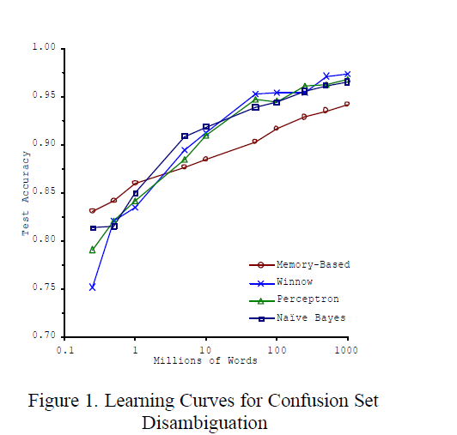
Big Data Trumps Better Algorithms
If you have enough data then the algorithms are not so important
The web has made this possible.
  Especially for text-related tasks
  Search engine uses the collective human intelligence
Google lecture: Theorizing from the Data

Slide 37
Apply-Test
How do you scale to very large datasets?
  Distributed computing – map-reduce implementations of machine learning algorithms (Mahut, over Hadoop)
How do you test something that is running online?
  You cannot get labeled data in this case
  A/B testing
How do you deal with changes in data?
  Active learning

Slide 38
GRAPHS and LINK ANALYSIS RANKING

Slide 39


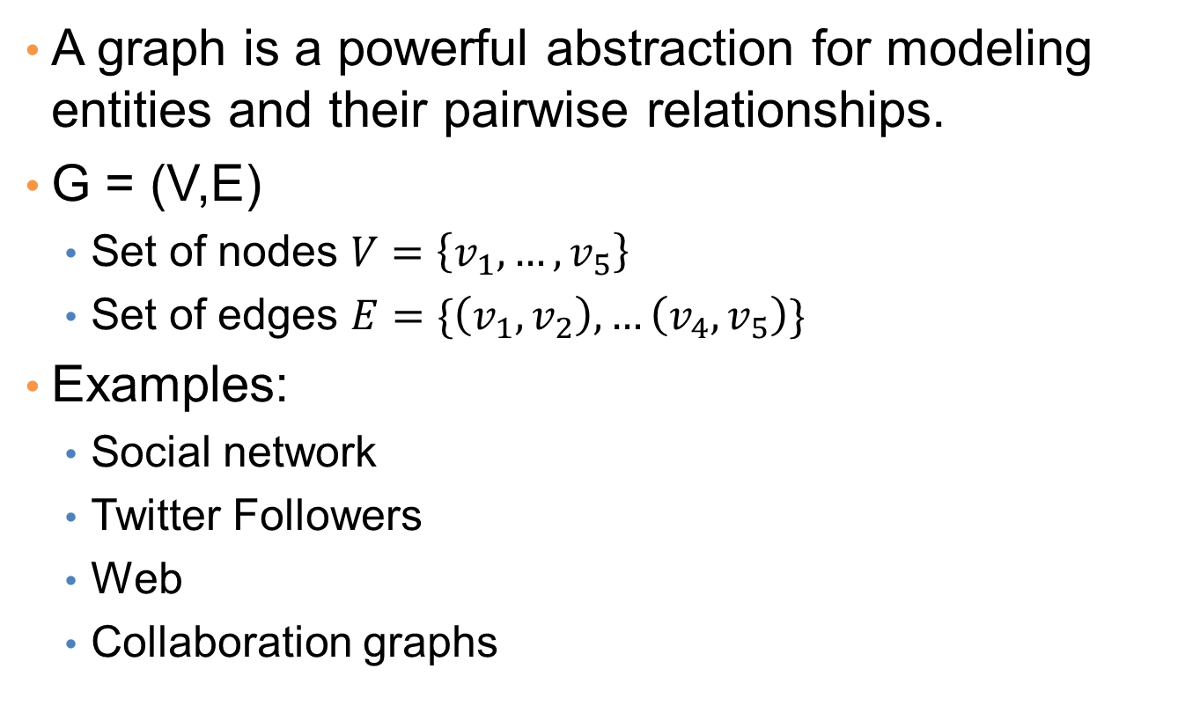



Graphs - Basics
A graph is a powerful abstraction for modeling entities and their pairwise relationships.
G = (V,E)
  Set of nodes $V=\left\{v_{1},…, v_{5}\right\}$
  Set of edges $E=\{\left(v_{1},v_{2}\right), …\left(v_{4},v_{5}\right)\}$
Examples:
  Social network
  Twitter Followers
  Web
  Collaboration graphs
$$v_{1}$$
$$v_{5}$$
$$v_{2}$$
$$v_{4}$$
$$v_{3}$$

Slide 40





Undirected Graphs
Undirected Graph: The edges are undirected pairs – they can be traversed in any direction.
Degree of node: Number of edges incident on the node
Path: A sequence of edges from one node to another
  We say that the node is reachable
Connected Component: A set of nodes such that there is a path between any two nodes in the set
$$v_{1}$$
$$v_{5}$$
$$v_{2}$$
$$v_{4}$$
$$v_{3}$$

Slide 41





Directed Graphs
Directed Graph: The edges are ordered pairs – they can be traversed in the direction from first to second.
In-degree and Out-degree of a node.
Path: A sequence of directed edges from one node to another
  We say that the node is reachable
Strongly Connected Component: A set of nodes such that there is a directed path between any two nodes in the set
Weakly Connected Component: A set of nodes such that there is an undirected path between any two nodes in the set
$$v_{1}$$
$$v_{5}$$
$$v_{2}$$
$$v_{4}$$
$$v_{3}$$

Slide 42





Bipartite Graph
A graph where the vertex set V is partitioned into two sets V = {L,R}, of size greater than one, such that there is no edge within each set.
$$v_{1}$$
$$v_{4}$$
Set L
Set R
$$v_{2}$$
$$v_{5}$$
$$v_{3}$$

Slide 43
Mining the graph structure
A graph is a combinatorial object, with a certain structure.
Mining the structure of the graph reveals information about the entities in the graph
  E.g., if in the Facebook graph I find that there are 100 people that are all linked to each other, then these people are likely to be a community
    The community discovery problem
  By measuring the number of friends in the facebook graph I can find the most important nodes
    The node importance problem
We will now focus on the node importance problem

Slide 44
Importance problem
What are the most important nodes in the graph?
  What are the most authoritative pages on the web
  Who are the important users in Facebook?
  What are the most influential Twitter accounts?

Slide 45
Link Analysis
First generation search engines
  view documents as flat text files
  could not cope with size, spamming, user needs
Second generation search engines
  Ranking becomes critical
  shift from relevance to authoritativeness
    authoritativeness: the static importance of the page
  use of Web specific data: Link Analysis of the Web graph
  a success story for the network analysis + a huge commercial success
  it all started with two graduate students at Stanford

Slide 46
Link Analysis: Intuition
A link from page p to page q denotes endorsement
  page p considers page q an authority on a subject
  use the graph of recommendations
  assign an authority value to every page
The same idea applies to other graphs as well
  Twitter graph, where user p follows user q

Slide 47
Constructing the graph
w
w
w
w
w
Goal: output an authority weight for each node
  Also known as centrality, or importance

Slide 48
Rank by Popularity
Rank pages according to the number of incoming edges (in-degree, degree centrality)
w=3
w=2
Red Page
Yellow Page
Blue Page
Purple Page
Green Page
w=2
w=1
w=1

Slide 49
Popularity
It is not important only how many link to you, but how important are the people that link to you.
Good authorities are pointed by good authorities
  Recursive definition of importance

Slide 50
PageRank
w
Good authorities should be pointed by good authorities
  The value of a page is the value of the people that link to you
How do we implement that?
  Assume that we have a unit of authority to distribute to all nodes.
  Each node distributes the authority value they have to their neighbors
  The authority value of each node is the sum of the authority fractions it collects from its neighbors.
  Solving the system of equations we get the authority values for the nodes
    w = ½ , w = ¼ , w = ¼
w
w
w + w + w = 1
w = w + w
w = ½ w
w = ½ w

Slide 51
A more complex example
v₂
v₁
w₁ = 1/3 w₄ + 1/2 w₅
v₃
w₂ = 1/2 w₁ + w₃ + 1/3 w₄
w₃ = 1/2 w₁ + 1/3 w₄
w₄ = 1/2 w₅
w₅ = w₂
v₅
v₄

Slide 52
Random Walks on Graphs
What we described is equivalent to a random walk on the graph
Random walk:
  Start from a node uniformly at random
  Pick one of the outgoing edges uniformly at random
  Repeat.

Slide 53

Random walks on graphs
Question: what is the probability of being at a specific node?
  $p_{i}$: probability of being at node i at this step
  $p_{i}′$: probability of being at node i in the next step
After many steps the probabilities converge to the stationary distribution of the random walk.
v₂
p’₁ = 1/3 p₄ + 1/2 p₅
v₁
p’₂ = 1/2 p₁ + p₃ + 1/3 p₄
v₃
p’₃ = 1/2 p₁ + 1/3 p₄
p’₄ = 1/2 p₅
p’₅ = p₂
v₅
v₄

