Slide 1
Online Social Networks and Media
Absorbing random walks
Label Propagation
Opinion Formation

Slide 2
Random walk with absorbing nodes
What happens if we do a random walk on this graph? What is the stationary distribution?
All the probability mass on the red sink node:
The red node is an absorbing node

Slide 3
Random walk with absorbing nodes
What happens if we do a random walk on this graph? What is the stationary distribution?
There are two absorbing nodes: the red and the blue.
The probability mass will be divided between the two

Slide 4
Absorption probability
If there are more than one absorbing nodes in the graph a random walk that starts from a non-absorbing node will be absorbed in one of them with some probability
The probability of absorption gives an estimate of how close the node is to red or blue

Slide 5
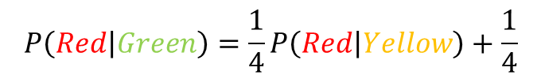
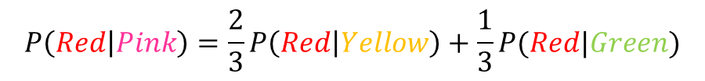
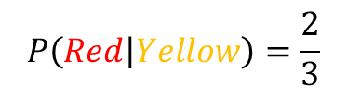
Absorption probability
Computing the probability of being absorbed:
The absorbing nodes have probability 1 of being absorbed in themselves and zero of being absorbed in another node.
For the non-absorbing nodes, take the (weighted) average of the absorption probabilities of your neighbors
if one of the neighbors is the absorbing node, it has probability 1
Repeat until convergence (= very small change in probs)
$$P\left(Red | Pink\right)=\frac{2}{3}P\left(Red | Yellow\right)+\frac{1}{3}P(Red|Green)$$
2
1
$$P\left(Red | Green\right)=\frac{1}{4}P\left(Red | Yellow\right)+\frac{1}{4}$$
1
1
2
$$P\left(Red | Yellow\right)=\frac{2}{3}$$
2
1

Slide 6
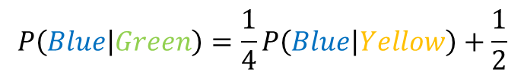
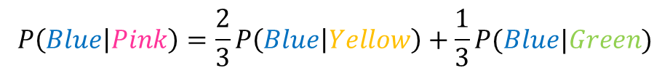
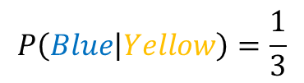
Absorption probability
Computing the probability of being absorbed:
The absorbing nodes have probability 1 of being absorbed in themselves and zero of being absorbed in another node.
For the non-absorbing nodes, take the (weighted) average of the absorption probabilities of your neighbors
if one of the neighbors is the absorbing node, it has probability 1
Repeat until convergence (= very small change in probs)
$$P\left(Blue | Pink\right)=\frac{2}{3}P\left(Blue | Yellow\right)+\frac{1}{3}P(Blue|Green)$$
2
1
$$P\left(Blue | Green\right)=\frac{1}{4}P\left(Blue | Yellow\right)+\frac{1}{2}$$
1
1
2
$$P\left(Blue | Yellow\right)=\frac{1}{3}$$
2
1

Slide 7
Why do we care?
Why do we care to compute the absorbtion probability to sink nodes?
Given a graph (directed or undirected) we can choose to make some nodes absorbing.
Simply direct all edges incident on the chosen nodes towards them.
The absorbing random walk provides a measure of proximity of non-absorbing nodes to the chosen nodes.
Useful for understanding proximity in graphs
Useful for propagation in the graph
E.g, some nodes have positive opinions for an issue, some have negative, to which opinion is a non-absorbing node closer?

Slide 8
Example
In this undirected graph we want to learn the proximity of nodes to the red and blue nodes
2
1
1
1
2
2
1

Slide 9
Example
Make the nodes absorbing
2
1
1
1
2
2
1

Slide 10
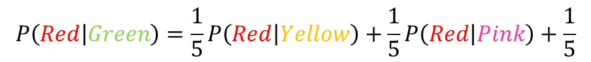
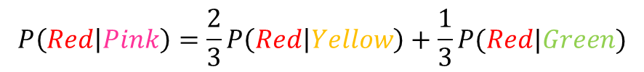
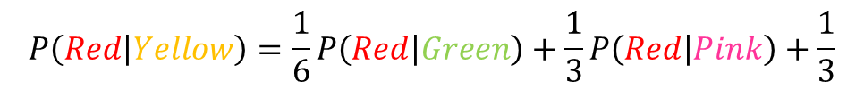
Absorption probability
Compute the absorbtion probabilities for red and blue
$$P\left(Red | Pink\right)=\frac{2}{3}P\left(Red | Yellow\right)+\frac{1}{3}P(Red|Green)$$
$$P\left(Red | Green\right)=\frac{1}{5}P\left(Red | Yellow\right)+\frac{1}{5}P\left(Red | Pink\right)+\frac{1}{5}$$
0.57
0.43
2
$$P\left(Red | Yellow\right)=\frac{1}{6}P\left(Red | Green\right)+\frac{1}{3}P\left(Red | Pink\right)+\frac{1}{3}$$
1
1
1
$$P\left(Blue | Pink\right)=1−P\left(Red | Pink\right)$$
2
2
$$P\left(Blue | Green\right)=1− P\left(Red | Green\right)$$
1
$$P\left(Blue | Yellow\right)=1−P\left(Red | Yellow\right)$$
0.52
0.48
0.42
0.58

Slide 11


Penalizing long paths
The orange node has the same probability of reaching red and blue as the yellow one
Intuitively though it is further away
0.57
0.43
0.57
0.43
2
$$P\left(Red | Orange\right)=P\left(Red | Yellow\right)$$
1
$P\left(Blue | Orange\right)=$ $P\left(Blue | Yellow\right)$
1
1
1
2
2
1
0.52
0.48
0.42
0.58

Slide 12
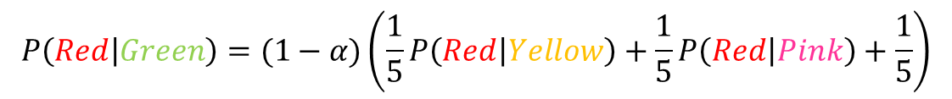
Penalizing long paths
Add an universal absorbing node to which each node gets absorbed with probability α.
With probability α the random walk dies
With probability (1-α) the random walk continues as before
α
1-α
1-α
α
1-α
1-α
The longer the path from a node to an absorbing node the more likely the random walk dies along the way, the lower the absorbtion probability
α
α
$$P\left(Red | Green\right)=(1−α)\left(\frac{1}{5}P\left(Red | Yellow\right)+\frac{1}{5}P\left(Red | Pink\right)+\frac{1}{5}\right)$$

Slide 13
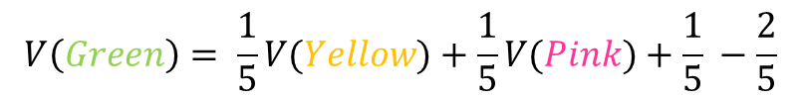
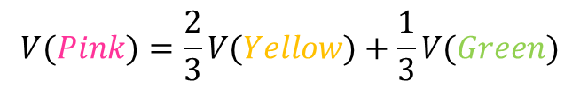
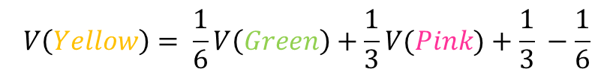
Propagating values
Assume that Red has a positive value and Blue a negative value
Positive/Negative class, Positive/Negative opinion
We can compute a value for all the other nodes in the same way
This is the expected value for the node
+1
$$V(Pink)=\frac{2}{3}V(Yellow)+\frac{1}{3}V(Green)$$
0.16
2
-1
1
$$V\left(Green\right)= \frac{1}{5}V(Yellow)+\frac{1}{5}V(Pink)+\frac{1}{5} −\frac{2}{5}$$
1
2
1
2
$$V\left(Yellow\right)= \frac{1}{6}V\left(Green\right)+\frac{1}{3}V(Pink)+\frac{1}{3} −\frac{1}{6}$$
1
0.05
-0.16

Slide 14

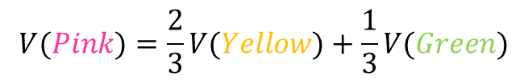
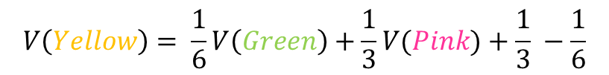
Electrical networks and random walks
Our graph corresponds to an electrical network
There is a positive voltage of +1 at the Red node, and a negative voltage -1 at the Blue node
There are resistances on the edges inversely proportional to the weights (or conductance proportional to the weights)
The computed values are the voltages at the nodes
+1
+1
0.16
2
$$V(Pink)=\frac{2}{3}V(Yellow)+\frac{1}{3}V(Green)$$
-1
1
$$V\left(Green\right)= \frac{1}{5}V(Yellow)+\frac{1}{5}V(Pink)+\frac{1}{5} −\frac{2}{5}$$
1
1
2
2
$$V\left(Yellow\right)= \frac{1}{6}V\left(Green\right)+\frac{1}{3}V(Pink)+\frac{1}{3} −\frac{1}{6}$$
1
0.05
-0.16

Slide 15
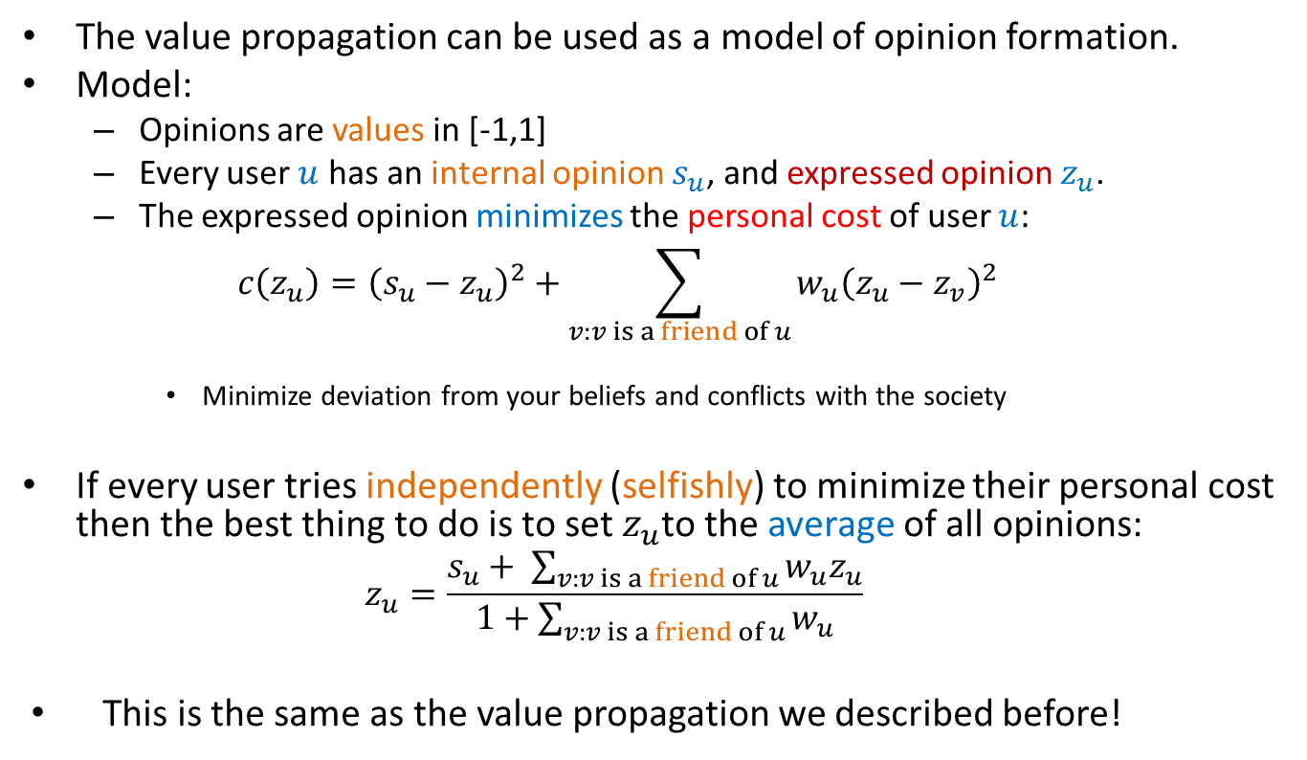
Opinion formation
The value propagation can be used as a model of opinion formation.
Model:
Opinions are values in [-1,1]
Every user $u$ has an internal opinion $s_{u}$, and expressed opinion $z_{u}$.
The expressed opinion minimizes the personal cost of user $u$:
$$c\left(z_{u}\right)={\left(s_{u}−z_{u}\right)}^{2}+\sum_{v:v is a friend of u}{w_{u}{\left(z_{u}−z_{v}\right)}^{2}}$$
Minimize deviation from your beliefs and conflicts with the society
If every user tries independently (selfishly) to minimize their personal cost then the best thing to do is to set $z_{u}$to the average of all opinions:
$$z_{u}=\frac{s_{u}+ \sum_{v:v is a friend of u}{w_{u}z_{u}}}{1+\sum_{v:v is a friend of u}{w_{u}}}$$
This is the same as the value propagation we described before!

Slide 16
Example
Social network with internal opinions
s = +0.5
2
s = +0.8
1
s = -0.3
1
1
2
2
1
s = +0.2
s = -0.1

Slide 17
Example
One absorbing node per user with value the internal opinion of the user
One non-absorbing node per user that links to the corresponding absorbing node
s = +0.5
1
z = +0.17
z = +0.22
2
1
s = +0.8
1
1
s = -0.3
2
1
The external opinion for each node is computed using the value propagation we described before
Repeated averaging
1
z = -0.01
2
1
z = -0.03
z = 0.04
1
1
Intuitive model: my opinion is a combination of what I believe and what my social network believes.
s = -0.5
s = -0.1

Slide 18
Transductive learning
If we have a graph of relationships and some labels on some nodes we can propagate them to the remaining nodes
Make the labeled nodes to be absorbing and compute the probability for the rest of the graph
E.g., a social network where some people are tagged as spammers
E.g., the movie-actor graph where some movies are tagged as action or comedy.
This is a form of semi-supervised learning
We make use of the unlabeled data, and the relationships
It is also called transductive learning because it does not produce a model, but just labels the unlabeled data that is at hand.
Contrast to inductive learning that learns a model and can label any new example

Slide 19
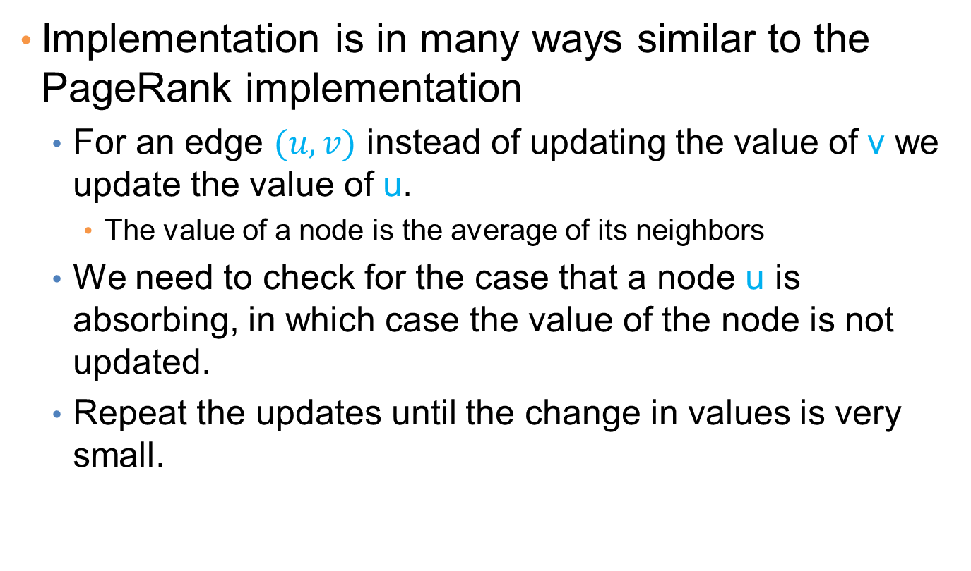
Implementation details
Implementation is in many ways similar to the PageRank implementation
For an edge $(u,v)$instead of updating the value of v we update the value of u.
The value of a node is the average of its neighbors
We need to check for the case that a node u is absorbing, in which case the value of the node is not updated.
Repeat the updates until the change in values is very small.

