Slide 1

Insight gaining from OLAP queries via data movies
Dimitrios Gkesoulis* | Panos Vassiliadis, Petros Manousis
UTC Creative Lab | Dept. of Computer Science & Engineering
Ioannina, Hellas | Univ. Ioannina, Hellas
*work conducted while in the Univ. Ioannina
Univ. of Ioannina

Slide 2
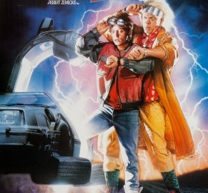
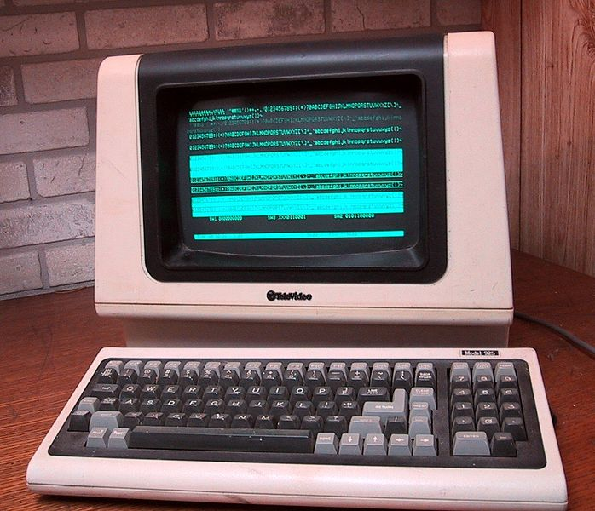
Caught somewhere in time
Query result = (just) a set of tuples
No difference from the 70’s when this assumption was established and tailored for
  what people had available then
    … a green/orange monochrome screen
    … a dot-matrix(?) printer
    … nothing else
  users being programmers
Photos copied from http://en.wikipedia.org/
Notes:
So far, database systems assume their work is done once results are produced, effectively prohibiting even well-educated end-users to work with them.

Slide 3
Replace query answering with insight gaining!
So far, database systems assume their work is done once results are produced, effectively prohibiting even well-educated end-users to work with them.
No more just sets of tuples …

Slide 4
Insight gaining: Aha! moments
The user starts with an original state of mind on the current state of affairs…
  … and suddenly, there is an "Aha!" moment:
  the user suddenly realizes a new way of looking at the data…
…and so, the user ends up with new understanding !
… works with the data…

Slide 5
Replace query answering with insight gaining!
What is insight?
  InfoVis community: "something that is gained" (after the observation of data by a participant)
  Psychologists:"Aha!" moment which is experienced
A combined view:
  the user starts with an original state of mind on the current state of affairs
  there is an "Aha!" moment where the user suddenly realizes a new way of looking at the data.
  resulting in a new mental model for the state of affairs, or else, new understanding
G. Dove. S. Jones. Narrative visualization: Sharing insights into complex data -- available at http://openaccess.city.ac.uk/1134/

Slide 6
Data analysis for insight gaining
How to facilitate insight? Data analysis!
In a recent SIGMOD keynote speech in 2012, Pat Hanrahan from Stanford University and Tableau Software:
    “ … get the data; deliver them in a clean usable form;
    contextualize them;
    extract relationships and patterns hidden within them;
    generalize for insight;
    confirm hypotheses and errors;
    share with others;
    decide and act…”

Slide 7
… and this is how naïve query answering will be replaced by insight gaining …
Data contextualization
  contextualize
(On-line) Pattern Mining & Forecasting
  extract relationships and patterns
  generalize for insight
  confirm hypotheses and errors
Presentation (share with others)
  … but how? … -- see next --

Slide 8
… explaining the presentation via data movies
We should and can produce query results that are
  properly visualized
  enriched with textual comments
  vocally enriched
… but then, you have a data movie

Slide 9
Goal and main idea
Goal: produce small stories -- data movies to answer the data worker’s query
Means: the CineCubes system and method to orthogonally combine the following tasks:
  expand a query result with the results of complementary queries which allow the user to contextualize and analyze the information content of the original query.
  extract meaningful, important patterns, or “highlights” from the query results
  present the results (a) properly visualized; (b) enriched with an automatically extracted text that comments on the result; (c) vocally enriched, i.e., enriched with audio that allows the user not only to see. but also hear

Slide 10
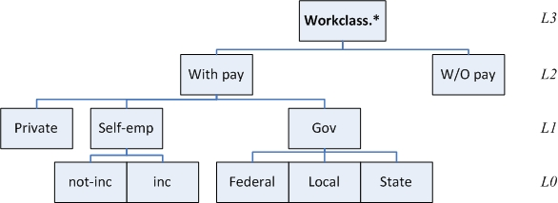
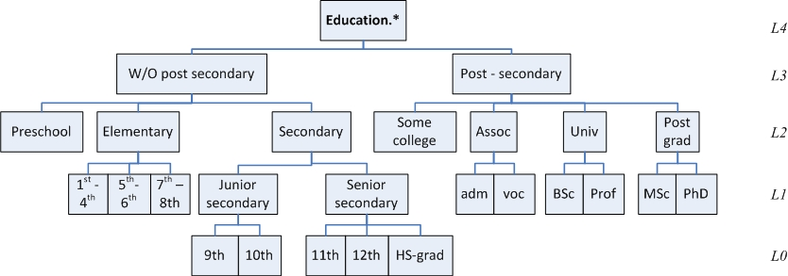
Example
Find the average work hours per week
  For persons with //selection conditions
    work_class.level2=’With-Pay’ . and
    education.level3= ‘Post-Sec’
  Grouped per //groupers
    work_class.level1
    education.level3
Notes:
We assume:
… the existence of a star schema
… that the end users are interested in working with OLAP queries
In this example. we have a cube over the Adult data set which is a data set containing census data.

Slide 11
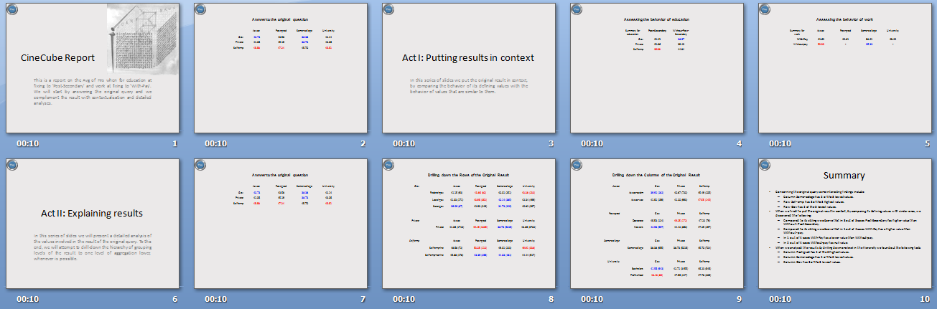
Example: Result

Slide 12

Answer to the original question
 | Assoc | Post-grad | Some-college | University
Gov | 40.73 | 43.58 | 38.38 | 42.14
Private | 41.06 | 45.19 | 38.73 | 43.06
Self-emp | 46.68 | 47.24 | 45.70 | 46.61
Here, you can see the answer of the original query. You have specified education to be equal to 'Post-Secondary‘, and work to be equal to 'With-Pay'. We report on Avg of work hours per week grouped by education at level 2. and work at level 1 .
You can observe the results in this table. We highlight the largest values with red and the lowest values with blue color.
Column Some-college has 2 of the 3 lowest values.
Row Self-emp has 3 of the 3 highest values.
Row Gov has 2 of the 3 lowest values.
Notes:
Here. you can see the answer of the original query. You have specified education to be equal to 'Post-Secondary'. and work to be equal to 'With-Pay'. We report on Avg of work hours per week grouped by education at level 2. and work at level 1 .
You can observe the results in this table. We highlight the largest values with red and the lowest values with blue color.
Column Some-college has 2 of the 3 lowest values.
Row Self-emp has 3 of the 3 highest values.
Row Gov has 2 of the 3 lowest values.

Slide 13
Contributions
We create a small “data movie” that answers an OLAP query
We complement each query with auxiliary queries organized in thematically related acts that allow us to assess and explain the results of the original query
We implemented an extensible palette of highlight extraction methods to find interesting patterns in the result of each query
We describe each highlight with text
We use TTS technology to convert text to audio

Slide 14
Contributions
Equally importantly:
  An extensible software where algorithms for query generation and highlight extraction can be plagued in
  The demonstration of low technical barrier to produce CineCube reports

Slide 15
Method Overview
Software Issues
Experiments and User Study
Discussion
Method Overview

Slide 16
Current CineCubes mode of work
… tell a nice story…
Presentation
…
3. Produce visual annotation. text & audio
audio
… trends. outliers. patterns…
text
Highlight Extraction
dominating rows/cols
top/low values
color
…
2. Mine highlights per query
answer original query
contextualize
1. Start by aux. queries
drill in
…
… get more and more relevant data …
Result Expansion
Notes:
1.
- execution of the original query: A first assessment of the current state of affairs
- Put the state in Context
- Analysis of why things are this way.
2. Per result, try to extract highlights
3. Per result, per highlight: text (and audio of the text). Combine the texts of highlights + colors for the presentation of the result

Slide 17
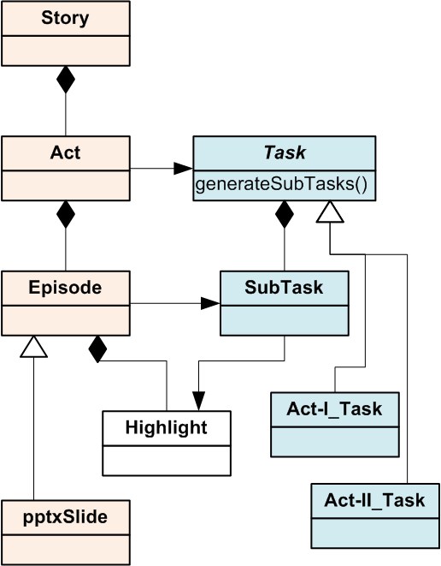
Result expansion: The movie’s parts
Much like movie stories, we organize our stories in acts
Each act includes several episodes all serving the same purpose
Tasks provide the machinery to produce results for episodes
Notes:
In a traditional story …
The first act provides contextualization for the characters as well as the incident that sets the story on the move.
The second act is where the protagonists and the rest of the roles build up their actions and reactions and
The third act is where the resolution of the story is taking place.
Pink column: internal structure of the movie, result-oriented
Blue column: task-oriented, how to get the job done, what produces the data for each result

Slide 18
Structure of the CineCube Movie
We organize the CineCube Movie in five Acts:
  Intro Act
  Original Act
  Act I
  Act II
  Summary Act

Slide 19
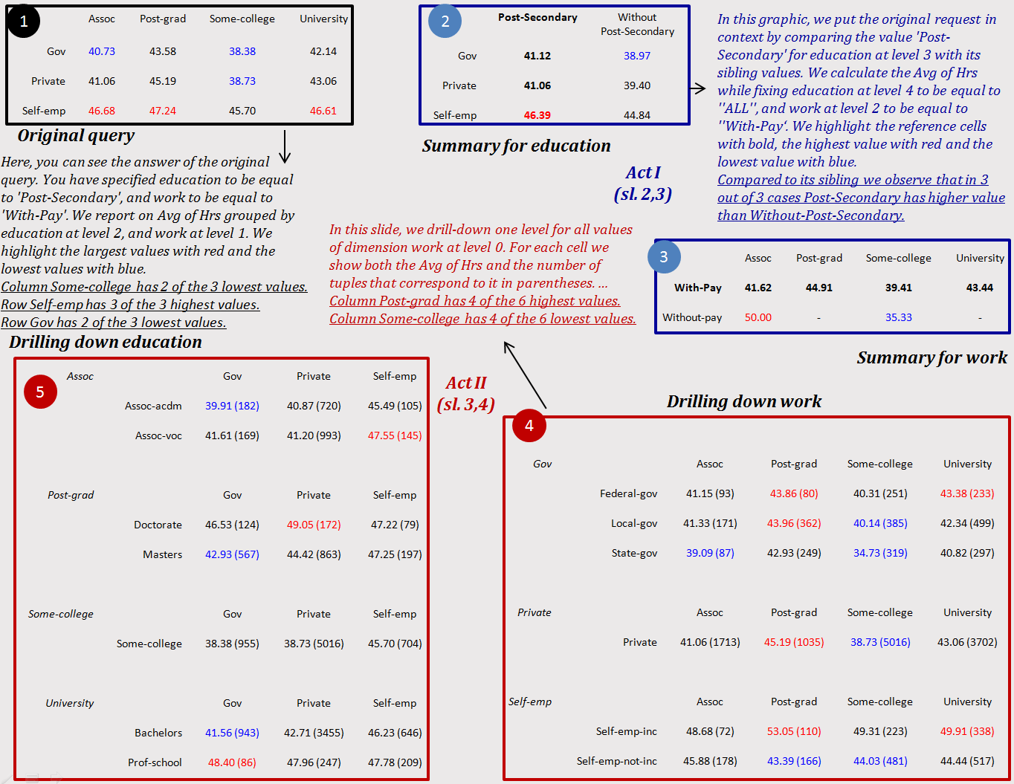

Slide 20
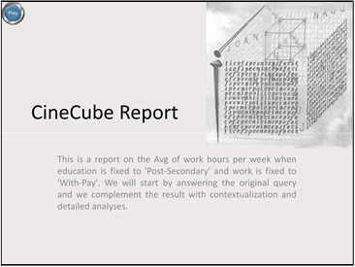
CineCube Movie – Intro Act
Intro Act has an episode that introduce the story to user
Notes:
This is a report on the Avg of work hours per week when education is fixed to 'Post-Secondary' and work is fixed to 'With-Pay'. We will start by answering the original query and we complement the result with contextualization and detailed analyses.

Slide 21
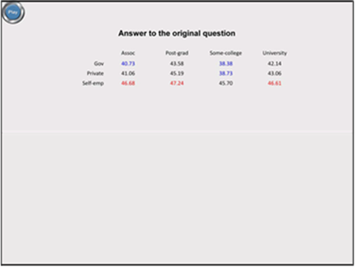
CineCube Movie – Original Act
Original Act has an episode which is the answer of query that submitted by user

Slide 22
CineCube Movie – Act I
In this Act we try to answer the following question:
  How good is the original query compared to its siblings?
We compare the marginal aggregate results of the original query to the results of “sibling” queries that use “similar” values in their selection conditions

Slide 23
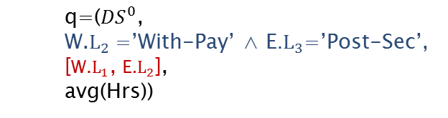
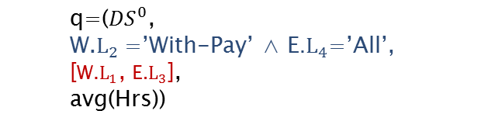
Act I – Example
Result of Original Query
 | Assoc | Post-grad | Some-college | University
Gov | 40.73 | 43.58 | 38.38 | 42.14
Private | 41.06 | 45.19 | 38.73 | 43.06
Self-emp | 46.68 | 47.24 | 45.70 | 46.61
  q=(${DS}^{0}$,
  W.$L_{2}$=’With-Pay’ ∧ E.$L_{3}$=’Post-Sec’,
  [W.$L_{1}$, E.$L_{2}$],
  avg(Hrs))
Assessing the behavior of education
Summary for education | Post-Secondary | Without-Post-Secondary
Gov | 41.12 | 38.97
Private | 41.06 | 39.40
Self-emp | 46.39 | 44.84
  q=(${DS}^{0}$,
  W.$L_{2}$=’With-Pay’ ∧ E.$L_{4}$=’All’,
  [W.$L_{1}$, E.$L_{3}$],
  avg(Hrs))

Slide 24
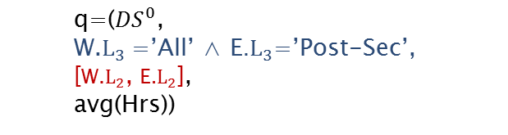
Act I – Example
Result of Original Query
 | Assoc | Post-grad | Some-college | University
Gov | 40.73 | 43.58 | 38.38 | 42.14
Private | 41.06 | 45.19 | 38.73 | 43.06
Self-emp | 46.68 | 47.24 | 45.70 | 46.61
  q=(${DS}^{0}$,
  W.$L_{2}$=’With-Pay’ ∧ E.$L_{3}$=’Post-Sec’,
  [W.$L_{1}$, E.$L_{2}$],
  avg(Hrs))
Assessing the behavior of work
Summary for work | Assoc | Post-grad | Some-college | University
With-Pay | 41.62 | 44.91 | 39.41 | 43.44
Without-pay | 50.00 | - | 35.33 | -
  q=(${DS}^{0}$,
  W.$L_{3}$=’All’ ∧ E.$L_{3}$=’Post-Sec’,
  [W.$L_{2}$, E.$L_{2}$],
  avg(Hrs))

Slide 25
CineCube Movie – Act II
In this Act we try to explaining to why the result of original query is what it is.
  “Drilling into the breakdown of the original result”
We drill in the details of the cells of the original result in order to inspect the internals of the aggregated measures of the original query.
Notes:
The purpose of Act II is to help the user understand why the situation is as observed in the original query
This is done by drilling down

Slide 26
Act II – Example
Result of Original Query
 | Assoc | Post-grad | Some-college | University
Gov | 40.73 | 43.58 | 38.38 | 42.14
Private | 41.06 | 45.19 | 38.73 | 43.06
Self-emp | 46.68 | 47.24 | 45.70 | 46.61
  q=(${DS}^{0}$,
  W.$L_{2}$=’With-Pay’ ∧ E.$L_{3}$=’Post-Sec’,
  [W.$L_{1}$, E.$L_{2}$],
  avg(Hrs))
Drilling down the Rows of the Original Result
Gov |  | Assoc | Post-grad | Some-college | University
 | Federal-gov | 41.15 (93) | 43.86 (80) | 40.31 (251) | 43.38 (233)
 | Local-gov | 41.33 (171) | 43.96 (362) | 40.14 (385) | 42.34 (499)
 | State-gov | 39.09 (87) | 42.93 (249) | 34.73 (319) | 40.82 (297)
Private
 | Private | 41.06 (1713) | 45.19 (1035) | 38.73 (5016) | 43.06 (3702)
Self-emp
 | Self-emp-inc | 48.68 (72) | 53.05 (110) | 49.31 (223) | 49.91 (338)
 | Self-emp-not-inc | 45.88 (178) | 43.39 (166) | 44.03 (481) | 44.44 (517)

Slide 27
Act II – Example
Result of Original Query
 | Assoc | Post-grad | Some-college | University
Gov | 40.73 | 43.58 | 38.38 | 42.14
Private | 41.06 | 45.19 | 38.73 | 43.06
Self-emp | 46.68 | 47.24 | 45.70 | 46.61
  q=(${DS}^{0}$,
  W.$L_{2}$=’With-Pay’ ∧ E.$L_{3}$=’Post-Sec’,
  [W.$L_{1}$, E.$L_{2}$],
  avg(Hrs))
Drilling down the Columns of the Original Result
Assoc |  | Gov | Private | Self-emp
 | Assoc-acdm | 39.91 (182) | 40.87 (720) | 45.49 (105)
 | Assoc-voc | 41.61 (169) | 41.20 (993) | 47.55 (145)
Post-grad
 | Doctorate | 46.53 (124) | 49.05 (172) | 47.22 (79)
 | Masters | 42.93 (567) | 44.42 (863) | 47.25 (197)
Some-college
 | Some-college | 38.38 (955) | 38.73 (5016) | 45.70 (704)
University
 | Bachelors | 41.56 (943) | 42.71 (3455) | 46.23 (646)
 | Prof-school | 48.40 (86) | 47.96 (247) | 47.78 (209)

Slide 28
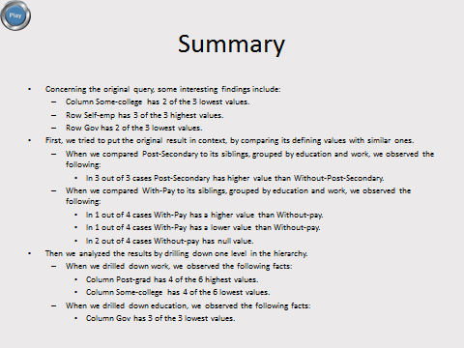
CineCube Movie – Summary Act
Summary Act represented from one episode.
This episode has all the highlights of our story.

Slide 29
Highlight Extraction
We utilize a palette of highlight extraction methods that take a 2D matrix as input and produce important findings as output.
Currently supported highlights:
  The top and bottom quartile of values in a matrix
  The absence of values from a row or column
  The domination of a quartile by a row or a column
  The identification of min and max values

Slide 30
Text Extraction
Text is constructed by a Text Manager that customizes the text per Act
Text comes from templates, coded
  for the slides of each act
  for each highlight extraction algorithm
Example:
  In this slide, we drill-down one level for all values of dimension <dim> at level <l>. For each cell we show both the <agg> of <measure> and the number of tuples that correspond to it.

Slide 31
Textual annotation of the original question
 | Assoc | Post-grad | Some-college | University
Gov | 40.73 | 43.58 | 38.38 | 42.14
Private | 41.06 | 45.19 | 38.73 | 43.06
Self-emp | 46.68 | 47.24 | 45.70 | 46.61
Contextualization text coming with the task
Here, you can see the answer of the original query. You have specified education to be equal to 'Post-Secondary‘, and work to be equal to 'With-Pay'. We report on Avg of work hours per week grouped by education at level 2, and work at level 1 .
You can observe the results in this table. We highlight the largest values with red and the lowest values with blue color.
One sentence per highlight
Column Some-college has 2 of the 3 lowest values.
Row Self-emp has 3 of the 3 highest values.
Row Gov has 2 of the 3 lowest values.
Notes:
Here, you can see the answer of the original query. You have specified education to be equal to 'Post-Secondary‘, and work to be equal to 'With-Pay'. We report on Avg of work hours per week grouped by education at level 2, and work at level 1 .
You can observe the results in this table. We highlight the largest values with red and the lowest values with blue color.
Column Some-college has 2 of the 3 lowest values.
Row Self-emp has 3 of the 3 highest values.
Row Gov has 2 of the 3 lowest values.

Slide 32
Method Overview
Software Issues
Experiments and User Study
Discussion
Software Issues

Slide 33
Low technical barrier
Our tool is extensible
  We can add new tasks to generate complementary queries easily
  We can add new highlight algorithms to produce highlights easily
Supportive technologies are surprisingly easier to use
  Apache POI for pptx generation
  TTS for text to speech conversion

Slide 34
Apache POI for pptx
A Java API that provides several libraries for Microsoft Word. PowerPoint and Excel (since 2001).
XSLF is the Java implementation of the PowerPoint 2007 OOXML (.pptx) file format.
      XMLSlideShow ss = new XMLSlideShow();
      XSLFSlideMaster sm = ss.getSlideMasters()[0];
      XSLFSlide sl= ss.createSlide (sm.getLayout(SlideLayout.TITLE_AND_CONTENT));
      XSLFTable t = sl.createTable();
      t.addRow().addCell().setText(“added a cell”);
Notes:
POI helps to manipulate file formats based upon the Office Open XML standards (OOXML) and Microsoft's OLE 2 Compound Document format (OLE2).
XSLF –XML Slide Layout Format

Slide 35


PPTX Folder Structure

Slide 36
MaryTTS for Text-to-Speech Synthesis
    MaryInterface m = new LocalMaryInterface();
    m.setVoice(“cmu-slt-hsmm”);
    AudioInputStream audio = m.generateAudio("Hello”);
    AudioSystem.write(audio. audioFileFormat.Type.WAVE.
    new File(“myWav.wav”));
Notes:
Espeak
Microsoft API
…..
cmu-slt-hsmm US female Voice
http://mary.dfki.de:59125/

Slide 37
Method Overview
Software Issues
Experiments and User Study
Discussion
Experiments

Slide 38
Experimental setup
Adult dataset referring to data from 1994 USA census
  Has 7 dimension Age, Native Country, Education, Occupation, Marital status, Work class, and Race.
  One Measure : work hours per week
Machine Setup :
  Running Windows 7
  Intel Core Duo CPU at 2.50GHz.
  3GB main memory.

Slide 39
Experimental Results
Notes:
This is a very interesting result showing which parts of the method are the most expensive.
X-axis: number of slides. Y-axis: time in LOG scale
Observe how many orders of magnitude the audio gen. is. Then, comes the (blue) db querying. Then, comes the (pink) wrap-up.
Clear opportunity for adding more highlights and improving text as the highlight extraction (dark red) and the text (green) are so much faster => we can do more sophisticated stuff with them without actually delaying the performance.

Slide 40
Experimental Results
Time breakdown(msec) for the method’s parts
 | # atomic selections in WHERE clause
 | 2 (10 sl.) | 3 (12 sl.) | 4 (14 sl.) | 5 (16 sl.)
Result Generation | 1169.00 | 881.40 | 2263.91 | 1963.68
Highlight Extraction & Visualization | 4.41 | 3.60 | 3.67 | 3.74
Text Creation | 1.32 | 1.42 | 1.80 | 2.35
Audio Creation | 71463.21 | 104634.27 | 145004.20 | 169208.59
Put in PPTX | 378.24 | 285.89 | 452.74 | 460.55
Notes:
The actual numbers for the previous slide

Slide 41
Method Overview
Software Issues
Experiments and User Study
Discussion
User Study

Slide 42
User Study Setup
Goal: compare the effectiveness of CineCubes to simple OLAP
Opponent: we constructed a simple system answering aggregate queries in OLAP style
Participants: 12 PhD students from our Department. all of which were experienced in data management and statistics.
Notes:
Both systems had the same user interface that allows users to construct queries by point-n-click without having to actually write them in SQL.

Slide 43
Experiment in 4 phases
Phase 0 – Contextualization: users were introduced to the data set and the tools.
Phase 1 – Work with simple OLAP: we asked the users to prepare a report on a specified topic via a simple OLAP tool. The report should contain
  a bullet list of key, highlight findings,
  a text presenting the overall situation, and,
  optionally, any supporting statistical charts and figures to elucidate the case better
Notes:
Ph 0. We presented the data set, its dimensions and levels. We also gave a demo of how to pose queries to the systems. We explained to the users that they could use any combination of (a) slideshow, (b) browsing through the slides, and (c) reading a printout of a query result or a CineCubes report. All users were given a pamphlet reminding the basics of the above. Then, the users returned to their offices, where they all had ample networking, computing and printing facilities to work with the next of the phases.
Ph1.

Slide 44
Experiment in 4 phases
Phase 2 – work with CineCubes: prepare a report on the same topic, but now, with CineCubes.
Phase 3 - evaluation: Once the users had used the two systems, they were asked to complete a questionnaire with:
  information for the time (efficiency) needed to complete their reports.
  an assessment in a scale of 1 to 5 (effectiveness) of
    the usefulness of the different acts of the CineCubes report.
    the usefulness of the textual parts and the voice features of CineCubes
    the quality of the two reports after having produced both of them.
Notes:
Ph2: Both the simple querying system and CineCubes were at the disposal of the users in order to pose auxiliary requests for simple queries or CineCubes reports. To speed up the process, we also provided a link with a version of Cinecubes without audio.

Slide 45
Usefulness of CineCubes’ parts
The users were asked to assess the usefulness of the parts of CineCubes in a scale of 1 (worst) to 5 (best)
All features scored an average higher than 3.
Users appreciated differently the different acts and parts of the system
  Likes: Drilling down (Act II), color + highlight + text
  Not so: contextualization (Act I), Summary, audio

Slide 46
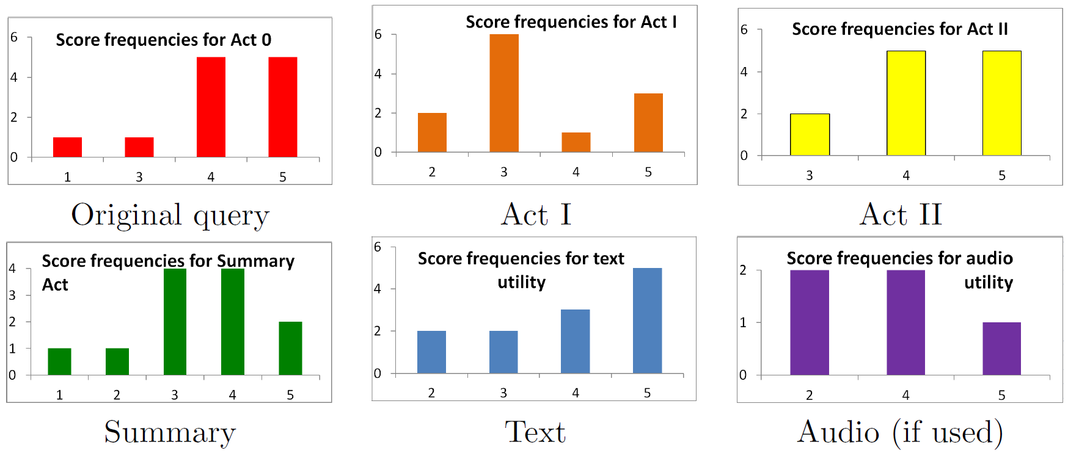
Usefulness of CineCubes’ parts

Slide 47
Popular features
The most popular feature: Act II, with the detailed, drill-down analysis of the groupers.
  ...giving information enlarging the picture of the situation that was presented to users & worth including at the report.
Second most popular feature: the treatment of the original query (that includes coloring and highlight extraction compared to the simple query results given to them by the simple querying system).

Slide 48
The less appreciated parts
The less appreciated parts were:
  Act I (which contextualizes the result by comparing it to similar values)
  summary act (presenting all the highlights in a single slide).
Why? The contextualization and the summary acts provide too much information (and in fact, too many highlights).
Lesson learned: above all, be concise!
Notes:
Users love concise reporting of facts and dislike information provided in large volumes to them. The free-form comments of the users and a post-mortem discussion with them confirmed this observation.
The peak is in the median value (3), the average value for both Act I and the Summary Act was 3.4 stars and the distribution of values towards the high end; yet, scores are not so heavy tailed on the higher values as for Act II and 0.

Slide 49
Text and audio
The textual part was quite appreciated by most of the users.
Out of 5 users that worked with audio, the result was split in half in terms of likes and dislikes. Due to...
  ... the quality of the produced audio by the TTS, and,
  the quality of the text that is served to it as input.
Lesson learned: audio seems to be useful for some users but not for all
  … so, it should be optional, which can provide gains in terms of efficiency without affecting effectiveness.

Slide 50
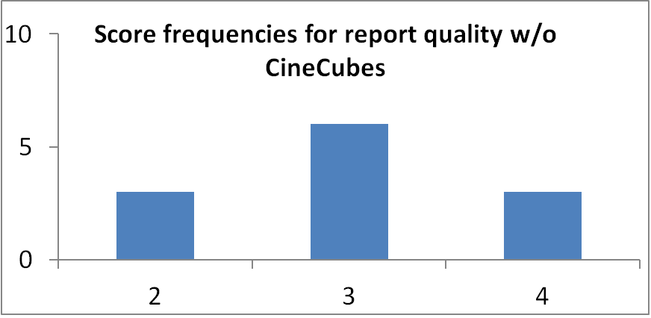
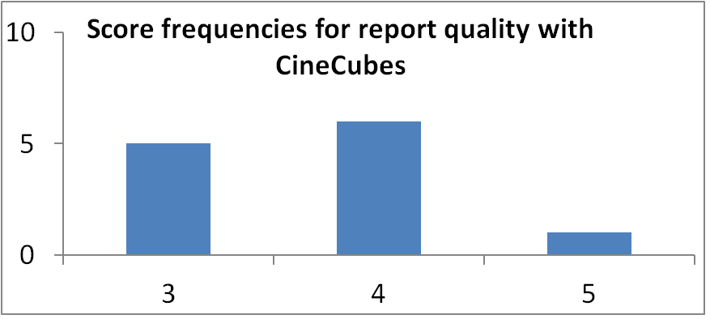
Report quality
Quality of the report improves with CineCubes:
  the distribution is shifted by one star upwards, with the median shifting from 3 to 4.
  the average value raised from 3 to 3.7 (23% improvement)
The free-form comments indicated that the score would have been higher if the tool automatically produced graphs and charts (an issue of small research but high practical value).

Slide 51
Time and quality considerations
Are there any speed-ups in the work of the users if they use CineCubes?
… or more realistically …
Does it pay off to spend more time working with the system for the quality of the report one gets?

Slide 52
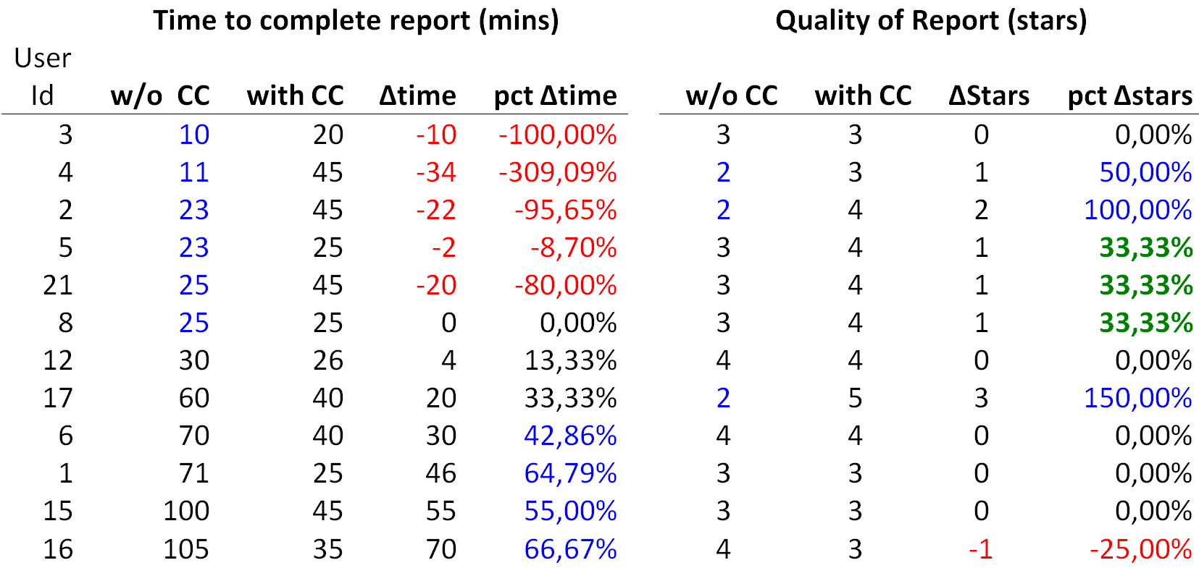
Benefit in time vs Benefit in quality
table rows are sorted by the time needed w/o CC
Notes:
A first very interesting observation lies in the fact that CineCubes did not result in clear time gains, as we would expect. In fact, there was a large number of people who spent more time with CineCubes than with the simple querying system! Although this originally did strike us as a failure, a better look at the data (and the graph) refutes this result. When we sorted the data by time spent without CineCubes (second column), it was clear that the users who demonstrated this kind of time loss were the ones who spent too little time (way less than the rest) for their original report. The small amount of time devoted to the original report, skyrockets the percentage deficit (a user who spends 10 minutes for the original report and 20 minutes for Cinecubes, gets a 100% time penalty).

Slide 53
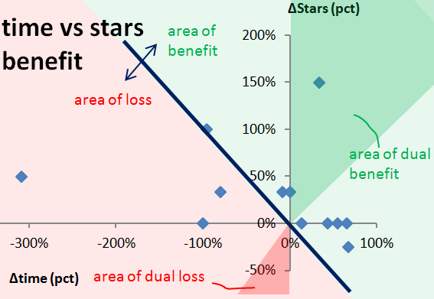
Benefit in time vs Benefit in quality
Notes:
The graphical representation of the figure compares the benefit in time (x-axis) over the benefit in stars (y-axis). In other words: does it pay off to spend more time working with the system for the quality of the report one gets? The diagonal line splits the plane in two parts: the right, green part is the area where you get more quality for the time you invest; the left, rose part is an area of loss. The intensely colored parts of the two areas are parts with two-fold benefit (more quality for less time) or loss (less quality for more time).

Slide 54
Lessons learned
For people in need of a fast report
  conciseness is key, as too many results slow them down
  CineCubes allows these people to create reports of better quality.
For people who want a quality report, i.e., would be willing to spend more time to author a report in the first place,
  CineCubes speeds up their work by a factor of 46% in average.

Slide 55
Method Overview
Software Issues
Experiments and User Study
Discussion
Discussion

Slide 56
Extensions
There are three clear “dimensions” of extensibility, each for a particular dimension of the problem:
    what kind of query results (episodes) we collect from the database – which means investigating new acts to add
    more highlight extraction algorithms to automatically discover important findings within these results
    how do we “dress” the presentation better, with graphs and texts around the highlights

Slide 57
Open Issues
Can I be the director? Interactively maybe?
  Interactivity, i.e., the possibility of allowing the user to intervene is challenge, due to the fact that CineCubes is intended to give stories. So, the right balance between interaction and narration has to be found.
Recommendations. Closely related to interactivity, is the possibility of guiding the subsequent steps of a CineCubes session -- e.g., via user profiles or user logs.
Efficiency
  Scale with data size and complexity, in user time
  Techniques like multi-query optimization have a good chance to succeed, especially since we operate with a known workload of queries as well as under the divine simplicity of OLAP.

Slide 58
Be compendious; if not, at least be concise!
The single most important challenge that the problem of answer-with-a-movie faces is the identification of what to exclude!
  The problem is not to add more and more recommendations or findings (at the price of time expenses): this can be done both effectively (too many algorithms to consider) and efficiently (or, at least, tolerably in terms of user time).
  The main problem is that it is very hard to keep the story both interesting and informative and, at the same time, automate the discovery of highlights and findings.
So, important topics of research involve
  the automatic ranking and pruning of highlights
  the merging of highlights that concern the same data values

Slide 59
Open issues
Show text
More than 2D arrays
Visualize
Structure more like a movie
More highlights
Multi-query
Back stage
Look like a movie
Info content
Speed-up voice gen.
More acts (more queries)
Crowd wisdom
Cloud/parallel
CC
now
Chase after interestingness
Star schema
Assumptions
Interaction
2D results (2 groupers)
Single measure
Equality selections
How to allow interaction with the user?
Personalization

Slide 60
Thank you!
Any questions?
More information
    http://www.cs.uoi.gr/~pvassil/projects/cinecubes/
Demo
    http://snf-56304.vm.okeanos.grnet.gr/
Code
    https://github.com/DAINTINESS-Group/CinecubesPublic.git

Slide 61
Auxiliary slides

Slide 62
Related Work

Slide 63
Related Work
Query Recommendations
Database-related efforts
OLAP-related methods
Advanced OLAP operators
Text synthesis from query results

Slide 64
Related Work
Query Recommendations
Database-related efforts
OLAP-related methods
Advanced OLAP operators
Text synthesis from query results

Slide 65
Query Recommendations
A. Giacometti, P. Marcel, E. Negre, A. Soulet, 2011. Query Recommendations for OLAP Discovery-Driven Analysis. IJDWM 7,2 (2011), 1-25 DOI= http://dx.doi.org/10.4018/jdwm.2011040101
C. S. Jensen, T. B. Pedersen, C. Thomsen, 2010. Multidimensional Databases and Data Warehousing. Synthesis Lectures on Data Management, Morgan & Claypool Publishers
A. Maniatis, P. Vassiliadis, S. Skiadopoulos, Y. Vassiliou, G. Mavrogonatos, I. Michalarias, 2005. A presentation model and non-traditional visualization for OLAP. IJDWM, 1,1 (2005), 1-36. DOI= http://dx.doi.org/10.4018/jdwm.2005010101
P. Marcel, E. Negre, 2011. A survey of query recommendation techniques for data warehouse exploration. EDA (Clermont-Ferrand, France, 2011), pp. 119-134

Slide 66
Database-related efforts
K. Stefanidis, M. Drosou, E. Pitoura, 2009. "You May Also Like" Results in Relational Databases. PersDB (Lyon, France, 2009).
G. Chatzopoulou, M. Eirinaki, S. Koshy, S. Mittal, N. Polyzotis, J. Varman, 2011. The QueRIE system for Personalized Query Recommendations. IEEE Data Eng. Bull. 34,2 (2011), pp. 55-60

Slide 67
OLAP-related methods
V. Cariou, J. Cubillé, C. Derquenne, S. Goutier, F.Guisnel, H. Klajnmic, 2008. Built-In Indicators to Discover Interesting Drill Paths in a Cube. DaWaK (Turin, Italy, 2008), pp. 33-44, DOI=http://dx.doi.org/10.1007/978-3-540-85836-2_4
A. Giacometti, P. Marcel, E. Negre, A. Soulet, 2011. Query Recommendations for OLAP Discovery-Driven Analysis. IJDWM 7,2 (2011), 1-25 DOI= http://dx.doi.org/10.4018/jdwm.2011040101

Slide 68
Advanced OLAP operators
Sunita Sarawagi: User-Adaptive Exploration of Multidimensional Data. VLDB 2000:307-316
S. Sarawagi, 1999. Explaining Differences in Multidimensional Aggregates. VLDB (Edinburgh, Scotland, 1999), pp. 42-53
G. Sathe, S. Sarawagi, 2001. Intelligent Rollups in Multidimensional OLAP Data. VLDB (Roma, Italy 2001), pp.531-540

Slide 69
Text synthesis from query results
A. Simitsis, G. Koutrika, Y. Alexandrakis, Y.E. Ioannidis, 2008. Synthesizing structured text from logical database subsets. EDBT (Nantes, France, 2008) pp. 428-439, DOI=http://doi.acm.org/10.1145/ 1353343.1353396

Slide 70
Formalities

Slide 71
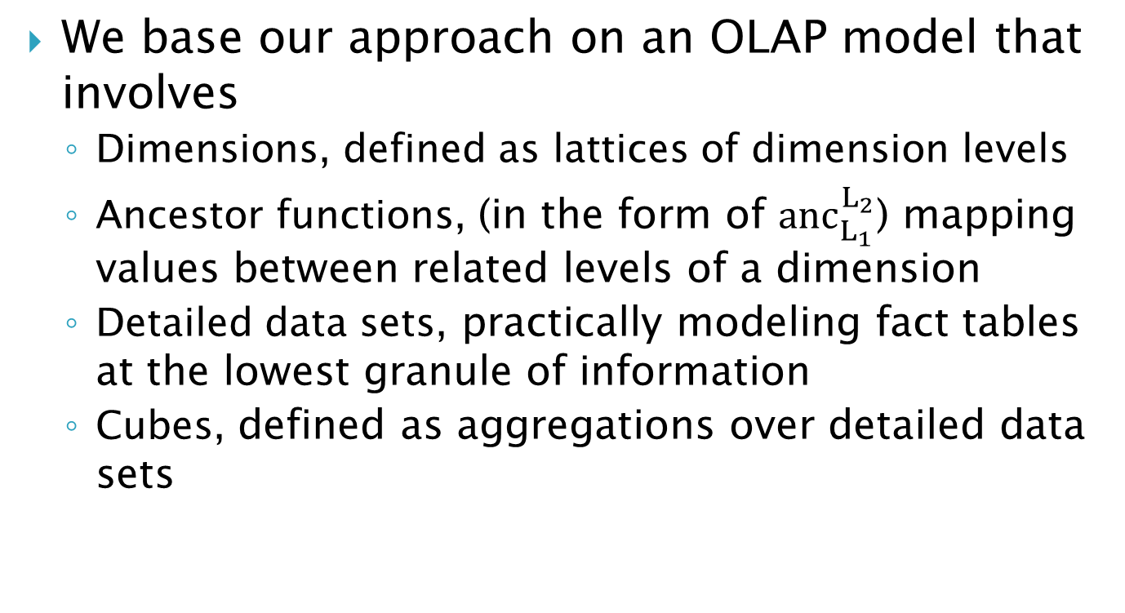
OLAP Model
We base our approach on an OLAP model that involves
  Dimensions, defined as lattices of dimension levels
  Ancestor functions, (in the form of ${anc}_{L_{1}}^{L_{2}}$) mapping values between related levels of a dimension
  Detailed data sets, practically modeling fact tables at the lowest granule of information
  Cubes, defined as aggregations over detailed data sets
Notes:
Dimensions are structured as hierarchies and hierarchies have levels
We use a star schema

Slide 72
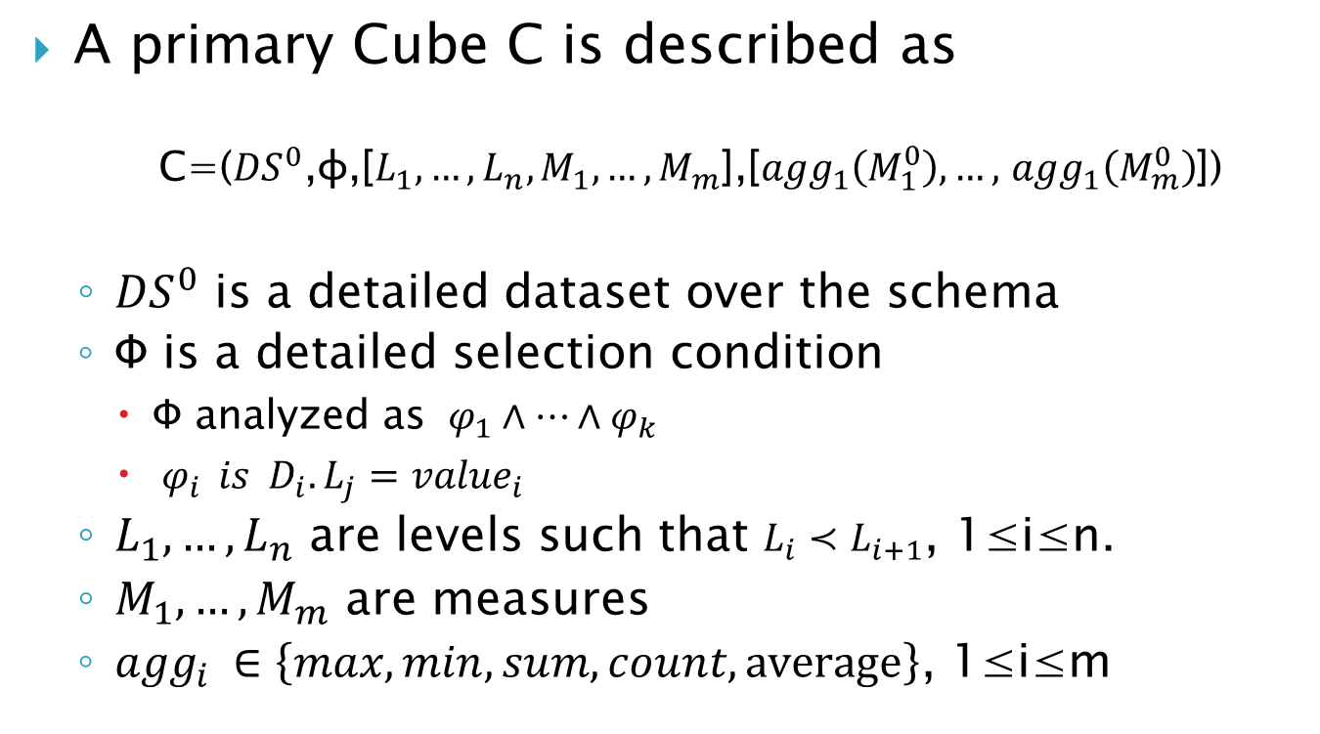
What is Cube?
A primary Cube C is described as
  C=(${DS}^{0}$,φ,[$L_{1},…,L_{n},M_{1}, …,M_{m}$],[${agg}_{1}\left(M_{1}^{0}\right), …,$ ${agg}_{1}\left(M_{m}^{0}\right)$])
  ${DS}^{0}$ is a detailed dataset over the schema
  Φ is a detailed selection condition
    Φ analyzed as $φ_{1}∧…∧φ_{k}$
    $φ_{i }{ is D}_{i}.L_{j}={value}_{i}$
  $L_{1},…,L_{n}$ are levels such that $L_{i}{≺L}_{i+1}$, 1≤i≤n.
  $M_{1}, …,M_{m}$ are measures
  ${agg}_{i }∈\left\{max,min,sum,count,average\right\}$, 1≤i≤m

Slide 73
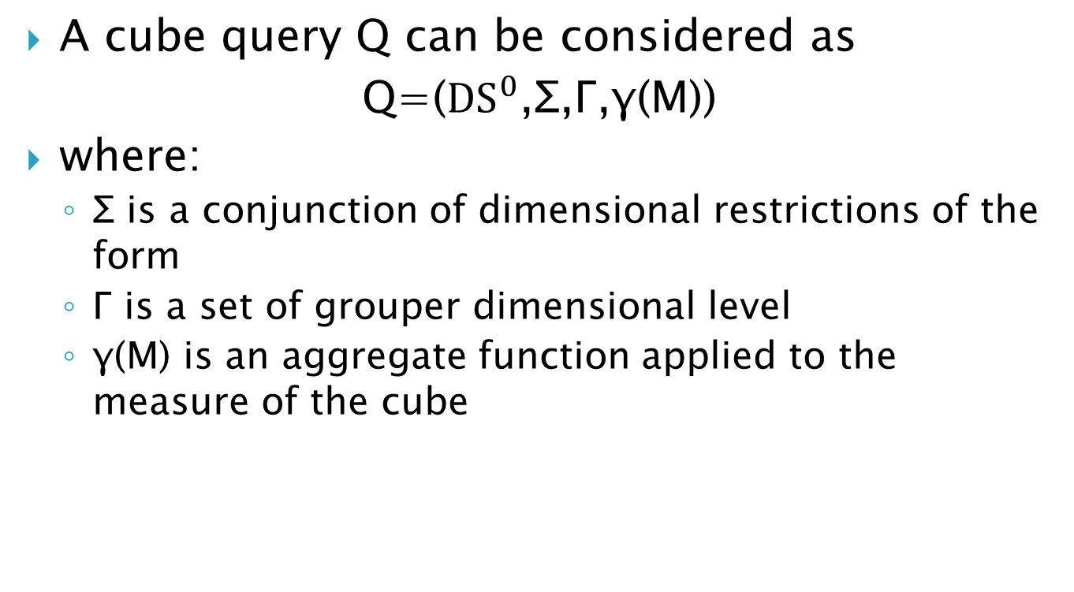
Cube Query
A cube query Q can be considered as
Q=(${DS}^{0}$,Σ,Γ,γ(M))
where:
  Σ is a conjunction of dimensional restrictions of the form
  Γ is a set of grouper dimensional level
  γ(M) is an aggregate function applied to the measure of the cube

Slide 74
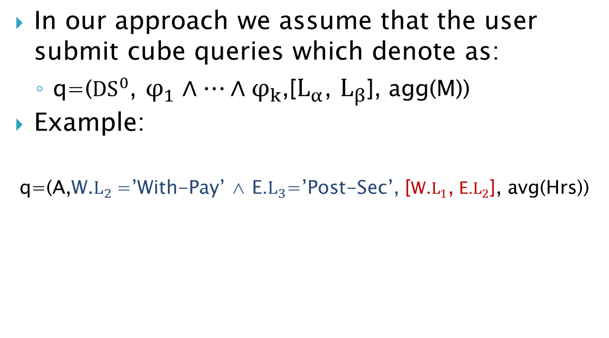
Cube Query
In our approach we assume that the user submit cube queries which denote as:
  q=(${DS}^{0}$, $φ_{1}∧…∧φ_{k}$,[$L_{α}$, $L_{β}$], agg(M))
Example:
    q=(A,W.$L_{2}$=’With-Pay’ ∧ E.$L_{3}$=’Post-Sec’, [W.$L_{1}$, E.$L_{2}$], avg(Hrs))

Slide 75
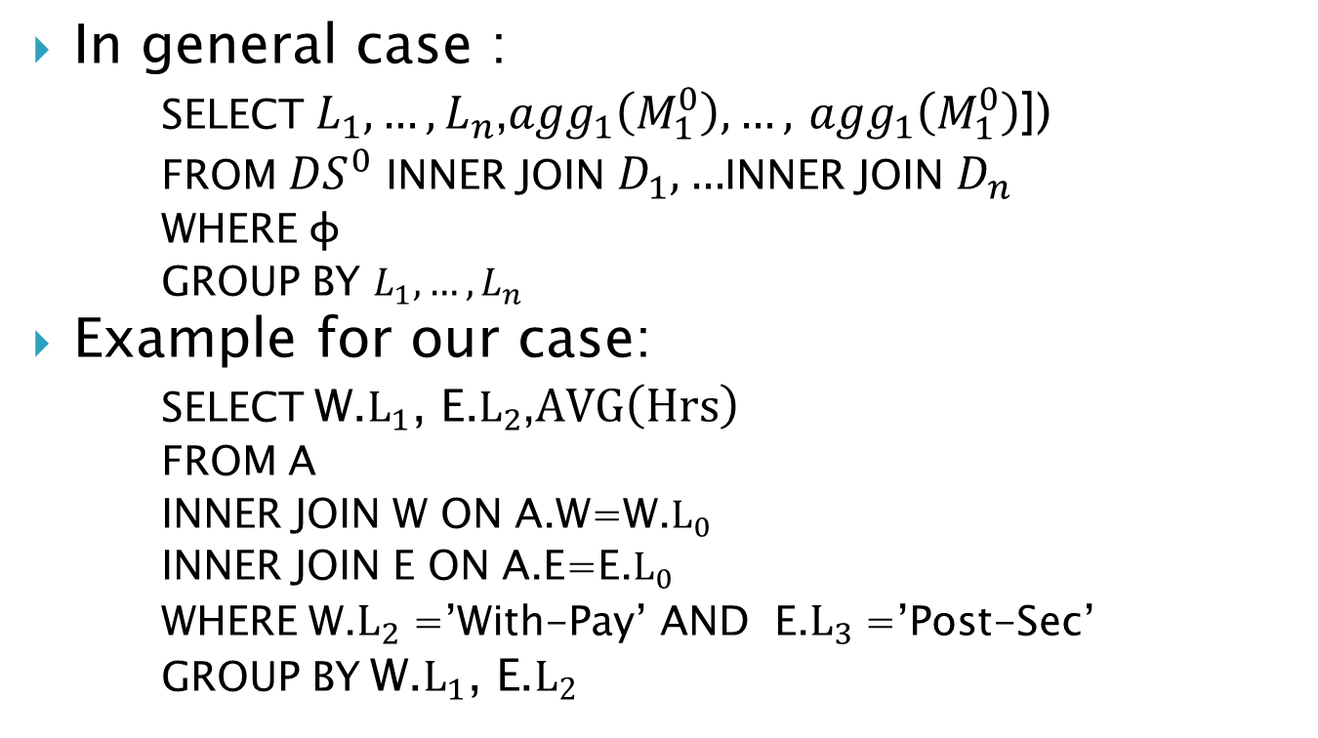
Cube Query to SQL Query
In general case :
      SELECT $L_{1},…,L_{n}$,${agg}_{1}\left(M_{1}^{0}\right), …,$ ${agg}_{1}\left(M_{1}^{0}\right)$])
      FROM ${DS}^{0}$ INNER JOIN $D_{1},…$INNER JOIN $D_{n}$
      WHERE φ
      GROUP BY $L_{1},…,L_{n}$
Example for our case:
      SELECT$\text{W}\text{.}L_{1}\text{, }\text{E}\text{.}L_{2}$,$AVG\left(Hrs\right)$
      FROM A
      INNER JOIN W ON A.W=W.$L_{0}$
      INNER JOIN E ON A.E=E.$L_{0}$
      WHERE W.$L_{2}$=’With-Pay’ AND E.$L_{3}$=’Post-Sec’
      GROUP BY$\text{W}\text{.}L_{1}\text{, }\text{E}\text{.}L_{2}$

Slide 76
Method Internals

Slide 77
Act I – Problem
The average user need to compare on the same screen and visually inspect differences
But as the number of selection conditions increase so the number of siblings increases.
It can be too hard to be able to visually compare the results
Notes:
Naturally, if q originally has k atomic selections, it also has k sibling queries.
The average user need to compare on the same screen and visually inspect differences
But as the number of selection conditions increase so the number of siblings increases.
It can be too hard to be able to visually compare the results

Slide 78
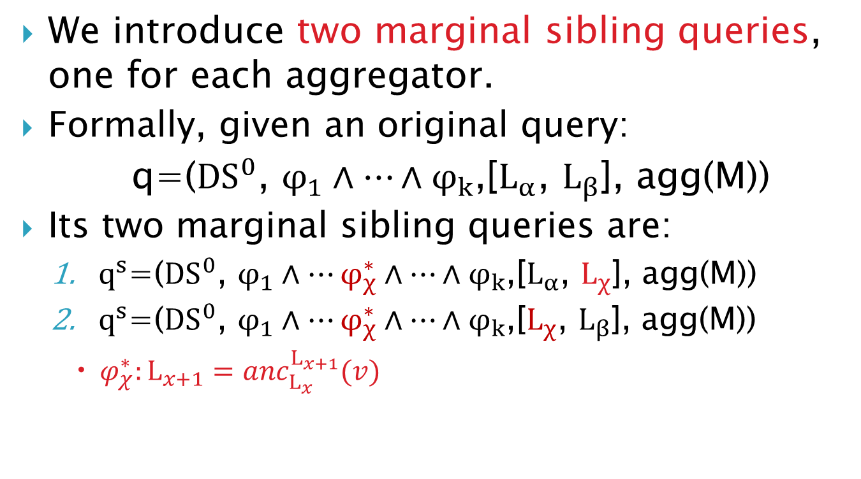
Act I – Our Definition
We introduce two marginal sibling queries, one for each aggregator.
Formally, given an original query:
  q=(${DS}^{0}$, $φ_{1}∧…∧φ_{k}$,[$L_{α}$, $L_{β}$], agg(M))
Its two marginal sibling queries are:
  $q^{s}$=(${DS}^{0}$, $φ_{1}∧…φ_{χ}^{∗}∧…∧φ_{k}$,[$L_{α}$, $L_{χ}$], agg(M))
  $q^{s}$=(${DS}^{0}$, $φ_{1}∧…φ_{χ}^{∗}∧…∧φ_{k}$,[$L_{χ}$, $L_{β}$], agg(M))
    $φ_{χ}^{∗}:L_{x+1}={anc}_{L_{x}}^{L_{x+1}}(v)$

Slide 79
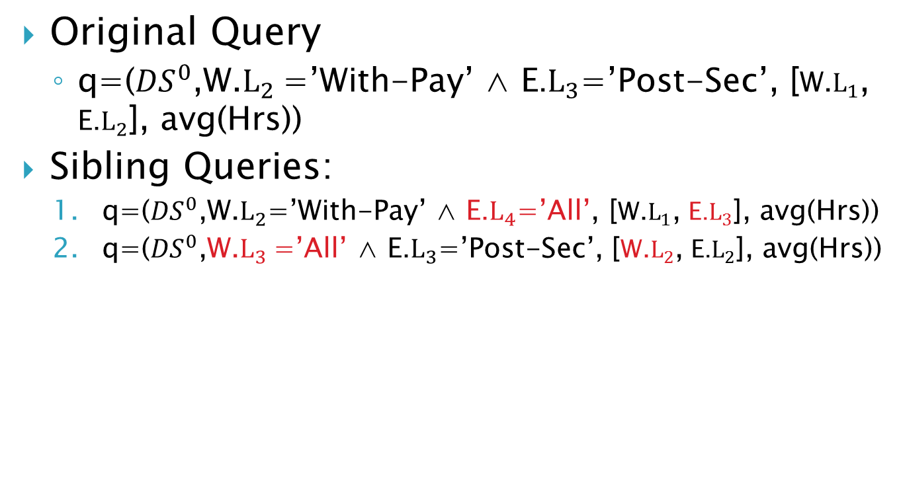
Act I – Query Example
Original Query
  q=(${DS}^{0}$,W.$L_{2}$=’With-Pay’ ∧ E.$L_{3}$=’Post-Sec’, [W.$L_{1}$, E.$L_{2}$], avg(Hrs))
Sibling Queries:
  q=(${DS}^{0}$,W.$L_{2}$=’With-Pay’ ∧ E.$L_{4}$=’All’, [W.$L_{1}$, E.$L_{3}$], avg(Hrs))
  q=(${DS}^{0}$,W.$L_{3}$=’All’ ∧ E.$L_{3}$=’Post-Sec’, [W.$L_{2}$, E.$L_{2}$], avg(Hrs))

Slide 80
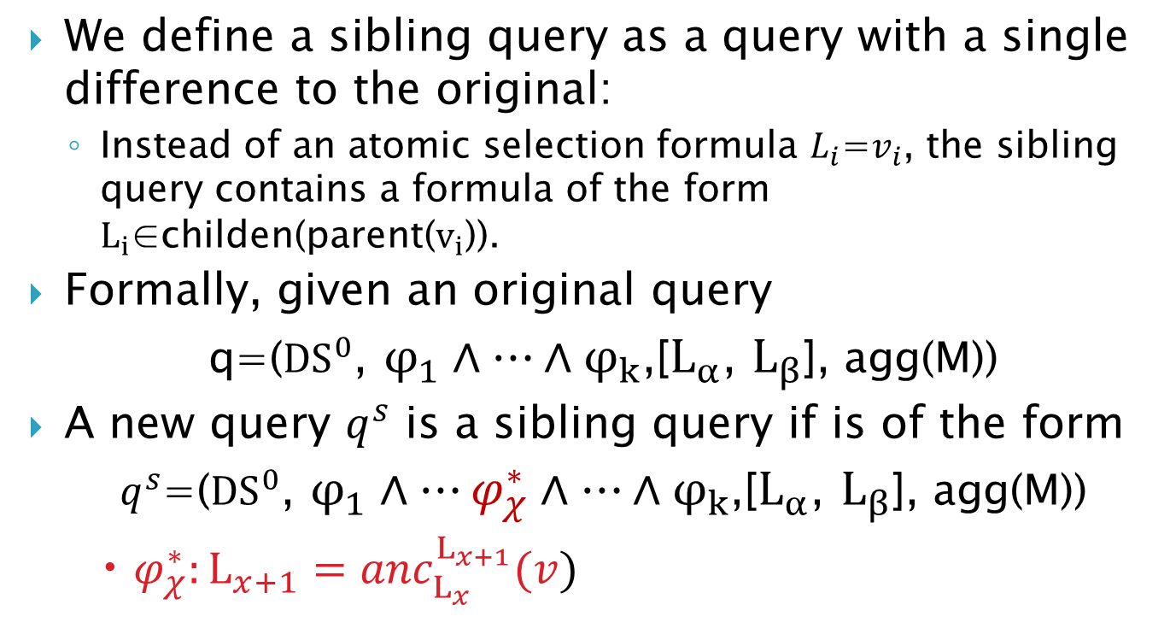
Act I – How produce it?
We define a sibling query as a query with a single difference to the original:
  Instead of an atomic selection formula $L_{i}$=$v_{i}$, the sibling query contains a formula of the form $L_{i}$∈childen(parent($v_{i}$)).
Formally, given an original query
  q=(${DS}^{0}$, $φ_{1}∧…∧φ_{k}$,[$L_{α}$, $L_{β}$], agg(M))
A new query $q^{s}$ is a sibling query if is of the form
  $q^{s}$=(${DS}^{0}$, $φ_{1}∧…φ_{χ}^{∗}∧…∧φ_{k}$,[$L_{α}$, $L_{β}$], agg(M))
    $φ_{χ}^{∗}:L_{x+1}={anc}_{L_{x}}^{L_{x+1}}(v)$

Slide 81
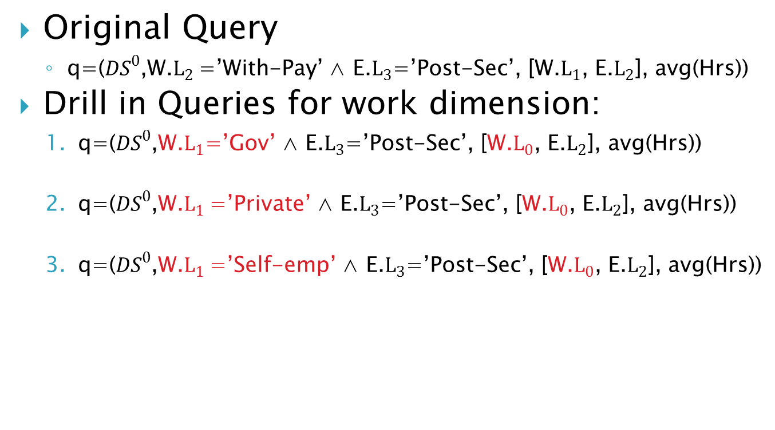
Act II – Query Example
Original Query
  q=(${DS}^{0}$,W.$L_{2}$=’With-Pay’ ∧ E.$L_{3}$=’Post-Sec’, [W.$L_{1}$, E.$L_{2}$], avg(Hrs))
Drill in Queries for work dimension:
  q=(${DS}^{0}$,W.$L_{1}$=’Gov’ ∧ E.$L_{3}$=’Post-Sec’, [W.$L_{0}$, E.$L_{2}$], avg(Hrs))
  q=(${DS}^{0}$,W.$L_{1}$=’Private’ ∧ E.$L_{3}$=’Post-Sec’, [W.$L_{0}$, E.$L_{2}$], avg(Hrs))
  q=(${DS}^{0}$,W.$L_{1}$=’Self-emp’ ∧ E.$L_{3}$=’Post-Sec’, [W.$L_{0}$, E.$L_{2}$], avg(Hrs))
For Education dimension: similarly

Slide 82
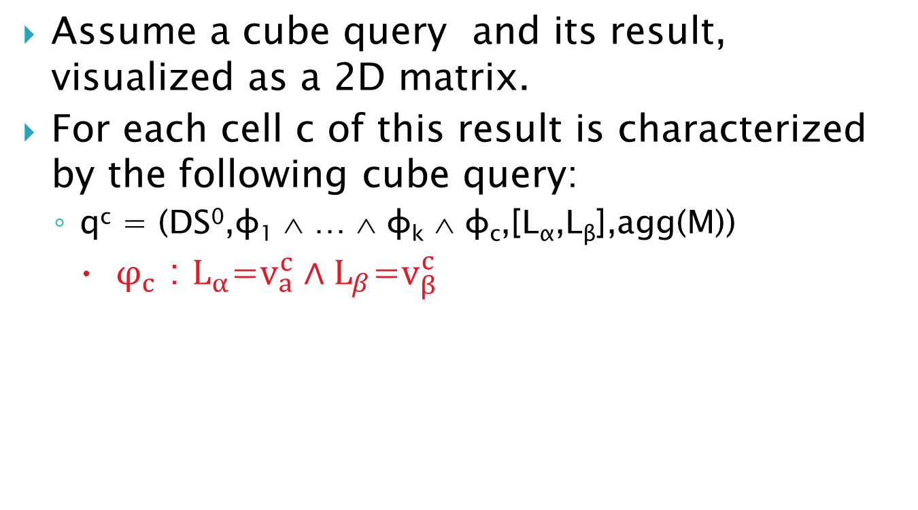
Act II- How produce it?
Assume a cube query and its result, visualized as a 2D matrix.
For each cell c of this result is characterized by the following cube query:
  q^{c} = (DS⁰,φ₁ ∧ … ∧ φ_{k} ∧ φ_{c},[L_{α},L_{β}],agg(M))
    $φ_{c}$ : $L_{α}$=$v_{a}^{c}∧L_{β}\text{=}v_{β}^{c}$
Notes:
The purpose of Act II is to help the user understand why the situation is as observed in the original query

Slide 83
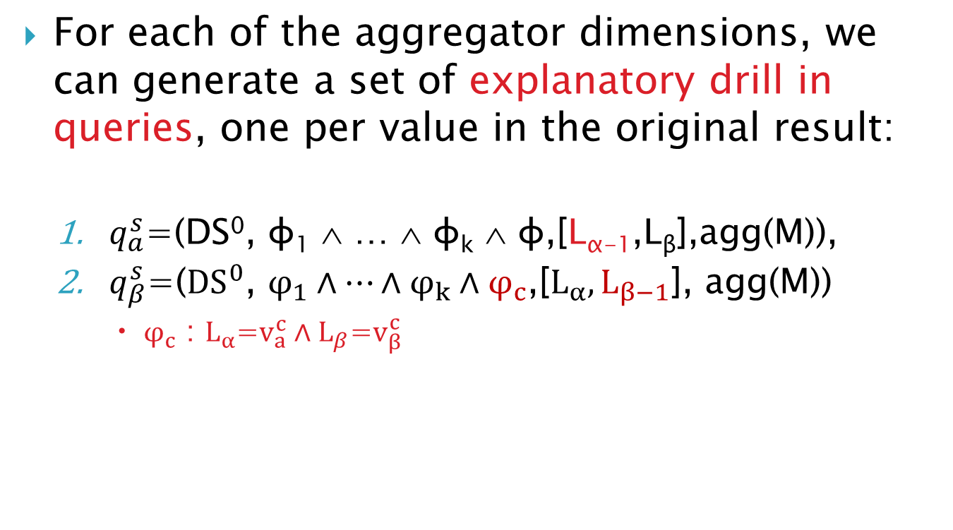
Act II- How produce it?
For each of the aggregator dimensions, we can generate a set of explanatory drill in queries, one per value in the original result:
  $q_{a}^{s}$=(DS⁰, φ₁ ∧ … ∧ φ_{k} ∧ φ,[L_{α-1},L_{β}],agg(M)),
  $q_{β}^{s}$=(${DS}^{0}$, $φ_{1}∧…∧φ_{k}∧φ_{c}^{}$,[$L_{α},L_{β−1}$], agg(M))
      $φ_{c}$ : $L_{α}$=$v_{a}^{c}∧L_{β}\text{=}v_{β}^{c}$
Notes:
In each of these slides we have one query for each of the values that appear in the original result for this dimension.
Then, for each of the two grouper dimensions we create a slide.

Slide 84
Our Algorithm
Algorithm Construct Operational Act Input: the original query over the appropriate database Output: a set of an act’s episodes fully computed Create the necessary objects (act, episodes, tasks, subtasks) appropriately linked to each other Construct the necessary queries for all the subtasks of the Act, execute them, and organize the result as a set of aggregated cells (each including its coordinates, its measure and the number of its generating detailed tuples) For each episode Calculate the cells’ highlights Calculate the visual presentation of cells Produce the text based on the highlights Produce the audio based on the text

Slide 85
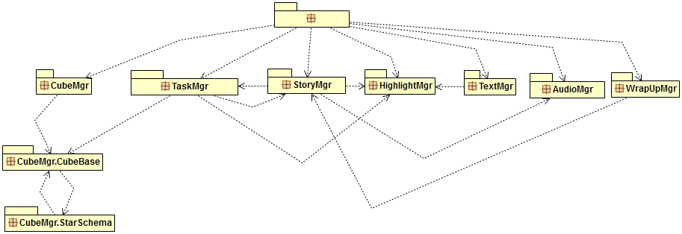
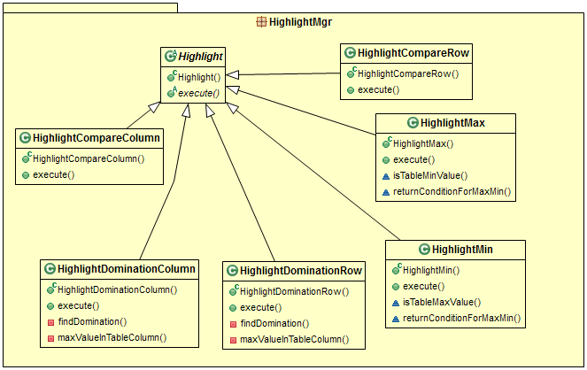

Slide 86
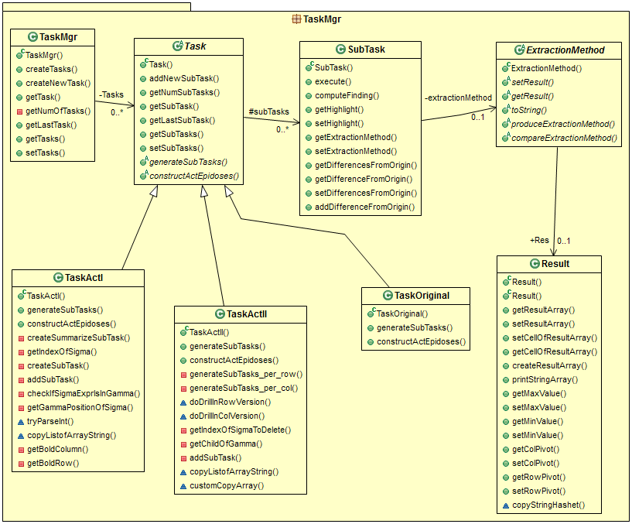

Slide 87
Experiments

Slide 88
Experiments
Notes:
Similarly to the previous, but instead of measuring the different parts of the method, we measure each act in separation.
Act I has a variant (increasing) number of slides, due to the increasing number of selection atoms => it gets slower and slower.
The rest are pretty much stable.

Slide 89
Experiments
Time breakdown(msec) per Act
 | # atomic selections in WHERE clause
 | 2 (10 sl.) | 3 (12 sl.) | 4 (14 sl.) | 5 (16 sl.)
Intro Act | 3746.99 | 4240.22 | 4919.71 | 5572.97
Original Act | 7955.17 | 8425.59 | 9234.47 | 9577.76
Act I | 21160.78 | 42562.10 | 70653.22 | 90359.89
Act II | 21250.44 | 22419.34 | 22819.94 | 22738.88
Summary Act | 18393.10 | 27806.35 | 39456.52 | 42750.78
Notes:
The numbers for the previous slide

Slide 90
Findings concerning ‘fast doers’
CineCubes did not result in clear time gains!!
In fact, there was a large number of people who spent more time with CineCubes than with the simple querying system!
  Why? Observe that the users with time loss were the ones who spent too little time (way less than the rest) for their original report. The small amount of time devoted to the original report, skyrockets the percentage deficit (a user who spends 10 minutes for the original report and 20 minutes for Cinecubes. gets a 100% time penalty).
  At the same time, this resulted also in an original report of rather poor quality. => significant improvements in the quality of the Cinecubes-based report.
There are no users with dual loss.
  Again, the explanation for the time increase is that the users spent extra time to go through the highlights offered by CineCubes.

Slide 91
Findings concerning ‘quality doers’
Users who spent less time with CineCubes than without it are the ones who invested more time working with data than the previous group. In all but one cases, there was no loss of quality for this group of users.
Clearly, for the people who would spend at least 30 minutes for their original report, there is a benefit in time gains.
  In fact, in all but one cases, the benefit rises with the time spent in the original report
    the relationship between time and quality improvements for the people with a positive time gain is almost linear, with a Pearson correlation of 0.940;
    the same applies for the correlation of the time spent without Cinecubes and time improvement with a Pearson correlation of 0.868).
Interestingly, as these users devoted quite some time working with the data in the first place, they had a quite satisfactory report in the first place (in all but one cases, no less than 3 stars).
  Therefore, the improvement of quality is on average half star (although the distribution of values is clearly biased, as the last column of the data in the table indicates).
  The speedup rises on average to 37.5 minutes (46%) for these cases.

Slide 92
Various helpful

Slide 93
Example
Notes:
Dimensions play a significant role for (a) selection filters and (b) grouping

Slide 94
The CineCubes method
… tell a nice story…
Presentation
…
audio
… trends, outliers, patterns…
text
Highlight Extraction
dominating rows/cols
top/low values
color
…
Orthogonally combine the 3 dimensions!
answer original query
contextualize
drill in
…
… get more and more relevant data …
Result Expansion
Notes:
All the member values of these dimensions will be explained more in the sequel – this is just an overview

