Slide 1
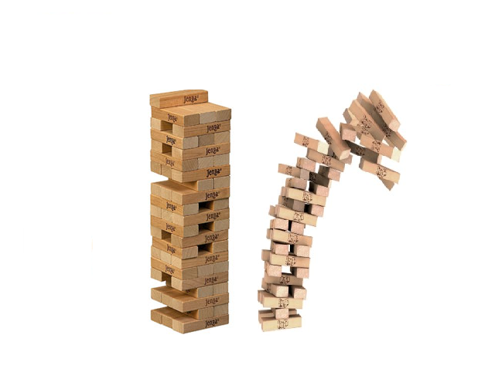

Jenga and the art of data-intensive ecosystems maintenance
Panos Vassiliadis
in collaboration with
G. Papastefanatos, P. Manousis, A. Simitsis, Y. Vassiliou
University of Ioannina, Greece

Slide 2
Software Evolution and ETL
Software evolution causes at least as much as 60% of the costs for the entire software lifecycle
ETL is not the exception:
  Source database change their internal structure
  Users require new structure and contents for their reports (and therefore for the collected DW data)
  DBA and development teams do not synch well all the time
  …

Slide 3
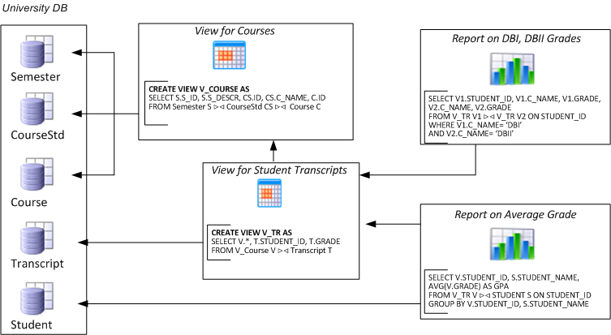
Evolving data-intensive ecosystem

Slide 4
Evolving data-intensive ecosystem
Remove CS.C_NAME
Syntactically invalid
Semantically unclear
Add exam year
The impact can be syntactical (causing crashes), semantic (causing info loss or inconsistencies) and related to the performance

Slide 5

The impact of changes & a wish-list
Syntactic: scripts & reports simply crash
Semantic: views and applications can become inconsistent or information losing
Performance: can vary a lot
We would like: evolution predictability
i.e., control of what will be affected
before changes happen
Learn what changes & how
Find ways to quarantine effects

Slide 6
Research goals
Part I: a case study for ETL evolution
  Can we study ETL evolution and see in what ways do DW/ETL environments evolve?
  Can we predict evolution in some way?
Part II: regulating the evolution
  Can we regulate the evolution?
  Can we forbid unwanted changes?
  Can we suggest adaptation to the code when the structure of data changes?

Slide 7

Zen and the Art of Motorcycle Maintenance, R. Pirsig
"Solve Problem: What is wrong with cycle?"
… By asking the right questions and choosing the right tests and drawing the right conclusions the mechanic works his way down the echelons of the motorcycle hierarchy until he has found the exact specific cause or causes of the engine failure, and then he changes them so that they no longer cause the failure…

Slide 8
Metrics for the Prediction of Evolution Impact in ETL Ecosystems: A Case Study
George Papastefanatos, Panos Vassiliadis, Alkis Simitsis, Yannis Vassiliou
Journal on Data Semantics, August 2012, Volume 1, Issue 2, pp 75-97
Work conducted in the context of the "EICOS: foundations for perSOnalized Cooperative Information Ecosystems" project of the "Thales" Programme. The only source of funding for this research comes from the European Social Fund (ESF) -European Union (EU) and National Resources of the Greek State under the Operational Programme "Education and Lifelong Learning (EdLL).

Slide 9
Main goals of this effort
We present a real-world case study of data warehouse evolution for exploring the behavior of a set of metrics that
  monitor the vulnerability of warehouse modules to future changes and
  assess the quality of various ETL designs with respect to their maintainability.
We model the DW ecosystem as a graph and we employ a set of graph-theoretic metrics to see which ones fit best the series of actual evolution events
We have used, Hecataeus, a publicly available, software tool, which allows us to monitor evolution and perform evolution scenarios in database-centric environments
http://www.cs.uoi.gr/~pvassil/projects/hecataeus/

Slide 10
Architecture Graphs: the graph-based Model for data-Intensive ecosystems
Nothing is possible without a model

Slide 11
Graph modeling of a data-intensive ecosystem
The entire data-intensive ecosystem, comprising databases and their internals, as well as applications and their data-intensive parts, is modeled via a graph that we call Architecture Graph
Why Graph modeling?
  Completeness: graphs can model everything
  Uniformity: we would like to module everything uniform manner
  Detail and Grand-View: we would like to capture parts and dependencies at the very finest level; at same time, we would like to have the ability to zoom-out at higher levels of abstraction
  Exploit graph management techniques and toolkits

Slide 12
Relations – Attributes - Constraints
CREATE TABLE EMP (EMP# INTEGER PRIMARY KEY,
NAME VARCHAR(25) NOT NULL,
TITLE VARCHAR(10),
SAL INTEGER NOT NULL);

Slide 13
Queries & Views
Q: SELECT EMP.Emp# as Emp#,
Sum(WORKS.Hours) as T_Hours
FROM EMP, WORKS
WHERE EMP.Emp# = WORKS.Emp#
AND EMP.SAL > 50K
GROUP BY EMP.Emp#

Slide 14
Modules: relations, queries, views

Slide 15
Zooming out to top-level nodes (modules)

Slide 16
Metrics
Can we relate graph-theoretic properties of nodes & modules to the probability of sustaining change?

Slide 17
Node Degree
Simple metrics:
in-degree, out-degree, degree
EMP.Emp# is the most important attribute of EMP.SAL, if one considers how many nodes depend on it.
Edge direction: from dependant
to depended upon

Slide 18
Transitive Node Degree
  Observe that there is both a view and a query with nodes dependent upon attribute EMP.Emp#.
Transitive Metrics:
in-degree, out-degree, degree

Slide 19
Strength: Zooming out to modules
Again, for modules, we can have both:
Simple strength
Transitive strength
A zoomed out graph highlights the dependence between modules (relations, queries, views), incorporating the detailed dependencies as the weight of the edges

Slide 20
Node Entropy
The probability a node v being affected by an evolution event on node y_{i} :
Examples
P(Q|V) = 1/4,
P(Q|EMP) = 2/4,
P(V|WORKS) = 1/3
Entropy of a node v : How sensitive the node v is by an arbitrary event on the graph.
Notes:
Intuitively, entropy metrics:
-- are transitive-related metrics,
- take into account the #paths arriving to a node especially when more than one paths exist between two nodes in the graph (in contrast to the transitive degree that measures the max path)
- the #paths are quantified as probability and entropy measures how sensitive a node is by an arbitrary event on the graph (more paths arriving to a node, more dependent this node is).

Slide 21
Experimental Assessment
A case study

Slide 22
Context of the Study
We have studied a data warehouse scenario from a Greek public sector’s data warehouse maintaining information for farming and agricultural statistics.
The warehouse maintains statistical information collected from surveys, held once per year via questionnaires.
Our study is based on the evolution of the source tables and their accompanying ETL flows, which has happened in the context of maintenance due to the change of requirements at the real world.
Practically this is due to the update of the questionnaires from year to year
Notes:
The survey data are primarily stored in 7 source tables and are subsequently processed so that they can be integrated in the organization’s warehouse and queried. Each survey varies its schema according to the different number and types of questions comprising the survey’s questionnaire; however, there are several common elements in all surveys.
One table (S1) holds information about the metadata of the survey (e.g., the year held, the sample size, etc.), which are rarely altered or renamed and mostly complemented or specialized yearly by adding new attributes in the survey’s metadata. All other source tables (S2-S7) retain the answers to the questionnaires, where most alterations occur every year.

Slide 23
Internals of the monitored scenario
The environment involves a set of 7 ETL workflows:
  7 source tables, (S1 to S7)
  3 lookup tables(L1 to L3),
  7 target tables, (T1 to T7), stored in the data warehouse.
  7 temporary tables (each target table has a temporary replica) for keeping data in the data staging area,
  58 ETL activities in total for all the 7 workflows.
Notes:
See next slides for details on the size of the schema of each table, in terms of number of attributes

Slide 24
PL/SQL to graph transformation
All ETL scenarios were source coded as PL\SQL stored procedures in the data warehouse.
  We extracted embedded SQL code (e.g., cursor definitions, DML statements, SQL queries) from activity stored procedures
  Each activity was represented in our graph model as a view defined over the previous activities
  Table definitions were represented as relation graphs.

Slide 25
Method of assessment
We have represented the ETL workflows in our graph model
We have recorded evolution events on the nodes of the source, lookup and temporary tables.
We have applied each event sequentially on the graph and monitored the impact of the change towards the rest of the graph by recording the times that a node has been affected by each change

Slide 26
Macroscopic view
ATTN: change of requirements at the real world determines pct breakdown!!
 | # tables affected | Occurrences | pct
Add Attribute | 8 | 122 | 29%
Add Constraint | 1 | 1 | 0%
Drop Attribute Count | 5 | 34 | 8%
Modify Attribute | 9 | 16 | 4%
Rename Attribute | 5 | 236 | 57%
Rename Table | 7 | 7 | 2%
 |  | 416

Slide 27
Workflow of the first ETL scenario, ETL1

Slide 28
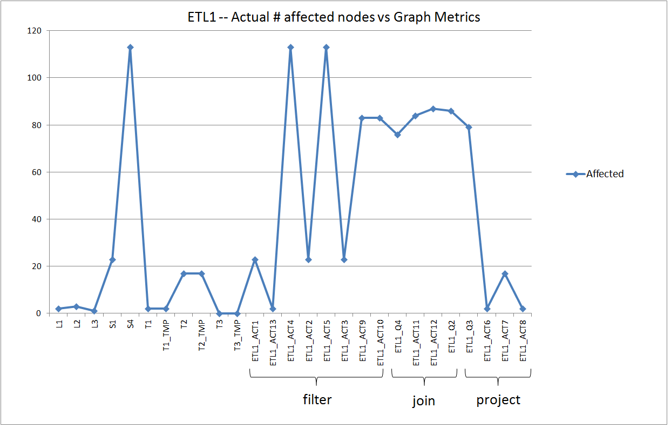

Slide 29
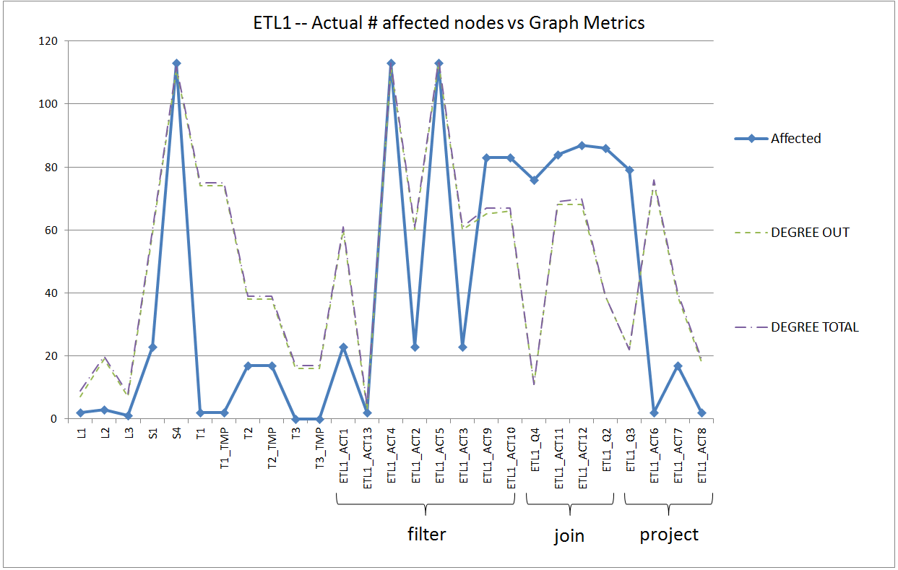
Out – degree
Schema size for tables
Output schema size for activities

Slide 30
Pretty good job for tables
Decent job for filters and joins
Not so good for projection activities

Slide 31
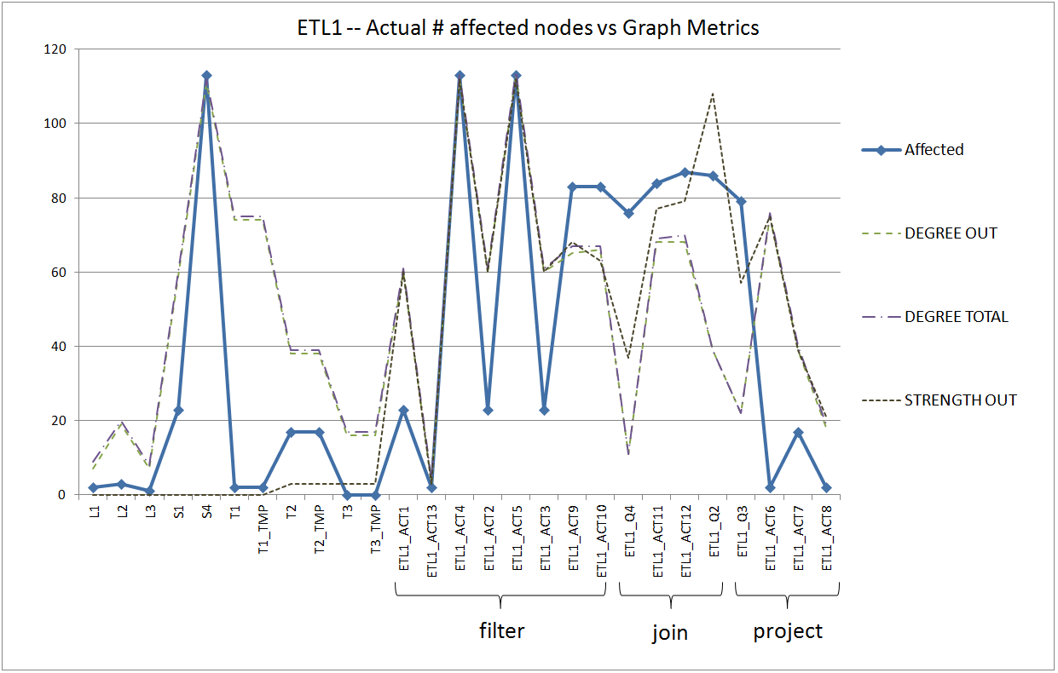
Strength out did not work so well -- esp. for tables, it is too bad

Slide 32
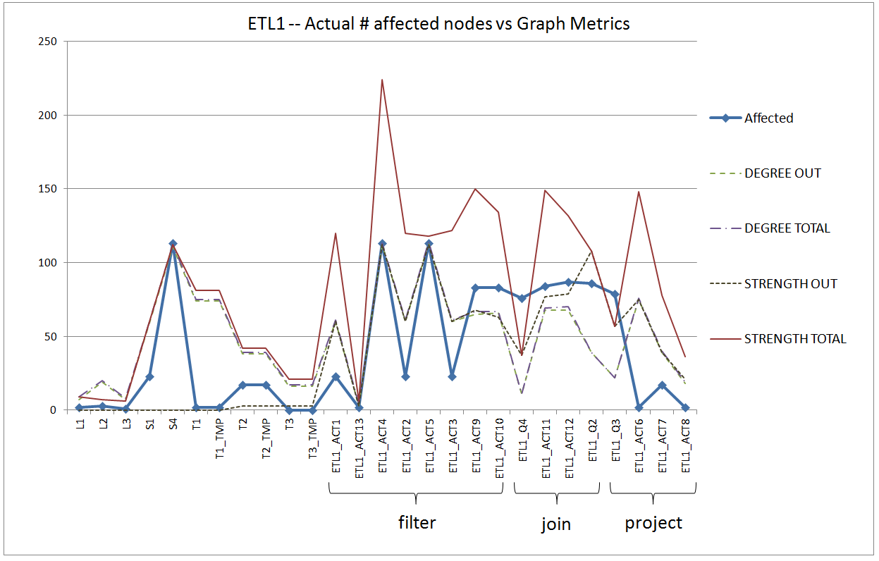
Strength-total works the other way around

Slide 33
Workflows of the second & third ETL scenarios, ETL2 – ETL3

Slide 34
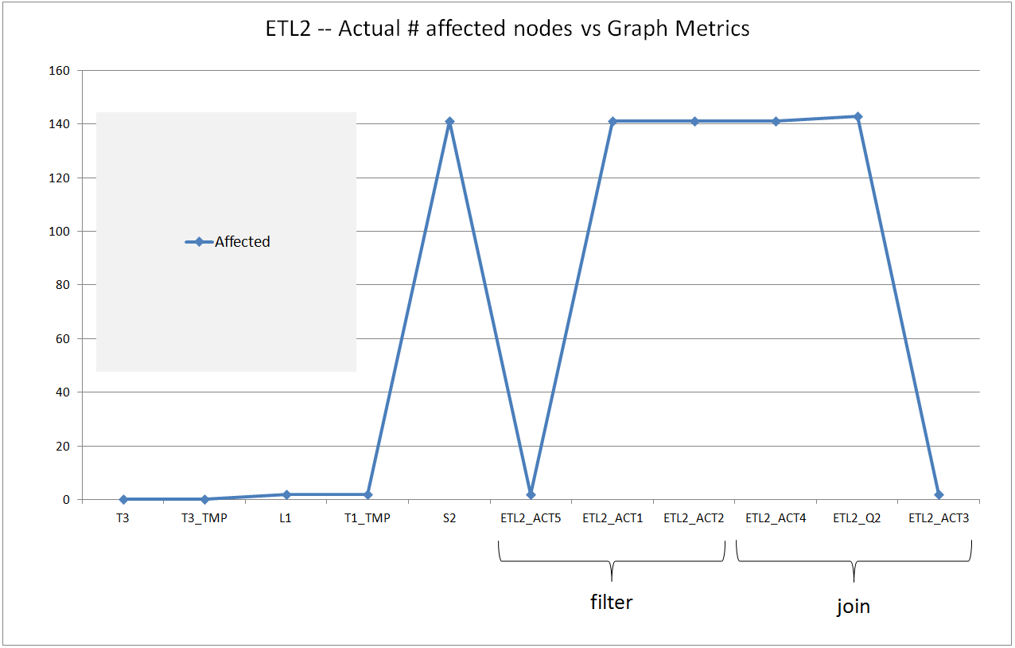

Slide 35
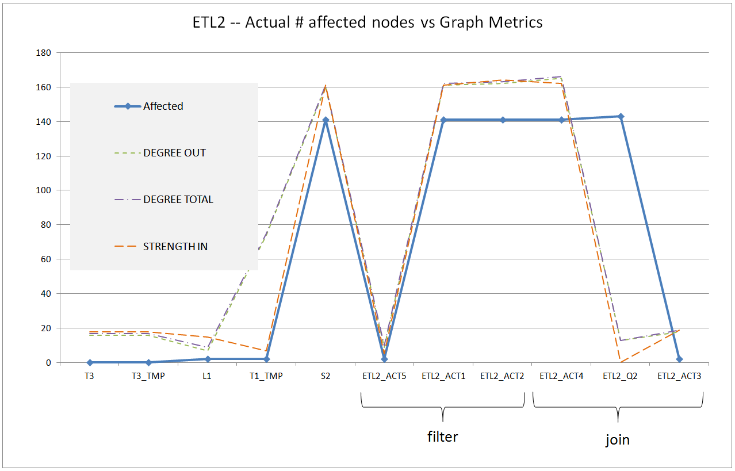

Slide 36
ETL 4

Slide 37
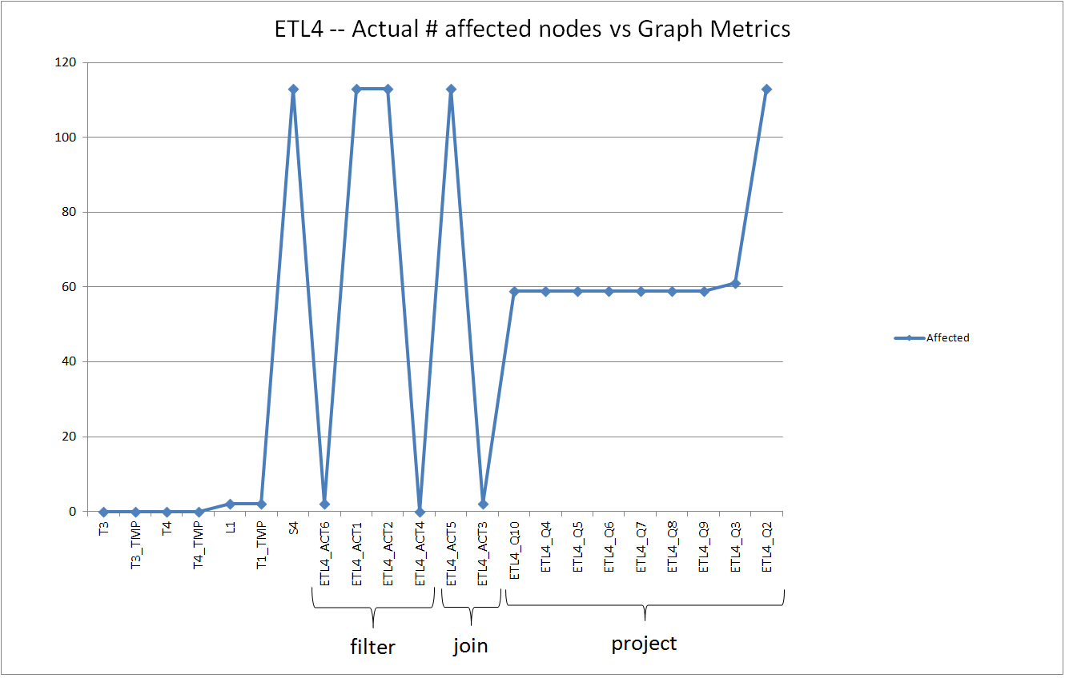

Slide 38
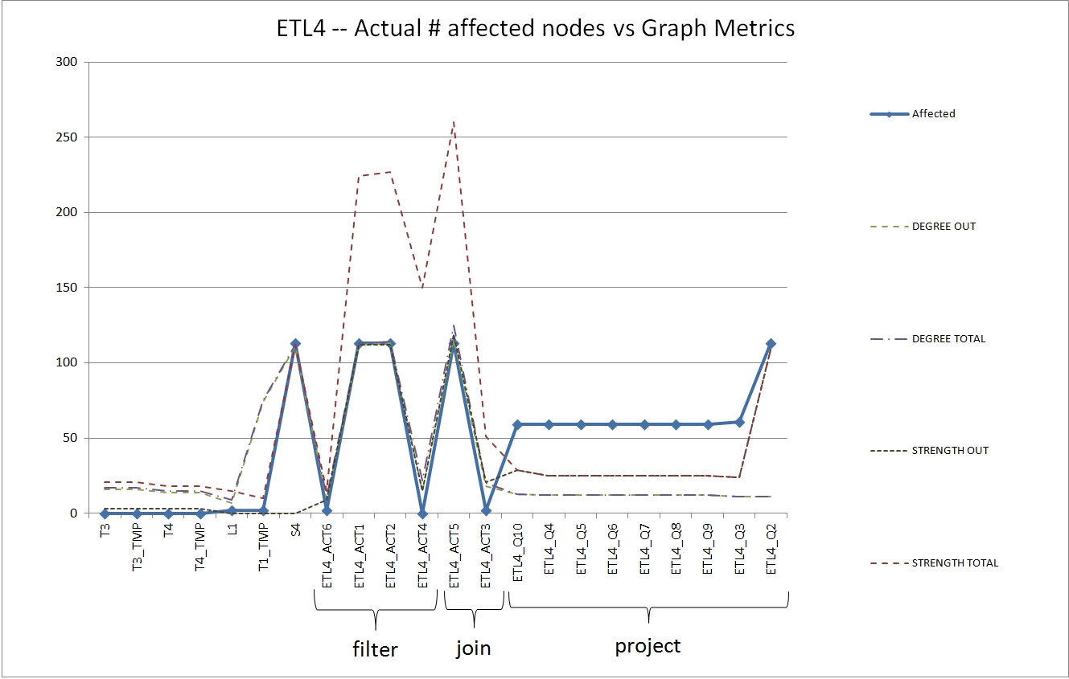
Suddenly everything is underestimated
Pretty good job in the left part

Slide 39
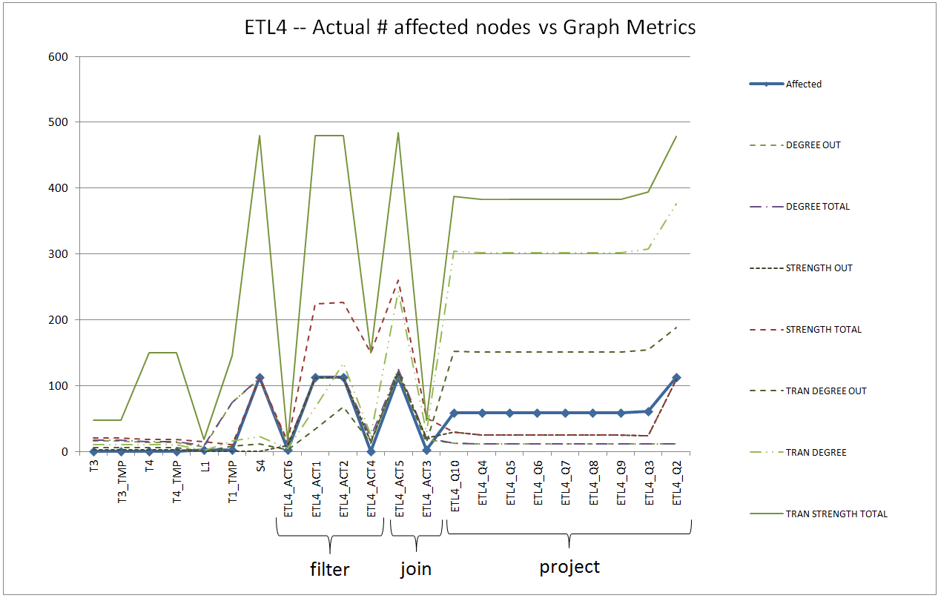
Transitive metrics to the rescue

Slide 40
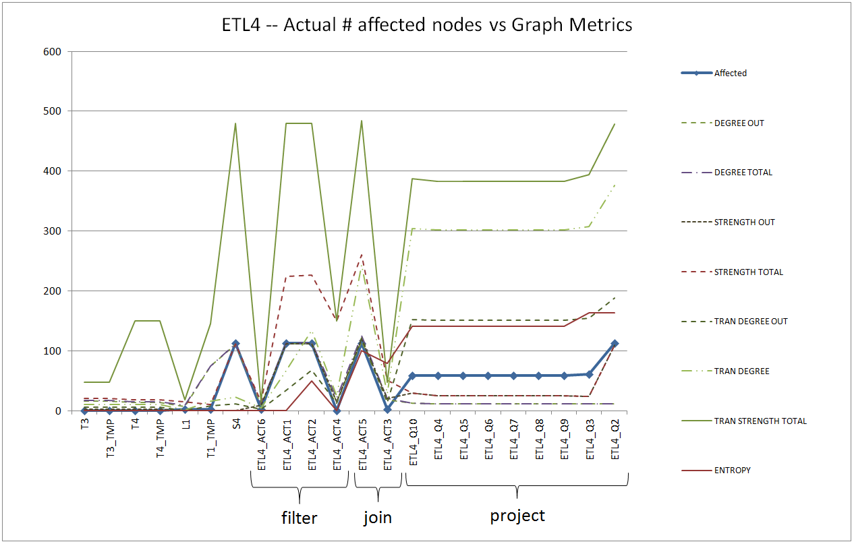
Entropy too

Slide 41
ETL 5,6,7

Slide 42
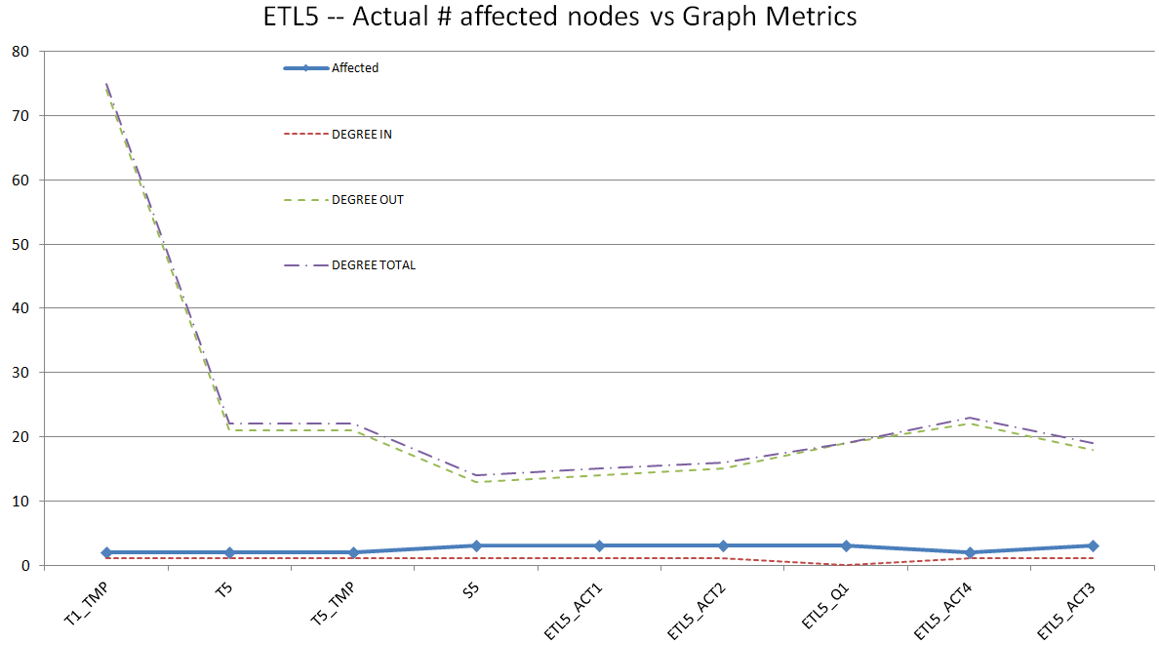

Slide 43
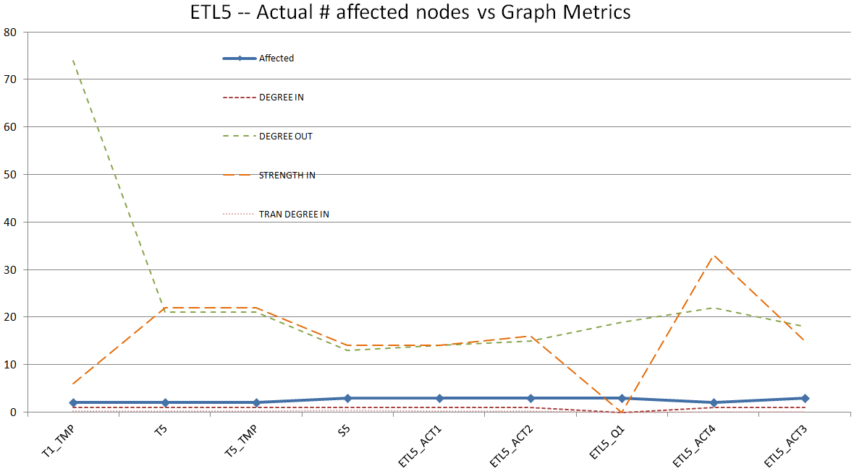

Slide 44
Lessons Learned

Slide 45
Schema size and module complexity as predictors for the vulnerability of a system
The size of the schemas involved in an ETL design significantly affects the design vulnerability to evolution events.
  For example, source or intermediate tables with many attributes are more vulnerable to changes at the attribute level.
  The out-degree captures the projected attributes by an activity, whereas the out-strength captures the total number of dependencies between an activity and its sources.
The internal structure of an ETL activity plays a significant role for the impact of evolution events on it.
  Activities with high out-degree and out-strengths tend to be more vulnerable to evolution
  Activities performing attribute reduction (e.g., through either a group-by or a projection operation) are in general, less vulnerable to evolution events.
  Transitive degree and entropy metrics capture the dependencies of a module with its various non-adjacent sources. Useful for activities which act as “hubs” of various different paths from sources in complex workflows.
The module-level design of an ETL flow also affects the overall evolution impact on the flow.
  For example, it might be worthy to place schema reduction activities early in an ETL flow to restrain the flooding of evolution events.

Slide 46
Summary & Guidelines
ETL Construct | Most suitable Metric | Heuristic
Source Tables | out-degree | Retain small schema size
Intermediate & Target Tables | out-degree | Retain small schema size in intermediate tables
Filtering activities | out-degree, out-strength | Retain small number of conditions
Join Activities | out-degree, out-strength, trans. out-degree, trans. out-strength, entropy | Move to early stages of the workflow
Project Activities | out-degree, out-strength, trans. out-degree, trans. out-strength, entropy | Move attribute reduction activities to early stages of the workflow and attribute increase activities to later stages

Slide 47
This was just a first step
… we need many more studies to establish a firm knowledge of the mechanics of evolution
… and we have not answered yet the core question:
Are we helpless in managing evolution with predictability?

Slide 48
Automating the adaptation of evolving data-intensive ecosystems
Petros Manousis, Panos Vassiliadis, and George Papastefanatos
Mainly based on the work of the MSc P. Manousis, currently under submission

Slide 49
Evolving data-intensive ecosystem
Remove CS.C_NAME
Block Deletion
Allow addition
Add exam year
Which parts are affected, how exactly are they affected and, how can we intervene and predetermine their reaction?

Slide 50
Policies to predetermine reactions
DATABASE: ON ADD_ATTRIBUTE TO RELATION THEN PROPAGATE;
DATABASE: ON ADD_CONDITION TO RELATION THEN PROPAGATE;
DATABASE: ON ADD_RELATION TO RELATION THEN PROPAGATE;
DATABASE: ON DELETE_ATTRIBUTE TO RELATION THEN PROPAGATE;
DATABASE: ON DELETE_CONDITION TO RELATION THEN PROPAGATE;
DATABASE: ON DELETE_RELATION TO RELATION THEN PROPAGATE;
DATABASE: ON MODIFYDOMAIN_ATTRIBUTE TO RELATION THEN PROPAGATE;
DATABASE: ON RENAME_ATTRIBUTE TO RELATION THEN PROPAGATE;
DATABASE: ON MODIFY_CONDITION TO RELATION THEN PROPAGATE;
DATABASE: ON RENAME_RELATION TO RELATION THEN PROPAGATE;
DATABASE: ON ADD_ATTRIBUTE TO VIEW THEN BLOCK;
DATABASE: ON ADD_CONDITION TO VIEW THEN BLOCK;
DATABASE: ON ADD_RELATION TO VIEW THEN BLOCK;
DATABASE: ON DELETE_ATTRIBUTE TO VIEW THEN BLOCK;
DATABASE: ON DELETE_CONDITION TO VIEW THEN BLOCK;
DATABASE: ON DELETE_RELATION TO VIEW THEN BLOCK;
DATABASE: ON MODIFYDOMAIN_ATTRIBUTE TO VIEW THEN BLOCK;
DATABASE: ON RENAME_ATTRIBUTE TO VIEW THEN BLOCK;
DATABASE: ON MODIFY_CONDITION TO VIEW THEN BLOCK;
DATABASE: ON RENAME_RELATION TO VIEW THEN BLOCK;
DATABASE: ON ADD_ATTRIBUTE TO QUERY THEN BLOCK;
DATABASE: ON ADD_CONDITION TO QUERY THEN BLOCK;
DATABASE: ON ADD_RELATION TO QUERY THEN BLOCK;
DATABASE: ON DELETE_ATTRIBUTE TO QUERY THEN BLOCK;
DATABASE: ON DELETE_CONDITION TO QUERY THEN BLOCK;
DATABASE: ON DELETE_RELATION TO QUERY THEN BLOCK;
DATABASE: ON MODIFYDOMAIN_ATTRIBUTE TO QUERY THEN BLOCK;
DATABASE: ON RENAME_ATTRIBUTE TO QUERY THEN BLOCK;
DATABASE: ON MODIFY_CONDITION TO QUERY THEN BLOCK;
DATABASE: ON RENAME_RELATION TO QUERY THEN BLOCK;
Remove CS.C_NAME
Allow deletion
Allow addition
Add exam year
Policies to predetermine the modules’ reaction to a hypothetical event?

Slide 51
Overview of solution
Architecture Graphs: graph with the data flow between modules (i.e., relations, views or queries) at the detailed (attribute) level; module internals are also modeled as subgraphs of the Architecture Graph
Policies, that annotate a module with a reaction for each possible event that it can withstand, in one of two possible modes:
  (a) block, to veto the event and demand that the module retains its previous structure and semantics, or,
  (b) propagate, to allow the event and adapt the module to a new internal structure.
Given a potential change in the ecosystem
  we identify which parts of the ecosystem are affected via a “change propagation” algorithm
  we rewrite the ecosystem to reflect the new version in the parts that are affected and do not veto the change via a rewriting algorithm
    Within this task, we resolve conflicts (different modules dictate conflicting reactions) via a conflict resolution algorithm

Slide 52
Status Determination: who is affected and how
Background
Status Determination
Path check
Rewriting
Experiments and Results

Slide 53
Correctness of “event flooding”
How do we guarantee that when a change occurs at the source nodes of the AG, this is correctly propagated to the end nodes of the graph?
  We notify exactly the nodes that should be notified
  The status of a node is determined independently of how messages arrive at the node
  Without infinite looping – i.e., termination
Q
V1
V2
R
Notes:
HotSWup11: theoretical framework
Manousis’ MSc: implementation and minor improvements

Slide 54
Method at a glance
Topologically sort the graph
Visit affected modules with its topological order and process its incoming messages for it.
Principle of locality: process locally the incoming messages and make sure that within each module
  Affected internal nodes are appropriately highlighted
  The reaction to the event is determined correctly
  If the final status is not a veto, notify appropriately the next modules
Notes:
Για τη διάδοση των μηνυμάτων χρησιμοποιούμε μια καθολική μεταβλητή σε αυτό το επίπεδο. Οι κόμβοι στέλνουν μηνύματα ο ένας στον άλλο εισάγοντάς τα σε μια ουρά την οποία όλοι μπορούν να δούνε.
Δεδομένου ότι ξέρουμε ποιοι είναι οι κόμβοι που επηρεάζονται από την αλλαγή (από τη χρήση της global queue για τη μετάδοση των μηνυμάτων) επισκεπτόμαστε μόνον αυτούς.
54

Slide 55
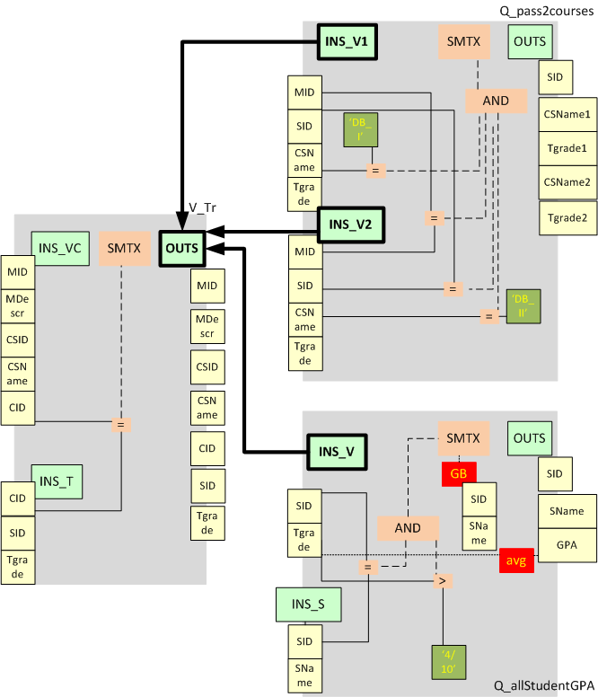
Propagation mechanism
Modules communicate with each other via a single means: the schema of a provider module notifies the input schema of a consumer module when this is necessary
Two levels of propagation:
    Graph level: At the module level, we need to determine the order and mechanism to visit each module
    Intra-module level: within each module, we need to determine the order and mechanism to visit the module’s components and decide who is affected and how it reacts + notify consumers
Notes:
Ενώ υπάρχει αλλαγή σε ένα module αν κάποιος από τους consumers του σχήματος δεν συνδέεται με αυτήν, δε λαμβάνει κάποια ειδοποίηση. Για παράδειγμα μια αλλαγή στη v_tr view που λέει πως θα διαγραφή από το output schema της το cid, δε θα δημιουργήσει κανένα μήνυμα αφού ούτε η πρώτη αλλά ούτε η δεύτερη query το χρησιμοποιούν.
55

Slide 56
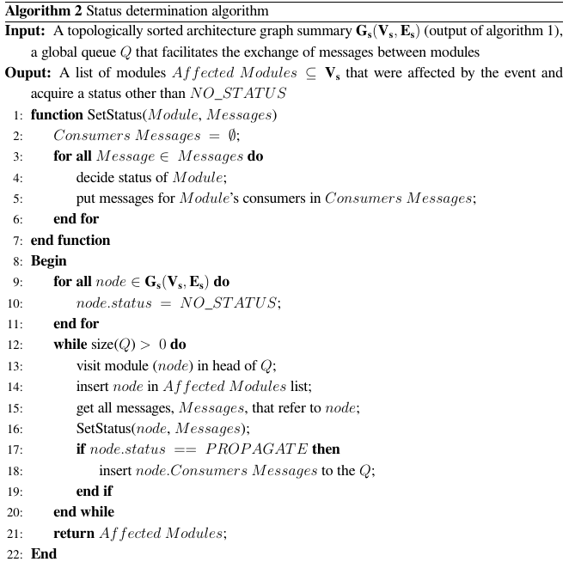

Slide 57
Theoretical Guarantees
At the inter-module level
    Theorem 1 (termination). The message propagation at the inter-module level terminates.
    Theorem 2 (unique status). Each module in the graph will assume a unique status once the message propagation terminates.
    Theorem 3 (correctness). Messages are correctly propagated to the modules of the graph
At the intra-module level
    Theorem 4 (termination and correctness). The message propagation at the intra-module level terminates and each node assumes a status.
Notes:
Επειδή ο γράφος μας είναι κατευθυνόμενος άκυκλος το θεώρημα 1 ισχύει.
Επειδή έχουμε ταξινομημένα τα status που μπορούν να λάβουν οι κόμβοι (με πρώτο το no_status, δεύτερο το propagate και τέλος το block), με οποιαδήποτε σειρά και αν έρθουν τα μηνύματα το status των module δεν αλλάζει σε κάποιο μικρότερης ισχύος. Αν είναι block θα μείνει ως το τέλος block.
Λόγο της τοπολογικής ταξινόμησης τα μηνύματα διαδίδονται στο γράφο όπως πρέπει.
Λόγο τις σειράς με την οποία διαδίδονται τα μηνύματα ο μηχανισμός μας τερματίζει και επιπλέον κάθε κόμβος μας έχει το σωστό status όπως περιγράψαμε παραπάνω.
57

Slide 58
Path Check: handling policy conflicts
Background
Status Determination
Path check
Rewriting
Experiments and Results

Slide 59
Conflicts: what they are and how to handle them
BEFORE
AFTER
R
R
View0
n
View0
View0
View1
View2
n
n
View1
View2
View2
Query1
Query2
n
Query1
Query2
View0 initiates a change
View1 and View 2 accept the change
Query2 rejects the change
Query1 accepts the change
The path to Query2 is left intact, so that it retains it semantics
View1 and Query1 are adapted
View0 and View2 are adapted too, however, we need two version for each: one to serve Query2 and another to serve View1 and Query1
Notes:
59
Query2 είναι blocker ενώ η query1 αποδέχεται την αλλαγή που ζήτησε η view0. Ζήτημα για εμάς είναι να ικανοποιηθούν και οι δύο συνθήκες.

Slide 60
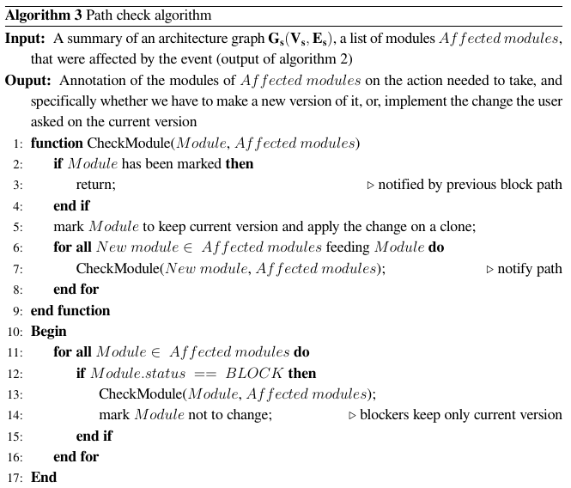
Path Check algorithm

Slide 61
Path Check
If there exists any Block Module we travel in reverse the Architecture Graph from blocker node to initiator of change
In each step we inform the Module to keep current version and produce a new one adapting to the change
We inform the blocker node that it should not change at all.
Notes:
Χρησιμοποιούμε έναν αναδρομικό αλγόριθμο που ξεκινάει από τον κόμβο που δεν αποδέχθηκε την αλλαγή και ενημερώνει όλους τους κόμβους του μονοπατιού ως τον αρχικό να κρατήσουν την τωρινή τους μορφή αλλά και να παράγουν αντίγραφό τους που θα αποτελέσει τμήμα του νέου μονοπατιού που θα πάει στους κόμβους που έχουν αποδεχτεί την αλλαγή. Εξαιτίας της αναδρομικότητας μπορούμε κάθε φορά να ελέγχουμε αν κάποιος κόμβος έχει ενημερωθεί και αν κάτι τέτοιο ισχύει να τότε όλο το μονοπάτι από αυτόν προς τον αρχικό πάει να πει πως έχει ενημερωθεί. Κάτι τέτοιο κάνει τον αλγόριθμο σχετικά οικονομικό ως προς το μέγεθος του χρόνου.

Slide 62
Path Check
Relation R
View0
View1
View2
Query1
Query2
Notes:
Επιστρέφοντας στο παράδειγμα, ο Query2 αποτελεί την αφετηρία του path check
62

Slide 63
Path Check
Query2 starts Path Check algorithm
Searching which of his providers sent
him the message and notify him that
he does not want to change
Relation R
View0
View1
View2
Query1
Query2
Notes:
Ο query2 ψάχνει τον τροφοδότη του για να τον ενημερώσει πως δεν επιθυμεί να αλλάξει μορφή.
63

Slide 64
Path Check
View2 is notified
to keep current version for Query2 and
produce new version for Query1
Relation R
View0
View1
View2
Query1
Query2
Notes:
Επόμενος κόμβος είναι ο View2
64

Slide 65
Path Check
View0 is notified
To keep current version for Query2 and
Produce new version for Query1
Relation R
View0
View1
View2
Query1
Query2
Notes:
Τέλος ο κόμβος που έκανε την αρχικοποίηση και αποτελεί τον τερματισμό του αλγορίθμου path check και είναι ο κόμβος View0.
65

Slide 66
Path Check
We make sure that Query2 will not
change since it is the blocker
Relation R
View0
View1
View2
Query1
Query2
Notes:
Σιγουρεύουμε πως ο κόμβος που άσκησε βέτο δε θα αλλάξει.
66

Slide 67
Rewriting: once we identified affected parts and resolved conflicts, how will the ecosystem look like?
Background
Status Determination
Path check
Rewriting
Experiments and Results

Slide 68
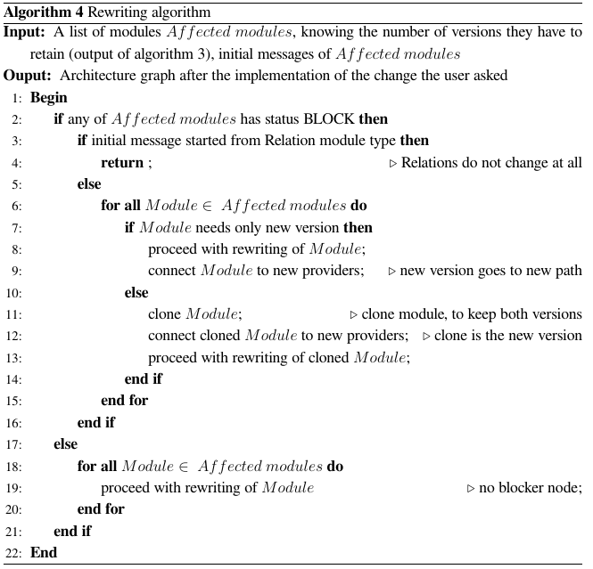
Rewriting algorithm

Slide 69
Rewriting
If there is no Block, we perform the rewriting.
If there is Block
  If the change initiator is a relation we stop further processing.
  Otherwise:
    We clone the Modules that are part of a block path and were informed by Path Check and we perform the rewrite on the clones
    We perform the rewrite on the Module if it is not part of a block path.
Within each module, all its internals are appropriately adjusted (attribute / selection conditions / … additions and removals)
Notes:
Δεδομένων των αρχικών μηνυμάτων που έχουμε διατηρήσει και της ενημέρωσης που έχουν λάβει τα modules του γράφου που μας αφορούν πλέον μπορούμε να ξαναγράψουμε τα modules ώστε να πραγματοποιηθούν οι αλλαγές που ζήτησε ο χρήστης. Εδώ φροντίζουμε να ενώνουμε τους νέους κόμβους στα νέα μονοπάτια ενώ τις ήδη υπάρχουσες μορφές που πρέπει λόγο ενός block να διατηρηθούν τις αφήνουμε ανεπηρέαστες.
Σημείωση: δεν κάνουμε επανεγγραφή όταν έχουμε φάει block σε αλλαγή που ξεκίνησε από relation (δεν παρέχουμε multiple versions) για τα δεδομένα των tables όπως κάνουμε με τις views που δεν έχουν κόστος χώρου.

Slide 70
Rewriting
Relation R
Keep current&
produce new
Relation R
View0
Keep current&
produce new
n
View0
View0
View1
View2
n
n
View1
View2
View2
Query1
Query2
n
Query1
Query2
Keep only
current
Notes:
Κλώνος της view0 & της view2, αφήνοντας τις αρχικές τους εκδόσεις απείραχτες για την query2. Οι view 1 & query 1 αποδέχτηκαν την αλλαγή οπότε την κάνουμε πράξη απευθείας επάνω στην υπάρχουσα μορφή τους. Τέλος η query 2 που είχε σημειωθεί από το message propagation να διατηρήσει την υπάρχουσα μορφή της, παρέμεινε απείραχτη.
70

Slide 71
Experiments and results
Background
Status Determination
Path check
Rewriting
Experiments and Results

Slide 72
Experimental setup
University database ecosystem (the one of we used in previous slides, consisting of 5 relations, 2 views and 2 queries)
TPC-DS ecosystem (consisting of 15 relations, 5 views and 27 queries) where we used two workloads of events
  WL1 with changes mainly at tables
  WL2 with changes mainly at views
Policies used (for both ecosystems):
  propagate all policy and
  mixture policy (20% blockers)
Measurements: effectiveness & cost
Notes:
Χρησιμοποιήσαμε σε ένα δημοφιλές workbench το tpc-ds στην έκδοση 1.1 που βγήκε τον Απρίλιο του 2012.
Στο tpc-ds χρησιμοποιήσαμε 2 ειδών workloads, ένα που είχε να κάνει κυρίως με tables και ένα δεύτερο που είχε να κάνει κυρίως με views.

Slide 73
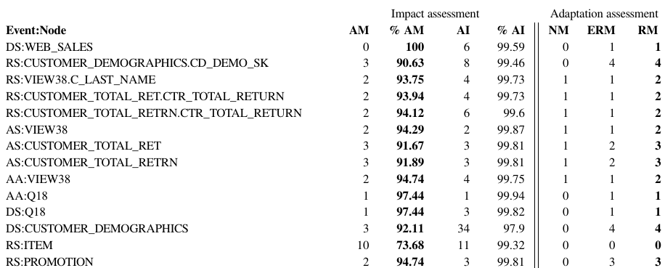
Impact & adaptation assessment for TPC-DS
Notes:
Μπορούμε να παρατηρήσουμε το πόσο κέρδος έχει ο χρήστης που χρησιμοποιεί το εργαλείο αυτό.

Slide 74
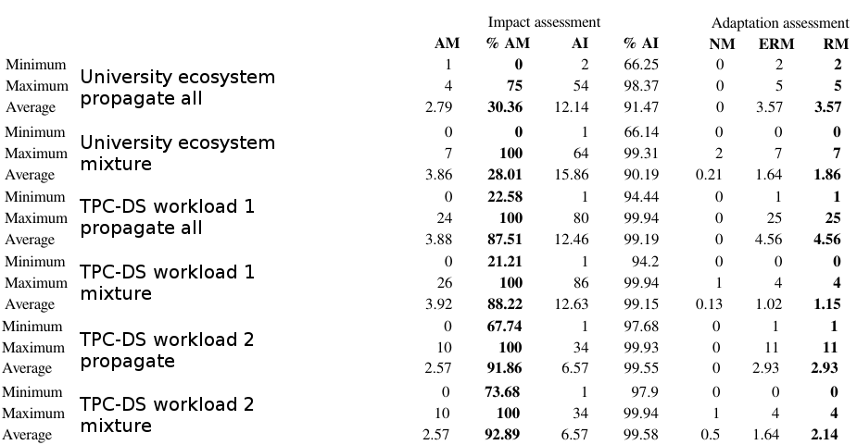
Impact & adaptation assessment

Slide 75
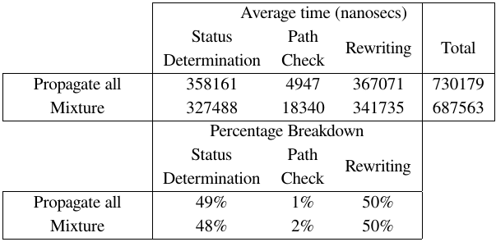
Cost analysis
The results of TPC-DS ecosystem in workload 1
Path check nearly no cost at all, but in 20% blockers doubled its value

Slide 76
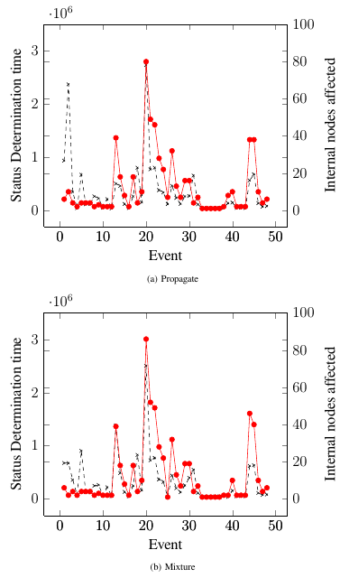
Status Determination Cost
Blue line: time
Red line: affected nodes
Slightly slower time in mixture
mode due to blockers.

Slide 77
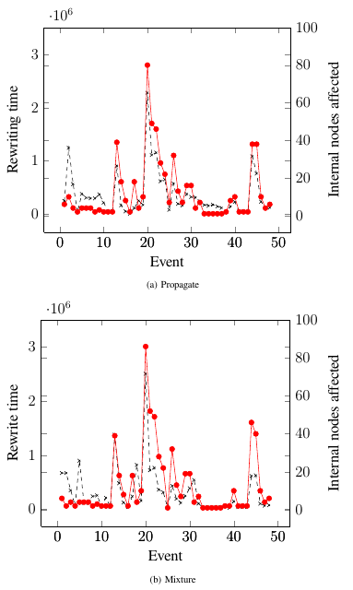
Rewrite Cost
Blue line: time
Red line: affected nodes
Due to blockers and workload containing mostly relation changes, we have no rewrites in mixture mode in a set of events

Slide 78
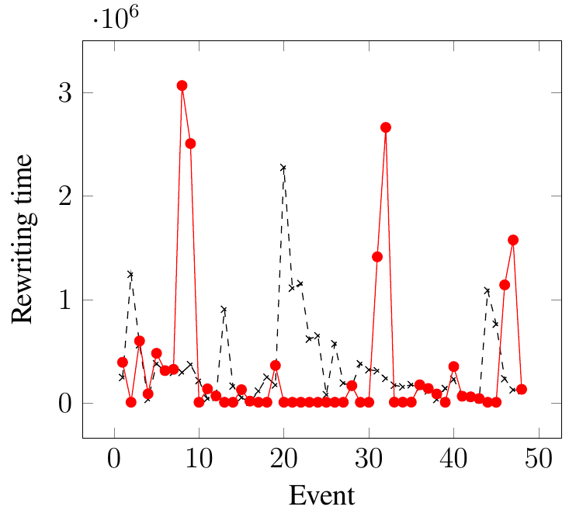
Rewrite time comparison
Peaks of red are due to cloning of modules.
Valleys of red are due to blockers at a relation related event.

Slide 79
Lessons Learned #1
Users gain up to 90% of effort.
Even in really cohesive environments, users gain at least 25% of effort.
When all modules propagate changes, on average there are 3.5 modules that rewrite themselves.

Slide 80
Lessons Learned #2
“Popular” modules need more time to process compared to unpopular ones.
Module-cloning costs more than other tasks
But since the time is measured in nanoseconds this is not big deal

Slide 81
Wrapping things up

Slide 82
In a nutshell
Studying the evolution of ecosystems is important
  Not just the database; the surrounding applications too!
  Case studies are important (and very rare!!)
  Reducing unnecessary schema elements can help us reduce the impact of maintaining applications in the presence of changes
Managing the evolution of ecosystems is possible
  We need to model the ecosystem and annotate it with evolution management techniques that dictate its reaction to future events
  We can highlight who is impacted and if there is a veto or not.
  We can handle conflicts, suggest automated rewritings and guarantee correctness
  We can do it fast and gain effort for all involved stakeholders

Slide 83
Selected readings
Matteo Golfarelli, Stefano Rizzi: A Survey on Temporal Data Warehousing. International Journal of Data Warehousing and Mining, Volume 5, Number 1, 2009, p. 1-17
Robert Wrembel: A Survey of Managing the Evolution of Data Warehouses. International Journal of Data Warehousing and Mining, Volume 5, Number 2, 2009, p. 24-56
Michael Hartung,James Terwilliger,Erhard Rahm: Recent Advances in Schema and Ontology Evolution. In: Zohra Bellahsene, Angela Bonifati, Erhard Rahm (Eds.): Schema Matching and Mapping. Springer 2011, ISBN 978-3-642-16517-7

Slide 84
Some thoughts for future work
Vision: come up with laws (i.e., recurring patterns) that govern the evolution of data-intensive ecosystems
  More (a lot more) case studies needed!
Visualization: graph modeling results in large graphs that are really hard to use interactively
Coupling applications with the underlying databases (e.g., via plugging A.G. + policies inside db’s or other repositories)
  Useful to avoid unexpected crashes
  Not without problems (too much coupling can hurt)
  Data warehouses pose a nice opportunity

Slide 85
Merci bien pour votre attention!
Commentaires, questions, …?

Slide 86
Auxiliary slides

Slide 87
Detailed experimental results

Slide 88
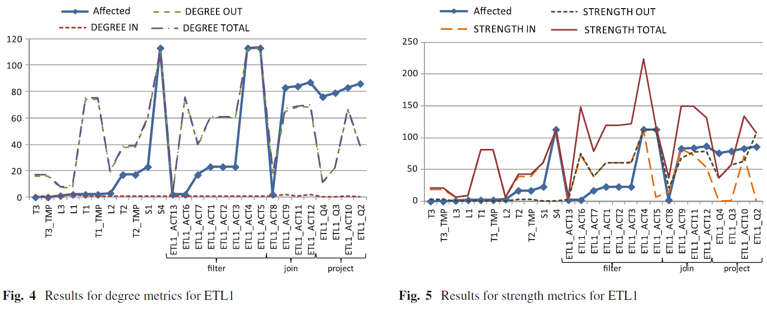
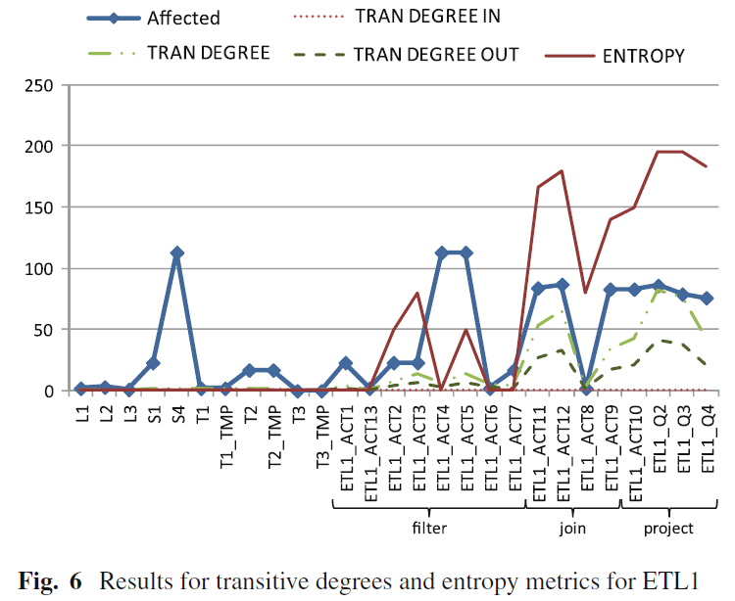
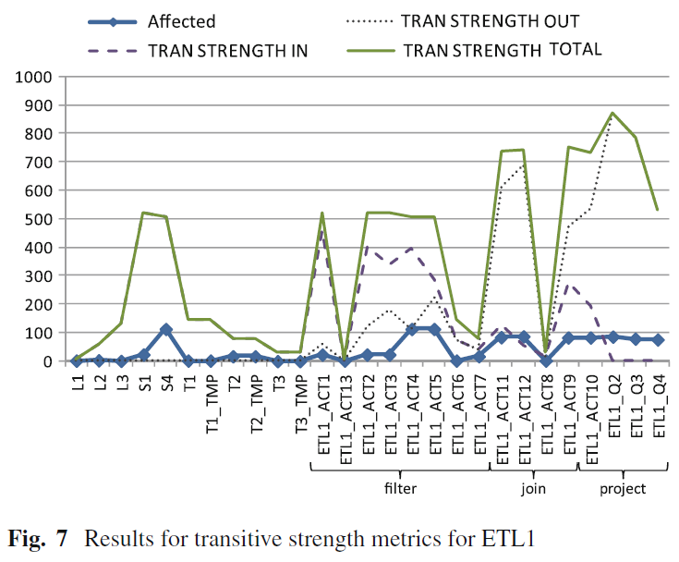

Slide 89
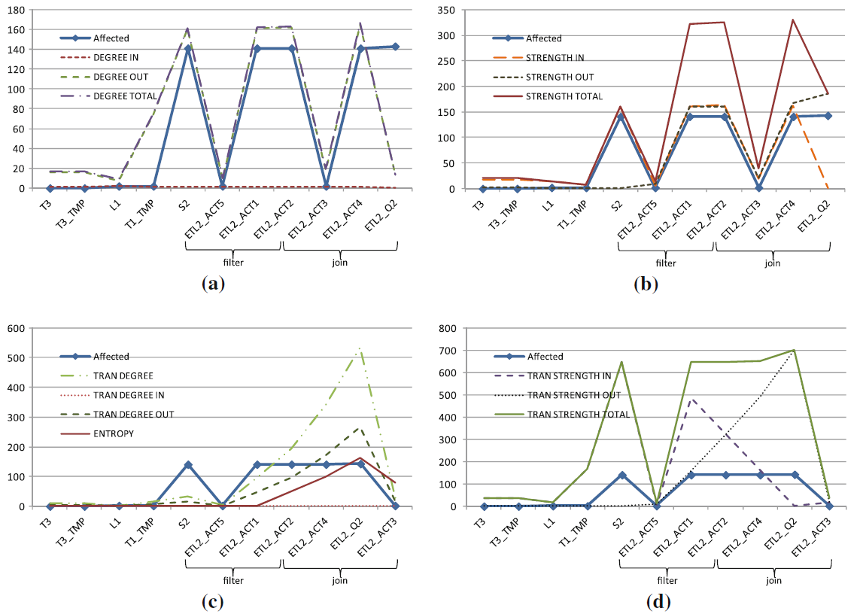
ETL 2

Slide 90
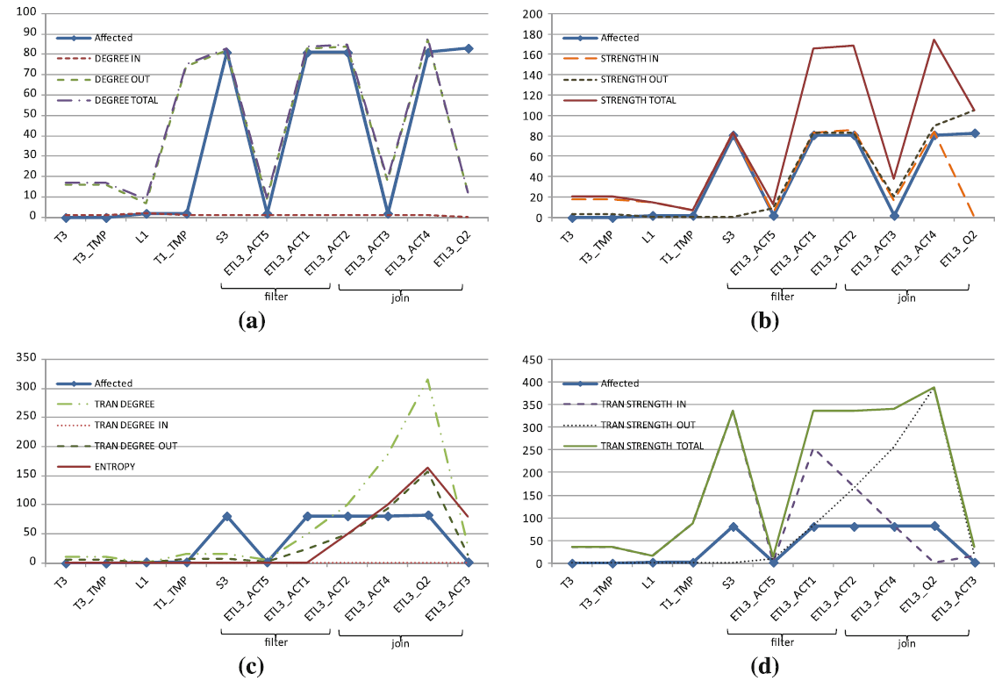
ETL 3

Slide 91
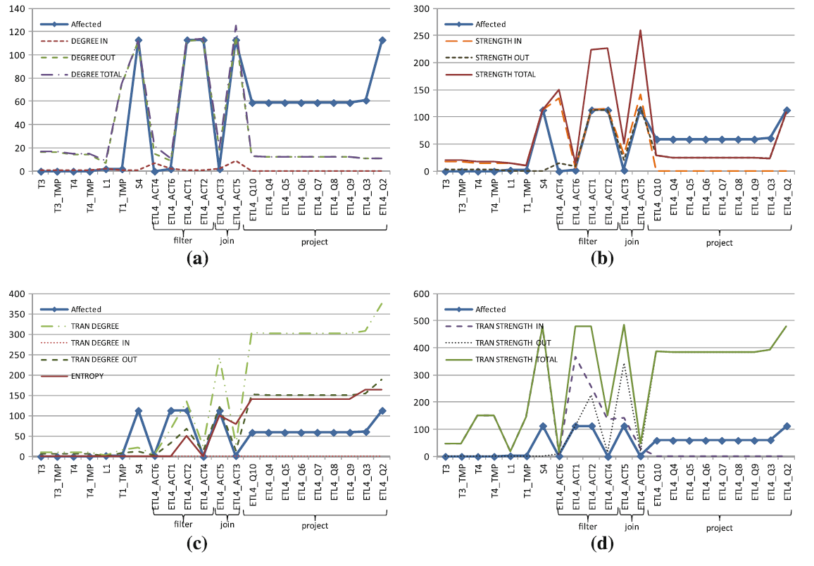
ETL 4

Slide 92
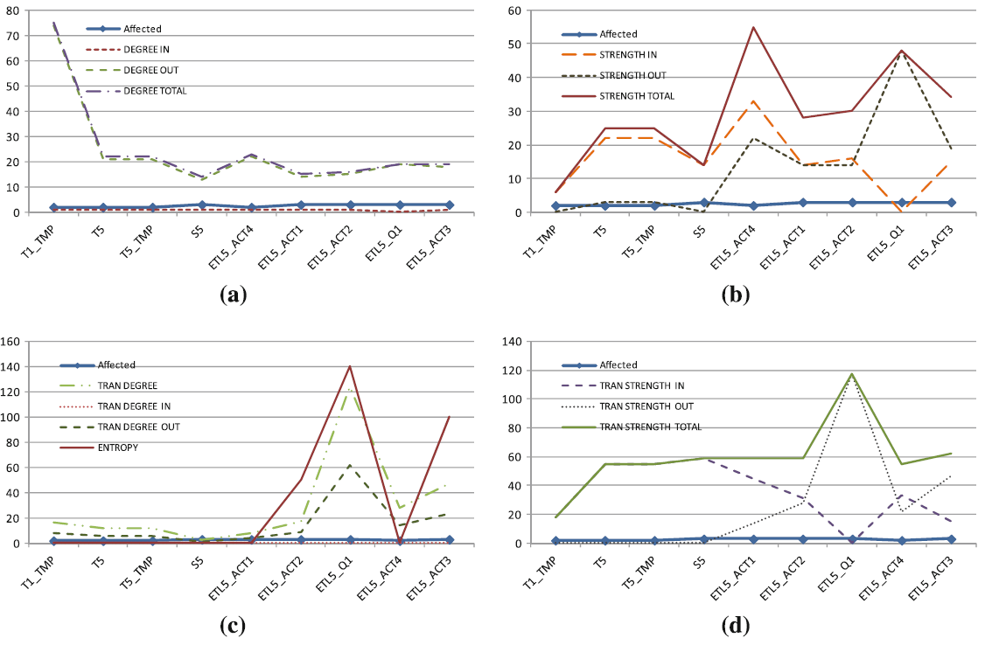
ETL 5

Slide 93
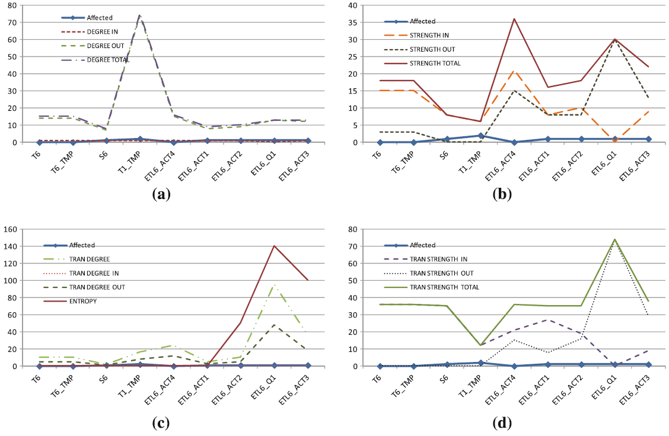
ETL 6

Slide 94
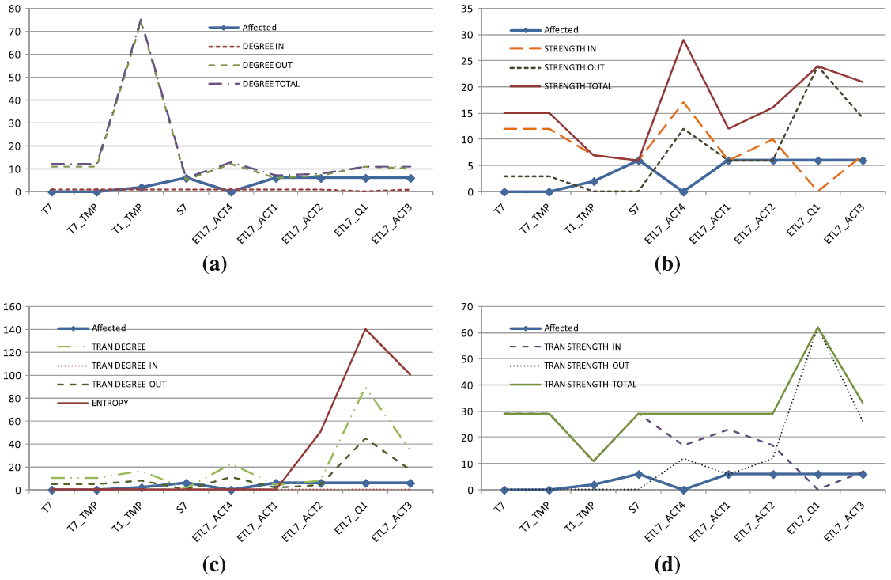
ETL 7

Slide 95
Modeling tools
Events and Policies

Slide 96
How to regulate evolution of ecosystems
Impact Analysis
  We employ evolution events to model how data-intensive ecosystems change
  We apply a hypothetical event and propagate it over the Architecture Graph to assess which modules are affected by it, and how (i.e., in which parts of their internal structure)
  This way, we can visualize and measure the impact of a potential change to the entire ecosystem
Impact Regulation
  We employ evolution policies to pre-determine how modules should react to incoming events
  Whenever a notification on an event “arrives” at a module, the module knows what to do: adapt to the incoming event, or block it and require to retain its previous structure and semantics
  This Blocking restricts the flooding of events to the entire Architecture Graph and can allow developers “fix contracts” with the underlying database

Slide 97
Evolving data-centric ecosystem
Remove CS.C_NAME
Allow deletion
Allow addition
Add exam year
Policies to predetermine the modules’ reaction to a hypothetical event?

Slide 98
A language for policies
DATABASE: ON ADD_ATTRIBUTE TO RELATION THEN PROPAGATE;
DATABASE: ON ADD_CONDITION TO RELATION THEN PROPAGATE;
DATABASE: ON ADD_RELATION TO RELATION THEN PROPAGATE;
DATABASE: ON DELETE_ATTRIBUTE TO RELATION THEN PROPAGATE;
DATABASE: ON DELETE_CONDITION TO RELATION THEN PROPAGATE;
DATABASE: ON DELETE_RELATION TO RELATION THEN PROPAGATE;
DATABASE: ON MODIFYDOMAIN_ATTRIBUTE TO RELATION THEN PROPAGATE;
DATABASE: ON RENAME_ATTRIBUTE TO RELATION THEN PROPAGATE;
DATABASE: ON MODIFY_CONDITION TO RELATION THEN PROPAGATE;
DATABASE: ON RENAME_RELATION TO RELATION THEN PROPAGATE;
DATABASE: ON ADD_ATTRIBUTE TO VIEW THEN BLOCK;
DATABASE: ON ADD_CONDITION TO VIEW THEN BLOCK;
DATABASE: ON ADD_RELATION TO VIEW THEN BLOCK;
DATABASE: ON DELETE_ATTRIBUTE TO VIEW THEN BLOCK;
DATABASE: ON DELETE_CONDITION TO VIEW THEN BLOCK;
DATABASE: ON DELETE_RELATION TO VIEW THEN BLOCK;
DATABASE: ON MODIFYDOMAIN_ATTRIBUTE TO VIEW THEN BLOCK;
DATABASE: ON RENAME_ATTRIBUTE TO VIEW THEN BLOCK;
DATABASE: ON MODIFY_CONDITION TO VIEW THEN BLOCK;
DATABASE: ON RENAME_RELATION TO VIEW THEN BLOCK;
DATABASE: ON ADD_ATTRIBUTE TO QUERY THEN BLOCK;
DATABASE: ON ADD_CONDITION TO QUERY THEN BLOCK;
DATABASE: ON ADD_RELATION TO QUERY THEN BLOCK;
DATABASE: ON DELETE_ATTRIBUTE TO QUERY THEN BLOCK;
DATABASE: ON DELETE_CONDITION TO QUERY THEN BLOCK;
DATABASE: ON DELETE_RELATION TO QUERY THEN BLOCK;
DATABASE: ON MODIFYDOMAIN_ATTRIBUTE TO QUERY THEN BLOCK;
DATABASE: ON RENAME_ATTRIBUTE TO QUERY THEN BLOCK;
DATABASE: ON MODIFY_CONDITION TO QUERY THEN BLOCK;
DATABASE: ON RENAME_RELATION TO QUERY THEN BLOCK;
Remove CS.C_NAME
Allow deletion
Allow addition
Add exam year
Policies to predetermine the modules’ reaction to a hypothetical event?

Slide 99
A language for policies
For all possible events, we define rules
DATABASE: ON <event> TO <module type> THEN <reaction policy>
Module types: relations, views, queries
Events:
{add, delete, rename} X {module internals}
Policies:
  Propagate: adapt to the incoming notification for change, willing to modify structure and semantics
  Block: resist change; require to retain the previous structure and semantics
  Prompt: indecisive for the moment, prompt the user at runtime (never implemented)

Slide 100
A language for policies
Language requirements:
  Completeness
  Conciseness
  Customizability
We can override default policies, to allow module parts to differentiate their behavior from the default
The two first req’s are covered by a complete set of default policies that have to be defined for the entire ecosystem
DATABASE: | ON | DELETE_ATTRIBUTE | TO | RELATION | THEN | PROPAGATE
TRANSICRIPT: | ON | DELETE_ATTRIBUTE |  |  | THEN | BLOCK
TRANSCRIPT.STUDENT_ID: | ON | DELETE_ATTRIBUTE |  |  | THEN | PROPAGATE

Slide 101
Other Useful: metrics
For the metrics part

Slide 102
Evolution Variants
Data Evolution: INS/DEL/UPD of data without affecting the structure of the db.
Schema Evolution: the structure of the db changes, without loss of existing data, but without retaining historical information on previous snapshots of the db.
Schema versioning: schema evolution + the ability to answer historical queries (practically being able to restore a snapshot of the db at a given timepoint).

Slide 103
Node Entropy
Entropy of a node v : How sensitive the node v is by an arbitrary event on the graph.
High values of entropy are assigned to the nodes of the graph with high level of dependence to other nodes, either directly or transitively.

Slide 104
Who is likely to undergo change?
Schema size is (quite expectedly) the most important factor for a relation’s vulnerability to change
The same holds for activities, too!

Slide 105
Most accurate predictors: out-degree and out-strength
Notes:
When a module has only one provider: out-degree/out strength capture the dependencies with an adjacent module.
Transitive degree metrics may act as predictors for the evolution of a module when it has many different providers and paths to evolving sources

Slide 106
Internal structure of activities
Activities with high out-degree and out-strength tend to be more vulnerable to evolution. The out-degree captures the projected attributes by an activity, whereas the out-strength captures the total number of dependencies between an activity and its sources.
Activities with joins between many sources tend to be more affected than activities sourced by only one provider, but still, the most decisive factor seems to be the activity size.
  Thus, activities that perform an attribute reduction on the workflow through either a group-by operation or a projection of a small number of attributes are in general, less vulnerable to evolution events and propagate the impact of evolution further away on the workflow (e.g., Q4 in ETL1 or Q2 – Q10 in ETL4).
  In contrast, activities that perform join and selection operations on many sources and result in attribute preservation or generation on the workflow have a higher potential to be affected by evolution events (e.g., observe the activities ETL1_ACT10 - ETL1_ACT12 or the activity ETL4_ACT5).

Slide 107
Transitive degrees
Transitive degree metrics capture the dependencies of a module with its various non-adjacent sources.
Useful for activities, which act as “hubs” of various different paths from sources in complex workflows.
For cases where the out-degree metrics do not provide a clear view of the evolution potential of two or more modules, the out-transitive degree and entropy metrics may offer a more adequate prediction (as for example ETL4_Q3 and ETL4_Q2).

Slide 108
Context and internals of evolution
As already mentioned, source S1 stores the constant data of the surveys and did not change a lot. The rest of the source tables (S2-S7), on the other hand, sustained maintenance.
The recorded changes in these tables mainly involve restructuring, additions and renaming of the questions comprising each survey, which are furthermore captured as changes in the source attributes names and types.
The set of evolution events includes renaming of relations and attributes, deletion of attributes, modification of their domain, and lastly addition of primary key constraints. We have recorded a total number of 416 evolution events (see next table for a breakdown).
The majority of evolution changes concerns attribute renaming and attribute additions.

Slide 109
Some numbers
ETL scenarios configuration
Scenario | # Activ. | Sources | Tmp Tables | Targets
ETL 1 | 16 | L1,L2,L3,S1,S4 | T1_Tmp, T2_Tmp, T3_Tmp | T1, T2, T3
ETL 2 | 6 | L1,S2 | T1_Tmp, T3_Tmp | T3
ETL 3 | 6 | L1,S3 | T1_Tmp, T3_Tmp | T3
ETL 4 | 15 | L1,S4 | T1_Tmp, T3_Tmp, T4_Tmp | T3, T4
ETL 5 | 5 | S5 | T1_Tmp, T5_Tmp | T5
ETL 6 | 5 | S6 | T1_Tmp, T6_Tmp | T6
ETL 7 | 5 | S7 | T1_Tmp, T7_Tmp | T7
Total | 58
Number of Attributes in ETL Source Tables
Table | S1 | S2 | S3 | S4 | S5 | S6 | S7 | L1 | L2 | L3
# Attributes | 59 | 160 | 82 | 111 | 13 | 7 | 5 | 7 | 19 | 7

Slide 110
Source | Change Type | Occurrence | Affected ETL
L1 | Add Attribute | 1 | ETL 1, 2, 3, 4
L1 | Add Constraint | 1 | ETL 1, 2, 3, 4
L2 | Add Attribute | 3 | ETL 1
L3 | Add Attribute | 1 | ETL 1
S1 | Add Attribute | 14 | ETL 1
S1 | Drop Attribute | 2 | ETL 1
S1 | Modify Attribute | 3 | ETL 1
S1 | Rename Attribute | 3 | ETL 1
S1 | Rename Table | 1 | ETL 1
S2 | Add Attribute | 15 | ETL 2
S2 | Drop Attribute | 4 | ETL 2
S2 | Rename Attribute | 121 | ETL 2
S2 | Rename Table | 1 | ETL 2
S3 | Rename Attribute | 80 | ETL 3
S3 | Rename Table | 1 | ETL 3
S4 | Add Attribute | 58 | ETL 1, 4
S4 | Drop Attribute | 26 | ETL 1, 4
S4 | Modify Attribute | 1 | ETL 1, 4
S4 | Rename Attribute | 27 | ETL 1, 4
S4 | Rename Table | 1 | ETL 1, 4
S5 | Modify Attribute | 2 | ETL 5
S5 | Rename Table | 1 | ETL 6
S6 | Rename Table | 1 | ETL 6
S7 | Rename Attribute | 5 | ETL 7
S7 | Rename Table | 1 | ETL 7
T1 | Drop Attribute | 1 | ETL 1
T1 | Modify Attribute | 1 | ETL 1
T1_tmp | Drop Attribute | 1 | ETL1-7
T1_tmp | Modify Attribute | 1 | ETL1-7
T2 | Add Attribute | 15 | ETL 1
T2 | Modify Attribute | 2 | ETL 1
T2_tmp | Add Attribute | 15 | ETL 1
T2_tmp | Modify Attribute | 2 | ETL 1
T5 | Modify Attribute | 2 | ETL5
T5_tmp | Modify Attribute | 2 | ETL5
Total |  | 416
Distribution of events at the ETL tables
Notes:
We have recorded a total number of 416 evolution events and the number of events per table is shown in Table 5. Observe that the majority of evolution changes concerns attribute renaming and attribute additions. These findings were due to the evolution context of the examined warehouse sources.
The last column in Table 5 shows the flows as affected by each change. L1 table is used in 4 ETL flows (1-4), S4 in 2 flows, namely ETL1 and ETL4, whereas all other source tables are used only to one flow. The most evolved table is S2 with a total of 141 changes and S4 follows with 113 changes. S2, however, supplies only one flow (ETL 2), whereas S4 supplies both ETL1 and ETL4. In addition, schema changes were applied in T₁, T₂, and T₅ target tables and their respective temporary tables as a result of the changes in the ETL sources. All evolution changes were applied in the form of annotations on the nodes of the graph.

Slide 111
How to design a scenario
When persistent data stores are involved, the generic guideline is to retain their schema as small as possible.
Since the schema size affects a lot the propagation of evolution events, it is advisable to reduce schema sizes across the ETL flow, so activities that help in that direction should be considered first.
Since attribute reduction activities (e.g., projections, group by queries) are less likely to be affected by evolution actions than other activities that retain or increase the number of attributes in the workflow (many projections with joins), the ETL designer should attempt placing the attribute reduction activities in the early stages of the workflow in order to restrain the flooding of evolution events.
Notes:
In addition, based on our discoveries related to what metric is suitable for each construct; e.g., transitive degree metrics are good predictors for modules with many providers and the out-degree and out strength metrics could be used for modules with a single provider.

Slide 112
Evolving data-intensive ecosystem

Slide 113
Evolving data-intensive ecosystem
Add exam year

Slide 114
Evolving data-intensive ecosystem
Remove CS.C_NAME
Add exam year

Slide 115
Evolving data-intensive ecosystem
Remove CS.C_NAME
Add exam year
Which parts are affected … ?

Slide 116
Evolving data-intensive ecosystem
Remove CS.C_NAME
Syntactically invalid
Semantically unclear
Add exam year
Which parts are affected, and how exactly are they affected …?

Slide 117
Other Useful: Regulation
For the regulation part

Slide 118
Problem definition
Changes on a database schema may cause syntactic or semantic inconsistency in its surrounding applications; is there a way to regulate the evolution of the database in a way that application needs are taken into account?
If there are conflicts between the applications’ needs on the acceptance or rejection of a change in the database, is there a possibility of satisfying all the different constraints?
If conflicts are eventually resolved and, for every affected module we know whether to accept or reject a change, how can we rewrite the ecosystem to reflect the new status?
Notes:
Οι αλλαγές στο σχήμα μιας βάσης μπορούν να επηρεάσουν της εφαρμογές που σχετίζονται με αυτή τη βάση, με τέτοιο τρόπο που είτε θα είναι ασυνεπείς ως προς τα αποτελέσματα που εμφανίζουν, είτε δε θα μπορούν καν να εμφανίσουν αποτελέσματα.
Υπάρχει τρόπος ώστε αυτές οι αλλαγές να γίνονται κάτω από κάποιο έλεγχο από το διαχειριστή του συστήματος?
Αν υπάρχει μπορεί με κάποιο γρήγορο τρόπο ο διαχειριστής να έχει αυτές τις αλλαγές που θα χρειαστούν?
Αν υπάρχουν συγκρούσεις σχετικά με την αποδοχή ή μη κάποιας αλλαγής από τις εφαρμογές που χρησιμοποιούν τη βάση, υπάρχει δυνατότητα να ικανοποιηθούν όλοι?

Slide 119
Part I: regulate the flooding of an evolutionary event over the graph
Model data-centric ecosystems with Architecture Graphs
Mechanism for propagating evolution events on the graph, based on
  Graph structure & semantics
  Types of evolution events
  Policies that regulate the message flooding
Guarantee the termination of the events propagation
Notes:
Χρησιμοποιούμε ένα γράφο ο οποίος αποτελεί αναπαράσταση του οικοσυστήματός μας και χρησιμοποιούμε μηχανισμούς που με βάση τις πολιτικές που καθορίζουμε επιτρέπουν ή όχι τις όποιες αλλαγές δοκιμάζει να κάνει ο χρήστης στο οικοσύστημά του, πριν την υλοποιήσει στην πραγματικότητα.
Βάζουμε policies ώστε να καθορίσουμε τον τρόπο συμπεριφοράς (αποδοχής δηλαδή ή μη) των αλλαγών αυτών. Πχ δεχόμαστε την προσθήκη νέας column στη view αλλά απορρίπτουμε τη διαγραφή στην query.
119

Slide 120
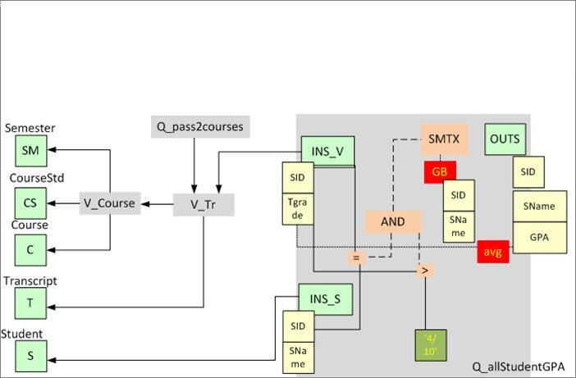
Architecture Graph
Modules and Module Encapsulation
Observe the input and output schemata!!
SELECT V.STUDENT_ID, S.STUDENT_NAME,
AVG(V.TGRADE) AS GPA
FROM V_TR V |><| STUDENT S ON STUDENT_ID
WHERE V.TGRADE > 4 / 10
GROUP BY V.STUDENT_ID, S.STUDENT_NAME
Notes:
Είναι ένας γράφος του οποίου τα κομμάτια αναπαριστούν τα δομικά στοιχεία του οικοσυστήματος. Εδώ βλέπουμε ειδικότερα ένα από αυτά τα δομικά στοιχεία, μια query που δίνει το μέσο όρο των επιτυχημένων μαθημάτων των φοιτητών του πανεπιστημίου. Μπορούμε να παρατηρήσουμε τα κύρια στοιχεία του που είναι τα σημεία εισόδου πληροφορίας που ξεχωρίζουμε με το INS και συνδέονται στο δομικό στοιχείο που παρέχει αυτή την πληροφορία, το σημείο εξόδου πληροφορίας που δηλώνει τι αποτελέσματα προσφέρει αυτό το δομικό στοιχείο στους χρήστες του και τέλος την εσωτερική του διαρρύθμιση που ουσιαστικά υποδηλώνει τα φίλτρα που θέλει ο χρήστης να χρησιμοποιήσει πάνω στην πληροφορία αυτή (για παράδειγμα το tgrade > 4/10)
120

Slide 121
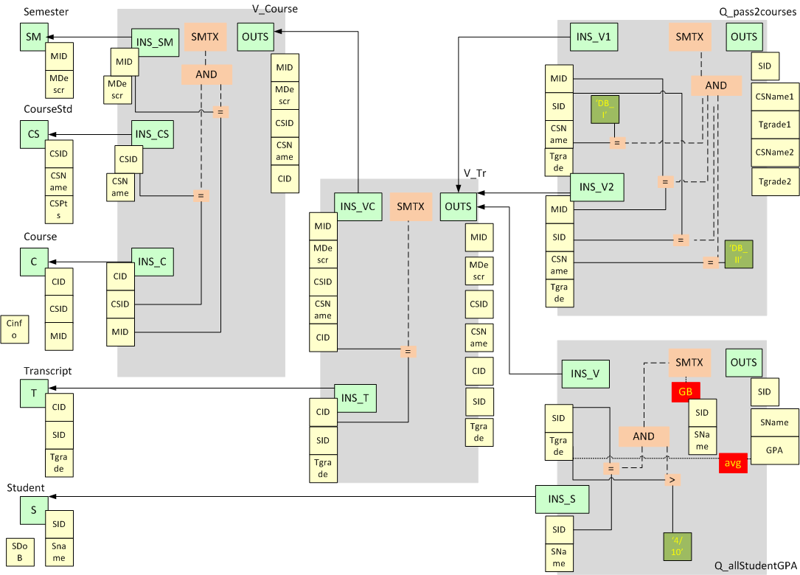
University E/S Architecture Graph
Notes:
Η πλήρης ανάπτυξη των δομικών στοιχείων του οικοσυστήματός μας είναι η ακόλουθη.
121

Slide 122
Annotation with Policies
On attribute deletion Then block
On attribute addition Then propagate
Status Determination
Notes:
Στις επικείμενες αλλαγές που συναντήσαμε νωρίτερα μπορούμε να δούμε ποια είναι τα επηρεαζόμενα δομικά στοιχεία αλλά και τα σημεία στα οποία αυτά επηρεάζονται. Αυτά τα σημεία είναι τα σημεία στα οποία θα πρέπει να ορισθούν πολιτικές για τις οποιεσδήποτε αλλαγές.
122

Slide 123
Module Level Propagation
Add Exam Year
Notes:
Ας δούμε ποιοί και με ποιά σειρά επιρεάζονται από την εισαγωγή μιας νέας στήλης στο table transcript του παραδείγματος.
123

Slide 124
Module Level Propagation
1
Add Exam Year
Notes:
Μιας και το transcript δεν έχει άλλον καταναλωτή παρά μόνο την view v_tr αυτή λαμβάνει το μήνυμα της εισαγωγής νέας στήλης (και μάλιστα το λαμβάνει στον αποδέκτη που σχετίζεται με το transcript).

Slide 125
Module Level Propagation
2
1
2
Add Exam Year
Notes:
Στη συνέχεια η v_tr τροφοδοτή τα 2 queries. Αυτά μπορεί να πει κανείς πως λαμβάνουν ταυτόχρονα την ειδοποίηση για την αλλαγή που έχει συμβεί. Όπως και πριν τα queries λαμβάνουν τις ειδοποιήσεις στα εισερχόμενα που σχετίζονται με την v_tr (okay η 1η query λαμβάνει 2 μηνύματα)
125

Slide 126
Message initiation
The Message is initiated in one of the following schemata:
  Output schema and its attributes if the user wants to change the output of a module (add / delete / rename attribute).
  Semantics schema if the user wants to change the semantics tree of the module.
Notes:
O χρήστηw του συστήματος κάνει αλλαγές που θα πρέπει να αφορούν είτε κάποιο από τα σχήματα εξόδου των δομικών στοιχείων είτε κάποια αλλαγή σε κάποιο semantics tree.
Ό,τι και αν είναι αυτό, το κατάλληλο σχήμα χρησιμοποιείται για την επεξεργασία του μηνύματος.
Τέλος δημιουργούνται τα κατάλληλα μηνύματα για τα δομικά στοιχεία που τροφοδοτούνται από αυτό το δομικό στοιχείο.

Slide 127
Intra-module processing
When a Message arrives at a module via the propagation mechanism, these steps describe the module's way of handling it:
Input schema and its attributes if applicable, are probed.
If the parameter of the Message has any kind of connection with the semantics tree, then the Semantics schema is probed.
Likewise if the parameter of the Message has any kind of connection with the output schema, then the Output schema and its attributes (if applicable) is probed.
Finally, Messages are produced within the module for its consumers.
Notes:
Έχουμε ένα σαφή ορισμό του πως θα ερωτηθούν τα επιμέρους σχήματα που αποτελούν κομμάτια ενός δομικού στοιχείου για το αν αποδέχονται ή όχι την αλλαγή.
Στο τέλος τις επεξεργασίας όλων των μηνυμάτων ενός module είμαστε βέβαιοι πως αυτό έχει το σωστό status μιας και έχουμε ταξινομίσει τα status και ένα μικρότερης ισχύος δε μπορεί να αντικαταστήσει ένα μεγαλύτερης ισχύος.

