Slide 1


Hierarchical Property Set Merging for SPARQL Query Optimization
Marios Meimaris, Athena Research Center, Greece
George Papastefanatos, Athena Research Center, Greece
Panos Vassiliadis, University of Ioannina, Greece

Slide 2
Preliminaries
RDF (Resource Description Framework)
  Abstract Data model for Linked Data
  Based on Triples: Subject-Predicate-Object
  RDF datasets are Directed Labelled Graphs
Characteristic Set (CS)
  A CS is a set of properties with the same subject as source node
  An RDF dataset can be described as a set of unique CSs
  Each CS is an implicit resource type
Notes:
A few preliminaries first. Our work is focused on the RDF data model, a W3C recommendation. RDF is an abstract way to model linked data as a directed labelled graph, where a subject node can point to an object node through a labelled predicate edge. In this context, a Characteristic Set, or CS for short, is all of the labelled edges that come out of a subject node. A CS is a way to represent all of the properties of a node as a single set, and an RDF dataset’s schema can be represented as a set of CSs.

Slide 3
Preliminaries
Use Characteristic Sets (CSs) and their links in order to store and index triples
Characteristic Sets (Neumann & Moerkotte, ICDE 2011)
  A Characteristic Set (CS) S_{c} of a node x is defined as the set of properties emitting from x (i.e., x as subject)
Notes:
Many works have taken advantage of CSs in order to store, index and query triples efficiently. Let’s go through an example. In this figure, John and Alice both belong to the professor type, and they share two common properties, name and origin. However, their schema’s differ in the third property, where for John is worksAt while for Alice is studiesAt.

Slide 4
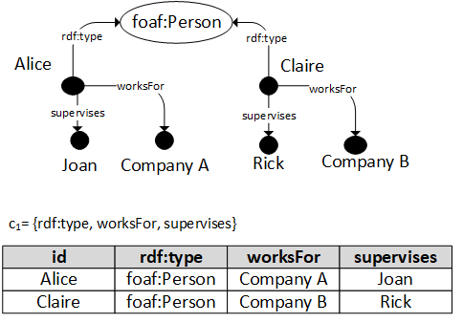
Background
Derive a relational representation of an RDF dataset
Use CSs as tables and links between CSs as relationships
CS properties → relation attributes
Notes:
There exist a large body of works that translate an RDF schema to a relational representation, and use CSs as relational tables, and links between CSs as relationships. In the example of the figure, we can see how Alice and Claire can be encoded in a relational schema.

Slide 5
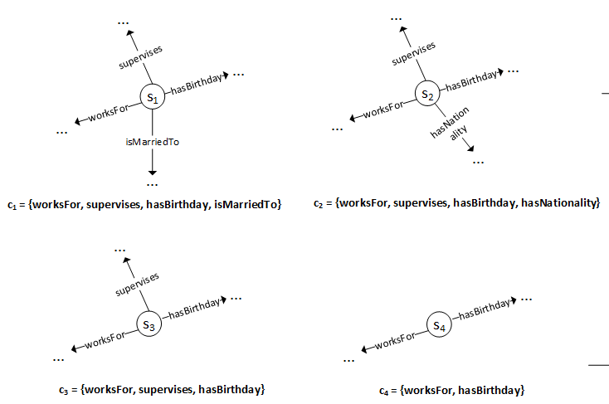
Problem statement
RDF structural looseness → multiple CSs → different representation strategies
Notes:
RDF is a loosely defined structure, in that there can exist multiple CSs that describe similar classes (or tables). In this figure, S1, S2, S3 and S4 are instances of the same type, professor, but they have different and overlapping CSs.

Slide 6
Trade-Off for creating a relational schema
A relational table for each different CS
A "universal" table for all CS’s
Notes:
If we translate each unique CS to a single relational table, we will come up with one table for each of the four Characteristic Sets. If, on the other hand we create a single table with the union of all the properties in the Characteristic Sets, we will have one single table that contains all records.

Slide 7
Trade-Off for creating a relational schema
A relational table for each different CS
A "universal" table for all CS’s
Space efficient
Large numbers of relational tables with few tuples in
Too many joins to answer queries
Captures all CSs into a single table
Too many NULL values
Space inefficient
Notes:
Of course, there is a trade-off here. In the first case on the left, we gain in space efficiency, because we do not have any NULL values or sparse tables. However, we lose in query performance, as we require too many joins to answer simple queries that select rows based on , for example, the intersection, or any overlap of the properties in the CSs.
On the other hand, a single large table is not space efficient as there are too many NULL values and it will require loads of self joins on a sparse table.

Slide 8
Trade-Off for answering a complex SPARQL query with many joins
SELECT ? x ?y ?z ?w
WHERE { ?x worksFor ?y .
?x supervises ?z .
?z hasBirthday '2011−02−24’.
?z isMarriedTo ?w.
?w hasNationality ‘GR’}
A relational table for each different CS
A "universal" table for all CS’s
One self-join for each one of the worksFor , supervises and isMarriedTo query conditions
Additionally three joins between each CS table and all other CS tables in the database – i.e., 4 joins per table.
One self-join for each one of the worksFor , supervises and isMarriedTo query conditions
Notes:
Let’s consider this query. On the left, the query will require 4 joins per table, while on the right, it will also require quite a few self joins. This, of course, is not ideal.

Slide 9
Problem to be solved
Context: Mapping heterogeneous RDF datasets to a relational schema with the aim to facilitate the processing of complex analytical SPARQL queries
Solution: automating the decision of which tables will be created for a set of CS, such that there are no overly empty tables and extremely large numbers of joins.
Notes:
Motivated by this, we propose an approach to map heterogeneous RDF datasets to a relational schema with the ultimate aim to improve query performance and space efficiency. Our proposed approach mitigates this problem by selecting a subset of CSs from the original dataset, and mapping the rest of the CSs to this subset such that there are no overly empty tables, that is, tables with large numbers of NULL cells, and thus, no extremely large numbers of joins will be needed.

Slide 10
Observations
Based on previous findings:
  CS number is generally low but exhibits skewed distribution
    E.g., many CSs with very few (<10) subjects
  CS number affects number of joins
Merging closely related CSs helps storage & querying
  Less CSs means less joins
  Less CSs means less I/O costs in disk-based systems
  Compact schema easier to understand and maintain
CSs are hierarchical, i.e., their property sets can be super/subsets of each other
Challenge: exploit the hierarchical structure in order to merge together closely related CSs
Notes:
Based on previous findings, we observe that the number of CSs in common RDF datasets is generally tractable, and dependent on how well defined is the dataset’s generation process. However, CSs are populated in wildly different ways. E.g. huge numbers of CSs with less than 10 subjects, or rows. To reduce the number of CS we can merge together hierarchically related CSs, that is, CSs that have overlapping property sets.

Slide 11
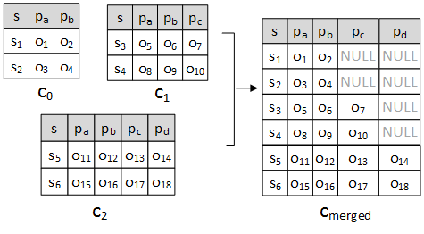
Challenge
Each CS defines a relational table (s, p₁, p₂, …, p_{k})
Merging of CS tables results in NULL values for non-shared attributes
Challenge: merge CSs and reduce NULL value effect
e.g.:
c₀ = {name, age}
c₁ = {name, age, marriedTo}
c₂ = {name, age, marriedTo, worksAt}
Notes:
As an example, consider the case of three CSs, c0, c1, and c2. Their respective relational tables can be seen in the middle of the figure, while one table that merges all three can be seen on the right. The challenge is to merge CSs in a way that reduces the NULL value effect and at the same time does not introduce tables with very few rows.

Slide 12
Approach
Use a dense child table and merge its parents into it
  Why dense? -> # of NULLs is proportional to # of records of table to be merged
  Why child? -> more specialized, thus will contain columns of parents
Identify dense CSs
    if |c_{i}| > m x |c_{max}| parameter => c_{i} is dense
  Every resulting (merged) table will contain exactly one dense node (and several non-dense)
Find optimal merging of ancestors to dense child CSs
e.g.
c₁: {name, age, address}, c₂: {name, age}: c₁ child of c₂
hier_merge(c₁, c₂) = c₁₂
  c₁₂: {name, age, address)
Notes:
To do this, we first find a set of dense CS tables, and we then merge their parents into them. Dense means that this CS has a relatively large number of rows. A child CS is a more specialized version of a parent CS, that is, it is a superset of the properties of its parent, thus it will completely represent the rows of its parent without needing any more columns.
To identify dense CSs, we use a simple approach that is based on comparing the cardinality of a CS to the size of the whole dataset, in rows.
The end result will be one table for each dense node, that will also encode some of its parents.

Slide 13
CS Graph Example
Notes:
In our approach, we model an RDF dataset’s schema as a CS graph, where edges between CSs denote parent-child relationships. As an example, consider the four RDF subjects, S1, S2, S3 and S4, shown in the figure. We can see that c1, that contains p1, p2, p3, p4 and p5, and c2 that contains p1, p2, p3, and p5 do not exhibit a subsumption relationship in their property sets. However, c3 exhibits a subsumption relationship with both c1 and c2, as the set p1, p2, p3 is a subset of both the the property sets of c1 and c2. Furhermore, c4 is a subset of all three CS. The resulting graph can be seen on the right, with the black lines. The dashed lines constitute the hierarchical closure of the graph, as they imply that c1 and c2 are both grand-children of c4.

Slide 14
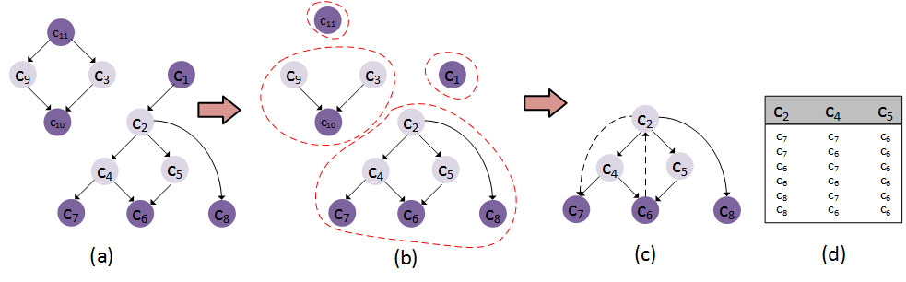
Approach - Example
Notes:
In this figure we can see an example merge. Dense nodes are represented in deep purple. On the right, we can see all of the ways we can merge the non dense c2, c4 and c5, to their dense children, c6, c7, c8.

Slide 15
Approach – Loading and Merging
Finding the optimal solution is equivalent to enumerating all possible sub-graphs -> exponential
Greedy approximation
  At each step, merge parent CS and dense child CS that minimize objective cost function
  Cost function minimizes the number of NULL values introduced by the merge
Tuning of m parameter
Notes:
Of course, finding the optimal solution is a computationally difficult problem to solve, as we have to enumerate all possible sub graphs and evaluate them based on an objective cost function.
As a greedy approach, we propose to merge parent CSs to the dense CSs that minimize this cost function. As a cost function, we choose one that minimizes the number of NULLs each step introduces.

Slide 16
Approach – Querying
Parse incoming SPARQL queries
  Identify query CSs that match merged CSs in the dataset
  Rewrite query as an SQL statement with UNIONs between matched CSs
  In case of SO/OS joins, prune off CSs that are not linked
Pass final query to relational optimizer
Build and output results
Notes:
After we are done with merging, we are ready to answer queries. This is done by first identifying CSs in the query’s graph that match our newly found schema. We then rewrite the query as a sequel statement, and we take care to prune off joins between CSs that are not linked. We then execute the query and build the result set.

Slide 17
Implementation & Evaluation (Loading)
Notes:
As we can see, in all cases, the original number of CSs can be compacted to a much smaller number. Also, the number of joins between CSs (ECSs) can be greatly reduced.

Slide 18
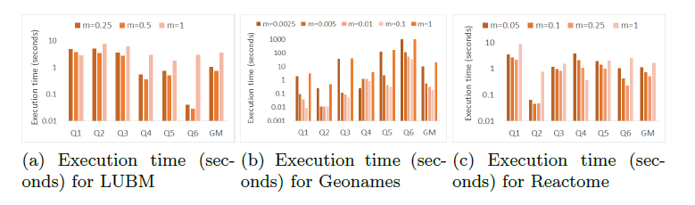
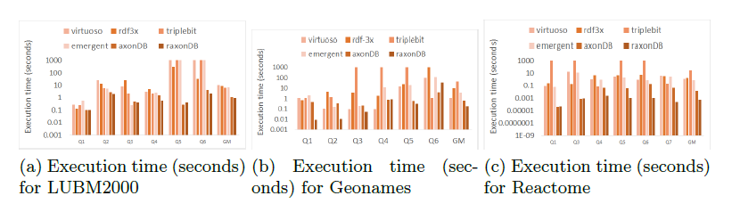
Implementation & Evaluation (Querying)
Notes:
In a set of complex benchmark queries that have been used in our past works, we observe how tuning the m parameter affects query performance (top row). We can also see that our approach offers great performance compared to state of the art competitors (bottom).

Slide 19
Future Work
Distributed version of raxonDB
  CS-based partitioning scheme
  Distributed query processing
Refined cost function
Different ways of defining density
Notes:
As future work, we intend to attempt a distributed version of hierarchical merging and implement it as part of our system. This would entail defining a CS-based partitioning scheme that would build on existing graph partitioning algorithms, and adapt query planning and query processing accordingly. Also, we intend to experiment with more refind cost functions for the merging operation, as well as different ways to define CS node density.

Slide 20
Thank you
{m.meimaris, gpapas}@athenarc.gr, pvassil@cs.uoi.gr
https://github.com/mmeimaris/raxonDB
https://visualfacts.imsi.athenarc.gr/
This research is funded by the project VisualFacts (#1614) - 1st Call of the Hellenic Foundation for Research and Innovation Research Projects for the support of post-doctoral researchers.

