Slide 1


Extraction of Embedded Queries via Static Analysis of Host Code
Petros Manousis, Apostolos Zarras, Panos Vassiliadis
University of Ioannina, Ioannina, Greece
George Papastefanatos
Research Center “Athena” \ IMIS, Athens, Greece

Slide 2
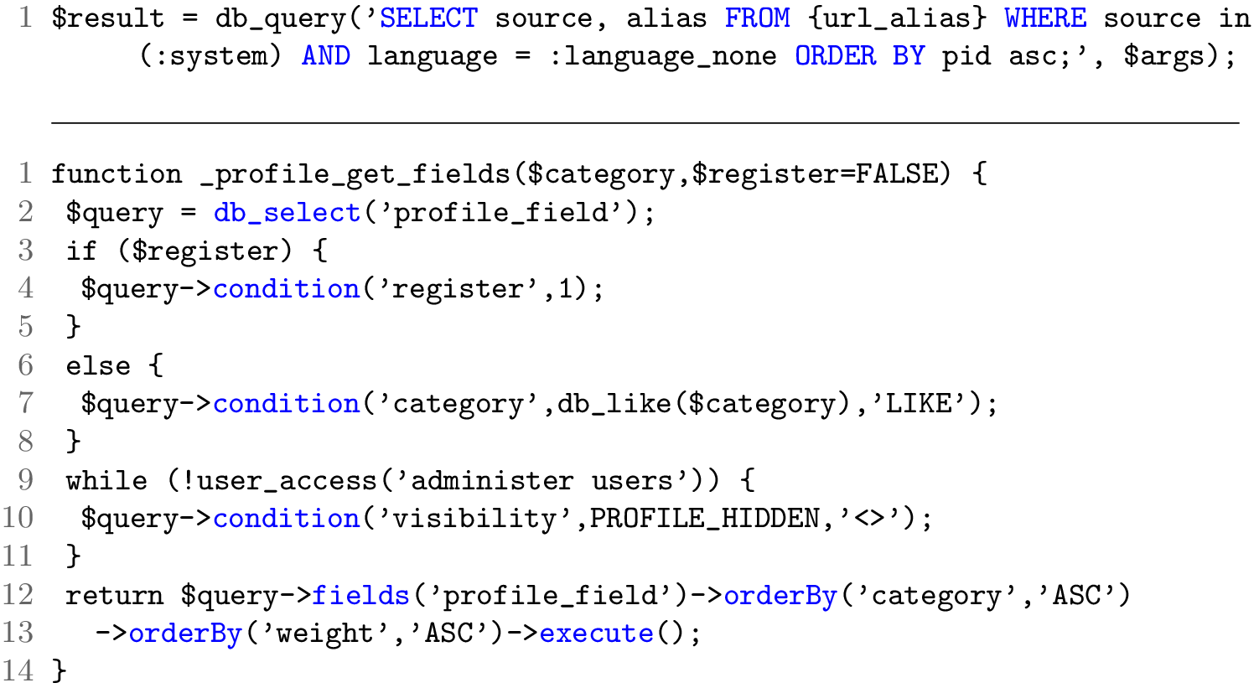
Embedded queries in data-intensive information systems
String-based
Object-based
Notes:
Evolution happens not only on changing the code, but also the style of asking queries.

Slide 3
Why bother?
It is really important to locate embedded queries in the host application of a data intensive information system
We need to be able to locate, inspect, and visualize data-related code for
- understanding how data and code inter-relate
- determining evolution’s possible impacts
- migrating the application to another development language
Yet, identifying the location and semantics of these queries is really hard, as already shown
Notes:
To operate properly, data-intensive applications rely on embedded queries, that
are programmatically constructed (typically, in progressive, incremental fashion)
to facilitate the retrieval of data from the underlying databases. Identifying the
location and semantics of these queries and making them available to develop-
ers is very important. In a most common scenario, database schema migration,
refactoring and evolution require the appropriate visualization and inspection
of data-related code, spread across multiple modules and les, for evaluating
the impact of the schema change to the overall software ecosystem. As another
example, when an administrator wants to modify a part of the database, it is
imperative that the developers of the surrounding applications are informed on
the change and have the means to identify the parts of the code that are going
to be affected by that change [1],[2].

Slide 4
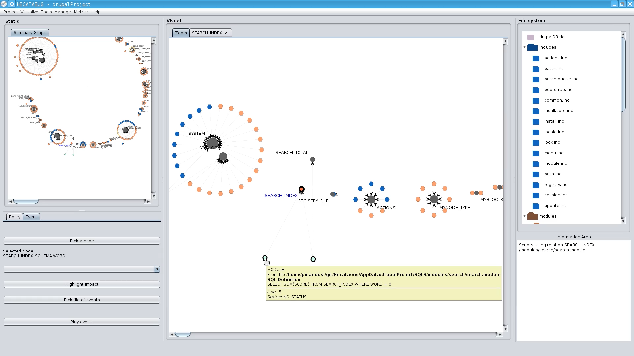
Hecataeus tool for charting and impact prediction
What happens if I modify table search_index? Who are the neighbors?
Dark nodes: tables
Colored nodes: queries “hitting” them, colored by their hosting file
Hecataeus tool: http://www.cs.uoi.gr/~pvassil/projects/hecataeus/

Slide 5
State of the art
 | Host languages | Query type | Variants
Christensen et al. (Static Anal. Symp. 2003) | Java | String-based
Gould et al. (ICSE 2004) | Java | String-based
Cleve et al. (WCRE 2006) | Java | String-based | Partial
Van den Brink et al. (SCAM 2007) | Pl/SQL, COBOL, V. Basic | String-based
Ngo and Tan (IST 2008) | PHP | String-based
Maule et al. (ICSE 2008) | C# | String-based
Annamaa et al. (Asian Symp. Prog. Lang. & Syst. 2010) | Java | String-based | ASTs
Notes:
Christensen et al. \cite{DBLP:conf/sas/ChristensenMS03} propose an approach that identifies type and syntax errors in Java source code, due to queries are constructed through string concatenation. To this end, the authors perform static source code analysis, based on flow graphs and finite state automata.
Gould et al. \cite{DBLP:conf/icse/GouldSD04,DBLP:journals/tosem/WassermannGSD07} use slicing to identify the SQL related parts in Java source code. Then, all the variations of a query are formed and tested for type (using the DB schema description) and syntax errors.
In a similar vein, Annamaa et al. \cite{DBLP:conf/aplas/AnnamaaBKV10} propose a method for testing database queries before their actual execution. The method identifies SQL queries embedded into Java source code, via searching for a given set of related functions.
Van den Brink et al. \cite{DBLP:conf/scam/BrinkLV07} use control and data-flow analysis to assess the quality of SQL queries, embedded in PL/SQL, COBOL and Visual Basic source code, while Ngo and Tan \cite{DBLP:journals/infsof/NgoT08} rely on symbolic execution to extract database interaction points from PHP applications.
Maule et al. \cite{DBLP:conf/icse/MauleER08} employ query extraction to identify the impact of relational database schema changes upon object-oriented applications. The proposed method targets C{\#} applications and is based on data-flow analysis, performed via a k-CFA algorithm.
Finally, Cleve et al. \cite{DBLP:conf/wcre/NagyMC15} propose a concept location technique that starts from a given SQL query and finds the specific source code location where the query is formed. This effort targets Java source code that uses JDBC or Hibernate.
Overall, although the existence of all these methods verifies the importance of the problem, the state of the art has dealt with query extraction (a) in a language-dependent way and (b) as the means, but not the main focus of research. Differently from the state of the art approaches, \emph{we propose a general-purpose query extraction method that clearly separates technology-specific from technology-independent aspects}. Our method extracts \emph{all} the variants of the queries that can be generated at runtime and \emph{produces query representations in more than one target query languages}.

Slide 6
Research goals
Be able to extract embedded queries with a simple, generic and understandable method regardless of the host language.
Provide understandable intermediate results (e.g., due to loop and branch statements of the source code).
Move from code dependent (string or object based constructed query) to a universal code-independent query representation.
Be able to output the queries in more than one “concrete” query language, to facilitate
  testing the correctness of the extraction
  migration from one system to another

Slide 7
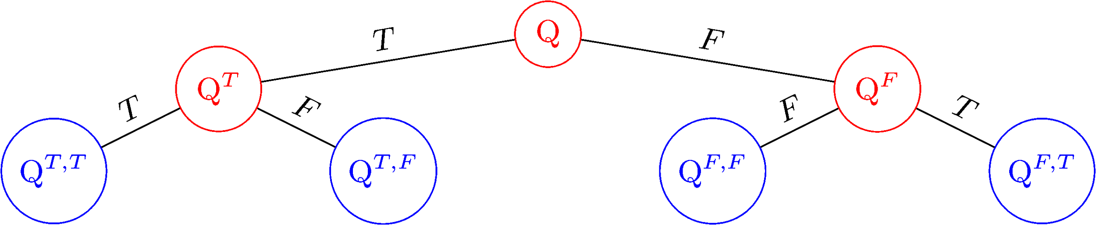
Roadmap
Overview
A method for Embedded Query Extraction
Experiments
Discussion

Slide 8
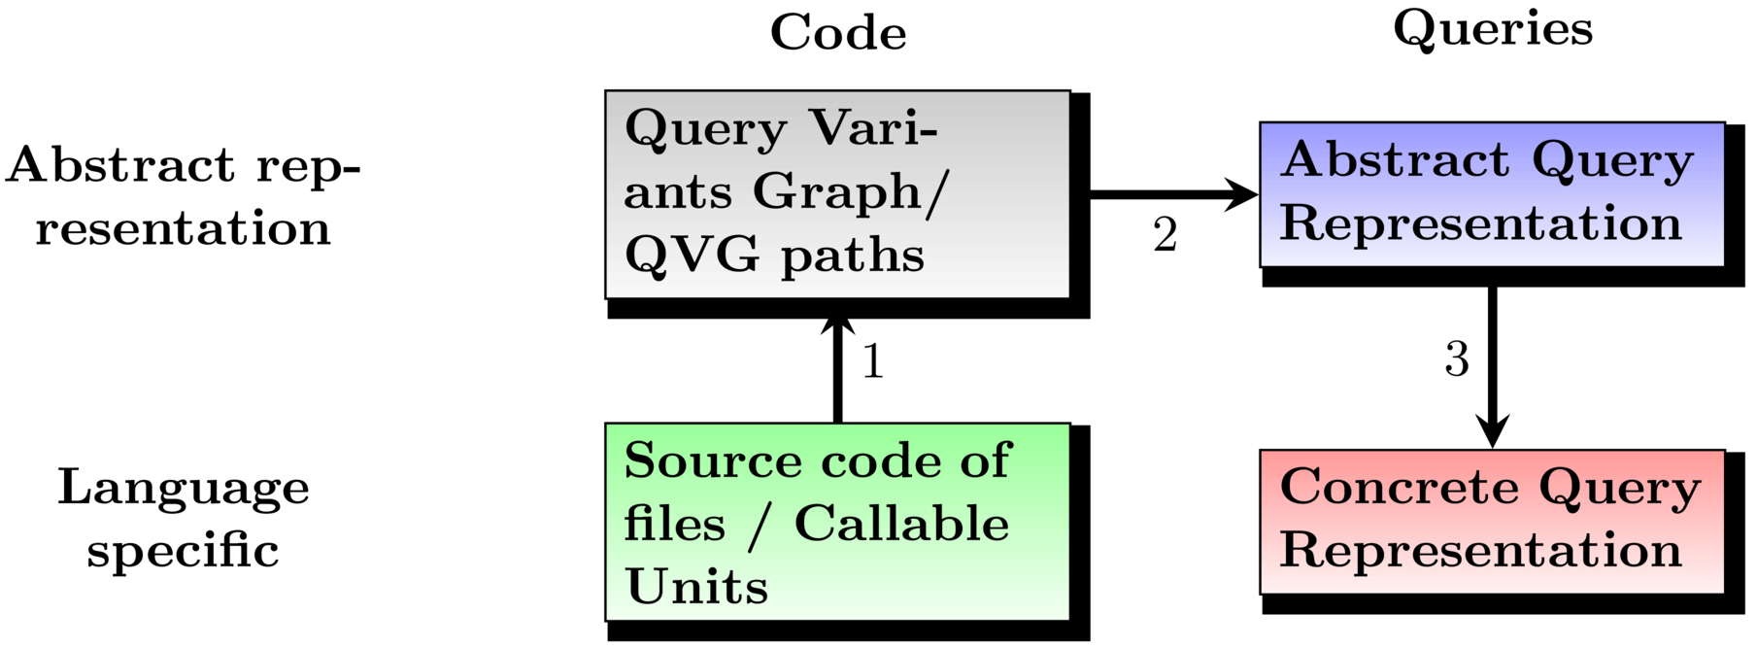
Overview of solution
Notes:
Our solution is to move from host language (PHP, C++, JAVA, Python, etc) to a tree-like graph with nodes that contain code information. Then we get every query related path and we create a universal query representation. Finally after making sure that we have no duplicates, we move on to get concrete queries in more than one environments (in our case we worked with SQL and MongoDB).

Slide 9
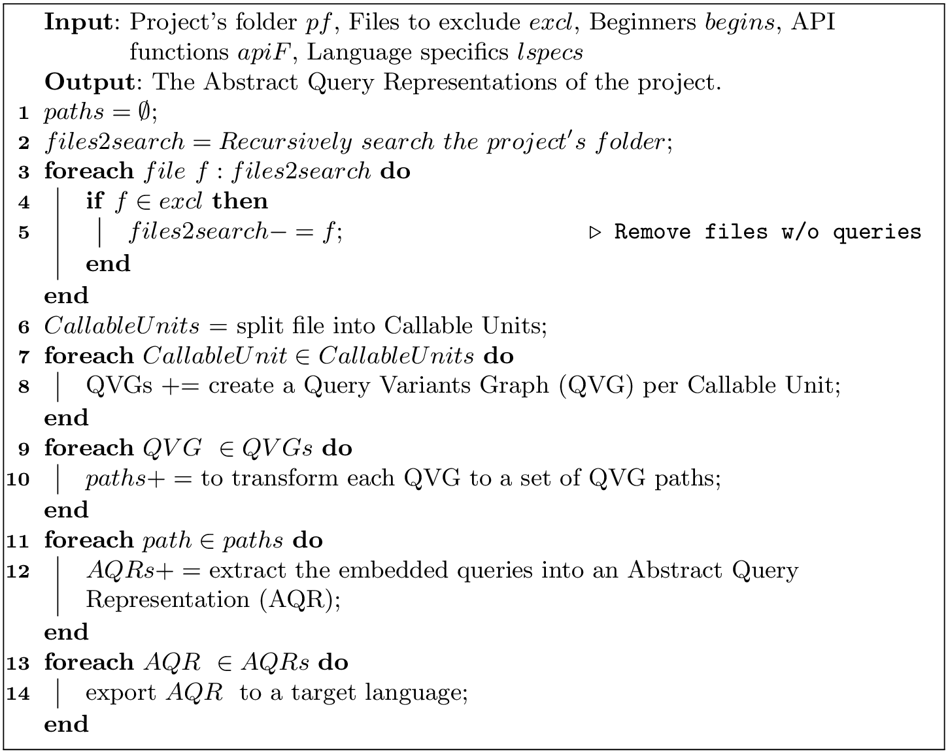
Roadmap
Input: Source files +
keywords
Concrete source code representation
Abstract source code
representation
Abstract
Query Representation
Output: Concrete,
target query representation
Notes:
This method is executed for each one of the files of the project that the user wants to check. Here we have the outline of our method.

Slide 10
Roadmap
Input: Source files +
keywords
Concrete source code representation
List of db-related functions
Abstract source code
representation
Abstract
Query Representation
Output: Concrete,
target query representation
Notes:
This method is executed for each one of the files of the project that the user wants to check. Here we have the outline of our method.

Slide 11
Example of source code file
/**
* Process variables for profile-wrapper.tpl.php.
*/
function template_preprocess_profile_wrapper(&$variables) {
$variables['current_field'] = '';
if ($field = arg(1)) {
$variables['current_field'] = $field;
$variables['theme_hook_suggestions'][] = 'profile_wrapper__' . $field;
}
}
function _profile_get_fields($category, $register = FALSE) {
$query = db_select('profile_field');
if ($register) {$query->condition('register', 1);}
else {$query->condition('category', db_like($category), 'LIKE');}
while (!user_access('administer users')) {$query->condition('visibility', PROFILE_HIDDEN, '<>');}
return $query->fields('profile_field')->orderBy('category', 'ASC')->orderBy('weight', 'ASC')->execute();
}
Steps
1. Remove comments
2. Remove files w/o db access
Notes:
This is a slightly modified file from Drupal 7.39 project. Instead of WHILE it should have been IF.

Slide 12
Example of source code file without comments
function template_preprocess_profile_wrapper(&$variables) {
$variables['current_field'] = '';
if ($field = arg(1)) {
$variables['current_field'] = $field;
$variables['theme_hook_suggestions'][] = 'profile_wrapper__' . $field;
}
}
function _profile_get_fields($category, $register = FALSE) {
$query = db_select('profile_field');
if ($register) {$query->condition('register', 1);}
else {$query->condition('category', db_like($category), 'LIKE');}
while (!user_access('administer users')) {$query->condition('visibility', PROFILE_HIDDEN, '<>');}
return $query->fields('profile_field')->orderBy('category', 'ASC')->orderBy('weight', 'ASC')->execute();
}
Steps
1. Remove comments
2. Remove files w/o db access
Notes:
We removed the text that was comments, saying something like: Process variables for profile-wrapper.tpl.php.

Slide 13
Has the source code of the file any DB connection?
function template_preprocess_profile_wrapper(&$variables) {
$variables['current_field'] = '';
if ($field = arg(1)) {
$variables['current_field'] = $field;
$variables['theme_hook_suggestions'][] = 'profile_wrapper__' . $field;
}
}
function _profile_get_fields($category, $register = FALSE) {
$query = db_select('profile_field');
if ($register) {$query->condition('register', 1);}
else {$query->condition('category', db_like($category), 'LIKE');}
while (!user_access('administer users')) {$query->condition('visibility', PROFILE_HIDDEN, '<>');}
return $query->fields('profile_field')->orderBy('category', 'ASC')->orderBy('weight', 'ASC')->execute();
}
Steps
1. Remove comments
2. Remove files w/o db access
Notes:
In Drupal the db_select function is used in order to make a select query to the database.

Slide 14
Roadmap
Notes:
This method is executed for each one of the files of the project that the user wants to check. Here we have the outline of our method.

Slide 15
Split file to Callable Units (methods/functions/...)
function template_preprocess_profile_wrapper(&$variables) {
$variables['current_field'] = '';
if ($field = arg(1)) {
$variables['current_field'] = $field;
$variables['theme_hook_suggestions'][] = 'profile_wrapper__' . $field;
}
}
function _profile_get_fields($category, $register = FALSE) {
$query = db_select('profile_field');
if ($register) {$query->condition('register', 1);}
else {$query->condition('category', db_like($category), 'LIKE');}
while (!user_access('administer users')) {$query->condition('visibility', PROFILE_HIDDEN, '<>');}
return $query->fields('profile_field')->orderBy('category', 'ASC')->orderBy('weight', 'ASC')->execute();
}
01
02
Steps
1. Split code in Callable Units (Cus)
2. Remove CUs w/o db access
Notes:
Here we have two functions: template_preprocess_profile_wrapper and _profile_get_fields.

Slide 16
Keep only DB related functions
function _profile_get_fields($category, $register = FALSE) {
$query = db_select('profile_field');
if ($register) {$query->condition('register', 1);}
else {$query->condition('category', db_like($category), 'LIKE');}
while (!user_access('administer users')) {$query->condition('visibility', PROFILE_HIDDEN, '<>');}
return $query->fields('profile_field')
->orderBy('category', 'ASC')
->orderBy('weight', 'ASC')
->execute();
}
Steps
1. Split code in Callable Units (Cus)
2. Remove CUs w/o db access

Slide 17
Roadmap
Input: Source files +
keywords
Concrete source code representation
Abstract source code
representation
Abstract
Query Representation
Output: Concrete,
target query representation
Notes:
This method is executed for each one of the files of the project that the user wants to check. Here we have the outline of our method.

Slide 18
Roadmap
Steps
For each CU
build a tree of possible execution paths
Notes:
This method is executed for each one of the files of the project that the user wants to check. Here we have the outline of our method.

Slide 19
Query
Variants
Graph
The Query Variants Graph is a “tree-like” graph with
blocks as its white nodes
loops and conditionals as its red nodes
alternatives of the control flow as its edges
Each node carries the respective src code with it

Slide 20
QVG serves an interim means to decide:
- all the alternative query generation control flow paths
- which query-generating parts of the CU pertain to each path
In Q we have not taken any decision for the branches of the query.
In Q^{T} and Q^{F} we have taken a decision for the first branch (Q^{T} has the code that will be executed if the condition is True, and in Q^{F} the code that will be executed if the condition is False).
Likewise, in Q^{T,T}, Q^{T,F}, Q^{F,F} and Q^{F,T} we have taken decisions for all the branches of the query Q.
Q^{T,T} is when in both branches the conditions are true.
Q^{T,F} is when the first condition is true while the second is false.
Q^{F,F} is when in both branches the conditions are false.
Q^{T,F} is when the first condition is false while the second is true.
Notes:
We have the tree that produces all the possible execution paths of the source code. We early prune the leaves that are not related to the DB. In our example, all the leaves are needed, but there are cases where the IF code has nothing to do with the queries.

Slide 21
Q^{T,T} execution plan
function _profile_get_fields($category, $register = FALSE) {
$query = db_select('profile_field');
if ($register) {$query->condition('register', 1);}
else {$query->condition('category', db_like($category), 'LIKE');}
if (!user_access('administer users')) {$query->condition('visibility', PROFILE_HIDDEN, '<>');}
return $query->fields('profile_field')
->orderBy('category', 'ASC')
->orderBy('weight', 'ASC')
->execute();
}
Notes:
When both conditions in the IFs are true the code that remains is this one.

Slide 22
Q^{T,F} execution plan
function _profile_get_fields($category, $register = FALSE) {
$query = db_select('profile_field');
if ($register) {$query->condition('register', 1);}
else {$query->condition('category', db_like($category), 'LIKE');}
if (!user_access('administer users')) {$query->condition('visibility', PROFILE_HIDDEN, '<>');}
return $query->fields('profile_field')
->orderBy('category', 'ASC')
->orderBy('weight', 'ASC')
->execute();
}
Notes:
When the first condition in the IFs is true and the second is false, the code that remains is this one.

Slide 23
Q^{F,T} execution plans
function _profile_get_fields($category, $register = FALSE) {
$query = db_select('profile_field');
if ($register) {$query->condition('register', 1);}
else {$query->condition('category', db_like($category), 'LIKE');}
if (!user_access('administer users')) {$query->condition('visibility', PROFILE_HIDDEN, '<>');}
return $query->fields('profile_field')
->orderBy('category', 'ASC')
->orderBy('weight', 'ASC')
->execute();
}
Notes:
When the first condition in the IFs is false and the second is true, the code that remains is this one.

Slide 24
Q^{F,F} execution plan
function _profile_get_fields($category, $register = FALSE) {
$query = db_select('profile_field');
if ($register) {$query->condition('register', 1);}
else {$query->condition('category', db_like($category), 'LIKE');}
if (!user_access('administer users')) {$query->condition('visibility', PROFILE_HIDDEN, '<>');}
return $query->fields('profile_field')
->orderBy('category', 'ASC')
->orderBy('weight', 'ASC')
->execute();
}
Notes:
Finally, when both conditions in the IFs are fals, the code that remains is this one.

Slide 25
On the side: loops converted to branches
function _profile_get_fields($category, $register = FALSE) {
$query = db_select('profile_field');
if ($register) {$query->condition('register', 1);}
else {$query->condition('category', db_like($category), 'LIKE');}
if (!user_access('administer users')) {$query->condition('visibility', PROFILE_HIDDEN, '<>');}
return $query->fields('profile_field')
->orderBy('category', 'ASC')
->orderBy('weight', 'ASC')
->execute();
}
This if used to be a while.
Yet: for abstracting the query structure, there is no difference!
Notes:
A loop would not produce anything different (regarding the schema dependencies) in the n-th (where n>0) repeat compared to the previous ones. So, a loop might not run at all, unless it is a <do...while> loop that runs at least once. Therefore, we change the loops to if branches.

Slide 26
Roadmap
Input: Source files +
keywords
Concrete source code representation
Abstract source code
representation
Abstract
Query Representation
Output: Concrete,
target query representation
Notes:
This method is executed for each one of the files of the project that the user wants to check. Here we have the outline of our method.

Slide 27
How to abstract each QVG path?
… At this point, we have at our disposal all the linear paths , each with its own sequence of db-related, query-generating, host-language statements
…Each QVG path creates one of the possible queries embedded in the code via its list of host language statements
Still, it is in host-language format. How to abstract?
Ingredients
A family of Abstract Data Manipulation Operators
A mapping of host language “method calls” to these operators
An Abstract Representation of Queries (AQR)
An algorithm to walk the path and create an AQR

Slide 28
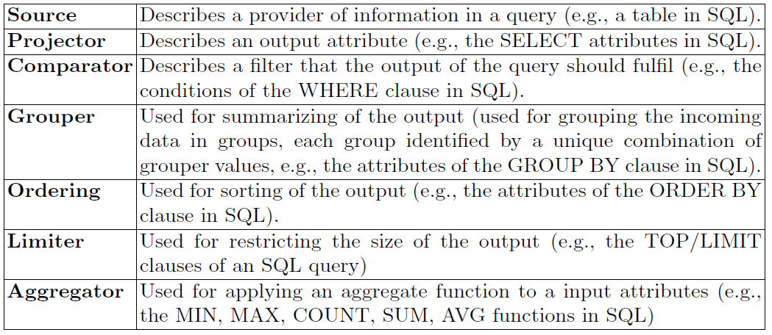
Abstract Data Manipulation Operators
- an extensible palette of operators for data manipulation
- currently with a minimal set of operators

Slide 29
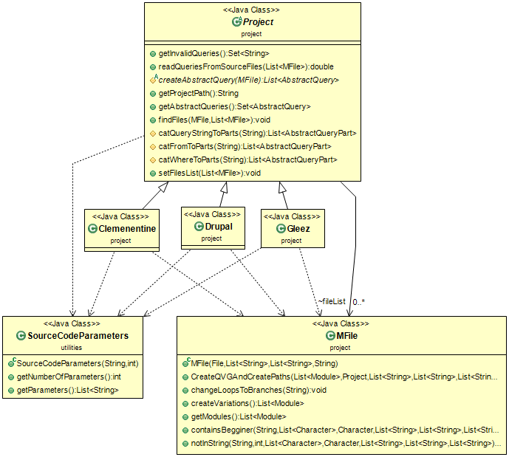
Mapping of host language to ADMO
Per project:
Must materialize the CreateAbstractQuery method!
Creation includes cases of diff. #params, string manipulation, …
See the exact price to pay later…

Slide 30
Algorithm to transform host language statements to ADMO

Slide 31
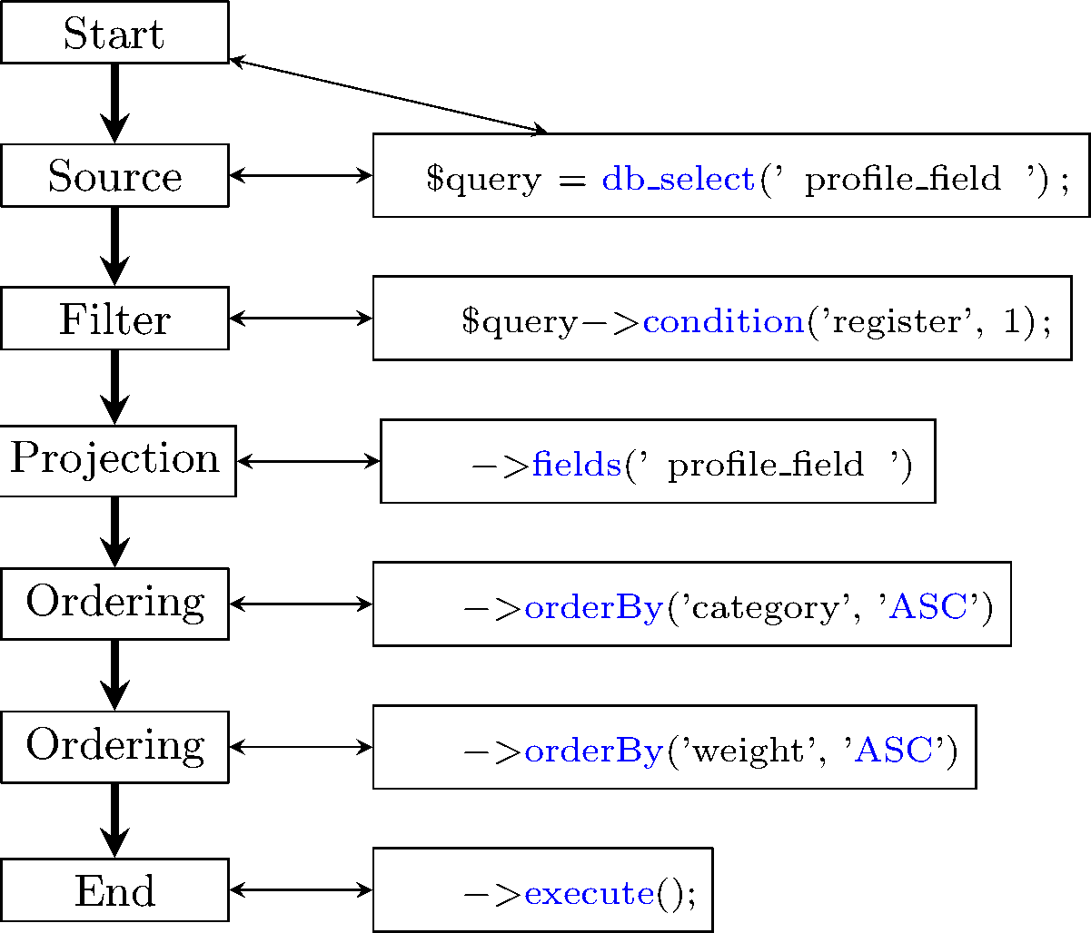
Abstract Query Representation of a host path
(a sequence of ADMO operators to which individual host method calls are translated)
function _profile_get_fields($category, $register = FALSE) {
$query = db_select('profile_field');
if ($register) {$query->condition('register', 1);}
else {$query->condition('category', db_like($category), 'LIKE');}
if (!user_access('administer users')) {$query->condition('visibility', PROFILE_HIDDEN, '<>');}
return $query->fields('profile_field')
->orderBy('category', 'ASC')
->orderBy('weight', 'ASC')
->execute();
}
Notes:
This part is project related… for example, we need to write some code so as to set in our Abstract Query Representation the correct values at our attributes. Those values come from the Drupal functions, for example db_select describes the table that will be used in the query.

Slide 32
Roadmap
Input: Source files +
keywords
Concrete source code representation
Abstract source code
representation
Abstract
Query Representation
Output: Concrete,
target query representation
Notes:
This method is executed for each one of the files of the project that the user wants to check. Here we have the outline of our method.

Slide 33
AQR to target
Translate each ADMO operator to a part of a “query statement” depending on the target language
SQL
SELECT profile_field.∗
FROM profile_field
WHERE register = 1
ORDER BY category ASC, weight ASC
;
MongoDB
db.profile_field.aggregate
([
{ $match: {register: { $eg: 1 } } },
{ $sort: { category: 1, weight: 1 } },
{ profile_field.*: 1 }
])
http://www.cs.uoi.gr/~pmanousi/publications/queryExtraction/
Notes:
From the Abstract Query Representation we are able to go to a concrete platform related representation (such as SQL or MongoDB).

Slide 34
Roadmap
Overview
A method for Embedded Query Extraction
Experiments
Discussion

Slide 35
Experimental setup
Two projects analyzed:
  Clementine (a music player written in C++)
  Drupal (a CMS written in PHP)
Metrics:
  Recall: the fraction of the retrieved queries of each le over the actually existing ones.
  Correctness: the fraction of the correctly reconstructed queries over the retrieved ones. “Correctly” = (a) retrieving all its structural parts + (b) assembling them as originally intended
Notes:
Effectiveness
We need to verify the extent to which our method retrieves
and correctly reconstructs queries from the application scripts of the ecosystem.
The performance measures for this kind of assessment are recall and correctness.
Recall is defined as the fraction of the retrieved queries of each le over the
actually existing ones. Correctness is defined as the fraction of the correctly
reconstructed queries over the retrieved ones. A correct reconstruction of a query
involves (a) retrieving all its structural parts and (b) assembling them correctly,
in order to result in a correct and complete query.

Slide 36
Recall
Ideally, to assess recall, we need to manually verify the percentage of queries that our method extracts with respect to the queries that actually exist in the code.
Due to the vastness of the task, we have sampled the 10% of the database-related files.
Also, we performed automated searches based on the prescription of the project’s manual, on how queries are authored in the code.
We manually inspected the code of the evaluated files and we were unable to find any other query, besides the ones that our tool reported.
Similarly, all automated searches failed to produce any misses
We claim 100% recall based on the above.
Notes:
Recall To assess recall, we need to manually verify the percentage of queries
that our method extracts with respect to the queries that actually exist in the
code. Due to the vastness of the task, we have sampled the 10% of the database-
related les. This is a standard practice in the software engineer community
whenever the size of a project is too large for full manual inspection. We man-
ually inspected the code of the evaluated les and we were unable to nd any
other query, besides the ones that our tool reported. In the functions that were
repeating a query in one or more places in their source code, we reported only
one occurrence of the query, since there was no variation. If a query changes, then
we report the \new" query (the modied one) as well. Our manual inspection
was further supported by automated searches in the source code. For Clemen-
tine, we decided to focus on a single table of the database. Then, we can search
for all occurrences of the table's name. For Drupal, we took advantage of the
fact that there are specic functions for querying the database, as prescribed by
its manual (both for string-based and for object-based queries): https://api.
drupal.org/api/drupal/includes!database!database.inc/function/).

Slide 37
Correctness
Used a classification of queries wrt their structure
1. Fixed structure: query structure not altered by host variables
(1a) All parts fixed: queries that have no variable at all
(1b) Variable values in filtering: queries that contain a variable that gets its value at execution time but does not intervene with the query structure. Typically, in a selection predicate.
2. Variable structure: query structure is defined at runtime via host variables. Typically occurs at FROM clause (!)

Slide 38
Correctness
Achieved
100% correctness
Currently, we fail to handle them
Percentages of queries per category for the two data sets

Slide 39
User effort
There is a preprocessing step to translate the projects’ API database-related functions to Abstract Data Manipulation Operators.
Effort is measured with
(a) the number of functions that needed translation from the project's API,
(b) the lines of code that were written for the translation of those API functions to Abstract Data Manipulation Operators.
Notes:
User Effort. There is a preprocessing step that
is needed in order to translate the projects API database-related functions to
Abstract Data Manipulation Operators. In Table 4 we describe the user's effort
for the two projects that we examined. The effort is measured in the number
of functions that needed translation from the project's API, and in the lines of
code that were written for the translation of those API functions to Abstract
Data Manipulation Operator.

Slide 40
Roadmap
Overview
A method for Embedded Query Extraction
Experiments
Discussion

Slide 41
We present a method to extract embedded queries from host code!
1
… and in a way that is simple and understandable
2
We can also represent interim structures in a principled & meaningful way!
3
We can envision a generic, all-encompassing, language independent representation of data retrieval that treats queries as workflows of data transformation Lego blocks

Slide 42
Open Issues
Work more on ADMO
Broaden the support for more host languages
Test with more systems
Broaden the query class to incorporate more flexible query structures
Improve the efficiency of the algorithms to gain memory (!) and time

Slide 43
Danke schön!
Thank you!
We present a method to extract embedded queries from host code!
… and in a way that is simple and understandable
We can also represent interim structures in a principled & meaningful way!
We can envision a generic, all-encompassing, language independent representation of data retrieval that treats queries as workflows of data transformation Lego blocks
http://www.cs.uoi.gr/~pmanousi/publications/2017_CAiSE/

