Slide 1

Open-Source Databases: Within, Outside, or
Beyond Lehman's Laws of Software Evolution?
This research has been co-financed by the European Union (European Social Fund - ESF) and Greek national funds through the Operational Program "Education and Lifelong Learning" of the National Strategic Reference Framework (NSRF) - Research Funding Program: Thales. Investing in knowledge society through the European Social Fund.
Ioannis Skoulis, Panos Vassiliadis, Apostolos Zarras
Department of Computer Science and Engineering
University of Ioannina, Hellas
Univ. of Ioannina

Slide 2

What are the laws of database schema evolution?

Slide 3
What are the laws of database (schema) evolution?
How do databases change?
In particular, how does the schema of a database evolve over time?
Long term research goals:
  Are there any “invariant properties” (e.g., patterns of repeating behavior) on the way database (schemata) change?
  Is there a theory / model to explain them?

Slide 4
Why care for the laws/patterns of schema evolution?
Scientific curiosity!
Practical Impact: DB’s are dependency magnets. Applications have to conform to the structure of the db…
  typically, development waits till the “db backbone” is stable and applications are build on top of it
  slight changes to the structure of a db can cause several (parts of) different applications to crash, causing the need for emergency repairing

Slide 5
Imagine if we could predict how a schema will evolve over time…
… we would be able to “design for evolution” and minimize the impact of evolution to the surrounding applications
  by applying design patterns
  by avoiding anti-patterns & complexity increase
  … in both the db and the code
… we would be able to plan administration and perfective maintenance tasks and resources, instead of responding to emergencies
Notes:
Example for syntactic impact
relation removed causes direct failure in apps
Example for semantic impact
attribute insertion might add information that is not known and ignored by apps
Benefits by applying design patterns and by avoiding anti-patterns.
Anti patterns will lead to cumulative complexity for both db an applications that will eventually make the entire system decline and be replaced by other systems.
We can find out not only good ways to do stuff but we can see what is the matter with those that go bad and avoid it.

Slide 6
Why aren’t we there yet?
Historically, nobody from the research community had access + the right to publish to version histories of database schemata
Open source tools internally hosting databases have changed this landscape:
  not only is the code available, but also,
  public repositories (git, svn, …) keep the entire history of revisions
We are now presented with the opportunity to study the version histories of such “open source databases”

Slide 7

Our take on the problem
Collected version histories for the schemata of 8 open-source projects
  CMS’s: MediaWiki, TYPO3, Coppermine, phpBB, OpenCart
  Physics: ATLAS Trigger --- Bio: Ensemble, BioSQL
Preprocessed them to be parsable by our HECATE schema comparison tool and exported the transitions between each two subsequent versions and measures for them (size, growth, changes)
Visualized the transitions in graphs and statistically studied the measures, in a study organized around the 8 laws of Lehman for software evolution

Slide 8
Schema evolution for o/s db’s
… and Lehman’s Laws of evolution

Slide 9
Lehman’s laws in a nutshell
An E-Type software system continuously changes over time (I) obeying a complex feedback-based evolution process (VIII) that prohibits the uncontrolled growth of the system (III).
Positive feedback: due to the need for growth and adaptation to user needs
  evolution results in an increasing functional capacity of the system (VI),
  produced by a growth ratio that is slowly declining in the long term (V),
  with effort typically constant over phases (with the phases disrupted with bursts of effort from time to time (IV)).
Negative feedback: to regulate the ever-increasing growth and control both the overall quality of the system (VII), with particular emphasis to its internal quality (II).
In our context:
  E-type system -> database, functional capacity -> information capacity
Notes:
The process is typically guided by a pattern of growth that demonstrates its self-regulating nature: growth advances smoothly; still, whenever there are excessive deviations from the typical, baseline rate of growth (either in a single release, or accumulated over time), the evolution process obeys the need for calibrating releases of perfective maintenance (expressed via minor growth and demonstrating negative feedback) to stop the unordered growth of the system's complexity (III).

Slide 10
Lehman’s Laws in groups
Three main groups for the Laws:
Feedback-based System
  I. Continuing change
  VIII. Feedback System
  III. Self Regulation
Positive feedback
  VI. Continuing Growth
  V. Conservation of Familiarity
  IV. Conservation of Organizational Stability
Negative feedback
  II. Increasing Complexity
  VII. Declining Quality

Slide 11
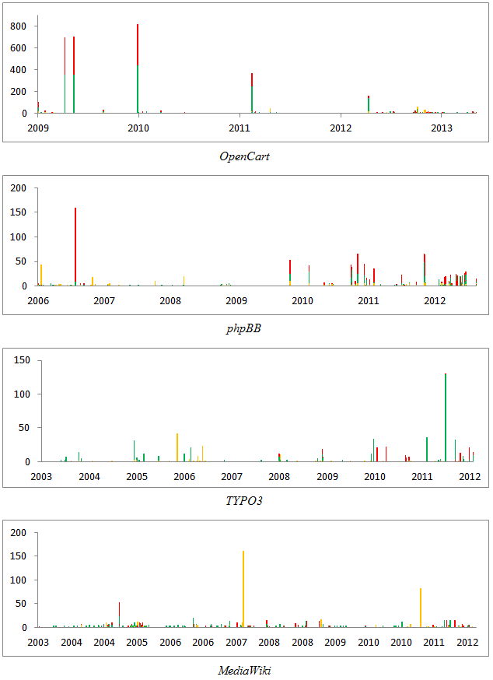
I. Continuing change
“The database schema is continually adapted or else it becomes progressively less satisfactory.”
Evaluation: The db must show signs of evolution as time passes
Metrics: heartbeat of changes over time and version
Outcome: Databases do change but not continuously
Ensembl
Notes:
In all occassions, we have periods of inactivity
Less activity observed with age
Changes come in bursts, in grouped periods of evo activity
Too many versions with zero change=> beautification or change in the physical schema
BioSQL: an exception to the rule

Slide 12
III. Self Regulation
“Database schema evolution is feedback regulated.”
Evaluation: i) indication of patterns in size growth, ii) existence of negative feedback (drop in size and growth locally decreasing), iii) “ripples” in growth
Metrics: size over version, system growth
Outcome: feedback is evident, although differently than in traditional software
Notes:
Schema grows in phases
Each db with smooth growth
Each db with shriking versions to calibrate long ones

Slide 13
Schema Size (relations)
Notes:
We see drops
sudden shift
take place in short periods
In all db’s, we see increase especially at the beginning or after large drops (positive feedback)
overall trend is to increase
In all db’s, we have periods of stability

Slide 14
Schema Size
Apparently, there is both positive and negative feedback; still, no Lehman-like recurring patterns
Overall increase in size
Periods of increase, esp. at beginning and after large drops -> positive feedback
Drops: sudden and steep (in short duration) -> negative feedback
Large periods of stability!
  Unlike traditional S/W, db’s are dependency magnets…

Slide 15
Schema growth is small!
Growth is bounded in small values!
Zipfian distribution of growth values around 0
  Predominantly: occurrences of zero growth; almost all deltas are bounded between [-2..2] tables
  [0..2] tables slightly more popular => average value of growth slightly higher than 0
No periods of continuous change; small spikes instead
Due to perfective maintenance, we also have negative values of growth (less than the positive ones).
Oscillations exist too: positive growth is followed with immediate negative growth or stability
Notes:
Growth: diff in schema size between subsequent versions

Slide 16
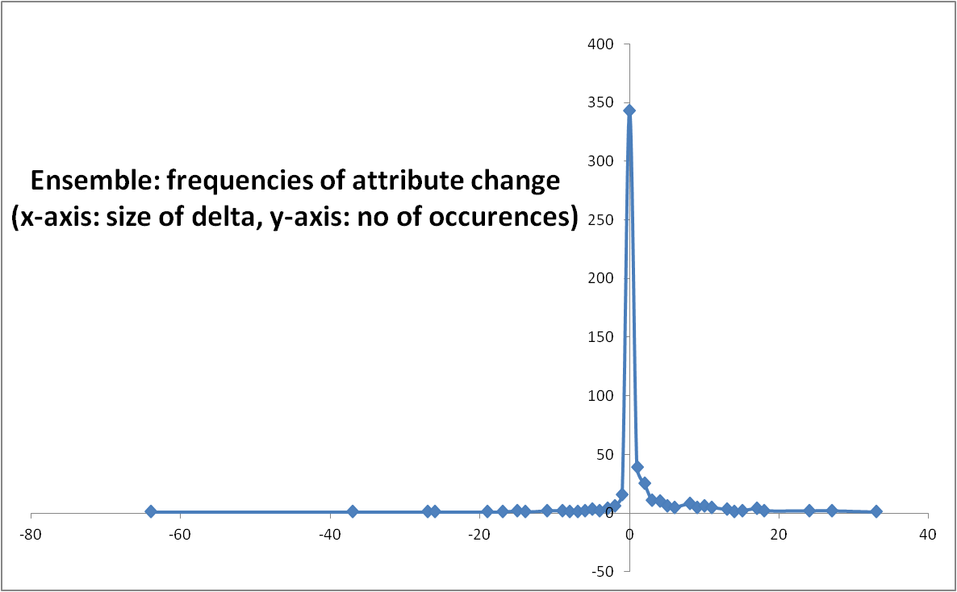
Zipfian model in the distribution of growth frequencies
Growth: delta in the schema size for two subsequent versions

Slide 17
Schema Growth
Notes:
Small growth for relations
Too many occurrences of zero growth
no periods of continuous change but we have small spikes
Average value close to zero (++ zipfian model)
Immediate + delta is followed with immediate - delta
Oscillations do exist; still much more on + axis
we cannot see patterns of smooth growth interrupted by perfective maintenance

Slide 18
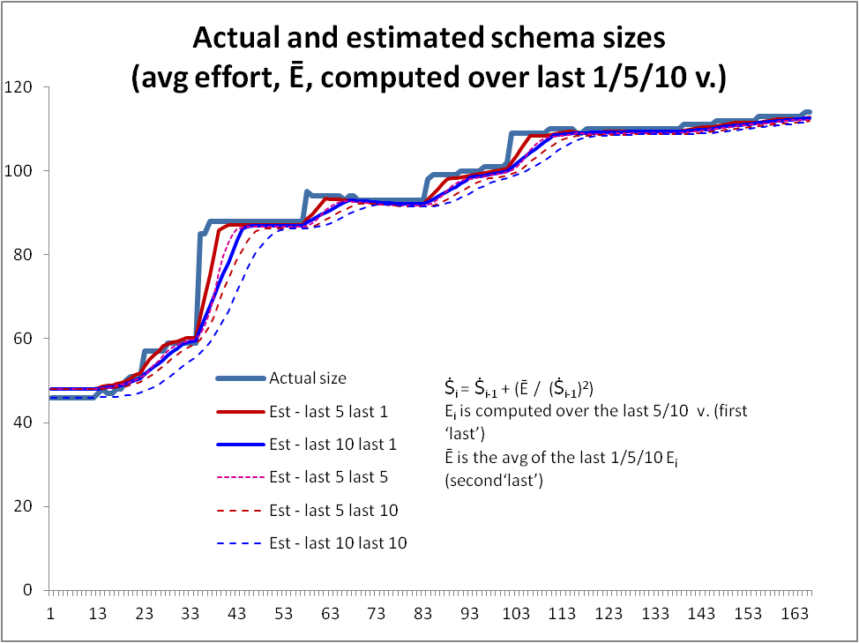
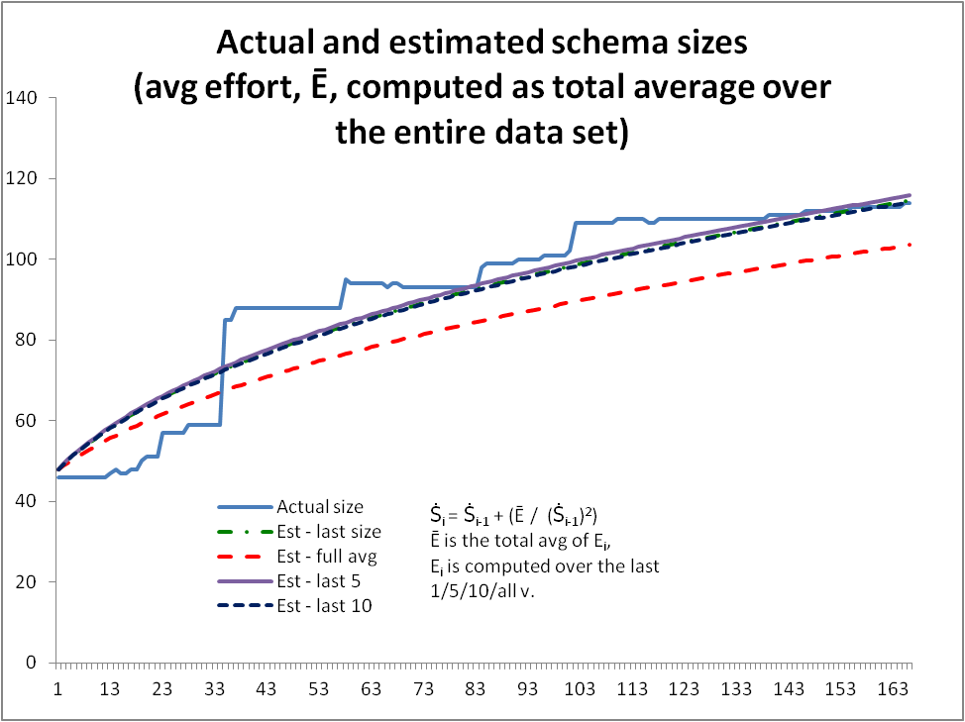
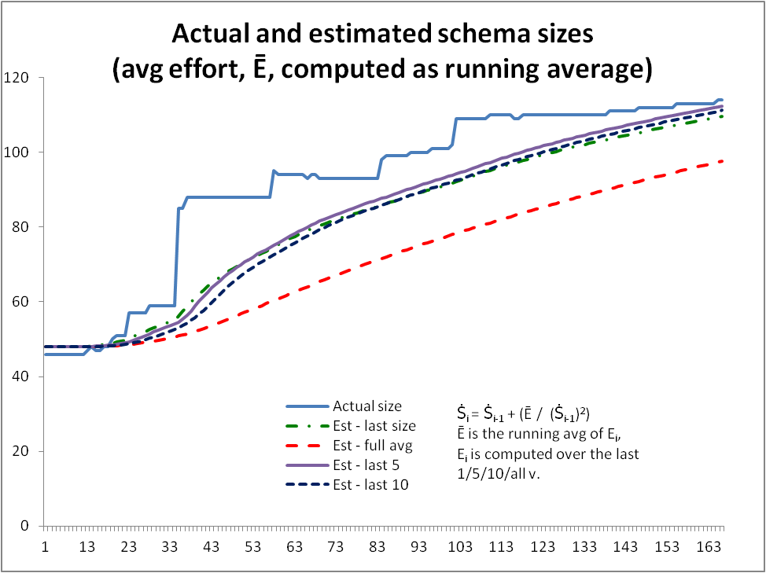
VIII. Feedback System
“Database schema evolution processes are multi-level, multi-loop, multi-agent feedback systems.”
Evaluation: Regression analysis to the estimate size of the database schemata
Metrics: estimated size , effort
Outcome: the regression formula holds, but with short memory!
Notes:
Can we estimate the size via a regressive formula?
We failed when E (average Ei, Ei= effort estimation per transition) was constant for the entire lifetime or a running average
The formula works when we take Ei as an average of very few versions (last 1, 5 or 10) and also using few versions (5/10) for the computation of each Ei
So, we can have the formula, but with very short memory and clearly NOT with the long phases of Lehman!

Slide 19
Laws for Schema Evolution
Three main groups for the Laws:
Feedback-based System
  I. Continuing Change
  VIII. Feedback System
  III. Self Regulation
Positive feedback
  VI. Continuing Growth
  V. Conservation of Familiarity
  IV. Conservation of Organizational Stability
Negative feedback
  II. Increasing Complexity
  VII. Declining Quality

Slide 20
VI. Continuing Growth
“The informational capacity of databases must be continually enhanced to maintain user satisfaction over system lifetime.”
Evaluation: Overall expansion trend for the metrics involved
Metrics: number of relations, number of attributes
Outcome: we see phases
  Stability (unique for databases compared to traditional SW systems)
  Smooth expansion upwards
  Abrupt change (up or down)
Notes:
Phases:
Stability (unique for databases Lehman never mentioned them)
smooth expansion upwards
Abrupt change (up and down)
We collect only schema related stuff
the other code is changed in the meantime
The law clearly holds

Slide 21
V. Conservation of Familiarity
“In general, the incremental growth of database schema is constrained by the need to maintain familiarity.”
Evaluation: i) growth is constant or declining with age, ii) versions with significant change in size are followed by small growth
Metrics: schema growth, schema growth rate
Questions: what happens after large changes?
how does age affect change rates?
Notes:
Most important: as we cannot really explain the ‘why’, we have to stick to the answer of the two red questions!

Slide 22
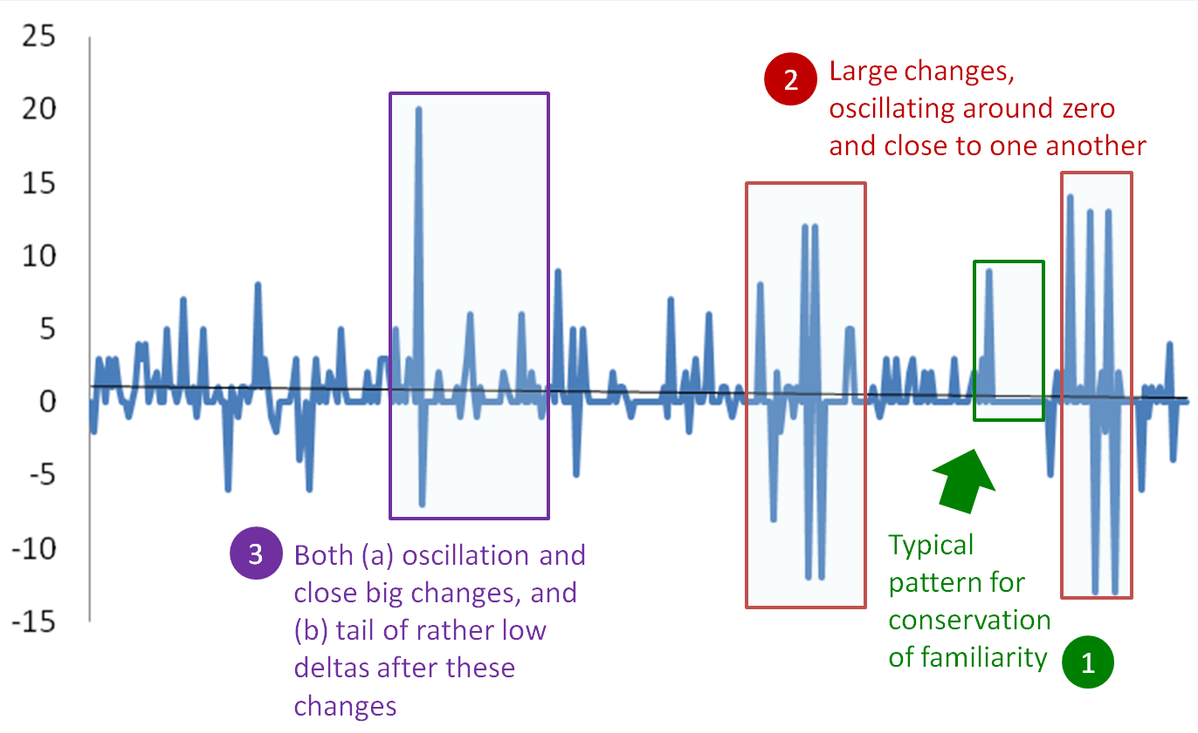
V. Conservation of Familiarity
Notes:
Patterns do exist
The traditional pattern of LL (here: green #1) is not here, though

Slide 23
V. Conservation of Familiarity
We observe a decline in the density of changes with age, but not a decline in growth size
  Change is frequent in the beginning
  Large changes and dense periods in any time
Growth reacts as expected but is it because of the need to maintain familiarity?
  Other modules are higly dependent on them
  Effort might be taken to clean and organize a database

Slide 24
IV. Conservation of Organizational Stability
“The work rate of an organization evolving a database schema tends to be constant over the operational lifetime of that schema or phases of that lifetime.”
Evaluation: i) detect phases with constant growth, ii) those phases must be connected with abrupt changes
Metrics: schema growth
Outcome: simply not the case (despite the existence of abrupt changes, there is no “constant growth” – instead: stability and spikes)
Notes:
Bounded in small values
Almost all numbers are between [-2,2] or [0,2]
Few changes

Slide 25
Laws for Schema Evolution
Three main groups for the Laws:
Feedback-based System
  I. Continuing Change
  VIII. Feedback System
  III. Self Regulation
Positive feedback
  VI. Continuing Growth
  V. Conservation of Familiarity
  IV. Conservation of Organizational Stability
Negative feedback
  II. Increasing Complexity
  VII. Declining Quality

Slide 26
II. Increasing Complexity
“Efforts to maintain internal quality must be made.”
Evaluation: i) We must identify version with perfective maintenance, ii) the VIII law must hold, iii) the approximate complexity must increase
Metrics:
Complexity is an estimate based on the literature.
Outcome: unclear -- complexity appears dropping (due to the decline of change density). Possibly, perfective maintainance has been successful?!
Notes:
Feedback holds so we expect perfective maintenance maintenace
Complexity is dropping rather than rising (!)
Changes also decline in density over time so complexity declines
Complexity is an estimate, however

Slide 27
Complexity
Notes:
It is dropping rather than rising
Changes also decline in density over time so complexity declines
Confidence?
Complexity is an estimate based on the literature

Slide 28
VII. Declining Quality
“Unless rigorously adapted and evolved to take into account changes in the operational environment, the quality of a database schema will appear to be declining.”
Evaluation: Hold by logical induction, if III, VIII, and II hold
Metrics: not possible to measure external quality
Outcome: We are unsure of the behavior of internal quality so we are even more reluctant towards declaring external quality as improving.

Slide 29
Laws for Schema Evolution
Three main groups for the Laws:
Feedback-based System
  I. Continuing Change
  VIII. Feedback System
  III. Self Regulation
Positive feedback
  VI. Continuing Growth
  V. Conservation of Familiarity
  IV. Conservation of Organizational Stability
Negative feedback
  II. Increasing Complexity
  VII. Declining Quality
?

Slide 30
Conclusions and open issues

Slide 31
Can we find any patterns on the way database (schemata) evolve?
Major scientific goal with tremendous impact on our discipline and economy
Now possible with the availability of data
First results here
Great potential for way too many more to come
Would be great to pass from observed patterns to laws / theories too

Slide 32

Main results
Schema size (#tables, #attributes) supports the assumption of a feedback mechanism
Schema size grows over time; not continuously, but with bursts of concentrated effort
Drops in schema size signifies the existence of perfective maintenance
Regressive formula for size estimation holds, with a quite short memory
Schema Growth (diff in size between subsequent versions) is small!!
Growth is small, smaller than in typical software
The number of changes for each evolution step follows Zipf’s law around zero
Average growth is close (slightly higher) to zero
Patterns of change: no consistently constant behavior
Changes reduce in density as databases age
Change follows three patterns: Stillness, Abrupt change (up or down), Smooth growth upwards
Change frequently follows spike patterns
Complexity does not increase with age
Grey for results requiring further search
Notes:
Divide findings in two categories:
-High Certainty
-need further work (grey)
We avoid the term law – don’t have unshakable evidence of their existence, we don’t have clear understanding of mechanisms

Slide 33
Future Work
Time related measures and patterns
  We have occasions were effort is high or low
  We need better patterns of change over time
Identifying changes better
  Capture renames, table splitting, …
Schema Complexity
  We lack a representative set of metrics that measure the complexity of a database schema (e.g., via FK’s / FD’s / semantic rel’s / …)

Slide 34
Thank you!
Any questions?
More information
http://www.cs.uoi.gr/~pvassil/publications/2014_CAiSE/
Hecate’s Code
https://github.com/DAINTINESS-Group/Hecate
Data sets & results
https://github.com/DAINTINESS-Group/EvolutionDatasets
http://cs.uoi.gr/~iskoulis/results/results_LehmanforDBs.xlsx

Slide 35
Auxiliary slides

Slide 36
Conclusions
… with a fairly high degree of certainty:
  Database schemata grow over time; not continuously, but with bursts of concentrated effort
  Regressive formula for size estimation holds, with a quite short memory
  Growth is small, smaller than in typical software
  The number of changes for each evolution step follows Zipf’s law
  Average growth is close to zero
  Changes reduce in density as databases age

Slide 37
Conclusions
… requiring further insight:
  Change follows three patterns:
    Stillness
    Abrupt change (up or down)
    Smooth growth upwards
  Change frequently follows spike patterns
  Large changes sequenced one after the other
  Complexity does not increase with age

Slide 38
Results in detail
As an overall trend, the information capacity of the database schema is enhanced -- i.e., the size grows in the long term (VI).
The existence of perfective maintenance is evident in almost all datasets with the existence of relation and attributes removals, as well as observable drops in growth and size of the schema (sometimes large ones). In fact, growth frequently oscillates between positive and negative values (III).
The schema size of a certain version of the database can be accurately estimated via a regressive formula that exploits the amount of changes in recent, previous versions (VIII).
Based on the above, we can state that the essence of Lehman's laws applies to open-source databases too: Schema evolution demonstrates the behavior of a feedback-regulated system, as it obeys the antagonism between the need for expanding its information capacity to address user needs and the need to control the unordered expansion, with perfective maintenance.

Slide 39
Results in detail
Observations concerning the heartbeat of change:
  The database is not continuously adapted, but rather, alterations occur from time to time, both in terms of versions and in terms of time (I). Change does not follow patterns of constant behaviour (IV).
  Age results in a reduction of the density of changes to the database schema in most cases (V).
Schema growth is small (observations):
  Growth is typically small in the evolution of database schemata, compared to traditional software systems (III).
  The distribution of occurrences of the amount of schema change follows a Zipfian distribution, with a predominant amount of zero growth in all data sets. (III)
  The rest of the frequently occurring values are close to zero, too. The average value of growth is typically close to zero (although positive) (III) and drops with time, mainly due to the drop in change density (V).

Slide 40
Philosophy of science
How does our approach stands from the viewpoint of…

Slide 41
“Laws” and other terminological issues
Pattern: reoccurrence of particular types of events with statistically significant properties in the context of a set of observations
Law/principle: a statement expressing a fundamental pattern that is omnipresent in a large set of experiments
  Non falsified yet, based on solid observations
  Allowing prediction ☺
Explanation: an inductive statement correlating the explanandum of a law with relevant causes

Slide 42
Disclaimer
We do not introduce any laws:
  … we just list our observations
  … we would like to see patterns emerging from an even larger set of data sets
  … we hope the scientific community can establish when we can switch from patterns to laws
    Are we safe to assume “Uniformity of Nature” in CS?
    Pessimistic on the future availability of version histories for the schemata of production db’s
We are very cautious to avoid expressing certainty on any issue related to causality, except for rare & obvious cases; thus we do not speak of theories / mechanisms / explanations, either!

Slide 43
Disclaimer: We are interested in the mechanics of schema evolution, not Lehman’s laws
Yes, we report on their validity on open-source db schemata
Yes, we would like to eventually come up with a set of patterns or laws on how schema evolution takes place – even with causalities if possible
No, we are not interested in Lehman’s laws per se
  For us, they are just a means to understand whether some properties hold for schema evolution
  We are not assessing their validity at a global setting

Slide 44
Fundamental concerns (1)
Yes, there are differences between traditional SW systems and DB’s:
E-type systems export functionality to their users; on the contrary databases export information capacity, i.e., the ability to store data and answer queries.
  Thus, we believe that when it comes to schema evolution, all references to functionality or functional capacity should be restated with a view to information capacity.
E-type systems are complete software systems that provide overall solutions to problems in the real world; databases, on the other hand, are typically parts of a larger information system, serving the purpose of accurately answering queries that populate the surrounding information systems with the necessary data.
  In other words, whereas there is a holistic view of systems in the former case, we have a specific component of a larger ecosystem in the latter.

Slide 45
Fundamental concerns (2)
Yet, we say that there is merit in using Lehman’s laws as a first tool to study db evolution
Databases resemble typical software systems as they have a specific “data provision” functionality with a large degree of independence and a stand-alone character.
  … as they come with users having requirements from them (in terms of information capacity), developers and administrators that deal with them and the code that surrounds them…
DB peculiarity: a database is a fairly independent module of an information system that is more or less insulated from changes to the other modules; at the same time, its evolution can potentially affect every other module.

Slide 46
Threats to validity
External validity: we study the evolution of the logical schema of databases in open-source software.
We avoid generalizing our findings to databases operating in closed environments or physical properties of db’s
Overall, we believe we have provided a safe, representative experiment with a significant number of schemata, having different purposes in the real world and time span (from rather few (40) to numerous (500+) versions). Our findings are generally consistent (with few exceptions that we mention).

Slide 47
Threats to validity
Internal validity and cause-effect relationships:
  we avoid directly relating age with phenomena like the dropping density of changes or the size growth; on the contrary, we attribute the phenomena to a confounding variable, perfective maintenance actions, which we anticipate to be causing the observed behavior.
Construct validity:
  all the measures we have employed are accurate, consistent with the metrics used in the related literature and appropriate for assessing the law to which they are employed …
  … except for Laws II and VII, dealing with the complexity and the quality of the schemata. Both terms are very general and the related database literature does not really provide adequate metrics other than size-related (which we deem too simple for our purpose); our own measurement of complexity requires deeper investigation. Therefore, the undisputed assessment of these laws remains open.

Slide 48
Lehman’s laws of software evolution

Slide 49
Laws on Software Evolution
A set of eight rules on the behavior of software as it evolves
Derived from a study, due to M. Lehman of proprietary software (OS/360)
Almost 40 years of reviewing and evaluation (first three laws published in 1976)
Have been recognized for their useful insights as to what and why evolves in the lifetime of a software system

Slide 50
Laws on Software Evolution
I. Continuing change
“An E-Type system must be continually adapted or else it becomes progressively less satisfactory.”
II. Increasing Complexity
“As an E-type system is changed its complexity increases and becomes more difficult to evolve unless work is done to maintain or reduce the complexity.”
III. Self Regulation
“Global E-type systems evolution is feedback regulated.”
IV. Conservation of Organizational Stability
“The work rate of an organization evolving an E-type software system tends to be constant over the operational lifetime of that system or phases of that lifetime.”

Slide 51
Laws on Software Evolution
V. Conservation of Familiarity
“In general, the incremental growth of E-type systems is constrained by the need to maintain familiarity.”
VI. Continuing Growth
“The functional capacity of E-type systems must be continually enhanced to maintain user satisfaction over system lifetime.”
VII. Declining Quality
“Unless rigorously adapted and evolved to take into account changes in the operational environment, the quality of an E-type system will appear to be declining.”
VIII. Feedback System
“E-type evolution process are multi-level, multi-loop, multi-agent feedback systems.”

Slide 52
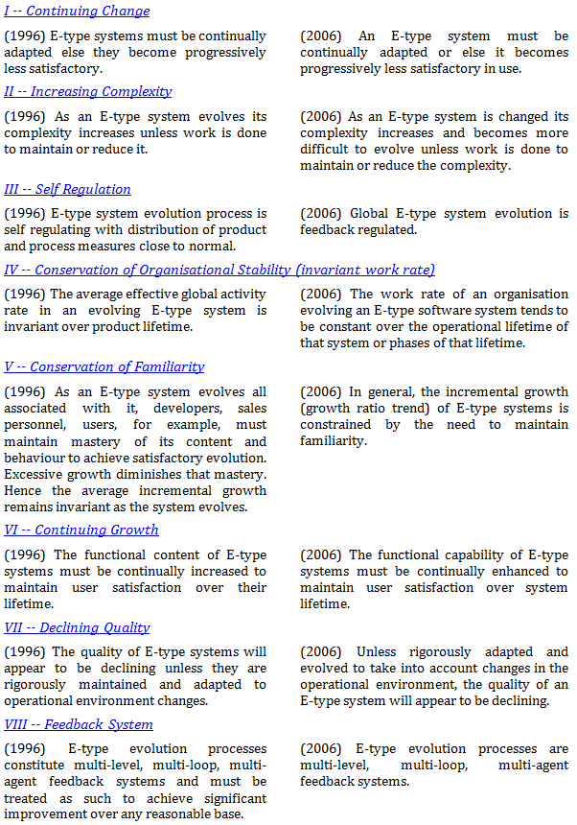
Evolution of the laws:
1996 vs 2006

Slide 53
Experimental setup

Slide 54
Datasets
https://github.com/DAINTINESS-Group/EvolutionDatasets
Content management Systems
  MediaWiki, TYPO3, Coppermine, phpBB, OpenCart
Medical Databases
  Ensemble, BioSQL
Scientific
  ATLAS Trigger

Slide 55
Data sets
Dataset | Versions | Lifetime | Tables Start | Tables End | Attributes Start | Attributes End | Commits per Day | % commits with change | Repository URL
ATLAS Trigger | 84 | 2 Y, 7 M, 2 D | 56 | 73 | 709 | 858 | 0,089 | 82% | http://atdaq-sw.cern.ch/cgi-bin/viewcvs-atlas.cgi/offline/Trigger/TrigConfiguration/TrigDb/share/sql/combined_schema.sql
BioSQL | 46 | 10 Y, 6 M, 19 D | 21 | 28 | 74 | 129 | 0,012 | 63% | https://github.com/biosql/biosql/blob/master/sql/biosqldb-mysql.sql
Coppermine | 117 | 8 Y, 6 M, 2 D | 8 | 22 | 87 | 169 | 0,038 | 50% | http://sourceforge.net/p/coppermine/code/8581/tree/trunk/cpg1.5.x/sql/schema.sql
Ensembl | 528 | 13 Y, 3 M, 15 D | 17 | 75 | 75 | 486 | 0,109 | 60% | http://cvs.sanger.ac.uk/cgi-bin/viewvc.cgi/ensembl/sql/table.sql?root=ensembl&view=log
MediaWiki | 322 | 8 Y, 10 M, 6 D | 17 | 50 | 100 | 318 | 0,100 | 59% | https://svn.wikimedia.org/viewvc/mediawiki/trunk/phase3/maintenance/tables.sql?view=log
OpenCart | 164 | 4 Y, 4 M, 3 D | 46 | 114 | 292 | 731 | 0,104 | 47% | https://github.com/opencart/opencart/blob/master/upload/install/opencart.sql
phpBB | 133 | 6 Y, 7 M, 10 D | 61 | 65 | 611 | 565 | 0,055 | 82% | https://github.com/phpbb/phpbb3/blob/develop/phpBB/install/schemas/mysql_41_schema.sql
TYPO3 | 97 | 8 Y, 11 M, 0 D | 10 | 23 | 122 | 414 | 0,030 | 76% | https://git.typo3.org/Packages/TYPO3.CMS.git/history/TYPO3_6-0:/t3lib/stddb/tables.sql

Slide 56
Hecate: SQL schema diff viewer
Parses DDL files
Creates a model for the parsed SQL elements
Differentiates two version of the same schema
Reports on the diff performed with a variety of metrics
Exports the transitions that occurred in XML format
  https://github.com/DAINTINESS-Group/Hecate

Slide 57
Experimental Setup
For each dataset:
We gathered DDL files from public repos
We collected all commits of the database at the time of the trunk/master branch
We ignored all other branches
We ignored commits of other modules of the project
Focused on MySQL
Notes:
We are interested only on changes of the database part of the projects

Slide 58
Related Work

Slide 59
What is the Status in Literature?
Schema Evolution
  Three main case studies [Sjob93], [PVSV12], [CMDZ13]
Software Evolution
  Laws on Software Evolution [LeRa06]
  Case studies on proprietary software [BeLe76, Lehm96, Leh+97,LeRP98, RaLe00, LeRa01, LeRa06]
  Open Source made things easier [GoTu00], [XiSt05], [WeYL08], [XiCN09]
Notes:
open source - more studies as data are available and can be studied after
kernel, jfreechart, eclipse, (samba, openssh, bind, sendmail, sqlite, vsftpd)

Slide 60
References
[BeLe76] | Laszlo A. Belady, M. M. Lehman. A Model of Large Program Development. IBM Systems Journal 15(3), pp: 225-252, 1976.
[CMDZ13] | Carlo A. Curino, Hyun J. Moon, Alin Deutsch and Carlo Zaniolo. Automating the database schema evolution process. The VLDB Journal - The International Journal on Very Large Data Bases 22, no. 1 (2013): 73-98.
[CMTZ08] | Carlo A. Curino, Hyun J. Moon, Letizia Tanca, Carlo Zaniolo. Schema evolution in Wikipedia: toward a web information system benchmark. In International Conference on Enterprise Information Systems (ICEIS 2008)
[CuMZ08] | Carlo A. Curino, Hyun J. Moon, Carlo Zaniolo. Graceful database schema evolution: the PRISM workbench. Proceedings of the VLDB Endowment 1.1 (2008): p. 761-772.
[FePf96] | Norman E. Fenton, Shari Lawrence Pfleeger: Software metrics - a practical and rigorous approach. International Thomson 1996, ISBN 978-1-85032-275-7.
[GoTu00] | M. W. Godfrey and Q. Tu. Evolution in Open Source Software: A Case Study. In Proceedings of the 16th IEEE International Conference on Software Maintenance (ICSM), pages 131-143, 2000.
[Leh+97] | Meir M. Lehman, Juan F. Ramil, Paul Wernick, Dewayne E. Perry, Wladyslaw M. Turski. Metrics and Laws of Software Evolution - The Nineties View. 4th IEEE International Software Metrics Symposium (METRICS 1997), November 5-7, 1997, Albuquerque, NM, USA, pp: 20.
[Lehm96] | M. M. Lehman. Laws of Software Evolution Revisited. 5th European Workshop on Software Process Technology (EWSPT '96), Nancy, France, October 9-11, 1996, pp: 108-124.

Slide 61
References
[LeRa01] | Meir M. Lehman and J F Ramil. Software Evolution, STRL Annual Distinguished Lecture, De Montfort Univ., Leicester, 20 Dec. 2001. Available at: http://www.eis.mdx.ac.uk/staffpages/mml/feast2/papers.html http://www.eis.mdx.ac.uk/staffpages/mml/feast2/papers/pdf/690c.pdf http://www.eis.mdx.ac.uk/staffpages/mml/feast2/papers/pdf/jfr103c.pdf
[LeRa06] | M.M. Lehman and J. C. Fernandez-Ramil. Software Evolution and Feedback: Theory and Practice, chapter Rules and Tools for Software Evolution Planning and Management. Wiley, 2006.
[LeRP98] | Meir M. Lehman, Juan F. Ramil, Dewayne E. Perry. On Evidence Supporting the FEAST Hypothesis and the Laws of Software Evolution. 5th IEEE International Software Metrics Symposium (METRICS 1998), March 20-21, 1998, Bethesda, Maryland, USA, pp: 84-88.
[Press00] | Roger Pressman. Software Engineering: A Practitioner’s Approach: European Adaption. McGraw-Hill, 5th edition, April 2000
[PVSV12] | George Papastefanatos, Panos Vassiliadis, Alkis Simitsis, and Yannis Vassiliou. "Metrics for the prediction of evolution impact in ETL ecosystems: A case study." Journal on Data Semantics 1, no. 2 (2012): 75-97.
[RaLe00] | Juan F. Ramil, M. M. Lehman. Effort estimation from change records of evolving software (poster). Proceedings of the 22nd International Conference on Software Engineering (ICSE 2000) Limerick Ireland, June 4-11, 2000, pp: 777

Slide 62
References
[Sjøb91] | Dag Sjøberg, The Thesaurus – A Tool for Meta Data Management, Technical Report FIDE/91/6, ESPRIT Basic Research Action, Project Number 3070---FIDE, February 1991.
[Sjøb93] | Dag Sjøberg. "Quantifying schema evolution." Information and Software Technology 35.1 (1993): 35-44.
[Skou10] | Ioannis Skoulis, Hecate: SQL schema diff viewer. Bachelor Thesis, Department of Computer Science, University of Ioannina, 2010
[SEBK] | IEEE. Software Engineering Body of Knowledge. IEEE – 2012 SWEBOK Guide V3 – Alpha Version. Available at http://www.computer.org/portal/web/swebok Retrieved at 13 September 2013.
[XiCN09] | G. Xie, J. Chen, and I. Neamtiu. Towards a better understanding of software evolution: An empirical study on open source software. In 25th IEEE International Conference on Software Maintenance (ICSM 2009), Edmonton, Alberta, Canada, pages 51-60, 2009.
[XiStr05] | Z. Xing and E. Stroulia. Analyzing the evolutionary history of the logical design of object-oriented software. IEEE Trans. Software Eng., 31(10):850-868, 2005.
[WeYL08] | M. Wermelinger, Y. Yu, and A. Lozano. Design Principles in Architectural Evolution: A Case Study. In 24th International Conference on Software Maintenance (ICSM), pages 396-405, 2008.

Slide 63
Several charts
...

Slide 64
Change over time
Notes:
BioSQL (2nd row, last) is an exception to 1st law
Large gaps of stability (inactivity) in all datasets
Apart from phpBB (3rd row, 1st), age results in less activity; density of activity drops

Slide 65
Change over version
Notes:
Apart from phpBB, age results in less activity; density of activity drops

Slide 66
Estimated Size
Notes:
Last 5 last 1
last 10 last 1

Slide 67
Maintenance Rate

Slide 68
Schema Growth
Notes:
No diminishing in values
reduction in density – drops the overall average value

Slide 69
Schema Size (relations)

