Slide 1
CineCubes: Cubes as Movie Stars with Little Effort
Dimitrios Gkesoulis* | Panos Vassiliadis
UTC Creative Lab | Dept. of Computer Science & Engineering,
Ioannina, Hellas | Univ. Ioannina, Hellas
*work conducted while in the Univ. Ioannina
Univ. of Ioannina

Slide 2
Can we answer user queries with more than just a set of records?
We should and can produce query results that are
properly visualized,
enriched with textual comments,
vocally enriched,
… but then, you have a movie

Slide 3
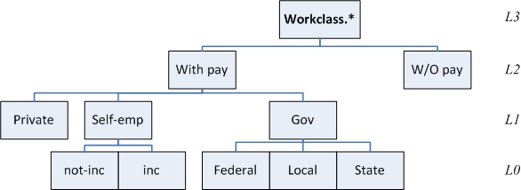
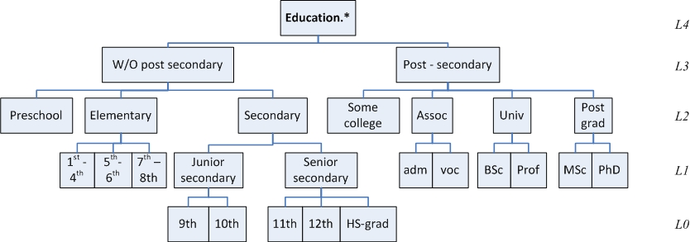
Example
Find the average work hours per week //measure
For persons with //selection conditions
work_class.level2=’With-Pay’ , and
education.level3= ‘Post-Sec’
Grouped per //groupers
work_class.level1
education.level3

Slide 4
Example

Slide 5
Example: Result

Slide 6
Answer to the original question
 | Assoc | Post-grad | Some-college | University
Gov | 40.73 | 43.58 | 38.38 | 42.14
Private | 41.06 | 45.19 | 38.73 | 43.06
Self-emp | 46.68 | 47.24 | 45.70 | 46.61
Here, you can see the answer of the original query. You have specified education to be equal to 'Post-Secondary', and work to be equal to 'With-Pay'. We report on Avg of work hours per week grouped by education at level 2, and work at level 1 . You can observe the results in this table. We highlight the largest values with red and the lowest values with blue color. Column Some-college has 2 of the 3 lowest values. Row Self-emp has 3 of the 3 highest values. Row Gov has 2 of the 3 lowest values.
Notes:
Here, you can see the answer of the original query. You have specified education to be equal to 'Post-Secondary', and work to be equal to 'With-Pay'. We report on Avg of work hours per week grouped by education at level 2, and work at level 1 . You can observe the results in this table. We highlight the largest values with red and the lowest values with blue color. Column Some-college has 2 of the 3 lowest values. Row Self-emp has 3 of the 3 highest values. Row Gov has 2 of the 3 lowest values.

Slide 7
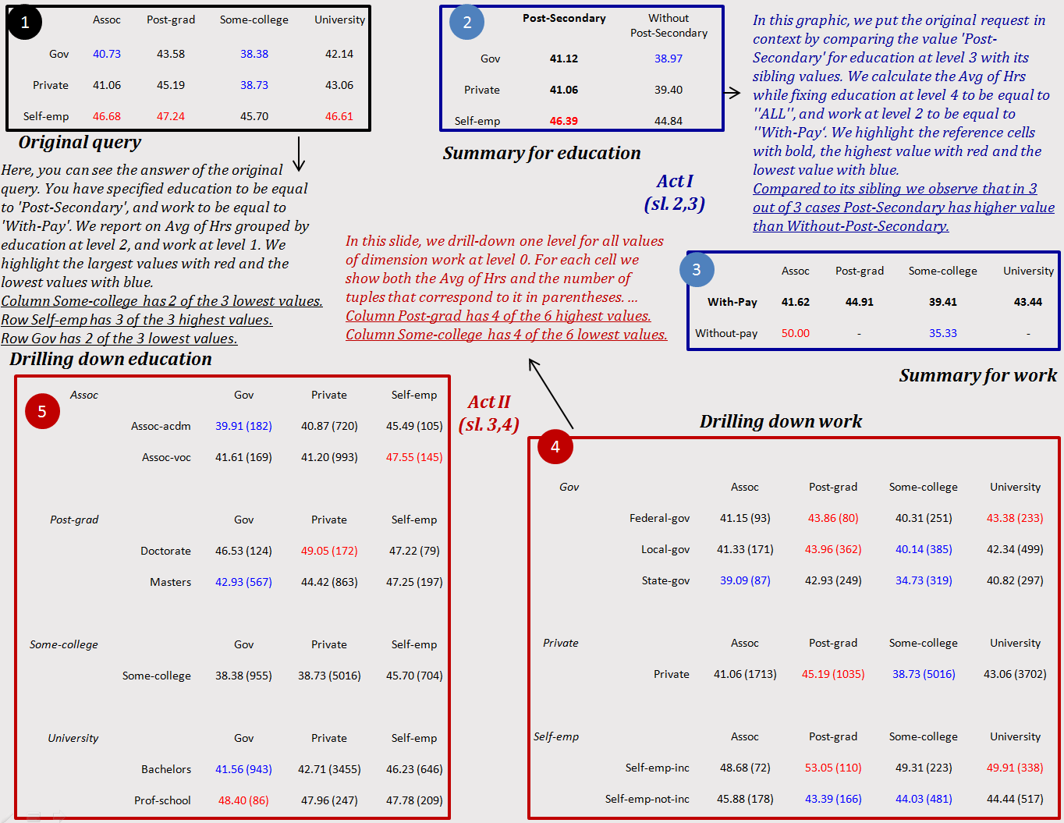

Slide 8
Contributions
We create a small “movie” that answers an OLAP query
We complement each query with auxiliary queries organized in thematically related acts that allow us to assess and explain the results of the original query
We implemented an extensible palette of highlight extraction methods to find interesting patterns in the result of each query
We describe each highlight with text
We use TTS technology to convert text to audio

Slide 9
Contributions
Equally importantly:
An extensible software where algorithms for query generation and highlight extraction can be plagued in
The demonstration of low technical barrier to produce CineCube reports

Slide 10
Method Overview
Software Issues
Discussion
Method Overview

Slide 11
Our Approach
A first assessment of the current state of affairs
Practically, this requirement refers to the execution of the original query.
Put the state in Context
Analysis of why things are this way.

Slide 12
Structure of the CineCube Movie
A typical movie story is structured in acts.
Each Act is composed of sequences of scenes
That’s why we organize the CineCube Movie in five Acts:
Intro Act
Original Act
Act I
Act II
Summary Act

Slide 13
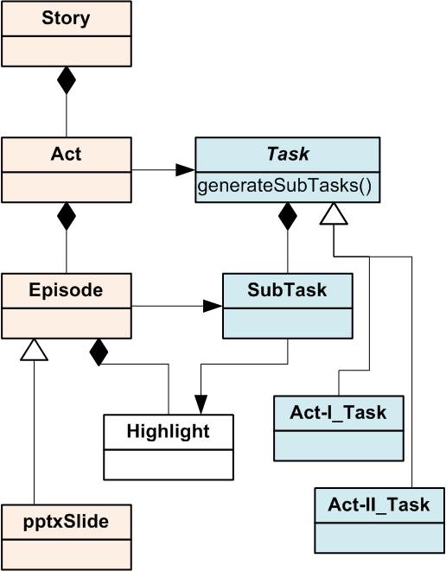
The movie’s parts
Much like movies, we organize our stories in acts
Each act including several episodes all serving the same purpose

Slide 14
CineCube Movie – Intro Act
Intro Act has an episode that introduce the story to user
Notes:
This is a report on the Avg of work hours per week when education is fixed to 'Post-Secondary' and work is fixed to 'With-Pay'. We will start by answering the original query and we complement the result with contextualization and detailed analyses.

Slide 15
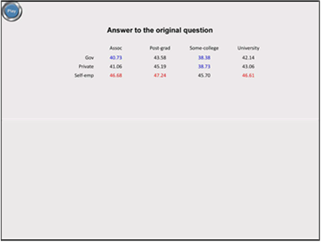
CineCube Movie – Original Act
Original Act has an episode which is the answer of query that submitted by user

Slide 16
CineCube Movie – Act I
In this Act we try to answer the following question:
How good is the original query compared to its siblings?
We compare the marginal aggregate results of the original query to the results of “sibling” queries that use “similar” values in their selection conditions

Slide 17
Act I – Example
Result of Original Query
 | Assoc | Post-grad | Some-college | University
Gov | 40.73 | 43.58 | 38.38 | 42.14
Private | 41.06 | 45.19 | 38.73 | 43.06
Self-emp | 46.68 | 47.24 | 45.70 | 46.61
q=(${DS}^{0}$,
W.$L_{2}$=’With-Pay’ ∧ E.$L_{3}$=’Post-Sec’,
[W.$L_{1}$, E.$L_{2}$],
avg(Hrs))
Assessing the behavior of education
Summary for education | Post-Secondary | Without-Post-Secondary
Gov | 41.12 | 38.97
Private | 41.06 | 39.40
Self-emp | 46.39 | 44.84
q=(${DS}^{0}$,
W.$L_{2}$=’With-Pay’ ∧ E.$L_{4}$=’All’,
[W.$L_{1}$, E.$L_{3}$],
avg(Hrs))

Slide 18
Act I – Example
Result of Original Query
 | Assoc | Post-grad | Some-college | University
Gov | 40.73 | 43.58 | 38.38 | 42.14
Private | 41.06 | 45.19 | 38.73 | 43.06
Self-emp | 46.68 | 47.24 | 45.70 | 46.61
q=(${DS}^{0}$,
W.$L_{2}$=’With-Pay’ ∧ E.$L_{3}$=’Post-Sec’,
[W.$L_{1}$, E.$L_{2}$],
avg(Hrs))
Assessing the behavior of work
Summary for work | Assoc | Post-grad | Some-college | University
With-Pay | 41.62 | 44.91 | 39.41 | 43.44
Without-pay | 50.00 | - | 35.33 | -
q=(${DS}^{0}$,
W.$L_{3}$=’All’ ∧ E.$L_{3}$=’Post-Sec’,
[W.$L_{2}$, E.$L_{2}$],
avg(Hrs))

Slide 19
CineCube Movie – Act II
In this Act we try to explaining to user why the result of original query is what it is.
“Drilling into the breakdown of the original result”
We drill in the details of the cells of the original result in order to inspect the internals of the aggregated measures of the original query.

Slide 20
Act II – Example
Result of Original Query
 | Assoc | Post-grad | Some-college | University
Gov | 40.73 | 43.58 | 38.38 | 42.14
Private | 41.06 | 45.19 | 38.73 | 43.06
Self-emp | 46.68 | 47.24 | 45.70 | 46.61
q=(${DS}^{0}$,
W.$L_{2}$=’With-Pay’ ∧ E.$L_{3}$=’Post-Sec’,
[W.$L_{1}$, E.$L_{2}$],
avg(Hrs))
Drilling down the Rows of the Original Result
Gov |  | Assoc | Post-grad | Some-college | University
 | Federal-gov | 41.15 (93) | 43.86 (80) | 40.31 (251) | 43.38 (233)
 | Local-gov | 41.33 (171) | 43.96 (362) | 40.14 (385) | 42.34 (499)
 | State-gov | 39.09 (87) | 42.93 (249) | 34.73 (319) | 40.82 (297)
Private
 | Private | 41.06 (1713) | 45.19 (1035) | 38.73 (5016) | 43.06 (3702)
Self-emp
 | Self-emp-inc | 48.68 (72) | 53.05 (110) | 49.31 (223) | 49.91 (338)
 | Self-emp-not-inc | 45.88 (178) | 43.39 (166) | 44.03 (481) | 44.44 (517)

Slide 21
Act II – Example
Result of Original Query
 | Assoc | Post-grad | Some-college | University
Gov | 40.73 | 43.58 | 38.38 | 42.14
Private | 41.06 | 45.19 | 38.73 | 43.06
Self-emp | 46.68 | 47.24 | 45.70 | 46.61
q=(${DS}^{0}$,
W.$L_{2}$=’With-Pay’ ∧ E.$L_{3}$=’Post-Sec’,
[W.$L_{1}$, E.$L_{2}$],
avg(Hrs))
Drilling down the Columns of the Original Result
Assoc |  | Gov | Private | Self-emp
 | Assoc-acdm | 39.91 (182) | 40.87 (720) | 45.49 (105)
 | Assoc-voc | 41.61 (169) | 41.20 (993) | 47.55 (145)
Post-grad
 | Doctorate | 46.53 (124) | 49.05 (172) | 47.22 (79)
 | Masters | 42.93 (567) | 44.42 (863) | 47.25 (197)
Some-college
 | Some-college | 38.38 (955) | 38.73 (5016) | 45.70 (704)
University
 | Bachelors | 41.56 (943) | 42.71 (3455) | 46.23 (646)
 | Prof-school | 48.40 (86) | 47.96 (247) | 47.78 (209)

Slide 22
CineCube Movie – Summary Act
Summary Act represented from one episode.
This episode has all the highlights of our story.

Slide 23
Highlight Extraction
We utilize a palette of highlight extraction methods that take a 2D matrix as input and produce important findings as output.
Such as:
The top and bottom quartile of values in a matrix
The absence of values from a row or column
The domination of a quartile by a row or a column
The identification of min and max values

Slide 24
Text Extraction
Text is constructed by a Text Manager that customizes the text per Act
Example:
In this slide, we drill-down one level for all values of dimension <dim> at level <l>. For each cell we show both the <agg> of <measure> and the number of tuples that correspond to it.

Slide 25
Experimental Results

Slide 26
Method Overview
Software Issues
Discussion
Software Issues

Slide 27
Low technical barrier
Our tool is extensible
We can add new tasks to generate complementary queries easily
We can add new highlight algorithms to produce highlights easily
Supportive technologies are surprisingly easier to use
Apache POI for pptx generation
TTS for text to speech conversion

Slide 28
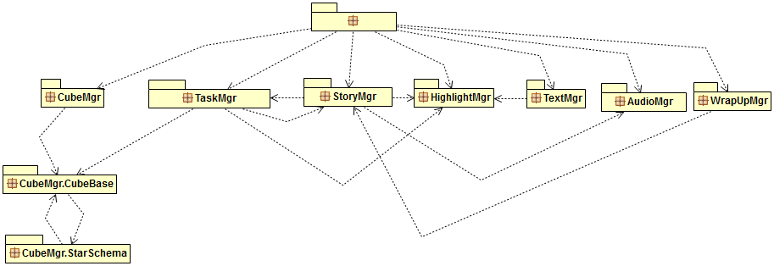
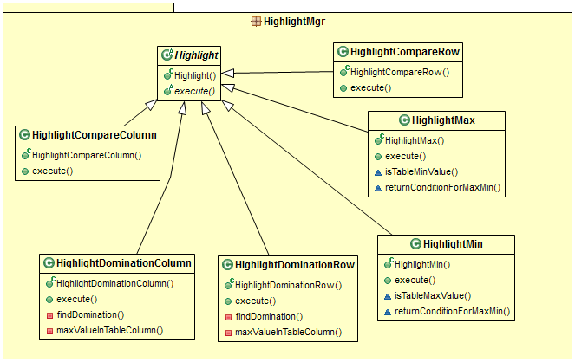

Slide 29
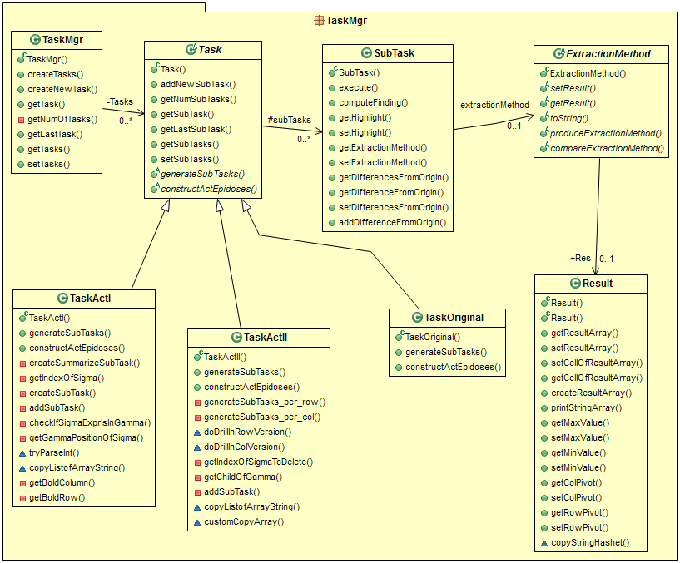

Slide 30
Apache POI for pptx
A Java API that provides several libraries for Microsoft Word, PowerPoint and Excel (since 2001).
XSLF is the Java implementation of the PowerPoint 2007 OOXML (.pptx) file format.
XMLSlideShow ss = new XMLSlideShow();
XSLFSlideMaster sm = ss.getSlideMasters()[0];
XSLFSlide sl= ss.createSlide (sm.getLayout(SlideLayout.TITLE_AND_CONTENT));
XSLFTable t = sl.createTable();
t.addRow().addCell().setText(“added a cell”);
Notes:
It helps to manipulating file formats based upon the Office Open XML standards (OOXML) and Microsoft's OLE 2 Compound Document format (OLE2).
XSLF –XML Slide Layout Format

Slide 31
PPTX Folder Structure

Slide 32
MaryTTS for Text-to-Speech Synthesis
MaryInterface m = new LocalMaryInterface();
m.setVoice(“cmu-slt-hsmm”);
AudioInputStream audio = m.generateAudio("Hello”);
AudioSystem.write(audio, audioFileFormat.Type.WAVE,
new File(“myWav.wav”));
Notes:
FreeTTS
Espeak
Microsoft API
…..
cmu-slt-hsmm US female Voice
http://mary.dfki.de:59125/

Slide 33
Method Overview
Software Issues
Discussion
Discussion

Slide 34
Open issues
Show text
More than 2D arrays
Be compendious; if not,
at least be concise!
Visualize
Structure more like a movie
More highlights
Multi-query
Back stage
Look like a movie
Info content
Speed-up voice gen.
More acts (more queries)
Crowd wisdom
Cloud/parallel
CC
now
Chase after interestingness
Star schema
Assumptions
Interaction
2D results (2 groupers)
Single measure
Equality selections
How to allow interaction with the user?
Personalization

Slide 35
Thank you!
Any questions?
More information
http://www.cs.uoi.gr/~pvassil/projects/cinecubes/
Demo
http://snf-56304.vm.okeanos.grnet.gr/
Code
https://github.com/DAINTINESS-Group/CinecubesPublic.git

Slide 36
Auxiliary slides

Slide 37
Related Work

Slide 38
Related Work
Query Recommendations
Database-related efforts
OLAP-related methods
Advanced OLAP operators
Text synthesis from query results

Slide 39
Query Recommendations
A. Giacometti, P. Marcel, E. Negre, A. Soulet, 2011. Query Recommendations for OLAP Discovery-Driven Analysis. IJDWM 7,2 (2011), 1-25 DOI= http://dx.doi.org/10.4018/jdwm.2011040101
C. S. Jensen, T. B. Pedersen, C. Thomsen, 2010. Multidimensional Databases and Data Warehousing. Synthesis Lectures on Data Management, Morgan & Claypool Publishers
A. Maniatis, P. Vassiliadis, S. Skiadopoulos, Y. Vassiliou, G. Mavrogonatos, I. Michalarias, 2005. A presentation model and non-traditional visualization for OLAP. IJDWM, 1,1 (2005), 1-36. DOI= http://dx.doi.org/10.4018/jdwm.2005010101
P. Marcel, E. Negre, 2011. A survey of query recommendation techniques for data warehouse exploration. EDA (Clermont-Ferrand, France, 2011), pp. 119-134

Slide 40
Database-related efforts
K. Stefanidis, M. Drosou, E. Pitoura, 2009. "You May Also Like" Results in Relational Databases. PersDB (Lyon, France, 2009).
G. Chatzopoulou, M. Eirinaki, S. Koshy, S. Mittal, N. Polyzotis, J. Varman, 2011. The QueRIE system for Personalized Query Recommendations. IEEE Data Eng. Bull. 34,2 (2011), pp. 55-60

Slide 41
OLAP-related methods
V. Cariou, J. Cubillé, C. Derquenne, S. Goutier, F.Guisnel, H. Klajnmic, 2008. Built-In Indicators to Discover Interesting Drill Paths in a Cube. DaWaK (Turin, Italy, 2008), pp. 33-44, DOI=http://dx.doi.org/10.1007/978-3-540-85836-2_4
A. Giacometti, P. Marcel, E. Negre, A. Soulet, 2011. Query Recommendations for OLAP Discovery-Driven Analysis. IJDWM 7,2 (2011), 1-25 DOI= http://dx.doi.org/10.4018/jdwm.2011040101

Slide 42
Advanced OLAP operators
Sunita Sarawagi: User-Adaptive Exploration of Multidimensional Data. VLDB 2000:307-316
S. Sarawagi, 1999. Explaining Differences in Multidimensional Aggregates. VLDB (Edinburgh, Scotland, 1999), pp. 42-53
G. Sathe, S. Sarawagi, 2001. Intelligent Rollups in Multidimensional OLAP Data. VLDB (Roma, Italy 2001), pp.531-540

Slide 43
Text synthesis from query results
A. Simitsis, G. Koutrika, Y. Alexandrakis, Y.E. Ioannidis, 2008. Synthesizing structured text from logical database subsets. EDBT (Nantes, France, 2008) pp. 428-439, DOI=http://doi.acm.org/10.1145/ 1353343.1353396

Slide 44
Formalities

Slide 45
OLAP Model
We base our approach on an OLAP model that involves
Dimensions, defined as lattices of dimension levels
Ancestor functions, (in the form of ${anc}_{L_{1}}^{L_{2}}$) mapping values between related levels of a dimension
Detailed data sets, practically modeling fact tables at the lowest granule of information
Cubes, defined as aggregations over detailed data sets
Notes:
Dimensions have hierachies and hierachies have levels
We use a star schema

Slide 46
What is Cube?
A primary Cube C is described as
C=(${DS}^{0}$,φ,[$L_{1},…,L_{n},M_{1}, …,M_{m}$],[${agg}_{1}\left(M_{1}^{0}\right), …,$ ${agg}_{1}\left(M_{m}^{0}\right)$])
${DS}^{0}$ is a detailed dataset over the schema
Φ is a detailed selection condition
Φ analyzed as $φ_{1}∧…∧φ_{k}$
$φ_{i }{ is D}_{i}.L_{j}={value}_{i}$
$L_{1},…,L_{n}$ are levels such that $L_{i}{≺L}_{i+1}$, 1≤i≤n.
$M_{1}, …,M_{m}$ are measures
${agg}_{i }∈\left\{max,min,sum,count,average\right\}$, 1≤i≤m
Notes:
Dimensions have hierachies and hierachies have levels
We use a star schema

Slide 47
Cube Query
A cube query Q can be considered as
Q=(${DS}^{0}$,Σ,Γ,γ(M))
where:
Σ is a conjunction of dimensional restrictions of the form
Γ is a set of grouper dimensional level
γ(M) is an aggregate function applied to the measure of the cube

Slide 48
Cube Query
In our approach we assume that the user submit cube queries which denote as:
q=(${DS}^{0}$, $φ_{1}∧…∧φ_{k}$,[$L_{α}$, $L_{β}$], agg(M))
Example:
q=(A,W.$L_{2}$=’With-Pay’ ∧ E.$L_{3}$=’Post-Sec’, [W.$L_{1}$, E.$L_{2}$], avg(Hrs))

Slide 49
Cube Query to SQL Query
In general case :
SELECT $L_{1},…,L_{n}$,${agg}_{1}\left(M_{1}^{0}\right), …,$ ${agg}_{1}\left(M_{1}^{0}\right)$])
FROM ${DS}^{0}$ INNER JOIN $D_{1},…$INNER JOIN $D_{n}$
WHERE φ
GROUP BY $L_{1},…,L_{n}$
Example for our case:
SELECT$\text{W}\text{.}L_{1}\text{, }\text{E}\text{.}L_{2}$,$AVG\left(Hrs\right)$
FROM A
INNER JOIN W ON A.W=W.$L_{0}$
INNER JOIN E ON A.E=E.$L_{0}$
WHERE W.$L_{2}$=’With-Pay’ AND E.$L_{3}$=’Post-Sec’
GROUP BY$\text{W}\text{.}L_{1}\text{, }\text{E}\text{.}L_{2}$

Slide 50
Method Internals

Slide 51
Act I – Problem
The average user need to compare on the same screen and visually inspect differences
But as the number of selection conditions increase so the number of siblings increases.
It can be too hard to be able to visually compare the results
Notes:
To compare the result of original query to the ones of its sibling on one screen becomes too hard to exploit as k increases
One would need to lay out all the k sibling queries on the same screen and visually inspect their differences
The increasing number of siblings are problem

Slide 52
Act I – Our Definition
We introduce two marginal sibling queries, one for each aggregator.
Formally, given an original query:
q=(${DS}^{0}$, $φ_{1}∧…∧φ_{k}$,[$L_{α}$, $L_{β}$], agg(M))
Its two marginal sibling queries are:
$q^{s}$=(${DS}^{0}$, $φ_{1}∧…φ_{χ}^{∗}∧…∧φ_{k}$,[$L_{α}$, $L_{χ}$], agg(M))
$q^{s}$=(${DS}^{0}$, $φ_{1}∧…φ_{χ}^{∗}∧…∧φ_{k}$,[$L_{χ}$, $L_{β}$], agg(M))
$φ_{χ}^{∗}:L_{x+1}={anc}_{L_{x}}^{L_{x+1}}(v)$
Notes:
To compare the result of original query to the ones of its sibling on one screen becomes too hard to exploit as k increases
One would need to lay out all the k sibling queries on the same screen and visually inspect their differences

Slide 53
Act I – Query Example
Original Query
q=(${DS}^{0}$,W.$L_{2}$=’With-Pay’ ∧ E.$L_{3}$=’Post-Sec’, [W.$L_{1}$, E.$L_{2}$], avg(Hrs))
Sibling Queries:
q=(${DS}^{0}$,W.$L_{2}$=’With-Pay’ ∧ E.$L_{4}$=’All’, [W.$L_{1}$, E.$L_{3}$], avg(Hrs))
q=(${DS}^{0}$,W.$L_{3}$=’All’ ∧ E.$L_{3}$=’Post-Sec’, [W.$L_{2}$, E.$L_{2}$], avg(Hrs))

Slide 54
Act I – How produce it?
We define a sibling query as a query with a single difference to the original:
Instead of an atomic selection formula $L_{i}$=$v_{i}$, the sibling query contains a formula of the form $L_{i}$∈childen(parent($v_{i}$)).
Formally, given an original query
q=(${DS}^{0}$, $φ_{1}∧…∧φ_{k}$,[$L_{α}$, $L_{β}$], agg(M))
A new query $q^{s}$ is a sibling query if is of the form
$q^{s}$=(${DS}^{0}$, $φ_{1}∧…φ_{χ}^{∗}∧…∧φ_{k}$,[$L_{α}$, $L_{β}$], agg(M))
$φ_{χ}^{∗}:L_{x+1}={anc}_{L_{x}}^{L_{x+1}}(v)$
Notes:
Naturally, if q originally has k atomic selections, it also has k sibling queries.
The average user need to compare on the same screen and visually inspect differences
But as the number of selection conditions increase so the number of siblings increases.
It can be too hard to be able to visually compare the results

Slide 55
Act II – Query Example
Original Query
q=(${DS}^{0}$,W.$L_{2}$=’With-Pay’ ∧ E.$L_{3}$=’Post-Sec’, [W.$L_{1}$, E.$L_{2}$], avg(Hrs))
Drill in Queries for work dimension:
q=(${DS}^{0}$,W.$L_{1}$=’Gov’ ∧ E.$L_{3}$=’Post-Sec’, [W.$L_{0}$, E.$L_{2}$], avg(Hrs))
q=(${DS}^{0}$,W.$L_{1}$=’Private’ ∧ E.$L_{3}$=’Post-Sec’, [W.$L_{0}$, E.$L_{2}$], avg(Hrs))
q=(${DS}^{0}$,W.$L_{1}$=’Self-emp’ ∧ E.$L_{3}$=’Post-Sec’, [W.$L_{0}$, E.$L_{2}$], avg(Hrs))
For Education dimension: similarly

Slide 56
Act II- How produce it?
Assume a cube query and its result, visualized as a 2D matrix.
For each cell c of this result is characterized by the following cube query:
q^{c} = (DS⁰,φ₁ ∧ … ∧ φ_{k} ∧ φ_{c},[L_{α},L_{β}],agg(M))
$φ_{c}$ : $L_{α}$=$v_{a}^{c}∧L_{β}\text{=}v_{β}^{c}$
Notes:
The purpose of Act II is to help the user understand why the situation is as observed in the original query
Ηe have changed the definition of Act 2
We find a bug to previous definition

Slide 57
Act II- How produce it?
For each of the aggregator dimensions, we can generate a set of explanatory drill in queries, one per value in the original result:
$q_{a}^{s}$=(DS⁰, φ₁ ∧ … ∧ φ_{k} ∧ φ,[L_{α-1},L_{β}],agg(M)),
$q_{β}^{s}$=(${DS}^{0}$, $φ_{1}∧…∧φ_{k}∧φ_{c}^{}$,[$L_{α},L_{β−1}$], agg(M))
$φ_{c}$ : $L_{α}$=$v_{a}^{c}∧L_{β}\text{=}v_{β}^{c}$
Notes:
In each of these slides we have one query for each of the values that appear in the original result for this dimension.
Then, for each of the two grouper dimensions we create a slide.

Slide 58
Our Algorithm
Algorithm Construct Operational Act Input: the original query over the appropriate database Output: a set of an act’s episodes fully computed Create the necessary objects (act, episodes, tasks, subtasks) appropriately linked to each other Construct the necessary queries for all the subtasks of the Act, execute them, and organize the result as a set of aggregated cells (each including its coordinates, its measure and the number of its generating detailed tuples) For each episode Calculate the visual presentation of cells Calculate the cells’ highlights Produce the text based on the highlights Produce the audio based on the text

Slide 59
Experiments and Results

Slide 60
Experimental setup
Adult dataset referring to data from 1994 USA census
Has 7 dimension Age, Native Country, Education, Occupation, Marital status, Work class, and Race.
One Measure : work hours per week
Machine Setup :
Running Windows 7
Intel Core Duo CPU at 2.50GHz,
3GB main memory.

Slide 61
Experiments
Time breakdown(msec) for the method’s parts
 | # atomic selections in WHERE clause
 | 2 (10 sl.) | 3 (12 sl.) | 4 (14 sl.) | 5 (16 sl.)
Result Generation | 1169,00 | 881,40 | 2263,91 | 1963,68
Highlight Extraction & Visualization | 4,41 | 3,60 | 3,67 | 3,74
Text Creation | 1,32 | 1,42 | 1,80 | 2,35
Audio Creation | 71463,21 | 104634,27 | 145004.20 | 169208.59
Put in PPTX | 378.24 | 285.89 | 452.74 | 460.55

Slide 62
Experiments

Slide 63
Experiments
Time breakdown(msec) per Act
 | # atomic selections in WHERE clause
 | 2 (10 sl.) | 3 (12 sl.) | 4 (14 sl.) | 5 (16 sl.)
Intro Act | 3746.99 | 4240.22 | 4919.71 | 5572.97
Original Act | 7955.17 | 8425.59 | 9234.47 | 9577.76
Act I | 21160.78 | 42562.10 | 70653.22 | 90359.89
Act II | 21250.44 | 22419.34 | 22819.94 | 22738.88
Summary Act | 18393.10 | 27806.35 | 39456.52 | 42750.78

