Slide 1
Programming for OO systems (esp., with Java)
Ανάπτυξη Λογισμικού (Software Development)
www.cs.uoi.gr/~pvassil/courses/sw_dev/
MYY301/ΠΛΥ 308
Σημειώσεις ΠΒ στο βιβλίο “Effective Java” 3rd Ed., by Joshua Bloch
https://github.com/jbloch/effective-java-3e-source-code

Slide 2
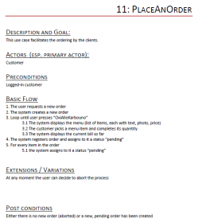
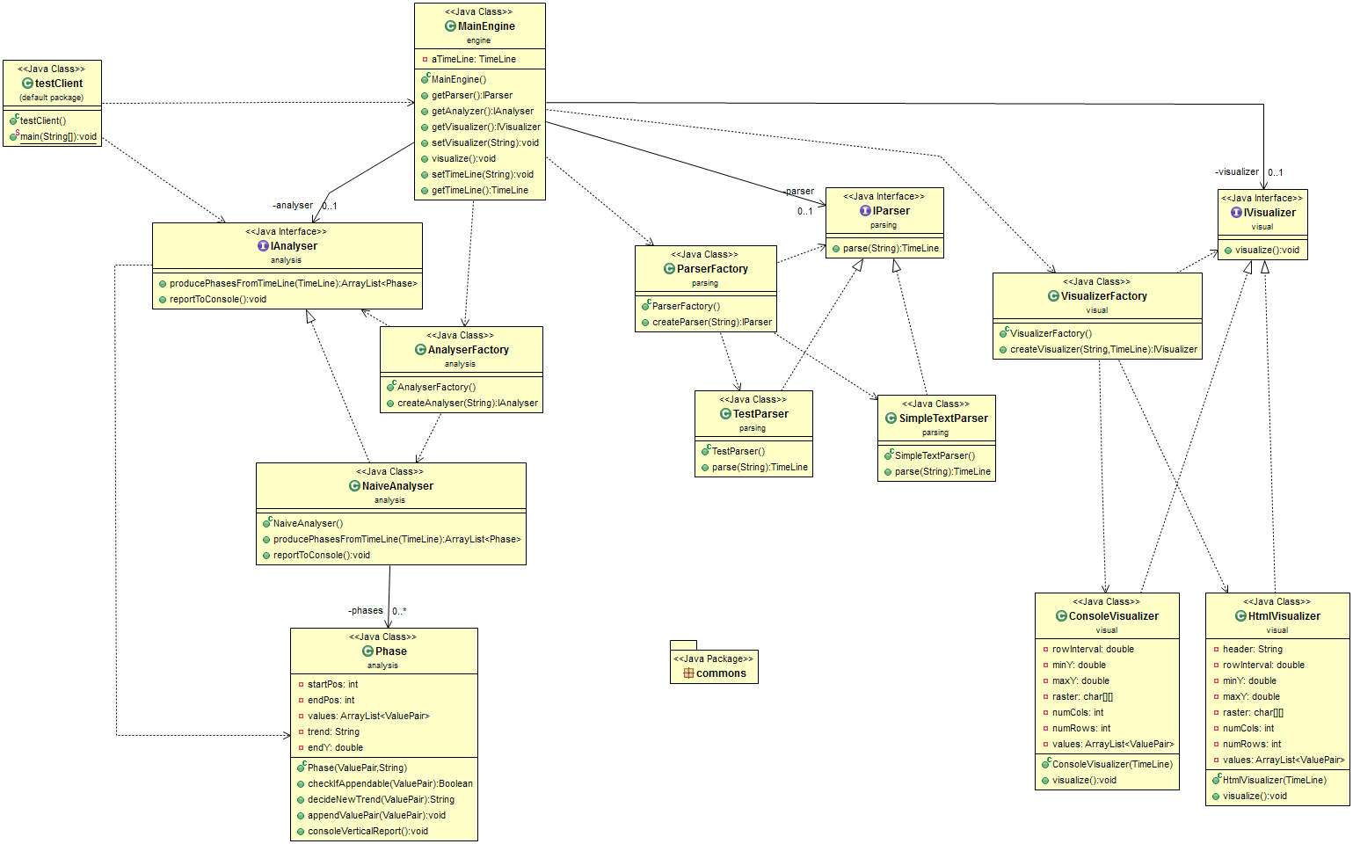

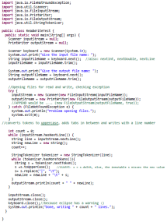
Real world problem
Requirements Engineering
Design
Requirements Specification
Maintenance
Design Specification
Testing
Implementation
Working code with quality assurances
Working
code

Slide 3
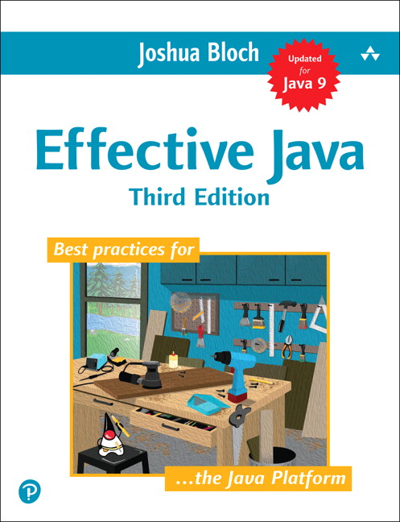
Πηγή
Εδώ παρέχω μερικές σκέψεις / σημειώσεις στο βιβλίο του Joshua Bloch, Effective Java (3rd ed., 2018)…
… που θεωρείται ένα από τα πιο σημαντικά βιβλία για τον ορθό προγραμματισμό της γλώσσας Java
Το Effective Java ΔΕΝ είναι textbook για να μάθει κανείς Java. Δεν είναι καν textbook για τη φιλοσοφία του αντικειμενοστρεφούς προγραμματισμού.
Ωστόσο, παρέχει συμβουλές για τεχνικά προβλήματα προγραμματισμού σε Java που δεν έχουν εύκολες απαντήσεις, για developers που ήδη κατέχουν τα βασικά.
Θα επισημάνω μόνο επιλεγμένα στοιχεία του βιβλίου, και όχι με τη σειρά που παρουσιάζονται στο βιβλίο
Το pdf του effective java 3rd edition δεν είναι διαθέσιμο δωρεάν στο διαδίκτυο, αλλά θα συζητήσουμε παραδείγματα στις διαλέξεις

Slide 4
Κεντρικές ιδέες
Ό,τι επιτρέπεται από τον compiler, δε σημαίνει ότι είναι και απαραίτητα σωστό!
Είναι σημαντικό να ξέρουμε αν, πού, και πώς πρέπει να χρησιμοποιήσουμε κάθε στοιχείο οποιασδήποτε γλώσσας!
Επίσης, είναι σημαντικό να μπαίνουμε «στη φιλοσοφία» κάθε οικογένειας γλωσσών προγραμματισμού!

Slide 5
Κεφάλαιο 9: Γενικός προγραμματισμός

Slide 6
Java code conventions (#68)
Construct | Form. Syntax | Essence | Example
package | lowercase | ουσιαστικό που αφορά στα περιεχόμενα του πακέτου | mainengine, dataload
Class | CamelCase | Ουσιαστικό που περιγράφει τι αναπαριστά η κλάση στον πραγματικό κόσμο, ή τι ρόλο έχει στον κώδικα | MainEngine, DataLoader
Interface | CamelCase | Επίθετο (συχνά) ή ουσιαστικό που εξηγεί τι ρόλο μπορεί να φέρει εις πέρας όποια κλάση υλοποιεί το interface (frequently starts with an I ) | IReporter, ISortedList
method | mixedCase | ρήμα (ενεργητικό) που περιγράφει τι κάνει η μέθοδος. Σύνταξη: ρήμαΠεριγραφήΑντικειμένου ΔΕΝ ΒΑΡΙΟΜΑΣΤΕ ΝΑ ΤΟ ΔΩΣΟΥΜΕ ΣΩΣΤΑ! | getMonetarySum(), produceTotalEuroAmount()
variable | mixedCase | ουσιαστικό που περιγράφει επαρκώς το ρόλο του πεδίου στην κλάση Κατ’ αντιστοιχία με τις μεθόδους! | receivedPackages, euroAmountSpent
CONSTANT | UPPERCASE | σαν variable, αλλά για να διακρίνεται ότι είναι σταθερά, όλα κεφαλαία. Συχνά ξεκινά και με _. Το μόνο construct where _ is allowed | _TOTAL_NUM_OWNERS

Slide 7
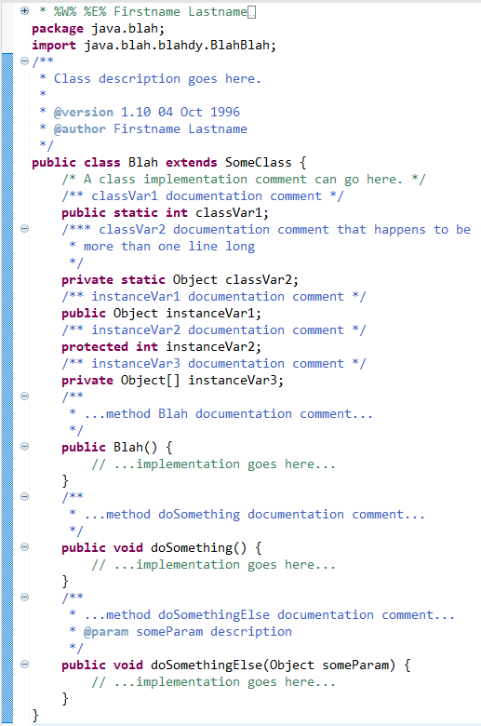
(#68) Element order inside a java file
package xxx.xxx
import java.xxx ;
import external.stuff.xxx;
import from.this.prj.xxx;
/** class comments */
<visibility> class <ClassName>{
{public; ;protected;private} static <type><classVrbl>;
{public; ;protected; private} <type><instanceVrbl>;
<visibility>constructor(){ …}
<visibility>constructor(…params…){…}
{public/ /protected/private} doSth(…){…}
  /* No particular order for methods:
  “methods should be grouped by functionality rather than by scope or accessibility. … The goal is to make reading and understanding the code easier.” */
}//end class
Package-private has no modifier; denoted via an empty space here
https://www.oracle.com/technetwork/java/codeconventions-150003.pdf

Slide 8
Know thy libraries (#59)
Millions of “users” of standard libraries guarantee a much more debugged, safe, robust code than your own
Do not re-invent the wheel; we stand on the shoulders of giants, not their foot toes!
For Java, essential libraries:
  java.lang <-- Types/excep./errors
  java.io <-- Files
  java.util <-- Collections
  java.util.stream
  java.util.concurrent
PV: repeatedly found very useful
  java.nio.file
  Apache commons
Revisit with each new release (ωραία θα ήταν)!!!
Όχι, δεν τα ξέρω όλα αυτά. Θα έπρεπε όμως!

Slide 9
Minimize the scope of local variables (#57)
Declare a local variable where it is first used!
… almost always initialize it!
  Keep methods short & focused: minimizes the #vrbl’s needed
  Postpone declaration until you know the initial value
  Special case: prefer for to while loops: easier to declare a variable inside the for loop (both (i) traditional for-loops and (ii) collection-related
  for (Element e: collection){ …use e …}
  Exception: variables to be used inside try/catch blocks

Slide 10
For-each is better than for (#58)
BOTH for collections AND arrays: Use
  for (Element e : elements) {
  ... // Do something with e …
  }
.. instead of (the visual clutter of)..
  for (Iterator<Element> i = c.iterator(); i.hasNext(); ) {
  Element e = i.next(); … // Do something with e …
  } or
  for (int i = 0; i < a.length; i++) {
  … // Do something with a[i] …
  }
Why? Because it allows the essential part of working with collections of similar items to be bluntly obvious to the reader:
  Iterate through the collection, by visiting one-item-at-a-time;
  Work with this single item you visit each time;
And yes, arrays are yet-another case of collection-of-similar-items
If time: make a lengthier discussion
&& also cover exceptions

Slide 11
Data types: summary
If time: make a lengthier discussion
for #61, #62
(#61) Prefer primitive types to boxed primitives (e.g., use int rather than Integer), wherever possible
(#60) For monetary types, use int, long (18 decimal digits) or BigDecimal (albeit not primitive && slower) rather than float and double (both known with problems of precision)!
(#62) Strings should NOT take the place of other data types/enum’s/composite objects!
  Το βλέπω και το ξαναβλέπω όλη την ώρα: φτιάξτε domain classes/enumerations/… όπως πρέπει, αντί να δηλώνετε/επιστρέφετε ένα string για να ξεμπερδεύουμε! Αμάν…
(#63) Contrary to what the 2018 book says, it is now perfectly OK to use String s = “’; s += “Extra stuff appended”;

Slide 12
Prefer Interfaces to Classes (#64)
(#64) If it is possible to refer to an object via an interface, use the interface (which is a contract) to declare the object, rather than the concrete class
Instead of (the concrete class)
    LinkedHashSet<Son> sonSet = new LinkedHashSet<>();
…use (the interface)
    set<Son> sonSet = new LinkedHashSet<>();
Ideally (granted, this is not always possible):
  <Interface> vrbl = new <ConcreteClass>();
Why? Because it guarantees public methods && it is absolutely feasible to switch to another implementation if needed
  PV: which is the basic maintenance strategy for evolving maintaining our code too!!

Slide 13
Chapter 4: classes & interfaces

Slide 14
(#25) Every file has a single top-level class
…and maybe some nested auxiliary classes too
Always put top-level classes in a file that has exactly their name (e.g., class Person in file Person.java)
The reasons are mainly, but not solely, due to the need that multiple persons cooperate in a team of developers under the principle of single location of the code, providing:
  Understandability of the code by everyone
  Easy location of code-of-interest by anyone, when in need, … and…
  Avoidance of multiple definitions of the same construct, by different persons in different locations

Slide 15
Encapsulation is paramount (#15, #16)
All that you make publicly available will be (ab)used by clients you do not control =>
Access to classes, methods and attributes should be given as sparingly as possible!
  If the visibility of a class can be made package-private, make it so!
  All attributes should be private; if possible, final too. This includes composite attributes too: e.g., all arrays should be private!
  Simple FINAL_STATIC_CONSTANTS can be public; but not if they are collections (as they point to mutable objects).
  All methods not publicly needed: private (in extremis: protected) or package-private for too cohesive packages

Slide 16
Why attribute encapsulation?
Why all this fuss (and resulting language verbosity) with making fields private and accessing them via public methods?
There is also the notion of “consenting adults”: we (are supposed to) know what we are doing with the classes that we use…

Slide 17
Why attribute encapsulation?
Typically, you prefer objects to be immutable! You do not want your clients to alter the state of your objects (not only in multithreaded environments, but overall).
[GOOD PRACTICE] The gurus will tell you that typically, the only change in the state of an object should be done via a parameterized constructor.
Later, if you want to change it, you want to consider the possibility of creating a new version.
This means: NO SETTERS ALLOWED!

Slide 18
Why on earth no public attributes and no setter methods?
Multiple composite objects can point to the same object: a change in the state of the object is not necessarily to be propagated to all of them (maybe some need a newer version, maybe some need the old one).

Slide 19
Ok, so we make the attribute private and we disallow setters. What about getters?
Again: you make a class available, but you do not control who is gonna use it!
The only way to control the usage is via a PUBLIC API OF METHODS
Whatever you make public is a “contract” to clients: you are supposed to support it “forever”; if you change it, the syntactic and semantic correctness of the code is in danger!

Slide 20
What about getters?
So, you allow a method to be public only if you know that the method is providing a service to other parts of the software, outside the class where the method is defined!
Exactly the same holds for classes and packages! You make a class public, i.e., you promise to support it “forever”, only if it is necessary for providing services to the rest of the system!

Slide 21
(#18) Prefer composition to inheritance
Strongest possible coupling of two classes
Not only all properties, but also all flaws of the parent are passed on to the child class
A small change in the parent class
  … can break the child class syntactically or semantically
  … actually changes the child class too (i.e., a change in class C1 implies a change in class C2)
In Java, specifically, a class can inherit only a single class (although it can implement several interfaces and be composed of several components) => if a class inherits a certain class, no further specialization can be via inheritance (e.g., if you want to implement a combination of {colored, non colored} X {rectangle, triangle, circle}, which is the mama class? )

Slide 22
(#18) Prefer composition to inheritance
All these problems are avoided if one uses composition
Inheritance is NOT a friend; overriding is, for specific situations where you can have multiple, alternative implementations of a generic functionality, provided via components implementing the same interface
Inheritance is appropriate in situations like the Template Method design pattern, where an abstract parent class implementing a sequence of steps can be customized in some of these steps
In all other cases, make your class a composite class, delegate the work from the composite object to the methods of the appropriate component, and handle their result in the composite class: delegation via composition is the most appropriate method to handle complex tasks (see Decorator, Façade, … design patterns)

Slide 23
(#18) Prefer composition to inheritance (mental checklist)
To avoid:
  ALWAYS: Think HAS-A before IS-A!
  is a class declared final to prohibit subclasses?
If (inheritance), check:
  the child IS-A mama in real-world?
  can we replace IS-A (inheritance) with HAS-A (composition)?
  Can we avoid protected at mama?
If time: make a lengthier discussion
for #19, not covered here…

Slide 24
(#21) Design interfaces for posterity
Interfaces are contracts
An interface ServiceProvider specifies a behavior of its implementing classes, say Srvc1 and Srvc2, such that a client class, say Client, defines variables of type ServiceProvider in its code, and deal with Srvc1 or Srvc2, only at object creation.
This means that if the implementors are updated, removed, or new implementors are introduced, the code dealing with the service is left untouched – only object creation is affected…

Slide 25
(#21) Design interfaces for posterity
… being contracts, to guarantee the provision of a service, means that interfaces change rarely, or else client code breaks!
With interfaces …
  You can extend them (but must retrofit implementor classes), or introduce new interfaces extending them
  You can complement them with new interfaces (as implementors can support multiple interfaces)
  But you cannot easily modify (even worse: delete) them, as both implementors and clients crash!

Slide 26
(#21) Design interfaces for posterity
Always test introduced interfaces with multiple implementations, ideally from different developers, before introducing them!
You cannot control your clients in OO! Once a code structure is made publicly available, its providers are bound to support it…

Slide 27
(#20) Prefer Interfaces to Abstract Classes to define contracts of behavior
Interfaces are more easy to manipulate when code changes:
  Existing classes can easily be retrofitted to fit an interface; much more difficult to fit an abstract class that passes structure to the child class
  Classes can implement multiple interfaces; abstract classes constrain the programmer to extend the code only via single-line inheritance
Abstract classes are much better for Template Method cases, where structure and basic algorithm are predefined, and what is overridden is just steps of an algorithm

Slide 28
Chapter 8: methods

Slide 29
(#56) Write doc comments for all exposed API elements
Precede every publicly exported
  class / interface / …
  method / constructor / static field…
with a comment describing the contract between the provider and the client
Methods (esp., at interfaces) are in the epicenter of this directive!
You will need all: @param, @return, @throws, … as well as preconditions and postconditions

Slide 30
(#51) Design methods carefully
Choose names that are (a) understandable, (b) consistent with the dev community (e.g., toString() has specific implied semantics), (c) consistent with the project’s conventions, and, (d) not too long
Try to avoid too many or too few methods. Understandability of the class and the methods is important!
Wherever possible, the types of the parameters should better be abstractions (ideally: interfaces) rather than concrete classes, wherever possible: Dependency Inversion Principle at work!
  Typical example: doSth(List aList) rather than doSth(ArrayList aList)
Prefer enum’s to Booleans (yes, I am guilty as hell)
Try not to make long parameter lists – can use helper classes to group parameter values [handle with care]

Slide 31
(#49) Check method parameters for validity
All method parameters should be checked (PV: and tested) for validity.
Yes, we are all bored to do it. But we must.
Where to test for validity?
  Outside of the method, at the caller’s site, before the method is called?
  First thing inside the method’s src, before anything else happens?
This becomes even more pressing when constructor methods are concerned….
https://www.oracle.com/java/technologies/javase/seccodeguide.html

Slide 32
(#49) Check first thing inside the method and throw an exception
Throw one of
IllegalArgumentException,
IndexOutOfBoundsException,
NullPointerException
Caller can catch it and now the method did not proceed
Observe the check is the 1st thing done, BEFORE anything else
From the book – observe the documentation too!!
/**
* Returns a BigInteger whose value is (this mod m). This method
* differs from the remainder method in that it always returns a
* non-negative BigInteger.
*
* @param m the modulus, which must be positive
* @return this mod m
* @throws ArithmeticException if m is less than or equal to 0
*/
public BigInteger mod(BigInteger m) {
if (m.signum() <= 0)
throw new ArithmeticException("Modulus <= 0: " + m);
... // Do the computation
}
//Alternative for NullPointerException
//Inline use of Java's null-checking facility
this.strategy = Objects.requireNonNull(strategy, "strategy");
https://stackoverflow.com/questions/45632920/why-should-one-use-objects-requirenonnull

Slide 33
(#49) Check first thing inside the method and throw an exception
You need to keep the checks close to the method (ideally inside it), such that the method and its checks are together in the src
Must make sure that illegal args do not harm the state of the system (e.g., system exit without closing streams, appropriate logging, …)
Remember to document the @throws
[PV] Constructors are a special case: due to their very specific nature, apart from the internal checks, one can always consider placing checks at factories, before the constructor is invoked.
… and, yes, they can throw exceptions too, to avoid object creation (but you must catch them at the invocation location, so as to react properly to what happens if the object is not constructed)
https://stackoverflow.com/questions/30803650/java-how-to-only-create-an-object-with-valid-attributes
https://stackoverflow.com/questions/1371369/can-constructors-throw-exceptions-in-java?noredirect=1&lq=1

Slide 34
(#52) If possible avoid overloading
Overloading = same method name with different arguments inside the same class
Overriding = identical methods at different classes overriding mama/interface method
Avoid overloading via different names
  If not possible, use method signatures with different numbers of parameters
    If not possible, use signatures where you cannot pass the same parameter via casts
      If not possible, ensure they produce identical behavior
But basically, avoid it ☺

Slide 35
(#54) Return empty collections instead of null’s
.. to avoid having to check for null
To avoid paying the price for allocating new empty collections you can invoke sth like
return Collections.emptyList();
or similarly.

Slide 36
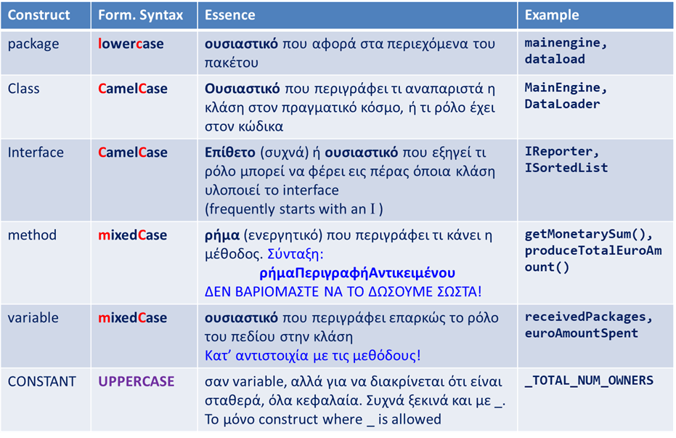
CHAPTER 9
(#68) Stick to language conventions: (a) naming + (b) ordering within a file
(#57) Minimize the scope of local variables + declare/[init] a local variable at its first use
(#57)(#58) All iterators (even for arrays(!)):
for (Element e : elements) {work with e}
(#61) Prefer primitive types to boxed primitives (e.g., int to Integer)
(#60) For monetary types, use int, long, or BigDecimal ; avoid float &double!
(#62) Strings should NOT take the place of other data types / enum’s / composite objects! (use enum)
(#64) If it is possible declare an object via an interface
<Interface> vrbl = new <ConcreteClass>();
CHAPTER 4
(#25) Every file: a single top-level class
(#15, #16) Enforce encapsulation
If the visibility of a class can be made package private, make it so!
All methods not publicly needed: private or package-private for too cohesive packages
All attributes should be private; if possible final too. This includes composite attributes too: e.g., all arrays should be private!
Simple FINAL_STATIC_CONSTANTS can be public; but not if they are collections
(#17) If possible, enforce immutability
No setters, just parameterized constructors
Methods (e.g., getters) return defensive copies of attributes, esp. if collections
(#18) Prefer composition to inheritance!
ALWAYS: Think HAS-A before IS-A!
Classes declared final (no subclasses)
If (inheritance), check: (a) the child IS-A mama in real-world? (b) can we replace IS-A with HAS-A? (c) can we avoid protected at mama?
(#20, #21) Prefer Interfaces to abstract classes to define contracts of behavior
design Interfaces for posterity
Use abs. classes for Template Method
CHAPTER 8
(#56) Write doc comments for all publicly exposed API elements
(#51) Design methods carefully!
Choose names that are (a) understandable, (b) consistent with the dev community & project’s conventions, and, (d) not too long
Choose a useful return type (PV)!!
Avoid too many/few methods in a class
Wherever possible, parameter types should be abstractions (ideally: interfaces)
Prefer enum’s to Booleans
Try not to make long parameter lists – can use helper classes to group parameters
(#49) Check parameters for validity …
… first thing inside the method’s body
throw appropriate exceptions (typically NullPointer, IllegalArgument)
(PV) For constructors: throwing an exception annules the object construction; the factory can do it too, externally.
Make sure exceptions do not destroy object state (use defensive copies) or common resources (e.g., IO streams)
Document @throws & explain why’s & when’s
(#52) Avoid overloading
(#54) Return empty collections instead of null’s
Short checklist, “Effective Java” 3rd Ed., by Joshua Bloch

