Slide 1


Crawling Twitter Data
Konstantinos Semertzidis
ksemer@cs.uoi.gr

Slide 2
What types of information can we extract?
Information about a user
User’s Followers or Friends
Tweets published by a user
Search results on Twitter
Places & Geo

Slide 3
What types of information can we extract?
Information about a user
User’s Followers or Friends
Tweets published by a user
Search results on Twitter
Places & Geo
HOW?

Slide 4
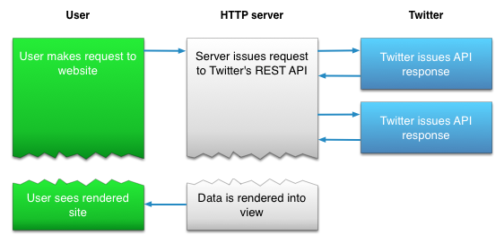
Twitter API
REST APIs
The REST APIs provides programmatic access to read and write Twitter data
Streaming APIs
Once a request for information is made, the Streaming APIs provide a continuous stream of updates with no further input from the user. (Tweets in real-time)
Search API
The Twitter Search API searches against a sampling of recent Tweets published in the past 7 days.

Slide 5
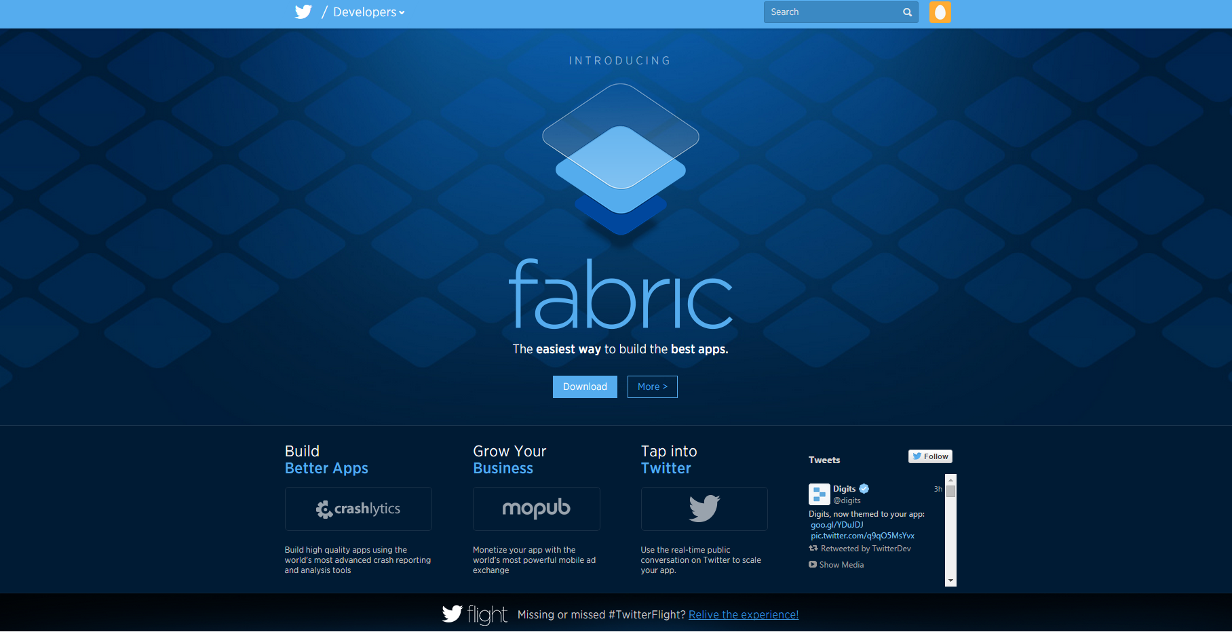
Twitter developers
Website: https://dev.twitter.com/
API resource documentation: https://dev.twitter.com/docs
Twitter libraries: https://dev.twitter.com/docs/twitter-libraries

Slide 6
Rest API Methods (Examples)
GET followers/ids
https://api.twitter.com/1.1/followers/ids.json?cursor=-1&screen_name=sitestreams&count=5000
GET friends/ids
https://api.twitter.com/1.1/followers/ids.json?cursor=-1&screen_name=sitestreams&count=5000
GET users/show
https://api.twitter.com/1.1/users/show.json?screen_name=rsarver

Slide 7
GET friends/ids (Example Result)
{
"previous_cursor": 0,
"ids": [
143206502,
143201767,
777925
],
"previous_cursor_str": "0",
"next_cursor": 0,
"next_cursor_str": "0"
}

Slide 8
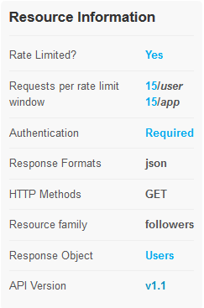
REST & SEARCH APIs Limits
GET followers API Limits:
  Window: 15 minutes
  Requests per rate limit window:
    15 calls/user and 15 calls/app
  Authentication is required
Check: https://dev.twitter.com/rest/public/rate-limiting

Slide 9
STREAMING APIs Limits
No rate limit
Streaming API allows to be streamed up to 1% tweets of the total volume
https://dev.twitter.com/streaming/overview

Slide 10
Libraries To Integrate AN Application With The Twitter Service
Available libraries:
  ActionScript/Flash, C++, Clojure, Erlang, Java, Javascript, .NET,
  Objective-C / Cocoa, Perl, PHP, Python, Ruby, Scala
https://dev.twitter.com/docs/twitter-libraries

Slide 11
Twitter4j
• Is an unofficial Java library for the Twitter API
• Easy integration between a Java App and the Twitter service.
• 100% Pure Java - works on Java Platform version 5 or later
• Website: http://www.twitter4j.org

Slide 12
How To Use Twitter4j
Download the latest stable version: http://twitter4j.org/en/index.html#download
Add twitter4j-core-version.jar to your application classpath
JavaDoc: http://twitter4j.org/en/javadoc.html

Slide 13
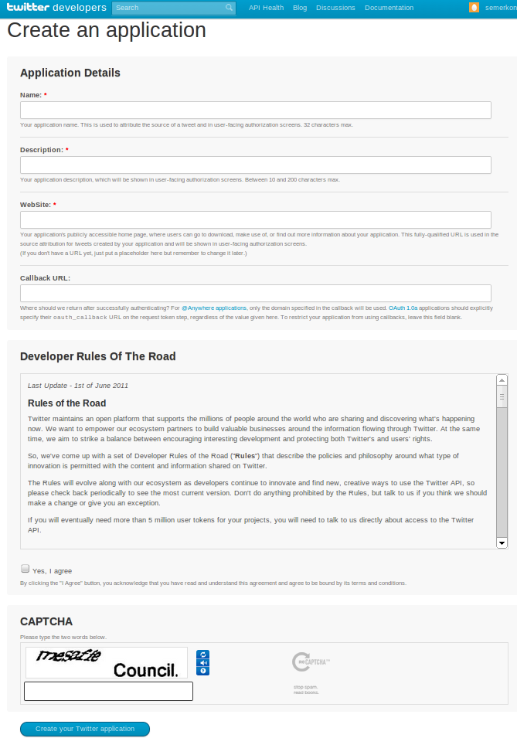
Create An Application
https://apps.twitter.com/

Slide 14
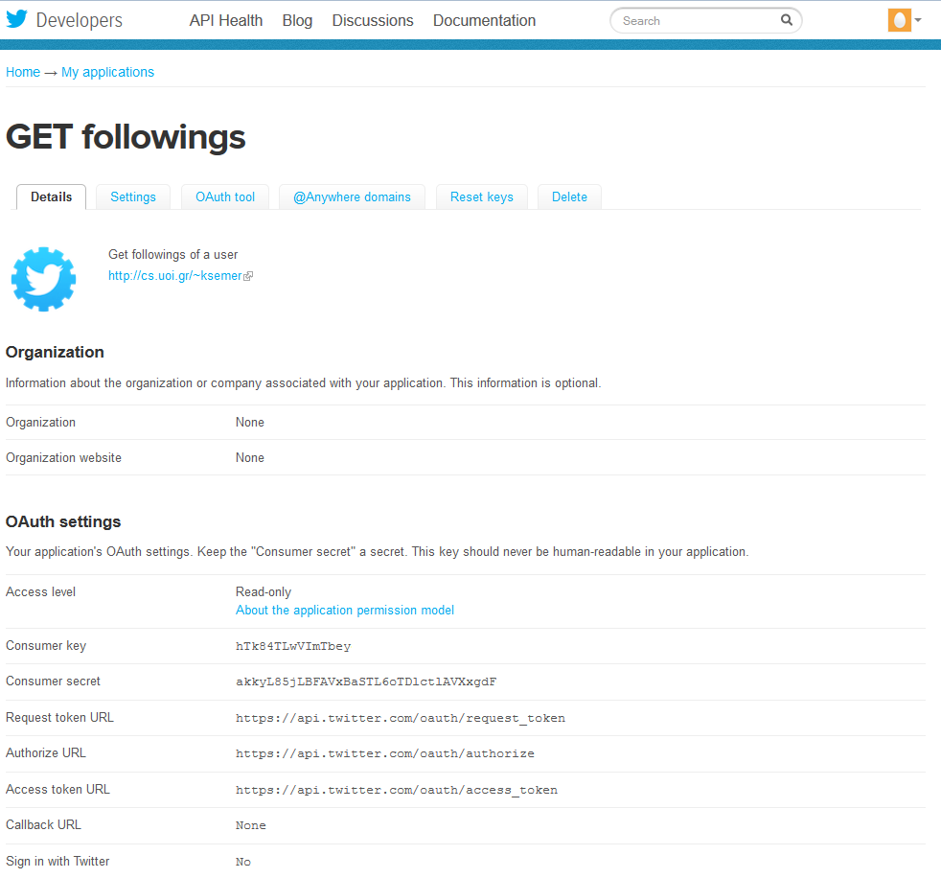
Application Details

Slide 15
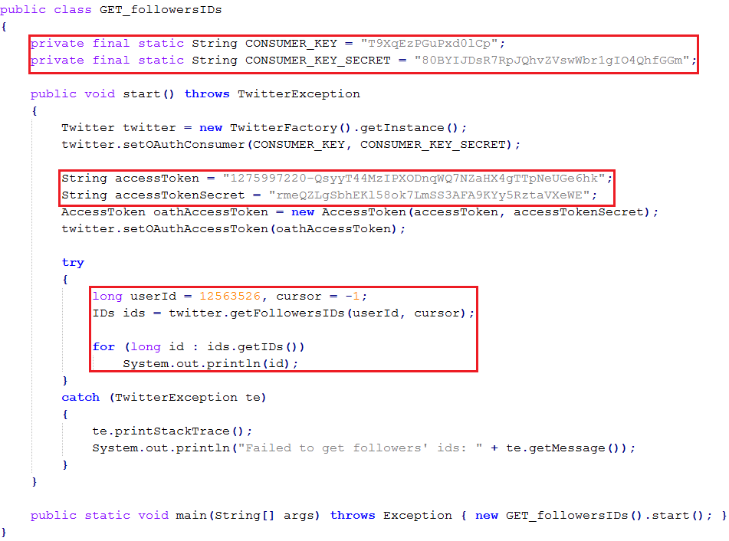
GET followers/ids Code Sample

Slide 16
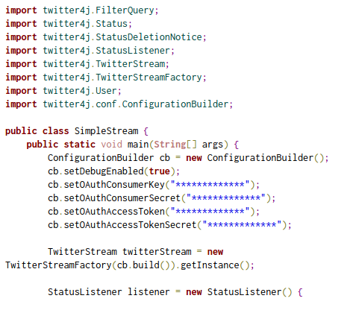
Streaming Code Example (1)

Slide 17
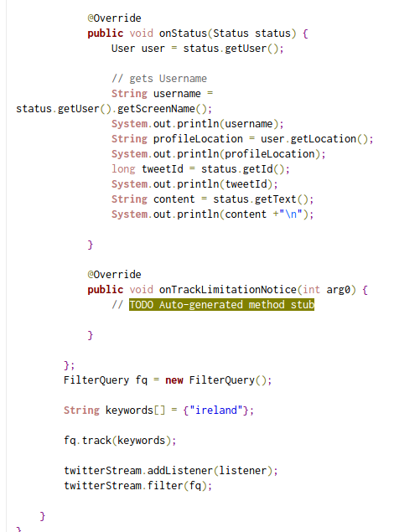
Streaming Code Example (2)

Slide 18
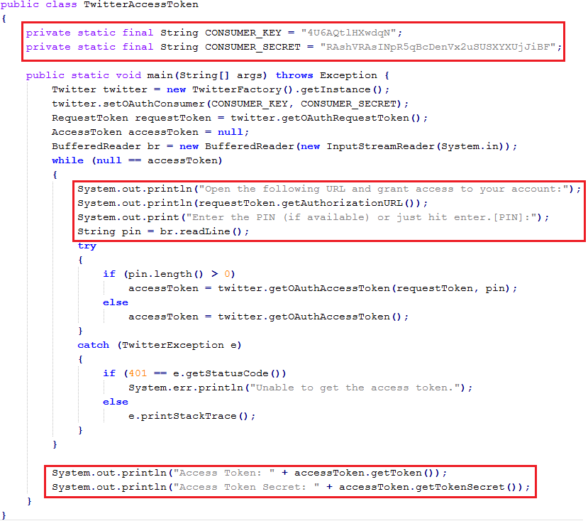
OAUTH Code Example

Slide 19
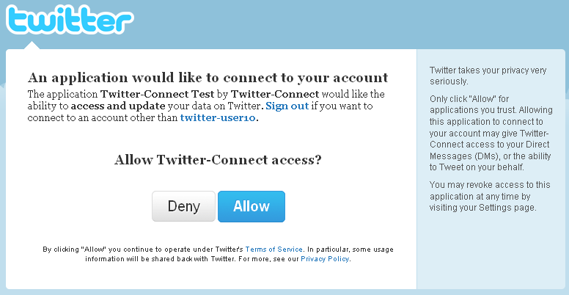
Authorization URL

Slide 20
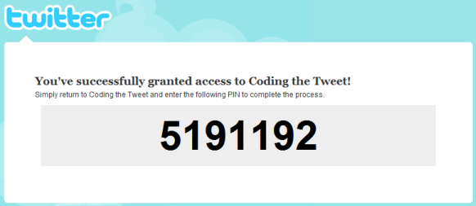
OAUTH PIN

Slide 21
Thank You!

