Slide 1
MYE003-ΠΛΕ70: Ανάκτηση Πληροφορίας
Διδάσκουσα: Ευαγγελία Πιτουρά
Διάλεξη 10: Βασικές Θέματα Αναζήτησης στον Παγκόσμιο Ιστό.

Slide 2
Ανάλυση Συνδέσμων (link analysis)
Κεφ 21
Ανάλυση συνδέσμων
  PageRank
  HITS (Κομβικές σελίδες και σελίδες κύρους)

Slide 3
PageRank
Κεφ 21
Ποιοι είναι οι σημαντικοί κόμβοι σε ένα γράφο;
Degree centrality degree(v)/|E|
Υποθέστε ότι ο Χ και ο Y έχουν 3 φίλους, αλλά οι φίλοι του Χ είναι ο Barak Obama, Larry Page, the Pope
  Είναι το ίδιο σημαντικό;

Slide 4
PageRank
Κεφ 21
Eigenvector centrality
While (not converged)
for each vertex v
for each incoming edge from node u
rank(v) = + rank(u)
Αλλά:
το ίδιο σημαντικό μια σελίδα να έχει link από μια σελίδα με εκατομμύρια outgoing links και από μια σελίδα με μόνο λίγα outgoing links?

Slide 5
PageRank
Κεφ 21
Eigenvector centrality
While (not converged)
for each vertex v
for each incoming edge from node u
rank(v) = + rank(u)/outdegree(u)

Slide 6





Παράδειγμα
$$v_{2}$$
$$v_{1}$$
w₁ = 1/3 w₄ + 1/2 w₅
$$v_{3}$$
w₂ = 1/2 w₁ + w₃ + 1/3 w₄
w₃ = 1/2 w₁ + 1/3 w₄
w₄ = 1/2 w₅
w₅ = w₂
$$v_{5}$$
$$v_{4}$$

Slide 7
Παράδειγμα
$$v_{2}$$
$$v_{1}$$
w₁ = 1/3 w₄ + 1/2 w₅
$$v_{3}$$
w₂ = 1/2 w₁ + w₃ + 1/3 w₄
w₃ = 1/2 w₁ + 1/3 w₄
w₄ = 1/2 w₅
w₅ = w₂
$$v_{5}$$
$$v_{4}$$

Slide 8
PageRank: Διανυσματική αναπαράσταση
Κεφ. 21.2
Stochastic Adjacency Matrix – Πίνακας Γειτνίασης Μ
Πίνακας M – πίνακας γειτνίασης του web
Αν j -> i, τότε Μ_{ij} = 1/outdegree(j)
Αλλιώς, M_{ij} = 0
Η πιθανότητα να πάμε στη σελίδα i αν είμαστε στη σελίδα j
j
Έστω ότι η σελίδα j έχει links σε 3 σελίδες, συμπεριλαμβανομένη της i αλλά όχι της x.
i
1/3
x
0

Slide 9
PageRank: Διανυσματική αναπαράσταση
Κεφ. 21.2
Page Rank Vector r
Ένα διάνυσμα με μία τιμή για κάθε σελίδα (το PageRank της σελίδας)
r = M r
Principal eigenvector του Μ
Προσομοιώνει ένα τυχαίο περίπατο (random walks)

Slide 10

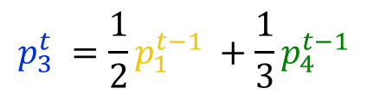


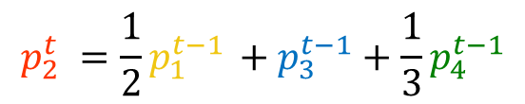




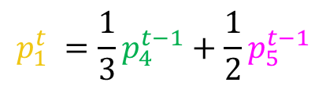






Random walk
Question: what is the probability $p_{i}^{t}$ of being at node $i$after $t$ steps?
$$v_{2}$$
$$v_{1}$$
$$p_{1}^{0} =\frac{1}{5}$$
$$p_{1}^{t} =\frac{1}{3}p_{4}^{t−1}+\frac{1}{2}p_{5}^{t−1}$$
$$v_{3}$$
$$p_{2}^{0} =\frac{1}{5}$$
$$p_{2}^{t} =\frac{1}{2}p_{1}^{t−1} +p_{3}^{t−1}+\frac{1}{3}p_{4}^{t−1}$$
$$p_{3}^{0}=\frac{1}{5}$$
$$p_{3}^{t} =\frac{1}{2}p_{1}^{t−1} +\frac{1}{3}p_{4}^{t−1}$$
$$p_{4}^{0}=\frac{1}{5}$$
$$p_{4}^{t} =\frac{1}{2}p_{5}^{t−1}$$
$$v_{5}$$
$$v_{4}$$
$$p_{5}^{0}=\frac{1}{5}$$
$$p_{5}^{t} = p_{2}^{t−1}$$

Slide 11
PageRank with restart
Κεφ. 21.2
Δύο προβλήματα
Dead ends: σελίδες χωρίς εξερχόμενες ακμές
  Έχουν ως αποτέλεσμα να ξεφεύγει (leak out) to PageRank
Spider traps: Ομάδα σελίδων που όλες οι εξερχόμενες ακμές είναι μεταξύ τους
    Τελικά απορροφούν όλο το PageRank

Slide 12
Dead end (αδιέξοδα)
Κεφ. 21.2
y
y a m
y 1/2 1/2 0
a 1/2 0 0
m 0 1/2 0
a
m
y
a =
m
1/3
1/3
1/3
1/3
1/6
1/6
3/12
1/6
1/12
5/24
3/24
1/12
8/48
5/48
3/48
0
0
0
. . .

Slide 13
Spider trap
Κεφ. 21.2
y a m
y
y 1/2 1/2 0
a 1/2 0 0
m 0 1/2 1
a
m
y
a =
m
1/3
1/3
1/3
1/3
1/6
1/2
3/12
1/6
8/12
5/24
3/24
9/12
8/48
5/48
39/48
0
0
1
. . .

Slide 14
PageRank with restart
Κεφ. 21.2
Dumping factor:
Random jump (teleport) to any node in the graph
Add a random jump to any node in the network
(reduce the effect of distant nodes in the PageRank)

Slide 15
Επεκτάσεις
Κεφ. 21.2
Topic specific PageRank
Personalized PageRank

Slide 16
HITS
Κεφ. 21.3
Κάθε σελίδα έχει δύο βαθμούς:
  ένα βαθμό κύρους (authority rank) και
  ένα κομβικό βαθμό (hub rank)

Slide 17
HITS
Κεφ. 21.3
Authorities: pages containing useful information (the prominent, highly endorsed answers to the queries)
Newspaper home pages
  Course home pages
    Home pages of auto manufacturers
Hubs: pages that link to authorities (highly value lists)
List of newspapers
Course bulletin
List of US auto manufacturers
A good hub links to many good authorities
A good authority is linked from many good hubs

Slide 18
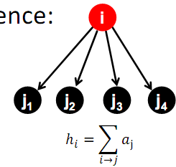
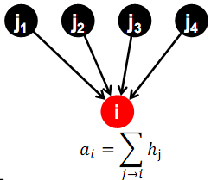
HITS: Algorithm
Κεφ. 21.3
Each page p, has two scores
  A hub score (h) quality as an expert
  Total sum of authority scores that it points to
  An authority score (a) quality as content
Total sum of hub scores that point to it

Slide 19
Iterative update
Κεφ. 21.3
Repeat the following updates, for all x:
I operation
x
O operation
x
Normalize (scale down)

Slide 20
Example
hubs
authorities

Slide 21
Example
Initialize
1
1
1
1
1
1
1
1
1
1
hubs
authorities

Slide 22
Example
Step 1: O operation
1
1
2
1
3
1
2
1
1
1
hubs
authorities

Slide 23
Example
Step 1: I operation
1
6
2
5
3
5
2
2
1
1
hubs
authorities

Slide 24
Example
Step 1: Normalization (Max norm)
1/3
1
2/3
5/6
1
5/6
2/3
2/6
1/3
1/6
hubs
authorities

Slide 25
Example
Step 2: O step
1
1
11/6
5/6
16/6
5/6
7/6
2/6
1/6
1/6
hubs
authorities

Slide 26
Example
Step 2: I step
1
33/6
11/6
27/6
16/6
23/6
7/6
7/6
1/6
1/6
hubs
authorities

Slide 27
Example
Step 2: Normalization
6/16
1
11/16
27/33
1
23/33
7/16
7/33
1/16
1/33
hubs
authorities

Slide 28
Example
Convergence
0.4
1
0.75
0.8
1
0.6
0.3
0.14
0
0
hubs
authorities

Slide 29
Πίνακας γειτνίασης
Κεφ. 21.3
n×n adjacency matrix A:
  each of the n pages in the base set has a row and column in the matrix.
  Entry A_{ij} = 1 if page i links to page j, else = 0.
1 2 3
1
2
1
2
3
0 1 0
1 1 1
3
1 0 0

Slide 30
Hub/authority vectors
Κεφ. 21.3
View the hub scores h() and the authority scores a() as vectors with n components.
Recall the iterative updates

Slide 31
Rewrite in matrix form
Κεφ. 21.3
h=Aa.
a=A^{t}h.
Recall A^{t} is the transpose of A.
Substituting, h=AA^{t}h and a=A^{t}Aa.
Thus, h is an eigenvector of AA^{t} and a is an eigenvector of A^{t}A.
Further, our algorithm is a particular, known algorithm for computing eigenvectors: the power iteration method.
Guaranteed to converge.

Slide 32
Query dependent link analysis
Κεφ. 21.3
Given text query (say browser), use a text index to get all pages containing browser.
  Call this the root set of pages.
Add in any page that either
  points to a page in the root set, or
  is pointed to by a page in the root set.
Call this the base set.

Slide 33
Query dependent input
Root set obtained from a text-only search engine
Root Set

Slide 34
Query dependent input
Root Set
IN
OUT

Slide 35
Query dependent input
Root Set
IN
OUT

Slide 36
Query dependent input
Base Set
Root Set
IN
OUT

Slide 37
Things to note
Κεφ. 21.3
Pulled together good pages regardless of language of page content.
Use only link analysis after base set assembled
  iterative scoring is query-independent.
Iterative computation after text index retrieval - significant overhead.

Slide 38
Τι άλλο θα δούμε σήμερα;
Κεφ. 19
Τι ψάχνουν οι χρήστες
Spam
Πόσο μεγάλος είναι ο Ιστός;

Slide 39
ΟΙ ΧΡΗΣΤΕΣ
Κεφ. 19.4

Slide 40
Ανάγκες Χρηστών
Κεφ. 19.4.1
Ποιοι είναι οι χρήστες;
Μέσος αριθμός λέξεων ανά αναζήτηση 2-3
Σπάνια χρησιμοποιούν τελεστές

Slide 41
Ανάγκες Χρηστών
Κεφ. 19.4.1
Need [Brod02, RL04]
  Informational (πληροφοριακά ερωτήματα) – θέλουν να μάθουν (learn) για κάτι (~40% / 65%)
    Συνήθως, όχι μια μοναδική ιστοσελίδα, συνδυασμός πληροφορίας από πολλές ιστοσελίδες
  Navigational (ερωτήματα πλοήγησης) – θέλουν να πάνε (go) σε μια συγκεκριμένη ιστοσελίδα (~25% / 15%)
    Μια μοναδική ιστοσελίδα, το καλύτερο μέτρο = ακρίβεια στο 1 (δεν ενδιαφέρονται γενικά για ιστοσελίδες που περιέχουν τους όρους United Airlines)
Low hemoglobin
United Airlines

Slide 42
Ανάγκες Χρηστών
Κεφ. 19.4.1
  Transactional (ερωτήματα συναλλαγής) – θέλουν να κάνουν (do) κάτι (σχετιζόμενο με το web) (~35% / 20%)
    Προσπελάσουν μια υπηρεσία (Access a service)
    Να κατεβάσουν ένα αρχείο (Downloads)
    Να αγοράσουν κάτι
    Να κάνουν κράτηση
  Γκρι περιοχές (Gray areas)
    Find a good hub
    Exploratory search “see what’s there”
Seattle weather
Mars surface images
Canon S410
Car rental Brasil

Slide 43
Examples of Typing Queries
Calculation: 5+4
Unit conversion: 1 kg in pounds
Currency conversion: 1 euro in kronor
Tracking number: 8167 2278 6764
Flight info: LH 454
Area code: 650
Map: columbus oh
Stock price: msft
Albums/movies etc: coldplay

Slide 44
Τι ψάχνουν;
Κεφ. 19.4.1
Δημοφιλή ερωτήματα
http://www.google.com/trends/hottrends
Και ανά χώρα
Τα ερωτήματα ακολουθούν επίσης power law κατανομή

Slide 45
Ανάγκες Χρηστών
Κεφ. 19.4.1
Επηρεάζει (ανάμεσα σε άλλα)
την καταλληλότητα του ερωτήματος για την παρουσίαση διαφημίσεων
τον αλγόριθμο/αξιολόγηση, για παράδειγμα για ερωτήματα πλοήγησης ένα αποτέλεσμα ίσως αρκεί, για τα άλλα (και κυρίως πληροφοριακά) ενδιαφερόμαστε για την περιεκτικότητα/ανάκληση

Slide 46
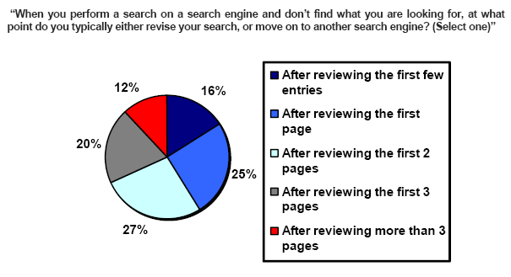
Πόσα αποτελέσματα βλέπουν οι χρήστες
(Source: iprospect.com WhitePaper_2006_SearchEngineUserBehavior.pdf)

Slide 47
Πως μπορούμε να καταλάβουμε τις προθέσεις (intent) του χρήστη;
Guess user intent independent of context:
  Spell correction
  Precomputed “typing” of queries
Better: Guess user intent based on context:
  Geographic context (slide after next)
  Context of user in this session (e.g., previous query)
  Context provided by personal profile (Yahoo/MSN do this, Google claims it doesn’t)

Slide 48
Geographical Context
Three relevant locations
Server (nytimes.com → New York)
Web page (nytimes.com article about Albania)
User (located in Palo Alto)
Locating the user
  IP address
  Information provided by user (e.g., in user profile)
  Mobile phone
Geo-tagging: Parse text and identify the coordinates of the geographic entities
Example: East Palo Alto CA → Latitude: 37.47 N, Longitude: 122.14 W
  Important NLP problem

Slide 49
Geographical Context
How to use context to modify query results:
  Result restriction: Don’t consider inappropriate results
    For user on google.fr only show .fr results
  Ranking modulation: use a rough generic ranking, rerank based on personal context
Contextualization / personalization is an area of search with a lot of potential for improvement.

Slide 50
Αξιολόγηση από τους χρήστες
Relevance and validity of results
  Precision at 1? Precision above the fold?
  Comprehensiveness – must be able to deal with obscure queries
    Recall matters when the number of matches is very small
UI (User Interface) – Simple, no clutter, error tolerant
      No annoyances: pop-ups, etc.
Trust – Results are objective
Coverage of topics for polysemic queries
  Diversity, duplicate elimination

Slide 51
SERP Layout

Slide 52
Αξιολόγηση από τους χρήστες
Pre/Post process tools provided
  Mitigate user errors (auto spell check, search assist,…)
  Explicit: Search within results, more like this, refine ...
  Anticipative: related searches
Deal with idiosyncrasies
  Web specific vocabulary
    Impact on stemming, spell-check, etc.
  Web addresses typed in the search box

Slide 53
Navigational

Slide 54
Informational

Slide 55
Typo: Ioanina
Transactional query: adds

Slide 56
SPAM
(SEARCH ENGINE OPTIMIZATION)

Slide 57
The trouble with paid search ads
Κεφ. 19.2.2
It costs money. What’s the alternative?
Search Engine Optimization (SEO):
  “Tuning” your web page to rank highly in the algorithmic search results for select keywords
  Alternative to paying for placement
  Thus, intrinsically a marketing function
Performed by companies, webmasters and consultants (“Search engine optimizers”) for their clients
Some perfectly legitimate, some very shady

Slide 58
Η απλούστερη μορφή
Κεφ. 19.2.2
Οι μηχανές πρώτης γενιάς βασίζονταν πολύ στο tf/idf
  Οι πρώτες στην κατάταξη ιστοσελίδας για το ερώτημα maui resort ήταν αυτές που περιείχαν τα περισσότερα maui και resort
SEOs απάντησαν με πυκνή επανάληψη των επιλεγμένων όρων
  π.χ., maui resort maui resort maui resort
  Συχνά, οι επαναλήψεις στο ίδιο χρώμα με background της ιστοσελίδα
    Οι επαναλαμβανόμενοι όροι έμπαιναν στο ευρετήριο από crawlers
    Αλλά δεν ήταν ορατοί από τους ανθρώπους στους browsers
Απλή πυκνότητα όρων δεν είναι αξιόπιστο ΑΠ σήμα

Slide 59
Παραλλαγές «keyword stuffing»
Κεφ. 19.2.2
a web page loaded with keywords in the meta tags or in content of a web page (outdated)
Παραπλανητικά meta-tags, υπερβολική επανάληψη
Hidden text with colors, position text behind the image, style sheet tricks, etc.
Meta-Tags =
“… London hotels, hotel, holiday inn, hilton, discount, booking, reservation, sex, mp3, britney spears, viagra, …”

Slide 60
Cloaking (Απόκρυψη)
Κεφ. 19.2.2
Παρέχει διαφορετικό περιεχόμενο ανάλογα αν είναι ο μηχανισμός σταχυολόγησης (search engine spider) ή ο browser κάποιου χρήστη
DNS cloaking: Switch IP address. Impersonate
SPAM
Is this a Search
Engine spider?
N
Y
Real
Doc
Cloaking

Slide 61
Άλλες τεχνικές παραπλάνησης (spam)
Κεφ. 19.2.2
Doorway pages
  Pages optimized for a single keyword that re-direct to the real target page
  If a visitor clicks through to a typical doorway page from a search engine results page, redirected with a fast Meta refresh command to another page.
Lander page:
optimized for a single keyword or a misspelled domain name, designed to attract surfers who will then click on ads

Slide 62
Άλλες τεχνικές παραπλάνησης (spam)
Κεφ. 19.2.2
Link spamming
  Mutual admiration societies, hidden links, awards
  Domain flooding: numerous domains that point or re-direct to a target page
  Pay somebody to put your link on their highly ranked page
  Leave comments that include the link on blogs
Robots (bots)
  Fake query stream – rank checking programs
    “Curve-fit” ranking programs of search engines
  Millions of submissions via Add-Url

Slide 63
The war against spam
Quality signals - Prefer authoritative pages based on:
  Votes from authors (linkage signals)
  Votes from users (usage signals)
Policing of URL submissions
  Anti robot test
Limits on meta-keywords
Robust link analysis
  Ignore statistically implausible linkage (or text)
  Use link analysis to detect spammers (guilt by association)
Spam recognition by machine learning
  Training set based on known spam
Family friendly filters
  Linguistic analysis, general classification techniques, etc.
  For images: flesh tone detectors, source text analysis, etc.
Editorial intervention
  Blacklists
  Top queries audited
  Complaints addressed
  Suspect pattern detection

Slide 64
More on spam
Web search engines have policies on SEO practices they tolerate/block
  http://help.yahoo.com/help/us/ysearch/index.html
  http://www.google.com/intl/en/webmasters/
Adversarial IR (Ανταγωνιστική ανάκτηση πληροφορίας): the unending (technical) battle between SEO’s and web search engines
Check out: Webmaster Tools (Google)

Slide 65
SIZE OF THE WEB

Slide 66
Ποιο είναι το μέγεθος του web ?
Κεφ. 19.5
Θέματα
  Στην πραγματικότητα, ο web είναι άπειρος
    Dynamic content, e.g., calendars
    Soft 404: www.yahoo.com/<anything> is a valid page
  Static web contains syntactic duplication, mostly due to mirroring (~30%)
  Some servers are seldom connected
Ποιο νοιάζει;
  Media, and consequently the user
  Σχεδιαστές μηχανών
  Την πολιτική crawl - αντίκτυπο στην ανάκληση.

Slide 67
Τι μπορούμε να μετρήσουμε;
Κεφ. 19.5
Το σχετικό μέγεθος των μηχανών αναζήτησης
  The notion of a page being indexed is still reasonably well defined.
  Already there are problems
    Document extension: e.g., engines index pages not yet crawled, by indexing anchortext.
    Document restriction: All engines restrict what is indexed (first n words, only relevant words, etc.)
    Multi-tier indexes (access only top-levels)

Slide 68
New definition?
Κεφ. 19.5
  The statically indexable web is whatever search engines index.
    IQ is whatever the IQ tests measure.
Different engines have different preferences
    max url depth, max count/host, anti-spam rules, priority rules, etc.
Different engines index different things under the same URL:
    frames, meta-keywords, document restrictions, document extensions, ...

Slide 69
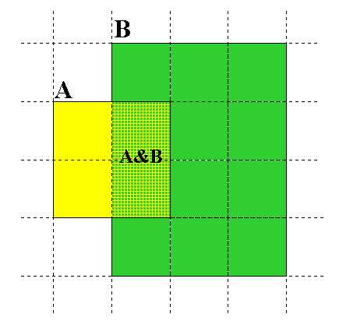
Μέγεθος μηχανών αναζήτησης
Κεφ. 19.5
Relative Size from Overlap
Given two engines A and B
Sample URLs randomly from A
Check if contained in B and vice versa
A ∩ B
A ∩ B = (1/2) * Size A
A ∩ B = (1/6) * Size B
(1/2)*Size A = (1/6)*Size B
∴ Size A / Size B =
(1/6)/(1/2) = 1/3
Each test involves: (i) Sampling (ii) Checking

Slide 70
Δειγματοληψία (Sampling) URLs
Κεφ. 19.5
Ideal strategy: Generate a random URL
Problem: Random URLs are hard to find (and sampling distribution should reflect “user interest”)
Approach 1: Random walks / IP addresses
  In theory: might give us a true estimate of the size of the web (as opposed to just relative sizes of indexes)
Approach 2: Generate a random URL contained in a given engine
  Suffices for accurate estimation of relative size

Slide 71
Statistical methods
Κεφ. 19.5
  Approach 2
  Random queries
  Random searches
  Approach 1
  Random IP addresses
  Random walks

Slide 72
Random URLs from random queries
Κεφ. 19.5
Generate random query: how?
  Lexicon: 400,000+ words from a web crawl
  Conjunctive Queries: w₁ and w₂
    e.g., vocalists AND rsi
Get 100 result URLs from engine A
Choose a random URL as the candidate to check for presence in engine B
This distribution induces a probability weight W(p) for each page.
Not an English
dictionary

Slide 73
Query Based Checking
Κεφ. 19.5
Either search for the URL if the engine B support this or
Generate a Strong Query to check whether an engine B has a document D:
  Download D. Get list of words.
  Use 8 low frequency words as AND query to B
  Check if D is present in result set.

Slide 74
Random searches
Κεφ. 19.5
Choose random searches extracted from a local query log [Lawrence & Giles 97] or build “random searches” [Notess]
Use only queries with small result sets.
For each random query: compute ratio size(r1)/size(r2) of the two result sets
Average over random searches

Slide 75
Random searches
Κεφ. 19.5
575 & 1050 queries from the NEC RI employee logs
6 Engines in 1998, 11 in 1999
Implementation:
  Restricted to queries with < 600 results in total
  Counted URLs from each engine after verifying query match
  Computed size ratio & overlap for individual queries
  Estimated index size ratio & overlap by averaging over all queries

Slide 76
Queries from Lawrence and Giles study
Κεφ. 19.5
adaptive access control
neighborhood preservation topographic
hamiltonian structures
right linear grammar
pulse width modulation neural
unbalanced prior probabilities
ranked assignment method
internet explorer favourites importing
karvel thornber
zili liu
softmax activation function
bose multidimensional system theory
gamma mlp
dvi2pdf
john oliensis
rieke spikes exploring neural
video watermarking
counterpropagation network
fat shattering dimension
abelson amorphous computing

Slide 77
Random IP addresses
Κεφ. 19.5
Generate random IP addresses
Find a web server at the given address
  If there’s one
Collect all pages from server
  From this, choose a page at random

Slide 78
Random IP addresses
Κεφ. 19.5
HTTP requests to random IP addresses
  Ignored: empty or authorization required or excluded
  [Lawr99] Estimated 2.8 million IP addresses running crawlable web servers (16 million total) from observing 2500 servers.
  OCLC using IP sampling found 8.7 M hosts in 2001
    Netcraft [Netc02] accessed 37.2 million hosts in July 2002
[Lawr99] exhaustively crawled 2500 servers and extrapolated
  Estimated size of the web to be 800 million pages
  Estimated use of metadata descriptors:
    Meta tags (keywords, description) in 34% of home pages, Dublin core metadata in 0.3%

Slide 79
Τυχαίοι Περίπατοι (Random walks)
Κεφ. 19.5
Το διαδίκτυο ως ένας κατευθυνόμενος
Ένας τυχαίος περίπατος σε αυτό το γράφο
  Includes various “jump” rules back to visited sites
    Does not get stuck in spider traps!
    Can follow all links!
  Συγκλίνει σε μια κατανομή σταθερής κατάστασης (stationary distribution)
    Must assume graph is finite and independent of the walk.
    Conditions are not satisfied (cookie crumbs, flooding)
    Time to convergence not really known
  Sample from stationary distribution of walk
  Use the “strong query” method to check coverage by SE

Slide 80
Size of the web
Κεφ. 19.5
Check out
http://www.worldwidewebsize.com/
The Indexed Web contains at least 3.57 billion pages (Tuesday, 20 May, 2014).
The Indexed Web contains at least 4.58 billion pages (Thursday, 19 May, 2016).

Slide 81
Size of the web
Based on the number of pages indexed by search engines (Google, Bing, Yahoo, Ask) (minus their overlap)
Size of the index of a search engine based on a method that combines
word frequencies obtained from a large offline text collection (corpus), and
search counts returned by the engines.

Slide 82
Size of index
Each day 50 words are sent to all four search engines.
Record number of webpages found for these words
Compare their relative frequencies in the background corpus
Make multiple extrapolated estimations of the size of the engine's index which are subsequently averaged.
Example
Say word 'the' is present in 67,61% of all documents within the corpus
Google says that it found 'the' in 14.100.000.000 webpages
Estimated size of the Google's total index would be 23.633.010.000.
Background corpus contains more than 1 million webpages from DMOZ
50 words selected evenly across logarithmic frequency intervals (Zipf's Law)

Slide 83
Size of the web
Overlap between the indices of two search engines is estimated by daily overlap counts of URLs returned in the top-10 by the engines
Words randomly drawn from the DMOZ background corpus.

Slide 84
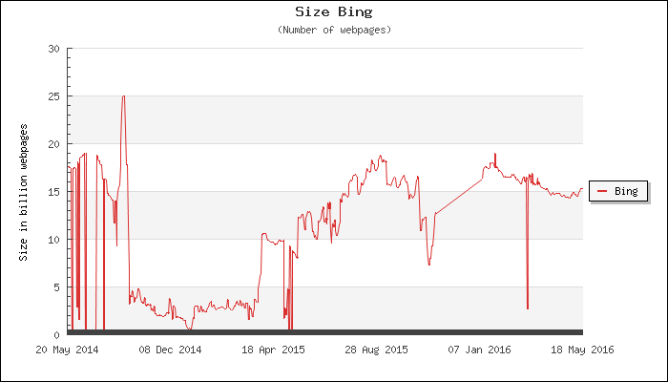
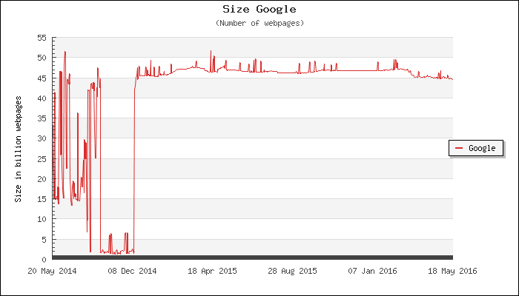

Slide 85
Τι άλλο θα δούμε
  Web crawlers or spiders (κεφ 20)

Slide 86
Spiders (σταχυολόγηση ιστού)
Web
Spider
Document
corpus
IR
System
Query String
1. Page1
2. Page2
3. Page3
.
.
Ranked
Documents

Slide 87
Web Crawling (σταχυολόγηση ιστού)
Κεφ 20
  Web crawler or spider
  How hard and why?
  Getting the content of the documents is easier for many other IR systems.
    E.g., indexing all files on your hard disk: just do a recursive descent on your file system
  For web IR, getting the content of the documents takes longer, because of latency.
    But is that really a design/systems challenge?

Slide 88
Βασική λειτουργία
κεφ. 20.2
Begin with known “seed” URLs
Fetch and parse them
  Extract URLs they point to
  Place the extracted URLs on a queue
Fetch each URL on the queue and repeat

Slide 89
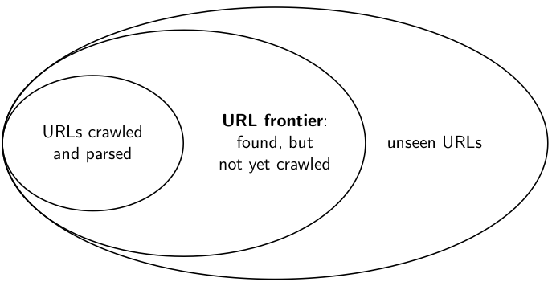
URL frontier
Κεφ. 20.1.1

Slide 90
Processing steps in crawling
Κεφ. 20.2.1
Pick a URL from the frontier
Fetch the document at the URL
Parse the URL
  Extract links from it to other docs (URLs)
Check if URL has content already seen
  If not, add to indexes
For each extracted URL
  Ensure it passes certain URL filter tests
  Check if it is already in the frontier (duplicate URL elimination)
Which one?
E.g., only crawl .edu, obey robots.txt, etc.

Slide 91
Simple picture – complications
κεφ. 20.1.1
Web crawling isn’t feasible with one machine
  All of the above steps distributed
Malicious pages
  Spam pages
  Spider traps – incl dynamically generated
Even non-malicious pages pose challenges
  Latency/bandwidth to remote servers vary
  Webmasters’ stipulations
    How “deep” should you crawl a site’s URL hierarchy?
  Site mirrors and duplicate pages
Politeness – don’t hit a server too often

Slide 92
Simple picture – complications
κεφ. 20.1.1
  Magnitude of the problem
  To fetch 20,000,000,000 pages in one month . . .
  we need to fetch almost 8000 pages per second!
  Actually: many more since many of the pages we attempt to crawl will be duplicates, unfetchable, spam etc.

Slide 93
Explicit and implicit politeness
Sec. 20.2
Explicit politeness: specifications from webmasters on what portions of site can be crawled
  robots.txt
Implicit politeness: even with no specification, avoid hitting any site too often

Slide 94
Robots.txt
Κεφ. 20.2.1
Protocol for giving spiders (“robots”) limited access to a website, originally from 1994
  www.robotstxt.org/wc/norobots.html
Website announces its request on what can(not) be crawled
  For a server, create a file /robots.txt
  This file specifies access restrictions

Slide 95
Robots.txt example
Κεφ. 20.2.1
No robot should visit any URL starting with
"/yoursite/temp/", except the robot called “searchengine":
User-agent: *
Disallow: /yoursite/temp/
User-agent: searchengine
Disallow:

Slide 96
Βασική αρχιτεκτονική του σταχυολογητή
Κεφ. 20.2.1
WWW
DNS
Doc
FP’s
robots
filters
URL
set
Parse
Fetch
Content
seen?
URL
filter
Dup
URL
elim
URL Frontier

Slide 97
DNS (Domain Name Server)
Κεφ. 20.2.2
A lookup service on the internet
  Given a URL, retrieve its IP address
  Service provided by a distributed set of servers – thus, lookup latencies can be high (even seconds)
Common OS implementations of DNS lookup are blocking: only one outstanding request at a time
Solutions
  DNS caching
  Batch DNS resolver – collects requests and sends them out together

Slide 98
Parsing: URL normalization
Κεφ. 20.2.1
When a fetched document is parsed, some of the extracted links are relative URLs
E.g., http://en.wikipedia.org/wiki/Main_Page has a relative link to /wiki/Wikipedia:General_disclaimer which is the same as the absolute URL http://en.wikipedia.org/wiki/Wikipedia:General_disclaimer
During parsing, must normalize (expand) such relative URLs

Slide 99
Content seen?
Κεφ. 20.2.1
Duplication is widespread on the web
If the page just fetched is already in the index, do not further process it
This is verified using document fingerprints or shingles

Slide 100
Distributing the crawler
Κεφ. 20.2.1
Run multiple crawl threads, under different processes – potentially at different nodes
  Geographically distributed nodes

Slide 101
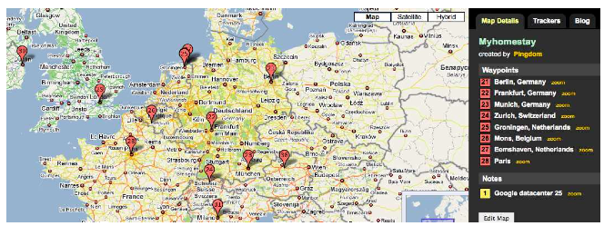
Distributing the crawler
Κεφ. 20.2.1

Slide 102
Distributing the crawler
Κεφ. 20.2.1
Partition hosts being crawled into nodes
  Hash used for partition
How do these nodes communicate and share URLs?

Slide 103
Communication between nodes
Κεφ. 20.2.1
Output of the URL filter at each node is sent to the Dup URL Eliminator of the appropriate node
WWW
DNS
To
other
nodes
URL
set
Parse
Doc
FP’s
robots
filters
Fetch
Content
seen?
URL
filter
Host
splitter
Dup
URL
elim
From
other
nodes
URL Frontier

Slide 104
URL frontier: two main considerations
Κεφ. 20.2.3
Politeness: do not hit a web server too frequently
Freshness: crawl some pages more often than others
  E.g., pages (such as News sites) whose content changes often
These goals may conflict each other.
(E.g., simple priority queue fails – many links out of a page go to its own site, creating a burst of accesses to that site.)

Slide 105
ΤΕΛΟΣ 10^{ου} Μαθήματος
Ερωτήσεις?
Χρησιμοποιήθηκε κάποιο υλικό από:
Pandu Nayak and Prabhakar Raghavan, CS276:Information Retrieval and Web Search (Stanford)
Hinrich Schütze and Christina Lioma, Stuttgart IIR class

