Slide 1
ΠΛΕ70: Ανάκτηση Πληροφορίας
Διδάσκουσα: Ευαγγελία Πιτουρά
Διάλεξη 10: Βασικά Θέματα Αναζήτησης στον Παγκόσμιο Ιστό.

Slide 2
Τι θα δούμε σήμερα;
Κεφ. 19
Τι ψάχνουν οι χρήστες
Διαφημίσεις
Spam
Πόσο μεγάλος είναι ο Ιστός;

Slide 3
ΟΙ ΧΡΗΣΤΕΣ
Κεφ. 19.4

Slide 4
Ανάγκες Χρηστών
Κεφ. 19.4.1
Ποιοι είναι οι χρήστες;
Μέσος αριθμός λέξεων ανά αναζήτηση 2-3
Σπάνια χρησιμοποιούν τελεστές

Slide 5
Ανάγκες Χρηστών
Κεφ. 19.4.1
Need [Brod02, RL04]
  Informational (πληροφοριακά ερωτήματα) – θέλουν να μάθουν (learn) για κάτι (~40% / 65%)
    Συνήθως, όχι μια μοναδική ιστοσελίδα, συνδυασμός πληροφορίας από πολλές ιστοσελίδες
  Navigational (ερωτήματα πλοήγησης) – θέλουν να πάνε (go) σε μια συγκεκριμένη ιστοσελίδα (~25% / 15%)
    Μια μοναδική ιστοσελίδα, το καλύτερο μέτρο = ακρίβεια στο 1 (δεν ενδιαφέρονται γενικά για ιστοσελίδες που περιέχουν τους όρους United Airlines)
Low hemoglobin
United Airlines

Slide 6
Ανάγκες Χρηστών
Κεφ. 19.4.1
  Transactional (ερωτήματα συναλλαγής) – θέλουν να κάνουν (do) κάτι (σχετιζόμενο με το web) (~35% / 20%)
    Προσπελάσουν μια υπηρεσία (Access a service)
    Να κατεβάσουν ένα αρχείο (Downloads)
    Να αγοράσουν κάτι
    Να κάνουν κράτηση
  Γκρι περιοχές (Gray areas)
    Find a good hub
    Exploratory search “see what’s there”
Seattle weather
Mars surface images
Canon S410
Car rental Brasil

Slide 7
Τι ψάχνουν;
Κεφ. 19.4.1
Δημοφιλή ερωτήματα
http://www.google.com/trends/hottrends
Και ανά χώρα
Τα ερωτήματα ακολουθούν επίσης power law κατανομή

Slide 8
Ανάγκες Χρηστών
Κεφ. 19.4.1
Επηρεάζει (ανάμεσα σε άλλα)
την καταλληλότητα του ερωτήματος για την παρουσίαση διαφημίσεων
τον αλγόριθμο/αξιολόγηση, για παράδειγμα για ερωτήματα πλοήγησης ένα αποτέλεσμα ίσως αρκεί, για τα άλλα (και κυρίως πληροφοριακά) ενδιαφερόμαστε για την περιεκτικότητα/ανάκληση

Slide 9
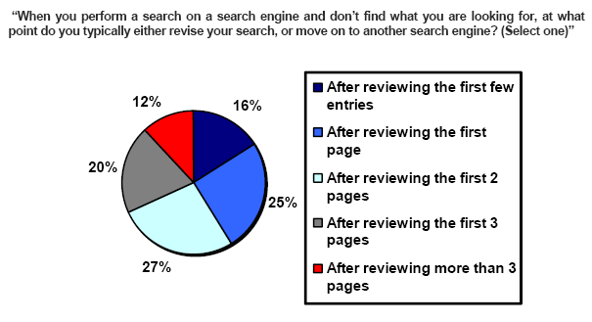
Πόσα αποτελέσματα βλέπουν οι χρήστες
(Source: iprospect.com WhitePaper_2006_SearchEngineUserBehavior.pdf)

Slide 10
Πως μπορούμε να καταλάβουμε τις προθέσεις (intent) του χρήστη;
Guess user intent independent of context:
  Spell correction
  Precomputed “typing” of queries
Better: Guess user intent based on context:
  Geographic context (slide after next)
  Context of user in this session (e.g., previous query)
  Context provided by personal profile (Yahoo/MSN do this, Google claims it doesn’t)

Slide 11
Examples of Typing Queries
Calculation: 5+4
Unit conversion: 1 kg in pounds
Currency conversion: 1 euro in kronor
Tracking number: 8167 2278 6764
Flight info: LH 454
Area code: 650
Map: columbus oh
Stock price: msft
Albums/movies etc: coldplay

Slide 12
Geographical Context
Three relevant locations
Server (nytimes.com → New York)
Web page (nytimes.com article about Albania)
User (located in Palo Alto)
Locating the user
  IP address
  Information provided by user (e.g., in user profile)
  Mobile phone
Geo-tagging: Parse text and identify the coordinates of the geographic entities
Example: East Palo Alto CA → Latitude: 37.47 N, Longitude: 122.14 W
  Important NLP problem

Slide 13
Geographical Context
How to use context to modify query results:
  Result restriction: Don’t consider inappropriate results
    For user on google.fr only show .fr results
  Ranking modulation: use a rough generic ranking, rerank based on personal context
Contextualization / personalization is an area of search with a lot of potential for improvement.

Slide 14
Αξιολόγηση από τους χρήστες
Relevance and validity of results
  Precision at 1? Precision above the fold?
  Comprehensiveness – must be able to deal with obscure queries
    Recall matters when the number of matches is very small
UI (User Interface) – Simple, no clutter, error tolerant
      No annoyances: pop-ups, etc.
Trust – Results are objective
Coverage of topics for polysemic queries
  Diversity, duplicate elimination

Slide 15
Αξιολόγηση από τους χρήστες
Pre/Post process tools provided
  Mitigate user errors (auto spell check, search assist,…)
  Explicit: Search within results, more like this, refine ...
  Anticipative: related searches
Deal with idiosyncrasies
  Web specific vocabulary
    Impact on stemming, spell-check, etc.
  Web addresses typed in the search box

Slide 16
ΔΙΑΦΗΜΙΣΕΙΣ
Κεφ. 19.3

Slide 17
Ads
Graphical graph banners on popular web sites (branding)
cost per mil (CPM) model: the cost of having its banner advertisement displayed 1000 times (also known as impressions)
cost per click (CPC) model: number of clicks on the advertisement (leads to a web page set up to make a purchase)
brand promotion vs transaction-oriented advertising

Slide 18
Brief (non-technical) history
Early keyword-based engines ca. 1995-1997
  Altavista, Excite, Infoseek, Inktomi, Lycos
Paid search ranking: Goto (morphed into Overture.com → Yahoo!)
  Your search ranking depended on how much you paid
  Auction for keywords: casino was expensive!

Slide 19
Ads in Goto
In response to the query q, Goto
return the pages of all advertisers who bid for q, ordered by their bids.
when the user clicked on one of the returned results, the corresponding advertiser payment to Goto
  Initially, payment equal to bid for q
  Sponsored search or Search advertising

Slide 20
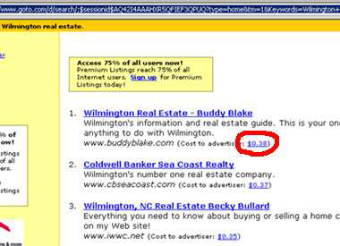
Ads in Goto

Slide 21
Ads
Provide
pure search results (generally known as algorithmic or organic search results) as the primary response to a user’s search,
together with sponsored search results displayed separately and distinctively to the right of the algorithmic results.

Slide 22
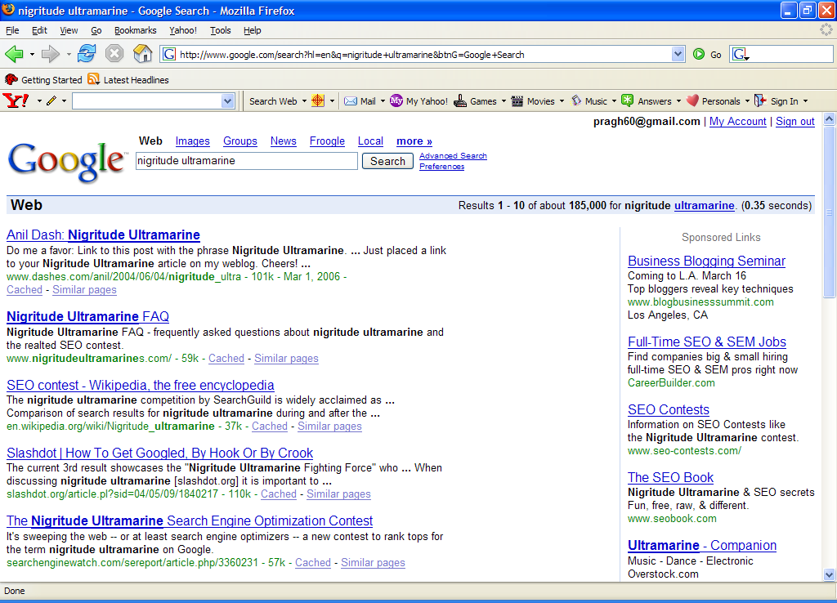
Paid
Search Ads
Algorithmic results.

Slide 23
Ads
Search Engine Marketing (SEM)
Understanding how search engines do ranking and how to allocate marketing campaign budgets to different keywords and to different sponsored search engines
Click spam: clicks on sponsored search results that are not from bona ﬁde search users.
  For instance, a devious advertiser

Slide 24
Ads
Paid inclusion: pay to have one’s web page included
in the search engine’s index
Different search engines have different policies on whether to allow paid inclusion, and whether such a payment has any effect on ranking in search results.
Similar problems with TV/newspapers

Slide 25
How are ads ranked?
Advertisers bid for keywords – sale by auction.
Open system: Anybody can participate and bid on keywords.
Advertisers are only charged when somebody clicks on their ad.
Important area for search engines – computational advertising.
  an additional fraction of a cent from each ad means billions of additional revenue for the search engine.

Slide 26
How are ads ranked?
How does the auction determine an ad’s rank and the price paid for the ad?
  Basis is a second price auction

Slide 27
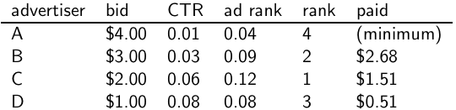
Google’s second price auction
  bid: maximum bid for a click by advertiser
  CTR: click-through rate: when an ad is displayed, what percentage of time do users click on it? CTR is a measure of relevance.
  ad rank: bid × CTR: this trades off (i) how much money the advertiser is willing to pay against (ii) how relevant the ad is
  rank: rank in auction
  paid: second price auction price paid by advertiser
27

Slide 28
Google’s second price auction
  Second price auction: The advertiser pays the minimum amount
  necessary to maintain their position in the auction (plus 1 cent).
  price₁ × CTR₁ = bid₂ × CTR₂ (this will result in rank₁=rank₂)
  price₁ = bid₂ × CTR₂ / CTR₁
  p₁ = bid₂ × CTR₂/CTR₁ = 3.00 × 0.03/0.06 = 1.50
  p₂ = bid₃ × CTR₃/CTR₂ = 1.00 × 0.08/0.03 = 2.67
  p₃ = bid₄ × CTR₄/CTR₃ = 4.00 × 0.01/0.08 = 0.50
28

Slide 29
Keywords with high bids
According to http://www.cwire.org/highest-paying-search-terms/
$69.1 mesothelioma treatment options
$65.9 personal injury lawyer michigan
$62.6 student loans consolidation
$61.4 car accident attorney los angeles
$59.4 online car insurance quotes
$59.4 arizona dui lawyer
$46.4 asbestos cancer
$40.1 home equity line of credit
$39.8 life insurance quotes
$39.2 refinancing
$38.7 equity line of credit
$38.0 lasik eye surgery new york city
$37.0 2nd mortgage
$35.9 free car insurance quote
29

Slide 30
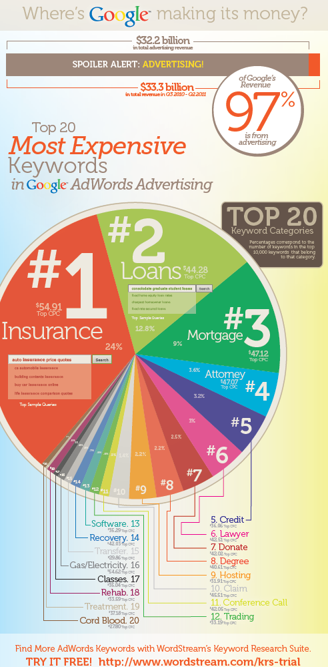
30

Slide 31
Search ads: A win-win-win?
  The search engine company gets revenue every time somebody clicks on an ad.
  The user only clicks on an ad if they are interested in the ad.
    Search engines punish misleading and nonrelevant ads.
    As a result, users are often satisfied with what they find after clicking on an ad.
  The advertiser finds new customers in a cost-effective way.
31

Slide 32
Not a win-win-win: Keyword arbitrage
  Buy a keyword on Google
  Then redirect traffic to a third party that is paying much more than you are paying Google.
    E.g., redirect to a page full of ads
  This rarely makes sense for the user.
  Ad spammers keep inventing new tricks.
  The search engines need time to catch up with them.
32

Slide 33
Not a win-win-win: Violation of trademarks
  Example: geico
  During part of 2005: The search term “geico” on Google was bought by competitors.
  Geico lost this case in the United States.
  Louis Vuitton lost similar case in Europe (2010).
  It’s potentially misleading to users to trigger an ad off of a trademark if the user can’t buy the product on the site.
33

Slide 34
SPAM
(SEARCH ENGINE OPTIMIZATION)

Slide 35
The trouble with paid search ads
Κεφ. 19.2.2
It costs money. What’s the alternative?
Search Engine Optimization (SEO):
  “Tuning” your web page to rank highly in the algorithmic search results for select keywords
  Alternative to paying for placement
  Thus, intrinsically a marketing function
Performed by companies, webmasters and consultants (“Search engine optimizers”) for their clients
Some perfectly legitimate, some very shady

Slide 36
Η απλούστερη μορφή
Κεφ. 19.2.2
Οι μηχανές πρώτης γενιάς βασίζονταν πολύ στο tf/idf
  Οι πρώτες στην κατάταξη ιστοσελίδας για το ερώτημα maui resort ήταν αυτές που περιείχαν τα περισσότερα maui και resort
SEOs απάντησαν με πυκνή επανάληψη των επιλεγμένων όρων
  π.χ., maui resort maui resort maui resort
  Συχνά, οι επαναλήψεις στο ίδιο χρώμα με background της ιστοσελίδα
    Οι επαναλαμβανόμενοι όροι έμπαιναν στο ευρετήριο από crawlers
    Αλλά δεν ήταν ορατοί από τους ανθρώπους στους browsers
Απλή πυκνότητα όρων δεν είναι αξιόπιστο ΑΠ σήμα

Slide 37
Παραλλαγές «keyword stuffing»
Κεφ. 19.2.2
a web page loaded with keywords in the meta tags or in content of a web page (outdated)
Παραπλανητικά meta-tags, υπερβολική επανάληψη
Hidden text with colors, position text behind the image, style sheet tricks, etc.
Meta-Tags =
“… London hotels, hotel, holiday inn, hilton, discount, booking, reservation, sex, mp3, britney spears, viagra, …”

Slide 38
Cloaking (Απόκρυψη)
Κεφ. 19.2.2
Παρέχει διαφορετικό περιεχόμενο ανάλογα αν είναι ο μηχανισμός σταχυολόγησης (search engine spider) ή ο browser κάποιου χρήστη
DNS cloaking: Switch IP address. Impersonate
SPAM
Is this a Search
Engine spider?
N
Y
Real
Doc
Cloaking

Slide 39
Άλλες τεχνικές παραπλάνησης (spam)
Κεφ. 19.2.2
Doorway pages
  Pages optimized for a single keyword that re-direct to the real target page
  If a visitor clicks through to a typical doorway page from a search engine results page, redirected with a fast Meta refresh command to another page.
Lander page:
optimized for a single keyword or a misspelled domain name, designed to attract surfers who will then click on ads

Slide 40
Άλλες τεχνικές παραπλάνησης (spam)
Κεφ. 19.2.2
Link spamming
  Mutual admiration societies, hidden links, awards
  Domain flooding: numerous domains that point or re-direct to a target page
  Pay somebody to put your link on their highly ranked page
  Leave comments that include the link on blogs
Robots (bots)
  Fake query stream – rank checking programs
    “Curve-fit” ranking programs of search engines
  Millions of submissions via Add-Url

Slide 41
The war against spam
Quality signals - Prefer authoritative pages based on:
  Votes from authors (linkage signals)
  Votes from users (usage signals)
Policing of URL submissions
  Anti robot test
Limits on meta-keywords
Robust link analysis
  Ignore statistically implausible linkage (or text)
  Use link analysis to detect spammers (guilt by association)
Spam recognition by machine learning
  Training set based on known spam
Family friendly filters
  Linguistic analysis, general classification techniques, etc.
  For images: flesh tone detectors, source text analysis, etc.
Editorial intervention
  Blacklists
  Top queries audited
  Complaints addressed
  Suspect pattern detection

Slide 42
More on spam
Web search engines have policies on SEO practices they tolerate/block
  http://help.yahoo.com/help/us/ysearch/index.html
  http://www.google.com/intl/en/webmasters/
Adversarial IR (Ανταγωνιστική ανάκτηση πληροφορίας): the unending (technical) battle between SEO’s and web search engines
Research http://airweb.cse.lehigh.edu/
Check out: Webmaster Tools (Google)

Slide 43
SIZE OF THE WEB

Slide 44
Ποιο είναι το μέγεθος του web ?
Κεφ. 19.5
Θέματα
  Στην πραγματικότητα, ο web είναι άπειρος
    Dynamic content, e.g., calendars
    Soft 404: www.yahoo.com/<anything> is a valid page
  Static web contains syntactic duplication, mostly due to mirroring (~30%)
  Some servers are seldom connected
Ποιο νοιάζει;
  Media, and consequently the user
  Σχεδιαστές μηχανών
  Την πολιτική crawl - αντίκτυπο στην ανάκληση.

Slide 45
Τι μπορούμε να μετρήσουμε;
Κεφ. 19.5
Το σχετικό μέγεθος των μηχανών αναζήτησης
  The notion of a page being indexed is still reasonably well defined.
  Already there are problems
    Document extension: e.g., engines index pages not yet crawled, by indexing anchortext.
    Document restriction: All engines restrict what is indexed (first n words, only relevant words, etc.)
    Multi-tier indexes (access only top-levels)

Slide 46
New definition?
Κεφ. 19.5
  The statically indexable web is whatever search engines index.
    IQ is whatever the IQ tests measure.
Different engines have different preferences
    max url depth, max count/host, anti-spam rules, priority rules, etc.
Different engines index different things under the same URL:
    frames, meta-keywords, document restrictions, document extensions, ...

Slide 47
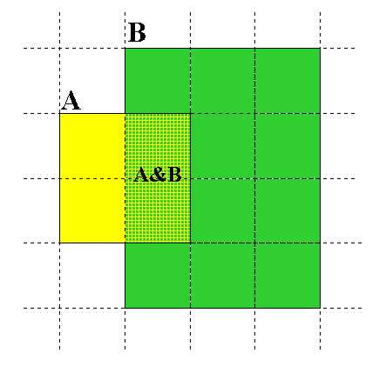
Μέγεθος μηχανών αναζήτησης
Κεφ. 19.5
Relative Size from Overlap
Given two engines A and B
Sample URLs randomly from A
Check if contained in B and vice versa
A ∩ B
A ∩ B = (1/2) * Size A
A ∩ B = (1/6) * Size B
(1/2)*Size A = (1/6)*Size B
∴ Size A / Size B =
(1/6)/(1/2) = 1/3
Each test involves: (i) Sampling (ii) Checking

Slide 48
Δειγματοληψία (Sampling) URLs
Κεφ. 19.5
Ideal strategy: Generate a random URL
Problem: Random URLs are hard to find (and sampling distribution should reflect “user interest”)
Approach 1: Random walks / IP addresses
  In theory: might give us a true estimate of the size of the web (as opposed to just relative sizes of indexes)
Approach 2: Generate a random URL contained in a given engine
  Suffices for accurate estimation of relative size

Slide 49
Statistical methods
Κεφ. 19.5
  Random queries
  Random searches
  Random IP addresses
  Random walks

Slide 50
Random URLs from random queries
Κεφ. 19.5
Generate random query: how?
  Lexicon: 400,000+ words from a web crawl
  Conjunctive Queries: w₁ and w₂
    e.g., vocalists AND rsi
Get 100 result URLs from engine A
Choose a random URL as the candidate to check for presence in engine B
This distribution induces a probability weight W(p) for each page.
Not an English
dictionary

Slide 51
Query Based Checking
Κεφ. 19.5
Either search for the URL if the engine B support this or
Generate a Strong Query to check whether an engine B has a document D:
  Download D. Get list of words.
  Use 8 low frequency words as AND query to B
  Check if D is present in result set.

Slide 52
Advantages & disadvantages
Κεφ. 19.5
Statistically sound under the induced weight.
Biases induced by random query
  Query Bias: Favors content-rich pages in the language(s) of the lexicon
  Ranking Bias: Solution: Use conjunctive queries & fetch all (picking from top 100)
  Checking Bias: Duplicates, impoverished pages omitted
  Document or query restriction bias: engine might not deal properly with 8 words conjunctive query
  Malicious Bias: Sabotage by engine
  Operational Problems: Time-outs, failures, engine inconsistencies, index modification.

Slide 53
Random searches
Κεφ. 19.5
Choose random searches extracted from a local query log [Lawrence & Giles 97] or build “random searches” [Notess]
Use only queries with small result sets.
For each random query: compute ratio size(r1)/size(r2) of the two result sets
Average over random searches

Slide 54
Advantages & disadvantages
Κεφ. 19.5
Advantage
  Might be a better reflection of the human perception of coverage
Issues
  Samples are correlated with source of log (unfair advantage for originating search engine)
  Duplicates
  Technical statistical problems (must have non-zero results, ratio average not statistically sound)

Slide 55
Random searches
Κεφ. 19.5
575 & 1050 queries from the NEC RI employee logs
6 Engines in 1998, 11 in 1999
Implementation:
  Restricted to queries with < 600 results in total
  Counted URLs from each engine after verifying query match
  Computed size ratio & overlap for individual queries
  Estimated index size ratio & overlap by averaging over all queries

Slide 56
Queries from Lawrence and Giles study
Κεφ. 19.5
adaptive access control
neighborhood preservation topographic
hamiltonian structures
right linear grammar
pulse width modulation neural
unbalanced prior probabilities
ranked assignment method
internet explorer favourites importing
karvel thornber
zili liu
softmax activation function
bose multidimensional system theory
gamma mlp
dvi2pdf
john oliensis
rieke spikes exploring neural
video watermarking
counterpropagation network
fat shattering dimension
abelson amorphous computing

Slide 57
Random IP addresses
Κεφ. 19.5
Generate random IP addresses
Find a web server at the given address
  If there’s one
Collect all pages from server
  From this, choose a page at random

Slide 58
Random IP addresses
Κεφ. 19.5
HTTP requests to random IP addresses
  Ignored: empty or authorization required or excluded
  [Lawr99] Estimated 2.8 million IP addresses running crawlable web servers (16 million total) from observing 2500 servers.
  OCLC using IP sampling found 8.7 M hosts in 2001
    Netcraft [Netc02] accessed 37.2 million hosts in July 2002
[Lawr99] exhaustively crawled 2500 servers and extrapolated
  Estimated size of the web to be 800 million pages
  Estimated use of metadata descriptors:
    Meta tags (keywords, description) in 34% of home pages, Dublin core metadata in 0.3%

Slide 59
Advantages & disadvantages
Κεφ. 19.5
Advantages
  Clean statistics
  Independent of crawling strategies
Disadvantages
  Doesn’t deal with duplication
  Many hosts might share one IP (oversampling), or not accept requests
  No guarantee all pages are linked to root page.
    E.g.: employee pages
  Power law for # pages/hosts generates bias towards sites with few pages. (under-sampling)
    But bias can be accurately quantified IF underlying distribution understood
  Potentially influenced by spamming (multiple IP’s for same server to avoid IP block)

Slide 60
Τυχαίοι Περίπατοι (Random walks)
Κεφ. 19.5
Το διαδίκτυο ως ένας κατευθυνόμενος
Ένας τυχαίος περίπατος σε αυτό το γράφο
  Includes various “jump” rules back to visited sites
    Does not get stuck in spider traps!
    Can follow all links!
  Συγκλίνει σε μια κατανομή σταθερής κατάστασης (stationary distribution)
    Must assume graph is finite and independent of the walk.
    Conditions are not satisfied (cookie crumbs, flooding)
    Time to convergence not really known
  Sample from stationary distribution of walk
  Use the “strong query” method to check coverage by SE

Slide 61
Advantages & disadvantages
Κεφ. 19.5
Advantages
  “Statistically clean” method, at least in theory!
  Could work even for infinite web (assuming convergence) under certain metrics.
Disadvantages
  List of seeds is a problem.
  Practical approximation might not be valid.
  Non-uniform distribution
    Subject to link spamming

Slide 62
Size of the web
Κεφ. 19.5
Check out
http://www.worldwidewebsize.com/
The Indexed Web contains at least 3.57 billion pages (Tuesday, 20 May, 2014).

Slide 63
Conclusions
Κεφ. 19.5
No sampling solution is perfect.
Lots of new ideas but the problem is getting harder

Slide 64
ΤΕΛΟΣ 10^{ου} Μαθήματος
Ερωτήσεις?
Χρησιμοποιήθηκε κάποιο υλικό από:
Pandu Nayak and Prabhakar Raghavan, CS276:Information Retrieval and Web Search (Stanford)
Hinrich Schütze and Christina Lioma, Stuttgart IIR class

