Slide 1
ΠΛΕ70: Ανάκτηση Πληροφορίας
Διδάσκουσα: Ευαγγελία Πιτουρά
Διάλεξη 9: Βασικές Αρχές Αναζήτησης στον Παγκόσμιο Ιστό.

Slide 2
Τι θα δούμε σήμερα;
Κεφ. 19
Ιστορικά στοιχεία και γενικές πληροφορίες
Πόσο μεγάλος είναι ο Ιστός;
Διαφημίσεις, spam
Διπλότυπες σελίδες

Slide 3
Web (WWW)
World Wide Web (World-Wide Web, WWW, W3, ή the Web) είναι μια συλλογή από έγγραφα κειμένου και άλλες πηγές (web σελίδες - ιστοσελίδες), που είναι συνδεδεμένα hyperlinks και URLs,
hosted web servers
viewed or navigated via hyperlinks with web browsers.
63 billion pages
1 trillion unique web addresses

Slide 4
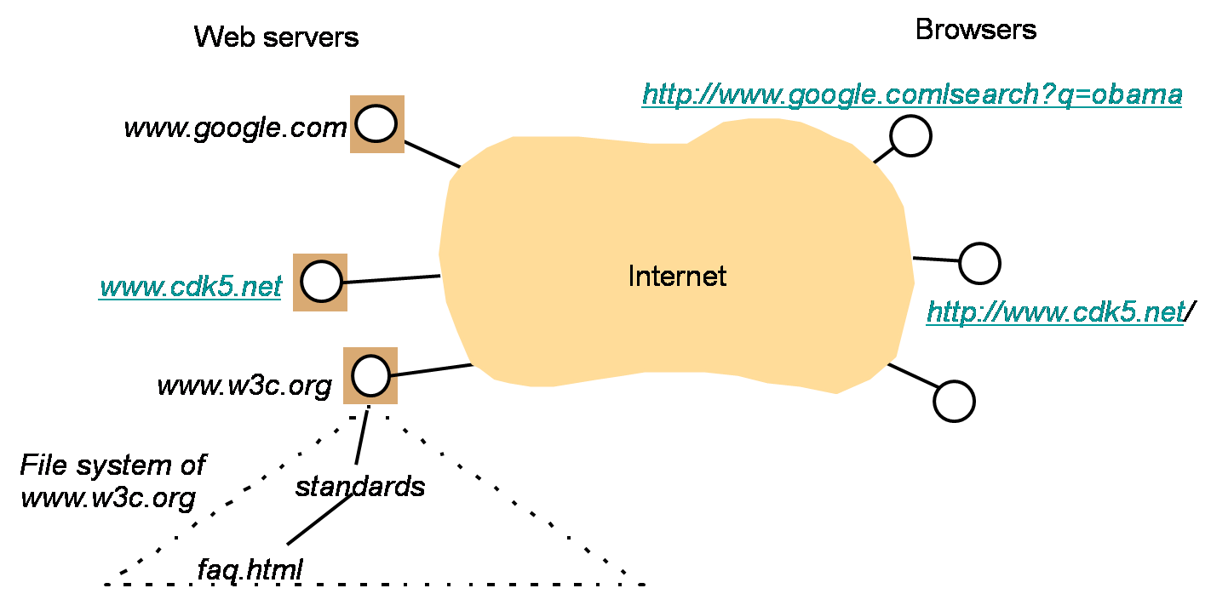
Web (WWW): Function
Client-server model
HTTP protocol
HTML

Slide 5
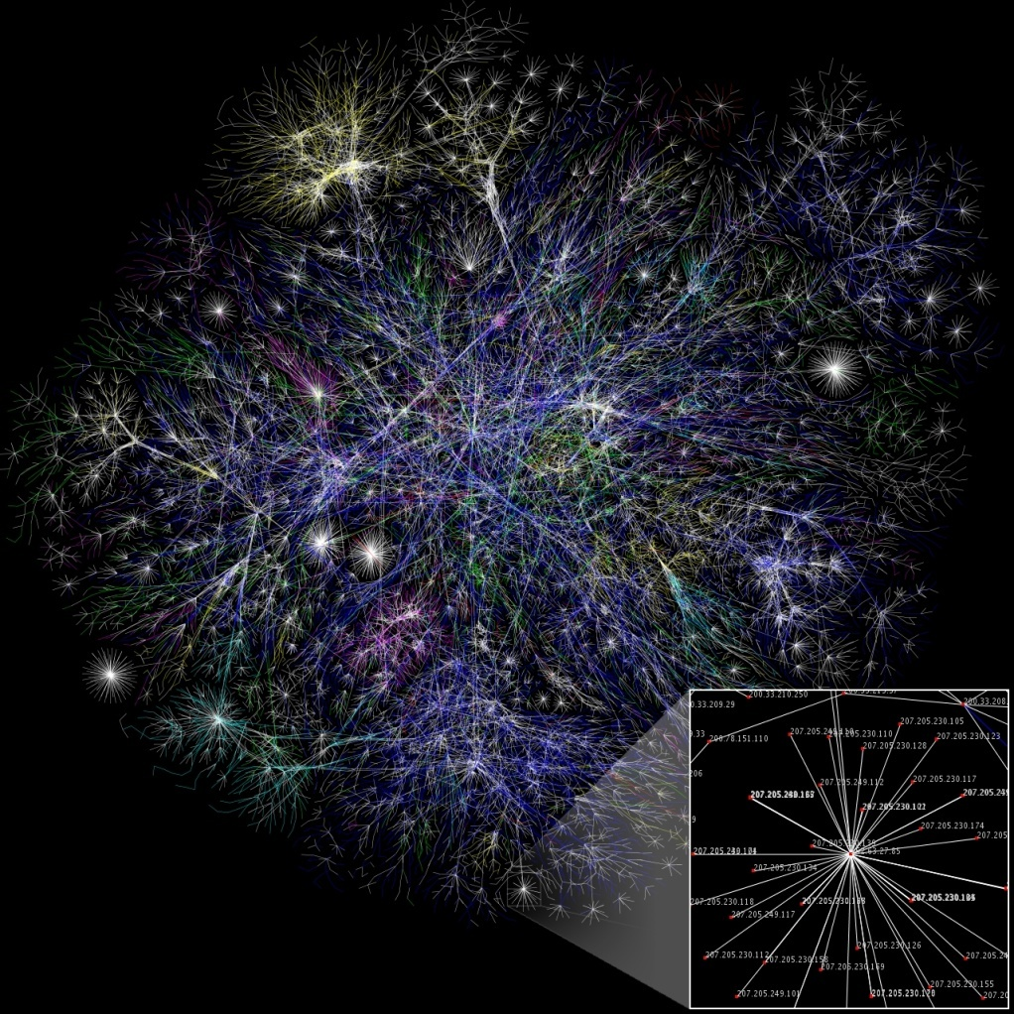
Internet
Το διαδίκτυο (Internet) είναι ολικό σύστημα δια-συνδεδεμένων δικτύων υπολογιστών που χρησιμοποιούν ένα standard Internet protocol suite (TCP/IP)
Το Web είναι μια εφαρμογή που τρέχει πάνω στο Internet

Slide 6
Web (WWW): Function
Viewing a web page
either by typing the URL of the page into a web browser or
by following a hyperlink to that page or resource.
The web browser then initiates a series of communication messages, to fetch and display it.

Slide 7
Web (WWW): Function
URL http://en.wikipedia.org/wiki/World_Wide_Web .
1. Browser resolves the server-name portion of the URL into an IP (Internet Protocol) address using the globally distributed database known as the Domain Name System (DNS)
[returns an IP address such as 208.80.152.2.]
URL – (DNS) -> IP address

Slide 8
Web (WWW): Function
URL http://en.wikipedia.org/wiki/World_Wide_Web .
2. Browser then requests the resource by sending an HTTP request across the Internet to the computer at that particular address.
It makes the request to a particular application port in the underlying IP normally port 80. The content of the HTTP request can be as simple as the two lines of text
Domain/file-under-the-root-directory of the server
GET /wiki/World_Wide_Web HTTP/1.1 Host: en.wikipedia.org

Slide 9
Web (WWW): Function
1. The computer receiving the HTTP request delivers it to Web server software listening for requests on port 80.
2. If the web server can fulfill the request it sends an HTTP response back to the browser indicating success, which can be as simple as
followed by the content of the requested page.
HTTP/1.0 200 OK Content-Type: text/html; charset=UTF-8

Slide 10
Web (WWW): Function
The Hypertext Markup Language for a basic web page
<html>
<head>
<title> World Wide Web — Wikipedia, the free encyclopedia </title>
</head>
<body> <p>
The World Wide Web, abbreviated as WWW and commonly known ...</p> </body>
</html>
The web browser parses the HTML, interpreting the markup (<title>, <p> for paragraph, and such) to draw that text on the screen.
Ignores what it cannot understand

Slide 11
Web (WWW): Function
Many web pages consist of more elaborate HTML which references the URLs of other resources such as images, other embedded media, scripts that affect page behavior, and Cascading Style Sheets that affect page layout.
(Asynchronous) A browser that handles complex HTML will make additional HTTP requests to the web server for these other Internet media types.
As it receives their content from the web server, the browser progressively renders the page onto the screen as specified by its HTML and these additional resources.

Slide 12
Web (WWW): Linking
Most web pages contain hyperlinks to other related pages and perhaps to downloadable files, source documents, definitions and other web resources
In the underlying HTML, a hyperlink looks like
<a href="http://www.w3.org/History/19921103hypertext/hypertext/WWW/">Early archive of the first Web site</a>
The hyperlink structure of the WWW described by the web graph

Slide 13
Web (WWW): Ιστορία
Στο τεύχος του Ιουνίου 1970 του περιοδικού Popular Science
Arthur C. Clarke
satellites would one day "bring the accumulated knowledge of the world to your fingertips" using a console that would combine the functionality of the Xerox, telephone, television and a small computer, allowing data transfer and video conferencing around the globe.

Slide 14
Web (WWW): History
1980, Tim Berners-Lee a proposal that referenced ENQUIRE, a database and software project he had built in 1980
November 1990, with Robert Cailliau, a more formal proposal to build a "Hypertext project" called "WorldWideWeb" (one word, also "W3") as a "web" of "hypertext documents" to be viewed by "browsers" using a client–server architecture.
Estimated that a read-only web would be developed within 3 months and that it would take 6 months to achieve "the creation of new links and new material by readers, [so that]
"authorship becomes universal" as well as "the automatic notification of a reader when new material of interest to him/her has become available.“

Slide 15
Web (WWW): History
By Christmas 1990, all tools for a working Web:
the first web browser (which was a web editor as well);
the first web server and
the first web pages, which described the project itself.
August 6, 1991, post on alt.hypertext newsgroup -> the debut of the Web as a publicly available service on the Internet.

Slide 16



Web (WWW): History
Ο πρώτος web server (και πρώτος web browser): A NeXT Computer -
Η πρώτη φωτογραφία στο web το 1992 (CERN house band Les Horribles Cernettes)
The Web's historic logo designed by Robert Cailliau

Slide 17
Web (WWW): History, why in CERN?
Web as a "Side Effect" of the 40 years of Particle Physics Experiments.
After the World War 2. the nuclear centers of almost all developed countries became the places with the highest concentration of talented scientists.
For about four decades many of them were invited to the international CERN's Laboratories.

Slide 18
Web (WWW): History
Berners-Lee's breakthrough: marry hypertext to the Internet
3 essential technologies:
a system of globally unique identifiers for resources on the Web and elsewhere, the Universal Document Identifier (UDI), later known as Uniform Resource Locator (URL) and Uniform Resource Identifier (URI);
the publishing language HyperText Markup Language (HTML);
the Hypertext Transfer Protocol (HTTP)

Slide 19
Web (WWW): History
Differences from other hypertext systems
required only unidirectional links rather than bidirectional ones.
  (+) possible for someone to link to another resource without action by the owner of that resource
  (+) reduced the difficulty of implementing web servers and browsers (in comparison to earlier systems)
  (-) presented the chronic problem of link rot (or dead links).
was non-proprietary (unlike, e.g., HyperCard)
  making it possible to develop servers and clients independently and to add extensions without licensing restrictions.
  On April 30, 1993, CERN announced that the World Wide Web would be free to anyone, with no fees due. Coming two months after the announcement that the server implementation of the Gopher protocol was no longer free to use, this produced a rapid shift away from Gopher and towards the Web.

Slide 20
Web (WWW): History
Early popular web browser was ViolaWWW for Unix and the X Windowing System.
In 1993, Mosaic web browser, a graphical browser developed by a team at the National Center for Supercomputing Applications at the University of Illinois at Urbana-Champaign (NCSA-UIUC), led by Marc Andreessen.
Prior to the release of Mosaic, graphics were not commonly mixed with text in web pages

Slide 21
Web (WWW): History
The World Wide Web Consortium (W3C) was founded by Tim Berners-Lee after he left (CERN) in October 1994.
World Wide Web and Internet

Slide 22

Web2.0
A Web 2.0 site allows users to interact and collaborate
(prosumers) of user-generated content in a virtual community,
Examples of Web 2.0 include social networking sites, blogs, wikis, video sharing sites, hosted services, web applications, mashups and folksonomies.

Slide 23
Web.2: History
The term "Web 2.0" was first used in January 1999 by Darcy DiNucci, a consultant on electronic information design (information architecture). In her article, "Fragmented Future", DiNucci writes:
The Web we know now, which loads into a browser window in essentially static screenfuls, is only an embryo of the Web to come. The first glimmerings of Web 2.0 are beginning to appear, and we are just starting to see how that embryo might develop.
The Web will be understood not as screenfuls of text and graphics but as a transport mechanism, the ether through which interactivity happens. It will [...] appear on your computer screen, [...] on your TV set [...] your car dashboard [...] your cell phone [...] hand-held game machines [...] maybe even your microwave oven.

Slide 24
Web.2: History
In 2003, rise in popularity when O'Reilly Media and MediaLive hosted the first Web 2.0 conference.
In their opening remarks, John Battelle and Tim O'Reilly outlined their definition of the "Web as Platform", where software applications are built upon the Web as opposed to upon the desktop.

Slide 25
Web.2: History
In the 2006 , TIME magazine Person of The Year (You).
TIME selected the masses of users who were participating in content creation on social networks, blogs, wikis, and media sharing sites.
In the cover story, Lev Grossman:
It's a story about community and collaboration on a scale never seen before. It's about the cosmic compendium of knowledge Wikipedia and the million-channel people's network YouTube and the online metropolis MySpace. It's about the many wresting power from the few and helping one another for nothing and how that will not only change the world but also change the way the world changes.
In 2009, Global Language Monitor declare Web2.0 to be the one-millionth English word

Slide 26
The Web document collection
Κεφ. 19.2
No design/co-ordination
Distributed content creation, linking, democratization of publishing
Content includes truth, lies, obsolete information, contradictions …
Unstructured (text, html, …), semi-structured (XML, annotated photos), structured (Databases)…
Scale much larger than previous text collections … but corporate records are catching up
Growth – slowed down from initial “volume doubling every few months” but still expanding
Content can be dynamically generated
The Web

Slide 27
Search Engines
Full text search (Altavista, Excite, Infoseek)
Taxonomies (Yahoo!) – browse through a hierarchical tree with category labels
About.com Open Directory Project

Slide 28
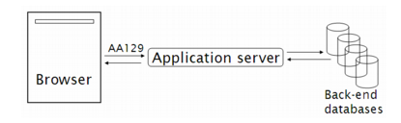
Dynamic vs static web pages
Hidden web – Deep web
Personal web site vs airport flight status
URL: not a file but a program on the server
Input part of the GET, e.g., http//www.google.com/search?q=obama

Slide 29

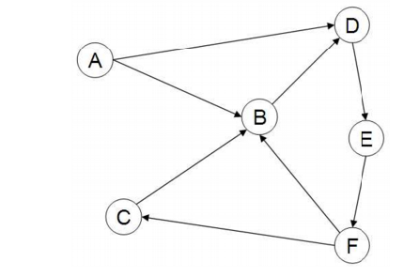
The Web graph
Anchor text <a></a>
In-links/Out-links
In-degree (8-15)
Out-degree

Slide 30
The Web Graph
the distribution of in-degrees not Poisson distribution (if every web page were to pick the destinations of its links uniformly at random).
Power law,
the total number of web pages with in-degree i is proportional to 1/i^{α}
α typically 2.1

Slide 31
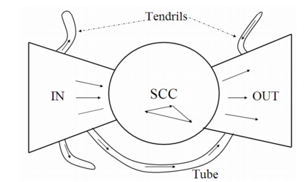
The Web graph
Bowtie shape
Three major categories of web pages
IN, OUT, SCC
A web surfer can pass by following hyperlinks
from any page in IN to any page in SCC,
from any page in SCC to any page in OUT.
from any page in SCC to any other page in SCC.
not possible to pass from a page in SCC to any page in IN, a page in OUT to a page in SCC (or, consequently, IN).

Slide 32
The Web graph
IN, OUT same size, SCC larger
Remaining pages:
Tubes: small sets of pages outside SCC that
lead directly from IN to OUT,
Tendrils: either lead nowhere from IN, or from nowhere to OUT.

Slide 33

Web search basics
Κεφ. 19.4.1
User
Web spider
Search
Indexer
The Web
Indexes
Ad indexes

Slide 34
ΟΙ ΧΡΗΣΤΕΣ

Slide 35
Ανάγκες Χρηστών
Κεφ. 19.4.1
Ποιοι είναι οι χρήστες;
Μέσος αριθμός λέξεων ανά αναζήτηση 2-3

Slide 36
Ανάγκες Χρηστών
Κεφ. 19.4.1
Need [Brod02, RL04]
  Informational (πληροφοριακά ερωτήματα) – θέλουν να μάθουν (learn) για κάτι (~40% / 65%)
    Συνήθως, όχι μια μοναδική ιστοσελίδα, συνδυασμός πληροφορίας από πολλές ιστοσελίδες
  Navigational (ερωτήματα πλοήγησης) – θέλουν να πάνε (go) σε μια συγκεκριμένη ιστοσελίδα (~25% / 15%)
    Μια μοναδική ιστοσελίδα, το καλύτερο μέτρο ακρίβεια ίση με 1 (δεν ενδιαφέρονται γενικά για ιστοσελίδες που περιέχουν τους όρους United Airlines
Low hemoglobin
United Airlines

Slide 37
Ανάγκες Χρηστών
Κεφ. 19.4.1
  Transactional (ερωτήματα συναλλαγής) – θέλουν να κάνουν (do) κάτι (σχετιζόμενο με το web) (~35% / 20%)
    Προσπελάσουν μια υπηρεσία (Access a service)
    Να κατεβάσουν ένα αρχείο (Downloads)
    Να αγοράσουν κάτι
  Γρι περιοχές (Gray areas)
    Find a good hub
    Exploratory search “see what’s there”
Seattle weather
Mars surface images
Canon S410
Car rental Brasil

Slide 38
Ανάγκες Χρηστών
Κεφ. 19.4.1
Επηρεάζει (ανάμεσα σε άλλα)
την καταλληλότητα του ερωτήματος για την παρουσίαση διαφημίσεων
τον αλγόριθμο/αξιολόγηση, για παράδειγμα για ερωτήματα πλοήγησης ένα αποτέλεσμα ίσως αρκεί, για τα άλλα (και κυρίως πληροφοριακά) ενδιαφερόμαστε για την περιεκτικότητα/ανάκληση

Slide 39
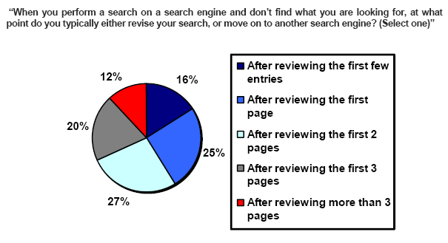
Πόσα αποτελέσματα βλέπουν οι χρήστες
(Source: iprospect.com WhitePaper_2006_SearchEngineUserBehavior.pdf)

Slide 40
Αξιολόγηση από τους χρήστες
Relevance and validity of results
  Precision at 1? Precision above the fold?
  Comprehensiveness – must be able to deal with obscure queries
    Recall matters when the number of matches is very small
UI (User Interface) – Simple, no clutter, error tolerant
      No annoyances: pop-ups, etc.
Trust – Results are objective
Coverage of topics for polysemic queries
  Diversity, duplicate elimination

Slide 41
Αξιολόγηση από τους χρήστες
Pre/Post process tools provided
  Mitigate user errors (auto spell check, search assist,…)
  Explicit: Search within results, more like this, refine ...
  Anticipative: related searches
Deal with idiosyncrasies
  Web specific vocabulary
    Impact on stemming, spell-check, etc.
  Web addresses typed in the search box

Slide 42
ΔΙΑΦΗΜΙΣΕΙΣ

Slide 43
Brief (non-technical) history
Early keyword-based engines ca. 1995-1997
  Altavista, Excite, Infoseek, Inktomi, Lycos
Paid search ranking: Goto (morphed into Overture.com → Yahoo!)
  Your search ranking depended on how much you paid
  Auction for keywords: casino was expensive!

Slide 44
Ads in Goto
In response to the query q, Goto would return the pages of all advertisers
who bid for q, ordered by their bids.
when the user clicked on one of the returned results, the corresponding advertiser payment to Goto
  Initially, payment equal to bid for q
  Sponsored search or Search advertising

Slide 45
Ads
Graphical graph banners on popular web sites (branding)
cost per mil (CPM) model: the cost of having its banner advertisement displayed 1000 times (also known as impressions)
cost per click (CPC) model: number of clicks on the advertisement (leads to a web page set up to make a purchase)
brand promotion vs and transaction-oriented advertising

Slide 46
Ads
Provide
pure search results (generally known as algorithmic search results) as the primary response to a user’s search,
together with sponsored search results displayed separately and distinctively to the right of the algorithmic results.

Slide 47
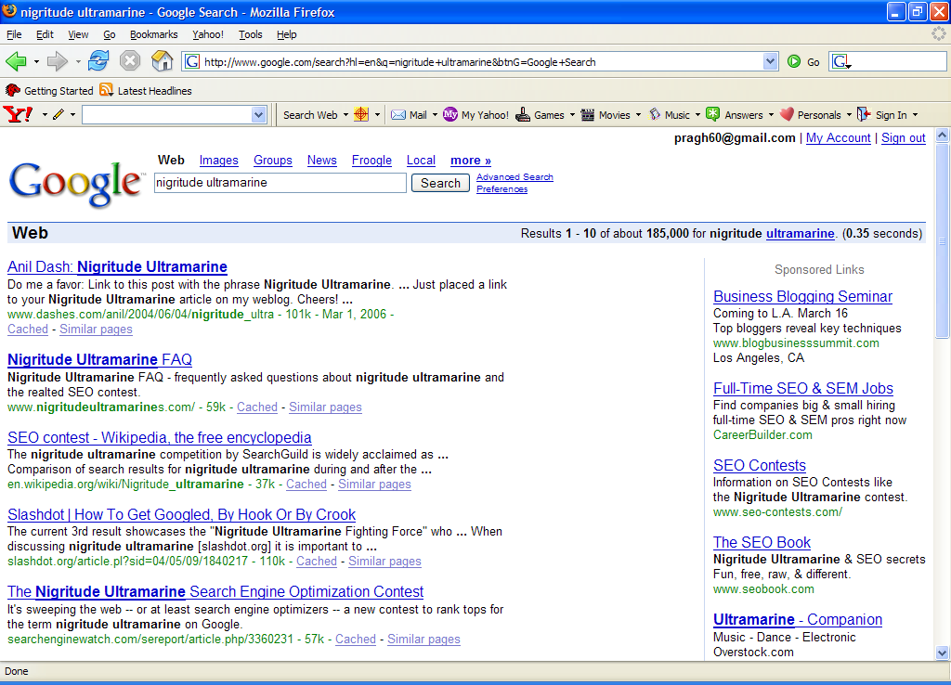
Paid
Search Ads
Algorithmic results.

Slide 48
Ads
Search Engine Marketing (SEM)
Understanding how search engines do ranking and how to allocate marketing campaign budgets to different keywords and to different sponsored search engines
Click spam: clicks on sponsored search results that are not from bona ﬁde search users.
  For instance, a devious advertiser

Slide 49
Ads
Paid inclusion: pay to have one’s web page included
in the search engine’s index
Different search engines have different policies on whether to allow paid inclusion, and whether such a payment has any effect on ranking in search results.

Slide 50
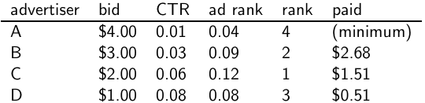
Google’s second price auction
  bid: maximum bid for a click by advertiser
  CTR: click-through rate: when an ad is displayed, what percentage of time do users click on it? CTR is a measure of relevance.
  ad rank: bid × CTR: this trades off (i) how much money the advertiser is willing to pay against (ii) how relevant the ad is
  rank: rank in auction
  paid: second price auction price paid by advertiser
50

Slide 51
Google’s second price auction
  Second price auction: The advertiser pays the minimum amount
  necessary to maintain their position in the auction (plus 1 cent).
  price₁ × CTR₁ = bid₂ × CTR₂ (this will result in rank₁=rank₂)
  price₁ = bid₂ × CTR₂ / CTR₁
  p₁ = bid₂ × CTR₂/CTR₁ = 3.00 × 0.03/0.06 = 1.50
  p₂ = bid₃ × CTR₃/CTR₂ = 1.00 × 0.08/0.03 = 2.67
  p₃ = bid₄ × CTR₄/CTR₃ = 4.00 × 0.01/0.08 = 0.50
51

Slide 52
Keywords with high bids
According to http://www.cwire.org/highest-paying-search-terms/
$69.1 mesothelioma treatment options
$65.9 personal injury lawyer michigan
$62.6 student loans consolidation
$61.4 car accident attorney los angeles
$59.4 online car insurance quotes
$59.4 arizona dui lawyer
$46.4 asbestos cancer
$40.1 home equity line of credit
$39.8 life insurance quotes
$39.2 refinancing
$38.7 equity line of credit
$38.0 lasik eye surgery new york city
$37.0 2nd mortgage
$35.9 free car insurance quote
52

Slide 53
Search ads: A win-win-win?
  The search engine company gets revenue every time somebody clicks on an ad.
  The user only clicks on an ad if they are interested in the ad.
    Search engines punish misleading and nonrelevant ads.
    As a result, users are often satisfied with what they find after clicking on an ad.
  The advertiser finds new customers in a cost-effective way.
53

Slide 54
Exercise
  Why is web search potentially more attractive for advertisers than TV spots, newspaper ads or radio spots?
  The advertiser pays for all this. How can the advertiser be cheated?
  Any way this could be bad for the user?
  Any way this could be bad for the search engine?
54

Slide 55
Not a win-win-win: Keyword arbitrage
  Buy a keyword on Google
  Then redirect traffic to a third party that is paying much more than you are paying Google.
    E.g., redirect to a page full of ads
  This rarely makes sense for the user.
  Ad spammers keep inventing new tricks.
  The search engines need time to catch up with them.
55

Slide 56
Not a win-win-win: Violation of trademarks
  Example: geico
  During part of 2005: The search term “geico” on Google was bought by competitors.
  Geico lost this case in the United States.
  Louis Vuitton lost similar case in Europe.
  See http://google.com/tm complaint.html
  It’s potentially misleading to users to trigger an ad off of a trademark if the user can’t buy the product on the site.
56

Slide 57
SPAM
(SEARCH ENGINE OPTIMIZATION)

Slide 58
The trouble with paid search ads
Κεφ. 19.2.2
It costs money. What’s the alternative?
Search Engine Optimization (SEO):
  “Tuning” your web page to rank highly in the algorithmic search results for select keywords
  Alternative to paying for placement
  Thus, intrinsically a marketing function
Performed by companies, webmasters and consultants (“Search engine optimizers”) for their clients
Some perfectly legitimate, some very shady

Slide 59
Search engine optimization (Spam)
Κεφ. 19.2.2
Motives
  Commercial, political, religious, lobbies
  Promotion funded by advertising budget
Operators
  Contractors (Search Engine Optimizers) for lobbies, companies
  Web masters
  Hosting services
Forums
  E.g., Web master world ( www.webmasterworld.com )
    Search engine specific tricks
    Discussions about academic papers ☺

Slide 60
Η απλούστερη μορφή
Κεφ. 19.2.2
Οι μηχανές πρώτης γενιάς βασίζονταν πολύ στο tf/idf
  Οι πρώτες στην κατάταξη ιστοσελίδας για το ερώτημα maui resort ήταν αυτές που περιείχαν τα περισσότερα maui και resort
SEOs απάντησαν με πυκνή επανάληψη των επιλεγμένων όρων
  π.χ., maui resort maui resort maui resort
  Συχνά, οι επαναλήψεις στο ίδιο χρώμα με background της ιστοσελίδα
    Οι επαναλαμβανόμενοι όροι έμπαιναν στο ευρετήριο από crawlers
    Αλλά δεν ήταν ορατοί από τους ανθρώπους στους browsers
Απλή πυκνότητα όρων δεν είναι αξιόπιστο ΑΠ σήμα

Slide 61
Παραλλαγές «keyword stuffing»
Κεφ. 19.2.2
a web page loaded with keywords in the meta tags or in content of a web page (outdated)
Παραπλανητικά meta-tags, υπερβολική επανάληψη
Hidden text with colors, position text behind the image, style sheet tricks, etc.
Meta-Tags =
“… London hotels, hotel, holiday inn, hilton, discount, booking, reservation, sex, mp3, britney spears, viagra, …”

Slide 62
Cloaking (Απόκρυψη)
Κεφ. 19.2.2
Παρέχει διαφορετικό περιεχόμενο ανάλογα αν είναι ο μηχανισμός σταχυολόγησης (search engine spider) ή ο browser κάποιου χρήστη
DNS cloaking: Switch IP address. Impersonate
SPAM
Is this a Search
Engine spider?
N
Y
Real
Doc
Cloaking

Slide 63
Άλλες τεχνικές παραπλάνησης (spam)
Κεφ. 19.2.2
Doorway pages
  Pages optimized for a single keyword that re-direct to the real target page
  If a visitor clicks through to a typical doorway page from a search engine results page, redirected with a fast Meta refresh command to another page.
Link spamming
  Mutual admiration societies, hidden links, awards – more on these later
  Domain flooding: numerous domains that point or re-direct to a target page
Robots (bots)
  Fake query stream – rank checking programs
    “Curve-fit” ranking programs of search engines
  Millions of submissions via Add-Url

Slide 64
The war against spam
Quality signals - Prefer authoritative pages based on:
  Votes from authors (linkage signals)
  Votes from users (usage signals)
Policing of URL submissions
  Anti robot test
Limits on meta-keywords
Robust link analysis
  Ignore statistically implausible linkage (or text)
  Use link analysis to detect spammers (guilt by association)
Spam recognition by machine learning
  Training set based on known spam
Family friendly filters
  Linguistic analysis, general classification techniques, etc.
  For images: flesh tone detectors, source text analysis, etc.
Editorial intervention
  Blacklists
  Top queries audited
  Complaints addressed
  Suspect pattern detection

Slide 65
More on spam
Web search engines have policies on SEO practices they tolerate/block
  http://help.yahoo.com/help/us/ysearch/index.html
  http://www.google.com/intl/en/webmasters/
Adversarial IR (Ανταγωνιστική ανάκτηση πληροφορίας): the unending (technical) battle between SEO’s and web search engines
Research http://airweb.cse.lehigh.edu/
Check out: Webmaster Tools (Google)

Slide 66
SIZE OF THE WEB

Slide 67
Ποιο είναι το μέγεθος του web ?
Κεφ. 19.5
Θέματα
  Στην πραγματικότητα, ο web είναι άπειρος
    Dynamic content, e.g., calendars
    Soft 404: www.yahoo.com/<anything> is a valid page
  Static web contains syntactic duplication, mostly due to mirroring (~30%)
  Some servers are seldom connected
Ποιο νοιάζει;
  Media, and consequently the user
  Σχεδιαστές μηχανών
  Την πολιτική crawl Αντίκτυπο στην ανάκληση.

Slide 68
Τι μπορούμε να μετρήσουμε;
Κεφ. 19.5
Το σχετικό μέγεθος των μηχανών αναζήτησης
  The notion of a page being indexed is still reasonably well defined.
  Already there are problems
    Document extension: e.g., engines index pages not yet crawled, by indexing anchortext.
    Document restriction: All engines restrict what is indexed (first n words, only relevant words, etc.)
    Multi-tier indexes (access only top-levels)

Slide 69
New definition?
Κεφ. 19.5
  The statically indexable web is whatever search engines index.
    IQ is whatever the IQ tests measure.
Different engines have different preferences
    max url depth, max count/host, anti-spam rules, priority rules, etc.
Different engines index different things under the same URL:
    frames, meta-keywords, document restrictions, document extensions, ...

Slide 70
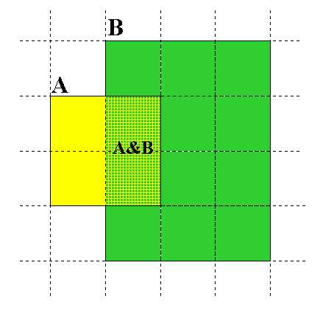
Μέγεθος μηχανών αναζήτησης
Κεφ. 19.5
Relative Size from Overlap
Given two engines A and B
Sample URLs randomly from A
Check if contained in B and vice versa
A ∩ B
A ∩ B = (1/2) * Size A
A ∩ B = (1/6) * Size B
(1/2)*Size A = (1/6)*Size B
∴ Size A / Size B =
(1/6)/(1/2) = 1/3
Each test involves: (i) Sampling (ii) Checking

Slide 71
Δειγματοληψία (Sampling) URLs
Κεφ. 19.5
Ιδανική στρατηγική: Παρήγαγε ένα τυχαίο URL και έλεγξε αν περιλαμβάνετε σε κάθε ευρετήριο.
Problem: Random URLs are hard to find! Enough to generate a random URL contained in a given Engine.
Approach 1: Generate a random URL contained in a given engine
  Suffices for the estimation of relative size
Approach 2: Random walks / IP addresses
  In theory: might give us a true estimate of the size of the web (as opposed to just relative sizes of indexes)

Slide 72
Statistical methods
Κεφ. 19.5
Approach 1
  Random queries
  Random searches
Approach 2
  Random IP addresses
  Random walks

Slide 73
Random URLs from random queries
Κεφ. 19.5
Generate random query: how?
  Lexicon: 400,000+ words from a web crawl
  Conjunctive Queries: w₁ and w₂
    e.g., vocalists AND rsi
Get 100 result URLs from engine A
Choose a random URL as the candidate to check for presence in engine B
This distribution induces a probability weight W(p) for each page.
Not an English
dictionary

Slide 74
Query Based Checking
Κεφ. 19.5
Strong Query to check whether an engine B has a document D:
  Download D. Get list of words.
  Use 8 low frequency words as AND query to B
  Check if D is present in result set.

Slide 75
Advantages & disadvantages
Κεφ. 19.5
Statistically sound under the induced weight.
Biases induced by random query
  Query Bias: Favors content-rich pages in the language(s) of the lexicon
  Ranking Bias: Solution: Use conjunctive queries & fetch all
  Checking Bias: Duplicates, impoverished pages omitted
  Document or query restriction bias: engine might not deal properly with 8 words conjunctive query
  Malicious Bias: Sabotage by engine
  Operational Problems: Time-outs, failures, engine inconsistencies, index modification.

Slide 76
Random searches
Κεφ. 19.5
Choose random searches extracted from a local query log [Lawrence & Giles 97] or build “random searches” [Notess]
  Use only queries with small result sets.
  Count normalized URLs in result sets.
  Use ratio statistics

Slide 77
Advantages & disadvantages
Κεφ. 19.5
Advantage
  Might be a better reflection of the human perception of coverage
Issues
  Samples are correlated with source of log
  Duplicates
  Technical statistical problems (must have non-zero results, ratio average not statistically sound)

Slide 78
Random searches
Κεφ. 19.5
575 & 1050 queries from the NEC RI employee logs
6 Engines in 1998, 11 in 1999
Implementation:
  Restricted to queries with < 600 results in total
  Counted URLs from each engine after verifying query match
  Computed size ratio & overlap for individual queries
  Estimated index size ratio & overlap by averaging over all queries

Slide 79
Queries from Lawrence and Giles study
Κεφ. 19.5
adaptive access control
neighborhood preservation topographic
hamiltonian structures
right linear grammar
pulse width modulation neural
unbalanced prior probabilities
ranked assignment method
internet explorer favourites importing
karvel thornber
zili liu
softmax activation function
bose multidimensional system theory
gamma mlp
dvi2pdf
john oliensis
rieke spikes exploring neural
video watermarking
counterpropagation network
fat shattering dimension
abelson amorphous computing

Slide 80
Random IP addresses
Κεφ. 19.5
Generate random IP addresses
Find a web server at the given address
  If there’s one
Collect all pages from server
  From this, choose a page at random

Slide 81
Random IP addresses
Κεφ. 19.5
HTTP requests to random IP addresses
  Ignored: empty or authorization required or excluded
  [Lawr99] Estimated 2.8 million IP addresses running crawlable web servers (16 million total) from observing 2500 servers.
  OCLC using IP sampling found 8.7 M hosts in 2001
    Netcraft [Netc02] accessed 37.2 million hosts in July 2002
[Lawr99] exhaustively crawled 2500 servers and extrapolated
  Estimated size of the web to be 800 million pages
  Estimated use of metadata descriptors:
    Meta tags (keywords, description) in 34% of home pages, Dublin core metadata in 0.3%

Slide 82
Advantages & disadvantages
Κεφ. 19.5
Advantages
  Clean statistics
  Independent of crawling strategies
Disadvantages
  Doesn’t deal with duplication
  Many hosts might share one IP, or not accept requests
  No guarantee all pages are linked to root page.
    E.g.: employee pages
  Power law for # pages/hosts generates bias towards sites with few pages.
    But bias can be accurately quantified IF underlying distribution understood
  Potentially influenced by spamming (multiple IP’s for same server to avoid IP block)

Slide 83
Τυχαίοι Περίπατοι (Random walks)
Κεφ. 19.5
Το διαδίκτυο ως ένας κατευθυνόμενος
Ένας τυχαίος περίπατος σε αυτό το γράφο
  Includes various “jump” rules back to visited sites
    Does not get stuck in spider traps!
    Can follow all links!
  Συγκλίνει σε μια κατανομή σταθερής κατάστασης (stationary distribution)
    Must assume graph is finite and independent of the walk.
    Conditions are not satisfied (cookie crumbs, flooding)
    Time to convergence not really known
  Sample from stationary distribution of walk
  Use the “strong query” method to check coverage by SE

Slide 84
Advantages & disadvantages
Κεφ. 19.5
Advantages
  “Statistically clean” method, at least in theory!
  Could work even for infinite web (assuming convergence) under certain metrics.
Disadvantages
  List of seeds is a problem.
  Practical approximation might not be valid.
  Non-uniform distribution
    Subject to link spamming

Slide 85
Size of the web
Κεφ. 19.5
Check out
http://www.worldwidewebsize.com/

Slide 86
Conclusions
Κεφ. 19.5
No sampling solution is perfect.
Lots of new ideas ...
....but the problem is getting harder
Quantitative studies are fascinating and a good research problem

Slide 87
DUPLICATE DETECTION
Κεφ. 19.6

Slide 88
Duplicate documents
Κεφ. 19.6
The web is full of duplicated content
Strict duplicate detection = exact match
  Not as common
But many, many cases of near duplicates
  E.g., last-modified date the only difference between two copies of a page

Slide 89
Duplicate/Near-Duplicate Detection
Κεφ. 19.6
Duplication: Exact match can be detected with fingerprints
Near-Duplication: Approximate match
  Overview
    Compute syntactic similarity with an edit-distance measure
    Use similarity threshold to detect near-duplicates
      E.g., Similarity > 80% => Documents are “near duplicates”
      Not transitive though sometimes used transitively

Slide 90
Computing Similarity
Κεφ. 19.6
Features:
  Segments of a document (natural or artificial breakpoints)
  Shingles (Word N-Grams)
  a rose is a rose is a rose →
  a_rose_is_a
  rose_is_a_rose
  is_a_rose_is
  a_rose_is_a
Similarity Measure between two docs (= sets of shingles)
  Jaccard coefficient: Size_of_Intersection / Size_of_Union

Slide 91
Shingles + Set Intersection
Κεφ. 19.6
Computing exact set intersection of shingles between all pairs of documents is expensive/intractable
  Approximate using a cleverly chosen subset of shingles from each (a sketch)
Estimate (size_of_intersection / size_of_union) based on a short sketch
Doc A
Shingle set A
Sketch A
Jaccard
Doc B
Shingle set B
Sketch B

Slide 92
ΤΕΛΟΣ 9^{ου} Μαθήματος
Ερωτήσεις?
Χρησιμοποιήθηκε κάποιο υλικό από:
Pandu Nayak and Prabhakar Raghavan, CS276:Information Retrieval and Web Search (Stanford)
Hinrich Schütze and Christina Lioma, Stuttgart IIR class

